Slide 1
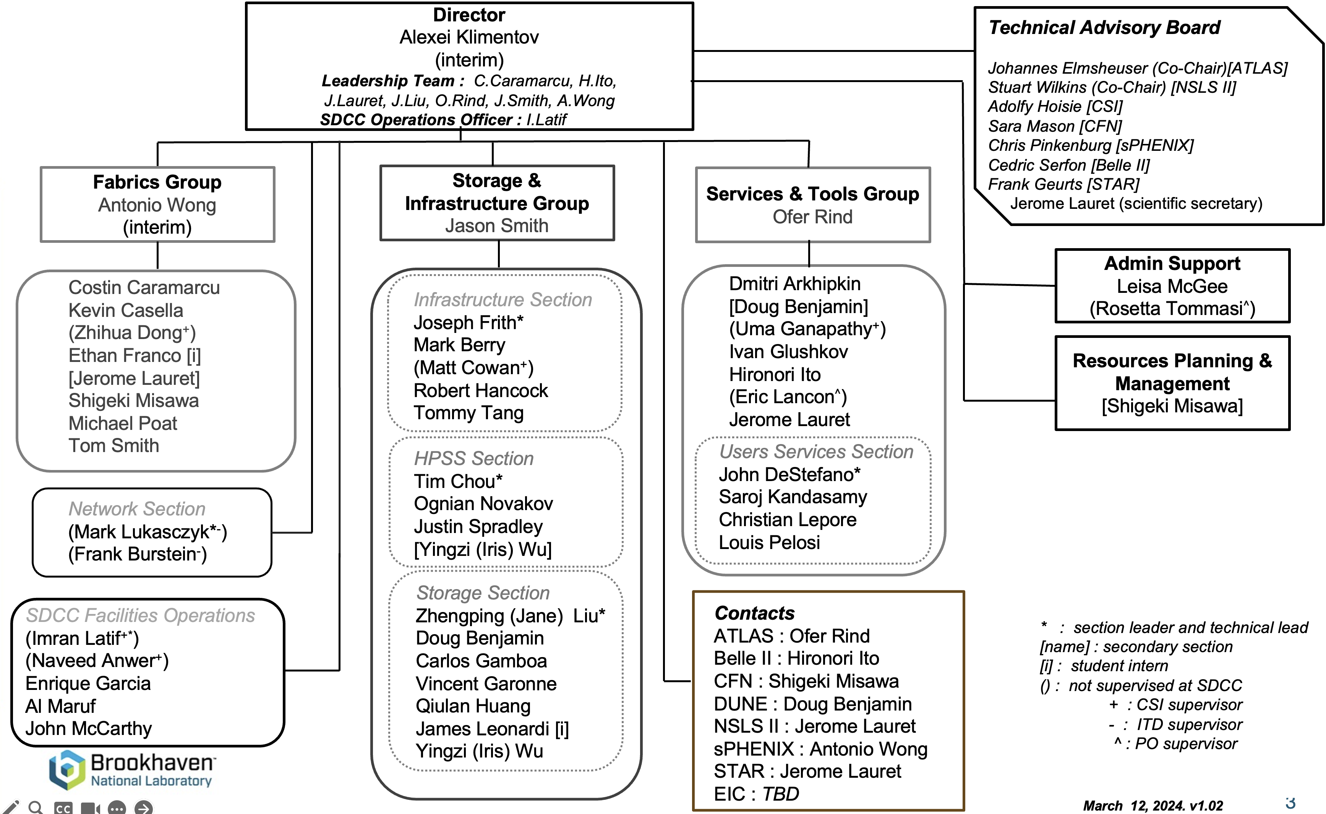

Slide 2
Storage & Infrastructure Group
Infrastructure Services
Staff members:
Joe Frith, Mark Berry, Matt Cowan, Robert Hancock & Tommy Tang
Responsibilities:
Virtualization & Container management (RHEV, OKD, OpenShift)
Central build & config mgmt (Cobbler, Foreman, Puppet)
Central storage (GPFS, NFS, AFS, STAR XRootD, Lustre hardware)
Central services (IPA/ldap, ntp, ssh, sftp, Globus DTN)
IAA services (COmanage, Keycloak)
Current Activities:
RHEV EoL: migration to OpenShift or VMWare
Puppet Upgrade to support RHEL 8/9
STAR & ATLAS T3 GPFS hardware upgrade
sPHENIX Lustre expansion (hardware/OS install)
SDCC IAA merge with ITD AD possibility?

Slide 3
Storage & Infrastructure Group
HPSS Tape Archive
Staff members:
Tim Chou, Ognian Novakov, Justin Spradley, Iris Wu
Responsibilities:
Tape libraries, HPSS data movers, core/DB servers, disk cache, FC infrastructures
Tape backup services (TSM & TiBS)
HPSS Batch
HPSS Clients
Current Activities:
Preparations for sPHENIX Run24 (cosmic run is in progress, collisions on Apr 15)
ATLAS data injection and staging
1,000 LTO8 (12TB/tape)tapes purchased in Feb, 2024
1,150 LTO8 tapes available (13.8PB)
TSM upgrade to 8.1.21
Repacking of data on older LTO to new LTO media
Development of next Batch tape staging

Slide 4
Storage & Infrastructure Group
Storage Services (Large Clustered Storage)
Staff members:
Jane Liu, Doug Benjamin, Carlos Gamboa, Vincent Garonne, Qiulan Huang, Iris Wu, James Leonardi
Responsibilities:
dCache (Belle II, ATLAS, DUNE, PHENIX, preprod testbed)
Lustre (sPHENIX, sPHENIX NEW, Three NSLS2 systems, CFN, CSI BNLBOX, STAR/EIC, ATLAS HPC, CSI SciSever)
Current Activities:
ATLAS dCache storage pool retirement/replacement
SciServer Lustre
sPHENIX Lustre expansion (~22PB)
Development of Generic Lustre Puppet Modules (including monitoring software) for RHEL8
BNL Directorates
NSLS2 – National Synchrotron Light Source
CFN – Center for Functional Nanomaterials
CSI – Computational Science Initiative
EIC – Electron-Ion Collider

