Slide 1

HEP-CCE: Storage OPtimization
Peter van Gemmeren (ANL)
On behalf of the HEP-CCE/SOP group

Slide 2
High Energy Physics-Center for Computational Excellence
Started as a 3 year (2020-2023) Pilot Project now Base Program
6 Experiments (Energy, Intensity and Cosmic Frontiers)
5 US National Labs (ANL, BNL, FNAL, LBNL & Oak Ridge joined)
Pilot Project of HEP-CCE:
Address one major issue: Deploying Leadership Computing Facilities (LCF) to help future HEP computing challenges (Processing Cycles)
Activities:
Portable Parallelization Strategies for High-Performance Computing Systems
Fine-Grained I/O and Storage on HPC Platforms, including Data Models and Structures
Demonstrated the capability of leveraging parallel I/O libraries to write HEP data into HPC native backends like HDF5 (CHEP23-Link)
Enhance I/O Characterization tool Darshan and monitor HEP workflows (CHEP23-Link)

Slide 3
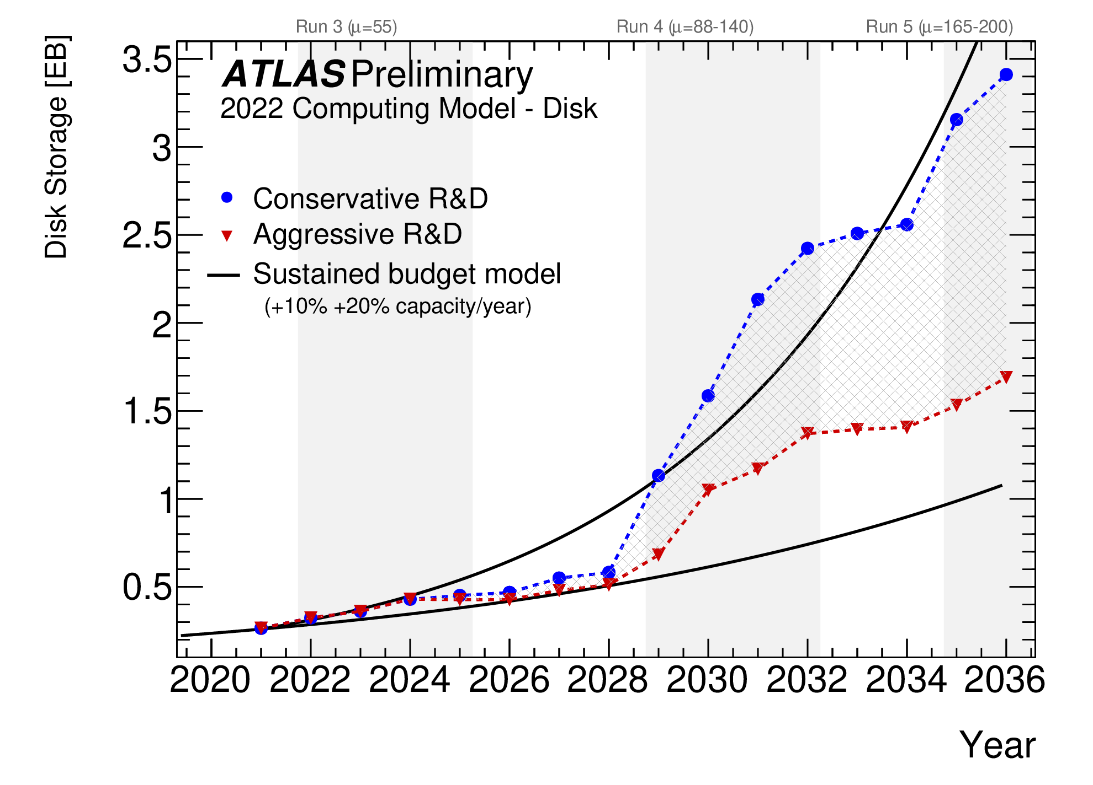
HEP-CCE2: IOS -> Storage Optimization SOP
After successful completion of Pilot Project and D.O.E. Review
HEP-CCE evolved as a Base Program and expanded its scope
Available storage resources can limit the physics reach of HL-LHC era experiments
Optimizing Data Storage and Data Management
Investigate new storage backends and data volume reduction methods
Tracking and aiding the evolution of ROOT I/O, in particular RNTuple
Reduced Precision and Intelligent Domain-specific Compression Algorithms
Object Stores and Strategies for Data Placement and Replication
Optimized Data Delivery to HPC systems
ATLAS-Link

Slide 4
ROOT: From TTree to RNTuple
ROOT: HEP Community software used from data processing to physics analysis
TTree as a storage backend that enables HEP experiments to use tools provided by ROOT ecosystem
Primary storage backend and I/O subroutine of HEP experiments for decades
Over Exabyte of data stored in TTree format
TTree evolved to address experimental needs and has been the backbone of HEP computational workflows
Now, supports persistence and I/O of complex experimental data
Decades of development made TTree outstanding in its support of C++ features
However, TTree architecture predates recent overhaul in C++, modern programming paradigms and evolving computational landscape

Slide 5
RNTuple, and upcoming HEP experiments
RNTuple: New Storage backend in ROOT version 7
State of the art, HEP community supported storage and I/O subsystem
Address storage & I/O requirements of upcoming HEP experiments
Streamlined compared to TTree, provides limited data model support
ATLAS and CMS report 20-40% saving in their storage (CHEP23-Link)
Use of modern C++ standards
Adoption of smart pointers, better error handling mechanisms, modern C++ libraries
HEP experiments have to adopt RNTuple to stay current with ROOT
Adopt to new RNTuple API
May have to change the data model to be persisted in RNTuple

Slide 6
HEP-CCE: Tracking and aiding the evolution of … RNTuple
HEP-CCE will aid HEP experiments to adopt RNTuple
Co-organized RNTuple Workshop:
RNTuple Format and Feature Assessment (6-7 November 2023) · Indico (cern.ch)
HEP-CCE is conducting RNTuple API review:
Special CCE-SOP tele-conference: RNTuple API Review Kick Off (February 28, 2024) · INDICO-FNAL (Indico)
Aid the development of RNTuple as per the experimental requirements
Find common guidelines and recipes for experiments frameworks and data models to migrate to RNTuple
ATLAS participation beyond HEP-CCE funded experts.
E.g.: Amit Bashyal (ANL), Doug Benjamin (BNL), Marcin Nowak (BNL), Serhan Mete (ANL), Scott Snyder (BNL), Rui Wang (ANL), myself (ANL)

Slide 7
Note: Since we are among friends
It’s probably true, that ATLAS is most advanced on RNTuple at this point.
We (in principal) can write/read all our production data to RNTuple
Result of prior decisions in our framework (including Transient/Persistent Separation, APR)
That does not mean we won’t profit from HEP-CCE
At this time implementation is not fully optimal
Not all production modes (e.g. multi-process, multithreaded) are supported, efficiently
There are missing features, e.g. Indexing and Friends and functionality, e.g. Merging and Metadata
ATLAS may be in the best position to steer future work on RNTuple

Slide 8
Reduced Precision and Intelligent Domain-specific Compression Algorithms
Most experiment HEP data is stored compressed format using lossless compression, lossy compression are less common
To reduce storage requirements further, experiments and ROOT are investigating means of reduced-precision storage as much of the data is derived from measurements with inherent uncertainties
For derived data, not RAW
Under study for ATLAS PHYSLITE data, Potential storage savings ~20-30%
Need trust-building/safeguarding validators, but may enable keep information down-stream.
IOS team has surveyed different tools developed by computer scientists:
Hybrid Learning Techniques for Scientific Data Reduction with MGARD
Compression of Scientific Data with SZ
Statistical Similarity for Data Compression with IDEALEM

Slide 9
Object Stores and Strategies for Data Placement and Replication
Numerous potential advantages for using in HEP:
Reference rather than copy upstream data, saving space
Allow fine-grained versioning, avoiding replication of unchanged objects
Facilitate user-driven data augmentation, to subset of events
These methods of referencing save storage space
Object storage activities on HPC side as well, e.g. Distributed Asynchronous Object Storage (DAOS)
DAOS is an object storage service developed for use on persistent memory technologies as a very high performance online storage layer
Data model includes both key:value objects and array objects
Array objects can be used to streamline storage of large multidimensional arrays with record addressability
Access can be via POSIX or directly via custom API

Slide 10
Object Stores, DAOS, and RNTuple
ROOT’s RNTuple supports DAOS
Decoupling of namespace operations from data read/write is natural for ROOT data.
Similar to key–value storage where the key is a UUID, but specifically tuned for low latency / high bandwidth workloads
HEP-CCE is studying RNTuple DAOS implementation using Darshan
Darshan already provides initial support for characterizing DAOS storage access
Building on: IOS has successfully used Darshan for current HEP workflows using ROOT
Aligns with, and will benefit from, other activities to understand and tune DAOS use by team members

Slide 11
Outlook
Since becoming base program, HEP-CCE can contribute to a wider variety of challenges, including storage.
Need to ensure to be relevant to our Clients, the experiments, such as ATLAS, DUNE, and CMS
In my belief, that is best done by working in close collaboration sharing expertise.

Slide 12
Acknowledgement
This work was supported by the U.S. Department of Energy, Office of Science, Office of High Energy Physics, High Energy Physics Center for Computational Excellence (HEP-CCE)

