Slide 1
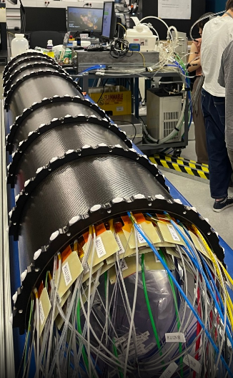
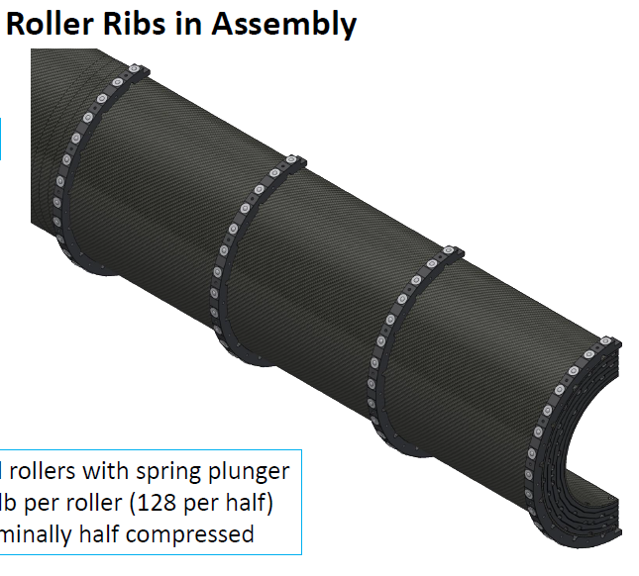
Software Topics
HotDead map in cosmic ray is urgent
Strongly requested in the software meeting. Thanks, Joseph and Maya for attending the meeting.
WeiChe is working on the cosmic data.
Implementing the survey geometry in simulation
Needed to evaluate mis-alignment effect for dN/deta analysis
HaoRen said he can help if necessary
Do the support structure and outer cover implemented in GEANT?
Cluster size in simulation is different with data
My macro to reconstruct INTT cluster doesn’t work
The macro was successfully run 3 month ago but…

Slide 2
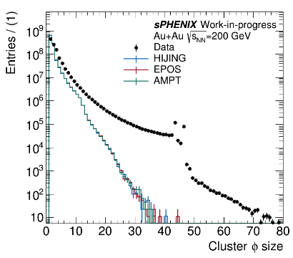
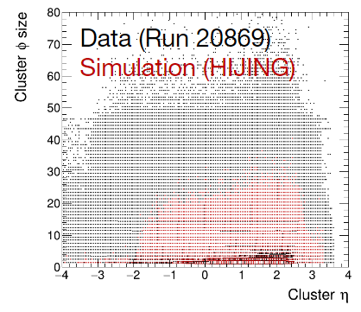
Sim vs Data : Cluster size
No hot/dead map and No BCO cut applied in data
No noise in simulation

Slide 3
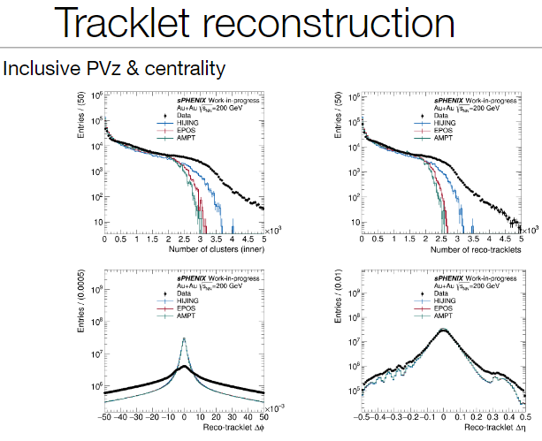
dN/deta : Sim vs DATA
Higher Ncls & Ntrk tail in data than simulation.
d(phi) & d(eta) difference can be due to mis-alignment in data

Slide 4
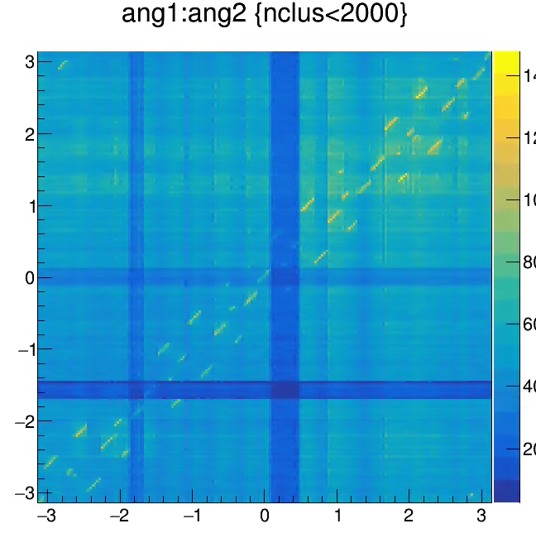
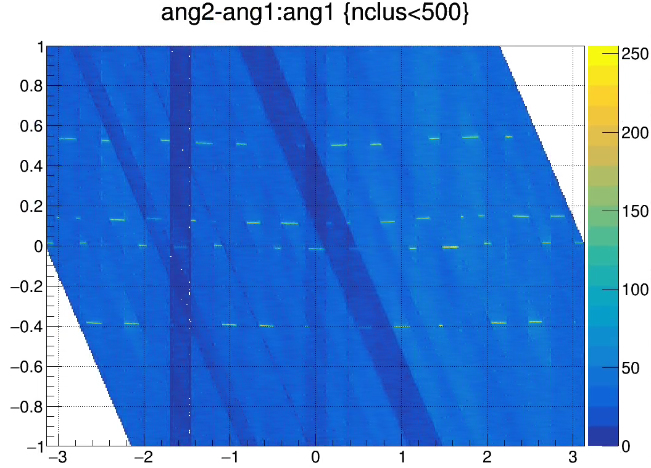
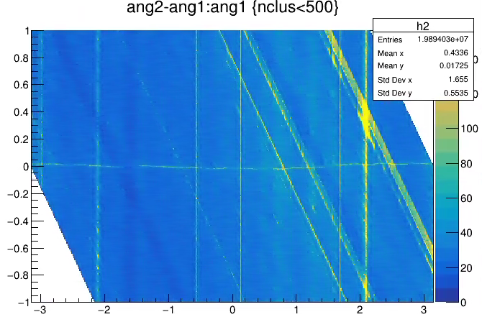
Strange inner and outer angle correlation
Old production
Correlation is splitted to 4 different lines
This is found with the current library (Jan. 29 2024)
Does anyone do something in the ch-conversion?

Slide 6
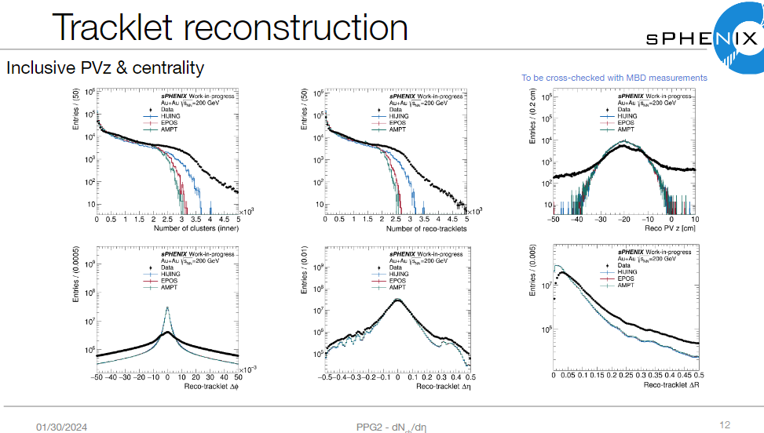
dN/deta : Sim vs DATA

Slide 7
