Slide 1
Proton beam gas update
Zhengqiao Zhang
BNL
2024.01.30

Slide 2
EICReco production
New production by Sakib Rahman for proton beam gas events:
S3/eictest/EPIC/RECO/23.12.0/epic_craterlake/BACKGROUNDS/BEAMGAS/proton/pythia8.306-1.0/
The production we used for DIS events:
S3/eictest/EPIC/RECO/23.12.0/epic_craterlake/SIDIS/pythia6-eic/1.0.0/18x275/q2_0to1/
Environment setup: source /opt/detector/setup.sh (source /opt/detector/epic-23.12.0/setup.sh ? SAME? export DETECTOR_CONFIG= epic_craterlake)
Event simulation: ddsim --compactFile $DETECTOR_PATH/$DETECTOR_CONFIG.xml --numberOfEvents 10000 --inputFile 275GeV_HiAc_25mrad_Asciiv3.hepmc --outputFile protonBeamGas.edm4hep.root (using npsim instead of ddsim, using the hepmc3.tree.root file instead of the hepmc file)
Reconstruction: eicrecon protonBeamGas.edm4hep.root

Slide 3
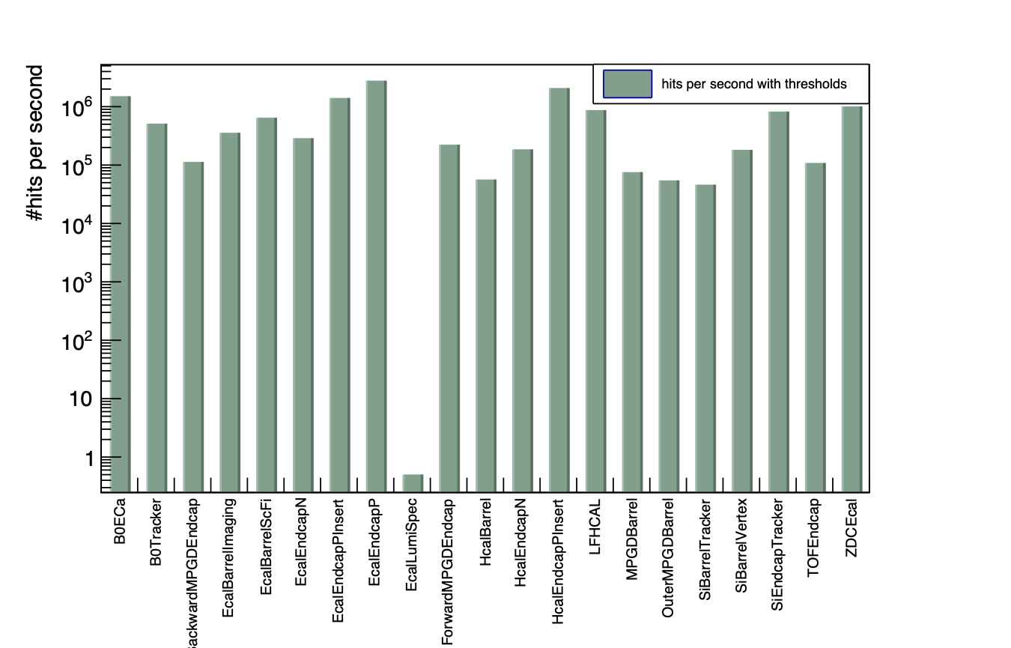
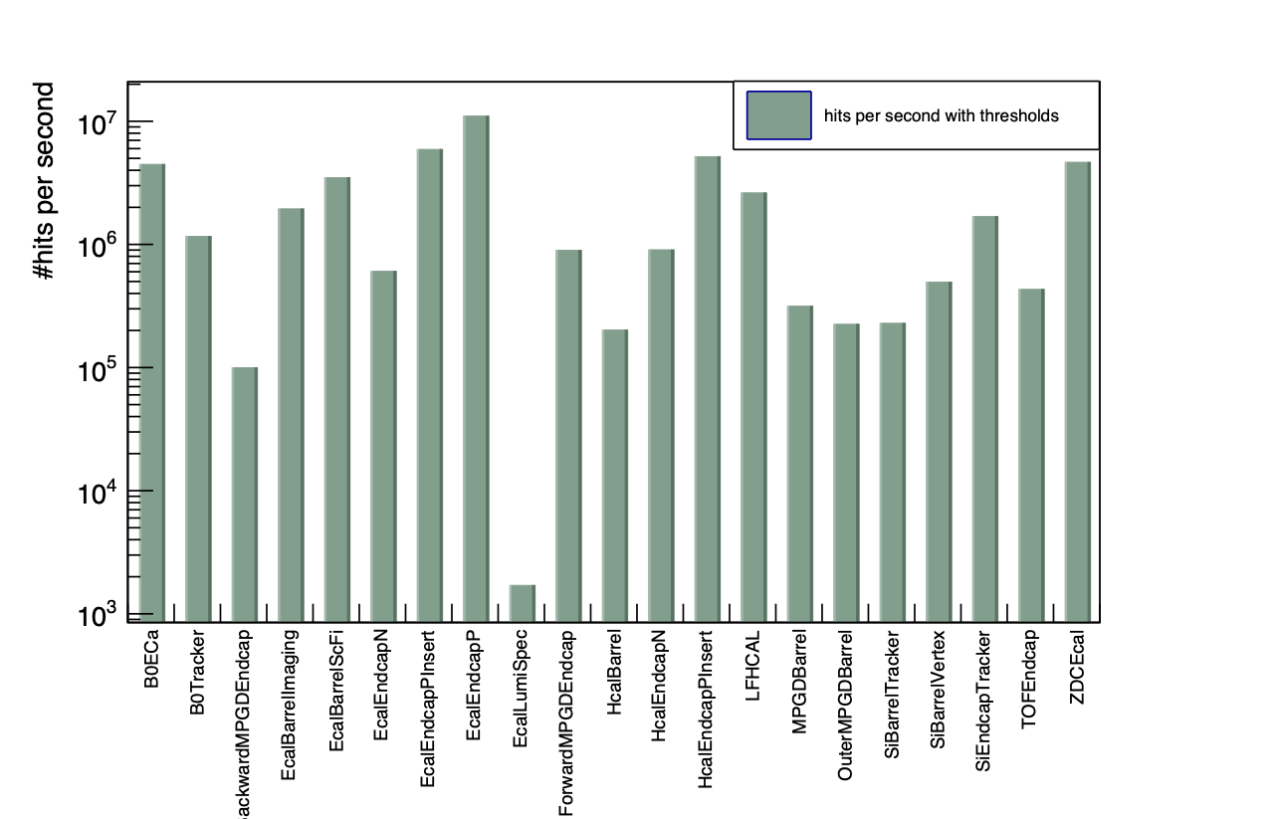
Hits rate in each sub detector
Proton beam gas
275 GeV
DIS
0 < Q² < 1
18x275 GeV

Slide 4
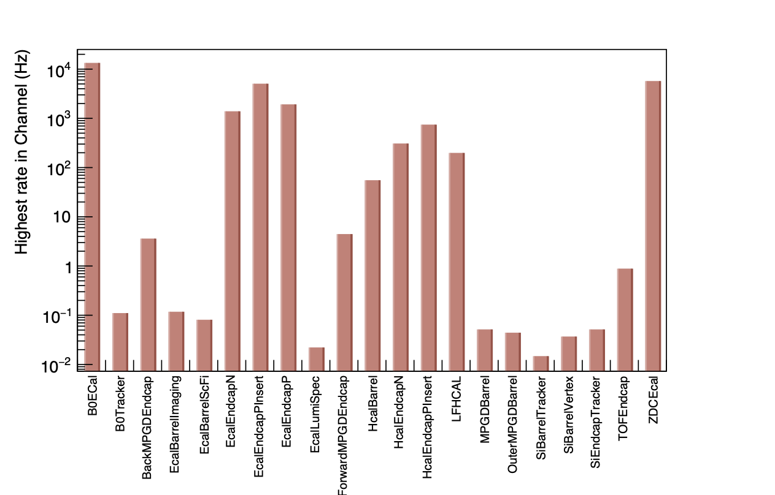
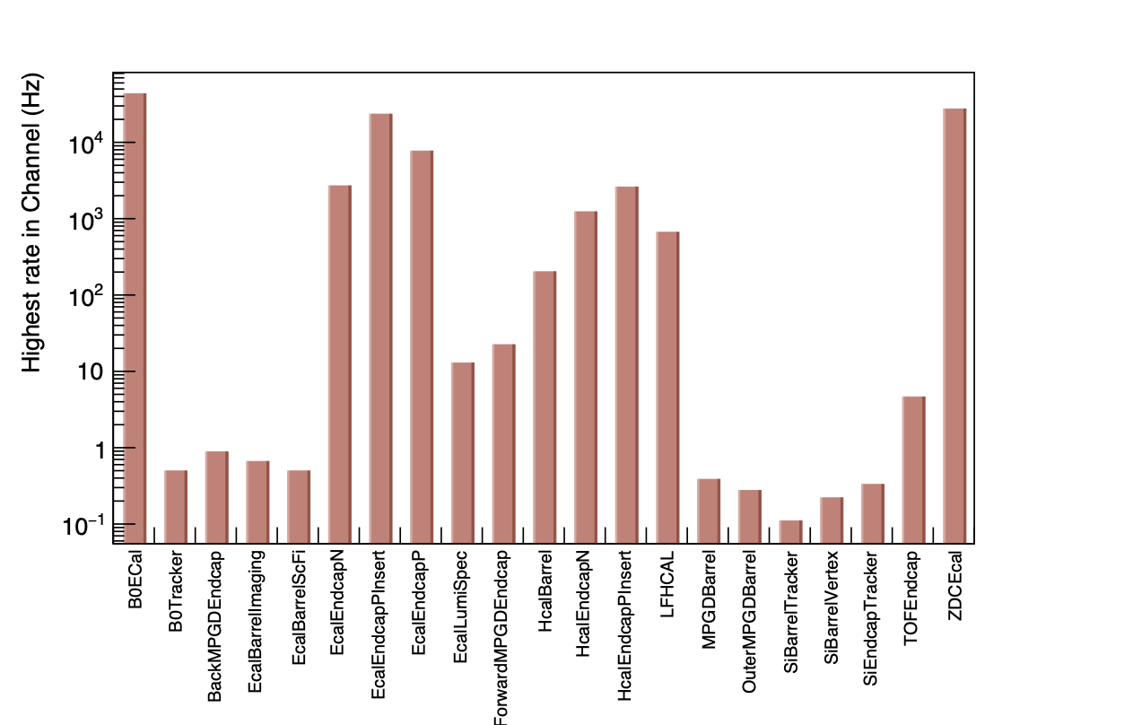
Highest rate in Channel for each sub detector
Proton beam gas
275 GeV
DIS
0 < Q² < 1
18x275 GeV

Slide 5
Highest rate in Channel for each sub detector
Sub Detector | Maximum Rate in Channel (Hz) | Cell ID
B0ECal | 13227.3 | 217513
B0Tracker | 0.10918 | 124411415737008534
BackwardMPGDEndcap | 3.55925 | 18324583925227259464
EcalBarrelImaging | 0.116458 | 3377671628147557
EcalBarrelScFi | 0.080065 | 18201297911282682985
EcalEndcapN | 1375.25 | 36827495
EcalEndcapPInsert | 4998 | 18446744052276691050
EcalEndcapP | 1896.91 | 18443366356851130470
EcalLumiSpec | 0.0218359 | 4522434
ForwardMPGDEndcap | 4.3963 | 18330776417664566866
HcalBarrel | 54.5534 | 190319
HcalEndcapN | 303.781 | 281466411975281
HcalEndcapPInsert | 735.63 | 18446744052235043187
LFHCAL | 196.188 | 450420
MPGDBarrel | 0.0509504 | 47780420263346493
OuterMPGDBarrel | 0.0436718 | 18338447117602844736
SiBarrelTracker | 0.0145573 | 18270908421865795900
SiBarrelVertex | 0.0363932 | 17220357720457597215
SiEndcapTracker | 0.0509504 | 15838878848293806662
TOFEndcap | 0.873436 | 18443647692087230842
ZDCEcal | 5647.01 | 120996
Proton beam gas
275 GeV

Slide 6
Highest rate in Channel for each sub detector
DIS
0 < Q² < 1
18x275 GeV
Sub Detector | Maximum Rate in Channel (Hz) | Cell ID
B0ECal | 43407 | 217513
B0Tracker | 0.496542 | 113997391354532246
BackwardMPGDEndcap | 0.882741 | 18324865387319116360
EcalBarrelImaging | 0.662056 | 18444210882349437029
EcalBarrelScFi | 0.496542 | 18444210882349437029
EcalEndcapN | 2699.26 | 32645479
EcalEndcapPInsert | 23481 | 18446744052276691050
EcalEndcapP | 7713.61 | 18443366356851130470
EcalLumiSpec | 12.9101 | 5112002
ForwardMPGDEndcap | 22.3996 | 18331057884051343954
HcalBarrel | 201.982 | 190319
HcalEndcapN | 1233.24 | 281466411975281
HcalEndcapPInsert | 2606.18 | 18446744052235043187
LFHCAL | 664.263 | 498804
MPGDBarrel | 0.386199 | 18302699207150018877
OuterMPGDBarrel | 0.275857 | 22095459271110720
SiBarrelTracker | 0.110343 | 18239984592910139707
SiBarrelVertex | 0.220685 | 18017776286529220895
SiEndcapTracker | 0.331028 | 16030281639183529039
TOFEndcap | 4.63439 | 18443647966965137786
ZDCEcal | 27436.6 | 120996

Slide 7
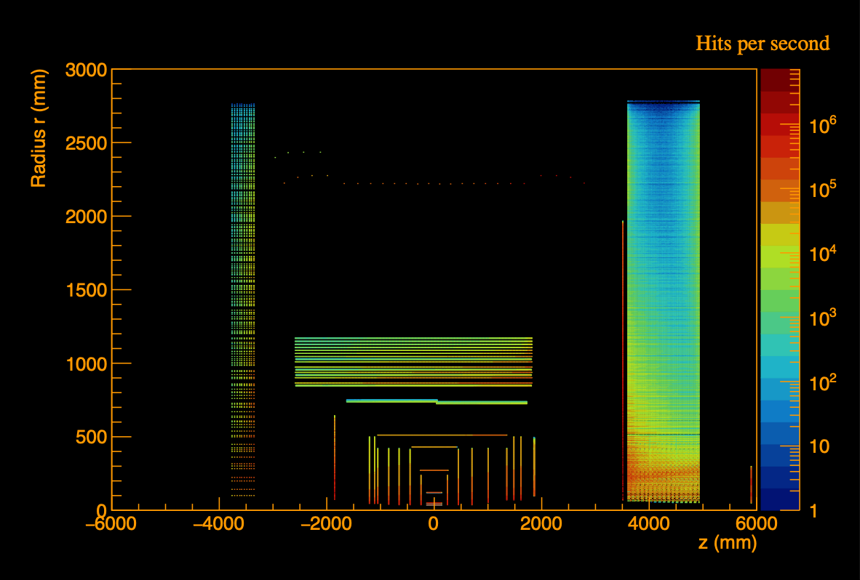
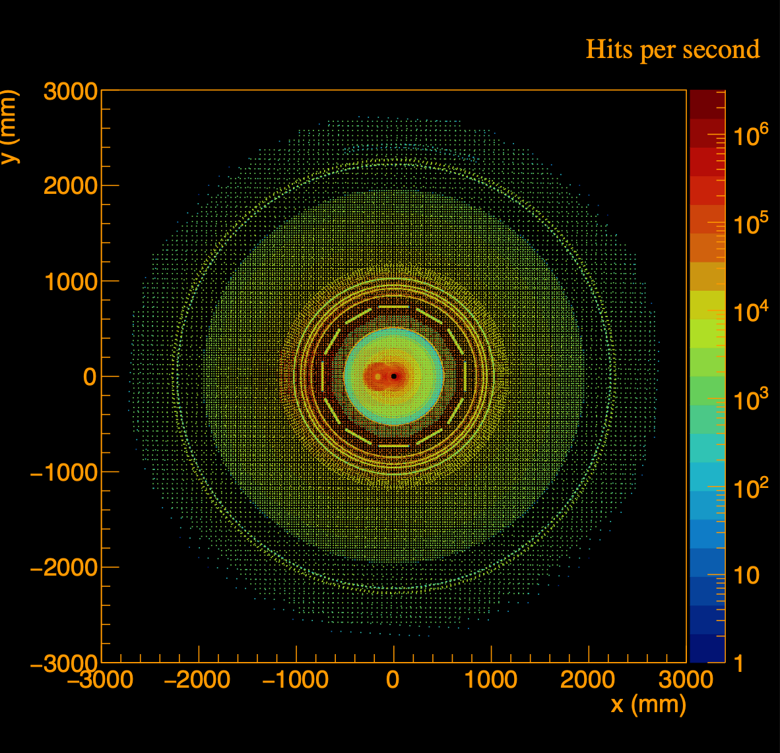
Hits Distribution for all sub detectors
Proton beam gas
275 GeV
Hits per gas event
Hits per gas event

Slide 8
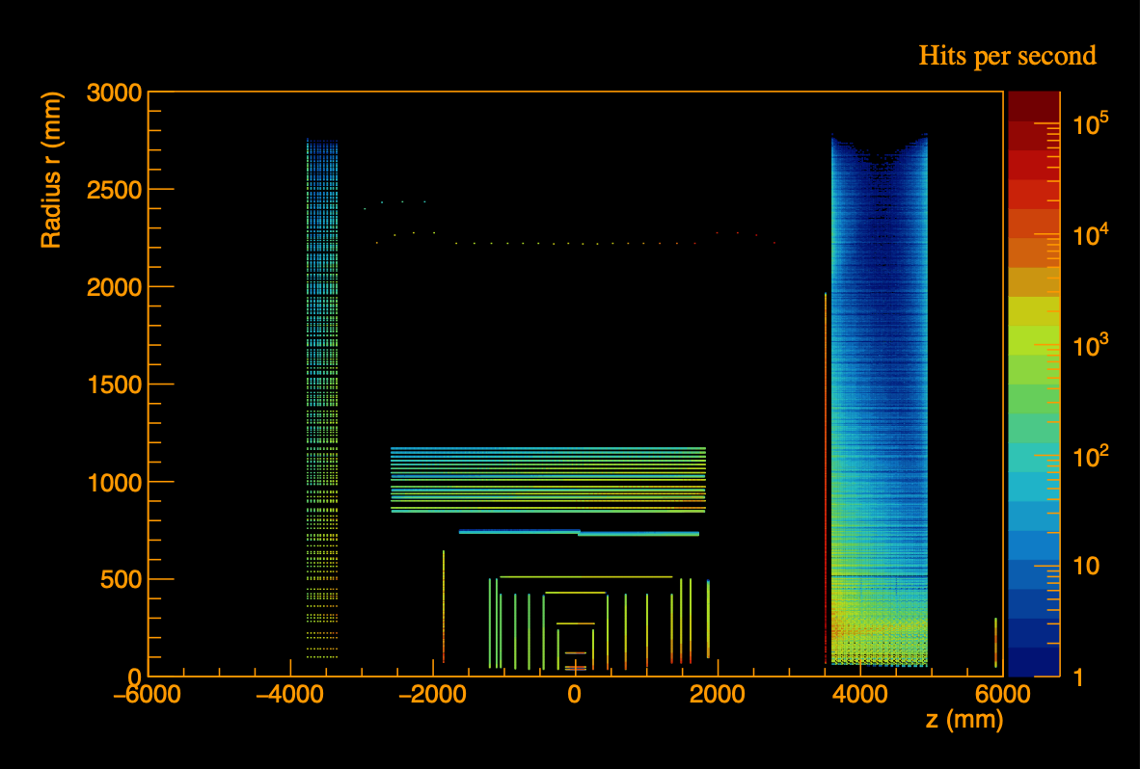
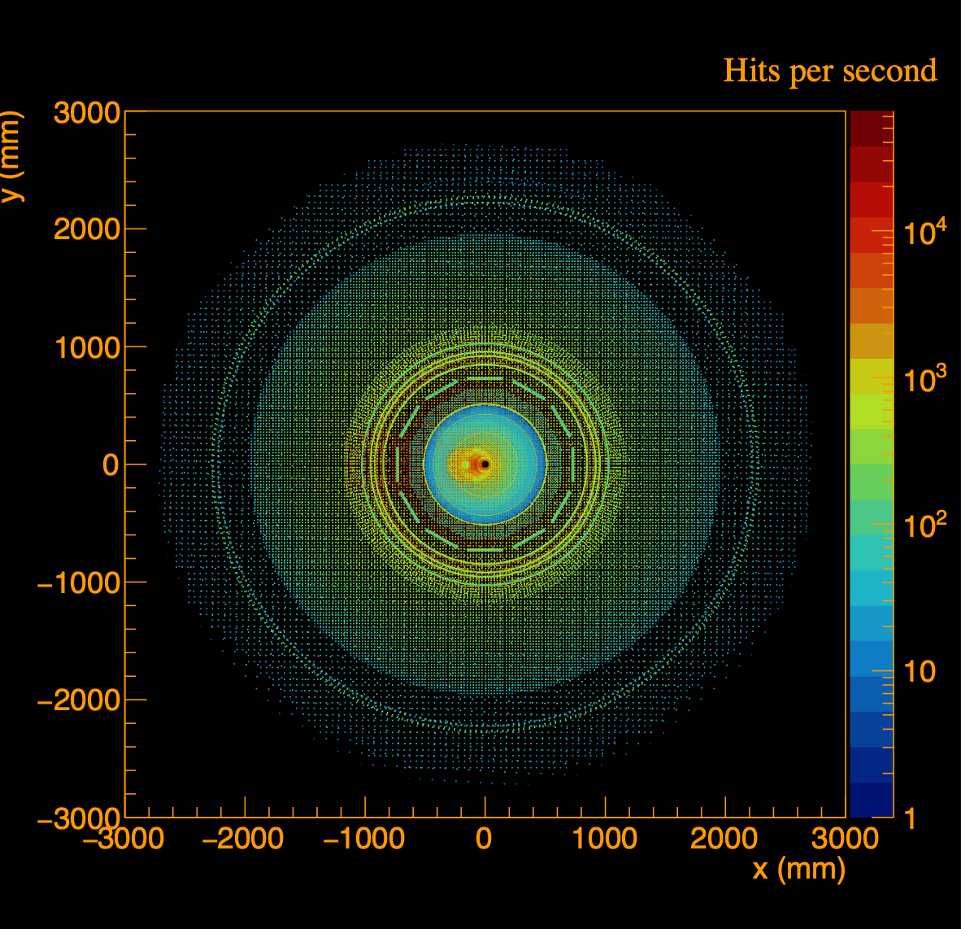
Hits Distribution for all sub detectors
DIS
0 < Q² < 1
18x275 GeV
Hits per gas event
Hits per gas event

Slide 9
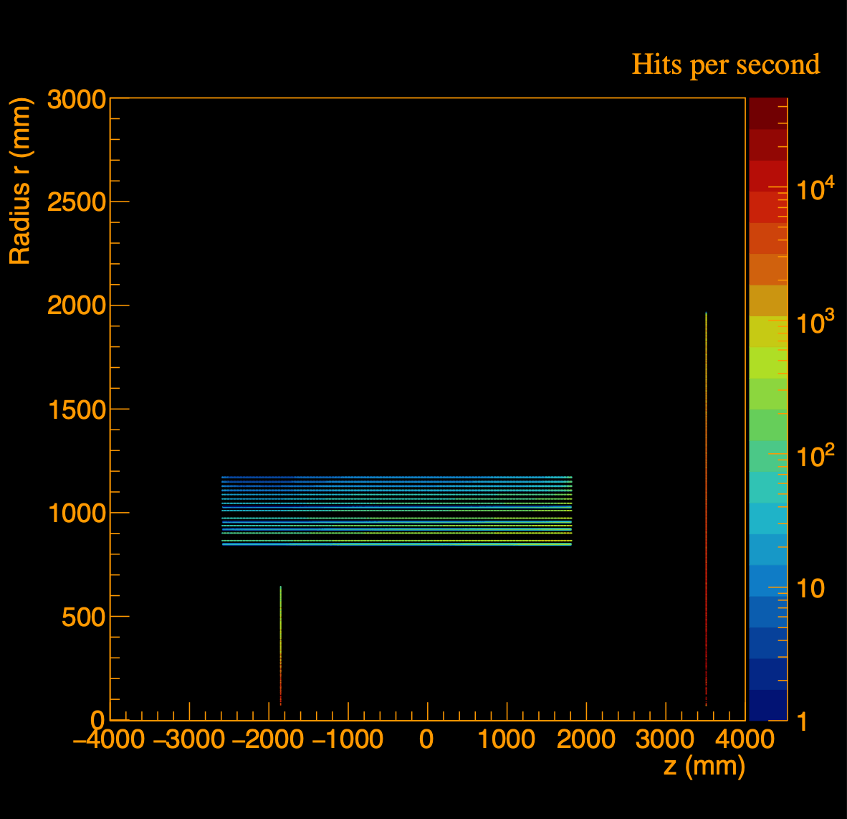
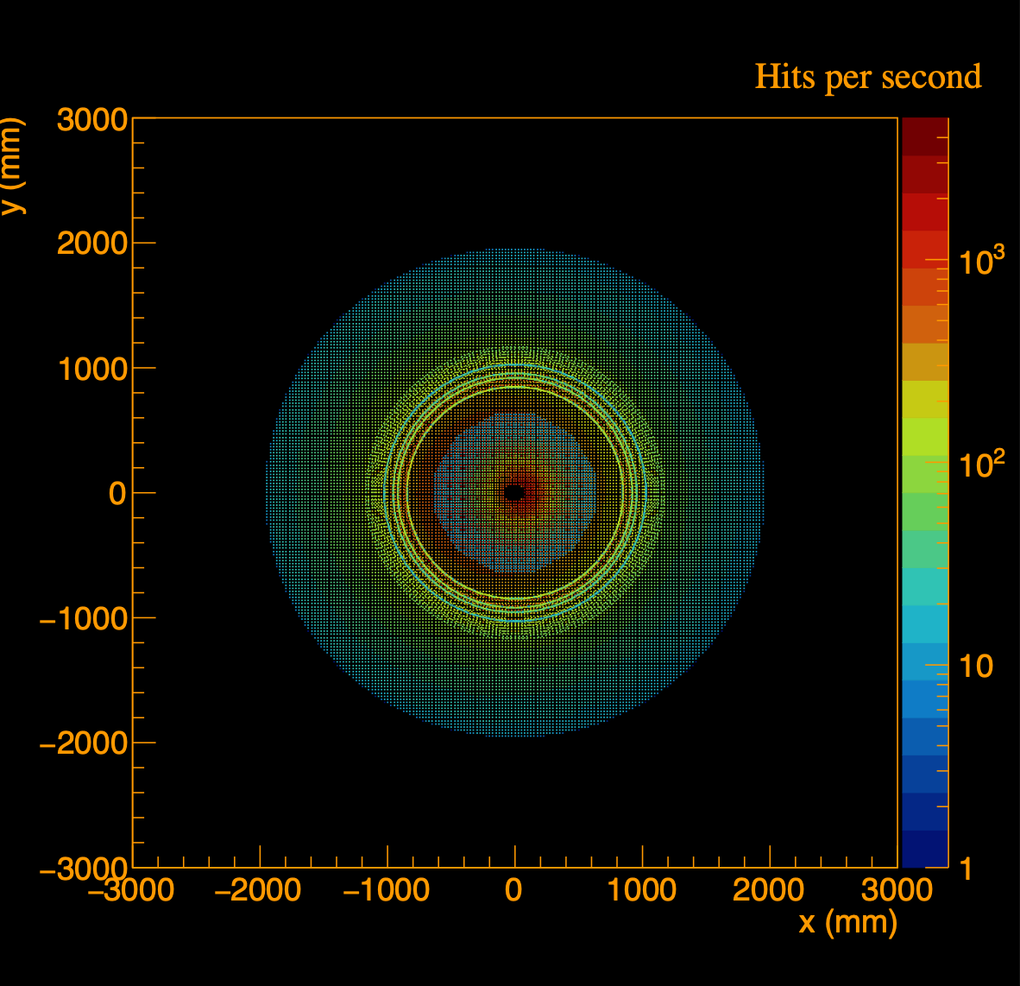
Electromagnetic calorimeters, EcalBarrelSciGlass+EcalEndcapP + EcalEndcapN +EcalEndcapPInsert
Proton beam gas
275 GeV

Slide 10
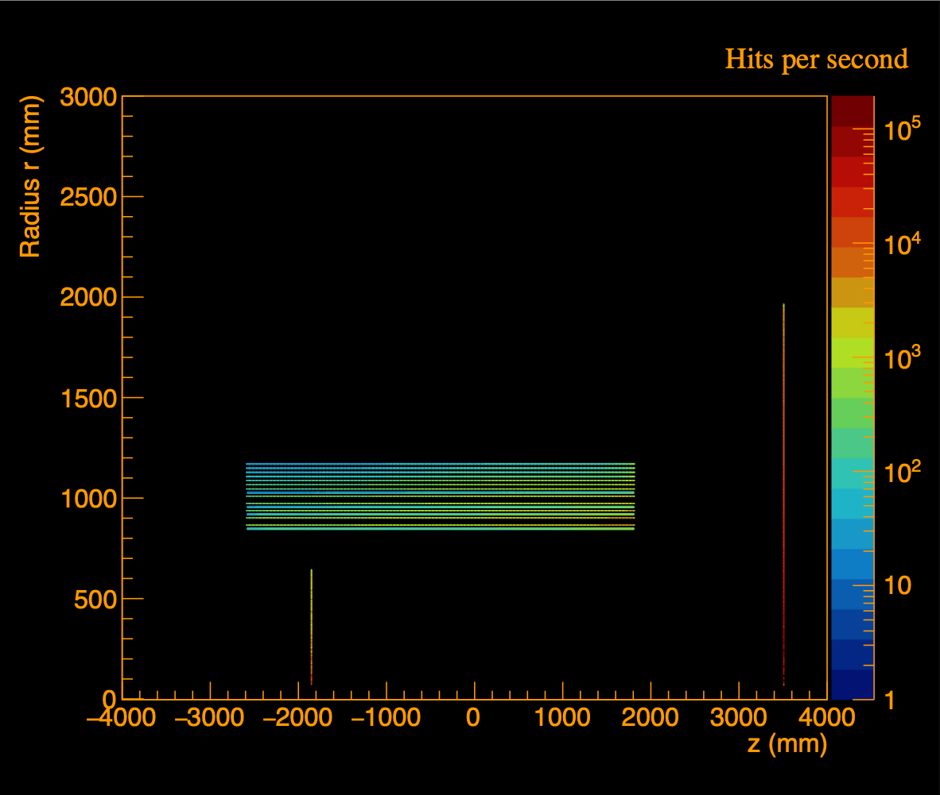
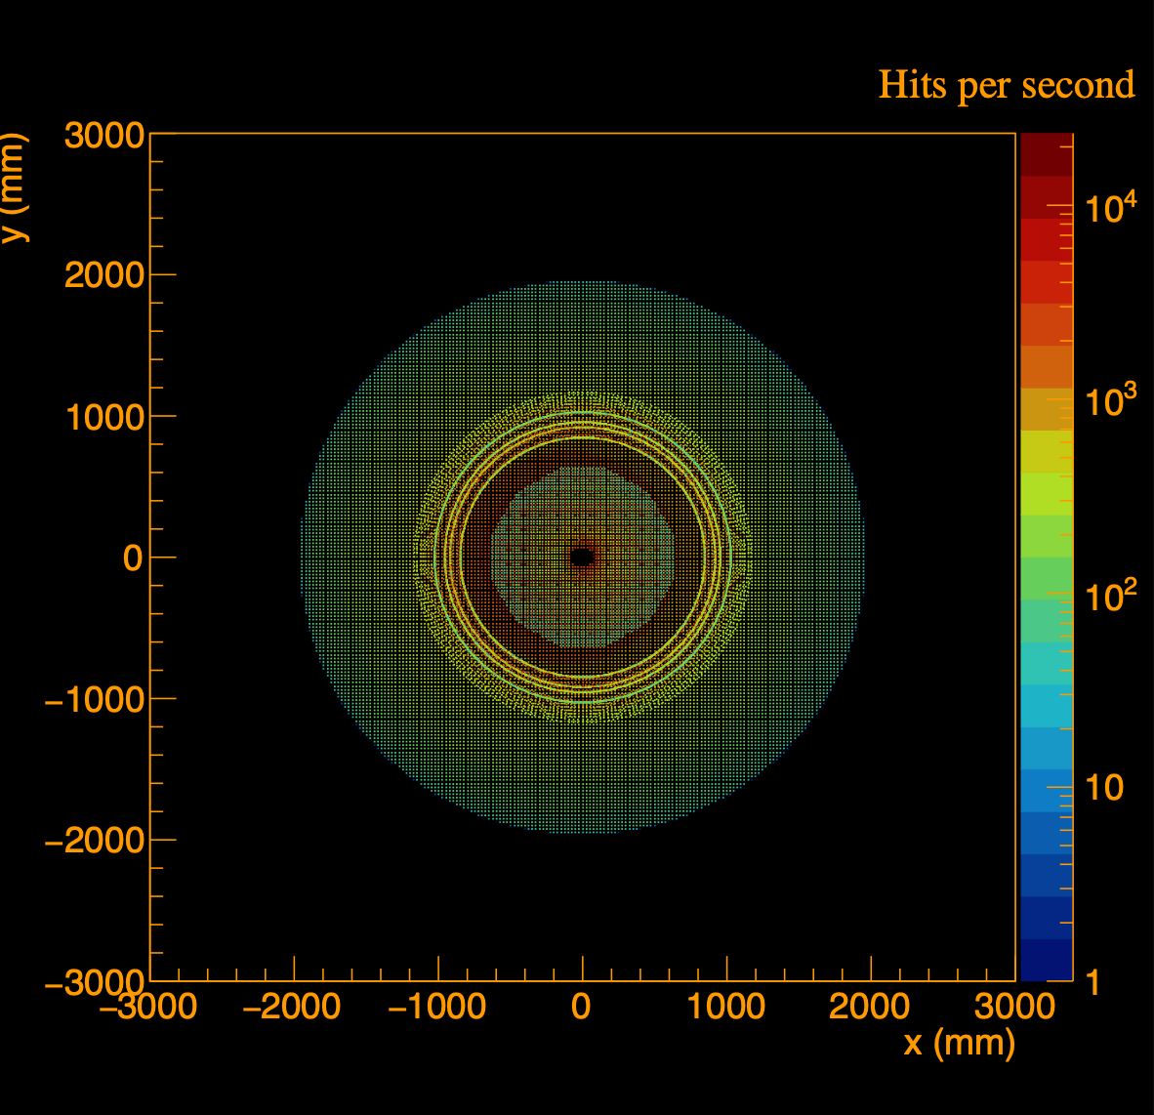
Electromagnetic calorimeters, EcalBarrelSciGlass+EcalEndcapP + EcalEndcapN +EcalEndcapPInsert
DIS
0 < Q² < 1
18x275 GeV

Slide 11
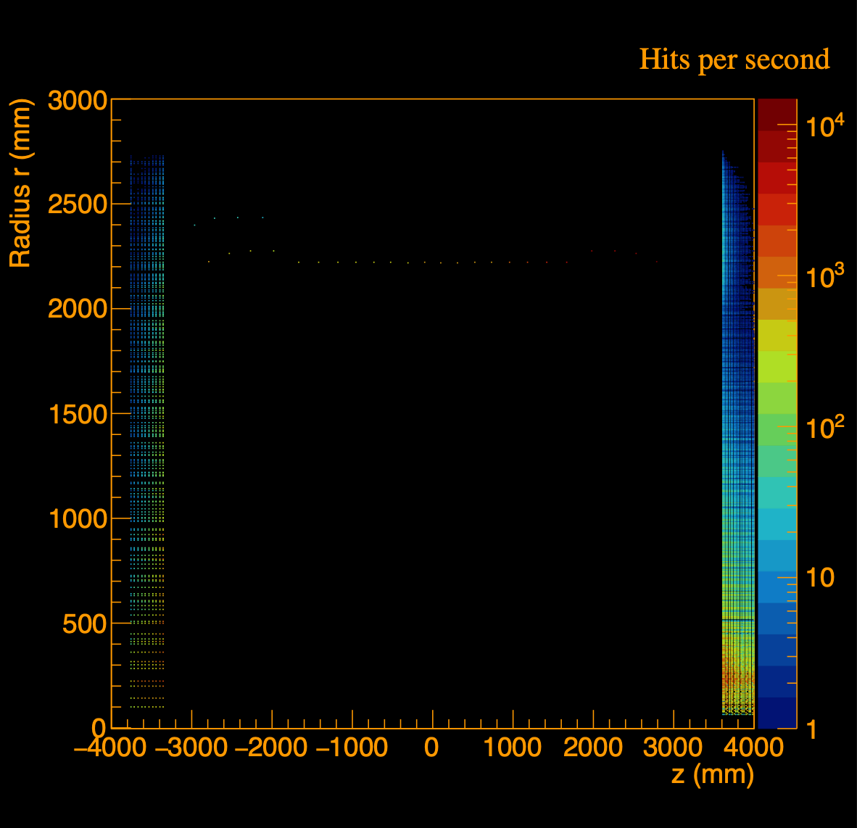
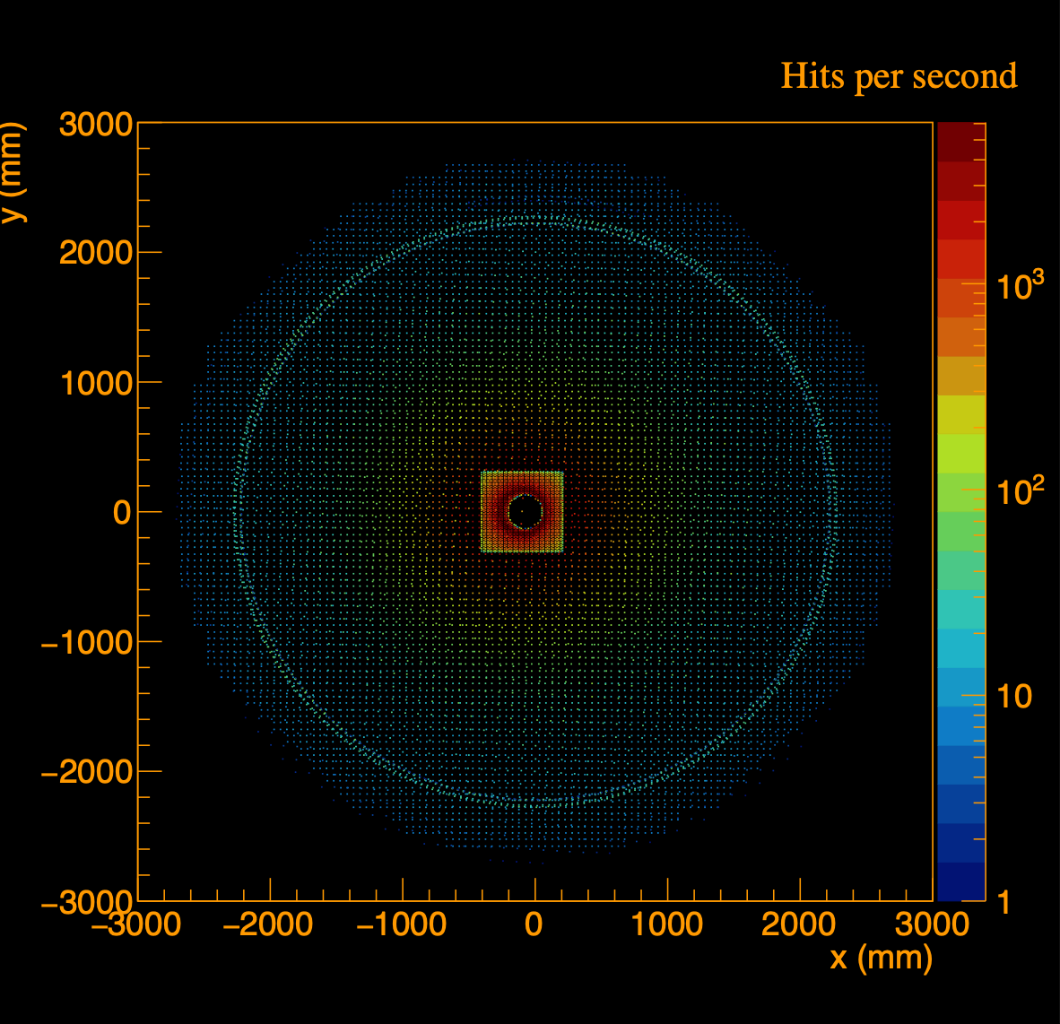
Hadron calorimeters, HcalBarrel + HcalEndcapN + HCalEndcapPInsert + LFHCAL
Proton beam gas
275 GeV
Hits per gas event
Hits per gas event

Slide 12
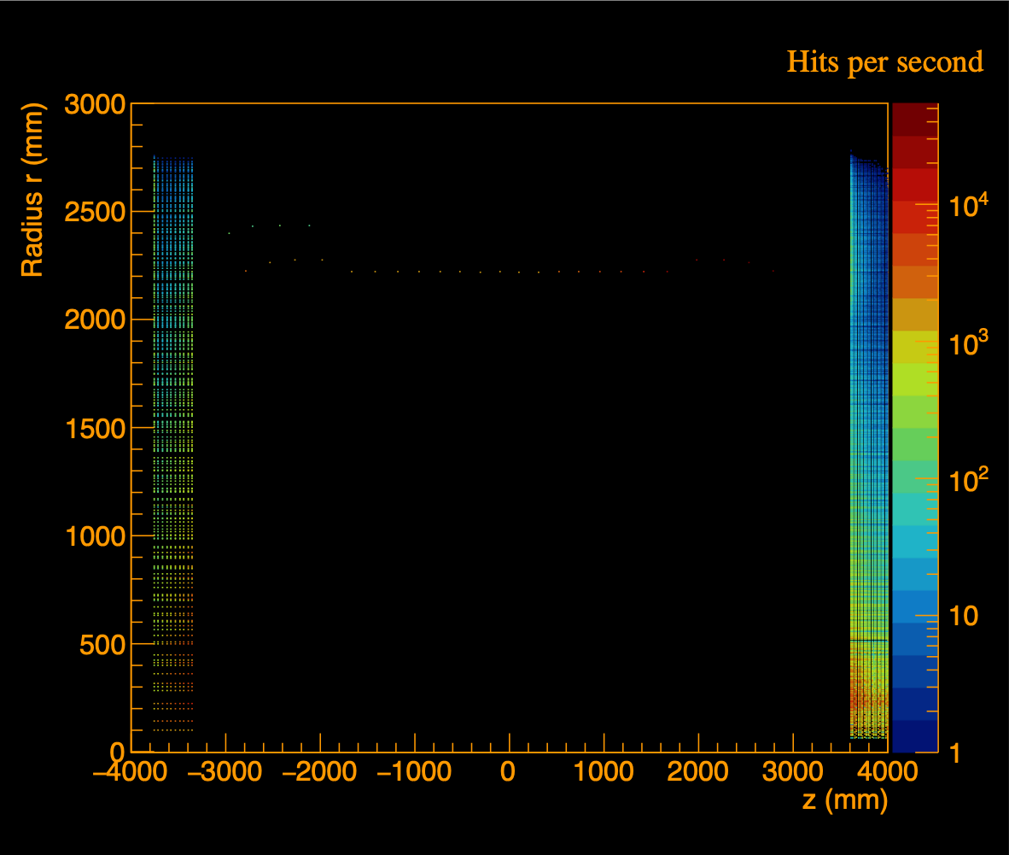
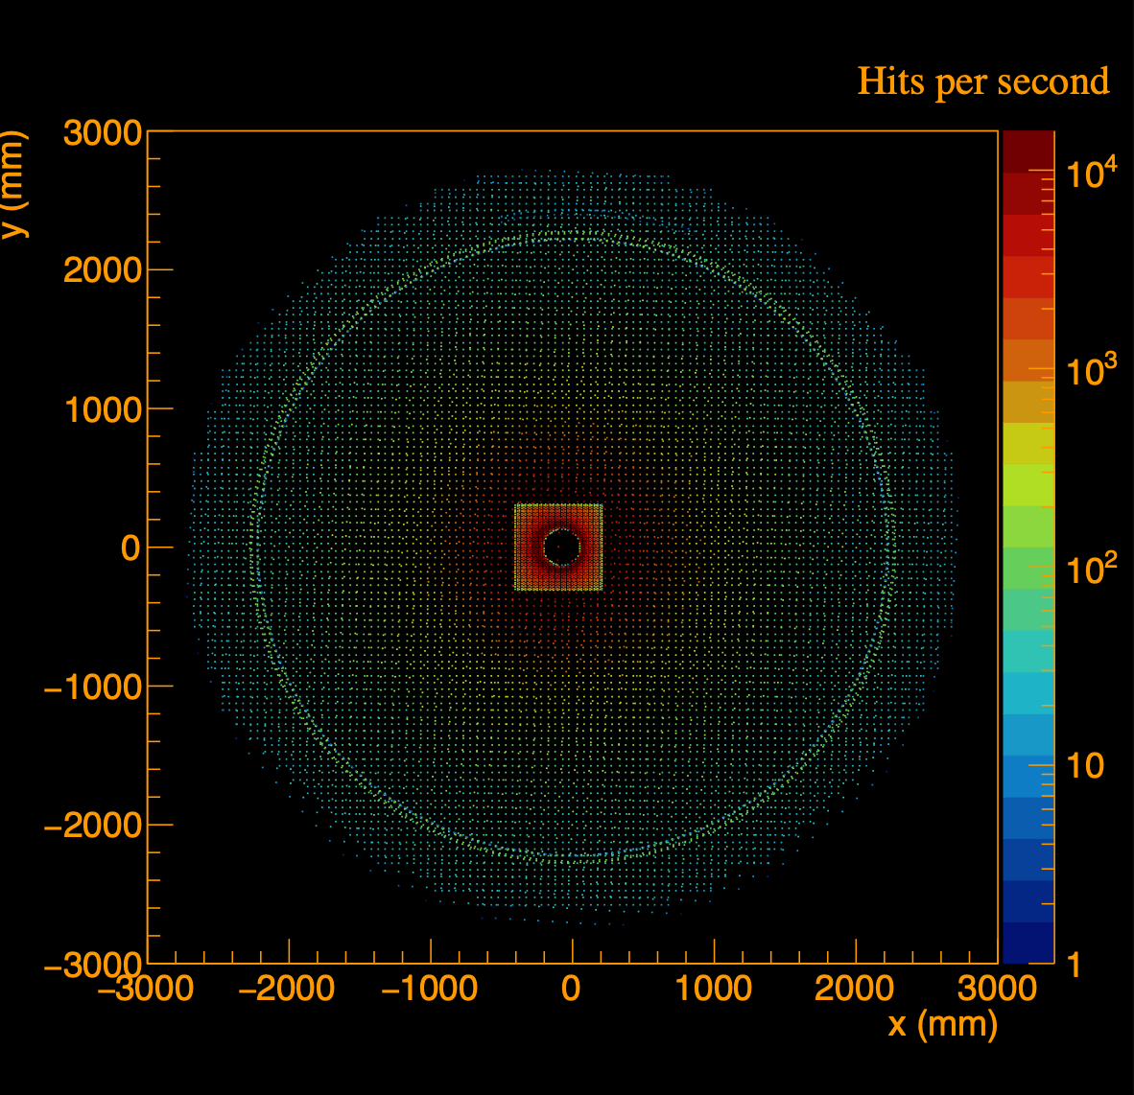
Hadron calorimeters, HcalBarrel + HcalEndcapN + HCalEndcapPInsert + LFHCAL
DIS
0 < Q² < 1
18x275 GeV
Hits per gas event
Hits per gas event

Slide 13
Thanks.

