Slide 1
Time-of-Arrival of hits and resolution better than 2 μs
G.W.Deptuch
note: 01/22/2024

Slide 2
Typical Charge Processing Chain
ALPIDE/ALICE-ITS3 uses significantly simpler processing chain due to:
power, and
Si area restrictions

Slide 3
Measurements of Time of Arrival (1)
indeterministic term, depending on noise contained in signal
term depending on slope of rising/falling edge, resulting in delayed crossing of discriminator threshold – can be compensated knowing amplitude
term depending on
slope of rising/falling edge (giving overdrive of discriminator’s input), resulting in delayed response of discriminator – can be compensated knowing relation threshold-amplitude
resolution of ToA measurement given by size of “time bucket”, aka “integration time”

Slide 4
Measurements of Time of Arrival (2)
METHOD 1
Leading Edge with amplitude correction
t₀ is real time of occurrence;
t₁ or t₂ are times when pulses cross threshold f(amp);
knowing amplitude (typically measured peak or Time-over-Threshold of pulse), correction can be made bringing t₁ and t₂ effectively to t₀;
Measurement of amplitude not always available / feasible as additional functionality consumes power and needs more silicon area, vide binary readout.

Slide 5
Measurements of Time of Arrival (2)
METHOD 2
Constant Fraction Discrimination
t₀ is real time of occurrence;
t_{CFD} is time when constructed pulse crosses “zero” f(amp);
new signal is constructed that is fraction of original signal and is compared against delayed original signal;
time at which two signals are equal is amplitude independent;
Effectively bipolar pulse is virtually created that is tested against zero-crossing;
measuring zero-crossing requires additional arming discriminator, to avoid “noise hits”;
Amplitude is not measured directly, but system is complex and there is no ideal delay in Integrated Circuit, vide matched transmission line would be required.

Slide 6
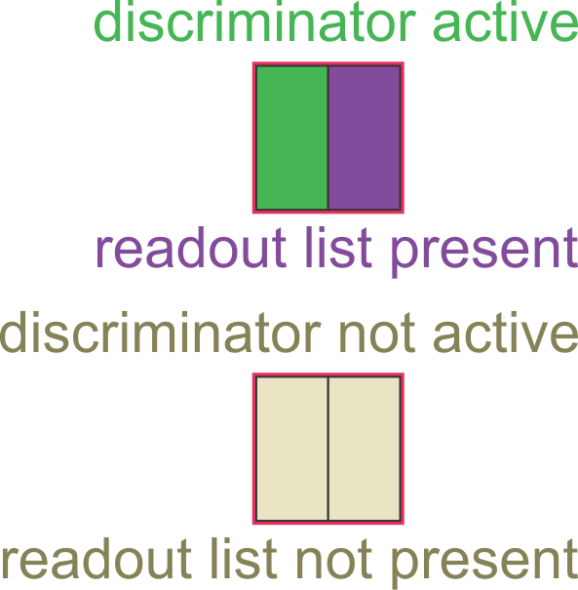
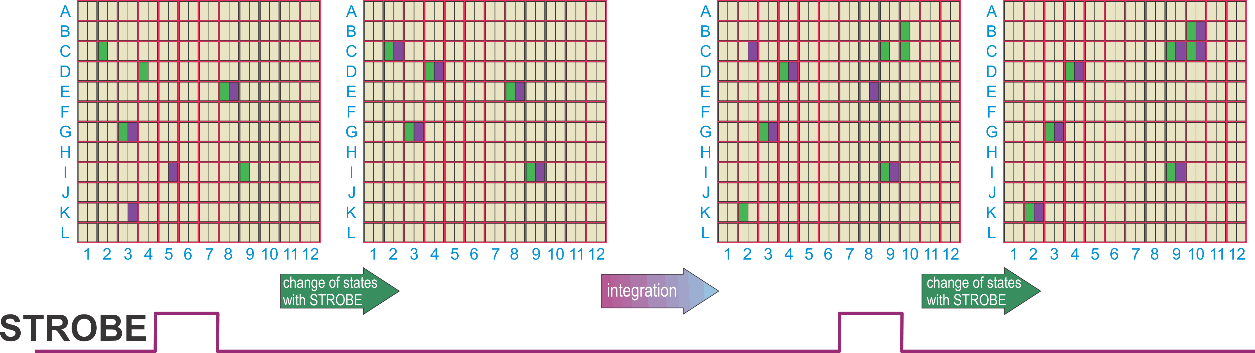
Is LE of CFD used in ALICE-ITS3?
NO
there is no fast clock distributed to pixels with which LE or CFD threshold crossing could be compared
How hits are registered in ALICe-ITS3 sensors:
matrices of pixels are main parts of RSUs (3 matrices read through one readout channel / RSU);
Analog Front-Ends with Discriminators are continuously active in every pixel;
periodic global to all RSUs signal (STROBE) samples discriminators’ outputs and if pixel possesses activated discriminator is brought to “virtual list” of pixels to be readout;
readout is static (aka snapshotted or framed), i.e., all pixels from “virtual list” are readout and new strobe create new “virtual list”;
frames are caused by STROBE, resulting in grouping all hits in STROBE-period-wide buckets.
strong hit = discriminator ON >T_{STROBE}
weak hit = discriminator ON <T_{STROBE}
C2, D4, I9 new hits,
K3, I5 weak hits, E8, G3 strong hits.
B10, C9, C10, K2 new hits,
C2, E8 weak hits,
D4, I9 strong hits.
T_{STROBE}

Slide 7
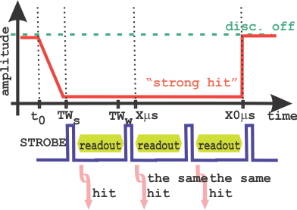
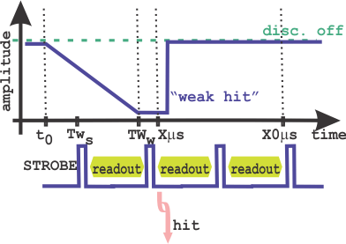
Four cases (1)
CASE 1
Difference in registration of “strong” and weak hits:
discriminator outputs swing rail-to-rail;
duration of discriminator pulse corresponds to magnitude of charge liberated and collected by in-pixel diode;
“weak hit” and “strong hit” may be simultaneous (originate from the same bunch collision), t₀, but may be registered at different frames, as “weak hit” may not be yet developed to be snapshot by STROBE that takes “strong hit” ð ToA uncertainty ð complication in analysis;
“strong hit” may have its discriminator active, for one, two or more frames give by pulsed strobe ð multiple readouts of same “strong hit”;
How many times single hit is consecutively read out can becomes equivalent of LE with amplitude correction ToA method; (probability of two distinct hits in pixel following one another is practically non-existent!)
Running STROBE at, e.g. 2 μs or less, ma result in much better timing resolution than resulting from simple time frame duration!
CASE 2

Slide 8
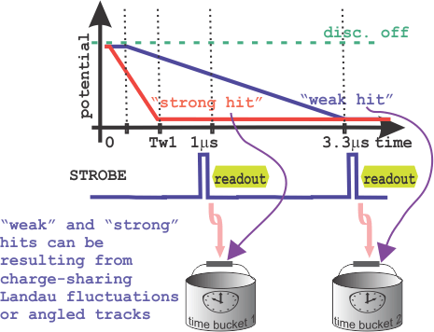
Summary of Time Walk Issue
Impact of TW on assigning hits to frames
(RO mode agnostic):
“weak hits” and “strong hits” can be mistimed (assigned to consecutive frames-buckets) – having time difference of X μs);
combination of TW (1-3 μs) and “sampling” of time with STROBE (@ 2 μs) results in potential spread of hits from one even between up to three time-frames.

Slide 9
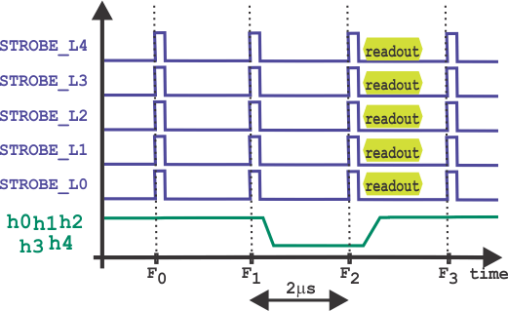
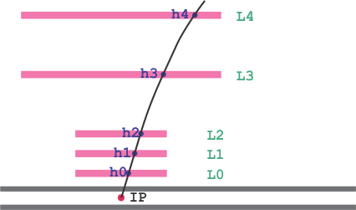
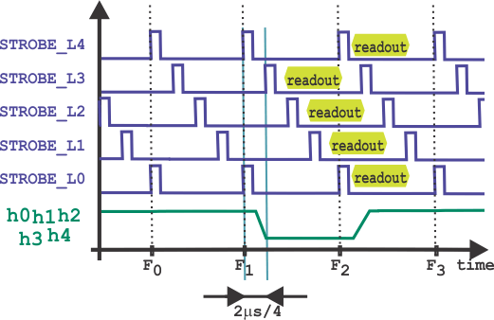
Four cases (2)
CASE 3
STROBEs in all layers are aligned
CASE 4
Simplified view:
particle leaves trace in all layers;
“strengths “ of hits even in all layers;
impacts not occurring in coincidence with TROBE pulses;
etc.
STROBEs are shifted in phase
Running STROBES with shifted phases per layer, may increase granularity of timing for reconstructed tracks significantly below 1 μs.

Slide 10
ALPIDE/ALICE-ITS3 FE-DISC-STROBE
assuming 50 μm thick active sensor layer Ü1 MIP produces MPV= 4 ke⁻/h⁺ and e⁻ are collected;
charge sharing in corner impact splits collected charge to MPV= 4 × 1 k e⁻;
taking Landau distribution max – min signals ∈ (0.3 MPV, 3 MPV) Ü ~(0.3 ke⁻, 15 ke⁻)
transient FE + disc
TW and ToT vs. signal
measured with LGAD 50 μm thick
ALICE – ITS3 plenary

Slide 11
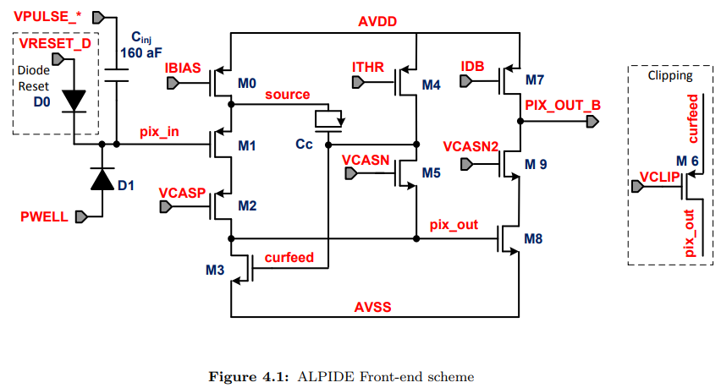
ALPIDE/ALICE-ITS3 Pixel Circuit
ALPIDE is voltage amplifier using independent bias of charge collecting diode, i.e. self-bias;
following every hit, amplifier finds new operating point;
STROBE selects 1 out of 3 latches to store state of discriminator;
then MEMSEL allow reading out 1 out of 3 latches through priority encoder
ALPIDE operation manual (ALICE-ITS3 modified circuit)

Slide 12
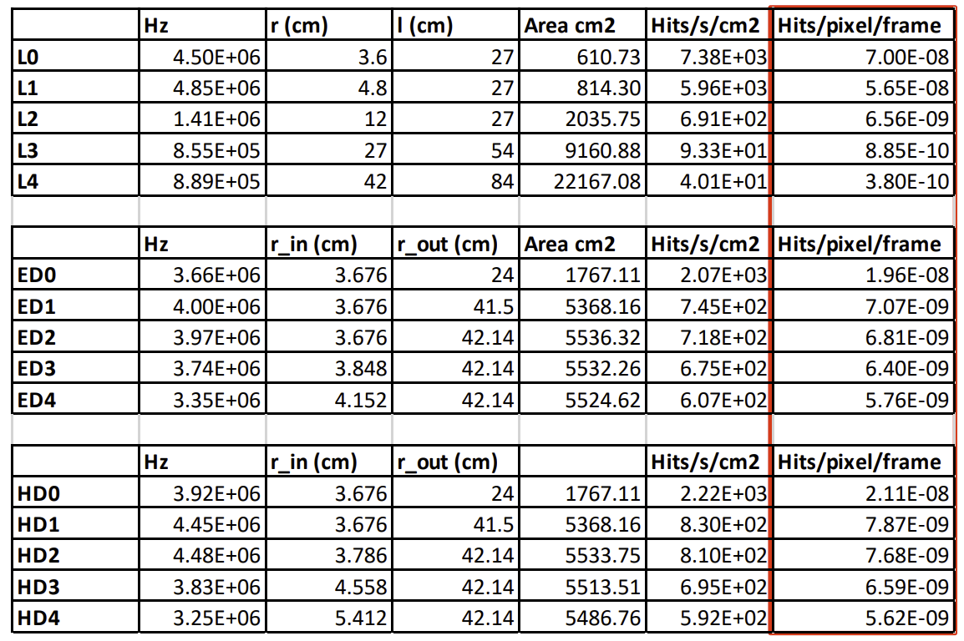
Event Rates at ePIC SVT
20.8×22.8 μm² pixel size @ 2 μs STROBE rate
Expected event rates are very;
Additional (repeated) readouts of the same hits should not clog data links but will allow information on signal amplitudes for improved timing
L. Gonella ePIC SVT collaboration meeting, ANL, 9-13 January 2024

Slide 13
Summary
Timing resolution is result of:
  Time-Walk “weak” vs. “strong” hits ð 2÷3 μs spread;
  Granularity of snapshotted readout (STROBE) ð create “integration frames”, may spill hit to one or one after frame;
  Out of time hits, incl. fake fractional signals “weak hits”;
Reading duplicated hits (initially planned to reject due to zero-probability of consecutive real hits in the same pixel) may help increasing timing precision by providing amplitude information;
Spreading phase of SROBE signal in SVT layers may allow further increase ToA resolution to significantly below 1 μs;
Requires confirmation of hit registering functionality implemented in ALICE-ITS3 pixel (is it the same as in ALPIDE?);

Slide 14

Reserve
Slides

