Slide 1
PS Dose Calculation
Nick Zachariou
Feb 6th 2024

Slide 2
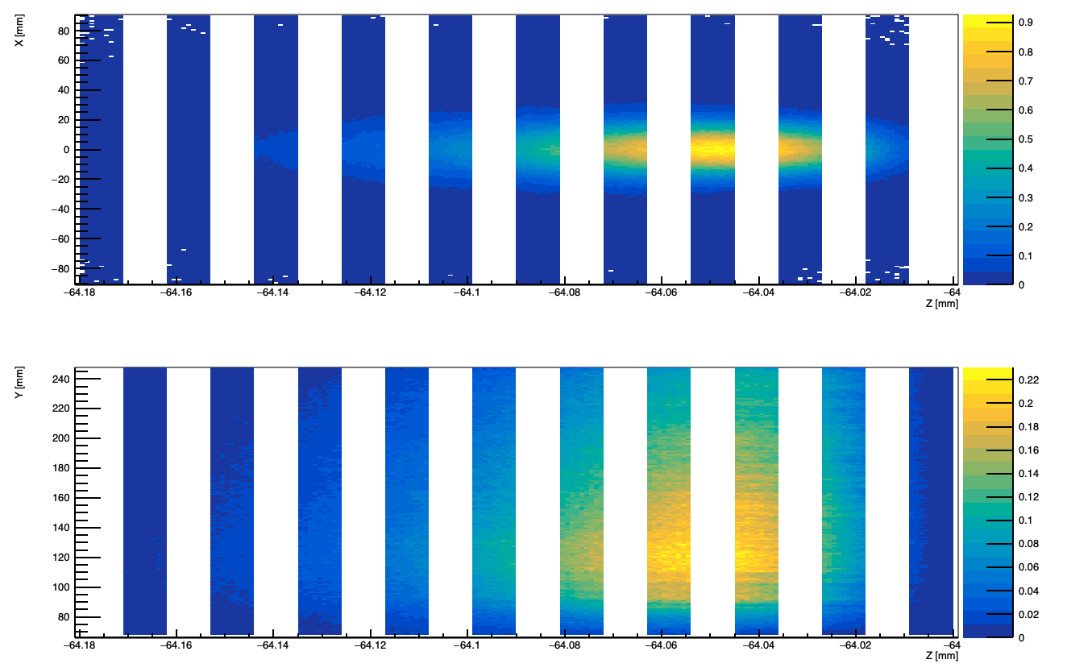
Total energy deposited for 25K converted photons
Energy deposited in each
Fiber for all 25K converted
Photons.
Each bin is 1 fiber
Z- scale in GeV

Slide 3
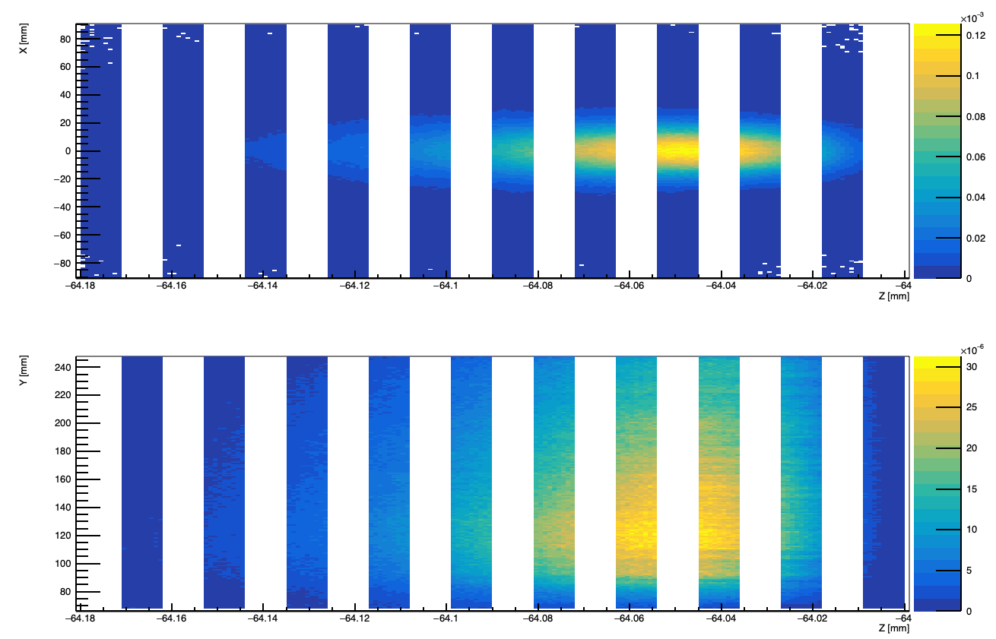
Average energy deposited for each hit
Average Energy deposited in each
Fiber per hit.
Number of hits established when cluster energy is larger than 20 MeV. Out of 25K converted photons we have ~7300 hits on each calorimeter
Each bin is 1 fiber
Z- scale in GeV

Slide 4
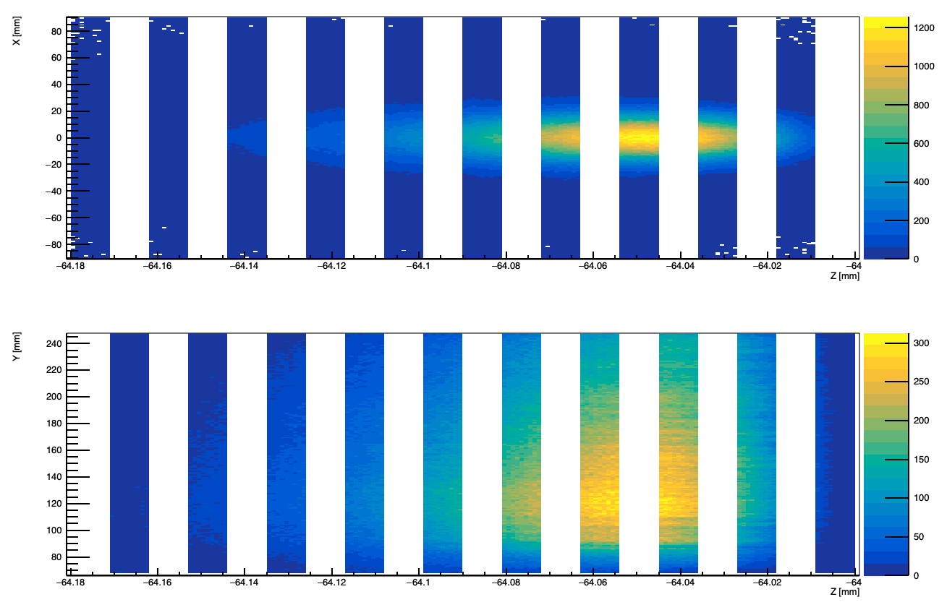
Average energy deposited Per Second
Average Energy deposited in each
Fiber per second.
Using that at highest lumi we would get 10⁻¹ Events per bunch crossing → Rate =10⁷ events/s
Each bin is 1 fiber
Z- scale in GeV/s

Slide 5
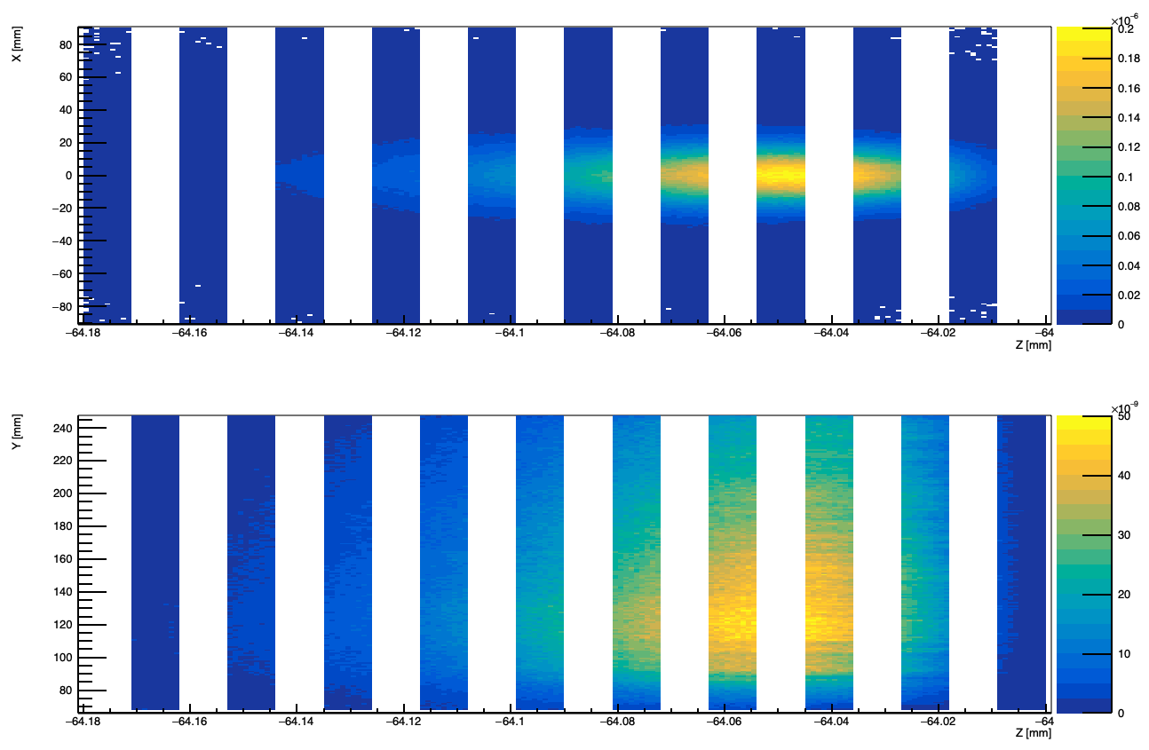
Converted to Joules/s
Average Energy deposited in each
Fiber per second.
Conversion from GeV to J → 1.6022e-10
Each bin is 1 fiber
Z- scale in Joules/s

Slide 6
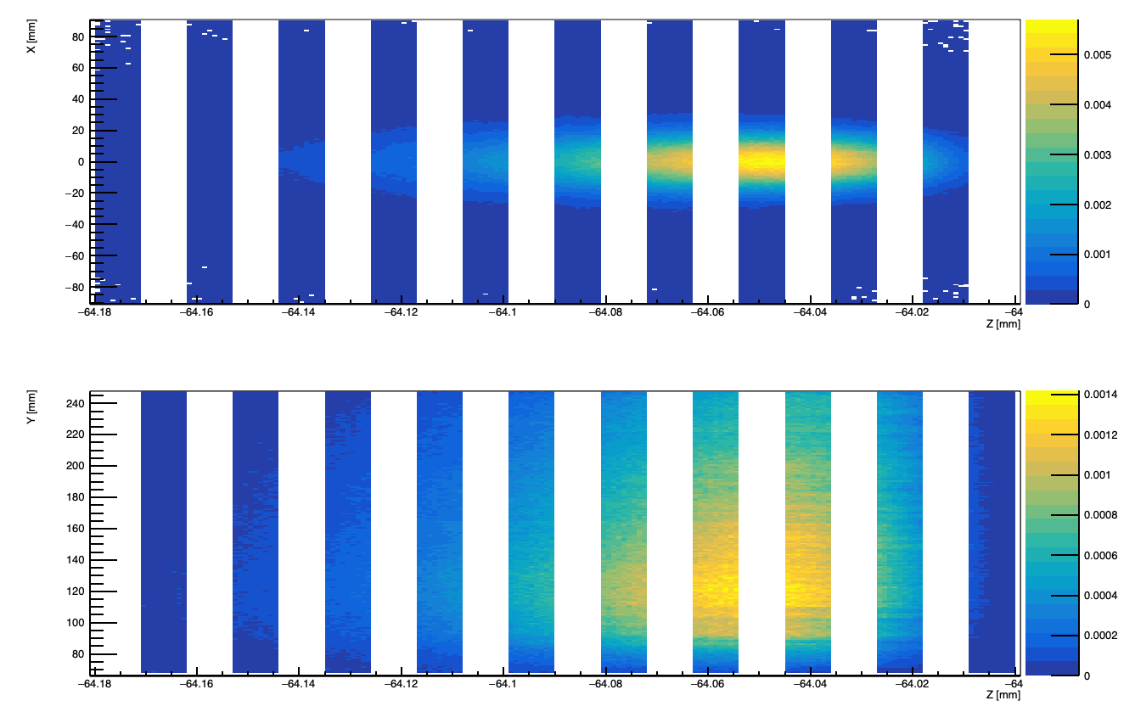
Converted to Gray/s
To convert to Gray we use that the volume of 1 fibre is πr^2L with r=0.025cm and L=18cm.
We use a density for fibres of 0.001 kg/cm3 to calculate J/kg (Gray)
Each bin is 1 fiber
Z- scale in Gray/s

Slide 7
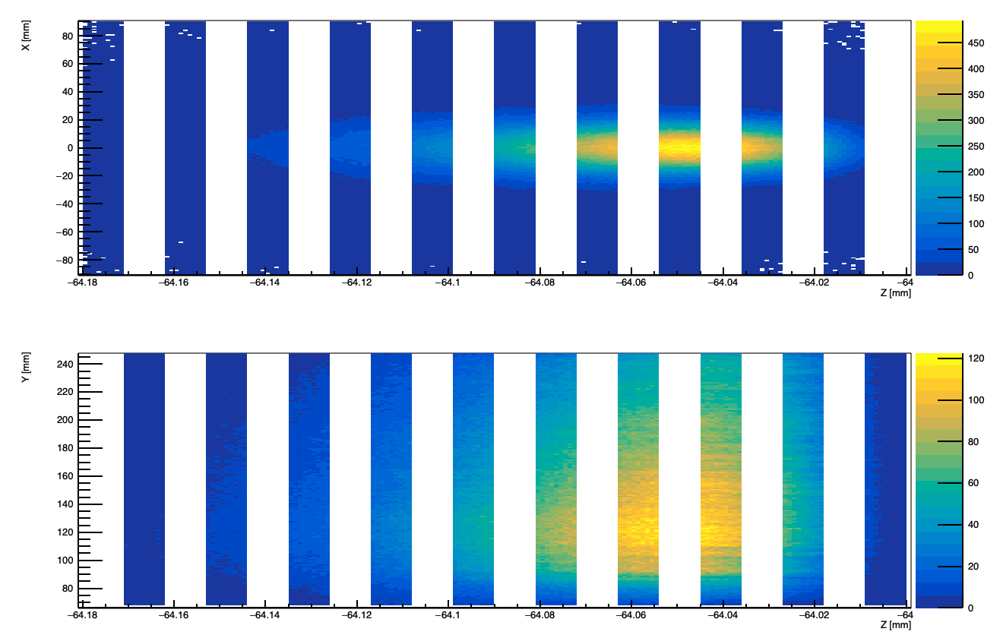
Converted to Gray/day
To convert to Gray we use that the volume of 1 fibre is πr^2L with r=0.025cm and L=18cm.
We use a density for fibres of 0.001 kg/cm3 to calculate J/kg (Gray)
Each bin is 1 fiber
Z- scale in Gray/day

