Slide 1
Data Volume for DAQ Status
Jeff Landgraf

Slide 2
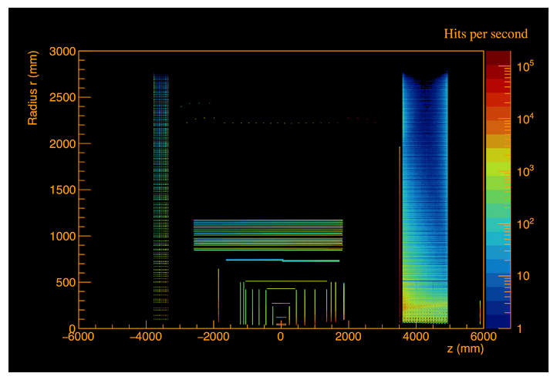
The Task
Take these plots and turn them into DAQ info
Starting point:
root files/code with raw data for each background & DIS (Thanks Zhengqiao, Jakub!) in the format :
detector, cellID, x, y, z
Ending point:
4 tables (channel &/or ASIC, RDO, tape)
detector, [element], hit_rate[each type + noise], channel_rate[each type + noise], hit_rate[total], channel_rate[total], data throughput [total]
Maximum values for each (histograms with distribution of rates)
Subtasks:
Identifying channel, asic, rdo from CELLID,x,y,z
Combining sources to do the summing
Adding information
Noise estimates, Charge Sharing, Sample time, known ASIC operations

Slide 3
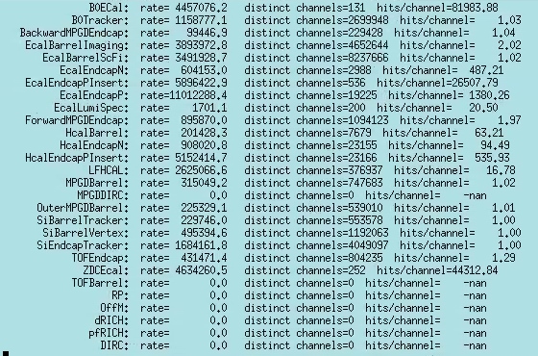
First look…many issues
More distinct channels hit than exist
Channel rate too low!
not auspicious for channel mapping
Unknown detectors
Most channels not hit
Channel rate too high!
Important detectors with no information
Different Geometry
Proton/DIS -> craterlake
Electron -> brycecanyon
Different framework
Proton/DIS xxx.edm4eic.root
Electron xxx.edm4hep.root
Different types of hits?
Proton/DIS → RecHits (thresholds applied ?!)
Electron → Hits
Understand / analyze each detector separately!

Slide 4
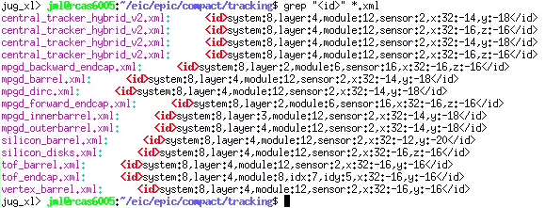
Second look…more issues
Mapping to ASICS/FEBS or even layers/disks harder than expected… no general solution
dd4hep CELLID defined by <id> fields… but
Very inconsistent implementation
Named parameters + [x,y] {not treated same while enumerating}
Actual channels are:
Mask named parameters, filter out x,y
Only use x,y
Combination of two
Complete variation
Even getting positions of detector elements is not easy.
Is there any way to execute the substitution of variables in the xml?
Can one grab them from root macros?

Slide 5
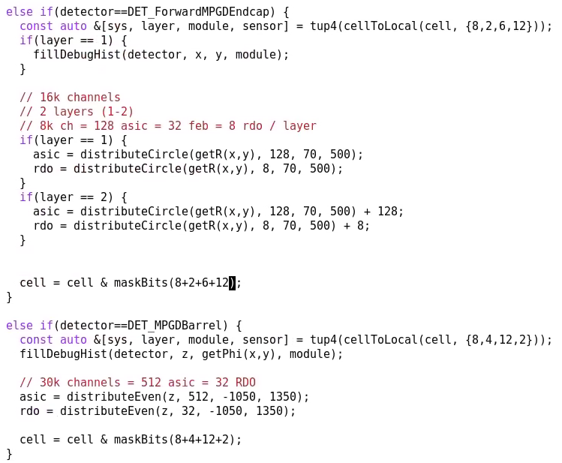
Assignment of channels / ASICS / RDOs
Reinterpreting geometry
LFHCAL
Actual counts (my tables): 64k channels. Counts from dd4hep much higher!
CELLID: [sys,moduleIDx,moduleIDy,moduletype,passive,towerx,towery,rlayerz,layerz]
Using [moduleIDx,moduleIDy,towerx,towery,rlayerz] alone, however gives 64,400 channels (close to actual value)
MPGD in general uses a fine grid to give the appropriate resolution in simulation. To find correct channel counts I distribute ASICS/RDO evenly over surfaces…

Slide 6
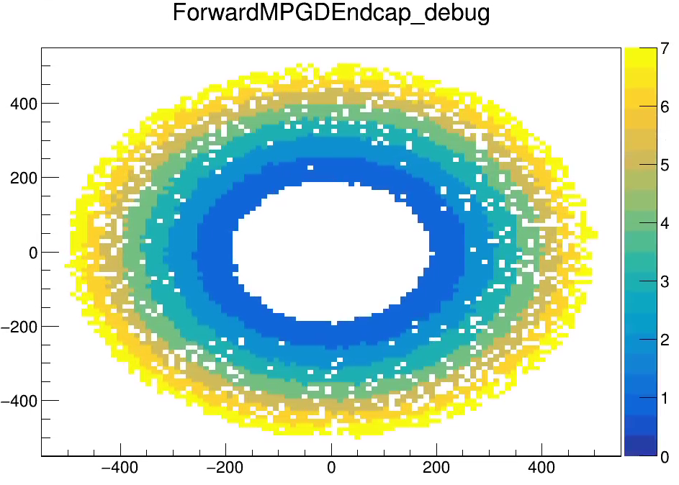
Assignment of channels / ASICS / RDOs
But need to take care that quantization effects don’t break the RDO counts as some detectors report in a course, precise grid!

Slide 7
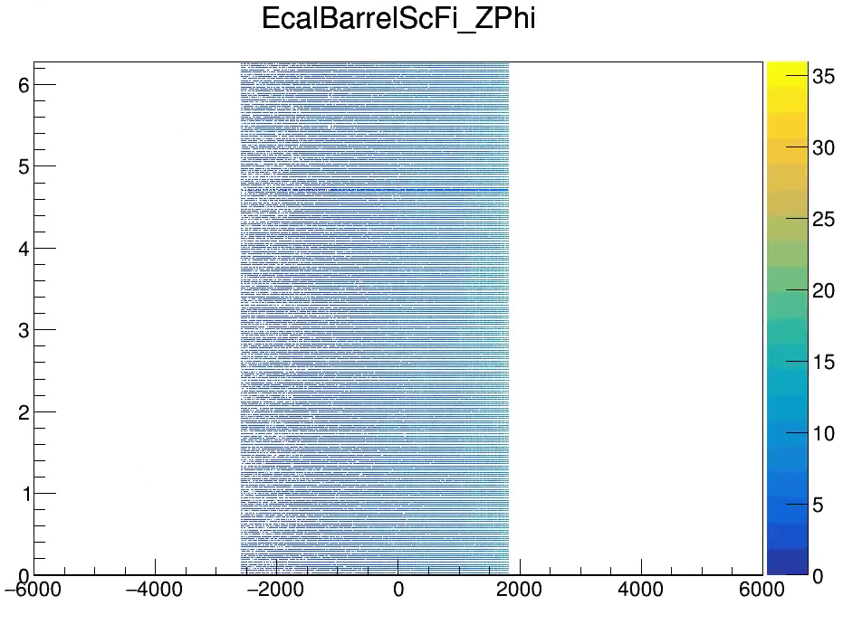
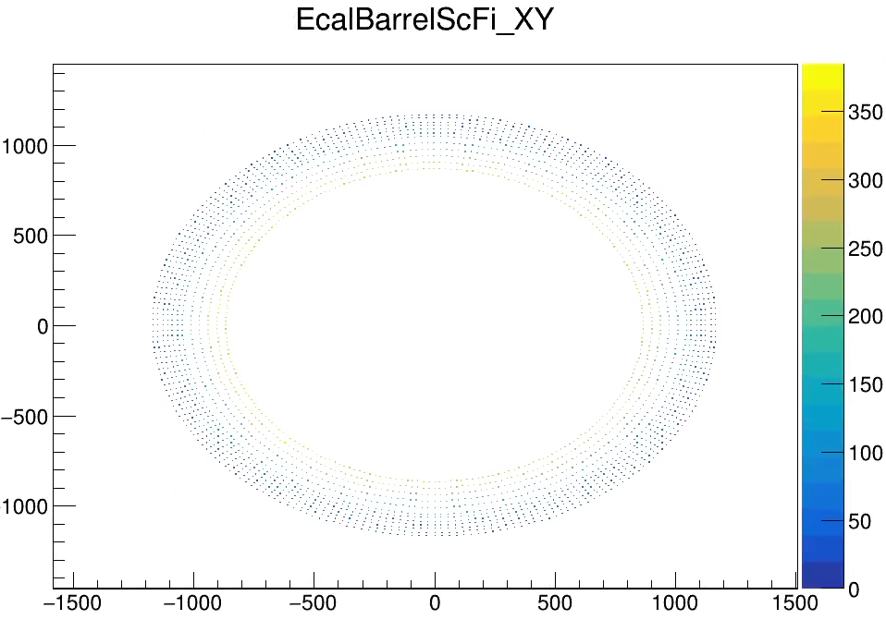
Assignment of channels / ASICS / RDOs
EcalBarrel
dd4hep gives a discrete readout in z for physics simulations
But these are really long fibers readout at both ends
The correct count can be corrected to the right value by
Masking the CELLID appropriately
Doubling each channel as defined in the CELLID

Slide 8
Assignment of channels / ASICS / RDOs
EcalBarrel
dd4hep gives a discrete readout in z for physics simulations
But these are really long fibers readout at both ends
The correct count can be corrected to the right value by
Masking the CELLID appropriately
Doubling each channel as defined in the CELLID

Slide 9
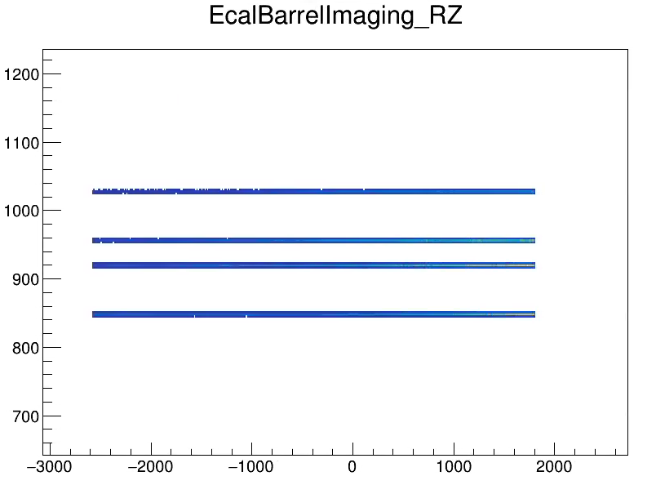
Assignment of channels / ASICS / RDOs
EcalBarrelImaging
The imaging calorimeter has only 4 layers (I think this was changed to 6)
The logic for assigning ASICS and RDOs is to take the astropix size and channel counts and evenly distribute on existing layers (16cm^2 per quad astropix chip and 5320 ch.)
The channel count is about 30% too low compared to the numbers in my tables.

Slide 10
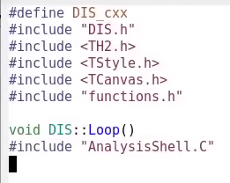
Status
Code available: https://github.com/jml985/epicJTools
Jakub is working on putting electron calibration into craterlake / edm4eic.root format. I also suggest using the 23.12.0 release of this to keep the geometry consistent between different backgrounds. We should be mindful of the geometry used.
Need to finish
Combine data
Convert to data Sizes / charge sharing / rates rather than hit counts
Incorporate Far Backward/Far Forward
The code is nearly done and is relatively turnkey
It will need to be updated when geometry changes because detector dimensions hardcoded
Can be used to study different species (I haven’t seen any eA simulations at all, but at least in far back the rates seem to be higher)
Note, DAQ is interested in:
Worst case rates
Signal to background even at lower rates
I’m not sure about incorporating synchrotron radiation.
We should have a useful summary of the numbers next week…
Autogen

Slide 11
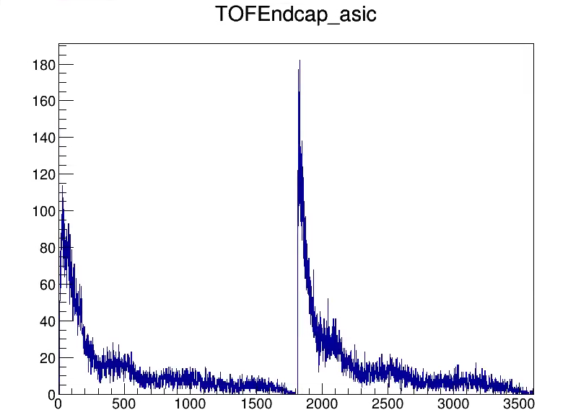
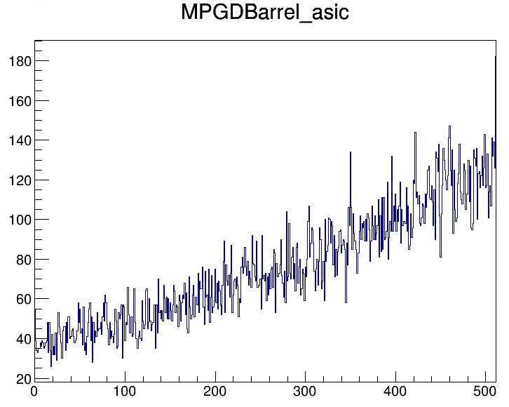
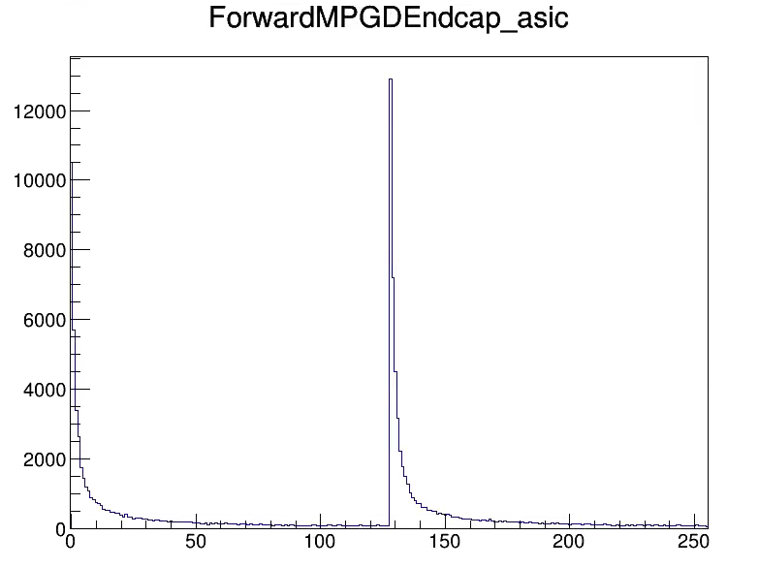
Status
Code available: https://github.com/jml985/epicJTools
Jakub is working on putting electron calibration into craterlake / edm4eic.root format. I also suggest using the 23.12.0 release of this to keep the geometry consistent between different backgrounds. We should be mindful of the geometry used.
The code is nearly done and is relatively turnkey
It will need to be updated when geometry changes because detector dimensions hardcoded
Can be used to study different species (I haven’t seen any Ae simulations at all, but at least in far back the rates seem to be higher)
Note, DAQ is interested in:
Worst case rates
Signal to background even at lower rates
I’m not sure about incorporating synchrotron radiation.
We should have a useful summary of the numbers next week…

Slide 12
Questions?
????
Do we revisit these plots?
They are NOT wrong
They do have granularity that varies and doesn’t necessarily match physical readout (although usually match the actual measurement correctly!)
They do have active hits that are aggregated

