Slide 1
Instability during debunch
Michael Blaskiewicz
February 26, 2024

Slide 2
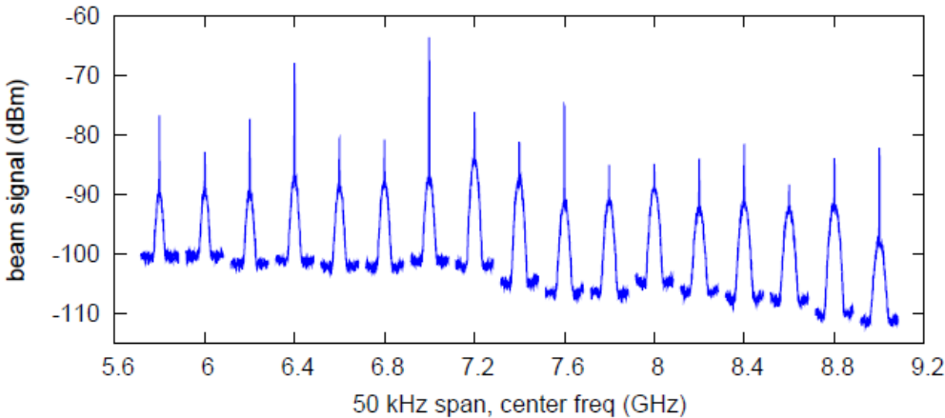
Basic idea
Suppose you have a single bunch in the accelerator and turn the RF quickly to zero.
As the beam debunches the local energy spread drops.
Microwave stability scales as ZI_{peak}/σ_{E}² < K
The growth rate depends on Z and is calculable assuming a known momentum distribution.
The longitudinal pickup is well understood.
Cable attenuation will be measured.
Δt
ΔE_{local}
ΔE_{tot}

Slide 3
Growth rates
Coasting beam instabilities
For a normalized frequency distribution ρ(ω)
For a rectangular distribution of half width Δ
Above transition η>0 so space charge drives instabilities.
It will be a challenge to disentangle a useful signal.
Doing the experiment at injection and at high energy will help.

Slide 4
Experimental Plan
title: broad band impedance measurement
spokesperson: Mike Blaskiewicz
Team: Mike, Kevin Mernick, Alexei Blednykh, MCR
goal: measure broad band longitudinal impedance
benefits: helpful for EIC planning
description:
Inject a single proton bunch into 9 MHz. 197 is off and cavity damper is inserted.
Reduce voltage until bunch length is maximum.
Snap off voltage
Take turn by turn data with longitudinal Schottky pickup.
Take turn by turn WCM data at same time for instantaneous current and dp/p
After doing injection measurements we ramp to top energy and repeat, this will greatly reduce the effects of space charge.
Hazards: no hazards
resources: fast scope, various pickups
applications: wall current monitor, rf ramps, specialized code from Kevin
time: 2 , 4 hour blocks. One if all is good the first time.
personnel: MCR, Mike, Kevin Mernick, Alexei Blednykh
Analysis
Mike/Alexei will do calculations and present. Write a tech note if warranted.

