Slide 1
APEX Priority, Readiness and Planning
Haixin Huang
2024 RHIC APEX Workshop
Large Seminar Room, Building 510, BNL
March 14, 2024

Slide 2
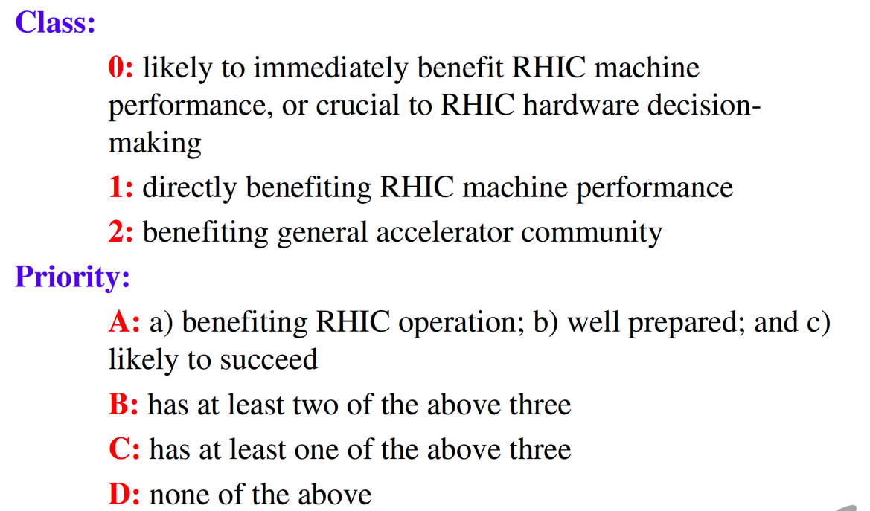
APEX Proposal Gradings
RHIC should be replaced by RHIC and EIC design and operation
EIC design is more critical than EIC operation
➔ Must do
➔ Recommended
➔ Considered for inclusion
➔ Declined

Slide 3
APEX Proposals for Runs 24 and 25
Previous proposals
Total of 214 hours.
Four still need ramp development.

Slide 4
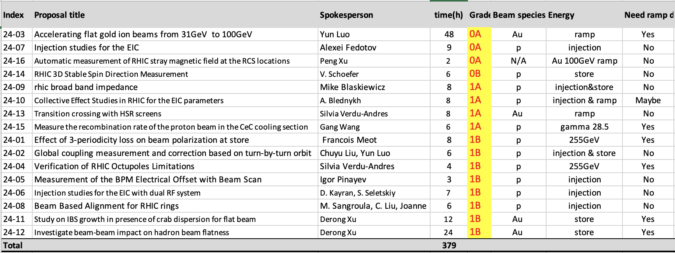
New proposals
Total of 214 hours for alive previous proposals. Total of 165 hours for new proposals.
Total hours of 379 hours.
More than five still need ramp development. The level of efforts of these are different.

Slide 5
Total Beam Time Requested for Runs 24&25
Total beam time requested: 379 hours
with proton beams: 87 hours, 23.0%
with He3+ ion beam: 22 hours, 5.8%
with gold ion beams: 270 hours, 71.2%
Proton and He3+ ones must be done in run24 (~109 hours).
25 cryo weeks-> 21 weeks physics -> 10 APEX sessions.
10sessionsX15hoursX 0.9(efficiency)=135hours.
With FY25 running time similar to FY24, we are short of ~100hours.
Additional end of RHIC run APEX (~2weeks) is requested by EIC.
Can the two weeks be separated into two runs to reduce risk?

Slide 6
Planning and Preparation of APEXs
APEX has got attention of review boards of RHIC operation and EIC design as well as DOE.
The priorities of experiments are set by the number in the rating.
Proton related must be done this year.
To ensure the efficient use of APEX time, readiness is the key to stream out the planned APEX.
The passive acceptance of APEX one week before didn’t work well: experimenters come to us for time when they are ready. FY23 was a bad example in that we had beam time but many experiments not ready especially at the beginning of run.
We should layout the overall APEX schedule for FY24 before run starts, with some fine tuning several weeks ahead of actual APEX to give enough time for preparation.
How can we improve the APEX schedule and preparation?

