Slide 1
ePIC SVT Outer Barrel Powering
James Glover
EIC-UK WP1 (MAPS) F2F @ Birmingham
Fri, 15th March 2024

Slide 2
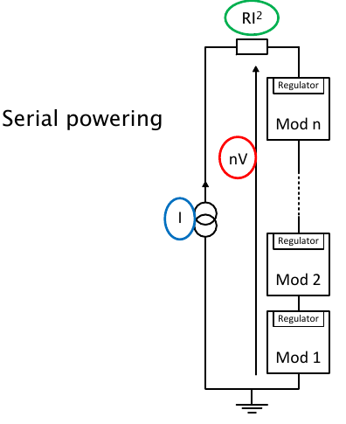
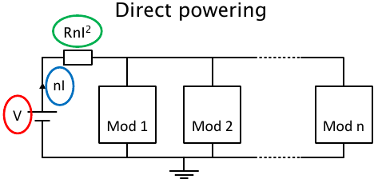
Serial powering basics
Serial powering is a current based powering scheme, where modules are powered in series by a constant current.
The current to voltage conversion is done by regulators close to/on module.
In a serial powering chain made of n modules, the transmitted current is only the current needed by one module, I.
For n modules powered in series, the current is reduced of a factor n with respect to a direct powering scheme → Higher power efficiency and reduced cable volume.
Cable cross-section and the power losses on the cables scale by the same factor.
From: Jan ’24 CM@ANL – L. Gonella, “Basics of serial powering and S-LDO”, https://indico.bnl.gov/event/20473/contributions/84989/

Slide 3
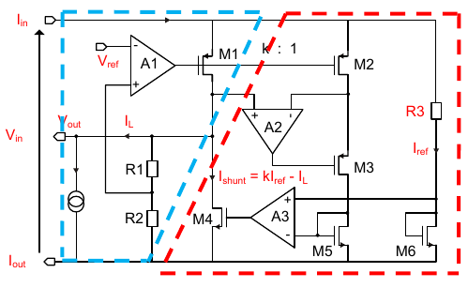
Shunt-LDO regulator
Details to come in Roy’s talk.
For this powering scheme, on-chip regulators are needed that can:
Operate in parallel
Generate different output voltages out of the current supply
Shunt additional current in case of device failure.
The Shunt-LDO regulator was designed to match these requirements.
First prototype version in the ATLAS pixel FEI4 chip (180 nm process).
Full SP version in the RD53 chip (65 nm process).
It combines two regulation loops.
Shunt regulation circuitry → regulates the current to the chip.
LDO (Low Drop Out) regulation loop → generates the voltage for the chip.
From: Jan ’24 CM@ANL – L. Gonella, “Basics of serial powering and S-LDO”, https://indico.bnl.gov/event/20473/contributions/84989/

Slide 4
FPC considerations
The flexible printer circuit (FPC) will be the interconnect between clusters of EIC-LAS. This needs:
To enable the readout of data from many EIC-LAS to 1 VTRx+*.
Host the current to voltage regulation (for each EIC-LAS) and interconnections within a SP chain.
Clusters of 4 EIC-LAS per SP chain work well with VTRx+ readout.
FPC designs are preferring clusters 1 EIC-LAS wide (even if interfacing sensors on different sides of the same structure).
* 4 read-out channels per VTRx+.

Slide 5
ITS3’s power domains
3 domains all around +1.2 V.
Services
Global analogue
Global digital
1 Serialisers domain at +1.8 V.
1 Substrate bias domain at -1.2 V.
From ITS3 TDR (Section 3.4.5):
https://indico.cern.ch/event/1372078/attachments/2790270/4865816/20240129ITS3_TDR_V3LHCC.pdf

Slide 6
Ancillary ASIC
Details can be seen in Iain’s talk.
Power domains to be achieved using S-LDOs and negative voltage generator (NVG),these will be part of an ancillary ASIC (along with multiplexing of slow controls).
Chip designers are working on power consumption estimates.
This will be dominated by the S-LDOs
Some aspects will be introduced here.
A talk by the chip designers will be at a future (SVT) meeting when power figures are finalised.

Slide 7
The 1.8 V problem
To keep the 1.8 V Serialisers domain of the wafer-scale sensor:
All Shunt-LDOs (S-LDOs) need to be in parallel, and if we run them at 1.8V, the 1.2V supplies will waste considerable power.
Chip design (MOSAIX) currently has on-chip LDOs for the serialisers (while each serialiser runs at 1.2 V).
We could remove this LDO and rely on the S-LDO to generate the 1.2V for the serialisers.
We then have 4 domains of 1.2 – 1.32 V.
From recent chip designers meeting (closed session).

Slide 8
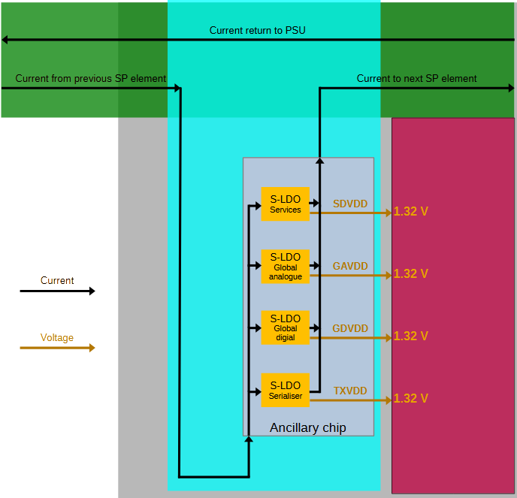
1 S-LDO per (+ve) domain
4 S-LDOs would be needed (in parallel).
Services (up to 1.32 V).
Global analogue (up to 1.32 V).
Global digital (up to 1.32 V).
Serialisers (up to 1.32 V).
What about redundancy?
Per EIC-LAS and per SP chain.

Slide 9
Redundancy options
1 S-LDO failure, kills 1 EIC-LAS, but keeps SP chain.
4 S-LDOs per EIC-LAS.
If any 1 fails, the EIC-LAS is lost.
Up to 2 (on the same EIC-LAS) can fail before the SP chain is lost*.
Redundancy for each S-LDO (2 per domain).
8 S-LDOs per EIC-LAS (more material).
Master/slave relationship (slave only supplies domain if master has failed).
Requires additional circuitry (and material), on top of the additional S-LDO.
Any (single) S-LDO failure does not affect the detector performance.
2 S-LDOs (for the same domain) would have to fail before losing an EIC-LAS.
Up to 2 domains (on the same EIC-LAS) can fail before the SP chain is lost.
*Assuming 2 S-LDOs remain, each shunting >$\frac{1}{2}$I_{EIC-LAS}.

Slide 10
Substrate bias domain
From: 9th Jan ’24, ePIC CM@ANL – G. Deptuch, “EIC-LAS ancillary / support IC”, https://indico.bnl.gov/event/20473/contributions/84985/attachments/51831/88643/ePIC_SVT_MAPS_design_org.pptx
The S-LDO configurations only cover the positive voltage power domains.
A -1.2 V domain is needed for the substrate of the chip.
Can not be supplied in a parallel powering scheme.
Each EIC-LAS in the SP chain will have a difference ground reference.
The -1.2 V must be referenced to the specific EIC-LAS’s ground.

Slide 11
S-LDO config per EIC-LAS
Basic configuration overview (no redundancy shown).
Negative voltage generator shown on Global analogue for ease.
Could be run from another domain’s S-LDO.
Or a dedicated S-LDO.

Slide 12
Powering the ancillary ASIC
The S-LDOs will be powered by the current supply.
Rest of the ASIC needs power from somewhere else.
Most likely needing 1.8 V.
Direct powering to ancillary ASIC?
Two lines = 1 PSU channel per ancillary ASIC.
Likely to want voltage regulation for the ASIC’s supply.
A separate 1.8V S-LDO running in LDO-mode?

Slide 13
Thank you very much!
Any questions?

Slide 14
Additional (support) slides

Slide 15
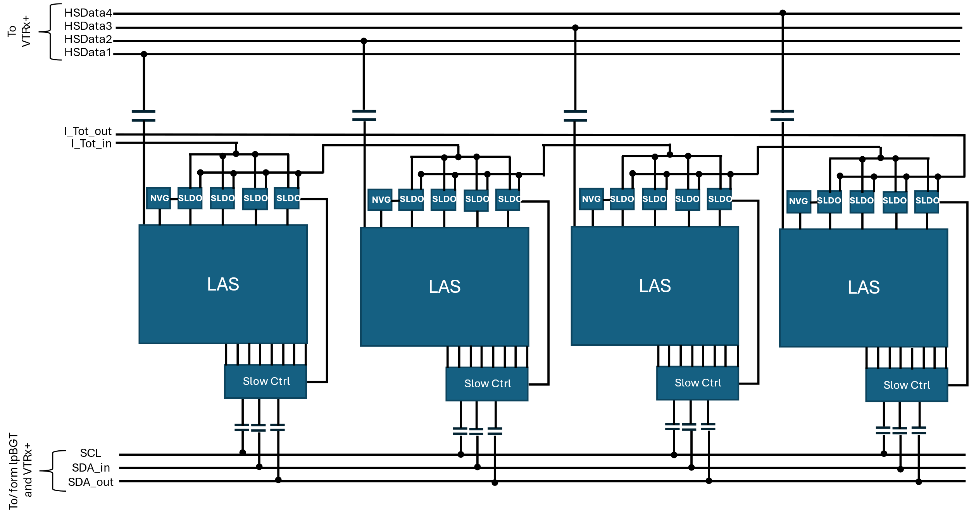
EIC-LAS connections on FPC
On this slide the three functions of the ancillary chip are shown separately for clarity.
Precise location of AC-coupling capacitors TBD.
Which SLDO powers what part of the auxiliary chip TBD.
Schematic drawing by Marcello Borri (STFC)

