Slide 1
Stave thermal FEA and CFD preliminary studies
Stephanie Yang (Oxford)
ePIC_UK F2F meeting at Birmingham University
15th March 2024

Slide 2
Introduction
Sensitivity studies have been carried out:
  Steady state thermal FEA to look at temperature profile of a single 5RSU sensor at various convection film coefficient values, and
  To establish a simplified model.
  CFD 2D with porous media to test out the input porous parameters.
  CFD 2D: extend the model to 2 sensors, then 4 sensors, finally full length (8 sensors) model.
  CFD 3D models: to observe their flow patterns.
The assumptions made for the input parameters and boundary conditions were rough estimates as we only look at the effect of cases and their implications.

Slide 3
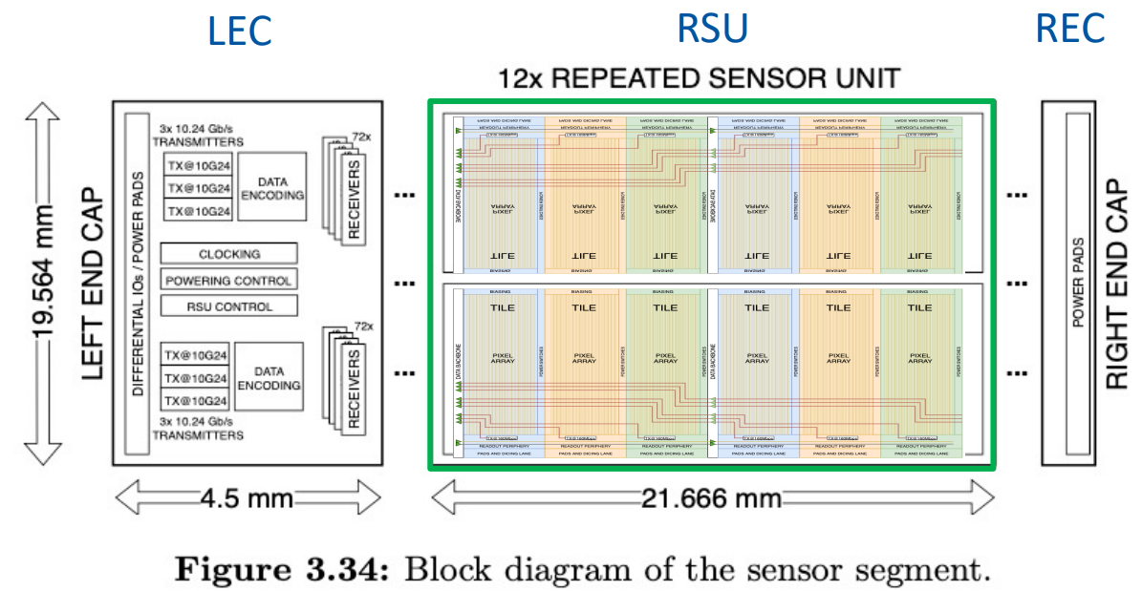
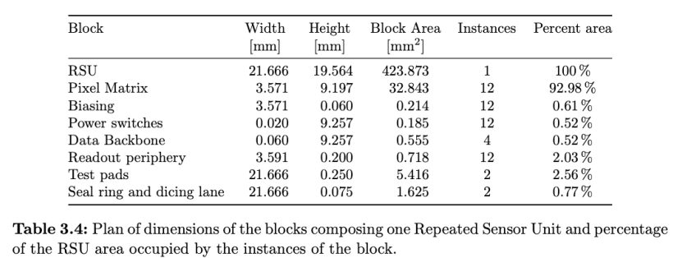
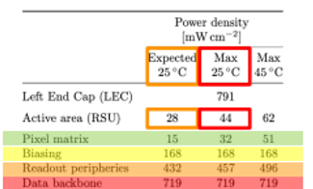
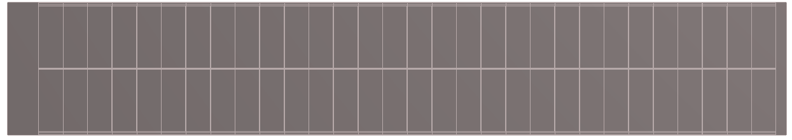
Sensor FEA geometry
https://indico.cern.ch/event/1341665/contributions/5648416/attachments/2751648/4789826/20231114-WP2-Report.pdf
114.330
LEC
Case2 input
RSU
Sensor geometry modelled using shell elements.
Source of Power density input
Case1 input

Slide 4
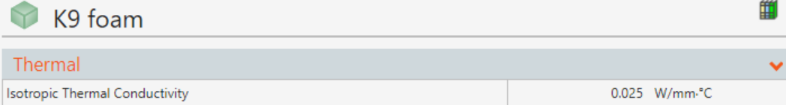
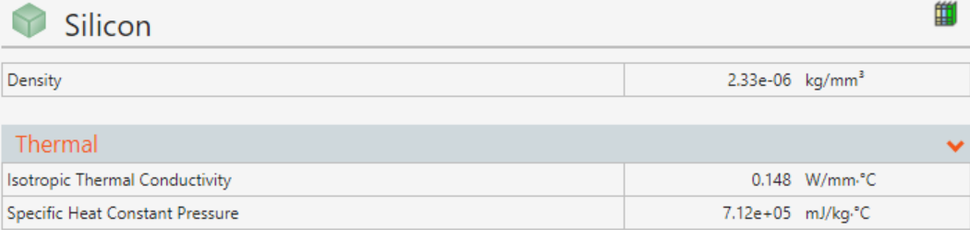
Material properties for thermal FEA

Slide 5
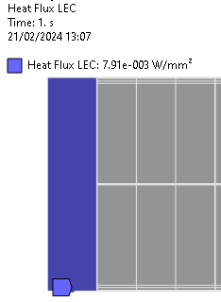
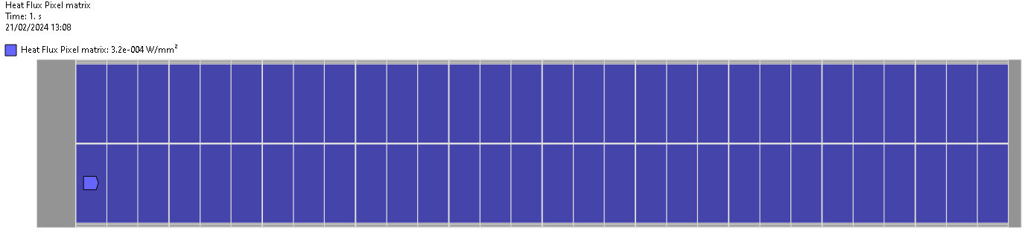
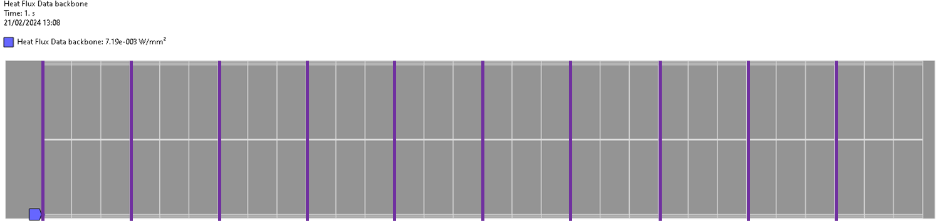
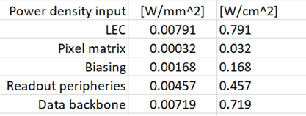
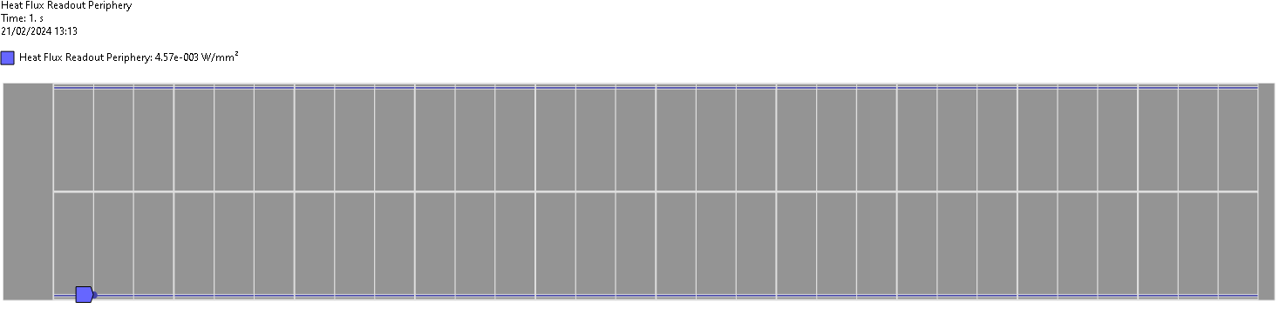
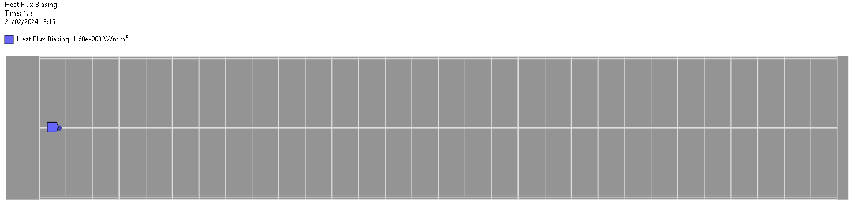
Power density input
Pixel matrix
LEC
Data backbone
Readout periphery
Boundary conditions:
Initial reference T = 22C;
HTC values from 5 to 1000 W/m²C are applied to the whole sensor surface
Steady state thermal analysis
Biasing

Slide 6
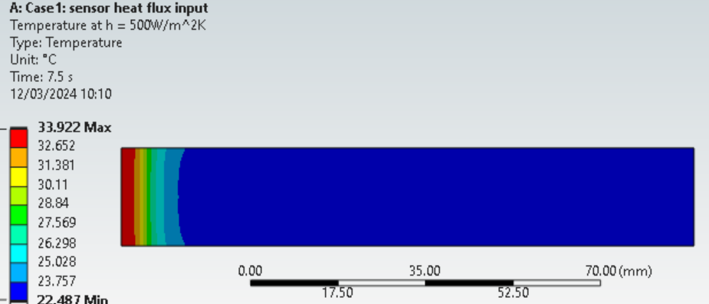
Thermal FEA case 1 (sensor detail model)
As expected, the higher the HTC values the smaller the dT.

Slide 7
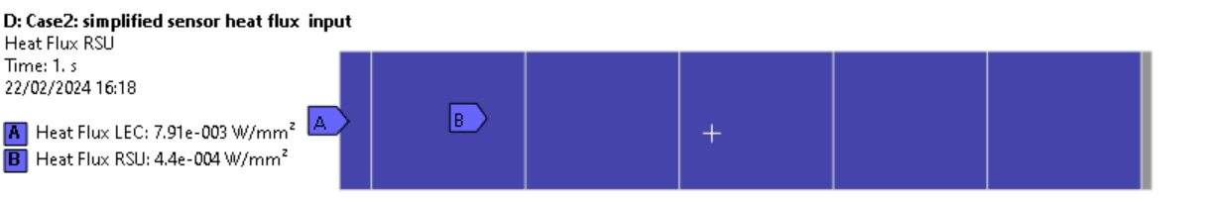
Thermal FEA case 2 (sensor simplified model benchmark)
This result shows that the simplified sensor model with equivalent power input gives the same result as the detail sensor model.
For further CFD studies, the simplified model and power input will be used.

Slide 8
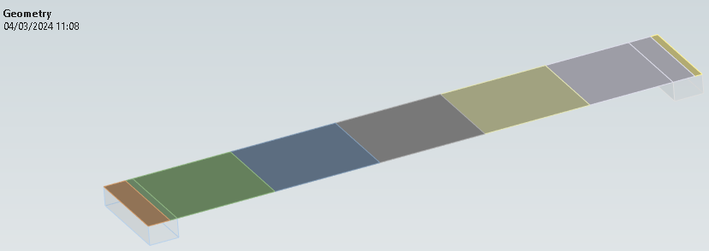
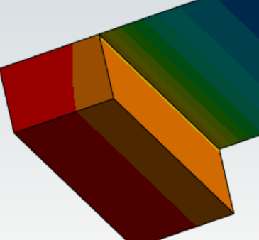
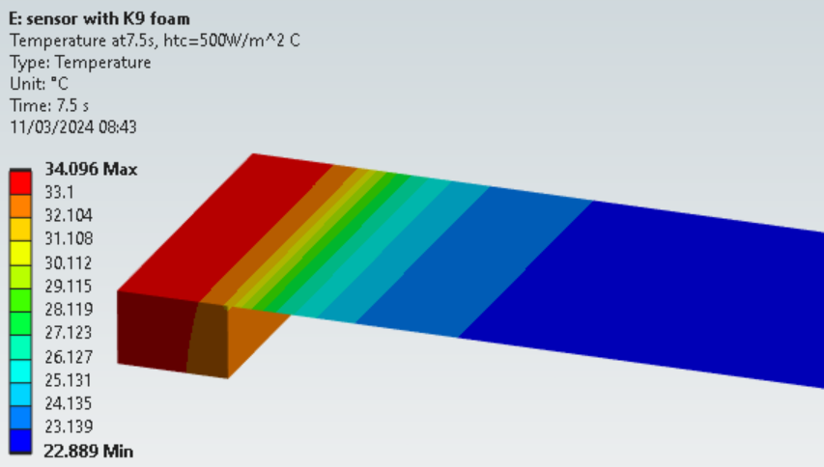
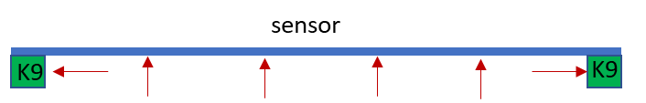
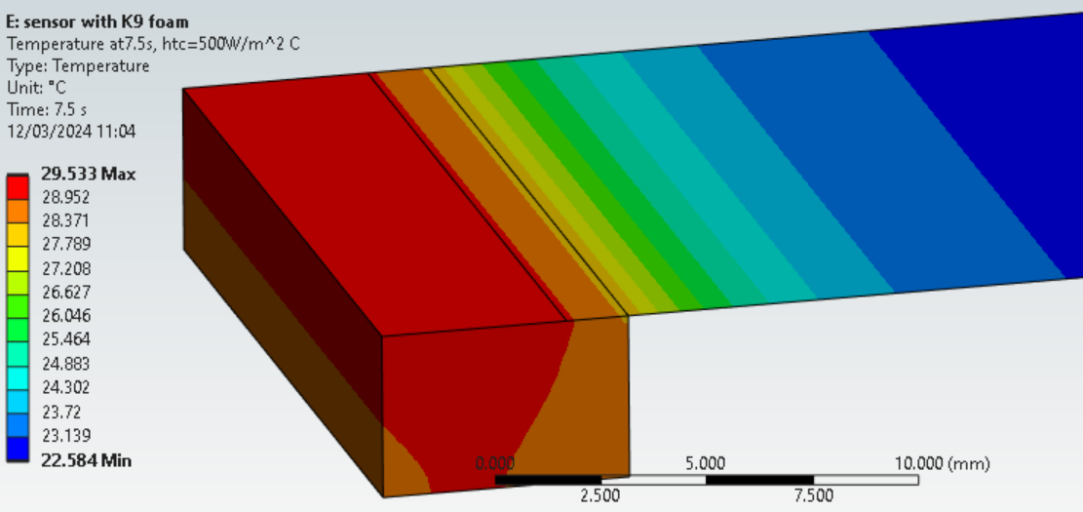
Thermal FEA case 3 (sensor simplified model with K9 foams)
sensor
RSU = 440W/m²
K9
K9
HTC area applied to inside faces of K9 foam and sensor area
LEC = 7910W/m²
Delt T =12 ºC
K9 foams
The additional surface area from K9 foams helps to remove the heat.
Additional HTC also applied to the end faces of the K9 foams
Delt T =7.5 ºC
Delta T = 7.53 ºC

Slide 9
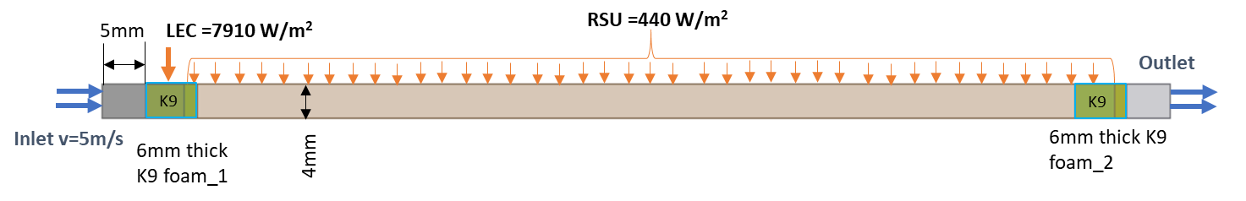
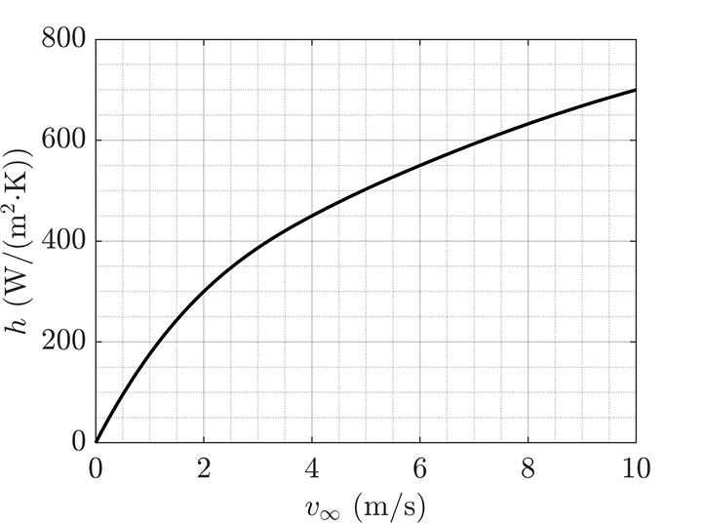
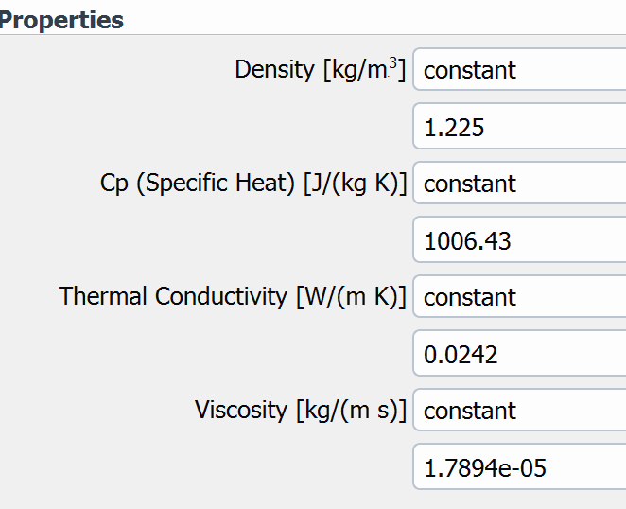
CFD 2D model (without K9 foams)
2D geometry and CFD input:
Inlet v=5/s
air
Adiabatic wall boundary conditions applied to the rest of the model
Fluid material: air
Reference:
https://indico.cern.ch/event/1228295/contributions/5390941/

Slide 10
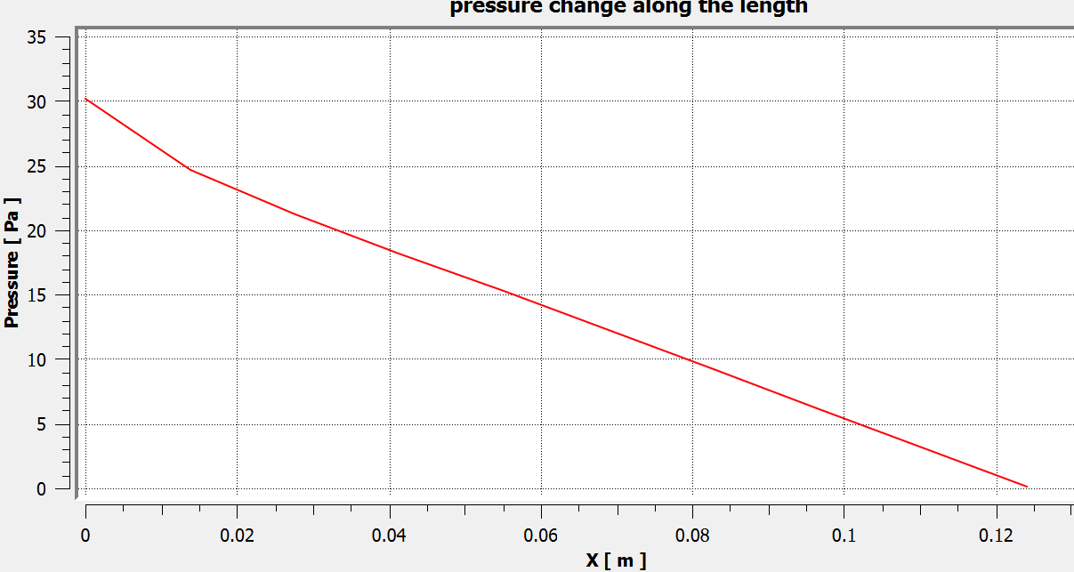
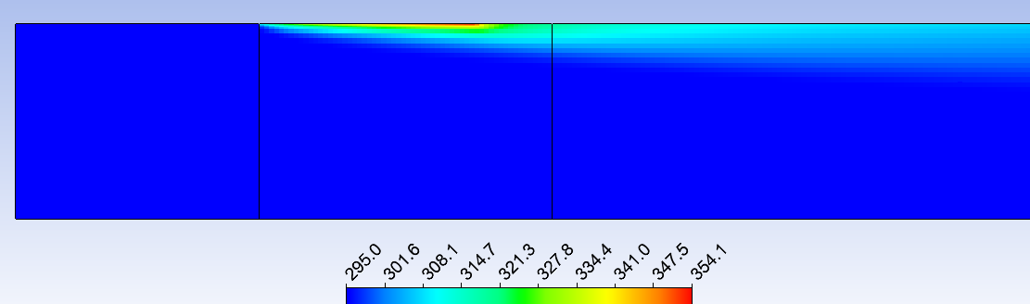
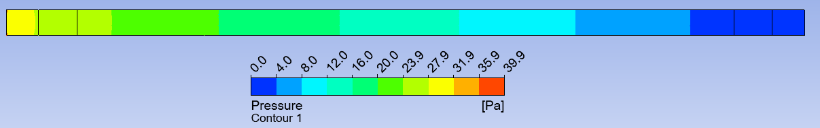
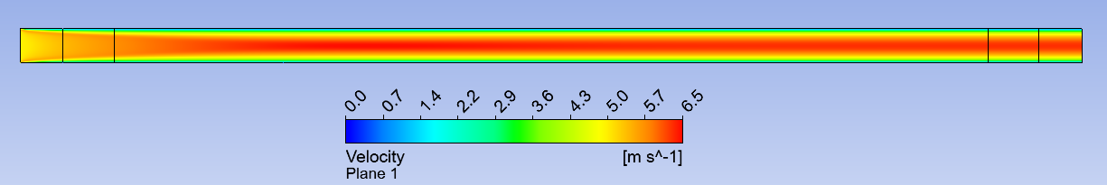
CFD 2D fluid model without K9 foams
Heat from sensor region has been moved to the right side by the flow, and spread along the channel length.
Linear pressure drop along the length
Delta T btw inlet and outlet =3K
Global delta T=59K

Slide 11
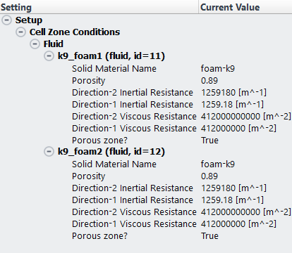
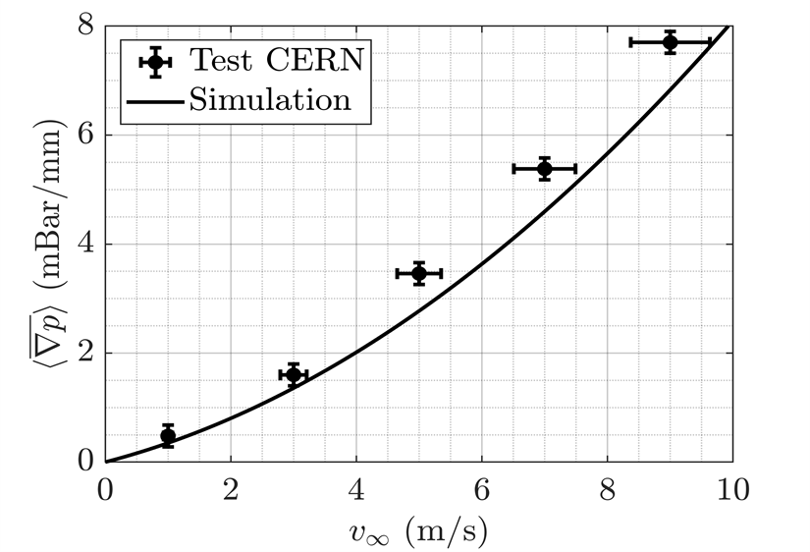
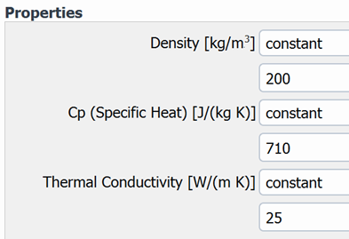
CFD 2D fluid porous model
air
Adiabatic wall boundary applied to the rest of the model
Key porous input parameters:
(derived from CERN experiment data on K9 foam: https://indico.cern.ch/event/1228295/contributions/5390941/):
K9 foam

Slide 12
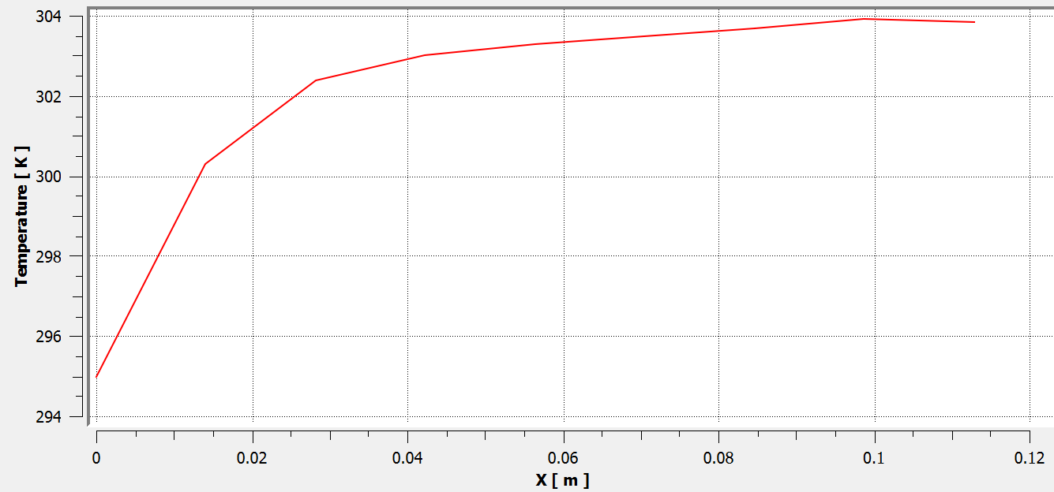
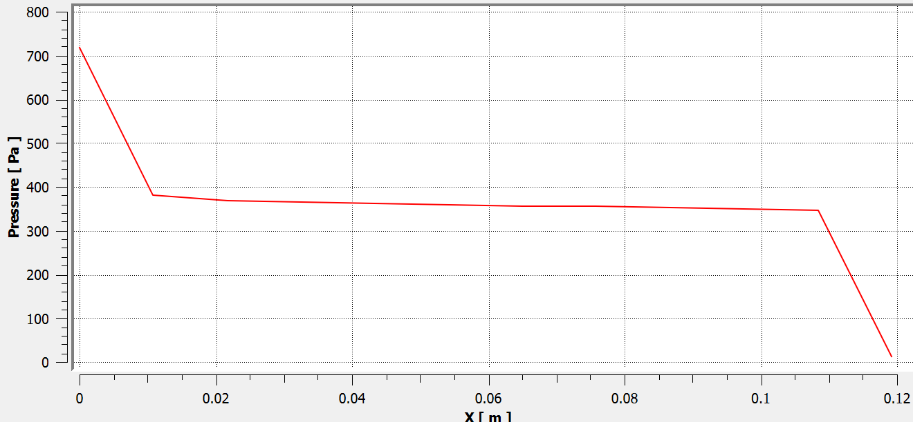
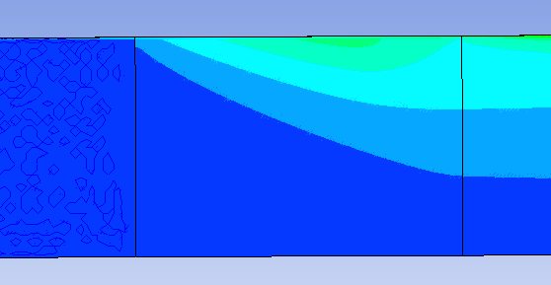
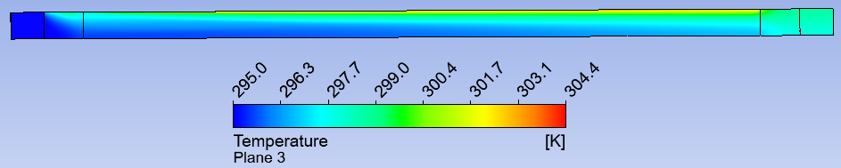
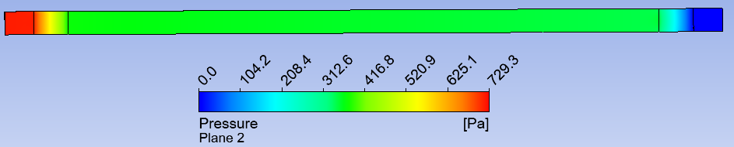
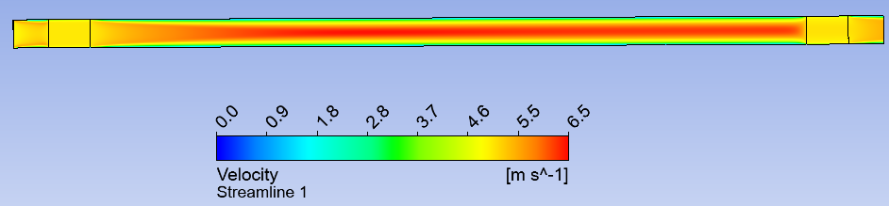
CFD 2D model with K9 foams
Region between two foams
Delta T btw inlet and outlet =3K
Global delta T=9.4K

Slide 13
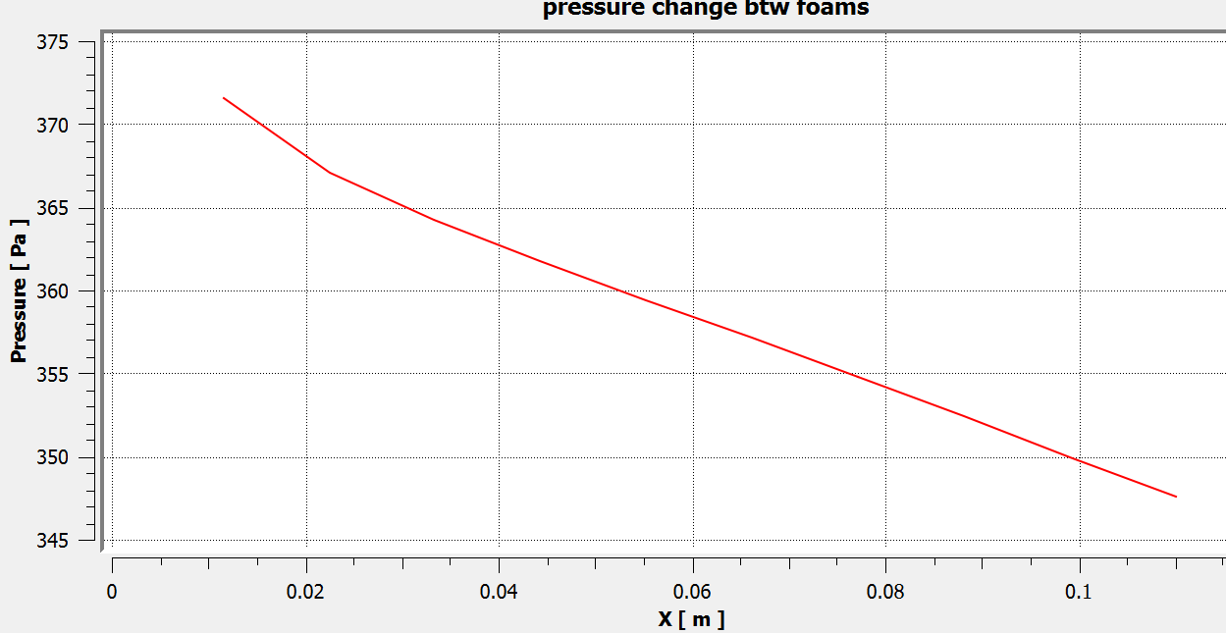
Effect of the pressure on heat transport
with foams
Without foams
Pressure remains high between the two foam blocks although pressure difference is the same as the case without foams. However, high pressure means higher inertia of the air there by making the heat transport more efficient.

Slide 14
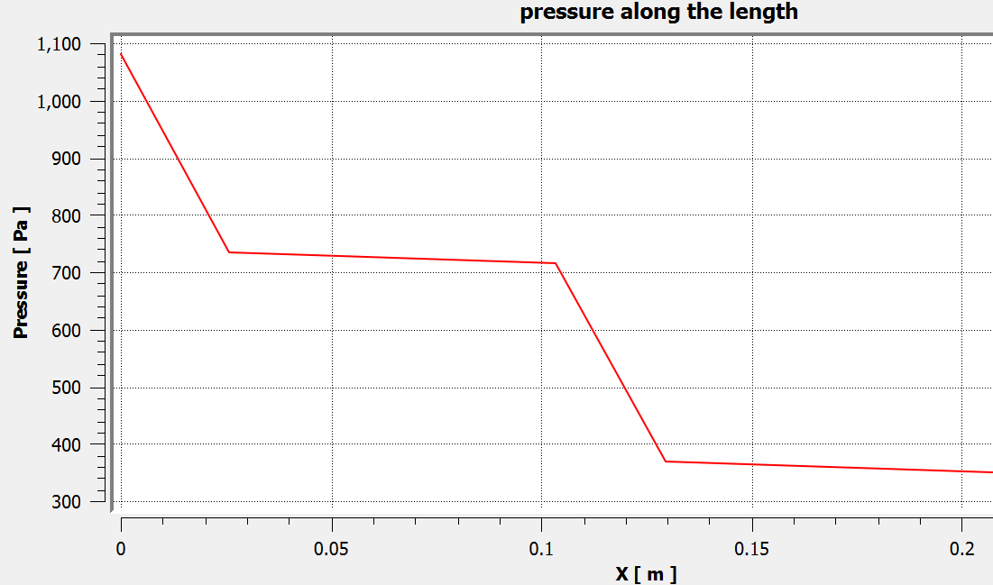
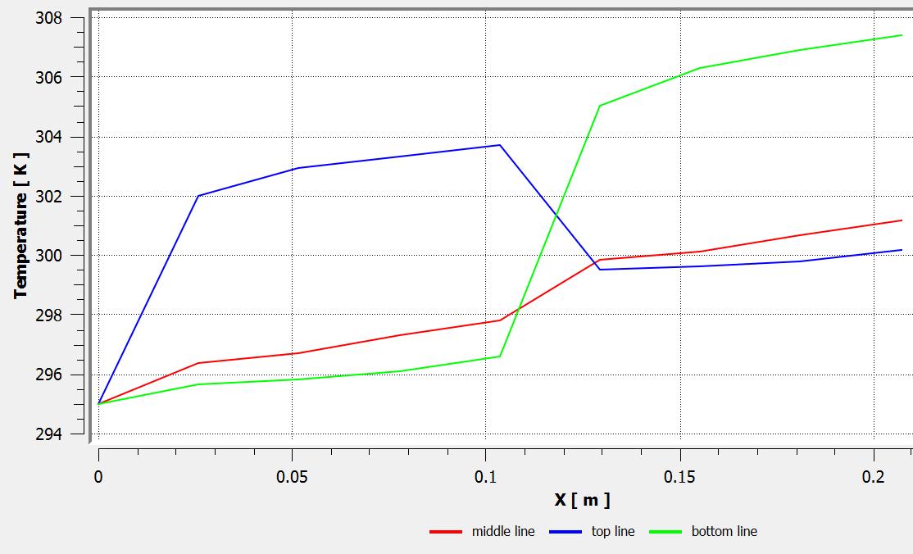
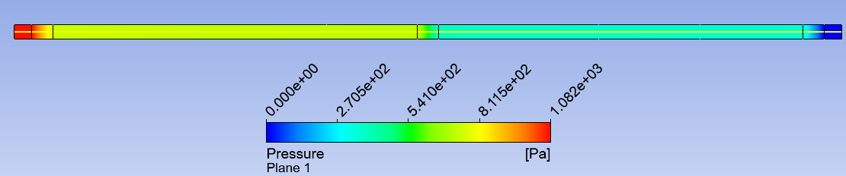
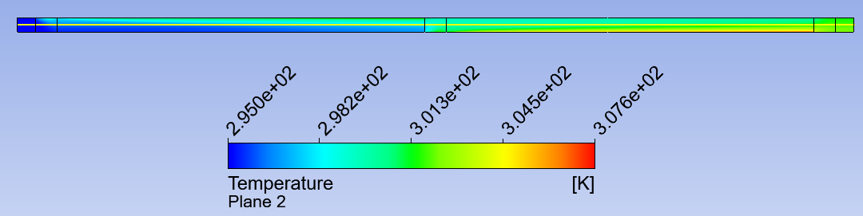
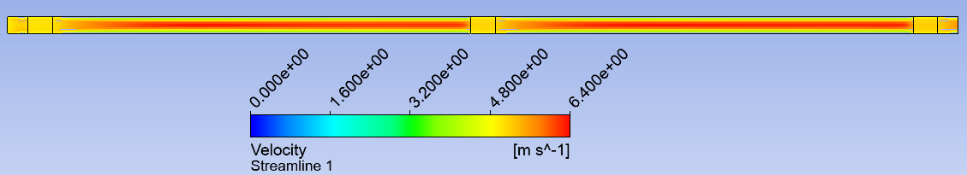
2D Two sensor length model
Inlet v=5m/s
LEC (red) = 7910W/m²
RSU (yellow) = 440W/m²
Outlet
Element size: 0.5mm
3 off K9 foams
Top line
Middle line
bottom line
Delta T btw inlet and outlet = 7K

Slide 15
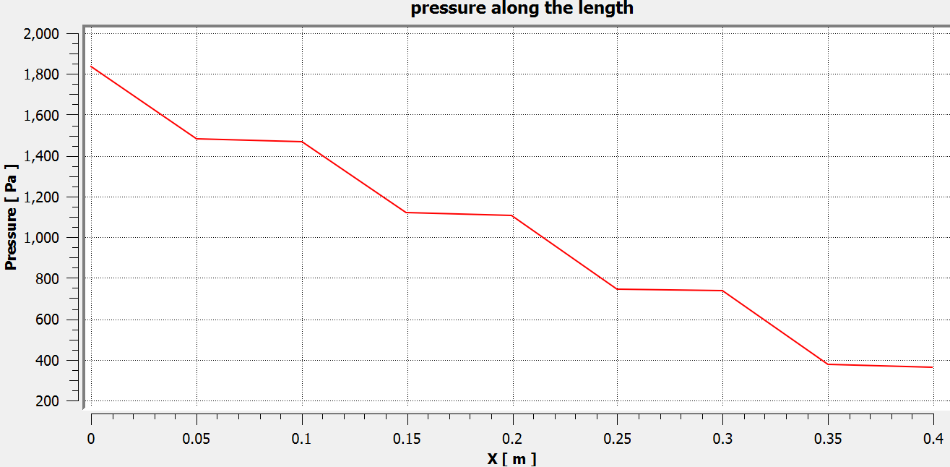
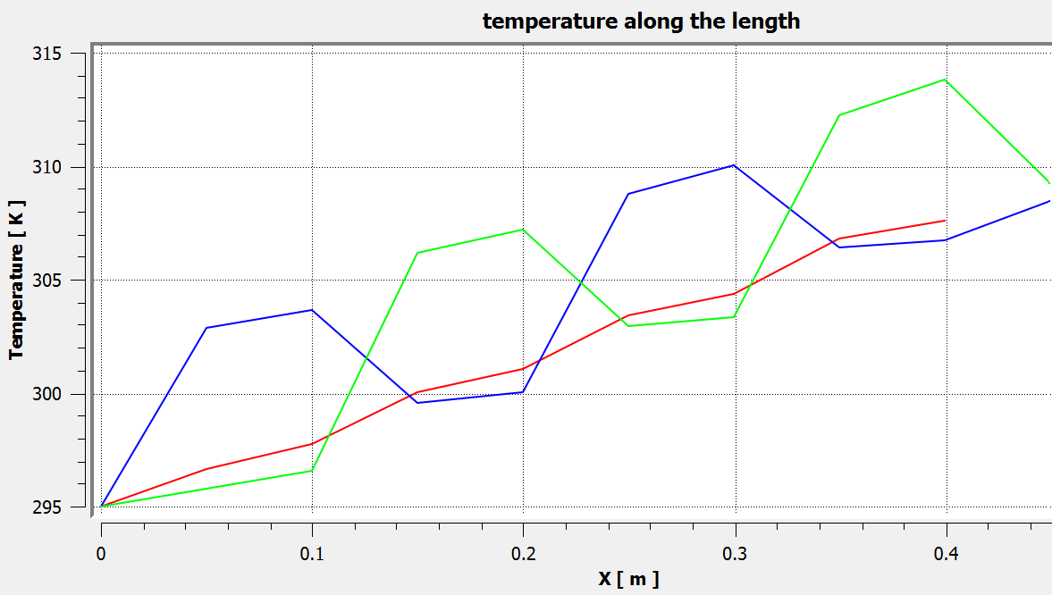
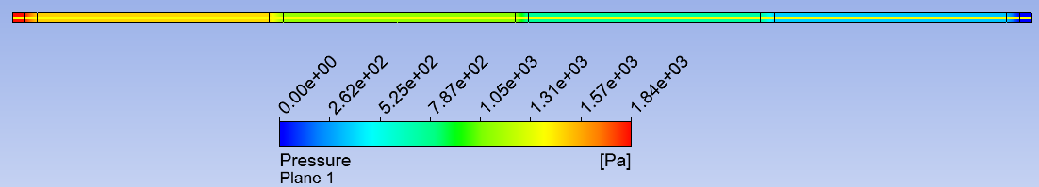
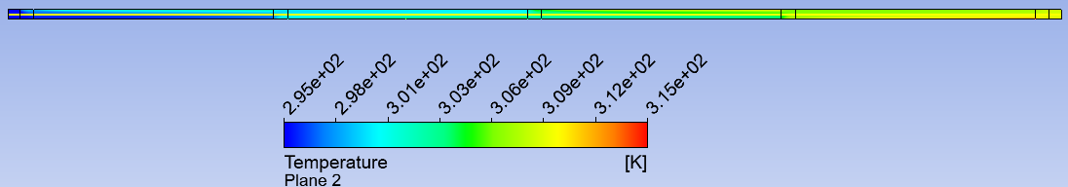
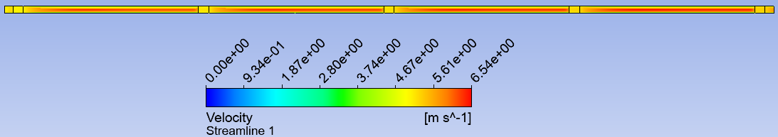
2D Four sensor length model
Delta T btw inlet and outlet = 14K

Slide 16
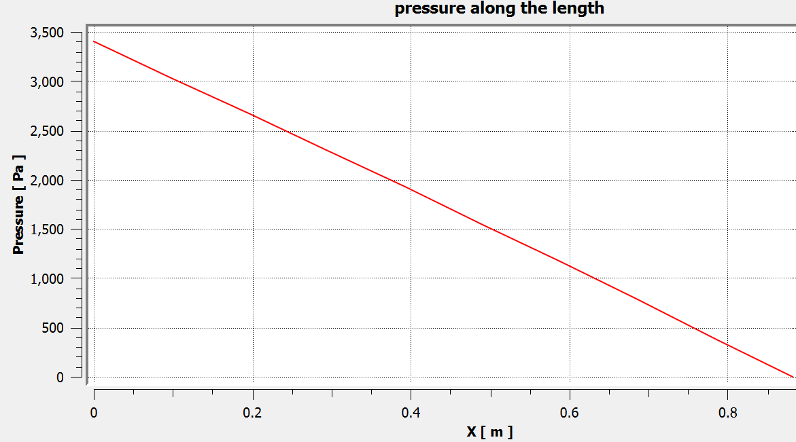
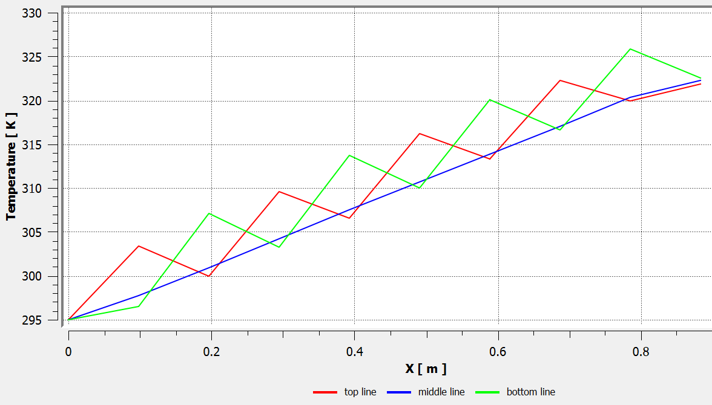
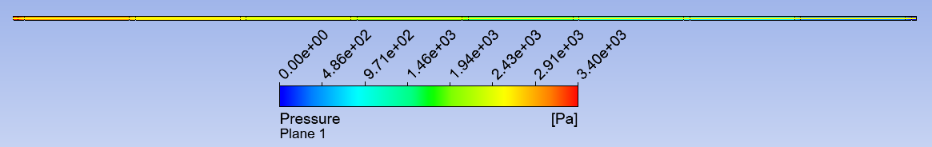
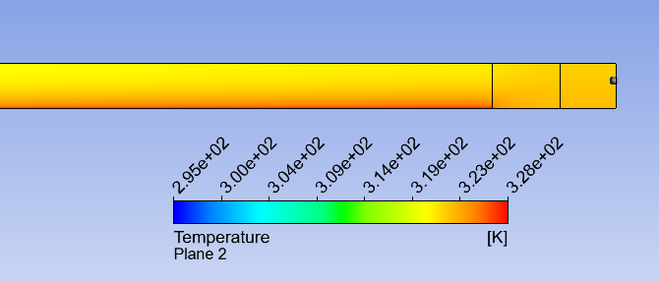
Full length model (8 sensors)
* Temperature profile at top, middle and bottom of the channel
Delta T btw inlet and outlet = 27K
top line
Middle line
bottom line

Slide 17


CFD 3D model without foam
Fluid material: Air
Nozzle dia: 2.5mm
The flow pattern without foam

Slide 18





CFD 3D model with foams
LEC area
RSU area
Inlet v = 5m/s
K9 foams

Slide 19
Final remark
All work in progress..
Ancillary chip power is not included in the study, it will be added to the later studies.
Simplified sensor model shows the same result as the detail model.
Existence of K9 foams helps remove the heat efficiently.
Continue working on CFD 3D modelling

Slide 20
Back up

Slide 21



Porous media coefficients
Porous media coefficients for K9 foam are derived from the experimental pressure and velocity data
[1].https://indico.cern.ch/event/1228295/contributions/5390941/
[2]. ANSYS Help, section 7.2.8.11
This yield to the following equation:
Δp = 4.6275ν²+ 44.252ν
where Δp is the pressure drop and ν is the velocity
$$⇒ 4.6275$$
With ρ =1.225kg/m³, and = porous media thickness which is 6mm, inertial resistance factor C2 is calculated. Likewise, 4.251= ; the μ=1.7894E-5 for air, the viscos inertial resistance factor 1/α is calculated.

Slide 22


CFD 2D model mesh
CFD 2D model mesh setting:
Element size = 0.1mm
Inflation total thickness =0.1mm, 4 layers
Axillary chip
LEC
RSU
K9

Slide 23

CFD 3D model with foams (double channel)
K9
RVC foam
K9

