Slide 1
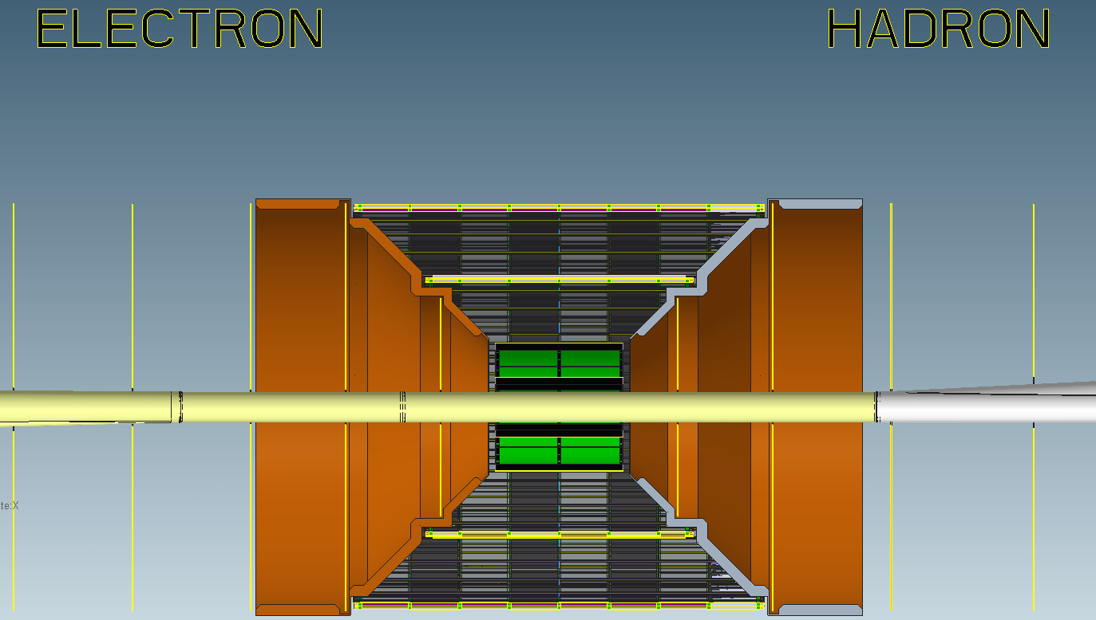
ePIC SVT Development Progress March 2024
K. DAVIES / R. SMITH

Slide 2
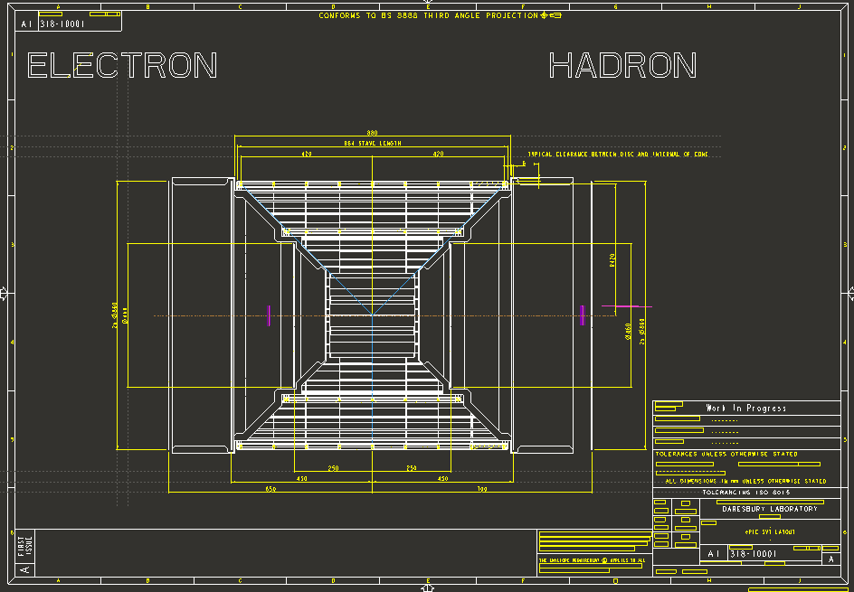

Slide 3
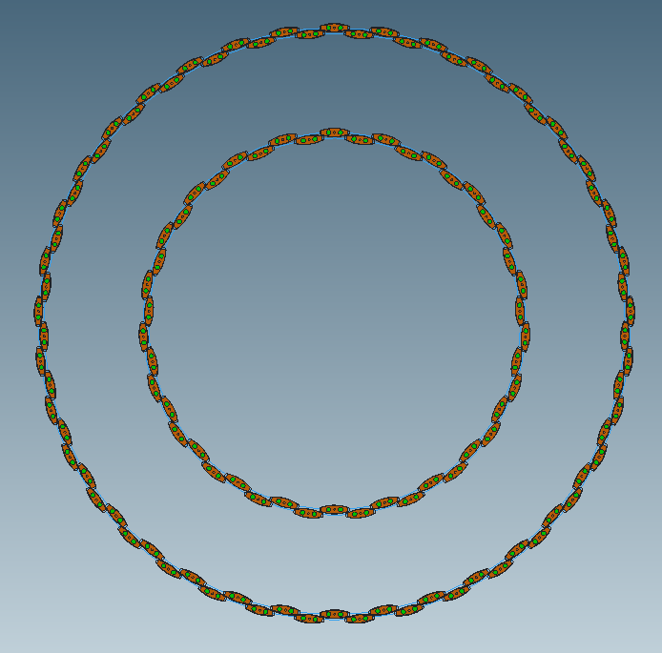
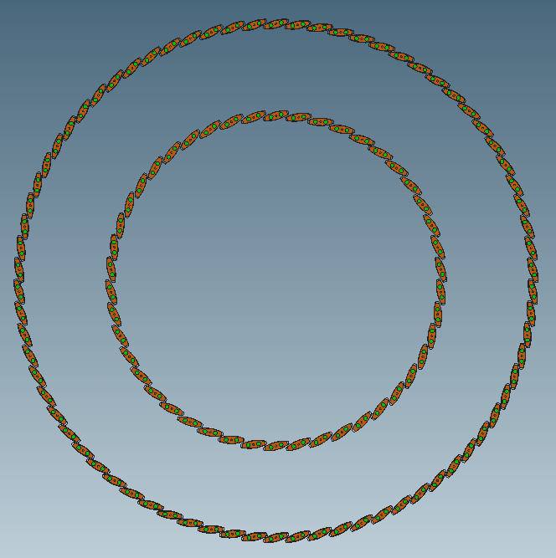
Preferred Stave arrangement with:
74 Staves on L4
46 Staves on L3
Alternative Stave arrangement with:
74 Staves on L4
46 Staves on L3

Slide 4
