Slide 1
Global supports for the SVT
20th February 2024
Andreas Jung, Sushrut Karmarkar and UG student team

Slide 2
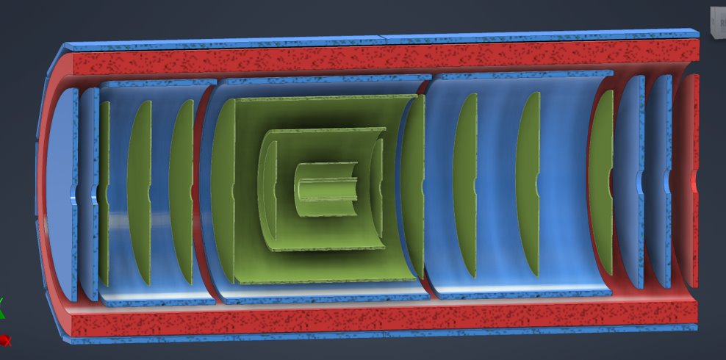
Global support structure for SVT
Design of supports for SVT depends on support hierarchy and detector “integration” and assembly
Dictates what structures are needed to support SVT and how…
Naturally, as light-weight as possible but services and “cooling” needs space and need to be considered
Lets first look at an integration sequence of “inner detectors”
Nomenclature: large global inner detector CF support tube or GST
…it’s more a global integration support tube: “GIST”
“Inner detectors” = inside of the large global CF support tube
Notes:
Initial design concept following the one from STAR, we know that there will be many back-and-forth design changes

Slide 3
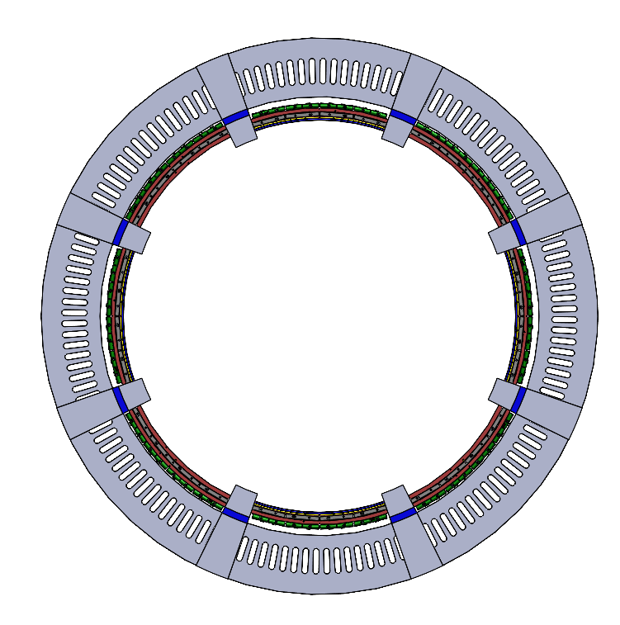
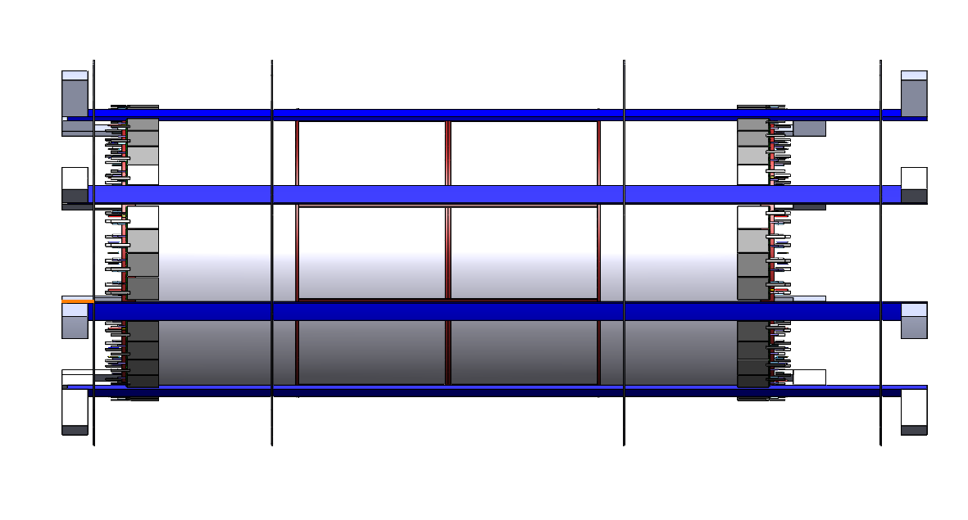
“Global” support structure inner detectors
1. Set of engagement rings mounted on inner rigid supports at off - 12, 3, 6, 9 o’clock positions for MPGD assembly
  - “stand-offs” (L-brackets) attach the structure in the last step to the GIST via inserts & screws
Mount inner MPGD on these “support beams/rails”
  Needs temporary support to feed out mechanics
“stand-offs”: for now looks very beefy and large, to be optimized
Notes:
Initial design concept following the one from STAR, we know that there will be many back-and-forth design changes

Slide 4
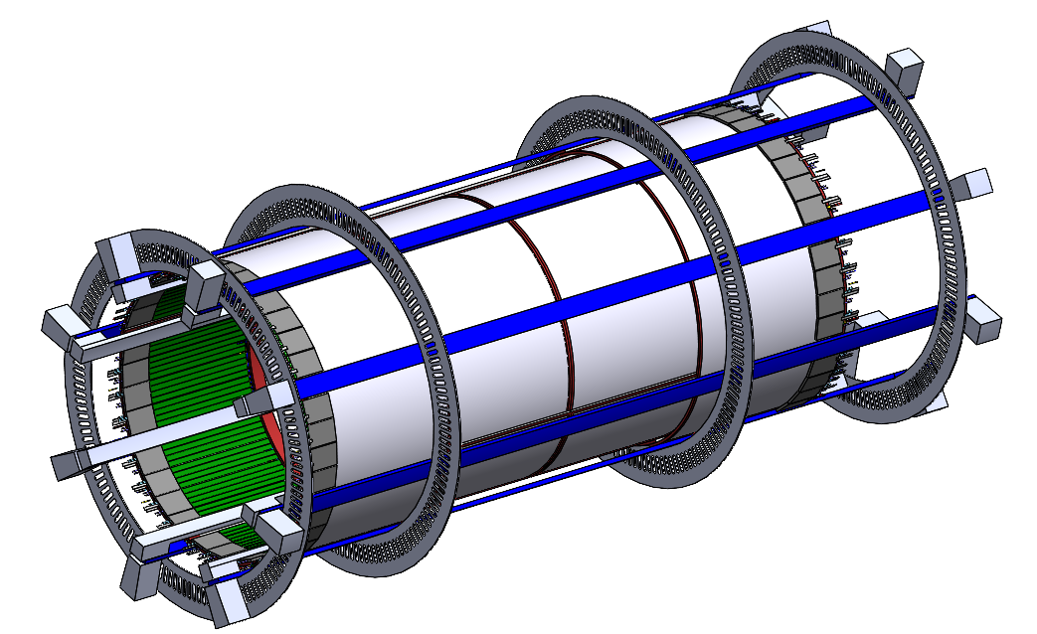
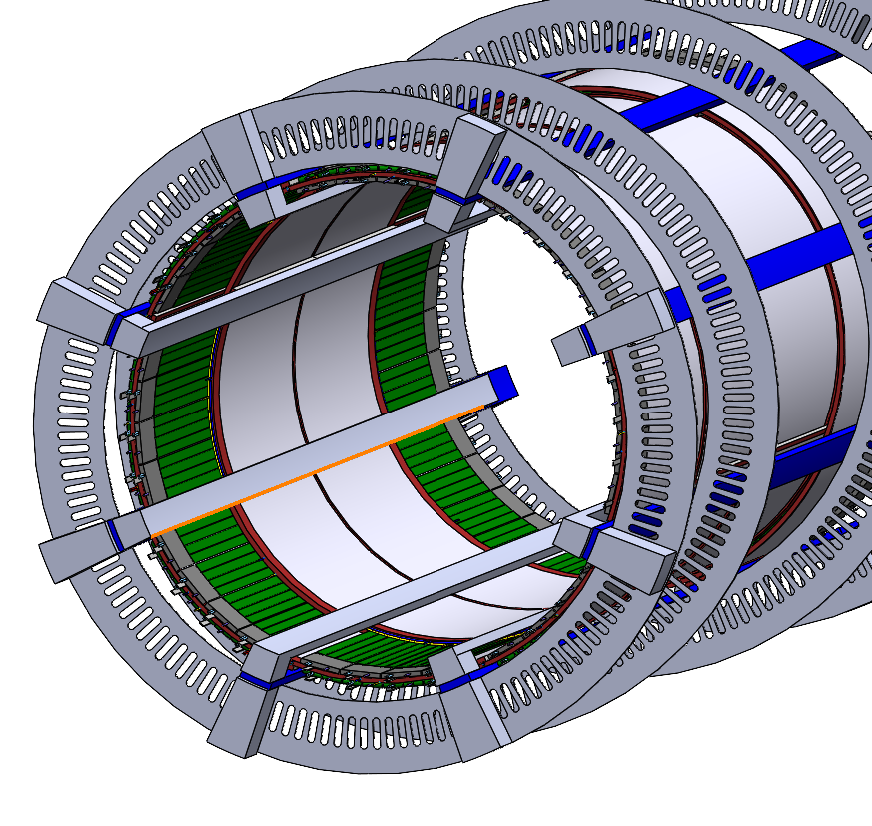
“Global” support structure inner detectors
3. Install inner tracks/beams per half/side to support SVT once MPGD integration is completed
- Total of 8 beams/rails support SVT
- Again L-brackets / standoff’s
Next step is to slide this “integrated” structure over the inner SVT
SVT includes the beam pipe which needs temporary support
Notes:
Initial design concept following the one from STAR, we know that there will be many back-and-forth design changes

Slide 5
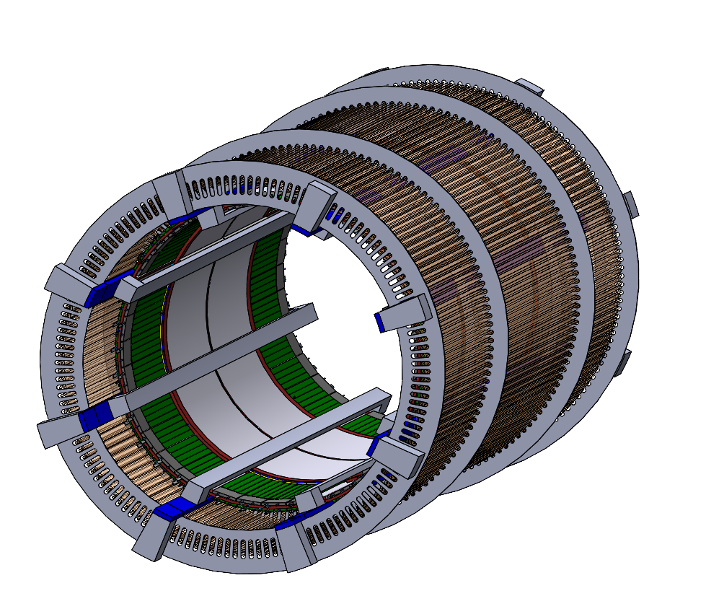
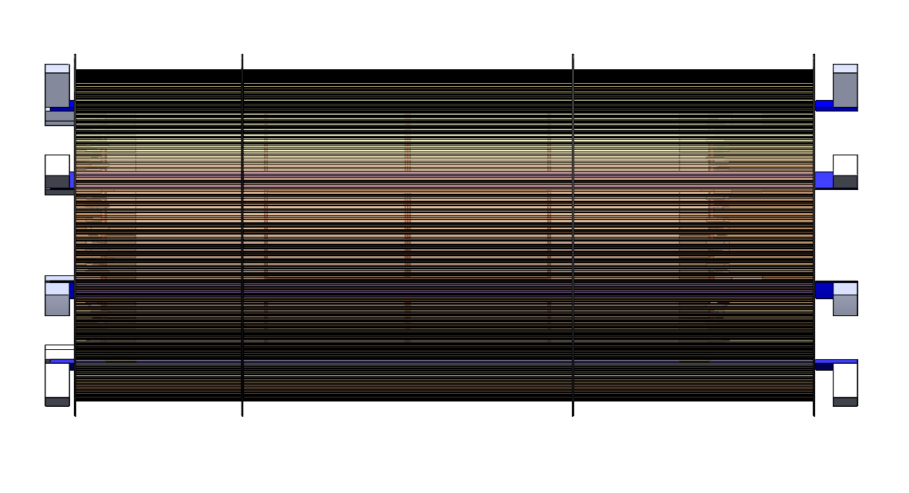
“Global” support structure inner detectors
3. LGAD is last in sequence prior to install whole inner detectors into EPIC
- last – either 1st sub-assembly or at the very end prior to inserting into EPIC
- temporary supports for services
TOF LGAD mounted on l-brackets or lips on engagement rings
Notes:
Initial design concept following the one from STAR, we know that there will be many back-and-forth design changes

Slide 6
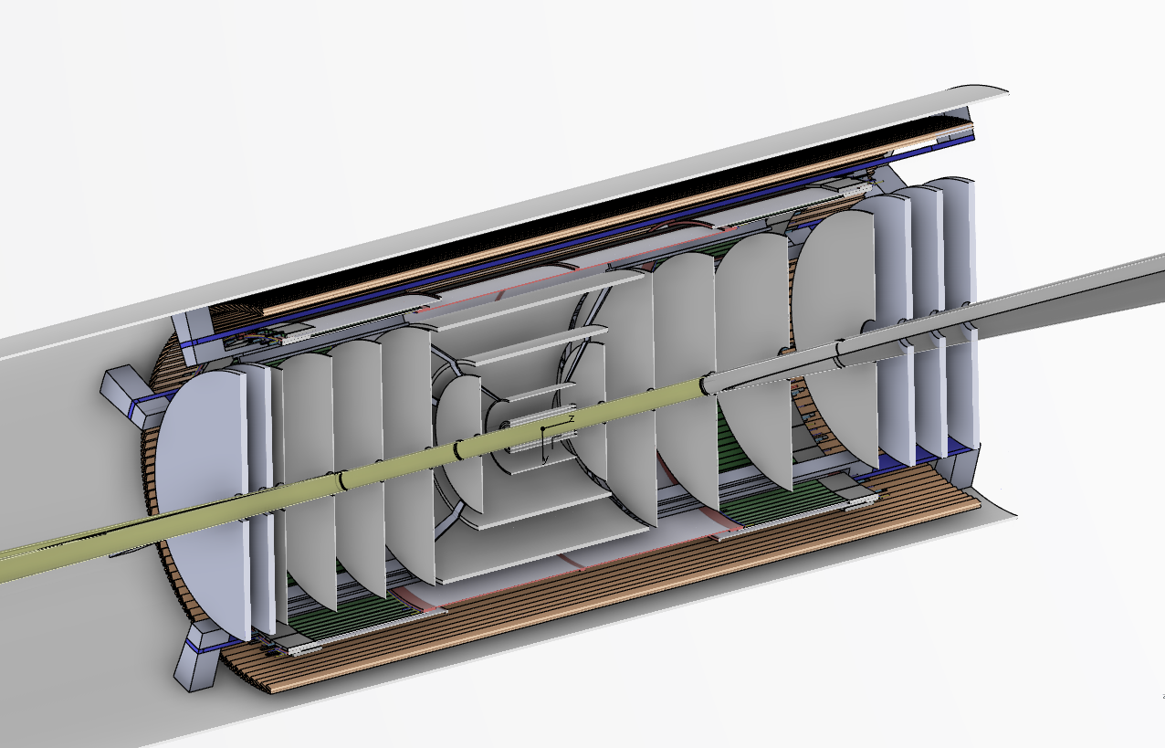
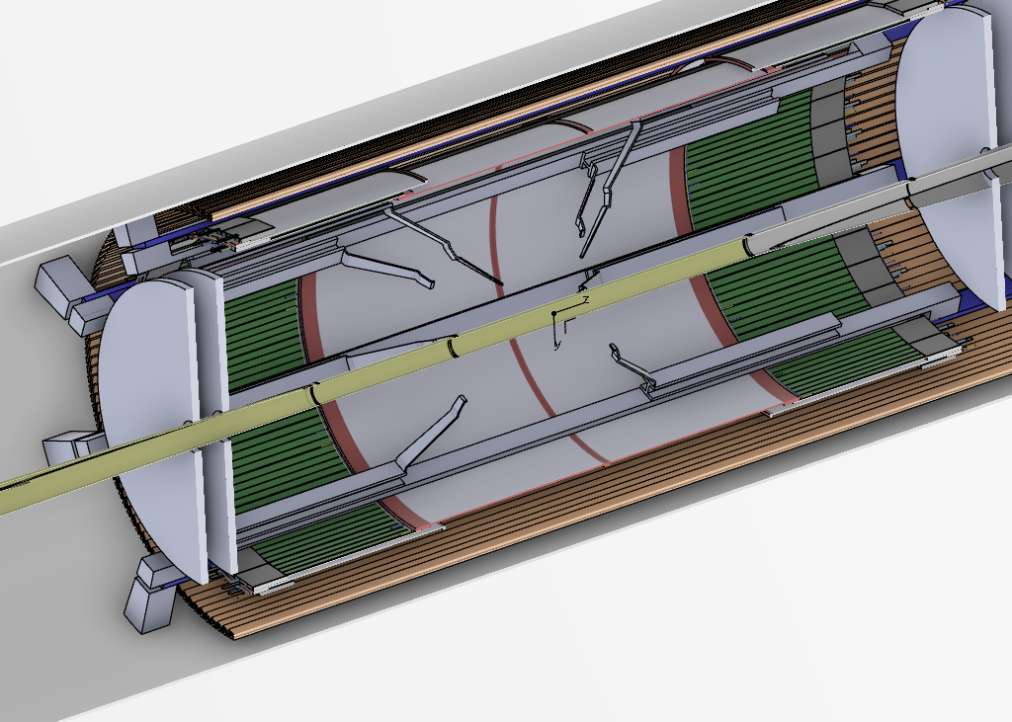
“Global” support structure inner detectors
3. SVT
– also based on discussion with Ernst, Laura, Georg at ANL meeting
Notes:
Initial design concept following the one from STAR, we know that there will be many back-and-forth design changes

Slide 7
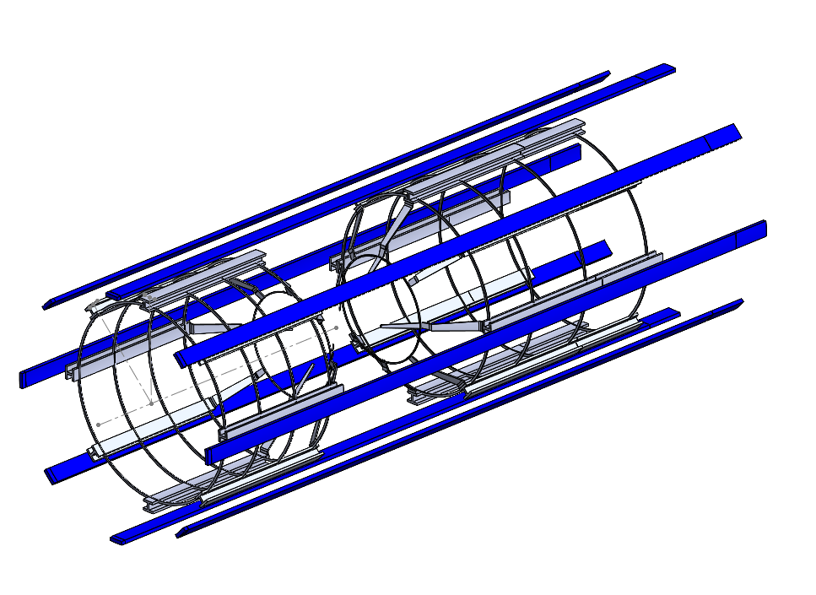
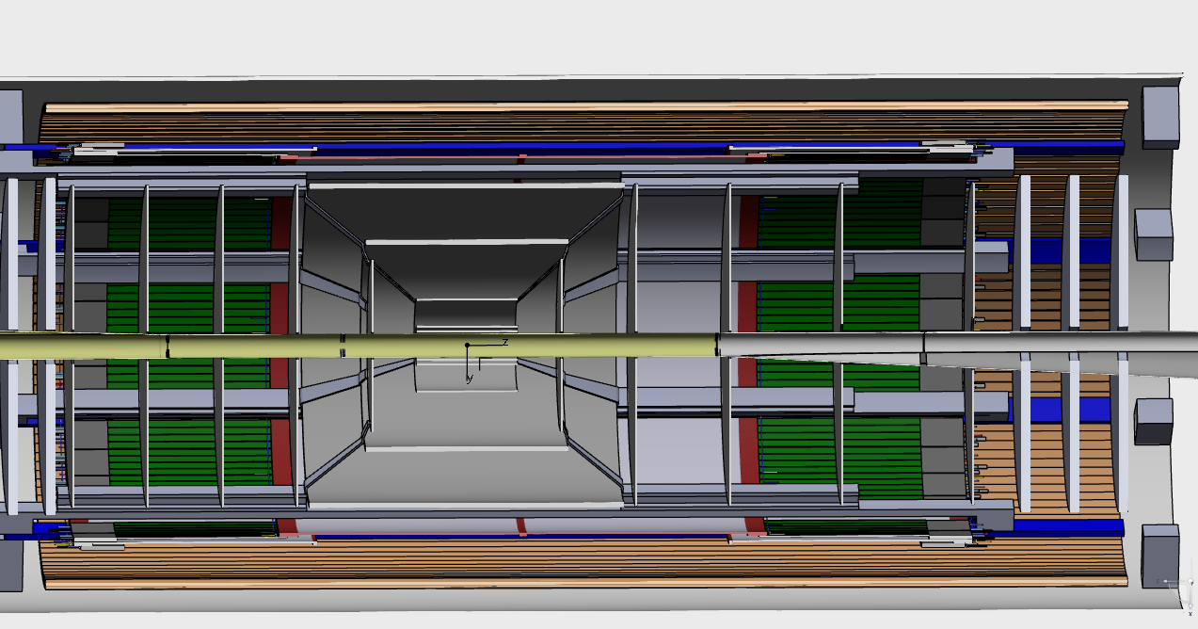
“Global” support structure inner detectors
3. SVT support by system of rips and rings to form a cage like structure
Provides support for VTRx cards, port cards, services, cooling pipes, etc. in shape of angled “wheels”
Notes:
Initial design concept following the one from STAR, we know that there will be many back-and-forth design changes

Slide 8
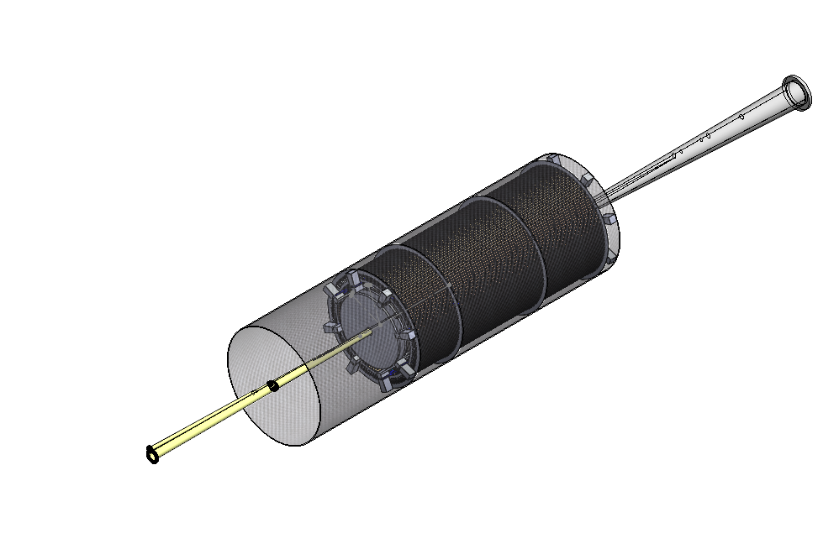
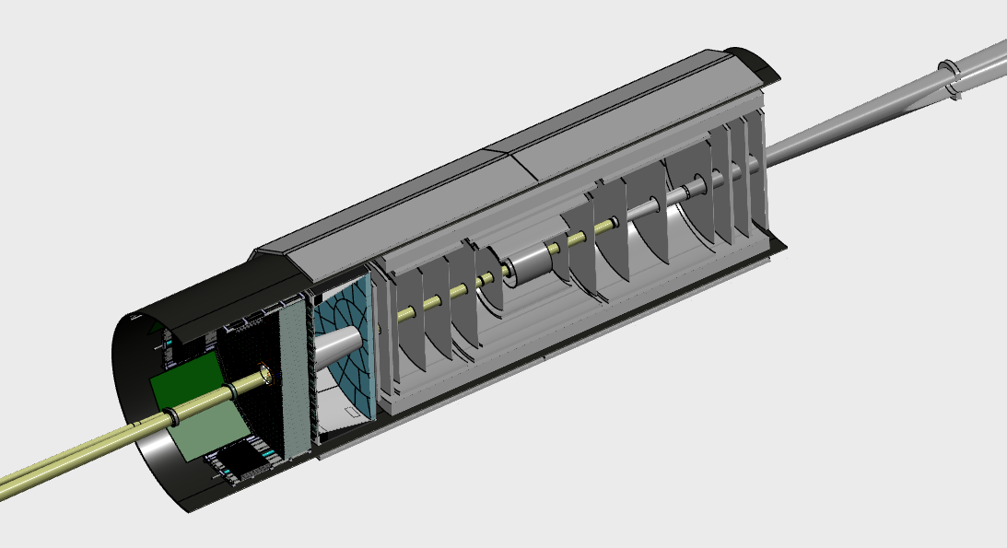
“Global” support structure inner detectors
3. Inside of EPIC (inner detector part first), followed by pfRICH, than ECAL
- needs temporary support for beam pipe and installation jigs to slide into GST
Notes:
Initial design concept following the one from STAR, we know that there will be many back-and-forth design changes

Slide 9
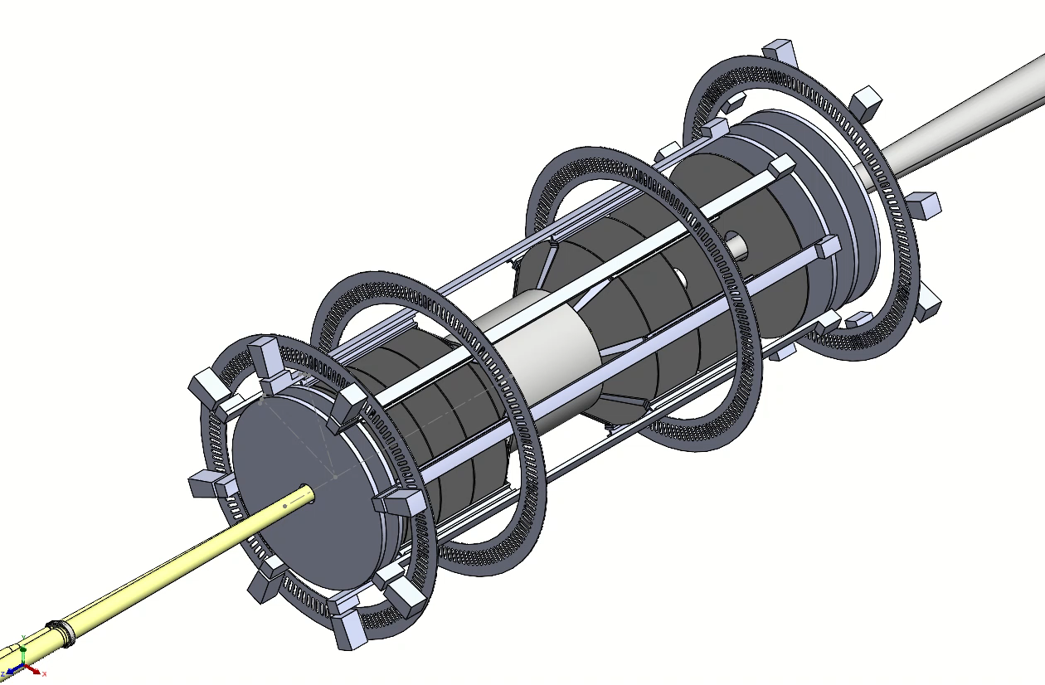
“Global” support structure inner detectors
Video….towards integration animation
Notes:
Initial design concept following the one from STAR, we know that there will be many back-and-forth design changes

Slide 10
Discussion / Next steps
Discussion…what should materialize by end of the day
  Better understanding of envelopes and agreement to provide numbers/space (realistic to get started)
  Heat loads needed to mitigate: holistic approach can safe mass for each one instead of all individually ofc
  Temperature stability also is a point
  These need to get to a rough +-25% number ideally or +-50% even so that more robust global mechanics and interface design can continue / start
Notes:
Initial design concept following the one from STAR, we know that there will be many back-and-forth design changes

Slide 11


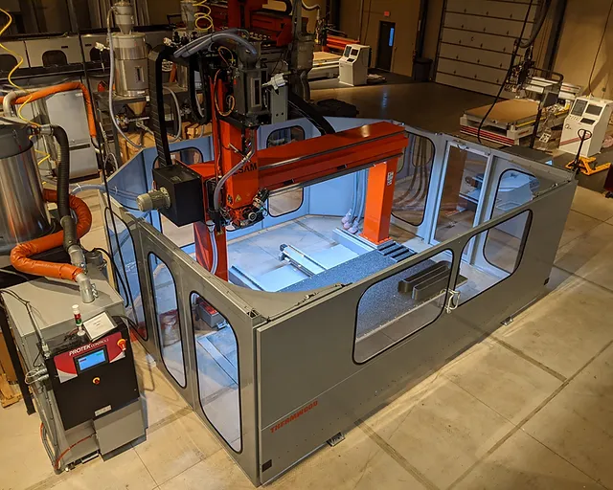
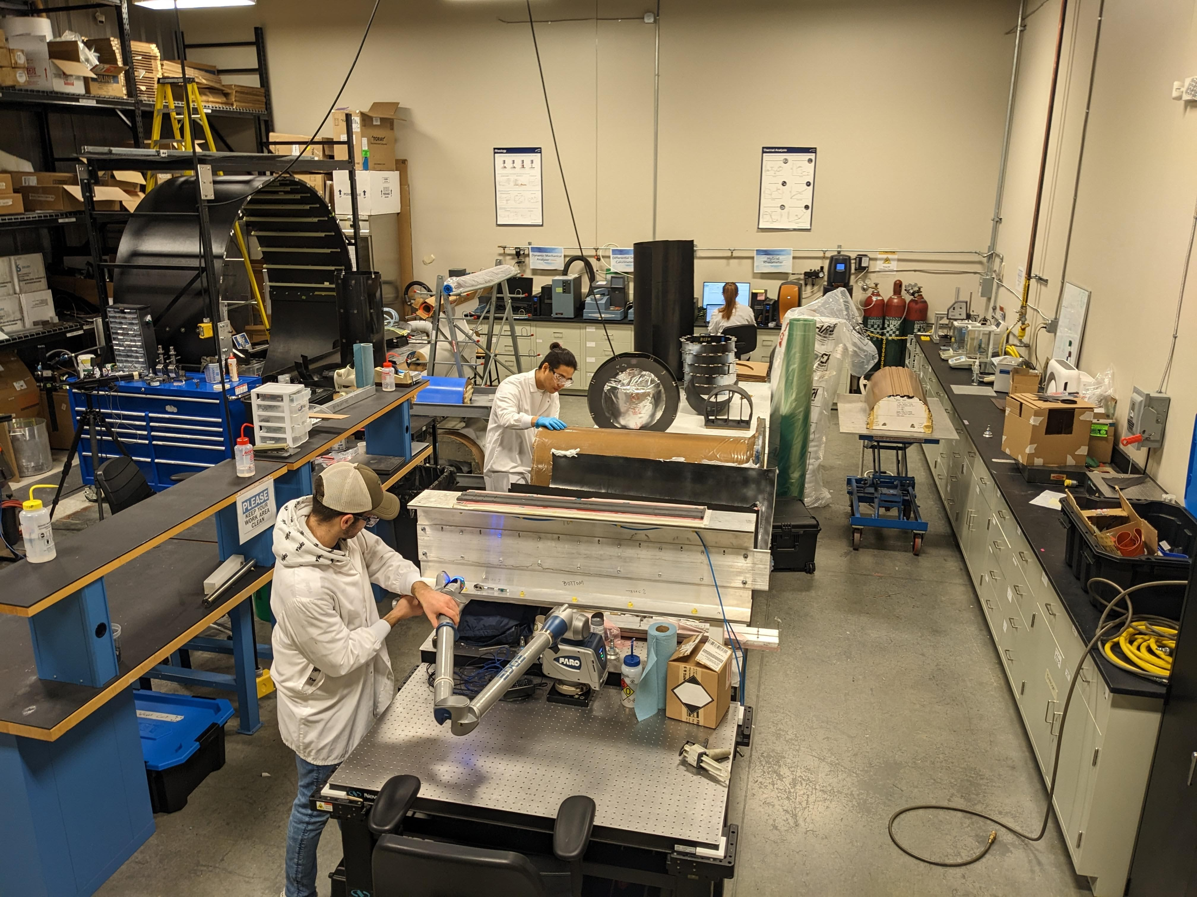
Advertisement
EPIC specific Mechanics workshop at Purdue
Aimed specifically at Mechanics, global and subdetector level – not just SVT
Discussed with engineering team (Rahul et al.)
Potential topics
  pfRICH, TOF LGAD and SVT, others subdetectors too
  Global mechanics
  Integration & Assembly
  Service & Mass optimization
  Envision 1 days ahead of the FTDM
  Project aspects / TDR etc.
Ahead of the forum for tracking detectors, Tuesday 28th May
Informal announcement, official soon
Notes:
Initial design concept following the one from STAR, we know that there will be many back-and-forth design changes

Slide 12
Backup
Notes:
Initial design concept following the one from STAR, we know that there will be many back-and-forth design changes

Slide 13
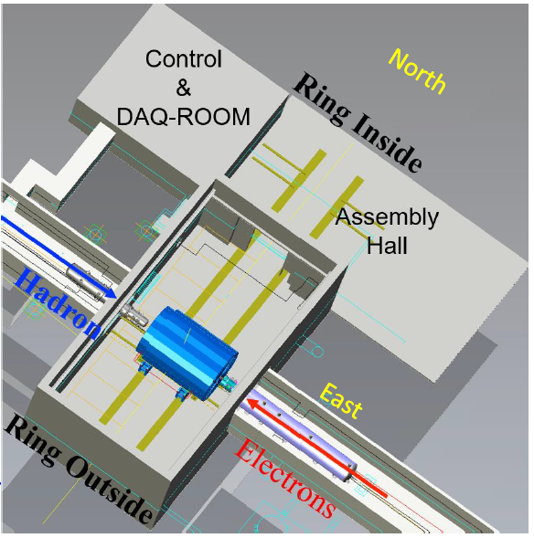
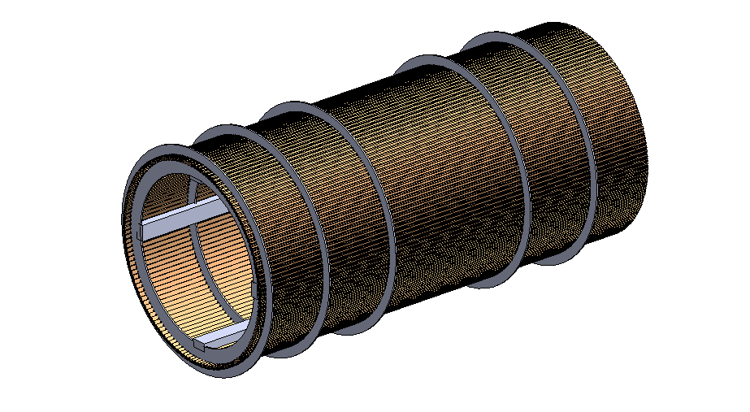
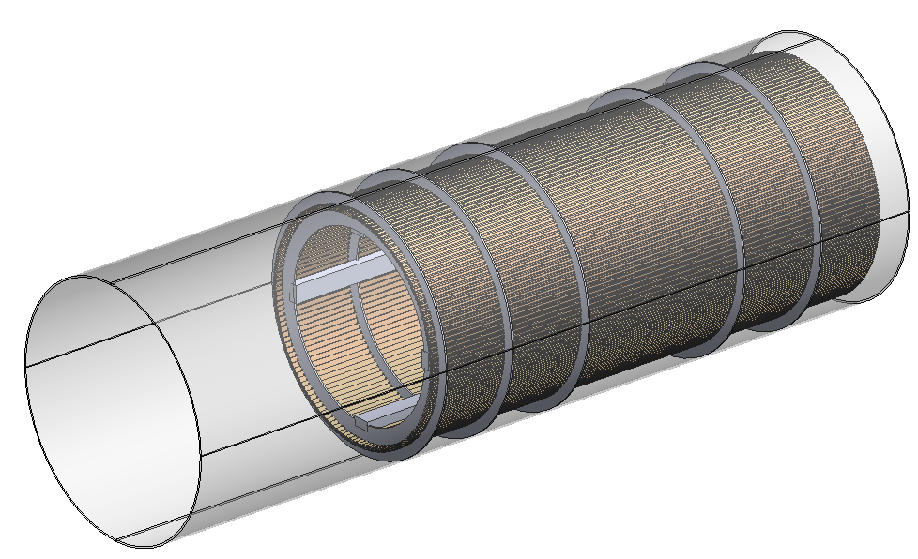
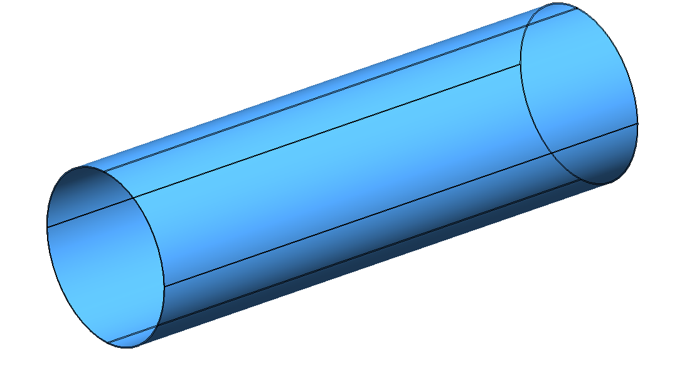
Integration sequence
Slide in the CF support tube using temporary rails and other supports that can be removed later.
  Installation “jig” and support for this task
Detailed FEA currently in process which may reveal adding “low-mass beams” connecting engagement rings
Fasten the engagement rings in place from outside of the CF tube to precise locations
Through-holes / threaded inserts allow to mount engagement rings
Likely want to “de-couple” as much as possible
Fasten the engagement rings and remove temporary inner supports (as seen from STEP 1)
Notes:
Initial design concept following the one from STAR, we know that there will be many back-and-forth design changes

Slide 14
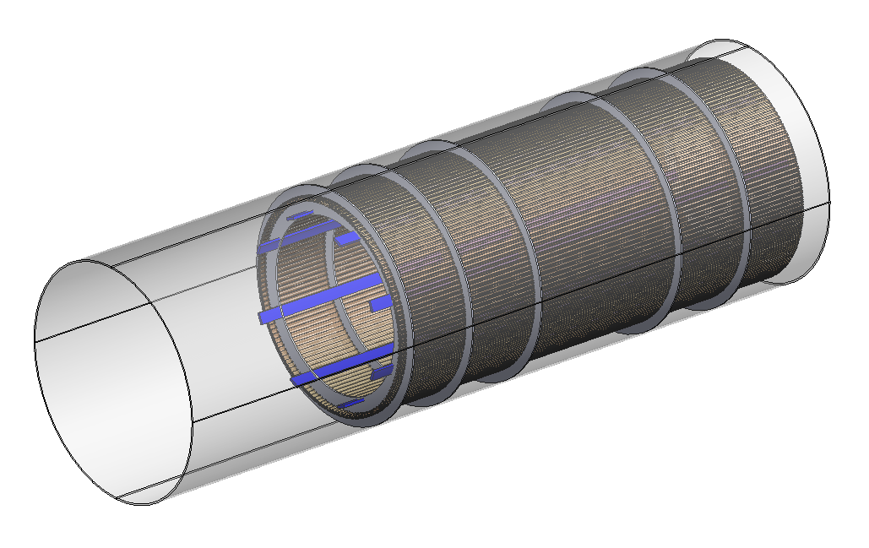
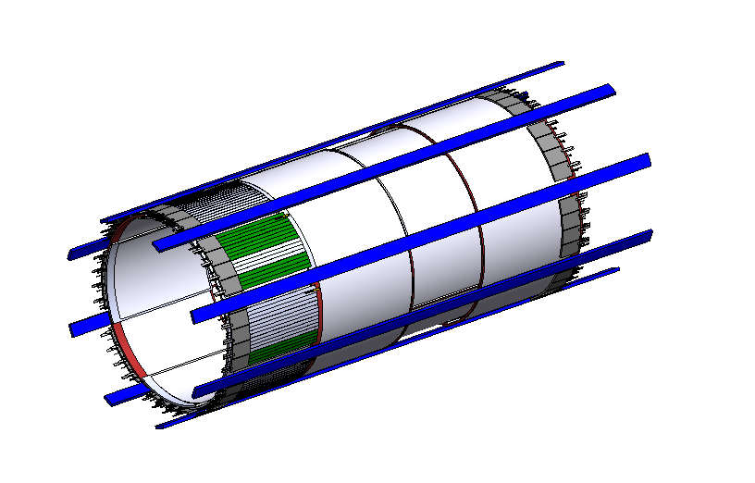
Integration sequence
5. Mount the blue inner MPGD supports on the engagement rings
The MPGDs interface with the red supports from MPGD design onto this blue tracks that are load bearing
2 parts of inner MPGD from each side will slide into these blue tracks
Note – this is barrelv4 – we are in the process of updating the CAD to barrelv3 – insertion concept will remain same
Temporary extension to blue tracks will be built to get those lengths all the way outside the CF tube
CF tube and engagement rings and ACLGADs are already in place – hidden here for better view
Notes:
Initial design concept following the one from STAR, we know that there will be many back-and-forth design changes

Slide 15
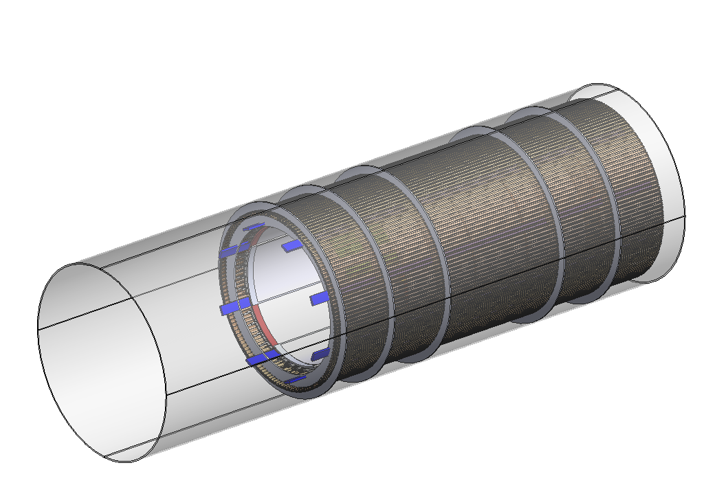
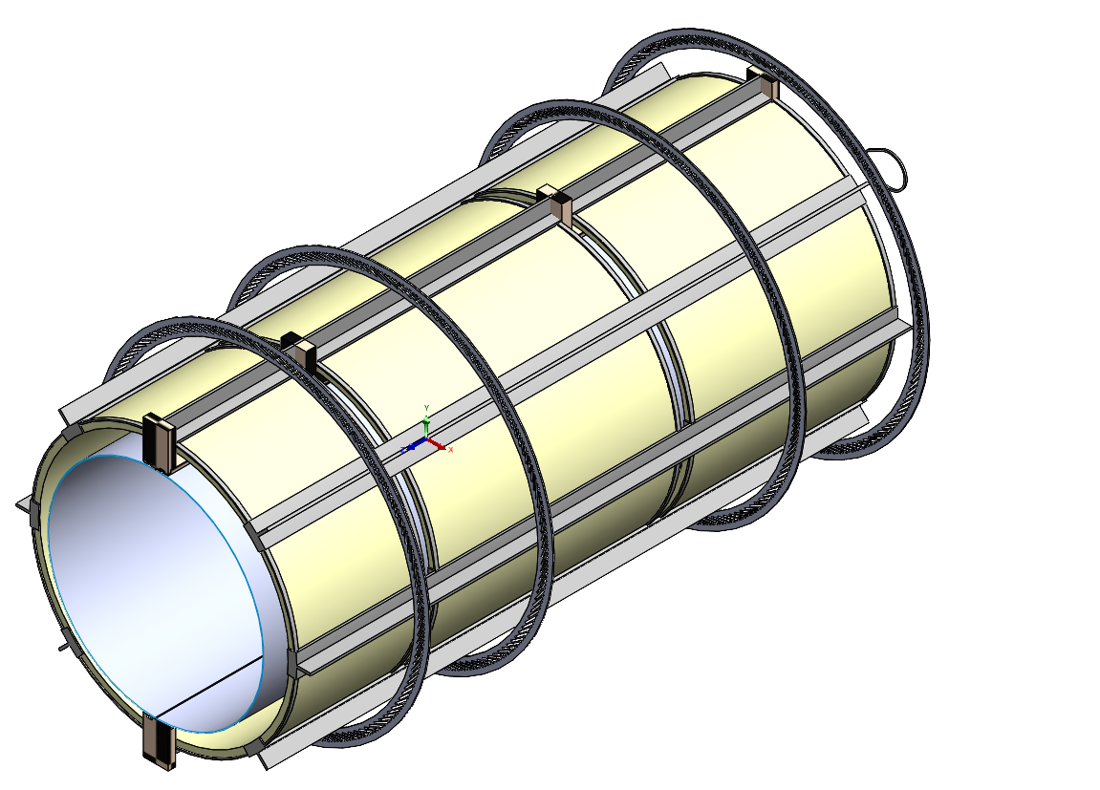
Integration sequence
6. Wire up the inner MPGDs on electron and hadron side
Temporary service supports might be needed
MPGD tray supports that connect to the engagement rings and “red” MPGD supports
OLD design of the rails for silicon tracker – just for visualization
7. The rails and support structure for vertex comes next
Silicon tracker can be mounted on rails to de-couple it from the MPGD support structure
Notes:
Initial design concept following the one from STAR, we know that there will be many back-and-forth design changes

Slide 16
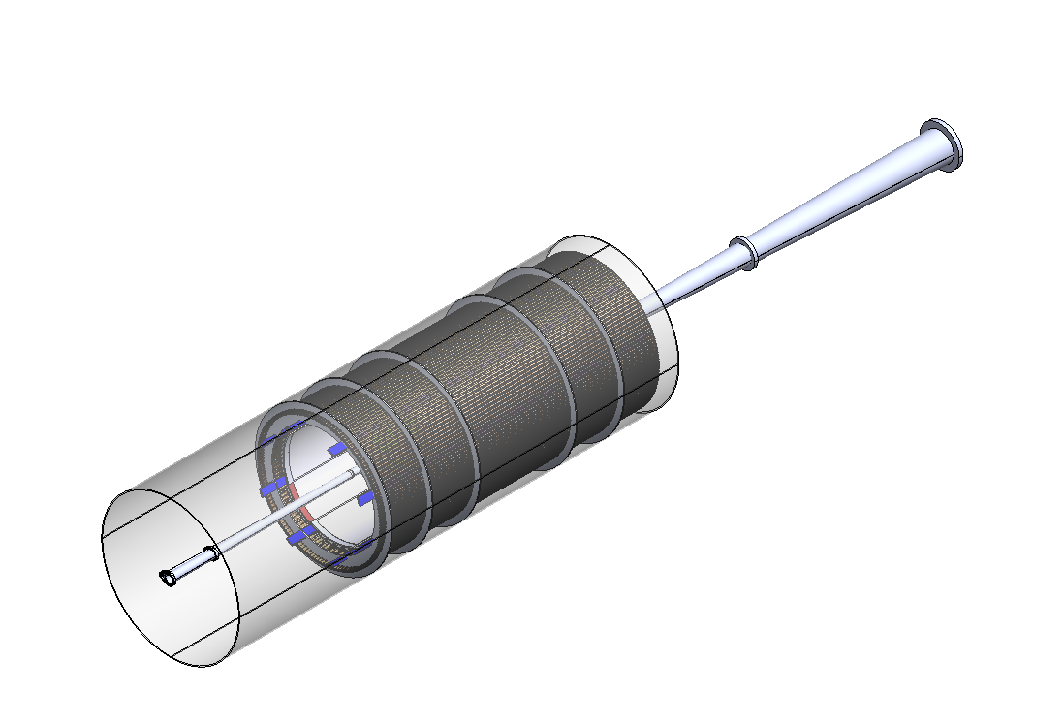
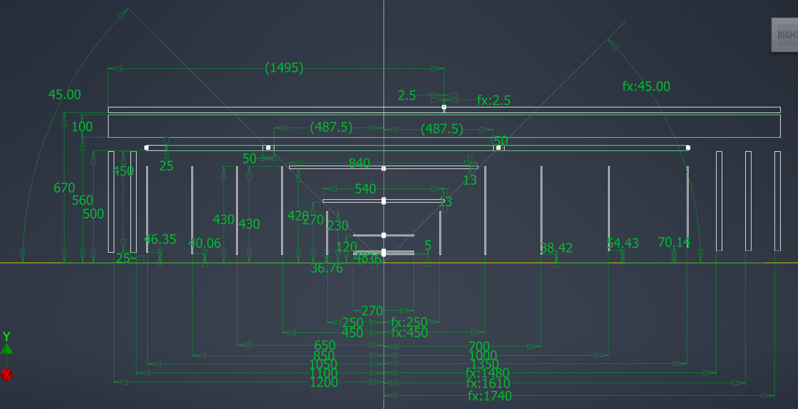

Integration sequence
8. Beam pipe comes in next before the silicon tracker so that there is still enough room for bake out and other beam pipe installation sequence.
Caveat: Requires full half hemispheres of SVT
BEAM pipe is after the silicon tracker support rails and structures – not shown in CAD
9. Inner silicon detectors are then slid on these rails from electron and hadron side – this is NOT symmetric – the structures will be split such that the changing diameter of the pipes is taken into account. A schematic is below.
Notes:
Initial design concept following the one from STAR, we know that there will be many back-and-forth design changes

Slide 17
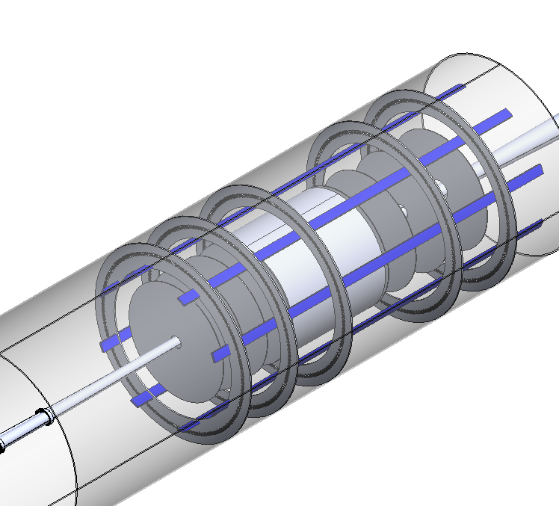
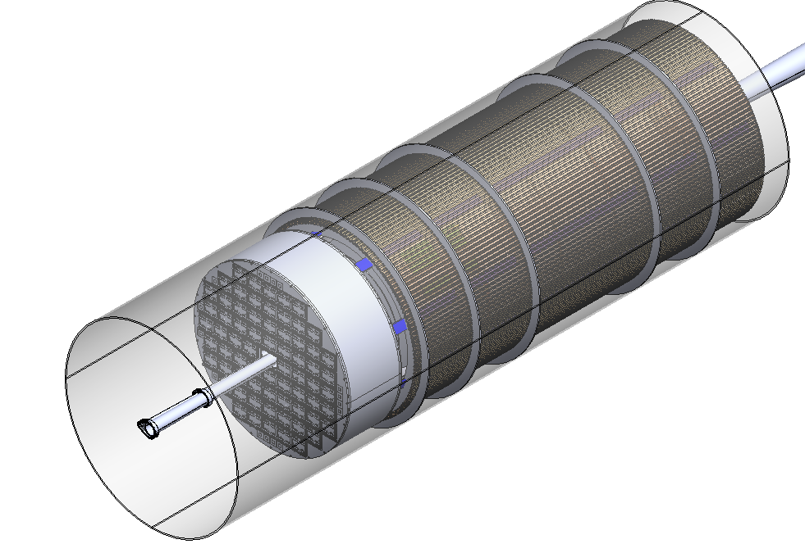
Integration sequence
10. The outer discs of MPGDs come in next
11. All the services and wiring is pulled out till the ends of CF tubes
12. pfRICH and EMCAL in installed in the CF tube
Needs “blocks” & brackets to avoid damaging the GST by EMCAL
pfRICH
Notes:
Initial design concept following the one from STAR, we know that there will be many back-and-forth design changes

Slide 18
Next steps towards supports for SVT
TOF supporting by engagement rings and GIST
Work starts now to investigate if and how the currently devised TOF AC-LGAD support can work in SVT context
Next steps: get ALICE ITS3 CADs and see how to integrate / support SVT via TOF
Notes:
Initial design concept following the one from STAR, we know that there will be many back-and-forth design changes

Slide 19
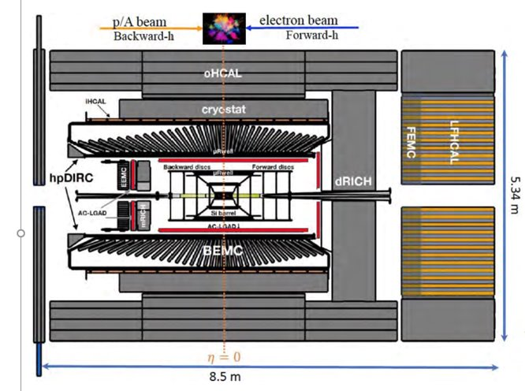
Discussion
Notes:
Initial design concept following the one from STAR, we know that there will be many back-and-forth design changes

Slide 20
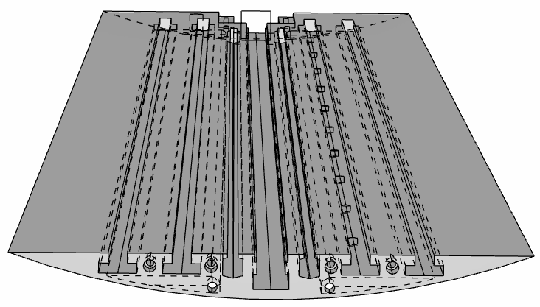
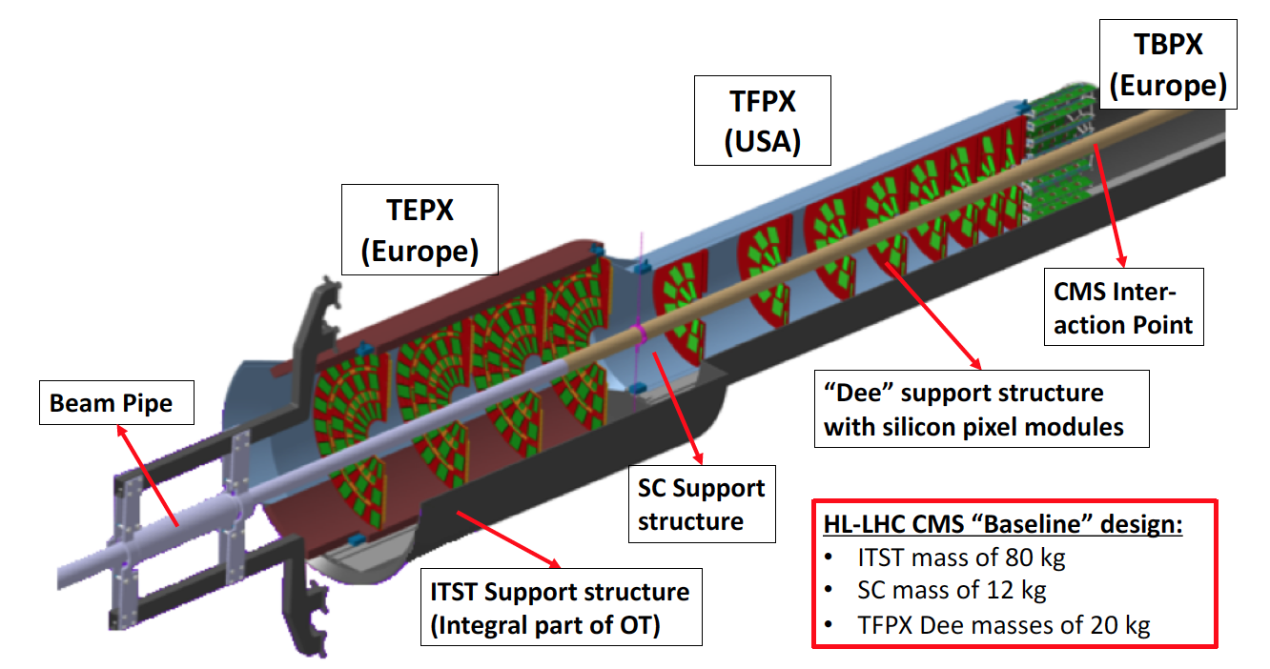
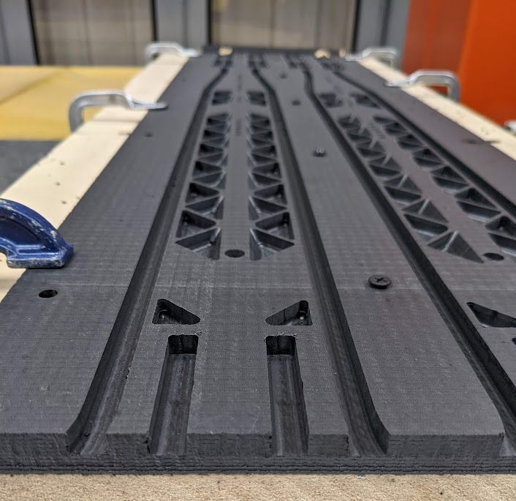
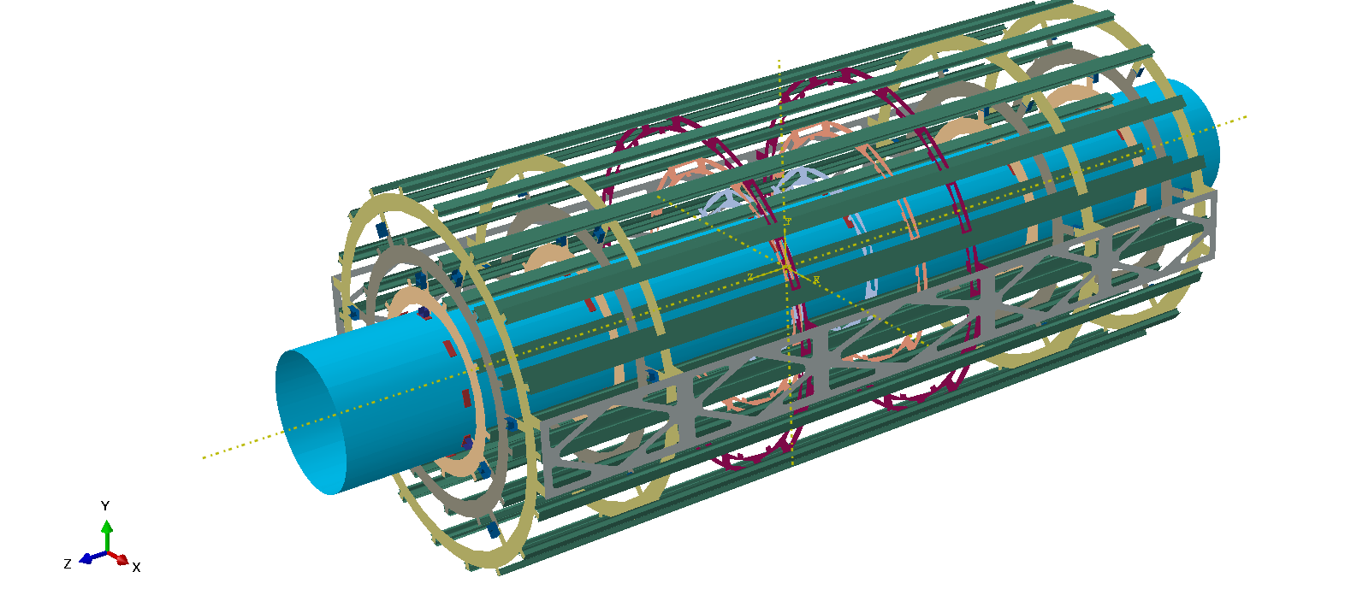
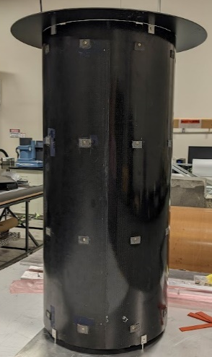
Supporting & Integration of SVT
Design concept is to insert “half SVT” at a time
  Requires reasonably rigid structure, at least temporarily supported with external structures
Example “track” from CMS for SC support and insertion, incl. dry-gas injection
Example from CMS, which is “inverted”
The GST is outermost and engagement rings go inside with support rods as needed to provide enough support
Low mass “tracks” to allow integration of SVT half-dectectors
Reduces number of cylinders to 1 global (GST), none inside and no real half-cylinders either (if needed low mass, aka w lots of holes)
Notes:
Initial design concept following the one from STAR, we know that there will be many back-and-forth design changes

Slide 21
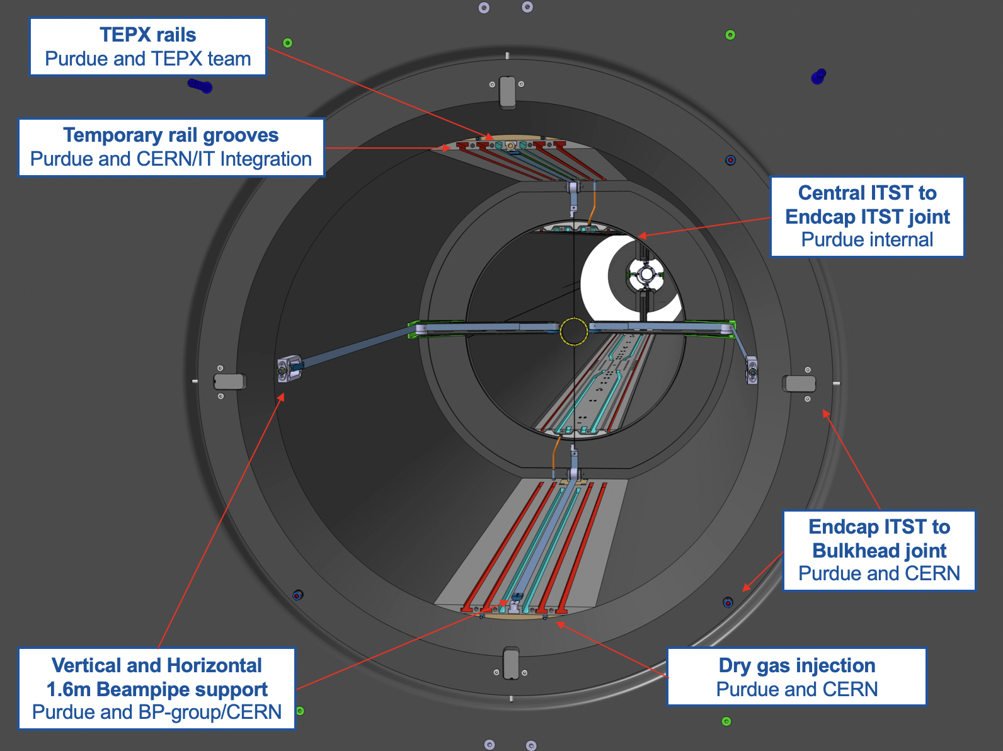
Example: IT pixel supports in CMS
Notes:
Initial design concept following the one from STAR, we know that there will be many back-and-forth design changes

Slide 22
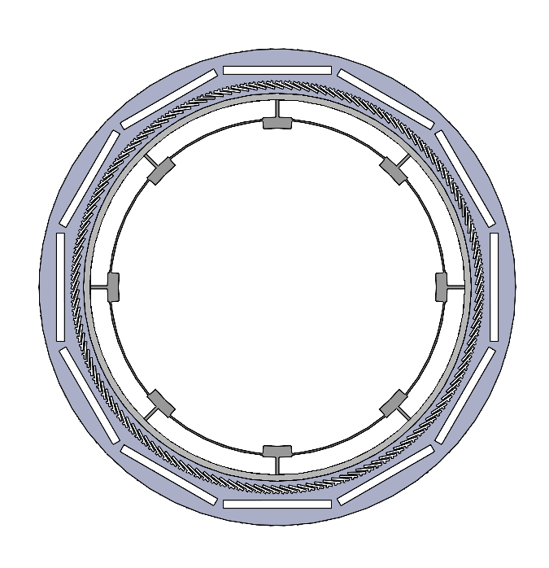
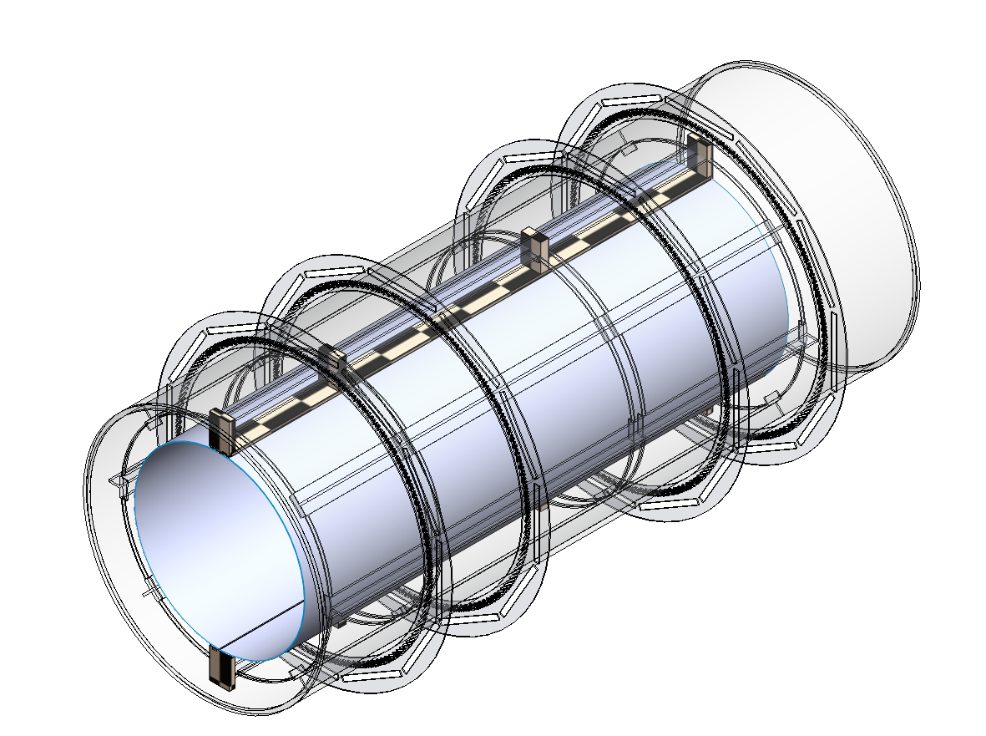
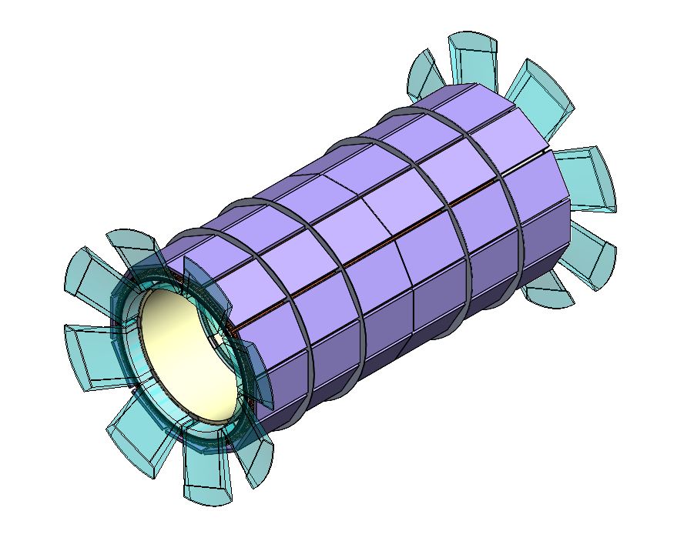
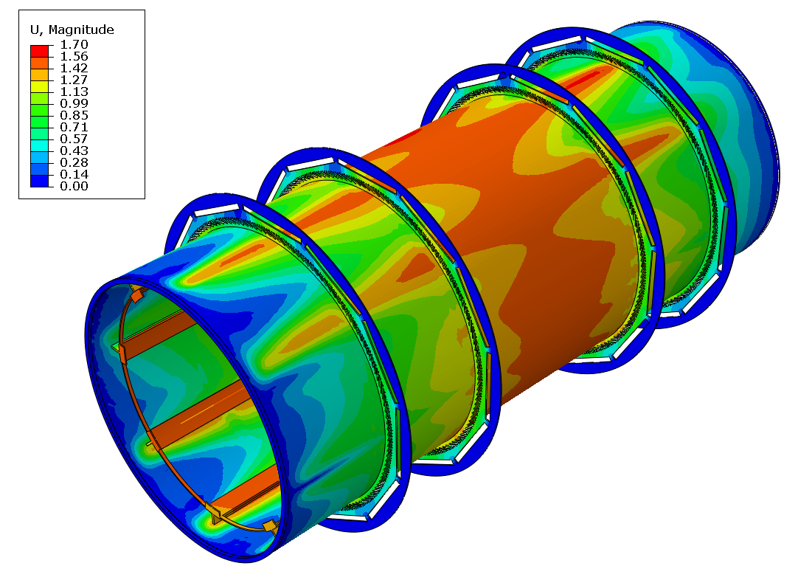
Support structure for barrel TOF
Concept idea of joined mechanics structure for barrel TOF, inner & outer MPGD layers, services, and even tracker
  1+8+1 mm sandwich composite structure w “end-rings” to support beam pipe during installation & integration
Integration
  Move/Place end cap TOF closer to dRICH to ease access to inner tracking volume
  ”Rail” system (internal and external) to support half-cylinders for tracker installation after barrel TOF system is in place
First preliminary FEAs for this design
  1.7mm deflection and weak regions at engagement rings – needs to be optimized!
12 & 6 o’clock can support “rails” for tracker
Circular engagement
rings
Sandwich Support Tube
Outer MPGD
Circular Engagement Rings
Unit mm
Details:
- LGADs = 70 kg
- MPGDs = 24 + 24 kg
- Silicone tracker = 10 kg
- Services (smeared) = 100 kg
- Designed engagement rings, end rings following CMS experience at Purdue
Space for services
Inner MPGD
Notes:
Prototype

Slide 23
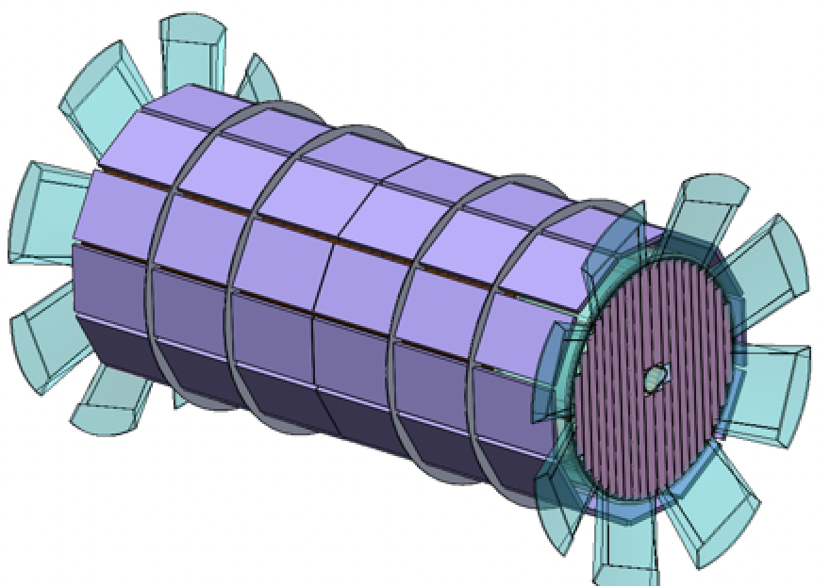
Endcap TOF
Endcap TOF supported by common structure supporting barrel TOF system
Under study: Integration & access to tracking volume eased if endcap TOF moved in front of dRICH
“Clam shells” or DEEs
  Convenient for installation/maintenance
  Each is patched by TOF modules (one or more types) on both faces
  No backward TOF
From the talk of Wei Li
https://indico.bnl.gov/event/16742/
Power Budget
 | Endcap TOF [kW]
Sensors | 0.6
ASIC | 8.5
DC-DC | 3.5
lpGBT, VTRx+, SCA | 0.5
Power cables | 0.5
Total | 13.6
Notes:
Initial design concept following the one from STAR, we know that there will be many back-and-forth design changes

