Slide 1
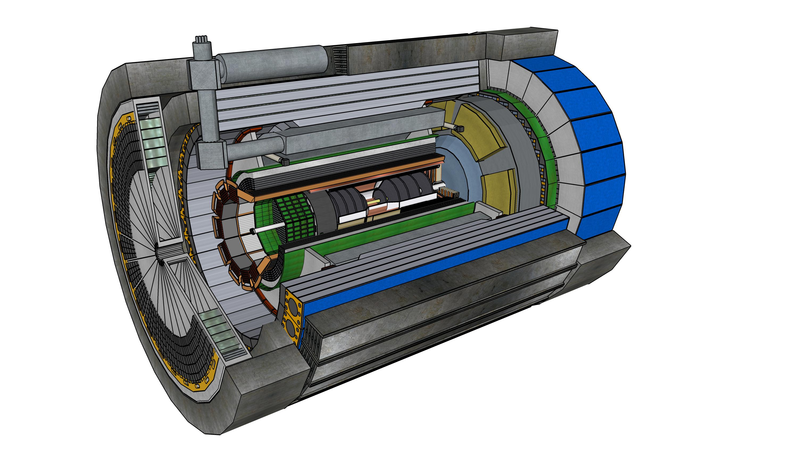

𝛍− 𝐑𝐰𝐞𝐥𝐥 𝐝𝐞𝐭𝐞𝐜𝐭𝐨𝐫𝐬 𝐟𝐨𝐫 𝐭𝐡𝐞 𝐄𝐏𝐈𝐂
Integration Meeting – 2/20/2024
Seungjoon Lee
Thomas Jefferson National Accelerator Facility

Slide 2
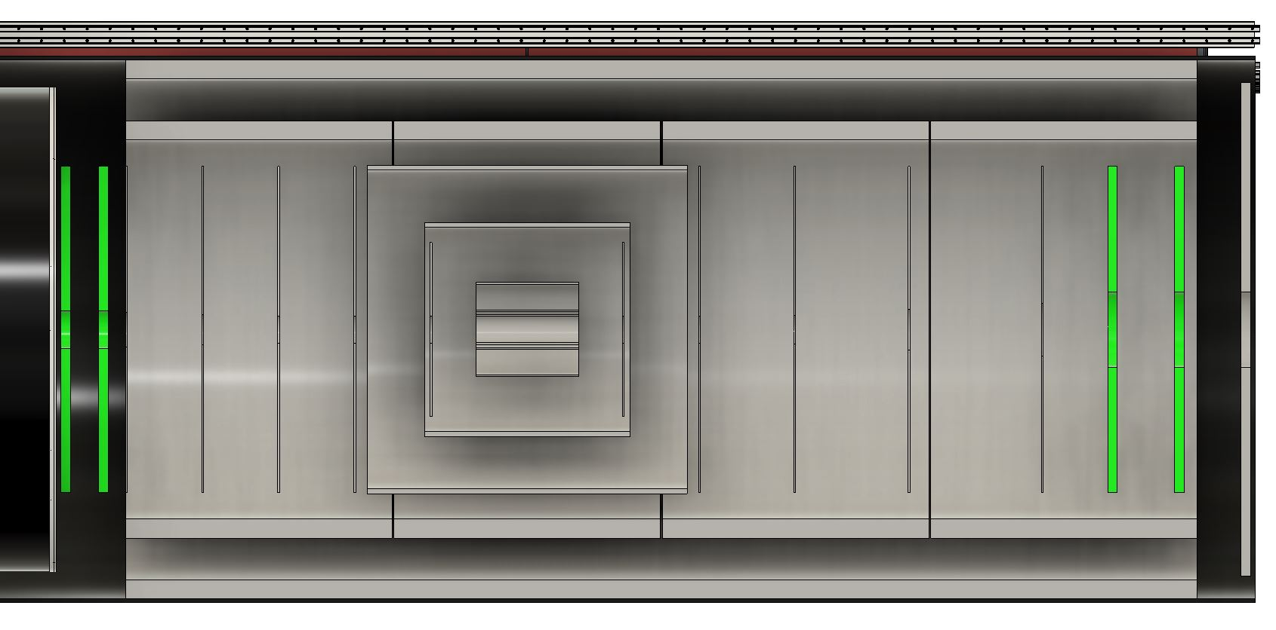
Detector model inconsistency
Inner Barrel (from engineering)
Endcap radius is 43 cm which is the same as silicon tracker disc.
HD Endcap is inside of the CyMBal

Slide 3
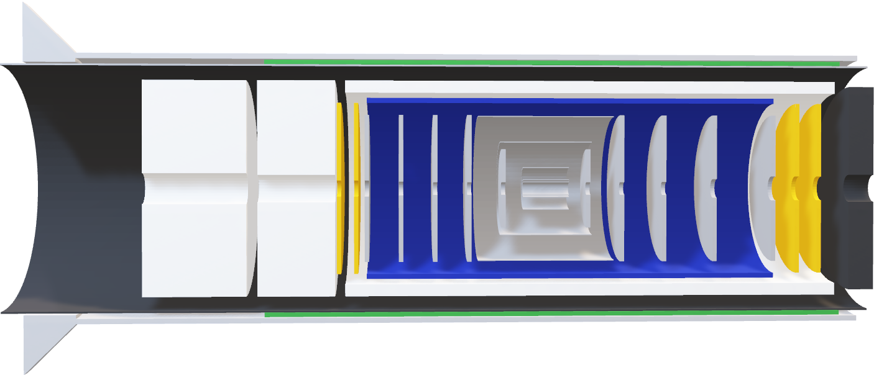
MPGDs ePIC simulation for the Crater Lake
Data from Matt Posick
Endcap radius = 50 cm
Endcaps are outside of CyMBal (blue)

Slide 4
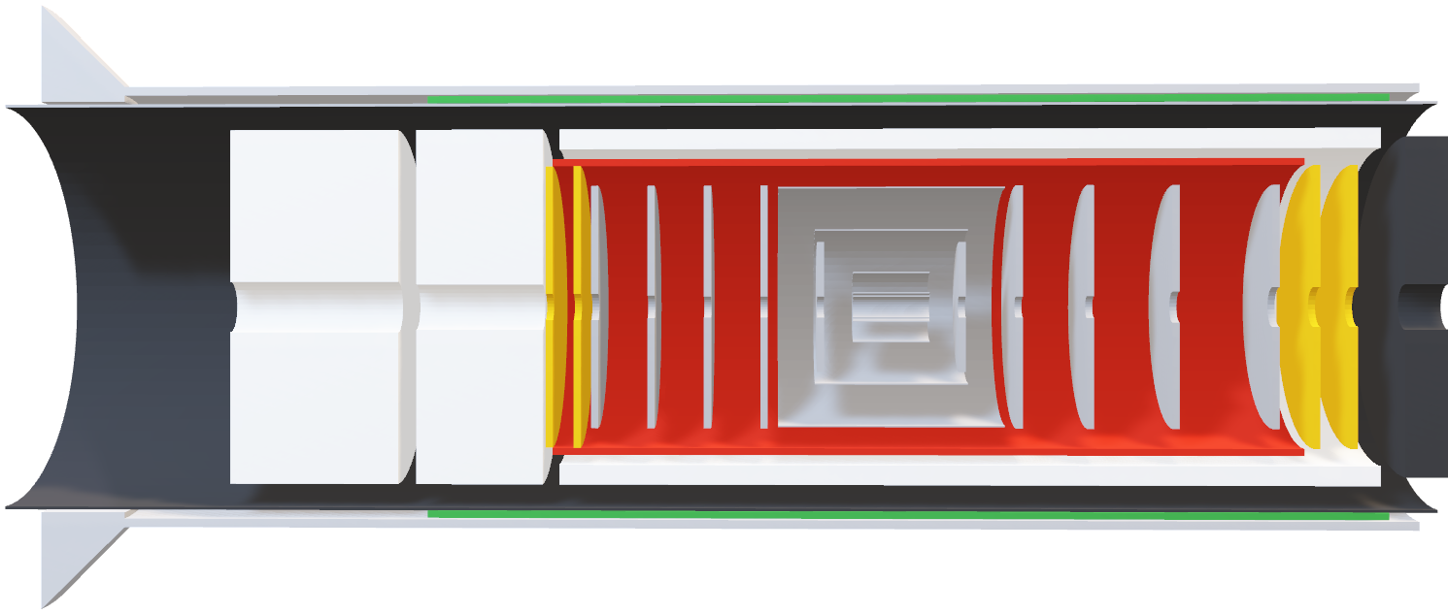
MPGDs
Data from menagerie table https://eic.jlab.org/Geometry/Detector/Detector-20240117135224.html
Endcap radius = 50 cm
LD Endcap is inside of CyMBal
HD Endcap has too narrow gap from CyMBal
LCLGAD Endcap size

Slide 5
Other considerations
Cooling: FEB (+RDO) is still under development.
LD Endcap spacing: space required for FEB/RDO
Assembly process (inner support)
Endcap is sandwiched by SVT, CyMBAL, ACLGAD, and pfRICH.

Slide 6
