Slide 1
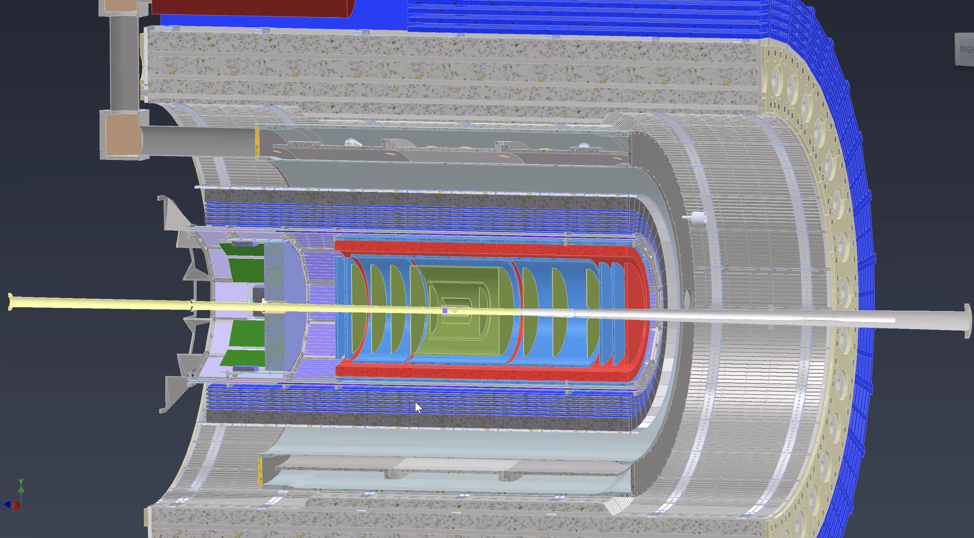
$μ−$ $Rwell detectors for the EPIC tracking at EIC$
Integration Meeting – February 20th 2024
Annalisa D’Angelo
University of Rome Tor Vergata & INFN Rome Tor Vergata Rome – Italy
for the EIC Collaboration

Slide 2
MPGD Endcaps Geometry
Last update: Jan. 17th2024
https://eic.jlab.org/Geometry/Detector/Detector-20240117135224.html
Endcaps - dimensions
50 cm external radius - including frames and services
5$÷8$ cm inner radius

Slide 3
Endcap Semi-Detectors Overlap
Overlap thickness (free from frames) = 2 cm
1000 mm
Frame thickness = 15 mm
Active area overlap = 20 mm
Vertical Diameter = 1000 mm
Horizontal width = 525 mm
525 mm

Slide 4
MPGD Endcap Semi-Detectors Overlap
1000 mm
1000 mm
525 mm
525 mm

Slide 5
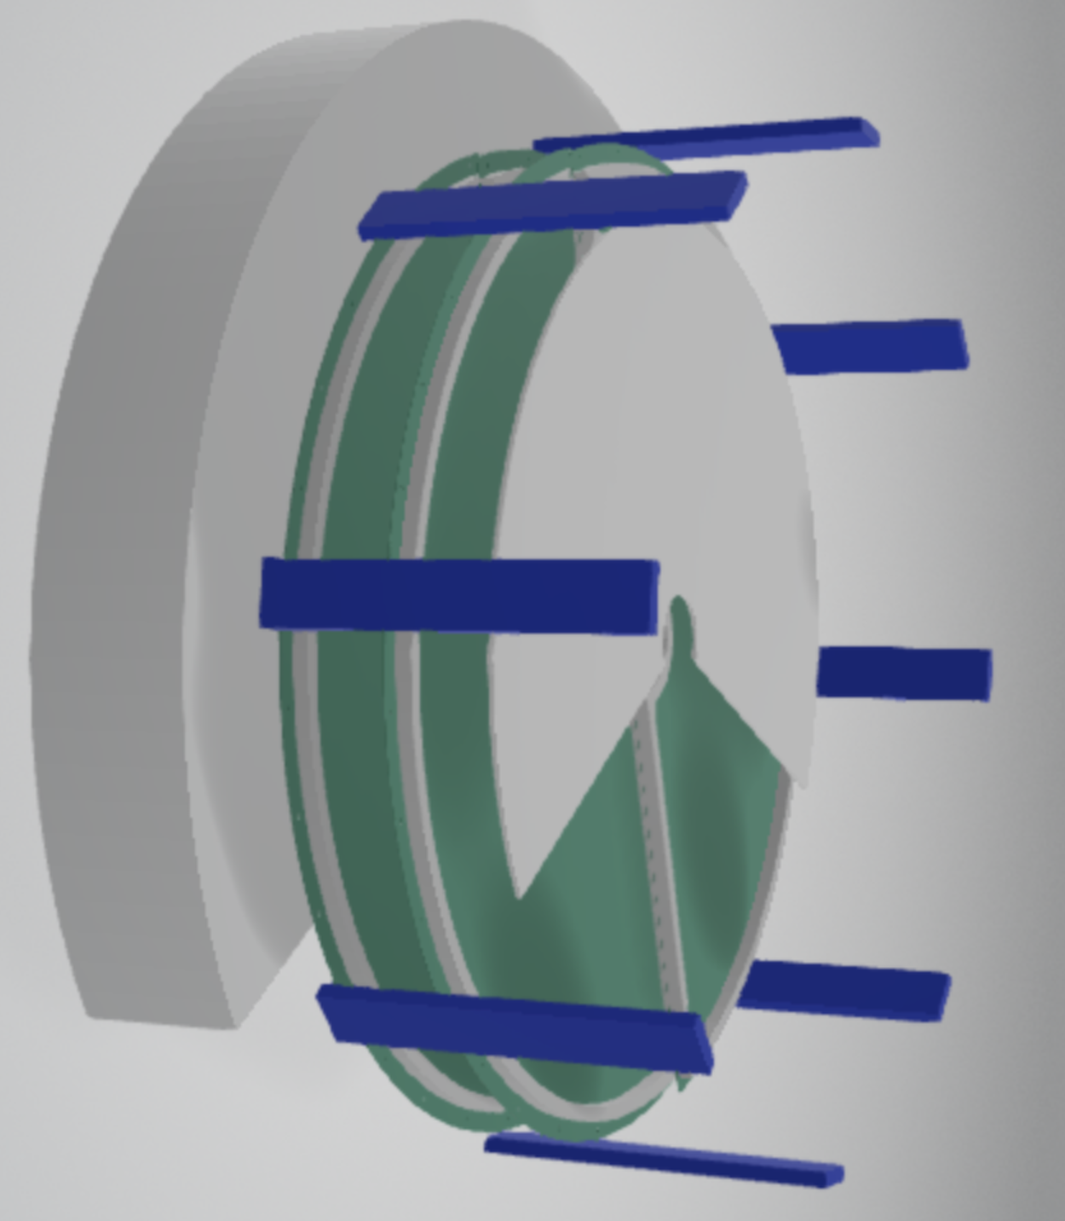
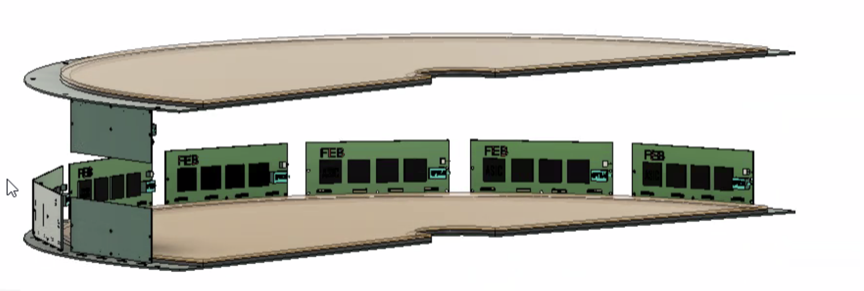
Endcap Semi-Detectors Overlap
Question
How are we going to attach the endcaps to the outer support?
By Seung Joon Lee

Slide 6
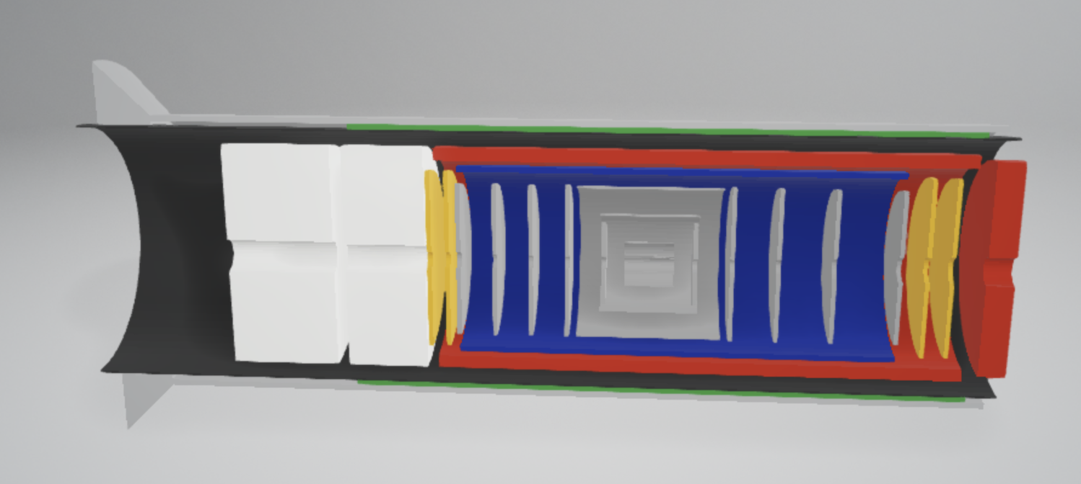
List of MPGD Endcaps Services
For each endcap disk (4 disks in total):
16 HV cables
4 gas inlets and 4 gas outlets
32 data cables
32 low low voltage cables
2 temperature sensors cables
2 humidity sensors cables
2 dry air inlet and 2 dry-air outlet cooling hoses
Space for 32 RDO cards
By Seung Joon Lee
Total services: all numbers x 4

Slide 7
List of Issues to Address
Geometry: Compatibility with CyMBal dimensions
Integration: Support details
To be understood: Space for electronic cards and services
By Seung Joon Lee

