Slide 1
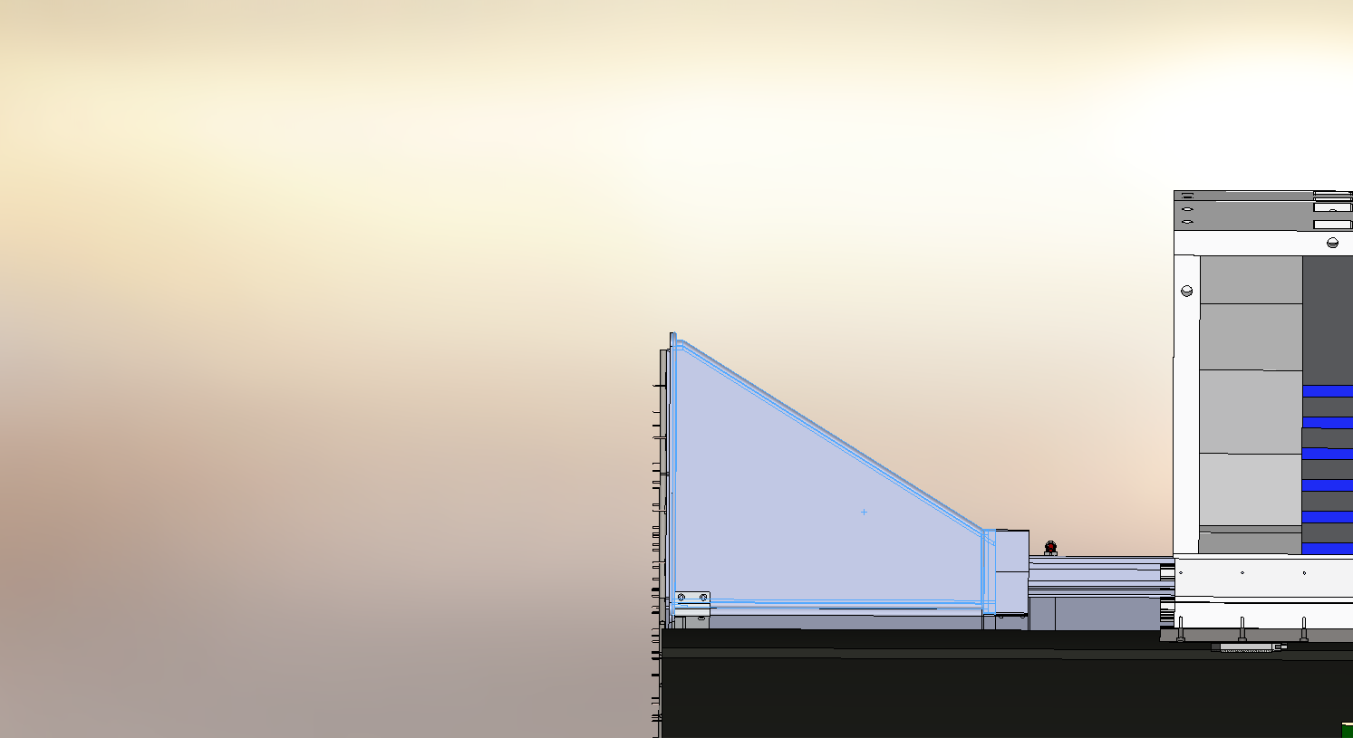
HpDIRC and MPGD integration issue
Feb 20 24
Avishay Mizrahi

Slide 2
The DIRC structure requires one end to be wider and this serves as the expansion volume.
Fused silica bars and expansion volume form the main components of the DIRC, with three lenses in between them.
Moving the DIRC bar boxes after insertion into the detector position is strongly discouraged. However, a single permissible adjustment is allowed during the lifetime of ePIC.
The fused Silica bars need to be consistently kept in a dry, impurity-free environment; therefore, storing them in nitrogen gas has been deemed necessary.
For system maintenance, the prism will be designed to be detached from the lenses, and a carrying mechanism is planned for the readout section.

Slide 3
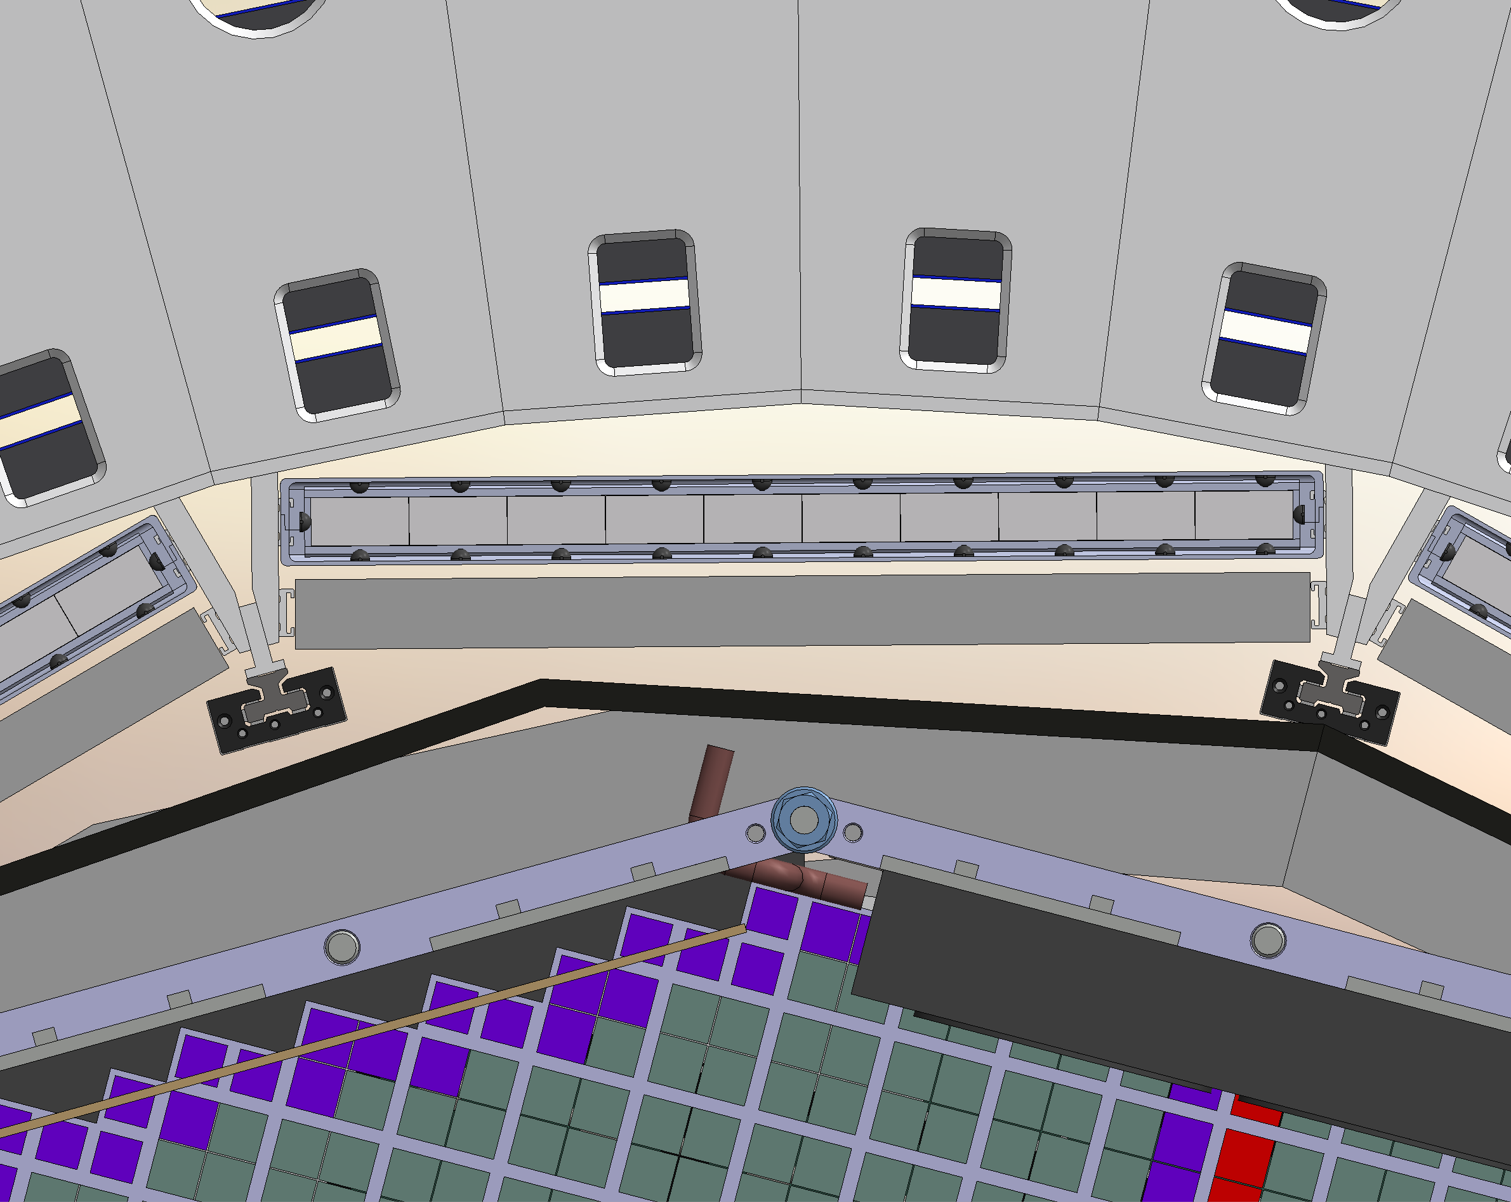
Both the HpDIRC and MPGD use the same triangular beams.
MPGD space for services is limited from the front side by the DIRC readout section.

Slide 4
