Slide 1
Progress on Cylindrical µRWELL Prototypes
Detector R&D Day Meeting
K. Gnanvo, P. Iapozutto, M. Hohlmann, A. kiselev
on behalf of eRD108 Consortium
March 25, 2024

Slide 2
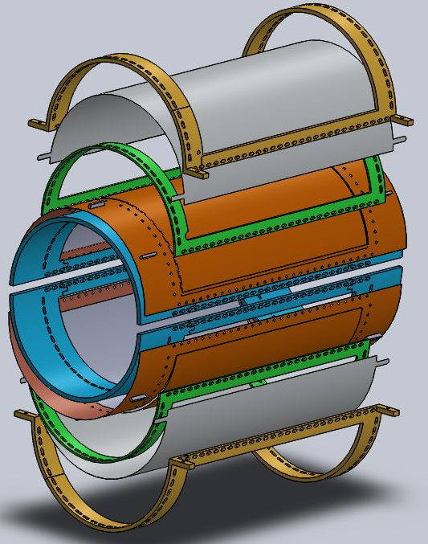
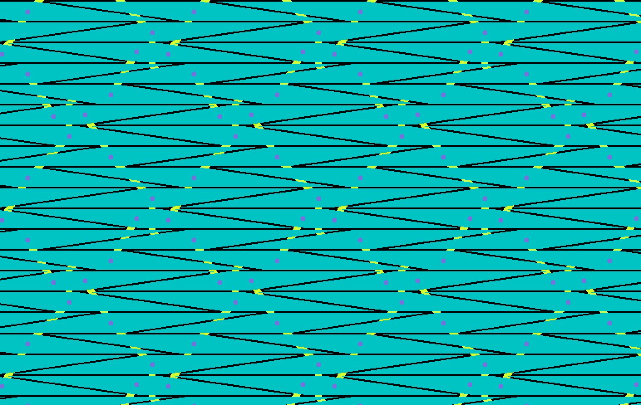
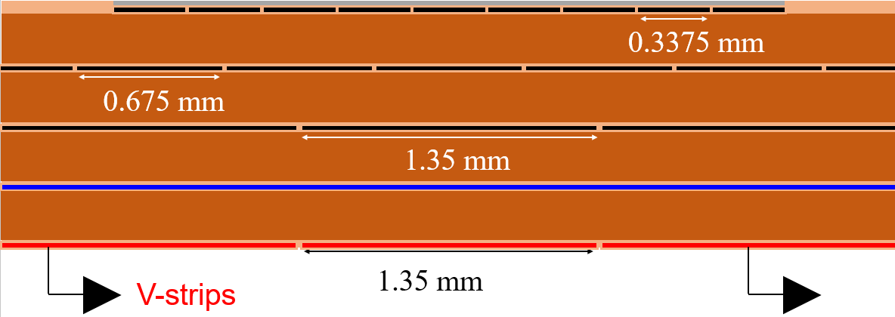
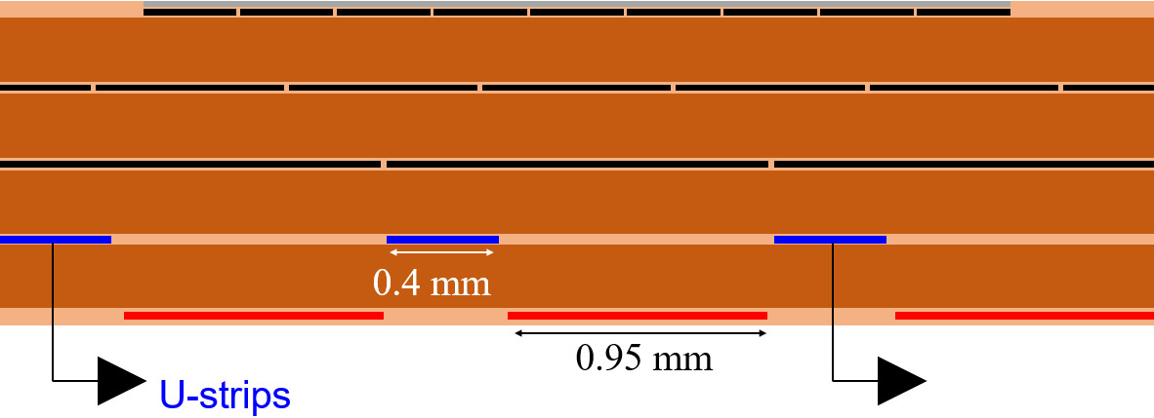
eRD108: R&D on Cylindrical µRWELL Prototypes
Motivation & Design features
Prototype consists of 2 half-cylinder chambers with different readout structures
2D capaSh proto: µRWELL/readout foil with U-V capacitive-sharing readout
2D zigzag proto: µRWELL/readout foil with U-V :zigzag” readout structure
Goal is to study the performance of the two readout options for cylindrical µRWELL
Design of mechanical structure completed with a set of 3 of frames per chamber
Exploded 3D view
Outer clamp
40 cm
Cathode foil
U-V zigzag readout concept (BNL)
U-V capacitive-sharing readout (JLab)
26 cm
U-strip
µRWELL-R/O
1.35 mm
pitch
1.35 mm
pitch
V-strip
Main frame
Inner clamp

Slide 3
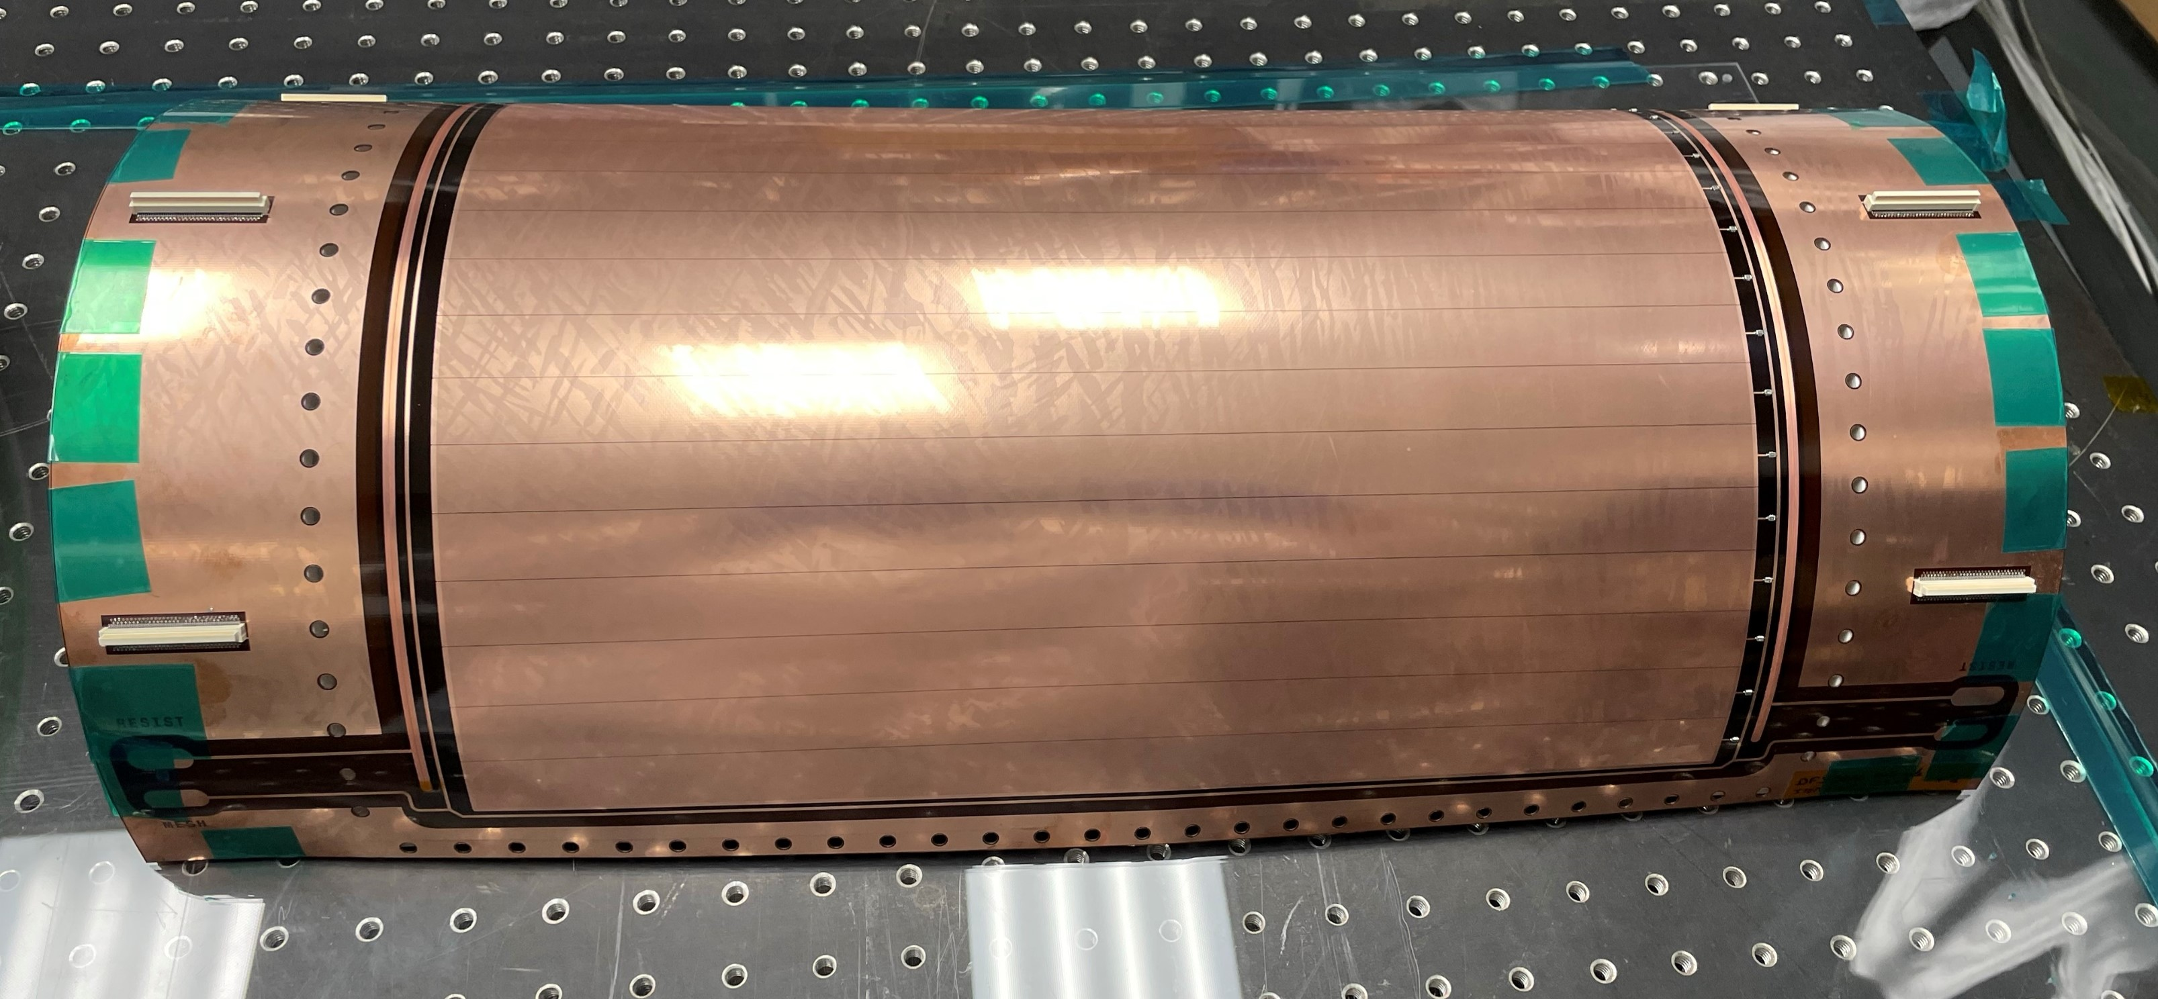
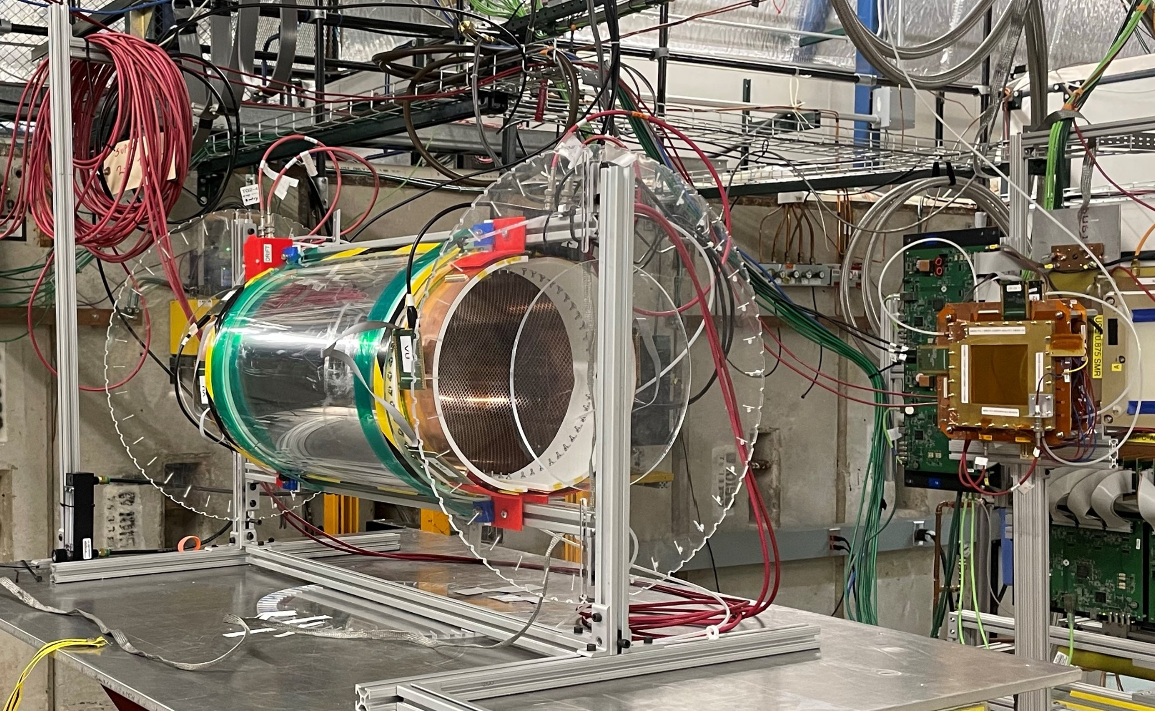
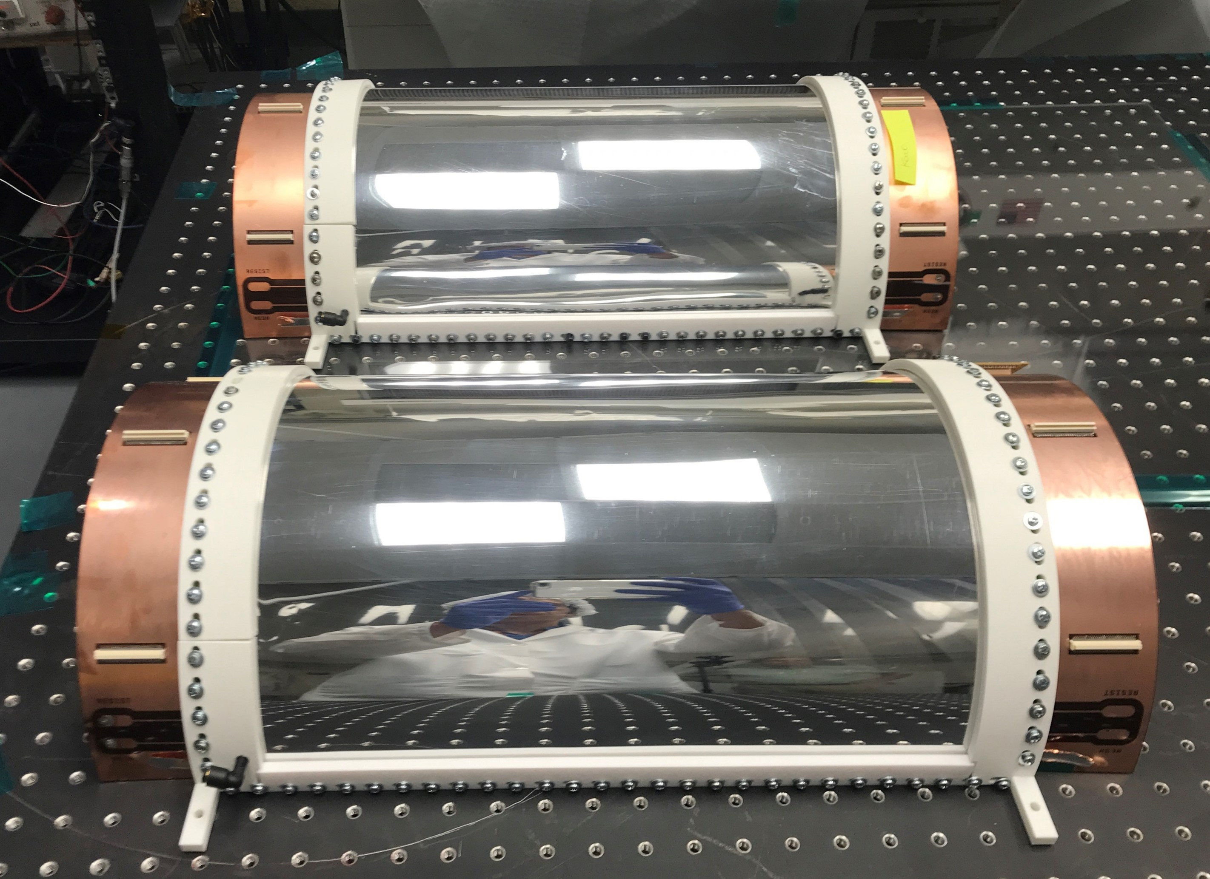
eRD108: Cylindrical µRWELL prototypes
Curved µRWELL /RO composite PCB
Cyl. µRWELL prototype at Fermilab test beam setup, June 2023
BNL & JLab: Design of uRWELL+ RO composites
Two half cyl. µRWELL prototypes
Cyl. µRWELL
Downstream
GEM Trackers
capaShRO proto
We were unable to operate and take data at the Fermilab 2023 test beam
Fermilab shut down that week for safety concerns at the lab
Dents appeared on the Al cathode when HV is applied ➔ HV instabilities
2024: Fix the dents issues and test the prototype at in Hall D JLab in Fall 2024
zigzagRO Proto
Florida Tech: Mechanical structure and detector assembly

Slide 4
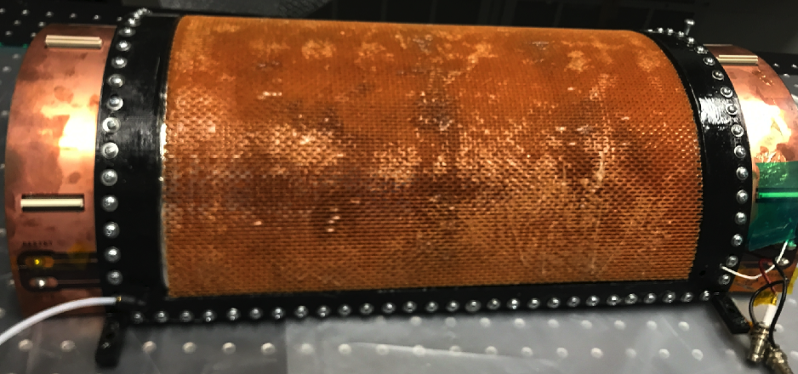
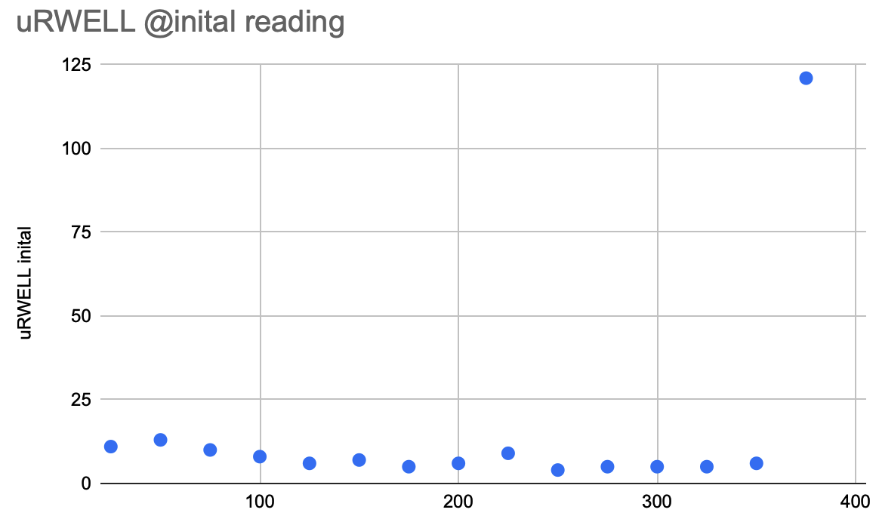
HV stability issues & design upgrade
Initial prototype with Al-mylar foil drift cathode
New drift cathode reinforced with honeycomb structure
Dents on cathode foil
HV and gas leakage tests
Gas pressure drops from 20 mbar to 10 mbar in two min.
µRWELL: small leakage current up to 350V
above 350V, sudden current increase observed
On the original prototype, the cathode foil shows some dents during operation at Fermilab test bean
HV stabilities issues ➔ Detector could not hold HV
Decide to reinforce the cathode by gluing the Al-Mylar foil on a honeycomb structure
Cathode could sustain up to 1 kV after reinforcement
Indicative of dust or
Al flakes on the µRWELL
µRWELL leakage current (nA)
µRWELL voltage (V)

Slide 5
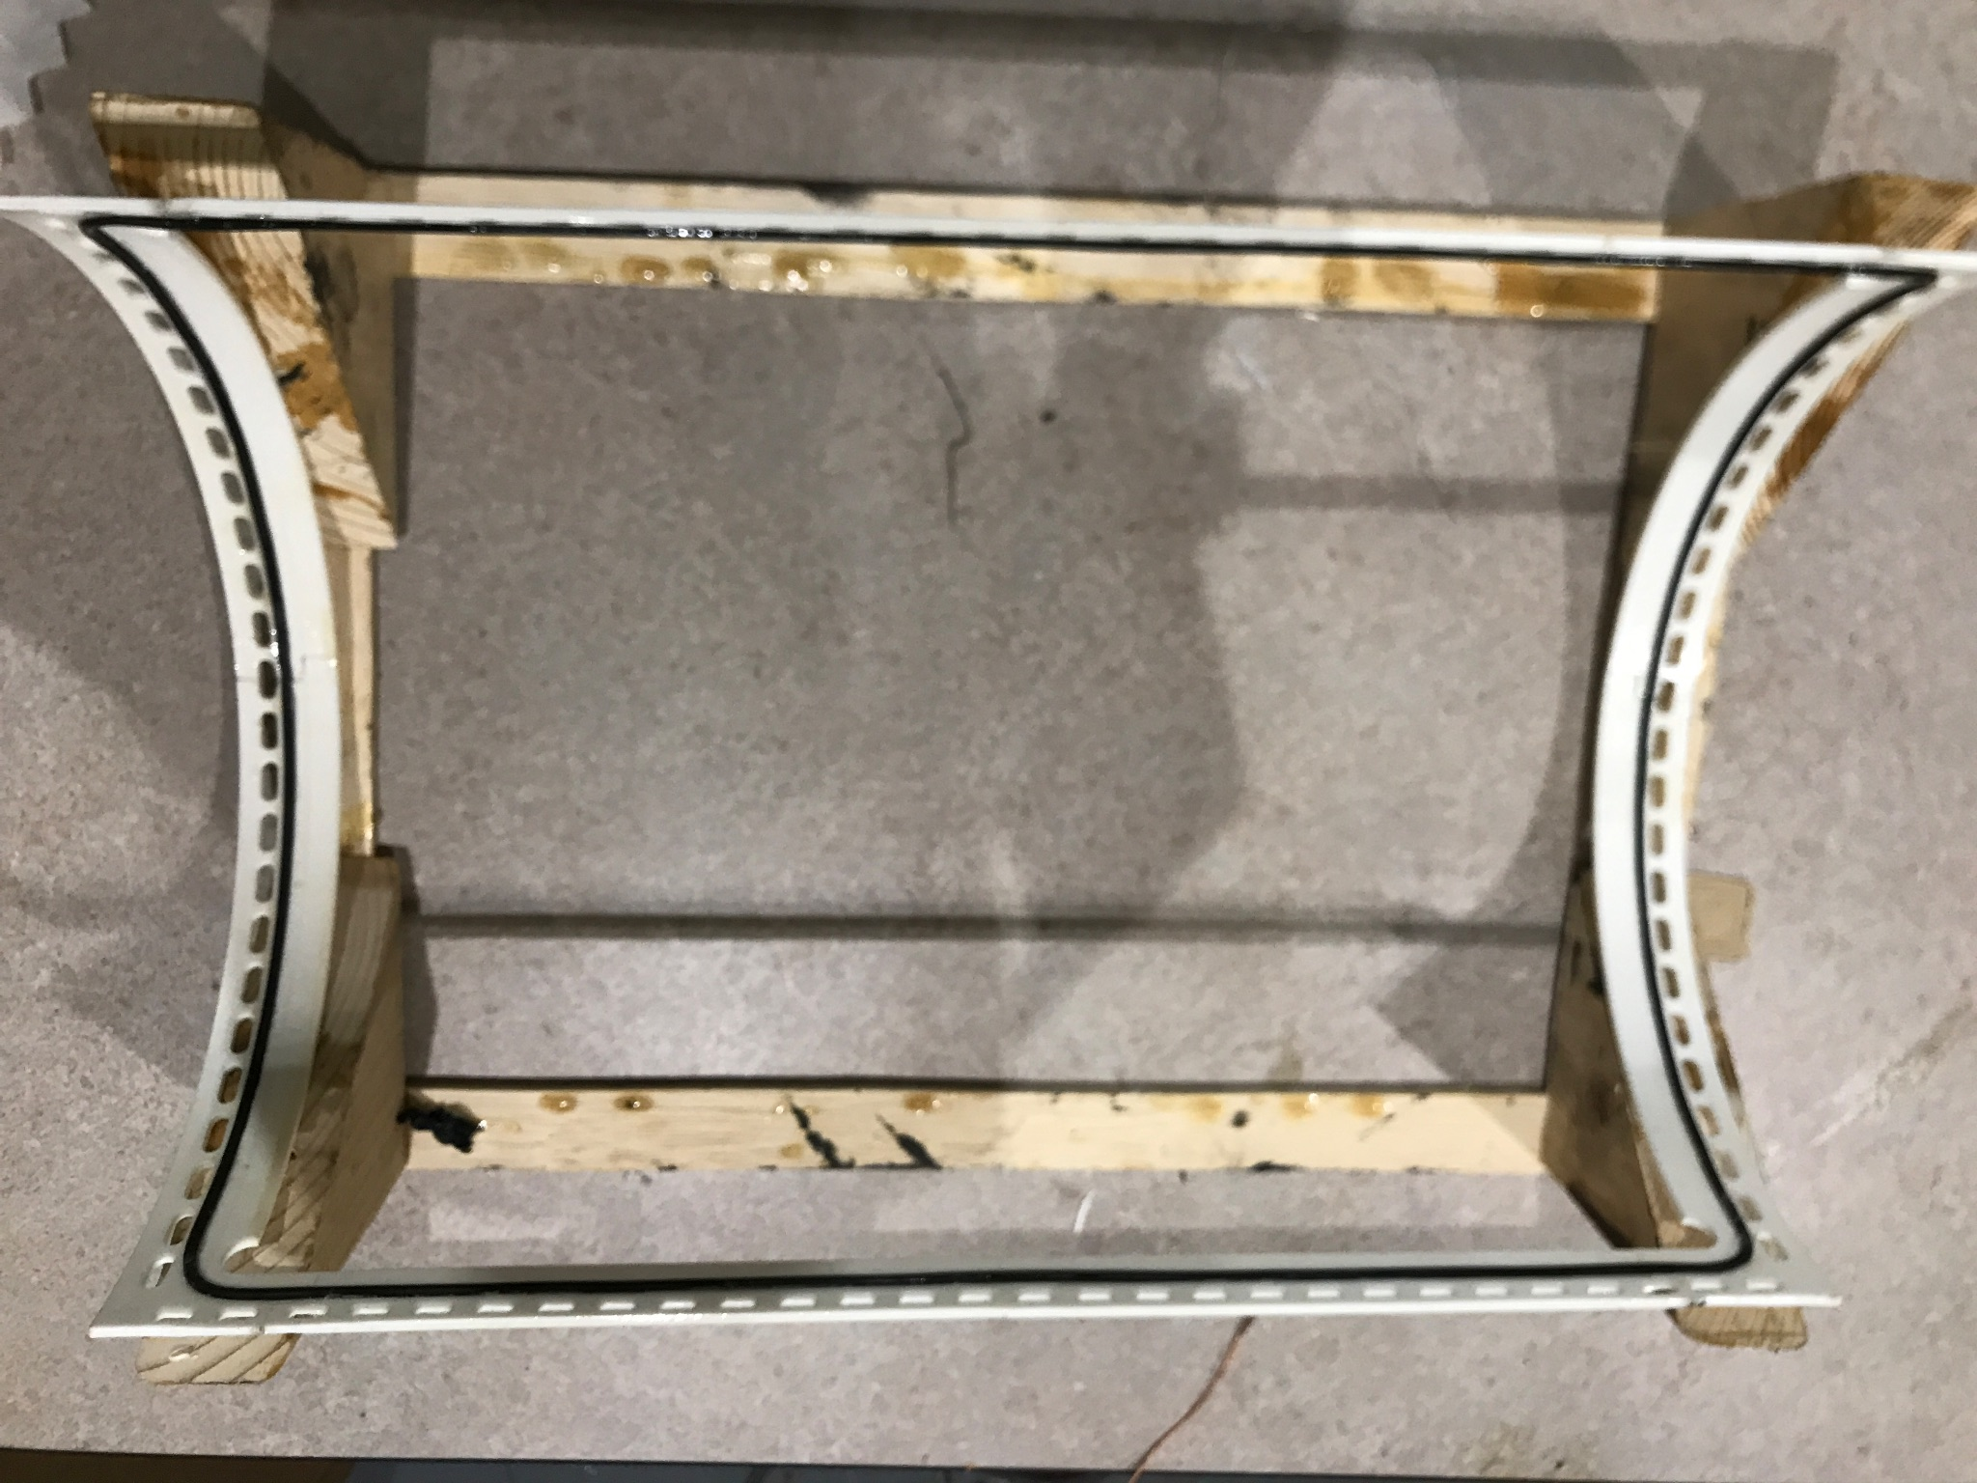
eRD108 completed: But - Next steps & plans
Open half cyl. detector and clean µRWELL foil (tacky roller)
Replace Al-Mylar by Cu-Kapton drift cathode
Assemble second detector half cylinder
Implement a larger O-ring to improve gas tightness (right)
Assemble second detector half cylinder
(Re)-assemble both half cyl. prototypes and perform cosmic test at FIT (possibly at JLab)
Conduct an opportunistic beam test at in Hall D JLAB (Fall 2024 run)
Frame with larger O-ring

Slide 6
Back up

Slide 7
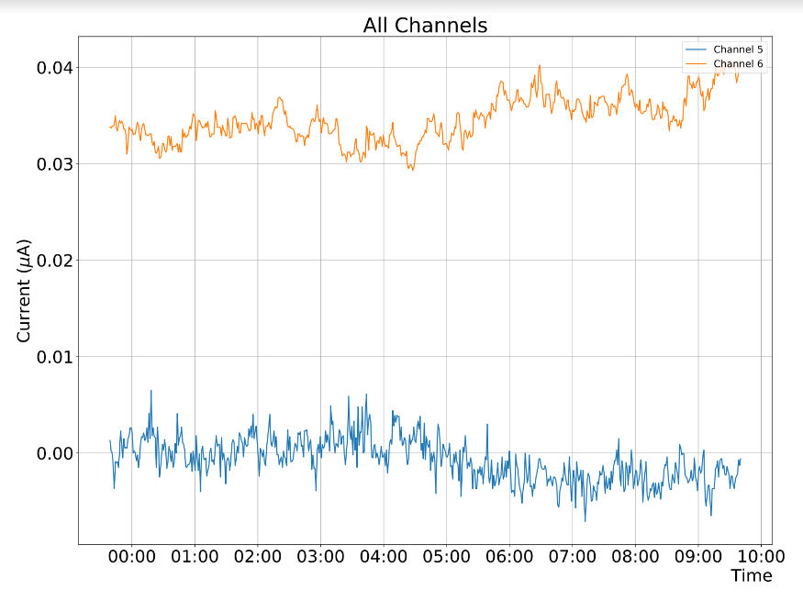
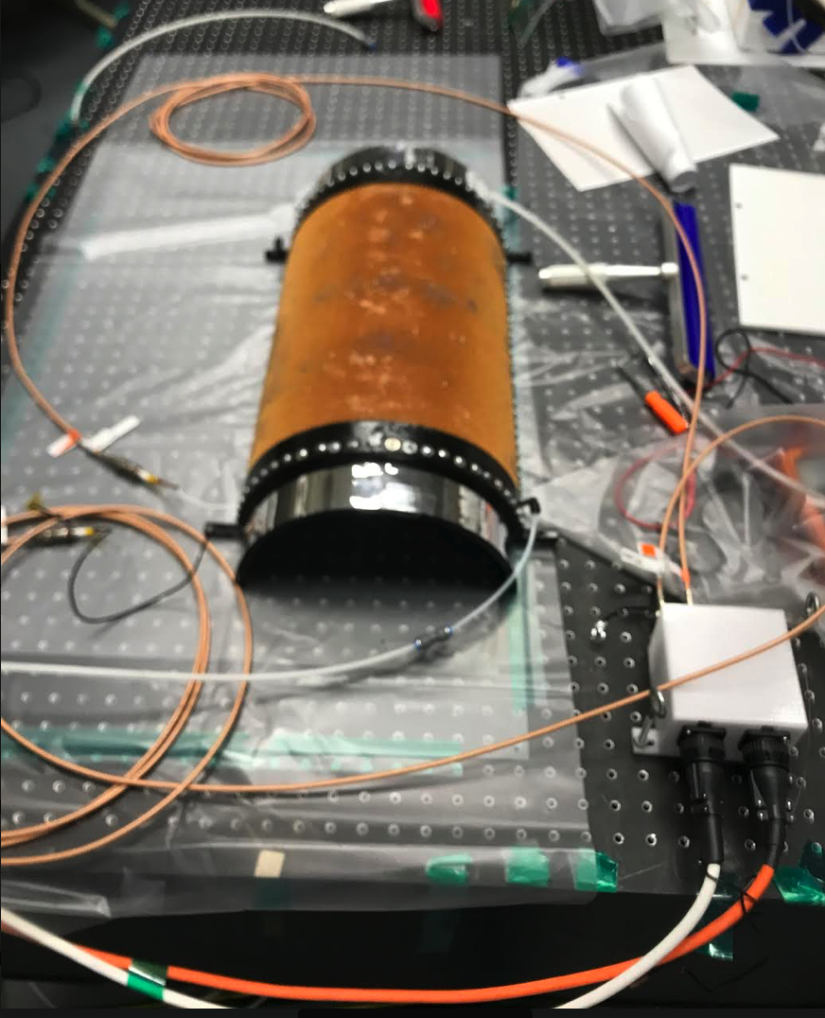
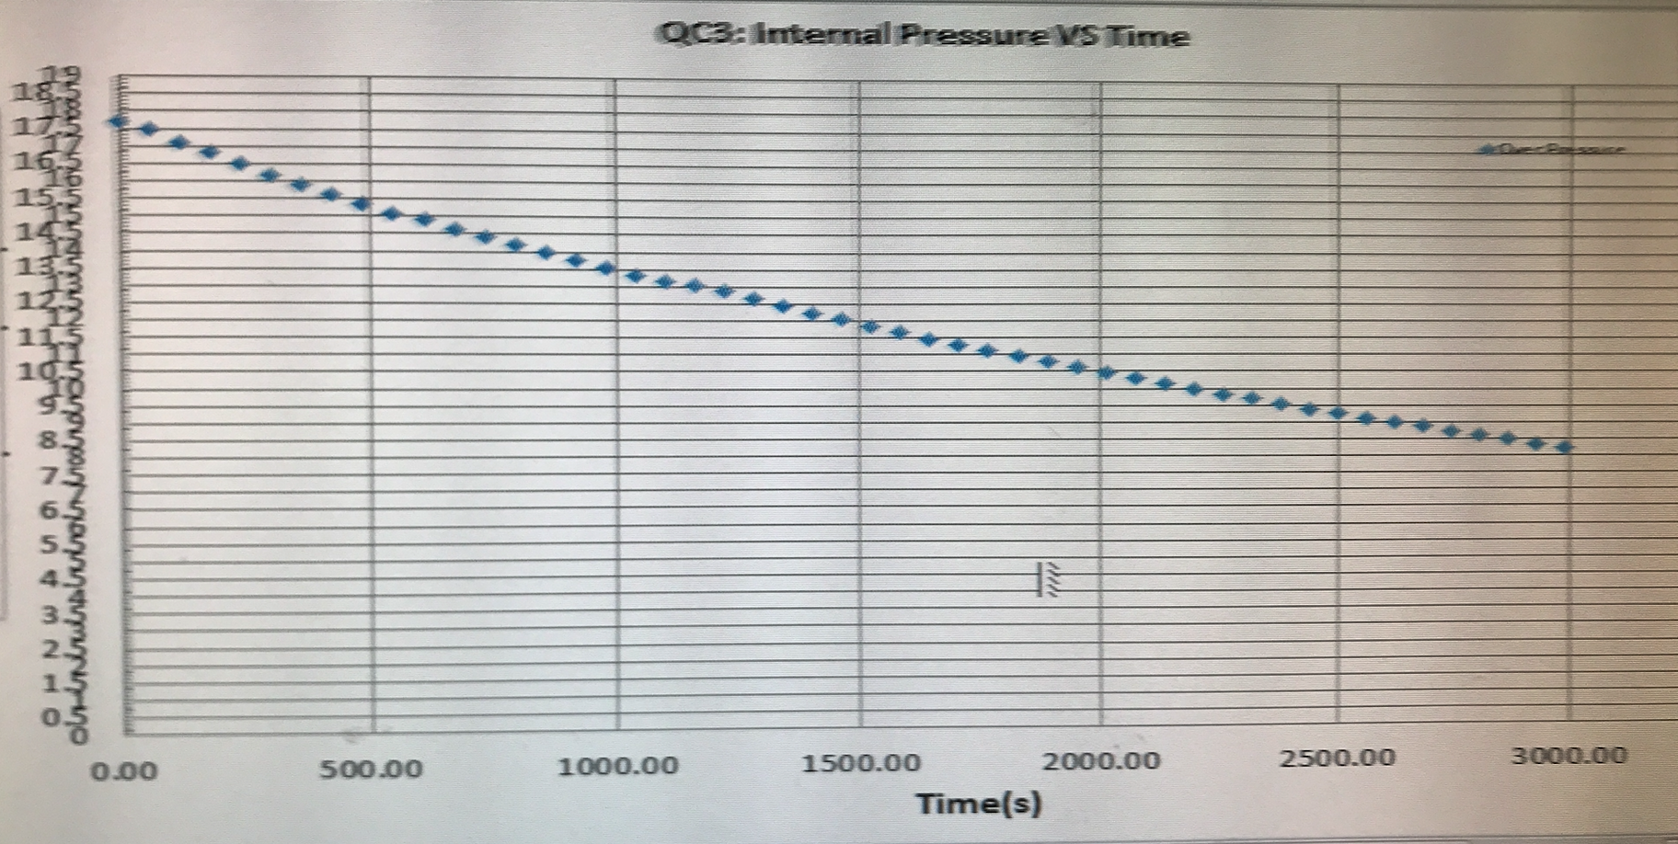
Gas Testing & HV continued
Bench Top testing of with high voltage and gas pressure was successfully conducted.
-The first trial included a 300 µm mockup foil instead of the µRWELL foil and the structure successfully held gas pressure with a measured drop from 20 to 10 mbar overpressure in 60 minutes.
-Second gas pressure trial included the µRWELL foil, the detector held gas pressure in the same range for 2 minutes. The leaking is possibly due to the O-ring being too small we plan to use a larger O-ring and modified groove.

Slide 8
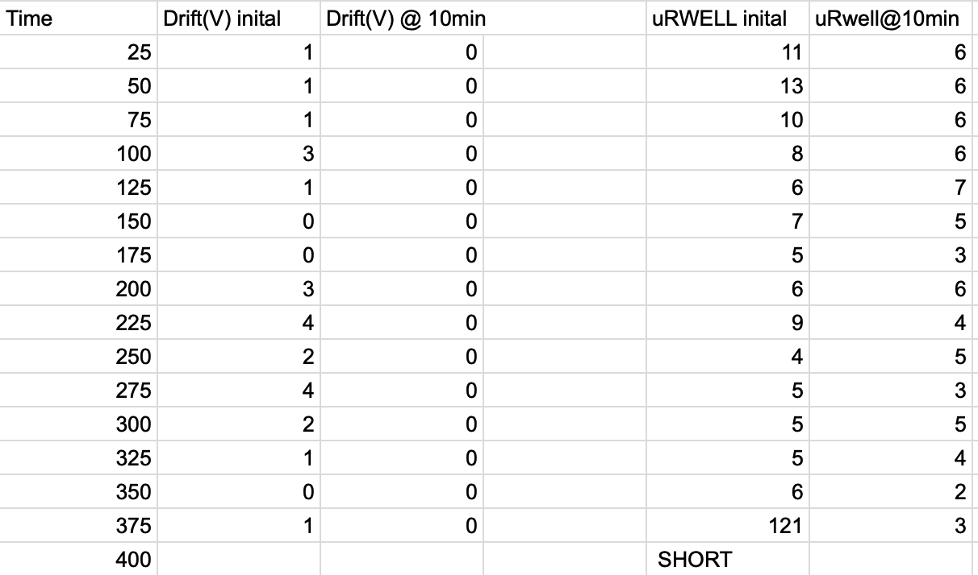
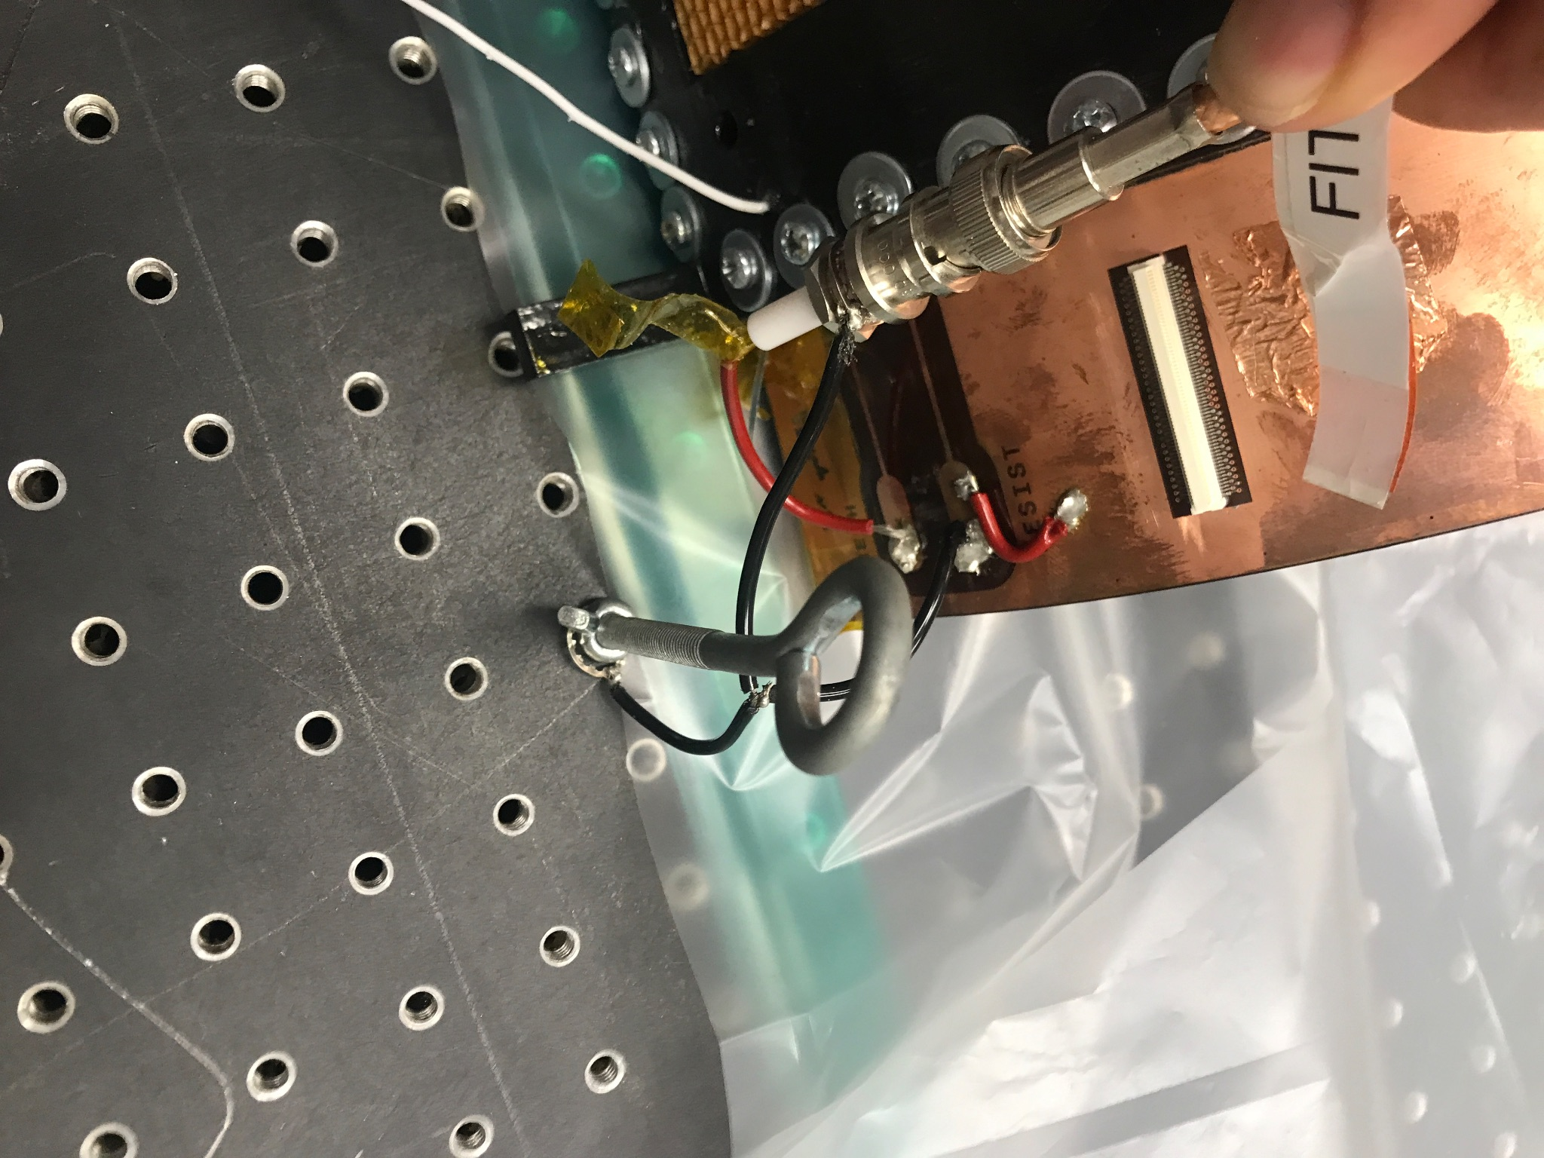
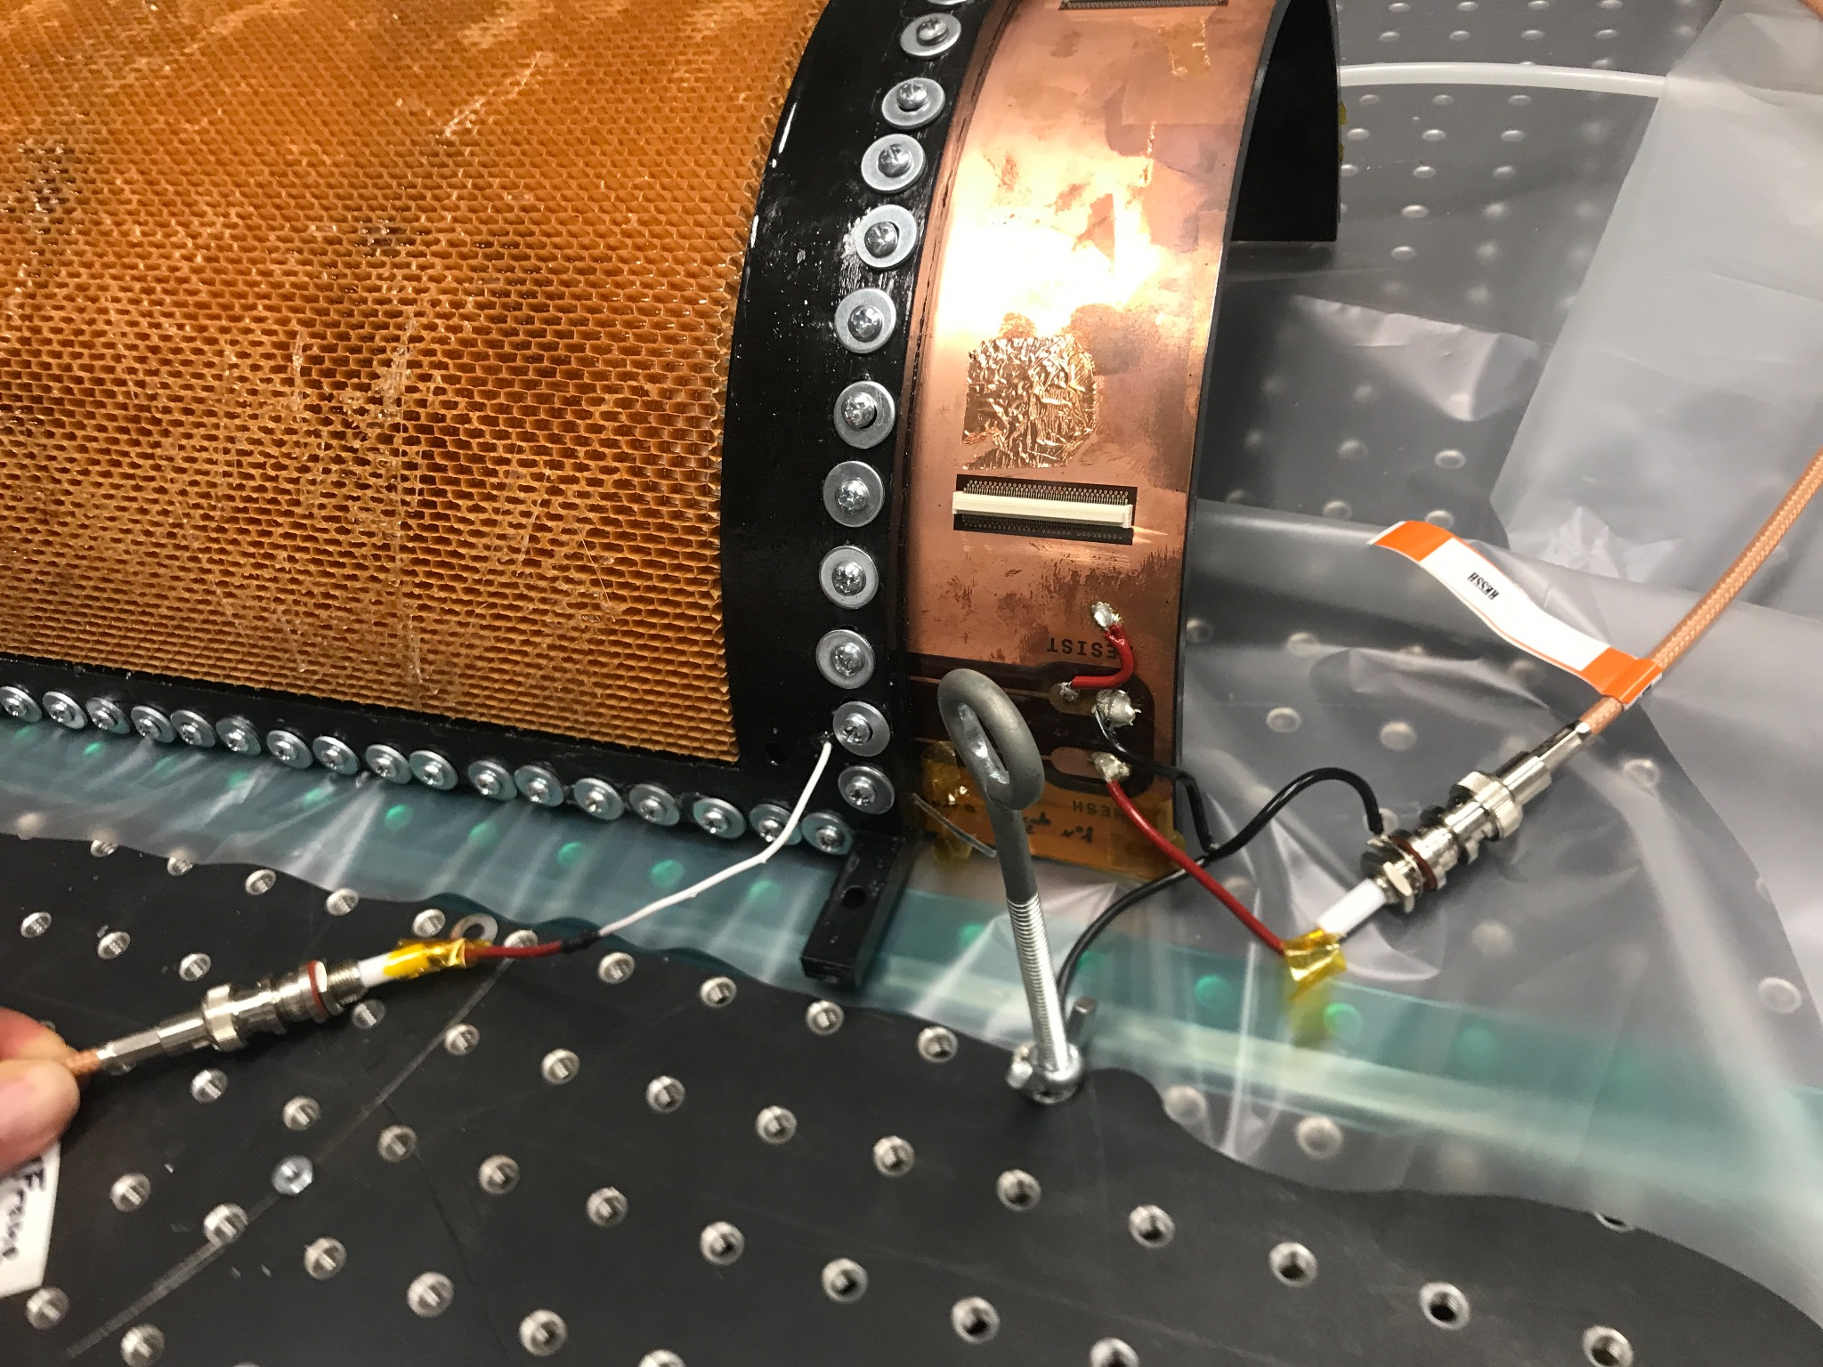
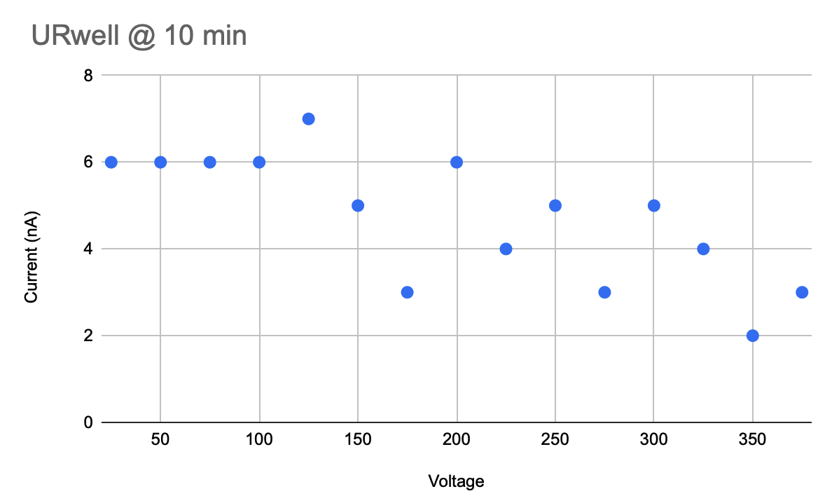
Backup Slides

