Slide 1
ePIC/EIC Project Detector R&D Day
eRD109 (ASICs/FEEs) – Progress & Outlook
Fernando Barbosa
25 March 2024

Slide 2
Outline
eRD109 - ASIC & Electronics R&D Initiatives
Proposals
Progress Reports:
ASIC & Discrete Developments
3rd Party ASIC Evaluations
Services
High Precision Timing
Outlook

Slide 3
eRD109 Proposals
FY23, FY24 sensibly similar
 | File | Authors | Sub-Detector | Sensor Type | Readout Solution
A | eRD109_pECAL_readout_prototype_FINAL | G. Visser (IU), et al. | Calorimeter | SiPM | Discrete, COTS
B | eRD109CalorimeterReadout | N. Novitzky (ORNL), et al. | Calorimeter | SiPM | H2GCROC
C | eRD109-alcor | M. Ruspa (INFN), et al. | dRICH | SiPM | ALCOR
D | ACLGAD_ASIC_Electronics_FY23 | Z. Ye (UIC), et al. | Central, Far-Forward | AC-LGAD | EICROC, FCFD
E | eRD109_SALSA_proposal_vfinal1 | D. Neyret (CEA), et al. | Micromegas, GEM, MicroRWell | MPGD | SALSA

Slide 4
eRD109 Progress
eRD109 Addresses EIC ASIC and Electronics R&D needs.
FY23 Proposals - DAC R&D Review August 2022
FY24 Proposals - DAC R&D Review August 2023
FY25 Proposals - DAC R&D Review August 2024 (submissions due by 1 July 2024)
ASIC & Discrete – Nominal Solutions: (FY23, FY24)
Discrete/COTS – Calorimeters, SiPMs, 12-14 bit
CALOROC (H2GCROC revision for EIC) – Calorimeters, SiPMs, 10 bit *
EICROC - AC-LGAD, pixel *
FCFD – AC-LGAD, strip**
ALCOR – dRICH, SiPM, 1 p.e.
SALSA – MPGD.
3rd Party Evaluations: (FY23)
HPSoC, HDSoC – NALU
ASROC – Anadyne
FAST – INFN
Services: Barrel TOF Low-Mass Service Hybrid, (FY23, FY24)
High Precision Timing, (FY24)
* Considerable commitment of resources by OMEGA/IN2P3.
** Considerable synergy with FNAL

Slide 5
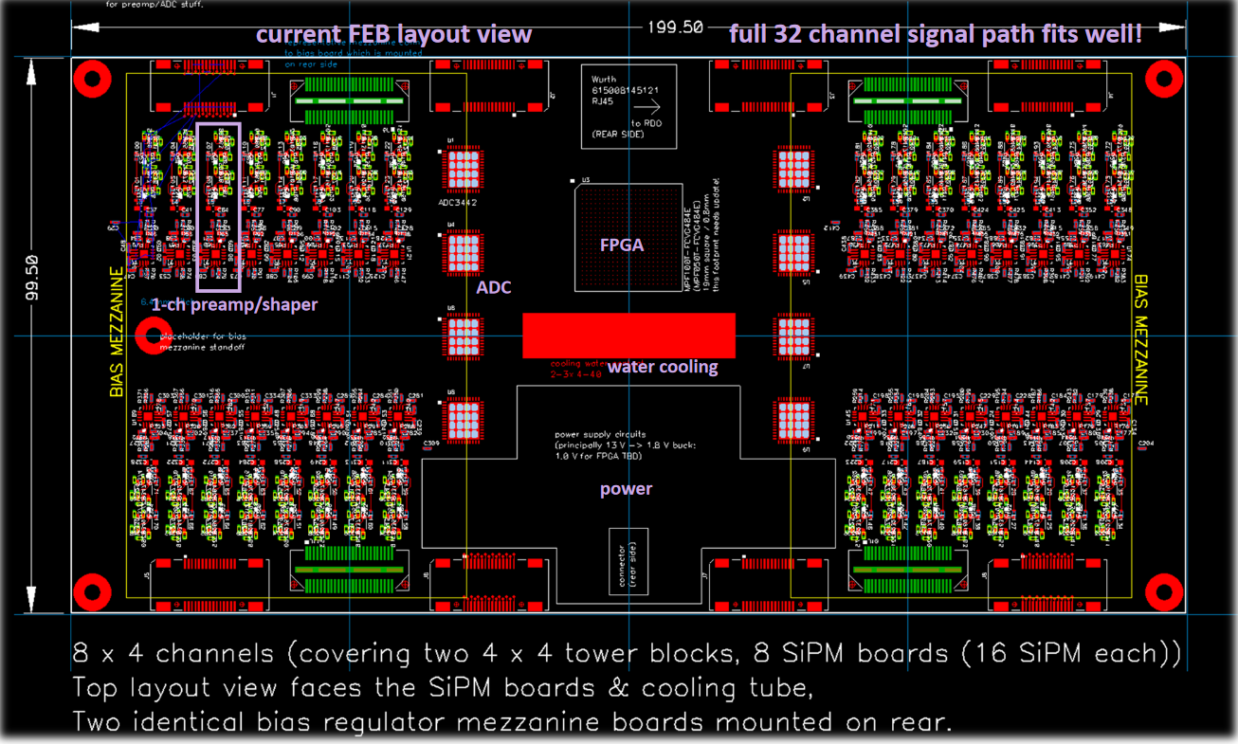
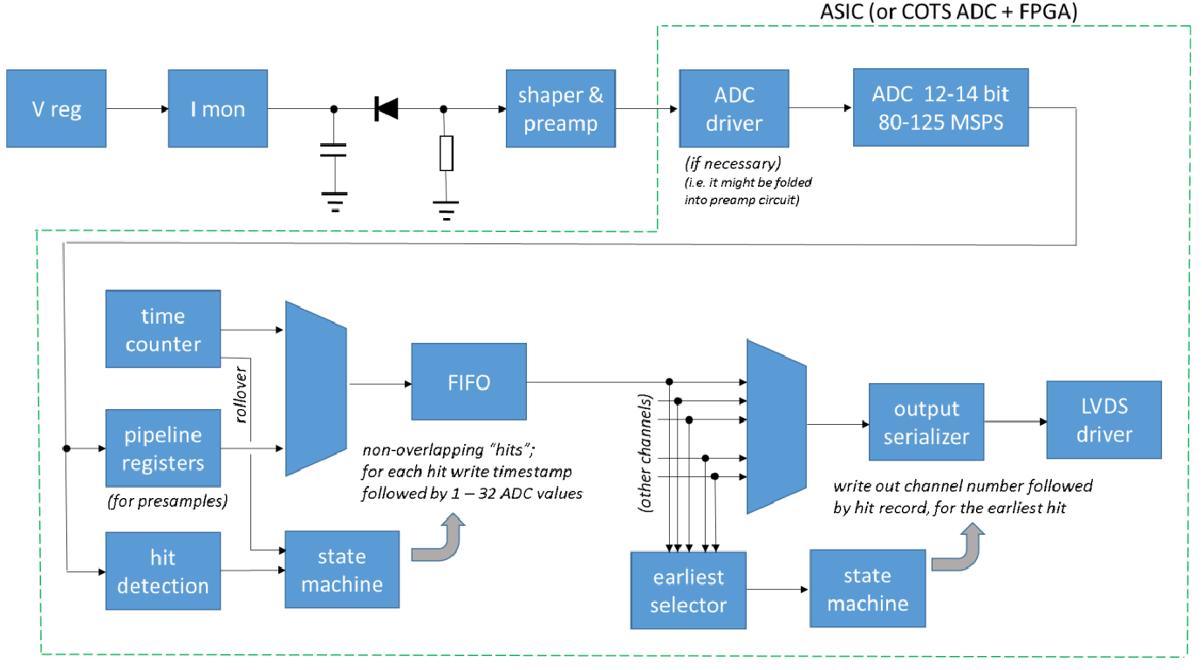
eRD109 – Discrete/COTS/ASIC (IU)
Calorimeters, SiPMs
FEB PCBs
Adapter PCB
Specs almost complete
Devices selected
Signal chain designed, including “dynamic range compressor”.
Defining FEB-RDO interface
DC/DC converters under tests, radiation tests coming.
PCB design is proceeding
SiPM frontend prototyped
SiPM Bias distribution established.
32 ch Waveform Digitizer
12/14-bit TI ADC3422
Microsemi MPF100T-FCVG484E Polarfire (radiation hard FPGA)
CERN DC/DC converter bPOL48V or LTC3601
Cabling, Power, Cooling, Packaging.
Design, Fab: FY23 –FY24
Tests + Beam: FY24 – FY25
Engineering Article: FY25
Production: FY25 – FY26

Slide 6
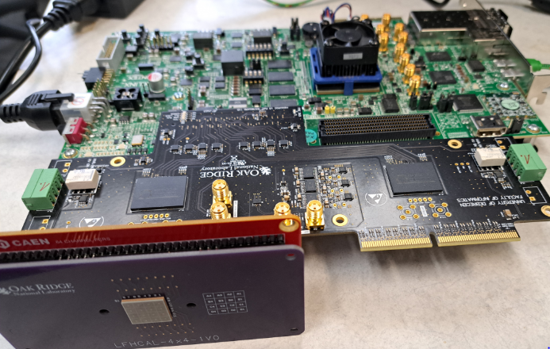
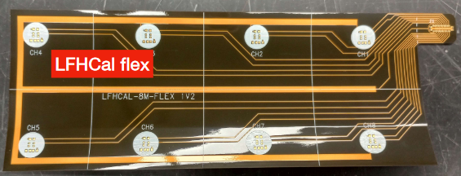
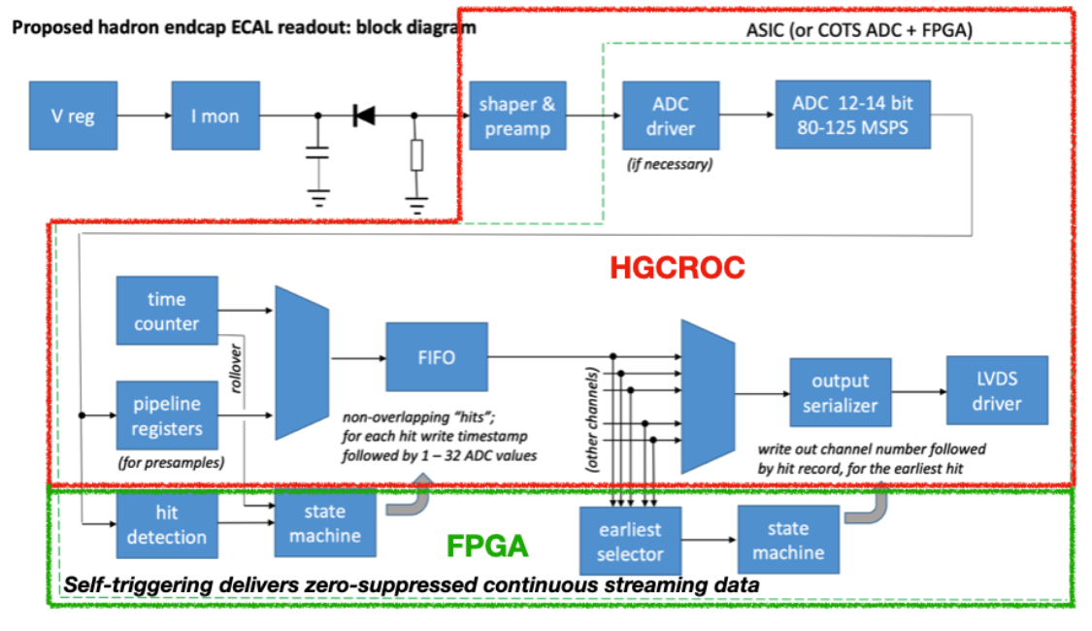
eRD109 – H2GCROC Studies (ORNL)
Calorimeters, SiPMs
Develop a readout solution for the calorimeters with SiPMs by:
Employing existing H2GCROCv3 ASIC
Developing PCBs for full readout chain
Developing cabling infrastructure
FEB PCBs
Adapter PCBs
H2GCROC & PCBs from OMEGA with KCU105 FPGA eval kit – tests are on-going to validate streaming readout operation algorithms
Tests confirm data from CMS operation
Cabling studies for interconnects from FEBs to RDOs are progressing (SAMTEC connectors)
LFHCAL, Barrel HCAL and ECAL, Bwd HCAL, – SiPM summing studies and FEB design in progress
Preparing for LFHCAL tests at CERN, 520 ch, May 2024
Input to OMEGA team for design of CALOROC.
RDO PCBs

Slide 7
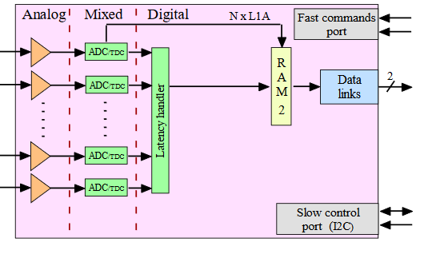
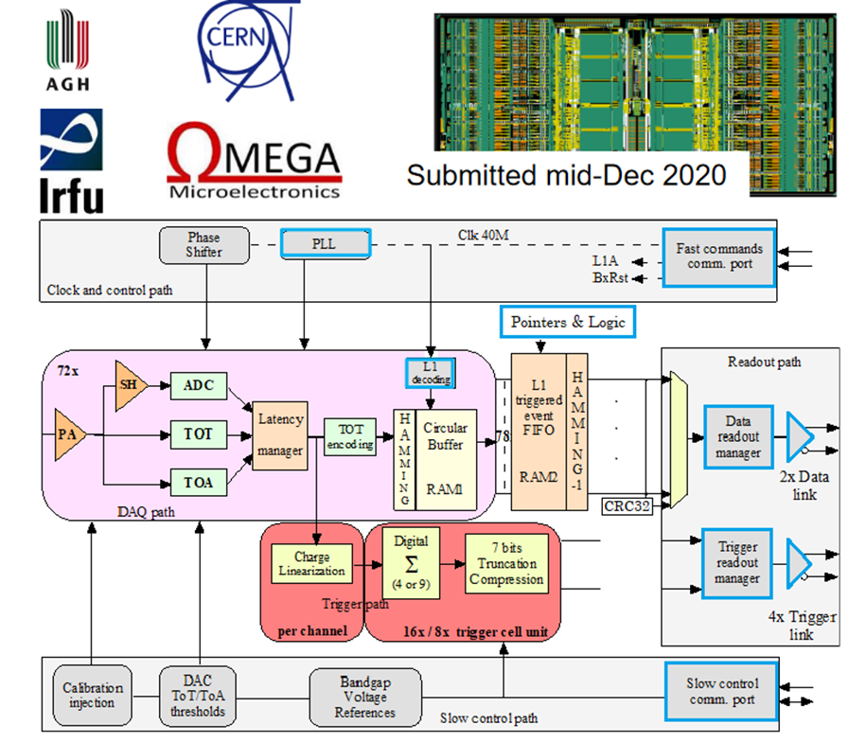
eRD109 – CALOROC (OMEGA/IN2P3)
Calorimeters, SiPMs
H2GCROC (not Streaming Readout)
No Change
Modify trig, mem, CLK dist.
1D, 64 ch.
130 nm CMOS
Charge (ADC+TOT) + Time (TOA)
Cdin: 500 pF - 2.5 nF
Dynamic Range: 1-320 pC
Timing: 100-120 ps
ADC: 10b
39.4 MHz operation from BX 98.5 MHz
Links: 1260.8 Mbps @ 39.4 MHz, multiple
Power: 5-10 mW/ch
Radiation tolerant
Preliminary specifications
Design in progress:
Analog part complete
Streaming Readout logic
Memory
Clock pre-scaling & distribution.
A (64 ch H2GCROC); B (32 ch, HKROC).
Design Backend: FY23 - FY24
CALOROC1 (A,B): FY24 – FY25
CALOROC: FY26

Slide 8
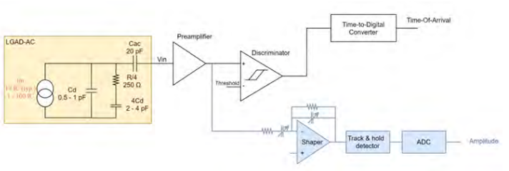
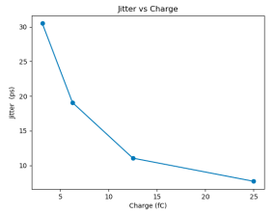
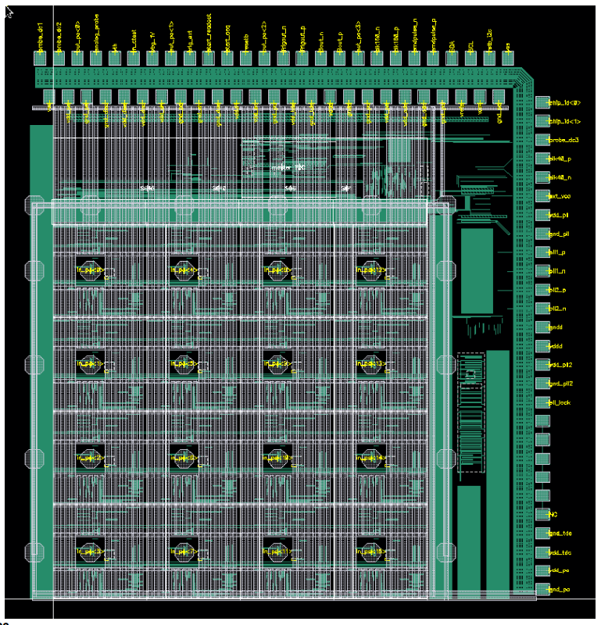
eRD109 – EICROC (OMEGA/IN2P3/IJCLab/CEA-IRFU/AGH)
AC-LGAD pixel
2D, 1024 ch (32x32), pixel readout
130 nm CMOS
Preamp, Discriminator, TOA, ADC
Cdin: 1-5 pF
Dynamic Range: 1-50 fC
Timing: 15-20 ps
ADC: 8b
39.4 MHz operation from BX 98.5 MHz
Links: 1260.8 Mbps @ 39.4 MHz, multiple
Power: <1 mW/ch
Packaging: Bump+Wire bonds
Radiation tolerant
One pixel – EICROC0
Sensor
EICROC0 (4x4) characterization in progress
Hybridization with AC-LGAD
EICROC0A – re-spin for lower power
Simulations in progress
EICROC1 – Layout started
4x16 or 8x16 or 4x32 or 8x32
Adding more test capabilities
Follows EICROC0
EICROC2 – 32x32
Plus backend of CALOROC
Wire
EICROC0: FY23
EICROC0A: FY23 – FY24
EICROC1: FY24 – FY25
EICROC2: FY26
Wire
Bump
4x4 500 um pixels

Slide 9
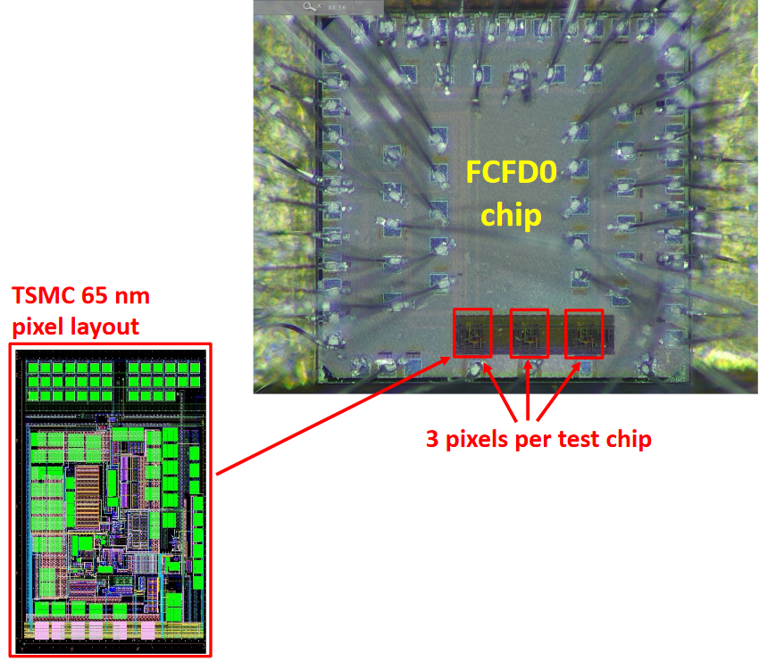
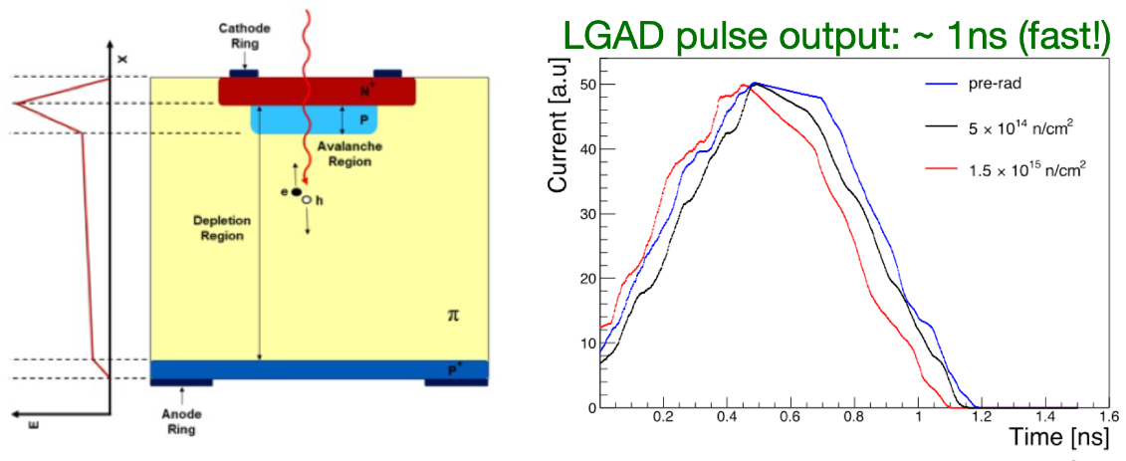
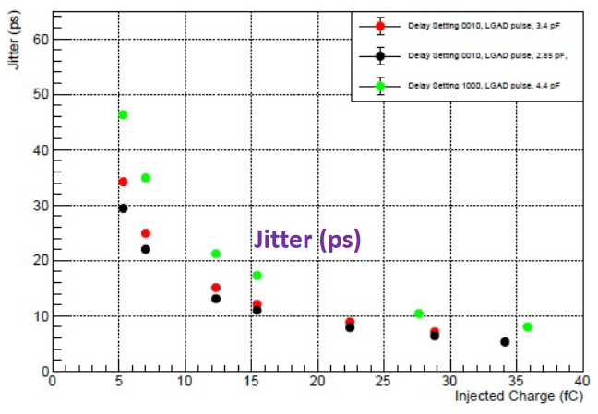
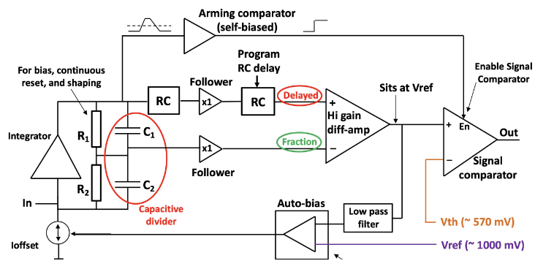
eRD109 – FCFD (FNAL)
AC-LGAD strip
FCFDv0 – characterized with charge injection, laser, beta, and proton beam
<25 ps @ >6 fC timing.
FCFDv1 – 6 channel designed and submitted (August 2023).
Received February 2024
Tests in progress
All channels functioning with CFDs operational
Full characterization on-going
Recently met with FNAL designers:
Adding interfaces
Designed ETROC for CMS
Scheduling FCFD work at FNAL
Proposal soon.
2D, 128 ch (8x16), strip readout
65 nm CMOS
Constant Fraction Discriminator
Plus TDC, ADC, interfaces
Cdin: <15 pF
Dynamic Range: 5-40 fC
Timing: 10-30 ps
Links: ~Gbps, multiple
FCFDv1: FY23
FCFDv2: FY24 – FY25
FCFDv3: FY26 – FY27

Slide 10
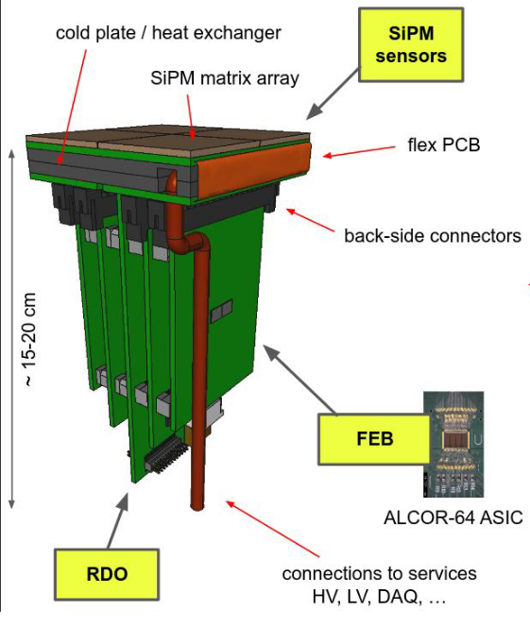
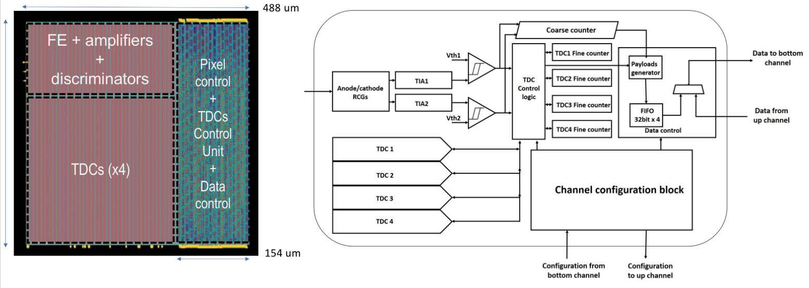
eRD109 – ALCOR (INFN)
dRICH – SiPMs, 1 p.e.
Originally developed by INFN for DARKSIDE.
2D, 64 ch (8x8), pixel readout
110 nm CMOS
Dual polarity, RCG Amplification, conditioning, inhibit , digitization.
Modes of operation: single-photon tagging or time and charge.
Triggerless and triggered operation.
25 ps TDCs, TOA+TOT, 5 MHz input
4 or 8x 640 Mbps LVDS links.
SPI configuration.
ALCOR v2: 32-pixel (8x4), characterization in progress
Preparing for beam tests (1280 ch), Spring 2024
ALCOR v3: 64-pixel (8x8), complete design with BGA package – Fall 2024
Design of RDO prototype – June 2024
SiPM Bias distribution, LV established; VTRX+ Optical transceiver.
Readout of RDO - tests – Fall 2024
Irradiation tests – ALCOR v2 (July 2024), RDO (December 2024)
ALCOR v3: FY25
ALCOR v4: FY26

Slide 11
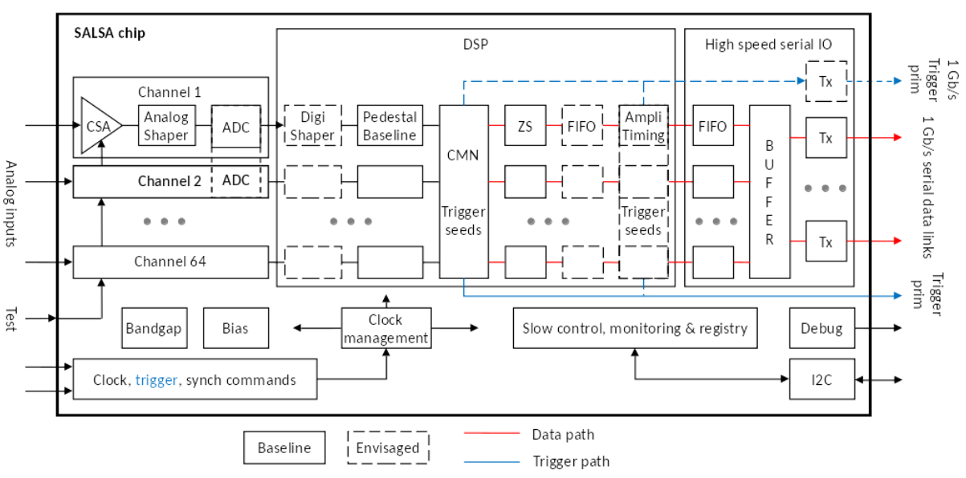
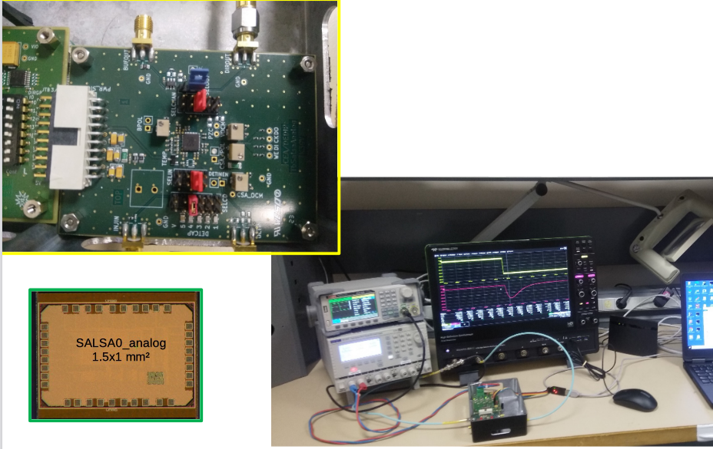
eRD109 – SALSA (CEA-Saclay, U. São Paulo)
MPGD
64 Ch
65 nm CMOS
Peaking time: 50 – 500 ns
Inputs: Cdin = 50 - 200 pF; Dual polarity
Gain Ranges: 0 – 50 to 0 – 5000 fC
Rates: <100 kHz/ch
ADC: 12 bits, 5 – 50 MSPS.
Extensive data processing capabilities.
Triggerless and triggered operation.
Power: 15 mW/Ch
Several 1 Gbps links
I2C configuration
Radiation hard, 2T field
SALSA0_analog and SALSA0_digital blocks submitted and received June 2023.
SALSA0_analog
performance in agreement with simulation. Some stability issues traced to PCB residues.
SALSA0_digital
Sampling rate too low
Lower dynamic range, offset issue
Lower power
Not resolved
DSP IP block design in progress.
PLL block
Proper functioning verified
Jitter tests in progress
SALSA1
4 ch: FE+ADC+PLL+I2C+test blocks
Improved pole-zero
Two ADC versions
TSMC submission April 2024
SALSA0 (IP blocks): FY23 (June 2023)
SALSA1: FY23 – FY24
SALSA2: FY24 – FY25
SALSAf: FY25 – FY26
SALSA: FY26

Slide 12
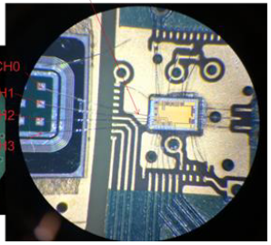
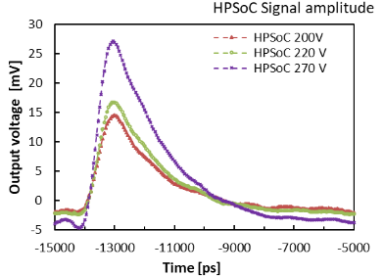
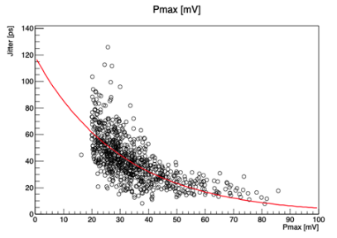
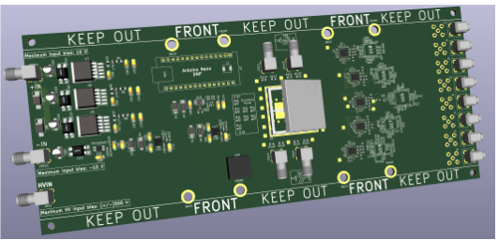
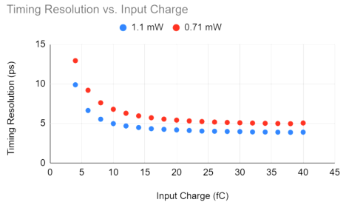
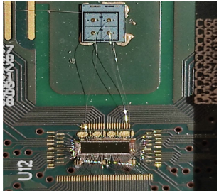
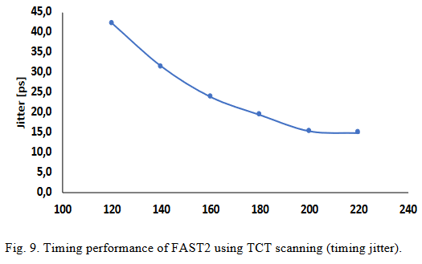
eRD109 – 3rd Party Evaluations (USC/SCIPP, JLab)
a) HPSoC (SCIPP) & HDSoc (Jlab) (NALU)
HPSoC – AC-LGAD
Waveform, 4 ch, 10 bit, 10 GSPS, 2 mW/ch, Timing precision: 10 ps – 20 ps.
HDSoC - SiPM
Waveform, 32/64 ch, 12 bit, 1 GSPS, 20-45 mW/ch, Timing precision: 80-120 ps.
b) ASROC (Anadyne)
Discriminator, SiGe BiCMOS, 16 ch, ~ 1 mW/ch, Timing precision: 5 ps – 15 ps.
HPSoCv2
Fixed digital back-end
Expected from TSMC March 2024
Tests soon
ASROC
Excessive cross-talk
No further work envisioned.
c) FAST (INFN)
TDC, 110 nm CMOS, 16/20 ch, ~2 mW/ch, Timing precision: 15 ps – 45 ps.

Slide 13
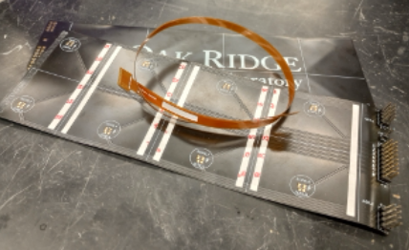
eRD109 – Barrel TOF Service Hybrid (ORNL)
Connect 64 ASICs along stave to RDO at end of stave:
LV, Bias (HV), GND
Differential e-links, clocks, slow controls (I2C)
Individual ASIC output data rate is only ~Mbit/s.
Low Mass: 1% X/X₀ total barrel material budget
Needs to fit barrel TOF geometry:
~1.3 m length.
Kapton flex PCB:
Custom geometry “sandwich” of Kapton and conductor layers.
Plan to demonstrate readout of ETROC (CMS endcap TOF ASIC) over long flex PCB with TOF prototype RDO (Tonko).
Design of TOF prototype RDO is almost complete with fab, tests soon.
Flex design support from Debrecen
Some design and fabrication technology issues identified and resolved
Production is in progress, three processes considered
High density connectors under consideration – w/ HV or separate.

Slide 14
Outlook
Finalize specifications:
Max. rates per channel – almost ready (Jeff)
ASIC interfaces for FEB-RDO – iterative process with designers, on-going
SALSA DSP functions – needs input from MPGD group(s)
Considerable resources needed for the next 2 – 3 years:
Expect a few prototype MPW runs per design ($)
Pre-production run per design ($$$) (masks: $250k/130 nm, $750k/65 nm)
Tests are resource intensive (EE, Tech, prototypes)
Address pfRICH, hpDIRC readout – FCFD, EICROCx
FY23 and FY24 contracts: awards >6 months after start of FY
Not sure this can be improved.

