Slide 1
AC-LGAD sensor irradiation test
Dr. Simone M. Mazza (SCIPP, UC Santa Cruz)

Slide 2
Current irradiation planned
Original plan: irradiation at LANSCE (Los Alamos) with 800 MeV protons
7e12 Neq to 2e14Neq
Try graded irradiation using beam edge and multiple foils
However, Last summer the LANSCE accelerator encountered a problem
Currently schedule is fluid and we don’t know when the run might happen
Sally applied for beam time at FNAL. Evan Niner accepted my application and asked me for details about, for example, number of samples and total requested fluence. We have ordered materials for fixturing the samples and we are taking our trainings for FNAL site access. We have not been notified of a date.
FNAL ITA says we'll probably get beamtime in mid to late March.

Slide 3
Possible solutions
It’s necessary to irradiate and test the devices before Q4 2024
Option 1: wait for LANL to sort out options, it’s very possible that we’ll get the irradiated sensors before summer but it’s not certain. Everything is packed and organized at LANL so it’s the option with less effort.
→ seems like we’ll get irradiation time at FNAL soon!
Option 2: explore other irradiation facilities, with either new sensors (if available it’s the best option) or recalling LANL sensors
Other facilities “Certified” for LGADs
CERN IRRAD: beam energy 23 GeV. CERN should open the floor to proposal in 2024 soon, slots from mid-April to mid-October. No support team there, might need to have someone travel to prepare samples and chip back.
CYRIC (Japan): beam energy 80 MeV. CYRIC had trouble since last summer and all beam time cancelled until March. Next beam time if all solved should be around May-June 2024
IJS Lubjiana TRIGA reactor: 1 MeV neutrons. Irradiation pretty much anytime. (I have to inquire if they can do 1E12Neq)
Might send some devices from UCSC to have a backup option
Are there more sensors available? Provide a list

Slide 4
backup

Slide 5
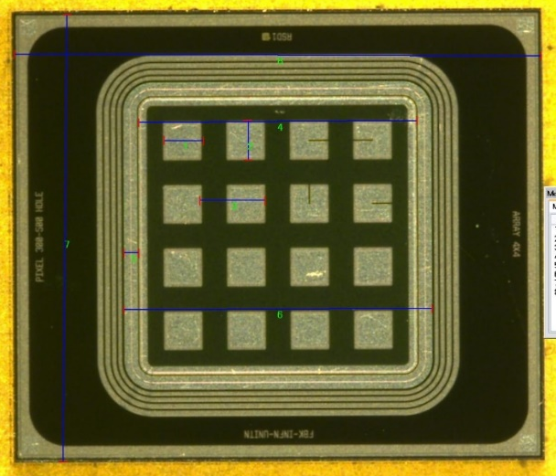
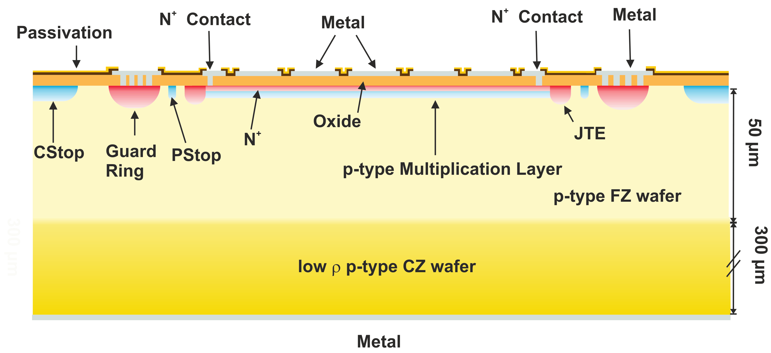
AC-LGADs
Most advanced high granularity LGADs are AC coupled LGADs
Finer segmentation and easier implantation process
(UCSC - US patent N. 9,613,993 B2, granted Apr. 4, 2017)
Continuous sheets of multiplication layer and N+ layer
100% fill factor
N+ layer is resistive and grounded through side connections
Readout pads are AC-coupled
Oxide insulator layer between N+ and pads
The response of the sensors can be tuned by modifying several parameters
Pad geometry and dimension
Pad pitch
N+ layer resistivity
Oxide thickness

Slide 6
Effect of irradiation on AC-LGADs
The gain layer will have more or less the same behavior of standard LGAD devices
The N+ can have some unexpected effects though
Normally is highly doped and conductive so it’s not affected by radiation damage
We don’t know well the effects of acceptor removal to N-type, might even be higher than in P-type
In AC-LGADs the N+ has low doping to have high resistivity necessary for charge sharing
Cannot be too low or depletion will reach the oxide and cause premature breakdown
Could be affected even by low irradiation
If the N doping drops it could change the resistivity and the behavior of the sensors
Plus, it could lead to premature breakdown due to low doping in the N+
N+
Not reaching oxide
P+
Full depletion

Slide 7
Effect of irradiation on AC-LGADs
The change in N+ resistivity can affect the charge sharing profile around the strip/pad
If the irradiation is not homogeneous (especially in the end-cap) it could change the centroid of the charge sharing between pads/strips and skew the reconstruction algorithm
This could be corrected with a correction per fluence/position, but would need a very precise model!
Affects position resolution and might also influence time resolution since the delays are calculated per position
Charge sharing profile
before
after
Strip

Slide 8
Radiation damage at ePIC
RAW
RAW Barrel average: 5.4e+09 | max: 5.9+10 | min: 3.4+09 End-cap average: 1.3e+10 | max: 1.6e+11 | min: 5.1e+09 FF average: 3.9e+10 | max: 1.8e+11 | min: 3.3+09
NEQ – (not correct for LGADs gain layer) Barrel average: 3.6e+09 | max: 1.3e+11 | min: 1.1+09 End-cap average: 1.2e+10 | max: 8.4e+10 | min: 3.2e+09 FF average: 4.5e+10 | max: 4.2e+11 | min: 2.7e+09
Safe to assume MAX damage is <1e+12, almost negligible for LGADs gain layer (effects start at >1e+13)
NEQ

