Slide 1
Agenda
(https://indico.bnl.gov/conferenceDisplay.py?confId=2241)
Calculation checking on the extension in case of quench being done by Bob Lambiase …
Zeynep to copy labview files/package from the old PC used in low-field test …
Force distribution plots (using Opera and a lot of help from Wuzheng)
AOB

Slide 2
From Bob Lambiase:
With a current of 4.7kA and a time constant of 33 seconds, the Miits requirement is 4.7² x 33 / 2 = 364 Miits
The smallest cross section of the stabilizing copper is 46mm x 12.7mm. This gives a cross section area of 4.6 x 1.27 = 5.84cm².
The cross section of RHIC 30 strand superconductor (dipole cable) is 0.1166cm x 0.973cm. Two are being used, so the area is 0.227cm². I remember that the 23 strand cable had a critical current of 11kA in 0T field, so two 30 strand cables might be overkill. It won’t hurt anything to have two.
According to the calculation, 364Miits will bring the temperature up to about 20K. That is a big hunk of copper you have there.

Slide 3
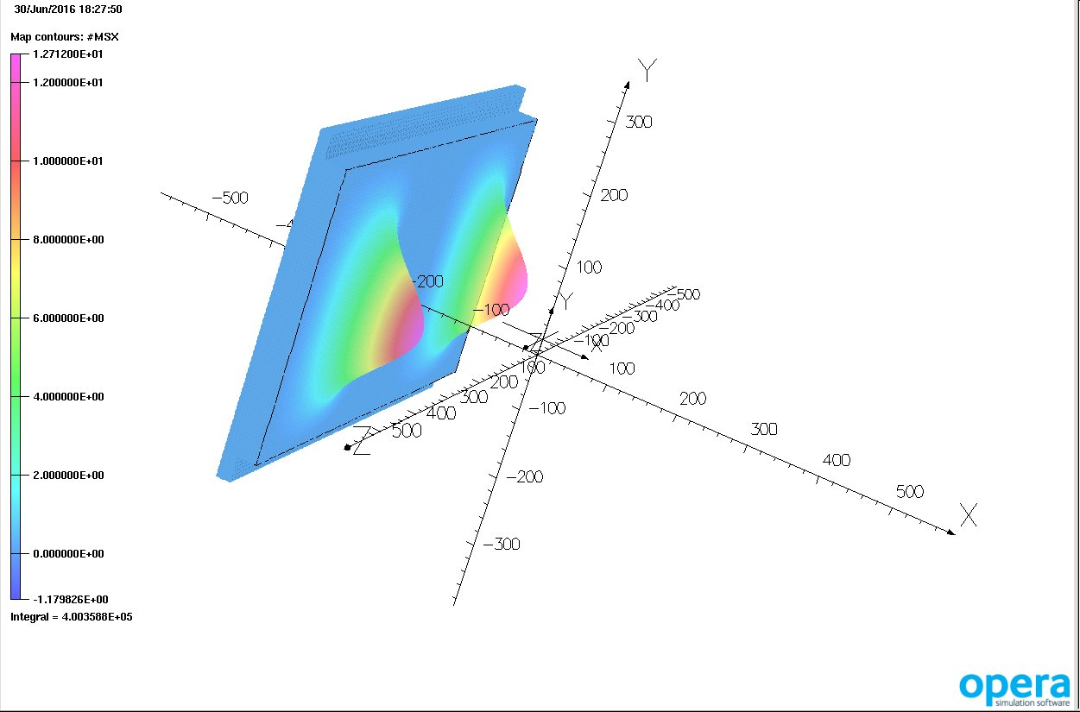
Left Wall

Slide 4
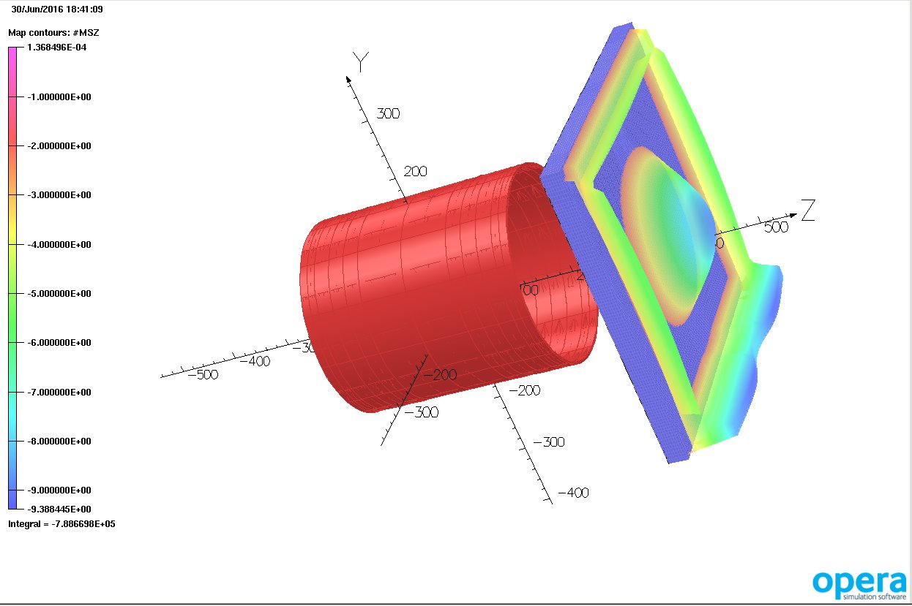
North Wall/Cap

