Slide 1
Integration, Installation and Infrastructure (Triple I Group)
TIC Update
Roland Wimmer

Slide 2
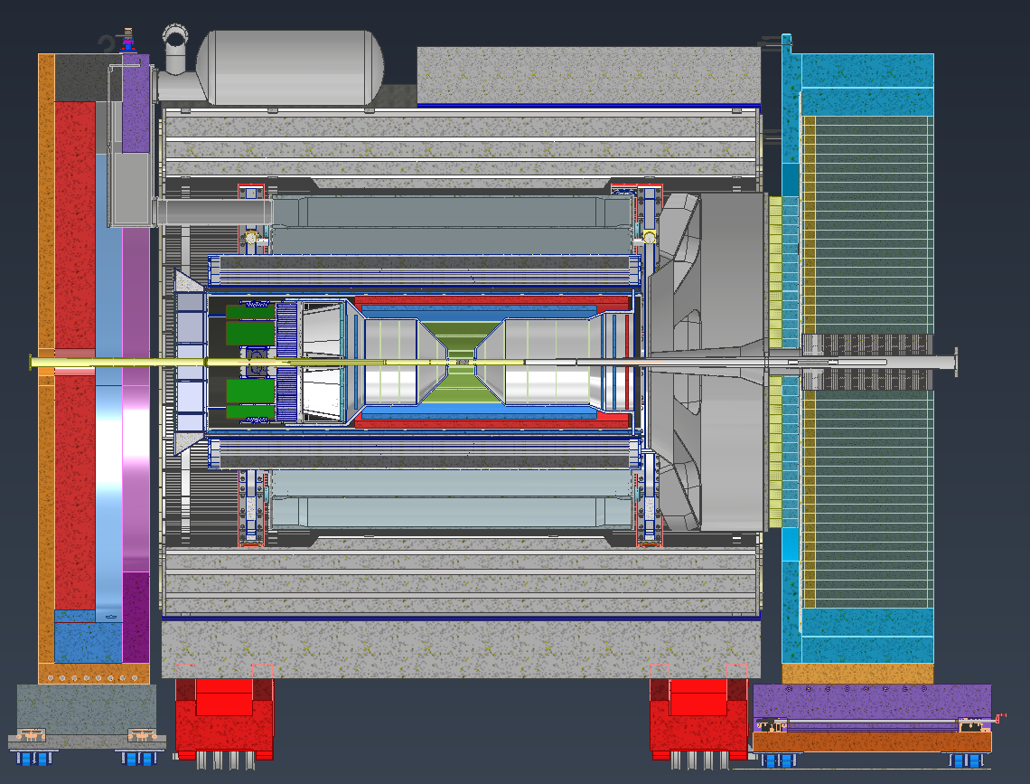
Detector Model Updates
Inner Tracker Adjustments
Material Budget
Engineering Workshop
Services Update
DIRC & Outer MPGD interference
Barrel Emcal Update
Flux Return Bars
Magnet Chimney
dRICH Decisions
Hall Maintenance
Looking into platforms

Slide 3
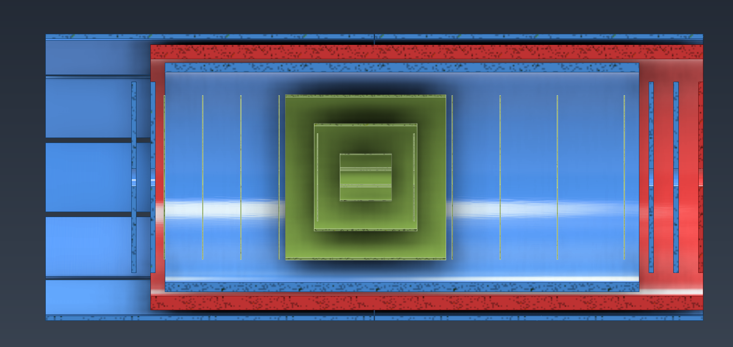
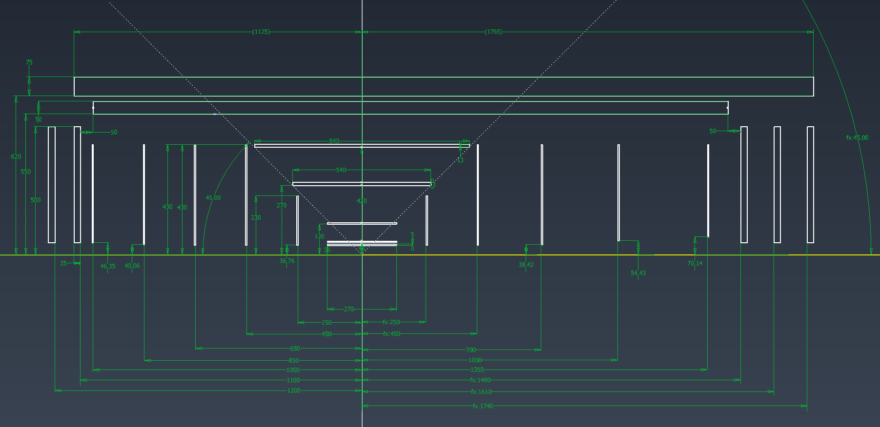
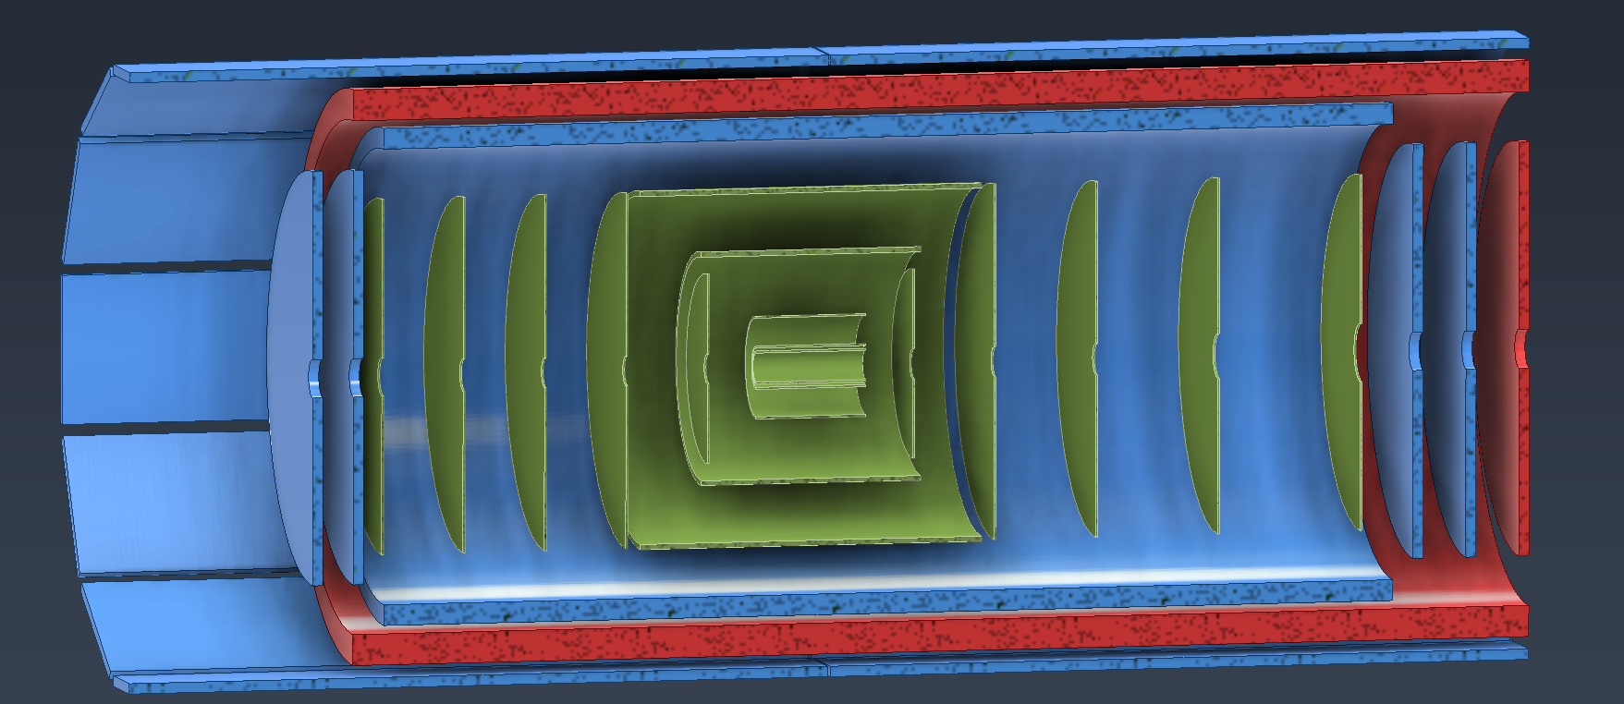
Inner Tracker Updates
Spoke with Andy during the engineering workshop and updated some Inner tracker dimensions
AC-LGAD adjusted, Inner MPGDs adjusted & MPGD disks adjusted
5
4
3
2
1

Slide 4
Inner Tracker Updates

Slide 5
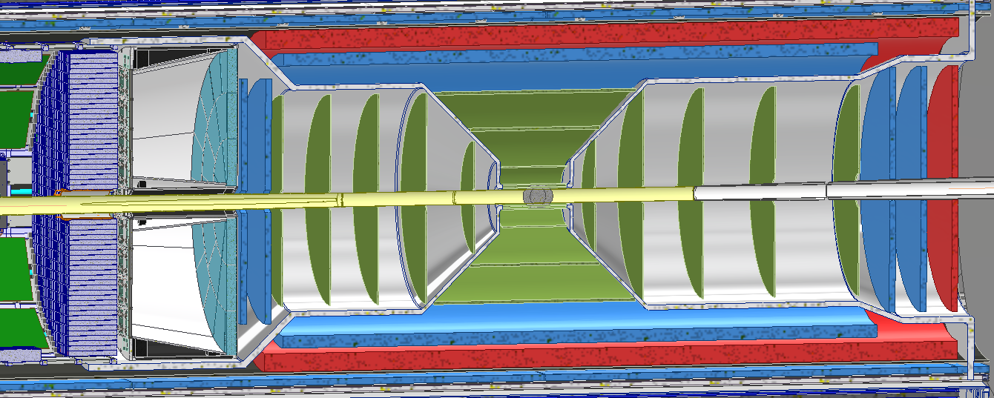
Inner Tracker Updates
Recently had an engineering workshop for the inner trackers last month
Discussed various topics from, most of which were cover in the last TIC meeting

Slide 6
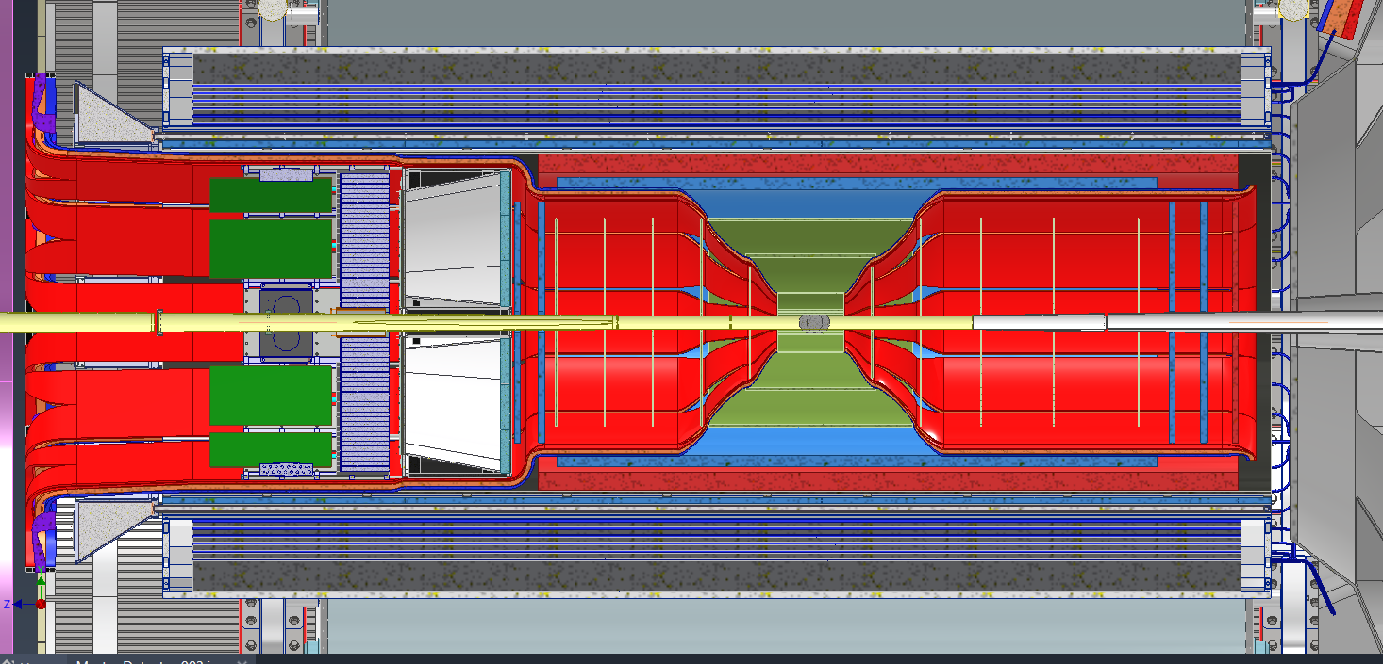
Services
Currently working on updating all services and creating new model for better viewing

Slide 7
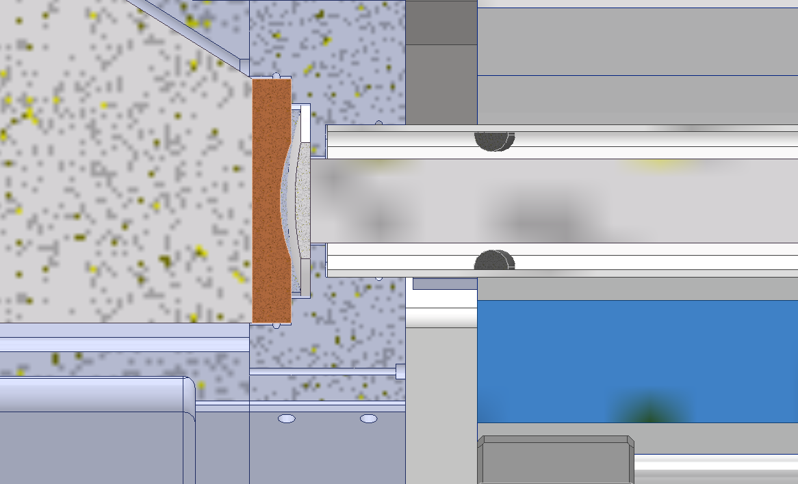
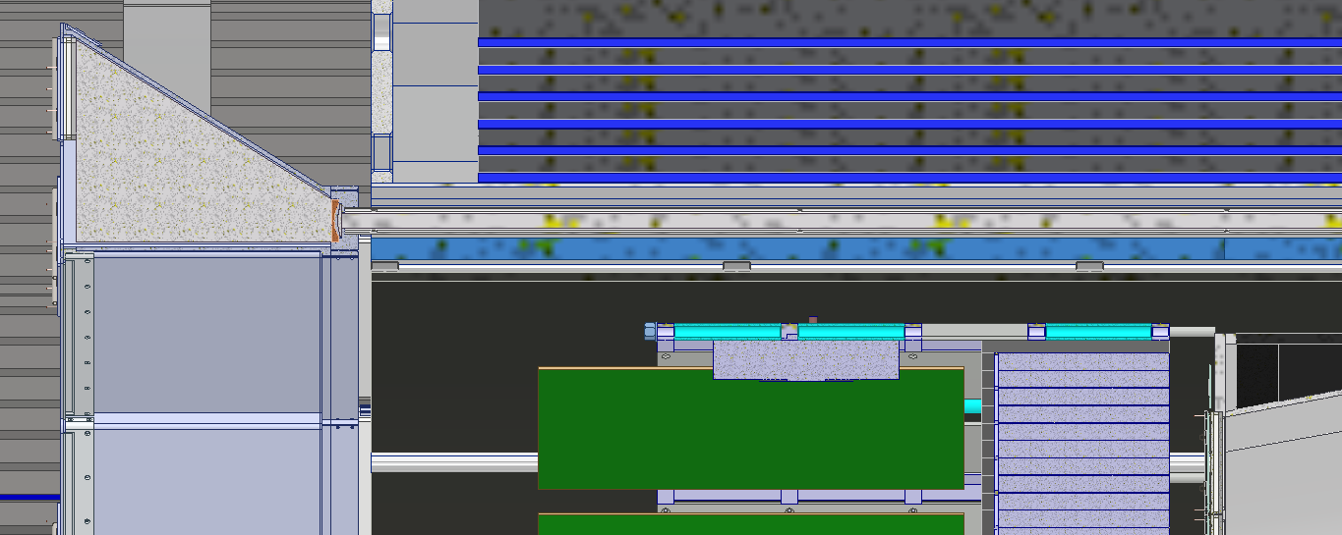
DIRC & Outer MPGD Interferences
Currently small overlap between the DRIC frame and the installation path of the Outer MPGDs
Exploring different options
Making it so that the Outer MPGD can still be installed and removed if the DIRC bars are pulled out
Setting up the Outer MPGDs such that both halves can be pulled out via the Hadron end

Slide 8
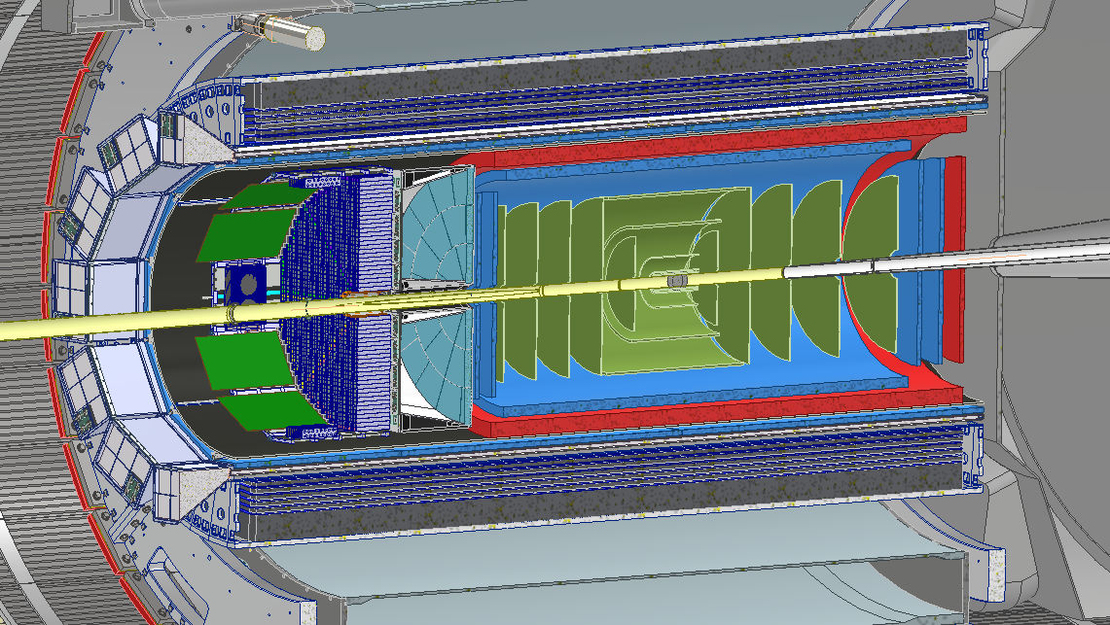
Barrel Emcal Updates
Spoke with the Barrel Emcal group to explore decreasing the weight of the detector so that we can use the crane in the hall
The space that the electronics occupied changed slightly, still working with the group to figure out exactly where they end on Hadron side

Slide 9
EIC Flux Return Bar Mechanical Design and Analysis
Preliminary mechanical analysis to guide the design strategy.
Main design strategies:
Re-using STAR flux return bars. ← Currently pursuing this option.
Heavier but lower material cost and lead time.
Will require additional machining/welding for attachment points.
Fabricating new flux return bars with air gap to reduce weight (bolt or weld together design).
Lower weight but long lead time.
Higher design, analysis, and fabrication complexity.
Self-supporting vs requiring support of barrel HCAL.
Self-supporting is expected to have minimal deflection (expected < 0.1 in). Pursuing this.
Cutout in the ring for cryostat chimney vs no cutout.
Either option appears to work mechanically.
Need to run magnetic simulations.

Slide 10
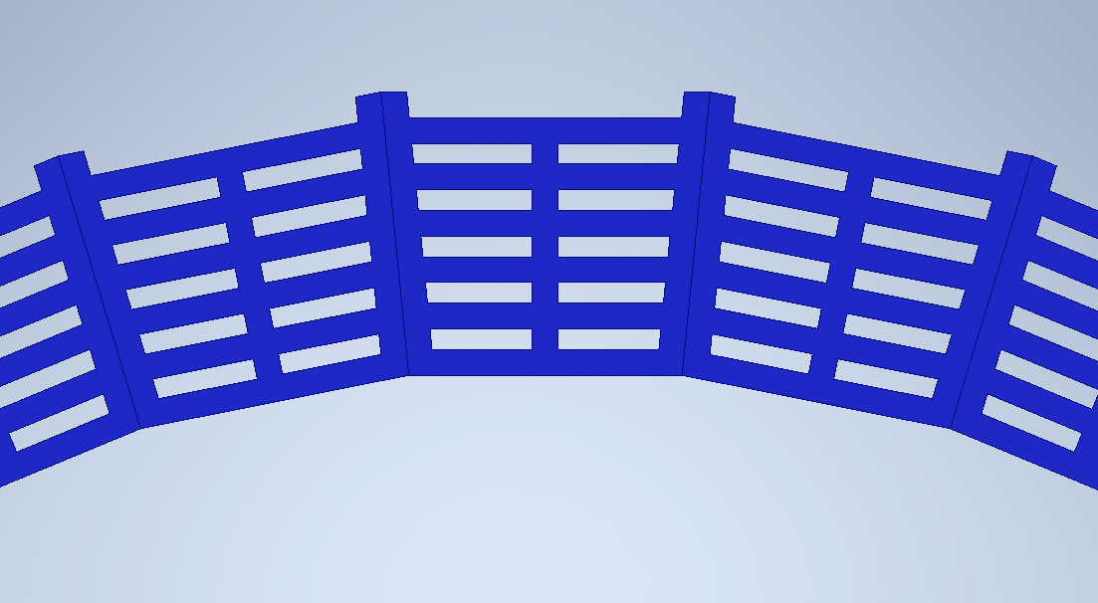
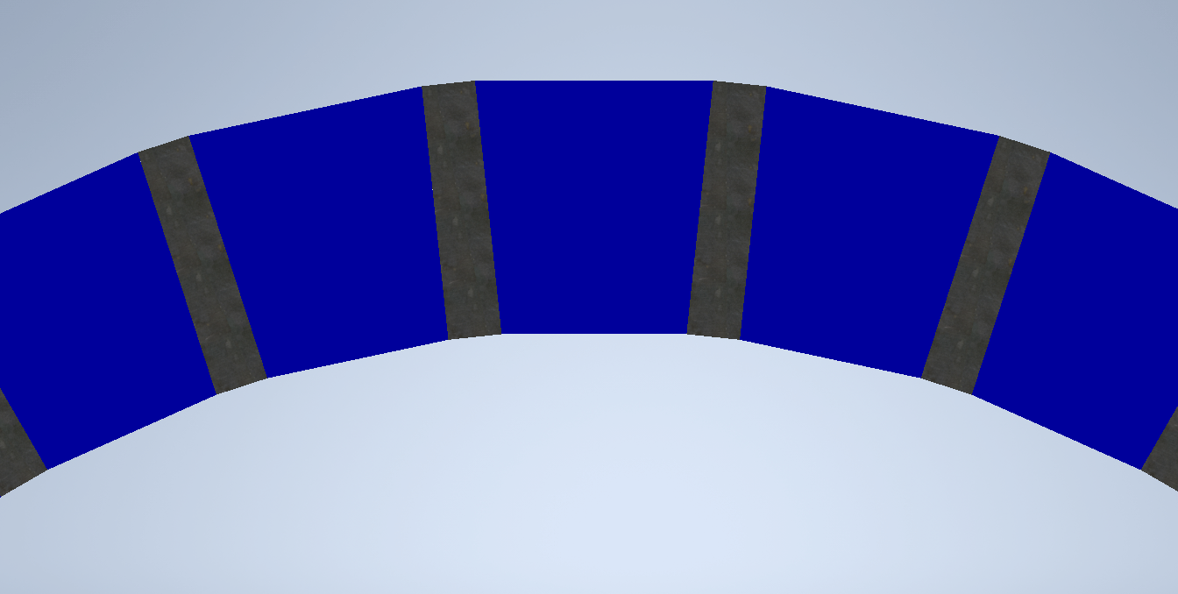
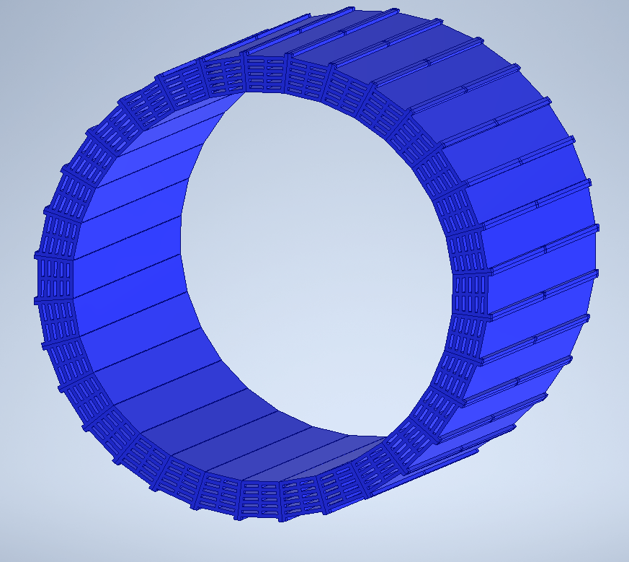
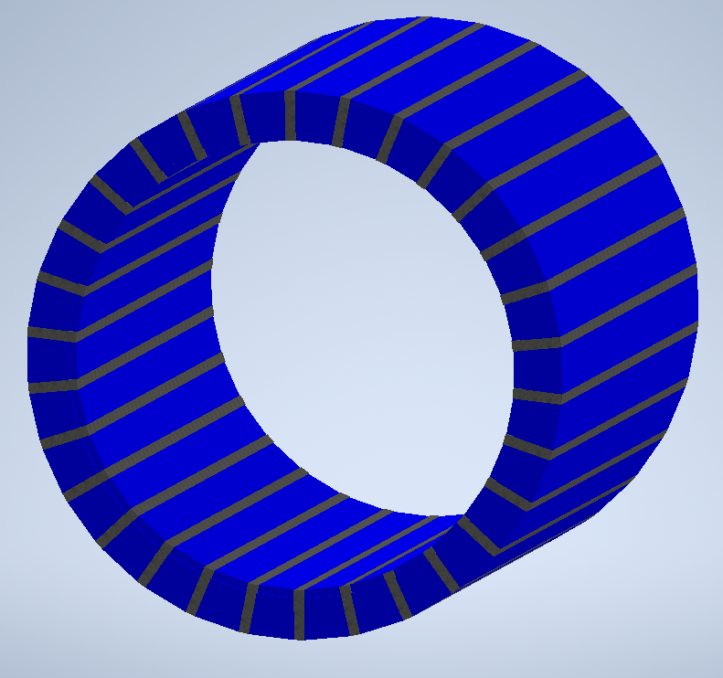
EIC Flux Return Bar Mechanical Design and Analysis
Flux return bar design with air gaps to reduce weight. Long lead time. Fabrication and analysis will be more difficult.
Currently not pursuing this option.
Flux return bar design reusing solid flux return bars from the STAR detector.
Requires additional flat plate spacers to make the assembly the right inner diameter.

Slide 11
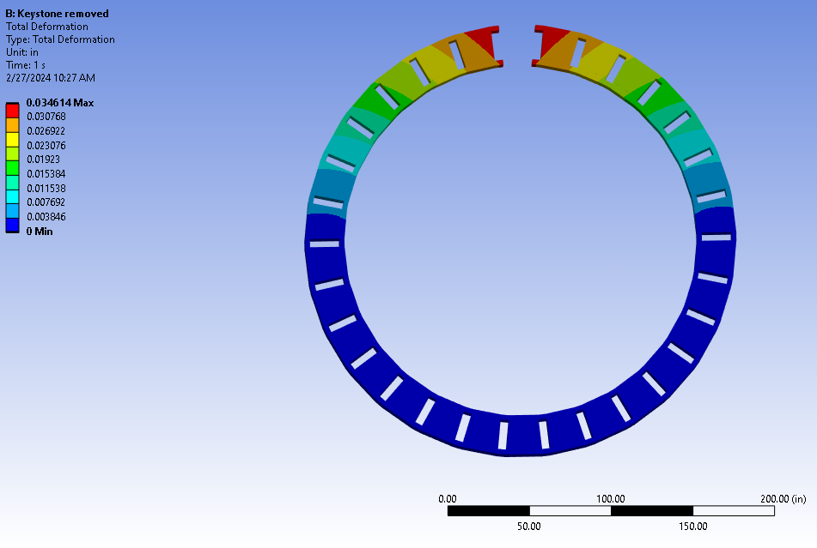
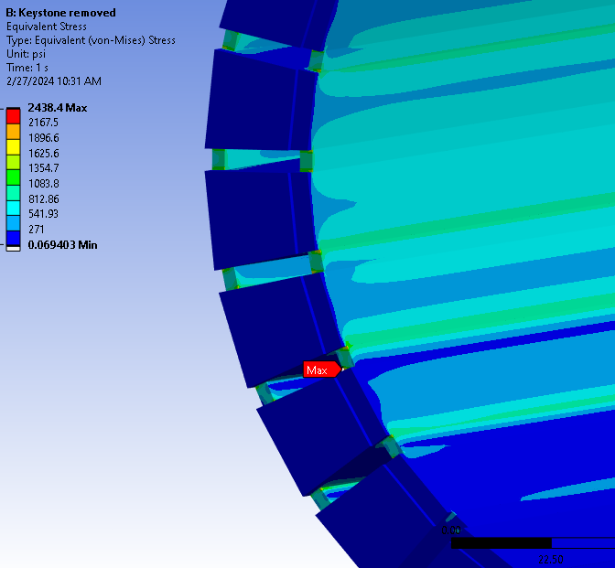
EIC Flux Return Bar Assembly
Looked at how the flux return bar ring would behave during assembly. Removing the top keystone will be the worst case for deflection and near worst case for stress.
The final design with bolted connections will have higher stresses and deflections than shown in this presentation, and further analysis is required.
With the top bar removed, the total deflection was calculated to be ~0.035 in.
The highest uniform stresses were < 2,000 psi. 1020 steel yield strength is 30,00 to 50,000 psi, depending on processing. This has enough margin to proceed with further iterations.
11

Slide 12
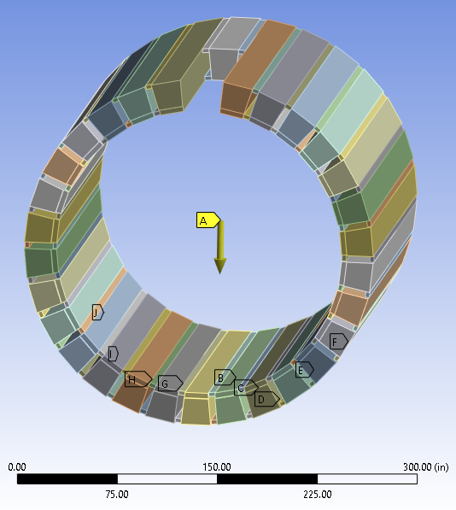
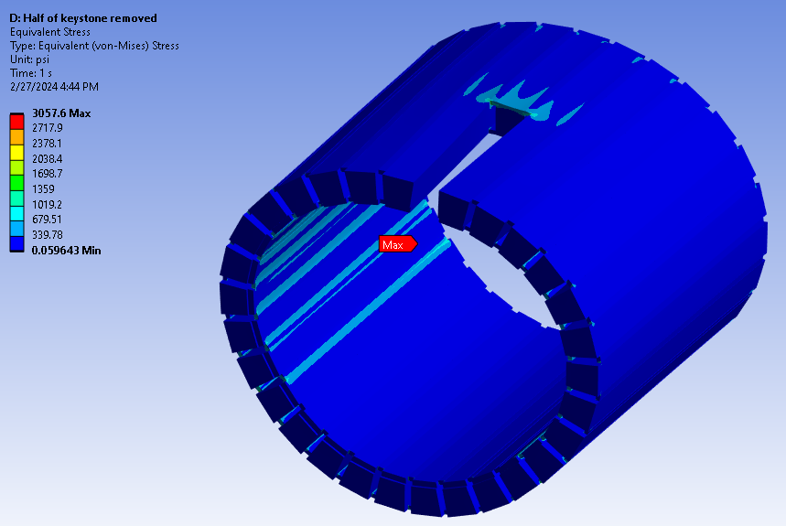
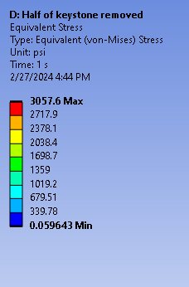
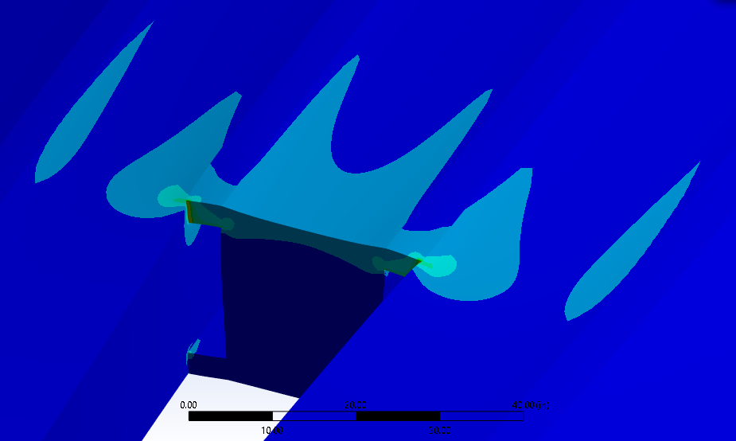
EIC Flux Return Assembly with Chimney Cutout
Ran a simulation to determine stress and deflection with a cutout for the cryostat chimney.
Removed only part of the topmost bar. Worst case for analysis with a cutout.
The maximum total deflection was 0.007 in.
The highest uniform equivalent stress around the cutout was less than 2,000 psi. 1020 steel yield strength is around 30,00 to 50,000 psi, depending on processing.
Based on deflection and stress, it appears that having a cutout for the chimney is a viable option mechanically.
Exaggerated deflection
12

Slide 13
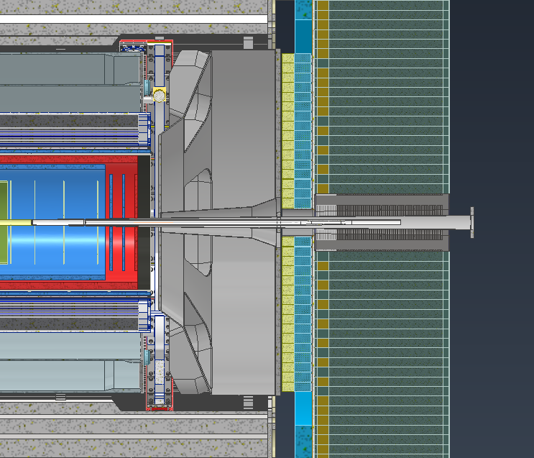
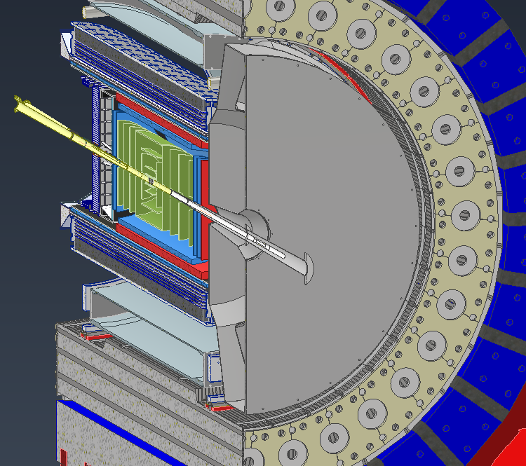
dRICH Decisions
Looking into ways to make maintenance in the experimental hall more feasible
Being able to pull the dRICH in and out in the experimental hall means access to many different systems and electronics
Splitting the dRICH into two pieces would have different implications on this.

Slide 14
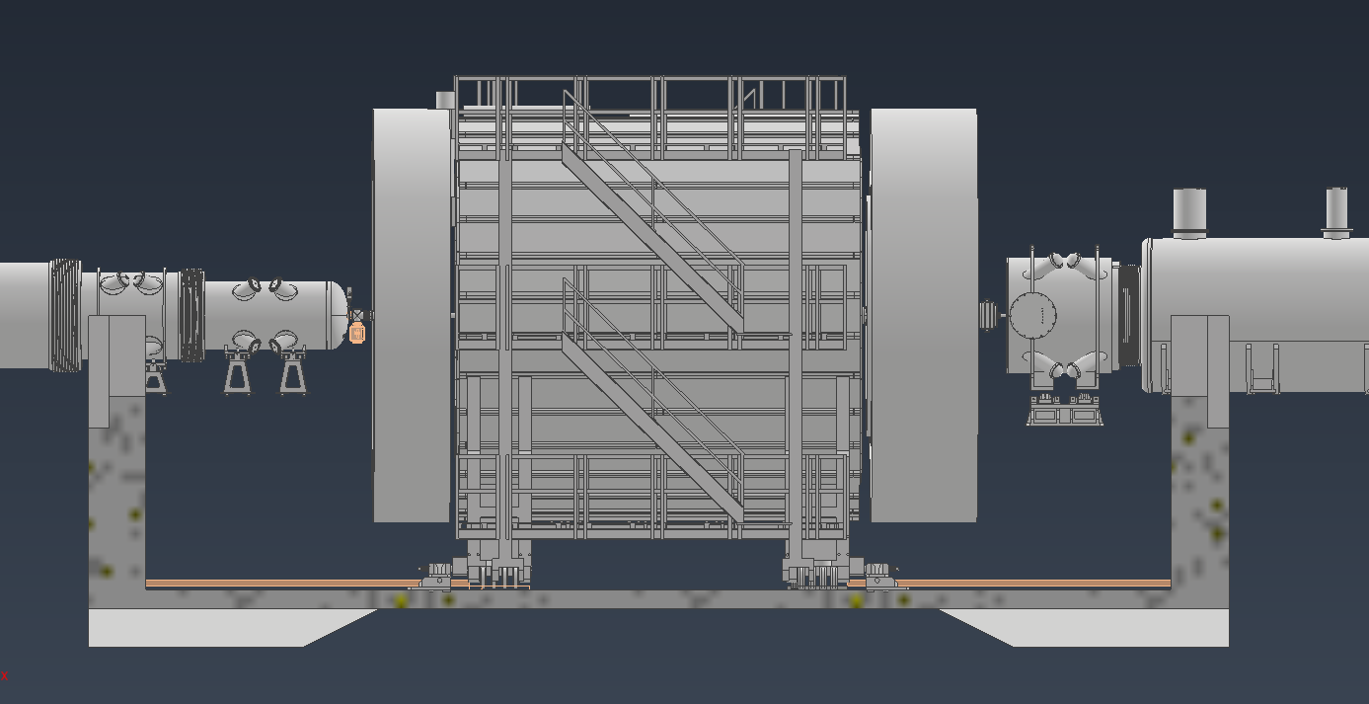
Platform work
Looking into platforms in the hall

Slide 15
Backup Slides

Slide 16
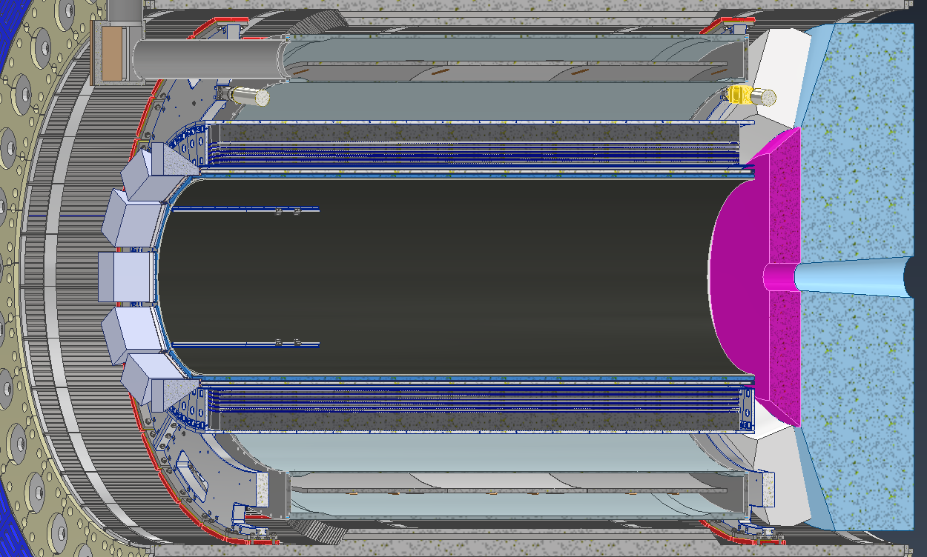
Model Overviews (Outer Detectors)
Barrel EMCAL (06.10.05.02):
Will be supported by the inner support rings from sPHENIX
There will be 2 end rings that will mount the EMCAL to the support rings
dRICH:
Currently there are slight interference issues that are being addressed.
Services from the inner detectors need space to pass in between the sensor boxes
Will be discussed in more detail in later slides
DIRC:
Still being developed and is being modified heavily as constraints change
Will be discussed in more detail in later slides
Barrel EMCAL
dRICH
DIRC & support

Slide 17
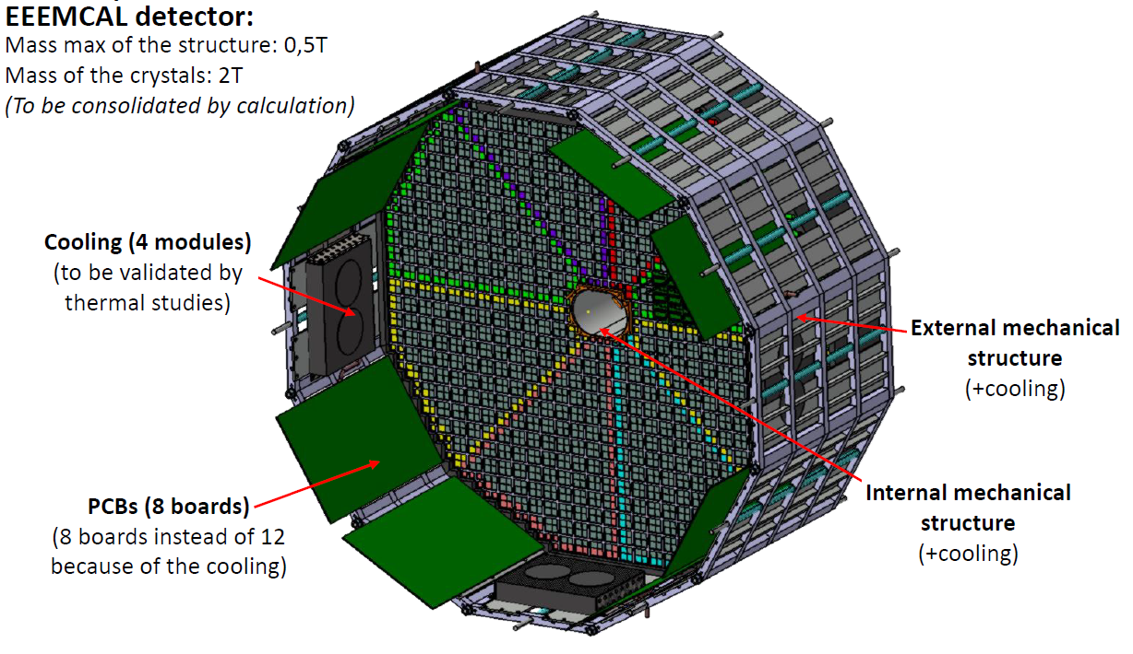
Model Overviews (Inner Detectors)
EEEMCAL (06.10.05.01): Support Structure design in progress.
pfRICH: Will most likely use the same rail structure that the EEEMCAL uses
AC-LGAD: Cylinder and disk models are placeholders. A support structure is being developed that will house the AC-LGAD, Inner MPGDs & disks and all the Silicon Trackers
MPGDs: Consists of outer and inner barrel layers along with 4 disks, 2 on each end. Outer layer will be supported with the DIRC
Silicon Vertex & Sagita Silicon: Will use same support structure as other inner detectors
Si Disks: 10 Disks total, 5 each side, using same support structure as other inner detectors
pfRICH
MPGDs
Silicon Trackers
AC-LGAD
EEEMCAL
Beampipe
Si Disks

Slide 18
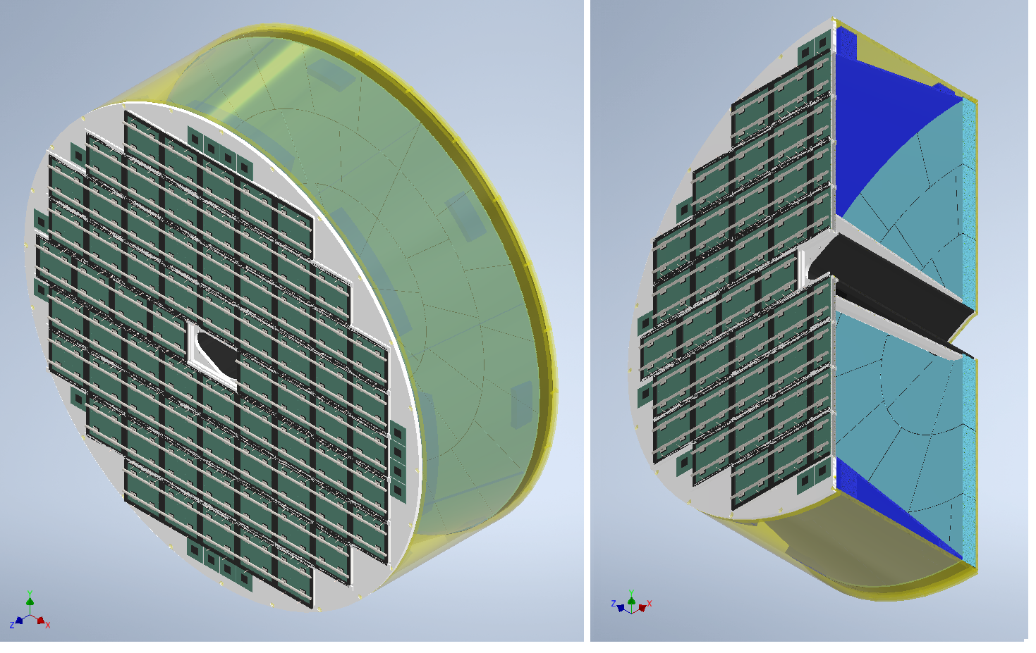
pfRICH
Mirrors
Aerogel Tiles
Sensors
Support Structure
pfRICH Prototype
pfRICH Full Detector Model
Detail design in progress and interference issues with beampipe resolved.
Design of prototype ready. Building and testing the prototype at Fermilab in 2024. The purpose is to address technical risks associated with the detector. Specific parameters of its main components will be evaluated for their impact on performance, such as the HRPPD photosensors, the aerogel tiles and the Time-of-Arrival (ToA)/ADC based electronics.

Slide 19
dRICH Overview
Services Representation
Spherical
Mirrors
Recent global positional changes have reduced integration interferences, however there are still a few minor areas of concern that are being addressed
Installation and support designs for the dRICH are still being developed but consistent with the overall design schedule
Sensor
Boxes
Gas
Volume
Inner Beampipe
Housing
Aerogel
Spherical
Sensor Plane
Estimated Weight: 2000kg

Slide 20
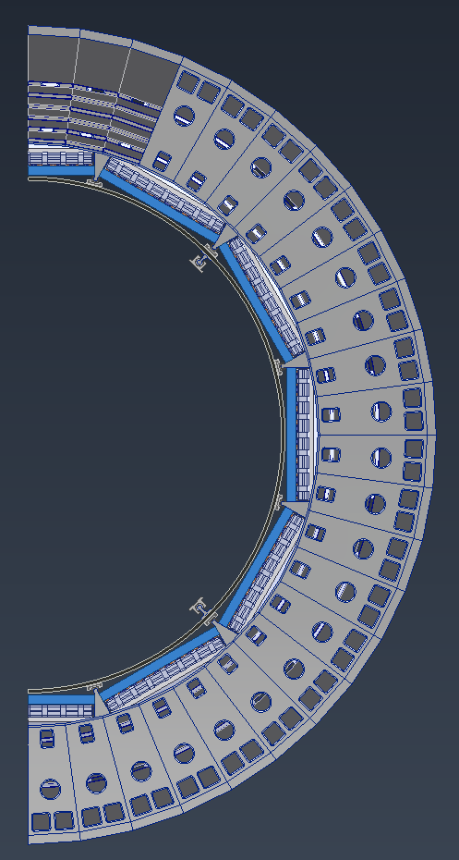
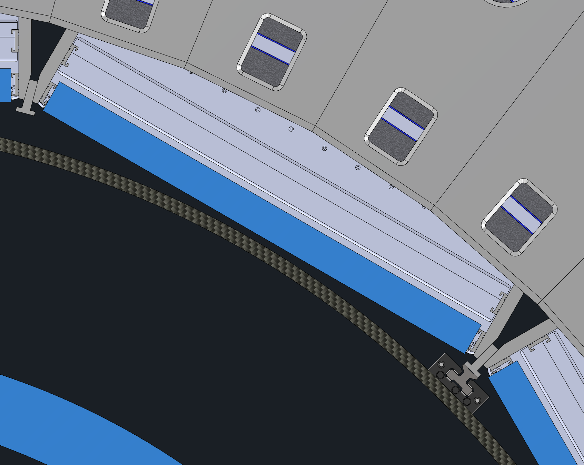
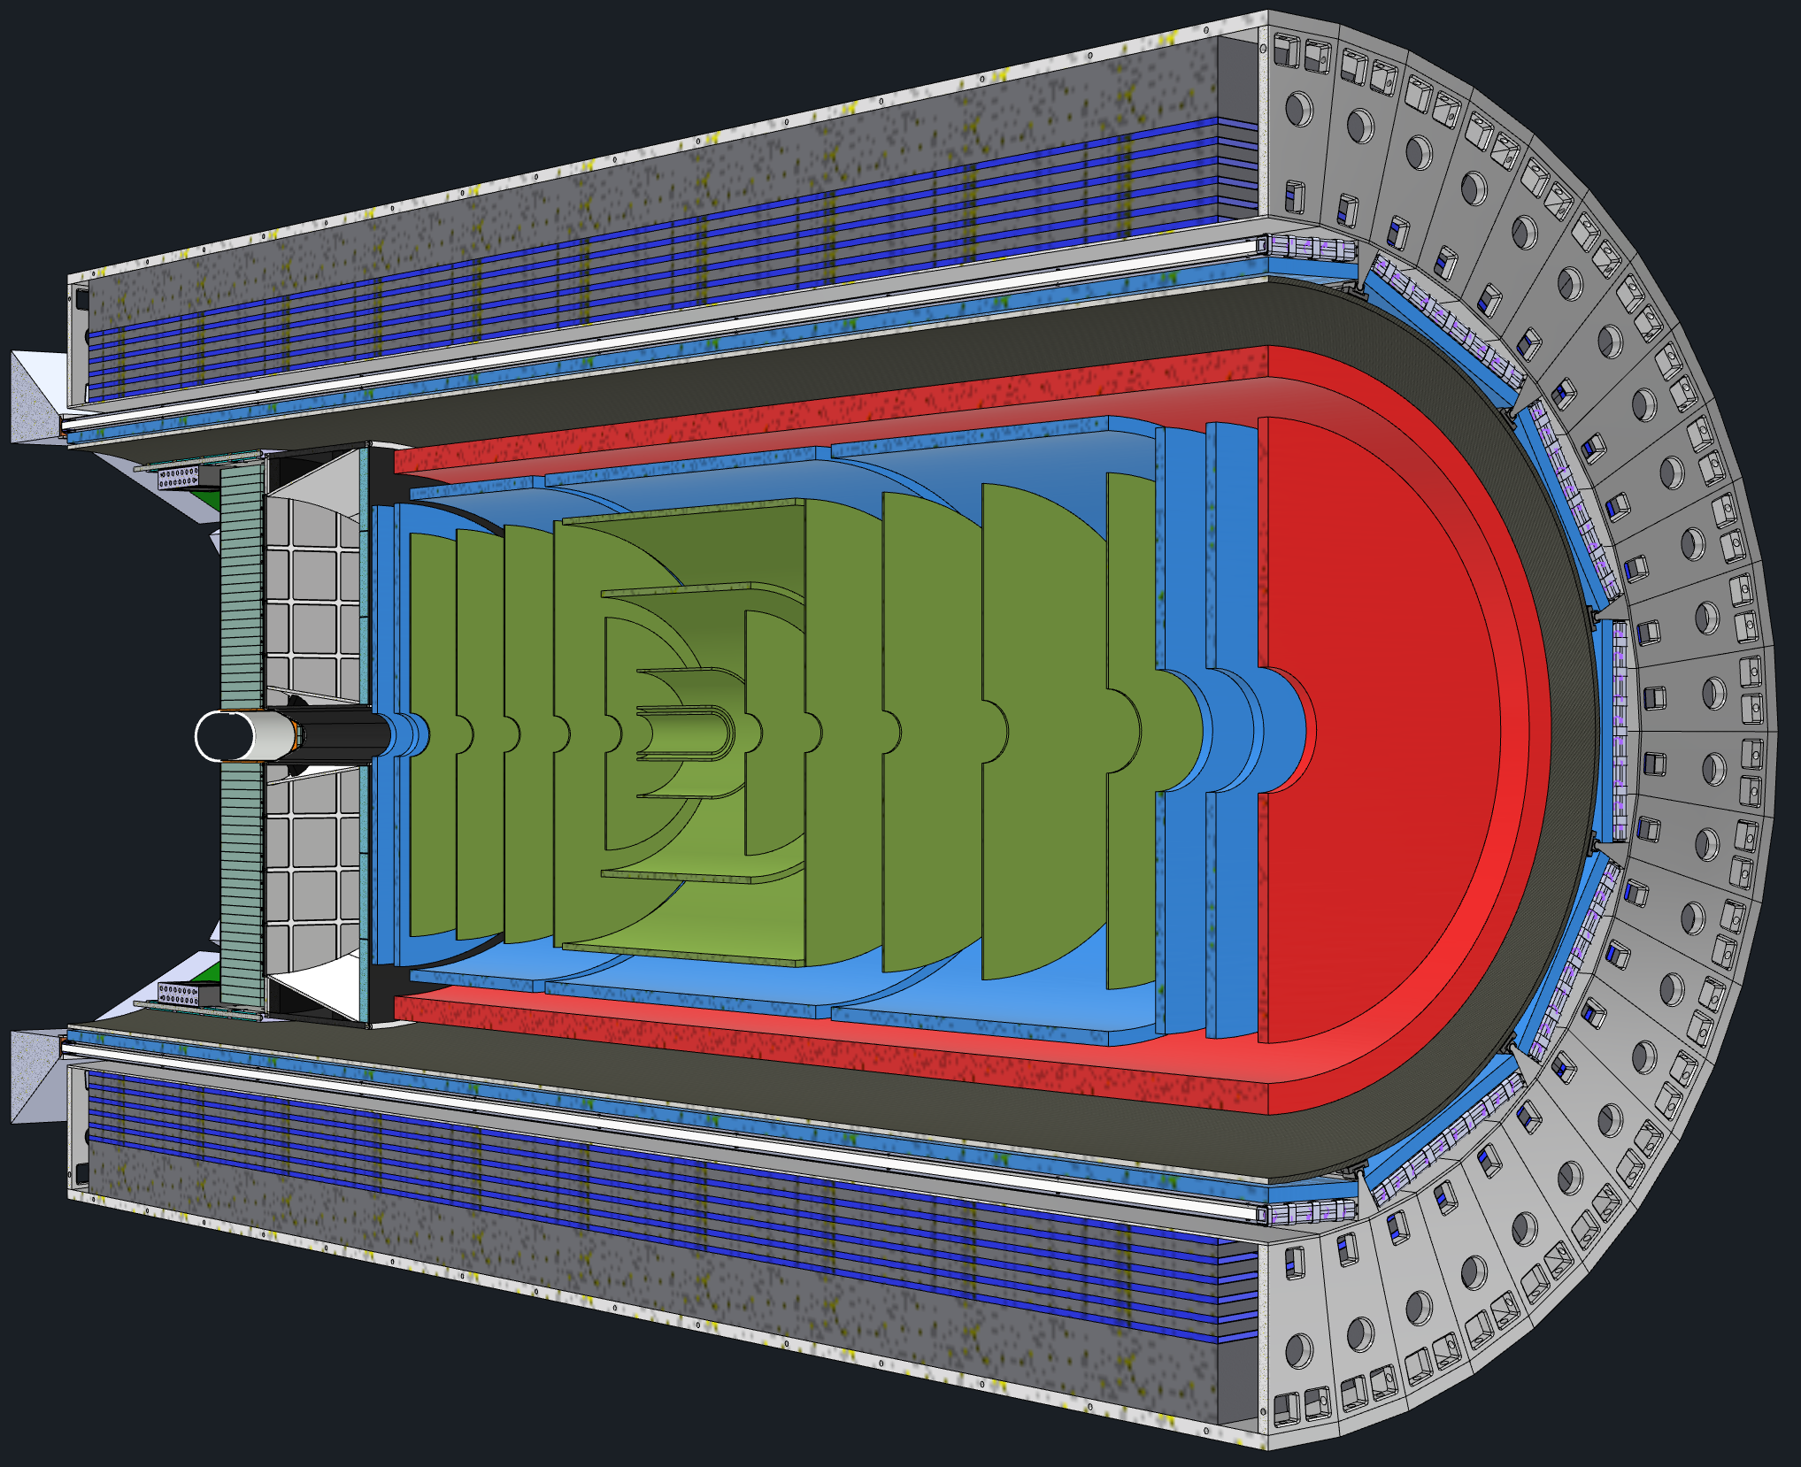
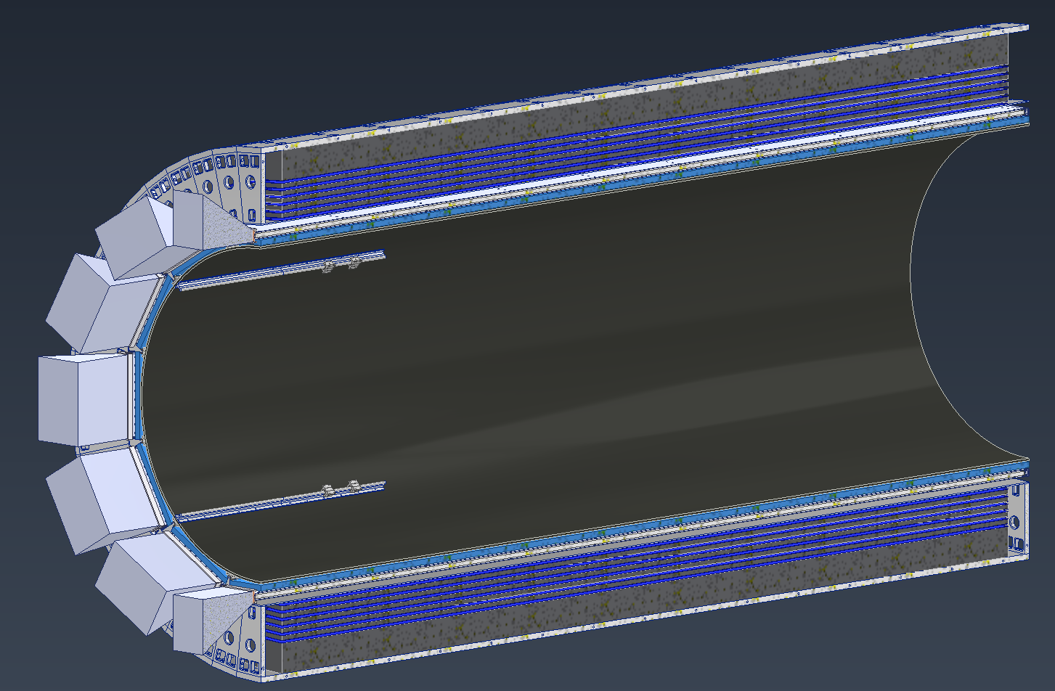
DIRC Support
DIRC Barboxes
Current plan is to use barrel EMCAL for support of Inner Detectors/Waiting for Barrel EMCAL group to confirm the design of Barrel EMCAL.
Outer MPGDs and DIRC barboxes will be nested in the area between rails.
A carbon fiber Support Structure supported using Barrel EMCAL will support all the inner detectors
Separate Rails will be used for EEEMCAL and pfRICH Installation
Gaps between the EEEMCAL and the carbon fiber cylinder will allow for inner services to be brought out
Outer MPGDs
CF Support Structure
Rails to Support Inner Detectors
Barrel EMCAL

Slide 21
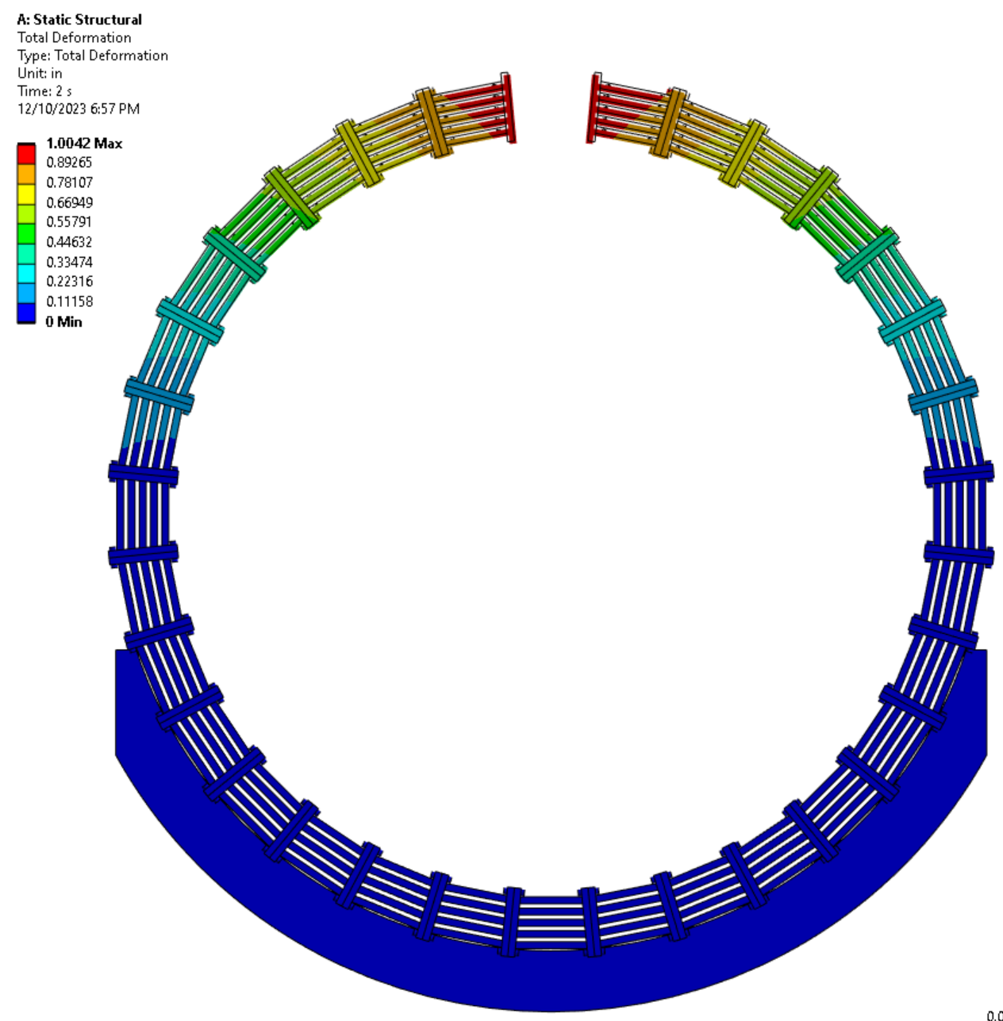
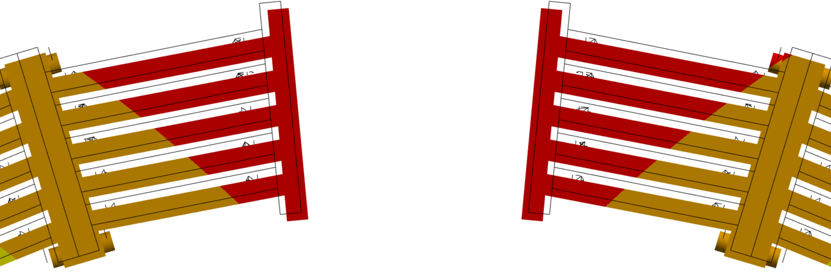
Barrel Flux Return Support
Very preliminary FEA of a conceptual design of the barrel flux return.
Concept is to assemble barrel flux return and HCal independently.
Current design cannot be assembled, and modifications may affect FEA results.
Deflections are reasonable and can either be accommodated by a gap or attachment to HCal, though there is concern about additional load on the HCal.
Stresses are reasonable.
Seismic and magnetic loads have not yet been considered.

Slide 22
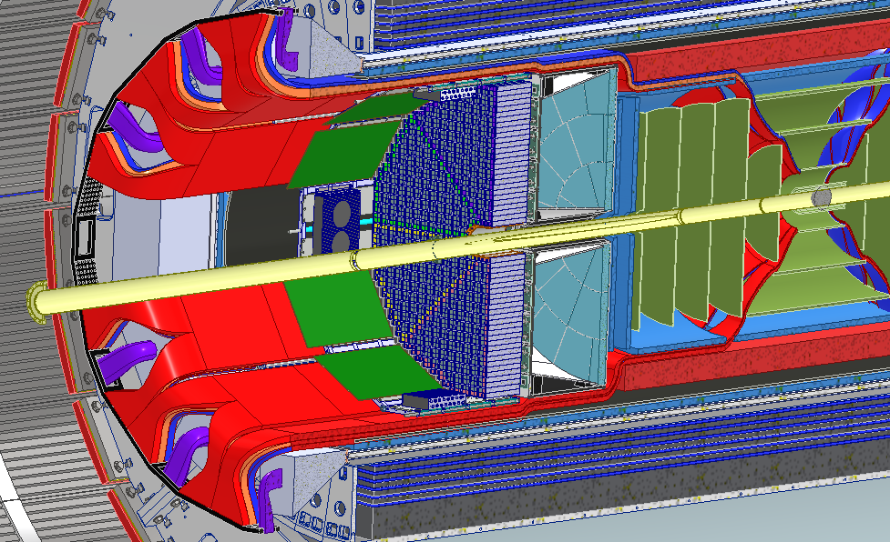
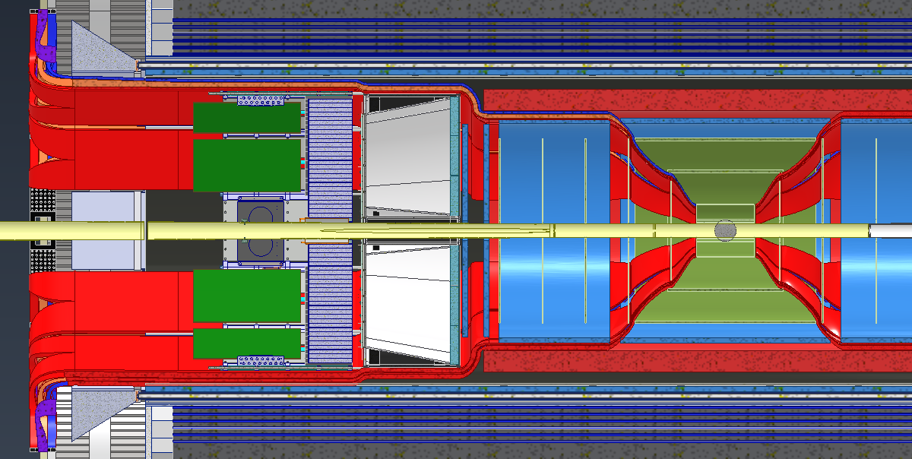
Services Layout
Services (Cable and Cooling Line Estimates) were collected from various subgroups.
Services Layout is shown in snapshots below:

Slide 23
Services Layout
Subsytem | Cross Area (cm^2) | +50% Packing for Bundles | +50% for MISC spacing needs | Used Space
Red Path IP to pfRICH Inner face
Total | 853.72 | 1280.58 |  | 1800.00 | Used space: | 71.14%
Red Path From pfRICH to EEEMCAL Inner face
Total | 920.17 | 1380.26 | 1725.32 | 2240.00 | Used space: | 77.02%
Red Path From EEEMCAL to Flux Return Bars
Total | 2497.31 | 3745.97 | 4096.57 | 9650.97 | Used space: | 42.45%
Orange Path From IP to AC-LGAD Disk
Total | 759.74 | 1139.61 |  | 1998.05 | Used space: | 57.04%
Orange Path From AC-LGAD disk to Aerogel
Total | 1559.01 | 2338.51 | 2937.96 | 4084.07 | Used space: | 71.94%
Orange Path From dRICH Aerogel to Dogbones
Total | 1597.23 | 2395.84 | 3023.96 | 4964.00 | Used space: | 60.92%
Orange Path From 4 to 5
Total | 2286.07 | 3429.11 | 4573.86 | 12189.38 | Used space: | 37.52%

Slide 24
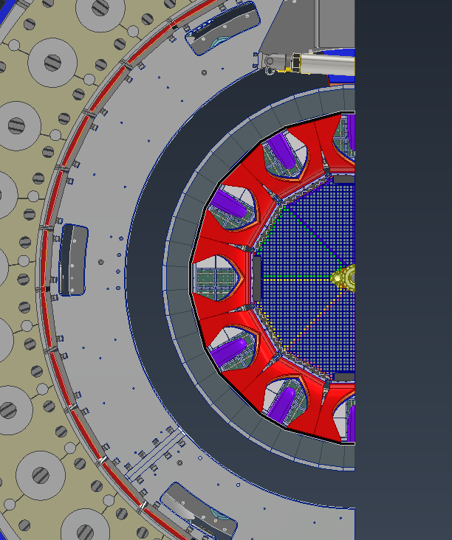
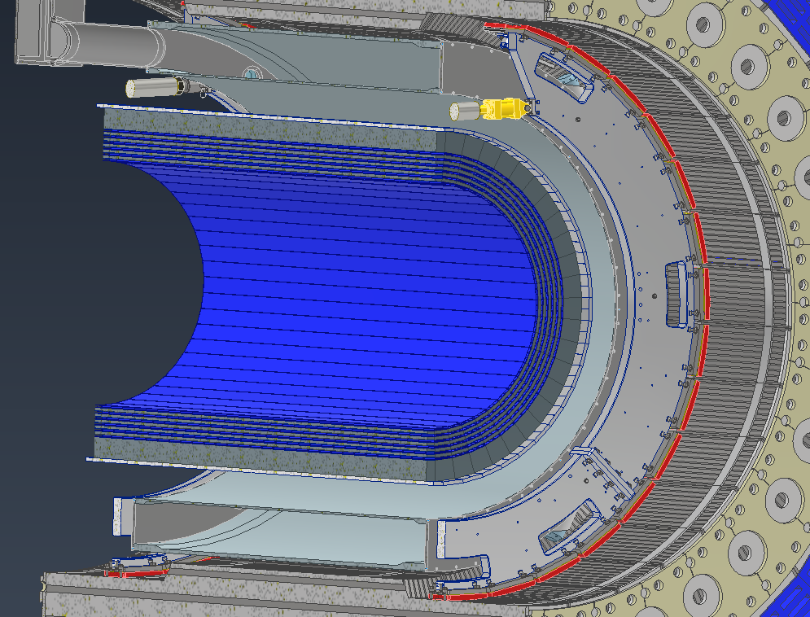
Services Layout
Manifold and electronics locations

Slide 25
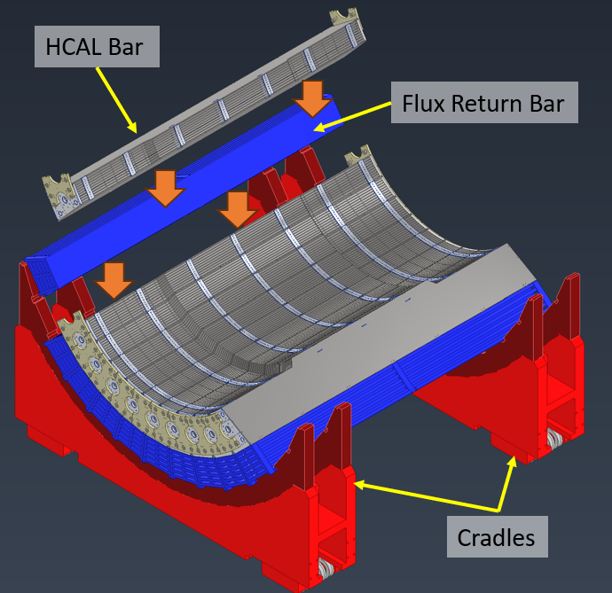
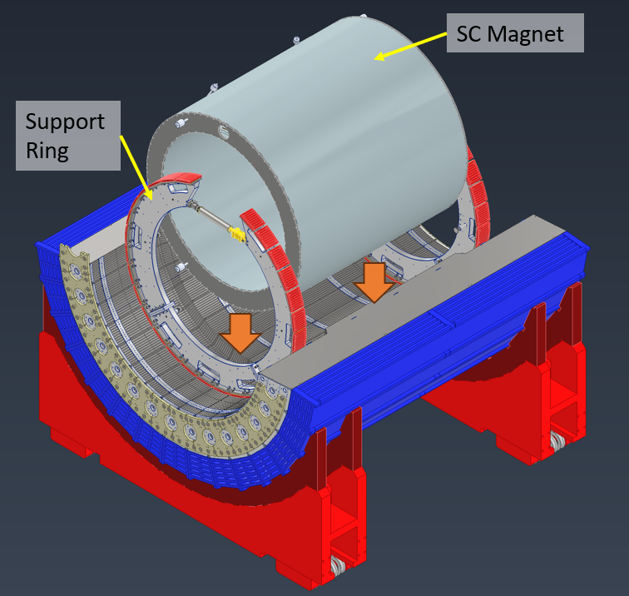
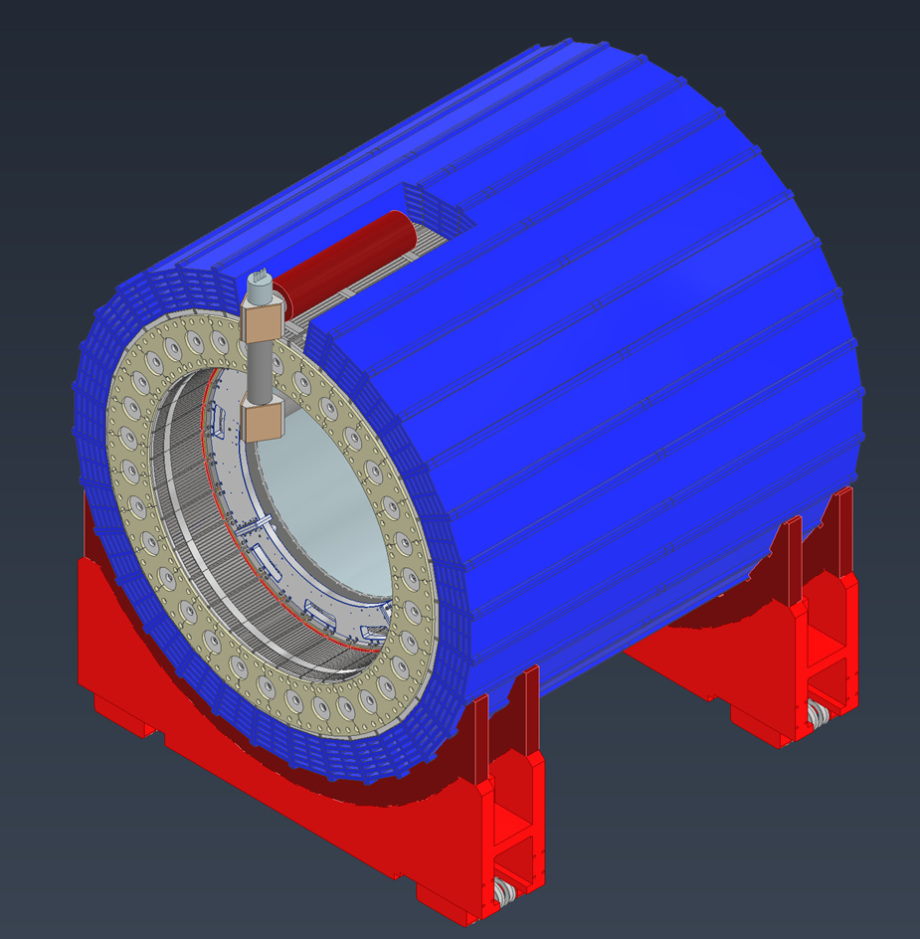
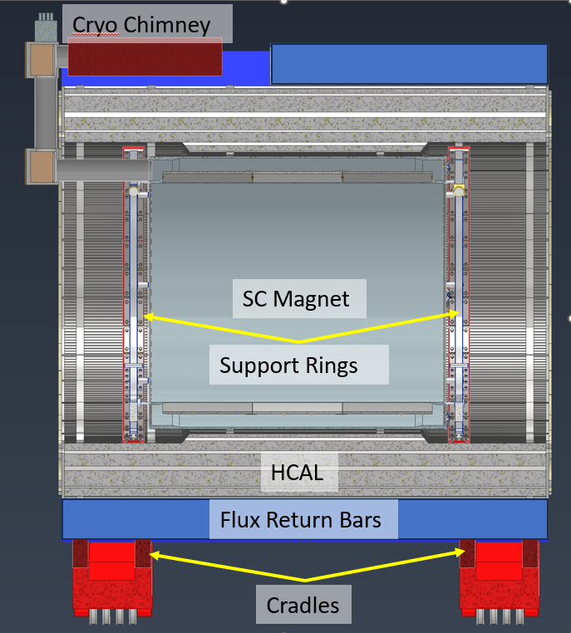
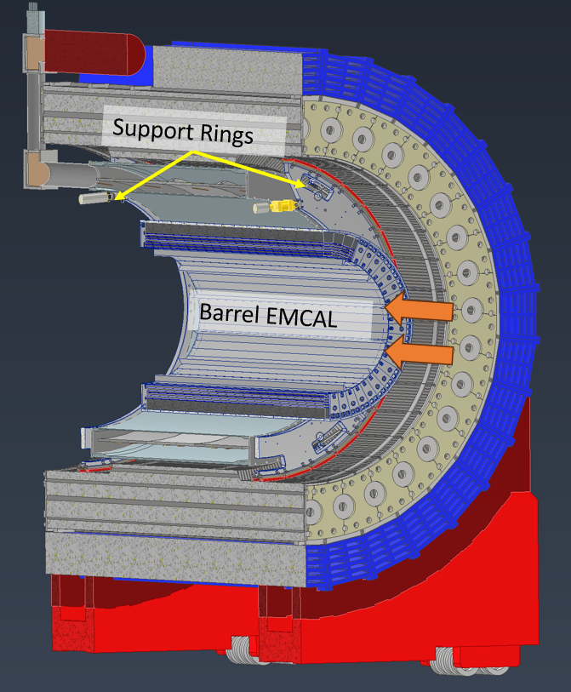
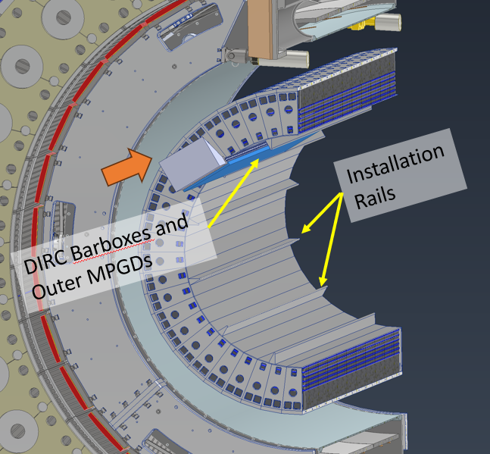
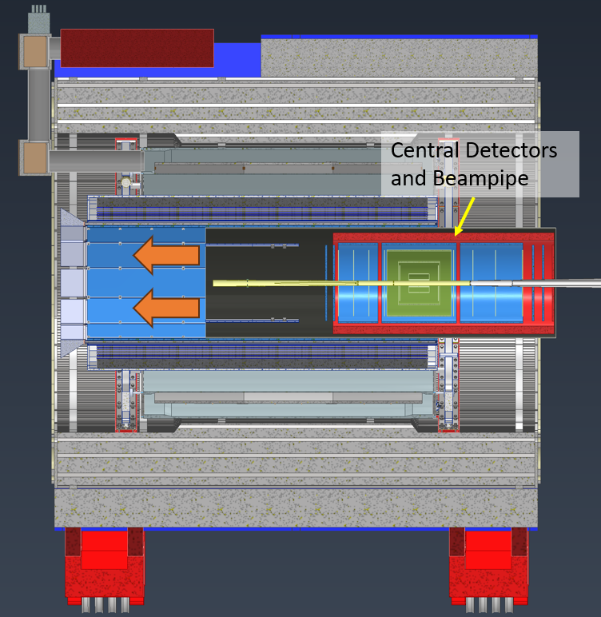
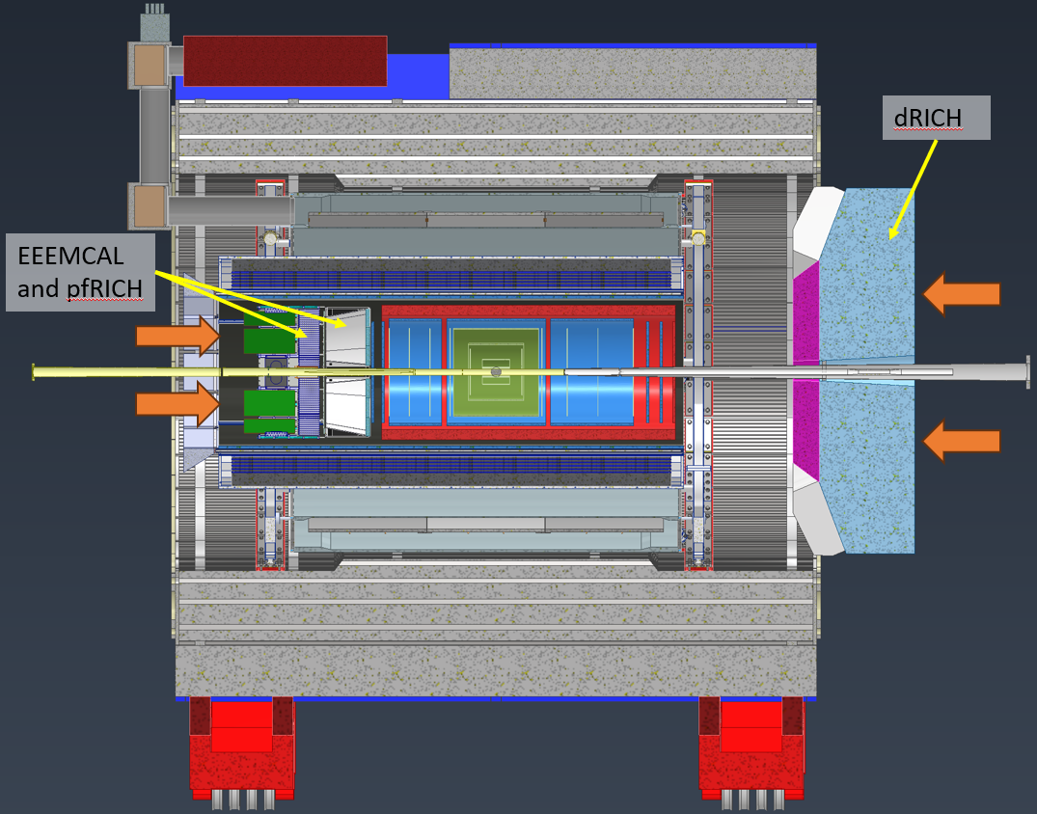
Installation Sequence (Barrel)

Slide 26
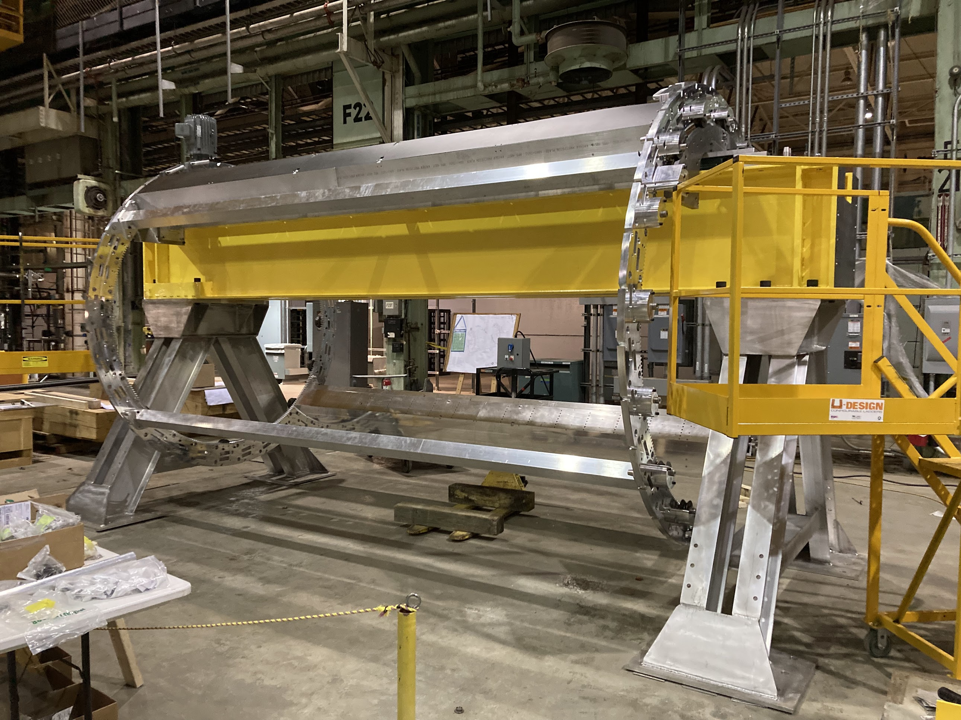
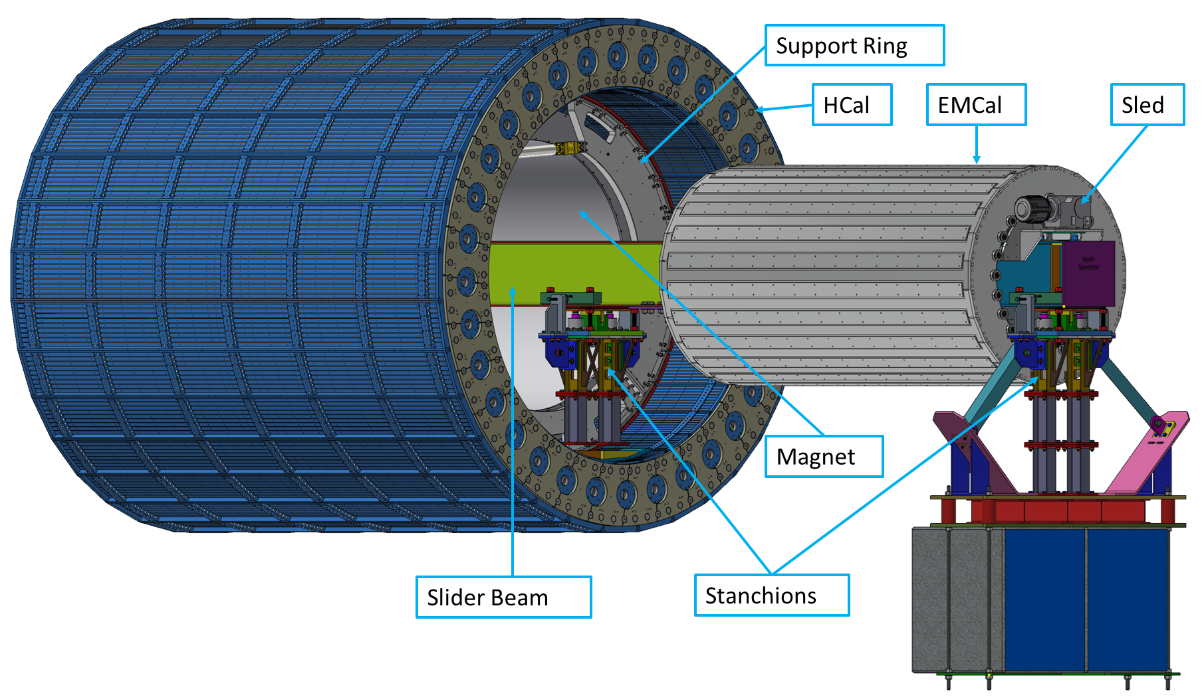
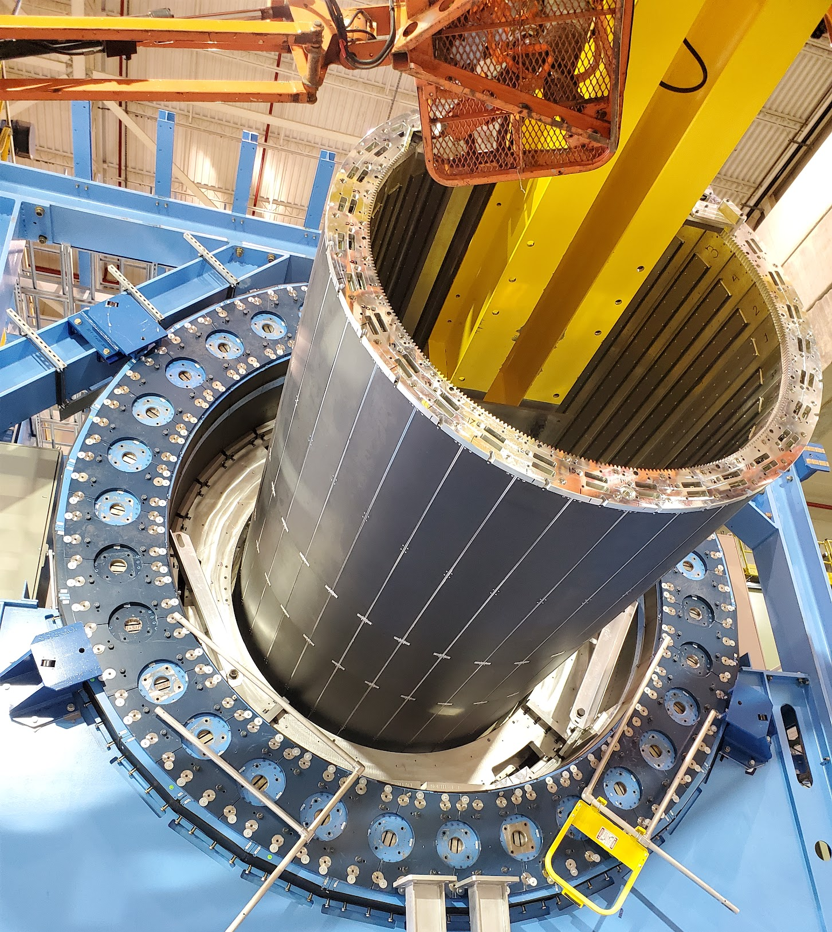
Barrel EMCAL (06.10.05.02) Installation Tooling
We plan to use existing installation tooling from sPHENIX that was used to install Inner HCAL as shown in photos.
Assemble Barrel EMCal on sled, A-frames and section of I-beam.
The I-beam is inserted into the HCal and supported on stanchions.
The Barrel EMCal is rolled in via the sled on the I-beam.
The Barrel EMCal is attached to the support rings.
The I-beam and stanchions are removed.

Slide 27
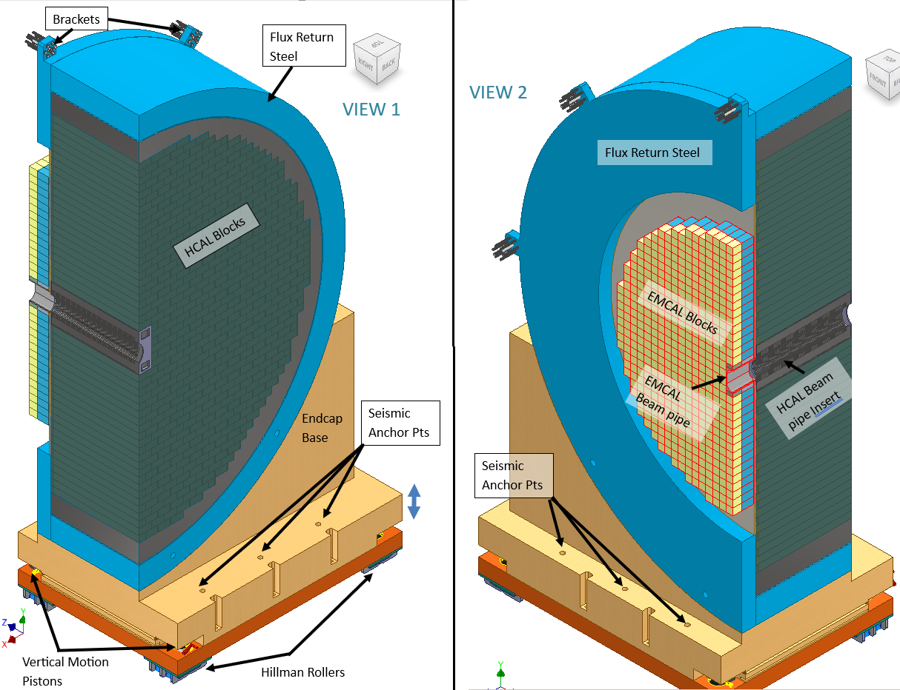
Hadron Endcap Design (06.10.05.03 and 06.10.06.03)
End Cap Structures accommodate HCAL (06.10.06.03) and EMCAL Detectors (06.10.05.03)
End Caps will be designed as two halves with a vertical split that will allow opening of End Caps for maintenance of detectors in the Barrel
Endcaps will be assembled in the Experimental Hall and will not impact Barrel Assembly/Installation. It can also be done in parallel with Barrel Assembly if additional resources are available.
Following Design and Analysis tasks need to be completed as next steps:
Seismic Analysis – Detailed Seismic Analysis required to figure out size of anchors and to determine stability during movement.
Analysis of Magnetic Forces for HCAL blocks and pins needed.
Pinning/Securing of HCAL/EMCAL detector Blocks
Rails for Endcaps
Moving Mechanism presenting challenge due to one corner being inaccessible.
Guiding Mechanism for Endcaps
North and South Platform Modifications to resolve interference issues

Slide 28
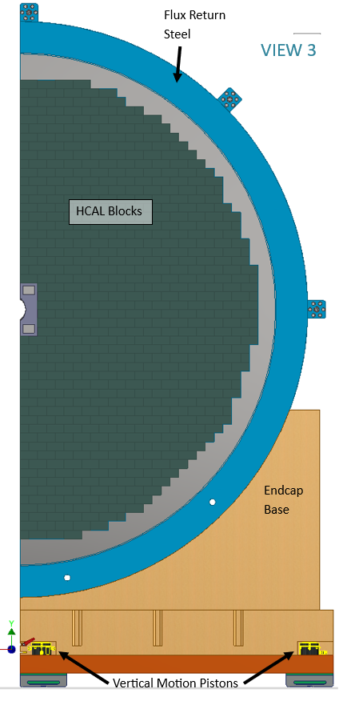
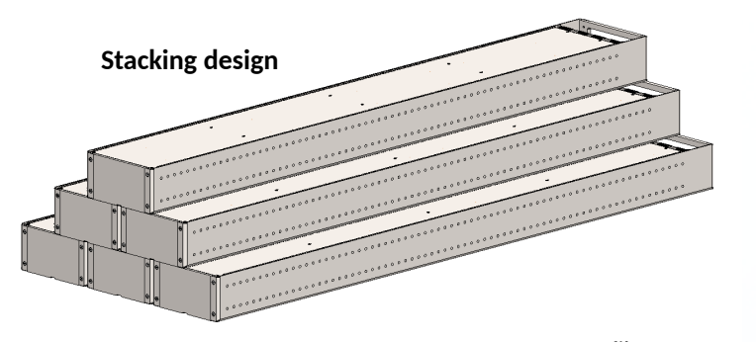
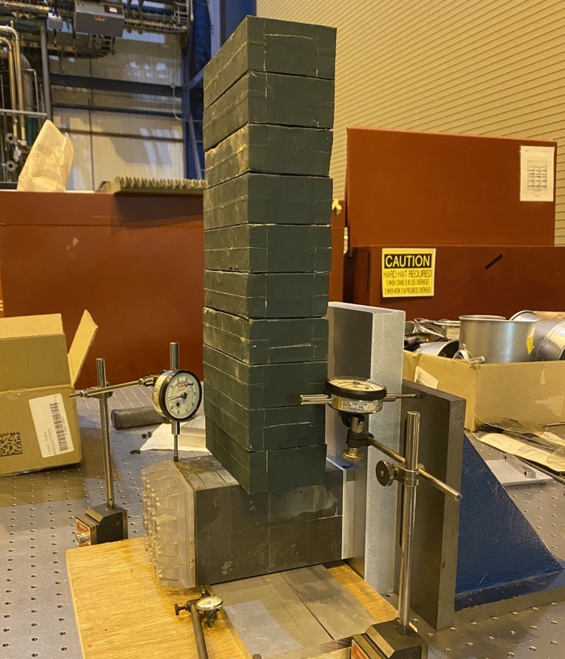
Hadron Endcap ECAL and HCAL Mounting Scheme

Slide 29
Power
New Power Supplies will be used for MARCO (SC Magnet 06.10.07). New DAQ Rack will be placed on Third Level.
Power requirements for detectors are being estimated and compared to available power.
Detector Electronic Racks on South Platform: Current assumption is that available power is enough. Trying to collect requirements and verify the assumption.
Shown below is the snapshot from Electronics, power and services spreadsheet. Full version in backup slides for reference.

Slide 30
Cooling Systems and Gas Systems
Gas Systems
Gas Detectors such as MPGDs need Gas Systems for mixing and delivery of required gases. We will design and build gas systems for the required detectors.
Cooling Systems
Need to fully gather cooling requirements for all the detectors and integrate cooling in the design.

Slide 31
Summary/ Next Steps
As shown in the slides, preliminary design of the support structures for LLP items looks promising.
Developing the designs of various sub detectors and their support structures.
Identification of conflicts and resolution.
Cabling plan needs to be further developed with cable trays etc.
All detectors and structures need to be analyzed for Seismic and Magnetic Forces but should not affect LLP items.
Moving Mechanisms for Endcaps need to be finalized and integrated into the design.
Power requirements for various detectors and electronics need to be further developed.
Grounding scheme for Magnet and detectors need to developed.
Cooling Requirements need to be further developed.
Gas Systems need to be designed (This can wait for now).
Safety systems (Fire Suppression, Smoke Detection and Interlock systems) need to be designed.

