Slide 1
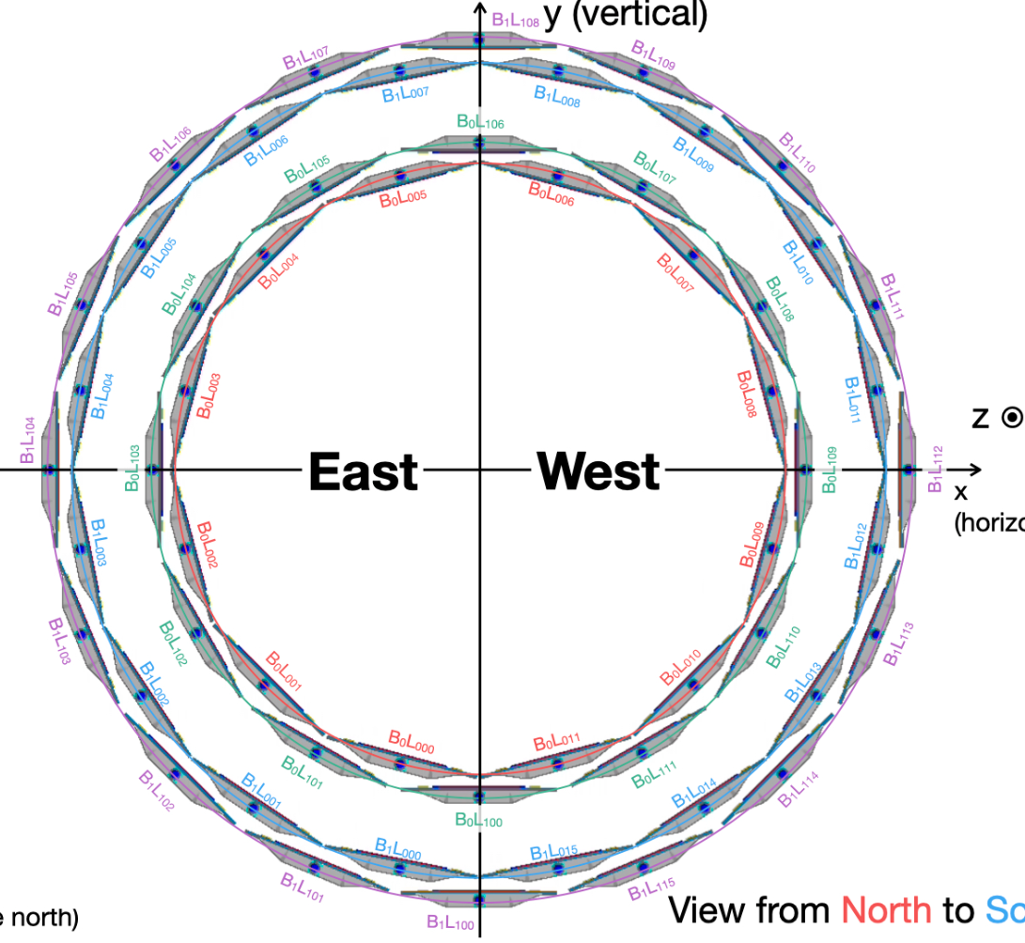
Definition of Channel ID: FELIX, ONLINE, OFFLINE
FELIX: connected btw LADDER and FELIX
ONLINE : default (virtual) numbering in online
OFFLINE : numbering used in the reconstruction (TrkrHitSet)
FELIX level
ONLINE level
OFFLINE level
3
7
8
9
4
7
13
4
5
7
8
5
5
4
3
11
10
0
6
10
6
6
6
9
10
6
6
3
3
2
12
8
1
2
5
5
6
7
4
4
3
2
6
9
7
11
5
4
7
10
7
5
2
2
0
1
8
12
5
4
8
11
7
5
1
1
INTT1
INTT2
9
13
INTT1
INTT2
11
6
INTT1
INTT2
1
3
5
4
3
8
8
1
4
2
0
4
3
9
12
8
6
0
0
3
13
8
1
4
3
2
9
12
9
7
0
0
7
12
INTT0
INTT3
INTT0
INTT3
INTT0
INTT3
9
2
5
3
2
10
13
9
7
11
15
10
7
6
2
1
10
13
10
8
11
15
11
1
5
9
8
1
0
11
11
8
9
10
10
2
6
10
2
1
0
14
14
10
11
9
14
14
11
12
13
0
3
13
12
1
0
15
15
11
13
4
0
12

Slide 2
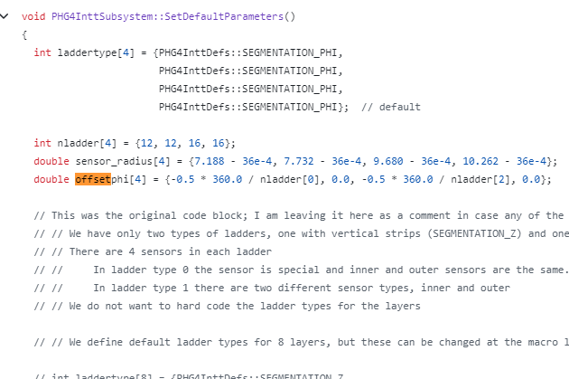
Ladder position in PHG4Intt

Slide 3
 | FELIX |  | Online |  | Offline
Ladder position | PacketID | Felix Ch | Layer | ladder | layer | ladder
B1L1 01S | 3001 | 0 | 3 | 1 | 6 | 11
B0L1 01S |  | 1 | 1 | 1 | 4 | 8
B1L0 01S |  | 2 | 2 | 1 | 5 | 10
B1L0 00S |  | 3 | 2 | 0 | 5 | 11
B1L1 00S |  | 4 | 3 | 0 | 6 | 12
B0L0 00S |  | 5 | 0 | 0 | 3 | 8
B0L1 00S |  | 6 | 1 | 0 | 4 | 9
B1L1 03S |  | 7 | 3 | 3 | 6 | 9
B0L0 02S |  | 8 | 0 | 2 | 3 | 6
B0L0 01S |  | 9 | 0 | 1 | 3 | 7
B1L0 02S |  | 10 | 2 | 2 | 5 | 9
B1L1 02S |  | 11 | 3 | 2 | 6 | 10
B0L1 02S |  | 12 | 1 | 2 | 4 | 7
B1L0 03S |  | 13 | 2 | 3 | 5 | 8
B1L1 05S | 3002 | 0 | 3 | 5 | 6 | 7
B0L1 04S |  | 1 | 1 | 4 | 4 | 5
B0L1 03S |  | 2 | 1 | 3 | 4 | 6
B1L0 04S |  | 3 | 2 | 4 | 5 | 7
B1L1 04S |  | 4 | 3 | 4 | 6 | 8
B0L0 03S |  | 5 | 0 | 3 | 3 | 5
B1L0 05S |  | 6 | 2 | 5 | 5 | 6
B1L1 07S |  | 7 | 3 | 7 | 6 | 5
B0L0 05S |  | 8 | 0 | 5 | 3 | 3
B0L0 04S |  | 9 | 0 | 4 | 3 | 4
B1L0 06S |  | 10 | 2 | 6 | 5 | 5
B1L1 06S |  | 11 | 3 | 6 | 6 | 6
B0L1 05S |  | 12 | 1 | 5 | 4 | 4
B1L0 07S |  | 13 | 2 | 7 | 5 | 4
B0L1 06S | 3003 | 0 | 1 | 6 | 4 | 3
B0L0 06S |  | 1 | 0 | 6 | 3 | 2
B0L1 07S |  | 2 | 1 | 7 | 4 | 2
B1L1 08S |  | 3 | 3 | 8 | 6 | 4
B1L0 08S |  | 4 | 2 | 8 | 5 | 3
B1L1 09S |  | 5 | 3 | 9 | 6 | 3
B1L0 09S |  | 6 | 2 | 9 | 5 | 2
B0L0 07S |  | 7 | 0 | 7 | 3 | 1
B0L1 08S |  | 8 | 1 | 8 | 4 | 1
B0L0 08S |  | 9 | 0 | 8 | 3 | 0
B1L1 10S |  | 10 | 3 | 10 | 6 | 2
B1L0 10S |  | 11 | 2 | 10 | 5 | 1
B1L1 11S |  | 12 | 3 | 11 | 6 | 1
B1L0 11S |  | 13 | 2 | 11 | 5 | 0
B0L1 09S | 3004 | 0 | 1 | 9 | 4 | 0
B0L0 09S |  | 1 | 0 | 9 | 3 | 11
B0L1 10S |  | 2 | 1 | 10 | 4 | 11
B1L1 12S |  | 3 | 3 | 12 | 6 | 0
B1L0 12S |  | 4 | 2 | 12 | 5 | 15
B1L1 13S |  | 5 | 3 | 13 | 6 | 15
B1L0 13S |  | 6 | 2 | 13 | 5 | 14
B0L0 10S |  | 7 | 0 | 10 | 3 | 10
B0L1 11S |  | 8 | 1 | 11 | 4 | 10
B0L0 11S |  | 9 | 0 | 11 | 3 | 9
B1L1 14S |  | 10 | 3 | 14 | 6 | 14
B1L0 14S |  | 11 | 2 | 14 | 5 | 13
B1L1 15S |  | 12 | 3 | 15 | 6 | 13
B1L0 15S |  | 13 | 2 | 15 | 5 | 12

