Slide 1
Instrumentation Group @Penn
Scientists/Engineers
Paul Keener (Group Leader)
Mitch Newcomer, Nandor Dressnandt, Adrian Nikolica, Bill Ashmanskas
Technical Staff
Godwin Mayers, Mike Reilly, Manny(Emannuel) Morales
MSEE Student workforce
Usually between 3 and 4 Students from the Moore EE School each year
2023 -2024 Xiaokai Ma, Chenjun Li, Meijun Tian (65nm) Analog Design / Layout & verification using parasitic extract NL
Hengji Ye (180nm) Design modification / Verification
MSEE’s working with our group have 100% placement rate in industry on Graduation or go on to PHD studies

Slide 2
Activities FEE System Design/Development/Production
Including Analog & Digital ASICs
  ASIC’s GF 130, TSMC 180, TSMC 65
  ATLAS upgrade ITK Strips 50M channel system GF130
    Leaders with CERN ESE in the design of the readout system including ASICs
    Designed Module readout protocols and most ASIC I/O communication blocks
    Rad and SEU tolerant techniques including TMR
    Implement Design with CI techniques, Test & Produce 35K AMACstar and 35K HCCstar ASICs
  Qpix analog readout for low rate pixel TPC target < 50uW / channel (TSMC 180n)
    Updated Result (p 26,27) showing LN operation
  APP Analog Photon Processor (TSMC 65n)
  COTS electronics
  ATLAS High Speed Readout 128 input HTT Trigger Processor Mother Board
  Dune warm electronics PTC board
  Super Fine Grain Detector SFGD for T2K upgrade RO electronics with U. Geneva
  EOS Detector System design: PMT HV dist. , Analog & NHIT sums, buffer to CAEN RO

Slide 3
ATLAS ITK Penn /CERN Leadership in System design
S t r i p s
P I x e l s
Module ( 5000 strips)
Credit Thomas Gosart, Bobby MCGovern Penn GS

Slide 4
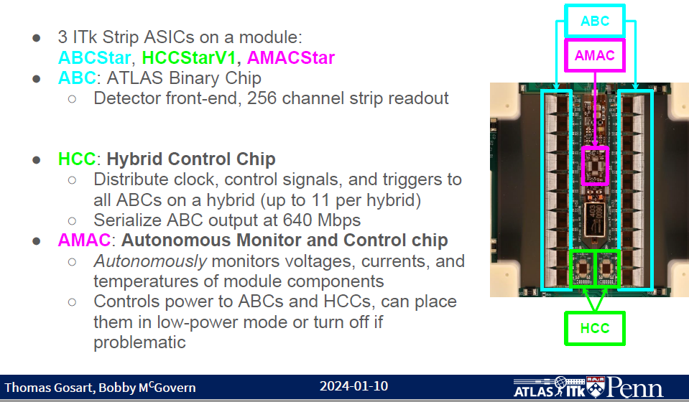
Barrel ITK Strip Module & ASICs
CERN Responsibility
Penn ASIC Responsibility

Slide 5
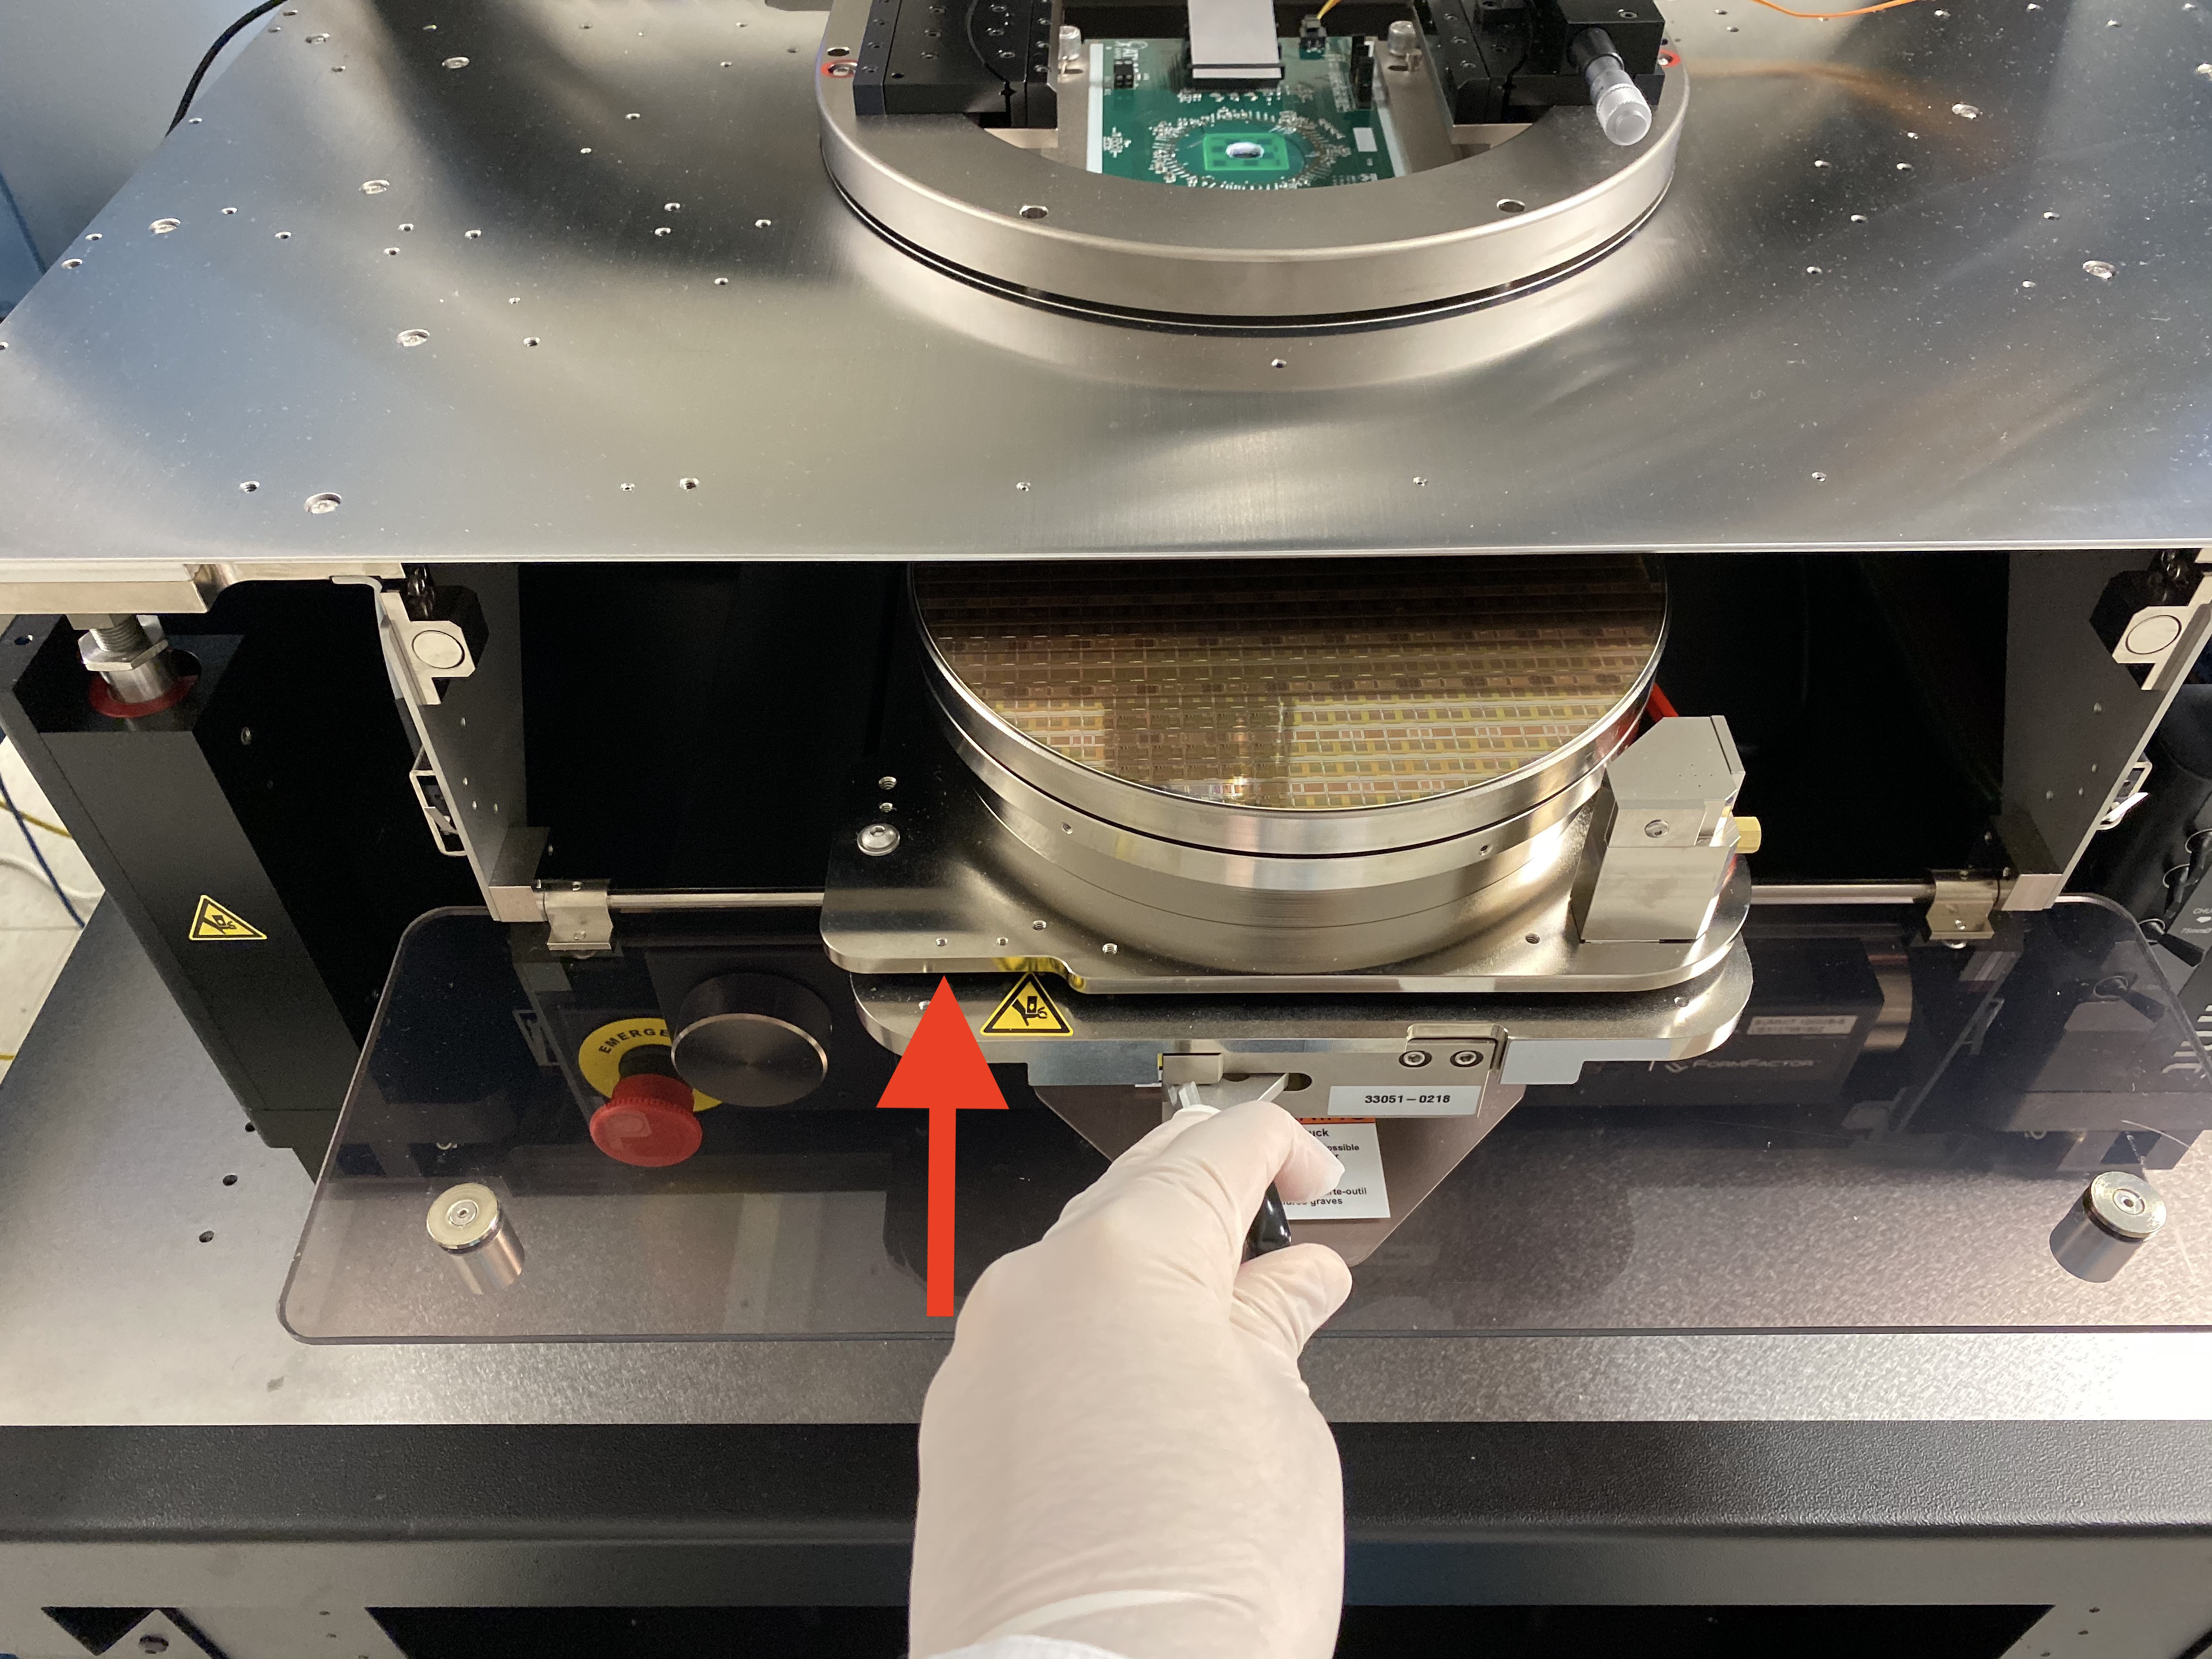
Wafer Probe Station
AMAC Testing Flow Chart

Slide 6
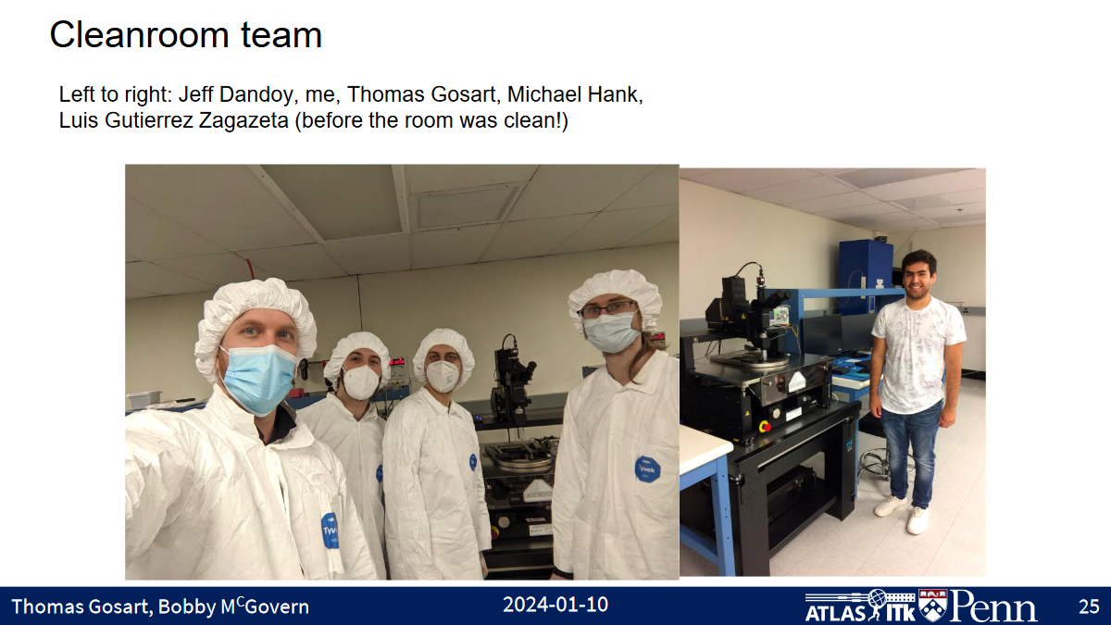
ITK ASIC Testing Team

Slide 7
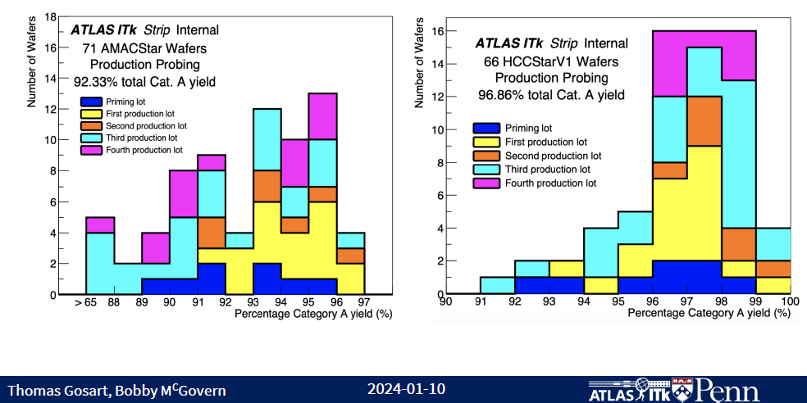
Probing Yield Distributions

Slide 8
Analog Feature Extraction Low PE count PMT or SiPM
  Maximum Likelihood studies at Penn using Hamamatsu R5912 have shown that multiple PE signals can be inferred with high accuracy by knowing only a few extracted parameters. The APP is being designed to extract relevant parameters and present extracted analog values to a commercial ADC or an ADC designed by another group.

Slide 9

The Analog Photon Processor → APP ASIC
Purpose: Dual Readout (Scin & Cherenkov) with PMT or SiPM analog for feature extraction for Underground Neutrino Detectors.
These sensors have an output shape based on their high statistics gain (10⁷⁻⁸ ) not determined by the physics of the interaction.
In low statistics (1 to 100PE) readouts APP seeks to extract physics measurements relevant number of PE by capturing:
TOT, Integral Q, T,V first peak, valley and 2nd peak within TOT.
Target Sensor has a 1-2ns Rise time → Chose 65nm node

Slide 10
Analog Photon Processor Chip
Nandor Dressnandt
APP CHIP
Peak2:
A2D_U2 (mV)
HOLD_U2 (ns)
aMemory: Single 400fF Cap
External
World
Peak1:
A2D_U1 (mV)
HOLD_U1 (ns)
TRACK/HOLD
PeakDetector
A2D_U1
A2D_U2
aMemoryx2
SEL/sample
aMemoryx2
analogMUX
5:1
Differential
Signals only
PMT Signal
A2D_D1
aMemoryx2
Valley1:
A2D_D1 (mV)
HOLD_D1 (ns)
A2D_D2
+
aMemoryx2
External1
A2D
20 MHz
HOLD_U1
External
World
APP CHIP
CLK
TACx2
aMemoryx2
-
HOLD_U2
OPAMP
Fully Differential
CLK
TACx2
aMemoryx2
-
HOLD_D1
+
PMT
CLK
TACx2
aMemoryx2
A2D Control
SEL/sample
analogMUX
5:1
100ns/sample:
~600ns to capture
all analog data
event
Comparator
+
External2
A2D
20 MHz
CLK
TACx2
aMemoryx2
DELAY
CLK
Counter
TACx2
-
eventB
CLK
aMemoryx2
OPAMP
Fully Differential
+
-
64
Record count at both
rising/falling edges
Memory
aMemoryx2
A2D Control
SEL/sample
Memory
+
Memory
Timeout Logic
Programmable: ~50ns
Compiled RTL logic
-Inteface logic
-Integrator controls
(cal, timeout)
-A2D controls (DC services)
-Analog mux control (sample)
-Reset
-PeakDet
(cal, controls)
-DELAY
LVDS
driver
-
A2D Control
Largely Completed
Integrator
LVDS Receive
-data
-CLK
CLK
DAC
DC services
+
PeakDetector: 4 voltages
Comparator Threshold: 1 voltage
Integrator Cal: 1 voltage
10
-
Programming

Slide 11
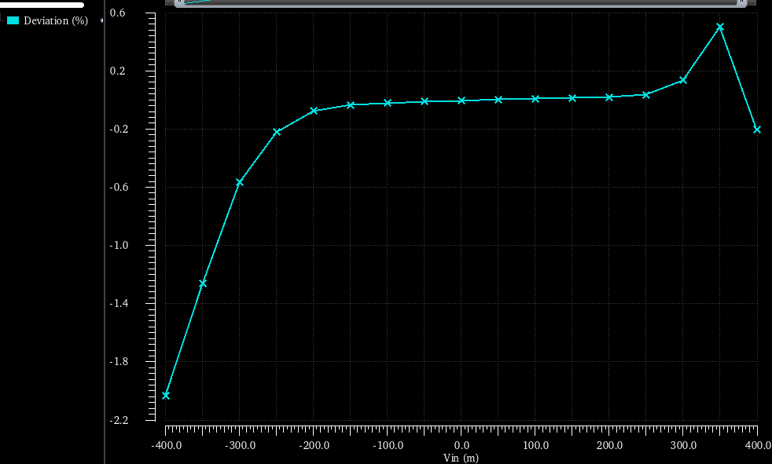
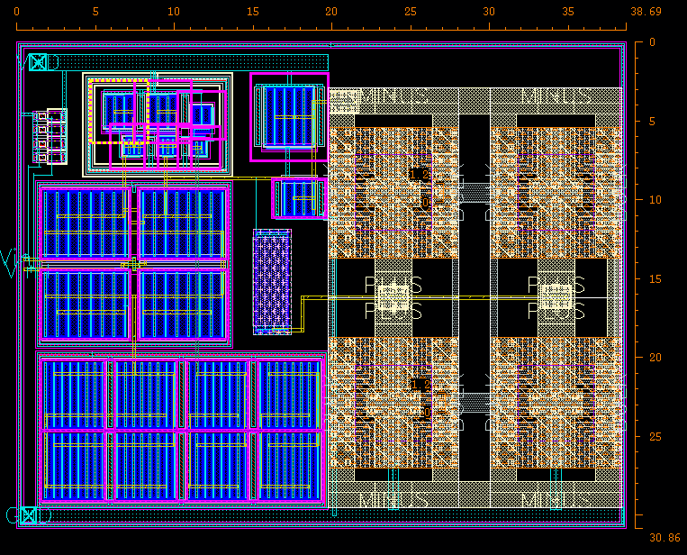
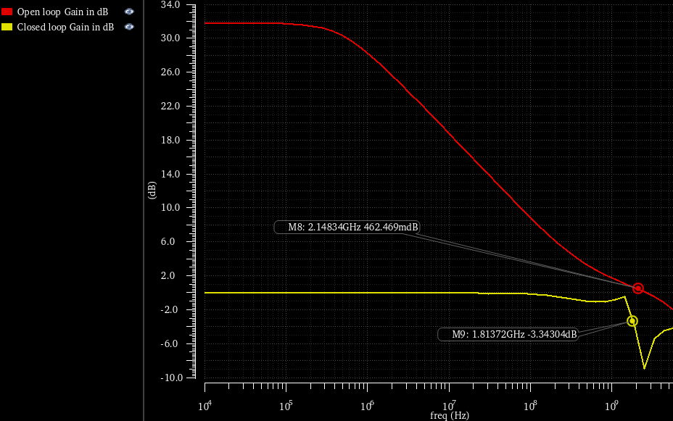
Wide BW Opamp NMOS diff pair input
0.6%
- 2%
- 400mV
- 400mV
Open loop gain | 1400
GBW | 2.3GHz
Closed loop -3dB bandwidth | 1.8GHz
Rise time | 1nS
Dynamic range | 200mV-1000mV
Steady power | 0.63mW
Random out offset (closed loop) | Sigma= 0.82mV
2.1GHz
0dB
-3dB
Unity Gain Bandwidth
Unity Gain Config 1.8GHz -3dB

Slide 12
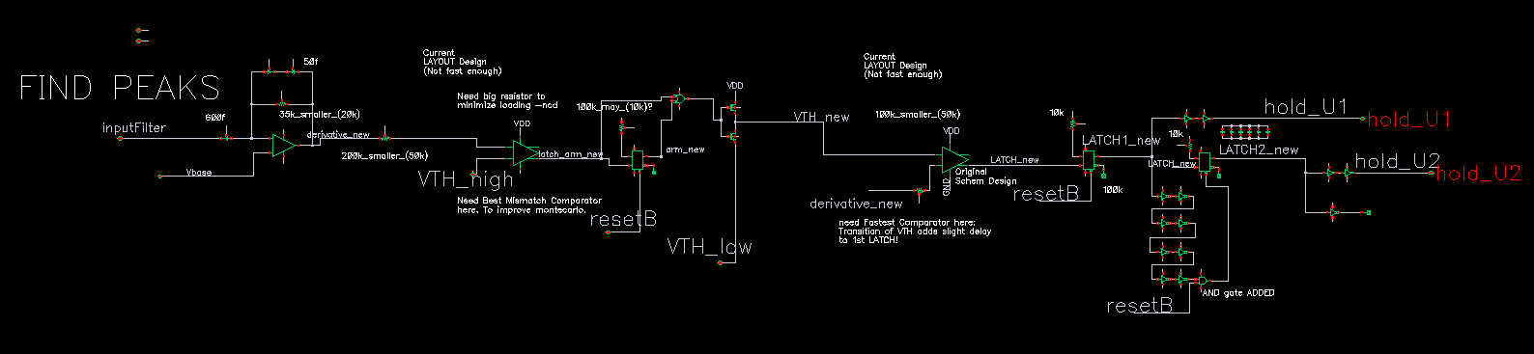
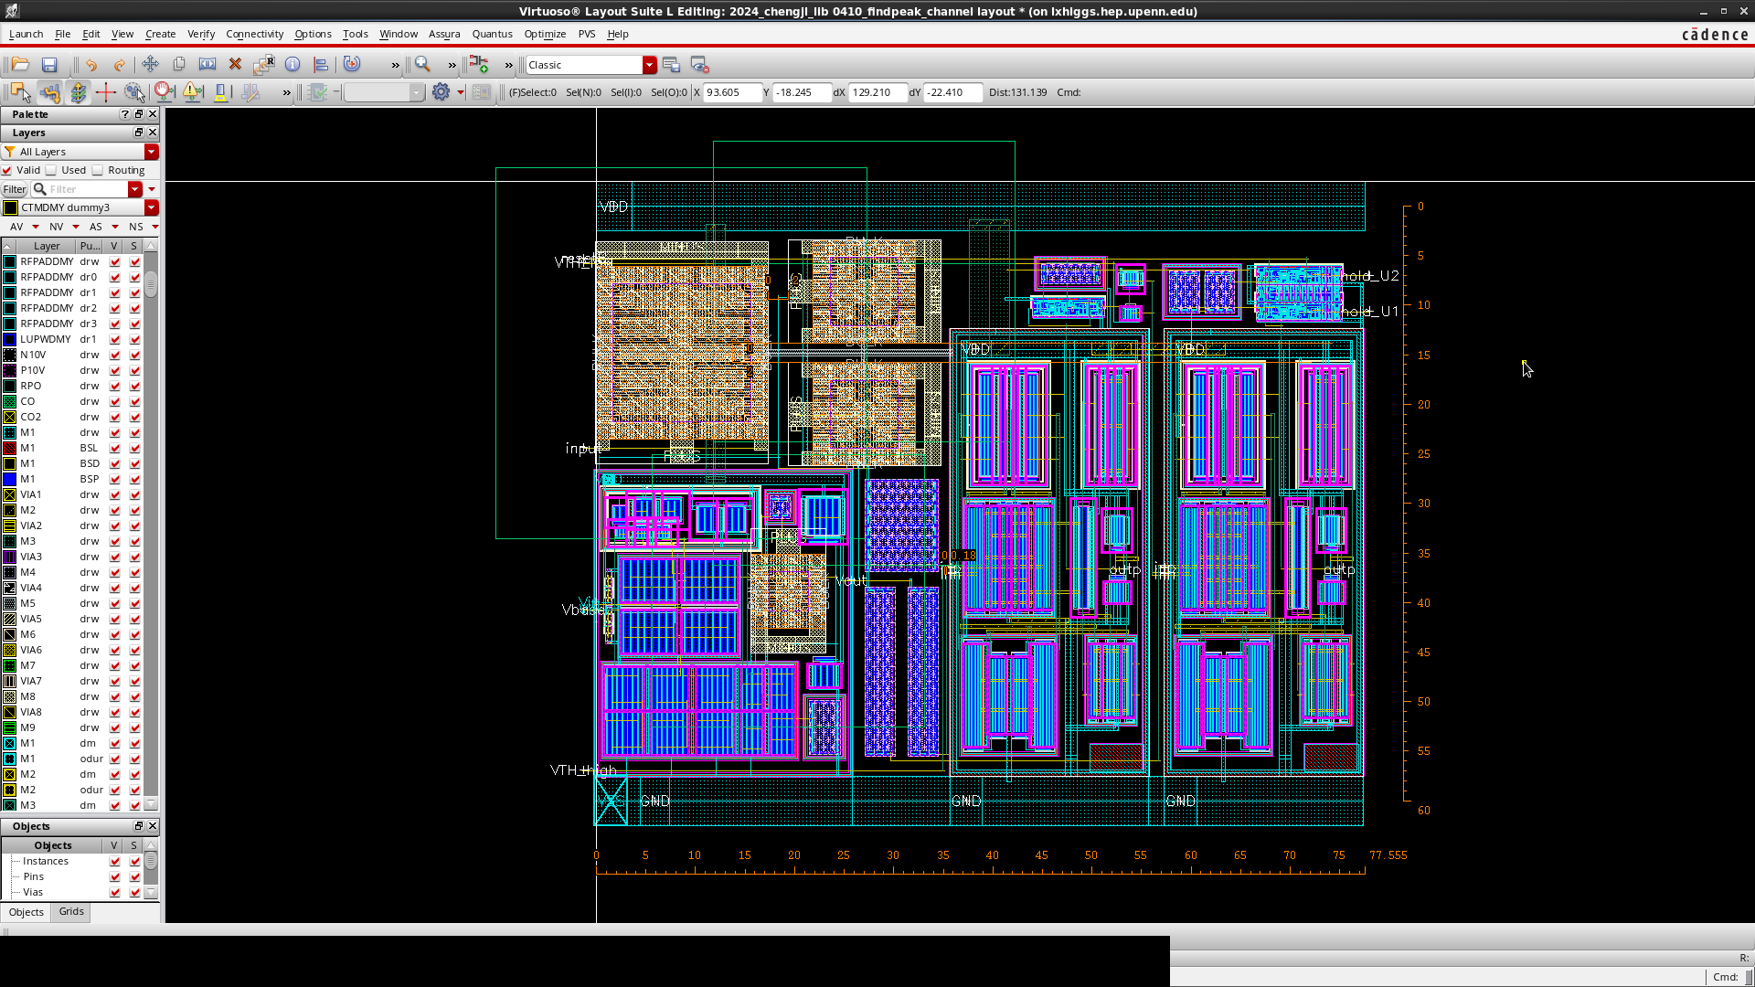
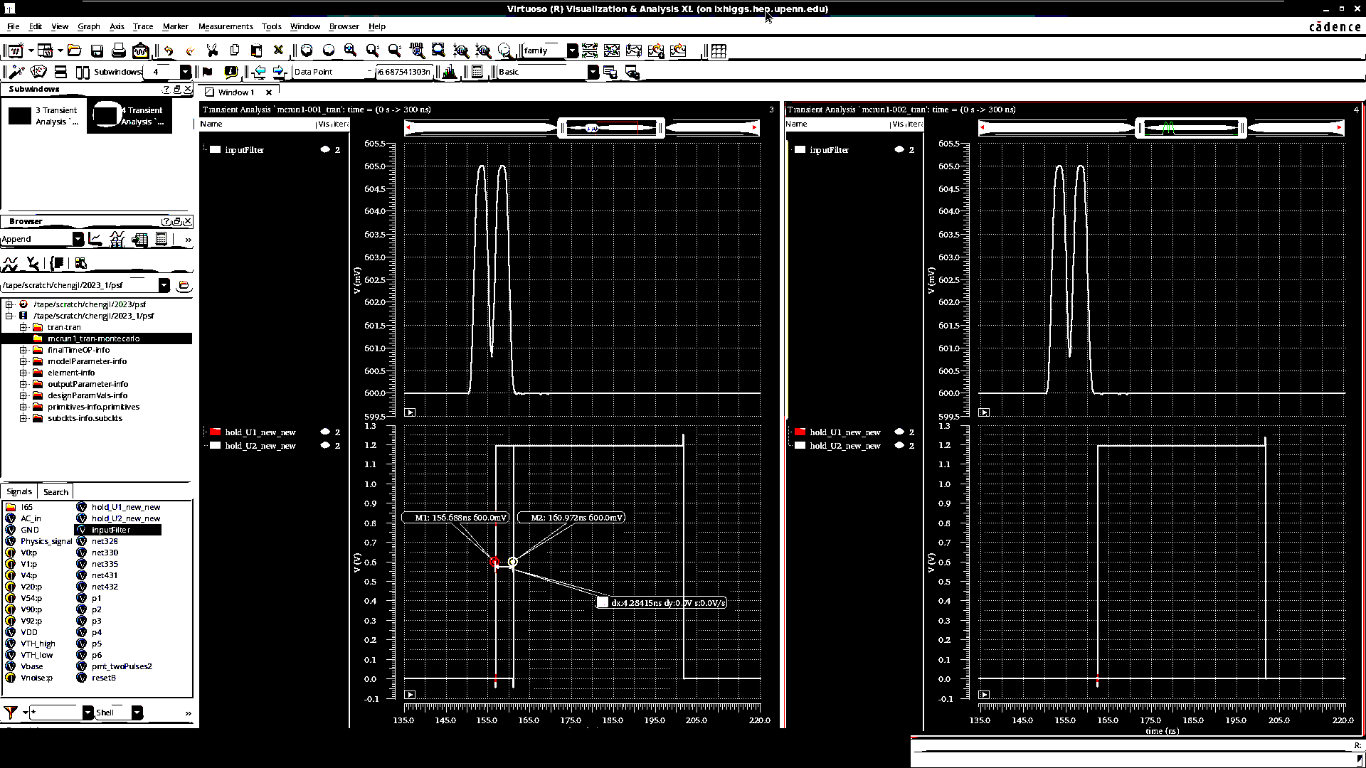
Prototype Peak Peak Finder
Static power consumption = 1.2V * 3.7mA
2 - 5mV signals,
4.2ns separation
78um(width) * 65um(height) = 5070um^2

Slide 13
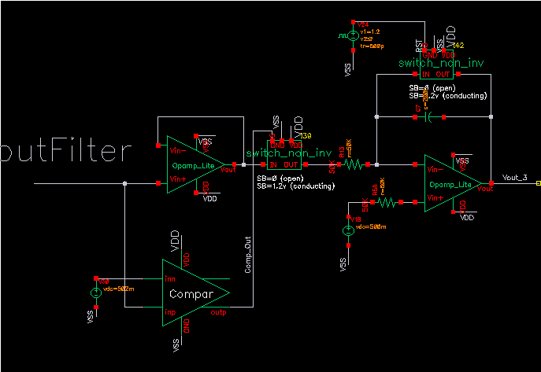
Gated Integrator test bench
Comparator gated input.
When no signal: switch off, source impedance becomes very high, which stops Cap leakage.
Able to integrate successively without reset
Source Switch
Delay Block
Vth
Vbase(set by DAC)
Trigger Comp

Slide 14
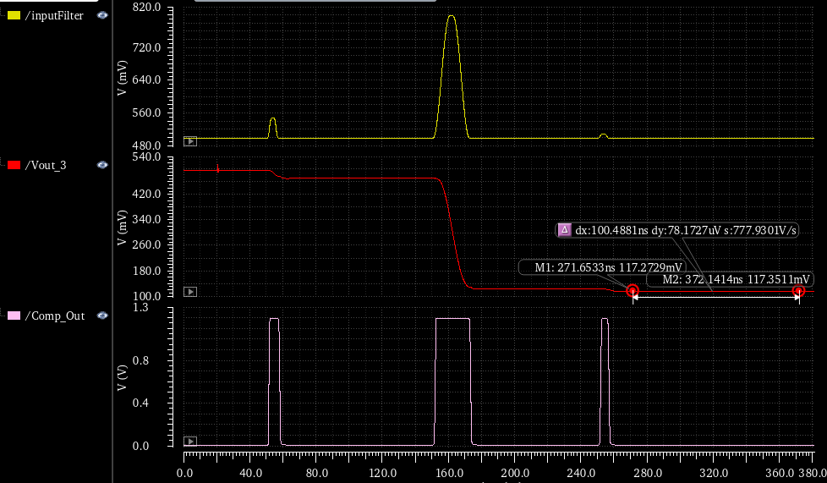
Integrator Simulation:
300mV
50mV
10mV
Comp determining valid integral

Slide 15
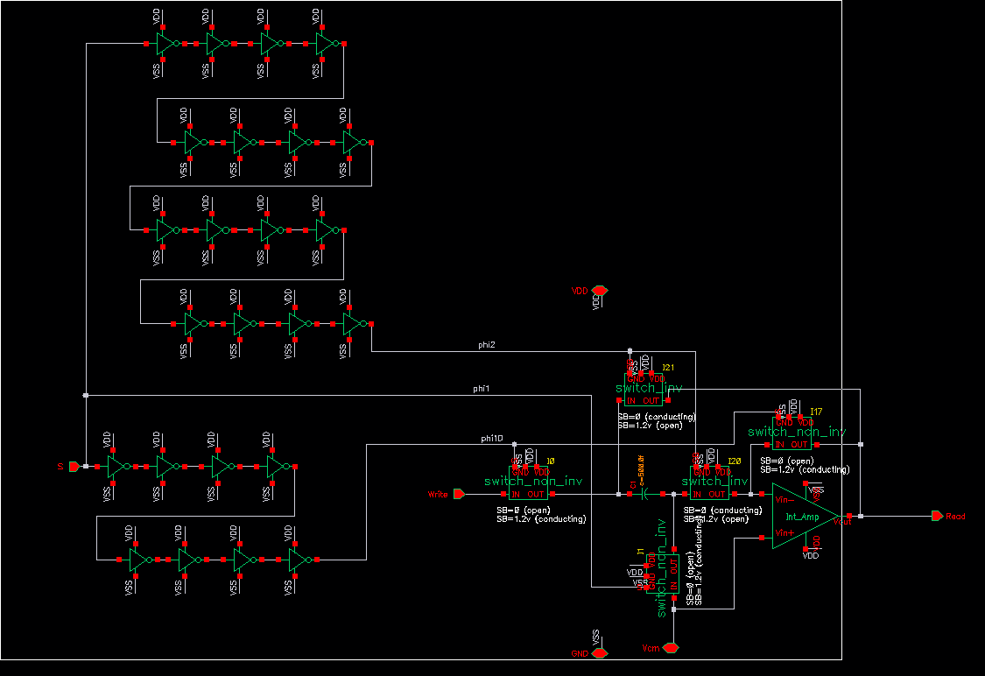
Analog Sampler-Schematic
sample using bottom plate sampler
sample immediately presented to the read port
high output drive
switch delay
output buffer
bottom plate sampler

Slide 16
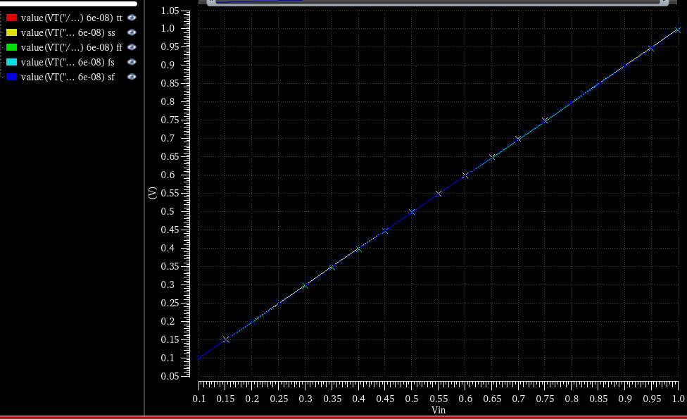
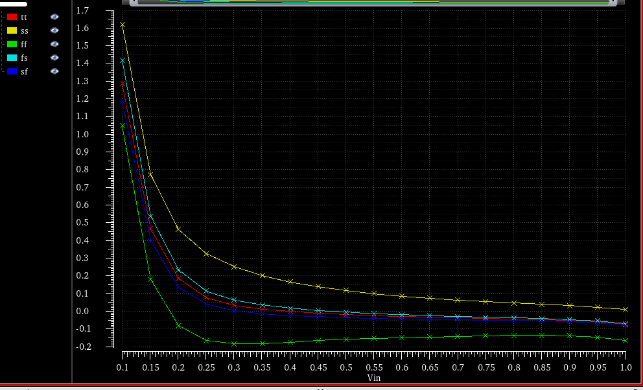
Sampler- Range / Precision over process Windows
Read output VS Write input (measure 80nS after sampling)
1.6 %
Percentage Error of measurement
Voltage on Sample Cap after 80ns
0
Input Voltage
1V
100mV
Input Voltage
100mV
1V

Slide 17
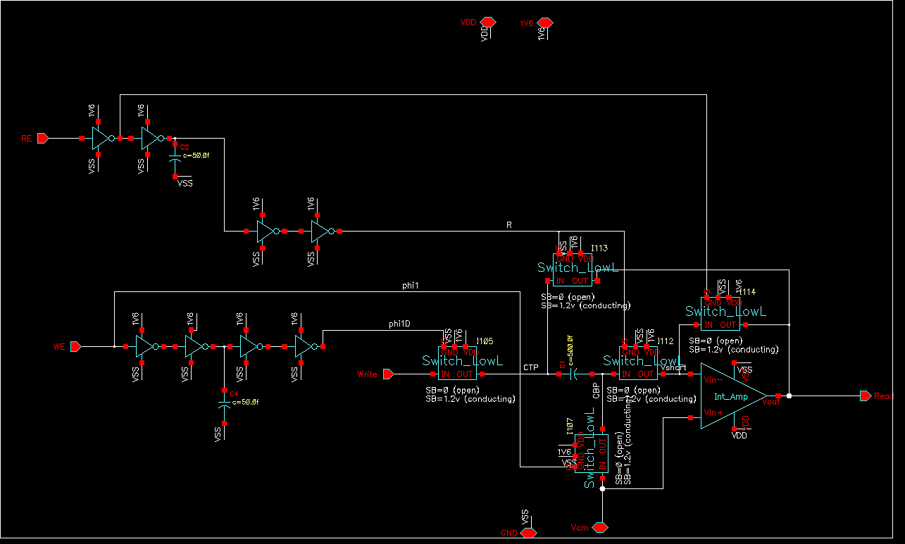
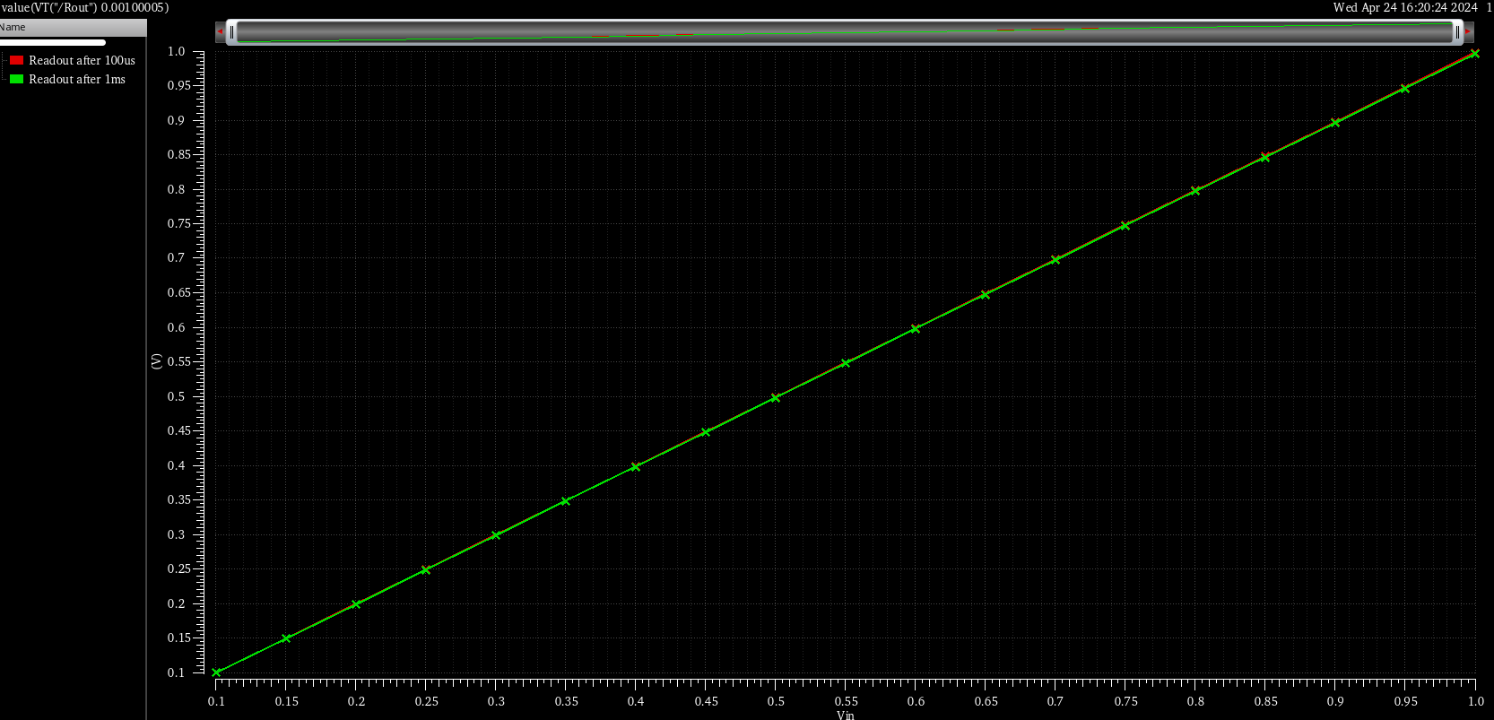
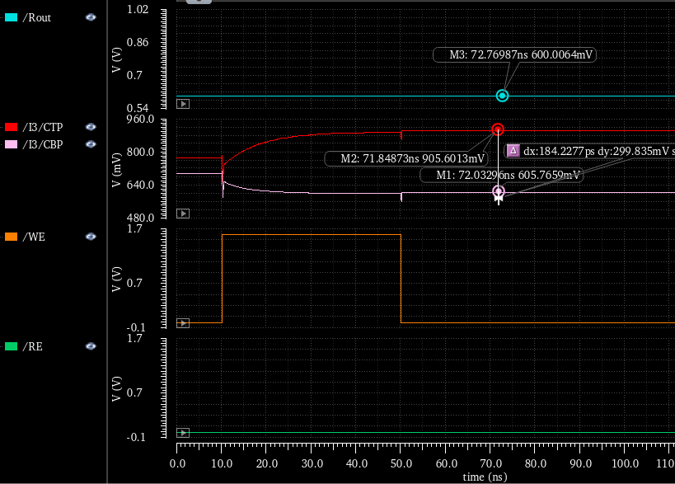
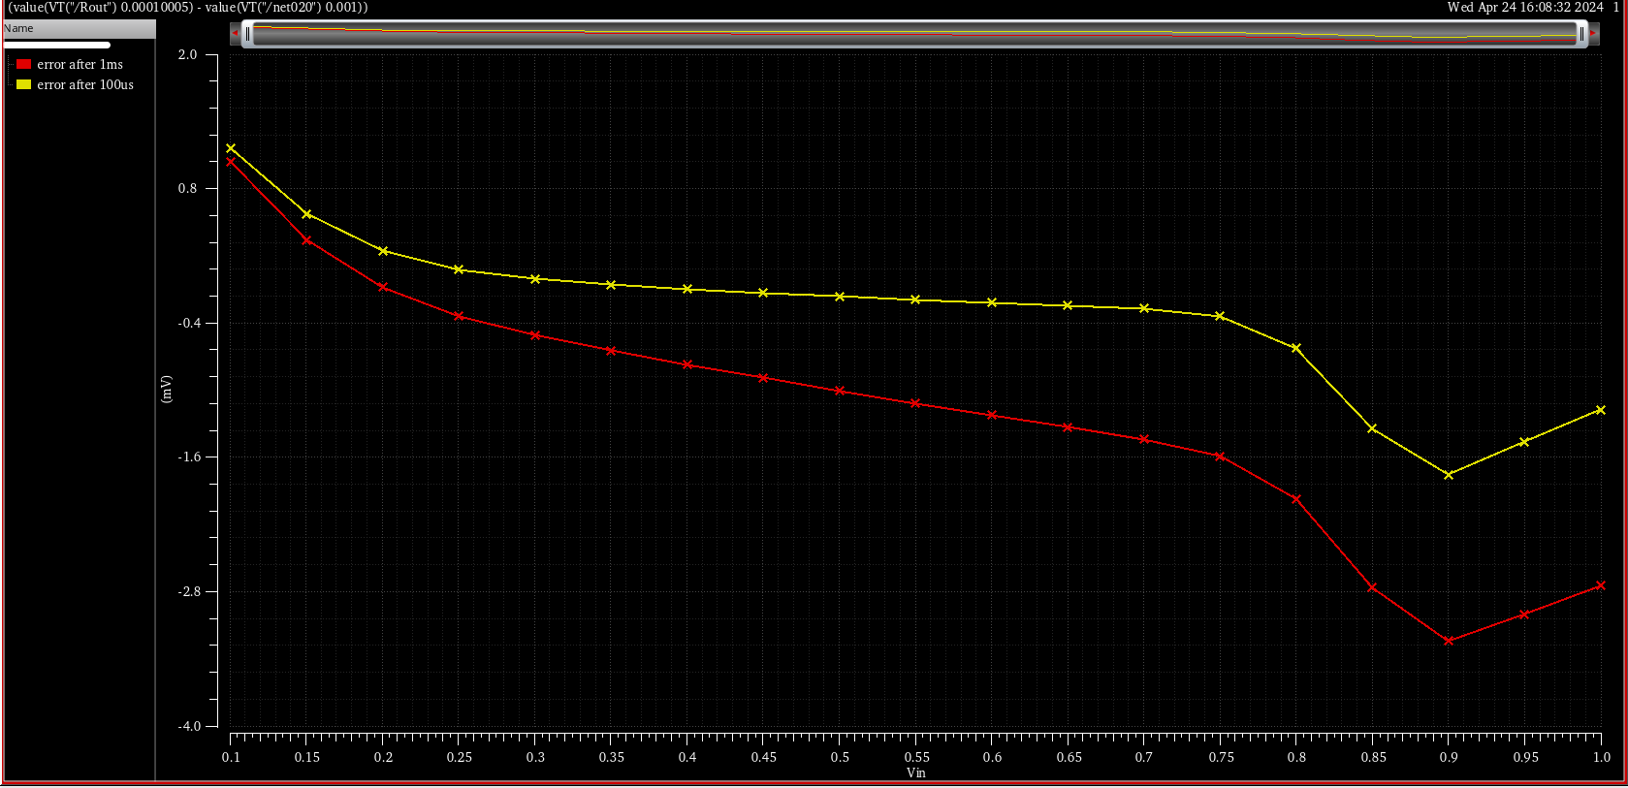
Bottom Sampling Analog Memory
1V
Output Voltage
After 1mS
Input Voltage
1V
0V
.8mV
Readout not Active
Top Plate
dy = 299.8mV
mV Deviation
After 100uS
Top Bottom Plate
-.4mV
-1.6mV
After 1ms
Write Enable
-2.8mV
Read Enable

Slide 18
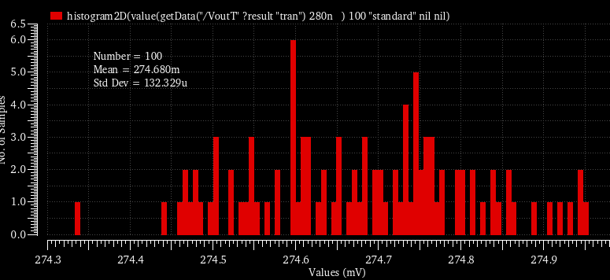
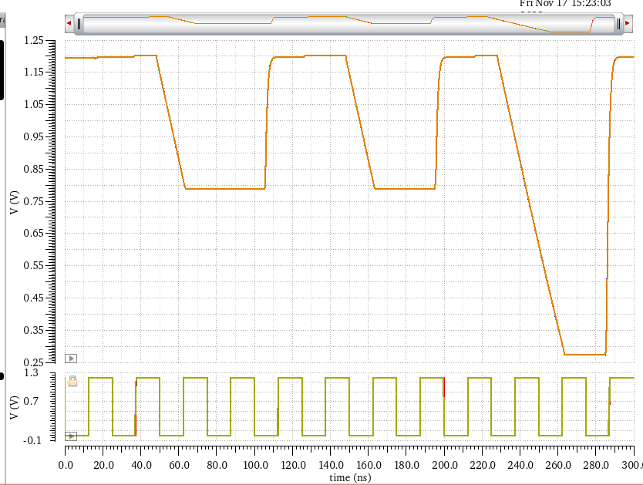
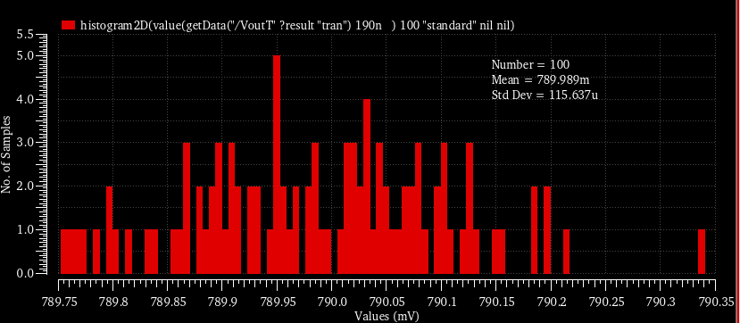
TAC Transient Noise Simulation
noise bandwidth: 1MHz~100MHz
temperature: 50 Celcius Degree
clock rate: 40MHz
100runs
Slope ~ 20mV/ns TAC (only) RMS < 10ps
Case1: T_min(0.5CLK) σ=115.64uV(410mV drop) RMS=0.79V
Case2: T_max(1.5CLK) σ=132.33uV(925.3mV drop) RMS=0.275V

Slide 19
Qpix Analog Front End: An Ionization Current Readout for Pixelated LAr TPC’s
adjustable
fixed current
Low Power 25 to 45uW
Local Logic
50uA
or
500uA
Low Power Diff
Replenish Pulse
One Clock width
Single Clock Out
Trig if input high
No Reset in DAQ mode
Q = i*Δt
←
50fF
Amplifier Discriminator
Clock (~ 40MHz)
external or
Internal Ring Osc
TPC ionization current
Pixel
Integrator
4x4mm
10uA
Bias
Replenishment eliminates problematic RESETs from the original concept
→ REMOVES RESET “noise” UNCERTAINTY observed in Transient Noise Analysis
→ Allows the pixel to function as an analog memory for large currents making Q accurate.
RESET dumps incoming charge. In Replenishment only the time between replenishments is
distorted. All charge is counted in units of Replenishment
Notes:
Transient Noise Analysis of the “Reset” approach led to questions about it’s accuracy for 1fC or lower measurements. Reset “noise” led to uncertain integrator offsets. The Replenishment approach shown above virtually eliminates the reason for resets as well as the unavoidable masking of the channel while reset takes place.

Slide 20
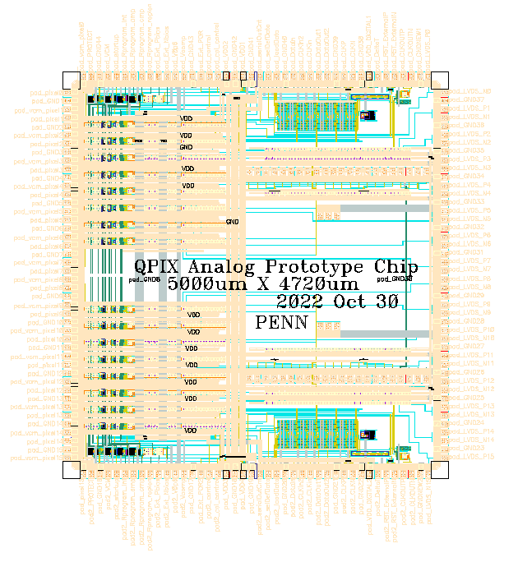
Qpix Analog: An Ionization Current Readout for Pixelated LAr TPC’s
16 channel prototype chip divided into 8 “Standard” gain channels (0-7) and 8 “Cgain” (capacitor based gain) channels (8 -15). Each bank of 8 channels has its own services: Serial Interface, Ring Oscillator, POR (Pwr-On Reset), Calibration circuit.
“Standard” gain channels consist of an analog Integrator (20mv/fC), an intermediate amplifier (x3), comparator and programmablereplenishment circuitry. ~ 45uW/channel ignoring prototype’s LVDS drivers
“Cgain” channels have the same functionality but use a different analog Integrator with much higher gain (48mv/fC) to avoid the need for an intermediate amplifier. This reduces unknown offsets, reduces internal delay & power and allows a wider range of bandwidth vs intrinsic noise tradeoffs. Power ~ 25uW/channel ignoring prototype’s LVDS drivers
Input 0
Ref 0
Input 1
Ref 1
Input 2
Ref 2
…
…
…
…
…
…
…
…
…
…
Input 15
Ref 15
Outp 0
Outn 0
Outp 1
Outn 1
Outp 2
Outn 2
…
…
…
…
…
…
…
…
…
…
Outp 15
Outn 15

Slide 21
Reconstructed Charge Time Resolution Investigation
Plot shows Appended results from 2 of 5 Transient Noise Runs
Integral Charge from a Physics simulation of a “proton” event ~80fC
One Qpix step per sensed fC of Ionization Charge
Physics input Signal
Green Trace
Spectre Simulation Results

Slide 22
Room Temp Replenish Current Calib. of 6 channels Qpix COB Bd #3
Qpix Measurement Results
Internal Ring Osc
Clock 33MHz

Slide 23
9 Step injection charge at Room Temp. High / Low Leakage
Injector
Q Step ~ 0.5pF*2mV → 1fC
Average Count 12.5
Average Cnt NO pulse 6.5
Average Count 5.5
Average Cnt NO pulse .2
Hi Leakage induced with 1G resistors at the input ~50pA
Qpix Replenish Output
Reduced Leakage 1G resistors at the input ~1pA
Qpix Replenish Output
Qpix Measurement Results

Slide 24
Calibration Circuit
In order to calibrate the size of the replenishment pulses a calibration voltage ramp is generated utilizing a programmable current source and an internal MIM capacitor. This ramp may be connected to individual channels through a 100fF connected to the integrator input. In the example below a 1nA current is generated for 100uS resulting in a 1fC charge injection every microsecond. Since the method depends only on capacitance and voltages it should be able to generate a reasonably precise +/- 10% charge that manifests as ~ 100 charge replenishments. Utilizing this method we should be able to have a high statistics replenishment count to calibrate the replenishment current.
Calibration
RAMP
Vary Slope
To study
Leakage

Slide 25
Internal Calibration Ramp slope 80uS - 160uS / 100fC
Calibration Time
Injection Current 1nA
Calibration Time
Injection Current 0.5nA
Qpix Measurement Results

Slide 26
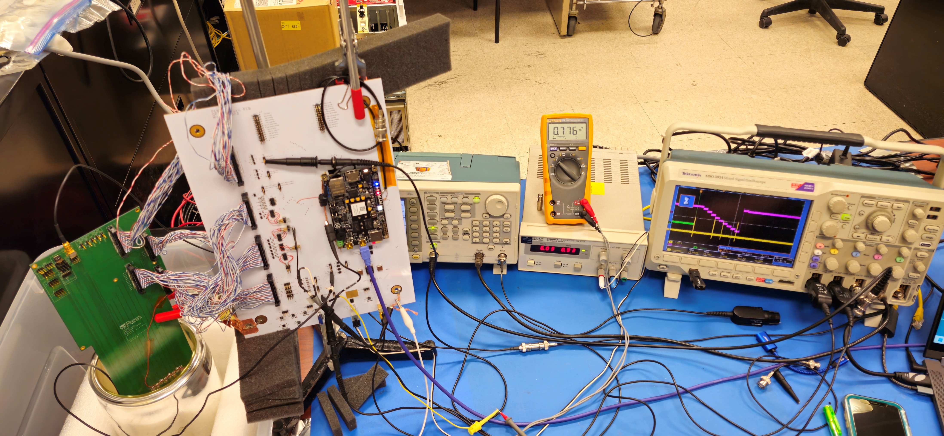
Qpix Operation at LN temp: First Observations

Slide 27
Qpix LN test showing Ch 15, C-Gain 25uW channel
“108.tif shows chan15 (c-gain). The blue is the Integrator output )(spy point) and the yellow shows replenishments. The pink shows an AC coupled descending staircase emulating a 'real' TPC track. The sequence starts with an Integrator reset, followed by the staircase. You can see the Integrator output increase step by step until about 60mV is accumulated... At which time replenishment ensue. after the the first replenishment (actually about 4-5 1fC replenishments) additional steps cause additional replenishment.”
Nandor Dressnandt
Integrator monitor point Shows Replenishment
Pulser Stepping
Replenishment Signal
“We ran for several hours in the cold, then de-iced, ran at room temp again, the back into the cold for two more hours.”

Slide 28
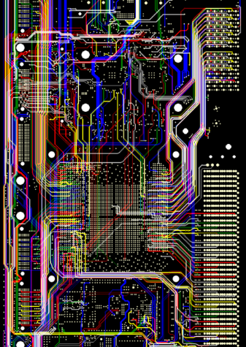
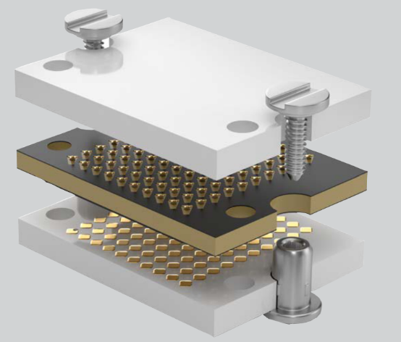
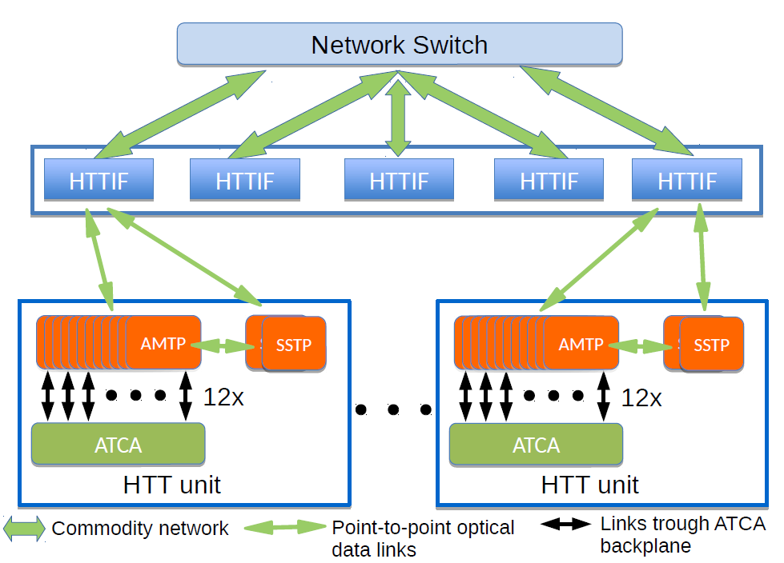
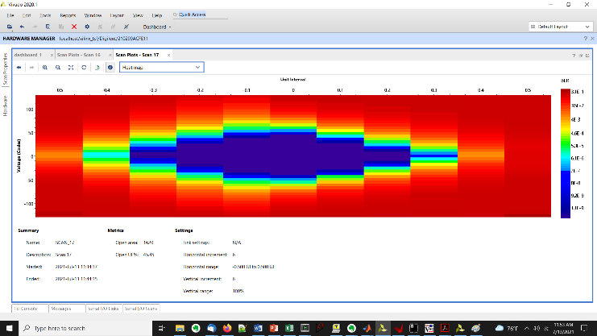
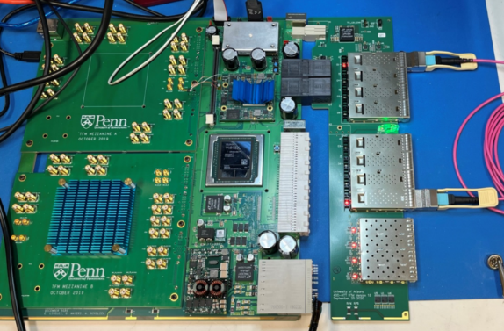
ATCA demonstrator Board for ATLAS HTT ATLAS TDAQ
High Level Track Trigger System
144 lead Zray
Lead Engineer
Adrian Nikolica
40A @850mV
FPGA core pwr
Highest rate eye diagrams for three categories of link. Top: 15Gbps @ 10⁻¹⁴ BER for longest link on mezzanines.
14x14 backplane mesh:
26 board-to-board links specified at 10 Gbps
  Performance exceeds 10Gbps spec.
RTM with up to 30 fiber links for data transmission plus additional monitoring
32 data links support for mezzanine
26 Layer Stackup Megatron-6
Eight layers of signal routing (left) and closeup (right). In the closeup, note high speed design techniques: length matching, “necking down” into the FPGA ball grid array, smooth bends. Backdrilled via’s 16 depths.
XVCU37P
FPGA
Support for 2 mezzanines either:
1 PRM Pattern Recognition Mezzanine with Associative Memory with FPGA I/O
2 TFM Track Fitting Mezzanines

