Slide 1
Trends in pixel readout chip designs for high rate and radiation
Dominik Gorni
05/01/2024

Slide 2
Readout chip
The readout chip is crucial in acquiring precise data from the sensor material, translating the charge signals induced by particle interactions into usable digital or analog information for high-rate and high-radiation environments.
Fig. Hybrid radiation detector system with acquisition system

Slide 3
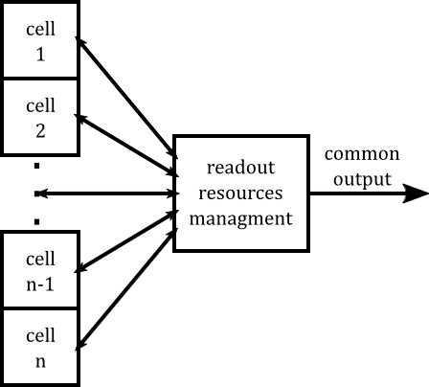
Readout of pixels
Data readout systems are engineered to maximize the efficiency of data collection and transmission within the constraints of link bandwidth.
While direct one-to-one connections from each sensor cell, channel, or pixel to the system periphery represent the most straightforward configuration, they are not the most bandwidth-efficient.
Advanced architectures aim to optimize this data pathway for enhanced performance.
Fig. Generalized block diagram of readout system

Slide 4
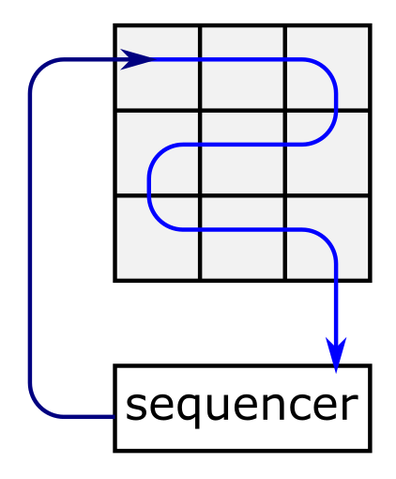
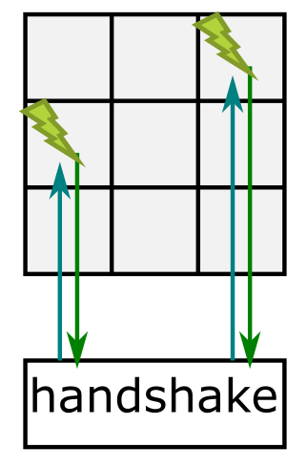
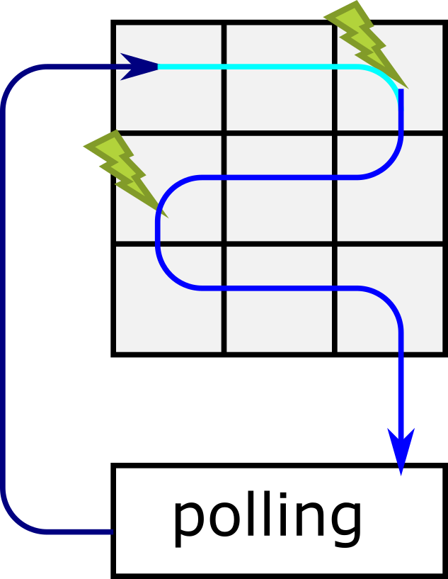
Frame vs Event driven readout
Fully sequential
All data are read out which requires additional processing and compression
Asynchronous sequence is started in response to an external event e.g., particle hit
Only relevant data are read out -> low throughput
External event sets a flag which is then checked by the readout circuitry
Frame readout
Event-driven readout
Sparse readout

Slide 6
ALICE readout – AERD
Current silicon detector readouts employ priority encoders, seen in ALICE ITS2/3.
These are prone to collision while readout due to fully combinatorial nature.
Conventional mitigation involves matrix state snapshots, but this constrains timing resolution to the frame rate.
For ITS3, efforts to reduce frame time from 10 µs to 2 µs could inadvertently increase repeat readouts.

Slide 7
AERD in ALICE-ITS3
Utilizable platform with readout periphery largely agnostic of how data from pixels is flowing in;
TWEPP 2023 Topical Workshop on Electronics for Particle Physics (1-October 6, 2023): Model and analysis of the data readout architecture for the ITS3 ALICE Inner Tracker System · Indico (cern.ch)

Slide 8
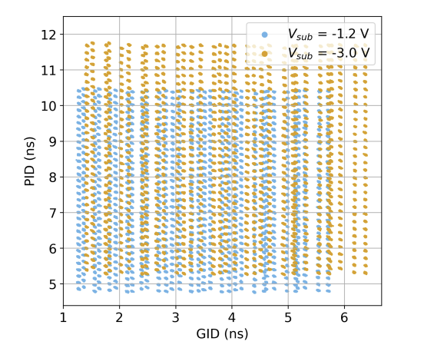
DPTS idea
Awareness of the limits of the priority-encoder-based readout is apparent and research on event-driven readouts is commonly carried out, but no success so far, e.g.:
The Digital Pixel Test Structure (DPTS) is CERN’s MAPS prototype MAPS in TPSCo65 nm process by CERN. DPTS encodes position in the time-domain position:
in-pixel discriminators trigger address generators to send two consecutive pulses on the CML outputs with a duration based on the pixel position;
duration of the first pulse is fixed,
time distance between the two pulses encodes the pixel position in a group of columns (PID);
duration of the second pulse encodes the column group position in the matrix (GID).
VERY SENSITIVE to any differences (including ageing) of operation points, biases, etc.
Digital Pixel Test Structures implemented in a 65 nm CMOS process (arxiv.org)

Slide 10
EDWARD structure

Slide 11
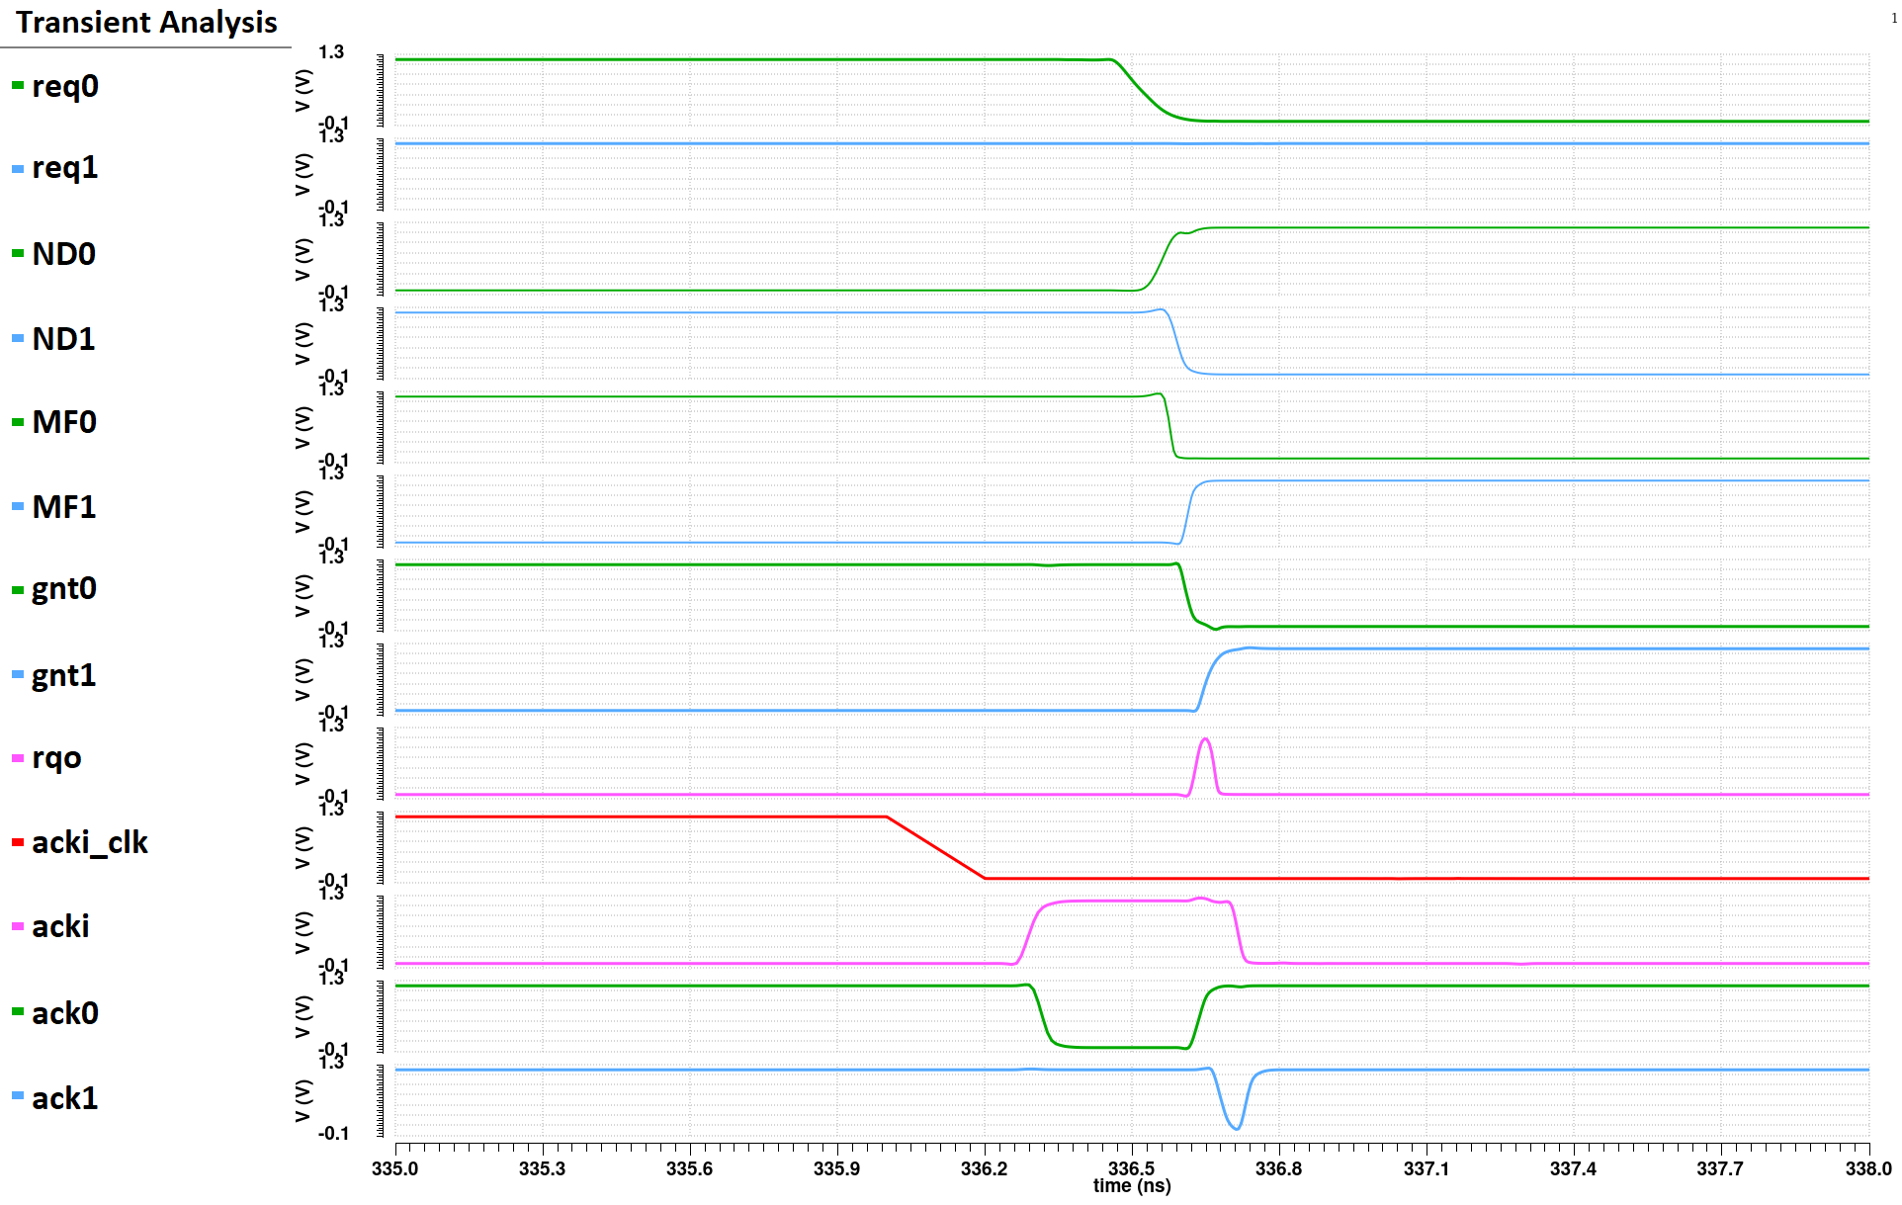
Why 3 arbiters in one cell?
Glitch in rqo is causing the race condition.

Slide 12
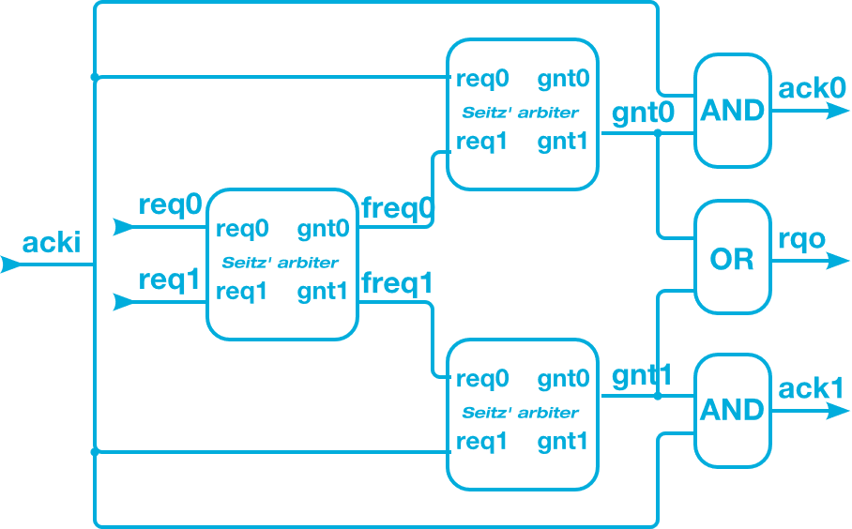
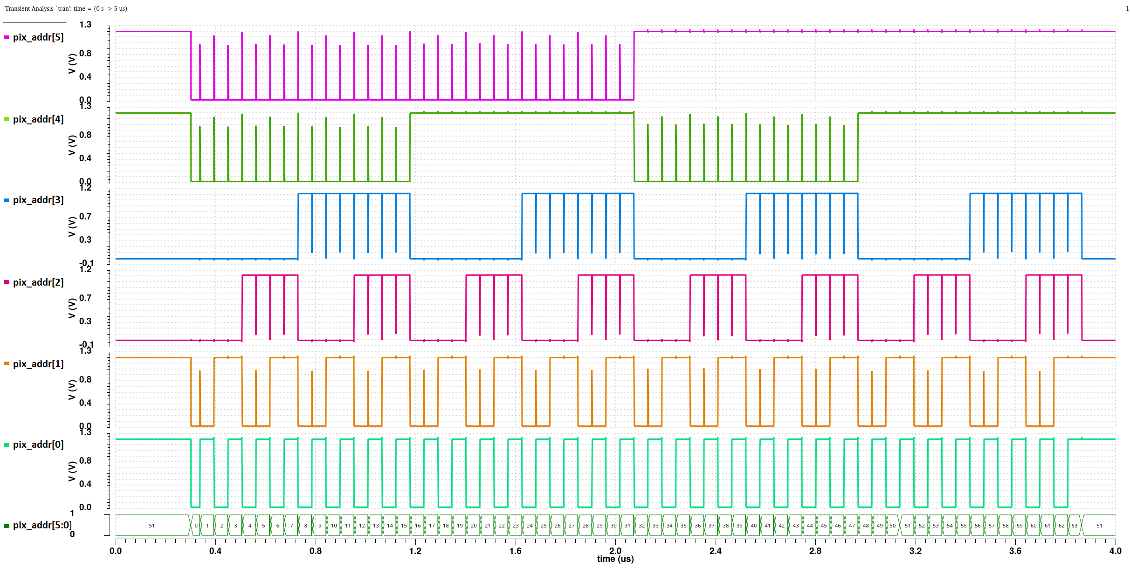
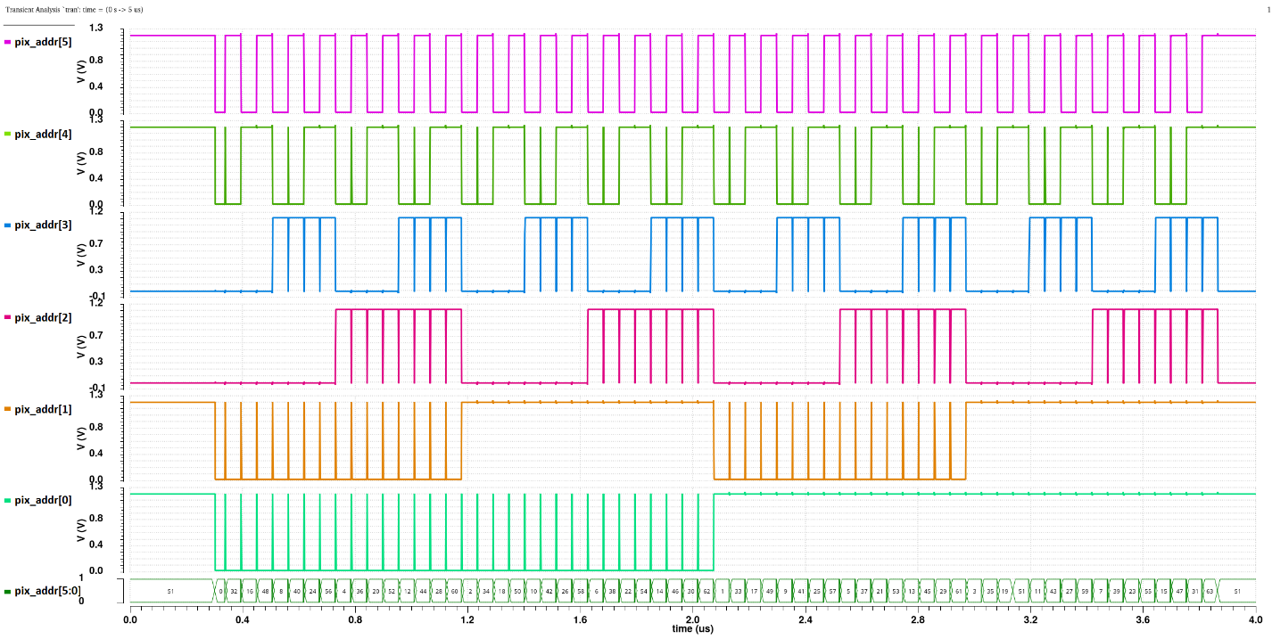
Unfair vs fair arbitration

Slide 13
Readout latency in EDWARD
Assumptions in the example:
1024 independent pixels with Poisson process generator (rate λ);
readout clock equal to 250 MHz/14 = 17.86 MHz
Readout latency – time passed from generating the event to latching data in the periphery

Slide 14
Readout latency in EDWARD
When only one pixel is active the readout delay has a uniform distribution,
When the generation rate is relatively low (compared to the readout rate), the data is read out from the pixel with the first active acknowledgement generated, but sometimes the pixel has to wait for servicing of other requesting pixels,
When the token generation rate increases the average readout delay increases due to more pixels simultaneously waiting to be read out,
In the extreme case, the readout delay seeks a limit equal to the frame readout, i.e., each pixel must wait for all other pixels to read.

Slide 15
Readout latency
The mean and RMS of readout latency as a function of particle flux (~event generation) for different readout clock speeds.

Slide 16
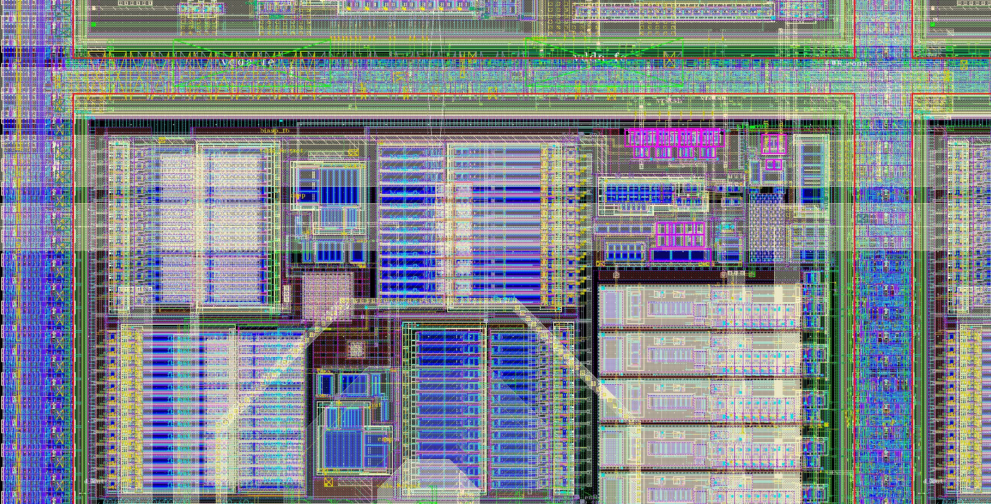
3FI65P1 chip
Flash view of implementation in X-ray pixel Readout ASIC, challenge of translation to monolithic O(20um) pixels
Readout and configuration implemented in digital gates
90 μm
Analog Front-end
CMOS 65 nm
about 4,000 transistors / pixel (100 ×100 μm²), 20 : 80 analog : digital

Slide 17
3FI65P1 chip

Slide 18
Backup slides

Slide 19
Low-Power Front-End Design
ALICE-ITS3 – modified ALPIDE FE
ALPIDE’s Front-End is suitable for framed readout but it is not enough beyond:
Time-Walk is shaded by frame durations;
hand-shake with priority-encoder-based readout uses global STROBE;
does not amplify input charge;
needs directly maximizing charge-to-voltage conversion what is slow.
Notes:
Pochwal ALPIDE – szybszy czas odczytu się nie nadaje jednak
Zamiast z małego ladungu (wolnego) generacje skoku napięcia mamy wzmacniacz ladunkowy (poprawa czasowa)
Tylko 3 stopnie (tak samo)
Moc – optymalizacja, kilkadziesiąt nw ~50nW, mniej biasow
Rozsmarowanie resourcow

Slide 20
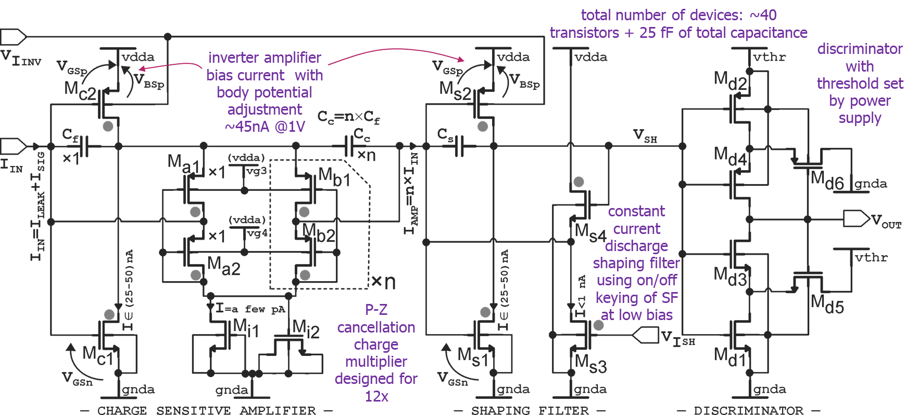
Low-Power Front-End Design
ALPIDE Æ ALICE-ITS3 Front End:
does not amplify charge but needs to create voltage amplitude large enough to discriminate;
high-gain stage operates at low current but does not allow increase of transconductance with signal;
It is still composed of three stages.
Direction for proposed FE paved by Electron Microscopy MAPS LDRD at BNL using SCFET amplifier for charge multiplication:
Low DC bias with signal-dependent increase (low power X0 nW),
Capacitive arithmetic charge multiplication;
Fast rise time and constant current discharge,
Discriminator with hysteresis and threshold applied as power supply
Minimal (2) number of biases,
Q-amplifying FE developed in Electron Microscopy LDRD at BNL
Q-amplification
I-const. discharge
discriminator

Slide 21
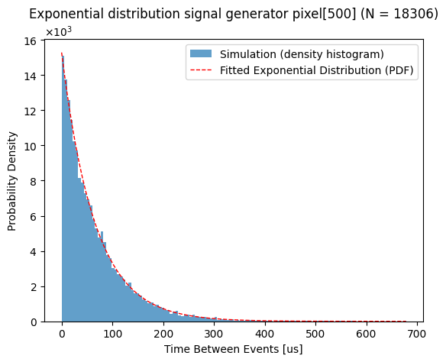
Medium requests rate
$$for f_{gen}=62.11 MHz and N_{mask}=12:$$
$$λ_{theoretical}=15164.0 S/s$$
$$λ_{measured}\left[1\right]=15169.2 S/s$$
$$λ_{measured}[500]=15275.8 S/s$$
[1]

Slide 22
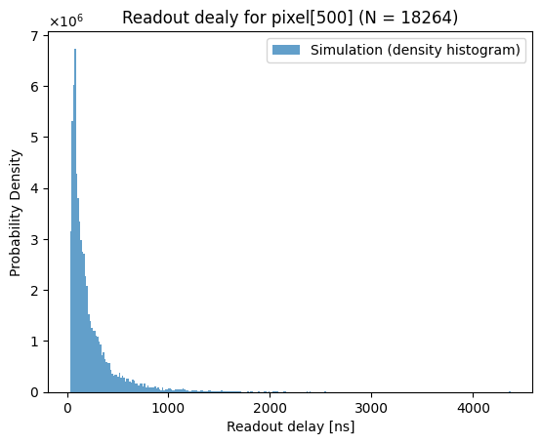
Medium requests rate – readout delay
Max readout delay [ns]: 5,177.62
Min readout delay [ns] : 33.42
Max readout delay [ns]: 4,368.29
Min readout delay [ns] : 32.09
[1]

Slide 23
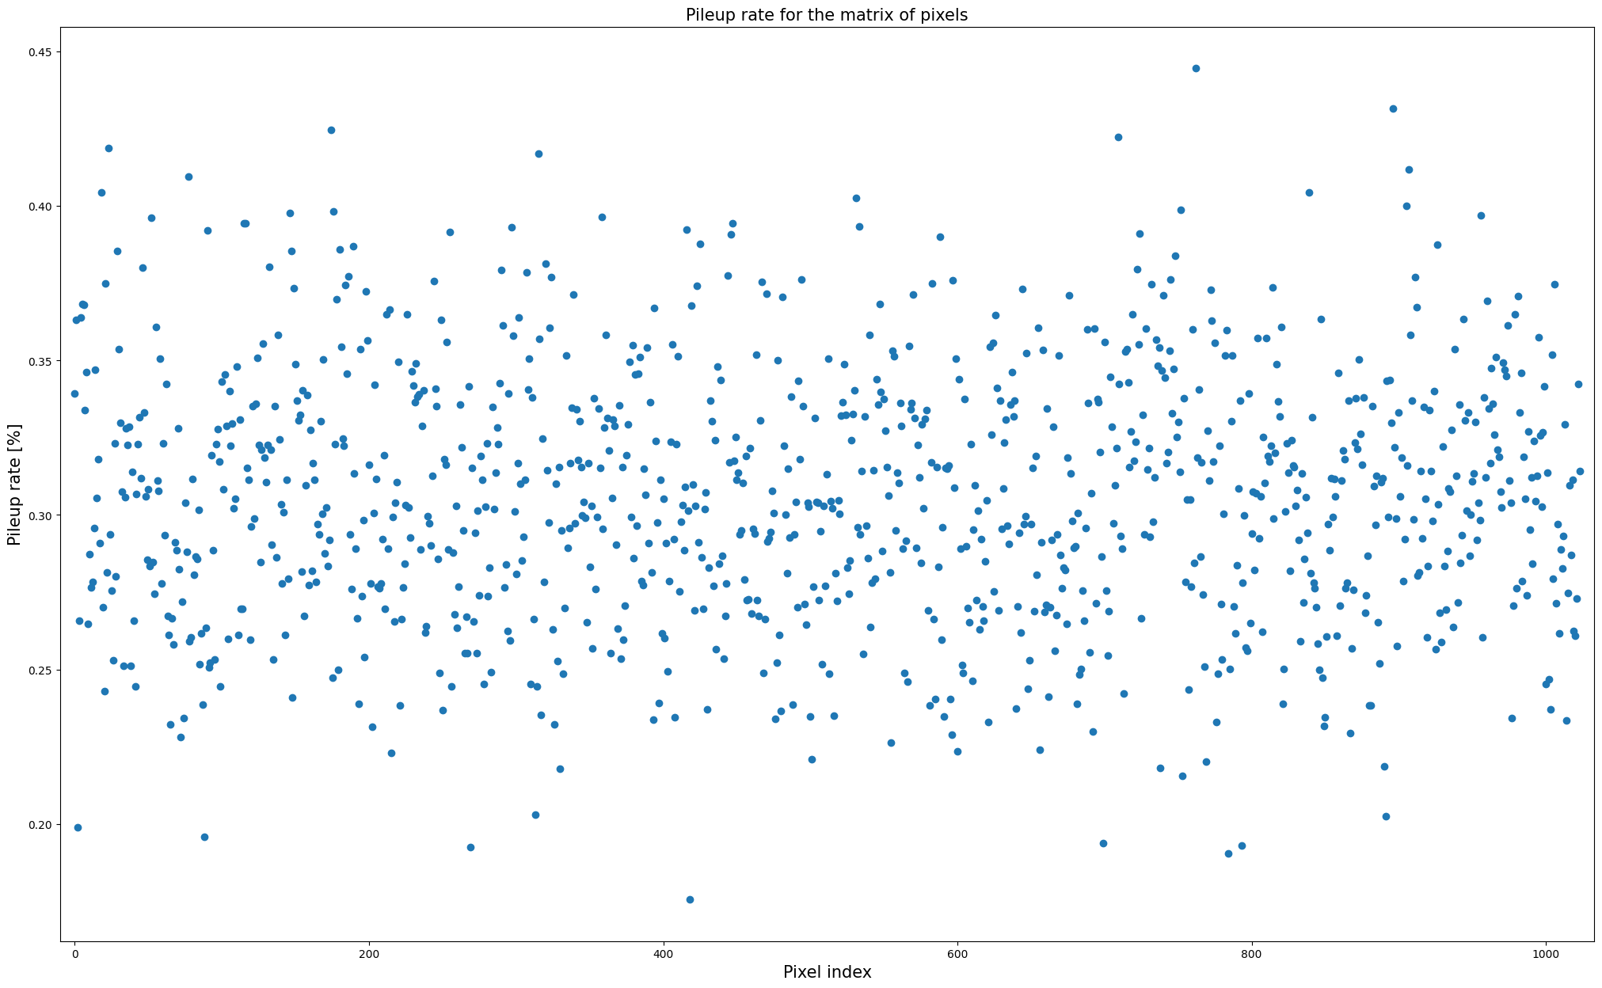
Medium requests rate – pileup rate
Minimum pileup count value: 32 (418)
Maximum pileup count value: 81 (762)
Minimum pileup rate value: 0.18% (418)
Maximum pileup rate value: 0.44% (762)

Slide 24
Medium requests rate – error bar plot
 | μ [ns] | σ [ns]
min | 223.0 (293) | 253.3 (1000)
max | 243.6 (766) | 304.0 (565)
cum | 232.6 | 272.9

