Slide 1
Front-Ends for Extreme Conditions
HEPIC 2024
Carl Grace 5/1/2024
Lawrence Berkeley National Laboratory

Slide 2
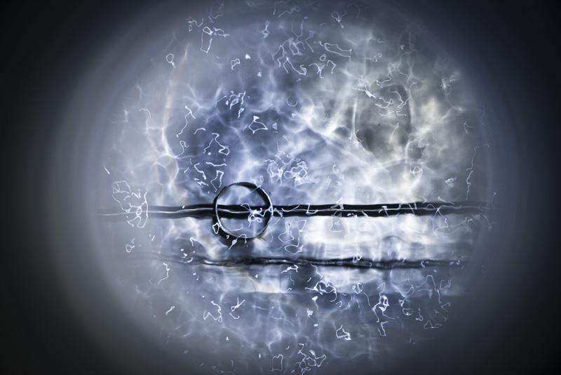
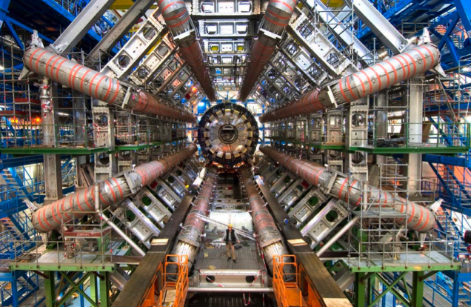
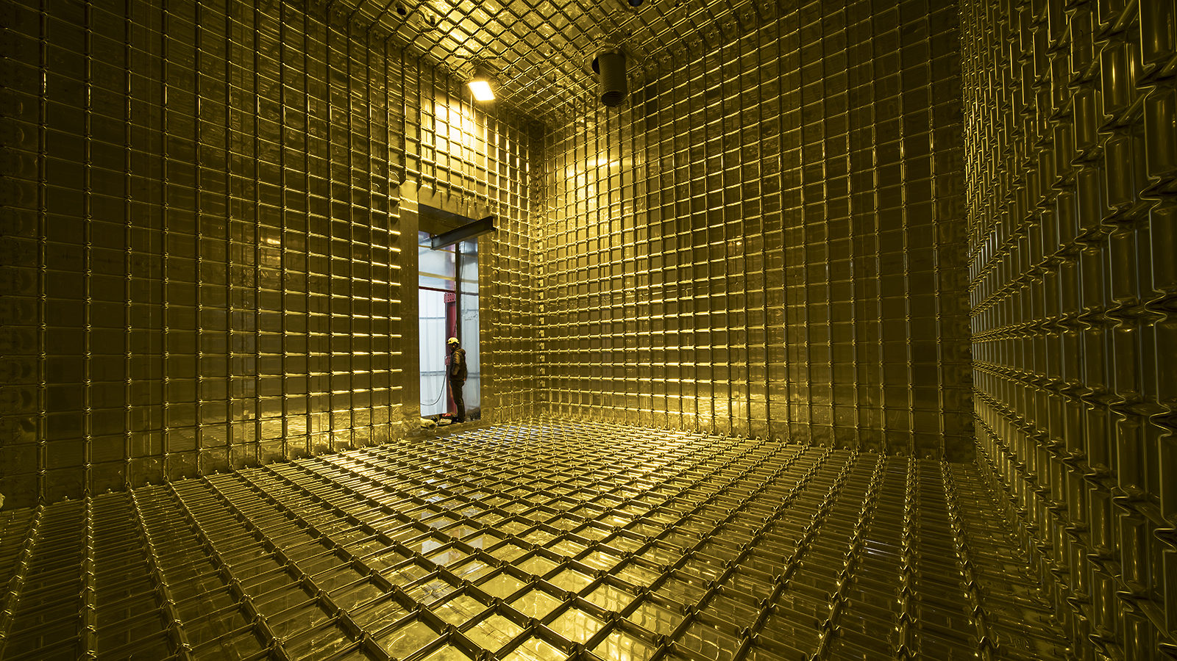
Challenges for Custom ASICs
Physics experiments often create extreme environments for their readout ASICs
High Radiation
Cold Temperature
Liquid Argon
ATLAS Detector
ProtoDUNE LAr TPC

Slide 3
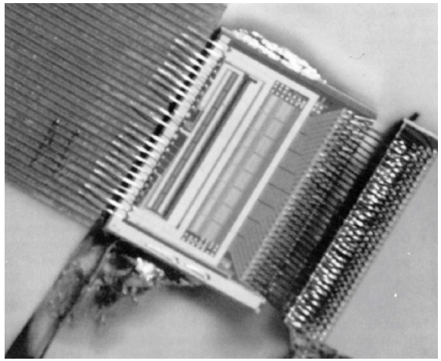
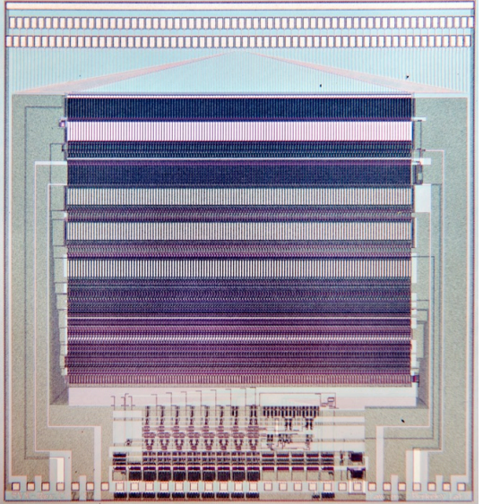
First Physics ASICs
Microplex – first custom ASIC for Physics Research
SVX – First CMOS ASIC for Physics Research
6.3 mm
11,000 transistors
CDF experiment used 240 SVX chips → 30720 channels
Already at discrete limit
Follow-on versions co-designed with FNAL
6.3 mm
NMOS process (no P-channel devices) - SLAC - 1984
CMOS process (with P-channel devices) - LBNL - 1987
128 channels
3 mW / channel
Walker, Parker, Hyams, Shapiro, “Development of High Density Readout for Silicon Strip Detectors,” NIM 226 (1984)
128 channels
1.25 mW / channel
Kleinfelder, et al.; “A Flexible 128-Channel Silicon Strip Detector Instrumentation Integrated Circuit with Sparse Data Readout”, TNS 35 (1988)

Slide 4
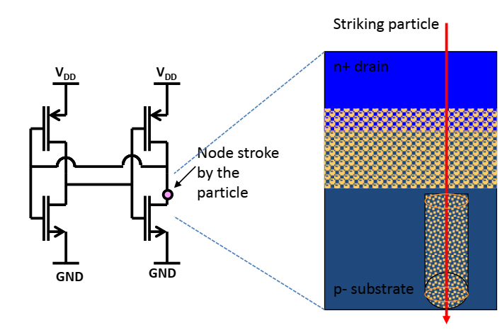
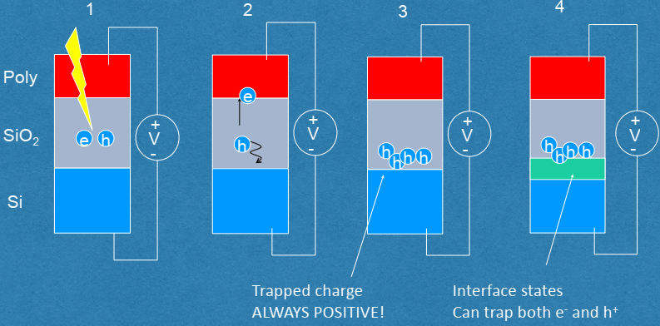
Challenges for Custom ASICs - Radiation
Two main types of radiation damage to integrated circuits that concern us (Single Event Latchup and Single Event Transients of less importance in HEP experiments)
Single Event Upset – transient effects that could modify data or lead to incorrect data
Total Integrated Dose – structural damage to silicon structure that leads to failures

Slide 5
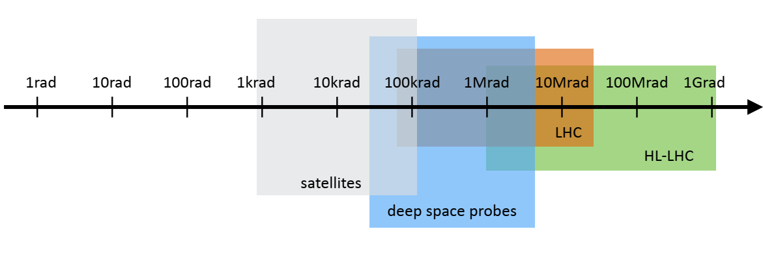
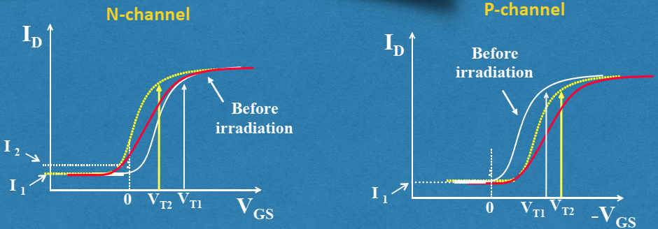
Radiation -- Total Integrated Dose (TID)
Requirements for TID radiation tolerance for physics far exceed any commercial application
F. Faccio

Slide 6
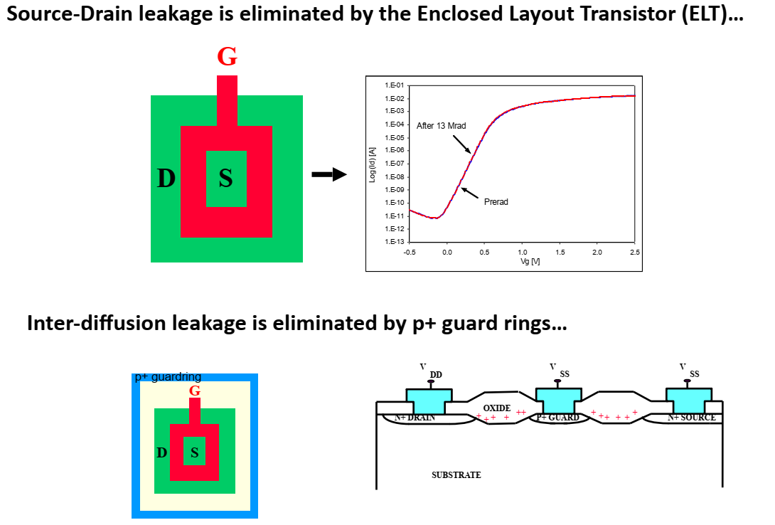
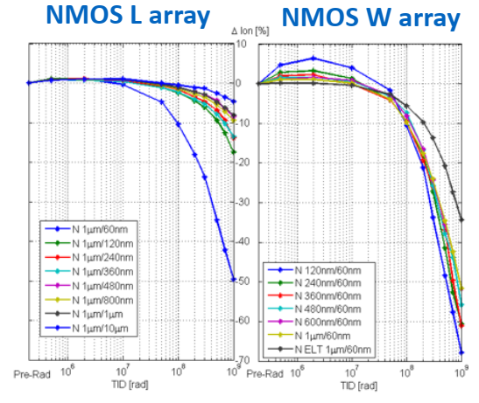
Radiation -- Total Integrated Dose (TID)
Key mitigations:
use scaled technologies (Microplex and SVX only radiation tolerant to 10s of krad)
“Hardness-By-Design” techniques (long devices / enclosed layout / guard rings / etc)
Annealing
F. Faccio

Slide 7
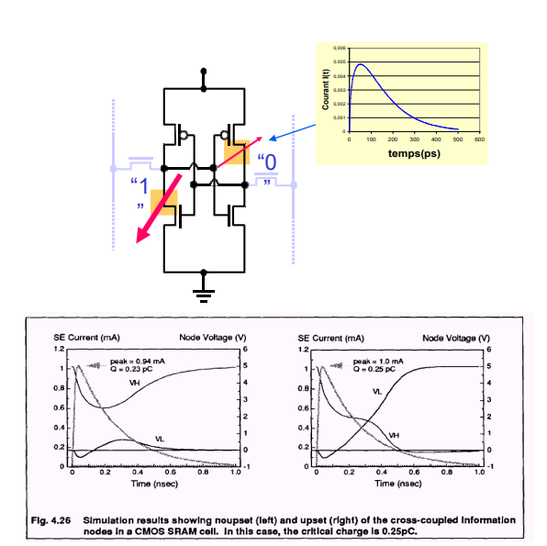
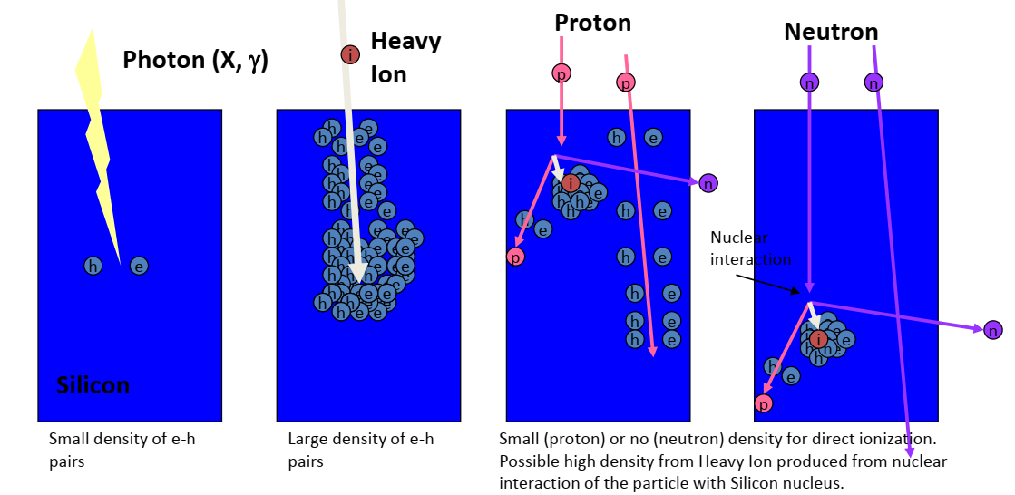
Radiation – Single Event Effects (SEE)
Scaling devices makes ASICs more resilient to TID, but less resilient to SEE
C. Zamantzas
R. Gaillard

Slide 8
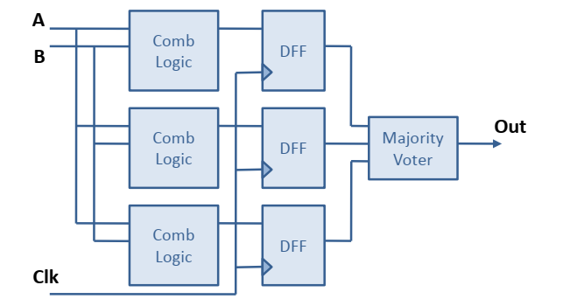
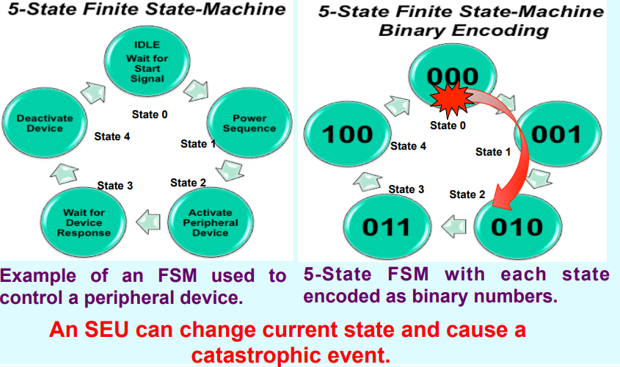
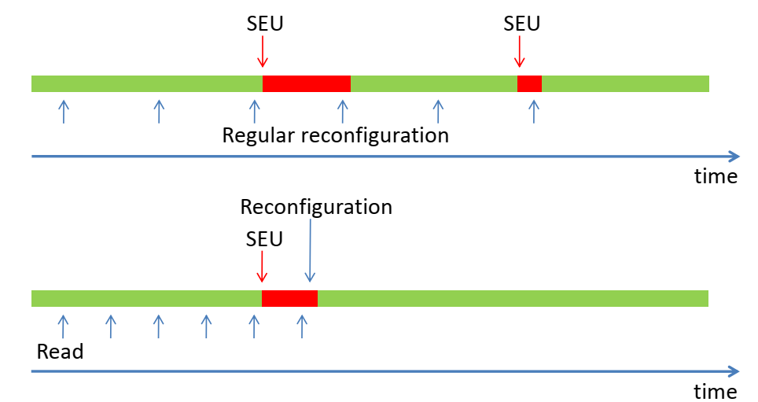
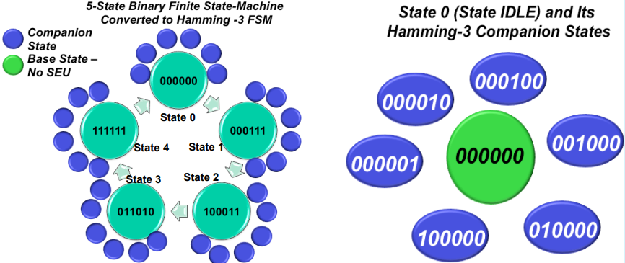
Radiation – Single Event Effects (SEE)
Key mitigations: Triple Modular Redundancy (TMR), Hamming encoding, continuous reconfiguration
Triple Modular Redundancy (TMR)
- Device level? Circuit? Module?
Continuous Reconfiguration
Hamming encoding
K. Berg

Slide 9
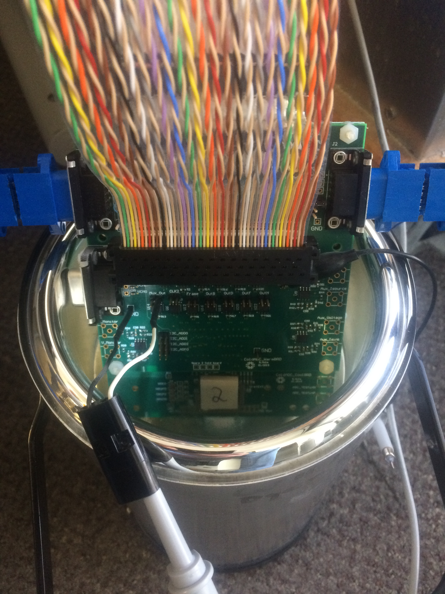
Challenges for Custom ASICs - Cryogenic Environment
Cryoelectronics are typically understood to be electronics that operate at temperatures below what can be found naturally on Earth.
From a practical IC Design standpoint, our cold integrated circuits typically operate in one of two regimes:
Liquid Nitrogen Regime → around 75 K (-200 °C)
Liquid Helium and Below Regime → 4 K or less (down to mK)
Key benefits of operating electronics in the cold:
Enabling technology that allows new system architectures that may offer improved performance
Promotes scaling by reducing cable plant and cryostat penetrations
Reduces noise (puts gain physically closer to the sensor / reduces capacitance)
Reduces overall system complexity and power dissipation

Slide 10
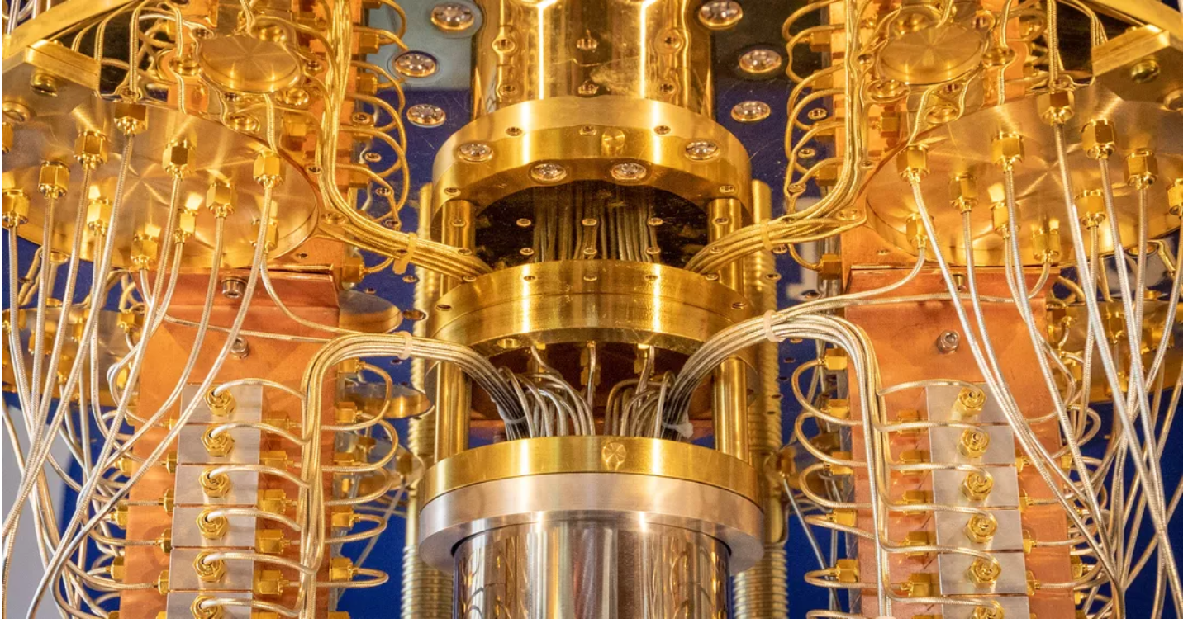
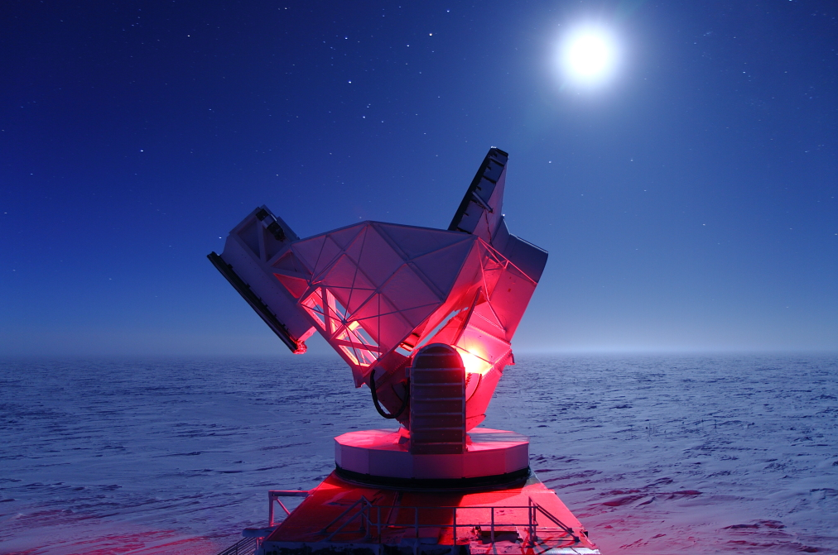
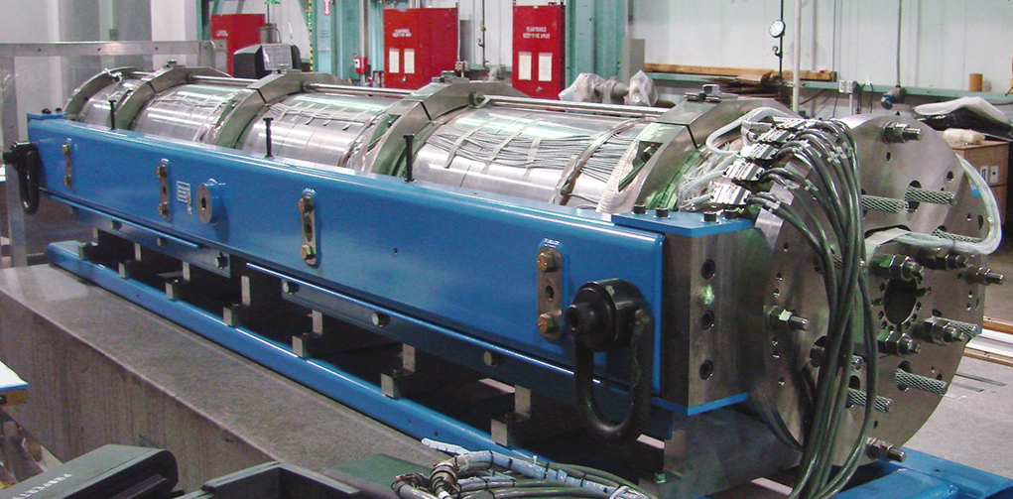
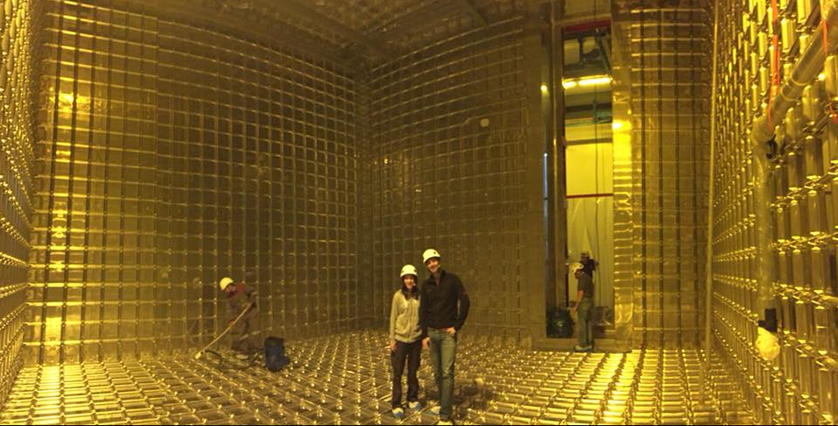
Cryogenic Electronics Applications
Quantum Computation / Science
CMB Studies
IBM Q-computer
South Pole Telescope
Superconducting Magnet Instrumentation
Nobel Liquid Particle Detectors
BNL Quadrupole magnet
ProtoDUNE-SP

Slide 11
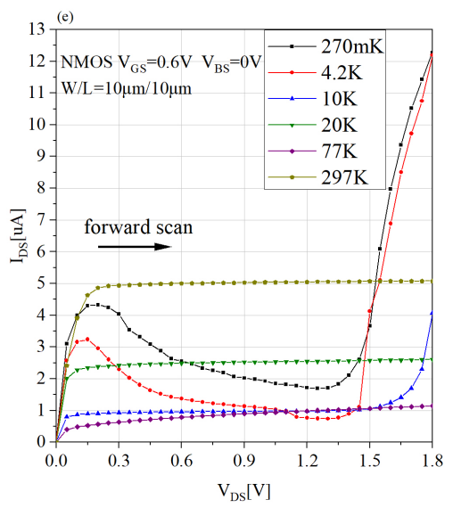
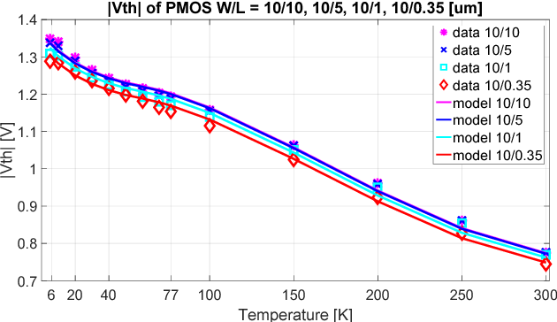
Cryogenic Operation
Reliability and biasing drift
180 nm
Negative resistance and hysteresis. Carrier freeze out also an issue.
Functionality, Threshold Shifts
180 nm

Slide 12
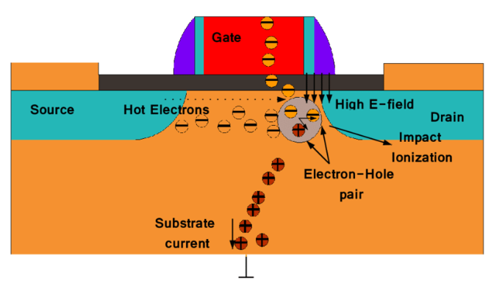
Key Challenge - Long-Term Reliability
Reliability and biasing drift
BNL and FNAL conducted lifetime studies and developed design guidelines to assure long-term reliability. Developed custom SPICE models.
UPenn and FNAL developed a cryogenic compatible standard cell library for 65nm CMOS
E. Afacan Thesis, 2016
“Hot” carriers cause early device aging

Slide 13
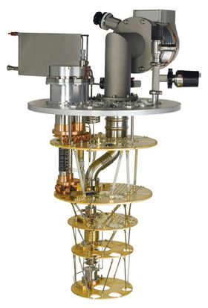
Key Challenge – Power Dissipation
Cooling Power
> 100 W
300 K
Large food fridge
100 W
70 K
LED lamp
~ 2 W
4 K
Heat dissipation through finger tip
100 µW / 1 mW
100 mK
Cellphone received signal
10 µW
20 mK
Dilution refrigerator
Oxford Instruments
Need low power-per-channel electronics to operate at coldest temperatures

Slide 14
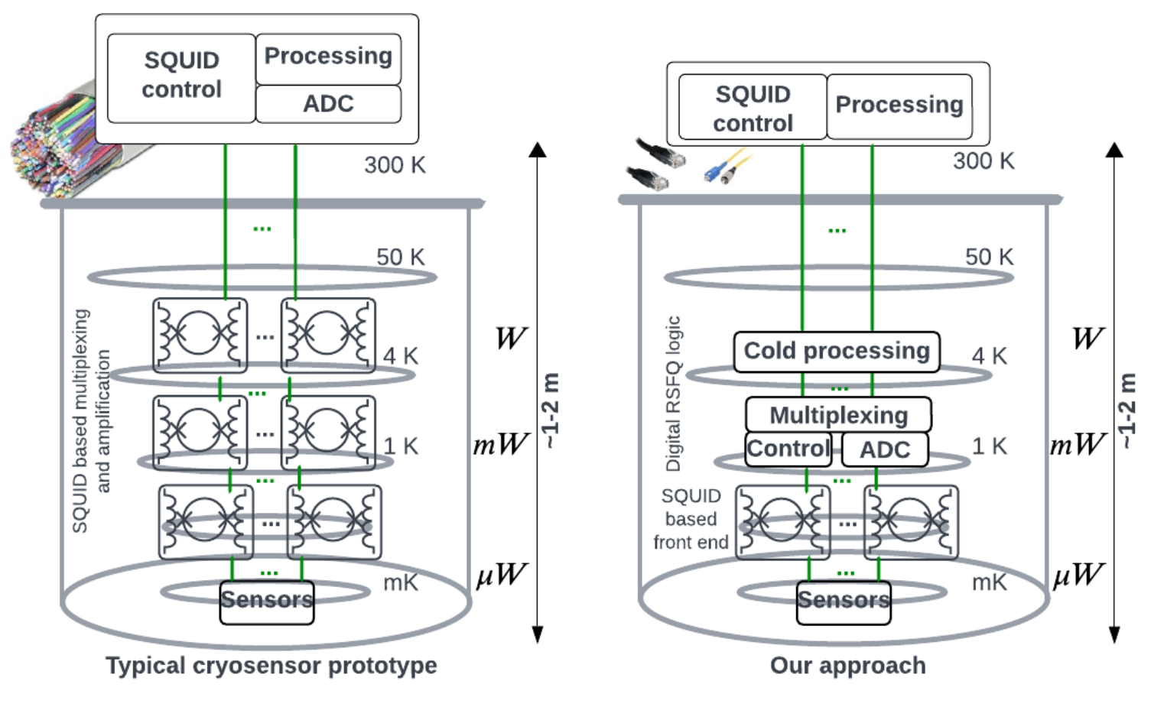
Potential Future Cryosensors – mix of CMOS and SC

Slide 15
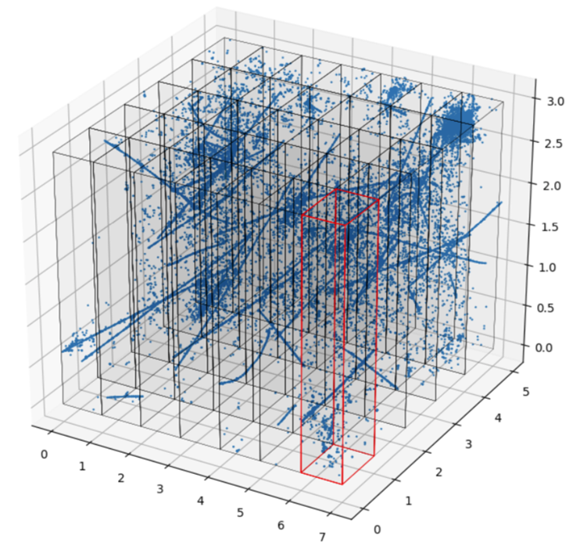
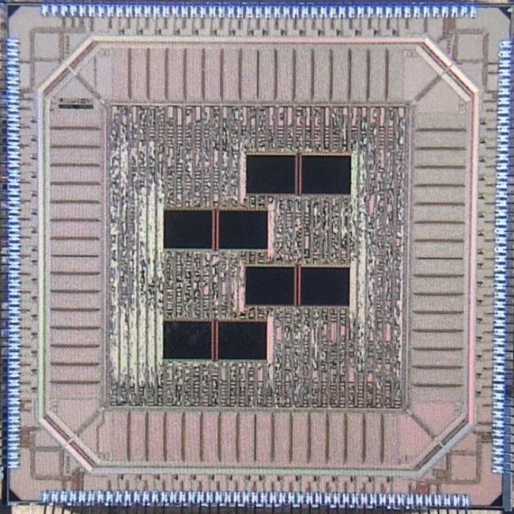
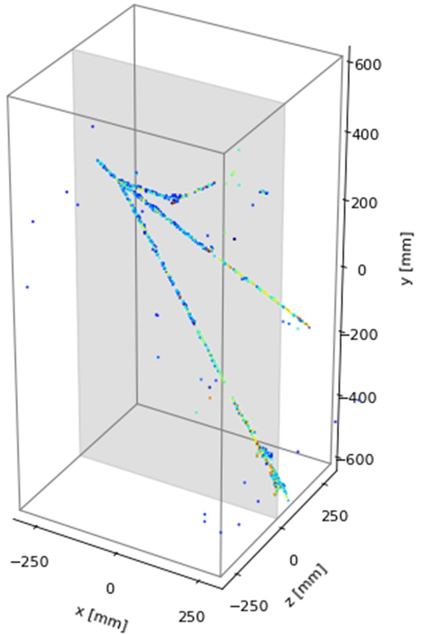
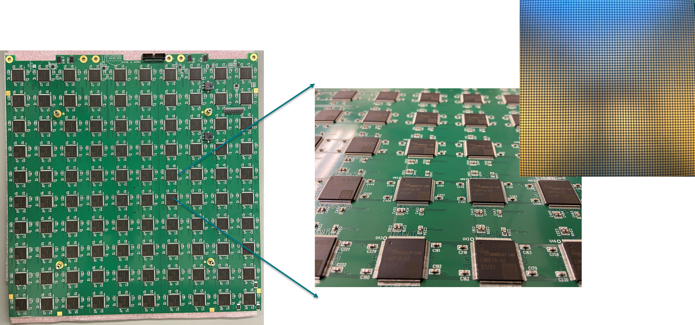
Liquid Noble Readout Electronics ~ -200° C
DUNE Near Detector
The final DUNE Near Detector will require approximately 350k ASICs to instrument a 100m² pixel plane (22.4 Mpix)
Neutrino Pileup Simulation
Front-Ends for Extreme Conditions
Pixelated solution solves reconstruction ambiguity problems with wire-plane readout

Slide 16
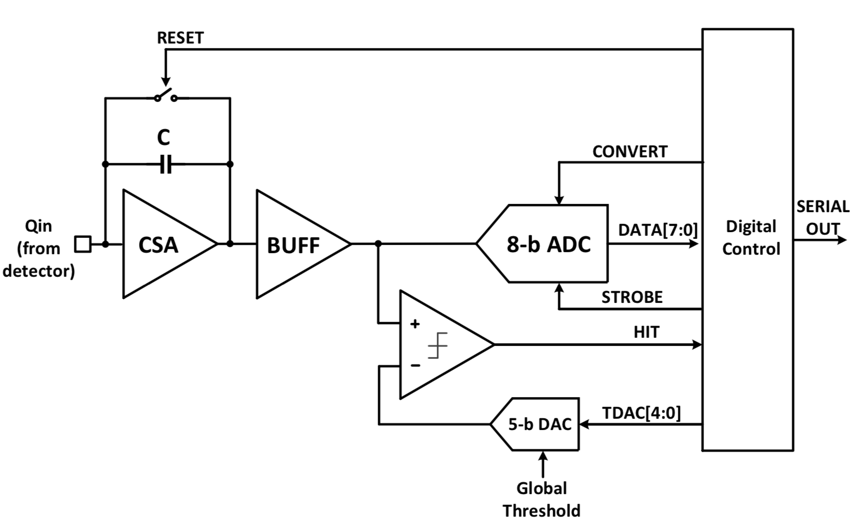
LArPix – Liquid Argon Pixel ASIC
Approach: Integrating Amplifier with Self-triggered Digitization and Readout
Digital Control
Front-end amplifier
64 channels per ASIC
Charge Sensitive Amplifier
Discriminator (self trigger)
ADC (per channel)
Digital Control logic
Global control logic
2k FIFO
On chip references and bias currents
Only decoupling capacitors needed
Immersed in Liquid Argon (-184° C)
Standard SAR Digitizer
Self-triggering Discriminator
Achieve low power: avoid digitization and readout of mostly quiescent data.

Slide 17
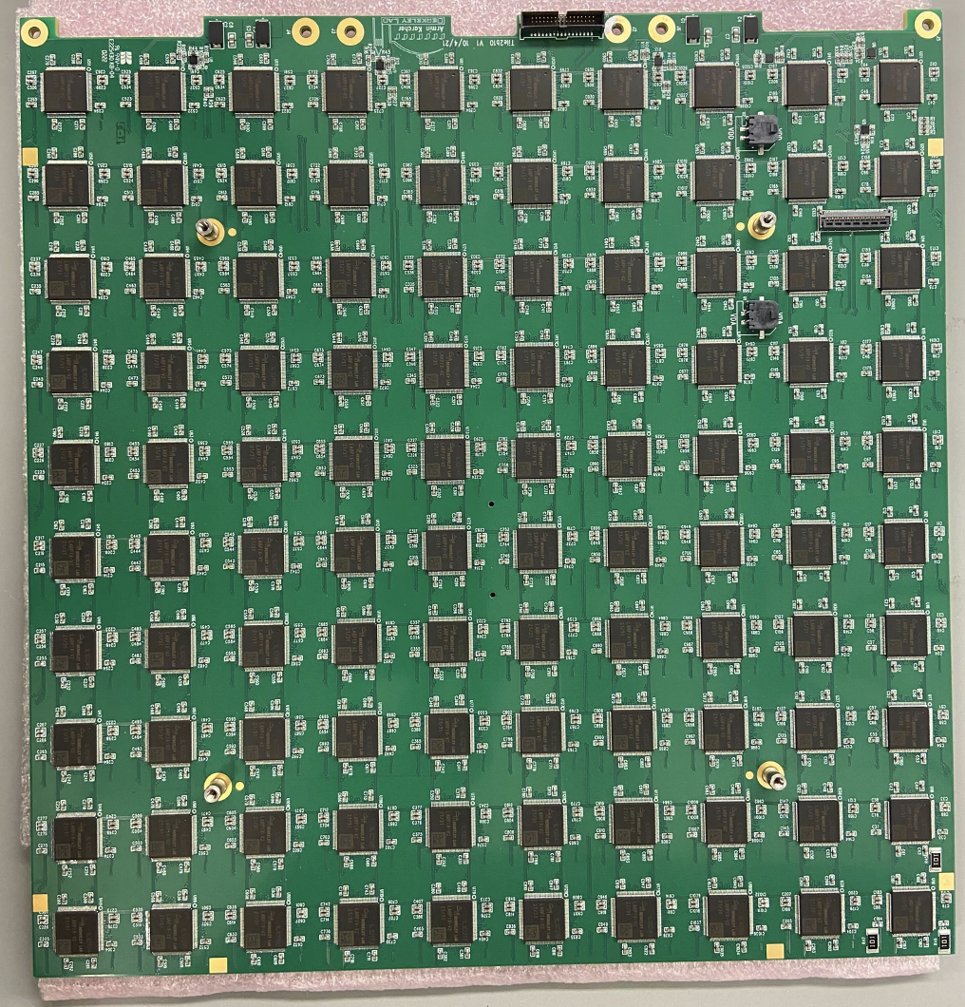
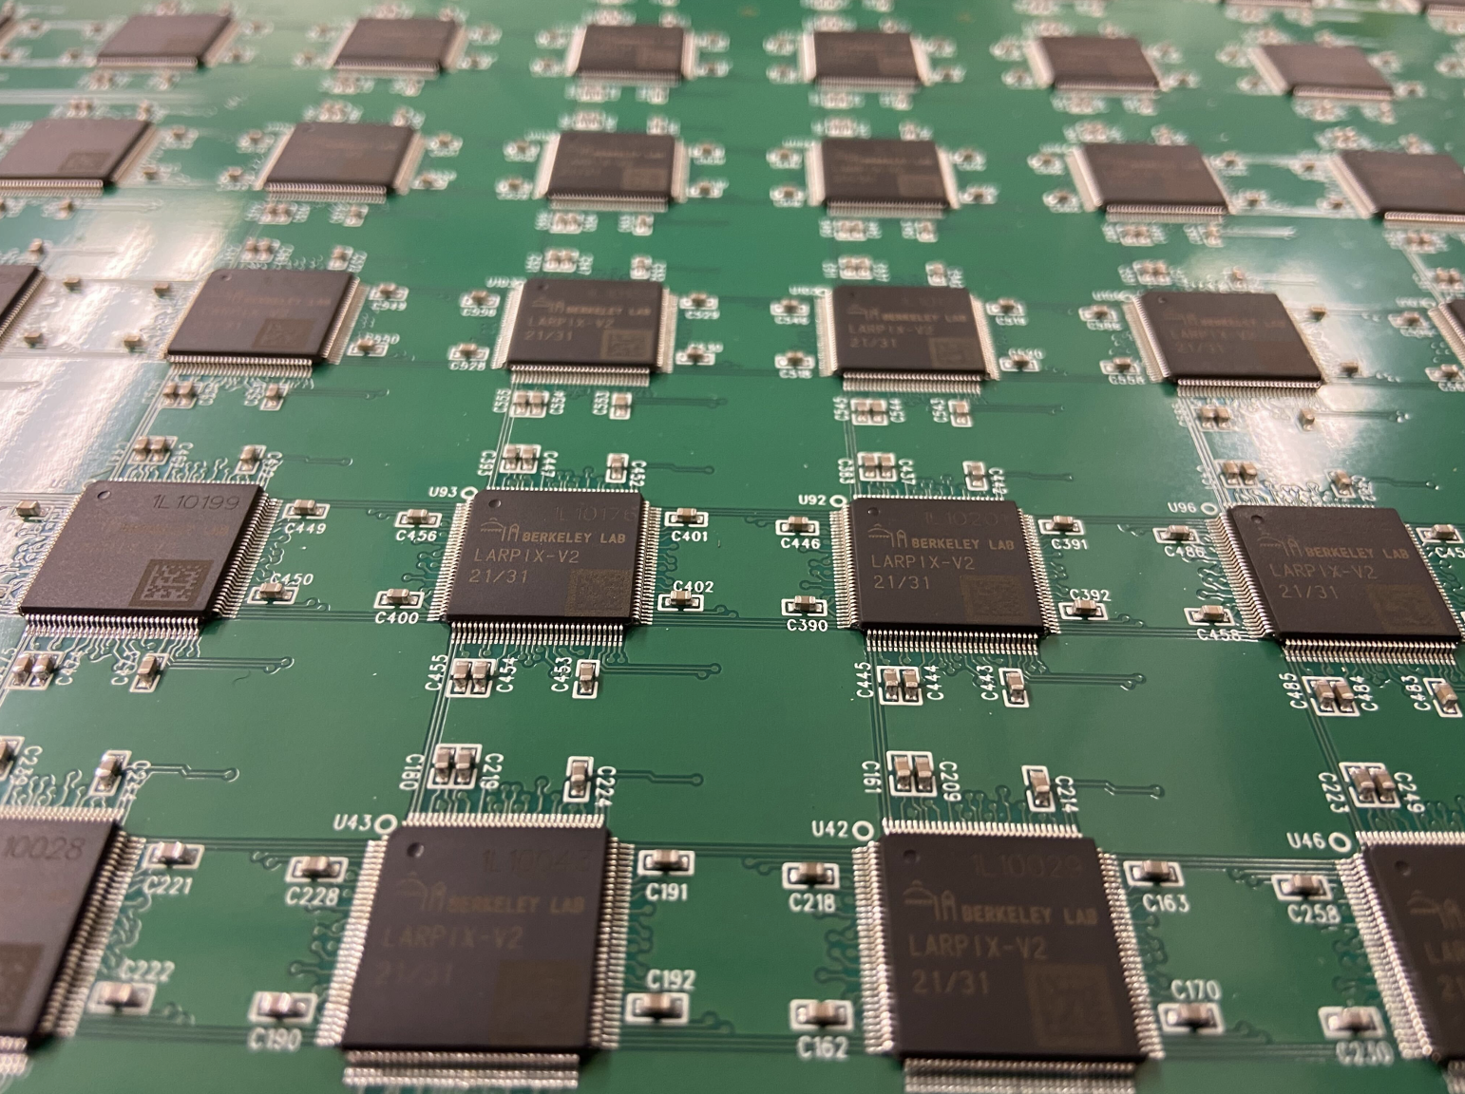
LArPix Pixel Tile
Need O(10 Million) pixels for ND
Closeup of tile
Front of tile with sensor array
Prototype tiles have 100 LArPix ASICs
(30 cm by 30 cm)
ND Tiles will scale to 160 ASICs/tile
Tile with 100 LArPix-v2 ASICs (6400 channels)

Slide 18
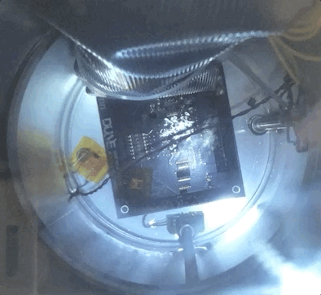
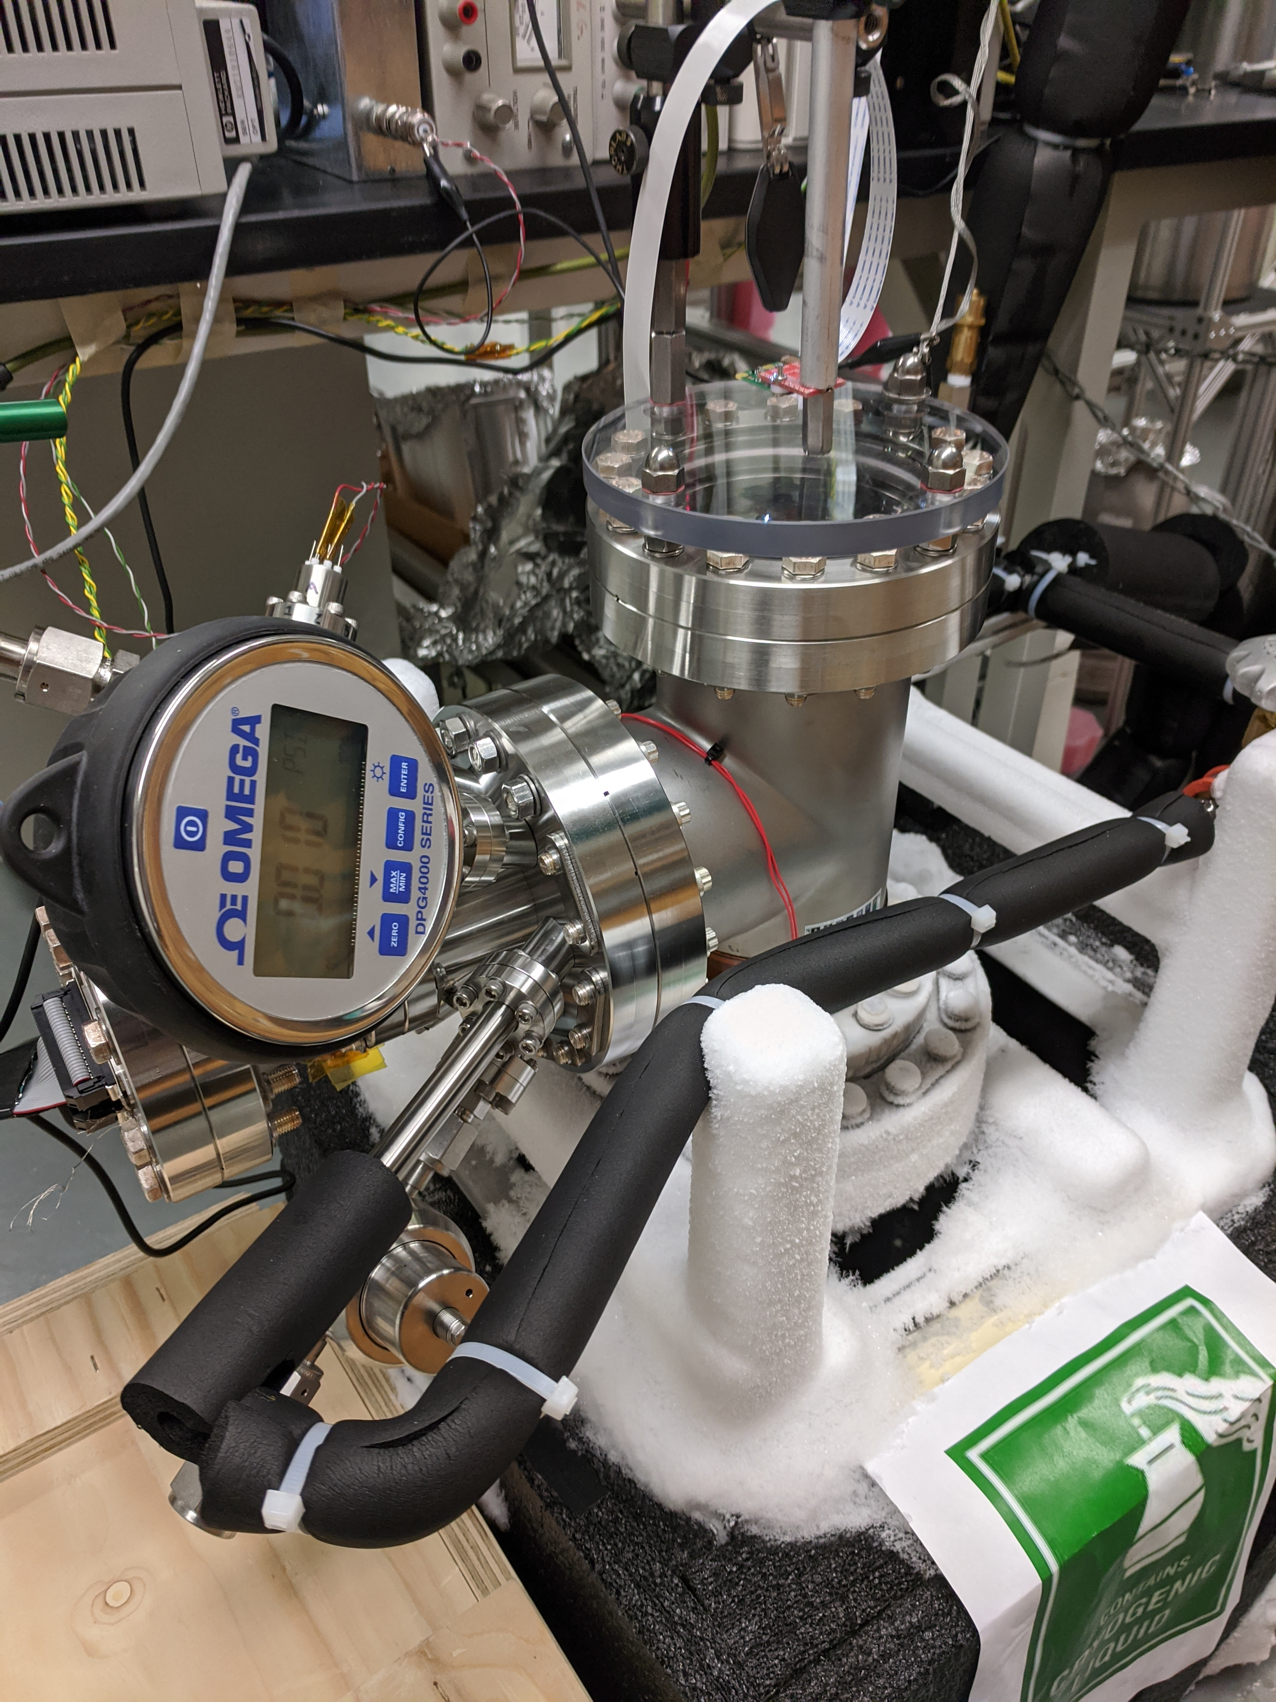
Liquid Noble Readout Electronics ~ -200° C
System in operation
Viewport
Electrical and gas/liquid feedthroughs
Test chamber
No boiling with > 3 cm LAr above chip (LArPix running full blast)
18
Front-Ends for Extreme Conditions

Slide 19
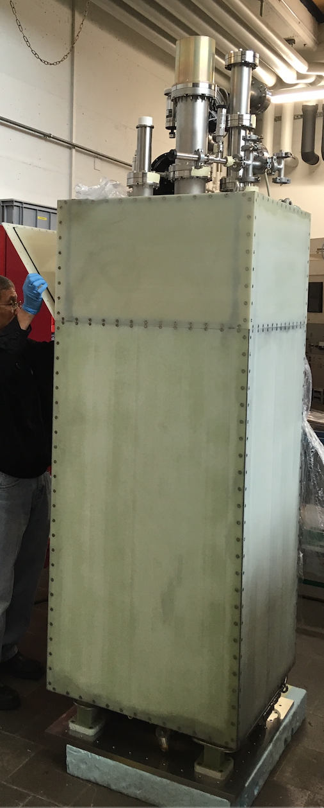
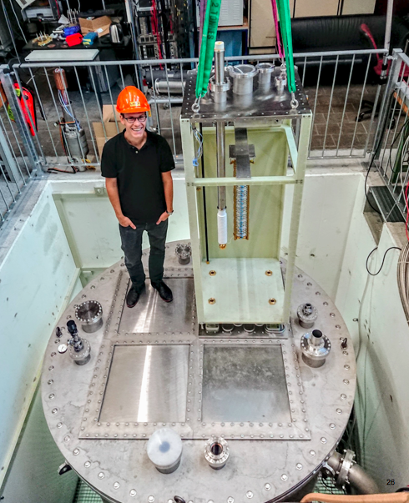
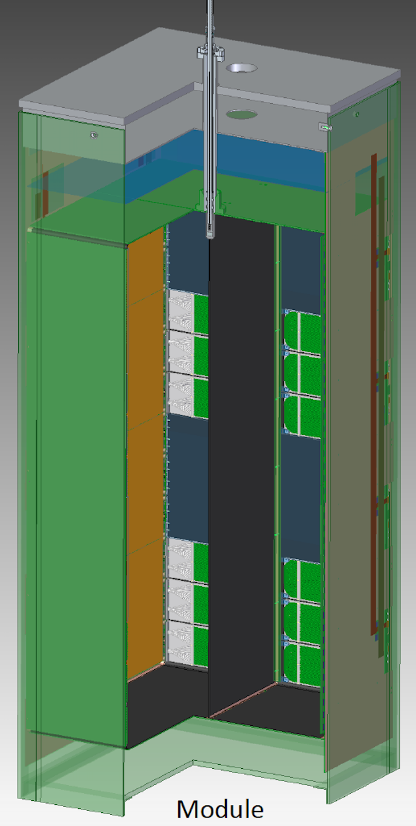
Demonstrate system scalability in large LArTPC: ArgonCube 2x2 Demonstrator
4 modular LArTPCs
Total active mass: ~3 ton
Readout area: 6.4 m²
400k pixels, 6.3k ASICs
System successfully operated.
Demonstrator for DUNE Near Detector

Slide 20
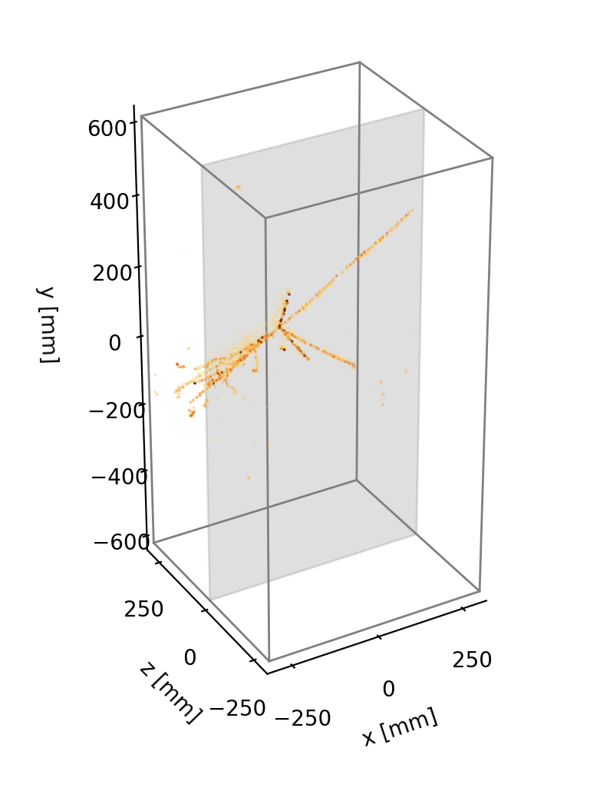
Demonstrate system scalability in large LArTPC: ArgonCube 2x2 Demonstrator
Raw data (no filtering) of cosmics in ArgonCube module0 demonstrator.
Detector delivers unprecedented track fidelity and would be impossible to implement without custom ASICs
The final DUNE Near Detector will require approximately 350k ASICs to instrument a 100m² pixel plane (22.4 Mpix)

Slide 21
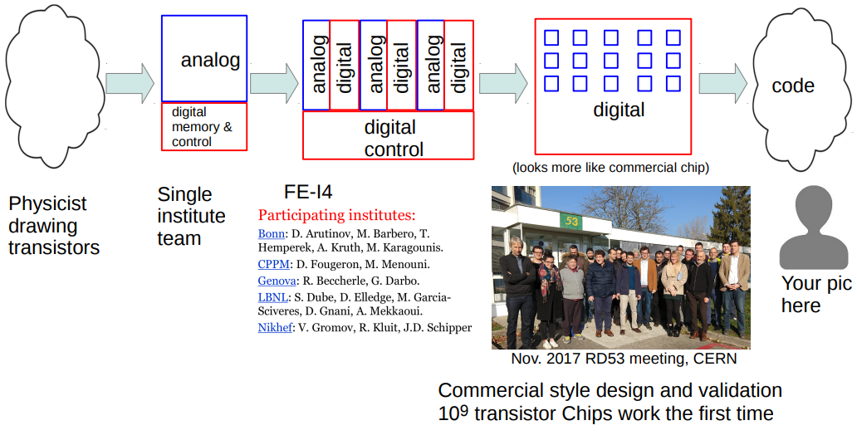
Final Thought (Courtesy M. Garcia-Sciveres)
(EEs)
1980s
1990s
2000s
2010s – 2020s
2030s?
M. Garcia-Sciveres

Slide 22
Thank You
This work was supported in part by the U.S. Department of Energy under Contract No. DE-AC02-05CH11231

