Slide 1
Compound Semiconductors for HEP ASICs
Soumyajit Mandal
smandal@bnl.gov
May 1, 2024

Slide 2
Monolithic Active Pixel Sensors in Silicon Carbide for Future Accelerators
Soumyajit Mandal¹, Grzegorz W. Deptuch¹, Gary Hunter², Philip Neudeck²
¹Instrumentation Department, Brookhaven National Laboratory
²NASA Glenn Research Center
May 1, 2024

Slide 3
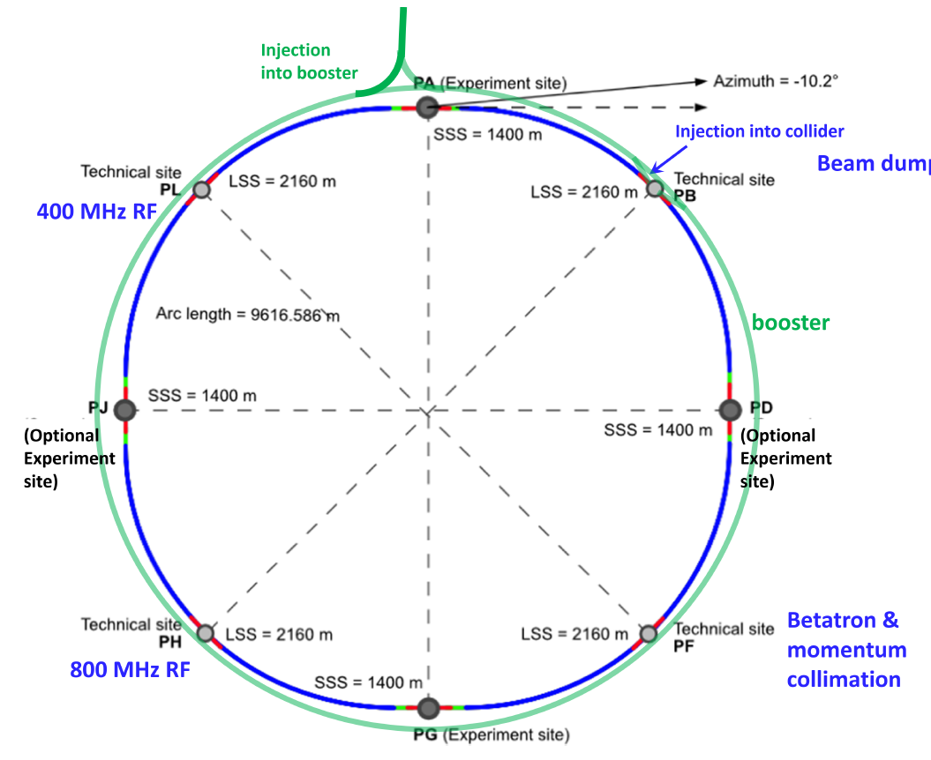
Motivation
Tracking and vertexing detectors for future accelerators, such as the Future Circular Collider (FCC) have extreme radiation hardness requirements¹.
  FCC proposals: FCC-ee (electron/positron), FCC-hh (hadron/hadron), and FCC-eh (electron-hadron)
  FCC-ee to be completed first (2040-2045)
  Four different center-of-mass energy levels: 91-365 GeV
  Very high luminosity: up to 200 x 10³⁴ cm²/s per interaction point (compare to 5 x 10³⁴ cm²/s for HL-LHC)
  Radiation hardness requirements for sensors and readout electronics:
    TID immunity of 1-3 Grad
    Displacement damage immunity of ~10¹⁸ cm⁻² (1 MeV equivalent neutron fluence)
    Both exceed requirements for LHC by up to 2 orders of magnitude
  Unlikely that silicon MAPS will be able to meet these requirements (particularly for fluence)
LHC
SPS
FCC-ee
¹I. Agapov et al., “Future Circular Lepton Collider FCC-ee: Overview and Status,” arXiv [physics.acc-ph], 15-Mar-2022.

Slide 4
Alternative semiconductor materials
Properties at 300K | Si | 4H-SiC | Diamond | GaN
Atomic number (Z) | 14 | 14/6 | 6 | 31/7
Density (g/cm³) | 2.33 | 3.22 | 3.51 | 6.15
Relative permittivity, ε_{r} | 11.9 | 9.7 | 5.7 | 9.6
Band gap energy, E_{g} (eV) | 1.12 | 3.23 | 5.5 | 3.39
e-h pair creation energy, ε (eV) | 3.6 | 7.6-8.4 | 13 | 8.9
e-h pair creation rate, MIP (eh/μm) | 80 | 57 | 25 | 65
Displacement energy, E_{d} (eV) | 13-15 | 20-35 | 43 | 10-20
Breakdown electric field, E_{max} (V/cm) | 3 x 10⁵ | 3-4 x 10⁶ | 10⁷ | 4 x 10⁶
Electron mobility, μ_{e} (cm²/V.s) | 1450 | 800-1000 | 1800-2200 | 1000
Hole mobility, μ_{h} (cm²/V.s) | 450 | 50-115 | 1200-1600 | 30
Saturated e⁻ drift velocity, v_{sat} (cm/s) | 0.8 x 10⁷ | 2 x 10⁷ | 2.2 x 10⁷ | 1.4 x 10⁷
Thermal conductivity, κ (W/K.cm) | 1.5 | 4.9 | 24-25 | 2.5
Diamond has the best material properties but is difficult to use for implementing electronics.
4H-SiC is commercially available and has an excellent combination of material and electronic properties:
  High band-gap: low dark current, insensitivity to low-energy photons
  High charge production rate: high sensitivity
  High displacement energy: radiation hardness
  High breakdown electric field: high reverse bias voltages
  High saturation velocity: fast signals, short transit times, low trapping probability

Slide 5
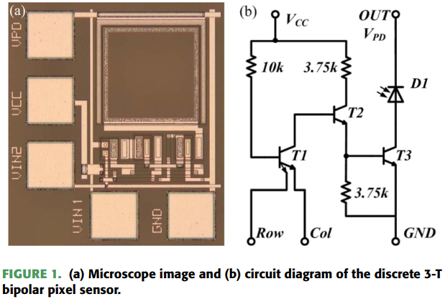
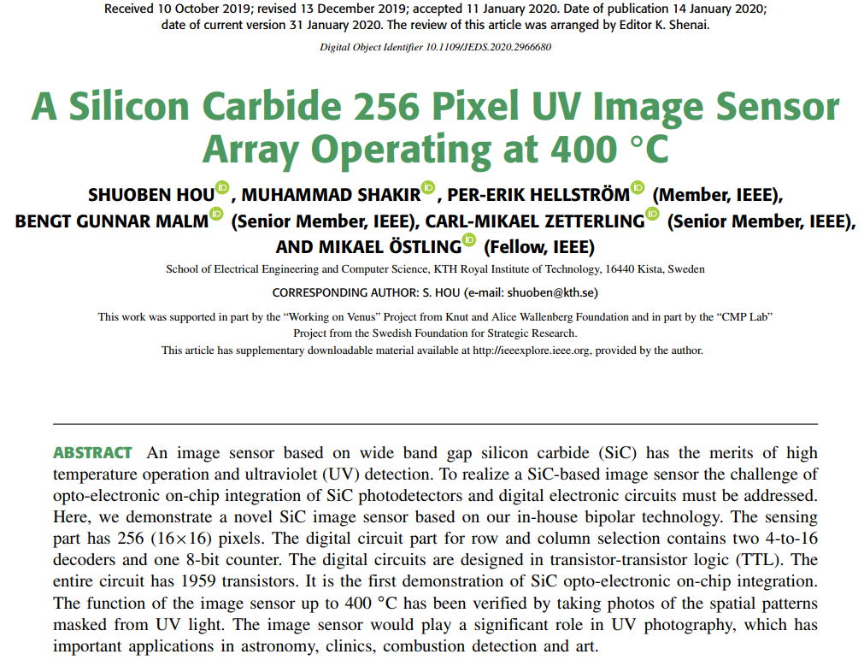
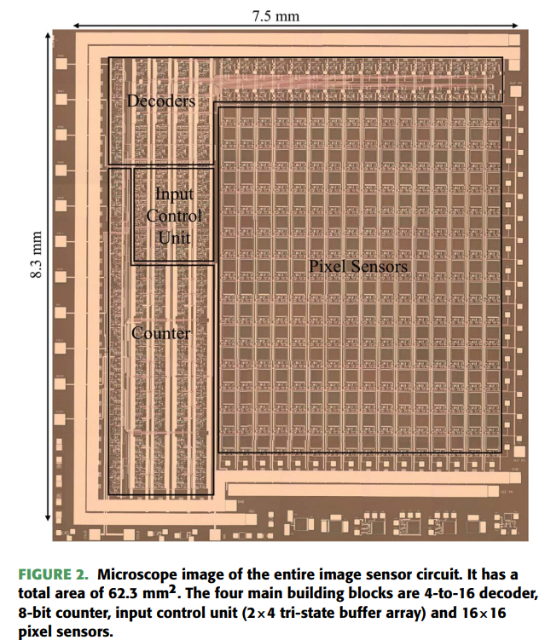
Existing work on SiC MAPS
Used an in-house SiC bipolar technology

Slide 6
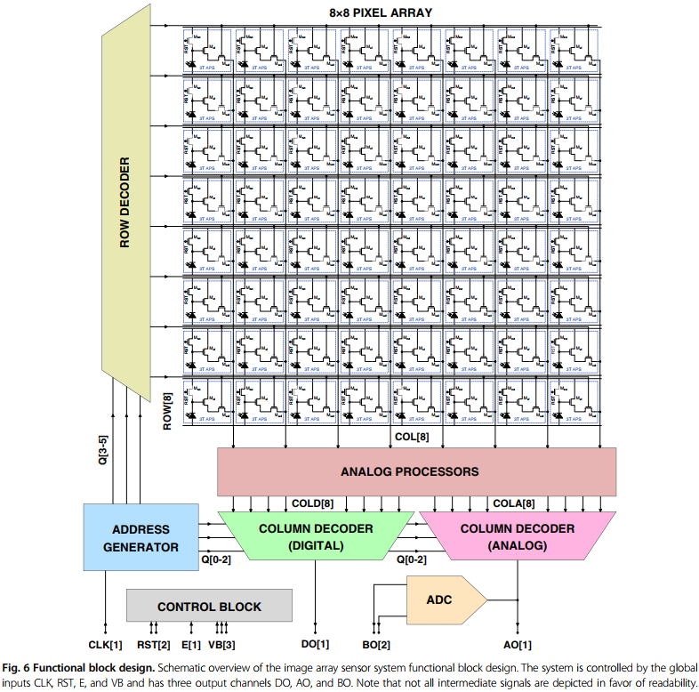
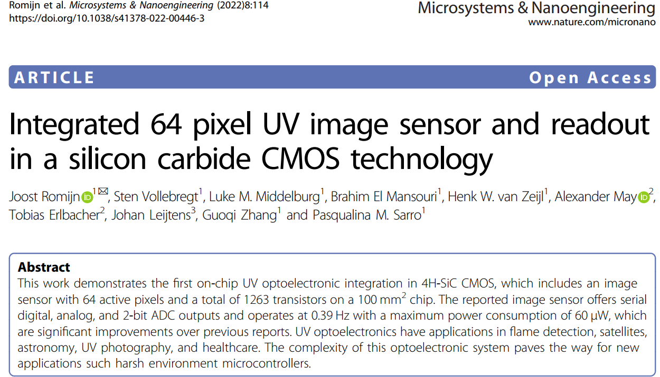
Existing work on SiC MAPS (2)
Uses a 6 μm SOI CMOS process from Fraunhofer IISB

Slide 7
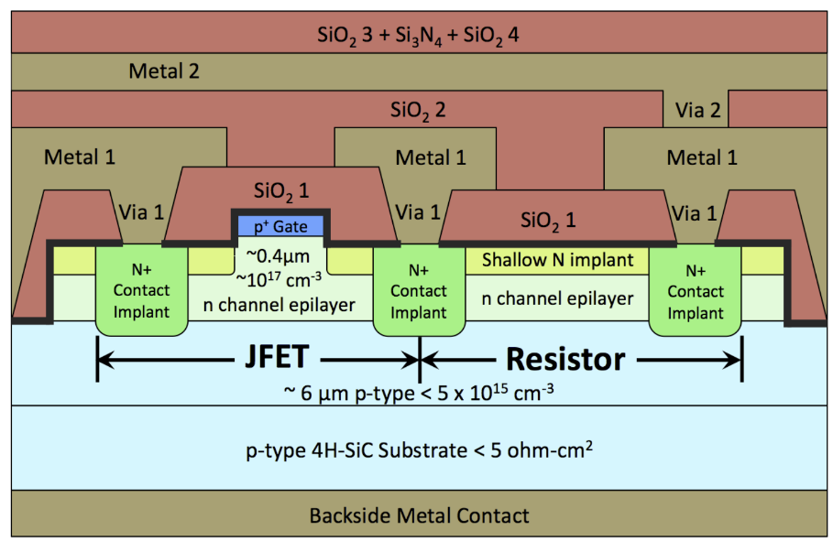
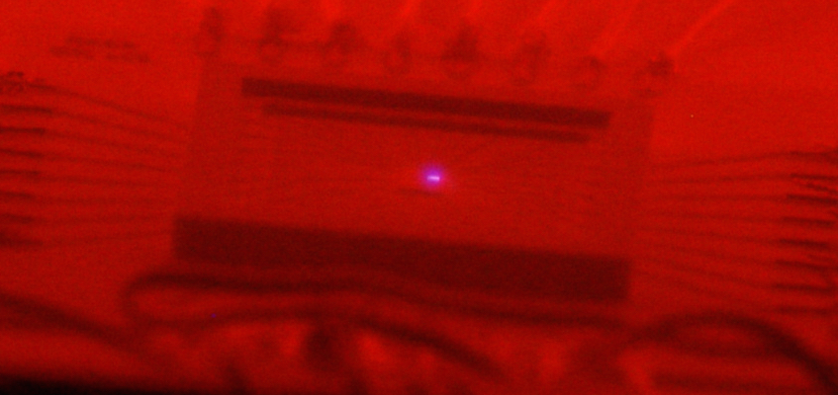
Sounds great, how do I make SiC MAPS?
Bad news: Ecosystem for SiC integrated circuit (IC) fabrication is decades behind that of Si.
Good news: The ecosystem is growing, and we already have an interested partner.
  NASA Glenn Research Center (GRC), Cleveland, OH
  GRC has developed two unique SiC IC processes: SiC-sensor and SiC-JFET
  The SiC-JFET process has been used to develop many functional circuits for a future Venus mission
  These circuits have been demonstrated to work for thousands of hours up to 900ºC¹
  Initial test results show excellent radiation hardness²
We have been engaged in discussions with GRC for several months
  Collaboration mechanism being set up
https://www1.grc.nasa.gov/research-and-engineering/silicon-carbide-electronics-and-sensors
Packaged SiC IC working at 650ºC (while glowing red-hot)
Electroluminescent gate
¹P. G. Neudeck, D. J. Spry, M. Krasowski, N. F. Prokop, and L. Y. Chen, “Demonstration of 4H-SiC JFET digital ICs across 1000 C temperature range without change to input voltages,” in Materials Science Forum, 2019, vol. 963, pp. 813–817.
²J.-M. Lauenstein et al., “Room Temperature Radiation Testing of a 500 °C Durable 4H-SiC JFET Integrated Circuit Technology,” in 2019 IEEE Radiation Effects Data Workshop, 2019, pp. 1–7.

Slide 8
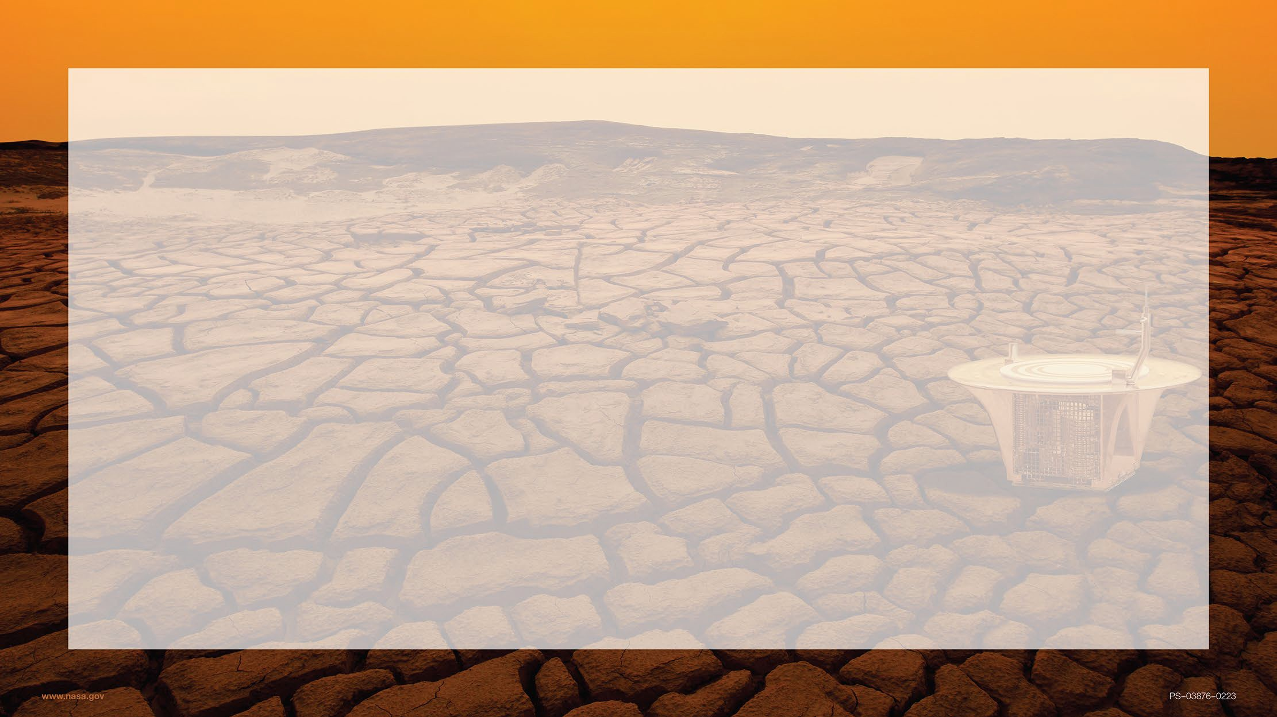
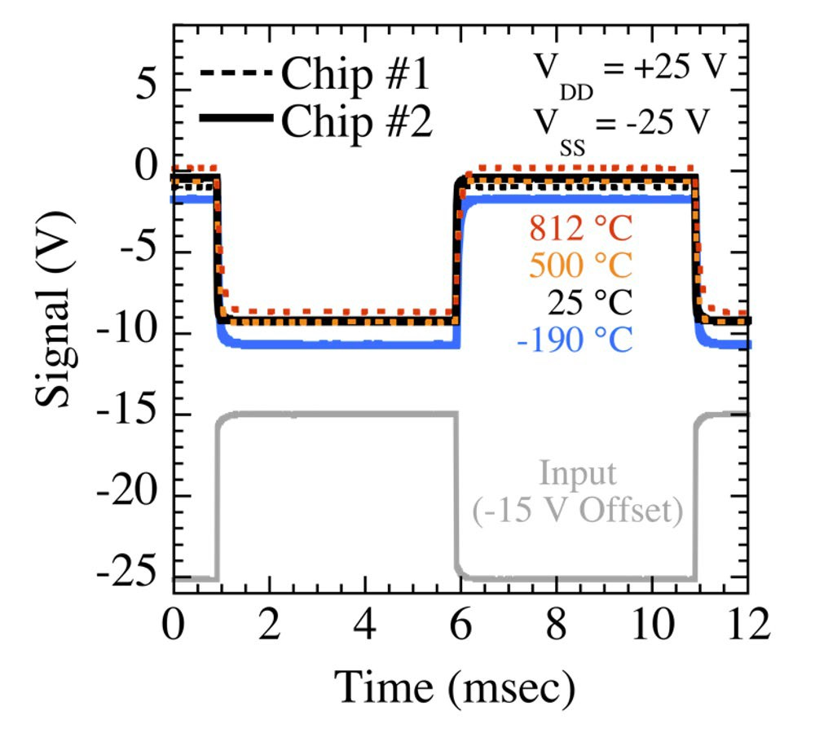
-190 °C to +812 °C and Rad Hard “Go Anywhere” Functionality^{1,2}
High Temperature, Rad Hard Silicon Carbide Electronics
(NASA Glenn IC Generation 10.1 NOT Gate Testing)
1000 °C temperature span WITHOUT changing signal/supply input voltages!
SiC JFET-R ICs function in cold environments WITHOUT “cold start” issues.
Temperature-accelerated 800 °C lifetime testing for long-duration 500 °C missions.
Straightforward functional yield screening at 25 °C (on-wafer probe test).
Radiation Tested > 7 Mrad(Si) & LET 86 MeV-cm²/mg
¹Neudeck, Spry, Krasowski, Prokop, Chen, Materials Science Forum, vol. 963, pp. 813-817 (2019).
²Lauenstein et al. IEEE Radiation Effects Data Workshop (2019) https://ntrs.nasa.gov/citations/20190031951

Slide 9
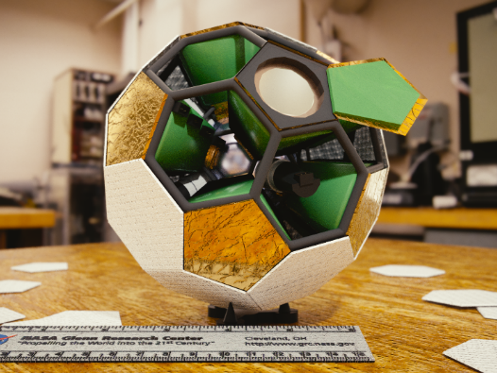
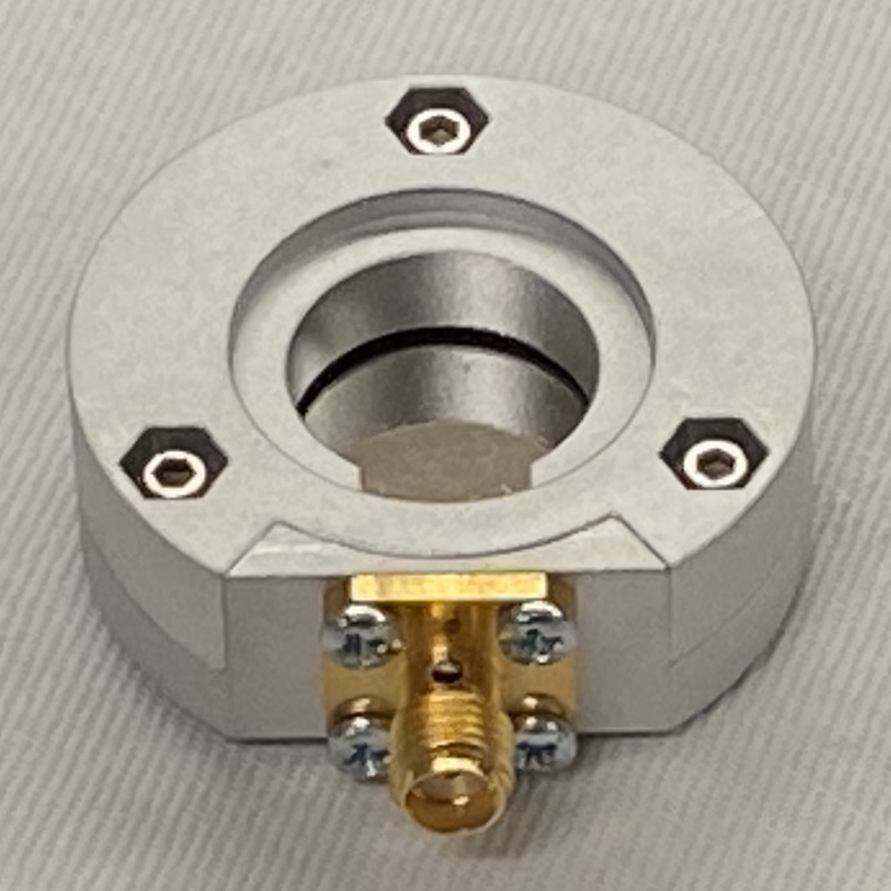
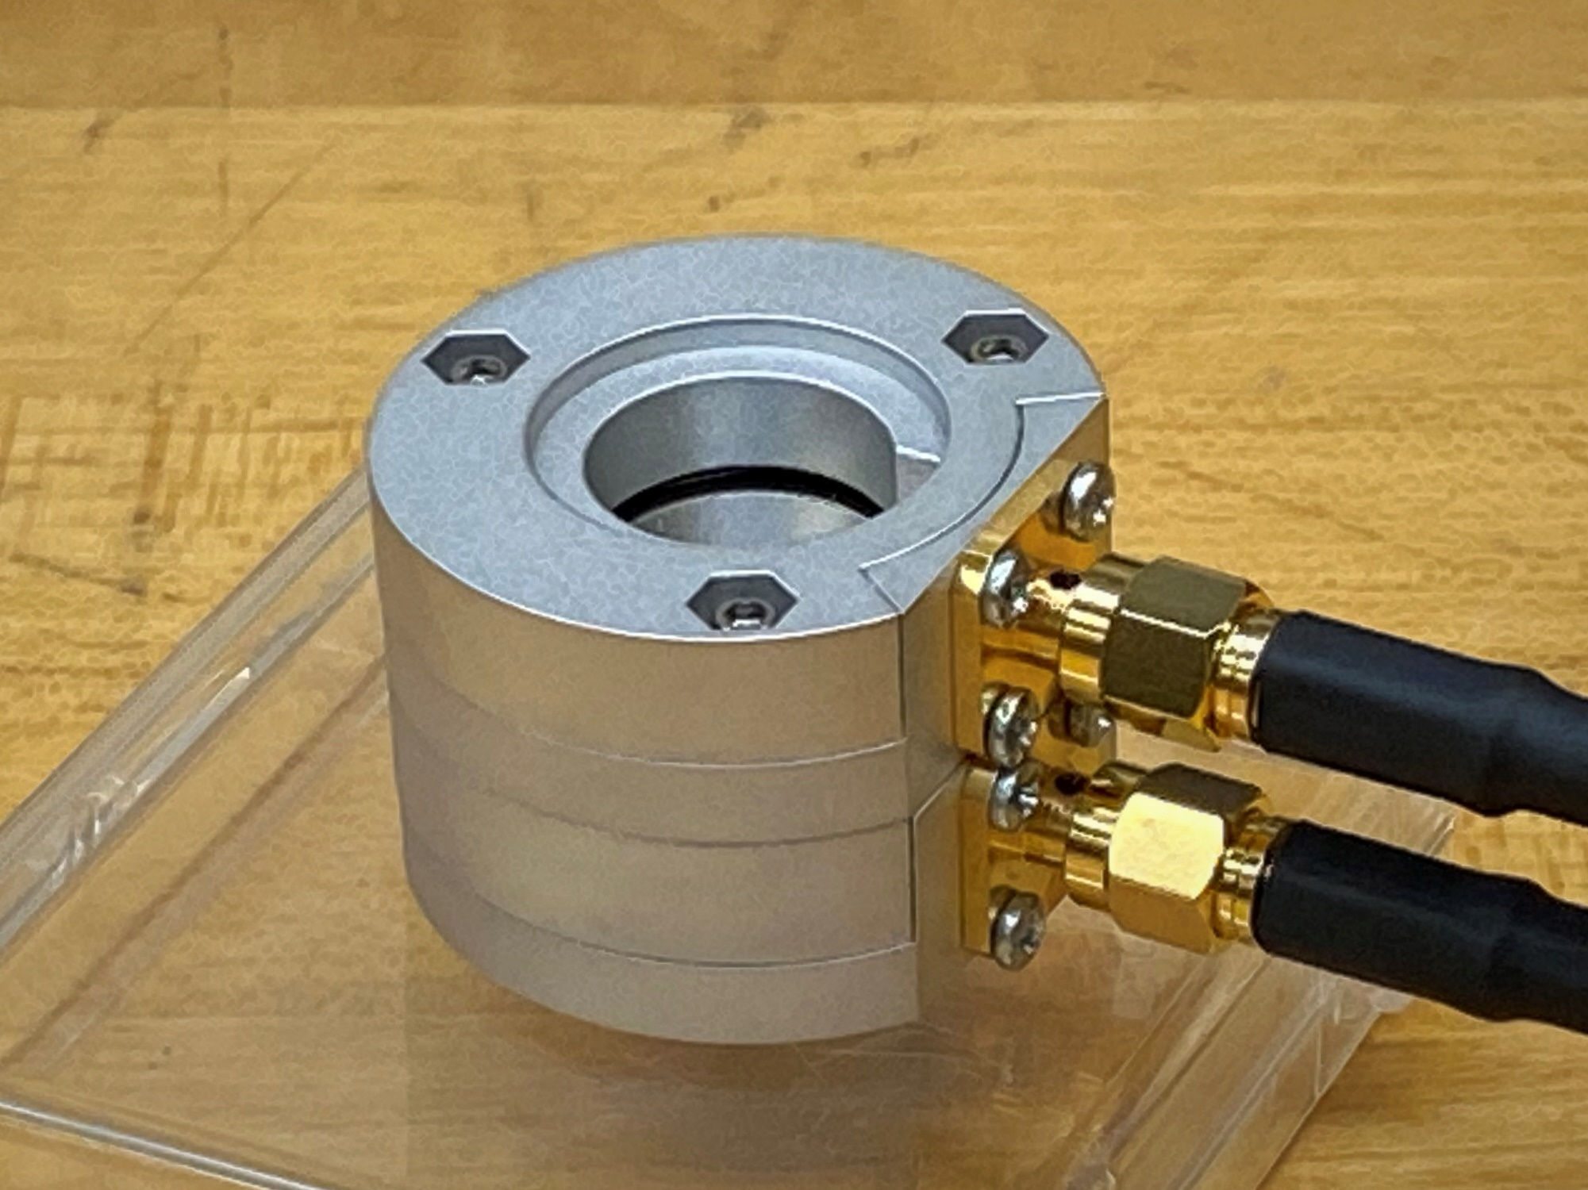
Advanced Radiation Instrumentation Research
Problem:
Radiation monitoring for NASA missions require:
  Embedded instrumentation to provide feedback for “smart”, adaptive systems
  Precision instrumentation to provide improved data to space radiation modeling efforts
  Compact instrumentation for more complete, real-time situational awareness on small platforms
  Robust instrumentation to survive long periods in varied radiation environments
Current technology limiters are radiation hardness, noise floor, thermal stability, and detector geometry.
Compact Full-field Ion Detector System (CFIDS) Concept
(US Patents 7,872,750 & 8,159,669)
Solution:
Development of compact, integrable detectors with low noise, solid state components enabled by the application of Wide Band Gap semiconductors as radiation detectors
Large Area SiC LET Detectors & Charged Particle Telescope
Approach:
Variety of detector development:
  SiC LET Detectors & Charged Particle Telescope
  Low Power Charged Particle Counter
  Fast Wide Band Gap Cherenkov Detector
Leverage GRC Expertise and Facilities in:
  Harsh Environment Thin Films
  SiC Devices & Harsh Environment Packaging
  Micro-Optics
  Flight Electronics
Applications to Space Science, Fission and Fusion Power, High Luminosity Particle Beam Experiments
Fast, Large Area, Wide Band Gap Cherenkov Detector
(U.S. Patent 10,054,691)
Low Power Charged Particle Counter
(U.S. Patent 10,429,521)

Slide 10
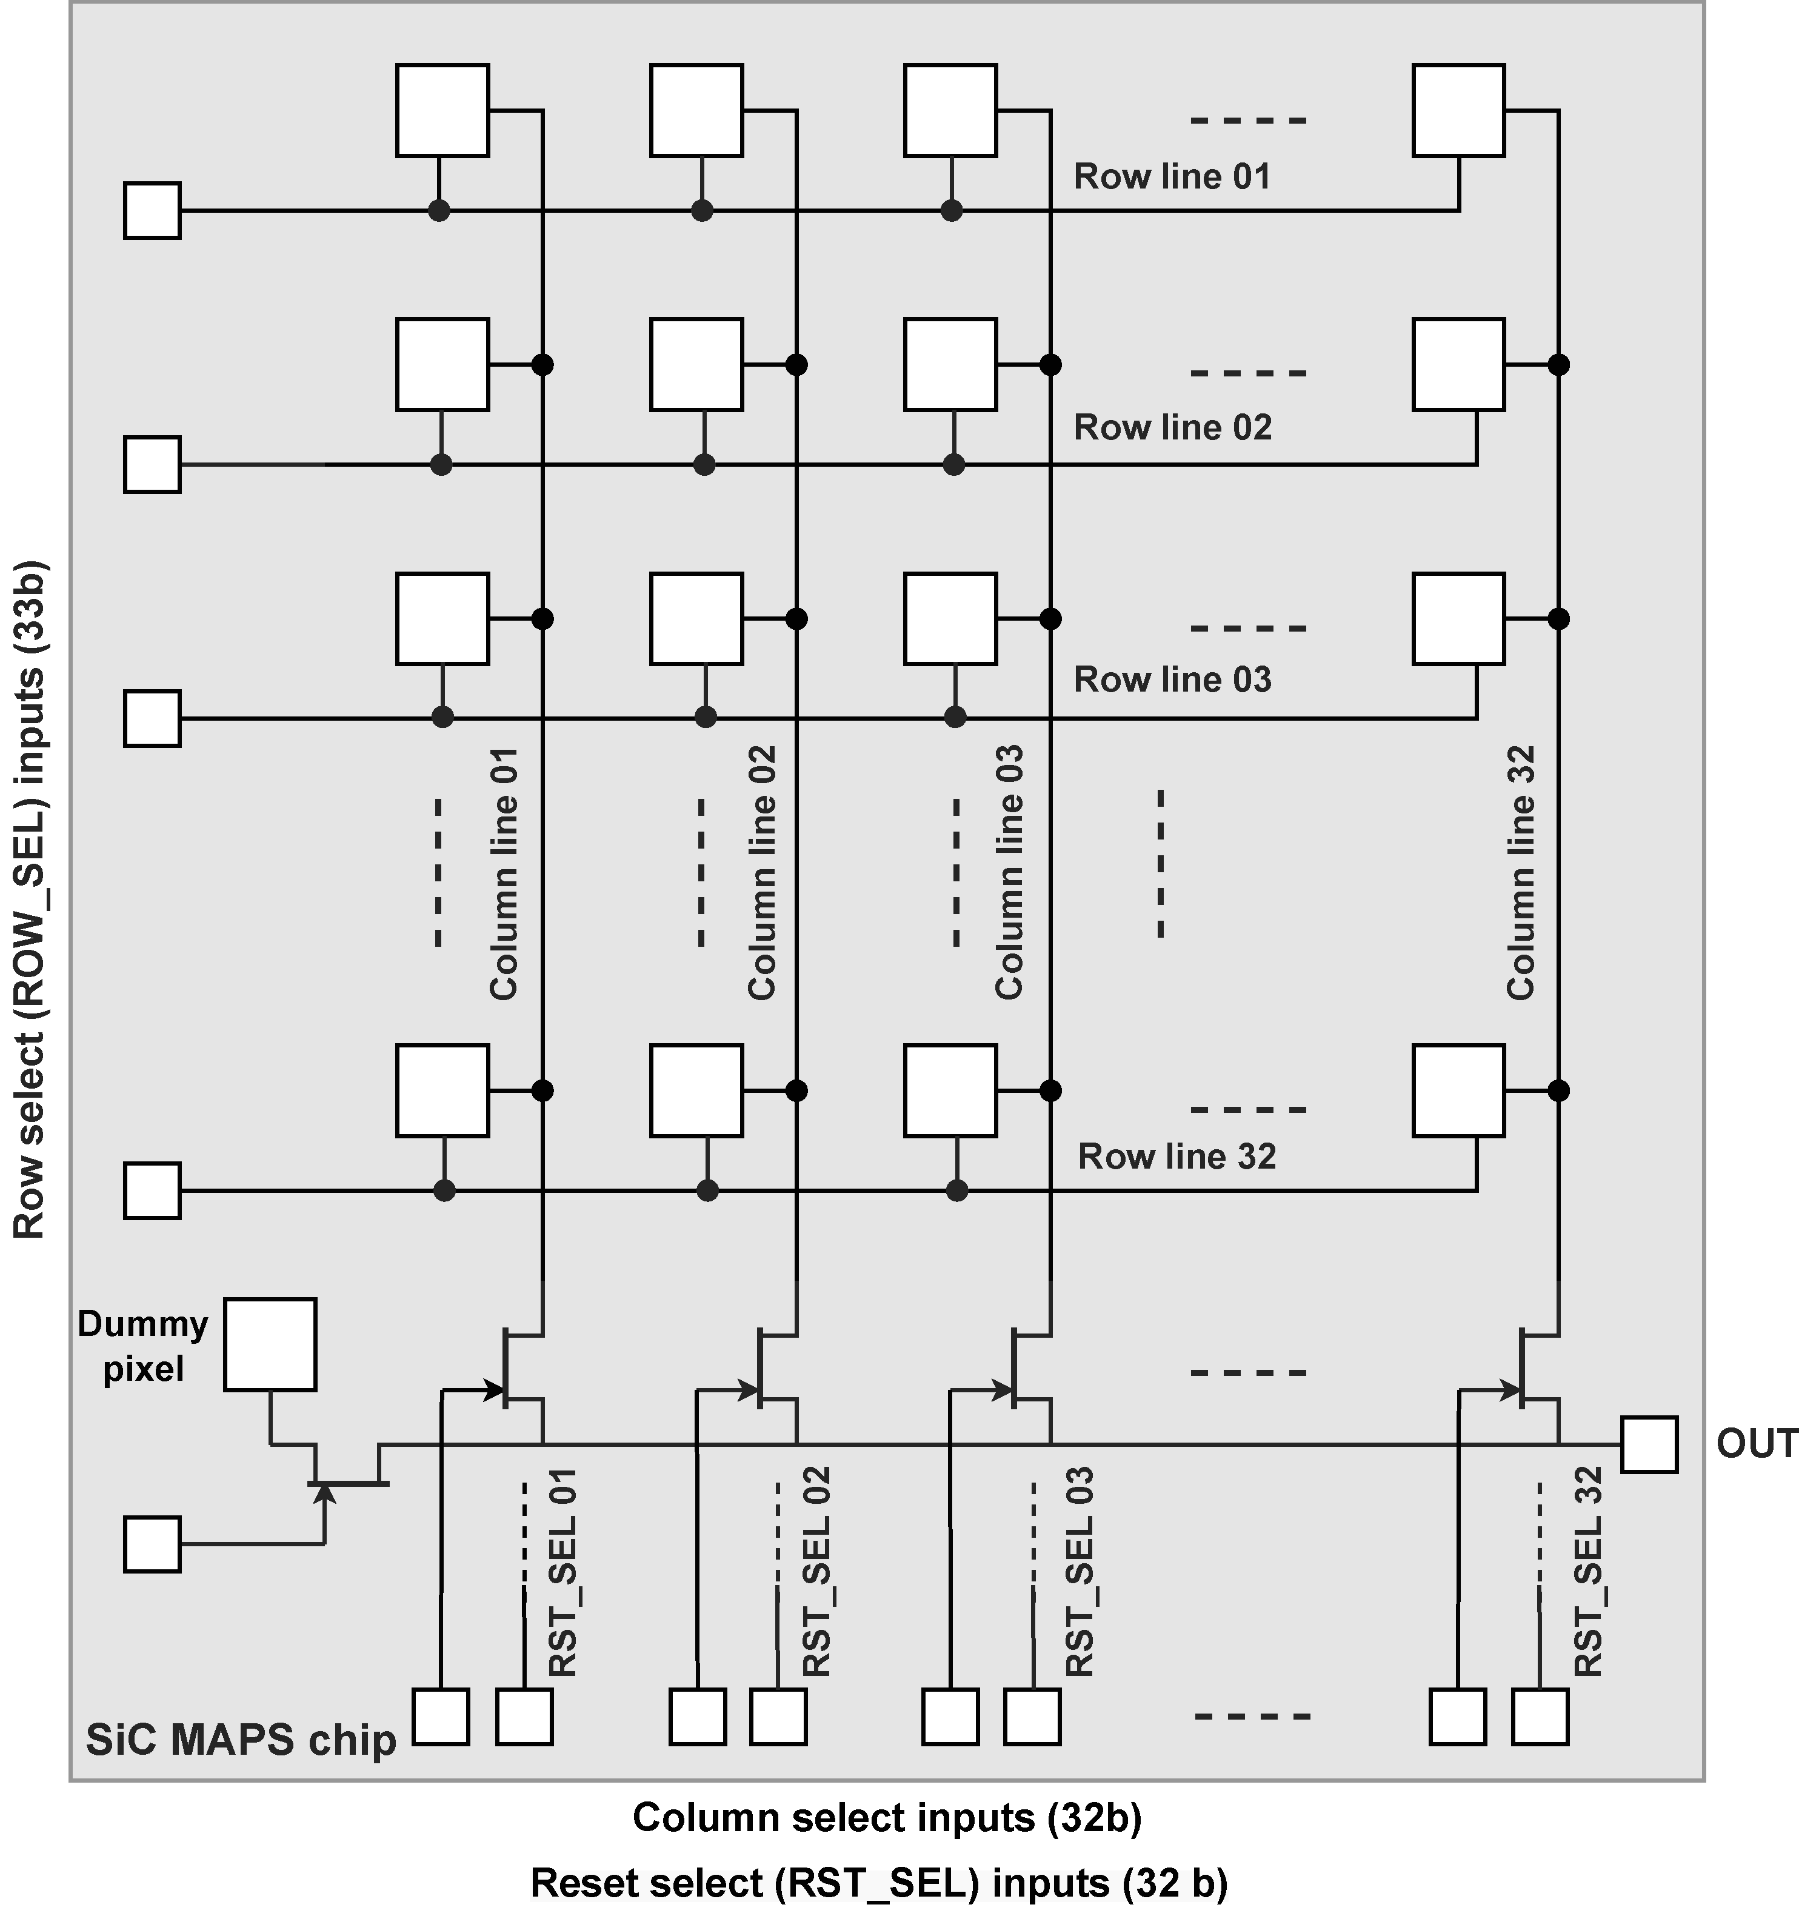
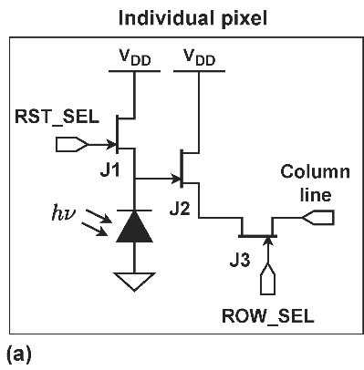
Key research goals
Goal 1: Test the light collection efficiency of photodiodes in the NASA SiC process
Goal 2: Test existing SiC IC samples at high radiation levels
Goal 3: Utilize baseline device models to design monolithic SiC MAPS pixels
Goal 4: Develop post-radiation device models based on radiation testing results
Goal 5: Design, simulate, and layout a 32 x 32 SiC MAPS chip
Goal 6: Fabricate and test the proposed SiC MAPS chip
Block diagram of the proposed SiC MAPS prototype

Slide 11
Expected results
Well aligned with BNL’s core research mission in high energy physics.
Will pioneer the development of MAPS in SiC, which is a material with great promise for both high-radiation and high-temperature applications.
Little prior work exists in this area, making the project ideal for blue-sky research.
Key scientific outcomes:
  Gaining fundamental knowledge of charge collection and radiation effects in integrated SiC devices
  Demonstrating state-of-the-art applications in the form of radiation-hard MAPS arrays
  Significant interest for FCC detector development
  Additionally, of significant interest for fusion energy sciences (FES)
Funding opportunities:
  Short term: Significant funding potential from the DoE Office of Science
  Medium term: Funding potential from NASA, DoD, and the private sector (aerospace, mining, nuclear, and geothermal sectors)

Slide 12
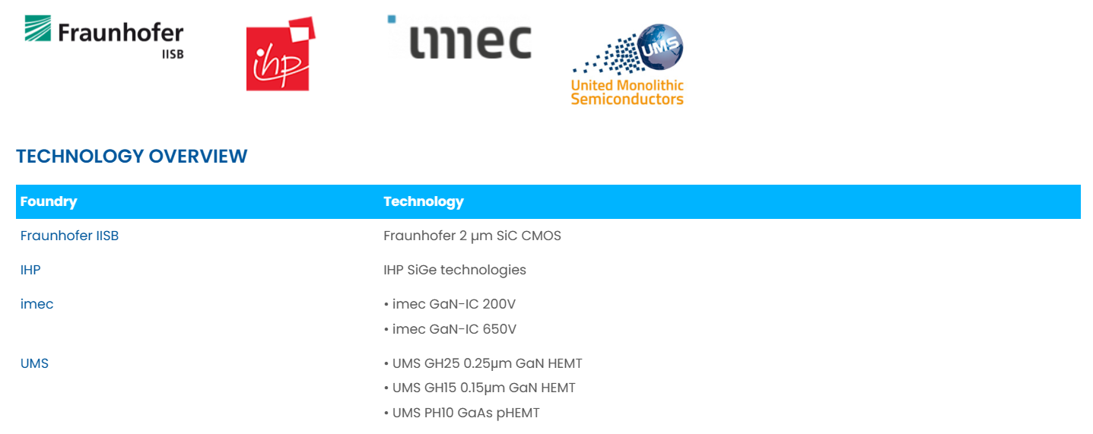
MPW fabrication options
Compound semiconductor processes available at Europractice

Slide 13
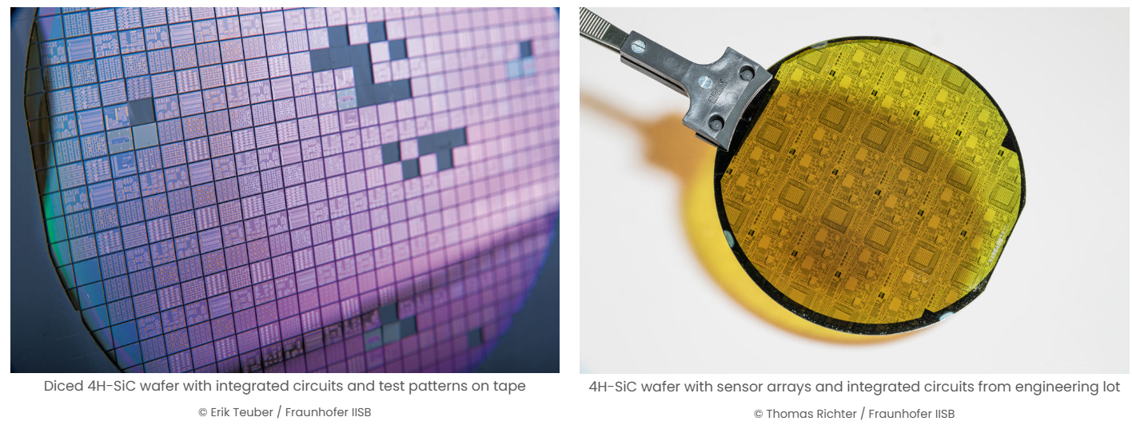
Fraunhofer SiC CMOS process
Focused on high-temperature (HT) and high-voltage (HV) applications
  2 μm CMOS, 1P2M (Pt) technology on 4H-SiC wafers
  Thick gate oxide allows drive voltages up to 20 V
Image credit: imec

Slide 14
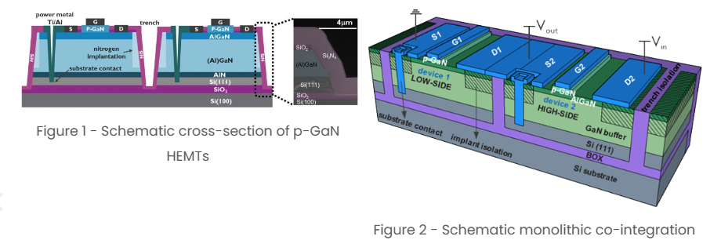
imec GaN HEMT processes
GaN on SOI with deep trench isolation (DTI)
Process variants: 200V, 650V
Focused on power electronics
Image credit: imec

Slide 15
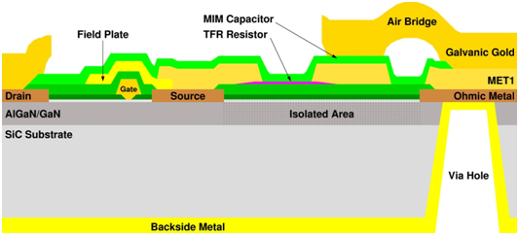
UMS GaN HEMT processes
250 nm and 150 nm GaN-on-SiC technology
Focused on high-power RF circuits
GH25 0.25µm GaN HEMT | AlGaN/GaN on SiC, 100µm substrate thickness 4.5 W/mm power density Power FETs: Ids+: 1A/mm Gm: 290mS/mm Recommended Operating Bias up to 30V Life Time >20 years at 200°C Tj Power and low noise RF amplification up to 20GHz
GH15 0.15µm GaN HEMT | AlGaN/GaN on SiC 70µm substrate thickness 4.2 W/mm power density Power FETs: Ids+: 1.45A/mm Gm: 405mS/mm Recommended Operating Bias up to 25V Life Time >20 years at 200°C Tj Power and low noise RF amplification up to 40GHz
Image credit: UMS

Slide 16

DoD access to GaN processes

Slide 17
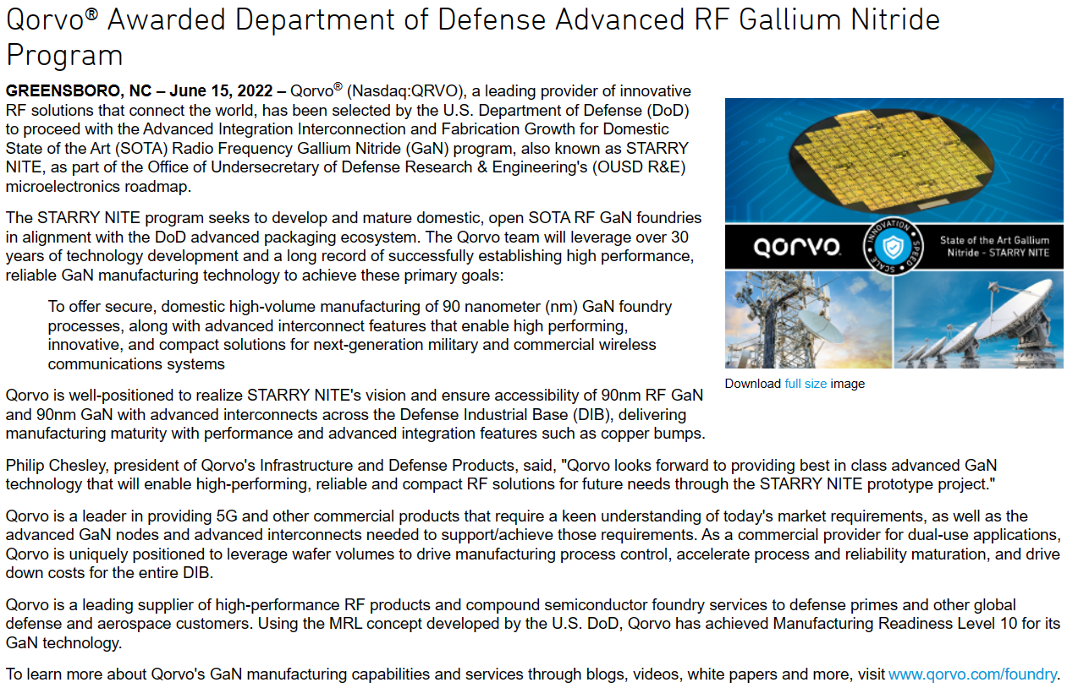

DoD access to GaN processes (2)

Slide 18
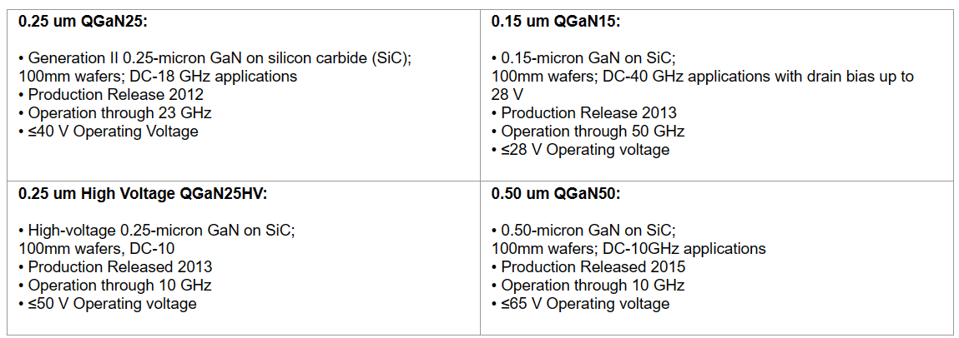
Qorvo GaN processes
DoD trusted foundry, access available through DMEA TAPO

Slide 19

Questions?

Slide 20
Backup slides

Slide 21
Active Pixel Sensors in Silicon Carbide for Plasma Monitoring
Soumyajit Mandal, Grzegorz W. Deptuch
May 1, 2024

Slide 22
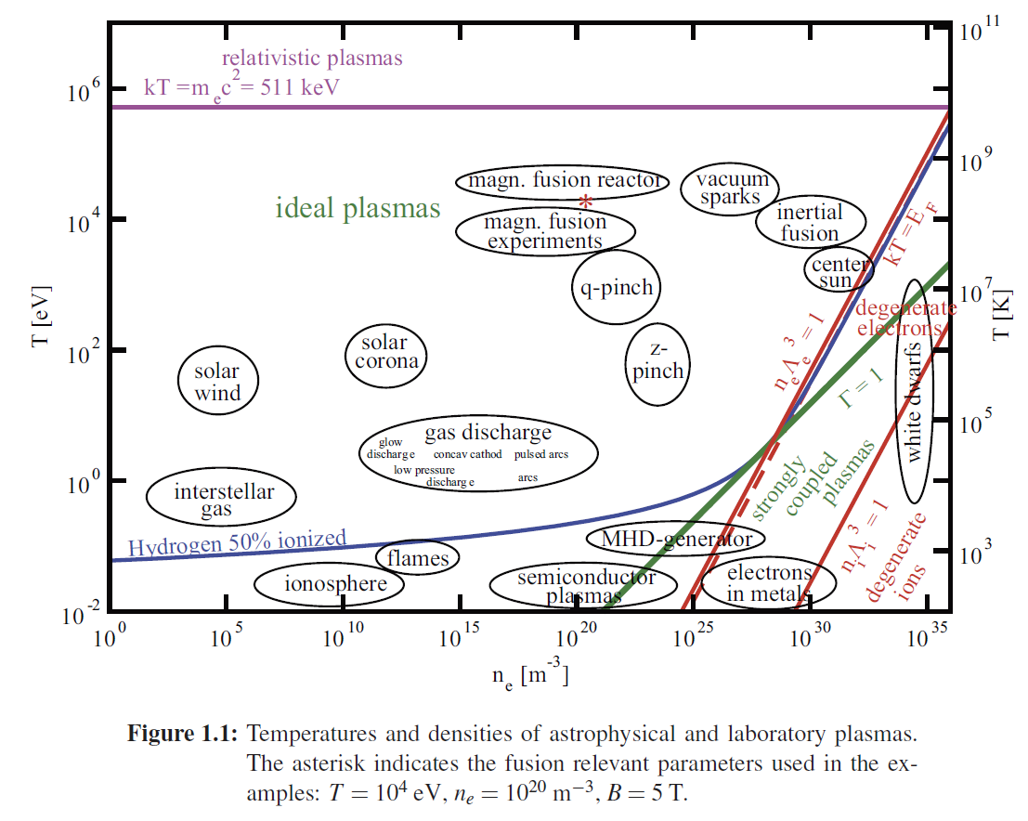
Types of plasmas

Slide 23
Magnetically confined fusion (MCF)

Slide 24
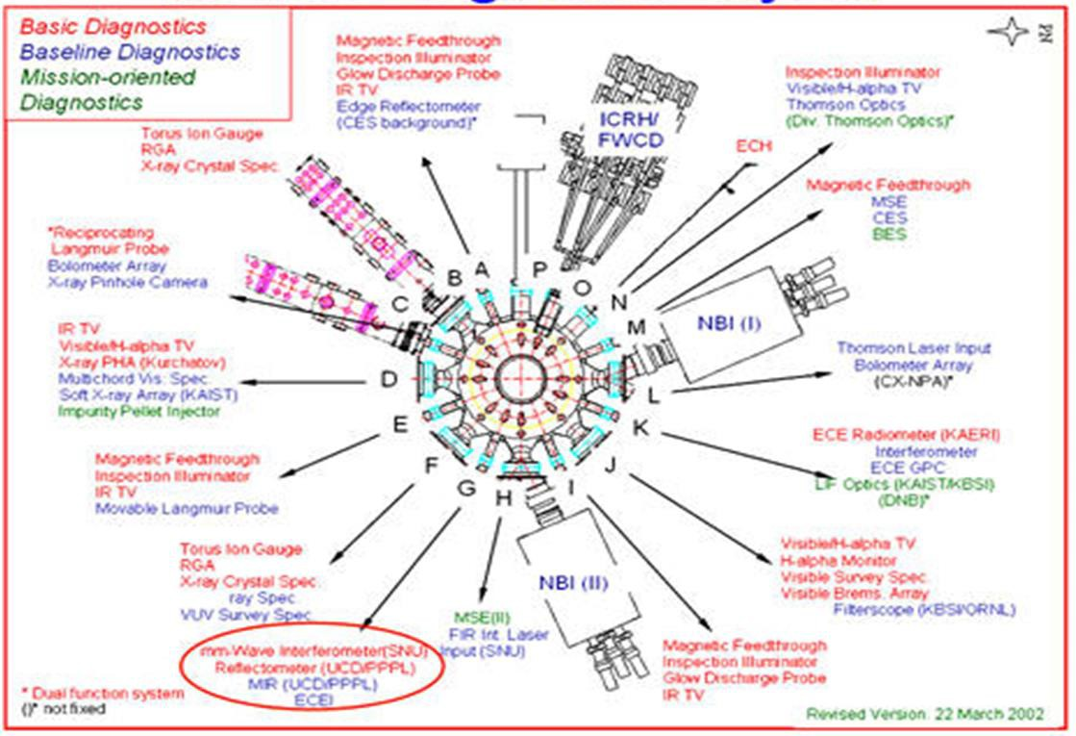
Strategy for Plasma Diagnostics in Fusion Reactors
Design state-of-the-art diagnostics for present day devices with
  high accuracy,
  high spatial and temporal resolution.
→ Establish appropriate plasma models
ITER diagnostics
Consider how to diagnose and control DEMO
  Harsh environment with radiation, heat and particles
  Small number of crude (but robust and reliable) diagnostics are available
→ Utilize models heavily
Reference: A.J.H. Donné | ESI | Garching, DE | 16th June 2015 |
1

Slide 25
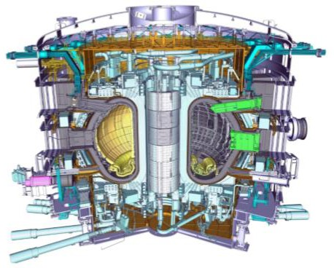
Challenges and Requirements for ITER Diagnostics
Many Challenges:
Advanced diagnostics for physics study and control
with Hostile environment (neutrons, gammas, ions, tritium)
Nuclear environment
Stringent demands on the engineering including remote handling
Requires robustness
Long plasma pulse length
Requires high stability
Control role of the measurements
Requires high accuracy and reliability
Integration of multiple diagnostics in single ports
Requires well organized engineering
2

Slide 26
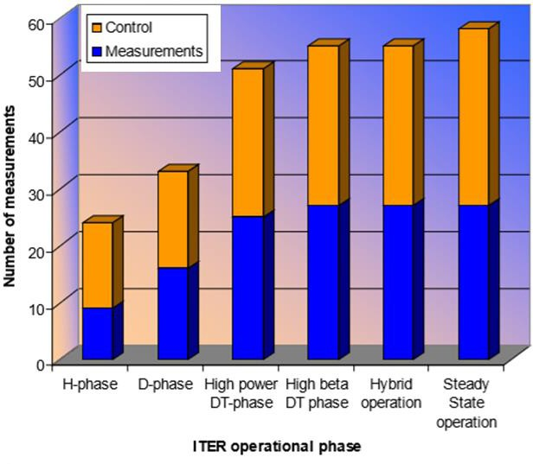
Roles of ITER Diagnostics
An extensive set of diagnostics to provide measurements for
Machine protection
Separatrix/wall gap, first wall temperature, etc.
Plasma control
Plasma shape and position, plasma current, divertor diagnostics, etc.
Physics studies
Confined alpha particles, alpha-driven modes, etc.
> 50 individual measurements

Slide 27
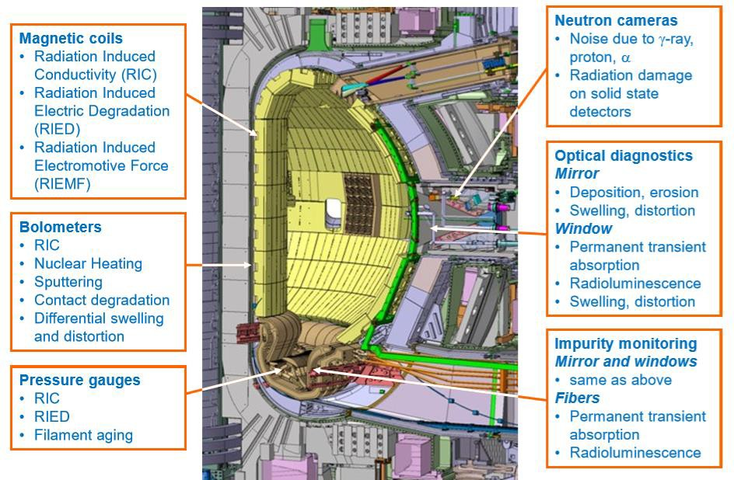
ITER Diagnostics Issues
Radiation
Deposition & erosion

Slide 28
Types of pixel detectors
Three types of physical integration of pixel detectors
Monolithic
3D integrated
Hybrid
SOI process
bulk process
multi-tier process
Monolithic active pixel sensor (MAPS)

Slide 29
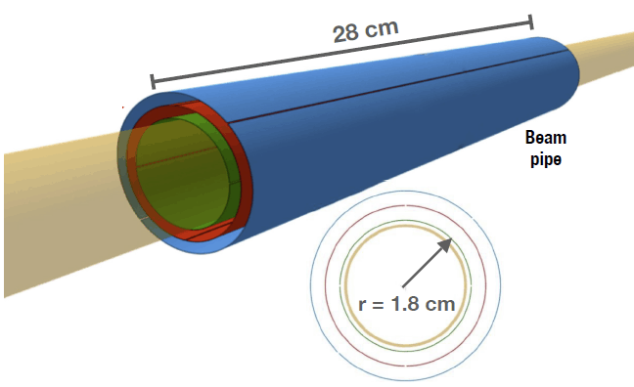
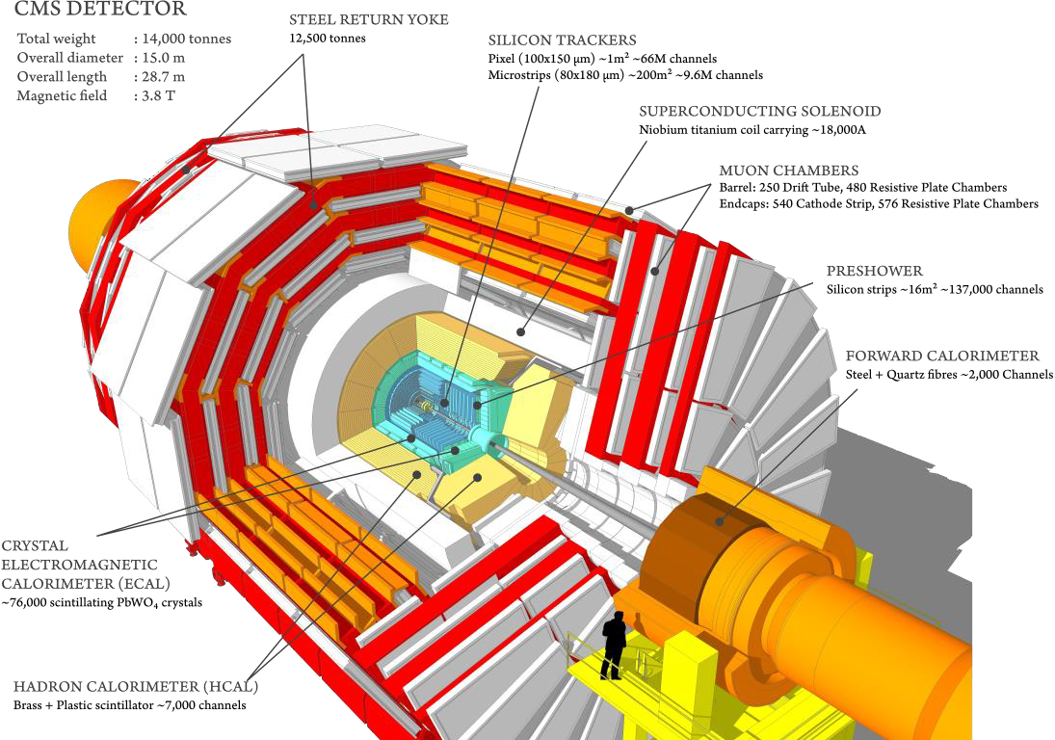
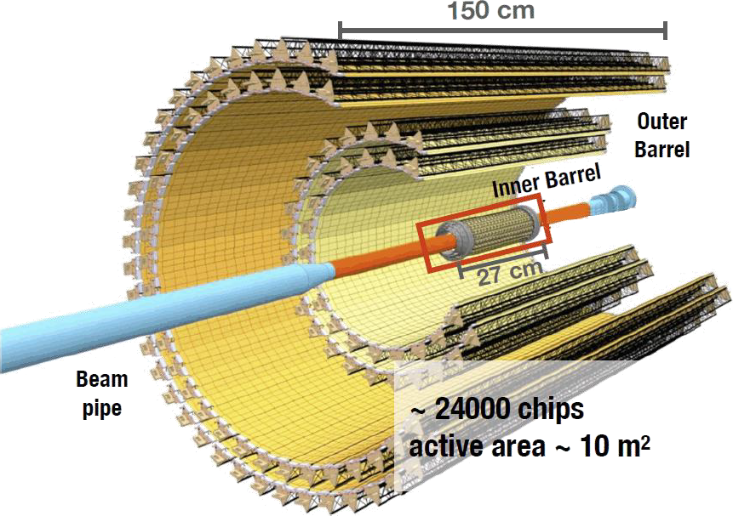
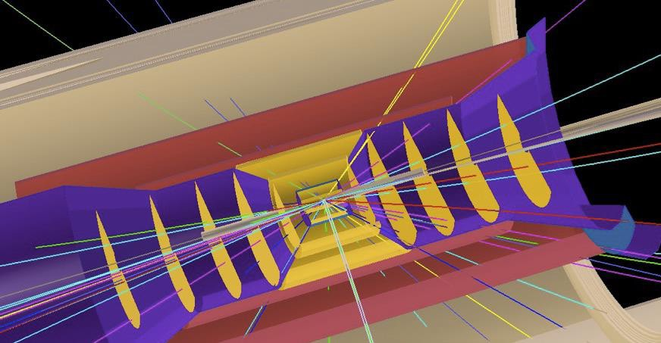
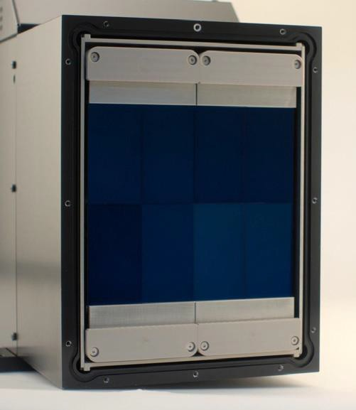
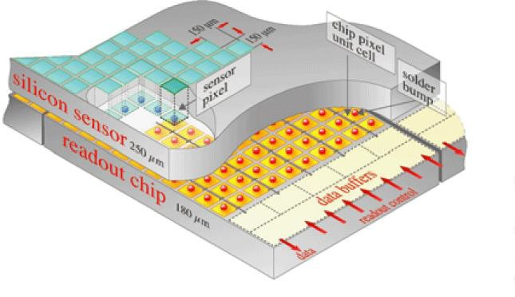
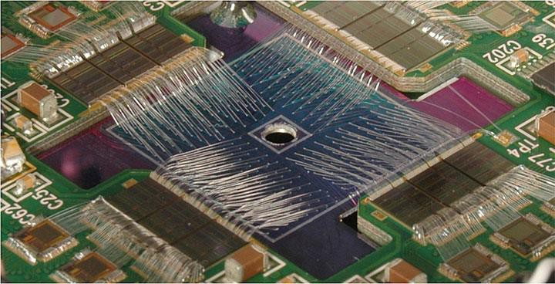
Use of MAPS within detectors
High-Energy Physics
SILICON TRACKERS
Pixel (100×150 mm²) ~1 m² ~66 M ch.) Microstrips (80×180 mm²)
~200 m² ~9.6 M ch.)
Nuclear Physics
Si literally wrapped around finger
EPIC MAPS vertex and tracking detector at the EIC at BNL
ALICE (CERN)
Photon Science (X-ray detection)
Astrophysics,
CMS (CERN)
https://cms.cern/detector/identify ing-tracks/silicon-pixels
Readout channels are laid out in 2D matrix connected to sensor elements at same pitch
CITIUS 2.2 M
pixel detector assembly (RIKEN)
G. Deptuch, BNL
MAIA 20×20 (BNL)

Slide 30
Application: Plasma diagnostics
The radiation environment of magnetic-confinement fusion devices is characterized by very high levels of neutron flux. The primary source is D-T fusion reactions, which release ∼80% of their energy in the form of 14.1 MeV neutrons.
  These neutrons participate in nuclear reactions and lose energy within various shield layers, resulting in a broadband spectrum extending from ∼1 eV to 14.1 MeV.
  High-energy (fast) neutrons damage both the reactor vessel and any close-to-plasma structures via induced nuclear reactions (activation) and atomic displacements (displacement damage).
Development of sensors and electronics robust to these damage mechanisms is
  critical for the eventual commercialization of fusion energy, and
  well aligned with the DoE’s long-range plan for Fusion Energy Sciences.
Gilbert, M. R., et al. "An integrated model for materials in a fusion power plant: transmutation, gas production, and helium embrittlement under neutron irradiation." Nuclear Fusion 52.8 (2012): 083019.

