Slide 1

Circuits and Devices for Edge AI
Emre Salman
Collaborators: Peter Milder (Stony Brook), Ayse K. Coskun (Boston), Vasilis Pavlidis (Manchester)
Students: C. Yan, M. Rathore, A. Abdurrob, P. Shukla
Department of Electrical and Computer Engineering
Stony Brook University (SUNY), Stony Brook, New York
https://nanocas.ece.stonybrook.edu
emre.salman@stonybrook.edu

Slide 2


Cloud vs. Edge
Inference in the cloud
  Advanced processing
  Large storage capability
  High cost
  Heavy traffic within mobile networks
  Privacy concerns
Inference at the Edge
  Reduced network congestion
  Low latency, real-time response
  Higher trustworthiness
  Limited power budget
  Limited storage capacity
Most of the emerging IoT applications require local intelligence where data is sensed and stored
2

Slide 3
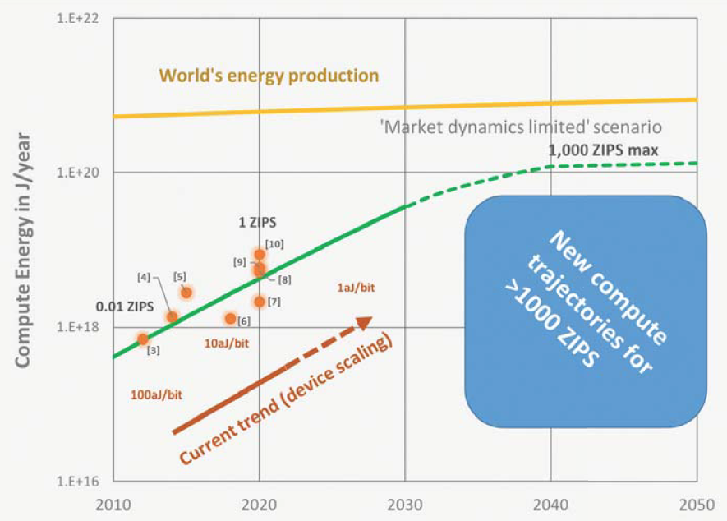
Need for Higher Energy Efficiency
Decadal Plan for Semiconductors, Semiconductor Research Corporation, January 2021
3

Slide 4
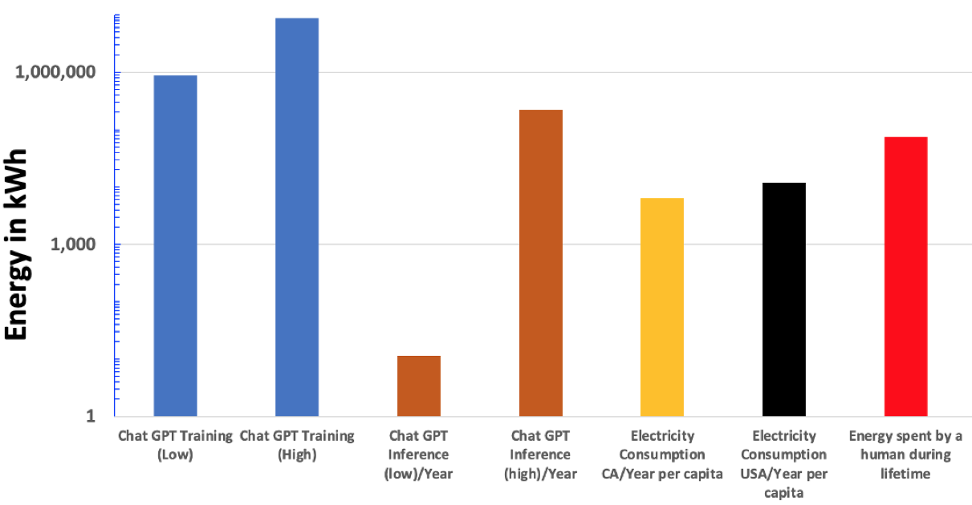
Energy for Executing Natural Language Processing Algorithms
12,000 kWh
S. Shankar, Energy Estimates Across Layers of Computing, arXiv, 2023
4

Slide 5
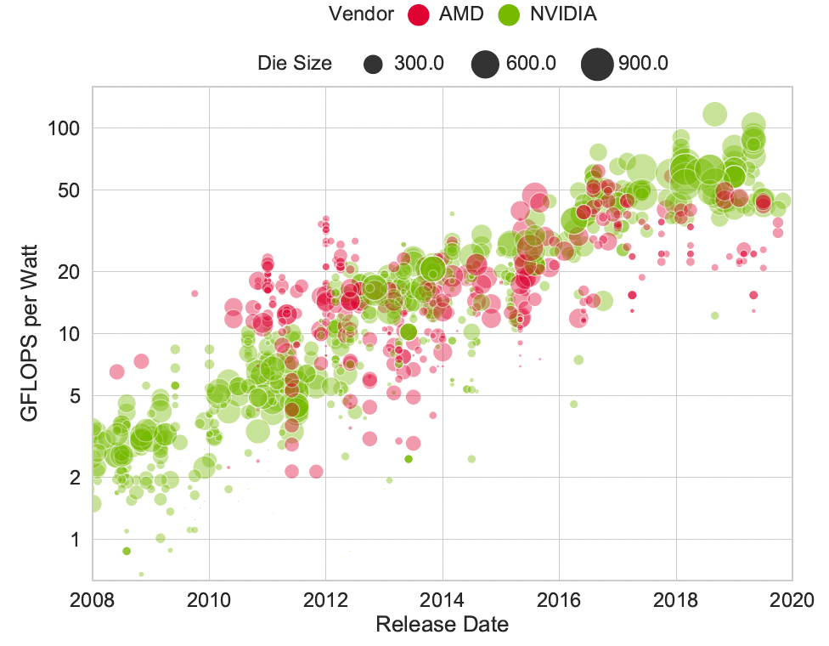
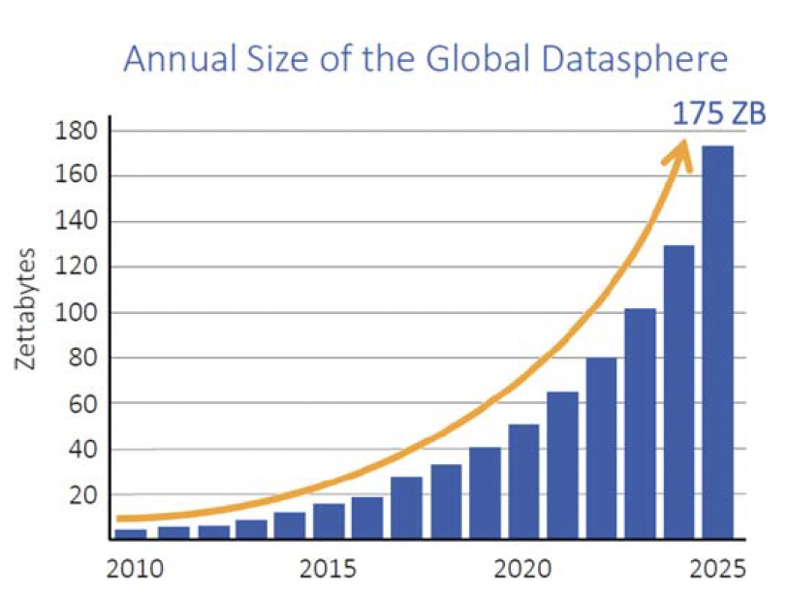
Energy Efficiency vs. Data Size
On average, doubles in every 3-4 years
GFLOPS/Watt
Y. Sun et al., Summarizing CPU and GPU Design Trends with Product Data, arXiv, 2020
SRC Decadal Plan
Flops/Watt is constrained by inefficiencies in data movement
5

Slide 6

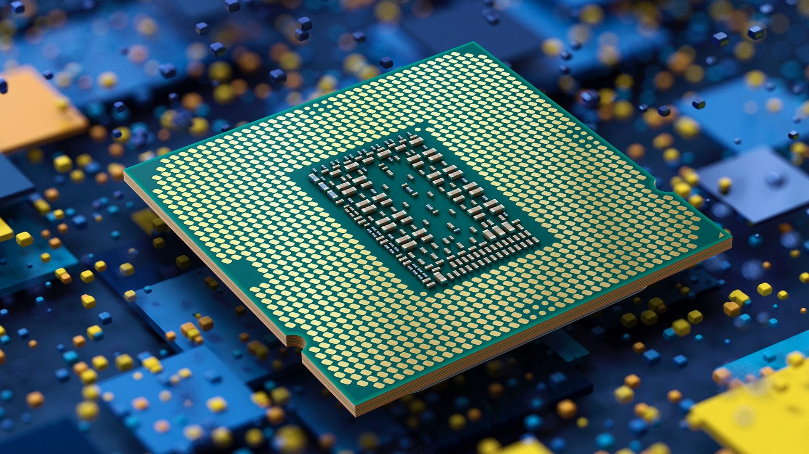
Emerging Technologies
  New device technologies
TFET, FeFET, negative capacitance FET, magnetic memory, resistive memory
?
  New integration technologies
Integration density
IBM, 2 nm process (nanosheet), Intel RibbonFET
Chiplets (2.5D), 3D, monolithic 3D, heterogeneous integration, photonics
Intel, expected in 2023
Core i7 Coffee Lake, 3.2/3.7 GHz, 65/95 W, 2018
  New computing paradigms
Domain specific computing
In-memory computing
Neuromorphic computing
Quantum computing
14 nm
4 nm (EUV)
2 nm – 1.8 nm
6

Slide 7
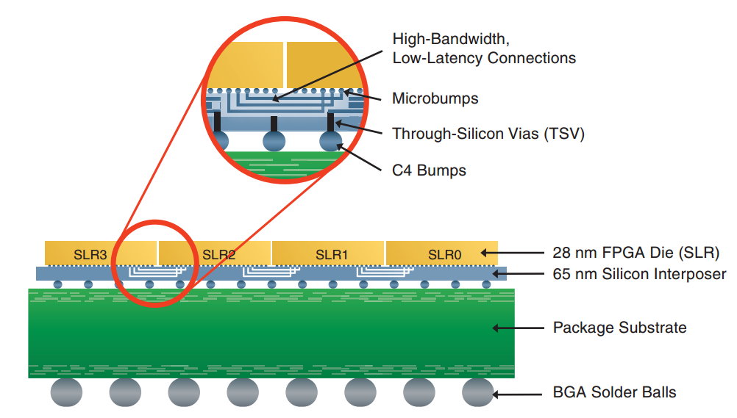
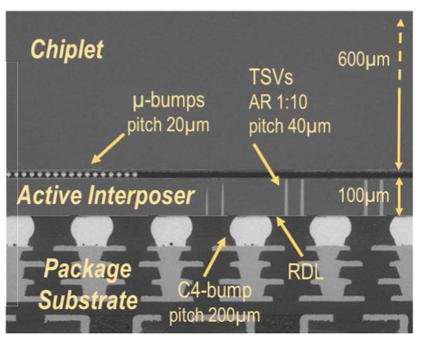
Chiplet based 2.5D/3D Integration
“… it may prove to be more economical to build large systems out of smaller functions, which are separately packaged and interconnected…”
G. Moore, 1965
Better yield due to reticle limit of monolithic integration
Heterogeneous integration of different technology nodes
Custom accelerators with common compute core
Much more efficient than off-chip SerDes (< pJ/bit)
Mechanical and thermal reliability challenges
  Problem moves from die-level to package-level
  Limit on package size
Cooling
Power delivery
  Back-side power delivery
Improvements are limited with die-level constraints such as ESD
Interposer based Integration (2.5D), Xilinx
P. Vivet et al., INTACT: A 96-Core Processor with 6 Chiplets 3D-Stacked on an Active Interposer, IEEE JSSC, 2021
7

Slide 8
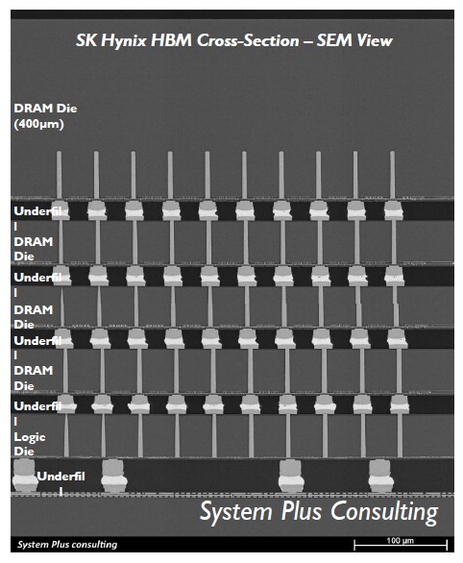
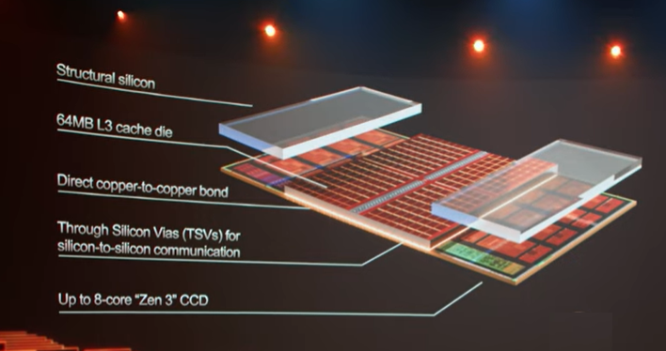
TSV-based Die Stacking
Cache-core stack, AMD Ryzen 5000 series
Uses hybrid bonding
Through Silicon Via (TSV), Intel FOVEROS
HBM can provide up to 3,200 Gbps bandwidth, about 64X improvement
Logic-memory stack enables near-memory computing
Limited scalability
  TSV dimensions
  Power overhead
  Thermal challenges
SK Hynix High Bandwidth Memory
8

Slide 9
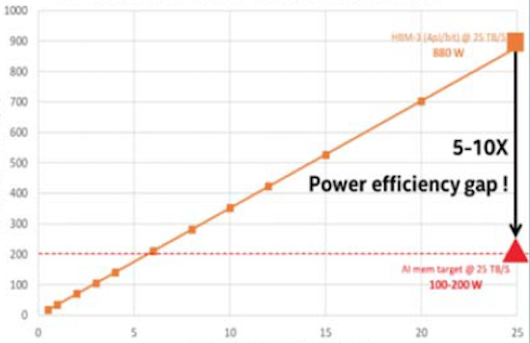
Memory Power Efficiency Gap
3D HBM achieves 25TB/s at 880 W
Estimated power (W)
Target: 25 TB/s at 100-200 W
System memory bandwidth (TB/s)
SRC Decadal Plan
9

Slide 10
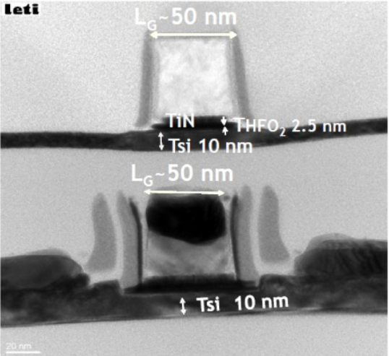
Monolithic 3D Integration Technology
“3D integration technology will be one of the most critical performance booster.” IRDS prediction 2021
  Monolithic 3D ICs with monolithic inter tier vias (MIVs), CEA-LETI
10

Slide 11
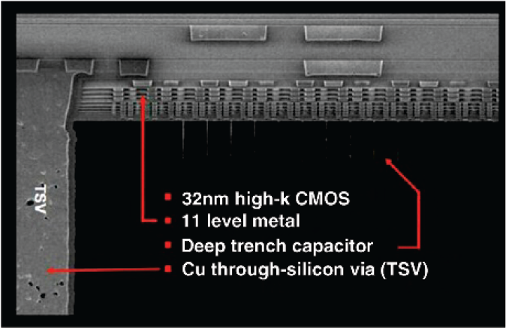
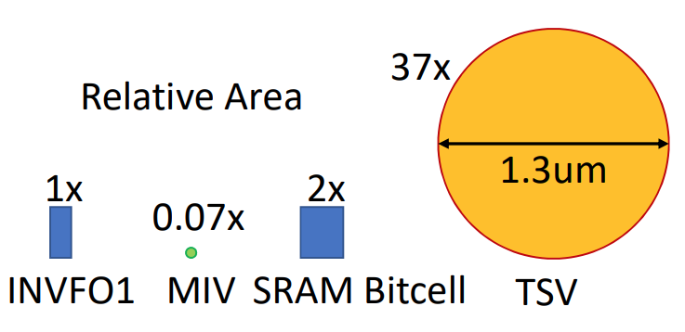
TSV vs. MIV
TSVs are large
  Diameter in the 2 to 10 μm range
  Height in the 8 to 60 μm range
  Large pitch (30 to 50 μm) and keep-out zone (KOZ) requirements
  Capacitance in the range of 5 fF
Most advanced microbumps have a pitch of 10 μm
MIVs provide unprecedented interconnect density
  Diameter ≈ 50 nm (similar to a metal via)
  Height ≈ a few 100 nms
  4000X higher bandwidth at iso data rate
  Capacitance in the range of 0.1 fF
    50X less energy per bit at ISO data rate
Courtesy of IBM
B. Gopireddy and J. Torrellas, ISCA, 2019
11

Slide 12
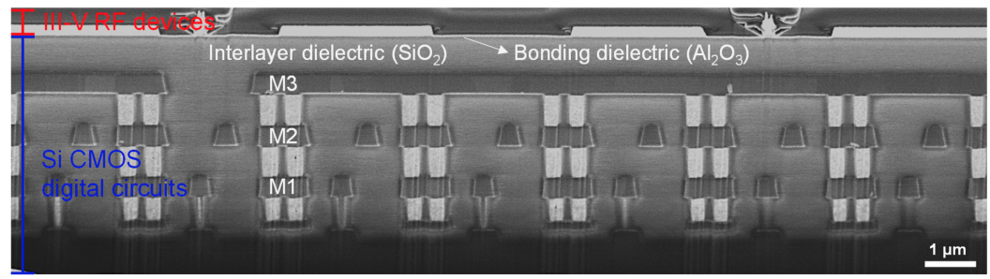
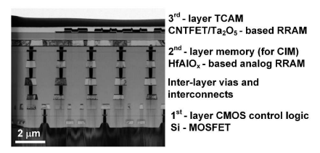
Recent Prototypes
Two-tier monolithic 3D
Heterogeneous integration
Difficult to reliably fabricate upper tier devices
  Low temperature processing
  Degraded device quality
  Lower yield
Three-tier monolithic 3D
Synergy with emerging devices that can withstand higher temperatures
149X lower power at ISO performance
  DNN for image super resolution task
J. Jeong et al., ACS Nano, 2022
Y. Li et al., IEDM, 2021
12

Slide 13
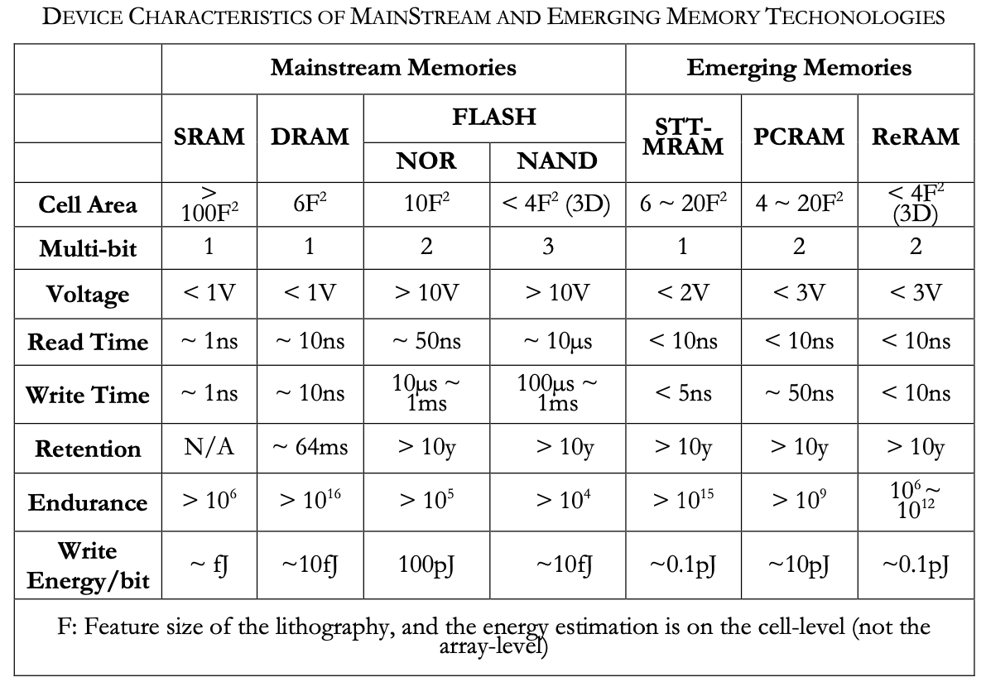
Emerging Memory
Challenges
  Variability
    Stochastic nature
    High sensitivity to temperature
  Reliability
  Cost/scaling
  Not to replace conventional SRAM, but to complement it as embedded memory
    New memory hierarchy
    Software-level support
S. Yu, Resistive Random Access Memory (RRAM): From Devices to Array Architectures, Morgan & Claypool, 2016
13

Slide 14
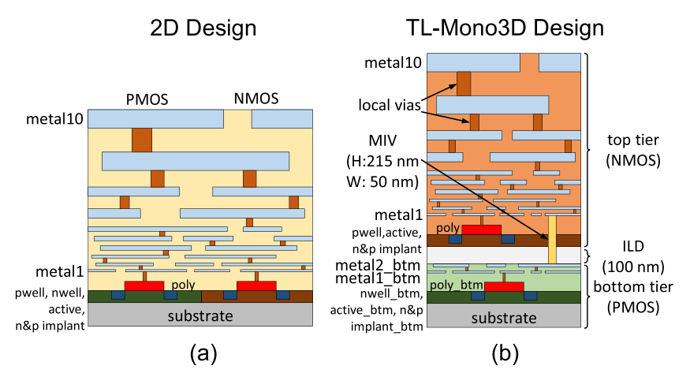
PDK and Cell Library for Monolithic 3D ICs
14
C. Yan and E. Salman, “Open Source Cell Library for Monolithic 3D Integrated Circuits,” IEEE TCAS-I, 2018

Slide 15
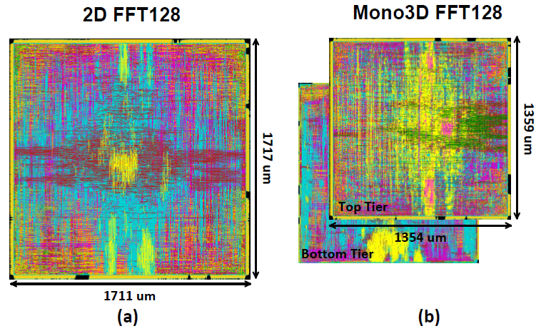
Chip-Level Evaluation: Footprint and Wirelength
128 – Point FFT core
  330K cells
  f = 1.5 GHz
40% smaller footprint
23% reduction in overall wirelength
15
C. Yan and E. Salman, “Open Source Cell Library for Monolithic 3D Integrated Circuits,” IEEE TCAS-I, 2018

Slide 16
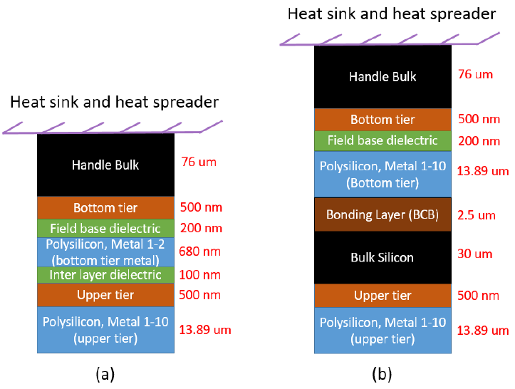
Thermal Challenges in Monolithic 3D ICs
Heat Dissipation Issues
  Particularly for tiers away from the heat sink
    Higher vertical thermal resistance
  Additional thermal issues in Mono3D
    Dense device integration
    Routing congestion (contributes to Joule heating)
    Strong vertical thermal coupling
Cross-section of a flip-chip stack for (a) two-tier Mono3D IC, (b) two-tier TSV-based 3D ICs
All analysis based on HotSpot thermal simulator (K. Shadron et al., ISCA 2003)
16
P. Shukla, E. Salman, A. Coskun, V. F. Pavlidis, “An Overview of Thermal Challenges and Opportunities for Monolithic 3D ICs,” GLSVLSI, 2019

Slide 17
Thermal Characteristics in Mono3D vs. TSV based 3D
Observations
  Stronger vertical thermal coupling in Mono3D
    Temp. diff ∼ 30⁰C in TSV 3D ICs
    Mono3D tiers have similar temperature patterns
    Absence of insulating layer in Mono3D
  Limited lateral thermal propagation in Mono3D
    More localized hot spots in Mono3D
    Presence of thin tiers in Mono3D
  Overall, better heat dissipation in Mono3D ICs
17
P. Shukla, E. Salman, A. Coskun, V. F. Pavlidis, “An Overview of Thermal Challenges and Opportunities for Monolithic 3D ICs,” GLSVLSI, 2019

Slide 18
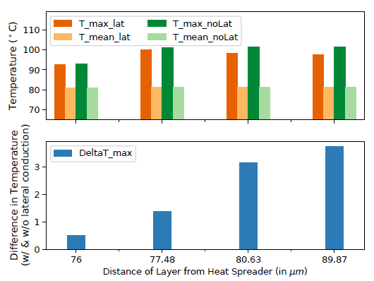
Lateral vs. Vertical Heat Flow in Mono3D ICs
  Two cases of modeling
    Lateral modeling turned on
    Lateral modeling turned off
  Maximum difference in on-chip temperature ∼ 4 ⁰C
  This difference is highest at the hot spot locations and the area around the hot spots
Ignoring lateral heat flow modeling induces significant errors with increasing distance from the heat sink
18
P. Shukla, E. Salman, A. Coskun, V. F. Pavlidis, “An Overview of Thermal Challenges and Opportunities for Monolithic 3D ICs,” GLSVLSI, 2019

Slide 19
Mono3D Energy Optimization under Thermal Constraints
DNN model
Array size
Performance constraints
SRAM size
Thermal constraint
Frequency
Optimization goal
Mono3D partition
Mono3D DNN Accelerator with 2 tiers
19
P. Shukla, S. S. Nemtzow, V. F. Pavlidis. E. Salman, and A. Coskun, “Temperature-Aware Optimization of Monolithic 3D Integrated DNN Accelerators,” ASPDAC, 2021

Slide 20
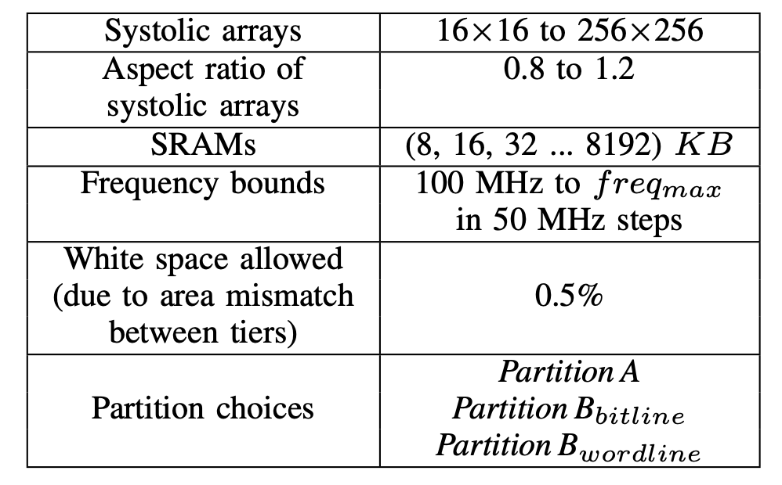
Design Space
Effectively explore design space
  Bottleneck: Thermal simulations
    45-60 mins per configuration
      Intel Xeon E5-2680 v4 CPU node with 128 GB of memory
    Power-temperature iterations
    Brute force search is not feasible
Produce pareto optimal frontier
Consider thermal constraints
263K unique configurations per DNN model
20
P. Shukla, V. F. Pavlidis. E. Salman, and A. Coskun, “TREAD-M3D: Temperature-Aware DNN Accelerators for Monolithic 3D Mobile Systems,” IEEE TCAD, 2023

Slide 21
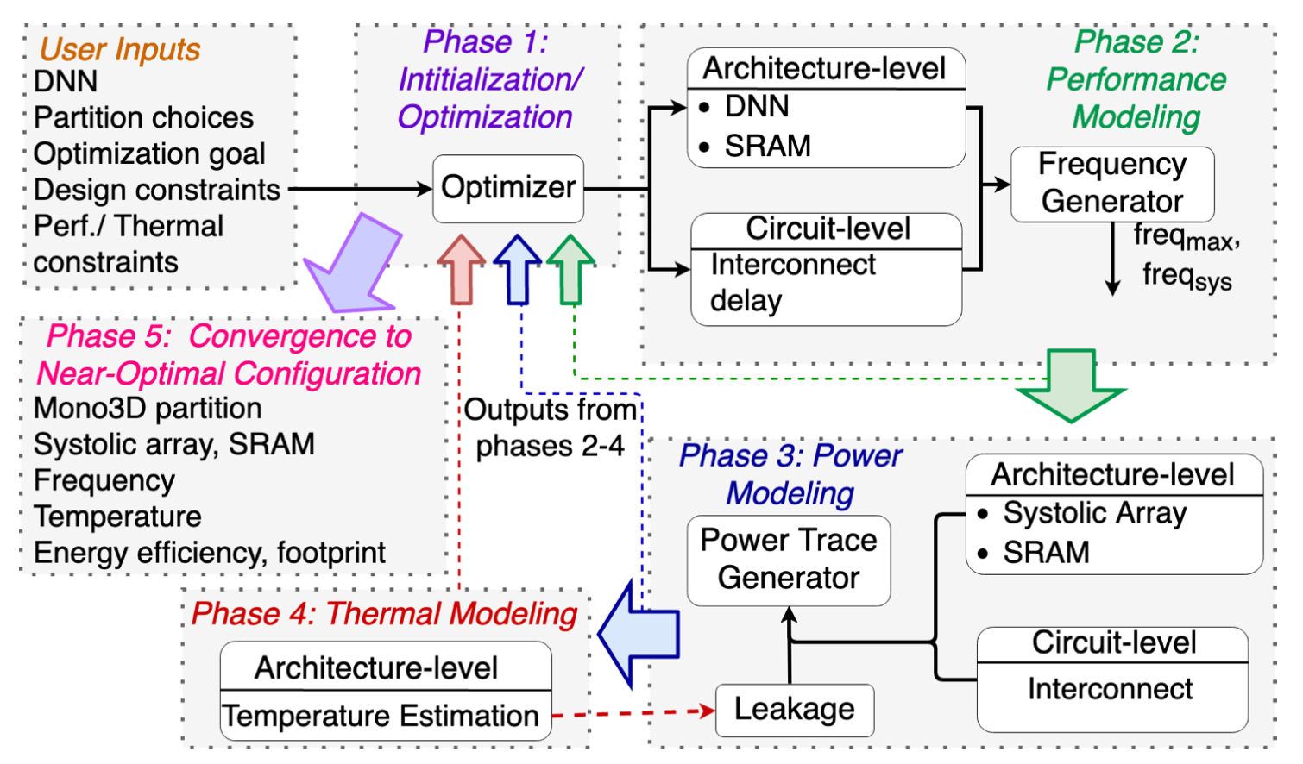
Proposed Framework
CACTI
HSPICE
SCALE-Sim
HotSpot-V6.0
21
P. Shukla, V. F. Pavlidis. E. Salman, and A. Coskun, “TREAD-M3D: Temperature-Aware DNN Accelerators for Monolithic 3D Mobile Systems,” IEEE TCAD, 2023

Slide 22
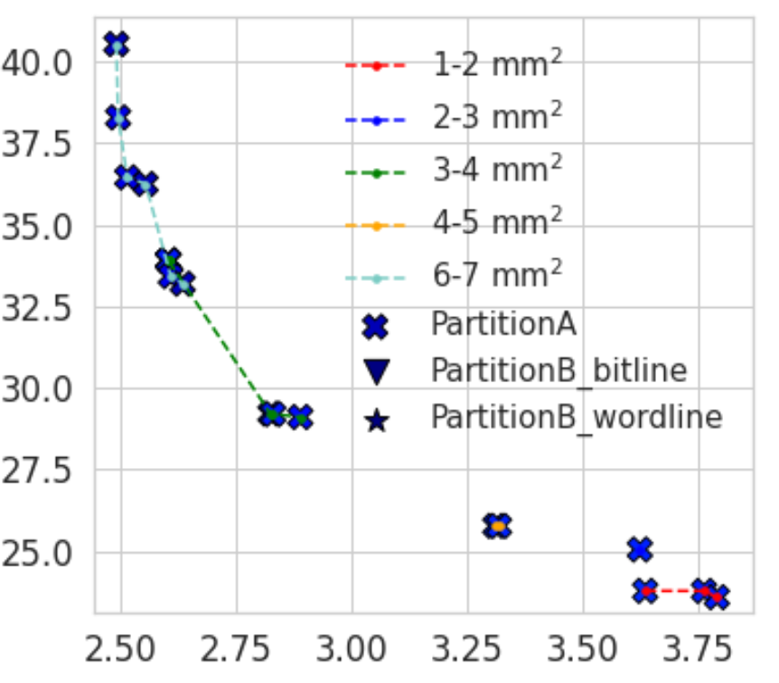
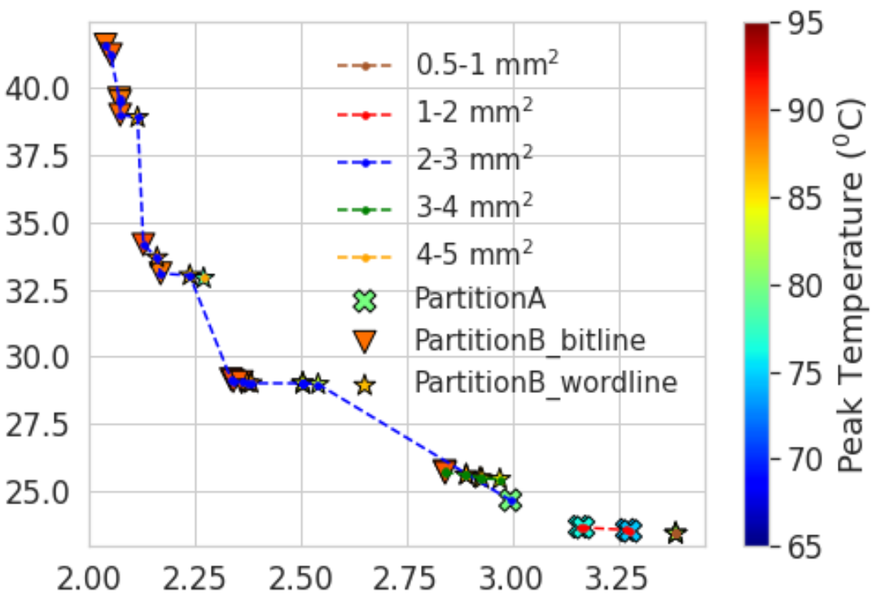
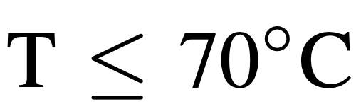
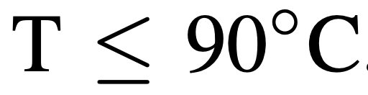
Pareto Optimal Frontier for VGG16
Energy (mJ)
Inference latency (ms)
22
P. Shukla, V. F. Pavlidis. E. Salman, and A. Coskun, “TREAD-M3D: Temperature-Aware DNN Accelerators for Monolithic 3D Mobile Systems,” IEEE TCAD, 2023

Slide 23
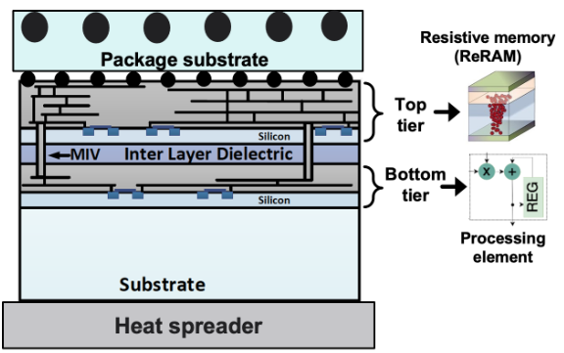
Mono3D Accelerator with Embedded ReRAM
High density
  Multiple bits per cell
CMOS compatible
  Mono3D compatible
Non-volatile
Reduce expensive off-chip DRAM accesses
Resistive window affected by temperature
  Impact on robustness
Higher write latency at elevated temperatures
23

Slide 24
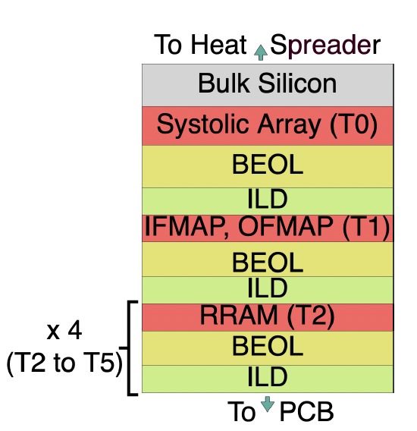
Mono3D Accelerator with Embedded ReRAM
Accelerator hardware in 22nm CMOS
Footprint of 8 mm²
  256X256 array
  2 MB SRAM for IFMAP
  2 MB SRAM for OFMAP
  32 MB ReRAM for weights
    ReRAM is read only
    Endurance issue is mitigated
Architectural optimizations via high density MIVs
  Read all weights into PE array in one cycle
  Multicast all IFMAPs to all the PEs
6-tier Mono3D Chip
24

Slide 25
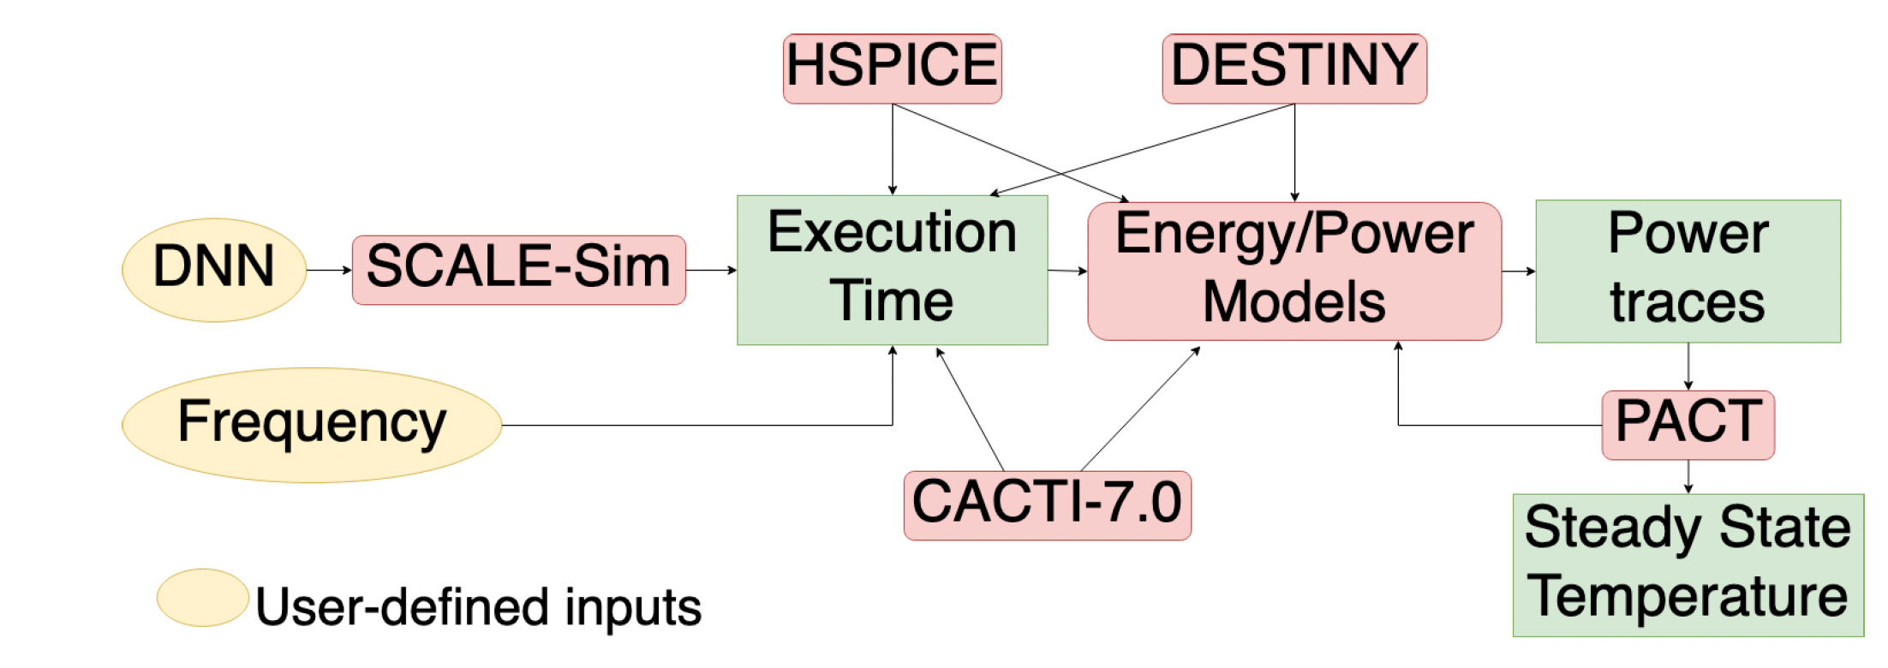
Evaluation Framework
25

Slide 26
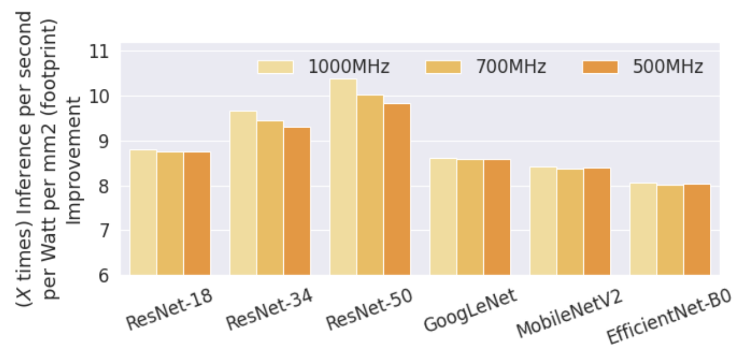
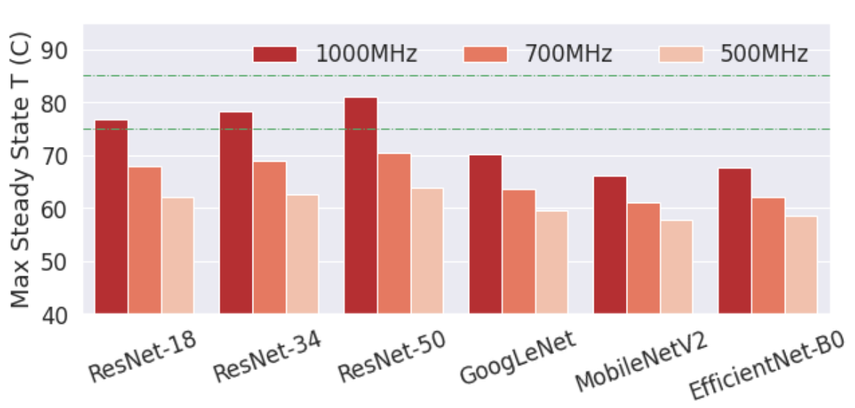
Improvements w.r.t to 2D System
Up to 10X improvement in inference per second per Watt per footprint
  Large improvement for more complex DNNs
Up to 81% improvement in inference per second per Watt
  DRAM power is not included
Achieving the same bandwidth with TSV based 3D stack is not feasible
  14X more area
  Requires costly serializer, deserializers
26

Slide 27
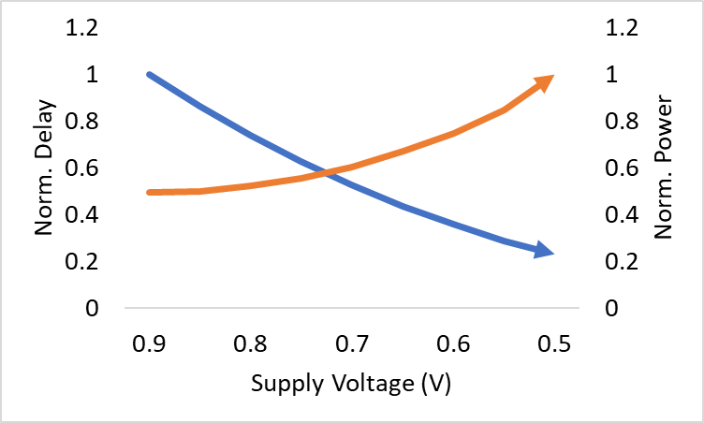
Supply Voltage as Another Optimization Parameter
Exploit the inherent error resilience of neural networks to design precision-aware and energy efficient low voltage DNN accelerators
Q1: How can we efficiently determine timing error probabilities as we reduce voltages?
Q2: How can we efficiently characterize the error resilience of a DNN at a fine granularity?
Q3: How do we know whether we should correct any errors and if so, which ones?
Delay
Power
27

Slide 28
Proposed Framework
Method to Model Timing Error Probabilities
DNN Error-Resilience Analysis and Error-Aware Inference
Accuracy-Aware Voltage Scaling
Analytically determine timing error rates w.r.t
  Netlist (e.g. multiply-accumulate unit)
  Supply voltage
  Operating frequency
  Uncertainty (e.g. supply noise)
Quantify DNN inference accuracy w.r.t
  Bit-level datapath errors
    Per-layer granularity
    Per-bit granularity
Identify robust and sensitive layers/bits
Scale supply voltage
  Map DNN to a systolic array
  Scale voltage
  Apply error detection and correction for select bits
28
M. Rathore, P. Milder, and E. Salman, “Precision and Performance-Aware Voltage Scaling in DNN Accelerators,” GLSVLSI, 2023

Slide 29
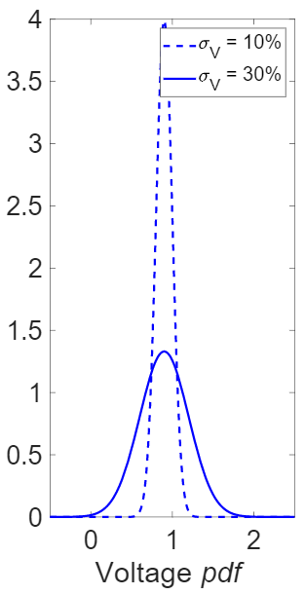
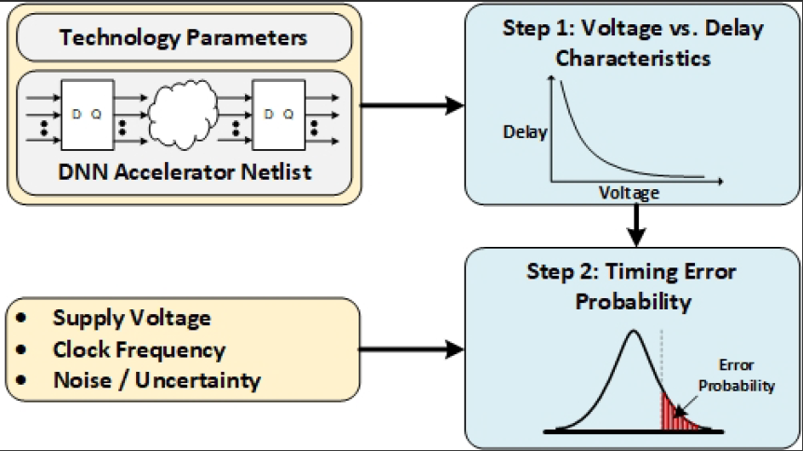

Modeling Timing Error Probabilities
σ = power supply noise
μ = operating voltage
Delay pdf
We extend this formulation to
  Multiple paths driving an output
  Multiple pipeline stages
  Automated
Clock period, T_{clk}
Timing error probability= $\int_{T_{clk}}^{∞}{p\left(δ\right)dδ}$
Verified with Monte Carlo simulations
M. Rathore, P. Milder, and E. Salman, "Error Probability Models for Voltage-Scaled Multiply-Accumulate Units," IEEE TVLSI, 2020.
29

Slide 30
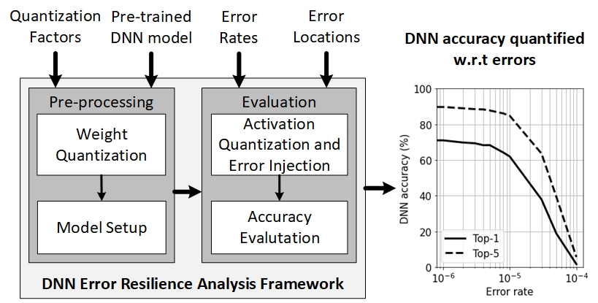
PyTorch based Platform for Error Injection
30
M. Rathore, P. Milder, and E. Salman, “Precision and Performance-Aware Voltage Scaling in DNN Accelerators,” GLSVLSI, 2023

Slide 31
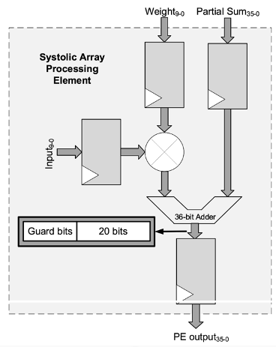
Evaluation Setup
DNN models
Accelerator
  Designed in 20nm FinFET node
  128 by 128 systolic array
  Output stationary dataflow
  10 bit PE with 36 bit outputs
  Nominal supply voltage is 0.9V
  Two clock frequencies: 0.7GHz and 1GHz
  iRazor based error detection and correction
MobileNet-V2
Inverted residual with linear bottleneck
3.5M parameters
Pre-trained on ImageNet
EfficientNet-B4
Compound Scaling method to scale width, depth and resolution
19M parameters
31

Slide 32
Results: MobileNet-V2 at 1GHz
+49.6%
-0.3%
-0.65%
-61.3%
≅ 0%
-57.2%
For 0.65V, errors in 3 most significant bits are detected and corrected.
For 0.55V, errors in 11 most significant bits are detected and corrected.
32

Slide 33
Results: EfficientNet-B4 at 1GHz
-0.72%
-64.3%
+1.8%
For 0.6V, errors in 10 most significant bits are detected and corrected.
33

Slide 34
Summary
Data movement while executing large AI workloads is a bottleneck
Monolithic 3D outperforms chiplets and TSV based die stacking
Thermal-awareness will be a key objective in future systems with advanced packages
  Not just thermal checks, but optimizing while considering thermals
Emerging memory devices such as embedded ReRAM are promising to reduce off-chip DRAM access
  Also sensitive to temperature
Supply voltage is an important design objective in AI workloads due to its effects on errors and potential error resilience of the AI applications
34

