Slide 1
Open-source ASIC ecosystem
HEPIC 2024
Tarun Prakash - 05/01/2024
Lawrence Berkeley National Laboratory

Slide 2
Exploring the Open-Source ASIC Ecosystem: Diving In
Brief overview of the open-source ASIC ecosystem revolutionizing chip design.
Foundation of the Ecosystem
Key components of the open-source ASIC ecosystem:
Open-source toolchain and methodologies
Open-source PDKs
Open-source ASIC cores

Slide 3
Analog Toolchain
Layout design tools.
Schematic capture tools.
Simulation tools.
Text-based layout editor known for its precision and control over layout geometries. Offers hierarchical design capabilities and integrates with various tools for simulation and verification.
Schematic capture tool for creating and editing schematics for digital, analog, and mixed-signal circuits. Offers basic to moderate component libraries and netlist generation for simulation tools.
Schematic capture tool for creating and editing schematics for digital, analog, and mixed-signal circuits. Offers basic to moderate component libraries and netlist generation for simulation tools.
Mosaic offers a modern, collaborative environment for analog design, featuring real-time feedback, intuitive simulation tools, and seamless cloud or offline.
Offers a modern graphical user interface for layout editing. Supports hierarchical design, DRC/LVS checks, and integrates with various EDA tools. Considered more approachable for new users compared to Magic.
Offers advanced features like parallel simulation, mixed-signal simulation, and user-defined models written in C++. Can handle larger and more complex circuits compared to Ngspice.
Notes:
Magic: A well-established layout editor known for its stability and wide range of capabilities. While considered "old school" it remains a cornerstone of many modern design flows.
Klayout: A more recent layout editor that offers a modern interface and features like hierarchical design, making it suitable for complex circuits.
Xschem: A popular and easy-to-use schematic capture tool that has been around for many years. Its large user base and extensive documentation make it a good choice for beginners.
Mosaic: A newer schematic capture tool that offers a more modern interface and advanced features such as mixed-signal simulation. While still under development, it has the potential to become a powerful tool for analog design.
Ngspice: A versatile SPICE simulator that can be used to simulate a wide range of analog circuits. Its long history and large user community make it a reliable choice for basic circuit simulation.
Xyce: A high-performance SPICE simulator that offers faster simulation times and advanced features such as support for large-scale circuits. It is a good option for complex designs or when simulation speed is critical.

Slide 4
Digital Toolchain
RTL-to-GDSII ASIC Design Flow
OpenROAD flow scripts automate the physical design process, leveraging the open-source OpenROAD engine for cost-effective, scalable ASIC design. Customizable and compatible with various tools and libraries, they streamline workflows while benefiting from community support for troubleshooting and customization.
Silicon Compiler - An open-source framework that automates the translation of HDL code into a manufacturable design.
Coriolis 2 - Offers a comprehensive open-source ASIC design flow with tools for synthesis, placement, routing, and power analysis.
https://github.com/The-OpenROAD-Project/OpenROAD-flow-scripts
A good list of Opensource tools - https://semiwiki.com/wikis/industry-wikis/eda-open-source-tools-wiki/
Notes:
Automation: OpenROAD flow scripts automate the entire physical design flow, reducing manual intervention and streamlining the process.
Open Source: Based on the open-source OpenROAD engine, these scripts offer a cost-effective alternative to commercial EDA tools.
Flexibility: The scripts can be customized to integrate with different tools and libraries based on your specific design requirements.
Scalability: OpenROAD is known for its good performance on larger designs, making the flow scripts suitable for complex ASIC designs.
Community Support: The open-source community around OpenROAD provides support and resources for troubleshooting and customization.
Silicon Compiler simplifies the process by automating design translation.
Coriolis 2 provides a robust alternative with a range of design analysis capabilities.

Slide 5
GF180MCU Open Source PDK (GlobalFoundries 180nm CMOS)
Collaboration between Google and GlobalFoundries.
Aimed at 0.18um 3.3V/6V MCU process technology.
Currently in an experimental preview stage.
Suitable for test chips and initial design verification.
SKY130 Open-Source PDK
Low power and low voltage
Up to 5 metal layers
Extensive digital and analog library
Free and open-source
Low cost and reduced time to market

Slide 6
IHP Open Source PDK:
Tailored for Analog/Digital, Mixed Signal, and RF Design.
Specifically designed for SG13G2 process node.
Key Features:
0.13 μm CMOS process with SiGe:C npn-HBT’s.
Transition frequency: Up to 350 GHz.
Oscillation frequency: 450 GHz.
Thin gate oxide for 1.2 V digital logic.
Thick gate oxide for 3.3 V supply voltage.
NMOS, PMOS, and isolated NMOS transistors.
Poly silicon resistors and MIM capacitors.
Backend Design:
5 thin metal layers.
2 thick metal layers (2 and 3 μm thick).
Dedicated MIM layer.
Notes:
heterojunction bipolar transistors

Slide 7
Virtual PDKs
asap7
This is a specific example of a predictive PDK, designed to mimic a 7nm FinFET manufacturing process with EUV lithography. It provides researchers with a way to explore designs for this advanced technology node without needing a confidential PDK from a manufacturer.
FreePDK3 and FreePDK15
Similar to ASAP7, these are open-source predictive PDKs. FreePDK3 targets the 3nm technology node, while FreePDK15 focuses on the 15nm node. These offer researchers the ability to experiment with mature (15nm) and cutting-edge (3nm) processes for their chip designs.

Slide 8
Open-Source ASIC IP Generator Tools
Memory Generators
Analog IP Generators
openFASoC
Block-level memory (RAM) generator for ASIC designs, offering parameterizable templates for various RAM types and allowing customization of size, width, access patterns, and technology options. Integrates seamlessly into open-source design flows using scripting languages like Python.
Leverages a cell-based approach. It breaks down complex AMS functionalities into smaller, reusable digital standard cells with auxiliary custom cells generated automatically. This approach aims to maintain analog performance while leveraging digital design automation techniques.
DFFRAM
Generator for digital flip-flop based memories, specifically for small memories or those requiring high performance
Notes:
OpenRAM: Offers parameterizable memory templates for various RAM types (e.g., single-port, dual-port, synchronous, asynchronous). It allows for customization of memory size, bit width, read/write access patterns, and technology-specific options.
Open-Source Fully-Autonomous SoC Synthesis

Slide 9
Accessible ASIC Design
Tiny Tape Out & Efabless Open Shuttle
Introduction & Audience
Tiny Tape Out simplifies chip design, catering to students, makers, and enthusiasts.
Tools & Resources
Free, open-source tools and community support aid beginners and experts alike.
Design Process & Specifications
From beginner-friendly tools to expert-level languages, designs start at 160x100 microns.
Analog & Mixed Signal Support
Supports analog and mixed-signal designs, including proprietary tools.
Manufacturing & Testing
eFabless manufactures on SkyWater 130nm; chips are tested via MicroPython interface.
Community Collaboration
Access and collaborate on various designs, from CPUs to USB devices.

Slide 10
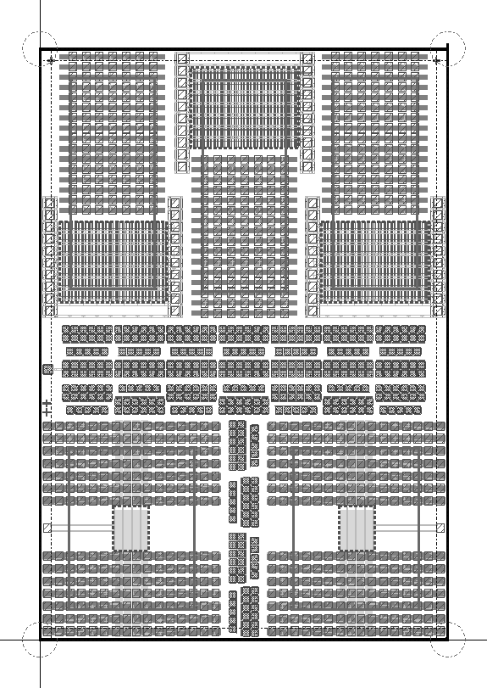
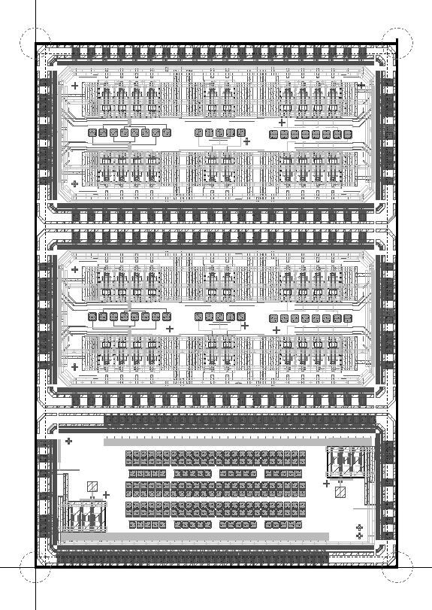
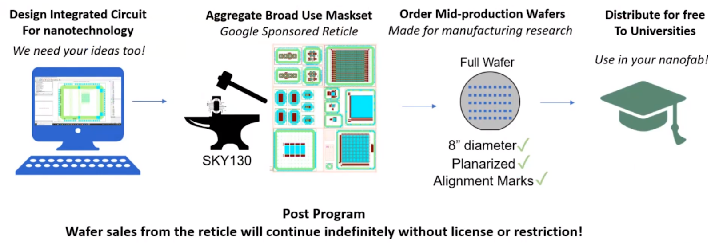
Co-design and integration of nano sensors on CMOS
Use of both opensource tools and Cadence tools
$$+$$
$$+$$
Nanotechnology Accelerator Program
a
b
Layout images of the two tiles that were set to fabrication. (a) A fully passive chip which includes padded-out test structures of various sizes, designed to facilitate post-processing steps such as electrode and hBN flake deposition. (b) Three active testchips, including instrumentation amplifiers as well as experimental hybrid amplification structures.
Wafer-level run with excellent 1nm planarity, and small 0.4um feature size
Design submitted in June 2023, including devices arrays and several variations of readout amplifiers
* Maurice and Katerina

Slide 11
Lessons Learned
Transitioning from Open Source to Cadence Tools – SkyWater130
Background:
Utilized Skywater 130 Open PDK in open-source tools.
Transitioned to commercial Cadence tools employing Skywater 130 PDK.
Observations & Challenges:
Layer Discrepancies: Open Source GDS contained duplicate mapping layers (e.g., diff, tap), causing issues during export/import due to lack of duplication in Commercial GDS.
Transistor Generation: Transistors generated in open-source toolchain using specific layers (e.g., tap under guard ring) led to incompatibility with Cadence tools.
Mitigation Strategies:
Manual Layer Adjustment: Manually adding missing layers or adjusting mappings in Cadence tools.
Thorough Verification: Double-checking designs to ensure compatibility across toolchains.
Rule Book Alignment: Ensuring design adheres to guidelines specified in commercial PDK documentation.

Slide 12
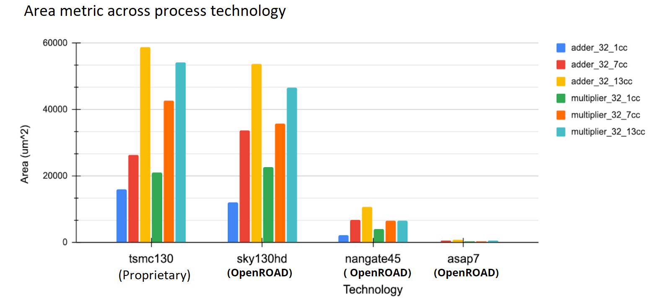
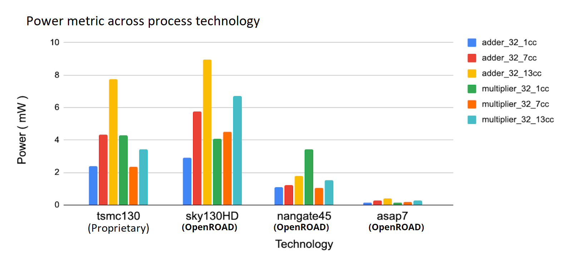
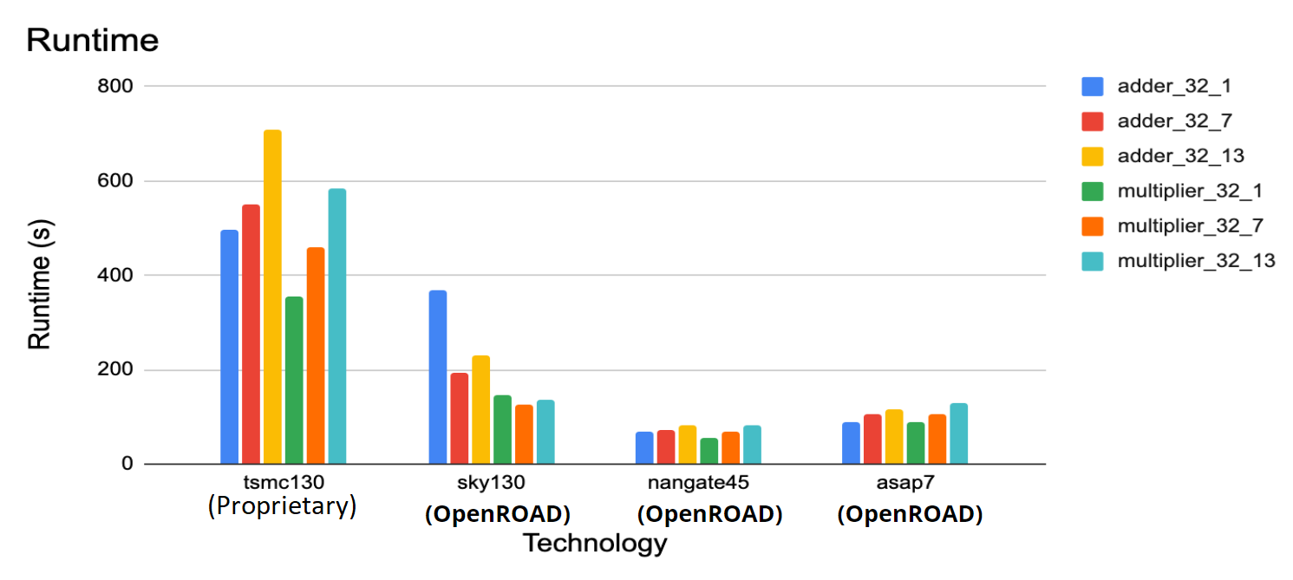
Performance Evaluation of Digital tools
Proprietary tool and OpenRoad flow scripts
*Darren Lyles, Meriam Bautista,
Nirmalendu Patra, John Shalf

Slide 13
Thank you

