Slide 1
Working with National Laboratories & Technology Transfer
Poornima Upadhya
Date 4-30-2024

Slide 2
Technology Transfer - Is a DOE Mission
Technology transfer is the process by which existing knowledge, facilities, or capabilities developed under federal research and development (R&D) funding are utilized to fulfill public and private needs.

Slide 3
Technology Transfer
Bayh–Dole Act-1980
Allows non-profit organizations and small businesses to retain ownership of inventions made under federal funding and to license the rights to those inventions.
Stevenson-Wydler Technology Innovation Act of 1980
Requires federally funded R&D organizations to actively participate in and budget for technology transfer activities.
• Federal Technology Transfer Act of 1986
Enables federal laboratories to negotiate licenses for patented inventions made at the laboratory and to enter into Cooperative Research and Development Agreements (CRADAs).

Slide 4
Tools to Establish Collaborations
Nondisclosure Agreements (NDA)
Enable labs and potential partners to exchange confidential information.
Materials Transfer Agreement (MTA)
Certain materials may be temporarily transferred to or from industry or academia.
Please note no collaborative work can be done with either of the agreements

Slide 5
Access to Expertise and Capabilities
Strategic Partnership Project (SPP)
Enables organizations to pay Labs to perform a defined scope of work with tasks that utilize unique facilities, equipment and personnel at the Lab.
Technical Service Agreement (TSA)
Intended for short-term projects that do not involve R&D.
Limited to domestic organizations.
Cooperative Research and Development Agreement (CRADA)
Enables organizations to work collaboratively with National Labs
Agreements for Commercializing Technology (ACT)
Intended for Lab Contractors to conduct sponsored research at the Contractor’s risk for third parties.
Please note agreement include handling of proprietary information

Slide 6
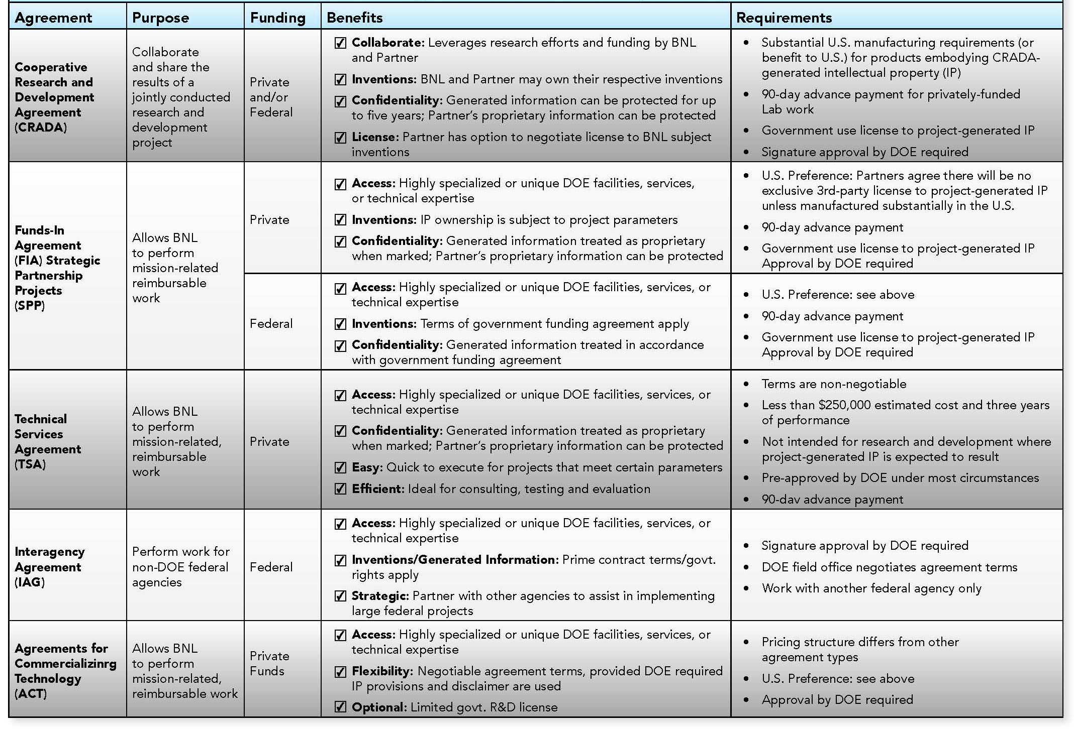
Matrix

Slide 7
Access to Intellectual Property
Labs seek companies that can successfully commercialize innovations resulting from lab research.
Several types of License Agreements are available:
Non-Commercial/Research License
Commercial License
Exclusive
Non-Exclusive
Option
Government

Slide 8
Summarize
There are numerous mechanisms for technology transfer at the National Labs.
Need and type of organization dictates the mechanism.
Connect the technology transfer point of contact at potential partner organization with those at the National Lab.

Slide 9
Thank you!

