Slide 1
Training initiatives by commercial tool vendors
Nicholas St. John
Brookhaven National Laboratory
HEPIC 2024
Thursday, May 2nd 2024

Slide 2
Introduction
Continuous learning is vital to stay relevant in a fast-paced and ever-changing research field
On top of changing technologies, the commercial tools used to develop them are constantly being changed as well
The ability to use these tools in an efficient and effective manner is paramount
Thus, finding and utilizing trainings to become more proficient in the tools given to us is of great interest
The goal of this presentation is to introduce new learning opportunities to all as well as provide links to access these trainings

Slide 3
Commercial Vendors and Tools Used

Slide 4
Cadence Training Opportunities
Cadence offers a variety of courses on using their tools with both in-person and self-paced online options
Cadence training services have developed a document of learning maps which illustrate all the different courses offered and how they weave with one another for a variety of topic areas
Some relevant topic areas are:
Custom IC, Analog and RF Design
Digital Design and Signoff
System Design and Analysis
IC Package Design and Analysis
Mixed-Signal Modeling and Verification
These courses offer certificates of completion after passing the final exam
Personal Experience:
I have used the courses offered on Verilog-A programming to learn and become proficient in using it in my daily work

Slide 5
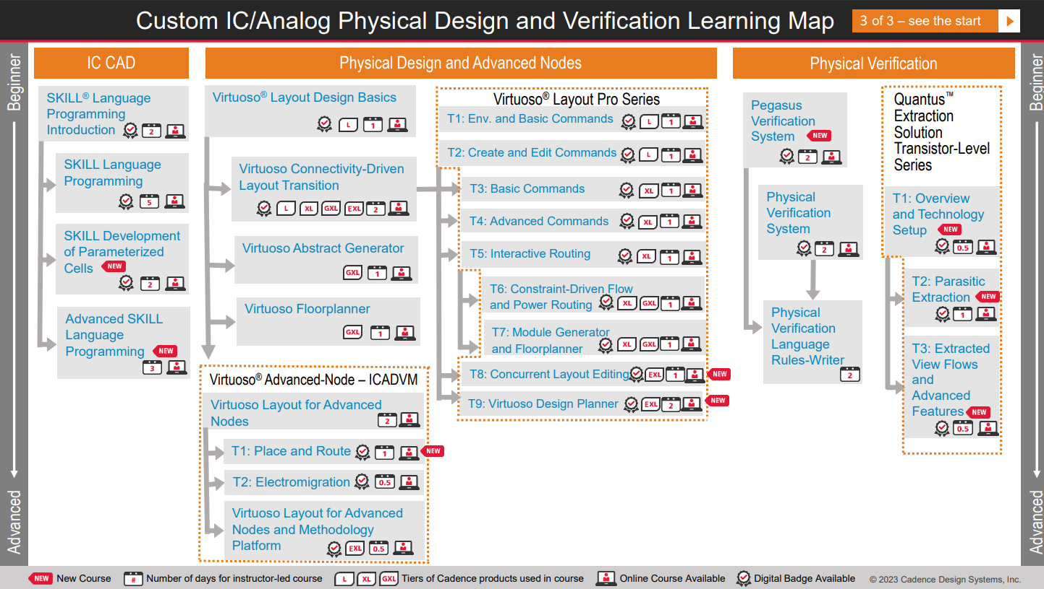
Example of Learning Map

Slide 6
Cadence Rapid Adoption Kits (RAKs)
Cadence offers a variety of RAKs allowing users to quickly integrate advanced features/functionalities into their design flow
A complete glossary of all RAKs can be found here
Personal experience:
We used a Cadence RAK to set up co-simulation of SpectreRF inside a Simulink testbench
From this, we were able to run an optimization problem via a MATLAB script, where we adjusted schematic parameters and ran a Spectre simulation and obtained all of the results in Simulink for further processing

Slide 7
MATLAB/Simulink Training and Resources
MathWorks offers a variety of courses allowing users to become more proficient in:
General usage of MATLAB/Simulink
Usage of tools for specific applications (e.g., AI/ML, HDL code generation, etc.)
Applications of MATLAB toolboxes and Simulink Blocksets
A list of training courses available can be found here
These courses can be offered in real-time via an online or classroom format, as well as self-paced options for some courses
Example programs can also be accessed via MathWorks for a wide variety of applications here
Personal Experience:
I took an online real-time course on the optimization toolbox and had a very pleasant experience understanding more of the intricacies in using the toolbox, having access to multiple interactive examples, and being able to keep all resources provided by the class

Slide 8
MATLAB/Simulink Credentials
MathWorks offers digital credentials to showcase your level of expertise in MATLAB and Simulink
A test must be taken to obtain each credential, more information can be found here
Foundational MATLAB is an exception, this just requires completion of the MATLAB Fundamentals online course

Slide 9
Wolfram U
Wolfram Mathematica also provides a very wide range of opportunities for continued learning and training at their website Wolfram U
These resources include:
Instructor led courses
Self-paced online courses
Video lectures
Many courses provide certificates upon successful course completion
These courses span a myriad of topics, both tool-centric and theory-centric, e.g.:
Tool-Centric (focus on how to use Mathematica)
Wolfram Data Science Bootcamp
Wolfram Language Programming Proficiency
Theory-Centric (focus on principles behind topic, use Mathematica to illustrate principles)
Multivariate Calculus
Control Systems Design

Slide 10
Synopsys Course Offerings
Synopsys offers a variety of courses for their tools and how they apply to specific types of designers
Like Cadence, Synopsys has a learning journeys document illustrating the recommended flow of courses based on the role of the user, or the tool that the user wishes to learn about
Courses are offered in a variety of ways, including:
Public in-person classroom
Private on-site
Self-paced online
Private and public virtual classroom

Slide 11
Synopsys Badging and Certification
Digital credentials are available for course completion based on the passing of an online exam
Furthermore, Synopsys has a more formal certification program called Purple Certification
This requires attending a hybrid course spanning multiple weeks and passing an exam at the end of it
It looks like these can be taken completely remotely, but I am not sure of this
Purple Certifications come for a variety of tracks including:
Physical Design
RTL Synthesis
Design Verification
Design for Test
AMS Circuit and Layout Design

Slide 12
Silvaco Resources
Silvaco has a variety of resources available online for educational purposes including:
Technical library consisting of published papers, white-papers, etc.
Application examples of Silvaco tools used in industry
Live and archived webinars

Slide 13
Conclusion
There are many resources out there to increase your knowledge in the usage of the commercial tools we use everyday
Many of these resources also provide certifications, bolstering CV’s/portfolios
Thank you all for your time!

