Slide 1
EDIT School @ BNL
Piotr Maj, Arif Iqbal
May 2 2024

Slide 2
EDIT School
Excellence in Detector and Instrumentation Technology
Enhance Skills in detector technologies and experimental methods
Geared towards students and young professionals
Hosted alternately in Europe, Asia and North America
Hands-on training in a variety of cutting-edge technologies and experimental techniques
Provides networking with experts, practical experience, and access to the latest technological advancements
A premier educational platform for budding professionals to advance their technical skills and professional networks in detector technology.
Sponsors and/or Co-sponsors
International Committee for Future Accelerators (ICFA)
Department of Energy (DOE)

Slide 3
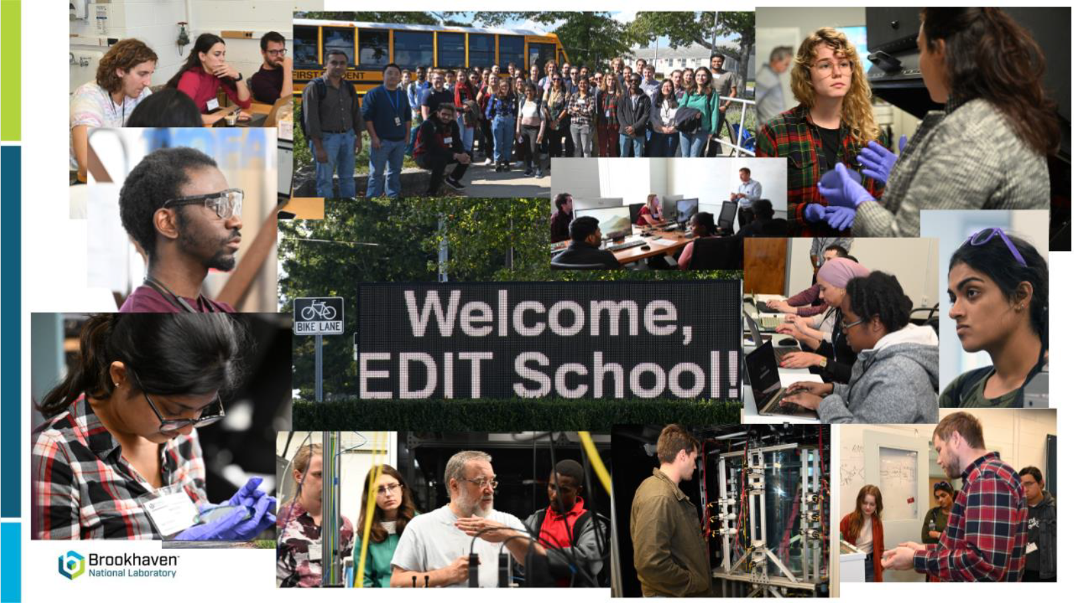

Slide 6
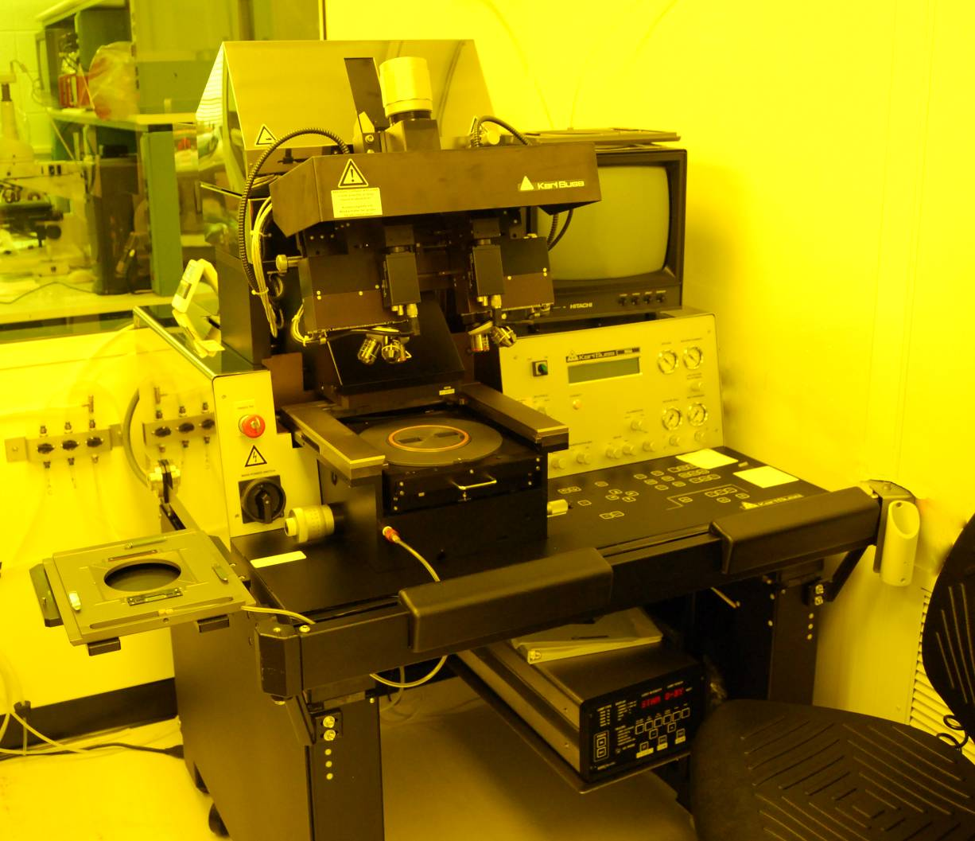
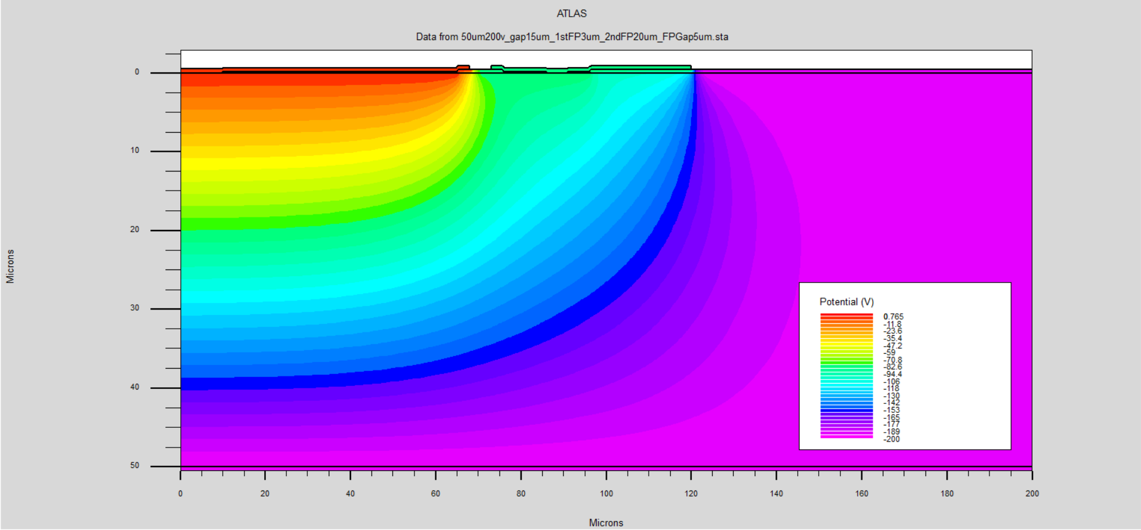
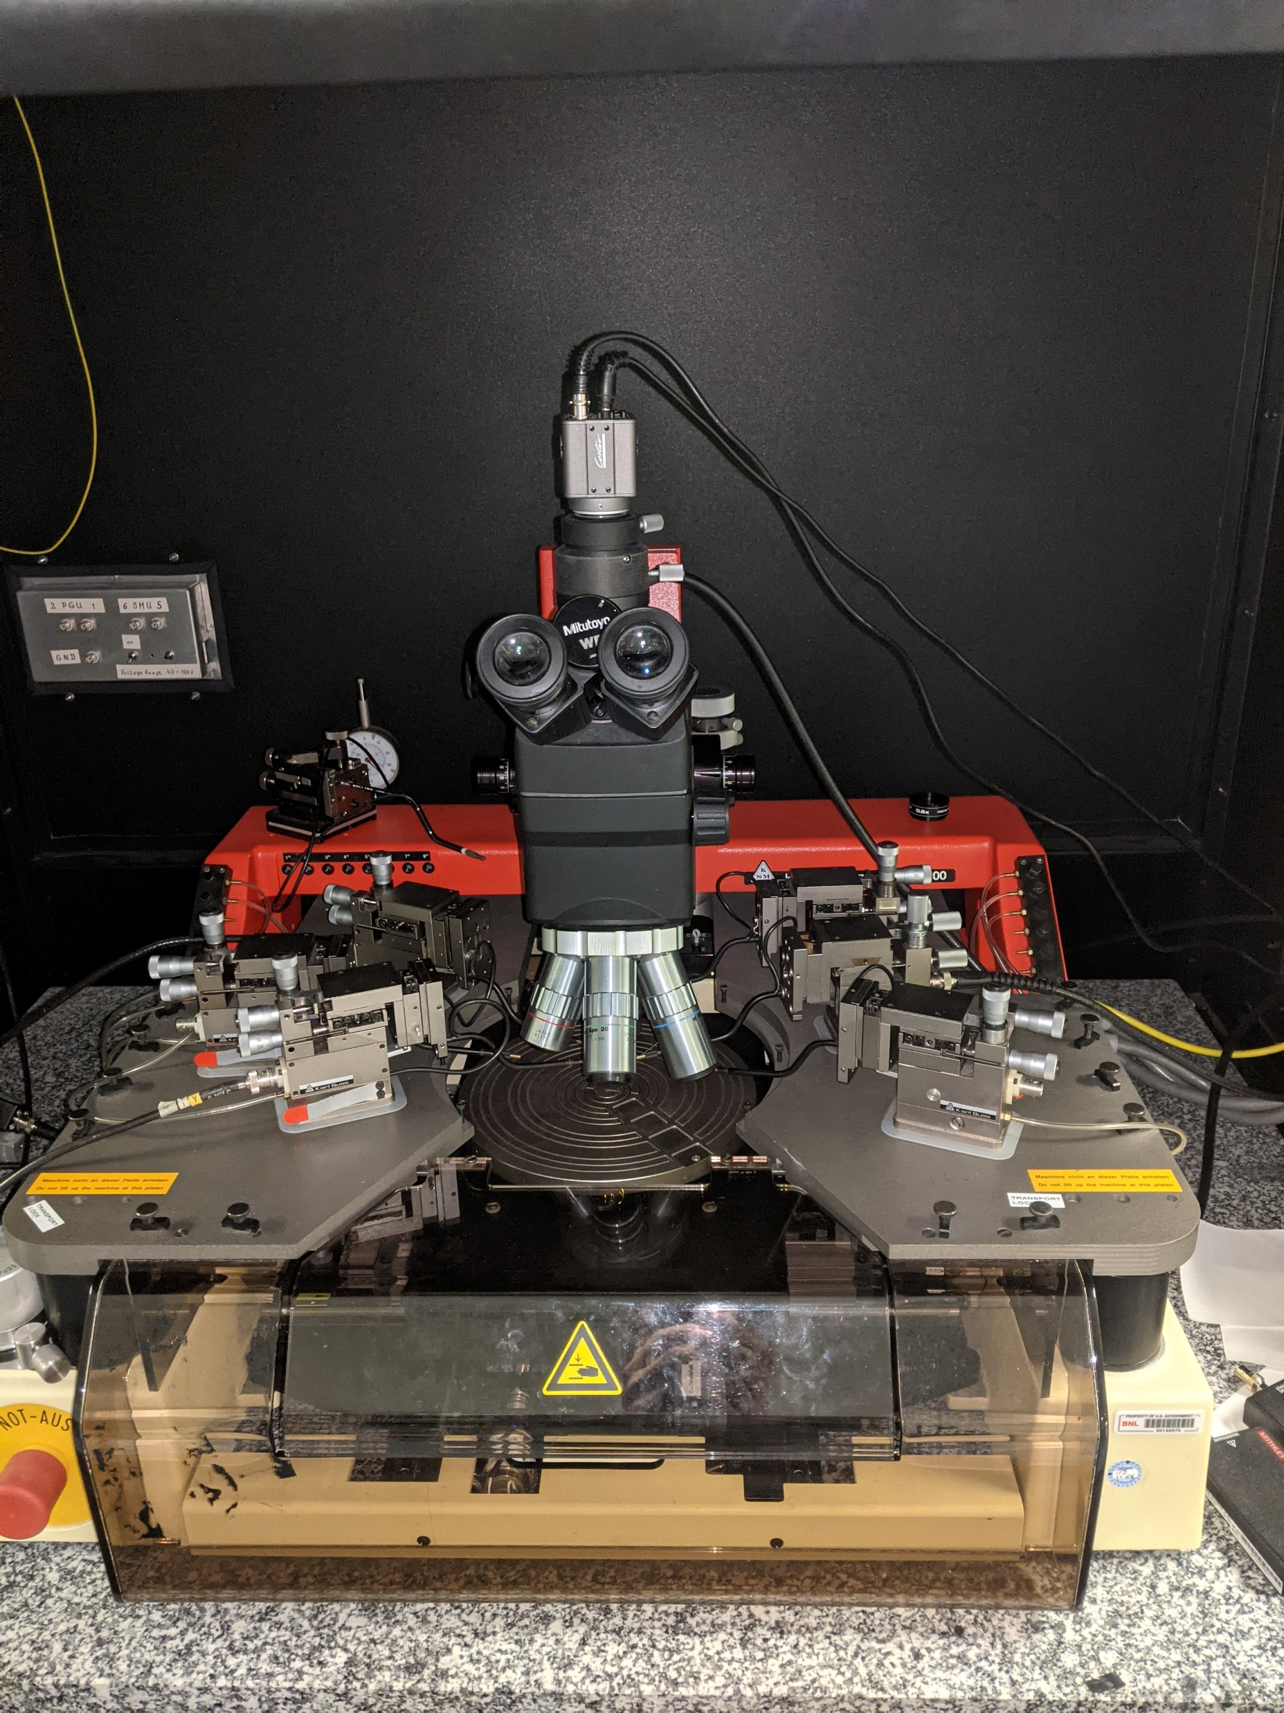
Silicon Sensors: design and fabrication
A lecture will be given covering an overview of the physics of silicon sensors and their scientific and industrial applications.
Laboratory sessions include: test at the probe station, TCAD simulations, and clean room process overview.
Class-100 Clean Room:
Students will go through the process steps to create a semiconductor sensor
Furnaces (oxidation and annealing)
Lithography
Sputtering
Etching
Cleaning
Diode @ GND
Floating GR
Tests:
Static characterization at the probe station of silicon devices (e.g., LGADs, microstrip, silicon drift detectors)
Current-voltage (I-V)
Capacitance-Voltage (C-V)
Stability tests
Back @ -200V
TCAD simulations:
Using SILVACO, the students will simulate the process flow to build, the physics and the electrical characteristics of a few silicon devices.

Slide 7
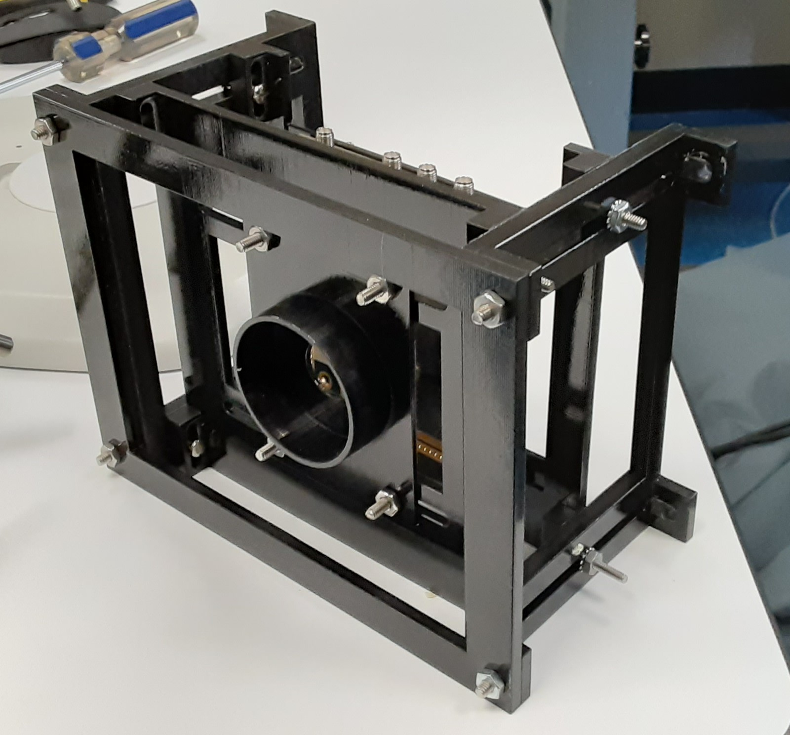
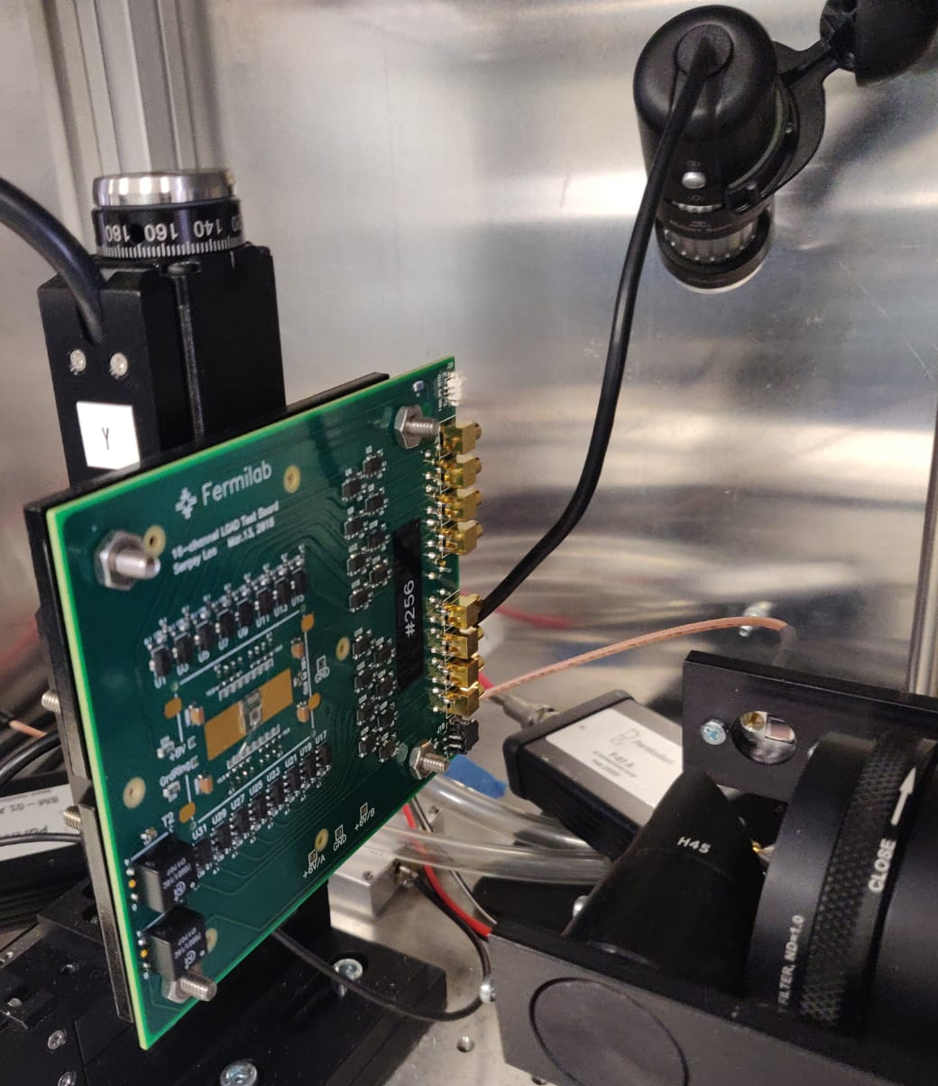
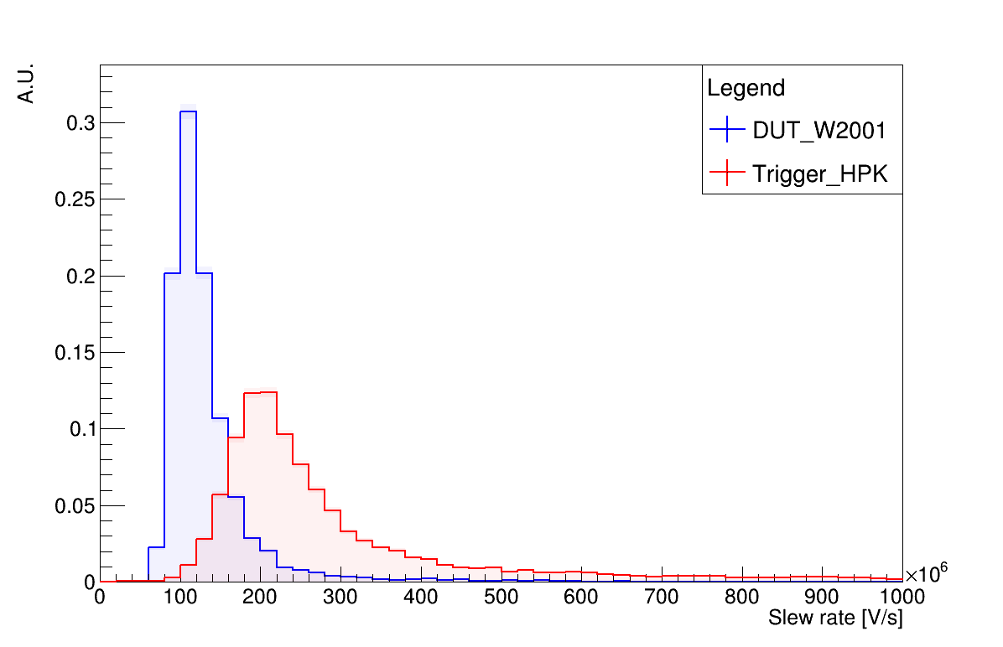
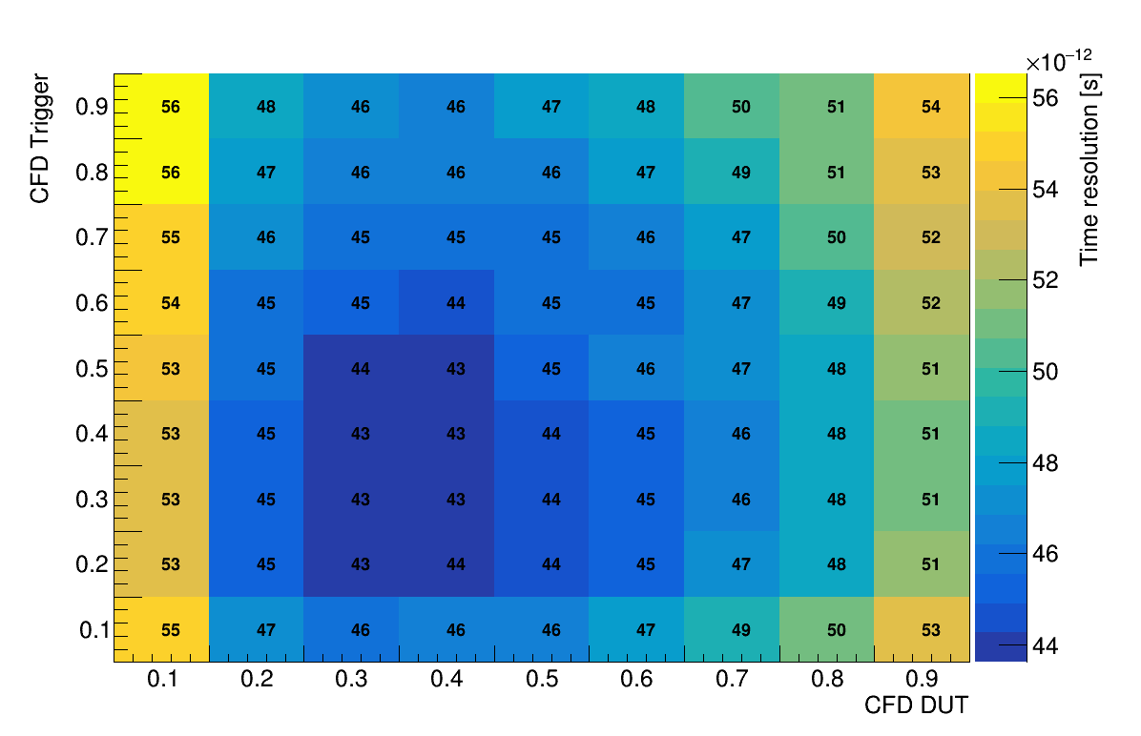
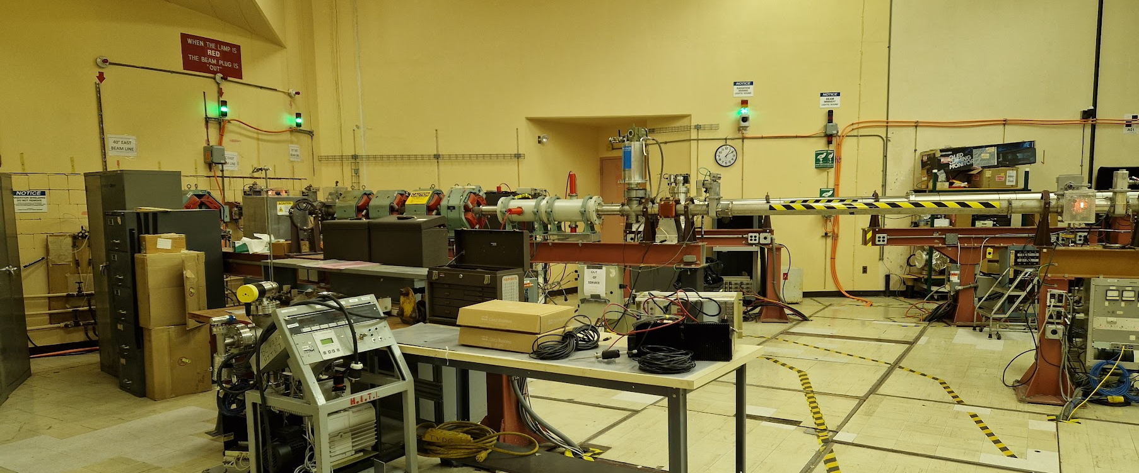
Silicon Sensors: testing
Data Analysis
Students will analyze waveforms obtained in lab and at test-beam using a python3 framework.
We will provide base functionalities (data loading, plotting, …); students will extrapolate physical quantities from waveform features
Characterization at Betascope
Students will measure gain and time resolution of a silicon sensor using betas from a ⁹⁰Sr source
Transient Current Technique
Students will map the response of the sensor using a focused IR laser with micrometric precision
Characterization at Test Beam
Measure space and time resolution of an LGAD silicon sensor at a real test beam facility. The sensor will be mounted on a custom made silicon telescope.
Students will set up the data taking from the accelerator control room, acquire data, and extrapolate the sensor space resolution by exploiting 4D data from the telescope.

Slide 8
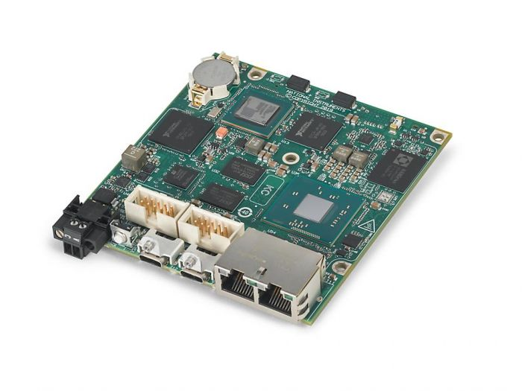
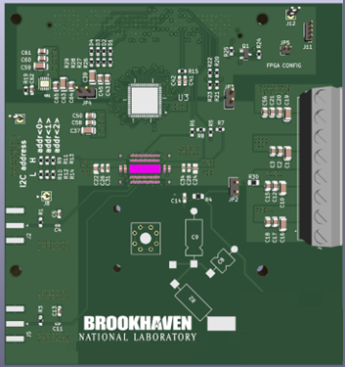
ASIC design and testing
Project
Students will get familiar with the fast-prototyping platform and programming methods.
They will learn and implement basic structures on FPGA and Real-Time Operating System, including:
counters, timing, generation and acquisition of real signals with high speed
FPGA – RT communication methods, RT OS application design patterns
GUI
Get familiar with the off-the-shelf electronics
Students will get familiar with the functionality and capabilities of the Artix7 FPGA-based system
ASIC Board
Students will get familiar with the design considerations towards PCB design for an ASIC testing purposes
Application Specific ADC testing system
Students will prepare the ADC ASIC testing system starting from an empty project.
Final system consists of an ADC PCB controlled by an FPGA and a Real-Time OS controlling FPGA and handling the data.
Students will prepare all necessary blocks for ADC control and data handling as well as a dedicated user interface for data display.
Application Specific Integrated Circuit design 101
Students will gain basic understanding of microelectronics and its central role to detector systems.
Students will have the opportunity to gain familiarity with desing tools and technology platforms.
A series of PC stations will be made available for small groups of students woirking with mentors.
Lectures will preceed the hands-on-training.

Slide 10
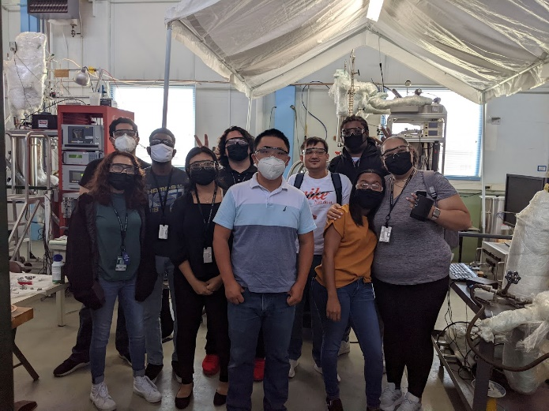
Liquid Argon Detectors
Lectures: LArTPC principle and cryogenic system, LArTPC reconstruction, LArTPC cold Electronics
Labs: Students divided into small groups between two test stands
Local 260 L LAr system cryogenic operation
Cryogenic system operation/monitoring
Refilling LN2 dewar from 6000-gallon supply tank
Change LN2 supply for 260-L system cryogenic operation
Assembly for new inline filter
Leak check the for new inline filter (follow with activation if time permits)
LXe transfer(if time permits)
Cold Electronics test stand (may be combined with other cryolectronics tests)
NuSTEAM students visiting the LAr R&D facilities (20-L cyrostat on left and 260-L on right) in July 2022.

Slide 11
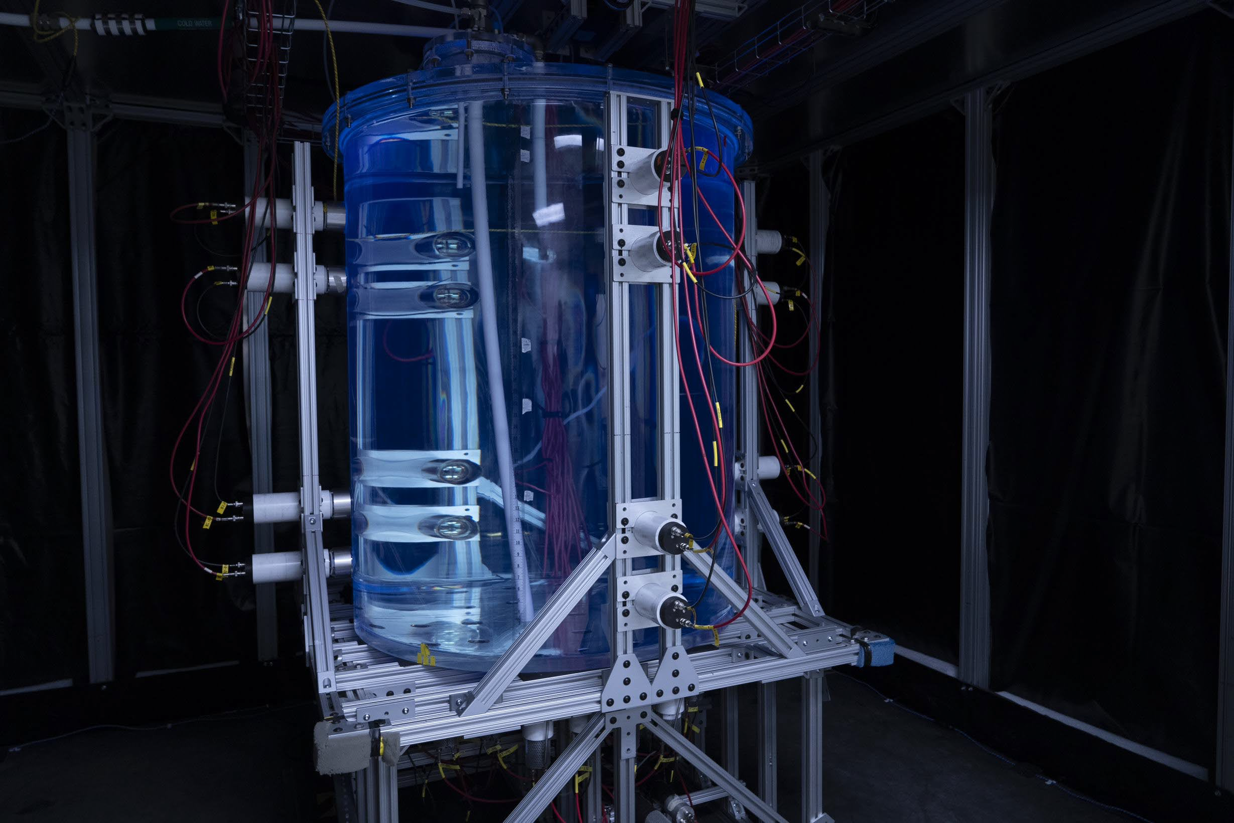
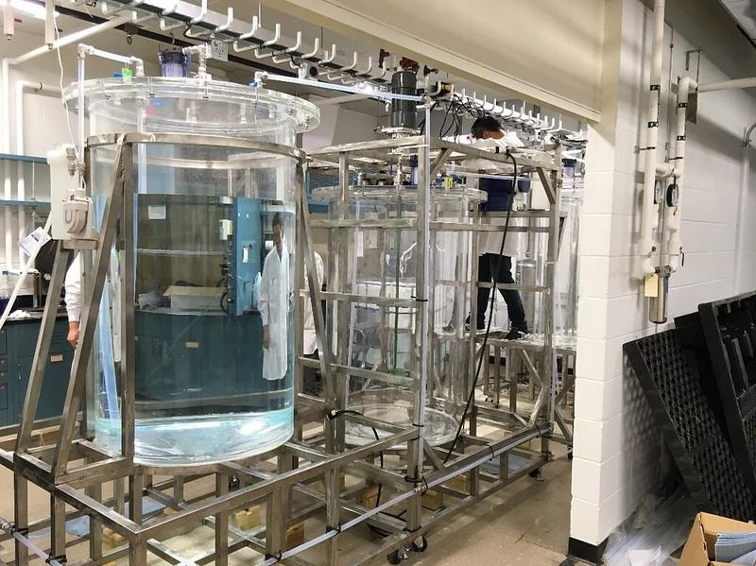
Liquid Scintillator Detector
Two groups of student for hands-on-activities
Two lectures (one-hour each) to cover (1) nature of scintillator detector, and (2) scintillator-based particle experiments
Two lab courses (3-hour each)
Lab-A: preparation and characterization of liquid scintillator; hand-on experience for students to prepare LS samples and measure their performances using benchtop instrument.
Lab-B: data-taking and -analysis at 1-ton Testbed; students will observe the configuration and operation of a ton-scale detector and learn of DAQ and analysis tool to analyze muon and alpha events.
Water-based liquid scintillator testbed
1000 L Sequential-Mixing Reactor System in Liquid Scintillator Production Facility (LSPF) at BNL.

Slide 12
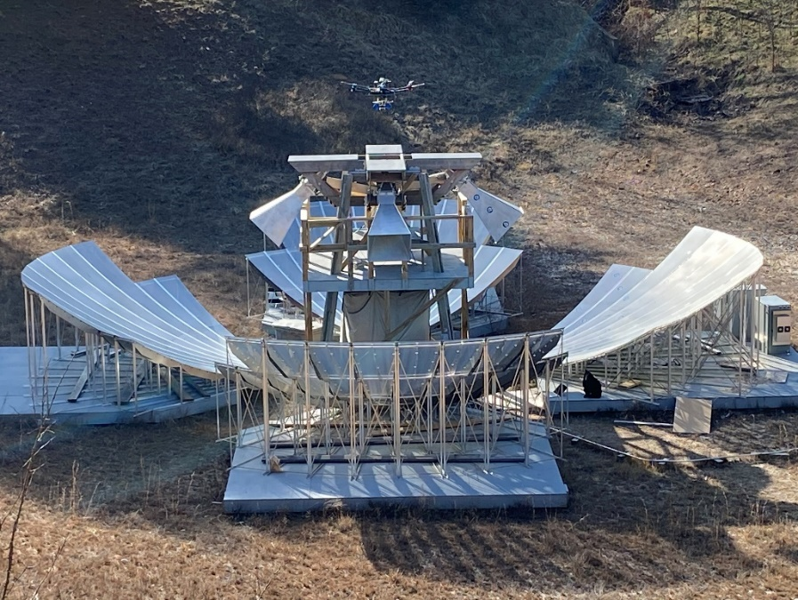
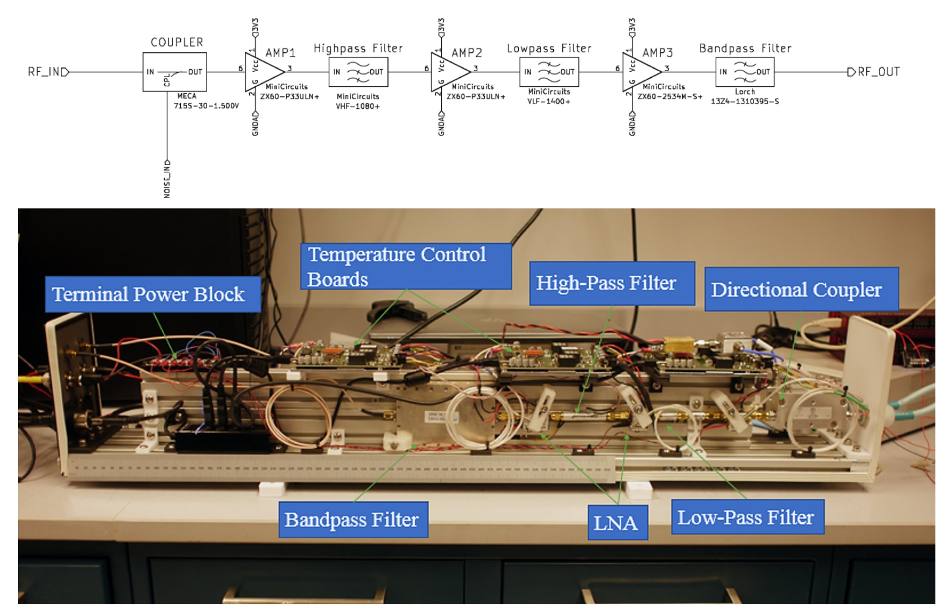
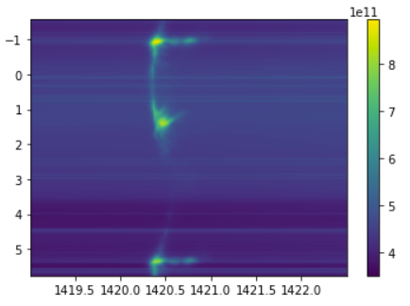
Radio Astronomy
The Baryon Mapping Experiment (BMX) located onsite at BNL is an ideal teaching telescope. It offers students the opportunity for hands on work with RF hardware and astrophysical data taken on location.
Experiments to detect the 21cm transition line of neutral hydrogen across a wide range of redshifts are at the forefront of astrophysics and cosmology.
Lectures will cover: (1) an overview of radio cosmology and the 21cm line in particular, (2) RF instrumentation for astronomy, and (3) drone beam calibration systems.
Laboratory activities include:
RF signal chain construction and measurements. Including use of RF components, signal generators and vector network analyzers.
Data analysis including RFI processing and astrophysical signal detection. (Milky Way seen in BMX data to left)

Slide 13
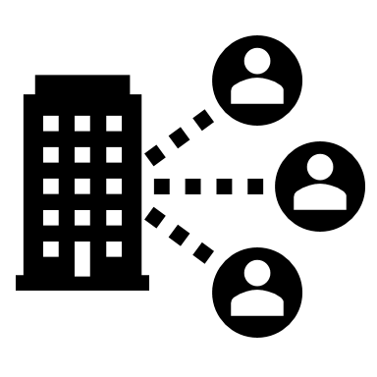
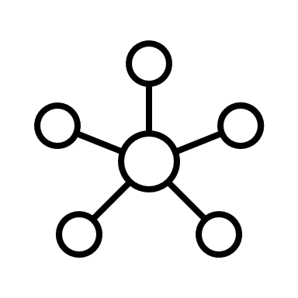
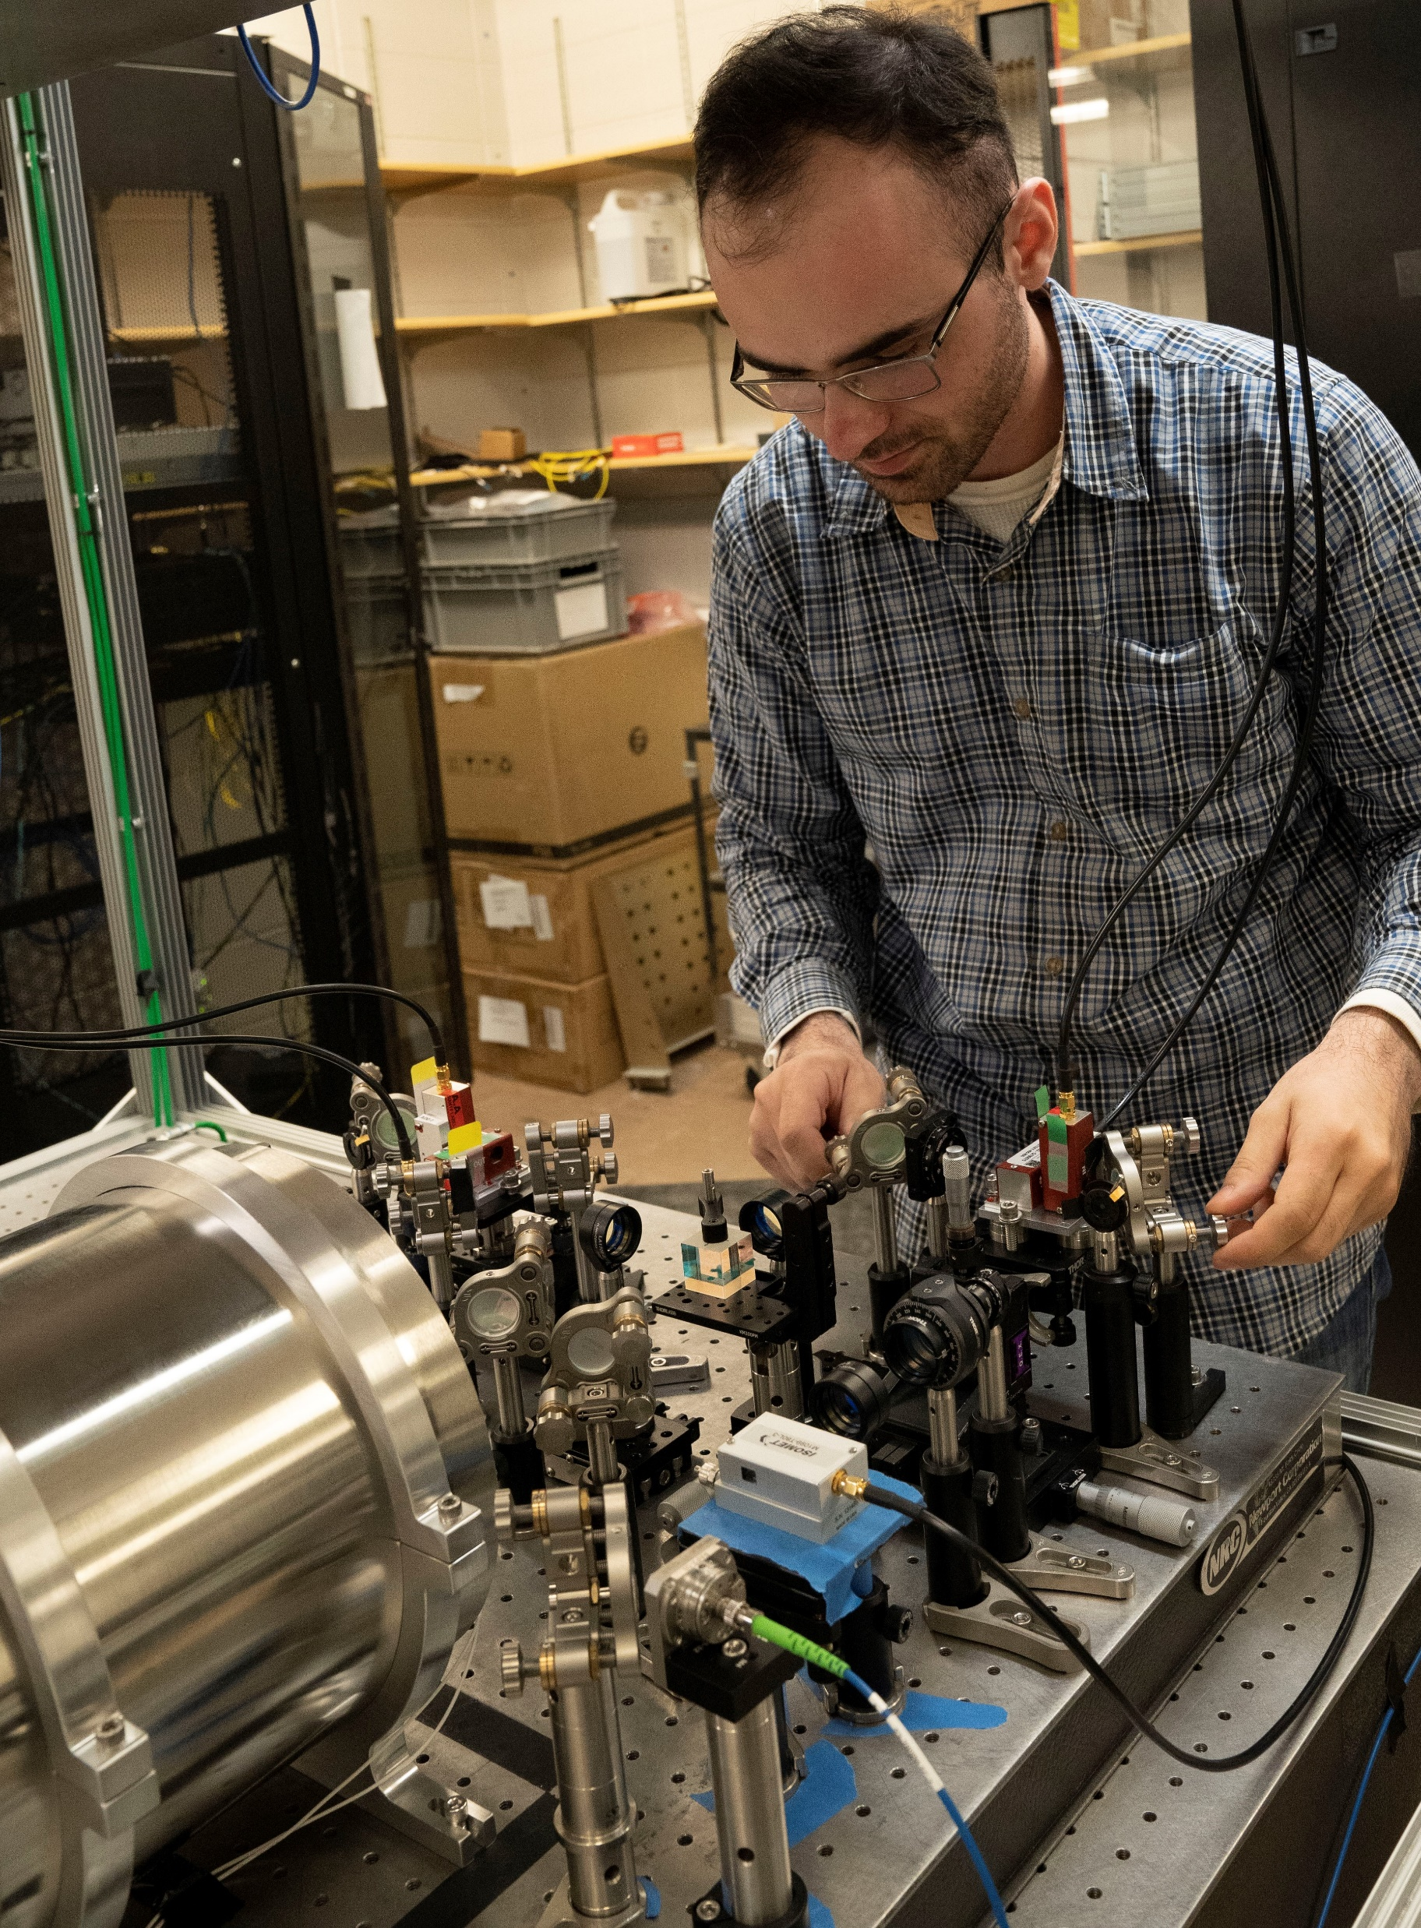
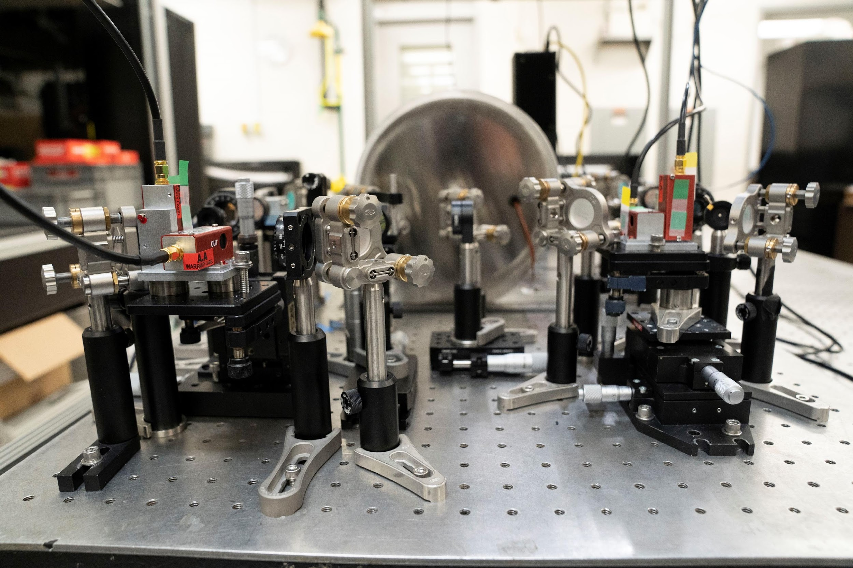
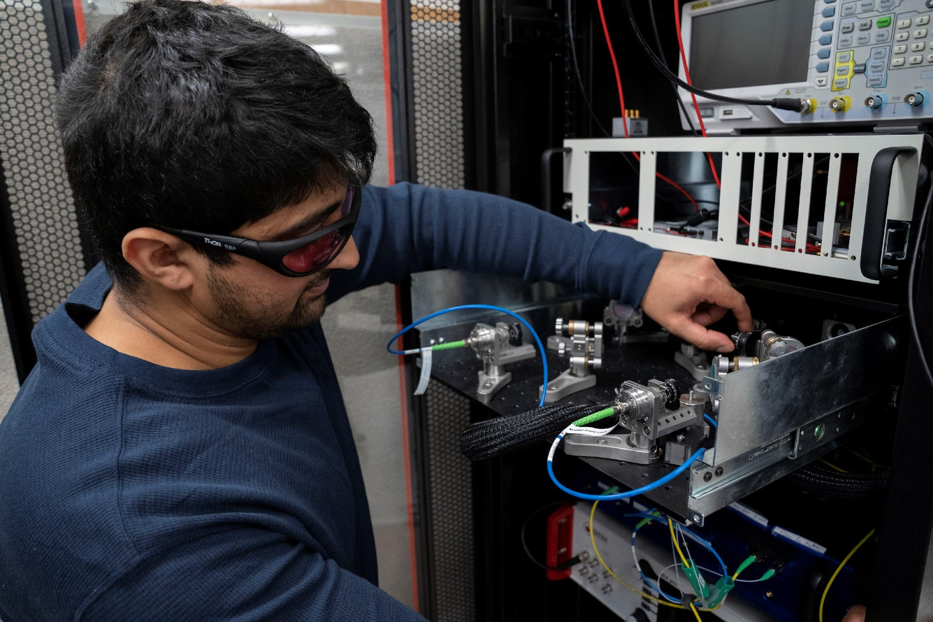
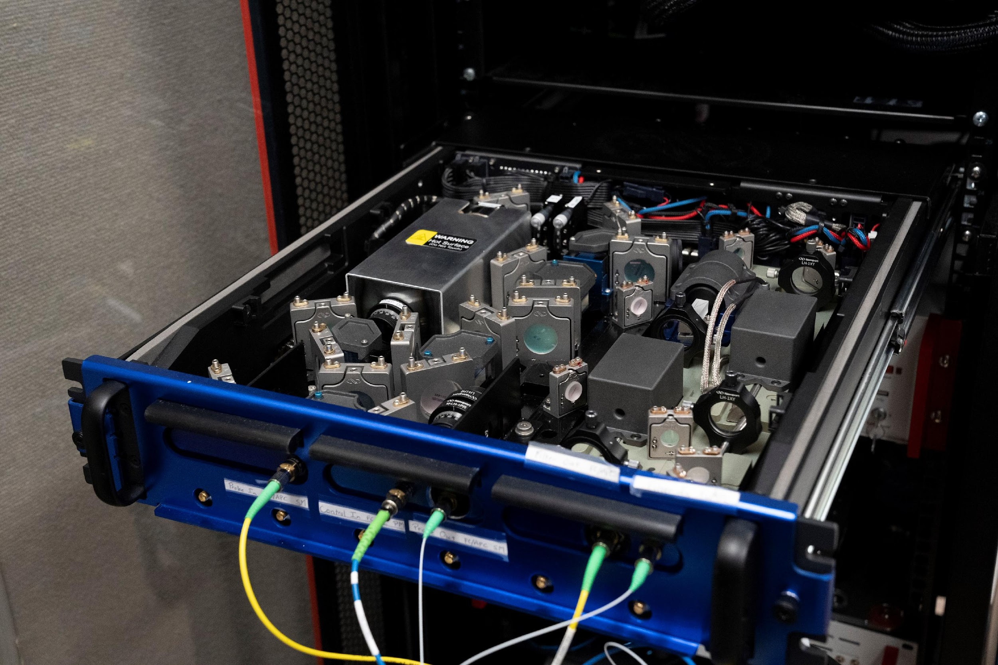
QN: First Experimental Facility Open to the User Community
Quantum technologies and the fabric of the quantum economy is enriched by allowing:
Users to test, benchmark, validate, and develop new concepts and ideas, as well as software and devices.
Accelerate the development of q. technology and the fabric of the q. economy
Contribute to the development of a diverse quantum-smart workforce
https://www.bnl.gov/instrumentation/quantum/
User Submits Proposal
Review
Access to Facility
Execution
We have the legal framework in place that allows us collaboration with private sector, academia, and government.
We are exploring collaborations with early users.
Increased involvement within the QED-C.
quantumfacility@bnl.gov
POC: jmartinez1@bnl.gov

