Slide 1
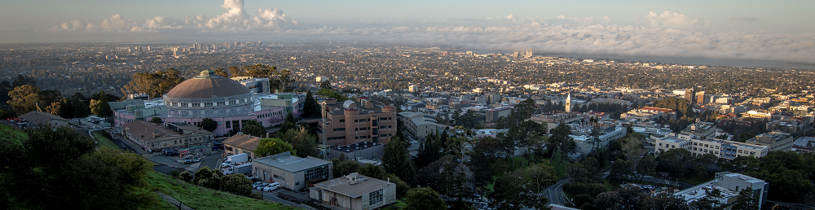
Recent Experience of Inter-Institutional Projects
Carl Grace, Lawrence Berkeley National Laboratory
05/01/2024

Slide 2
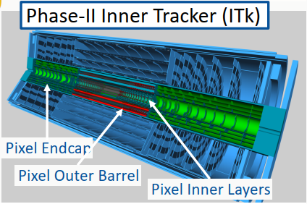
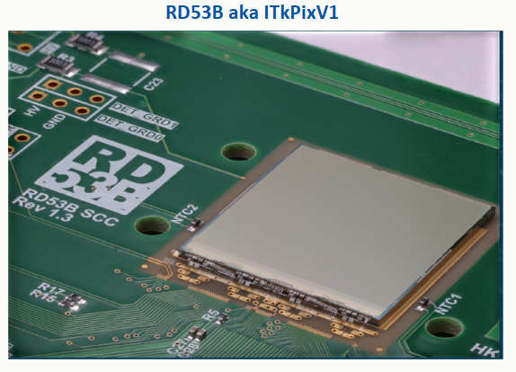
Inter-Institutional Collaboration
Collaborating between institutions brings many benefits
Resource-limited groups can tackle projects of larger scope
Groups with different strengths can complement each other
Promotes culture of openness, sharing, and joint skills development
Example: RD53 ITk development (5+ institutions, 20+ designers)

Slide 3
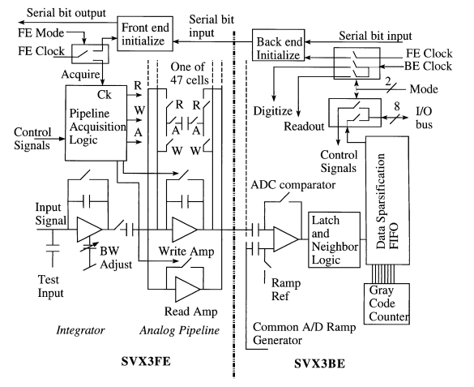
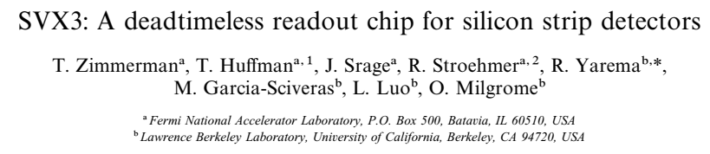
Early Efforts
Early efforts of collaboration were limited by technology
One early such project was SVX, jointly developed by LBNL and FNAL, starting in the late 1980s and developed through the 1990s and beyond
Early designs had two physically distinct dies (front end and back end) that were connected by wirebonding (eventually a monolithic version was developed)
Enabled “collaboration by interfaces”
Project was a huge success, and was applied in D0 and CDF
FNAL
LBNL
NIMA 409 (1998)

Slide 4
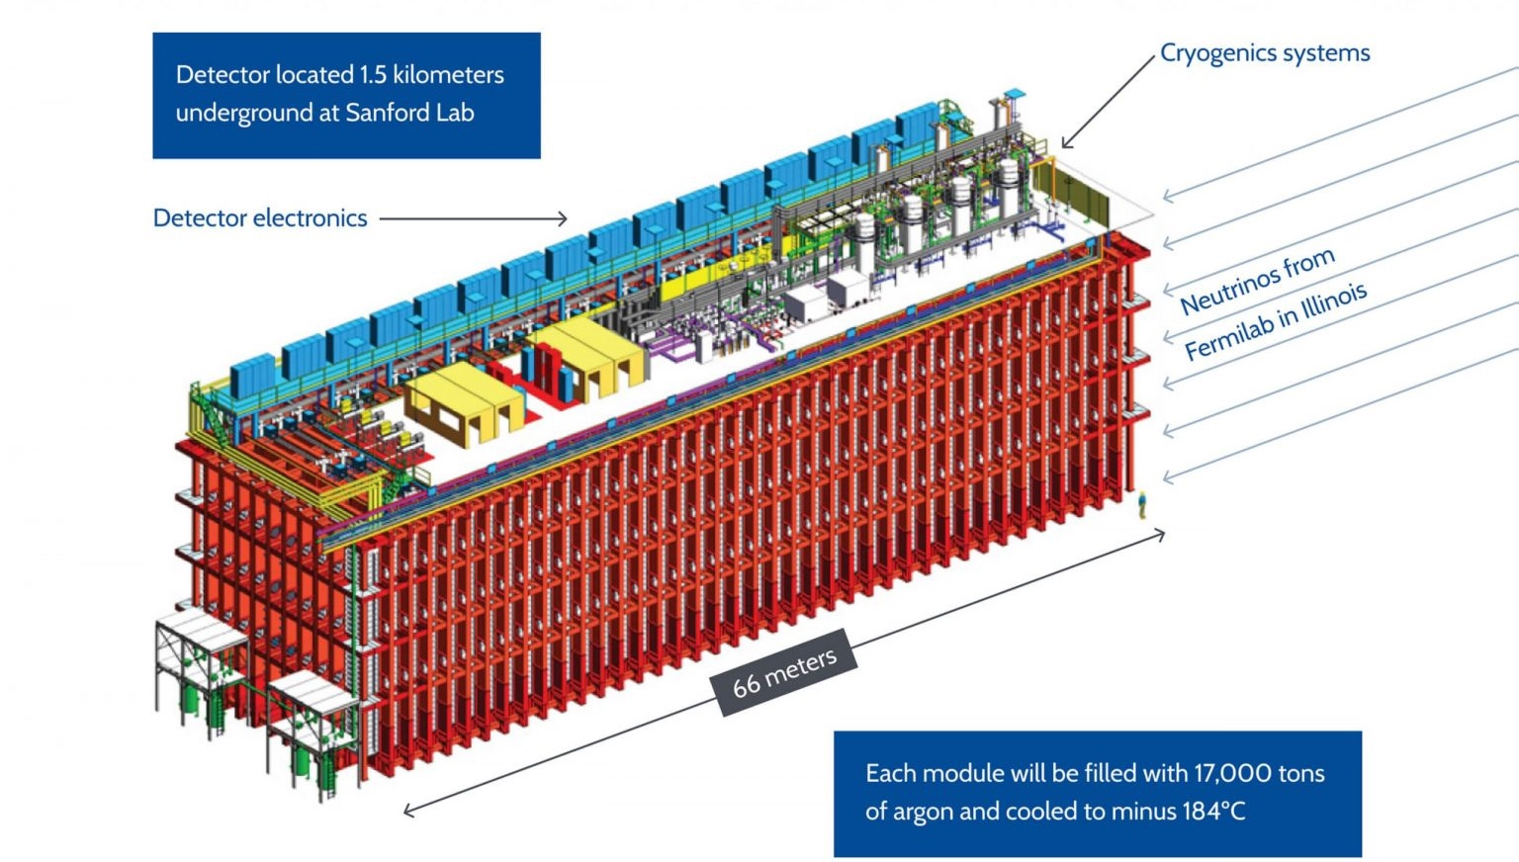
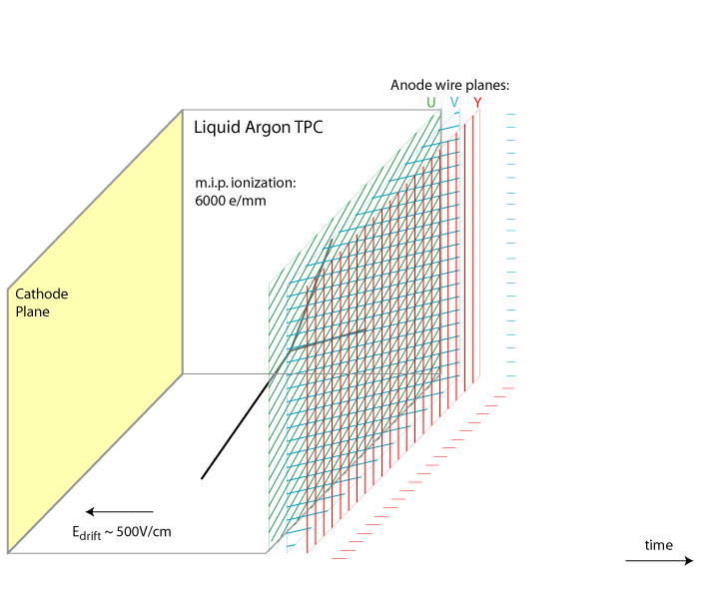
Example: ADC for DUNE Far Detector
Liquid argon is incredibly dense, chemically inert, and cheap. It makes a fantastic neutrino detector.
Only problem? It’s cold!
Bo Yu (BNL)
DUNE Far detector module
Wireplane TPC operating principle
Detector material, liquid Argon, is –184 °C!

Slide 5
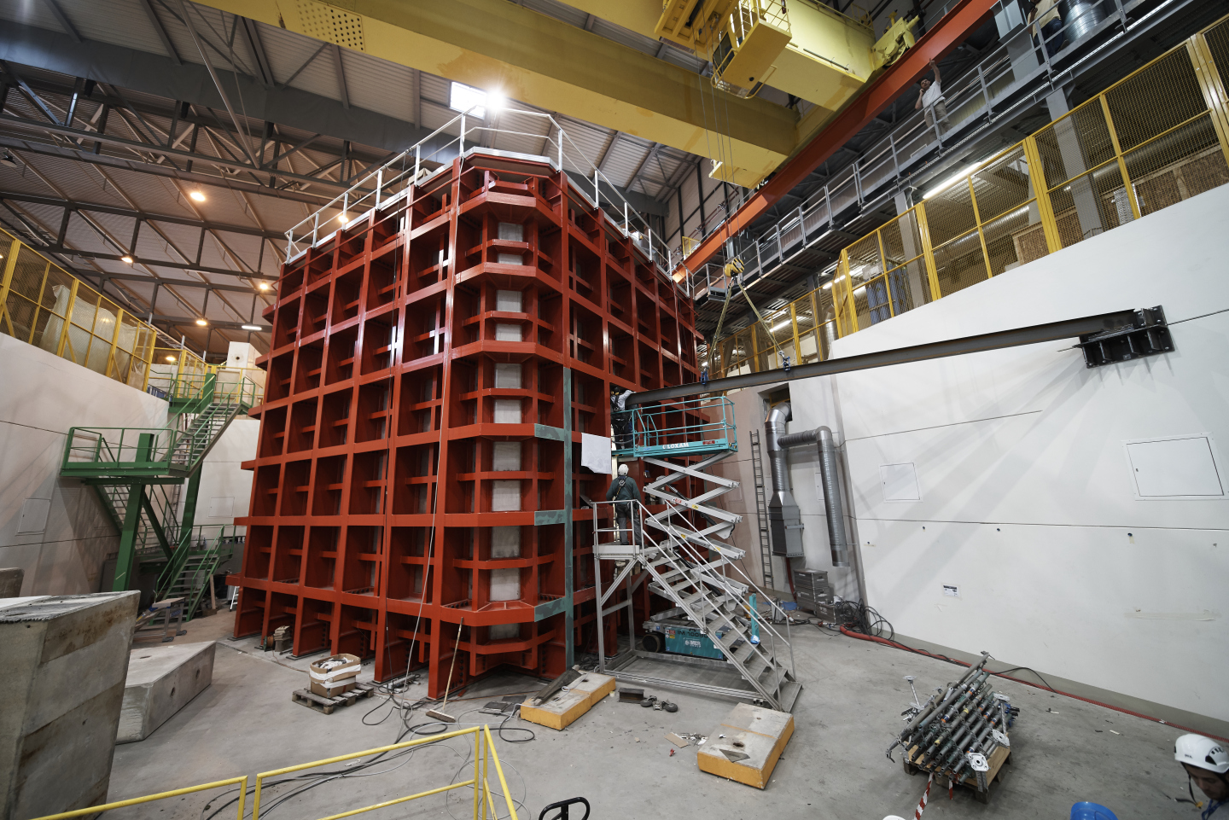
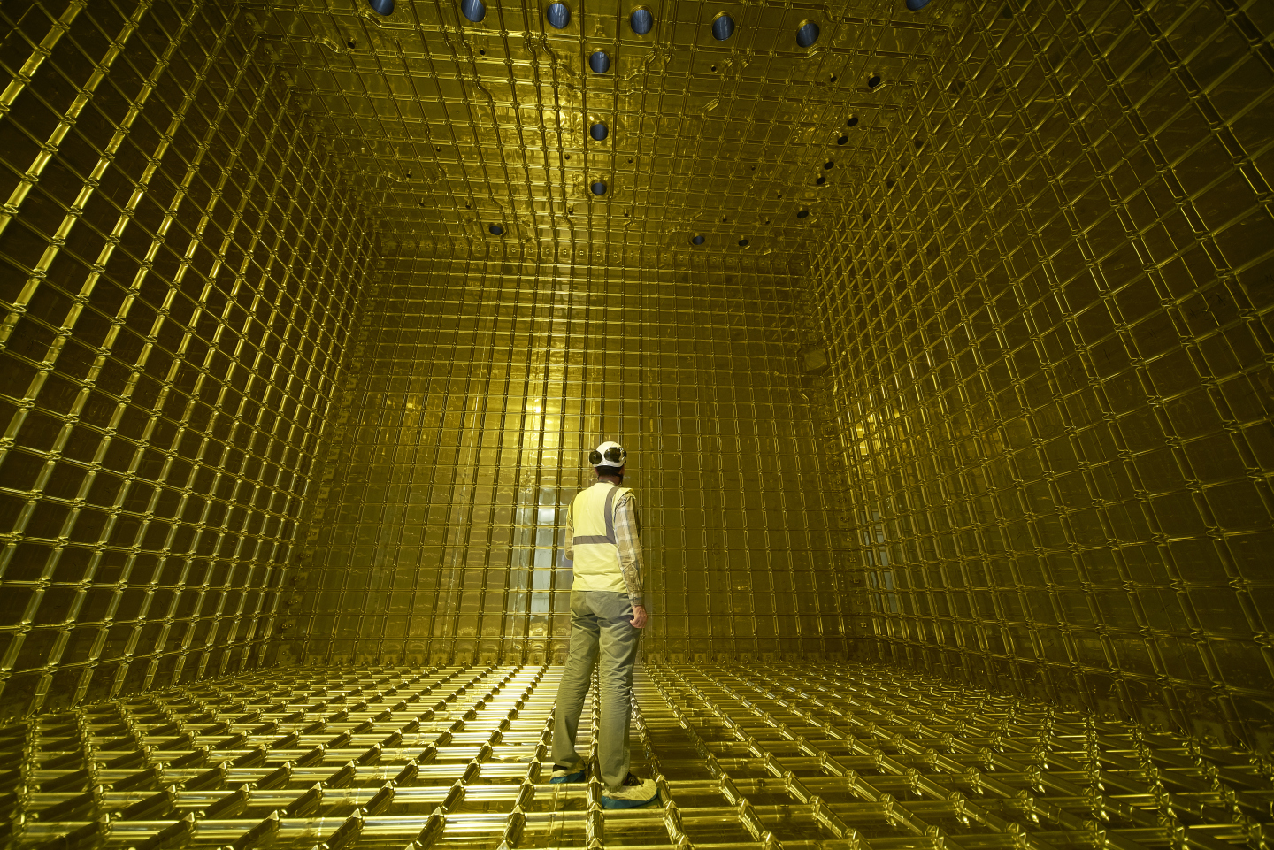
ProtoDUNE Detector Prototype
ProtoDUNE – smaller prototype detector at CERN Prevessin Site in France. ProtoDUNE contains about 800 metric tons of liquid Argon. Each DUNE Far Detector module will be about 20 times larger!
Inside the Time Projection Chamber at ProtoDUNE (before it was filled with liquid Argon)

Slide 6
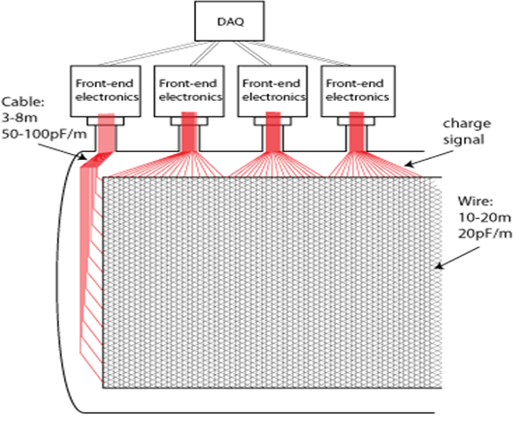
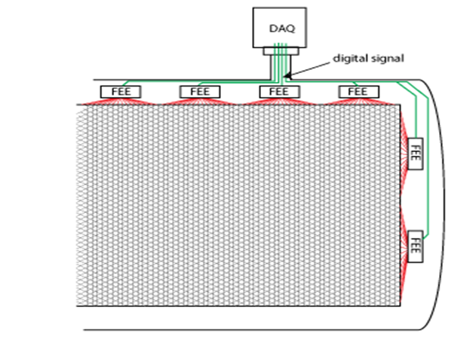
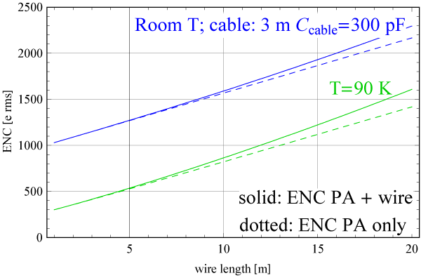
DUNE Far Detector – Scaling & Low Noise
Warm Electronics
Cold Electronics
JINST 15/T08008
Immersing the electronics in Liquid Argon greatly reduces the cabling capacitance, allowing lower achievable noise, and serves as an enabling technology for DUNE

Slide 7
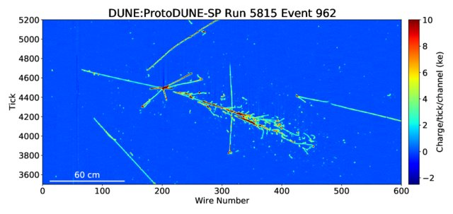
ADC Requirements
To meet physics goals, the ADC needs ability to digitize 16 channels at 12-bit resolution and 2 MS/s sampling rate/channel
Needs lower noise than typical of 12-bit ADCs (sub-LSB noise performance)
Needs 30-years reliability in cold environment (-184 °C) without replacement
Must be able to work at both room temperature and cold for testing
Custom ASIC is a must!

Slide 8
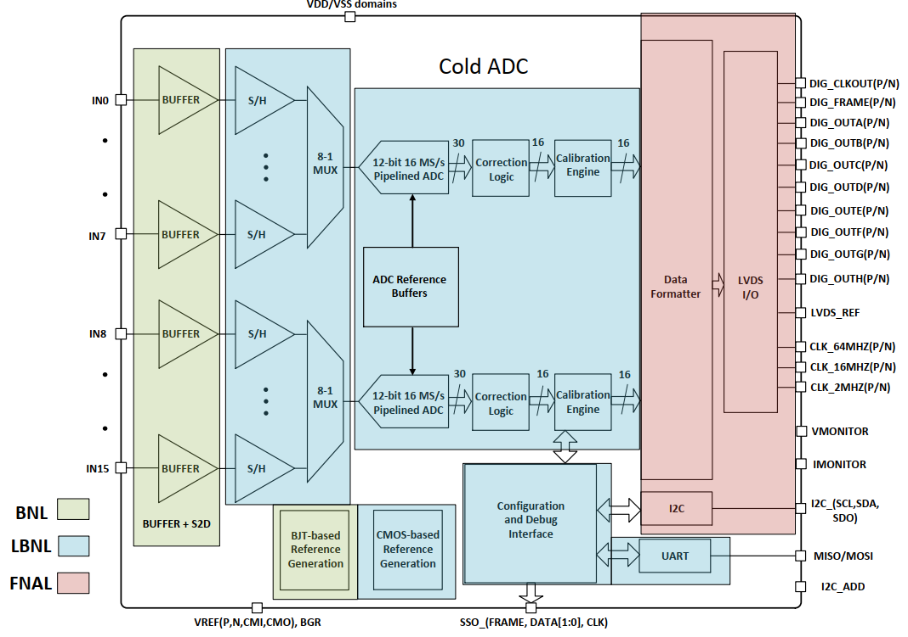

DUNE Far Detector (ColdADC)
LBNL led a three-lab collaboration (with Fermilab and Brookhaven) to successfully develop a Cold ADC for the DUNE Far Detector
Small design teams and multiple responsibilities make a single-lab design impractical
Needed way to effectively share design data and work as tightly integrated design team, with different tools, methodology, and strengths

Slide 9






Co-developing Intellectual Property
Co-development Tools
PDK
PDK
PDK
Virtuoso (sch/layout)
Virtuoso (sch/layout)
Virtuoso (sch/layout)
RTL
Constraints /
Back Annotation
Constraints /
Back Annotation
Testing, PCB design, python scripts
Testing, PCB design, python scripts
Testing, PCB design, python scripts
Documents (PDFs)
Custom IC / Technology
Digital Design Files
Text Documents
Notes:
Cliosoft solution used to keep data synchronized across three diverse sites.
Keeping all design and supporting data in one place allowed us to partition tasks without missing a beat. For instance, both LBNL and FNAL wrote RTL, but physical design was done at FNAL. SDF files for back annotation were immediately available for full-chip simulations at both sites.

Slide 10
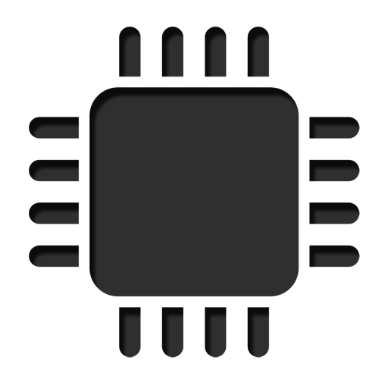

Sharing Data Efficiently & Securely
LBNL produced IPs
IP @ FNAL
Cached data from FNAL & BNL
IP @ LBNL
IP @ LBNL
IP @ BNL
LBNL
IP @ BNL
IP @ FNAL
IP @ LBNL
IP @ LBNL
IP @ FNAL
IP @ BNL
IP @ BNL
IP @ FNAL
FNAL
BNL
  Automated design-aware and surgical data synchronization
  Network storage optimization at each participating site
  Fine-grained access controls for each participating National Lab
  Secure SSL Encryption during transit without a VPN
Notes:
Efficiently sharing our work for coldADC was a big challenge even before we started. Traditionally, such a program would require teams to be co-located. But that was not a viable option for us—the engineers working on the project report to different organizations and are dispersed across the United States. The only available option was to provide a virtually-onsite user experience for the team members across the three organizations.
What that means is the IP that is developed at LBL should be cached at BNL and FNAL. But you can not blindly sync the data between these organizations’ servers. You need to have the correct versions of the relevant design objects synchronized at the right time so that the users and workflows run smoothly. Of course, this must happen securely with little to no human intervention.
Cliosoft’s solutions allowed us to do precisely that. We connected compute infrastructure from three national labs - each with its security policy and architectures - to make the design sharing possible and co-build the coldADC.

Slide 11
Collaboration is sometimes hard…
Calibration System in Prototype Version of Cold ADC
CAL_UNIT in different partition from rest of digital core
Calib. coefficents stored here
Calib. coefficents calculated here
Calib. coefficients calculated and stored in different blocks

Slide 12
… but we figured it out
Calibration System in Final Version of Cold ADC
CAL_UNIT in same partition as rest of digital core
Calib. coefficents calculated here
Calib. coefficents stored here
Calib coefficients calculated and stored in the same block

Slide 13
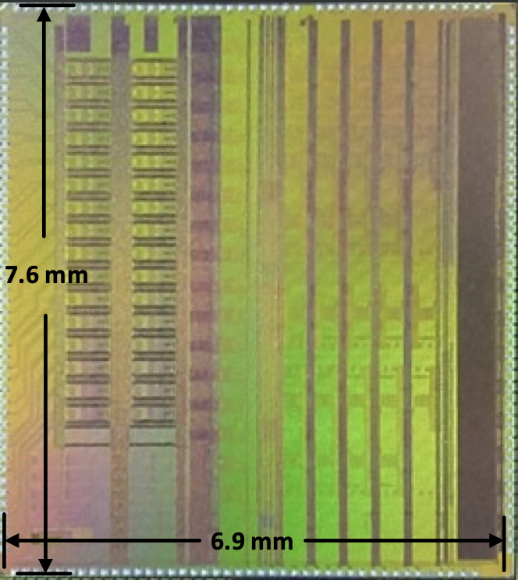
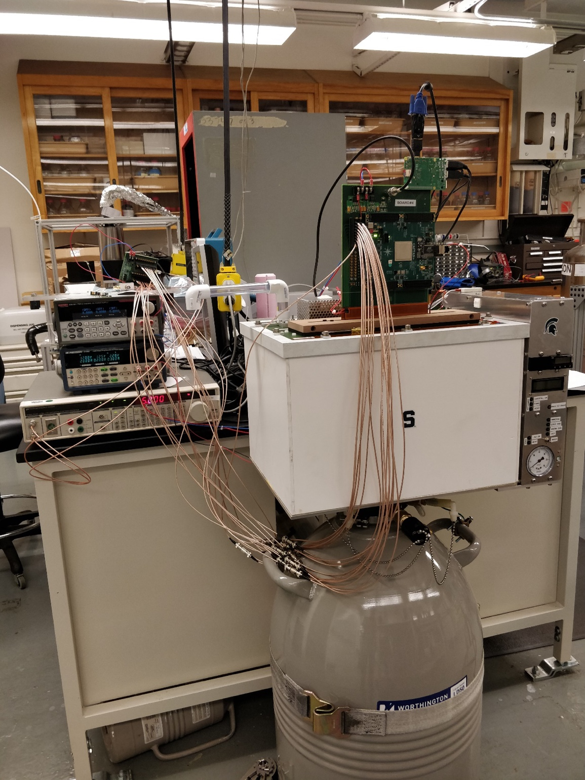
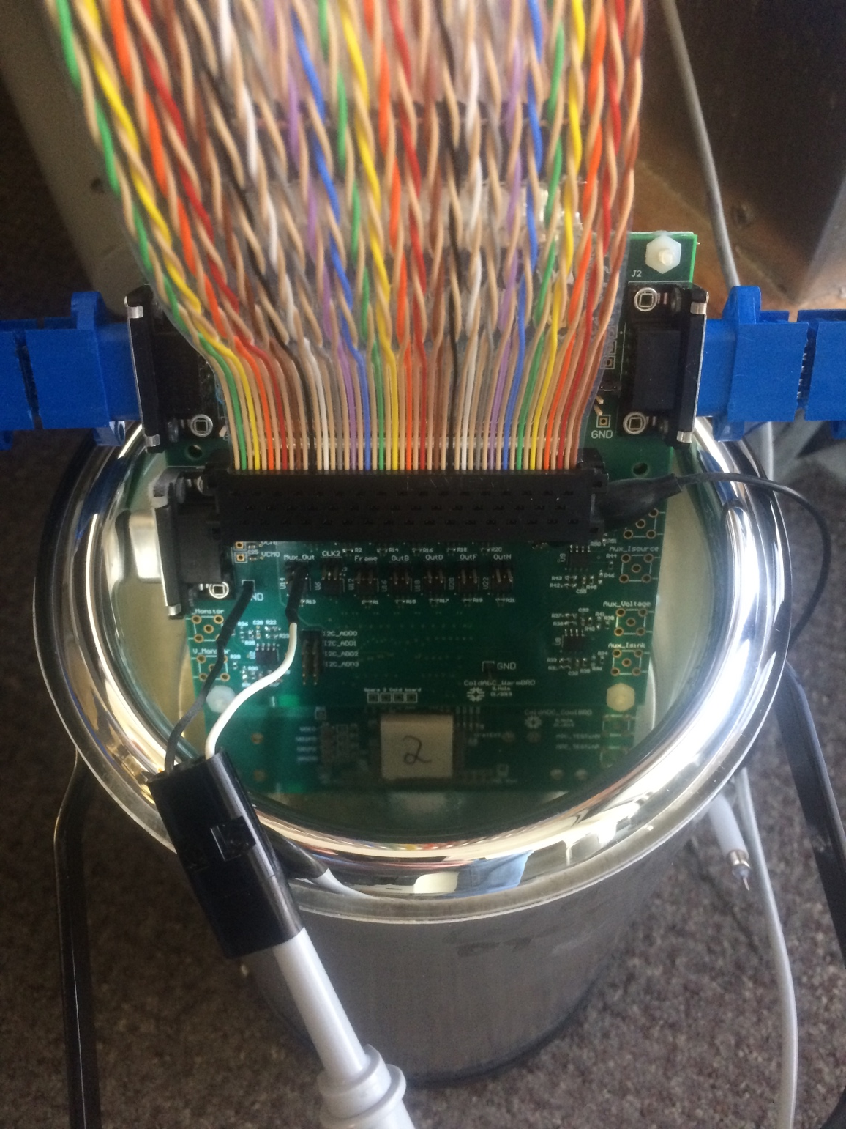
DUNE ColdADC Testing
Die photo. 65 nm CMOS
Initial bringup in LN₂ bath at Fermilab
Cold Test System at LBNL

Slide 14
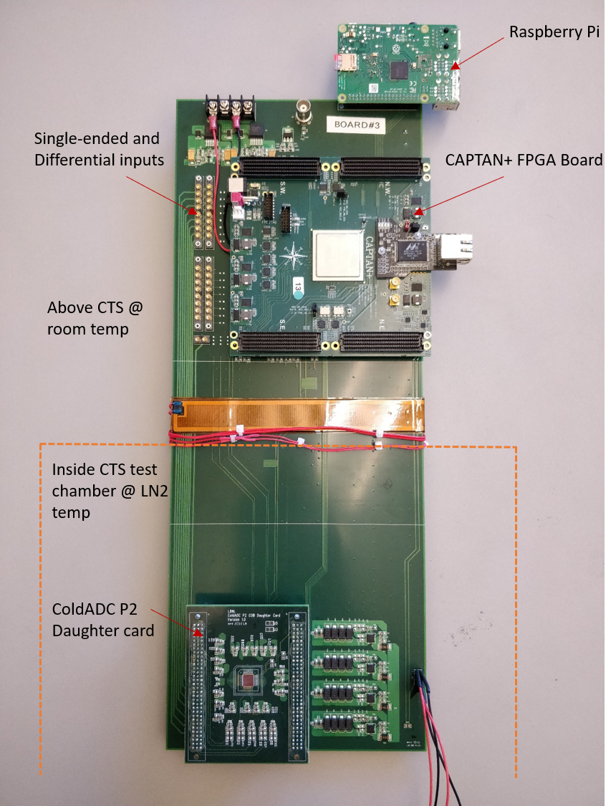
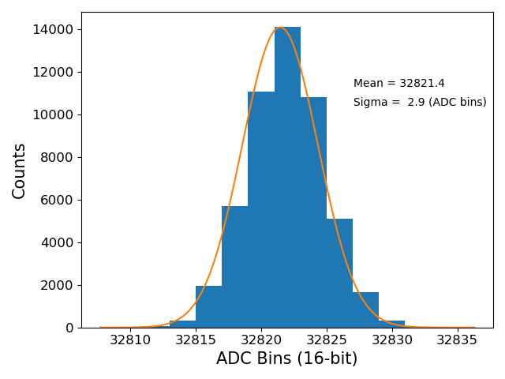
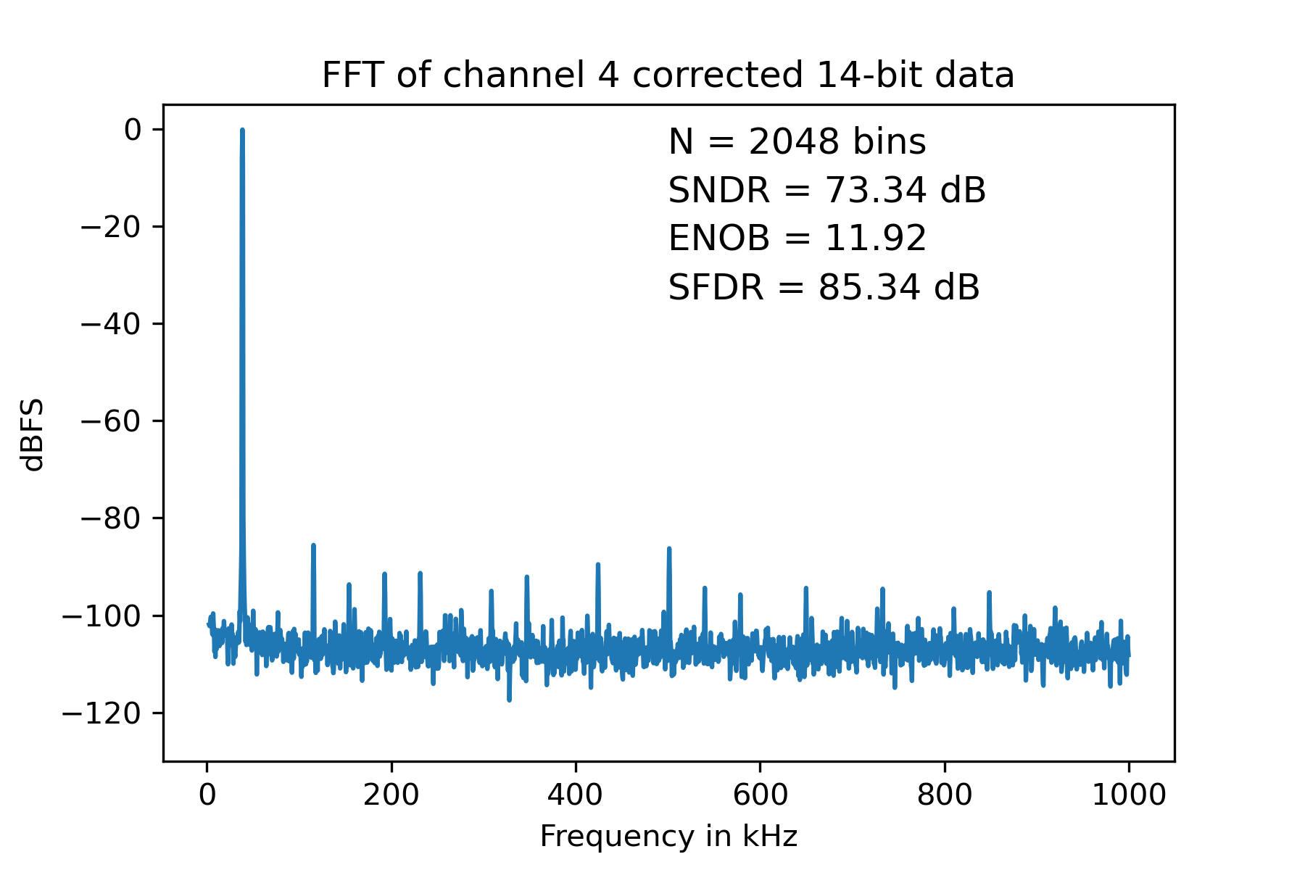
DUNE ColdADC Testing
The DUNE Far Detector Cold ADC will have to operate for 30 years sealed in a cryostat and was designed using design techniques for reliability and custom simulation models. Currently taking data at ProtoDUNE.
Measured Performance
Superior Noise Performance at Cold Temperature (well below preamp noise)
Excellent dynamic performance
(73.34 dB SNDR)
138 µV-rms noise (~ 0.2 LSB @ 12 bits) with 21 mW / channel
IEEE Trans. Nuclear Science 2022
Achieved better noise performance than commercial solution
used in Short Baseline Neutrino Detector (SBND) Experiment

Slide 15
Conclusion
While inter-institution collaborations can be challenging, they can be powerful force multipliers, increasing the collective reach of DOE and University IC Design Groups
ColdADC successfully developed by three-lab team to instrument a neutrino detector while immersed in liquid Argon
Keeping a clean, synced data repository that ensured everyone was able to share data seamlessly was essential
Final chip met requirements, can be operated over a 250 °C range, and gives better noise performance than commercial ADCs
Approximately 40,000 ColdADC ASICs (reading out 640,000 wire channels) will be deployed at the DUNE Far Detector complex and will be immersed in liquid Argon for the duration of the experiment.

Slide 16
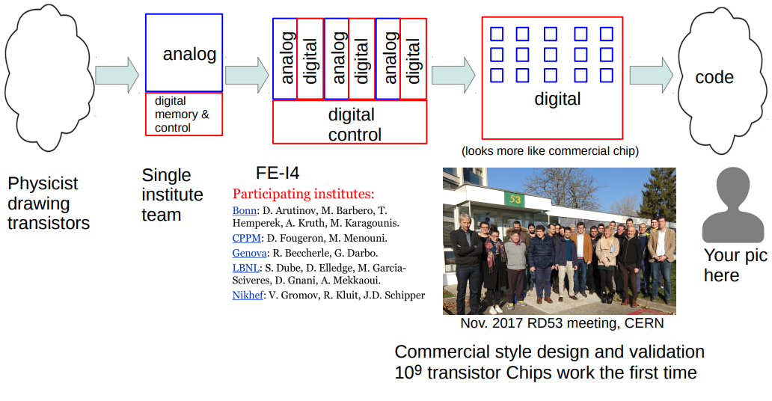
Final Though (Courtesy M. Garcia-Sciveres)
(EEs)
1980s
1990s
2000s
2010s – 2020s
2030s?
M Garcia-Sciveres

Slide 17
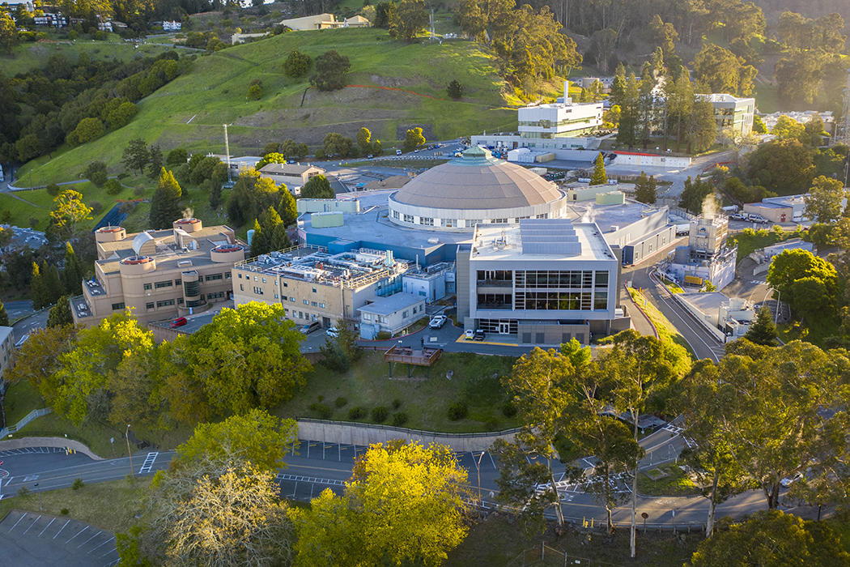
Thank You
This work was supported in part by the U.S. Department of Energy under Contract No. DE-AC02-05CH11231

