Slide 1
Cryogenic Front-end ASICs for Low-Noise Charge and Light Readout
Prashansa Mukim, Grzegorz Deptuch, Gabriella Carini, Hucheng Cheng, Shanshan Gao, Dominik Gorni, Jay Hyun Jo, Lingyun Ke, Steven Kettel, Soumyajit Mandal, Xin Qian, Sergio Rescia, Vladimir Tishchenko, Chao Zhang
May 1, 2024

Slide 2
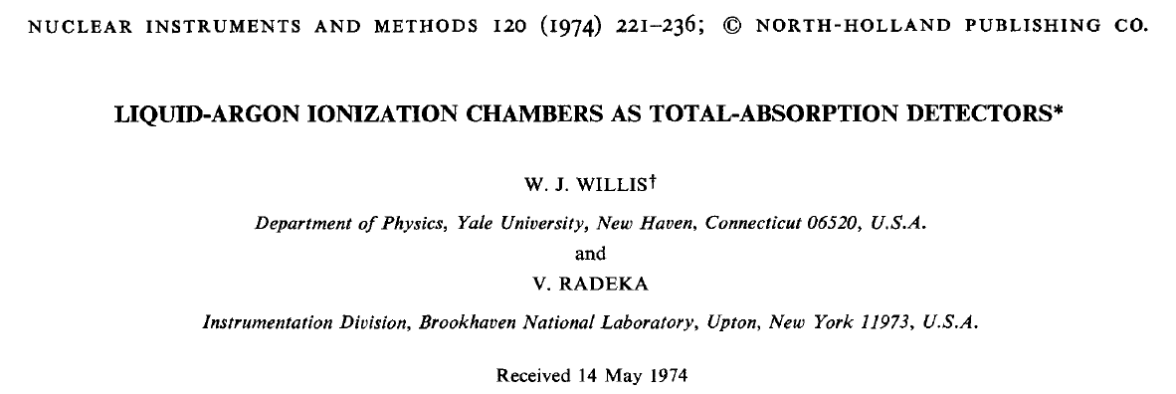
Long history of noble liquid detector R&D at BNL
1974
1980
1990
2000
2010
2020
2030
Advancement of Cold Electronics
R806
BNL pioneered liquid argon based detector technology in 1974
  Unique experience in cryogenic electronics and low-noise microelectronics
  Strong collaboration between Physics and Instrumentation Departments at BNL for half a century
R&D → Experiments → R&D
  Readout electronics has always been an integral part of detector R&D effort for precision measurement with noble liquid detector
HELIOS
JFET FE
DZero
NA48/62
JFET FE
Noble Liquid R&D at BNL
ATLAS
𝛍BooNE
CMOS FE
ProtoDUNE
CMOS FE+ADC+FPGA
SBND
CMOS FE+ADC+FPGA
DUNE
CMOS FE+ADC+COLDATA
FCC-ee, nEXO, PIONEER
CMOS Cold Electronics?

Slide 3
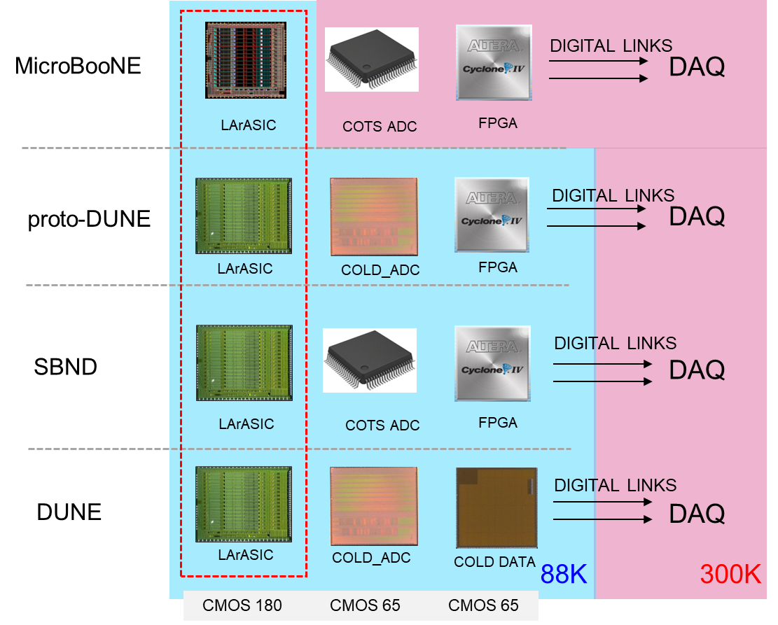
Three ASIC solution
3 ASICs vs. 1 ASIC solution:
Initially two readout options were proposed:
  3 ASICs vs. 1 ASIC
  (idea of building 1 ASIC, combining FE/ADC/transmission brought in 2016 and included as parallel path of development)
Evolutionary development MiCroBooNE→ DUNE led to the 3 ASIC solution that:
  Helped perfect the FE (through multiple iterations)
  Allowed debugging (procedure for ADC calibration)
  Allowed independent optimization of each chip
  Disallowed analog – digital interfaces
Currently in development: CHARMS (CHARge aMplifer + Shaper -> LArASIC translated to 65 nm, shorter peaking times + additional features)
89 K
About a decade of development

Slide 4
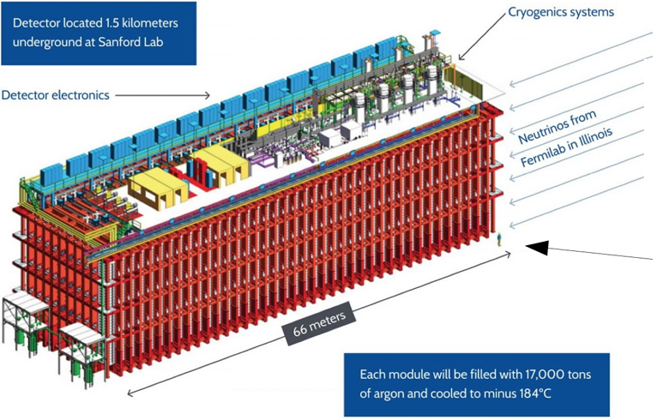
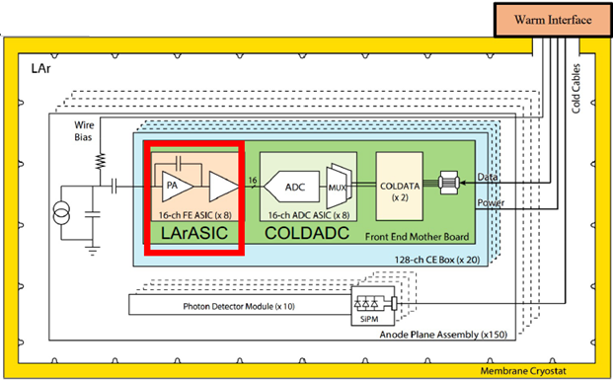
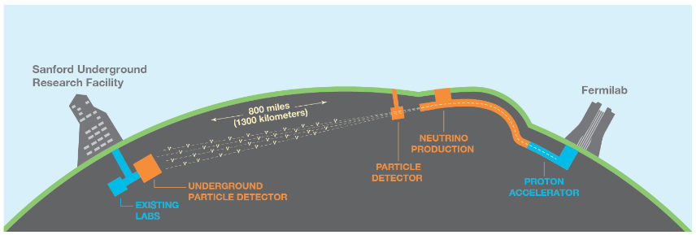
Targets for CHARMS - DUNE [1]
Deep Underground Neutrino Experiment:
Major scientific experiment for studying neutrino/antineutrino oscillations, detect neutrinos emerging from exploding stars, search for signs of proton decay
DUNE far detector (FD) located 1.5 km underground in South Dakota will operate with an intense neutrino beam generated at Fermilab
FD will utilize four 10kTon liquid argon time projection chambers (TPCs) to detect ionization charge and scintillation light generated when incident neutrinos interact with argon atoms
Usage | Temperature | Detector Capacitance | Shaping Time | Noise | Dynamic Range
FD 3/4 charge readout | 89 K – 300 K | 150 pF – 200 pF | 250 ns – 2 µs | 500 e⁻ at 87 K | 10 bits
FD 3/4 light readout | 89 K – 300 K | TBD | 20 ns – 250 ns | TBD | 10 bits

Slide 5
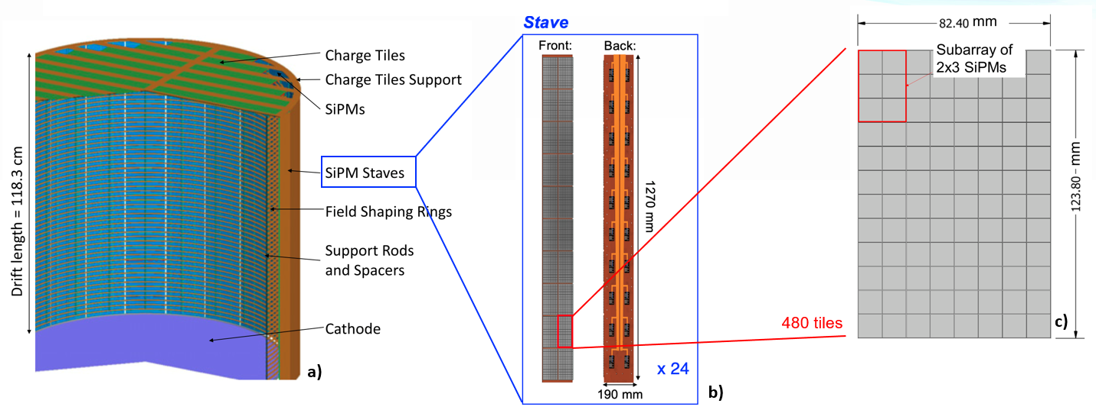
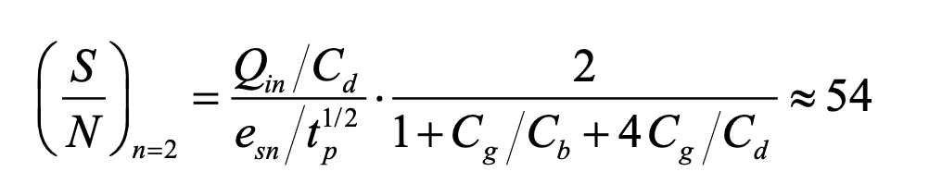
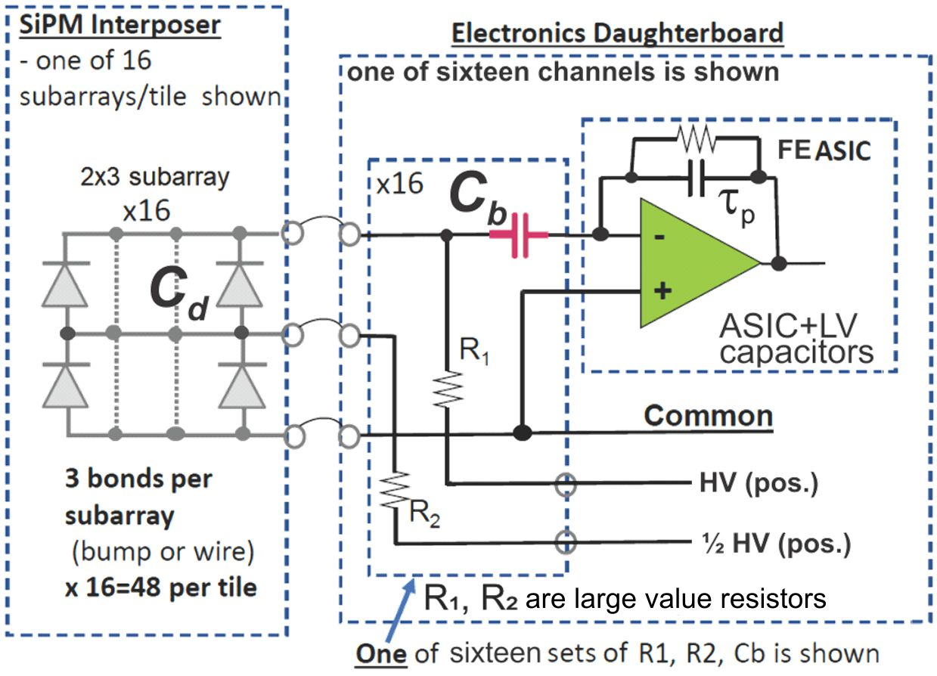
Targets for CHARMS - nEXO [2]
Enriched Xenon Observatory Experiment:
Experiment for studying a rare nuclear decay called neutrinoless double beta decay
nEXO will search for neutrinoless double beta decay in 5000 kg of the xenon-136 isotope (2 x 10²⁸ nuclei), allowing potential observation of a few decays in the 10-year experiment span
Combination of ionization charge and scintillation light detected at the anode of the TPC used to reconstruct the kinetic energy of the electrons from the decay
Silicon photo-multipliers (SiPMs) used to convert the generated light signals to electrical signals
Usage | Temperature | Detector Capacitance | Shaping Time | Noise | Dynamic Range
nEXO light readout | 160 K – 300 K | 5 nF | 1 µs | 0.1 pe⁻ at 160 K | 10 bits
C_{b} is a radiopure 100-500 pF/100 V capacitor

Slide 6
Targets for CHARMS - PIONEER [3]
PIONEER:
Next generation rare pion decay experiment proposed at the Paul Scherrer Institute (PSI)
Aims to measure the charged-pion branching ratio to electrons vs. muons
Later phases will also study pion beta decay, aiming at an order of magnitude improvement in precision
Front-end peaking time of ≈ 20 ns to allow identification of double hits
Readout
Usage | Temperature | Detector Capacitance | Shaping Time | Noise | Dynamic Range
PIONEER | 160 K – 300 K | 20 pF | 20 ns | 570 e⁻ at 160 K | 10 bits
LGAD strip target (ATAR)

Slide 7
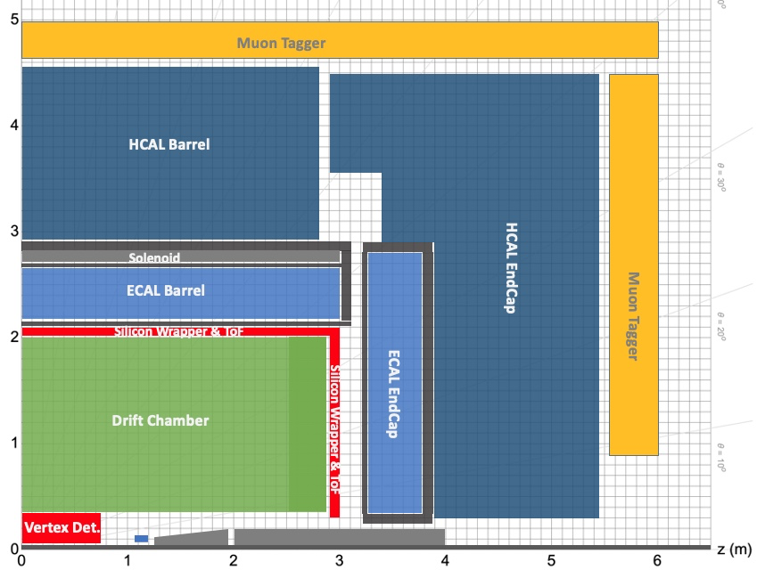
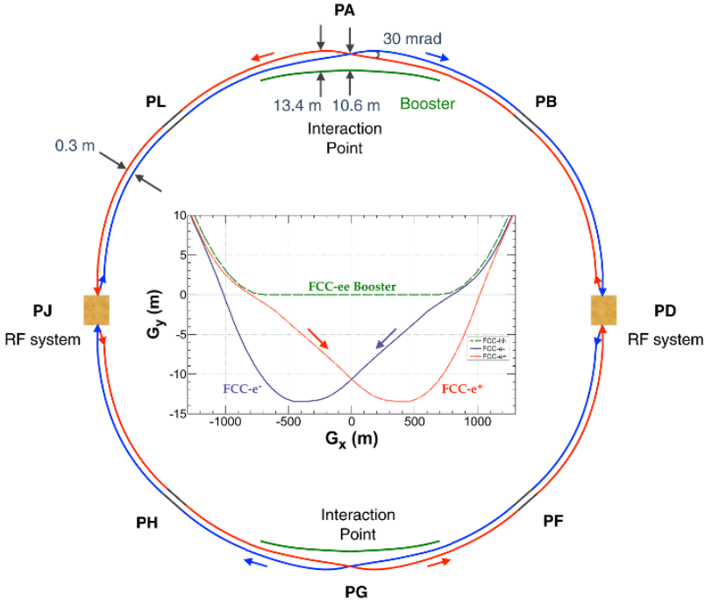
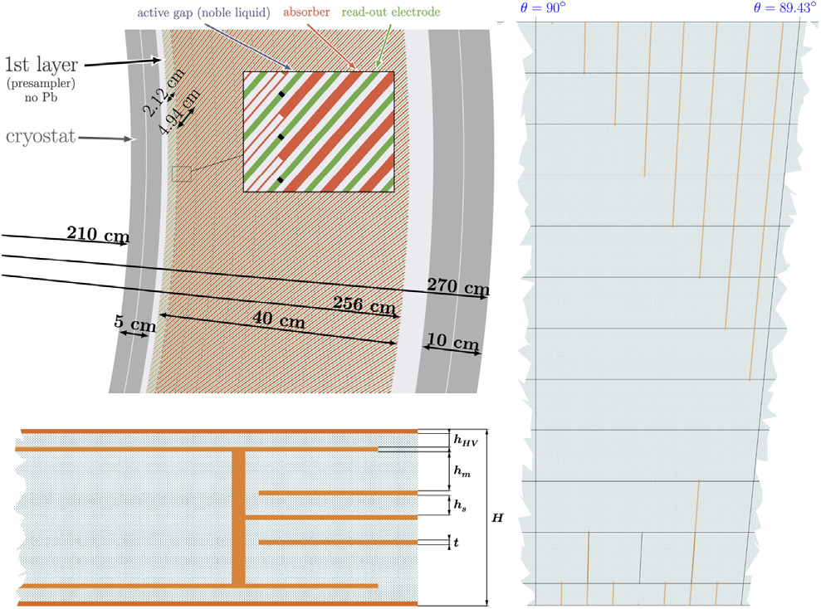
Targets for CHARMS – FCC-ee [4]
Electron-Positron Future Circular Collider:
Being constructed at CERN to serve as a general precision instrument for exploration of nature at the smallest scales
Optimized to study with high precision the Z bosons, W pairs, Higgs bosons and top quark pairs
ALLEGRO (A Lepton coLlider Experiment with Granular calorimetry Read-Out), one of the proposed detectors, features a high granularity noble liquid electromagnetic calorimeter (ECAL) at its core
ALLEGRO detector layout with ECAL as the core housed inside the solenoid
Usage | Temperature | Detector Capacitance | Shaping Time | Noise | Dynamic Range
Allegro | 89K/160K – 300K | TBD | 100 ns – 200 ns | TBD | 12 bits
High granularity noble liquid ECAL with PCB based electrodes

Slide 8
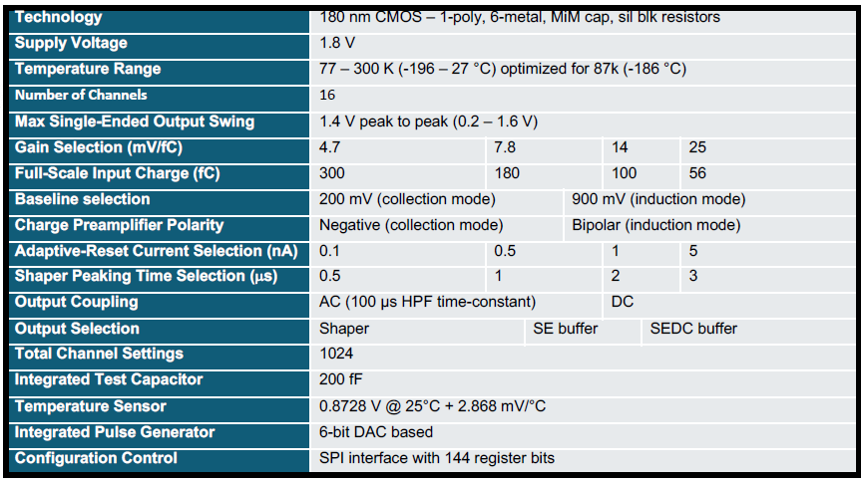

Planned specifications
LArASIC (P5B)
CHARMS250
CHARMS10
65 nm CMOS: 1-poly, 9-metal
250 ns – 2 µs
TBD
TBD
I²C interface
65 nm CMOS: 1-poly, 9-metal
10 ns – 250 ns
TBD
TBD
I²C interface
Key features and challenges
  65 nm CMOS with thick oxide → Max V_{dd} (1.8 V, 2.5 V) to support extended dynamic range
  Fast peaking time (in the order of 10 ns) → support signal processing with stringent time resolution
  Low power consumption → support detector electrodes with fine segmentations
  Cryogenic operation with long lifetime → achieve optimum SNR
  Long term goals: fast front-end architecture (~GHz bandwidth), high radiation tolerance → FCC-hh

Slide 9
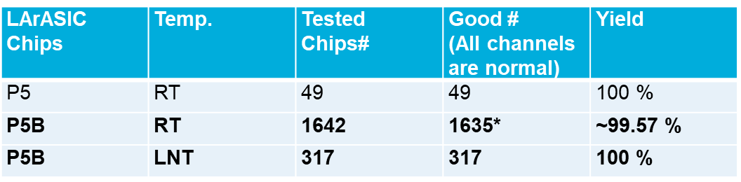
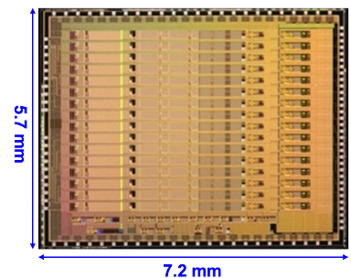
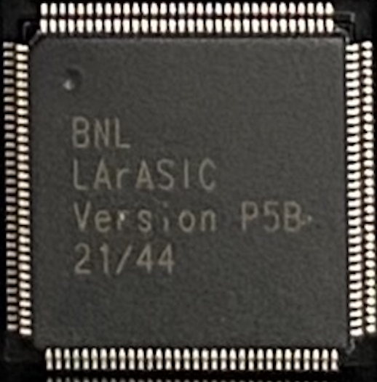
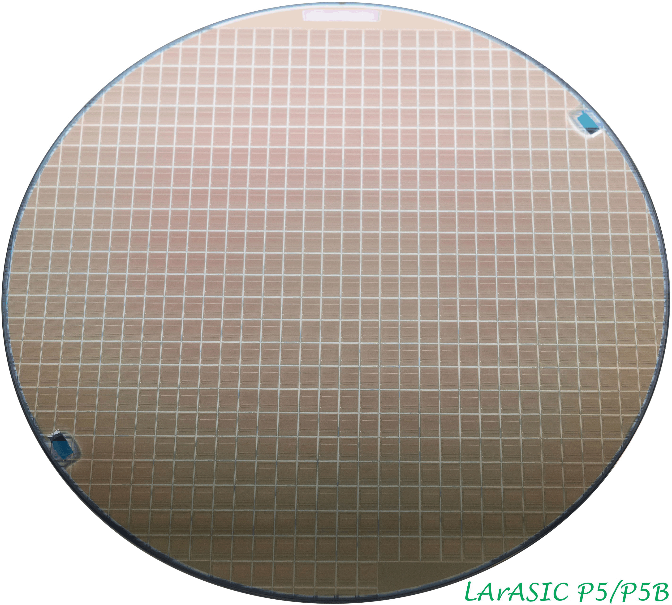
Status of ASICs
LArASIC MPW met all the DUNE requirements → fabricated ~1800 P5 and 1800 P5B (180 nm) chips (eng. run) for ProtoDUNE II
P5B has improved input ESD
protection compared to P5
*Only 1 out of 16 channels in each
of the two chips are non-functional
>1 year ago, now more statistics is available
LArASIC performance with differential interface
CHARMS
Schematic level simulations completed with both cryogenic and room temperature models with 6 mW power consumption and programmable shaping times of 250 ns, 500 ns, 1 µs and 2 µs
Layout of the front-end chain has been started
CHARMS250 to be fabricated at the end of this year
Work on CHARMS10 to start next fiscal year
8” wafer with 610 LArASICs P5 and P5A(B) w. increased ESD protection
24 FEMBs arrived at CERN for ProtoDUNE-II installation
250 wafers LArASIC production run for DUNE 75k P5 and 75k P5B chips

Slide 10
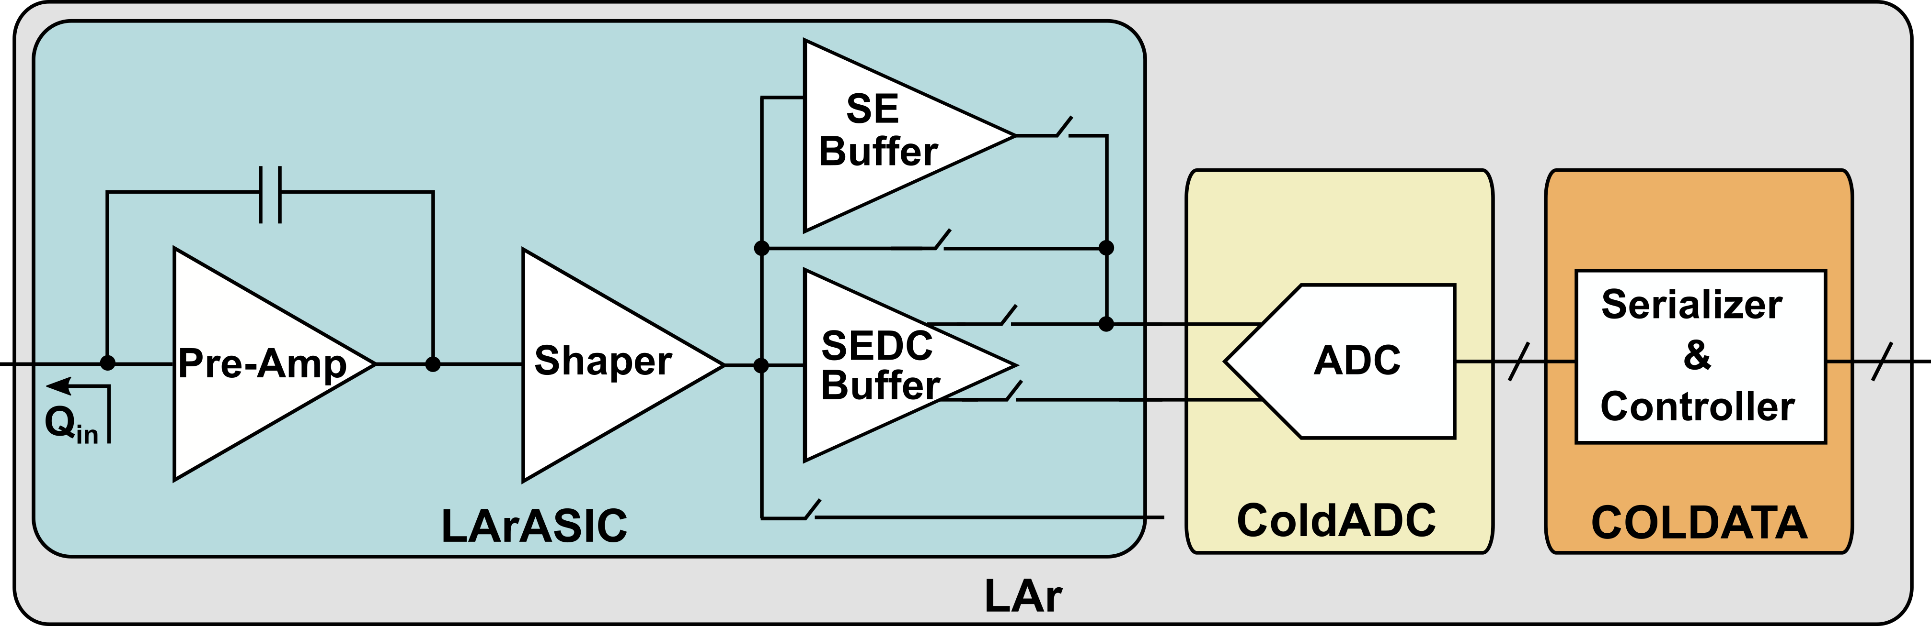
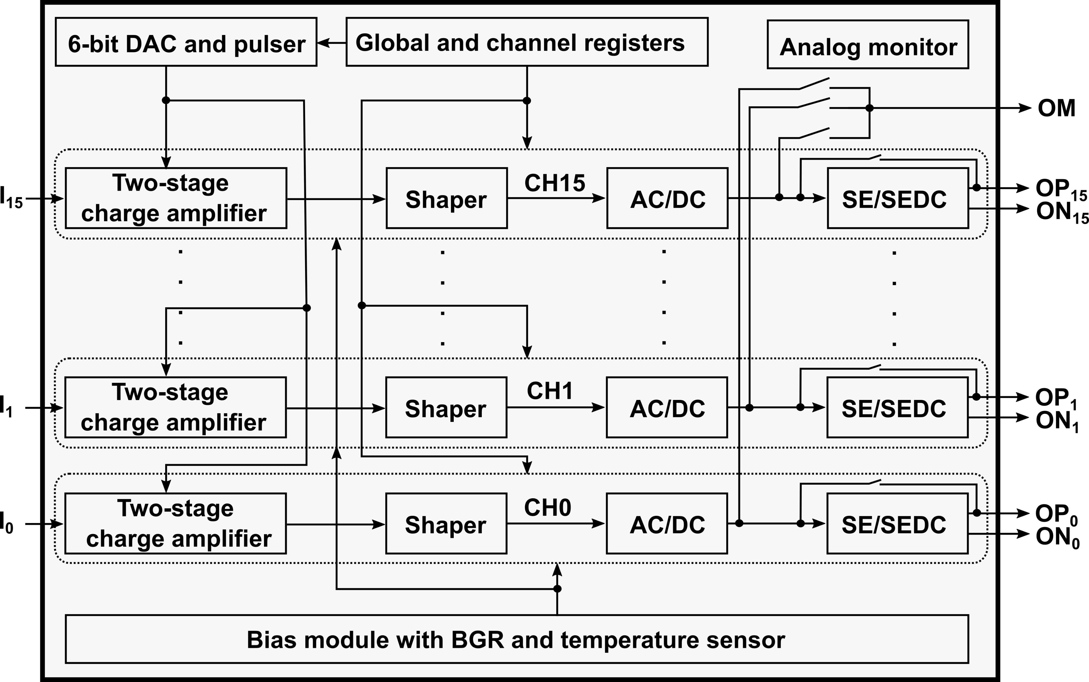
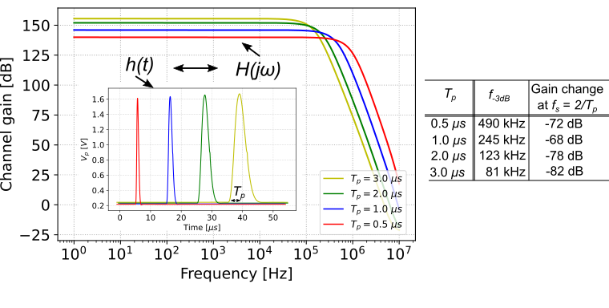
Usage, functionality and architecture
3-ASIC solution for DUNE
Overall channel response of LArASIC (acts as an anti-aliasing filter)
Top-level block diagram

Slide 11
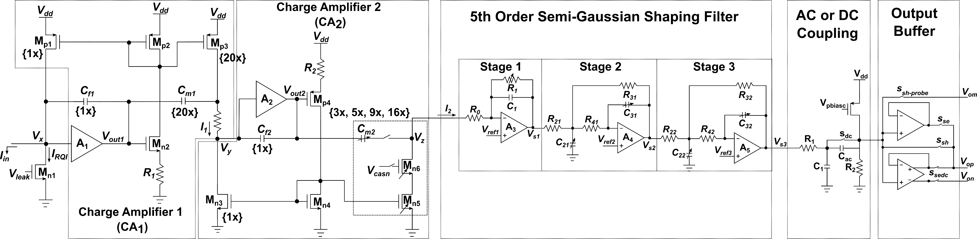
Core channel circuits
Amplification
Filtering
Output
drive

Slide 12
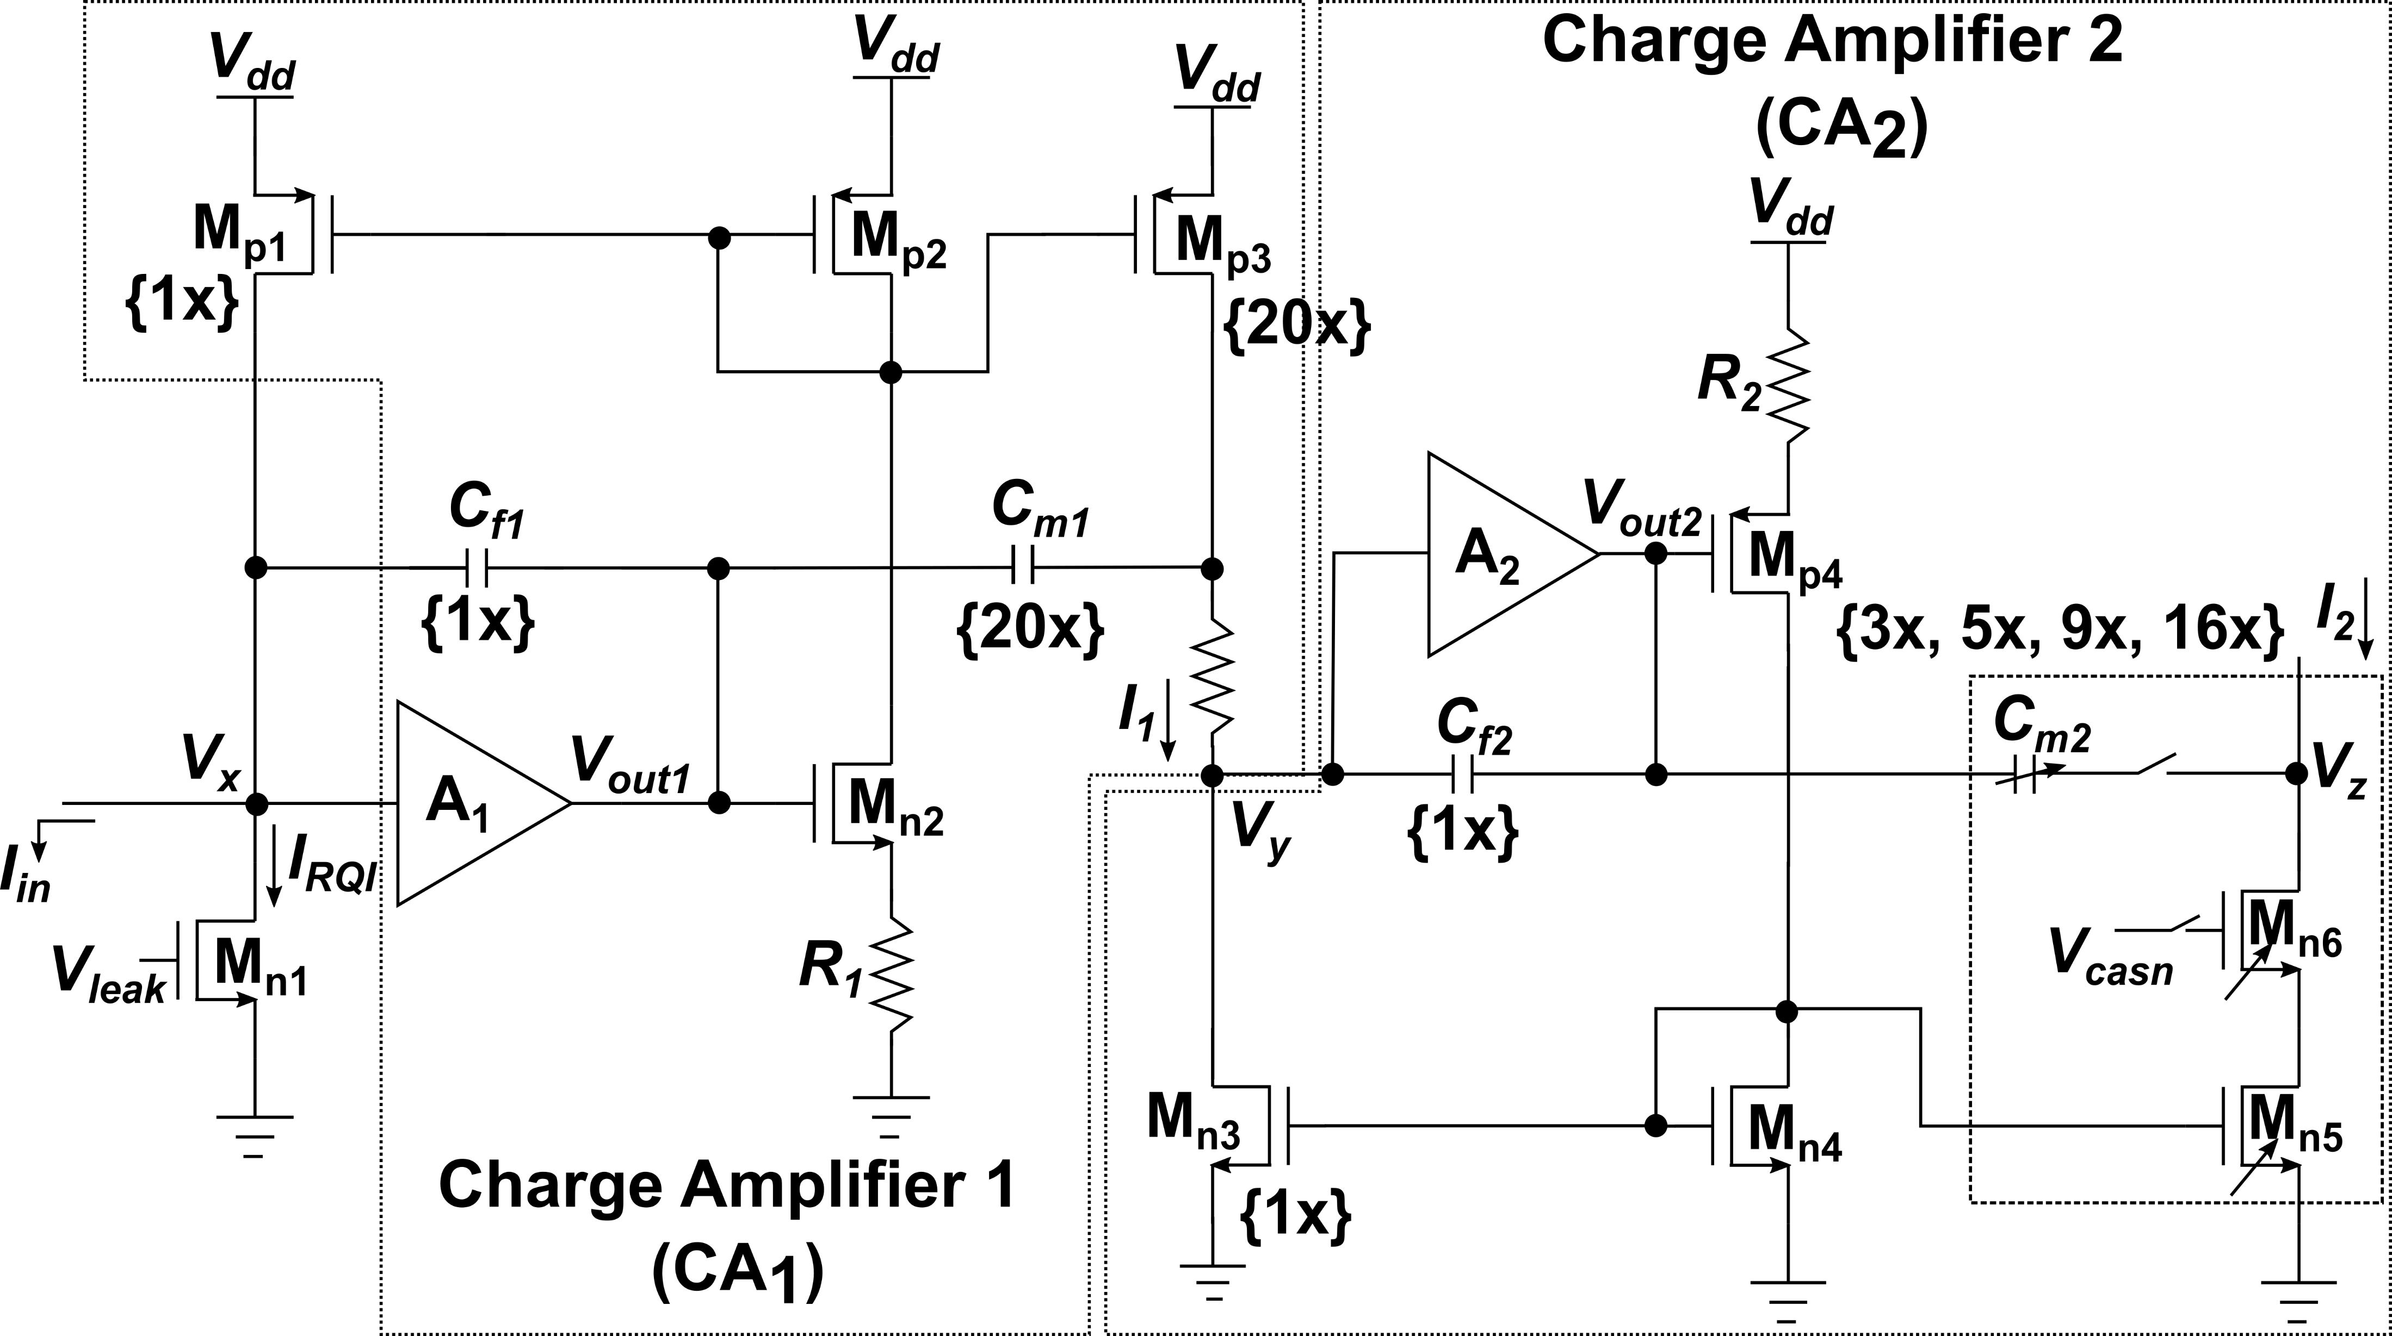
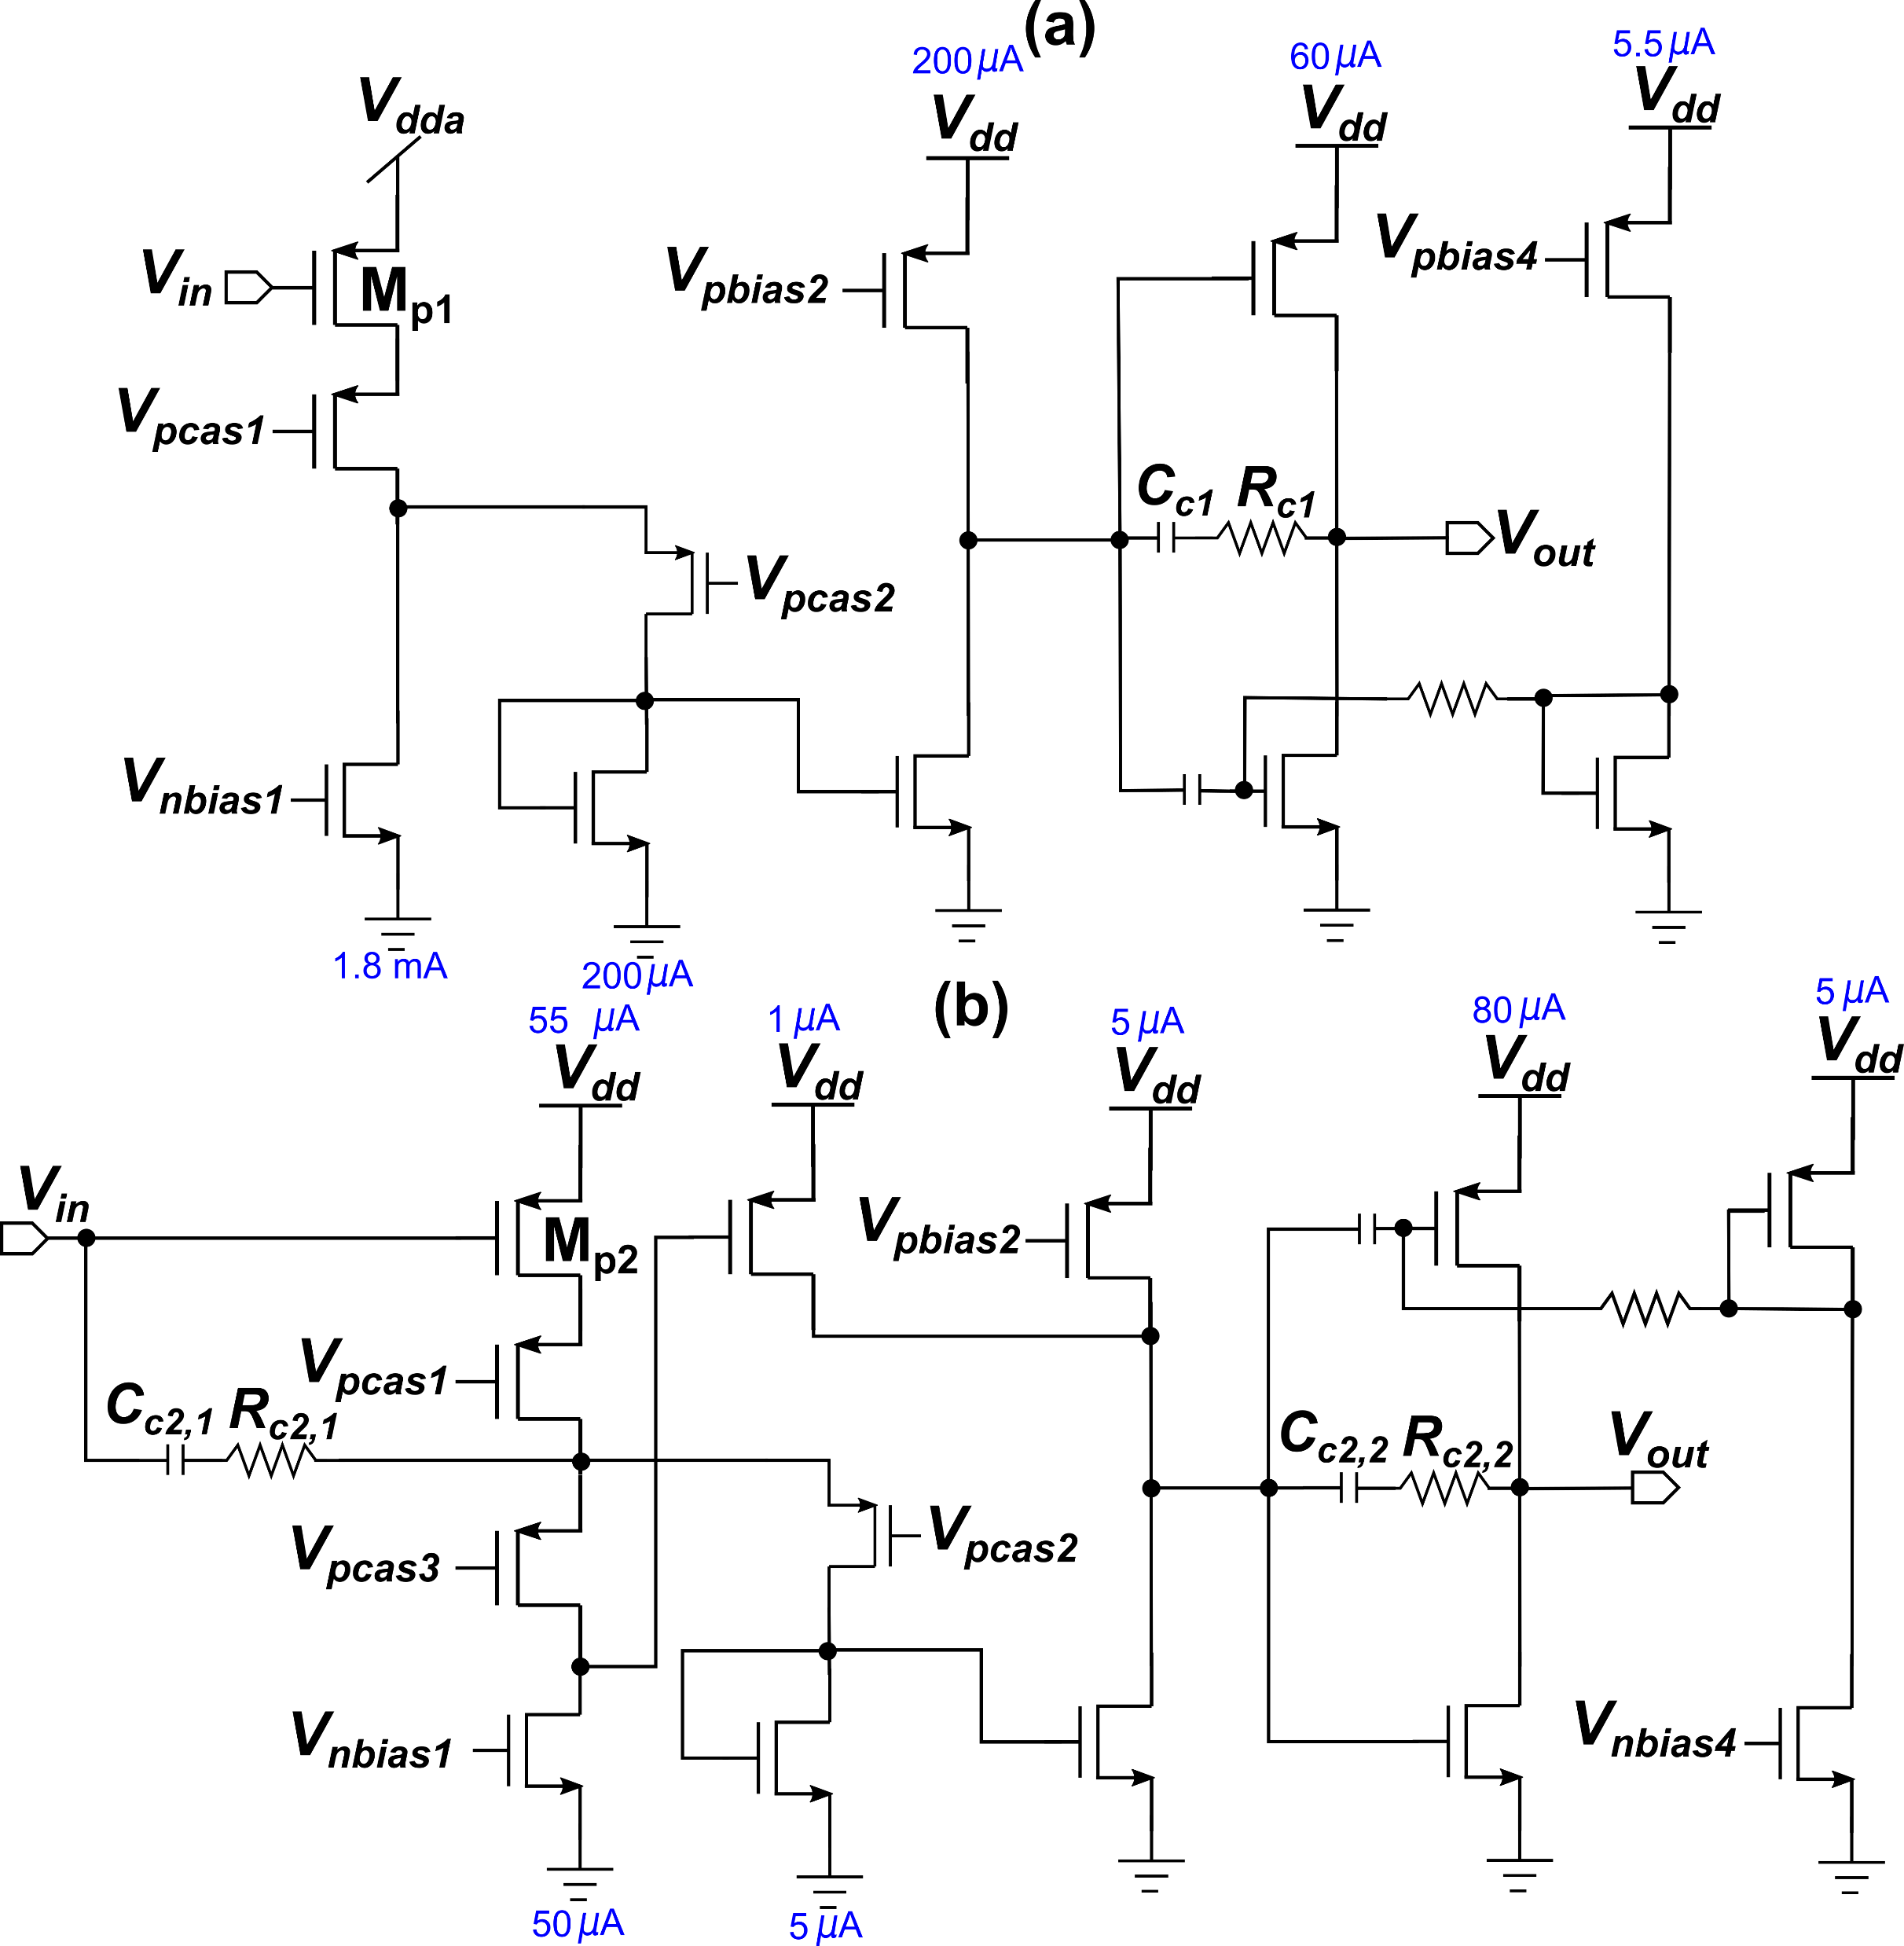
Charge amplifier design
A₁ schematic diagram
Charge amplifiers use current-mirror based adaptive continuous reset (I_{RQI} = 100 pA, 500 pA, 1 nA or 5 nA)
Pole-zero cancellation implemented in each stage
Charge gain provided by CSA₁ = 20
Charge gain (programmable) provided by CSA₂ = 3 or 5 or 9 or 16
A₂ schematic diagram
A₁ and A₂: 3-stage amplifiers (> 100 dB gain for each, at both room and LAr temperatures)
Ref: G. De Geronimo et. al., Front-End ASIC for a GEM based Time Projection Chamber

Slide 13
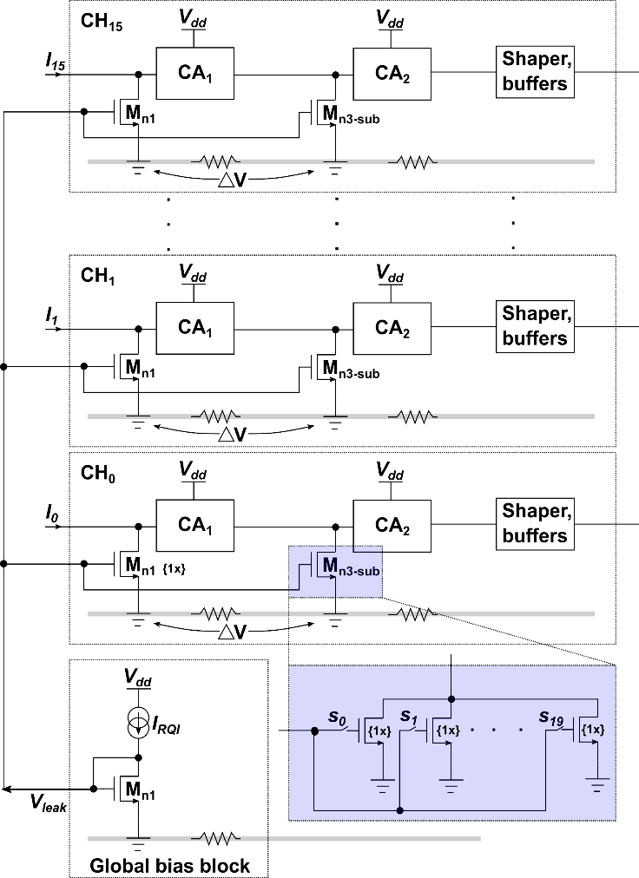
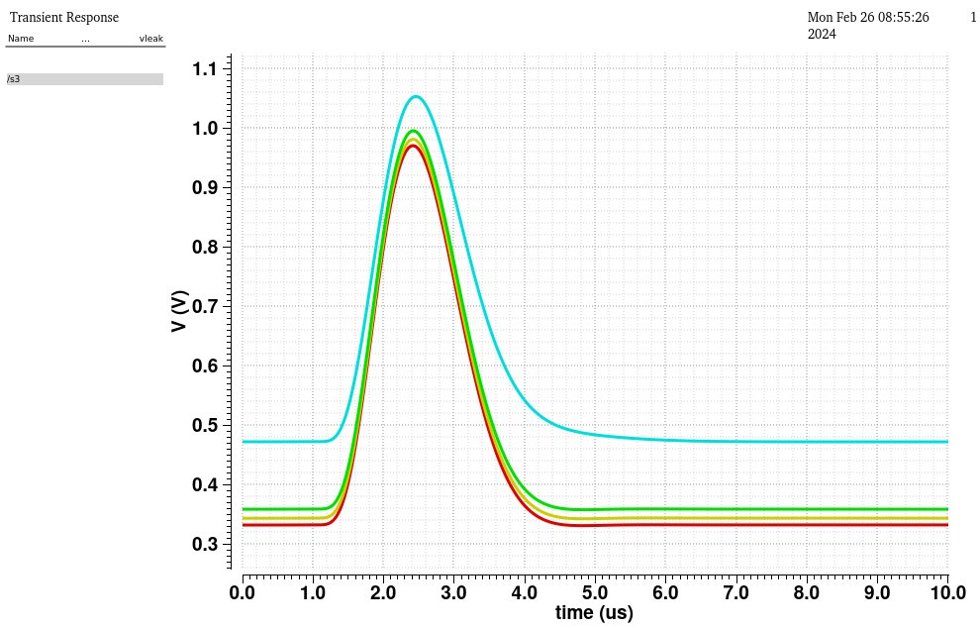
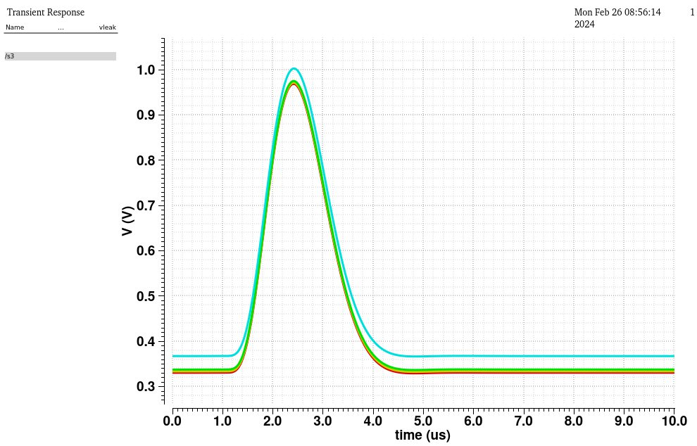
Programmable 5-bit RQI subtraction implemented in CHARMS
No I_{RQI} subtraction
15x I_{RQI} subtraction
V_{s3}
V_{s3}
Baseline drift reduced
Programmable I_{RQI} subtraction provides immunity against process mismatches and layout induced non-ideality
For M_{n1} and M_{n3-sub} operating in deep-subthreshold (I_{RQI} ∝ e^{(Vgs-Vth)(q/ηkT)}), variance in at LNT almost 10x higher than at RT
Previously, with fixed I_{RQI} subtraction, even few-millivolts of V_{gs} difference at M_{n1} and M_{n3-sub} due to IR drop in ground rail was seen to cause subtraction to become > 20x and make the second stage reset mechanism non-operational
Current DAC

Slide 14
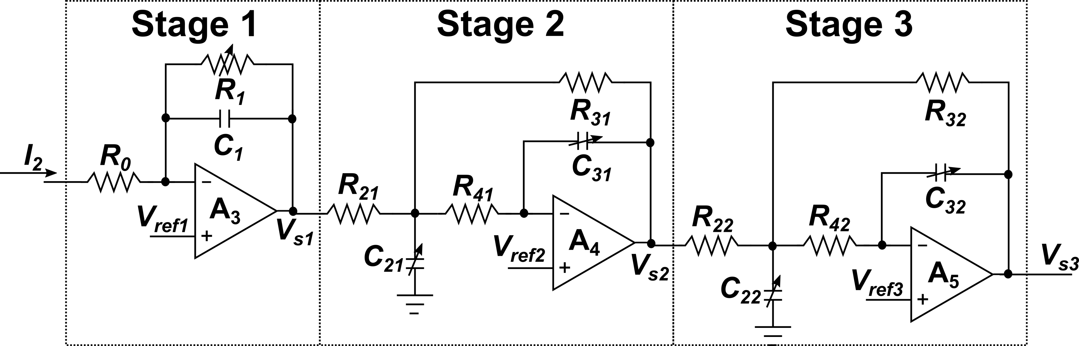
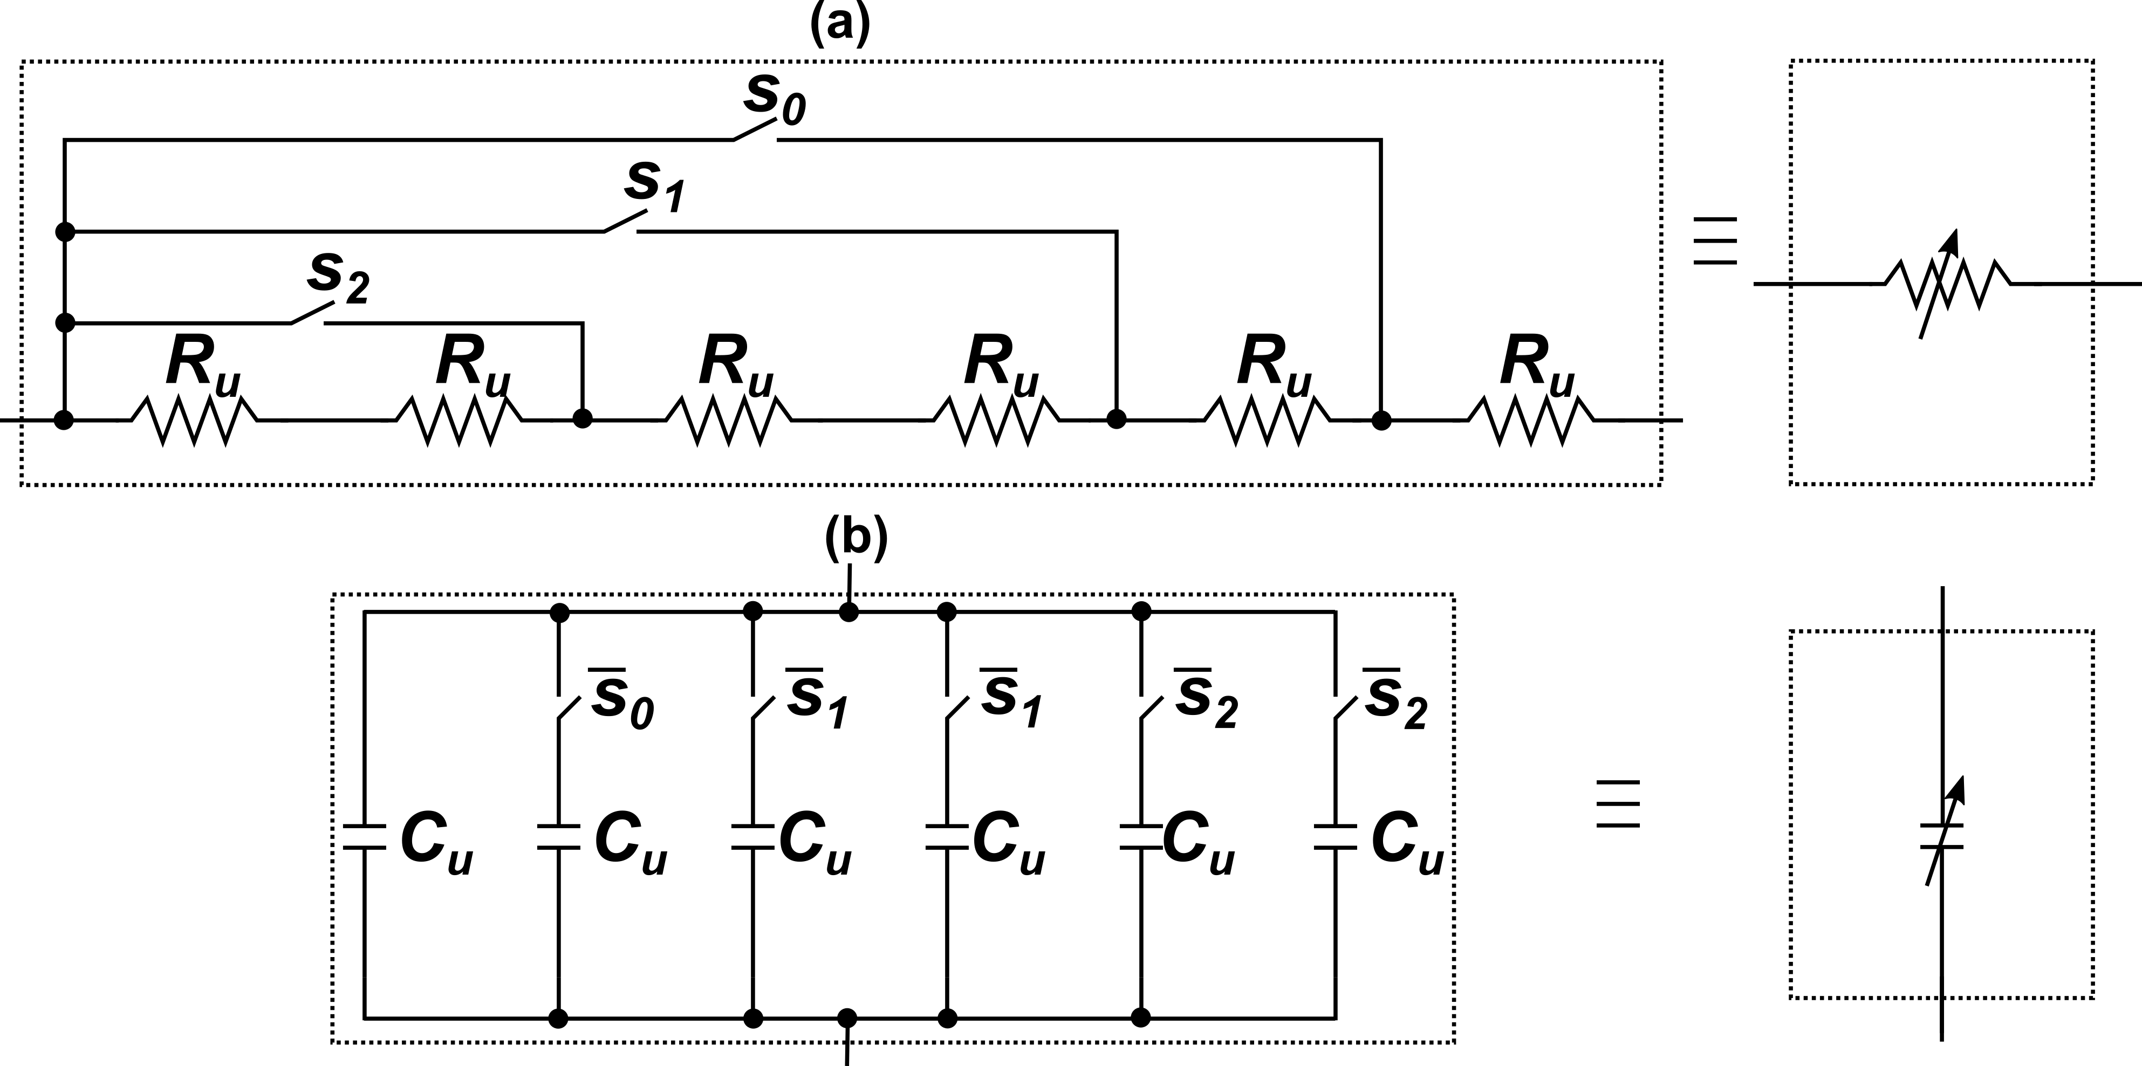
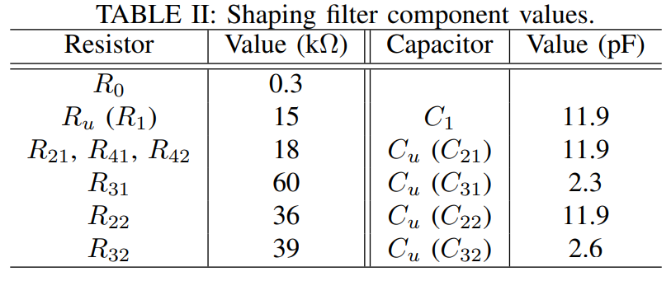
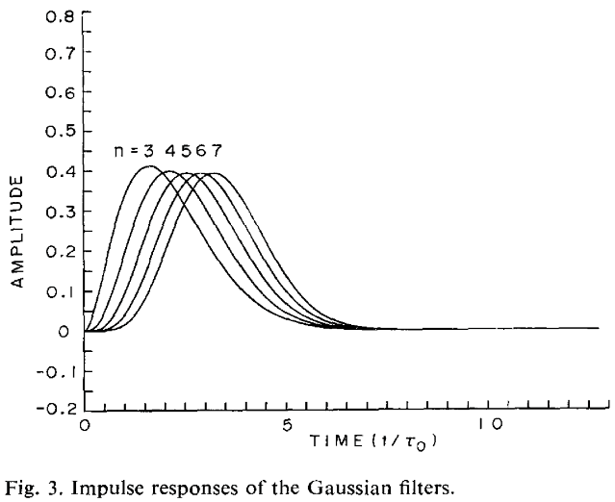


Shaping filter design
Implemented shaper is a 5th order semi-gaussian filter with complex conjugate poles
Slows down the variations near signal peak
Semi-gaussian shaper has a faster drop-off and lower noise contribution than a CR-RC^{n} shaping filter
A₃, A₄, A₅ are two-stage miller compensated differential amplifiers
V_{ref1}, V_{ref2}, V_{ref3} selected based on output baseline setting
$$V_{s1}\left(s\right)= {−I}_{2}\left(s\right)\frac{R_{1}}{(1+sC_{1}R_{1})}$$
$$V_{s2}\left(s\right)=−V_{s1}\left(s\right)\frac{\frac{1}{R_{21}R_{41}C_{21}C_{31}}}{s^{2}+s\left(\frac{1}{R_{21}C_{21}}+\frac{1}{R_{31}C_{31}}+\frac{1}{R_{41}C_{21}}\right)+\frac{1}{R_{31}R_{41}C_{21}C_{31}}}$$
V_{s3}(s) is similar……
S. Ohkawa, M. Yoshizawa, K. Husimi,
Direct synthesis of the Gaussian filter for nuclear pulse amplifiers.
Notes:
Bessel filter – advantages of better phase response?

Slide 15
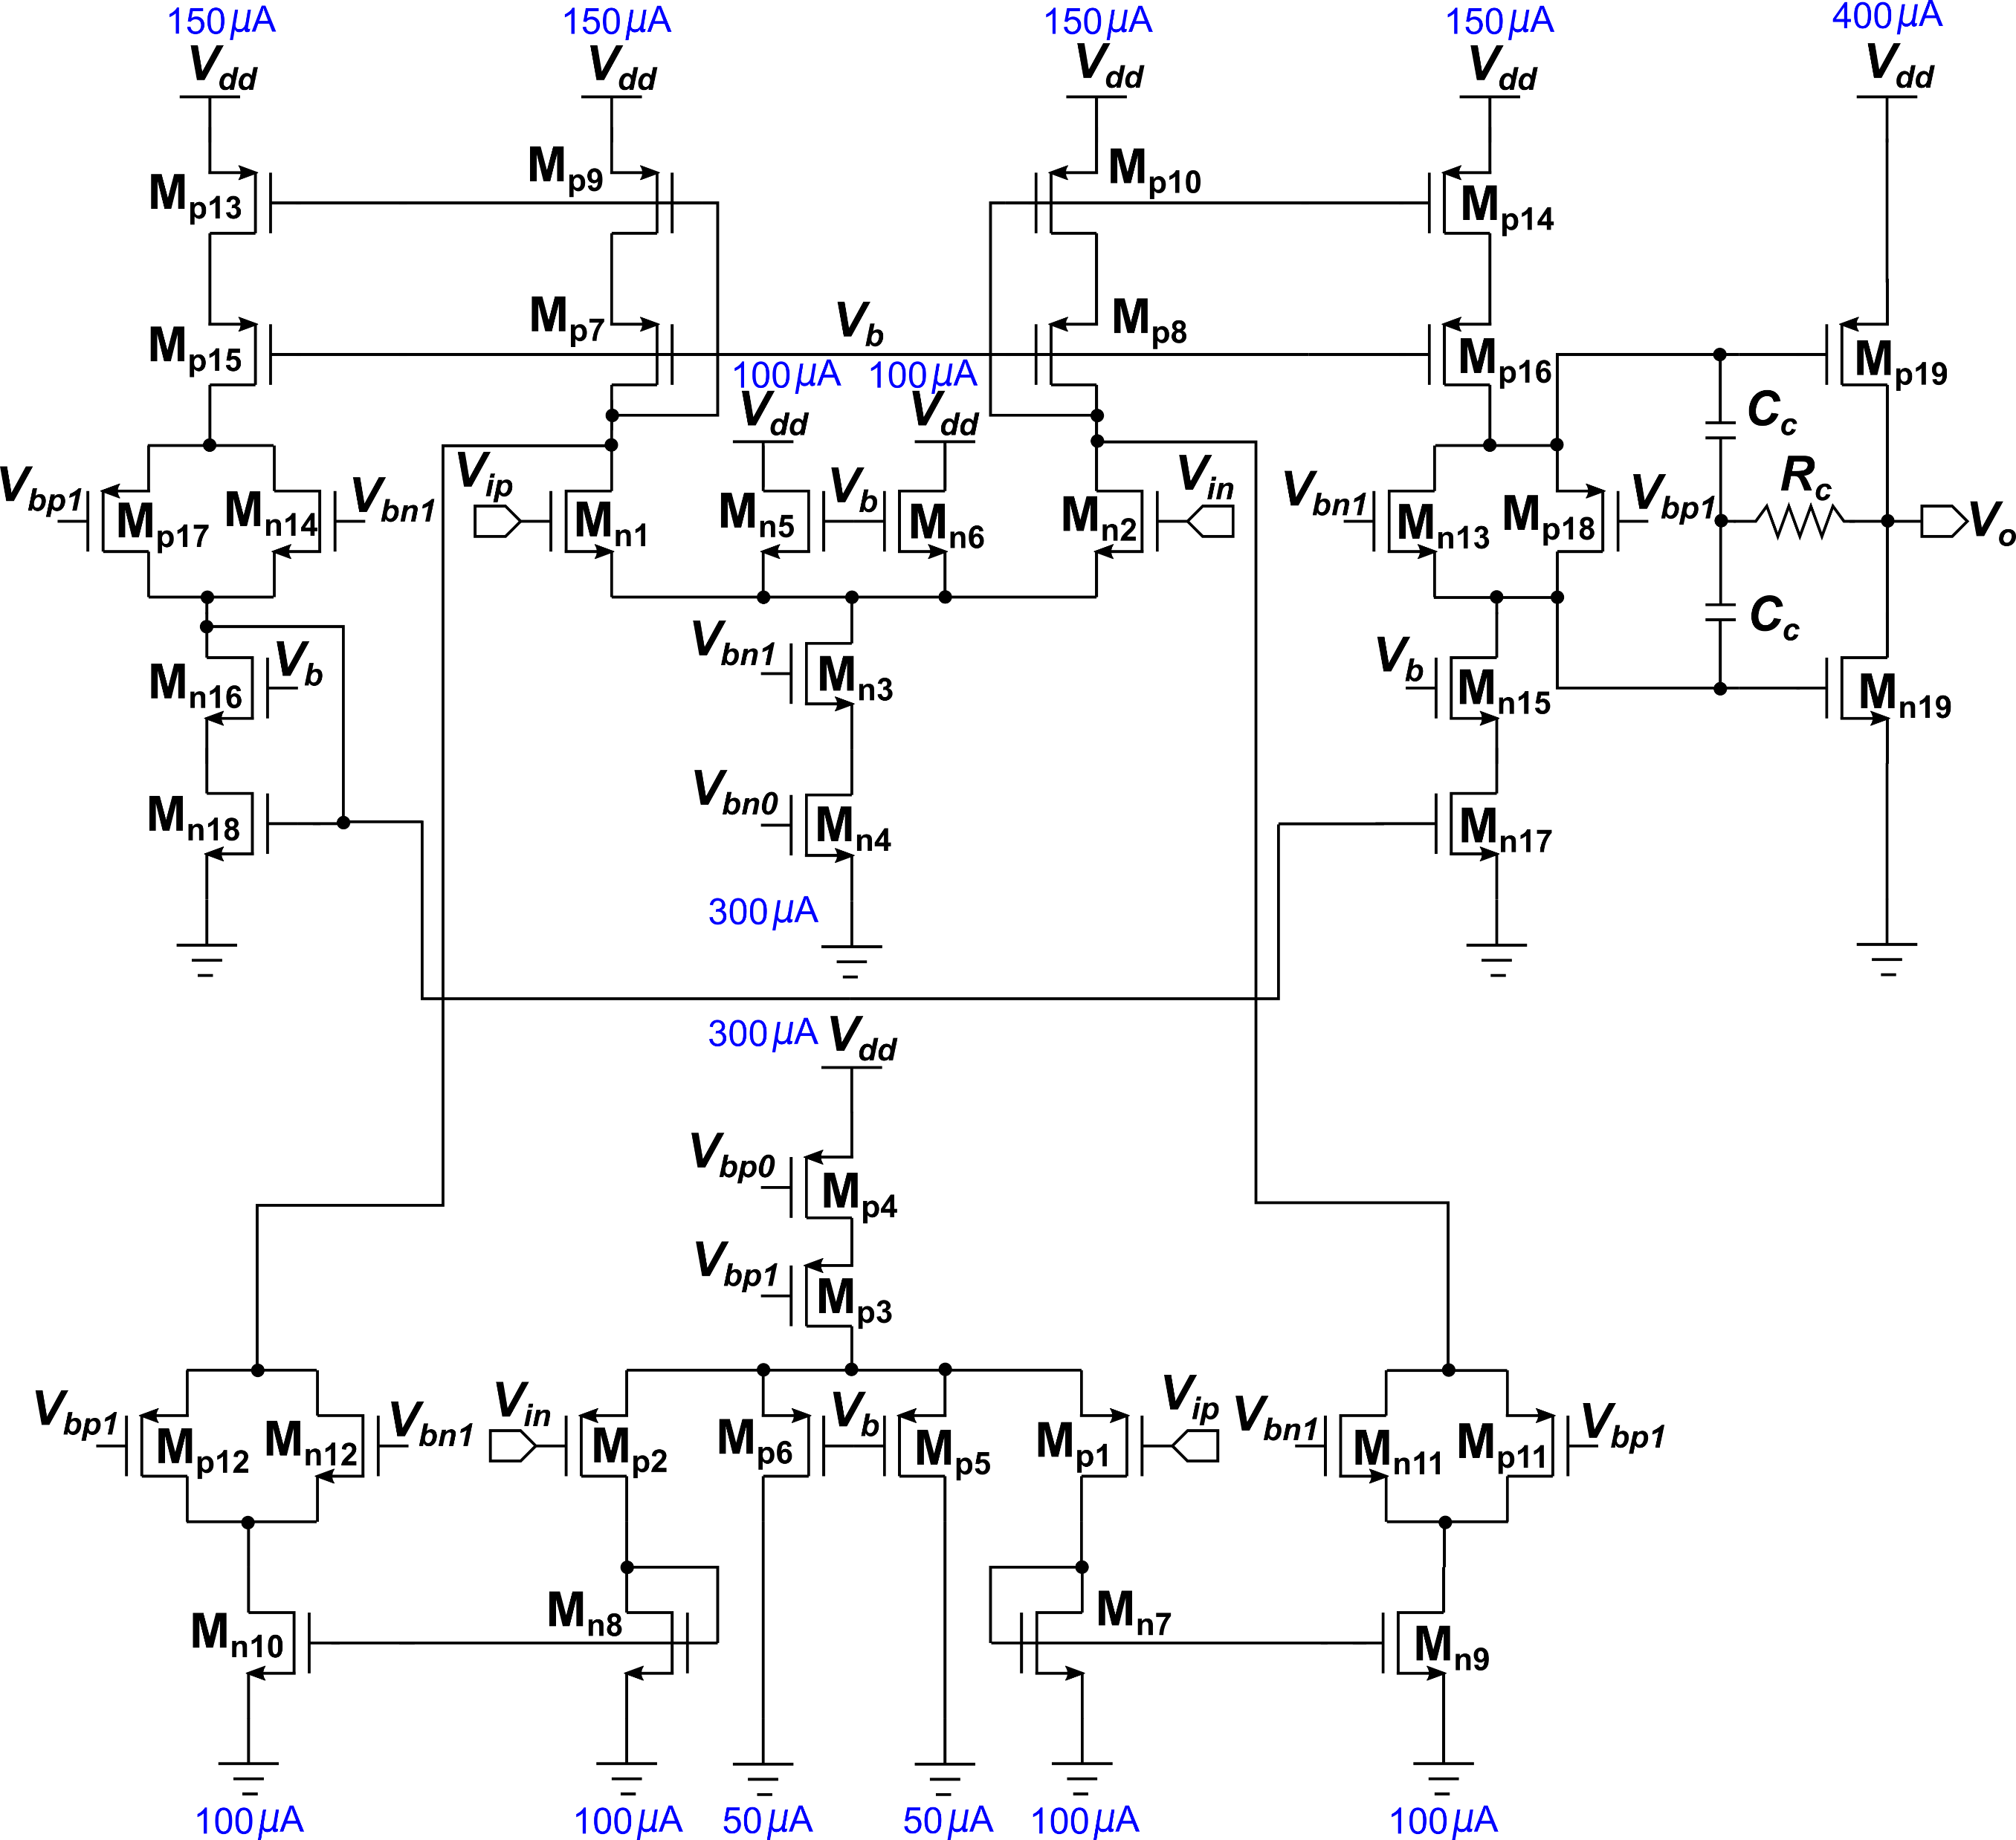
Output buffer design – single ended (SE) buffer
Based on a folded-cascode current-mirror based operational transconductance amplifier
Comprises of parallel NMOS and PMOS input pairs to support rail-to-rail operation
Monticelli class-AB output stage used
High open-loop DC gain (118 dB at LArT) ensures minimal introduction of distortions in the output signal
Suitable to drive tens of pF of capacitance load (chip-to-chip trace)

Slide 16
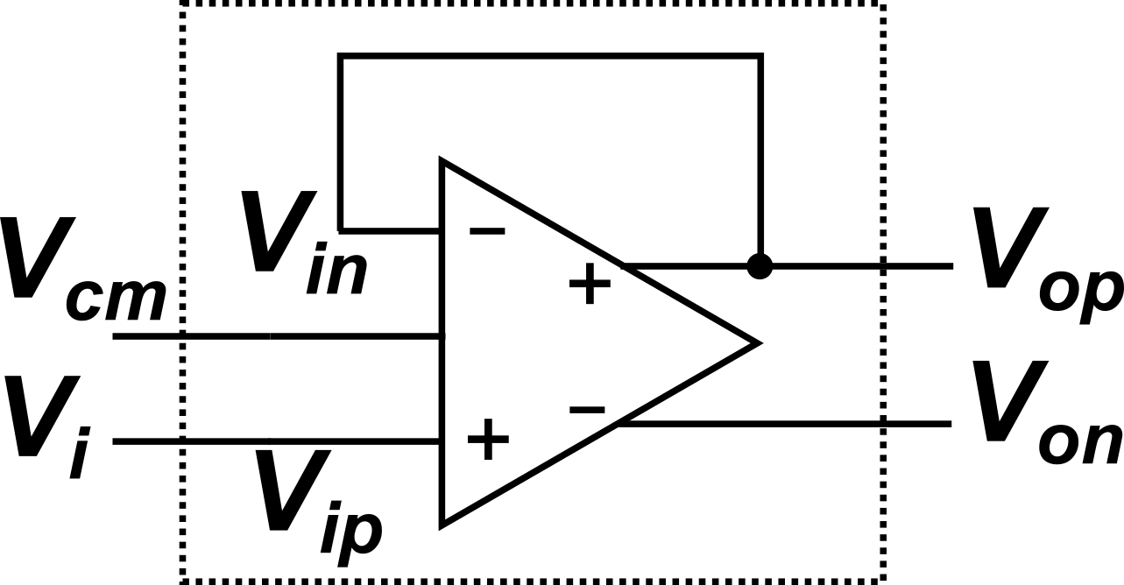
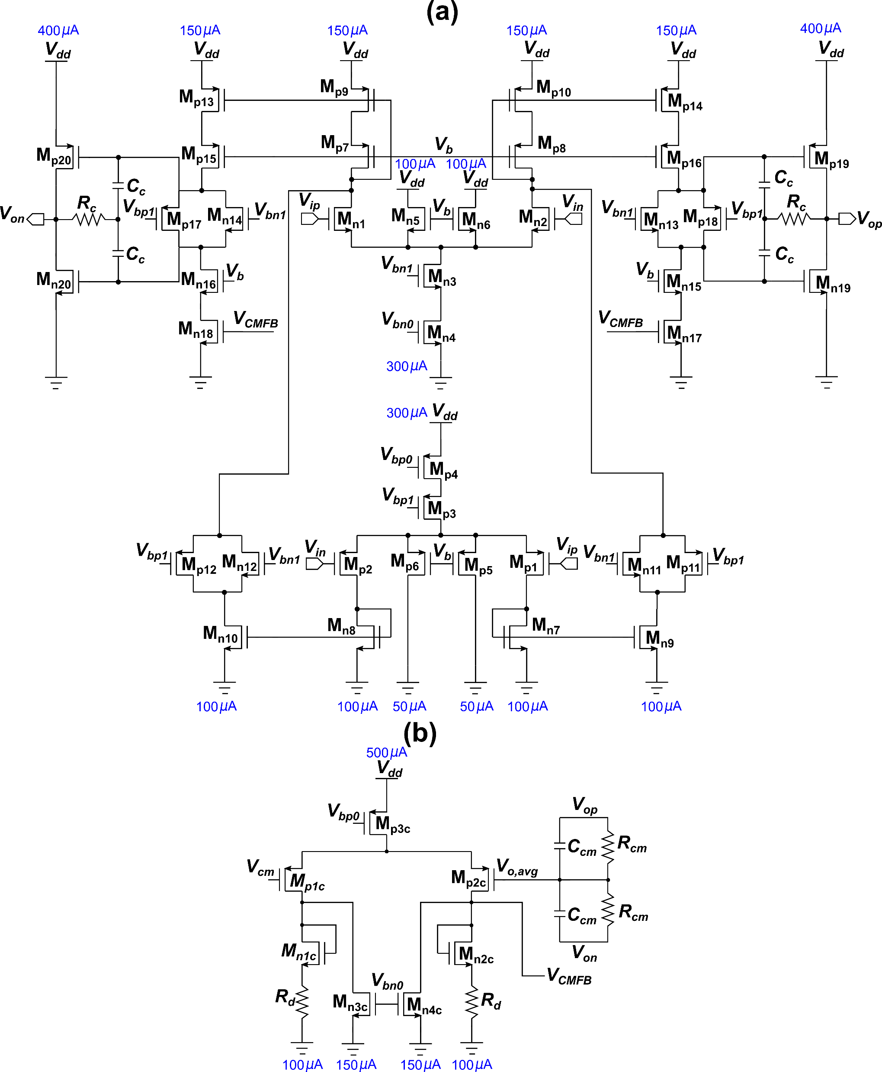
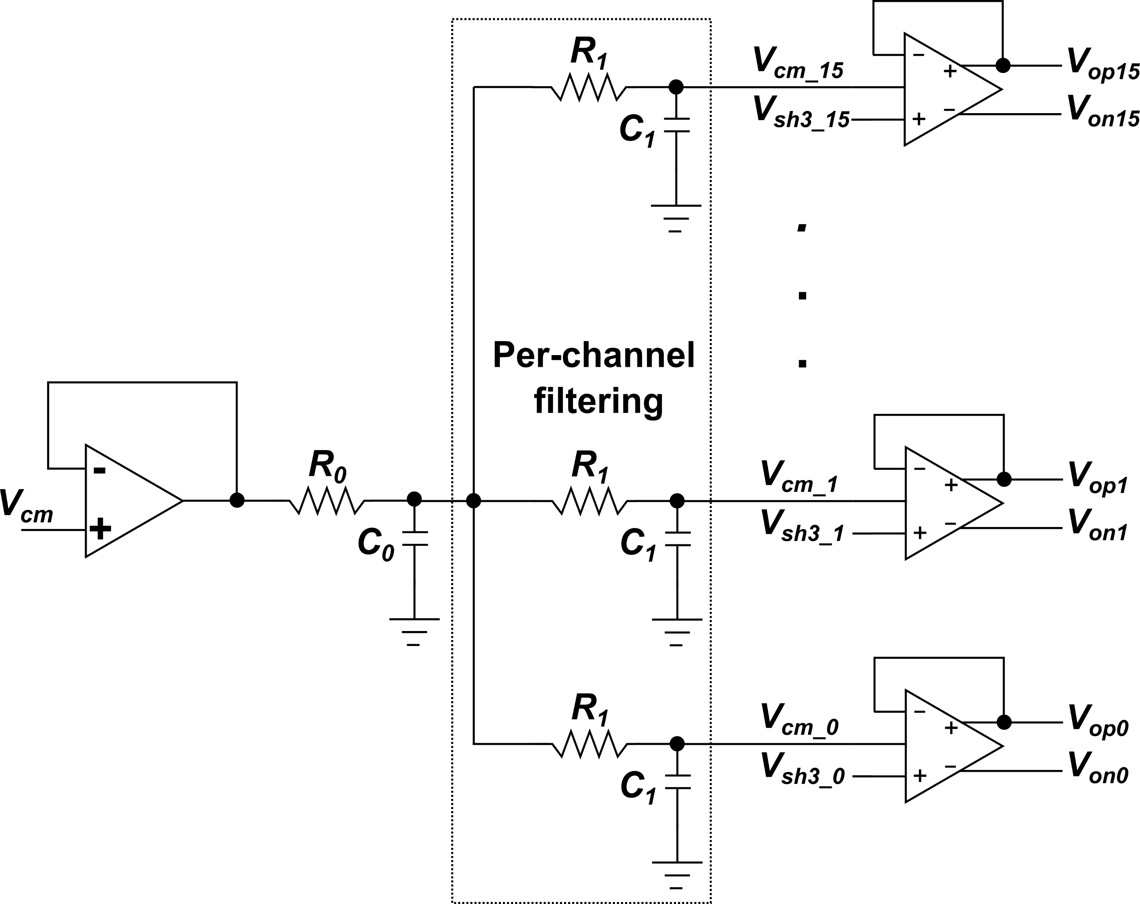
Output buffer design – single ended (SEDC) buffer
Main loop
Simpler, more compact and power-efficient compared to resistor or 3-operational amplifier based SEDC designs
Circuit implementation similar to SE buffer, but core is fully-differential (inputs and outputs)
Noise transferred from common-mode input signal (V_{cm}) to the output with 6 dB gain
Global and local noise filtering implemented for V_{cm}
Both common-mode and differential paths have high open loop DC voltage gains (> 110 dB) and comparable bandwidths ( ≈100 MHz) at LArT
CMFB loop

Slide 17
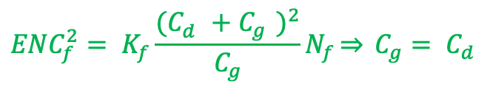
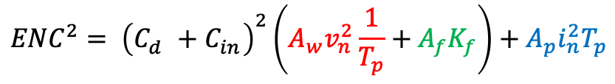
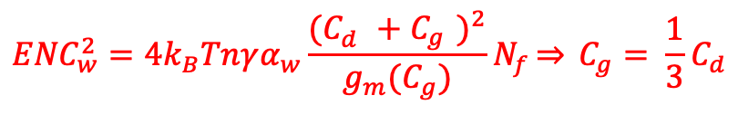
Noise minimization strategy
$${ENC}^{2}= {\left(C_{d}^{}+C_{in}^{}\right)}^{2}\left(A_{w}v_{n}^{2}\frac{1}{T_{p}}+A_{f}K_{f}\right)+A_{p}i_{n}^{2}T_{p}$$
(Sum of white series noise, 1/f series noise and parallel noise components)
$${ENC}_{f}^{2}= K_{f}\frac{{(C_{d}^{}+C_{g}^{})}^{2}}{C_{g}}N_{f}\overset{⇒}{} C_{g}= C_{d}$$
Input stage transistor sized to have C_{g} ~ 40 pF, optimal choice for minimizing noise with C_{det} ~ 150 pF with given power budget
$${ENC}_{w}^{2}=4k_{B}Tnγα_{w}\frac{{(C_{d}^{}+C_{g}^{})}^{2}}{{g_{m}(C}_{g})}N_{f}\overset{⇒}{} C_{g}= {\frac{1}{3}C}_{d}$$
Input stage transistors for A₁ implemented using thick oxide (2.5 V) devices in 65 nm for CHARMS to limit leakage current and associated parallel noise
Thin oxide device of the same dimensions has a gate leakage current of ≈ 20 nA, contributing almost 200 electrons to the ENC for a 1µs peaking time and triangular weighting function!
 | Minimum allowable transistor length | Input transistor length | Input transistor width
180 nm | 180 nm | 270 nm | 20 mm
65 nm | 280 nm | 400 nm | 24 mm
Ref: [1] Angelo Rivetti, Front-End Electronics for Radiation Sensors
[2] Veljko Radeka, Signal Processing for Particle Detectors

Slide 18
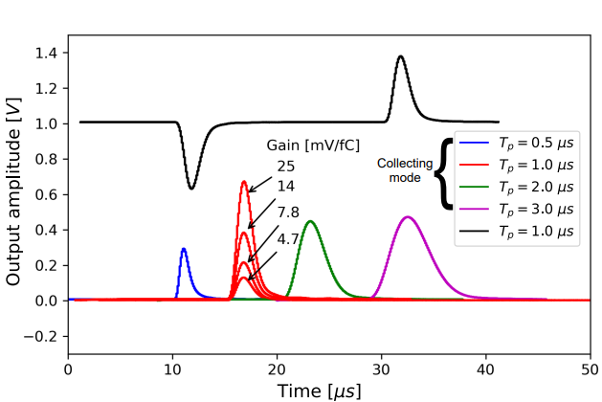
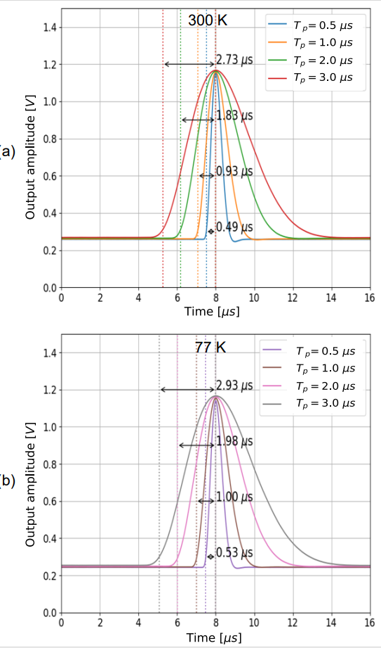
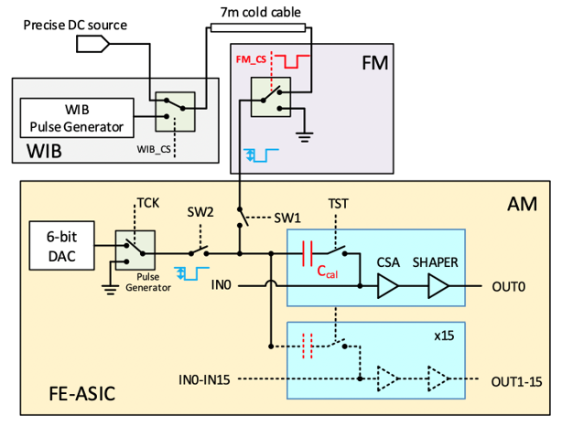
LArASIC measurement results [1]
Measurement setup
Oscilloscope outputs at 77 K
Test pulse charge inputs with programmable amplitudes provided either by on-chip 6-bit DAC or external source
On-chip MiM capacitor calibrated to be 186 fF with less than 1% channel-to-channel dispersion at RT and LNT included in test input path
Application of variable-amplitude voltage pulse injects known charge into the channel
Full-scale range of DAC programmable based on gain setting
Very small deviations seen between RT and LNT in the measured peaking time and channel gain (< 2%)
Measured peaking times

Slide 19
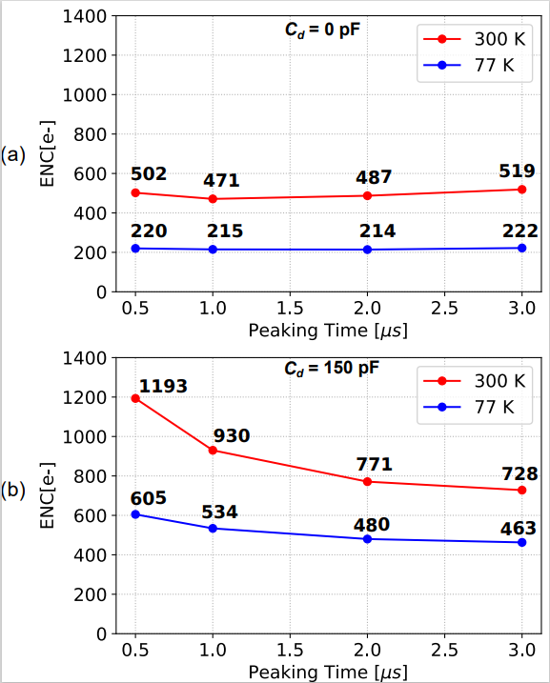
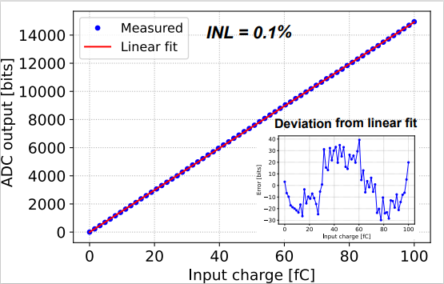
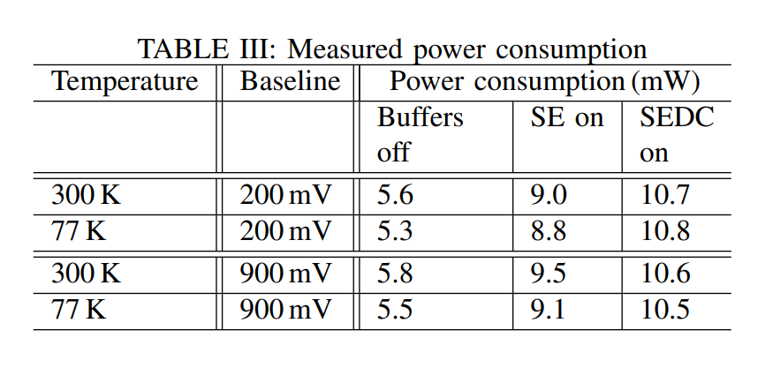
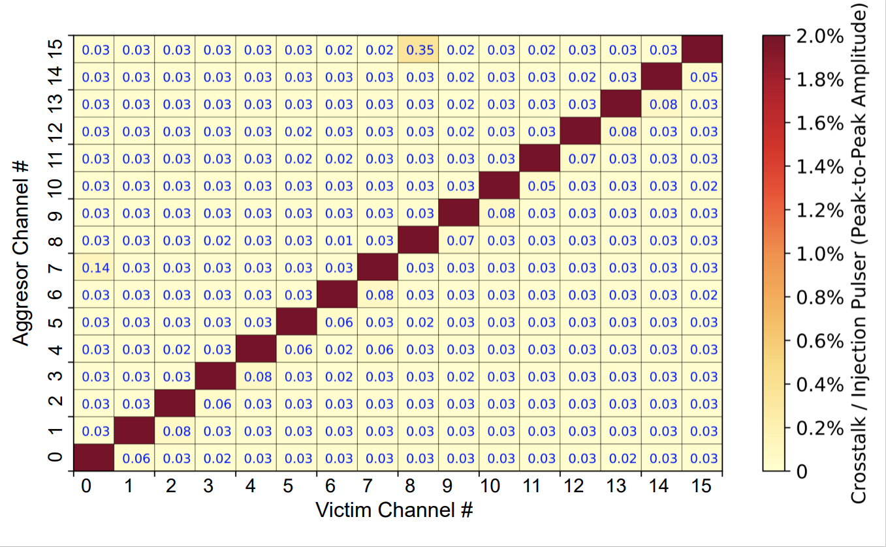
LArASIC measurement results [2]
High linearity
Power consumption
Low crosstalk (mean: 0.04%)
Low noise

Slide 20
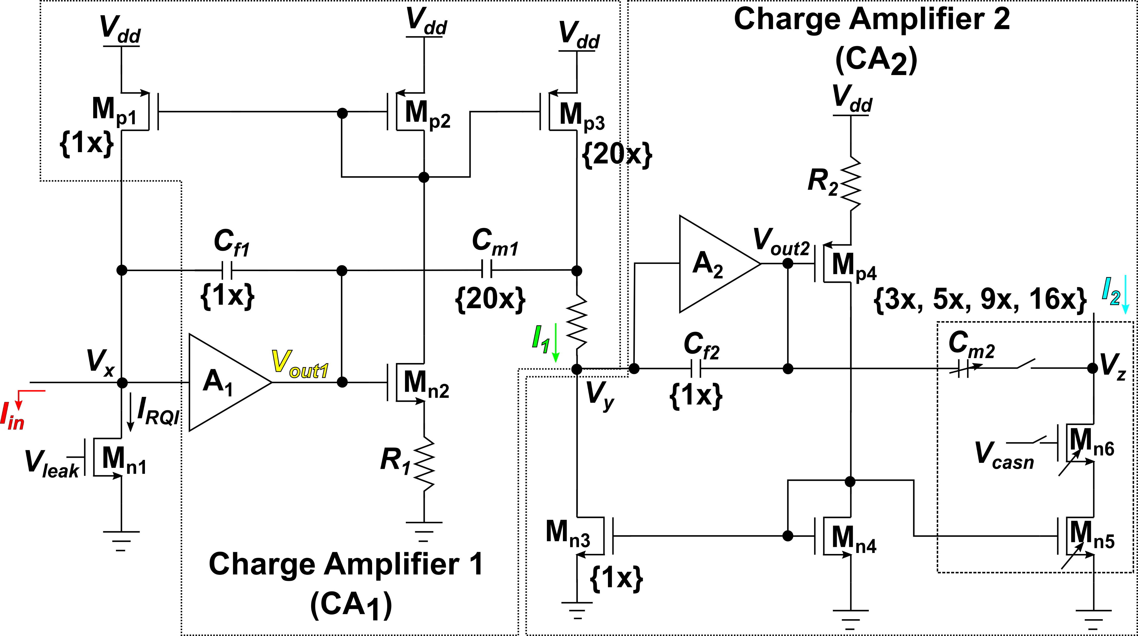
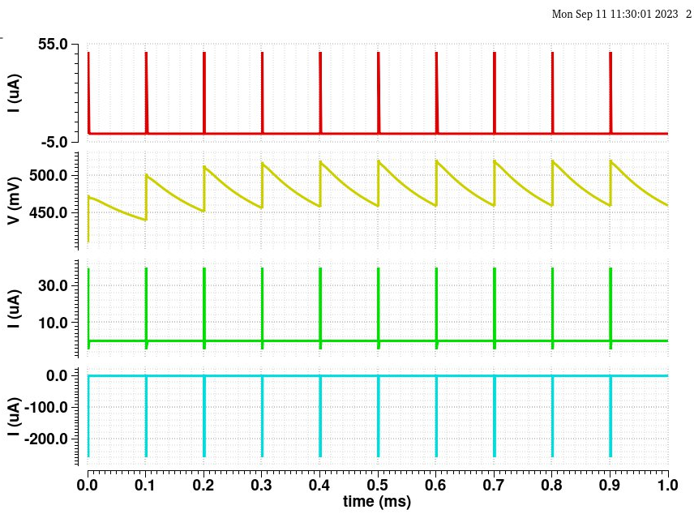
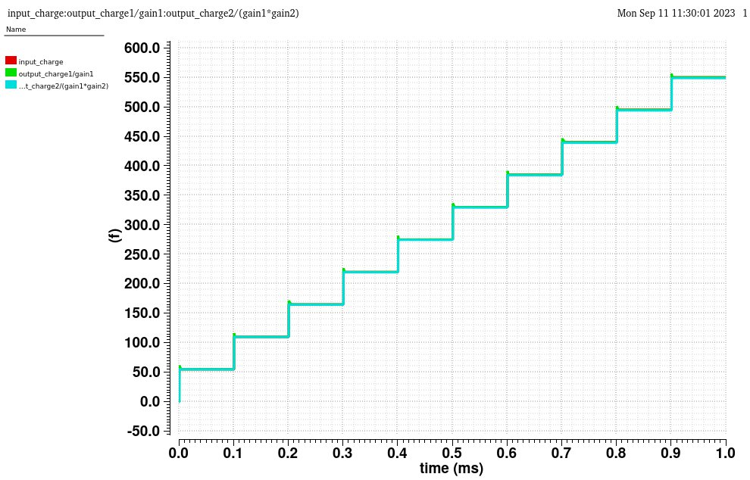
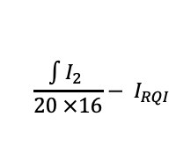
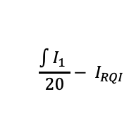
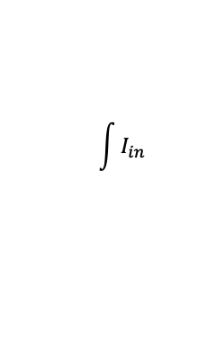
CHARMS250 simulation results [1]
CA₁ and CA₂ charge multiplication check
I_{in}
V_{out1}
$$\int{I_{in}}$$
I₁
$$\frac{\int{I_{1} }}{20}− I_{RQI}$$
I₂
$$\frac{\int{I_{2} }}{20 ×16}− I_{RQI}$$

Slide 21
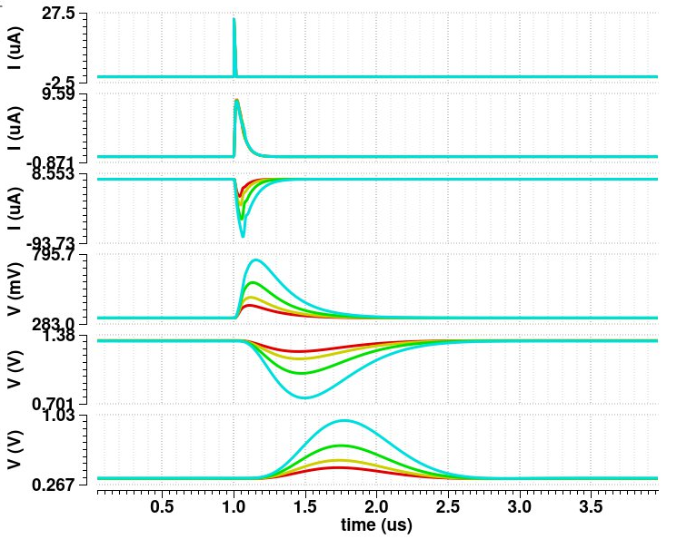


CHARMS250 simulation results [2]
Programmable gain, peaking time and linearity simulated at LArT
I_{in}
I_{in}
I₁
I₁
I₂
I₂
V_{s1}
V_{s1}
V_{s2}
V_{s2}
V_{s3}
V_{s3}
> 10 bits linearity for the shortest peaking time of 0.25 µs
Programmable gain
(4.7 mV/fC, 7.8 mV/fC, 14 mV/fC, 25 mV/fC)
Programmable peaking time (0.25 µs, 0.5 µs, 1.0 µs, 2.0 µs)

Slide 22


Plan for CHARMS10 (10 ns ≤ T_{p} ≤ 250 ns)
Transient response for variable input charge (50 fC – 300 fC) with A₁, A₂, A₃ modeled as ideal VCVS
I_{in}
I₁
I₂
Limited bandwidth of A₁ and A₂ disallows shaping times < 250 ns
Currently, amplifiers A₁ and A₂ implemented as 3-stage amplifiers
Difficult to achieve higher bandwidth without sacrificing stability
CHARMS10 will incorporate current increase and topology modification for A₁ and A₂
V_{s1}
V_{s2}
V_{s3}

