Slide 1
Tracking Systems Overview and Requirements
Brian Eng
L3 CAM
Jefferson Lab

Slide 2
Charge Questions Addressed
Are the technical performance requirements appropriately defined and complete for this stage of the project?
Are the plans for achieving detector performance and construction sufficiently developed and documented for the present phase of the project?
Are the current designs and plans for detector, electronics readout, and services sufficiently developed to achieve the performance requirements?
Are plans in place to mitigate risk of cost increases, schedule delays, and technical problems?
Are the fabrication and assembly plans for the various tracking detector systems consistent with the overall project and detector schedule?
Are the plans for detector integration in the EIC detector appropriately developed for the present phase of the project?
Have ES&H and QA considerations been adequately incorporated into the designs at their present stage?

Slide 3
Outline
Requirements
Interfaces
Tracking Detector Layout
Risks
Safety
Summary

Slide 4
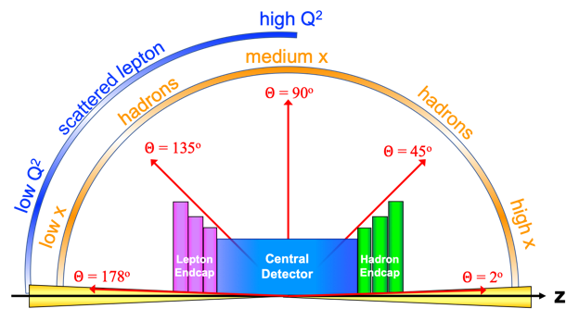
Requirements
Charge 1
https://eic.jlab.org/Requirements/index.html
Based physics in Yellow Report
 | Momentum Resolution | Spatial Resolution
Backward (-3.5 to -2.5) | ~0.10%×p⊕2.0% | ~ 30/pT µm ⊕ 40 µm
Backward (-2.5 to -1.0) | ~ 0.05%×p⊕1.0% | ~ 30/pT µm ⊕ 20 µm
Barrel (-1.0 to 1.0) | ~0.05%×p⊕0.5% | ~ 20/pT µm ⊕ 5 µm
Forward (1.0 to 2.5) | ~0.05%×p⊕1.0% | ~ 30/pT µm ⊕ 20 µm
Forward (2.5 to 3.5) | ~0.10%×p⊕2.0% | ~ 30/pT µm ⊕ 40 µm

Slide 5
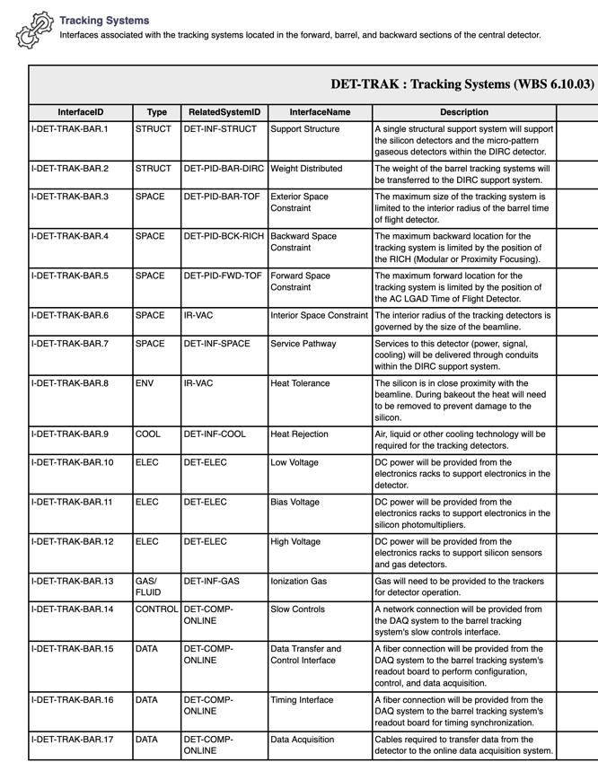
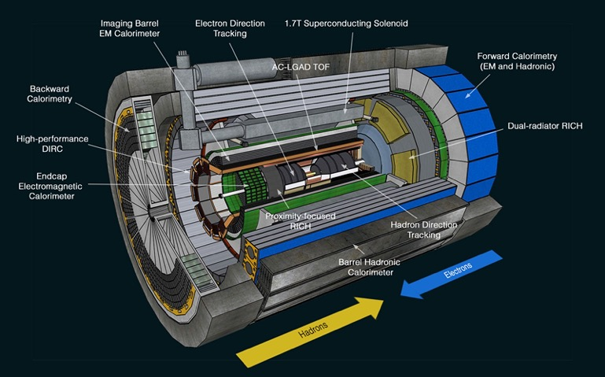
Interfaces
Charge 1
https://eic.jlab.org/Interfaces/Interfaces.html
Outer barrel limited by DIRC
Disks limited by pfRICH/AC-LGAD
Inner Barrel first vertex layer 5mm from beampipe

Slide 6
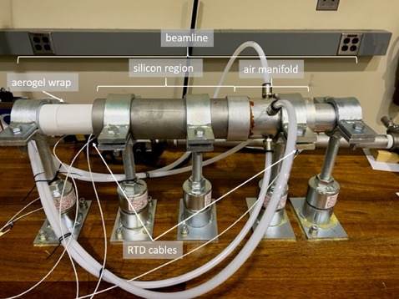
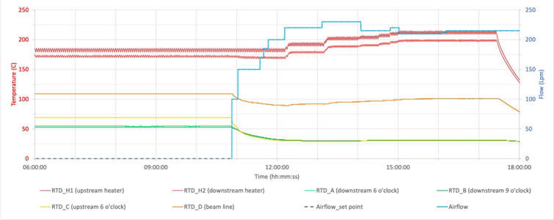
Interfaces – Beam Pipe
Charge 1
Unique beampipe
Tapered beampipe, tracking detectors must be installed prior to beampipe installation in central detector
Beampipe exposed to ambient prior to installation
Need min 100°C in beampipe to break H₂O bonds
Silicon detector limited to <50°C due to CTE of materials
Additional details in Nicole’s talk
Only covers 1 m of 3 m beryllium section

Slide 7
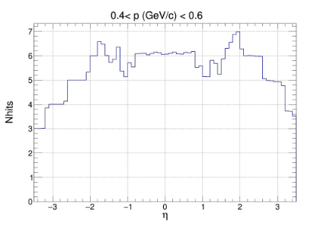
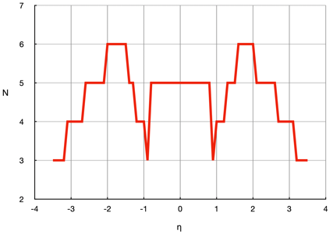
Tracking Detector Layout Modifications
Charge 2, 3
Low number of hits in certain rapidity ranges
Need more planes
Red = Si Only, fast simulation
Blue = Previous layout, full simulation
Solve impact from 5 (2) μs MAPS frame accumulation time
Need enough hits from faster detectors to form a tracklet with a good pointing resolution, e.g. MPGDs
Need to utilize ToF and maybe Barrel-ECal AstroPix as possible
Note: Barrel ToF has good time resolution but not spatial resolution
Current layout finalized in Spring 2023

Slide 8
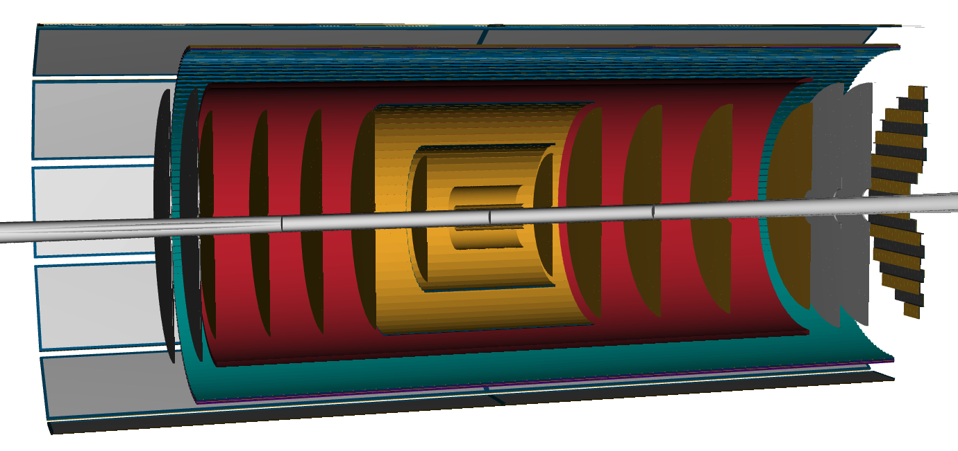
Overall Tracking Layout
MPGD
BOT Length: 340 cm
BOT Radius: 72.5 cm
Silicon
Outer Length: 84 cm
Outer Radius: 42 cm
AC-LGAD
ToF: Part of PID
μRWELL-ECT
μRWELL-BOT
CyMBaL
μRWELL-ECT
AC-LGAD Endcap
SVT Endcaps
SVT OB
SVT IB
SVT Endcaps
AC-LGAD Barrel

Slide 9
Simulation – Nhits vs η
Only tracking detectors included, will improve further once calorimeters included which should remove dip at rapidity ±1, details in Matt’s talk

Slide 10
Silicon
MAPS (monolithic active pixel sensors) in 65 nm CMOS technology, developed with ALICE ITS3 collaboration, details in Laura’s talk
Inner Barrel: Directly use ITS3 wafer scale sensor
Outer Barrel: EIC Large Area Sensor (LAS), modification of ITS3 sensor
EIC Project, ePIC SVT Collaboration and CERN ALICE/ITS3 meeting in Q2 23
Path forward on collaboration (draft completed at BNL legal)
EIC has hired 2 engineers to work directly with ALICE team on sensor development

Slide 11
Silicon – Inner and Outer Barrel
Inner: three layers of thin, bent, wafer scale ITS3 based sensors
ITS3 concept adapted to ePIC radii, details in Ernst’s talk
X/X0 % = 0.05
Outer: Traditional stave design
Layer | Radius (mm) | Length (mm) | Sensors
L0 | 36 | 270 | 4
L1 | 48 | 270 | 4
L2 | 120 | 270 | 8
Layer | Radius (mm) | Length (mm) | X/X0%
L3 | 270 | 540 | 0.25
L4 | 420 | 840 | 0.55

Slide 12
Outer Barrel – MPGD
CyMBaL
Additional Tracking Points
Single Tile
65 x 46 cm
Simplifies production
More details in Francesco’s talk
μRWELL-BOT
Provides hits for DIRC
Single module design
24 modules in total
More details in Kondo’s talk

Slide 13
Forward / Backward Disks – Silicon
Foundry rule/limitation, need to limit number of sizes (2-3 total)
Direct outcome from meeting with ALICE
More details in Ernst’s talk

Slide 14
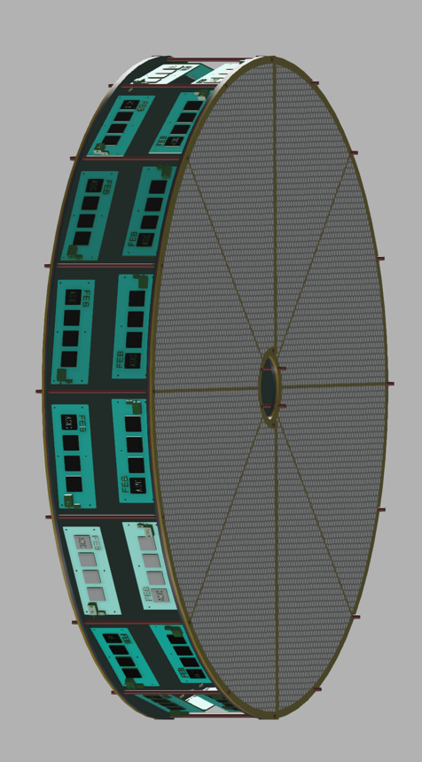
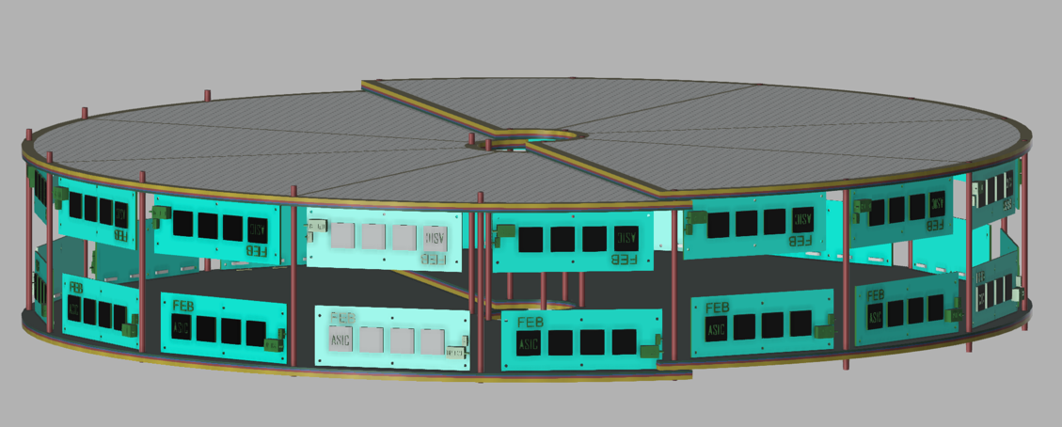
Forward / Backward Disks – MPGD
μRWELL-ECT
4 disks in total (8 half-disks)
Diameter ~100 cm with 2 cm overlap
More details in Annalisa’s talk

Slide 15
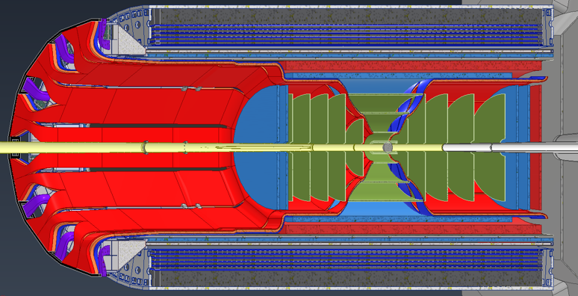
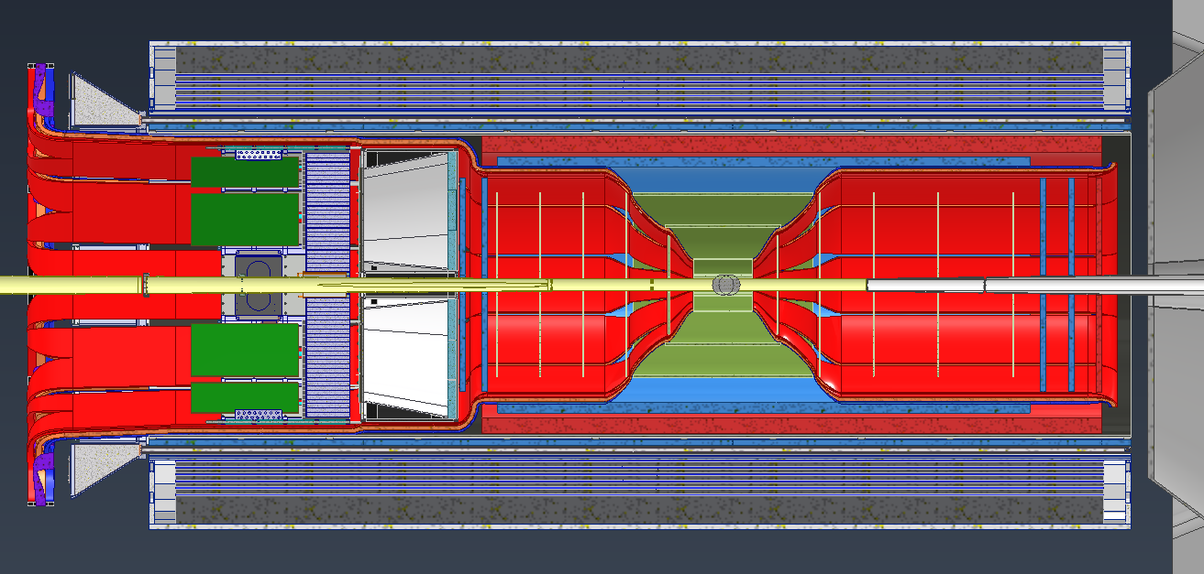
Services
Charge 3
Service volume increases as get further from Interaction Point
More details in Roland’s talk
RED = power
BLUE = cooling/gas
ORANGE = signal

Slide 16
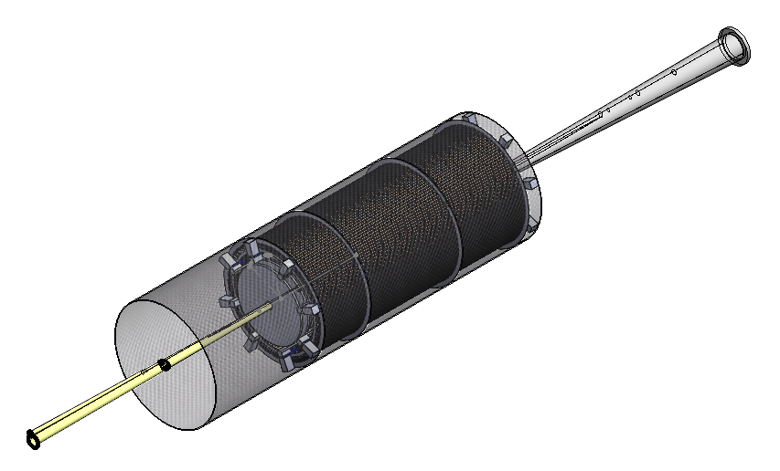
Integration
Charge 6
Assembled in stages
μRWELL-BOT together with hpDIRC
CyMBaL with TOF
Silicon barrels and disk clamshell around beampipe (SVT is separate sub-assembly)
TOF assembly slides over SVT
μRWELL-ECT are added as last step
More details in Roland’s and Andy’s talks

Slide 17
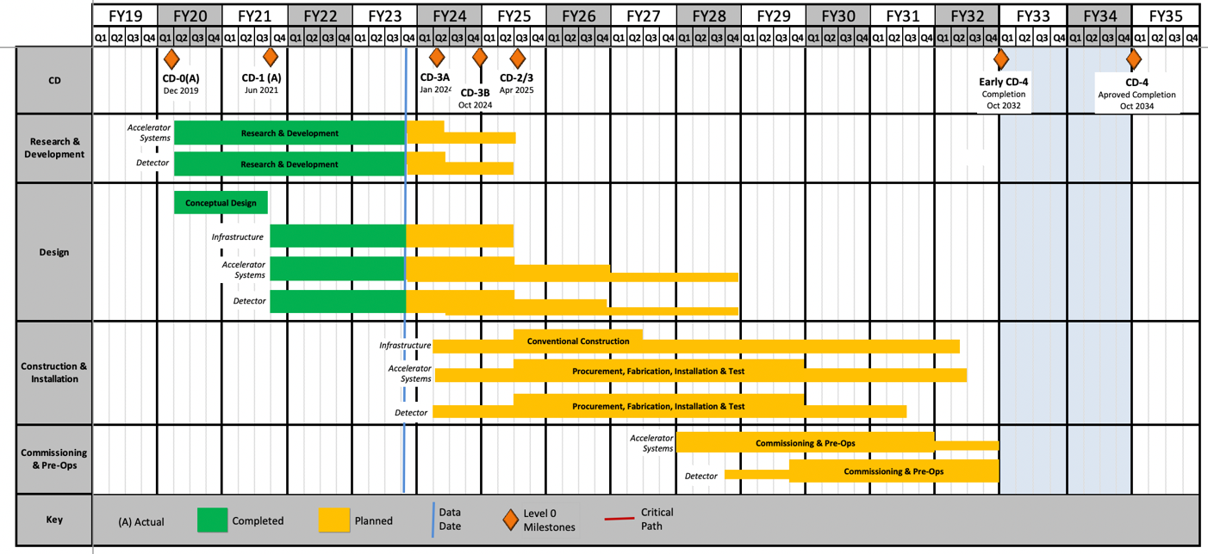
Cost / Schedule
Charge 5
Cost / Schedule is based on engineering estimates from detector experts
Inner Barrel Silicon (ITS3)
2024-2026
Outer Barrel/Disk Silicon (LAS)
2025-2027
Stave/Disk Construction Complete
Q4 29
Ready for integration
Q2 30

Slide 18
Risks
Charge 4
Currently for the silicon trackers there is a planned engineering run during R&D with the production run taking place during PED
Benefit from ALICE ER1 and ER2 runs and that the EIC runs would be based on the final ER3 design
However, if unforeseen issues arise another engineering run for the sensors might be needed
The risk register has a proposed risk (ID RT-6-10-014) if a second engineering run is needed which would use contingency
CD-3A Director’s Review comment: “Upfront discussion of risks of R&D not coming to a favorable conclusion, and mitigation plans in this case, should be more clearly documented and presented. Where appropriate, for example for the tracking detector, more detailed plans should be developed.”
Silicon detectors have external dependency on ITS3 sensors
See later talk for alternative layout discussion

Slide 19
Safety
Charge 7
Generally the tracking WBS is in the design phase and and such doesn’t have any safety issues
However, there are a few test stands being developed which follow their institution’s safety protocols
Protocols include required training
LBNL testing carbon foam cooling: ISM, documented in Work Planning & Control
JLAB testing beampipe bake-out: ISM, Task List and ePAS (JLab-PR-725)
Equipment going in the BNL Experimental Hall must follow NEC/NFPA 70E, 2021 and electrical safety guidelines: DOE-HDBK-1092-2013
Defines voltage hazards, cable type requirements, circuit protection, etc
Equipment must be NRTL listed or approved by BNL Electrical Equipment Inspection program

Slide 20
Summary
Recent design change to address performance issues, which has been incorporated into the ePIC collaboration’s latest models
Cost and schedule developed with input from ePIC collaborators and ALICE/ITS3 efforts
Scope change request for additional personnel based on discussions from CERN visit in progress.
Tracking WBS is in the final design stage no major ES&H issues
Test stands follow the relevant institution’s policies.
Proposed risk added to register for additional engineering runs of silicon sensors

