Slide 1
Detector Integration Status and CAD Design
Roland Wimmer
Mechanical Engineer
Brookhaven National Laboratory

Slide 2
Charge Questions Addressed
Are the technical performance requirements appropriately defined and complete for this stage of the project?
Are the plans for achieving detector performance and construction sufficiently developed and documented for the present phase of the project?
Are the current designs and plans for detector, electronics readout, and services sufficiently developed to achieve the performance requirements?
Are plans in place to mitigate risk of cost increases, schedule delays, and technical problems?
Are the fabrication and assembly plans for the various tracking detector systems consistent with the overall project and detector schedule?
Are the plans for detector integration in the EIC detector appropriately developed for the present phase of the project?
Have ES&H and QA considerations been adequately incorporated into the designs at their present stage?

Slide 3
EPIC Integration, Installation and Infrastructure Team:
Rahul Sharma (BNL) – Chief Mechanical Engineer
Walt Akers (JLAB) – Systems Integration
Roland Wimmer (BNL)– Mechanical Engineer
Dan Cacace (BNL) – Mechanical Engineer
Alex Eslinger (JLAB) – Mechanical Engineer – pfRICH and dRICH Design
Ron Lassiter (JLAB)– Forward Detectors - Mechanical Engineer
Karim Hamdi (BNL)– Mechanical Designer
Tim Camarda (BNL) – Electronics Engineer
Jim Kelsey (MIT Bates) – Mechanical Engineer
Avishay Mizrahi (MIT) – Mechanical Engineer - DIRC
Joshua Crafts (CUA) – Postdoc - EEEMCAL
Tom O’Connor and Kevin Bailey (ANL) – Barrel EMCAL Design
Andreas Jung (Purdue University) – AC LGAD and Carbon Fiber Support Structure
Sushrut Karmarkar (Purdue University) – AC LGAD and Carbon Fiber Support Structure
Johnathan Smith (JLAB)
Eric Anderssen and Joe Silber (LBNL)
Seung Joon Lee (JLAB) - MPGDs
Regular weekly engineering meetings are held to discuss and resolve engineering problems and check progress. Hope to add more Mechanical Engineers and Mechanical Designers to the group soon as the project evolves.

Slide 4
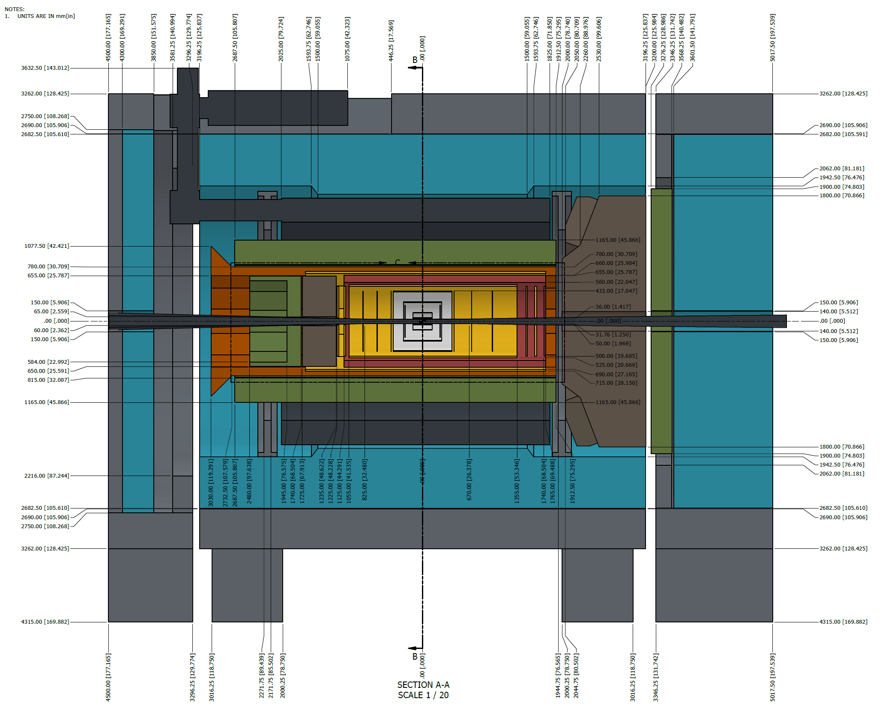
Outline
Charge Questions
EPIC Engineering Team
Detector Integration
Detector overviews
Layout
Support Structures
Services
Routing
Layout
Space Envelopes
Material budgets
Summary

Slide 5
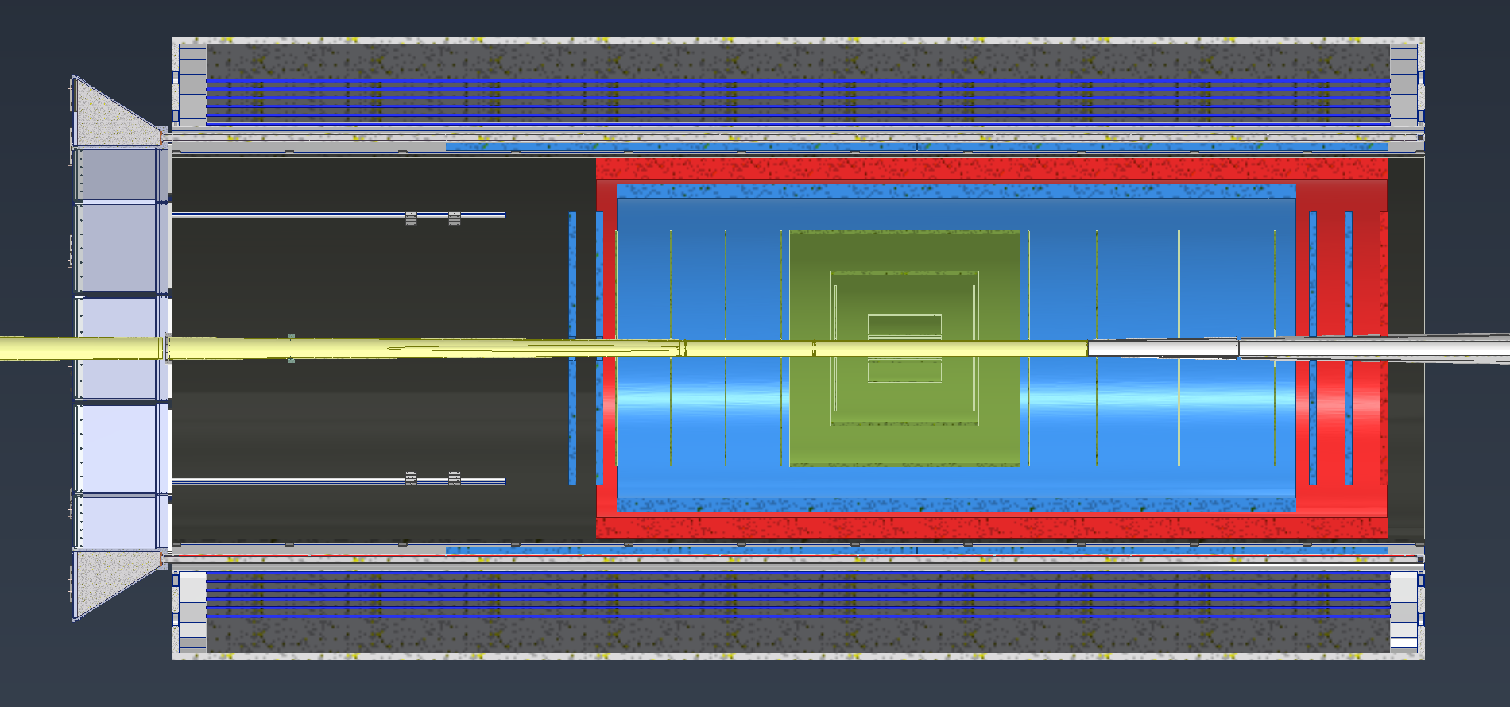
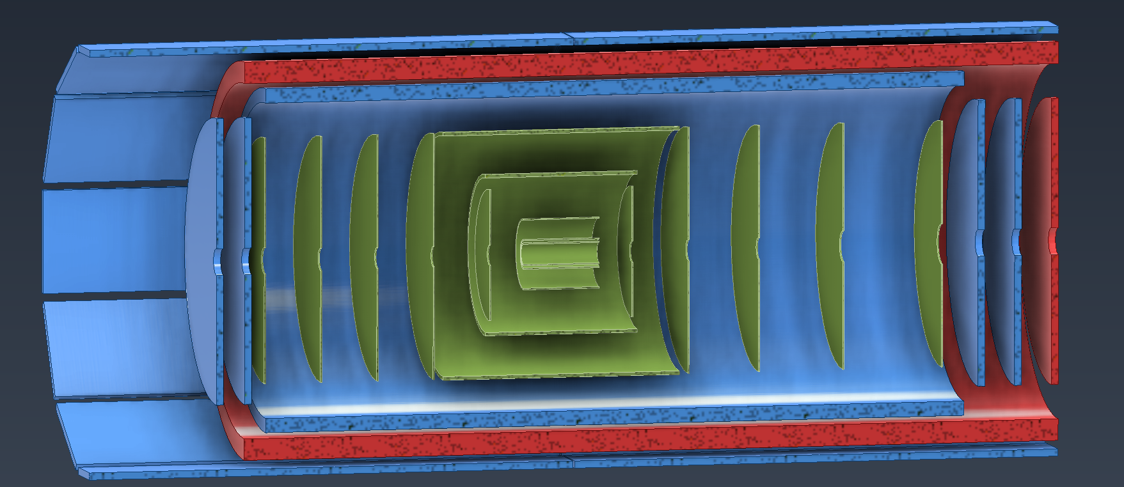
Detector Integration
Charge 3, 6
Red: AC-LGAD Tof
Main barrel
HE Disk
Blue: MPGDs
Outer MPGDs
Inner MPGD Barrel
(2) EE Disks
(2) HE Disks
Green: Silicon Trackers
(3) Inner barrels
(2) Outer barrels
(5) EE Disks
(5) HE Disks
344 cm
150 cm

Slide 6
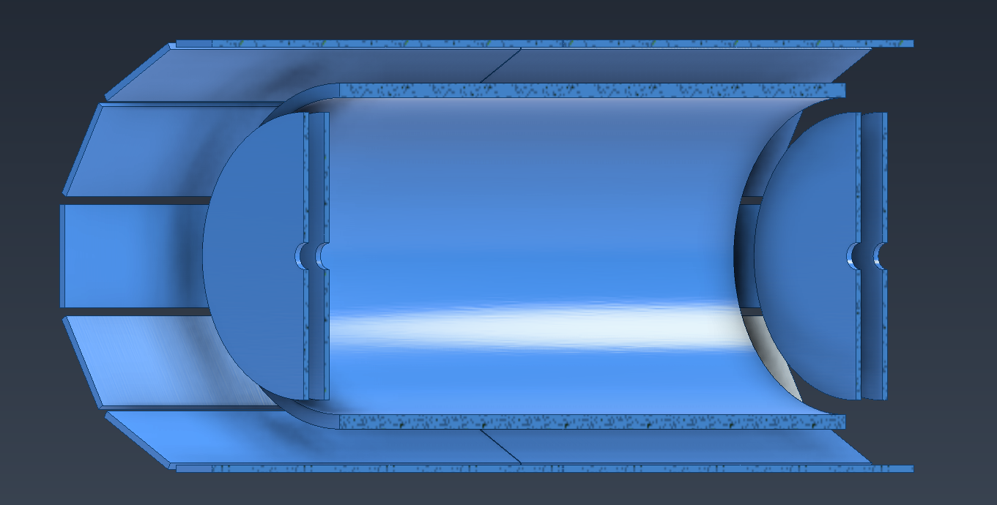
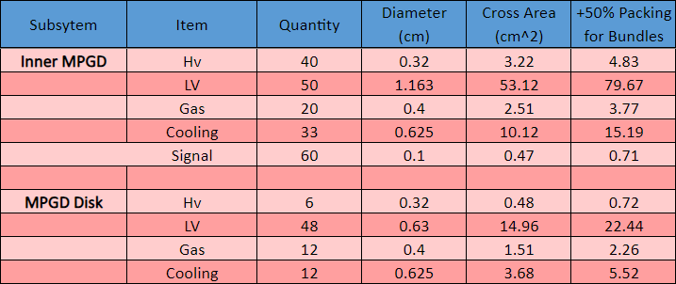
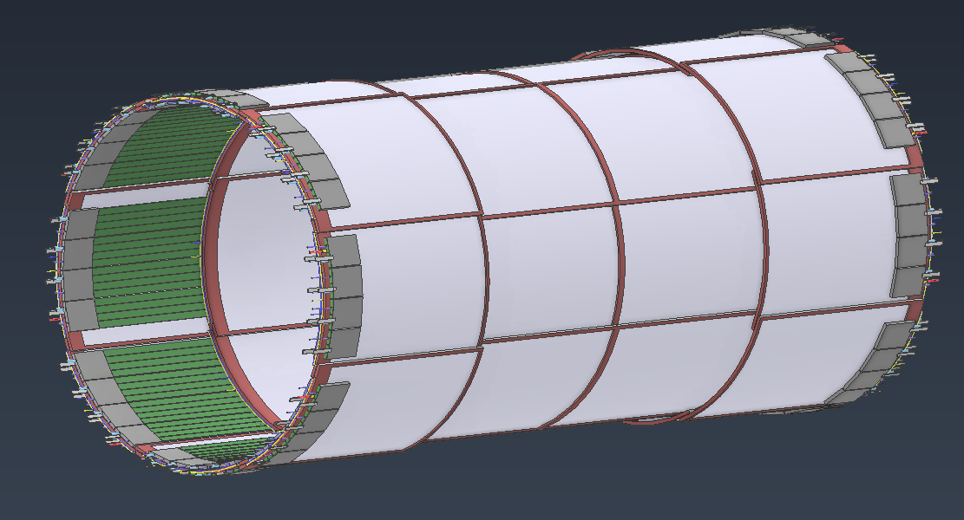
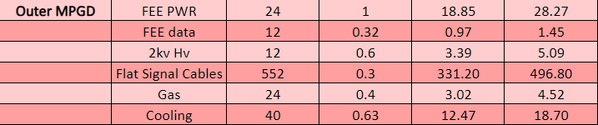
MPGD Overview
Charge 3, 6
344 cm
Outer MPGDs
(24) Modules, 12 sectors each broken in half
Inner MPGD Barrel
(32) Modules, (8) in azimuth and (4) in Z
(4) Disks
Likely to be segmented in quarters or halves
248 cm
150 cm
100 cm
Inner MPGD Barrel

Slide 7
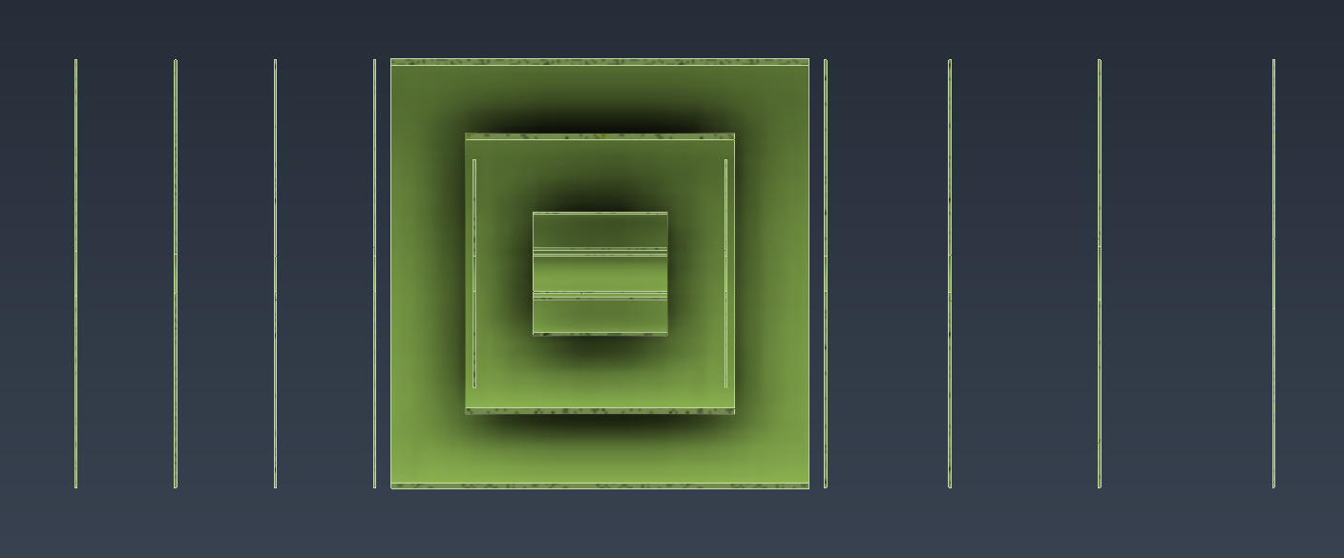
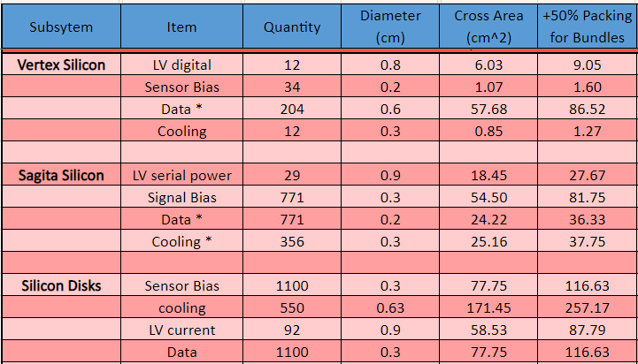
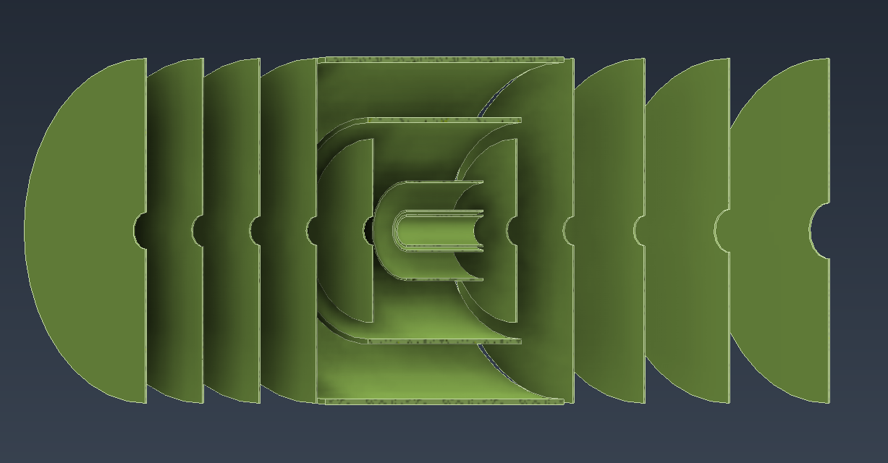
Silicon Trackers Overview
Charge 3, 6
(3) Inner barrels
Innermost barrel sits right around beampipe
(2) Outer barrels
(5) EE Disks
(5) HE Disks
241 cm
86 cm
84 cm
Outer Barrels
Inner Barrels

Slide 8
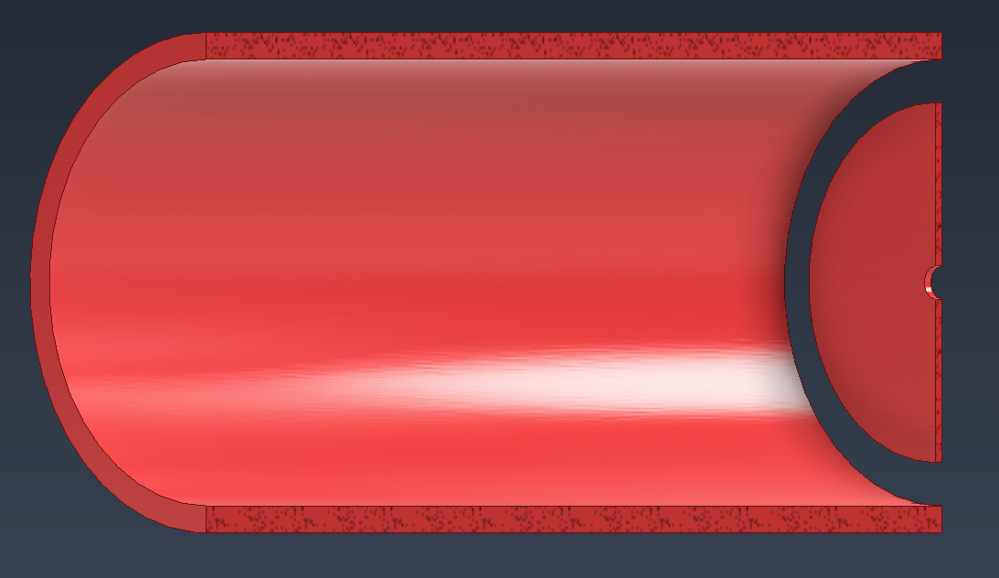
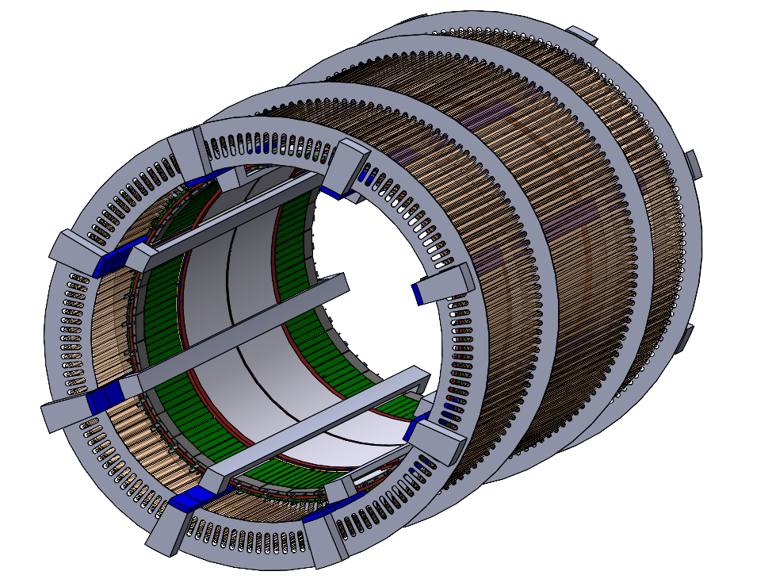
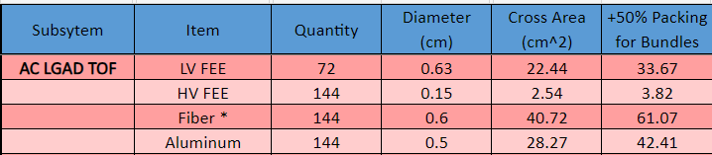
AC-LGAD ToF Overview
Charge 3, 6
289 cm
Main barrel
Made up of 144 staves
HE Disk
Only 1 disk in the forward direction
100 cm
139 cm

Slide 9
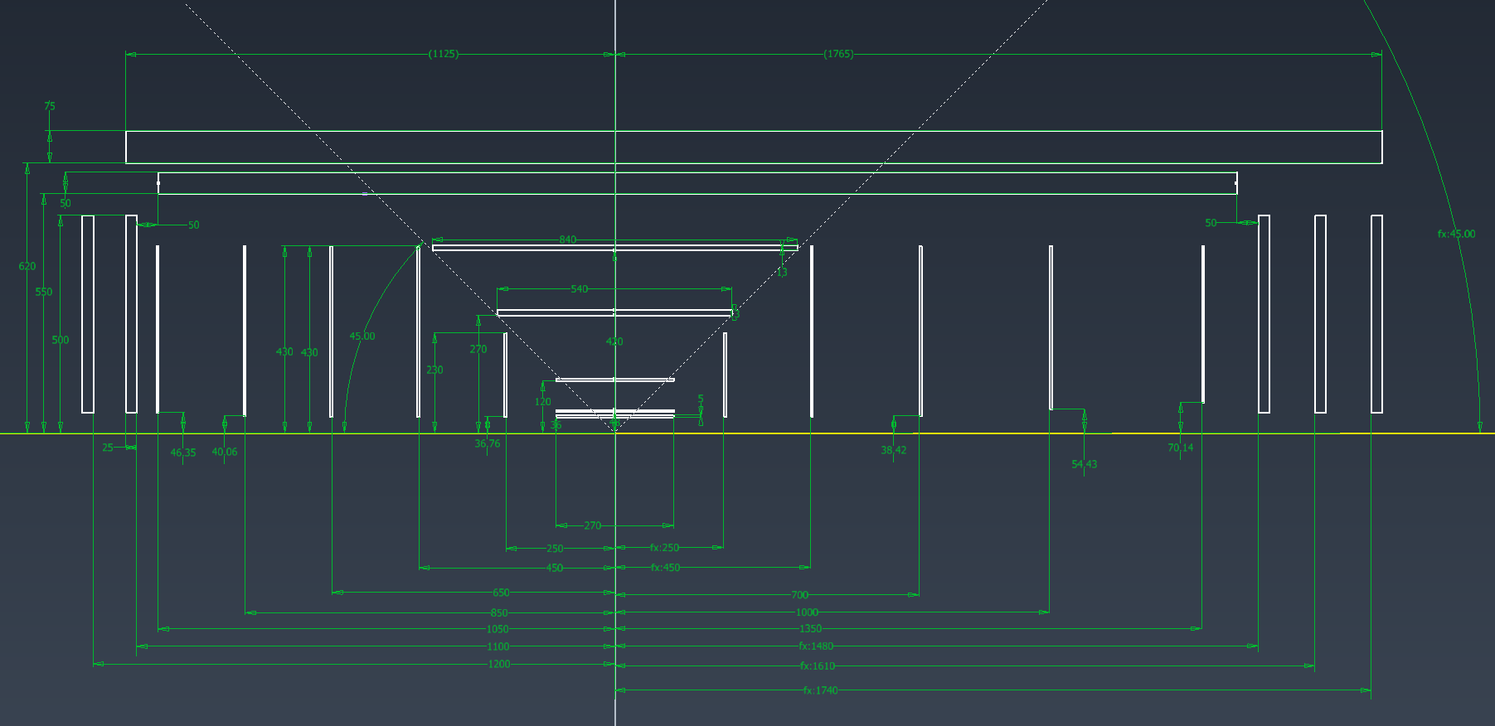
Detector Integration Layout
Charge 3, 6
All the inner tracker space envelopes laid out together
Used for detectors, services, and electronics space envelopes

Slide 10
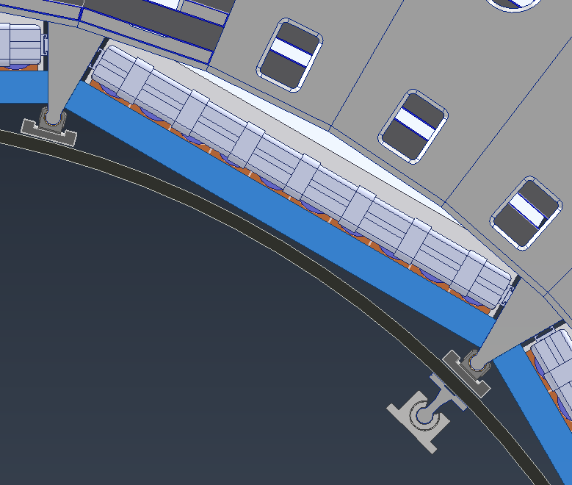
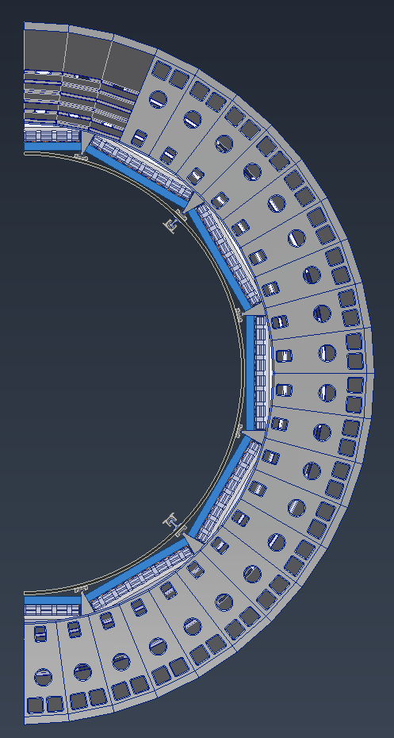
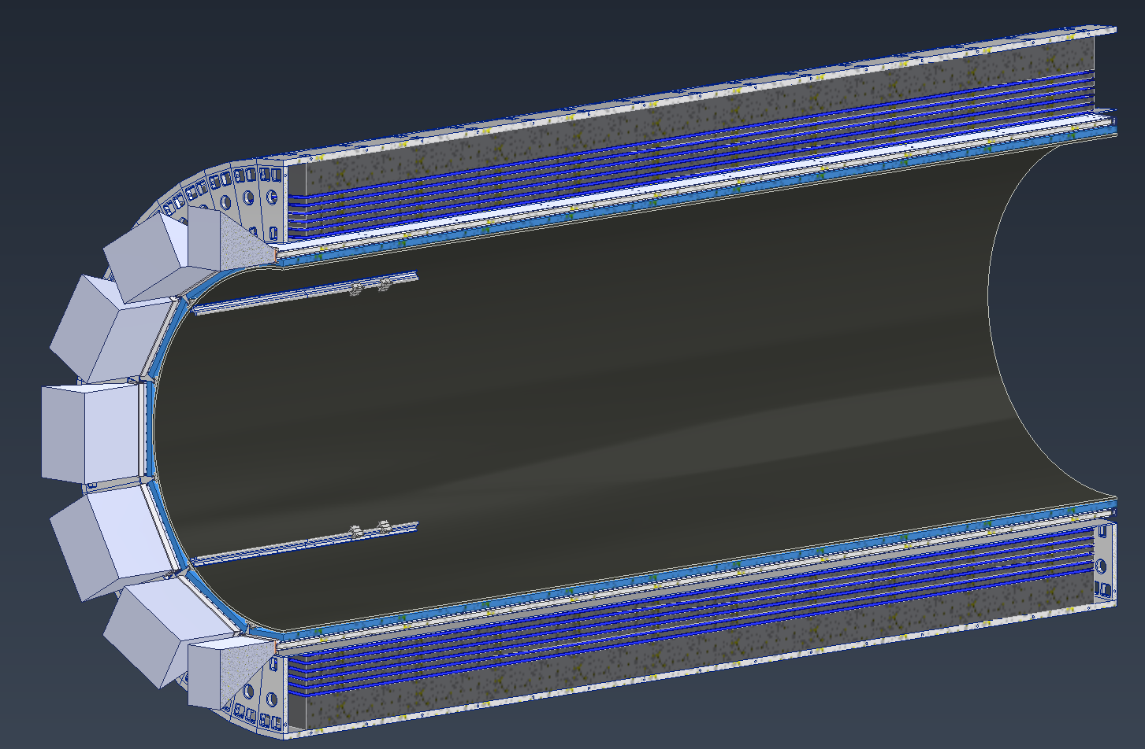
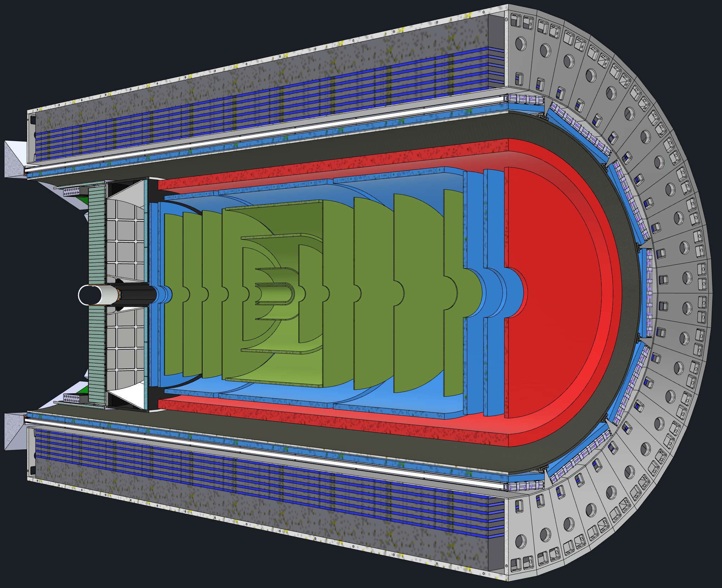
Support Structures
Charge 3, 6
Current plan is to use barrel EMCAL for the support of the Inner Detectors
Outer MPGDs and DIRC barboxes will be nested in the area between the rails
A carbon fiber support structure supported from the Barrel EMCAL will house and support all the inner detectors
Gaps between the EEEMCAL and the carbon fiber cylinder will allow for services to be brought out
DIRC Barboxes
Outer MPGDs
CF Support Structure
Rails to Support Inner Detectors
Barrel EMCAL

Slide 11
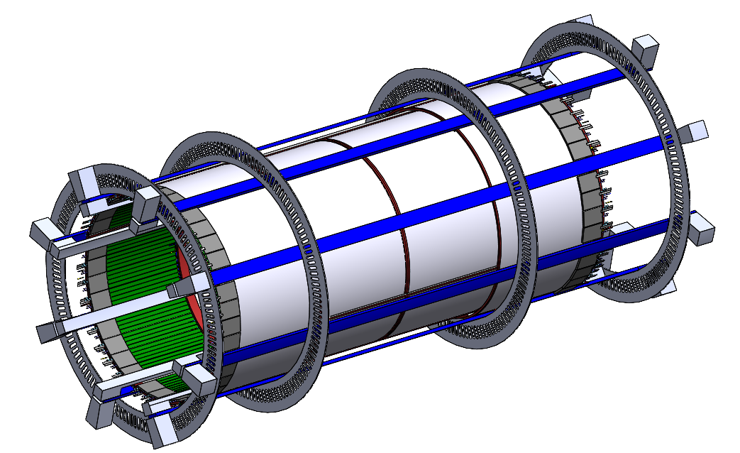
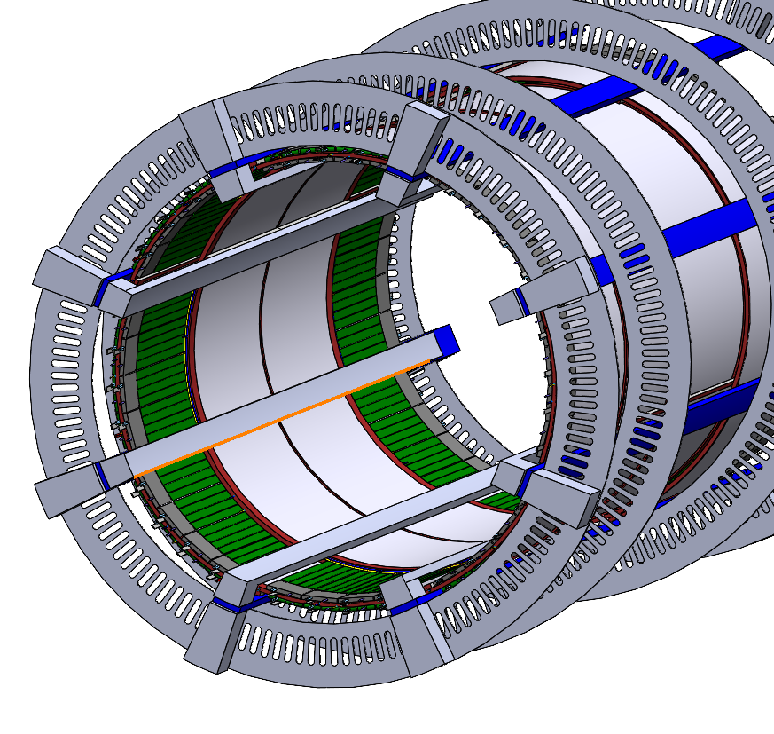
Inner Support Structures
Charge 3, 6
Will work with the carbon fiber tube to directly support the inner detectors.
Made up of two sub-assemblies that will be integrated together

Slide 12
Services Routing
Charge 3
Used 2 main paths for getting the services out from the inner trackers.
Red path on the electron end and orange path on the hadron end.
Used estimates from the subgroups to figure gaps needed at various bottle necks

Slide 13
Services Space
Charge 3
Estimates for cabling, cooling, gas, etc. were collected from all the various subgroups
Looked into where bottlenecks might occur based off the models
We compiled all the estimates and added space where needed
Subsytem | Cross Area (cm^2) | +50% Packing for Bundles | +50% for MISC spacing needs | Used Space
Red Path IP to pfRICH Inner face
Total | 853.72 | 1280.58 |  | 1800.00 | Used space: | 71.14%
Red Path From pfRICH to EEEMCAL Inner face
Total | 920.17 | 1380.26 | 1725.32 | 2240.00 | Used space: | 77.02%
Red Path From EEEMCAL to Flux Return Bars
Total | 2497.31 | 3745.97 | 4096.57 | 9650.97 | Used space: | 42.45%
Orange Path From IP to AC-LGAD Disk
Total | 759.74 | 1139.61 |  | 1998.05 | Used space: | 57.04%
Orange Path From AC-LGAD disk to Aerogel
Total | 1559.01 | 2338.51 | 2937.96 | 4084.07 | Used space: | 71.94%
Orange Path From dRICH Aerogel to Dogbones
Total | 1597.23 | 2395.84 | 3023.96 | 4964.00 | Used space: | 60.92%
Orange Path From 4 to 5
Total | 2286.07 | 3429.11 | 4573.86 | 12189.38 | Used space: | 37.52%

Slide 14
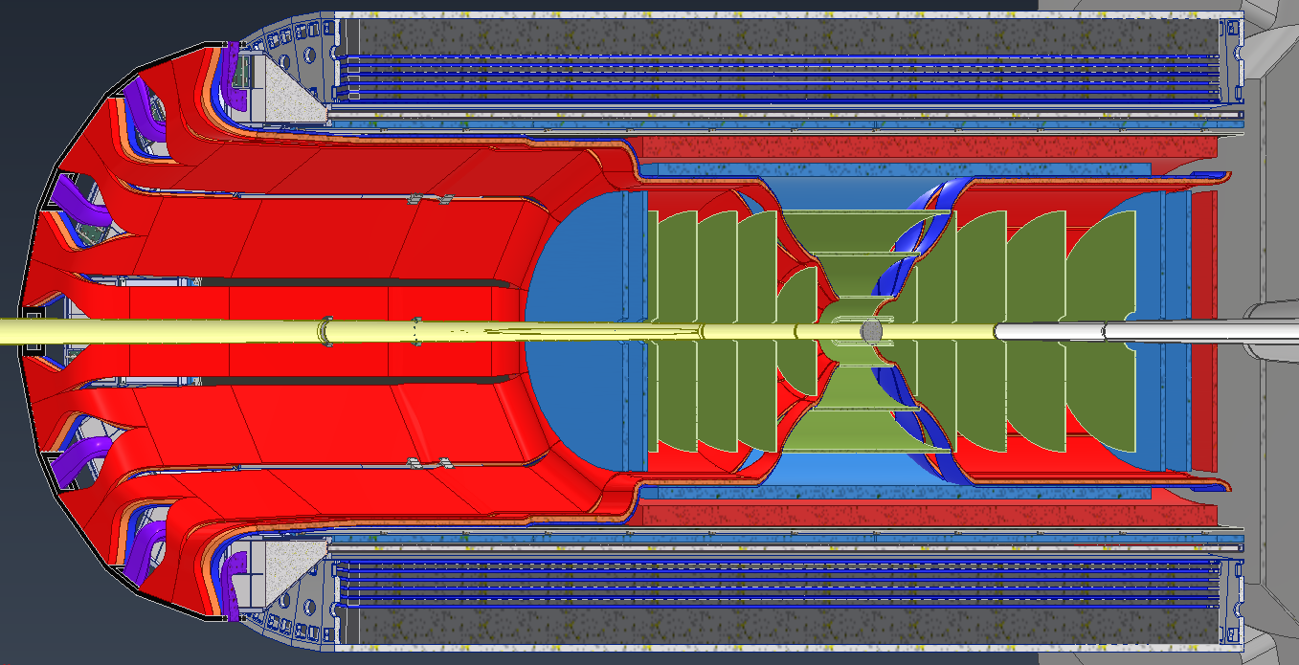
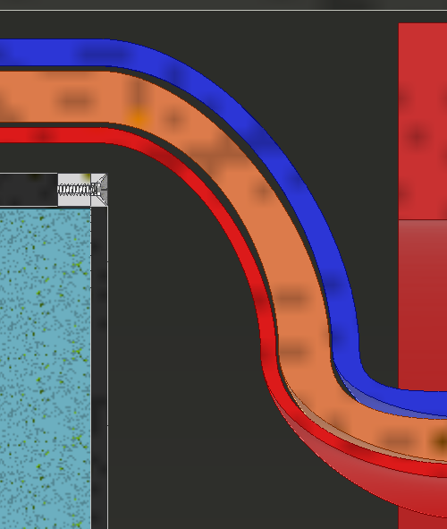
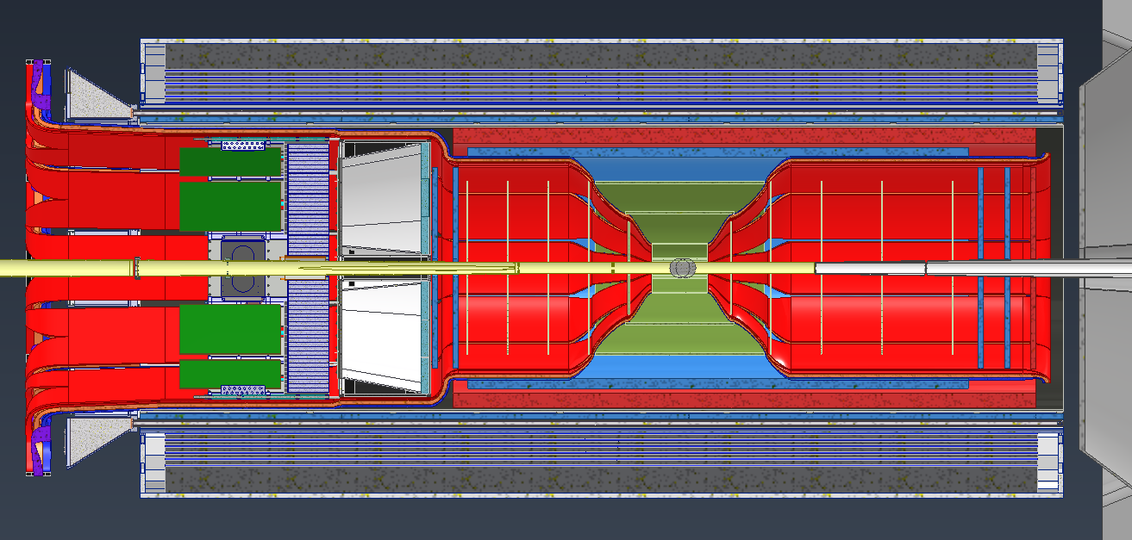
Service Routing
Charge 3
Broke the services up into 3 separate categories- Power, Signal, Cooling & gas
The volumes of the sections increase as they progress along the paths mentioned before
Blue: Cooling & Gas
Orange: Signal
Red: Power

Slide 15
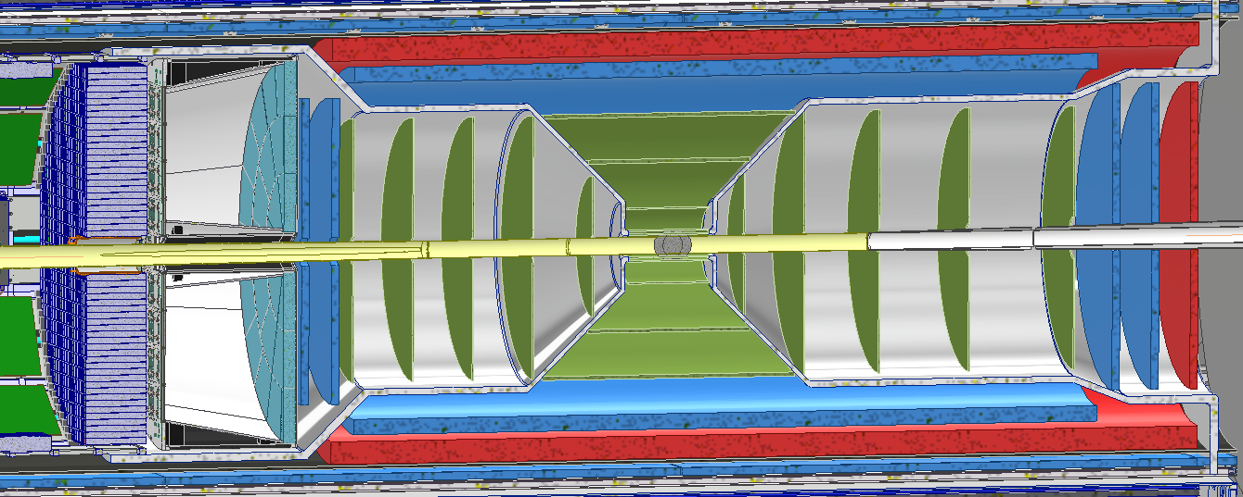
Material Budget
Charge 3
The Collaboration has been running simulations to account for the impact of the services on tracking
Below: Average total material particles will see leaving from IP
Using these simulations to optimize layouts

Slide 16
Detector Electronics Power & Services
Charge 3
Detector | Type | Front End LV Power | HV Bias | LV Power Supply Type | HV Power Supply Type | Power Supply Location | LV Power Feed | LV Feed Cables (Tray Rated) | Cooling (Board Electronics)
EE MPDG Disk | uRWELL | 350W | 1.5W@1.5kV | MDH-07/16 | CAEN A1515BV | S. Platform, 19” rackmount | 10V @ 315A | 2x 10AWG | Liquid
Outer Barrel MPGD | uRWELL | 1.6kW | 1.5W@1.5kV | MDH-07/16 | CAEN A1515BV | S. Platform, 19” rackmount | 10V @160A | 12x 12AWG | Liquid
Inner Barrel MPGD | uRWELL | 700W | 1.5W@1.5kV | MDH-07/16 | CAEN A1515BV | S. Platform, 19” rackmount | 10V@120A | 15x 12AWG | Liquid
MAPS Disk | EIC-LAS | 3kW | Derived from LV system | MPV 4018I | N/A | S. Platform, 19” rackmount | 3.6V@ 960A | 48x 10AWG | Liquid
MAPS Sagita Layer3 | EIC-LAS | 680W | Derived from LV system | MPV 4018I | N/A | S. Platform, 19” rackmount | 2.4V@ 194A | 16x 12AWG | Liquid
MAPS Sagita Layer4 | EIC-LAS | 1.4kW | Derived from LV system | MPV 4018I | N/A | S. Platform, 19” rackmount | 4.8V @ 235A | 18x 12AWG | Liquid
MAPS Vertex | EIC-LAS | 200W | Derived from LV system | MPV 4018I | N/A | S. Platform, 19” rackmount | 1.2V @ 60A | 4x 12 AWG | Liquid

Slide 17
Summary
The current designs for the detectors, their services, and their electronics are well developed for the current phase of the project
These designs are all integrated into the larger detector model
Services, electronics and readouts are integrated into the model along with sufficient contingency spacing should any adjustments be needed
Adjustments and optimizations are quickly worked into the larger integrated model to ensure that all components mesh

Slide 18
Backups

Slide 19
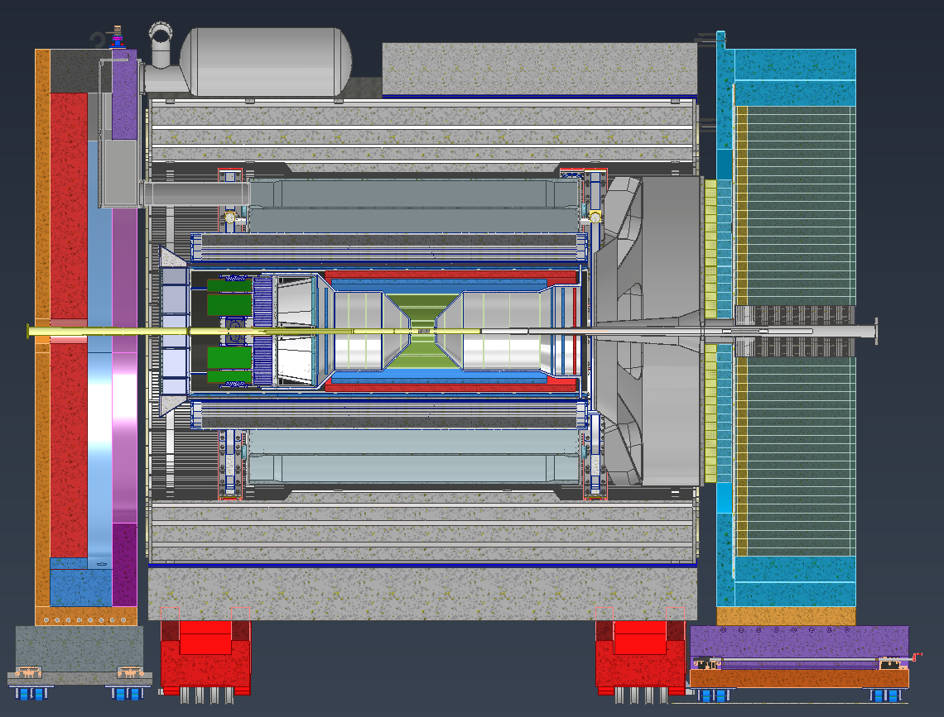

Slide 20
