Slide 1
Flow of Requirements, Interfaces and System Engineering
Walt Akers
Systems Engineer for Detector Systems
Thomas Jefferson National Accelerator Facility

Slide 2
Charge Questions Addressed
Are the technical performance requirements appropriately defined and complete for this stage of the project?
Are the plans for achieving detector performance and construction sufficiently developed and documented for the present phase of the project?
Are the current designs and plans for detector, electronics readout, and services sufficiently developed to achieve the performance requirements?
Are plans in place to mitigate risk of cost increases, schedule delays, and technical problems?
Are the fabrication and assembly plans for the various tracking detector systems consistent with the overall project and detector schedule?
Are the plans for detector integration in the EIC detector appropriately developed for the present phase of the project?
Have ES&H and QA considerations been adequately incorporated into the designs at their present stage?

Slide 3
Outline
Systems Engineering:
Framing the detector systems to create a hierarchy of sub-systems, requirements and interfaces.
Requirements Development:
Types of requirements and their hierarchy
How requirements are managed and coordinated
System Interfaces:
Hierarchy and relationships of interfaces
How interfaces are being derived
The types of interfaces that are being developed within our system
Where We Are Now:
Current state of requirements and interfaces
Where We Are Going:
Revising and finalizing data, and the development of Interface Control Documents

Slide 4

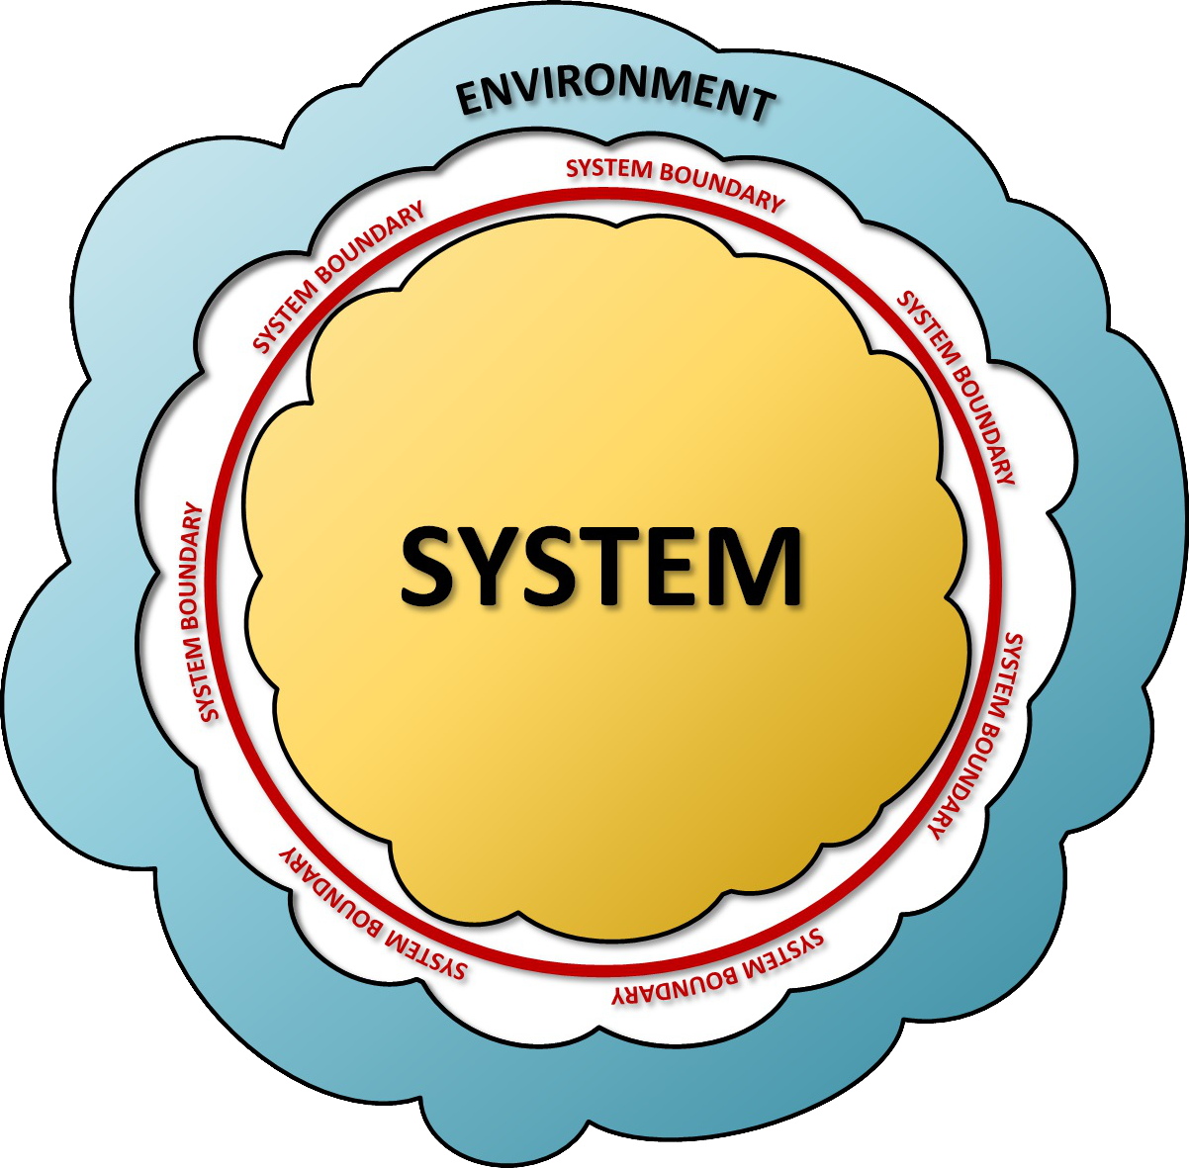
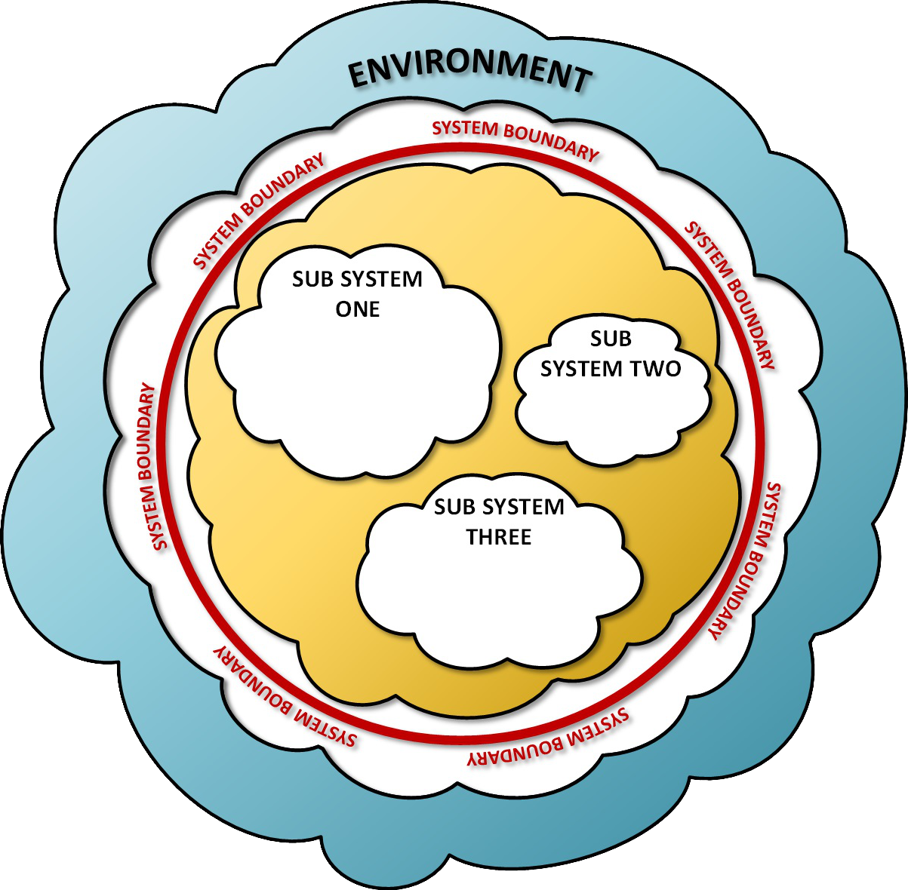
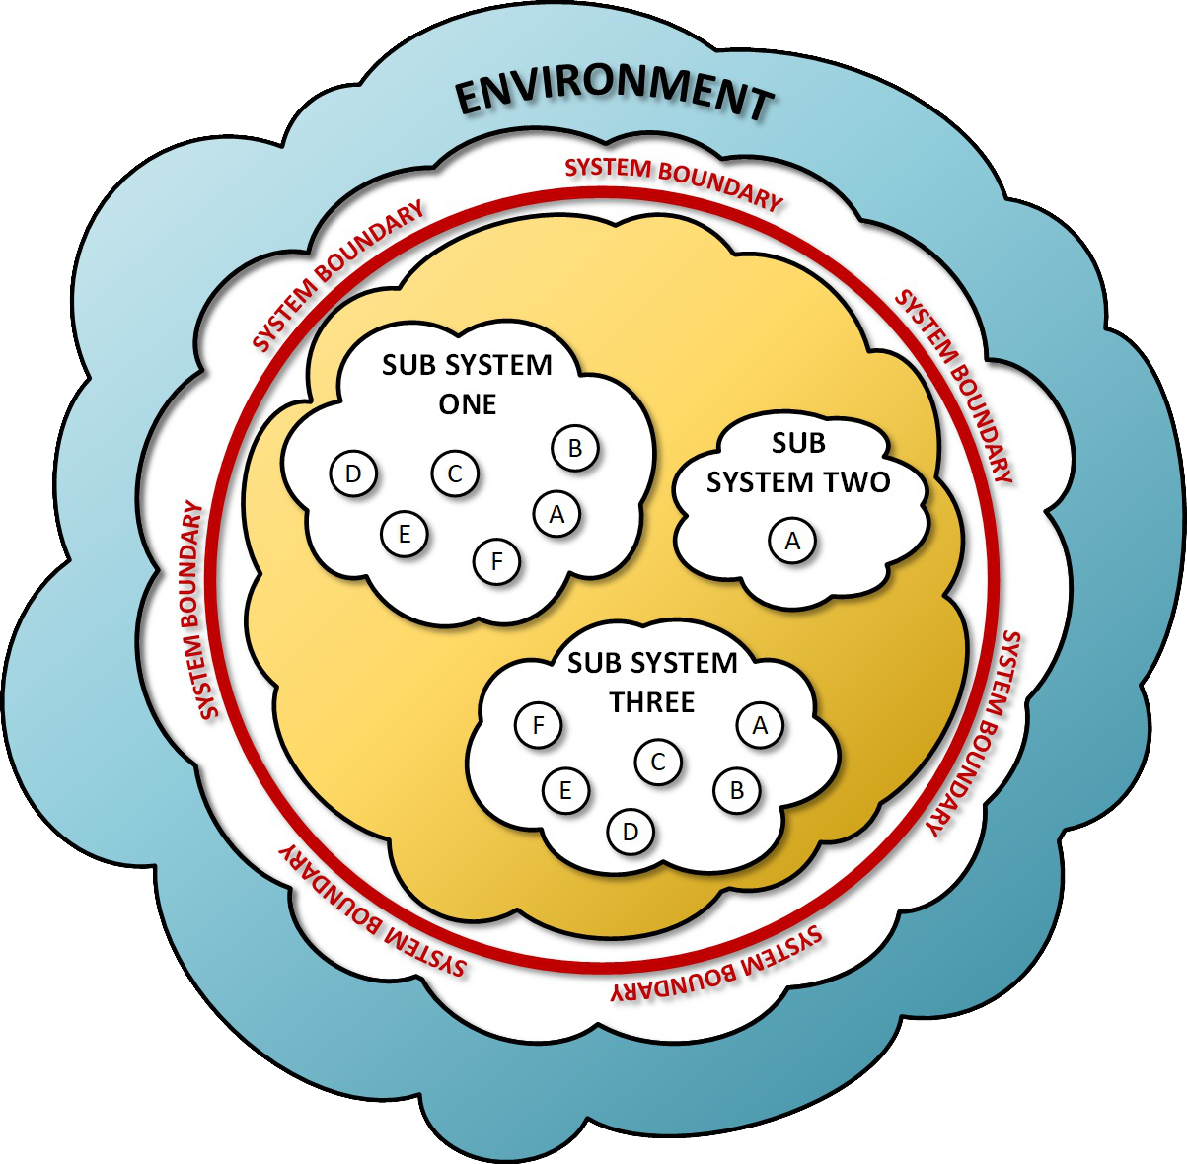
Systems Engineering
The System Hierarchy
Framing the System
System Framing is the process of establishing what elements are within your system and which are not.
The Environment
Everything outside of your system’s boundary is in the environment. You cannot necessarily control the environment, but you have to accommodate it and coordinate with it to share resources.
The System
Everything inside your system’s boundary is part of your system – a collection of related entities that work together to achieve a function or purpose.
Systems Are Recursive
The complete Electron Ion Collider can be considered a single large system that consists of the detector, the electron storage ring, and other sub-systems.
Likewise, the detector can be considered a single system consisting of hadron calorimeters, electron calorimeters, trackers, and particle identifiers.
The way you bound your system depends on the problem you’re trying to solve.
Components and Devices
These are parts of a sub-system or system, but they are not systems by themselves.
4

Slide 5
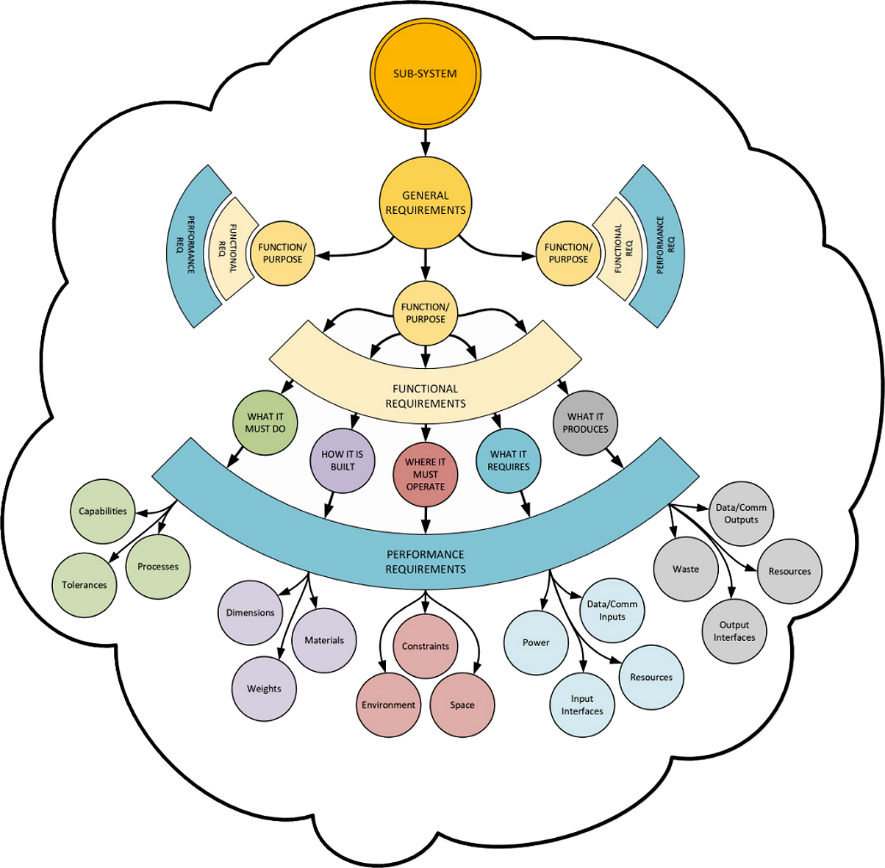
Requirements Development
Defining Requirement Levels and Structure
  Requirements exist in a hierarchy and should have traceability from top to bottom; i.e. no orphaned requirements.
  General Requirements What is it?
    These are the highest level requirements that define the function or purpose of the sub-system with respect to the overall system.
  Functional Requirements What does it do?
    These requirements identify the features and capabilities that the sub-system must have in order to satisfy its general requirements.
  Performance Requirements How well does it do it?
    These requirements quantify the performance levels that must be met by the sub-system during operation. These requirements provide the minimal critical specification¹ that the engineering staff will use to design the system.
¹ The minimum set of core requirements with which an operable unit can produce a satisfactory result without external control of its internal functions. (Herbst, Socio-Technical Design, 1974)
5

Slide 6
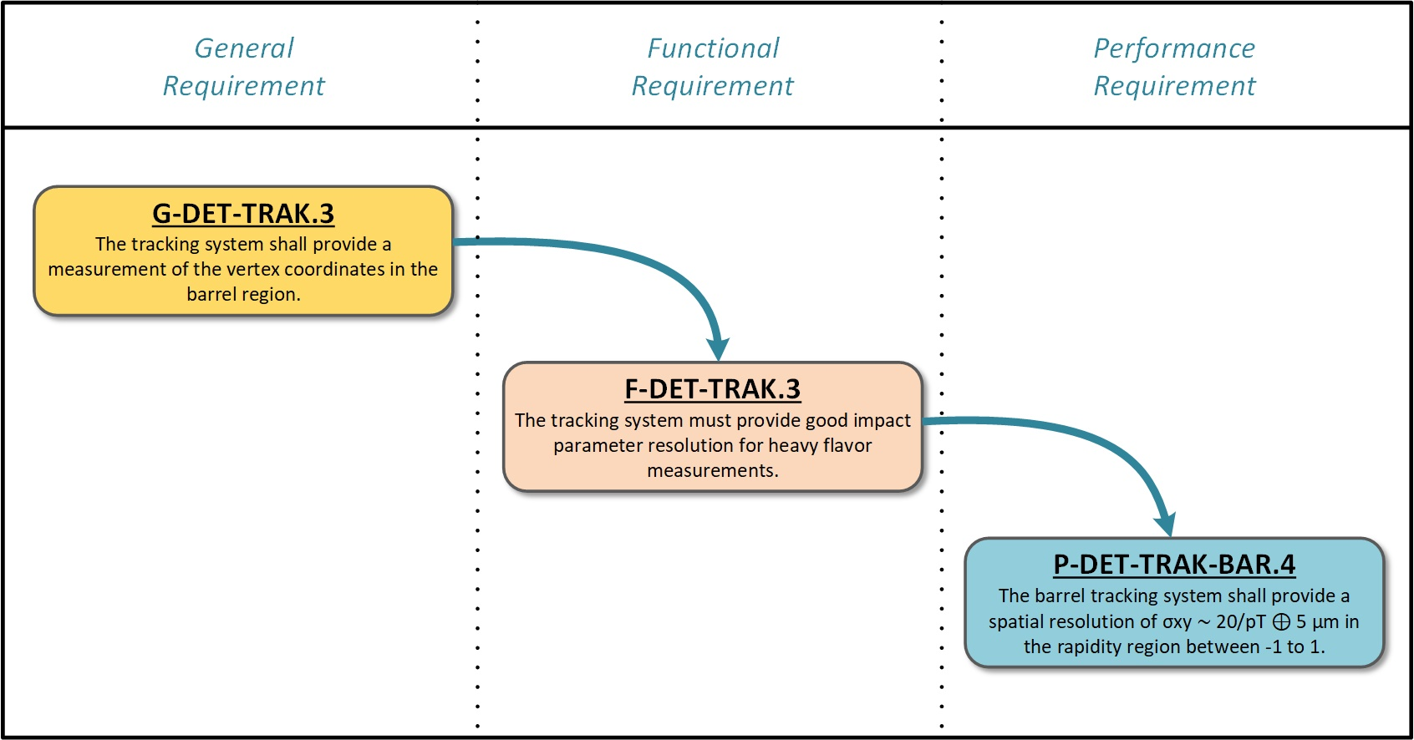
Requirements Development
A Concrete Example
  An example from the tracking system requirements.
  General Requirement
    Specifies that the tracking system must have the ability to measure vertex coordinates in the barrel region.
  Functional Requirement
    When performing measurements, the tracking system must provide good impact parameter resolution for heavy flavor measurements.
  Performance Requirements
    Must perform the measurements to the specified resolution.
  When properly satisfied, these requirements will assure that the tracking detector will have the ability to tag
  reactions with heavy-flavor particles in EIC, and have the vertex resolution to properly identify them.
6

Slide 7
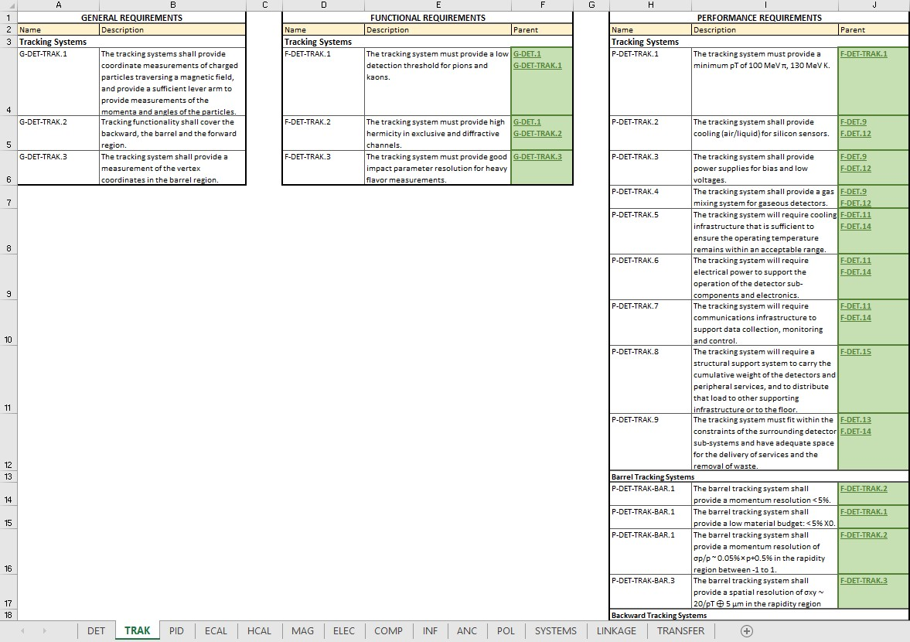
Requirements Development
Managing and Coordinating Requirements
Charge 1
Requirements are developed in narrative form and then submitted for approval by the project.
Once approved, requirements become controlled documents in the EIC Document and Record Center.
The requirement line items are integrated into Visure, a software package that allows them to be linked and related to one another.
Joel Watkins of Jefferson Lab is our Visure Data Coordinator and is supporting the entire EIC Systems Engineering Group.
7

Slide 8
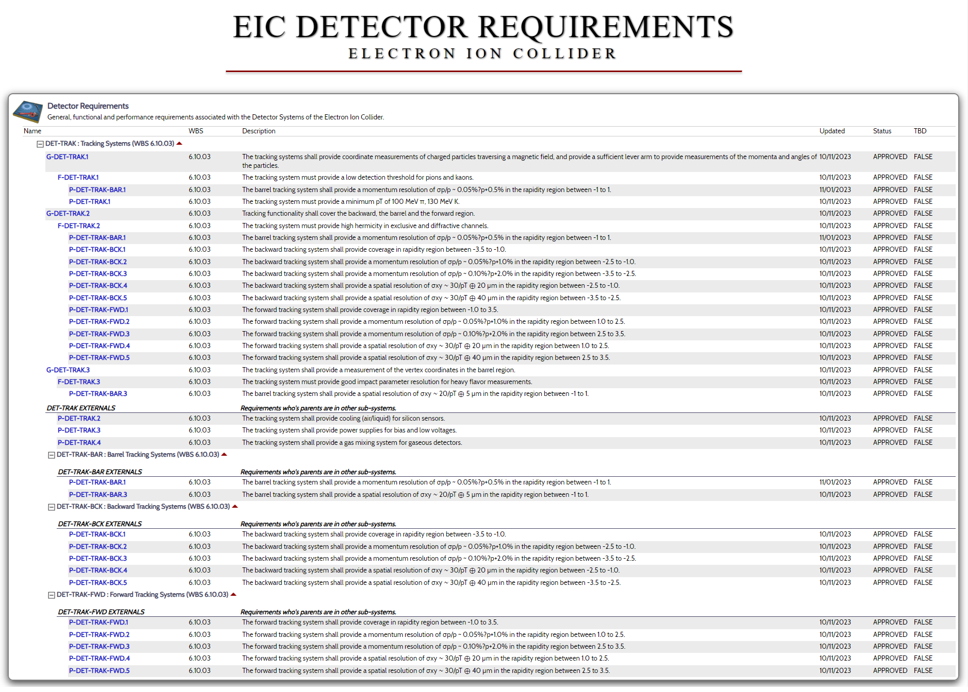
Requirements Development
Sharing Requirements with Collaborators
Charge 1
Once validated and approved, EIC detector requirements are placed on a reference page where they can be accessed by the user community.
In addition to the current requirements, older versions will be maintained in an archive to allow researchers to see changes that were introduced over time.
A comment log will be included to document what updates were made and the rationale for the decision.
8

Slide 9
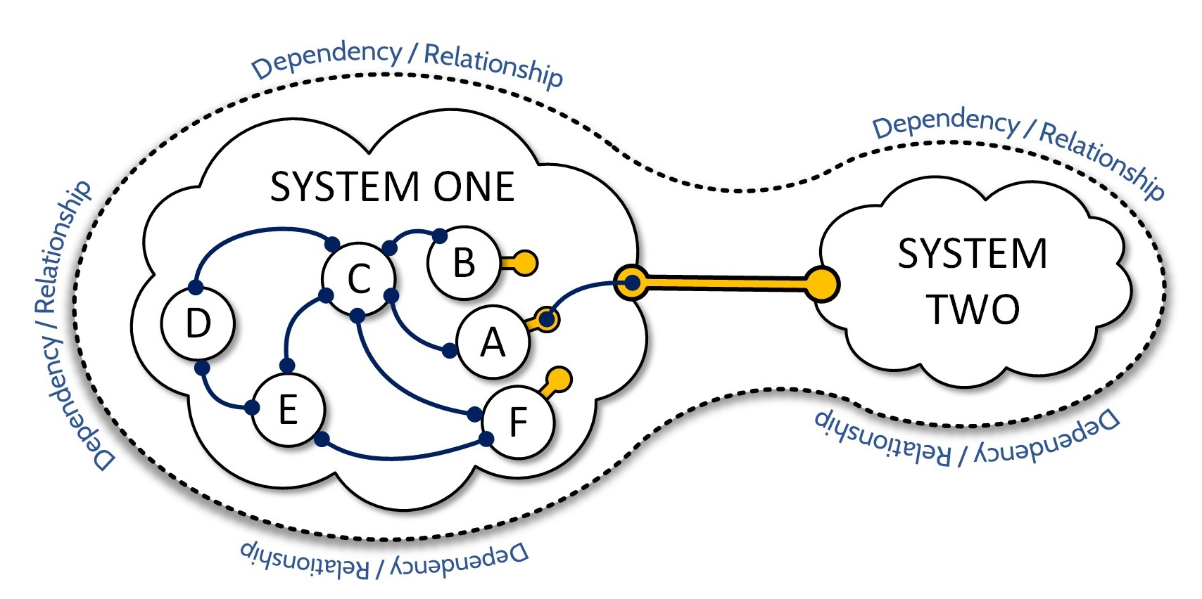
Interface Development
Relating Requirements to Interfaces
Properly written requirements will identify the dependencies that exist between two sub-systems.
Dependencies are satisfied by interfaces that conduct material, energy, or information, or provide static support.
As shown in the figure at left, interfaces between systems are defined at the highest level. The system that is providing the resource can then decide how best to satisfy the requirement.
This minimizes the amount of information that one system must have about the internal functions or configuration of another.
“An interface is a defined relationship between two otherwise distinct entities that exists in order to satisfy a dependency or requirement. Interfaces may be between a human and a machine, between two components, or between a system and its external environment. In each case, though, an interface defines an essential relationship between the connected entities.”
(Akers, Aschenauer & Ent, Deriving Preliminary Interfaces Using System Requirements, 2022)
9

Slide 10
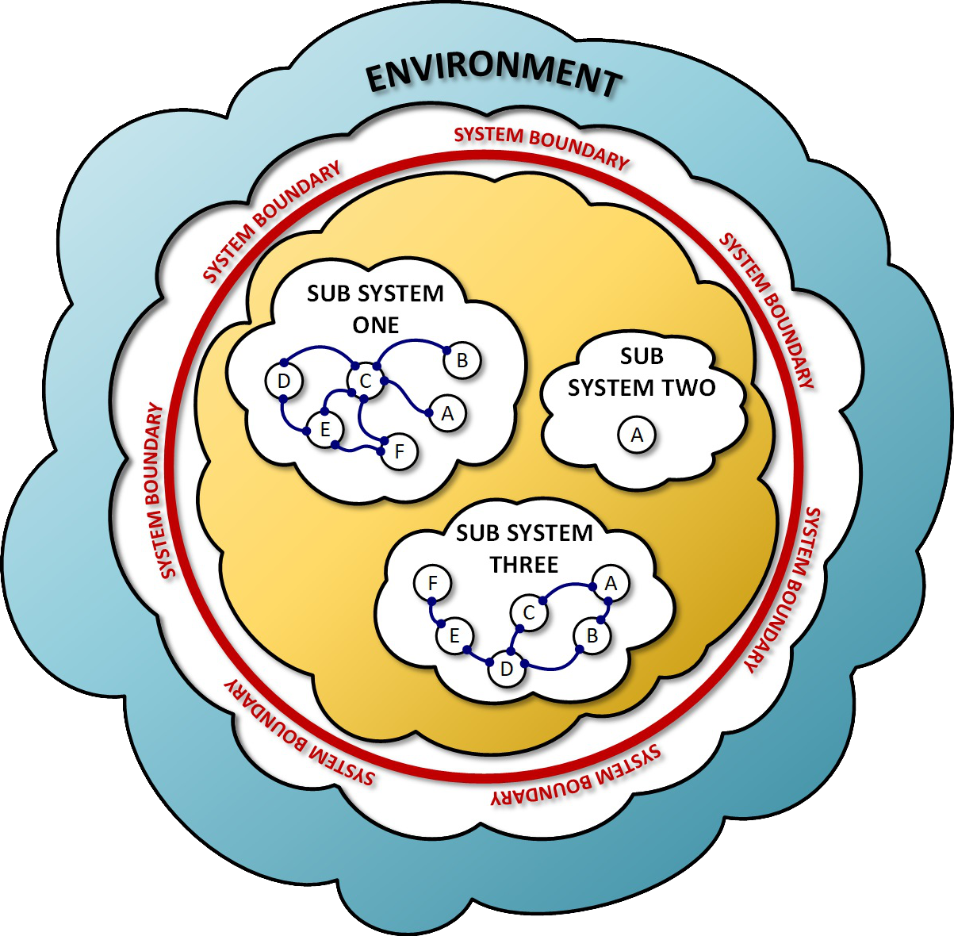
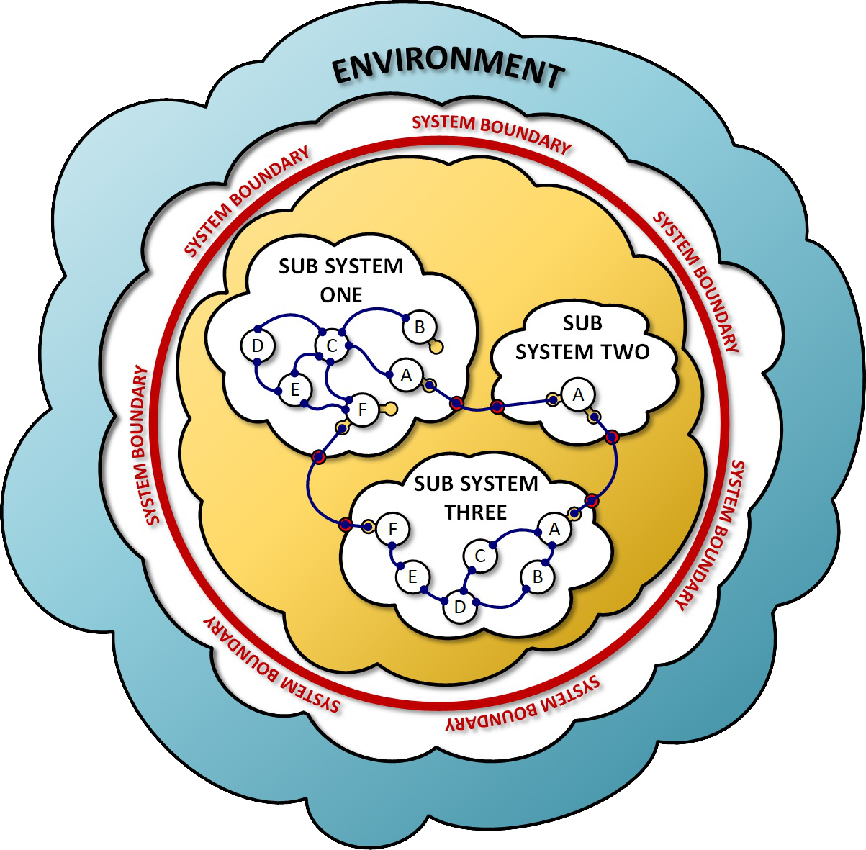
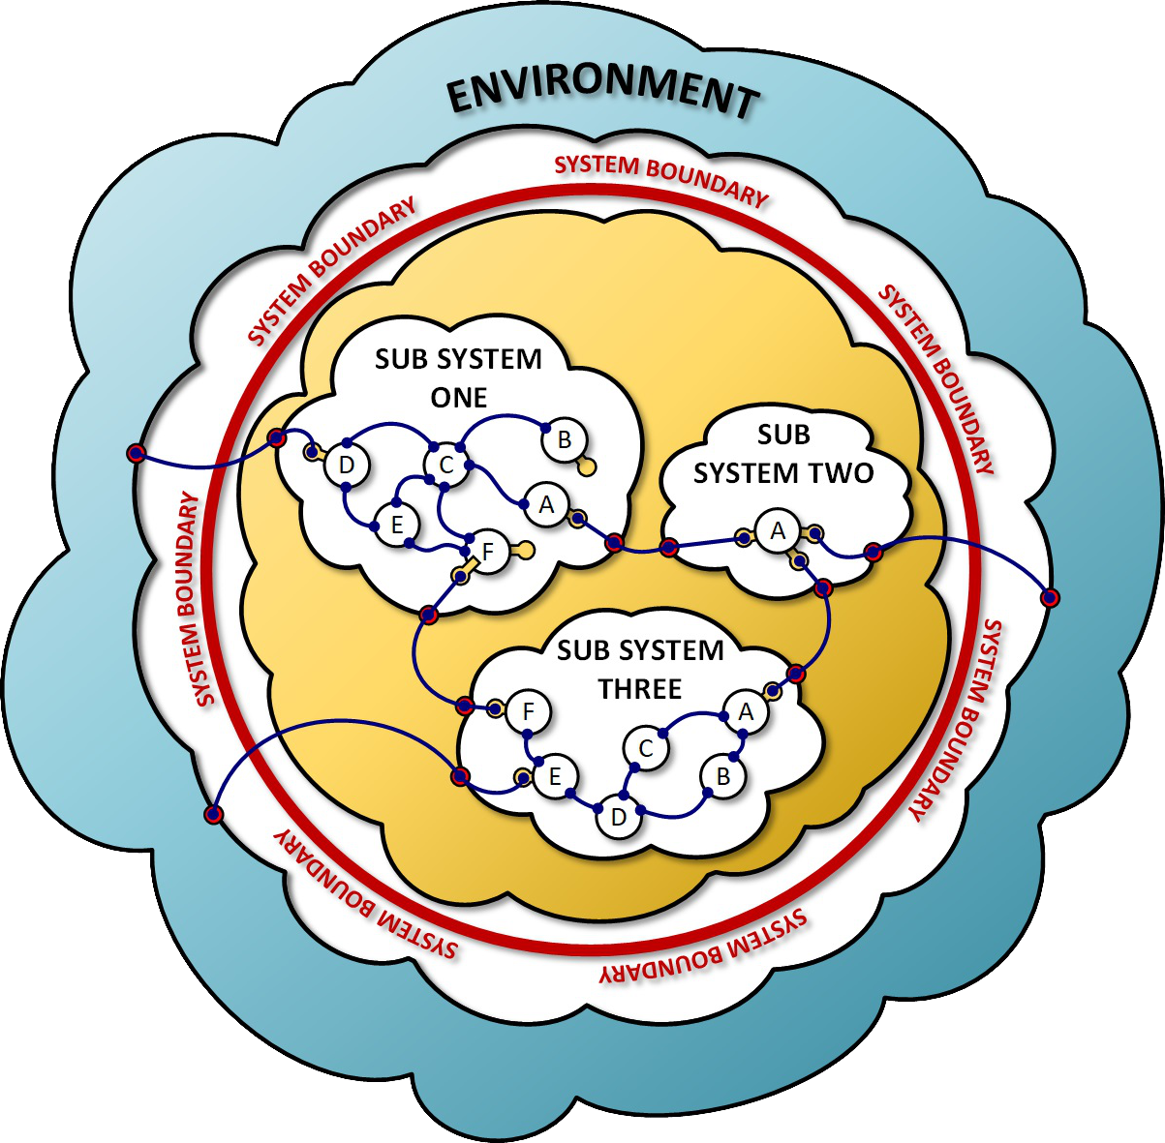
Interface Development
Hierarchy of Interfaces
  Interfaces fall into three distinct categories.
  Inward Facing Interfaces
    These are the connections that exist entirely within a sub-system and are used to exchange material, energy, information or support internally. They are private to the sub-system.
  Outward Facing Interfaces
    These are the connections that are used to join sub-systems within the larger system. Because they cross sub-system boundaries, they must be well-defined and coordinated.
  External Interfaces
These are connections that join the system or sub-systems to resources and services outside of the system. They must be be developed in coordination with resource providers, and accommodate changing conditions within the system AND in the external environment.
10

Slide 11
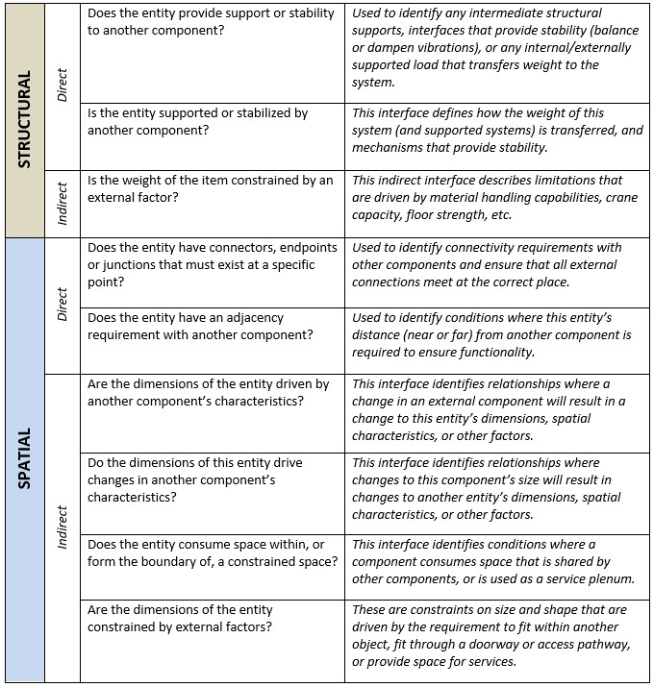
Interface Development
Deriving Interfaces
Charge 1
Interfaces can be derived using an interrogative process that examines the stated requirements and identified dependencies. It is a three part process that includes:
  Interrogating Requirements
    Identify relationships or dependencies that are represented by each requirement. For each relationship, identify and document the type of interface that will be required to accommodate it.
  Interrogating Known Interfaces
    Using a list of expected system interfaces (provided by an SME), confirm that each one is represented by an interface identified in the prior step. If it is missing, then the reviewer should determine if the requirements need to be revised.
  Inter-System Interrogation
    For each interface that extends outside of the local system, ensure that there is a corresponding interface on the external system.
Documented interfaces are being collected, reviewed and maintained as controlled documents by the project.
Like requirements, detector interfaces will be made available to the user community to guide their decision making process.
Visit https://eic.jlab.org/Documents/InterfaceInterrogation.pdf
for more details.
11

Slide 12
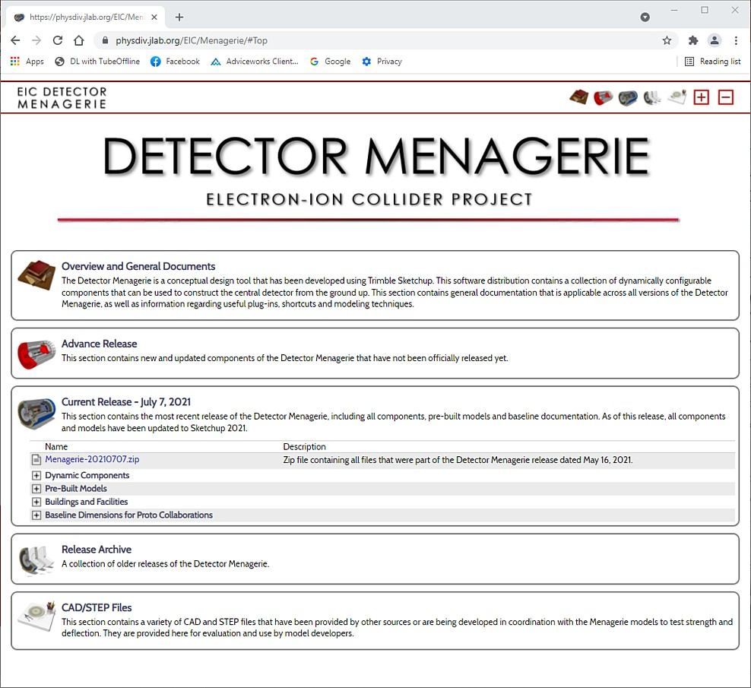
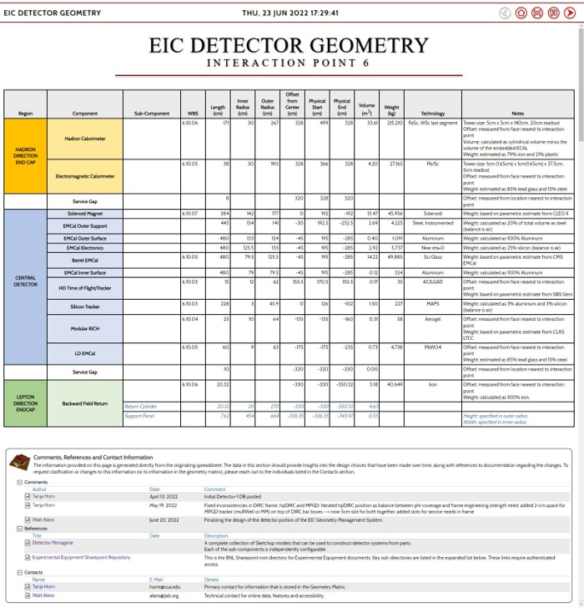
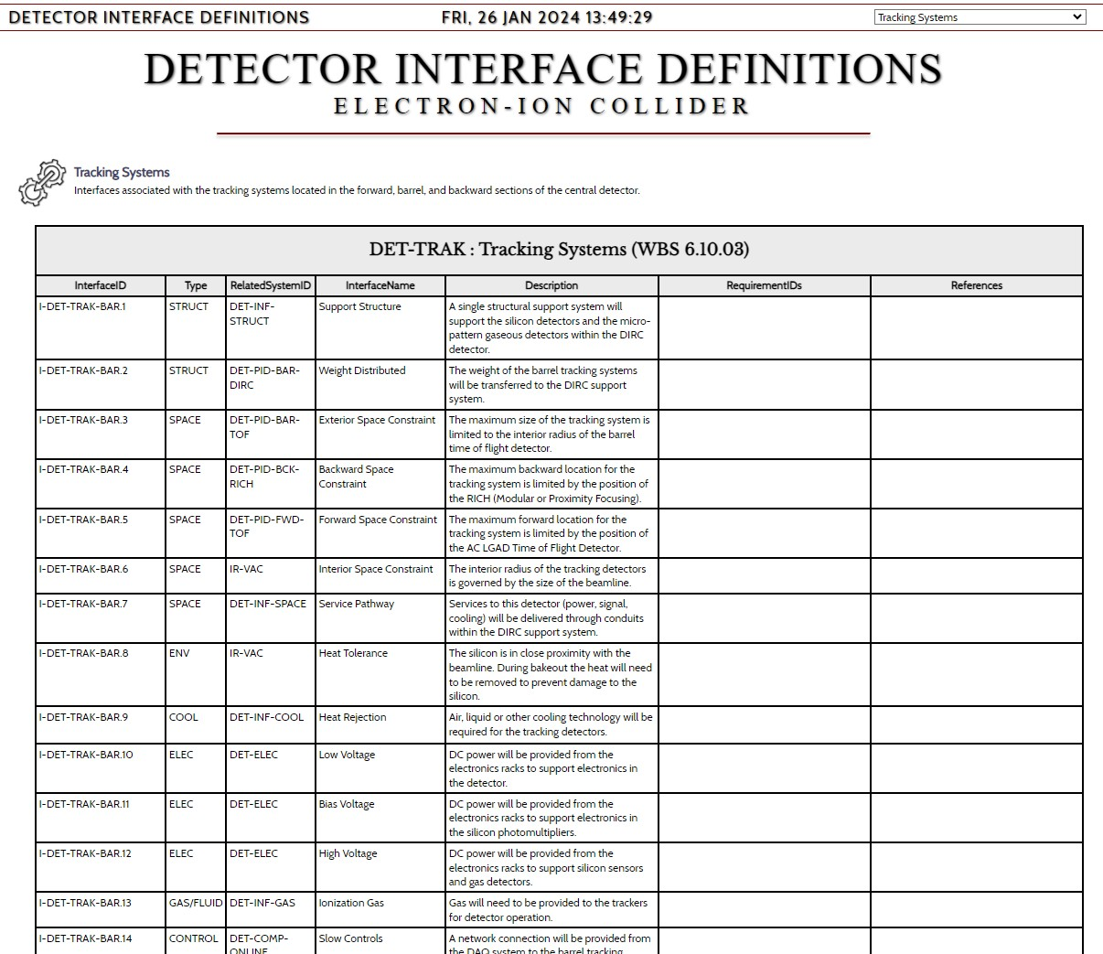
Current Activities
Where Are We Now?
Charge 1
  Detector Modeling
    Our collaboration continues to enhance and improve the detector design through the use of shared models and collaborative tools.
    The Detector Menagerie contains past and current revisions of the detector models that allow users to see how sub-systems relate to one another.
    The EIC Detector Geometry database provides a central repository for users to see the parameters that define the configuration and spatial envelope of each detector.
  Requirement Development
    We have collected an initial set of requirements for all detector sub-systems. We are currently reviewing relationships to ensure that we have a consistent hierarchy, and updating as necessary.
  Interface Development
    We have collected interfaces for all detector subsystems and are organizing them into a standard format. They will be made available to our collaborators for review and comment, and will form the basis of our interface control documents.
Visit
https://eic.jlab.org/Menagerie ,
https://eic.jlab.org/Geometry/Detector , and
https://eic.jlab.org/Interfaces/Interfaces.html
for more details.
12

Slide 13
Future Activities
Where Are We Going?
Charge 1
Requirements:
We will continue to refine our requirements to ensure that they are internally consistent and fully adequate to support detailed design.
Interfaces:
By CD-2 we will finalize our interface definitions and map them to our requirements.
We are developing a general approach to Interface Control Documents that can follow directly from the collected sets of interfaces. These will provide a complete specification for all interfaces, and will be the foundation for detailed design outside of the detector.
Systems Engineering Database Management:
We will continue to incorporate information into the Visure database so that the impact of requirement and interface changes can be detected across the project.
Communications and Collaboration
Effective communications and collaboration with our research partners remains a high priority.
We will continue to look for ways to improve the distribution of accurate, up-to-date information to our users and collaborators.
13

Slide 14
Questions?

