Slide 1
Barrel Outer MPGD Tracker (BOT)
Thin-gap GEM-µRWELL hybrid Detector
Kondo Gnanvo, Jefferson Lab
ePIC MPGD DSL
Incremental Design and Safety Review of the EIC Tracking Detectors March 20-21, 2024

Slide 2
Charge Questions Addressed
Are the technical performance requirements appropriately defined and complete for this stage of the project?
Are the plans for achieving detector performance and construction sufficiently developed and documented for the present phase of the project?
Are the current designs and plans for detector, electronics readout, and services sufficiently developed to achieve the performance requirements?
Are plans in place to mitigate risk of cost increases, schedule delays, and technical problems?
Are the fabrication and assembly plans for the various tracking detector systems consistent with the overall project and detector schedule?
Are the plans for detector integration in the EIC detector appropriately developed for the present phase of the project?
Have ES&H and QA considerations been adequately incorporated into the designs at their present stage?

Slide 3
Outline
Requirements
µRWELL-BOT Detector Layout
Technology Choice & Design Considerations
PED - Engineering Test Article
Assembly Schedule, ES&H & QA
Summary

Slide 4
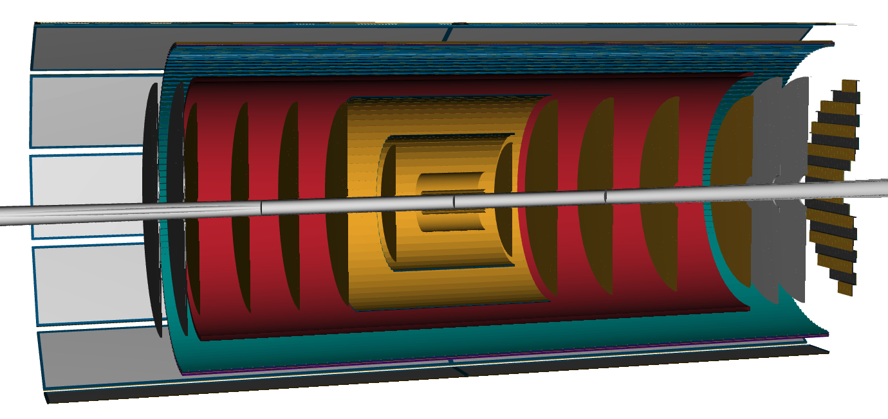



Overview of ePIC Tracking Detector
Charge 1
$µ$RWELL-ECT
$µ$RWELL-BOT
CyMBaL
$µ$RWELL-ECT
Technologies
MAPS (Si)
MPGDs (Gaseous)
AC-LGADs (Si)
AC-LGAD Endcap
AC-LGAD Barrel
SVT Endcaps
SVT Barrels
SVT
SVT Endcaps

Slide 5
Requirements

Slide 6
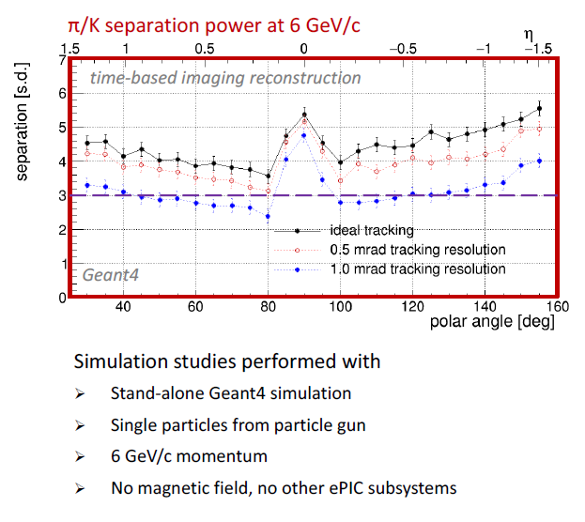
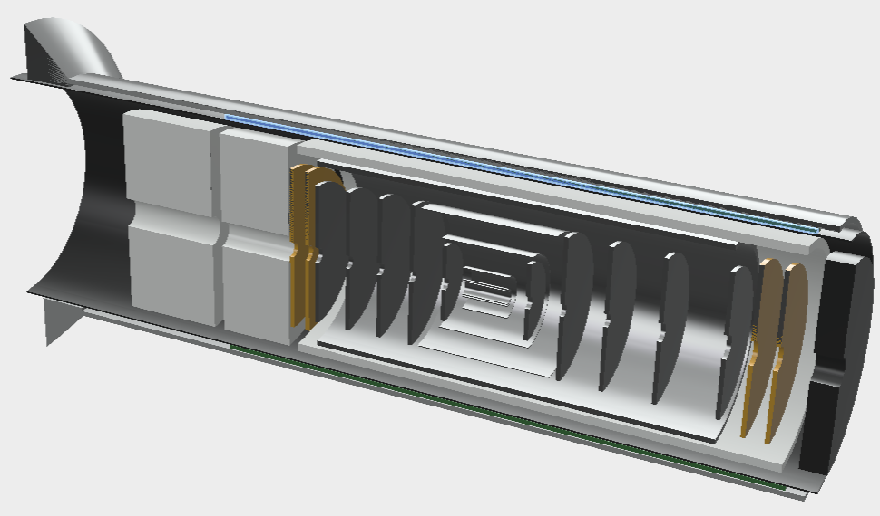
Requirements: Tracking needs from hpDIRC in the barrel
Charge 1
Impact of tracking angular resolution on hpDIRC performance
ePIC Barrel Outer Tracker (µRWELL-BOT)
Tracking layer close to hpDIRC detector
improved and angular and space point resolution at the DIRC level
Acceptance matching with hpDIRC bars
Spatial resolution: better than150 µm on average over the full eta range in barrel region
hpDIRC (barrel PID)
Barrel Outer Tracker
Studies from ePIC PID Detector Subsystem Collaboration

Slide 7
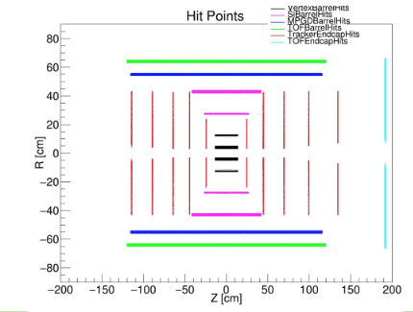
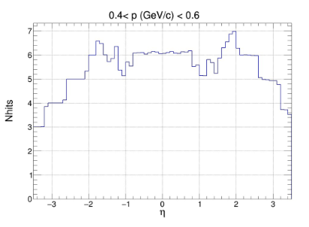
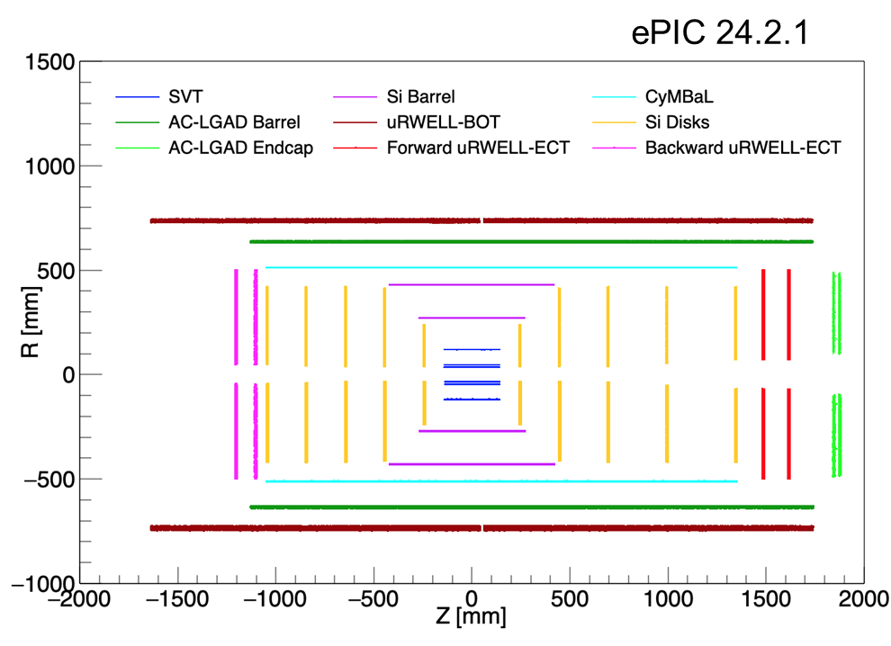
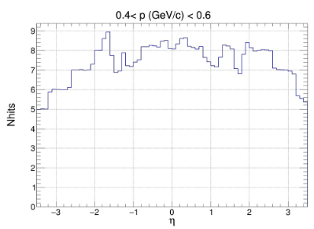
Requirements: Pattern recognition & tracking redundancy
Charge 1
ePIC Barrel Outer Tracker (µRWELL-BOT)
Outer layer for pattern recognition together with the TOF (AC-LGAD) and Inner barrel layer (CyMBaL) trackers
Provide fast timing capabilitiy (~10 ns) to help the slow Si trackers with pattern recognition in high background.
Provide additional hit point to tracking for redundancy
Previous configuration Before June 2023
Current configuration After June 2023
See Matt’s presentations
Tracking simulation and reconstruction

Slide 8
µRWELL-BOT Detector Layout

Slide 9
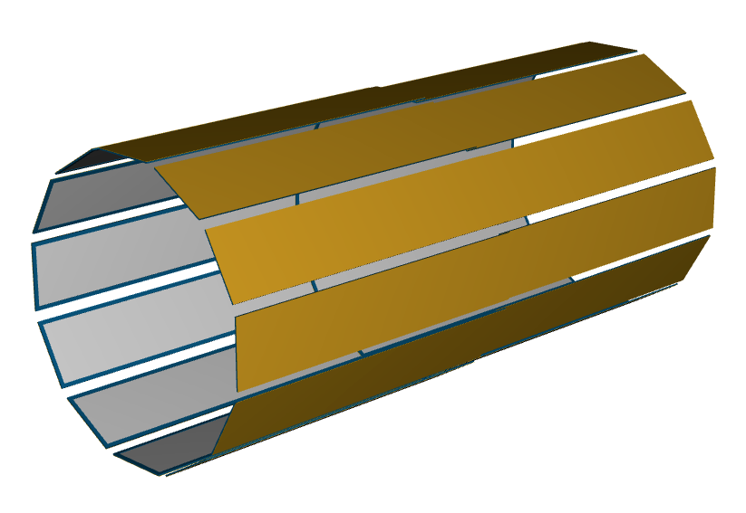
µRWELL-BOT Layout
Charge 2,3
µRWELL-BOT Layout
24 planar modules arrange in 12-sided polygon shape
L = 340 cm (−165 cm ≤ 𝑍 ≤ 175 cm)
R = 72.5 cm
Segmented into
2 sectors (A & B) in z along beam axis
12 modules in phi azimuthal direction
hpDIRC (barrel PID)
Barrel Outer Tracker
B1
B12
A1
µRWELL-BOT specifications
Thin-gap & double amplification (GEM & µRWELL)
2D-strip readout
Nominal 70 µm (perpendicular tracks)
On average 150 µm on for tracks in angle range [0, 45 degrees]
Fast timing layer ~ 10 ns
Radiation length < 2% in active area
B11
A12
A11

Slide 10
µRWELL-BOT Module:
Charge 2,3
V-strips
U-strips
Top view
340 mm
360 mm
1700 mm
µRWELL-BOT module
Thin-gap (1-mm drift) hybrid amplification GEM-µRWELL detector
Capacitive-sharing U-V strips readout layers(45^{O} stereo angle)
Pitch: 1.14 mm (1790 U-strips and 1790 V-strips per modules)
On-detector Front End Boards (FEBs) based on SALSA chips
14 FEB / modules (assuming 4 SALSA chips i.e 256 e-ch / FEB)
Direct connection on the back of the modules (no need for flex cables)
Back view
1800 mm
340 mm
Cross section view
2.5 cm
360 mm

Slide 11
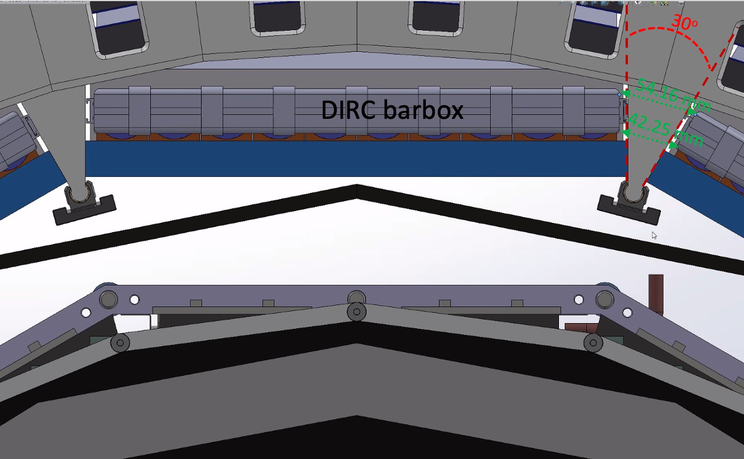
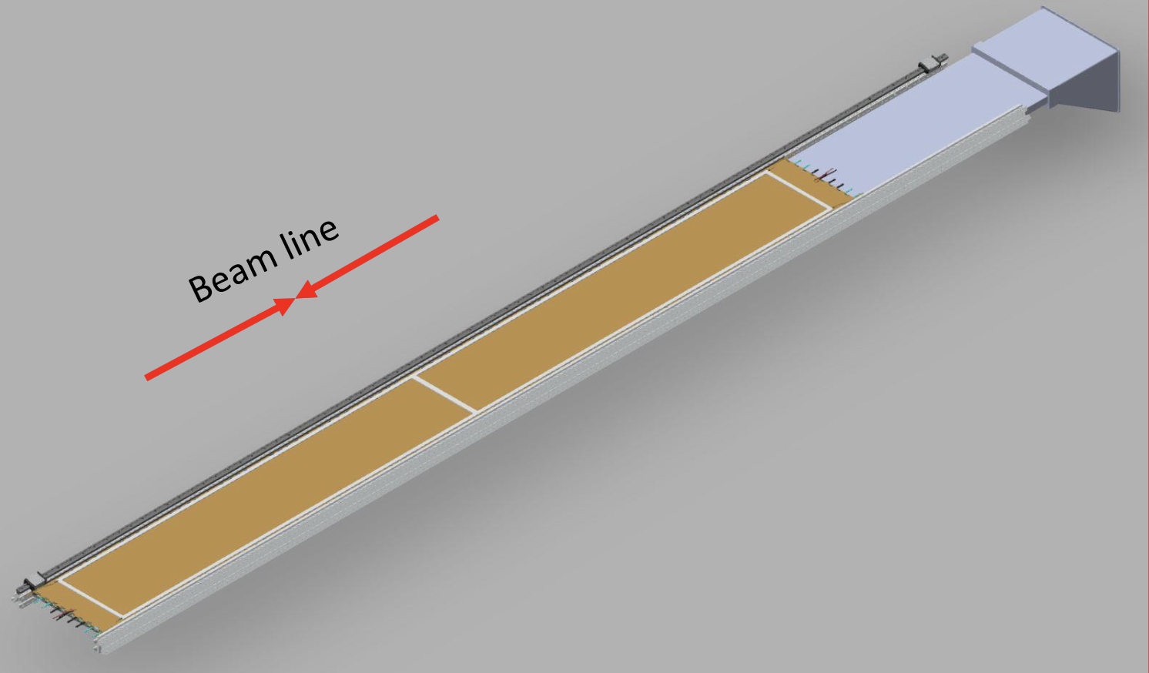
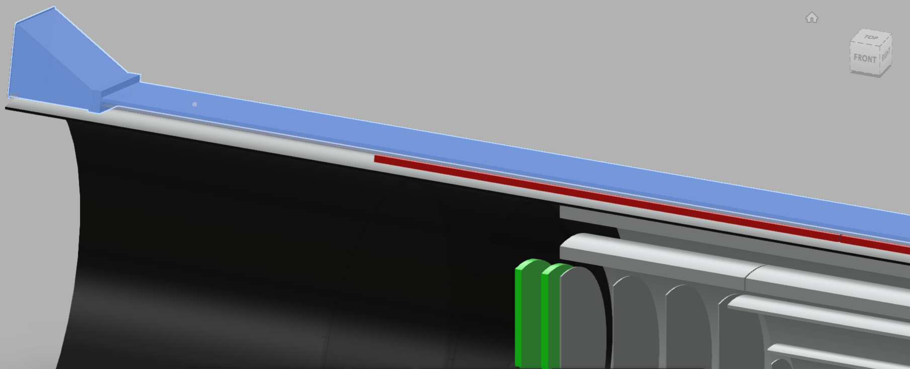
µRWELL-BOT Module: Integration considerations
Charge 6
Main integration challenges: Space limitation in ePIC detector environment
µRWELL-BOT detector envelop in ePIC
In radial direction: 2.5 cm
Azimuthal direction: 36 cm
Installed in support structure of barrel ECAL in front (from IP) of hpDIRC bar
Optimization of the acceptance matching with hpDIRC
Implications in the design of the µRWELL-BOT module
FEB cards on the back of the modules ➔ material budget
Carefully consider how services, cables choices affect maintenance in the future
Barrel ECAL support structure
370 mm
µRWELL-BOT module
DIRC bar box
µRWELL-BOT

Slide 12
Technology Choice & Design Considerations

Slide 13
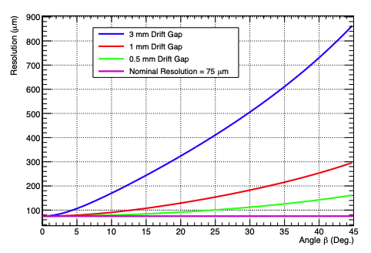
Technology choice: Thin-gap GEM-µRWELL Hybrid Detector
Charge 2,3
Challenges with standard (> 3-mm drift gap) MPGD
Degradation of the spatial resolution with track angle .
E × B in magnetic field negatively impact resolution
Development of Thin-gap MPGDs:
Small drift gap improve spatial resolution at large angle
Small gap ➔ minimize E × B effect in magnetic field
Improve the detector timing performance
Thin-gap GEM-µRWELL detector concept
hybrid amplification MPGD:
GEM (preamplification) and µRWELL (main amplification)
Allow large detector gain and stable operating HV
Readout layer: 3-layer capacitive-sharing U-V strip readout
Achieve excellent spatial resolution with thin gap detector
Active area 36 cm
Active area 34 cm
3 mm honeycomb
G10 frames
µRWELL
GEM
cathode
readout PCB
FEB
cross-section view of thin-gap GEM-µRWELL detector
parametrization from EPJ Web of Conferences 174, 06005 (2018)
https://wiki.bnl.gov/eic/upload/ERD_tgMPGD_FY22_endOfYearReport_final.pdf

Slide 14
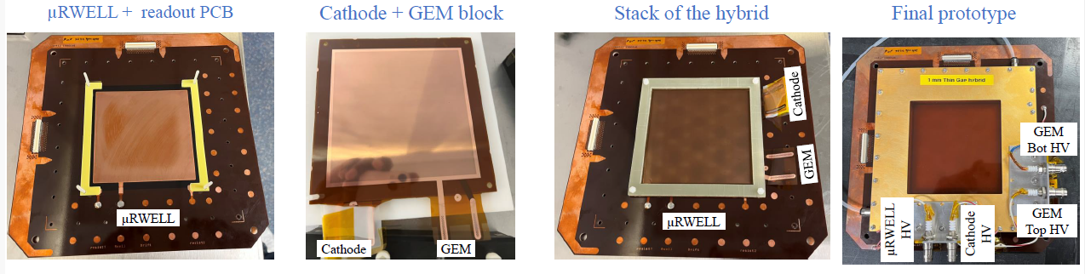
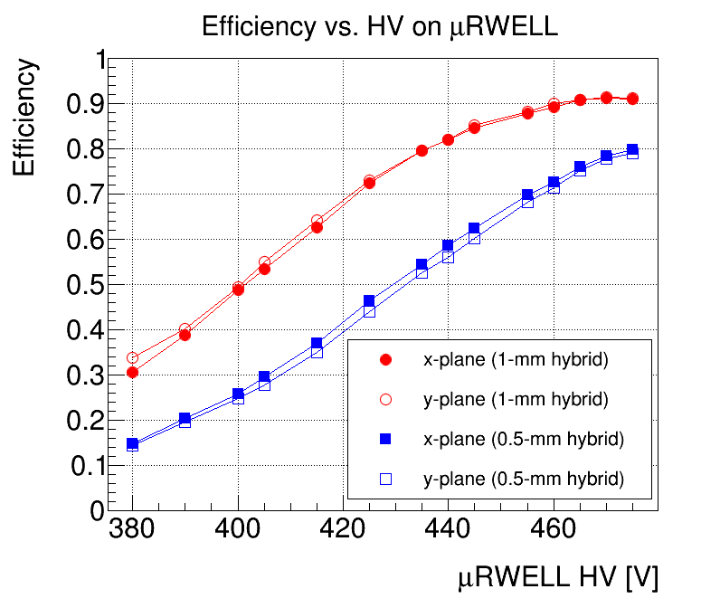
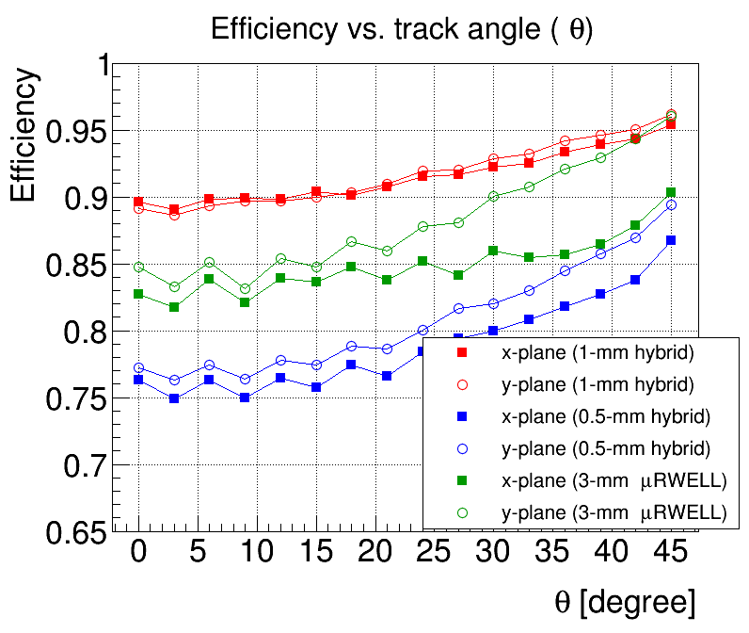
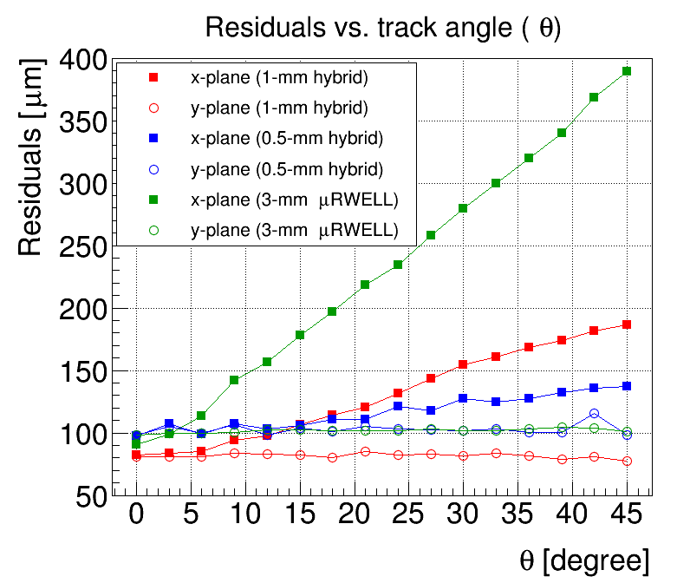
Technology choice: Thin-gap GEM-µRWELL Hybrid Detector
Charge 2,3
Proof of concept
Concept of thin-gap GEM-µRWELL hybrid prototype demonstrated in beam test at the Fermilab Test beam Facility in Summer 2023 (red plots)
Space resolution < 150 µm and efficiency of 92% on average for 1-mm thin-gap GEM-µRWELL prototype (red dots) and for track in an angle range between 0 – 45 degrees.
Baseline technology for ePIC outer MPGD tracker
R&D funded by JLab administered DOE EIC Generic R&D Program as EICGENRandD_2022_23
Efficiency
Efficiency
Residuals
https://wiki.bnl.gov/eic/upload/ERD_tgMPGD_FY22_endOfYearReport_final.pdf

Slide 15
PED: Engineering Test Article

Slide 16
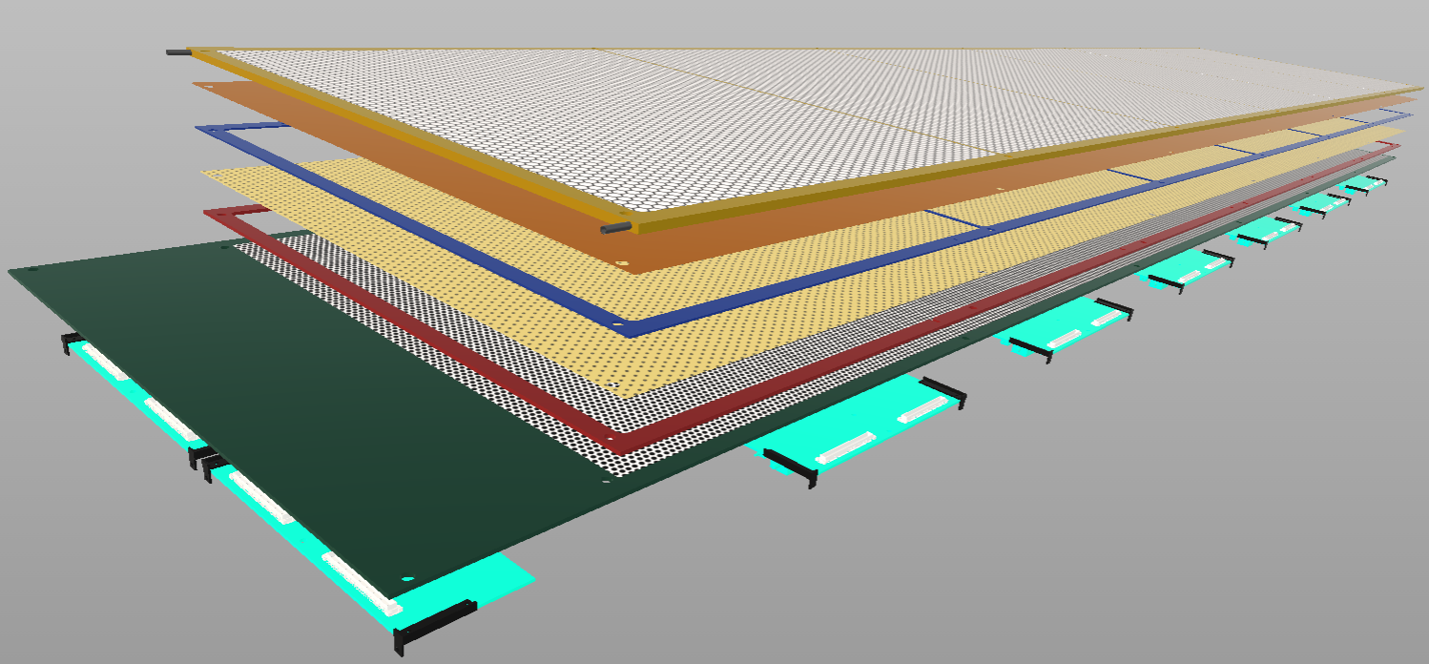
Design consideration: Breakdown of µRWELL-BOT module
Charge 2,3
Top honeycomb support
Cathode foil
Drift frame
GEM foil
induction frame
PED activities 2024–2025: Design of full scale module
Full scale Engineering test article based on 1-mm thin-gap prototype for the choice validation
Design to address integration challenges of ePIC
Test article module fabrication completion end 2024
Will be tested in beam at FNAL summer 2025
Design by the RD & I Group at JLab
µRWELL foil
UV readout PCB
FEBs

Slide 17
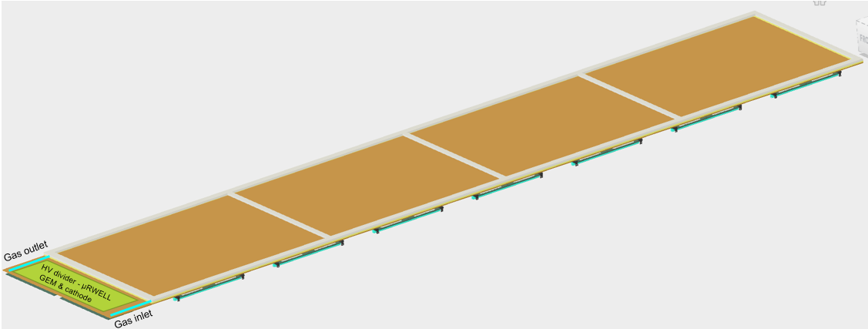
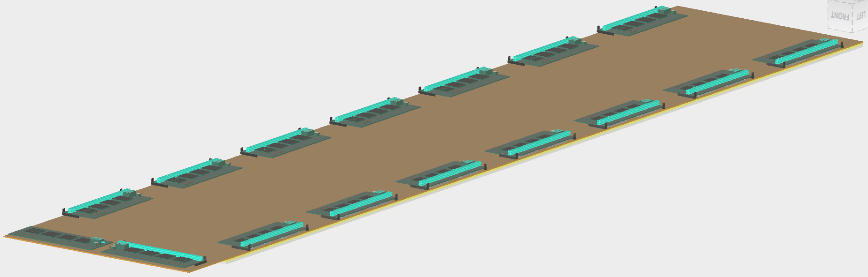
Design consideration: µRWELL-BOT module
Charge 2,3
Front view of the µRWELL-BOT module design
back view of the µRWELL-BOT module design

Slide 18
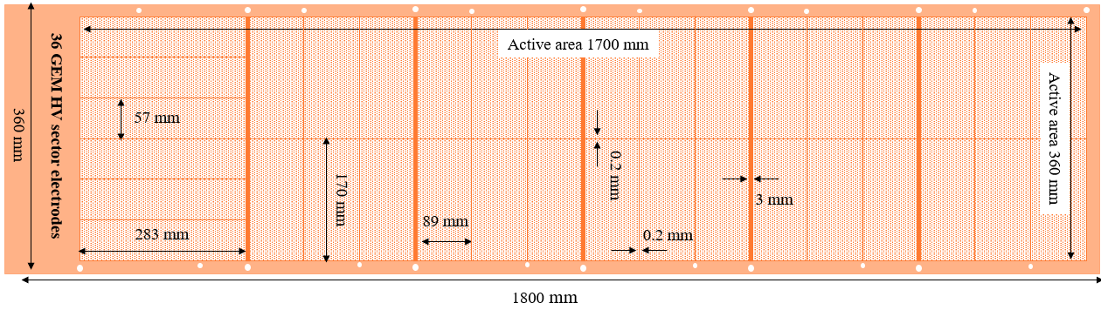
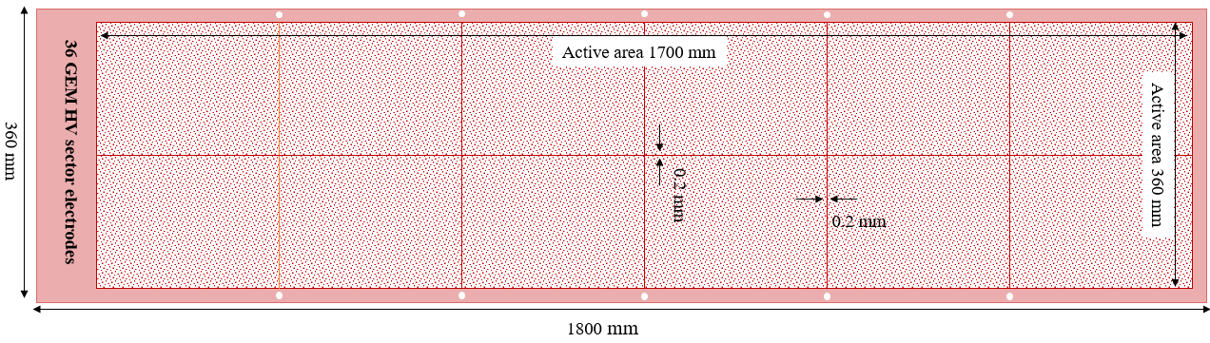
Design consideration – µRWELL and GEM foil design
Charge 2,3
GEM foil: Conceptual design
foil divided into 36 HV sector ~ 160 cm²
Optimization trade-off between active-to-dead area ratio for gap uniformity
Final design with input from GEM experts at CERN MPT workshop - 06/24
Procurement by 12/24
µRWELL foil: Conceptual design
Foil divided into 12 HV sector ~ 480 cm²
Final design with input from GEM experts at CERN MPT workshop - 06/24
Procurement by 12/24

Slide 19
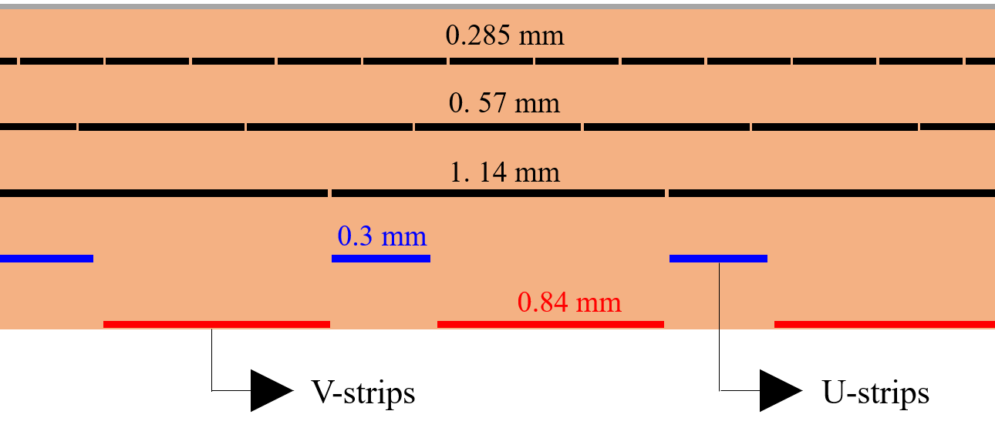
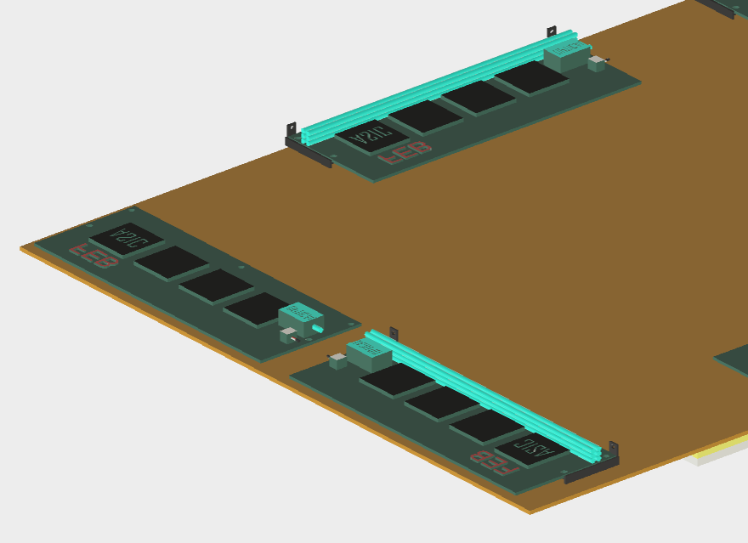
Design consideration: 2D (U-V)-strip readout layer
Charge 2,3
Readout strip layers
3-layer capacitive-sharing U-V strip readout
Strip pitch: 0.8 mm (along U and V axis)
Trace pitch: 1.14 mm along horizontal axis (traces)
All connectors on the back of the rigid µRWELL / readout PCB
cross-section view of 3-layers U-V strip capacitive-sharing readout
https://doi.org/https://doi.org/10.1016/j.nima.2022.167782
1.14 mm
0.8 mm
V-strips
U-strips
U-V strip configuration

Slide 20
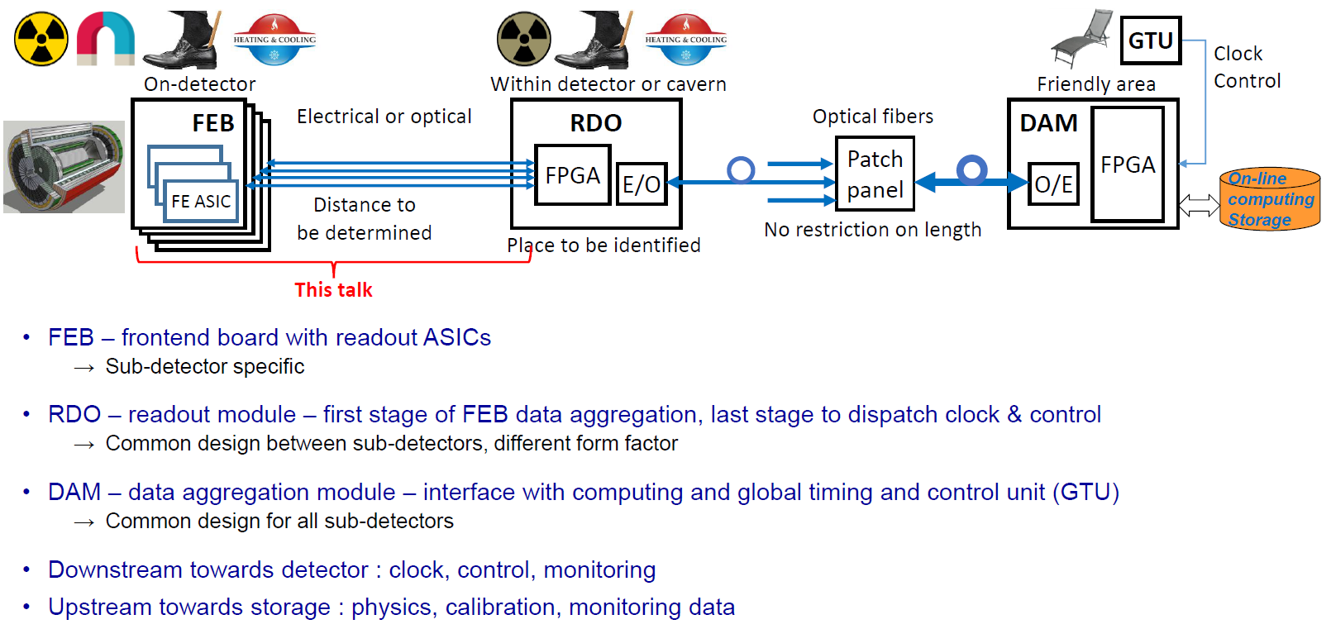
Design consideration: µRWELL-BOT Readout Electronics
Charge 2,3
See Irakli’s presentations
MPGD Readout Electronics

Slide 21
Assembly plans, ES&H & QA

Slide 22
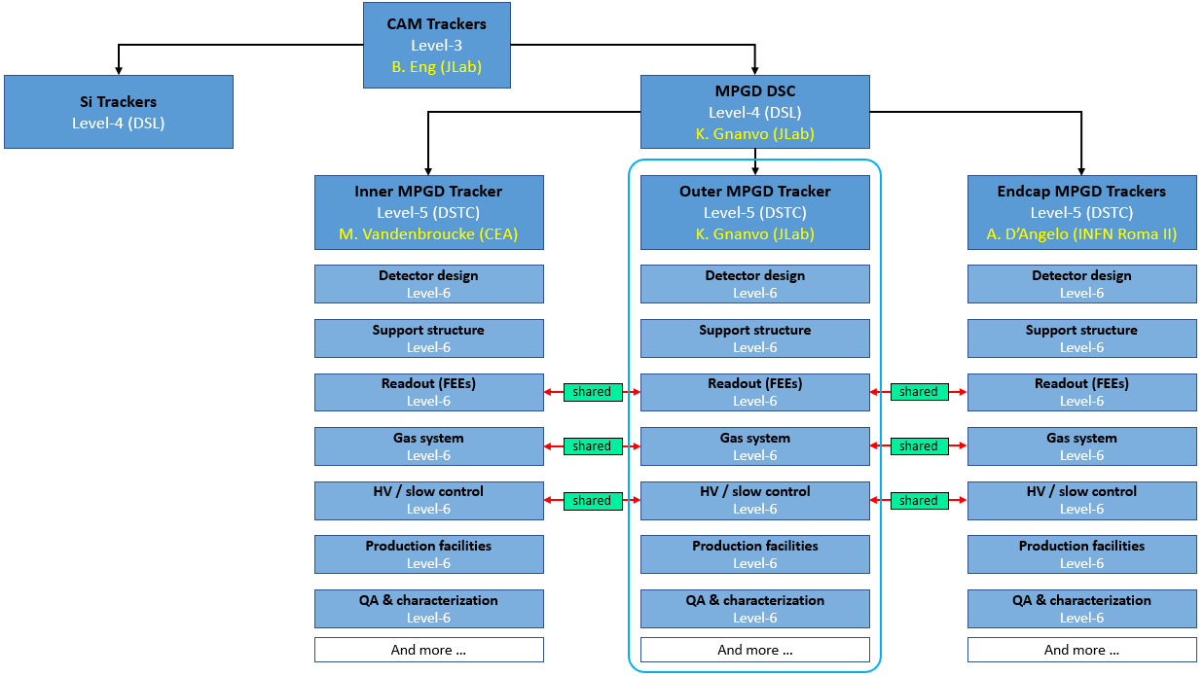
MPGD-DSC: Organization of ePIC MPGD Subsystem Collaboration
Charge 5
Outer MPGD Tracker: Module assembly
Production sites: University of Virginia (UVa), Florida Institute of Technology (FIT) and Jefferson Lab (JLab)
Vast experience with large scale and large MPGD projects among the 3 institutions
10 modules per site (8 + 2 spares)
Welcome to new institutions to join the effort

Slide 23
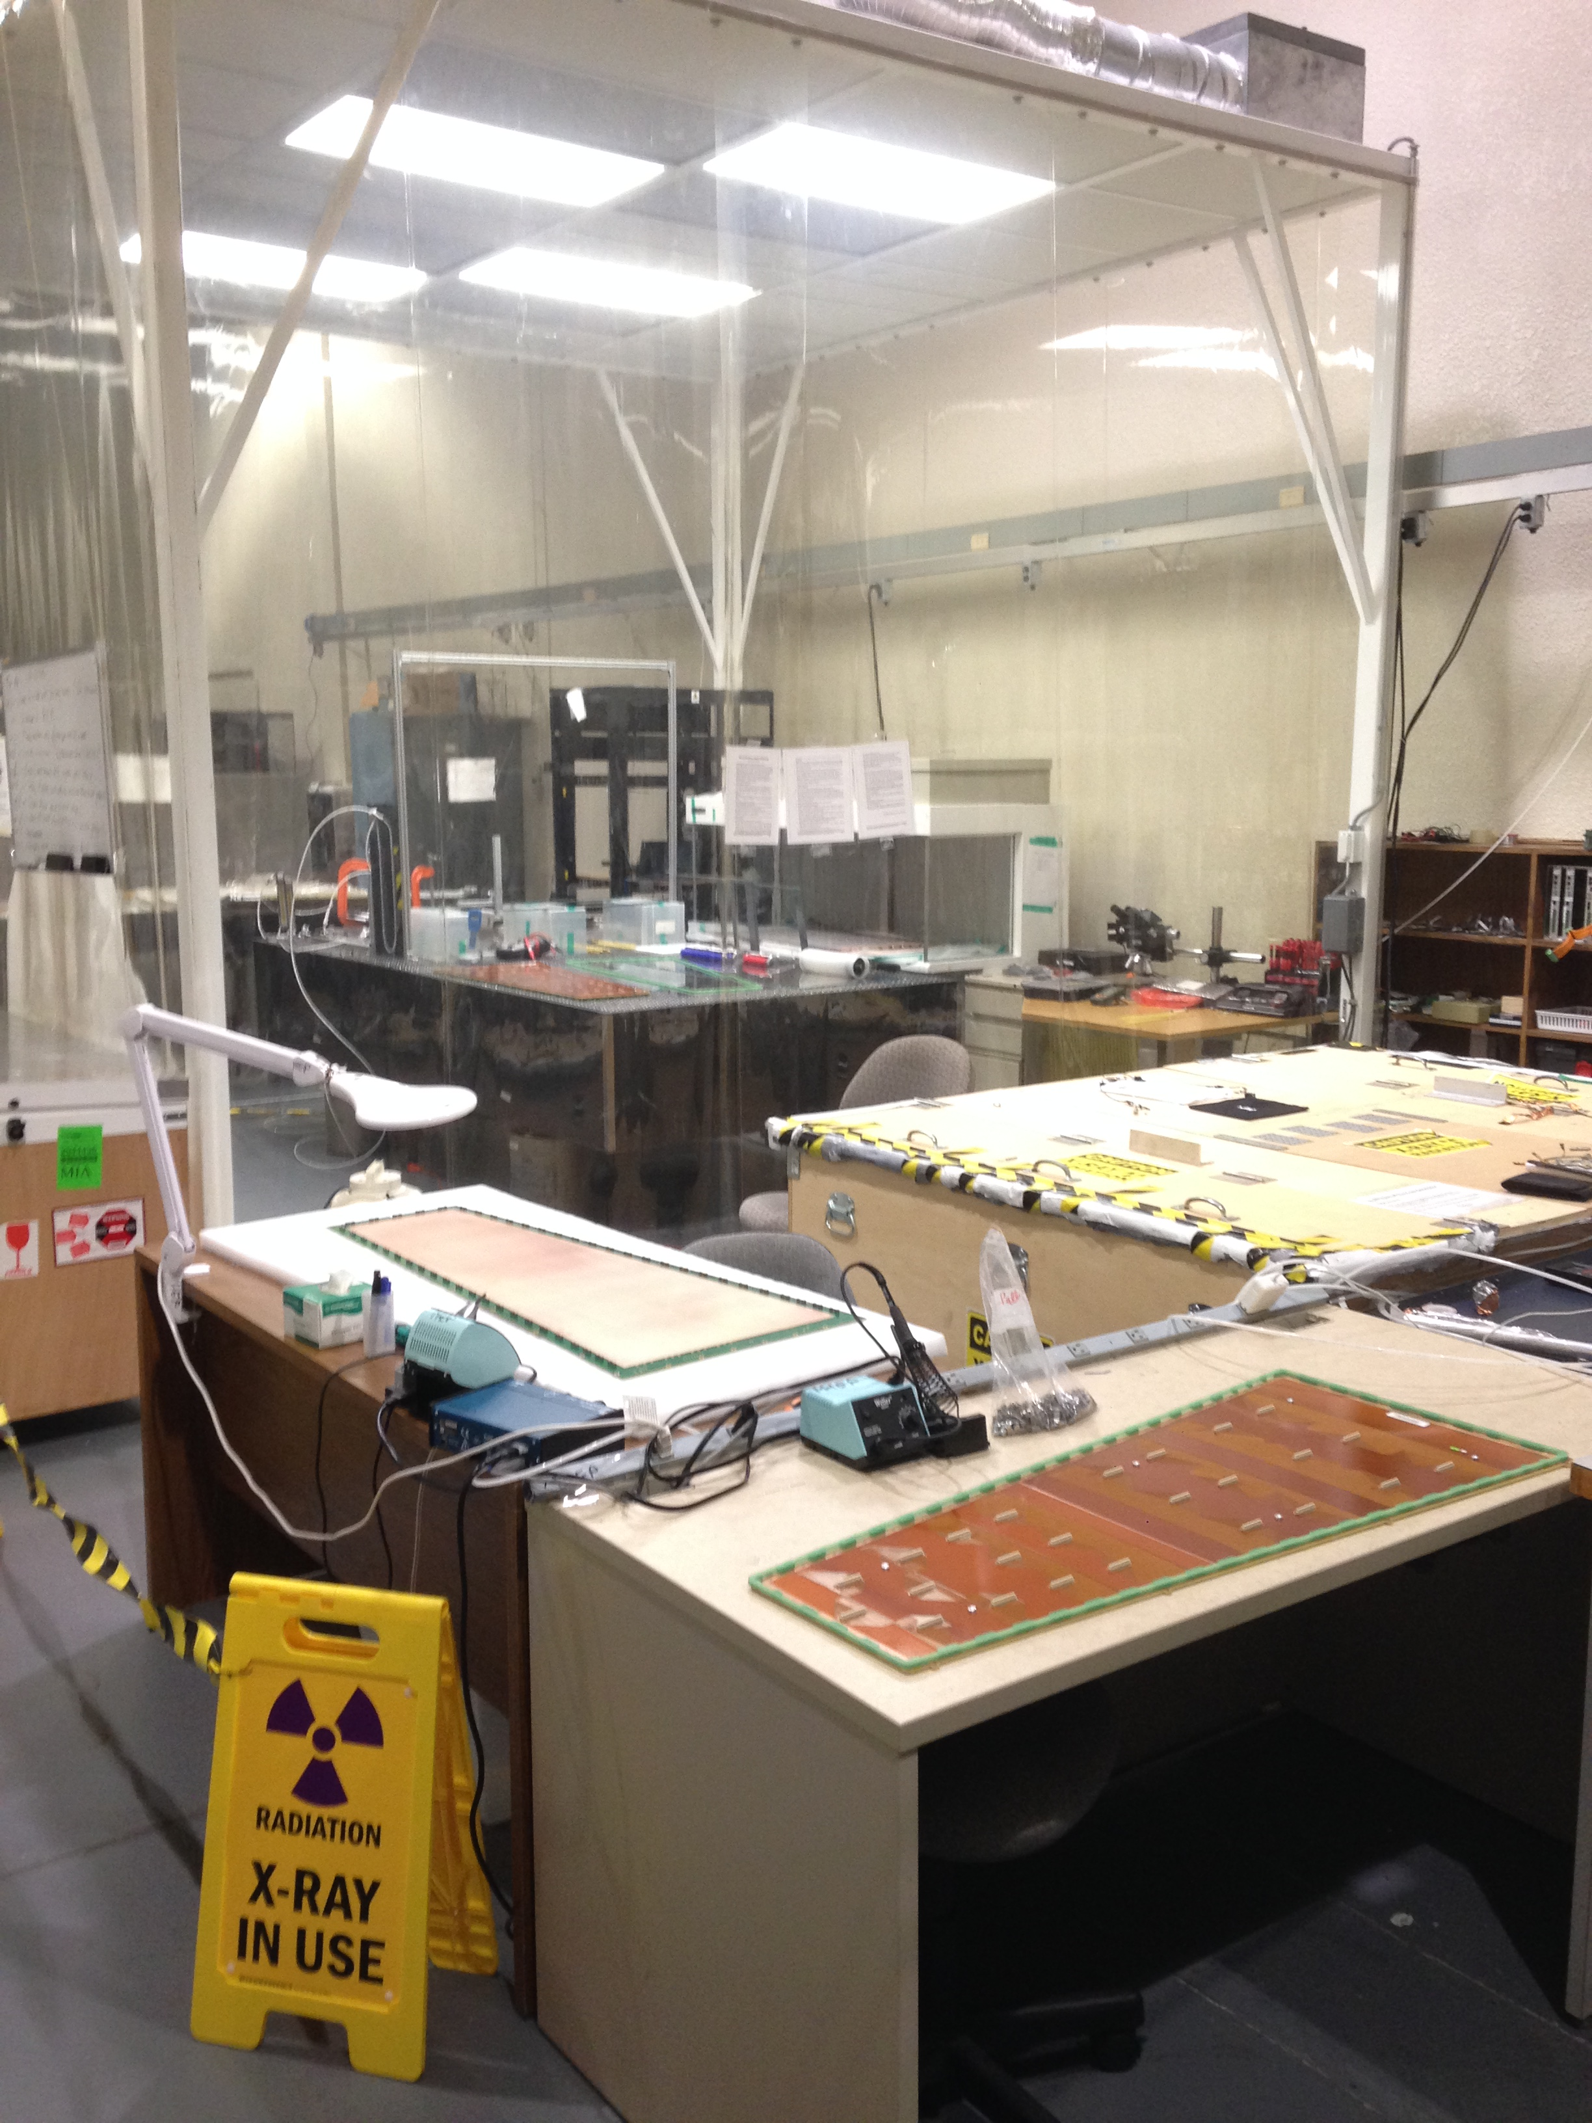
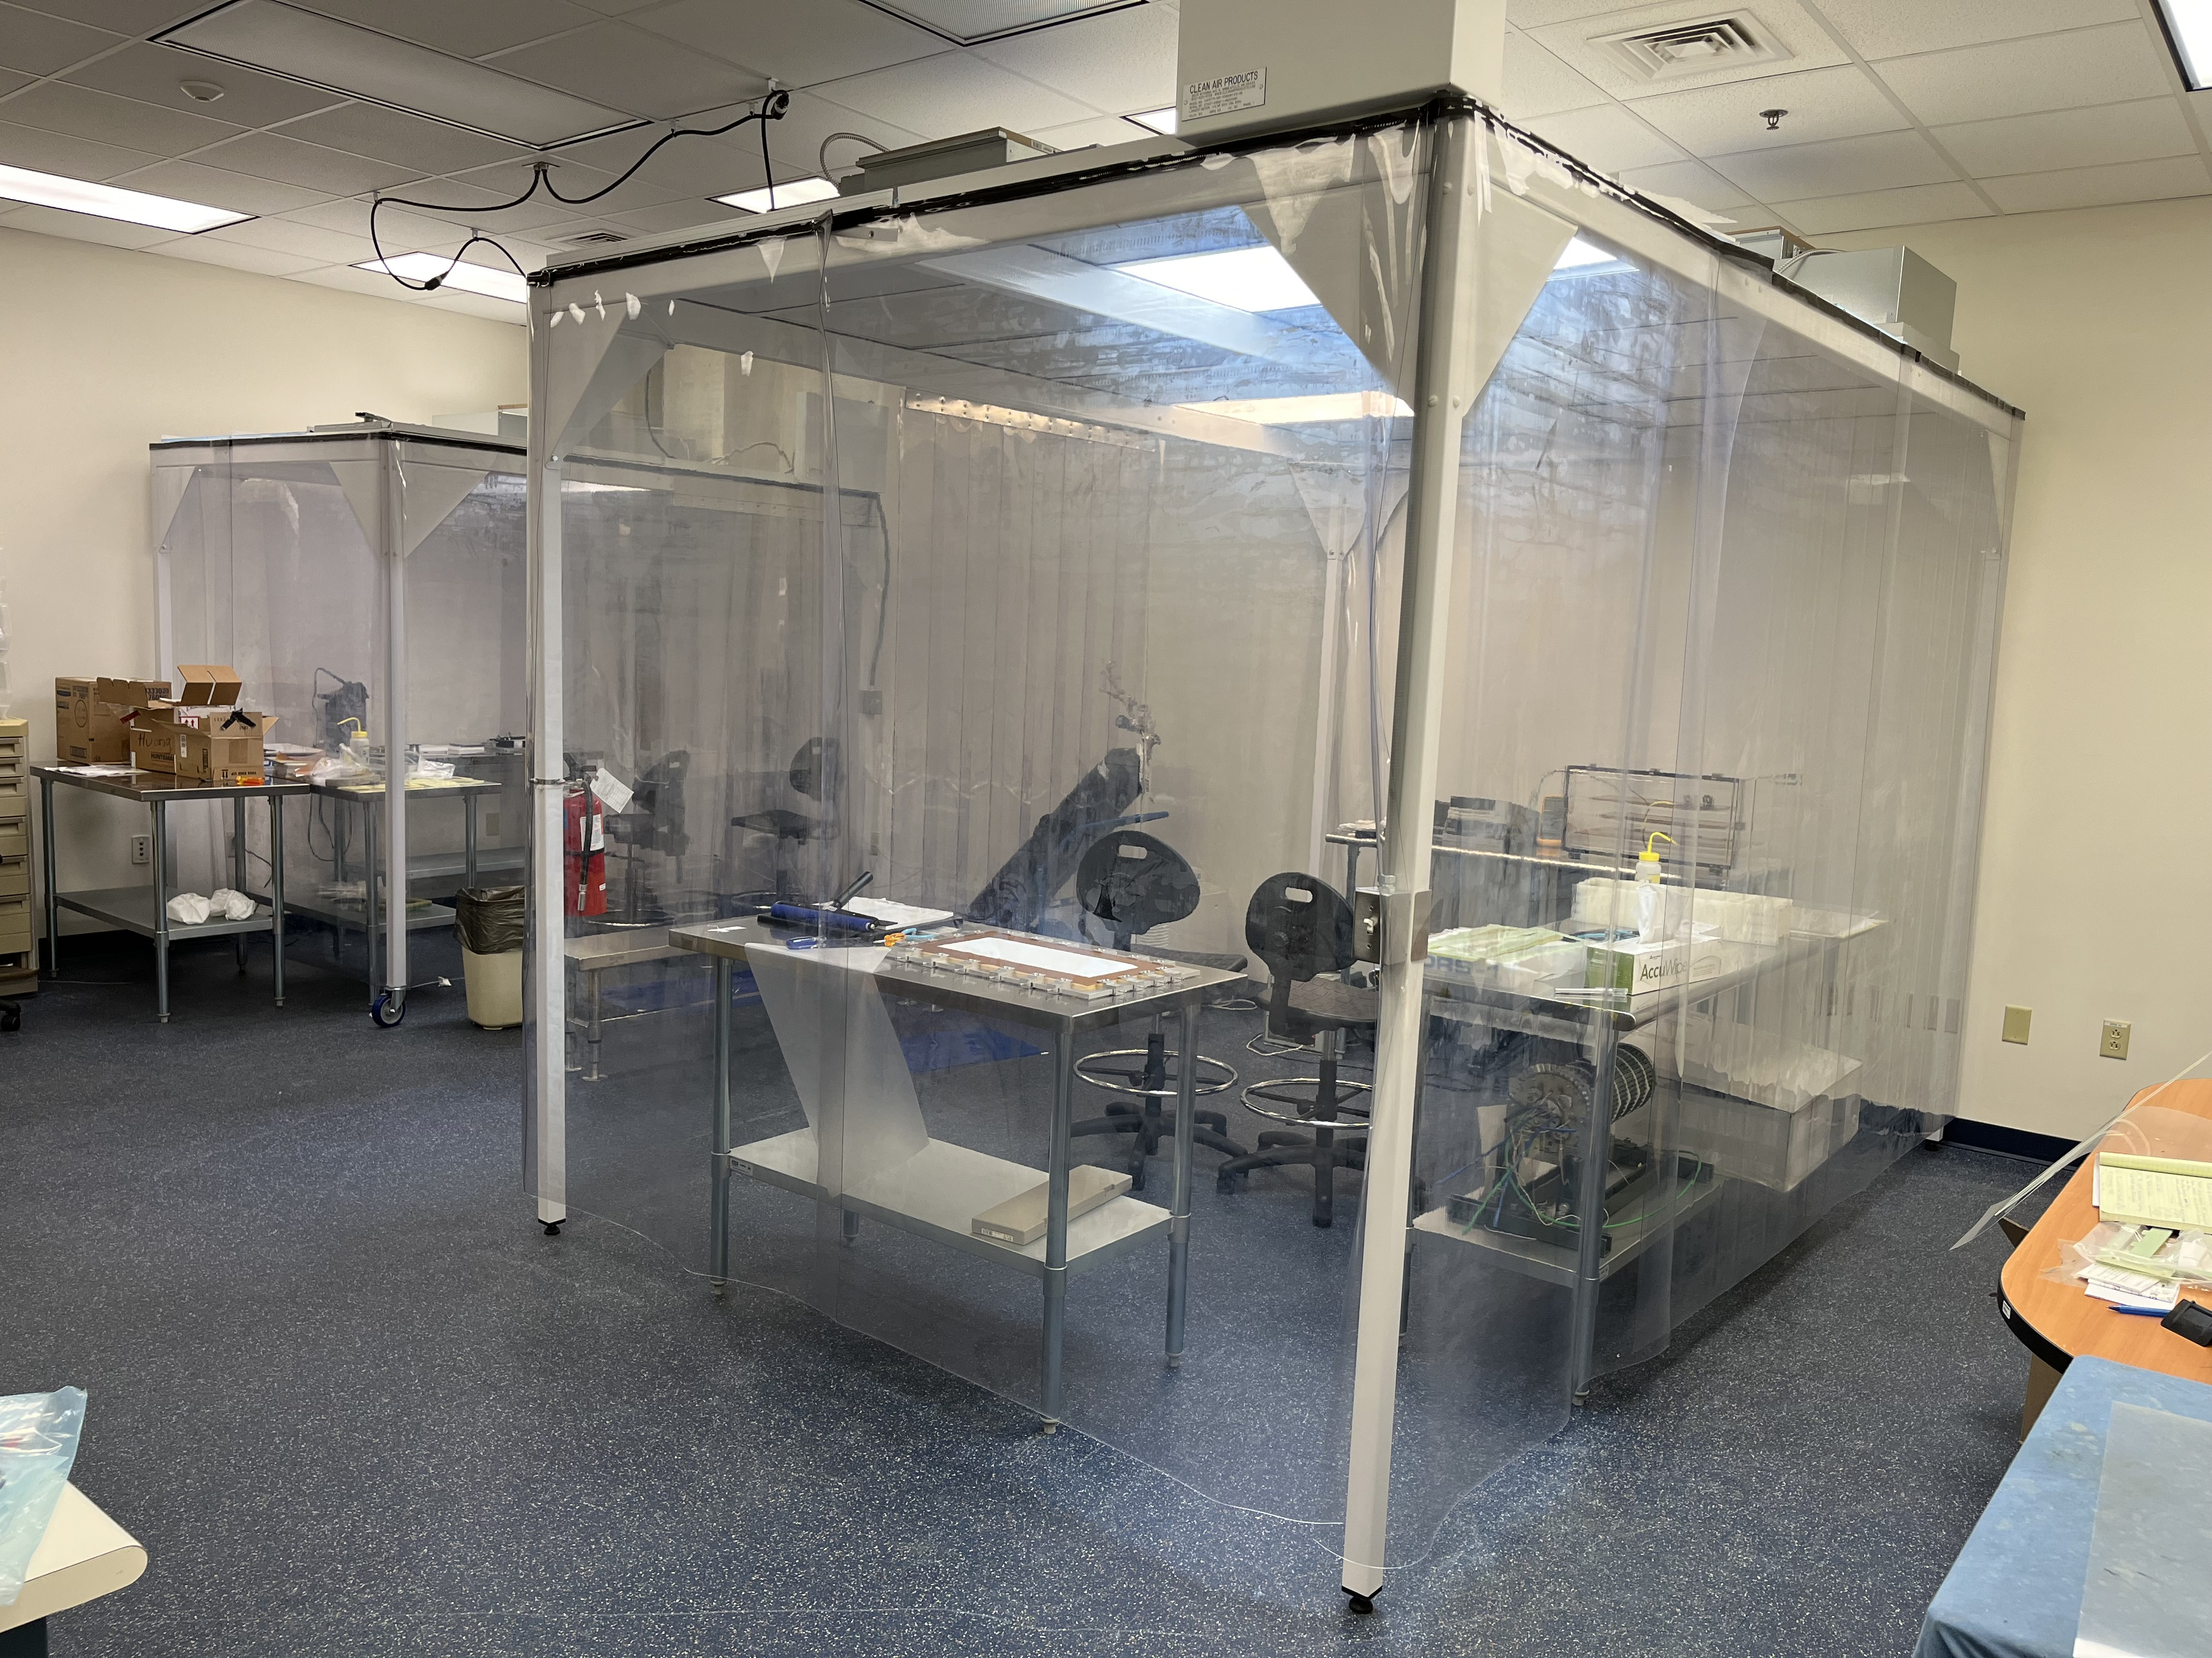
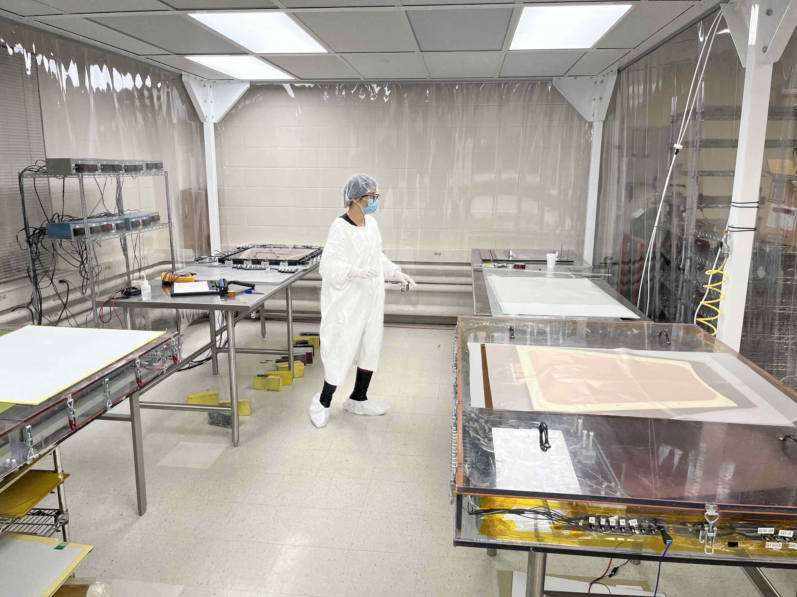
Assembly plans: Equipment at the assembly sites
Charge 6
All 3 assembly sites have fully equipped MPGD Detector Lab
Fully equipped CLASS 1000 Clean rooms for module assembly
Cosmic tracking telescope setup with coincidence trigger counters and readout & DAQ system
X-ray setup for high rate studies and long term stability …
Will setup DAQ and readout system for SALSA – MPGD readout system
FIT Clean Room: assembly of
CMS GE1/1 GE2/1 and ME0 GEMs
JLab MPGD Clean Room: New capacity for large MPGD module assembly
UVa Clean Room: SBS GEMs, MOLLER GEMs, PRad GEMs, CLAS12 µRWELL, Hall D GEM-TRD prototype
CMS GEMs
Moller GEM foil

Slide 24
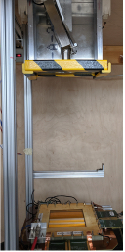
Assembly plans: Quality Assurance (QA)
Charge 7
Test and characterization of µRWELL-BOT modules
HV test in N₂ of GEM and µRWELL sectors before, during and after assembly (in clean room)
Gas leak test and sealing after module assembly
Electrical connection capacitance and pedestal noise test of all U & V and strips
Tag dead strips and replace FEB cards with dead readout channels
Efficiency and relative gain uniformity studies with cosmic setup
absolute gain measurement with radioactive source (local measurement)
Large 2D X-Ray scanner for absolute gain uniformity (JLab)
UVa X-Ray box

Slide 25
Assembly plans: ES&H
Charge 7
ES&H procedure will derived from past experience in each assembly site with similar system
Non flammable operation gas mixture Ar / CO2 ➔ no special safety concern or implementation procedure needed
HV supply via simple passive divider ➔ Procedure to isolate any electric point on the detector
Will follow JLab ES & H procedures for handling radiation sources during QA at the lab
Similar procedures will be implemented in the various institutions
Will have all these procedure documented in the appropriate ePIC documentation database (for example EICLOG @ JLab)

Slide 26
Assembly plans: Planning & schedule
Charge 6
06/2025
06/2026
04/2029
06/2029
PED & validation
Pre-production
Production
Shipment to JLab
Commissioning & Installation
Ongoing design of full size µRWELL-BOT module
Procurement of GEM foils, µRWELL PCB – 12 / 2024
Assembly at JLab test in at FNAL - 06/2025
Assembly of one pre-production module (module#0)
Setup of infrastructure and equipment in assembly sites
Assembly and QA of 9 production modules at assembly sites
Full characterization at assembly sites of each module on cosmic stand and with radioactive sources
Shipment of all 24 modules to BNL
Commissioning at BNL cosmic test stand of all µRWELL-BOT as well as µRWELL-ECT
Commissioning
Installation

Slide 27
Summary
The ePIC Barrel Outer MPGD Tracker (µRWELL-BOT) is based on thin-gap GEM-µRWELL amplification technology
µRWELL-BOT provides improved tracking option to the hpDIRC and pattern recognition with fast timing hit to Si tracker in the barrel
Design of the µRWELL-BOT is well advanced and integration issues and mechanical constraints are being addressed in the design
The engineering test article pre-production module is under development and expected to be validated by Summer 2025
Preliminary plans and schedule for the production of µRWELL-BOT modules in assembly sites is initiated
The ePIC MPGD DSC is established and very active with several institutions with vast experience with large MPGD productions

Slide 28
Backup

Slide 29
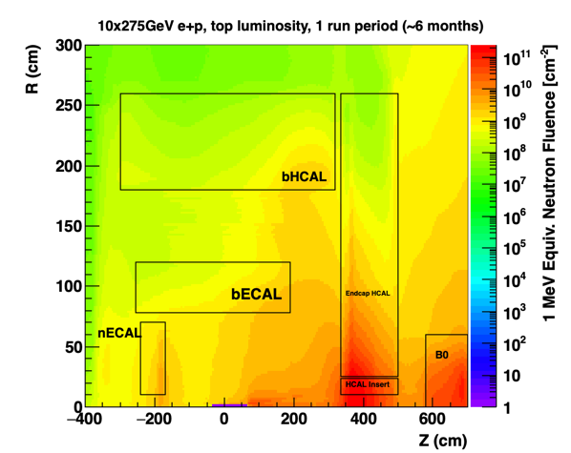
Design consideration: Some General considerations
Charge 2,3
Rate Capability
Not critical ~ 1 kHz/cm² or less
Radiation Hardness
Not critical for the detectors
Important for FEBs and RDO electronics boards
Temperature Stability
Not critical for the detector performances
Detector calibration should consider gas pressure variations
Electronics power consumption and cooling
SALSA ASIC consumption ~ 15 mW/ channel at 1.2V
Air vs liquid cooling is under study at Saclay – see Irakli’s talk
1 MeV neutrons
4 × 10⁹
µRWELL-BOT

