Slide 1

MPGD ENDCAP Trackers (ECT)
GEM - $μ$Rwell technology
Annalisa D’Angelo
ECT project coordinator
Incremental Design and Safety Review of the EIC Tracking Detectors March 20-21, 2024

Slide 2
Charge Questions Addressed
Are the technical performance requirements appropriately defined and complete for this stage of the project?
Are the plans for achieving detector performance and construction sufficiently developed and documented for the present phase of the project?
Are the current designs and plans for detector, electronics readout, and services sufficiently developed to achieve the performance requirements?
Are plans in place to mitigate risk of cost increases, schedule delays, and technical problems?
Are the fabrication and assembly plans for the various tracking detector systems consistent with the overall project and detector schedule?
Are the plans for detector integration in the EIC detector appropriately developed for the present phase of the project?
Have ES&H and QA considerations been adequately incorporated into the designs at their present stage?

Slide 3

Outline
Technical performance requirements
Scope of the MPGD Endcap Trackers Detector
Detector Geometry: Envelope and Active Regions
Pseudo-rapidity coverage: effective $η$ranges
List of Technical Performance Characteristics
Detector Performances and Production Plans
(X,Y) readout – 500 $μ$m pitch
Detector technology
Detector, Electronics Read-out and Services
MPGD semi-disks endcap configuration
Electronic FEBs configuration
Services
Fabrication and Assembly Plans
Timeline
Workforce
Detector Integration in ePIC
Summary
Charge 1
Charge 2
Charge 3
Charge 5
Charge 6

Slide 4
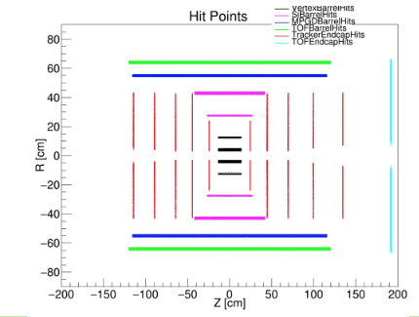
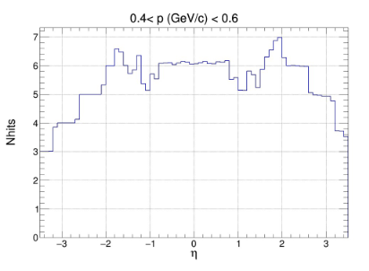
Scope of the MPGD Endcap Trackers
Charge 1
Are the technical performance requirements appropriately defined and complete for this stage of the project?
In May 2023, MC simulations showed that the tracking configuration in the endcap regions of the ePIC detector, which will experience the highest backgrounds in the experiment, would not provide enough hit points in the |η| > 2 region for good pattern recognition.
Previous Configuration
ePIC tracker geometry before June 2023

Slide 5
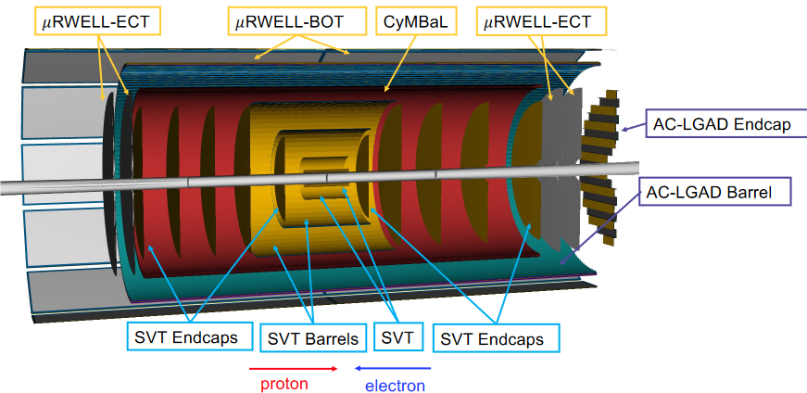
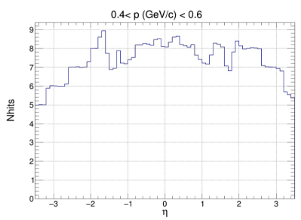
Scope of the MPGD Endcap Trackers
Charge 1
Adding two MPGD Endcap Tracking (ECT) disks both in the hadronic and in the leptonic regions increased the number of hits in the |η| > 2 region to improve pattern recognition.
Present Configuration
Present ePIC tracker geometry

Slide 6
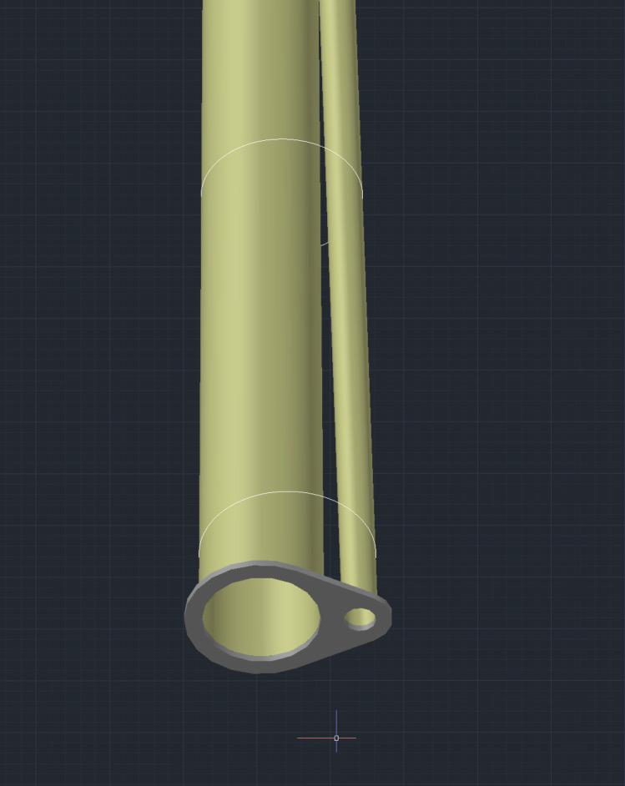
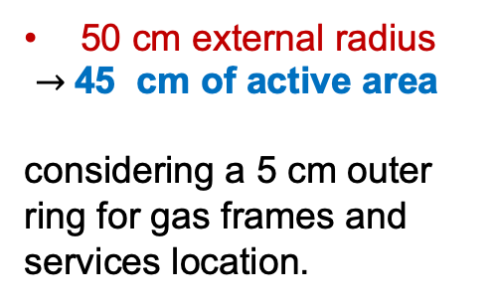
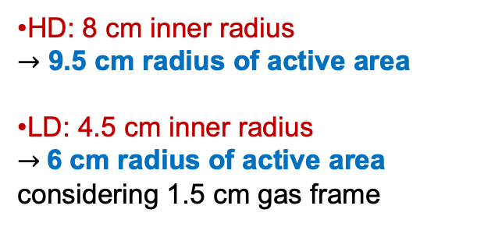
Detector Geometry: Envelope and Active Regions
Charge 1
The geometrical envelopes are available at: https://eic.jlab.org/Geometry/Detector/Detector-20240117135224.html
Endcaps Envelope Dimensions -
Beam Pipes Envelope Radii and Offsets
MPGD Disk | Max Z Pos (cm) | Disk Outer Radius (cm) | Outer Active Reg. radius (cm) | Calculated Beam pipes radii (mm) | Offset (mm) | Disk Inner Radius (cm) | Inner Active Reg. radius (cm)
HD MPGD 2 | 163.5 | 50 | 45 | 55.8 | 22.5 | 8 | 9.5
HD MPGD 1 | 150.5 | 50 | 45 | 53.1 | 19.9 | 8 | 9.5
LD MPGD 1 | -112.5 | 50 | 45 | 37.7 | -3.1 | 4.5 | 6.0
LD MPGD 2 | -122.5 | 50 | 45 | 39.2 | -3.4 | 4.5 | 6.0
Disks Outer Radius
Disks Inner Radius
different for the two HD and LD regions
50 cm external radius
$→$45 cm of active area
considering a 5 cm outer ring for gas frames and services location.
Calculated
Radii
HD: 8 cm inner radius
$→$ 9.5 cm radius of active area
LD: 4.5 cm inner radius
$→$6 cm radius of active area
considering 1.5 cm gas frame

Slide 7
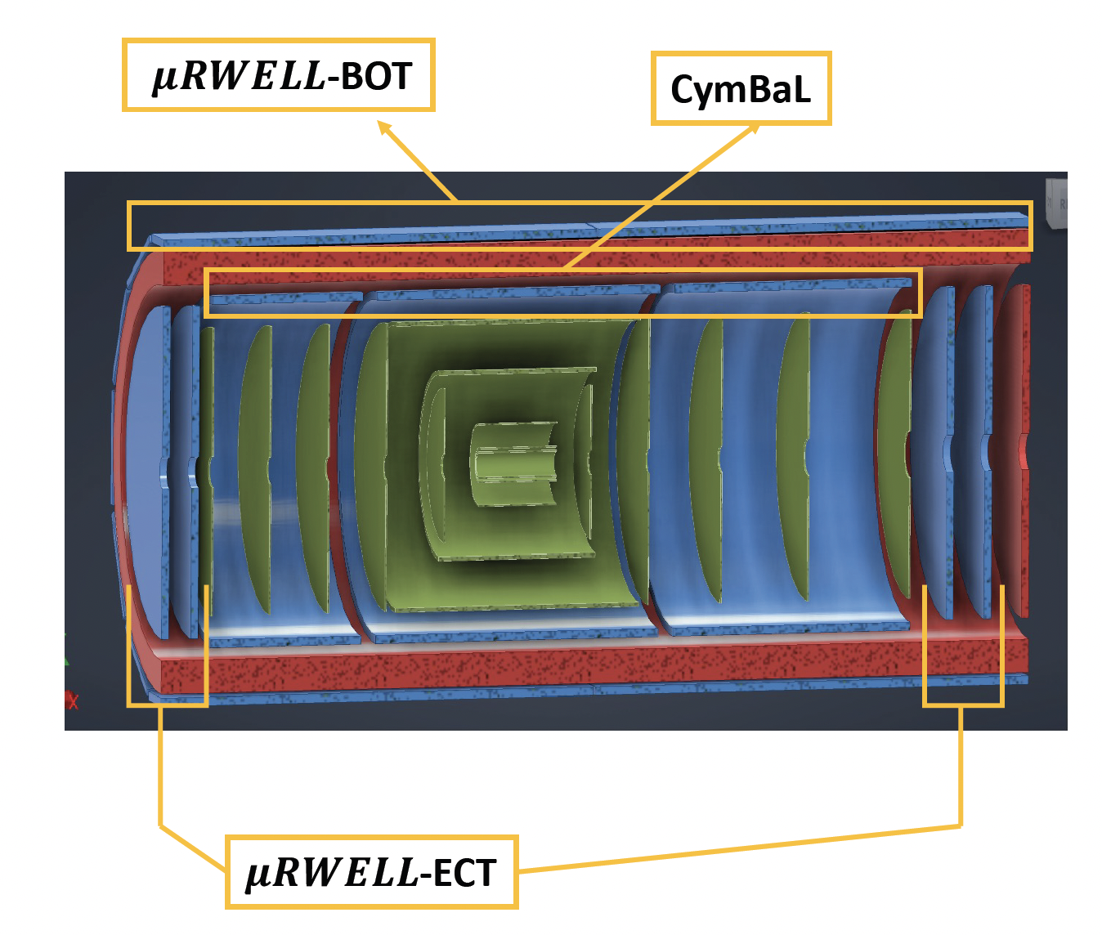
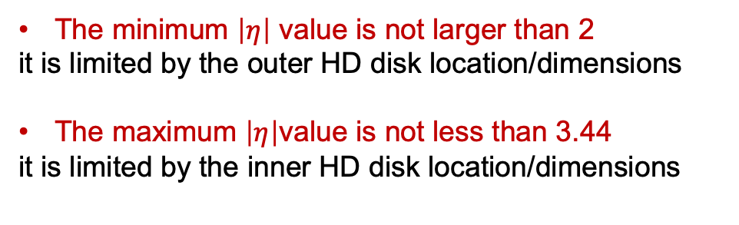


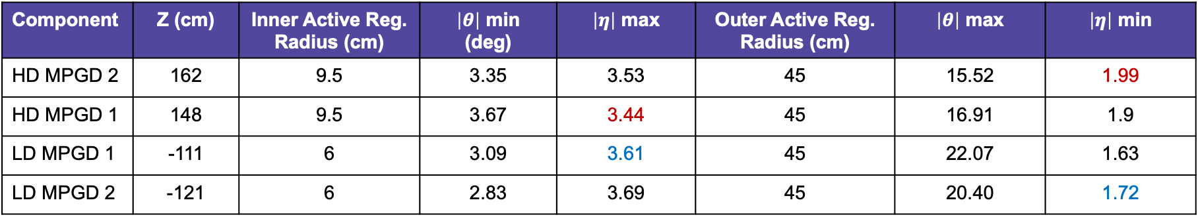

Pseudo-rapidity coverage: effective $η$ranges
Charge 1
Component | Z (cm) | Inner Active Reg. Radius (cm) | $\left|θ\right|$ min (deg) | $\left|η\right|$ max | Outer Active Reg. Radius (cm) | $\left|θ\right|$ max | $\left|η\right|$ min
HD MPGD 2 | 162 | 9.5 | 3.35 | 3.53 | 45 | 15.52 | 1.99
HD MPGD 1 | 148 | 9.5 | 3.67 | 3.44 | 45 | 16.91 | 1.9
LD MPGD 1 | -111 | 6 | 3.09 | 3.61 | 45 | 22.07 | 1.63
LD MPGD 2 | -121 | 6 | 2.83 | 3.69 | 45 | 20.40 | 1.72
The minimum $\left|η\right|$ value is not larger than 2
it is limited by the outer HD disk location/dimensions
The maximum $\left|η\right|$value is not less than 3.44
it is limited by the inner HD disk location/dimensions
-3.61$<η<−1.72$
1.99$<η<$3.44
The$η$ range covered by the MPGD Endcap tracking disks is compliant with requirements.

Slide 8
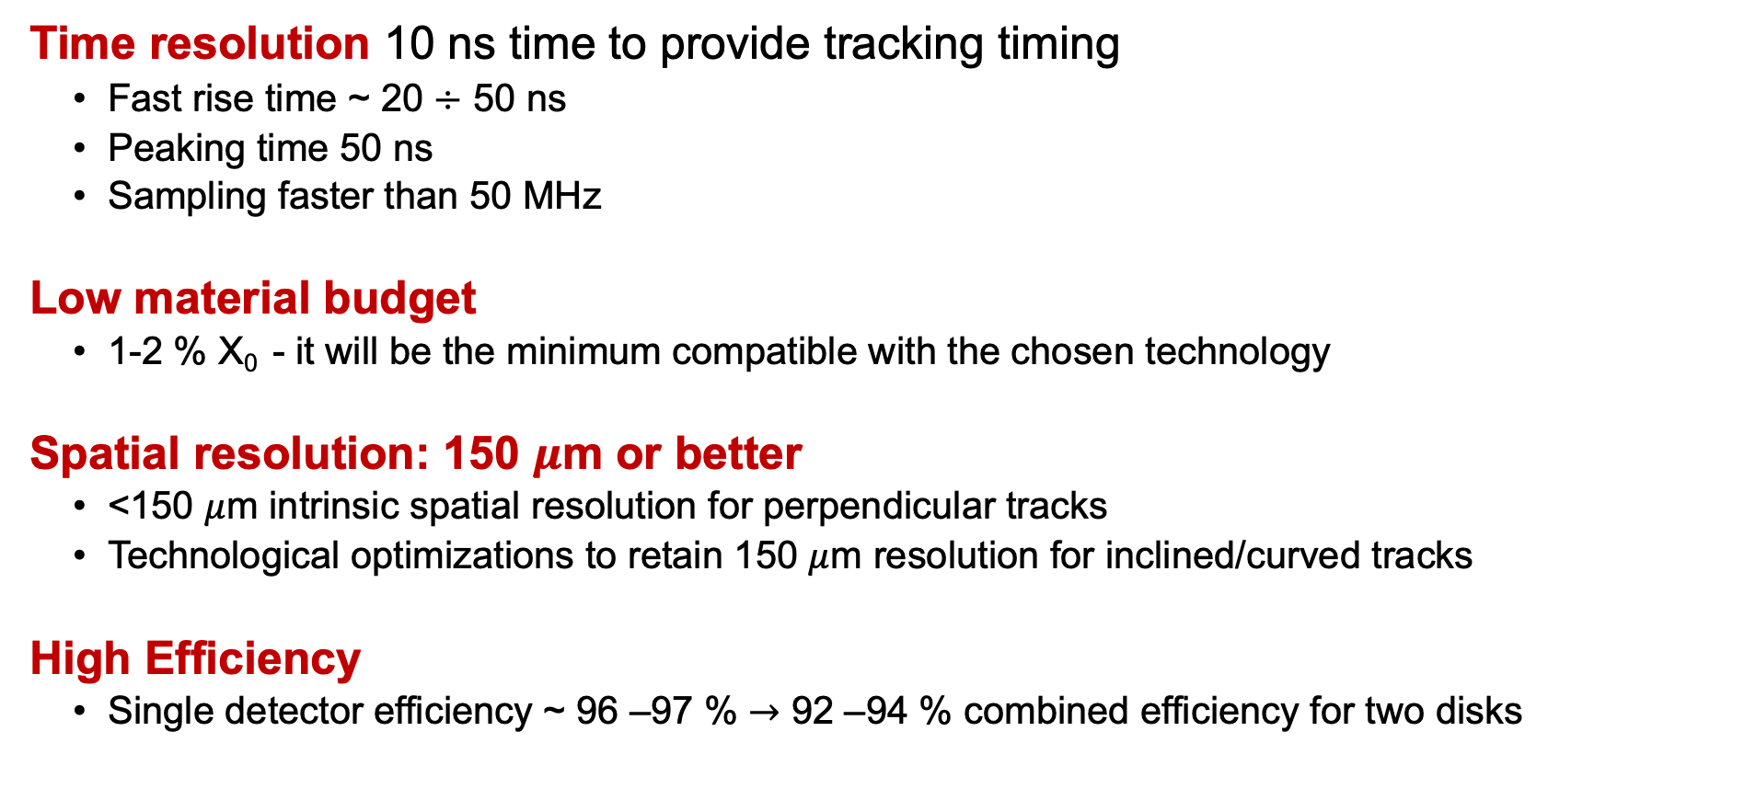
Technical Performance Requirements
Charge 1
Time resolution 10 ns time to provide tracking timing
Fast rise time ~ 20 $÷$ 50 ns
Peaking time 50 ns
Sampling faster than 50 MHz
Low material budget
1-2 % X₀ - it will be the minimum compatible with the chosen technology
Spatial resolution: 150 $μ$m or better
<150 $μ$m intrinsic spatial resolution for perpendicular tracks
Technological optimizations to retain 150 $μ$m resolution for inclined/curved tracks
High Efficiency
Single detector efficiency ~ 96 –97 % $→$ 92 –94 % combined efficiency for two disks

Slide 9
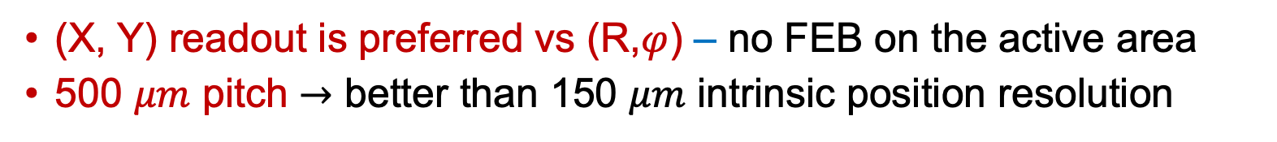
Detector performance and construction plans
Charge 2
Are the plans for achieving detector performance and construction sufficiently developed and documented for the present phase of the project?
(X, Y) read-out geometry
PROs | CONs
The strip length does not vary much along the active area | Alignment is critical
All readout FE hybrids may be located outside the active area | Routes to read-out connectors must be accurately studied
(X, Y) readout is preferred vs (R,$φ$) – no FEB on the active area
500 $μm$ pitch $→$ better than 150 $μm$ intrinsic position resolution

Slide 10
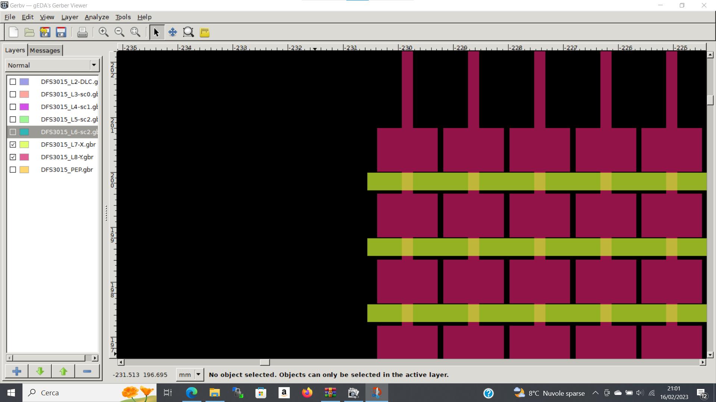
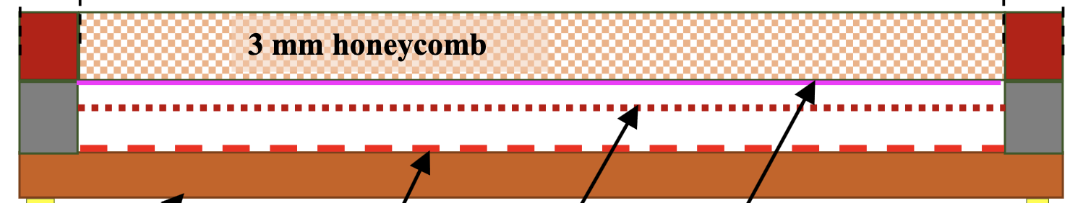


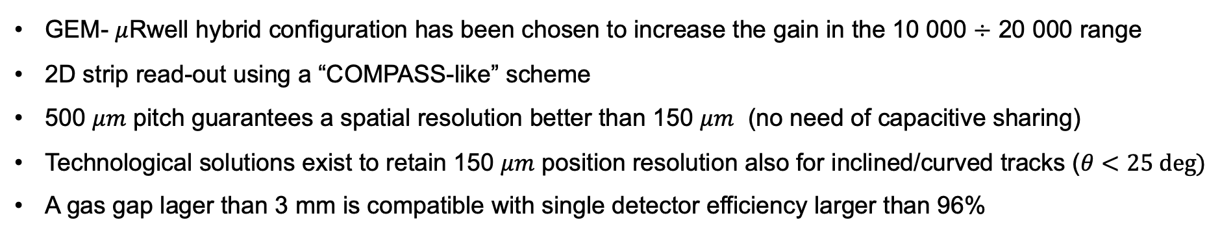
Detector Technology
Charge 2
GEM - $μ$Rwell Technology
3 mm gas gap
PCB read-out
$μ−$Rwell
GEM
cathode
GEM- $μ$Rwell hybrid configuration has been chosen to increase the gain in the 10 000 $÷$ 20 000 range
2D strip read-out using a “COMPASS-like” scheme
500 $μm$ pitch guarantees a spatial resolution better than 150 $μm$ (no need of capacitive sharing)
Technological solutions exist to retain 150 $μm$ position resolution also for inclined/curved tracks ($θ<25 deg⁡)$
A gas gap lager than 3 mm is compatible with single detector efficiency larger than 96%
All R&D Studies for EIC disks performed within eRD108 and in synergic collaboration with INFN-LNF and JLAB

Slide 11

Detector, Electronics Readout, and Services
Charge 3
Are the current designs and plans for detector, electronics readout, and services sufficiently developed to achieve the performance requirements?
MPDG Endcaps semi-detectors overlap
The split may be mounted to be either horizontal or vertical
1000 mm
1000 mm
$\left|η\right|$>1.99
525 mm
525 mm
The two half disks will have 2 cm of active area overlap

Slide 12
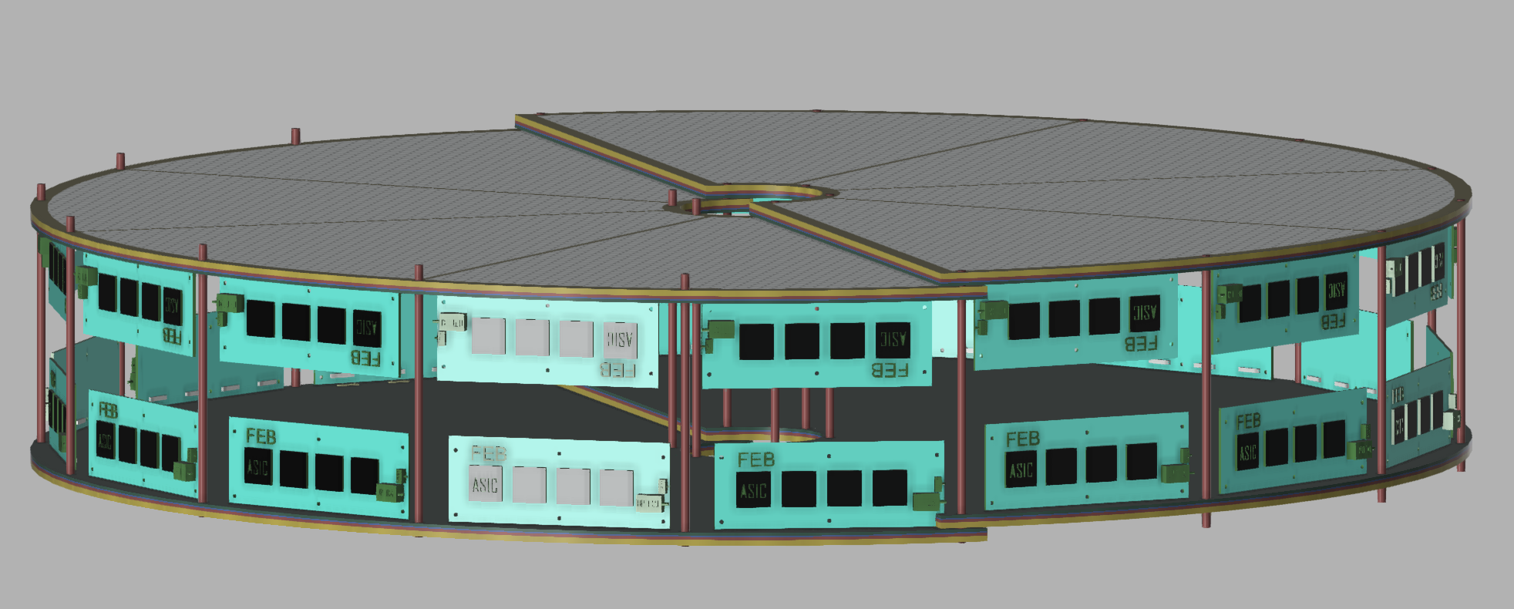
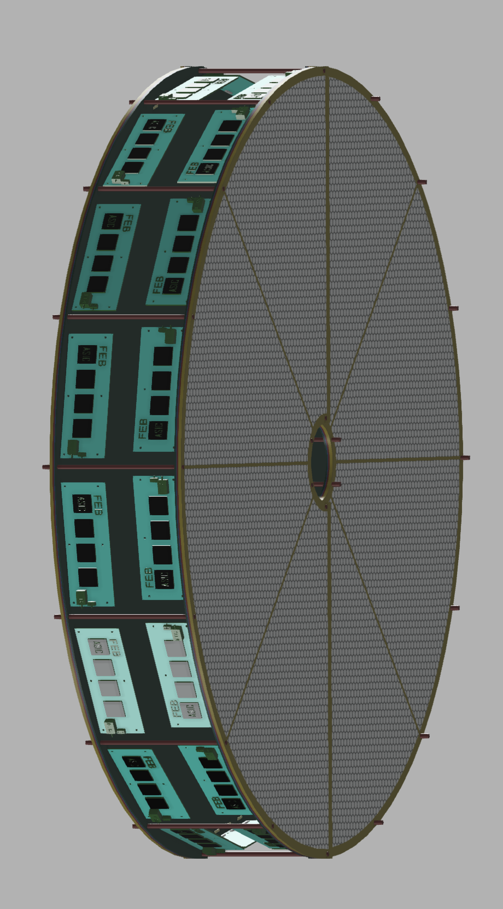
Detector, Electronics Readout, and Services
Charge 3
Are the current designs and plans for detector, electronics readout, and services sufficiently developed to achieve the performance requirements?
MPGD Endcaps configuration
$\left|η\right|$>1.99
by Seung Joon Lee
The two disks are mounted facing each another
The FEBs are connected perpendicularly to the disks and will not overlap the active area
by Seung Joon Lee
1000 mm

Slide 13
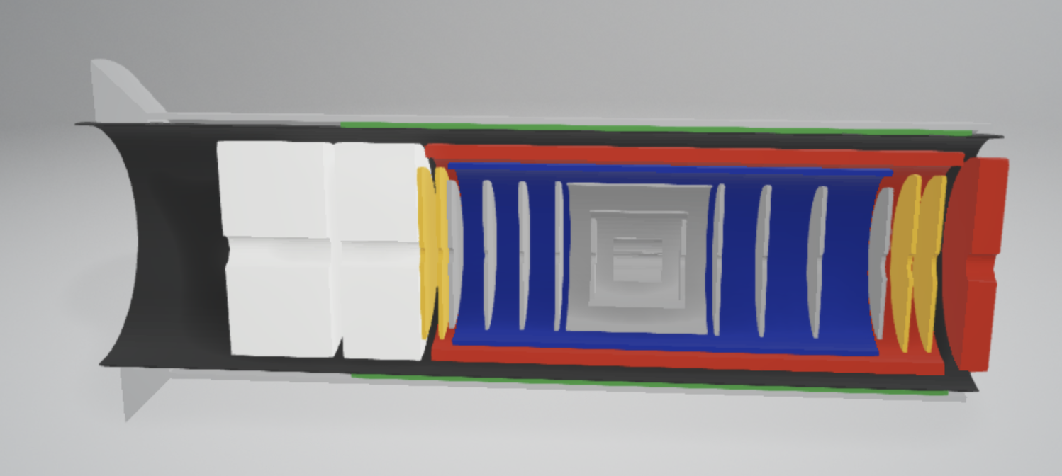
Services
Charge 3
Electronics Readout based on SALSA ASIC developed at Saclay
For each endcap disk (4 disks in total):
16 HV cables
4 gas inlets and 4 gas outlets
32 data cables
32 low voltage cables
2 temperature sensors cables
2 humidity sensors cables
2 inlet and 2 outlet cooling hoses (dry-air or liquid)
Space for 32 RDO cards
4 disks
All the service requirements have been communicated to the Integration group

Slide 14
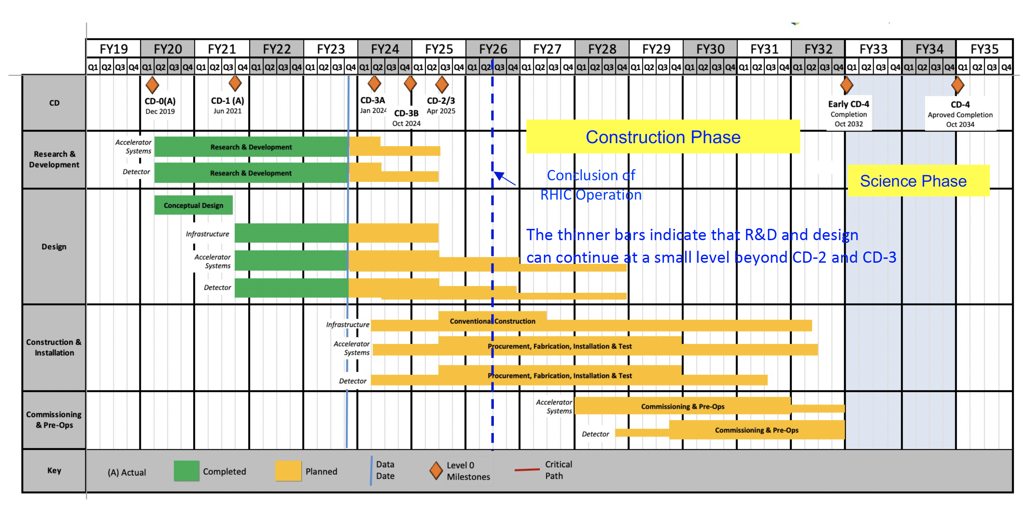
Fabrication and Assembly Plans
Charge 5
Are the fabrication and assembly plans for the various tracking detector systems consistent with the overall project and detector schedule?
Design by end of 2024
2025 - 2026 pre-production and Engineering Test Article
2027 - 2029 production & QA
2030 Commissioning & Installation
MPGD Timeline |  |  | DURATION (years)
START DATE | END DATE | DESCRIPTION
3/1/24 | 12/31/24 | Detectors Overall Design | <1
1/1/25 | 12/31/26 | Pre - Production | 2
1/1/27 | 31/12/29 | Production & QA | 3
1/1/30 | 6/1/30 | Commissioning & Installation | 0.5

Slide 15
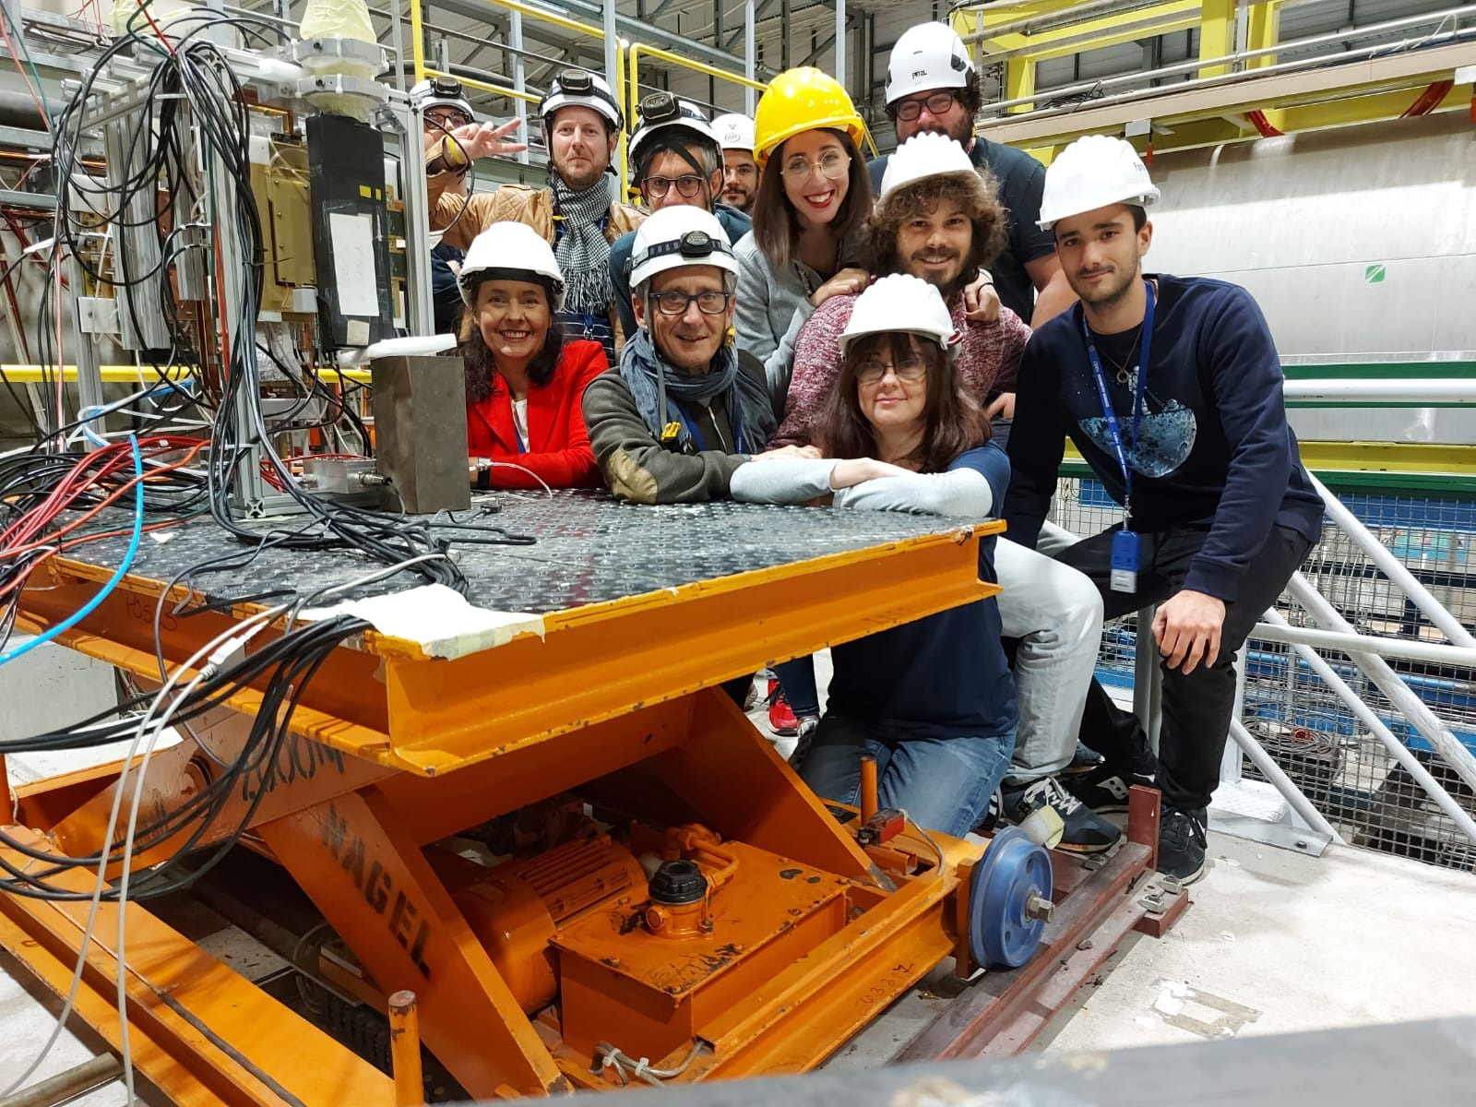
Involved Institutions & Workforce
Charge 5
INFN Workforce:
Roma Tor Vergata
Coordinator: A. D’Angelo,
Detector Hardware and QA: E. Sidoretti (PhD) A. Fantini, L. Lanza
Simulation & Reconstruction: L. Lanza, A. Fantini, R. Di Salvo
FEB Electronics: R. Ammendola
Genova
FEB Electronics: Paolo Musico, M. Battaglieri (streaming ro)
Catania
Simulation & Reconstruction: Mariagela Bondi’
The work will be performed in close connection with:
the group of Gianni Bencivenni @ INFN LNF and with the JLab detector group (Kondo Gnanvo, Seung Joon Lee)
Interest in the project has been expressed also by:
BNL (A. Kiselev et al.), Florida Tech.(M. Hohlmann et al.), Temple U. (M. Posik, et al.)

Slide 16
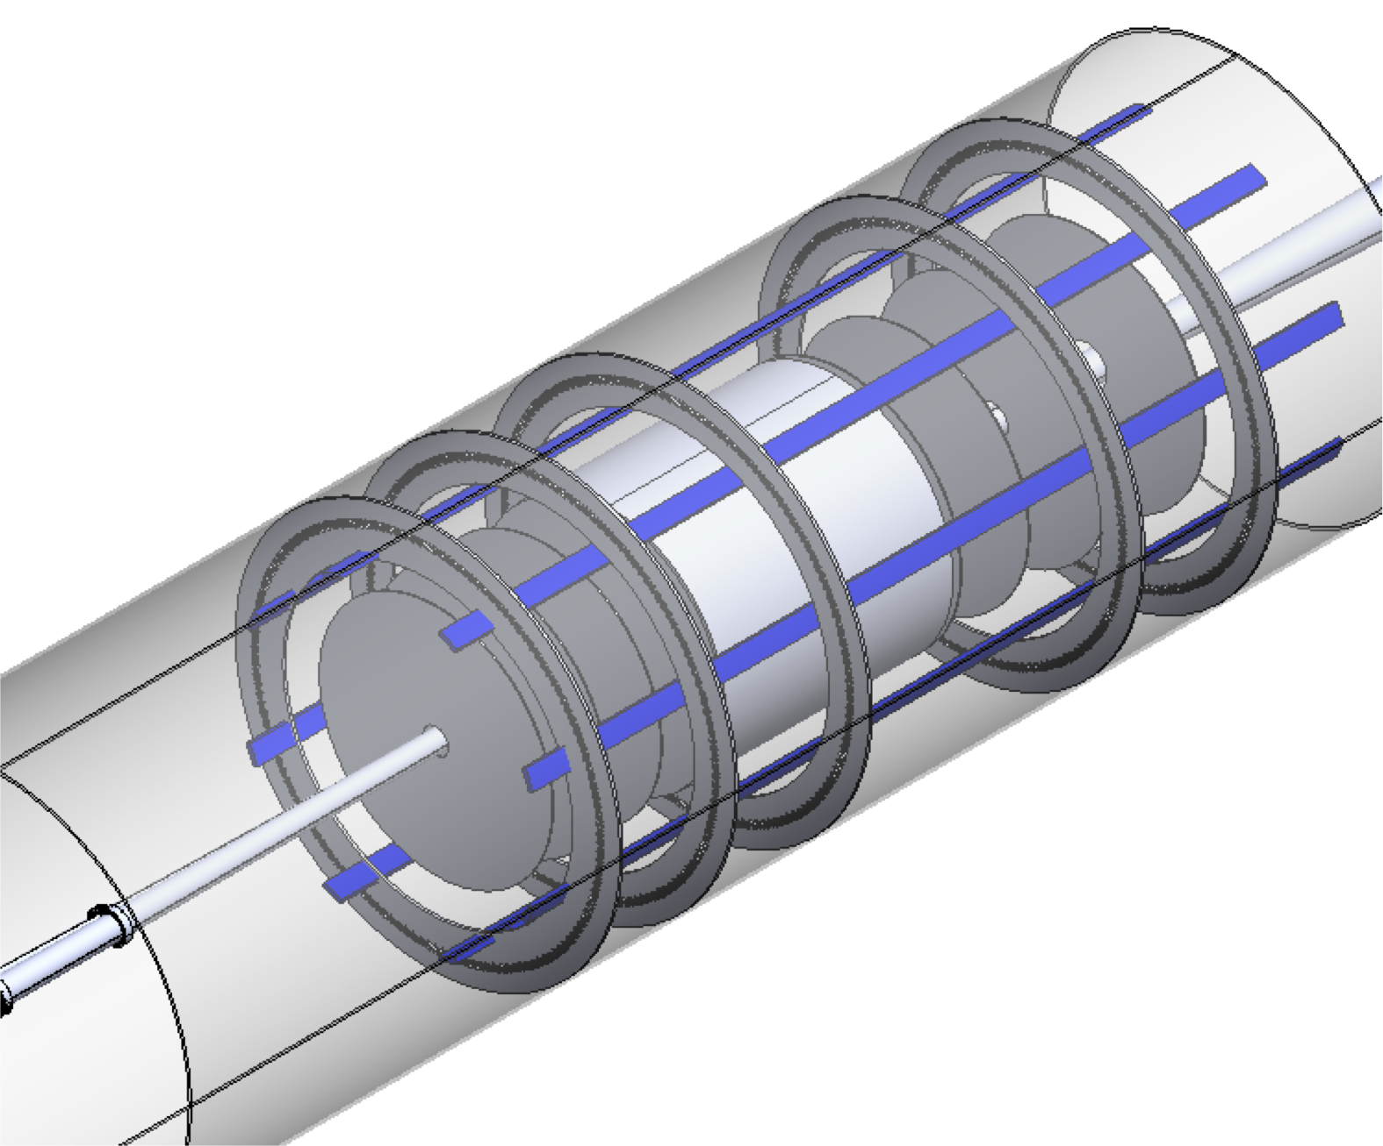

Detector Integration in ePIC
Charge 6
The assigned envelope will include the detectors and the FEB electronics.
The disks will be attached together and to the support frame under design.
$\left|η\right|$>1.72
$\left|η\right|$>1.99

Slide 17
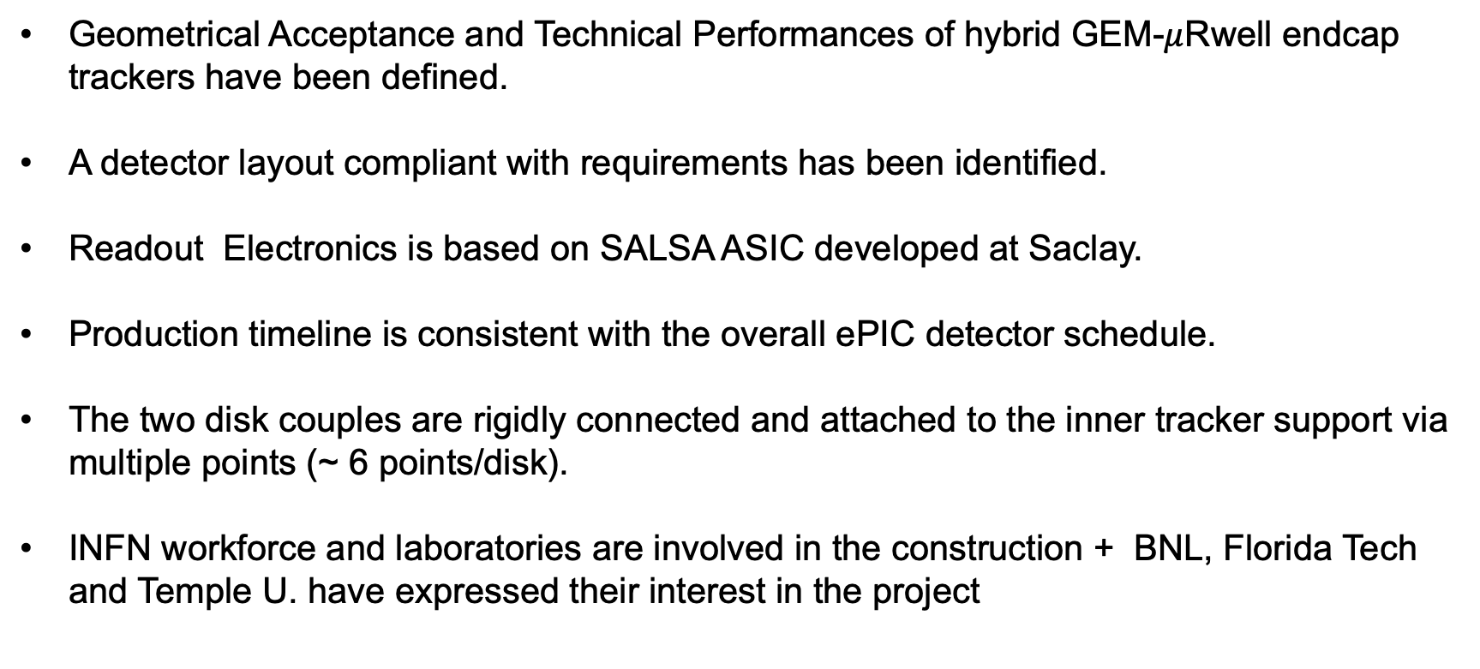
Summary
Geometrical Acceptance and Technical Performances of hybrid GEM-$μ$Rwell endcap trackers have been defined.
A detector layout compliant with requirements has been identified.
Readout Electronics is based on SALSA ASIC developed at Saclay.
Production timeline is consistent with the overall ePIC detector schedule.
The two disk couples are rigidly connected and attached to the inner tracker support via multiple points (~ 6 points/disk).
INFN workforce and laboratories are involved in the construction + BNL, Florida Tech and Temple U. have expressed their interest in the project

Slide 18
Back-up Slides

Slide 19
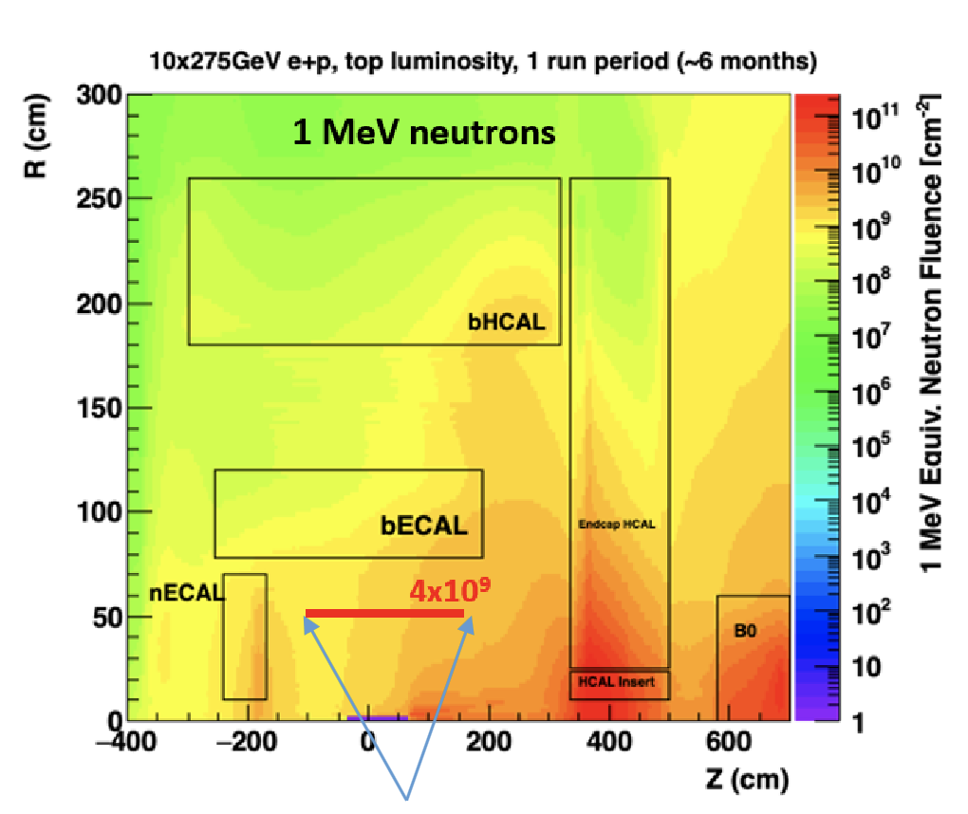
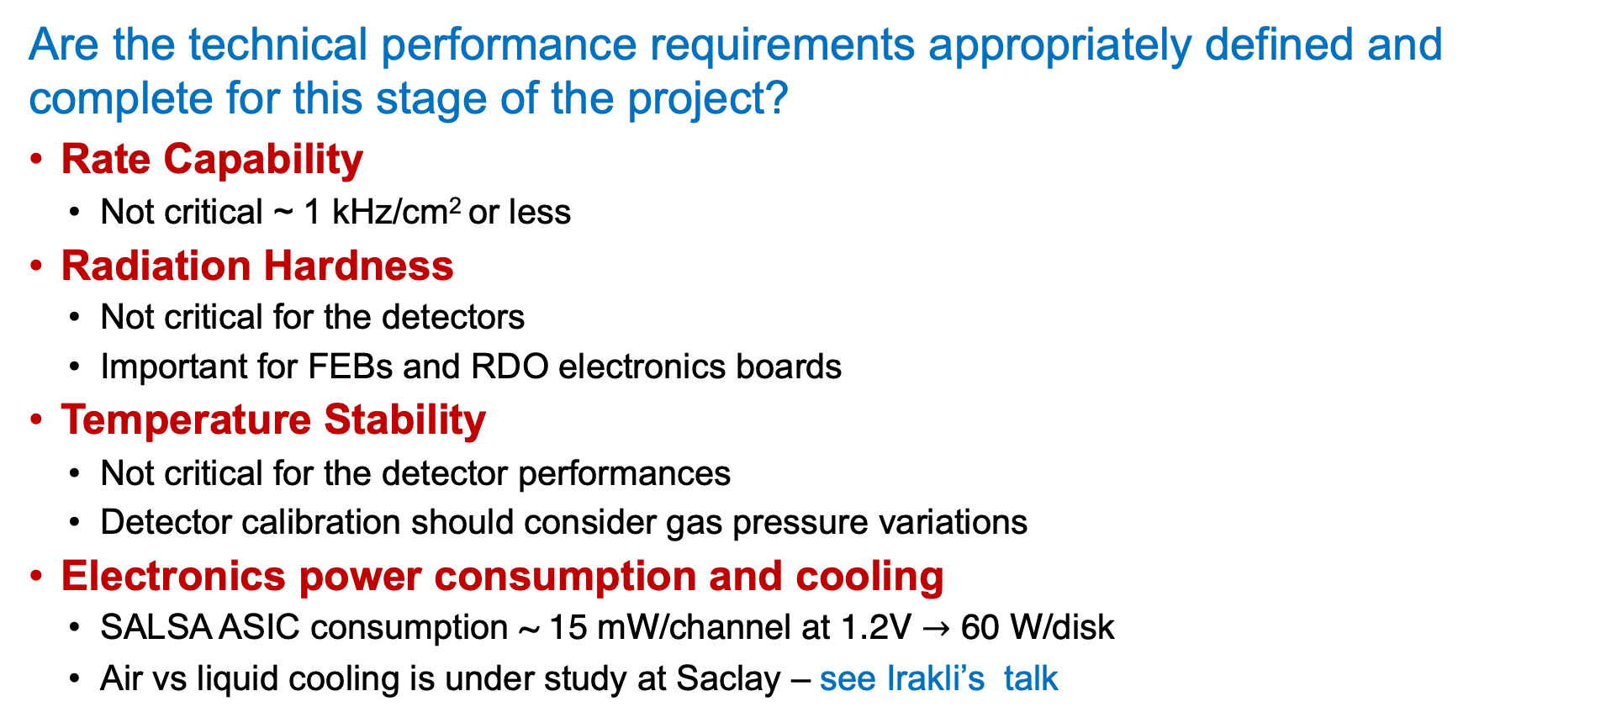
Technical performance requirements
Charge 1
Are the technical performance requirements appropriately defined and complete for this stage of the project?
Rate Capability
Not critical ~ 1 kHz/cm² or less
Radiation Hardness
Not critical for the detectors
Important for FEBs and RDO electronics boards
Temperature Stability
Not critical for the detector performances
Detector calibration should consider gas pressure variations
Electronics power consumption and cooling
SALSA ASIC consumption ~ 15 mW/channel at 1.2V $→$ 60 W/disk
Air vs liquid cooling is under study at Saclay – see Irakli’s talk
MPGD Endcaps

Slide 20
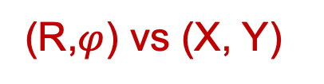
Detector performance and construction plans
Charge 2
Are the plans for achieving detector performance and construction sufficiently developed and documented for the present phase of the project?
(R,$φ$) vs (X, Y)
PROs | CONs
Direct radial and azimuthal information | The linear density of the azimuthal strips increases by a factor 10 on the inner hole
 | The radial readout hybrid FE overlaps the active area or long flex cables should be used.
 | Radial strip length varies by a factor 10.
PROs | CONs
The strip length does not vary much along the active area | Alignment is critical
All readout FE hybrids may be located outside the active area | Routes to read-out connectors must be accurately studied
(X, Y) readout is preferred vs (R,$φ$) – no FEB on the active area
500 $μm$ pitch $→$ better than 150 $μm$ intrinsic position resolution

Slide 21
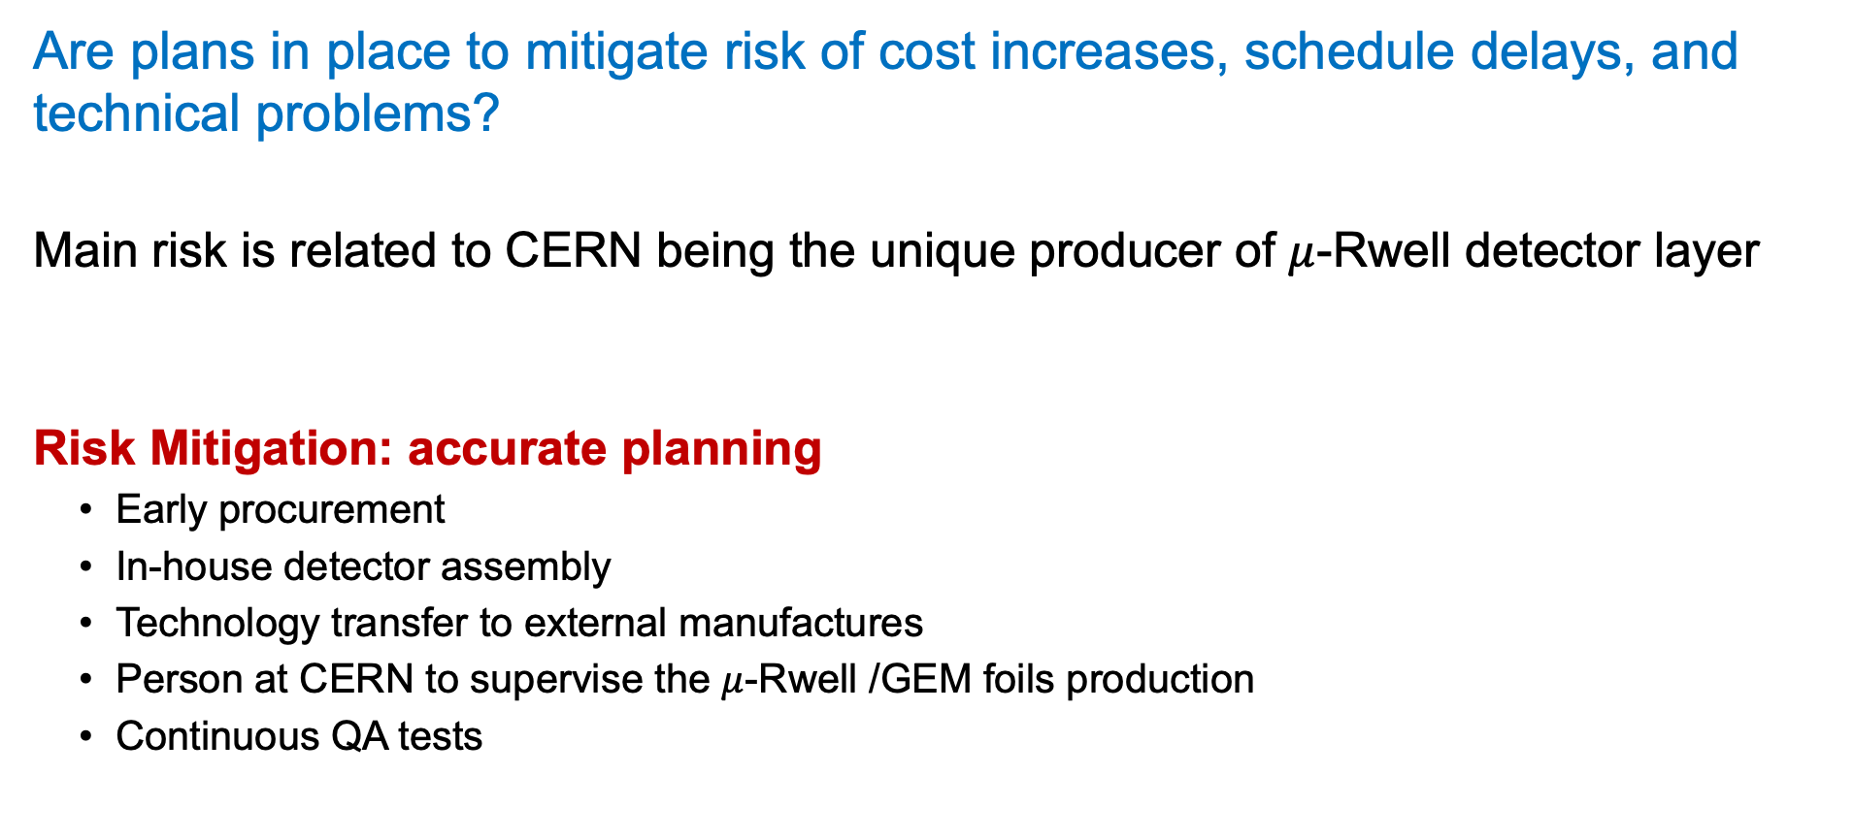
Risks Mitigation
Charge 4
Are plans in place to mitigate risk of cost increases, schedule delays, and technical problems?
Main risk is related to CERN being the unique producer of $μ$-Rwell detector layer
Risk Mitigation: accurate planning
Early procurement
In-house detector assembly
Technology transfer to external manufactures
Person at CERN to supervise the $μ$-Rwell /GEM foils production
Continuous QA tests

Slide 22
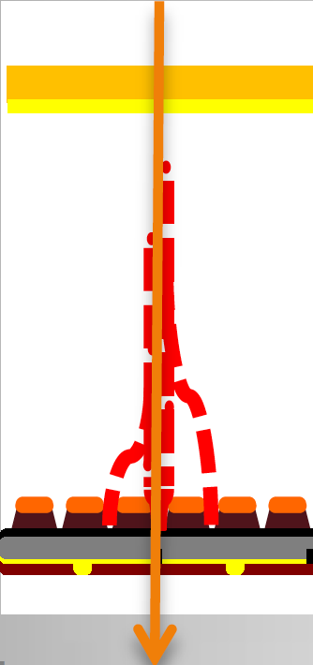
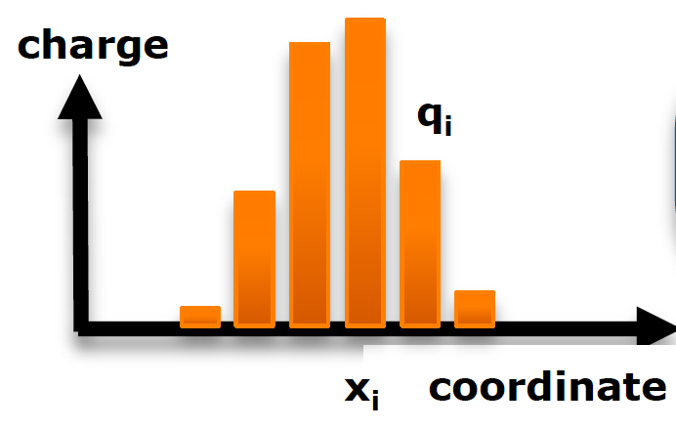
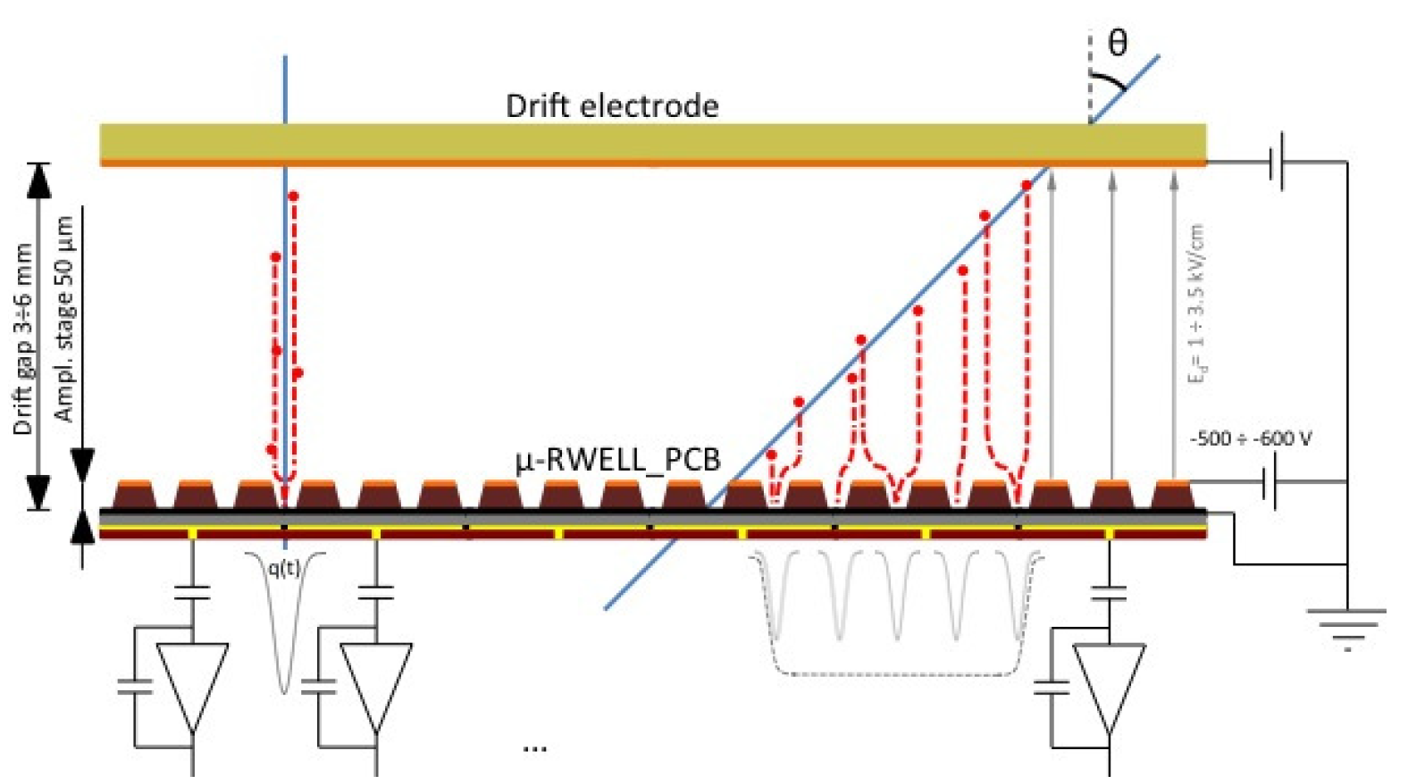
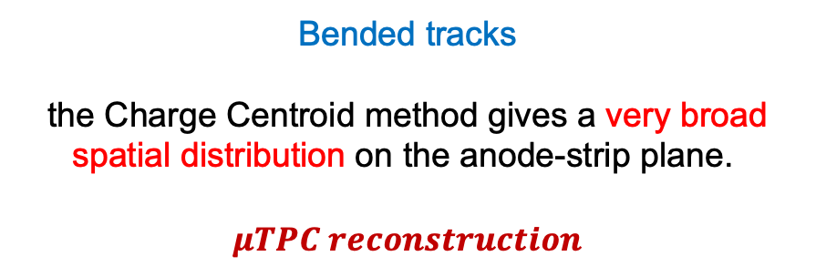
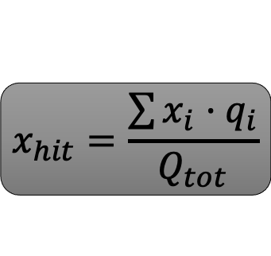
$$Spatial Resolution$$
Charge Centroid (CC)reconstruction method
The track position is determined as a weighted average of fired strips
GOOD FOR ORTHOGONAL TRACKS
$$x_{hit}=\frac{\sum{x_{i}·q_{i}}}{Q_{tot}}$$
Bended tracks
the Charge Centroid method gives a very broad spatial distribution on the anode-strip plane.
$$μTPC reconstruction$$
The spatial resolution is strongly dependent on the impinging angle of the track =>
A not uniform resolution in the solid angle covered by the apparatus => Large systematical errors.

Slide 23
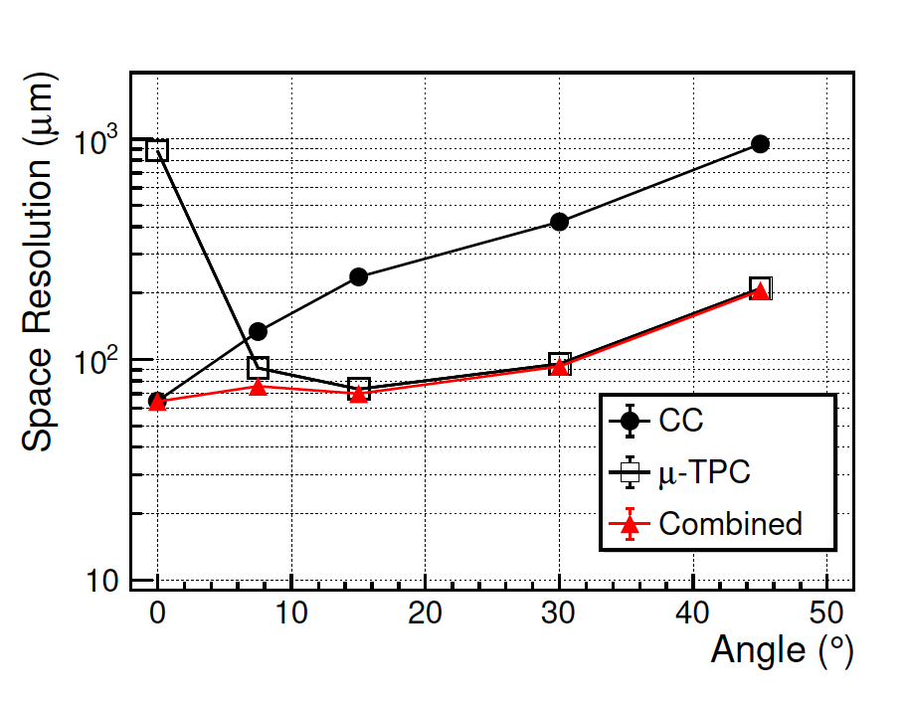
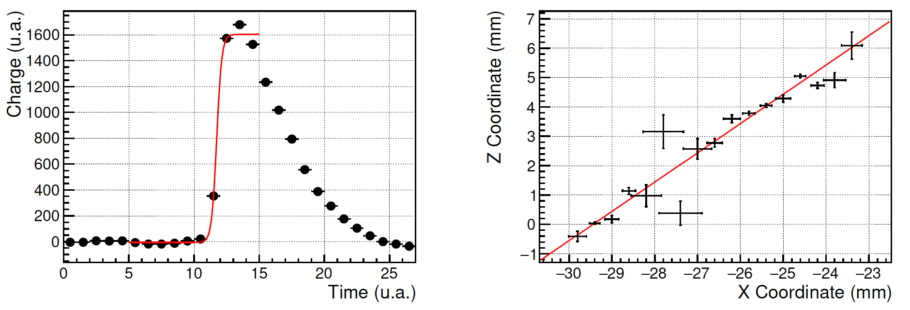

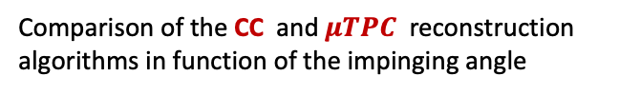
$μ$TPC reconstruction
A possible solution :
The electrons created by the ionizing particle drift towards the amplification region
In the μTPC mode from the knowledge of the drift time and the measurement of the arrival time of electrons, the track segment in the gas gap is reconstructed
The fit of the analog signal gives the arrival time of drifting electrons.
By the knowledge of the drift velocity, the 3D trajectory of the ionizing particle in the drift gap is reconstructed.
drift field $E_{D} = 1 kV/cm$
Integrated charge as a function of the
sampling time
Example of a track reconstruction using the TPC algorithm.
Comparison of the CC and $μTPC$ reconstruction algorithms in function of the impinging angle
Notes:
The idea developed for the ATLAS MicroMegas of the New Small Wheels [10, 11], and also implemented on the BESIII cylindrical GEM [12, 13], is to reconstruct a track segment inside the detector conversion gap rather than a single hit exploiting the analog readout of the signals.

