Slide 1
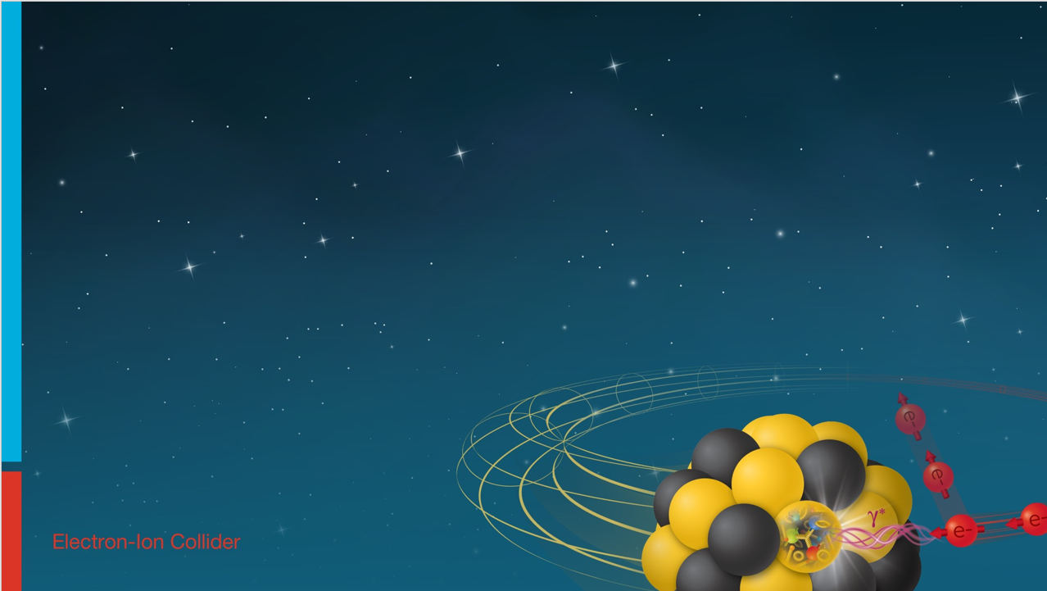

MPGD readout electronics
I. Mandjavidze
Irfu, CEA Saclay
Incremental Design and Safety Review of the EIC Tracking Detectors March 20-21, 2024

Slide 2
Outlook
Requirements
Readout architecture
Salsa ASIC
FEB
System scale
Organization
Production strategy
Planning
QA and risk mitigation
Summary
References
Signal - https://indico.bnl.gov/event/20965/contributions/82420/attachments/50649/86604/231026_IM_CyMBal_ExpectedSignal.pdf
Data collection - https://indico.bnl.gov/event/18118/contributions/72179/attachments/45781/77366/221221_MpgdDataCol_IM.pdf
Calibration - https://indico.bnl.gov/event/16040/contributions/64090/attachments/41290/69185/220520_MpgdTrack_CalibRates_IM.pdf
Salsa - https://indico.bnl.gov/event/22053/contributions/86152/attachments/52272/89395/SALSA_EPIC_electronics_DAQ_20240125.pdf
MPGD LV - https://indico.bnl.gov/event/22316/contributions/87363/attachments/52727/90159/240215_IM_MpgdPower.pdf
FEB options - https://indico.bnl.gov/event/21104/contributions/83856/attachments/51197/87574/231127_IM_Mpgd_VtrxPlus.pdf
Detailed study of FEB organization options and their powering schemes – provided in support material
Run control state machine and proposal of synchronous commands – provided in support material
Salsa and Prisme PLL IP – proposals, provided in support material

Slide 3
Charge questions addressed
Are the technical performance requirements appropriately defined and complete for this stage of the project?
Are the plans for achieving detector performance and construction sufficiently developed and documented for the present phase of the project?
Are the current designs and plans for detector, electronics readout, and services sufficiently developed to achieve the performance requirements?
Are plans in place to mitigate risk of cost increases, schedule delays, and technical problems?
Are the fabrication and assembly plans for the various tracking detector systems consistent with the overall project and detector schedule?
Are the plans for detector integration in the EIC detector appropriately developed for the present phase of the project?
Have ES&H and QA considerations been adequately incorporated into the designs at their present stage?

Slide 4
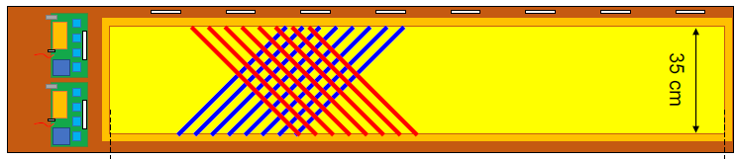
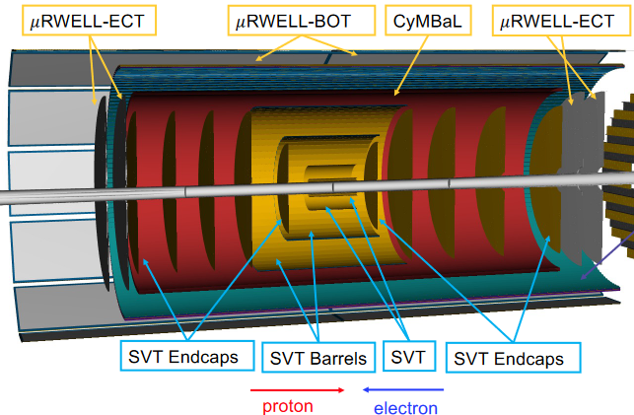
Reminder on MPGD sub-systems and channel counts
Cylindrical Micromegas Barrel Layer : CyMBaL : ~30k channels
32 tiles of 1024 channels each
µRWELL Barrel Outer Tracker : µRWell-BOT : ~100k channels
24 modules of 4 096 U-V strips each
µRWell End Cap Tracker : µRWell-ECT : ~30k channels
8 half-disks of 4 000 X-Y strips each
~160k-channel heterogeneous system
Micromegas, µRWell, barrel, endcap, curved, planar, circular
Common approach to acquire data from different types of ePIC MPGDs
Use same frontend ASIC
Share frontend design between groups
Adapt form factor if needed
45 x 60
170 x 35
R 50

Slide 5
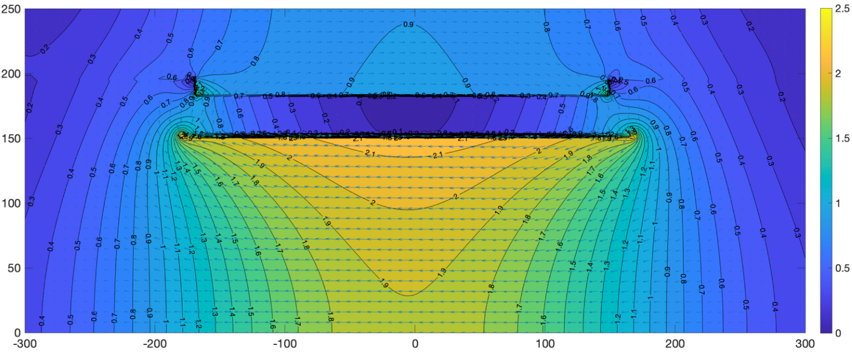
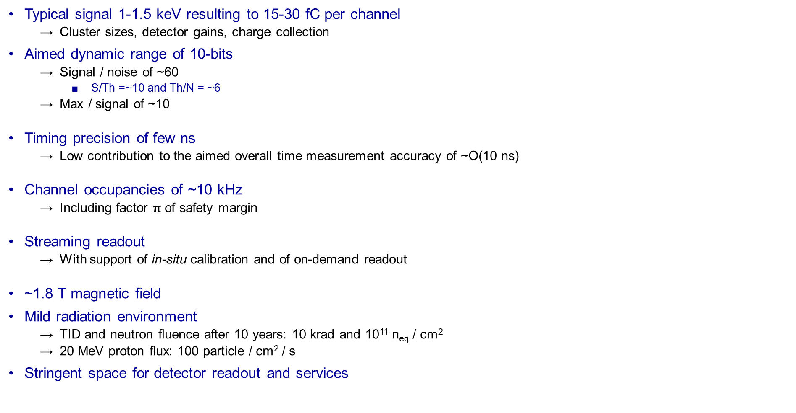
Requirements
Typical signal 1-1.5 keV resulting to 15-30 fC per channel
Cluster sizes, detector gains, charge collection
Aimed dynamic range of 10-bits
Signal / noise of ~60
S/Th =~10 and Th/N = ~6
Max / signal of ~10
Timing precision of few ns
Low contribution to the aimed overall time measurement accuracy of ~O(10 ns)
Channel occupancies of ~10 kHz
Including factor $π$ of safety margin
Streaming readout
With support of in-situ calibration and of on-demand readout
~1.8 T magnetic field
Mild radiation environment
TID and neutron fluence after 10 years: 10 krad and 10¹¹ n_{eq} / cm²
20 MeV proton flux: 100 particle / cm² / s
Stringent space for detector readout and services
Magnetic field map
R(cm)
B (T)
FEB
CyMBaL
FEB
Z(cm)
Charge 1

Slide 6
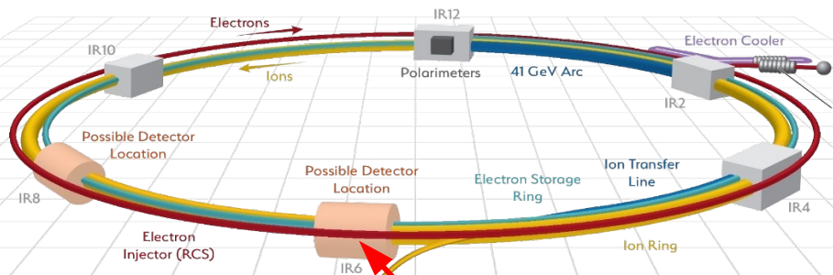


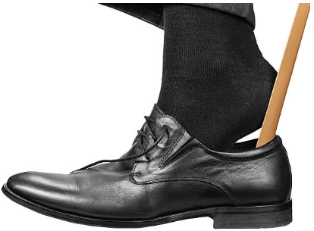


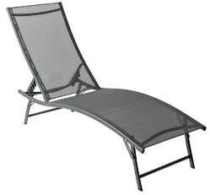
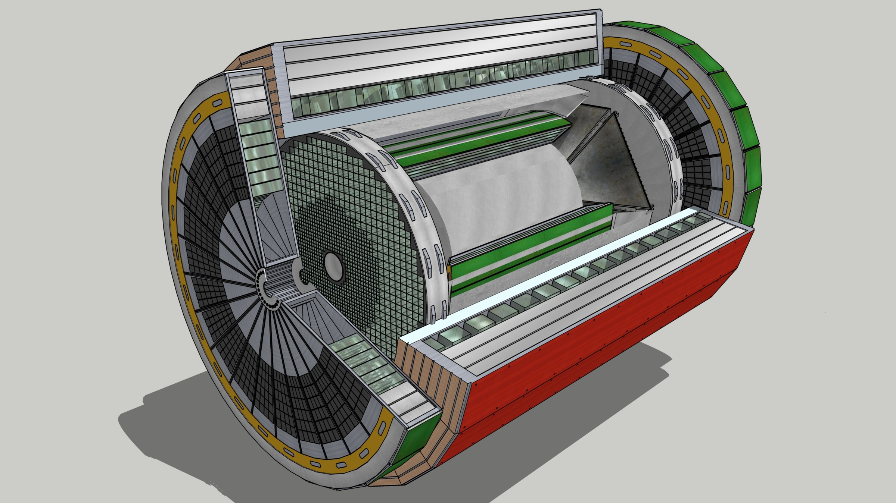
Readout organization of ePIC detector
GTU
Clock
Control
On-detector
Within detector or cavern
Friendly area
FEB
Electrical or optical
RDO
Optical fibers
DAM
FPGA
FPGA
Patch panel
E/O
O/E
On-line computing Storage
FE ASIC
Distance to be determined
No restriction on length
Place to be identified
This talk
FEB – frontend board with readout ASICs
Sub-detector specific
RDO – readout module – first stage of FEB data aggregation, last stage to dispatch clock & control
Mostly common design framework between sub-detectors, different form factor
DAM – data aggregation module – interface with computing and global timing and control unit (GTU)
Common design for all sub-detectors
Downstream towards detector : clock, control, monitoring
Upstream towards storage : physics, calibration, monitoring data
Charges 2, 3

Slide 7
Readout strategy: signal shape sampling
ZS threshold
Signal
T_{Max}
ADC clock
Signal is continuously sampled with an ADC
Signal samples above threshold are retained
Nominal (physics data) readout : signal amplitude and timing is derived
Time of max (as on example) or time of arrival (fitting samples on rising edge)
On-demand readout : signal shapes or raw non-ZS data are provided
Calibration, detector studies
Guarantees best noise immunity and thus best S/N ratio
Allows on-line common mode noise (CMN) subtraction before ZS
Charges 2, 4

Slide 8
Salsa : a 64-channel versatile MPGD readout ASIC
Trigger prim
Salsa
DSP
High speed serial IO
Tx
1 Gb/s Trigger prim
Channel 1
ZS
FIFO
Trigger
seeds
Analog Shaper
ADC
CMN
Trigger
seeds
Ampli
Timing
FIFO
B
U
F
F
E
R
CSA
ADC
Digi Shaper
Pedestal Baseline
Tx
Channel 2
1 Gb/s serial data links
Analog inputs
Tx
Channel 64
Test
FIFO
Clock management
Prisme IP
Bandgap
Bias
Slow control, monitoring & registry
Debug
Clock, trigger, synch commands
M U X
MUX
1 Gb/s serial link
Rx
CDR
I2C
Baseline
Envisaged
Data path
Trigger path
Currently under development by a collaboration of Irfu, CEA Saclay and University of Sao-Paolo
Support from Project R&D program for Salsa prototyping including clock management IP Prisme
Charges 2, 3

Slide 9
64-channel Salsa : brief recap of specifications
Channel features ePIC MPGD needs
4 dynamic ranges : 50 fC, 250 fC, 500 fC, 5 pC 250 fC
10 peaking times : from 50 ns to 500 ns 100-200 ns
Support for high input capacitances up to 1 nF and beyond ~200 pF
Both signal polarities Negative
Rate per channel : up to 100 kHz <10 kHz
Sampling rate : programmable, up to at least 50 MSPS 50 MSPS
12-bit ADC with >10-bit ENOB >9.6 bits
Digital stage programmable features
Pedestal equalization, common mode noise subtraction, zero suppression All
Baseline tracking
Signal amplitude and timing extraction Main readout option
Clock management with Prisme IP :
Wide range jitter cleaner PLL, 4 clock frequency synthesizer, phase adjustment 100 MHz
Streaming and triggered readout
Four 1 Gbit/s serial links Single Gbit/s link
Non-ZS, signal shape or time-amplitude readout All
Backend
Traditional interface with separated clock, sync command and control ports
Innovative unified interface over 1 Gbit/s input link Baseline
Implementation
65 nm TSMC
10-15 mW/ch @ 1.2V
Radiation hardened : SEU, > 300 Mrad, > 10¹³ n_{eq} / cm² 10 krad, 10¹¹ n_{eq} / cm²
Charges 2, 3

Slide 10
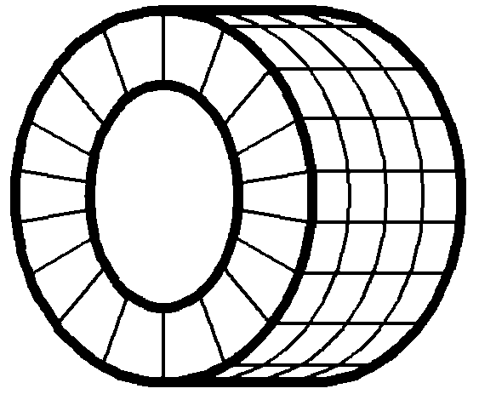

256-channel FEB with optical interface: aimed baseline
On-detector
Low restriction area
FEB
Optical fibers with no restriction on length
RDO
Adapt
ASIC 4
O F p i t r i e c F
a l
l y
O F p i t r i e c F
a l
l y
FPGA
Data
ASIC 3
Embedded clock, synch, control
E/O
ASIC 2
To / from DAM
ASIC 1
1.2V
3.3V
V_{in}=12V
Power distribution
4-Tx and 4-Rx optical FireFly
FEB
ASICs directly connected to 4-lane bidirectional parallel optic FireFly transceivers from Samtec
Single 1 Gbit/s Rx line encoding clock, sync run-control and asynchronous slow control and monitoring commands
Single 1 Gbit/s Tx line for physics, calibration, control and monitoring data
Low active component count
Easier to adapt to challenging on-detector environment
Samtec FireFly : reported to stand TID of 50-100 krad and neutron fluence of at least 5x10¹¹ n_{eq} / cm²
RDO
Based on common ePIC design with minimal adaptation for MPGDs
Can be placed anywhere in experimental hall with no particular environmental restrictions
Optimal tradeoff between complexity of the on-detector electronics and its power consumption
Charges 2, 3

Slide 11
Example of CyMBaL configuration under study
256-channel FEBs
32K channels
128 256-channel FEBs
4 Salsa ASICs per FEB
32 1024-channel RDOs
4 FEBs per RDO
32-channel µcoaxial cables
16 Salsa-s, 4 FEBs, 1 RD0 = 1024 channels
Charges 2, 3

Slide 12
FEBs, Salsa-s and RDOs for MPGDs
Estimates of operational quantities for MPGDs assuming 256-channel FEBs
Production quantities
Including prototyping, test-bench and quality assurance needs
750 FEBs
4 000 Salsa-s
200 RDOs
Work in progress to understand impact of mechanical constraints on FEB design
Possibility to use the same form factor and ASIC integration level for all MPGDs
 |  | CyMBaL |  |  | µRWell-BOT |  |  | µRWell-ECT |  |  | Total
 |  | Tile | Sub-detector |  | Module | Sub-detector |  | ½ disk | Sub-detector |  | MPGDs
FEB |  | 4 | 128 |  | 16 | 384 |  | 16 | 128 |  | 640
Salsa |  | 16 | 512 |  | 64 | 1 536 |  | 64 | 512 |  | 2 536
RDO |  | 1 | 32 |  | 4 | 96 |  | 4 | 32 |  | 160
Charge 5

Slide 13
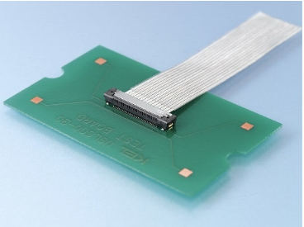
Feasibility studies
Salsa and clock management Prisme IP prototypes developed
Analog channel and clock synthesizer validated
Several alternative FEB options have been evaluated
Passive electrical RDO interface, VTRX+ optical RDO interface, merged FEB/RDO
Data collection and calibration protocols elaborated
Physics and calibration data throughput estimated
On-line periodic calibration is possible
FEB – RDO link occupancy is ~30 % : comfortable safety margin
LV power requirements estimated and power distribution schemes compared
e.g. Baseline FEB with FireFly optical interface requires : ~9W or 35 mW / channel
Detector – FEB connectivity studies on-going
Compact and low-cost micro-coaxial cable assemblies from KEL under evaluation
R&D on Samtec FireFly optical transceivers
In close contact with Samtec optical division
Bilateral NDA between Samtec and Irfu, CEA Saclay renewed
More info in links on Outlook page and in backup slides
USLS20-40-x-C
USLS00-40-A
Charges 2, 3, 4

Slide 14
Design and production strategy
Salsa will be produced and tested in quantities that will cover the needs of all ePIC MPGDs
The FEB design will be shared with all MPGD groups
If needed, FEB design adaptation for a particular geometry will be under sub-detector responsibility
Common effort to adapt RDO-s and DAM-s to MPGD readout
Firmware and Software
And partially RDO hardware
Common effort on services
LV and HV distribution, interlock, slow control and cooling
Common concern of several sub-detector systems in magnetic field
FEB and RDO production and qualification tests will be shared between several sites
Faster completion track
Especially in case of different FEB form factors
Lower risk associated with procurement and task execution delays
Charges 4, 5

Slide 15
Planning
2024
2025
2026
2027
2028
Q2
Q3
Q4
Q1
Q2
Q3
Q4
Q1
Q2
Q3
Q4
Q1
Q2
Q3
Q4
Q1
Q2
Q3
Q4
Prod review
Salsa
Salsa 1: 4-ch.
Salsa
Salsa 2: 32-ch., final package
Tender
Production
Prod review
FEB
Det interface / comp / form factor
Pre-series w/ Salsa
Proto w/ Salsa 2
Tender
Prod.
RDO
FEB interface / adaptation hw / fw / sw
Valid. w/ DAM
Prod.
Services
Keep-in zones, HV-LV dist., interlocks, cooling
Validation
Prod.
Present in each MPGD group
System
Det/FEB proto/RDO/DAM
Shipment
 Ready for deployment
Tight schedule mainly driven by Salsa development phases
With ~6-9-month contingency
Charges 4, 5

Slide 16
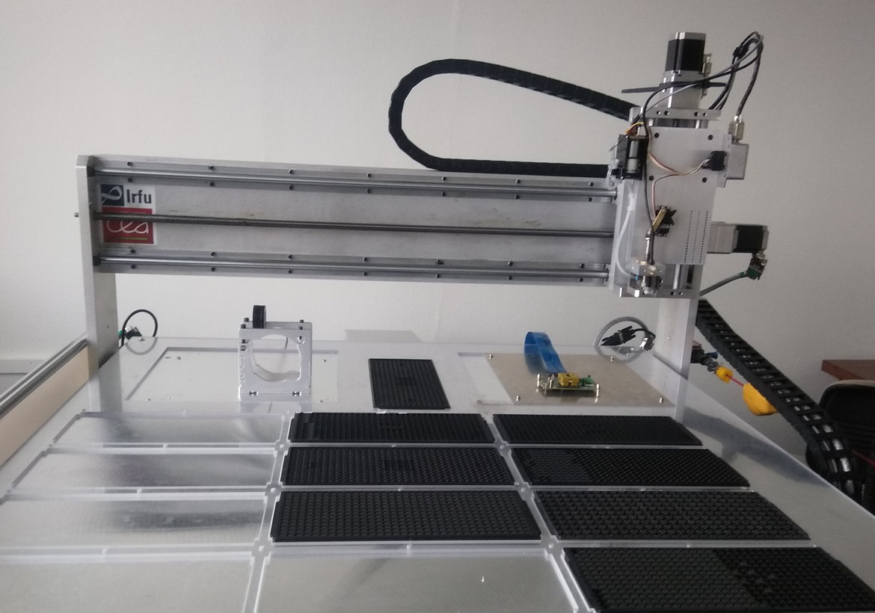
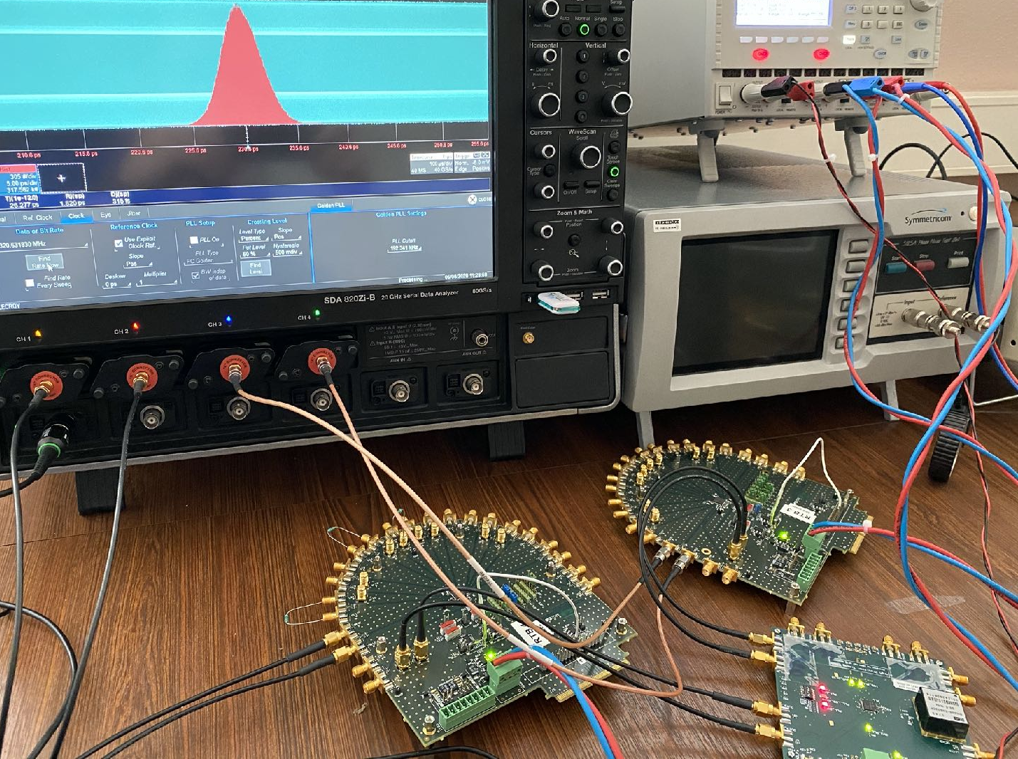
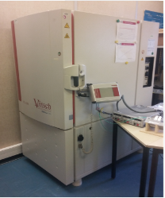
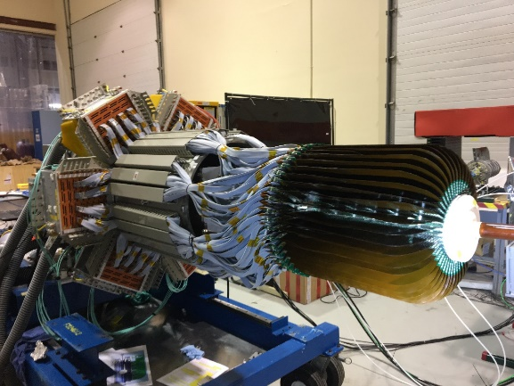
Quality assurance
Expertise at Saclay in large scale production of ASICs and frontend boards
In-house : automated ASIC tester robots and FE production test benches
In industry : providing turn-key test benches
Ex: 40 000 Rafael and 80 000 Catia ASICs for CMS Ph2 upgrade
Ex: 700 Alice Solar, 170 LTDB Atlas, 150 Clas12 FEU boards
Rich set of equipment for Salsa and FEB test benches
High-end LeCroy and Tectronix oscilloscopes
High performance phase noise analyzer
Low jitter precision clock sources
Climate chamber
Bonding machines
Expertise in system-level design, production, commissioning, maintenance
Detector – readout electronics – acquisition software – analysis
Clas12 MVT, T2K TPCs, Asacusa tracker, …
Respecting ES&H regulations of host labs (BNL, CERN, JLab, J-PARC)
Expertise in radiation hard ASIC design and validation techniques
Access to CERN, French and European radiation source facilities
Access to high magnetic field facilities
At CERN and at Saclay
Charge 7

Slide 17
Identified risks and their mitigation
Unexpected Salsa behavior or performances issues
Diagnostic-correction-production-validation cycle may require 1 year
Delays in mass-production of FEBs and RDOs
At least two production and validation sites
Component procurement delays
Usual practice of anticipated acquisition of long lead time components of choice
Establishing privileged partnership with manufacturers
e.g. Irfu CEA Saclay has renewed bilateral NDA with Samtec optical division
Radiation impact on COTS components
Use of components from the list of components proven for radiation tolerance
Validation of components in radiation facilities for ePIC-like ionization doses and particle fluxes
SEU : implementing error detection and recovery mechanisms adopted by ePIC collaboration
Noise impact on data volume
On-line coherent noise subtraction
Enough bandwidth to readout signal shapes and apply more sophisticated discrimination algorithms on-line
Charge 4

Slide 18
Summary
Envisaged solutions for the ePIC MPGD readout are viable and cover performance requirements
Engaged groups have necessary experience for large scale system design, production and commissioning
R&Ds are on-going
Detector – FEB connectivity
Integrated ASIC interface
COTS components validation for ePIC environment
Design of Salsa ASIC drives current planning
Closely following and contributing to collaboration-wide efforts
Precise identification of keep-in-out zones between the sub-detectors
Efficient low form factor magnetic-field tolerant powering means
Defining of run-control state machine and set of rules that detector partitions need to obey
Error detection and recovery strategy
Pursuing discussions within the MPGD DSC to identify second site for FEB design and production
In addition to Irfu, CEA Saclay
Planning is compatible with the overall ePIC installation schedule

Slide 19
Backup

Slide 20
Readout strategy: signal shape sampling
Signal
ZS threshold
Phase
ADC clock
BX clock
BX counter
Origin
O+1
O+2
O+3
O+4
O+5
O+6
O+7
O+8
O+9
O+10
O+11
O+12
O+13
O+14
T_{Max}
Rev counter
R-1
R
R+1
R+2
ADC clock is derived from bunch crossing clock and is its (sub)multiple (e.g. ~50 MHz)
Known frequency and phase relationship exists between the two clocks
Signal above threshold is tagged by a timestamp relative to revolution tick
Max (as on example) or time of arrival (fitting samples on rising edge)
Timing association with data from other sources possible

Slide 21
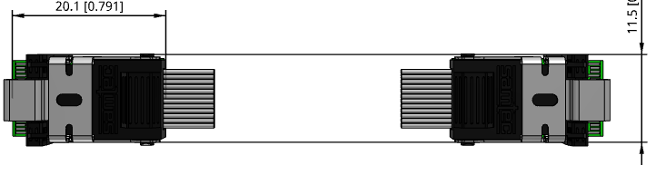
Backup option: 256-channel FEB with electrical interface
On-detector
Low restriction area
FEB
RDO
Shielded twinax copper cables
Adaptation
ASIC 4
Buffer
driver
P F a i s r s e i F
v l
e y
P F a i s r s e i F
v l
e y
Buffer
driver
FPGA
Data
ASIC 3
Embedded clock, synch, control
E/O
To / from DAM
ASIC 2
ASIC 1
8-lane passive electrical FireFly
1.2V
2.5V
V_{in}=12V
Power distribution
FEB
ASICs directly connected to 4-lane bidirectional parallel optic FireFly transceivers from Samtec
Single 1 Gbit/s Rx line encoding clock, sync run-control and asynchronous slow control and monitoring commands
Single 1 Gbit/s Tx line for physics, calibration, control and monitoring data
Low active component count
Easier to adapt to challenging on-detector environment
Samtec electrical FireFly : drop-in compatibility with optical counterpart
RDO
Based on common ePIC design with minimal adaptation for MPGDs
Possibly can be placed in a low restriction area
Attention must be payed for ground loops and noise pickup over long distance

Slide 22
Frontend data volume estimates
Estimated CyMBaL physics data bandwidth per Salsa ASIC
Physics: support two zero suppression modes
Nominal : peak finding readout
12-bit amplitude, 12-bit time of max, 8-bit ToT
On-demand : full signal shape readout
All samples (12-bit) above threshold (typically 15-25)
On-line calibration : on demand readout
Programmable number of non-ZS samples
Signal shape for calibration pulse
FEB – RDO link occupancy : ~30 %
Comfortable safety margin, even for on-demand signal shape readout
Overall physics frontend data of MPGDs
Accurate estimates still to be done
NB: in nominal operation, the bulk of the physics frontend data will be further processed before being archived
e.g. clustering
Channel rate kHz |  | Peak finding Mbit/s |  | Signal shape Mbit/s
10 (5 x safety) |  | 40 |  | 265
Estimated calibration data bandwidth per ASIC ~6 Mbit/s
 |  | CyMBaL |  | µRWell-BOT |  | µRWell-ECT |  | Total
Data (Gbit/s) |  | 35 |  | 100 |  | 35 |  | 170

Slide 23
Excerpt from data collection protocol proposal
Rev counter: R-1
R
R+1
DAM
FEB k
RDO
n
FE ASIC
Payload: R
DH
HB
FEB
j
RDO
m
FE ASIC
Payload: R
DH
HB
Revolution R-2
R-1
R
R+1
Broadcast “RevTick” sync commands
Combine FEB (ASIC) data belonging to the same revolution
If needed, heartbeat (RevTick) acknowledgement is sent after the last data belonging to the same revolution
Revolution-level granularity might be handy for fragment building in RDO and in DAM
A compromise between memory requirement and aggregation
If too long, data fragments can be sent in a succession of packets
DAM performs revolution record building based on revolution numbers embedded in data
Heartbeat packet can be used as indication that no more data is expected from RDO or FEB for this revolution
In other words, consider the RevTick as a 78.195 kHz constant rate trigger
Do classical event building in RDO and DAM with a readout window of ~12.7886 µs

Slide 24
Calibration example : single “Calib” request – window readout
DAM
RDO
n
FEB k
FE ASIC
Physics: R
DH
Calibration: R
CH
HB
RDO
m
FEB
j
FE ASIC
Physics: R
DH
Calibration: R
CH
HB
Gap
Rev counter: R-1
R
R+1
Broadcast “RevTick” sync commands
Multicast “Calib” sync command
Pedestal variation
A “Calib” request results in a window readout
N consecutive samples
Full readout of non-ZS data
All channels of all ASICs in concerned FEBs
Window size programmable
“Calib” command distributed in barrel shifter mode
Only to a predefined FEBs to avoid data congestion
A special “TestPulse” command to fire on FEB pulser
Read ASIC response to know charge
S_{k}
S_{k+1}
S_{k+2}
S_{k+3}
S_{k+4}
S_{k+5}
S_{k+6}
S_{k+7}
S_{k+8}
S_{k+9}
S_{k+10}
S_{k+11}
S_{k+12}
S_{k+13}
S_{k+14}
S_{k+15}
S_{k+16}
“Calib”
Window of N consecutive samples
12 in this example

Slide 25
LV power distribution for MPGD frontends
Powering fronted electronics in ~2 T magnetic field is a challenge task
Efficient scheme requires on-board magnetic field tolerant DC/DC converters
Coupled with ultra low drop-out (LDO) linear regulators
Avoids significant power dissipation in LV cables
256-channel FEB with a bidirectional 4-lane FireFly optical interface : 9 W or 35 mW / channel
LV wire cross-section : 1 mm²
NB : In absence of DC-DC converters, LDO-based power distribution will require 5.5 mm² wires
Estimates of MPGD sub-detector power needs
Engaging common intra- and extra-MPGD efforts to devise power distribution and cooling infrastructure
Profit from expertise available within the Project in small form factor magnetic field tolerant DC-DC converters
FEB (illustration only)
Remote power supply
<12.5V
12V
1.5V
1.2V
80% DC-DC
Ultra LDO
ASIC
20 m
 |  | CyMBaL |  |  | µRWell-BOT |  |  | µRWell-ECT |  |  | Total
 |  | Tile | Sub-detector |  | Module | Sub-detector |  | ½ disk | Sub-detector |  | MPGDs
Power(W) |  | 36 | 1.2k |  | 144 | 3.5k |  | 144 | 1.2k |  | 6k

Slide 26
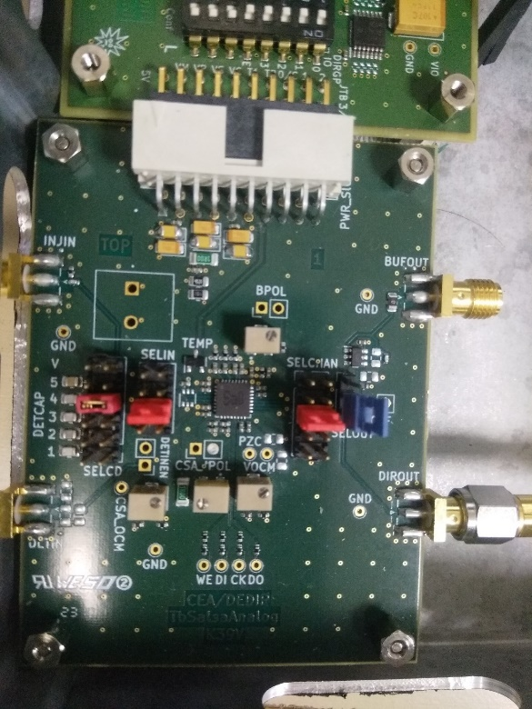
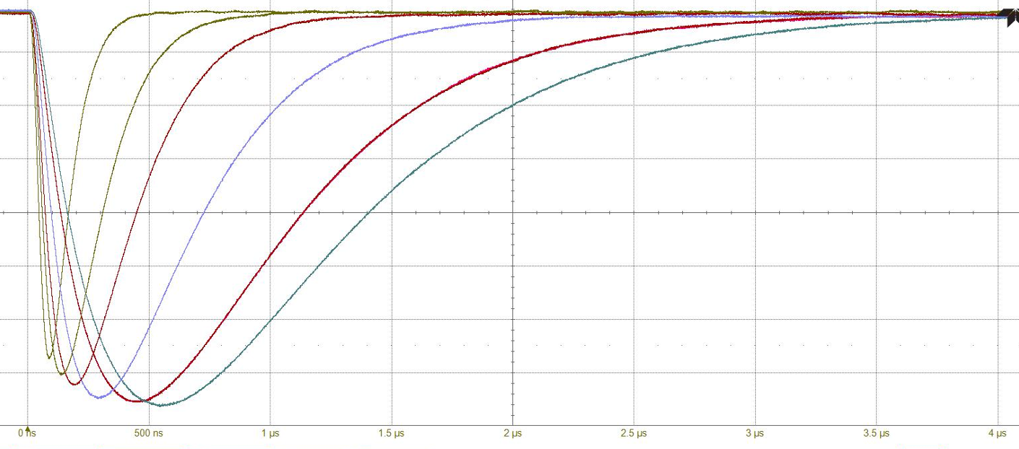
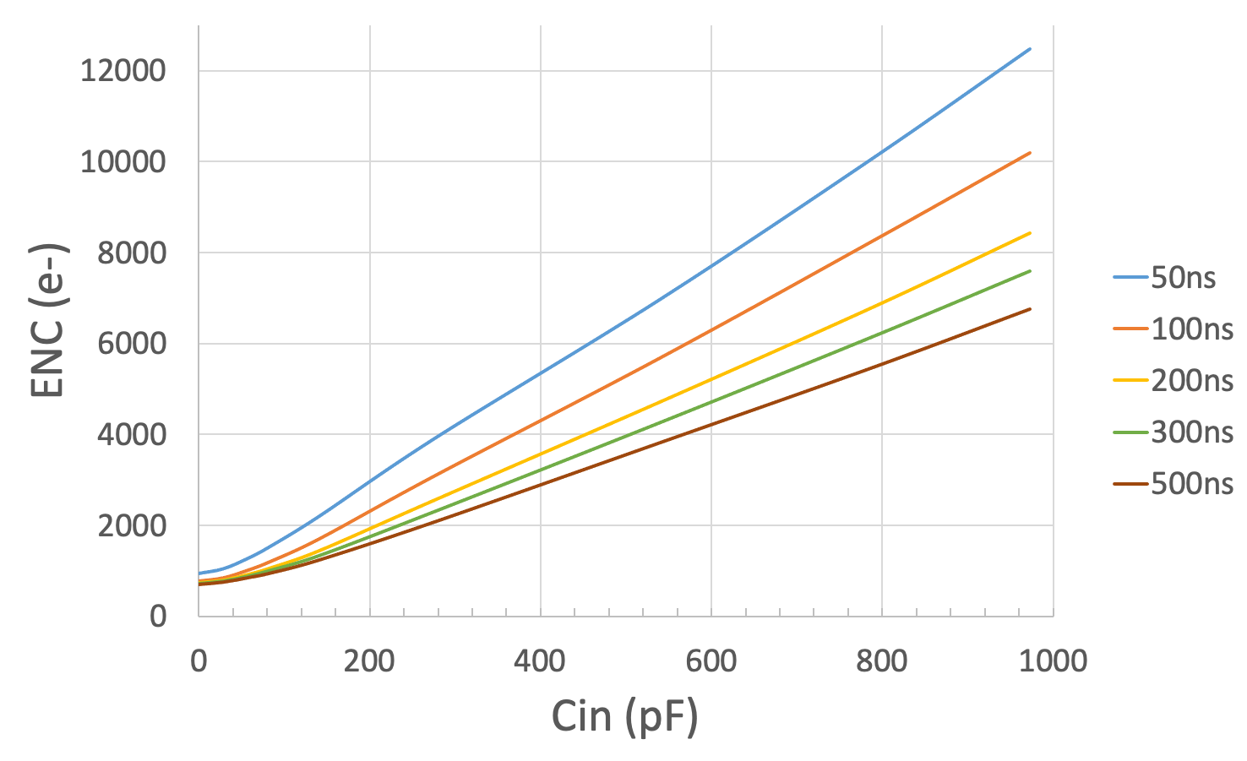
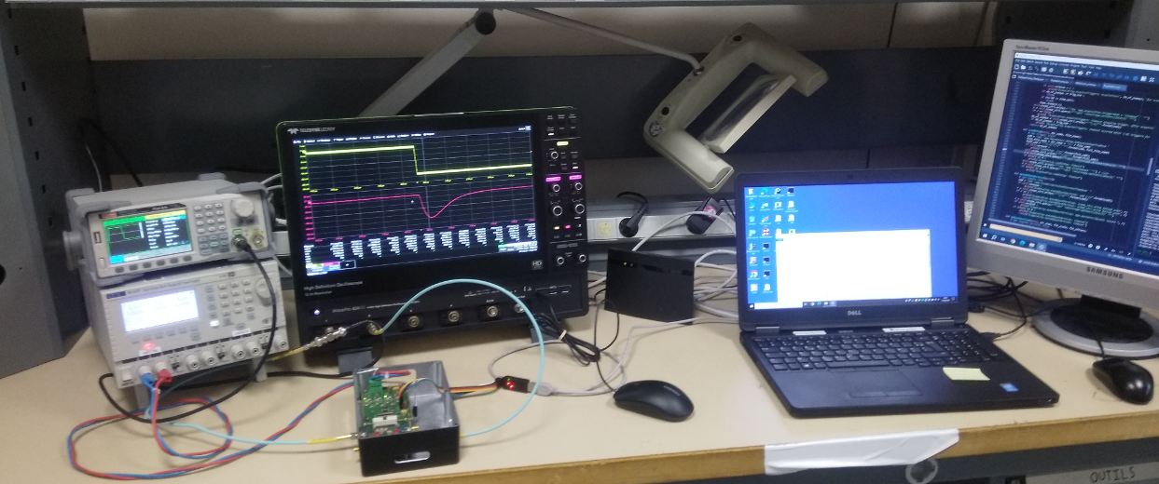
Salsa0Analog: very frontend prototype
Prototype ASIC with 4 channels
4 dynamic ranges : 50 fC, 250 fC, 500 fC, 5 pC
10 peaking times : from 50 ns to 500 ns
Support for high input capacitances
Both signal polarities
Programmable Peaking time
50 ns to 500 ns
SalsaAnalog
250 fC range
Equivalent Noise Charge in 250 fC range
500ns
Power board
Test bench
Typical 120 pF input capacitor
2000 e- at 50 ns
1200 e- at 500 ns

Slide 27
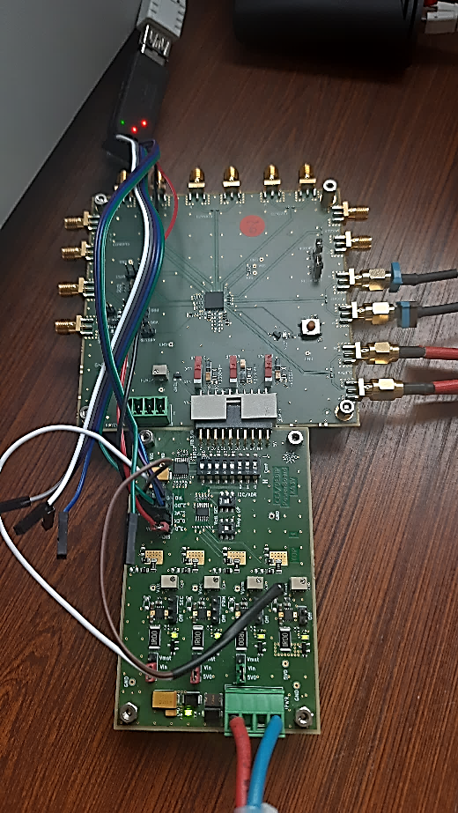
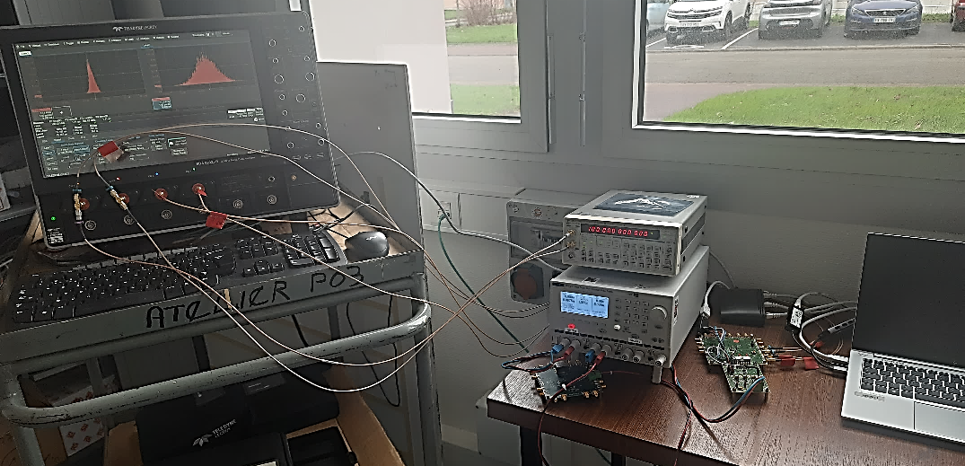
Prisme: clock management jitter cleaner PLL IP
Prisme prototype to test a new 65 nm hybrid PLL IP for Salsa and high fidelity fan-out ASIC
Large input frequency range
4 clock outputs with programmable frequencies and phase
Test boards arrived end of February
Test bench completed clock generator, high-end 80 GS/S scope and phase noise analyzer
Preliminary results
Power consomption nominal
I2C working to read and write registers
Low voltage differential (CLPS) receivers and transmitters operational
Digital branch of PLL operational
Allows to find the right frequency range for the analog branch
Internal oscillator reaches nominal 3.2 GHz
Locks occur for 40 MHz and 100 MHz input
All for outputs tested with programmable frequencies
Ongoing tests on jitter characterization and optimization
Prisme test bench
Prisme
Power board

Slide 28
Planning
Salsa
2024 : Salsa1
Several fully instrumented channels including analog very fronted and 12-bit MSPS ADC
Clock management circuitry based on Prisme IP
2025 : Salsa2
A 32-channel prototype with main DSP functionalities and serial link interfaces targeting final packaging
Prototyping of unified backend interface based on a serial link
2026 : Salsa pre-series
A 64-channel fully functional prototype
2027 : Mass production
FEB
2024-2025 : small prototype developments
Assessment of COTS components – e.g. power and monitoring solutions for radiation and magnetic field environment
R&D on detector – FEB interface connectors
FEB form factor and Salsa integration studies for different MPGDs
Validation of unified interface with ASICs
2026 : advanced prototype development
Based on Salsa2
2027 : Pre-series production
Based on pre-series Salsa
2028 : Mass production

Slide 29
Planning
RDO
2024 – 2025 : FEB – RDO interface specification and validation, plus adaptation hardware design
2026 : FEB-RDO communication validation based on Salsa2 prototype systems
2027 : RDO production
Services
2024 : Identify clearly keep-in-out zones
2025 : Validate LV distribution & come out with cooling scheme, plus interlocks
Profit from rich expertise within the ePIC groups on magnetic field tolerant DC/DC regulators
2026-2027 : production
System
2027 : Fully instrumented slice for every group
including FEB prototypes, at least two RDOs and a DAM
2028 : Full system chain validation
Including slow control and monitoring

