Slide 1
Silicon: Overview
Ernst Sichtermann
ePIC Silicon Vertex Tracker Detector Subsystem Collaboration Lead
Lawrence Berkeley National Laboratory

Slide 2
Charge Questions Addressed
Are the technical performance requirements appropriately defined and complete for this stage of the project?
Are the plans for achieving detector performance and construction sufficiently developed and documented for the present phase of the project?
Are the current designs and plans for detector, electronics readout, and services sufficiently developed to achieve the performance requirements?
Are plans in place to mitigate risk of cost increases, schedule delays, and technical problems?
Are the fabrication and assembly plans for the various tracking detector systems consistent with the overall project and detector schedule?
Are the plans for detector integration in the EIC detector appropriately developed for the present phase of the project?
Have ES&H and QA considerations been adequately incorporated into the designs at their present stage?

Slide 3
Outline
Requirements
Sensor
Sensor Tiling and Grouping
Local Mechanics
Detector Subsystem Collaboration
Timeline
Risks and Mitigation
Summary

Slide 4
Requirements

Slide 5
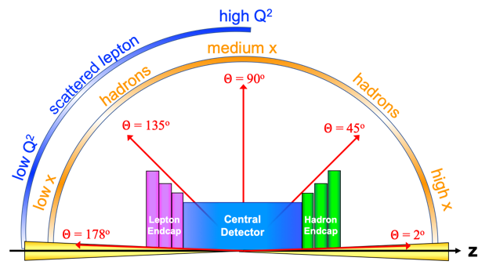
Performance Requirements
Charge 1
https://eic.jlab.org/Requirements/index.html
Based on physics in the Yellow Report
 | Momentum Resolution | Spatial Resolution
Backward (-3.5 to -2.5) | ~0.10%×p⊕2.0% | ~ 30/pT µm ⊕ 40 µm
Backward (-2.5 to -1.0) | ~ 0.05%×p⊕1.0% | ~ 30/pT µm ⊕ 20 µm
Barrel (-1.0 to 1.0) | ~0.05%×p⊕0.5% | ~ 20/pT µm ⊕ 5 µm
Forward (1.0 to 2.5) | ~0.05%×p⊕1.0% | ~ 30/pT µm ⊕ 20 µm
Forward (2.5 to 3.5) | ~0.10%×p⊕2.0% | ~ 30/pT µm ⊕ 40 µm

Slide 6
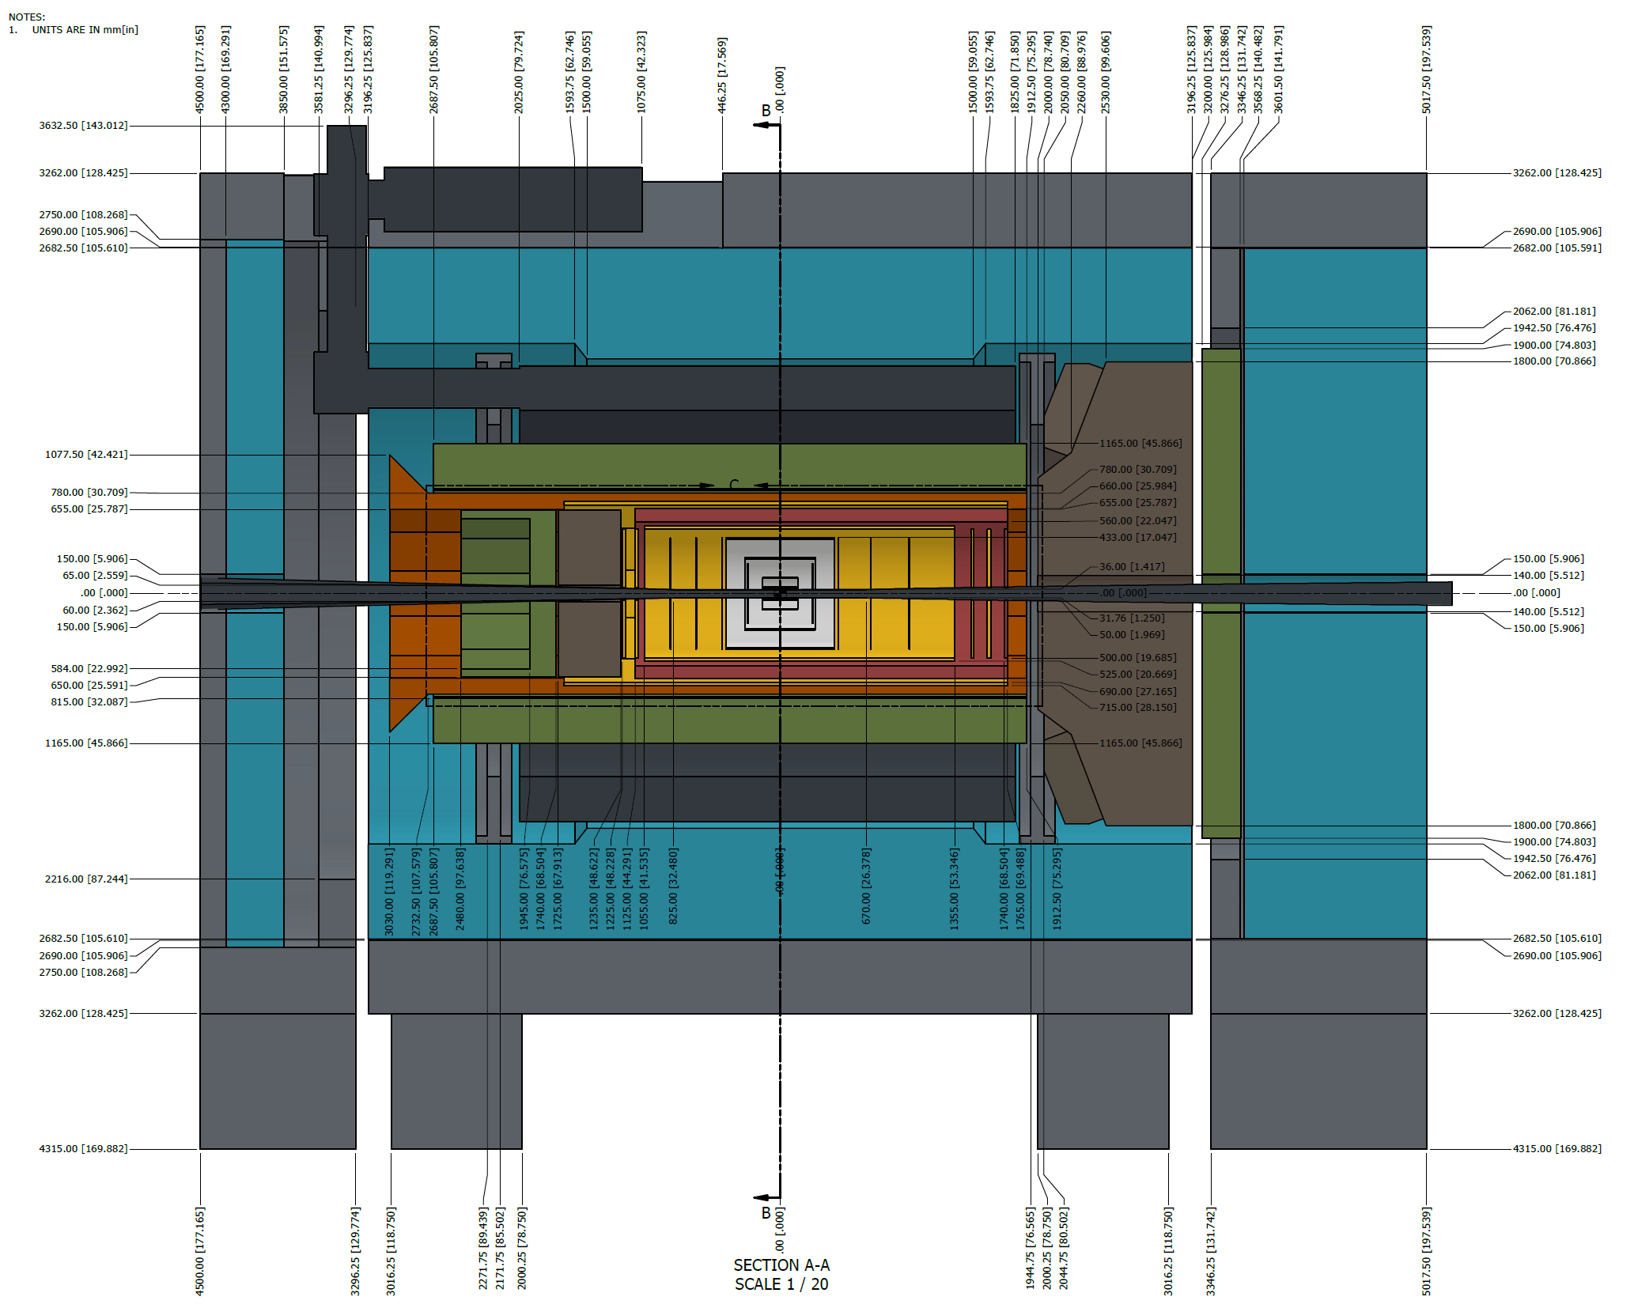
Experiment Constraints
Charge 1,6
Spatial extent along the beam axis:
-106.25 < z_{SVT} < 136.25 cm
Radially:
r_{out} < 43.00 cm
r_{in}(z) determined by beam-pipe + 5mm
Beam-pipe bake-out with SVT installed; clamshell of detector halves,

Slide 7
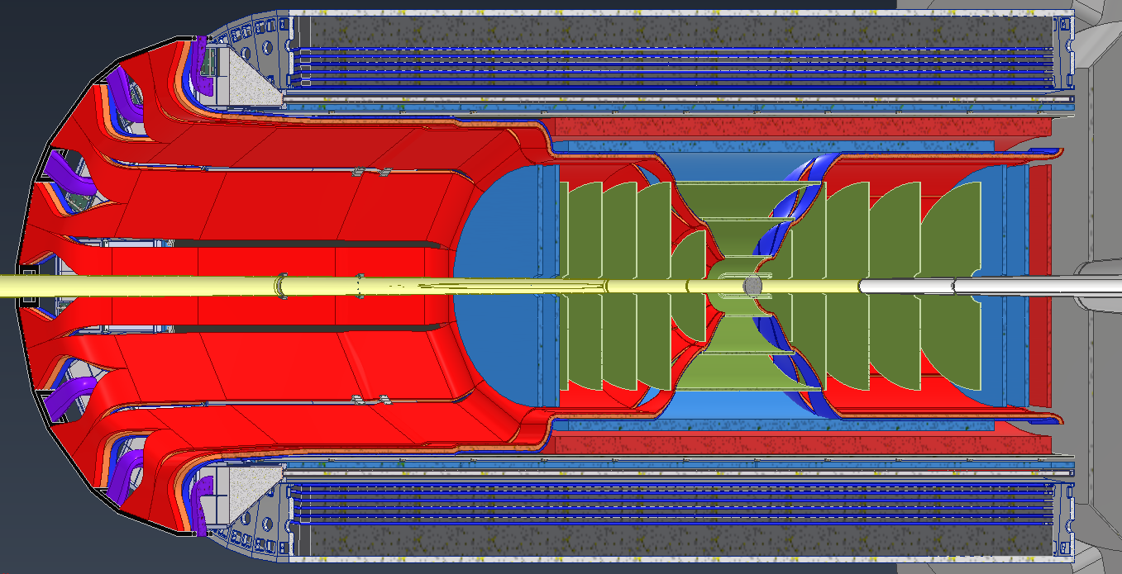
Experiment Constraints
Charge 1,3
Spatial extent along the beam axis:
-106.25 < z_{SVT} < 136.25 cm
Radially:
r_{out} < 43.00 cm
r_{in}(z) determined by beam-pipe + 5mm
Beam-pipe bake-out with SVT installed; clamshell of detector halves,
Minimized services – space is at a premium.

Slide 8
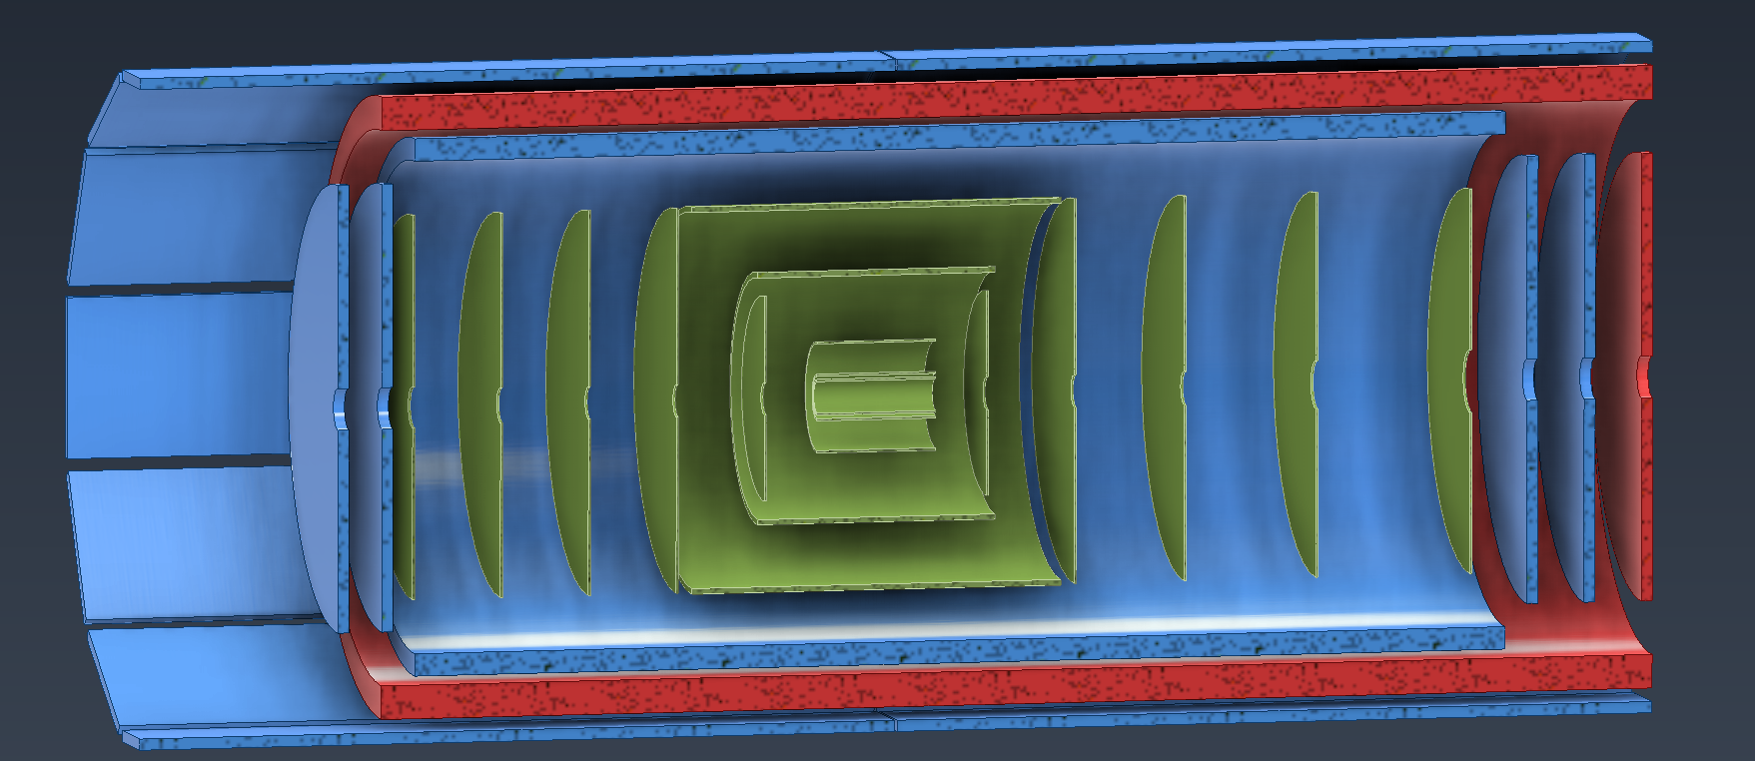
SVT Concept
Charge 1,2
Inner Barrel (IB)
Three layers, L0, L1, L2,
Radii of 36, 41, 120 mm
Length of 27 cm
X/X₀ ~ 0.05% per layer
Curved, thinned, wafer-scale sensor
Outer Barrel (OB)
Two layers, L3, L4
Radii of 27 and 42 cm
X/X₀ ~0.25% and ~0.55%
More conventional structure w. staves
Electron/Hadron Endcaps (EE, HE)
Two arrays with five disks
X/X₀ ~0.25% per disk
More conventional structure
Lengths for L2—L4 increase so as to project back to z = 0; disk radii adjust accordingly
Inner Barrel (IB)
Outer Barrel (OB)
Electron and Hadron Endcap Disks (EE, HE)

Slide 9
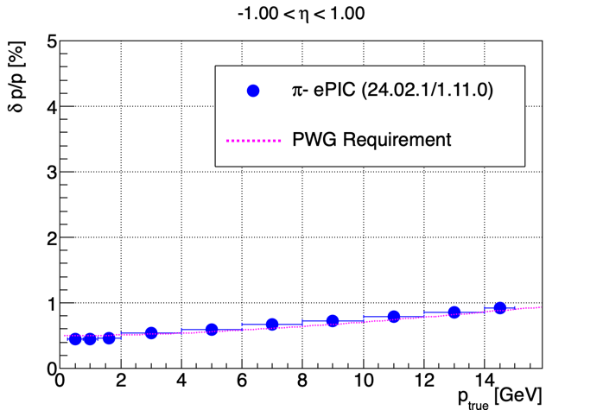
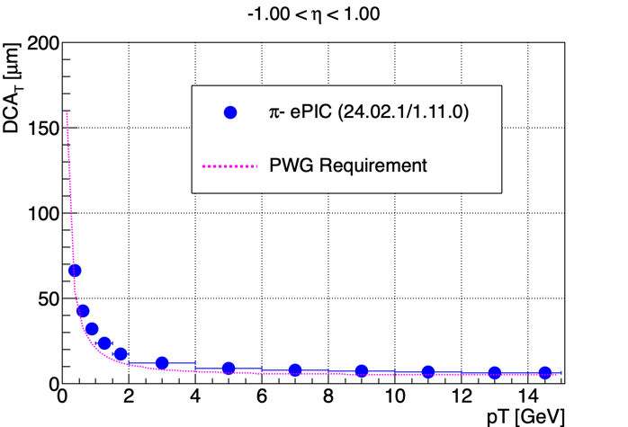
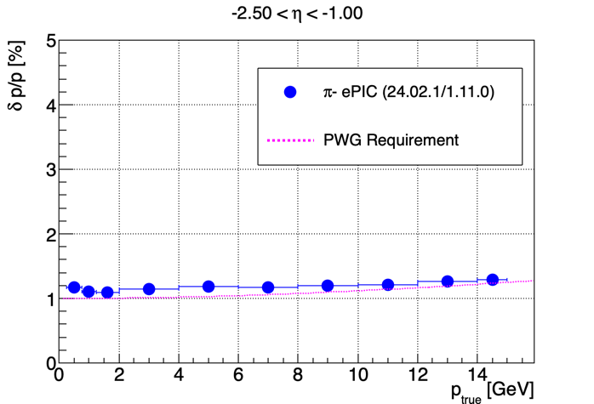
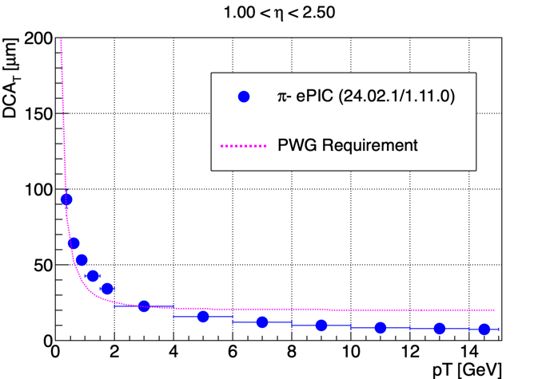
Preliminary Performance
Charge 2,3
SVT concept is optimized for resolution,
Simulated resolutions meet the requirement in the central region,
Simulated resolutions substantially meet the requirements in the forward/hadron and backward/electron region,
Physics objectives in the far backward/ electron region will need to be met by means of a combination of precision tracking and precision electron calorimetry.
Momentum
Distance of Closest Approach

Slide 10
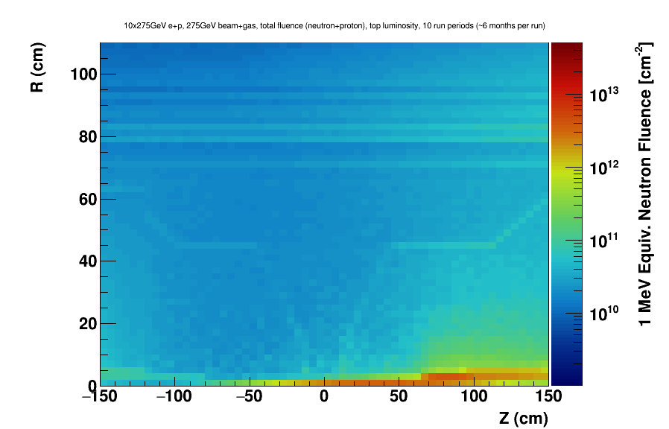
Preliminary Radiation Environment
Charge 1
Preliminary
Evaluation for:
10 GeV electron beam,
275 GeV proton beam,
10⁻³⁴ cm⁻²s⁻¹ luminosity,
DIS interactions (~ 500kHz),
Beam-gas background 10 kAhr,
No synchrotron radiation (yet),
10 half-year running periods,
100% up-time,

Slide 11
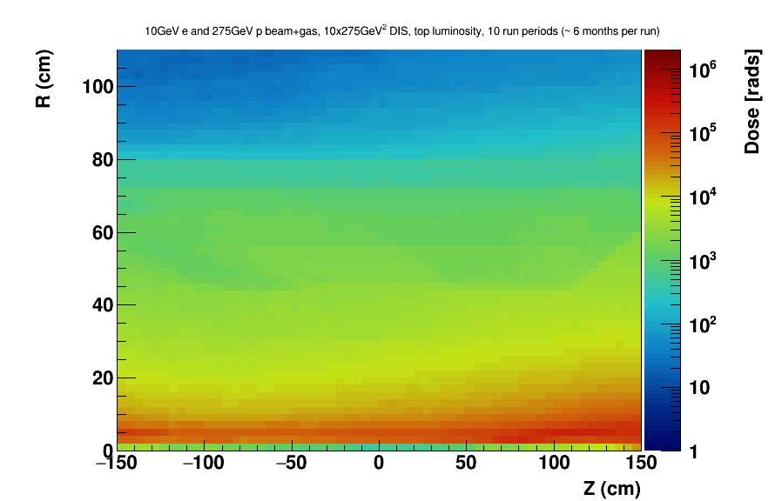
Preliminary Radiation Environment
Charge 1
Region close to the beampipe is projected to experience a few hundred kRad,
Most of the SVT projected to be below ten kRad,
Fluence up to few 10¹² n_{eq}/cm² for the inner region of the the hadron endcap, otherwise 10¹¹ n_{eq}/cm² or less,
Low, O(10⁻⁷) hit occupancy per pixel in a O(µs) readout frame
Preliminary

Slide 12
Sensor

Slide 13
Sensor Choice
Charge 2,3,4
Technology of choice for the SVT is Monolithic Active Pixel Sensor,
This choice was made following a technology survey, c.f.
Laura Gonella on behalf of eRD16 and eRD18, “EIC Silicon Vertex and Tracking: Technology Survey”
at the 1st EIC Yellow Report Workshop
Drivers include high granularity, low power consumption, and low material, as well as synergies with large-scale developments in the broader community – in particular the ALICE-ITS3 development,
Pragmatic choice to seek to join the ITS3 development and adapt, where needed, the sensor, called “MOSAIX”, for use in the SVT,
Large SVT area of ~8 m² is one of the drivers in the need to adapt ITS3 to become EIC-LAS; same for the choice to use an ancillary IC to provide serial powering, bias voltage, and multiplex slow controls,
Formal partnership with ITS3 now in an advanced stage.

Slide 14
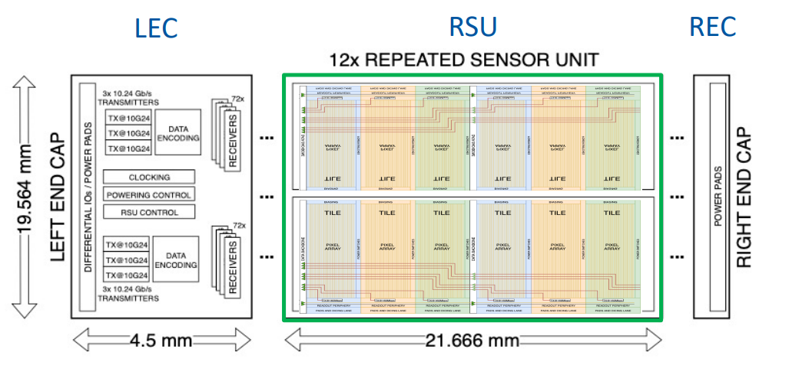
MOSAIX
Charge 1,2,3
Credit: ALICE ITS3 Collaboration
Pixel size: ~ 20 x 22 μm²
Frame duration: 2 to 5 μs
Data link: 10.24 Gbps
L0 sensor: 3 x 12 RSU
L1 sensor: 4 x 12 RSU
L2 sensor: 5 x12 RSU

Slide 15
Sensor Tiling and Grouping

Slide 16
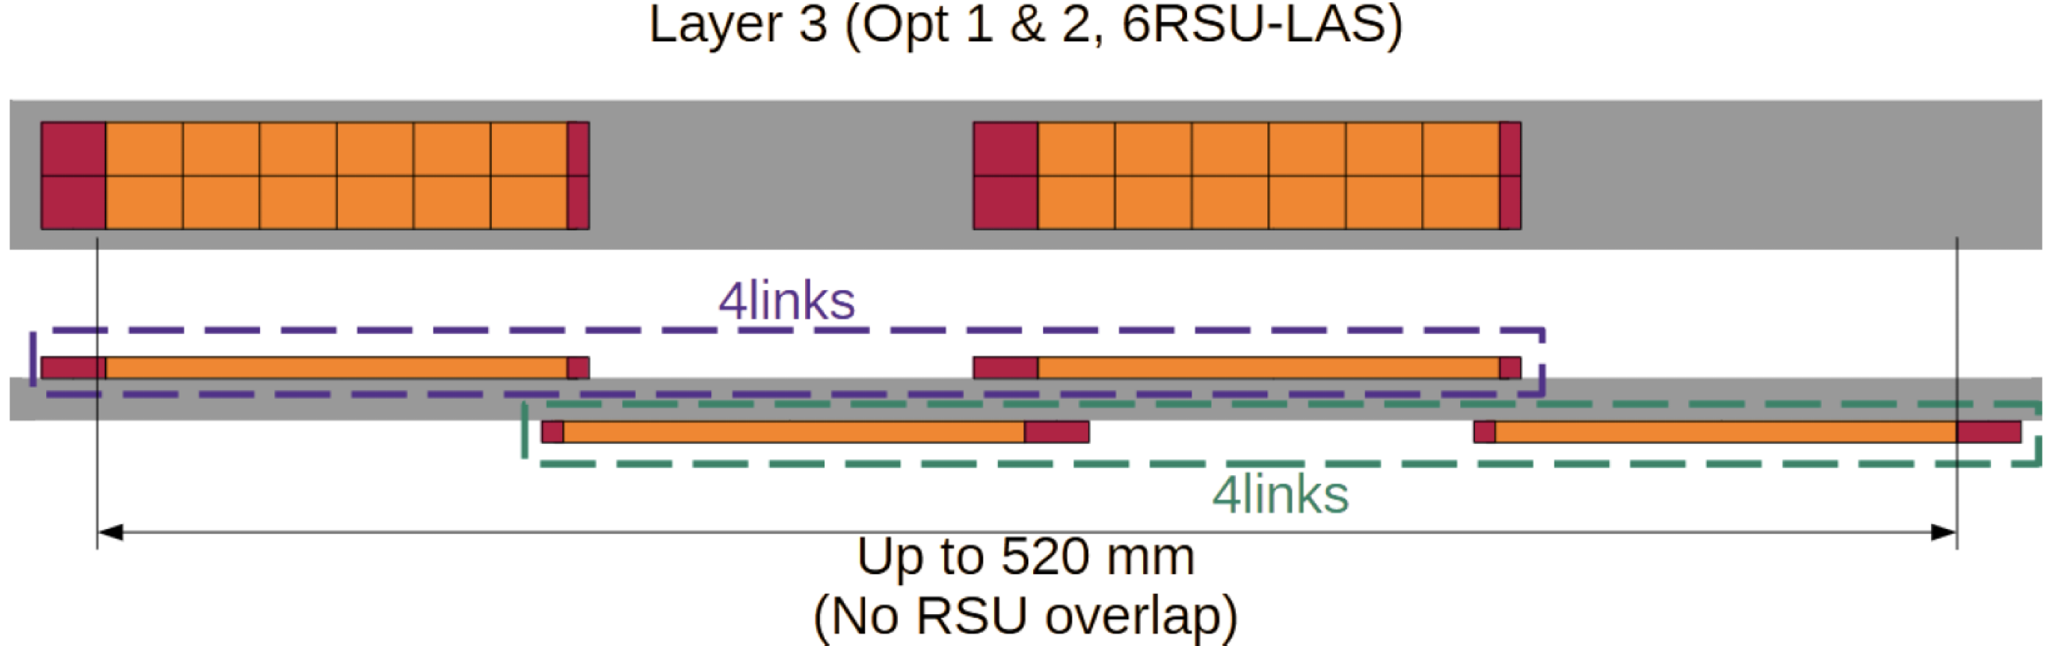
Sensor Tiling and Grouping
Charge 2,3
EIC-LAS with 5 or 6 RSUs is the outcome of extensive tiling studies and foundry constraints as they are currently known; a) only a single variant will be accommodated on any given wafer and b) NRE considerations limit the number of variants to two, at most.
Staves are foreseen as the basic building elements for the Outer Barrel, i.e. L3 and L4.
Tiling of EIC-LAS sensors onto staves is relatively straightforward, provided the structure allows for geometrical overlap:
This tiling naturally leads to groupings of (up to) four EIC-LAS in powering, readout and slow-control.

Slide 17
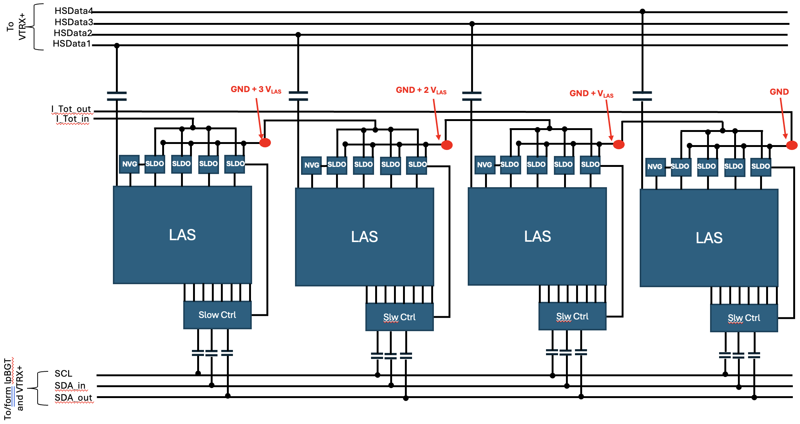
Sensor Tiling and Grouping
Charge 3
Tiling naturally leads to groupings of (up to) four EIC-LAS; this is key to service reduction with serial powering and multiplexed slow control.
At a functional level:
A group of (up to) four EIC-LAS is serially powered via one current loop; controlled with three slow-control lines.

Slide 18
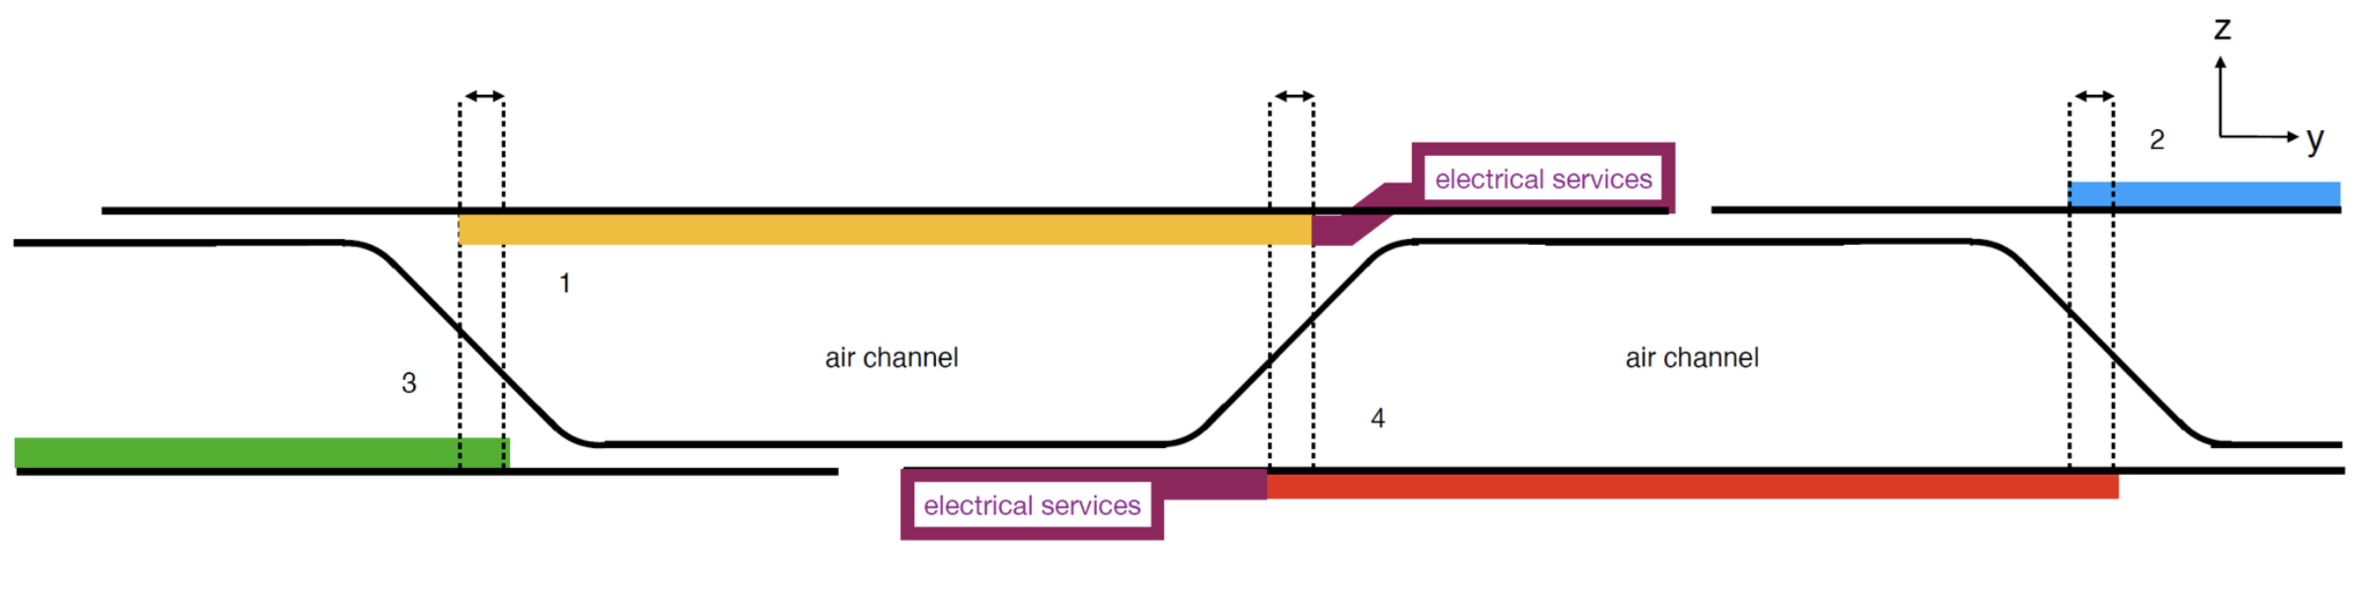
Sensor Tiling and Grouping
Charge 2,3
EIC-LAS with 5 or 6 RSUs is the outcome of extensive tiling studies and foundry constraints as they are currently known; a) only a single variant will be accommodated on any given wafer and b) NRE considerations limit the number of variants to two, at most.
Disks are currently foreseen to have a corrugated core. Tiling can then be done on four surfaces.
In sideview, with the length axis of the sensor going into or coming out of the screen:
Overlap along the length axis is possible by alternation,
Corrugation pitch and height determine EIC-LAS overlap along the short axis; current values of ~34 mm and 6 mm, respectively, are being further optimized.

Slide 19
Local Mechanics

Slide 20
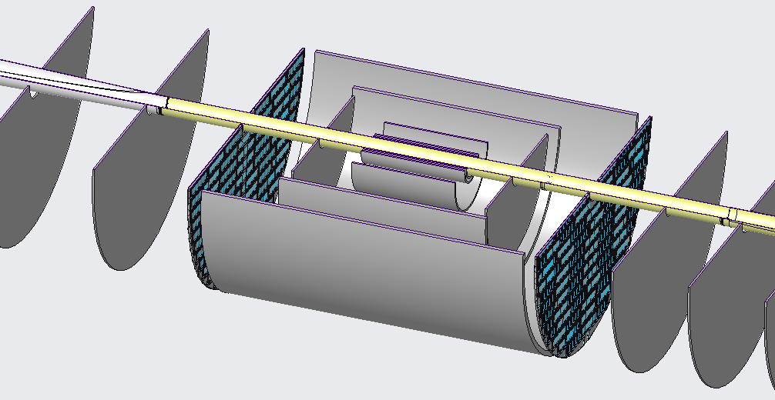
Disks
Charge 3
Note the crossing angle and acceptance cones of the beampipe. Top-down symmetry favors a horizontal segmentation of the disks.

Slide 21
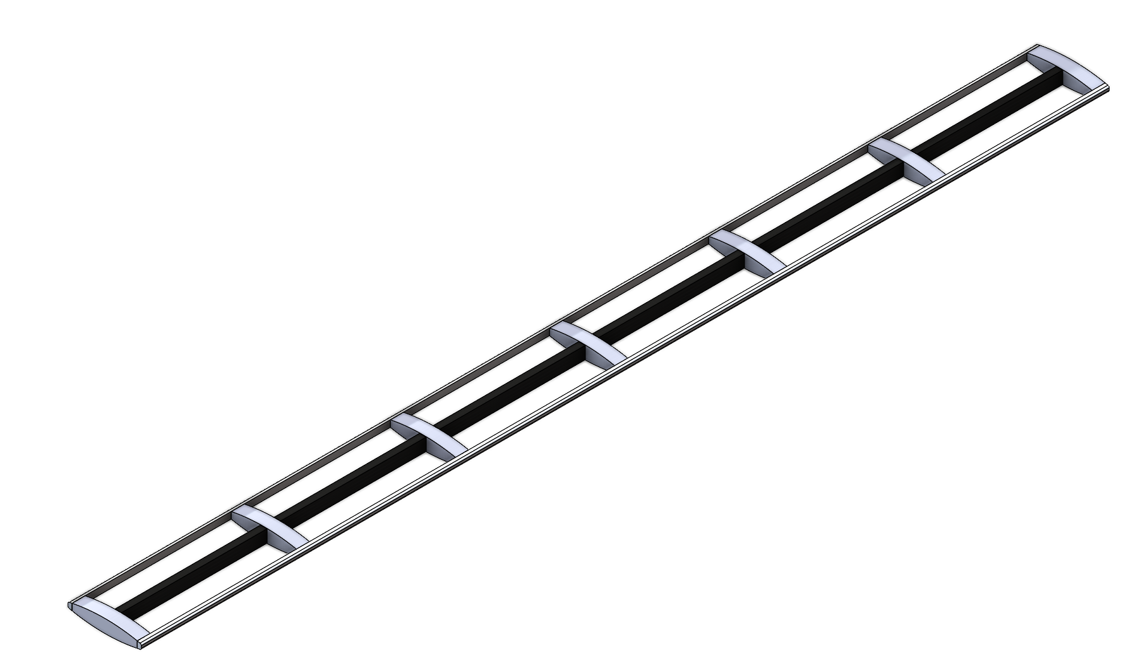
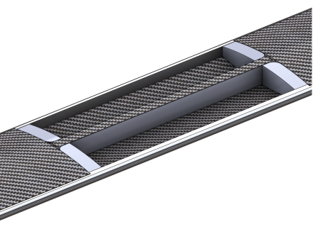
Outer Barrel
Charge 3
The Outer Barrel will consist of staves,
Stave will have twins of sensors on alternating sides (c.f. slide 16),
Core will consist of foam blocks, supporting all sensor edges,
Surface between twins of sensors will be covered with a CF skin,
Thickness and possible curvature, as well as material and lay-up
remain to be optimized,
After co-cure or bonding the structure will be self-supporting.
Castellated as well as tilted arrangement of
staves being considered for the OB.

Slide 22
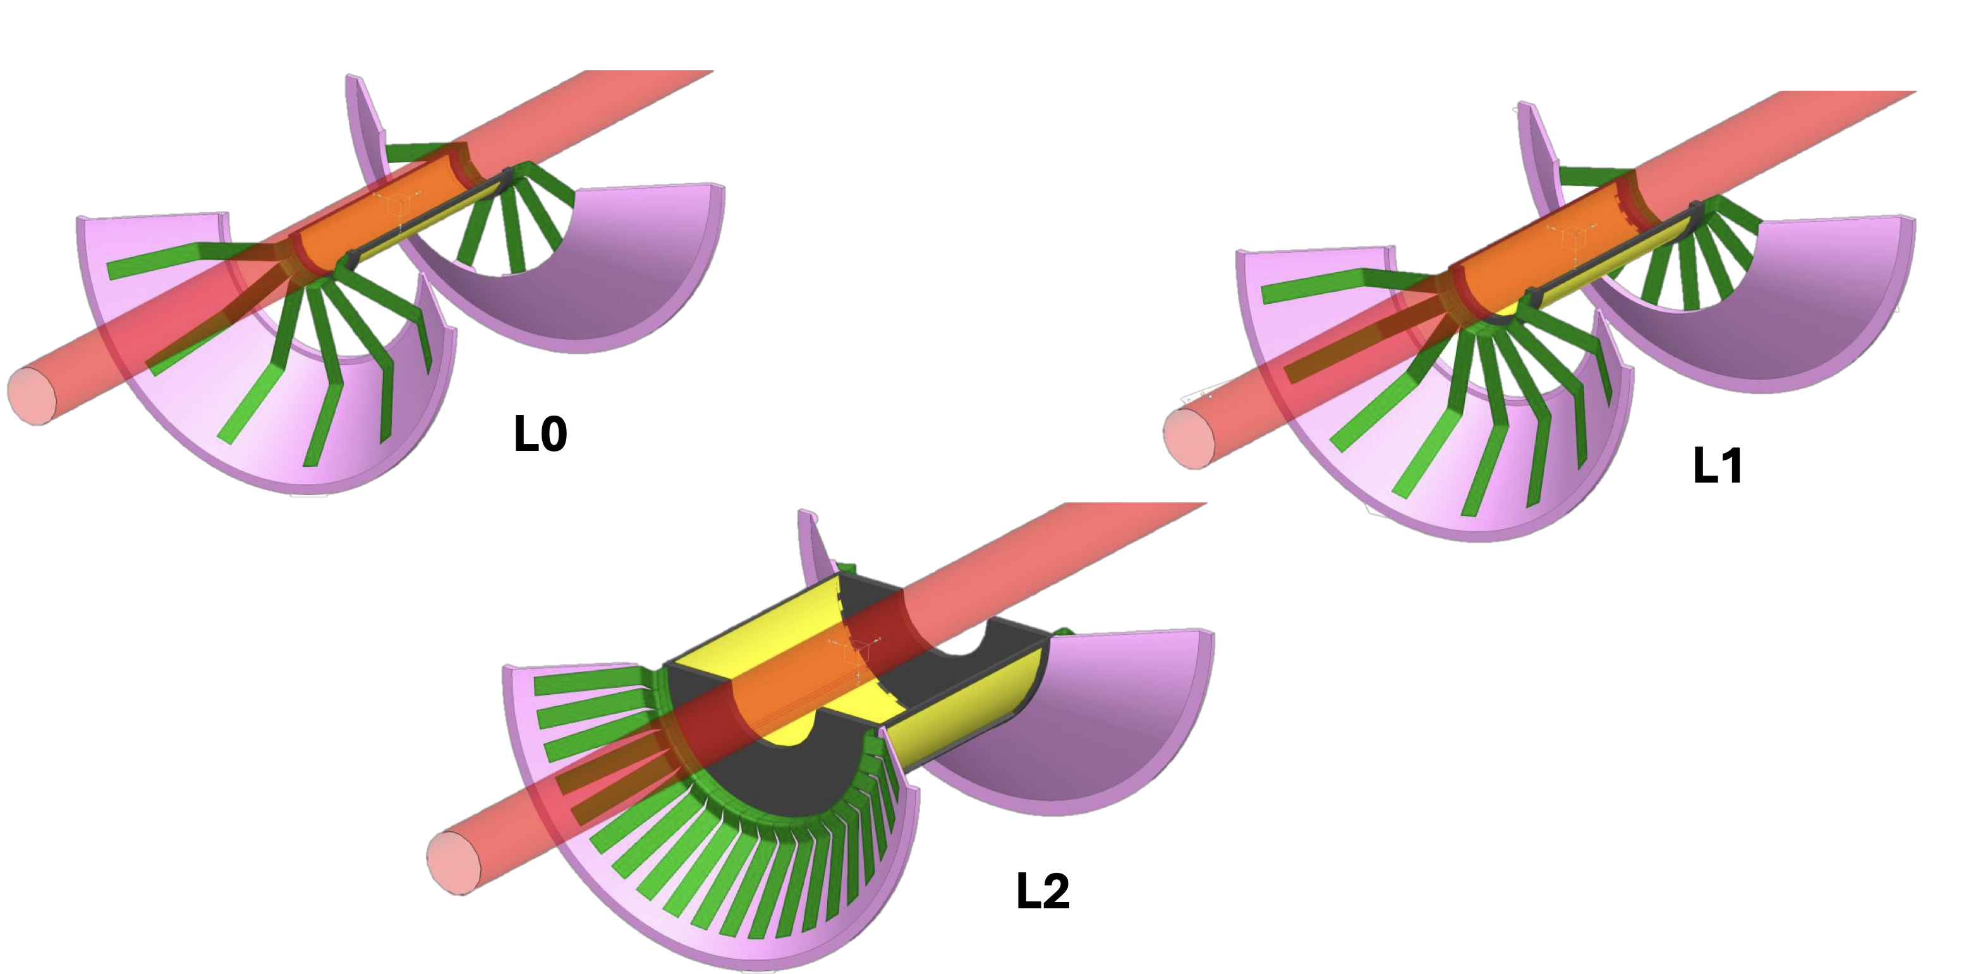
Inner Barrel
Charge 3
Initial stages of suitably adapting the ITS3 concept(s) to the ePIC SVT

Slide 23
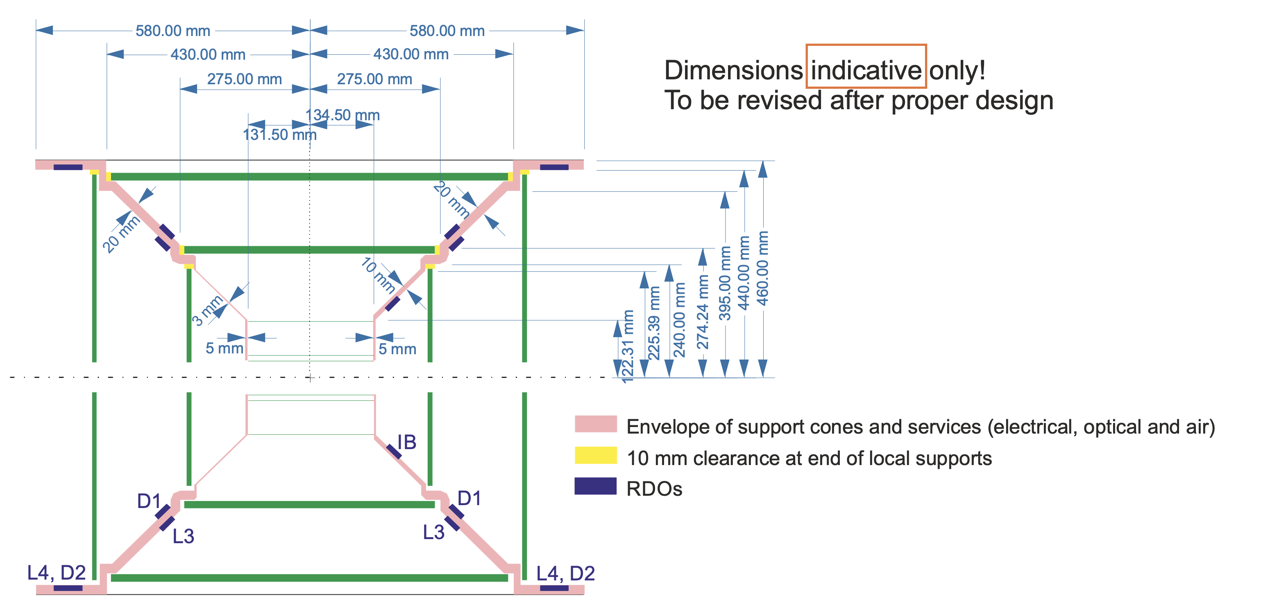
Internal Envelopes
Initial stages of developing internal envelopes;
internal dimensions are indications and will change
as design advances.

Slide 24
Detector Subsystem Collaboration

Slide 25
















Participating Institutions
Charge 5
Extensive Si-detector experience in the ALICE, ATLAS, CMS, sPHENIX, STAR collider experiments

Slide 26
Organization
Charge 5
Lead
Ernst Sichtermann (LBNL)
Technical Coordinator
Laura Gonella (Birmingham)
WP1 -- Sensor Design
Iain Sedgwick (RAL)
Joao de Melo (BNL)
WP2 -- Sensor Testing
Gian-Michele Innocenti (MIT)
Lukas Tomasek (CTU)
WP3 – Electrical Interfaces
Marcello Borri (Daresbury)
TBD
WP4 – Layers and Disks
Domenico Elia (INFN)
Georg Viehhauser (Oxford)
Nicole Apadula (LBNL)
WP5 – Readout and Powering
James Glover (Birmingham)
Jo Schambach (ORNL)
WP6 – Global Mechanics and Integration
Andreas Jung (Purdue)
Eric Anderssen (LBNL)
WP7 – Interlocks, Slow Control, and Monitoring
TBD
WP8 -- Database
TBD
WP9 – Software and Simulations
Shujie Li (LBNL)

Slide 27
Institutional Interests
Charge 5
INFN, LBNL, MIT
UK groups
LANL, LBNL+UCB, Purdue
Sensor and IC design: BNL, LBNL, MIT, RAL – further groups in characterization
Readout: ORNL, MIT
Additional groups expressed interest

Slide 28
Schedule

Slide 29
Timeline
Charge 5,7
Sensor development:
ITS3 wafer scale sensor development (ER2, ER3) for IB 2024 – 2026,
EIC-LAS development for OB and Disks complete and ready for production start in calendar Q4 2026,
Ancillary IC development for EIC-LAS complete and ready for production start in calendar Q2 2026.

Slide 30
Timeline
Charge 5,7
Construction:
Engineering test articles following R&D in 2025—2026,
Pre-production phase of about 1 year for IB; 2 years for OB,
Production and QA through calendar Q2 2029 followed by assembly,
Current plan is shipment of surveyed and assembled half barrels and disks to BNL in calendar Q4 2029,
Final assembly and testing at BNL through calendar Q1 and Q2 2030, prior to installation in ePIC.
SVT schedule is compatible with Project requirements, being finalized.

Slide 31
Risks and Mitigation

Slide 32
Alternative Tracker
Charge 4
Goal is always to progress towards using ITS3 based sensors
Only way to meet full performance requirements
Branchpoints – both based on schedule delays:
ITS3 (inner barrel) schedule remains compatible with project schedule but LAS (outer barrel & disks) development is delayed
ITS3 (inner barrel) schedule becomes incompatible with project schedule

Slide 33
Alternative Tracker – Layout
Charge 4
Replaced by two or three layers based on the existing ITS2 sensor, as used in ALICE and sPHENIX without EIC specific modifications
Branchpoint 2 only
Inner Barrel (IB)
Outer Barrel (OB)
Replaced with two MPGD barrel layers derived from the outer MPGD tracker, specifically its innermost (Micromegas) layer
Branchpoint 1 & 2
Replaced with (in total up to) seven near-identical MPGD disks on each side, specifically based on existing uRWELL disks
Branchpoint 1 & 2
Electron and Hadron Endcap Disks (EE, HE)

Slide 34
Alternative Tracker – Schedule
Charge 4
Will be further refined leading up to CD-2 based on ITS3 development
Branchpoint | Date | Milestones
1 (LAS Delay) | Q2/Q3 2026 | 1 year for MPGD foils + 3 years construction
2 (ITS3 Delay) | Q3/Q4 2027 | Same 3 years construction as current IB
CD-3
04/2025
early CD-4
09/2032
CD-4
09/2034
Oct 2028
June 2030
Apr 2031
Oct 2030
Jan 2031
Construction
Pre-OPS
Detector Assembled and Ready for Cosmic Data Taking
IR-6 ready
for installation
Early start of
Operations
&
Science
Start of
Operations
&
Science
Hadron Endcap
Detectors
installed
Barrel Detectors
installed
Electron Endcap Detectors installed

Slide 35
Summary
Silicon Vertex Tracker acceptance and technical performance requirements are defined,
SVT layout, consistent with the requirements, has been optimized for resolution,
SVT will be based on a new Monolithic Active Pixel Sensor in 65 nm technology that is being developed in collaboration with the ongoing ALICE-ITS3 MOSAIX development,
SVT will use an ancillary IC for serial powering, biasing, and multiplexing of slow controls with minimized material in view of risk, schedule, and resources,
SVT designs are advancing,
SVT workforce identified and growing,
SVT timelines are consistent with the Project timelines and critical decisions.

