Slide 1
Silicon: Sensors (Inner & Outer Barrel, Disks)
Dr Laura Gonella
ePIC SVT Technical Coordinator
University of Birmingham

Slide 2
Charge Questions Addressed
Are the technical performance requirements appropriately defined and complete for this stage of the project?
Are the plans for achieving detector performance and construction sufficiently developed and documented for the present phase of the project?
Are the current designs and plans for detector, electronics readout, and services sufficiently developed to achieve the performance requirements?
Are plans in place to mitigate risk of cost increases, schedule delays, and technical problems?
Are the fabrication and assembly plans for the various tracking detector systems consistent with the overall project and detector schedule?
Are the plans for detector integration in the EIC detector appropriately developed for the present phase of the project?
Have ES&H and QA considerations been adequately incorporated into the designs at their present stage?

Slide 3
Outline
ePIC SVT sensors
Development status and plan
Summary

Slide 4
ePIC SVT sensors

Slide 5
Sensor technology for the SVT
Charge 3, 4
The ePIC SVT will be built with Monolithic Active Pixel Sensors (MAPS) in 65 nm CMOS imaging technology
High granularity and low power → High spatial resolution
Stitching on 300 mm wafers for large area sensors → Increased detector active area, reduced material budget
Collaboration with ITS3 → Reduced risk and cost of sensor development

Slide 6
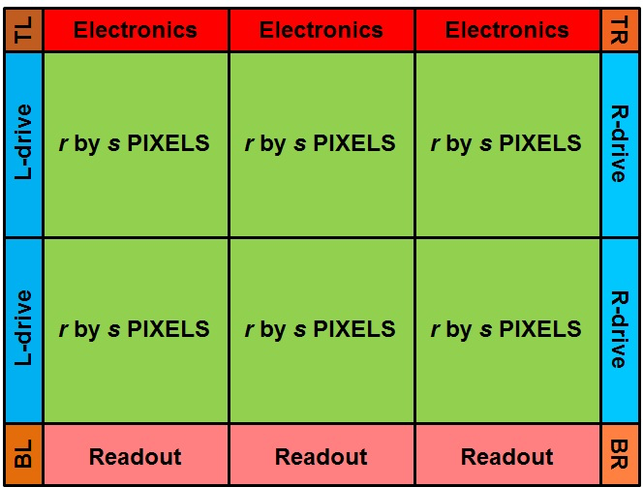
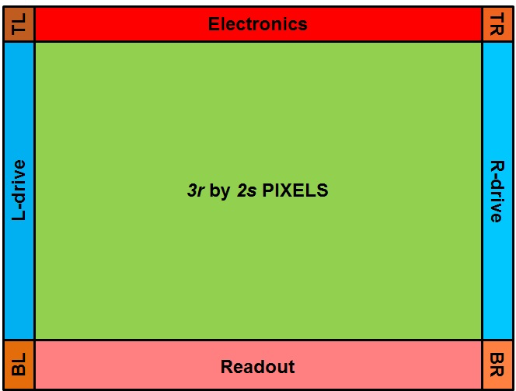
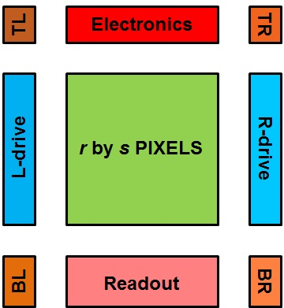
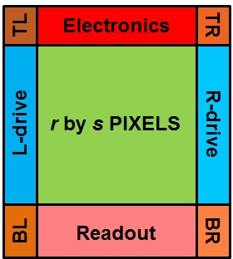
Stitched MAPS
MAPS size is typically constrained to the size of a single reticle (~ cm^2)
Stitched MAPS sensor can achieve larger active area
  Lithography elements can be applied separately over the wafer
  Stitching allows to form a uniform pixel matrix
  The sensor size can be up to wafer scale

Slide 7
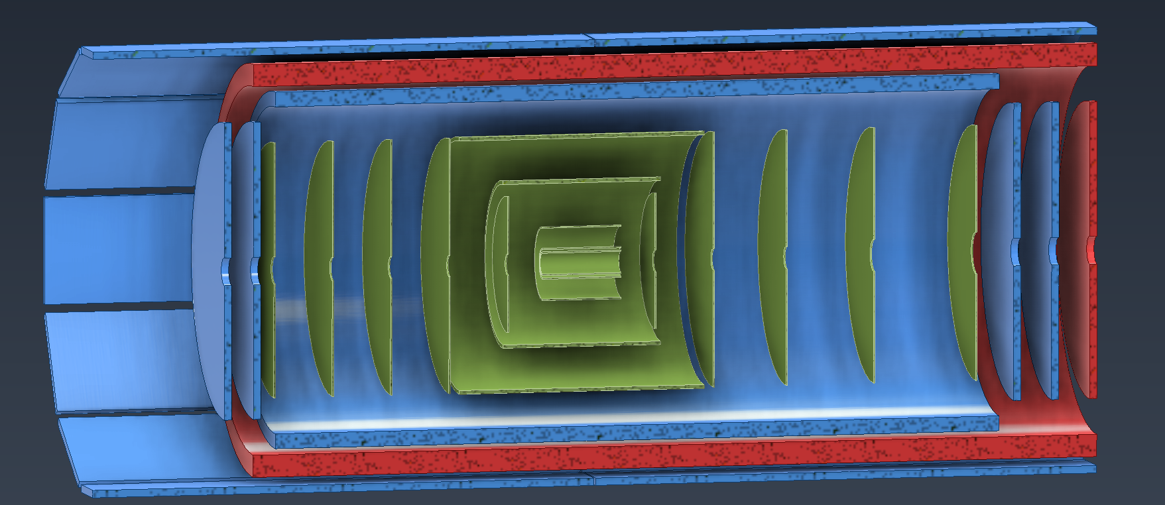
SVT Sensors
Charge 3
ITS3 wafer scale sensor
  Inner Barrel
EIC-LAS
  Outer Barrel
  Electron/hadron endcaps
Ancillary ASIC
  Outer Barrel
  Electron/hadron endcaps
Inner Barrel (IB)
Outer Barrel (OB)
SVT MPDGs ToF (fiducial volume)
Electron/Hadron Endcaps (EE, HE)

Slide 8
ITS3 Wafer Scale Sensor
Charge 3
The ITS3 sensor will be used in the ePIC Inner Barrel
This is a wafer scale, low power sensor enabling the design of truly cylindrical vertex layers with 0.05% X0 material budget
Ultra-low mass detector concept pioneered by ITS3
  Thin, bent sensors → Minimal mechanical support
  Low power sensors → Air cooling
  Large sensor → No services in active area

Slide 9
ITS3 Wafer Scale Sensor
MLR1 - Submitted Q4 2020
  Technology exploration and prototype circuit blocks for future sensors
  Large number of test structures; including Analogue and Digital Pixel Test Structures (APTS, DPTS)
ER1 - Submitted Q4 2022
  Exploratory designs (MOSS, MOST sensors) for proof of stitching principles, learning methodology and yield
  Also, small prototypes and test chips
ER2 – Design ongoing, submission in 2024
  MOSAIX sensor aims to satisfy ITS3 requirements
  Not an evolution of MOSS/MOST; substantial redesign of existing circuits, with new features
ER3 – Production version
  Minimal modifications to MOSAIX

Slide 10
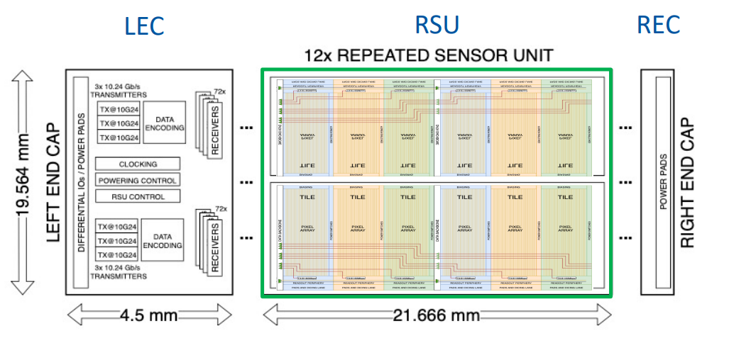
MOSAIX
Charge 1, 2, 3
Complex circuit designed, led by ITS3 team at CERN
  Approximately 30 FTE of designers working on the submission, including ePIC SVT designers
Pixel size: ~ 20 x 22 μm²
Frame duration: 2 to 5 μs
Data link: 10.24 Gbps
L0 sensor: 3 x 12 RSU
L1 sensor: 4 x 12 RSU
L2 sensor: 5 x12 RSU

Slide 11
EIC-LAS
Charge 3, 4
The ePIC SVT OB, EE and HE will cover an area of approximately 8 m²
A sensor design is needed for low-cost, high acceptance, large area coverage
The EIC LAS sensor will be based off the ER2 and ER3 designs with modifications for use in the SVT
Modifications of MOSAIX are kept to a minimum
  Work within the available time and resources
  Reduce risk of submission failure

Slide 12
MOSAIX to EIC-LAS
Charge 2
Inner Barrel
12 RSUs
8 data links
7 slow control links
Direct powering
Outer Barrel, E/H Endcaps
5 or 6 RSUs
Single data link
Multiplex slow control
Serial powering
MOSAIX segment
EIC-LAS and ancillary chip
Improve yield and coverage
EIC-LAS
Lower material budget
Lower material budget,
fit integration requirements
Ancillary ASIC
Lower material budget,
fit integration requirements

Slide 13
Ancillary Chip
Charge 2, 3, 4
The ancillary chip will provide sensor power, bias and slow control interfaces
The main elements of this ASIC are
  SLDO regulator for serial powering
  Negative Voltage Generator (NVG) for sensor biasing
  Slow control interface for low material communication to/from the control room
It will be designed in a 180 nm SOI process
  No modification of MOSAIX needed for optimised, low material power, biasing and slow control
  4 MPW runs per year allowing for fast and cost-effective prototyping

Slide 14
Development status and plan

Slide 15
CERN/EIC agreement
Charge 2, 4
Meeting at CERN in April 2023: EIC, ePIC SVT, ALICE ITS3 → Agreed on partnership
Draft of agreement received in December 2023
  Further discussions with ITS3 colleagues on ER2 and ER3 sensors procurement
  Now with BNL legal
The agreement provides a collaborative framework around four main points
  Procurement of components for the EIC ePIC detector
  Participation in the design of the Pixel Sensor Chip for the ALICE ITS3
  Transfer of the design database of the ITS3 sensor to BNL
  Contribution to other CERN activities related to the ALICE ITS3

Slide 16
Designers’ group
Two sensor designers affiliated with ePIC institutions (BNL, MIT) are embedded in the ITS3 team at CERN
  As per CERN/EIC agreement
  Transfer of knowledge to the ePIC designers for EIC-LAS
Complemented with team of experienced designers in the UK (RAL) and the US (BNL, LBNL)
By-weekly WP1 Sensor Design meetings (I. Sedgwick, RAL; J. De Melo, BNL)
Tools for collaborative work in place and being set up
  Cliosoft being setup by BNL for collaborative working on sensor designs
  Action tracker, specification document, schedule gannt project, shared document repository

Slide 17
MOSAIX Design – ePIC contributions
Development of logic libraries
  Enhanced Design for Manufacture (DfM) rules, reduced leakage current for improved power consumption, specialised cells for use in the pixel array
  Overall management of the effort, library generation (netlists, abstracts etc) and verification of the generated cells by ePIC SVT designers, with layout work split across several institutes on the MOSAIX team
Work on MOSAIX tile circuitry
  Stitched backbone
  Tile serialiser
Serialiser

Slide 18
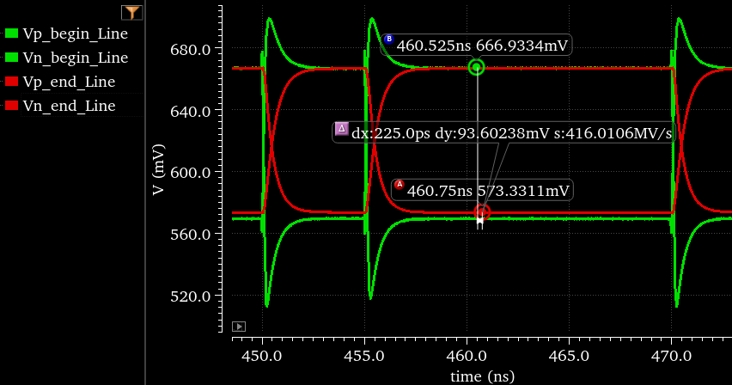
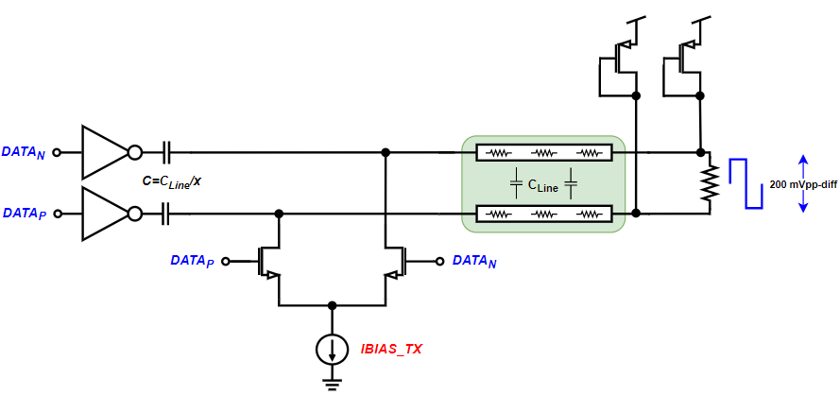
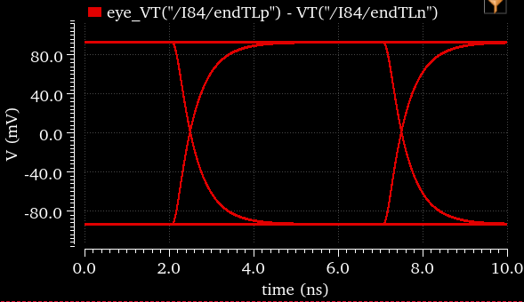
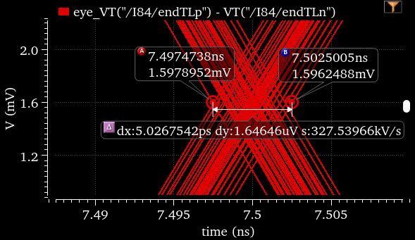
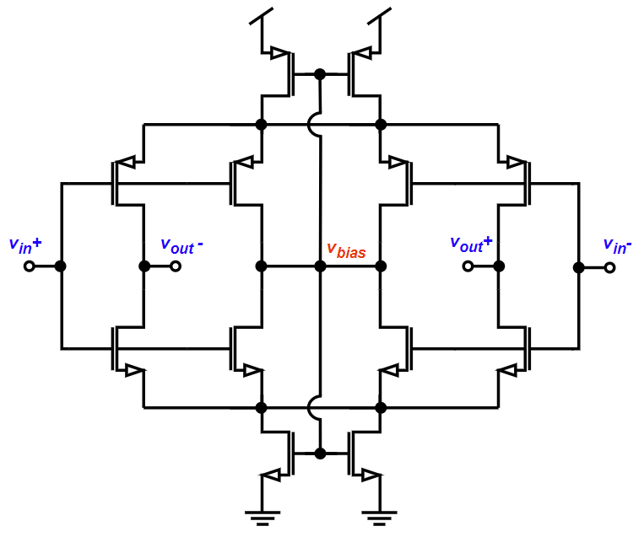
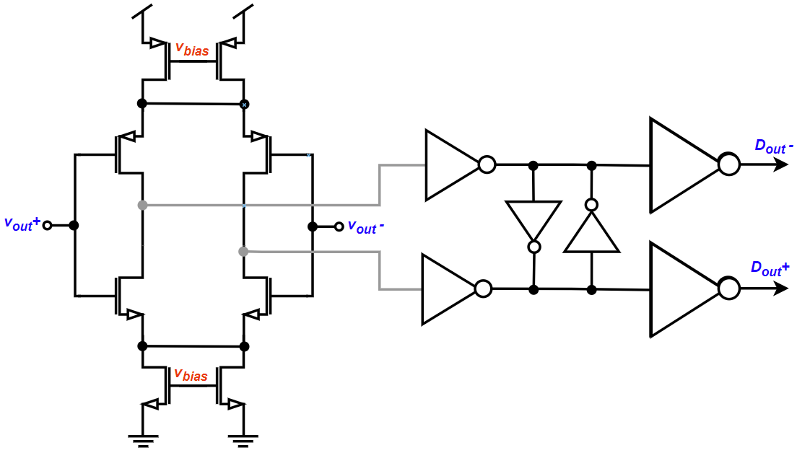
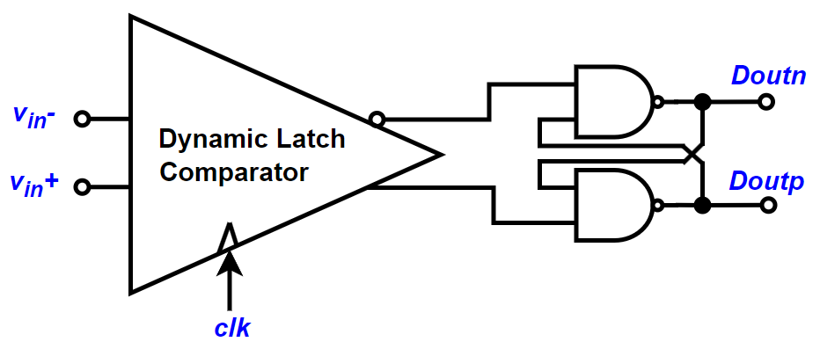
MOSAIX Design – ePIC contributions
Stitched backbone design
SBB – 160MHz Clock/Data Buffer TX
SBB floorplan
SBB – 160MHz Clock Buffer RX
SBB – 160MHz Data Buffer RX
Continuous time comparator
Clocked comparator

Slide 19
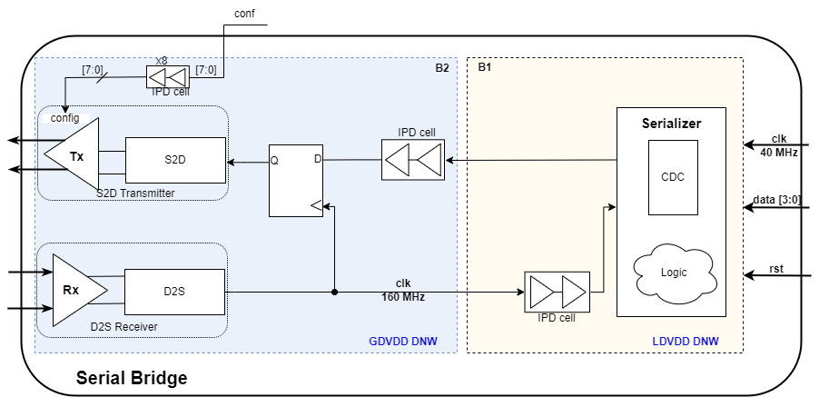
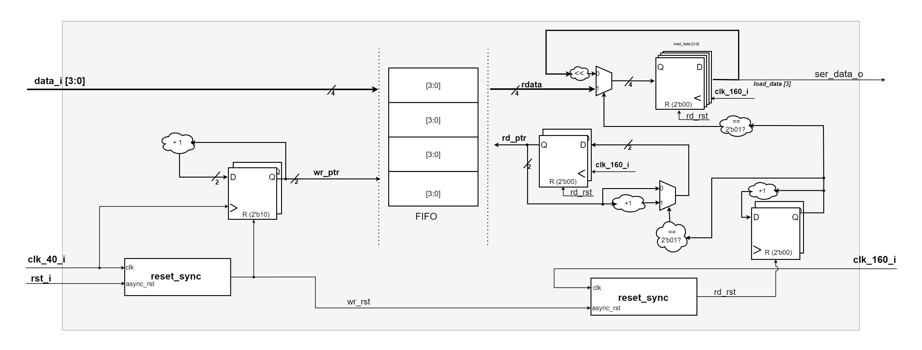
MOSAIX Design – ePIC contributions
Tile serialiser
  Digital design of tile serializer and its integration inside the tile periphery (i.e. serial bridge)
  Digital implementation flow of the tile periphery
Liberate characterization of the SBB to LEC and SBB to tile periphery interfaces

Slide 20
EIC-LAS
Charge 1, 2
Specification capture in progress
Access to MOSAIX database needed to start work
  Pending progress with agreement signature
Estimated power consumption range: 1.2 – 1.6 W per EIC-LAS
  Derived from evolving MOSAIX power figures
  This estimate takes into account the reduction in the number of RSUs
  LEC power consumption not yet scaled to reflect the reduction in the number of data links
    More information needed on power consumption of various LEC blocks
    Significant reduction in power consumption expected

Slide 21
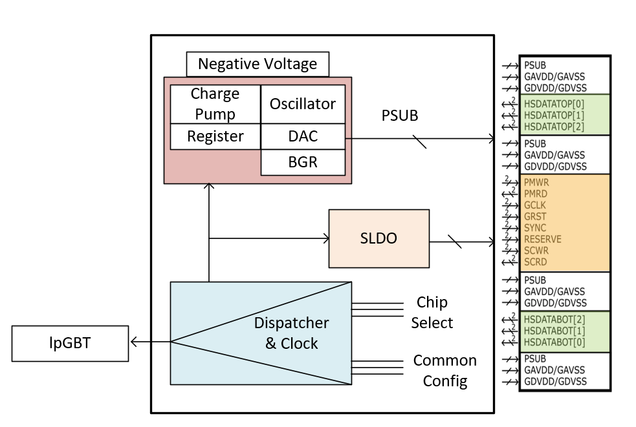
Ancillary ASIC - Overview
Charge 1, 2
Ancillary ASIC
High level block diagram
GA/GD
PMWR/RD, SCWR/RD
GCLK
GRST
SYNC
EIC-LAS LEC
(PWR, I/O)
Estimated power consumption: up to 50% of EIC-LAS power
  Dominated by SLDO regulators
    Based on MOSAIX/EIC-LAS current needs as estimated at this time
  Further optimisations considered for a more efficient current to voltage conversion

Slide 22
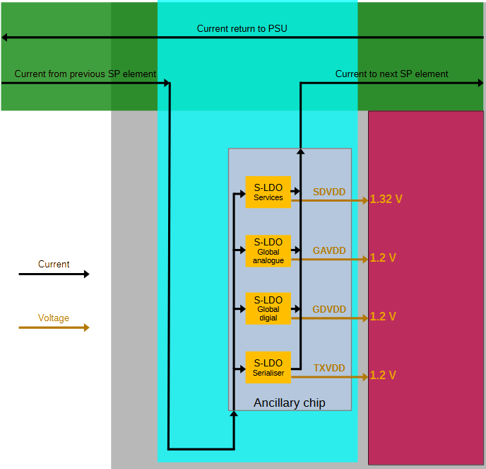
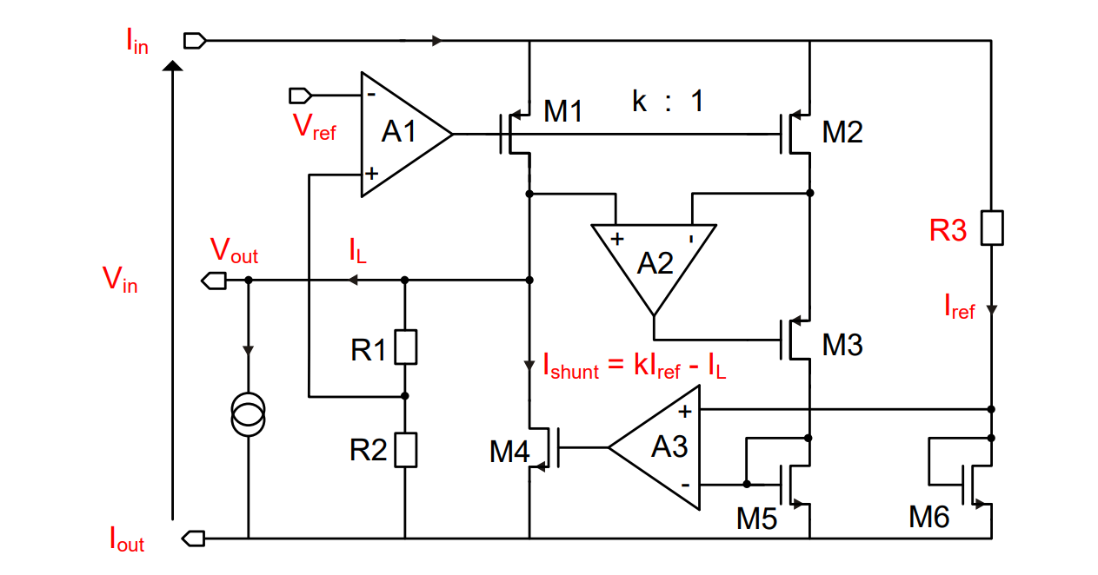
Ancillary Chip - SLDO
Current to voltage conversion to power the EIC-LAS in serial powering
Design adapted from ATLAS/CMS Serial Powering SLDO design for the HL-LHC
  > 10 years development, multiple prototypes in different technologies
  Robust design, failure modes addressed to safeguard SP chain from failures of one regulator
  No need for bypassing element in the SP chain
EIC-LAS

Slide 23
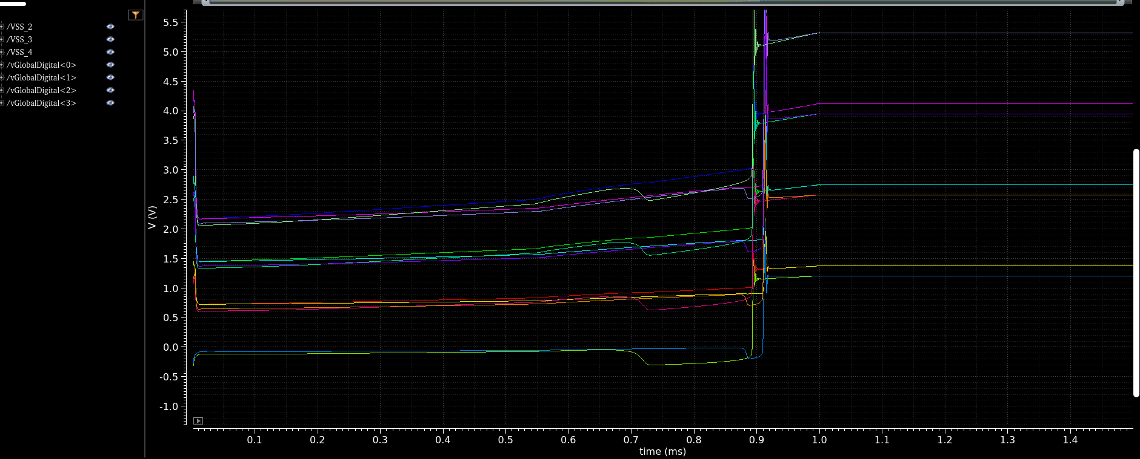
Ancillary Chip - SLDO
Functional schematic implemented in 65 nm technology adapted to recent MOSAIX current consumption figures
  Simulations include stave power model to inform SVT development
Next: Additional features (tri-state, over-voltage protections etc.); port to 180 nm technology; full verification; layout; tape-out

Slide 24
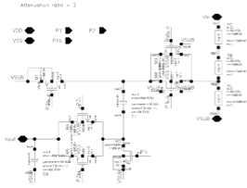
Ancillary Chip - NVG
Creates the negative bias for charge collecting volume from positive regulated power supply 1.2 V
  Diode-based charge-pump circuit
Circuit design progressed to demonstration of feasibility
Next: realistic model of output load; corner and MC simulations; voltage DAC to generate VREF; trial layout and impact of layout parasitics; ELT transistors for radiation-hardness
Switching network
Voltage sensor (resistive divider)

Slide 25
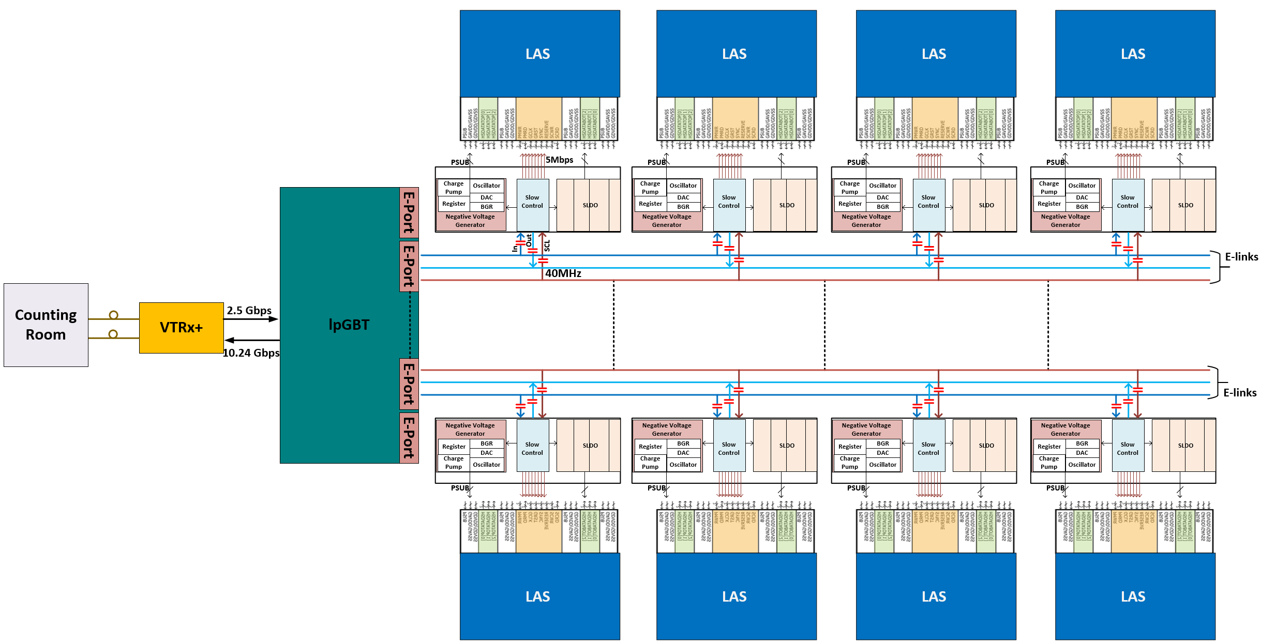
Ancillary Chip – Slow Control
Need to reduce number of EIC-LAS slow control links for material reduction and to fit within SVT assigned FELIX channels - See Jo’s talk
AncASIC slow control circuit interfaces with EIC-LAS on one side and lpGBT on the other side
Per EIC-LAS:
7 slow control links
One elink serves up to 4 AncASIC
Per lPGBT:
1 down link & 1 up link (fibers)
Up to 16 elinks (3 differential lines each)

Slide 26
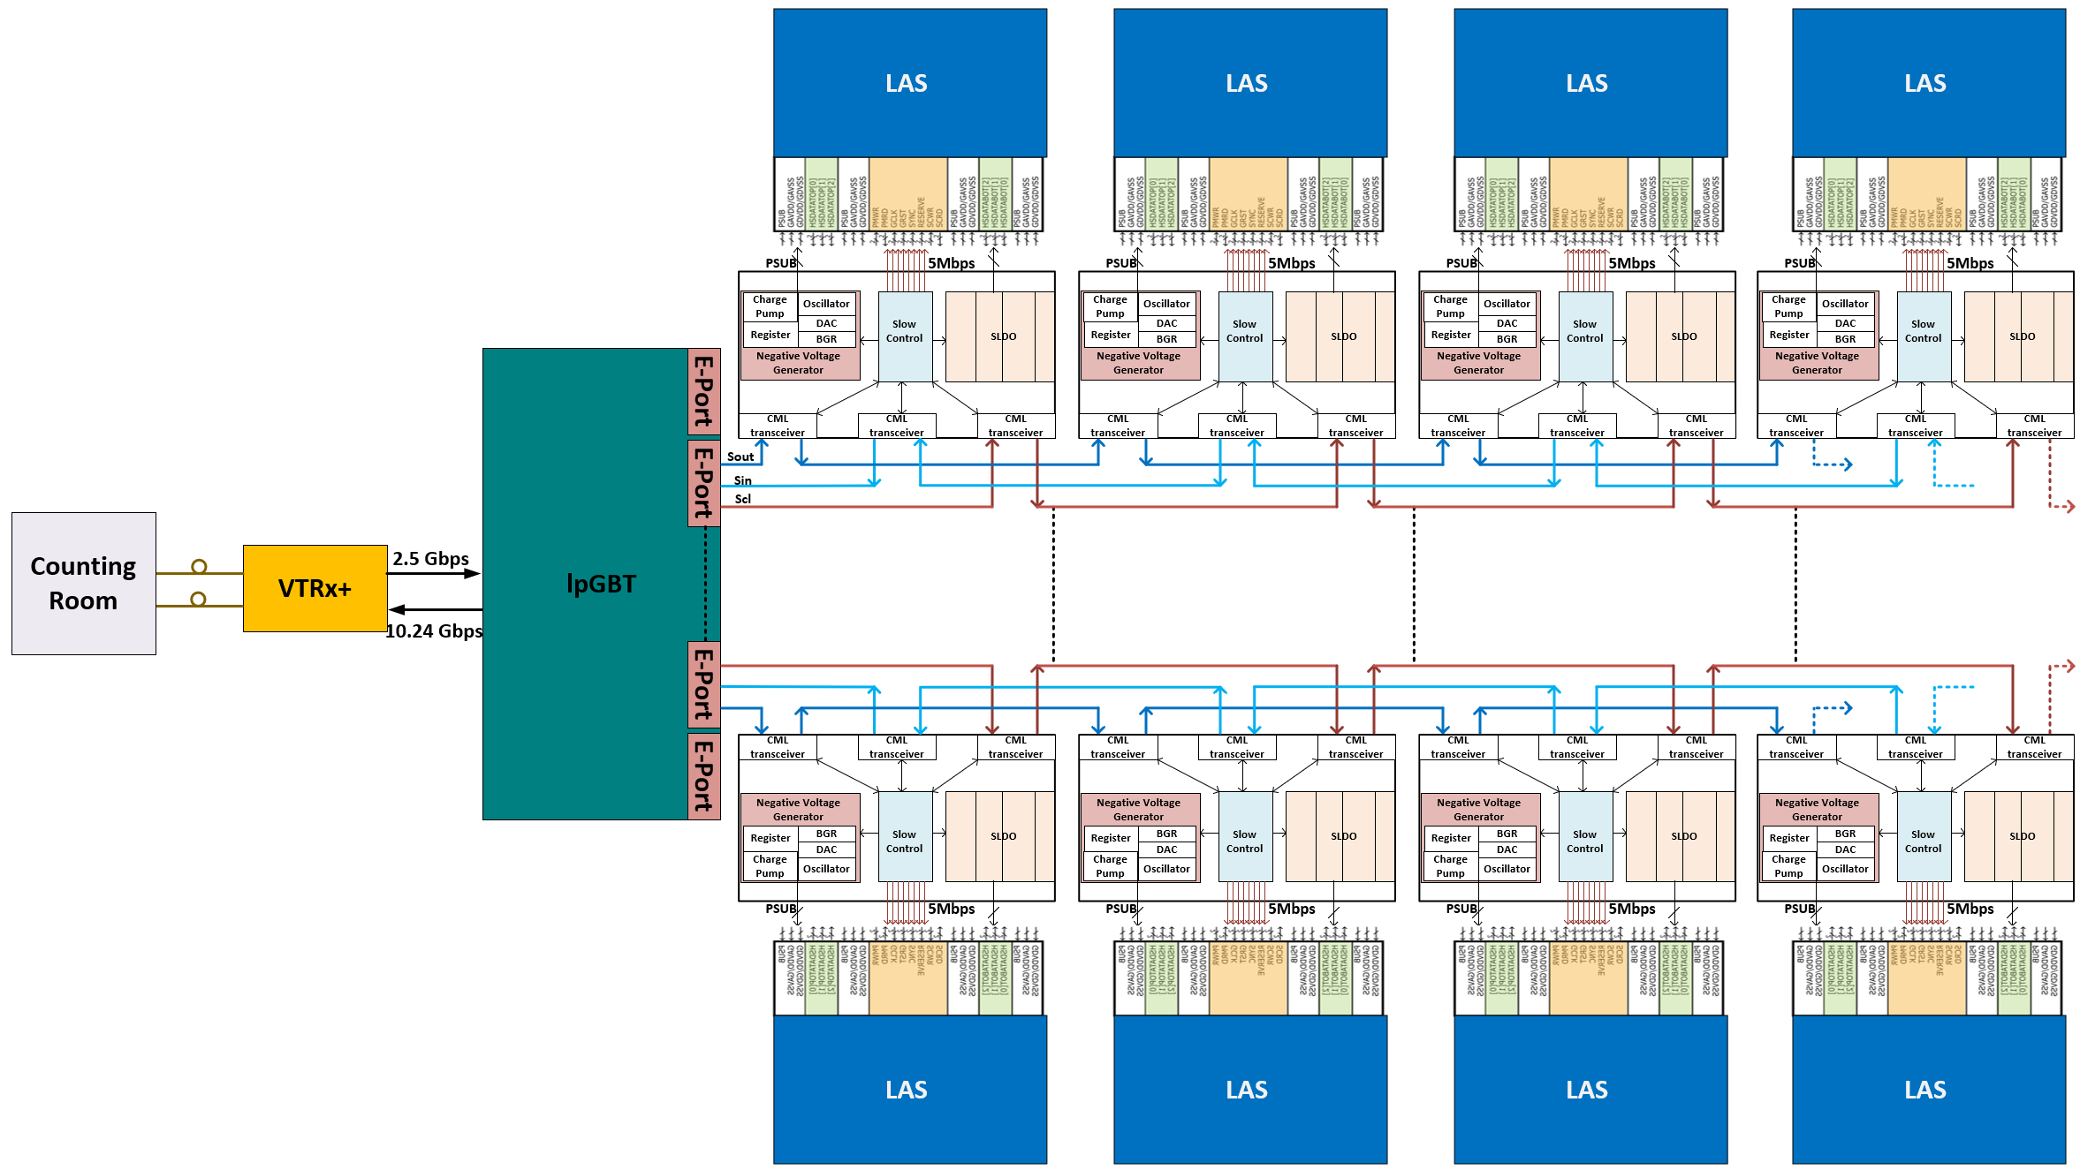
Ancillary Chip – Slow Control
Current work focused on defining protocol and specs for communication between lpGBT and AncASIC
  Matching of clock speeds of eLink and EIC-LAS, buffering of data inside AncASIC
  lpGBT data format to include addresses of AncASIC and EIC-LAS data structure
  Internal configuration of AncASIC
  Data integrity methodology (checksums, correction, triplication, read back)
  Built in fast commands (reset, synchronize, status readout, etc.)
  AC vs DC-coupled communication
SOF: Start of Frame
Anc_Address: Address of Ancillary Chip
Data_Type: Read/Write
Data: To MOSAIX / EIC-LAS
FCS: Frame Checksum Field
EOF: End of Frame

Slide 27
Sensor Testing
Charge 7
Effort coordinated within the ePIC SVT WP2 Sensor Testing (G. M. Innocenti, MIT; L. Tomasek, CTU Prague)
  Covers ITS3 sensors, EIC-LAS and AncASIC, including test setups development
Characterisation of prototypes
  Tests in labs and test beams
  Development of wafer probing capability for production
  Irradiations at SVT facilities
Production testing/QA
  Probing of all ER3, EIC-LAS production, AncASIC production wafers

Slide 28
Sensor Testing - Facilities
Clean rooms and labs equipped with radioactive sources, climate chambers, wire bonders, wafer probers, etc
Irradiation facilities in the collaboration available for displacement damage, TID and SEE testing
  Birmingham: 27 MeV protons, upcoming neutron irradiation facility
  CTU Prague: X-ray source, slow and fast neutrons
  UJP Prague: Cobalt-60 gamma ray
  Nuclear Physics Institute CAS Rez: reactor neutrons, ~30 MeV proton and heavy ion beam, electrons up to 25 MeV
  LBNL: BASE @ 88” cyclotron (protons, heavy ions, neutrons)
  Daresbury lab: X-ray source
  LANL: 800 GeV protons

Slide 29
Schedule
Acces to MOSAIX database to start work on EIC-LAS
IB wafer scale sensor
EIC-LAS v1 fabrication linked to MOSAIX testing to confirm functionality
EIC-LAS
EIC-LAS production starts in cQ4-2026
AncASIC functionalities implemented standalone for fast prototyping of all blocks
Ancillary ASIC
AncASIC full functionality prototype
AncASIC production starts in cQ2-2026
N.B.: calendar quarters

Slide 30
Summary
MAPS detectors in 65 nm CMOS imaging technology have been identified to meet the tracking requirements at ePIC
The ePIC SVT will be built wafer-scale ITS3 sensors in the IB and the ITS-3 derived EIC-LAS in the OB, complemented by the AncASIC for low mass power and slow interfaces
The choice of these sensors has taken into accounts reduction of cost and risks, and EIC schedule, in addition to performance

Slide 31
Summary
ePIC SVT designers are actively involved in the development of the ITS3 MOSAIX sensors
Specification capture for the EIC-LAS and AncASIC is advancing, with progress on the design of AncASIC circuit blocks
The sensor development schedule is in agreement with the EIC Critical Decisions timeline

