Slide 1
Silicon: Readout
Joachim Schambach
SVT Readout and Powering Work Package Co-Coordinator
Oak Ridge National Laboratory

Slide 2
Charge Questions Addressed
Are the technical performance requirements appropriately defined and complete for this stage of the project?
Are the plans for achieving detector performance and construction sufficiently developed and documented for the present phase of the project?
Are the current designs and plans for detector, electronics readout, and services sufficiently developed to achieve the performance requirements?
Are plans in place to mitigate risk of cost increases, schedule delays, and technical problems?
Are the fabrication and assembly plans for the various tracking detector systems consistent with the overall project and detector schedule?
Are the plans for detector integration in the EIC detector appropriately developed for the present phase of the project?
Have ES&H and QA considerations been adequately incorporated into the designs at their present stage?

Slide 3
Outline
Top Level Readout Design
Inner Barrel Readout Design
Outer Barrel and Disk Readout Design
SVT Numbers
Prototype Developments
Summary

Slide 4
Top Level Readout Design

Slide 5
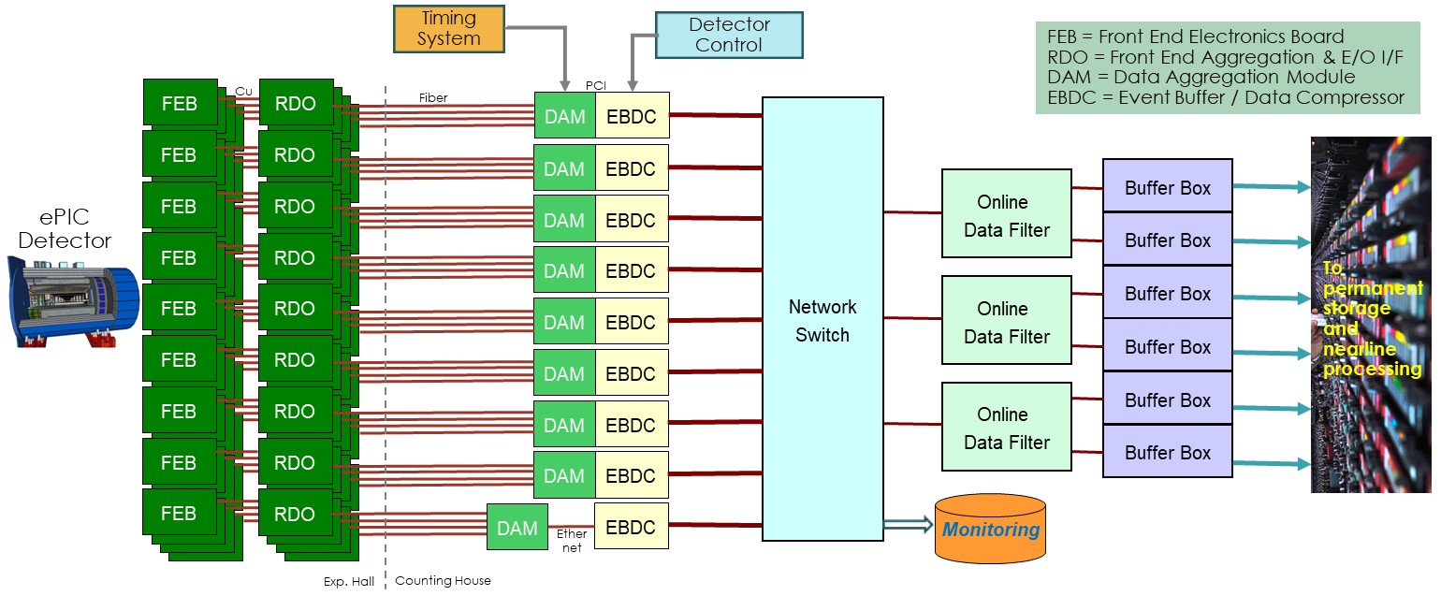
ePIC Streaming DAQ for SVT

Slide 6
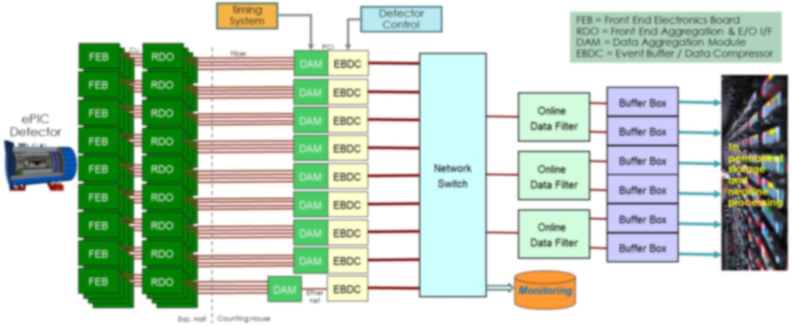
ePIC Streaming DAQ for SVT
Most ePIC detectors have their Readout ASIC on the FEB, connected to the detector via copper cables.
The FEB is then connected to a Readout Board that converts the electrical signals into optical fibers and transmits them to the DAM board in the counting house.

Slide 7
ePIC Streaming DAQ for SVT
SVT
Most ePIC detectors have their Readout ASIC on the FEB, connected to the detector via copper cables.
The FEB is then connected to a Readout Board that converts the electrical signals into optical fibers and transmits them to the DAM board in the counting house.
In case of the SVT, a lot of the Readout functionality is already integrated in the MAPS ASIC itself, thus SVT does not have an FEB

Slide 8
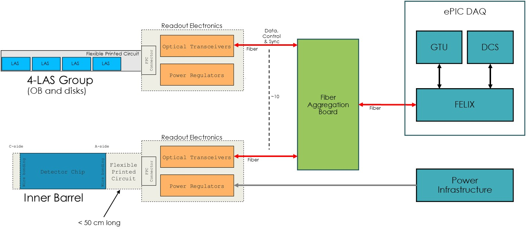
SVT Electronics for Data & Control

Slide 9
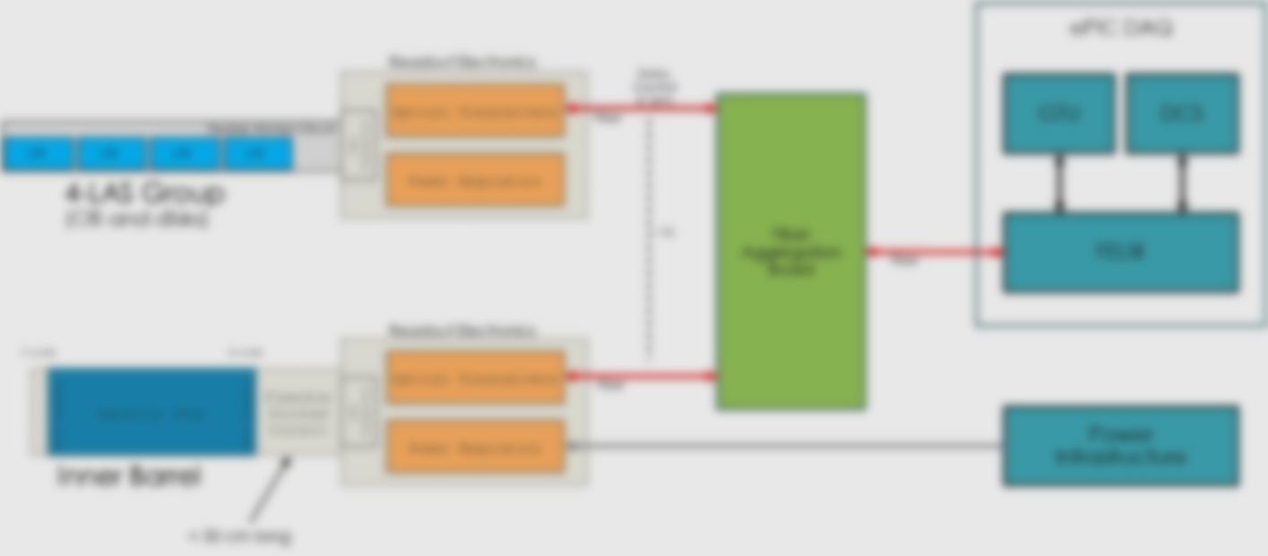
SVT Electronics for Data & Control
For the inner barrel, a wafer scale sensor is connected to the RDO via a Flex Printed Circuit (FPC)
The Readout Electronics converts the high-speed data lines into (fiber) optical signals
The slow controls lines of the sensor are controlled individually via fiber-optic/electrical interfaces.
The Inner Barrel RDO also houses the direct powering for the sensors as well as the fiber optic interfaces

Slide 10
SVT Electronics for Data & Control
For the Outer Barrel staves and the disks, the RDO converts groups of up to 4 SVT LAS high-speed lines to fiber optic signals.
The slow control lines of the whole 4-LAS group are connected to electric/fiber optic interfaces.
The groups of LASs use serial powering, so the power section of the RDO is solely for the RDO electronics itself.

Slide 11
SVT Electronics for Data & Control
FPGA based “Fiber Aggregation” Boards in the DAQ room aggregate multiple (relatively low bandwidth) individual fibers from the RDOs into single fibers towards the DAM boards

Slide 12
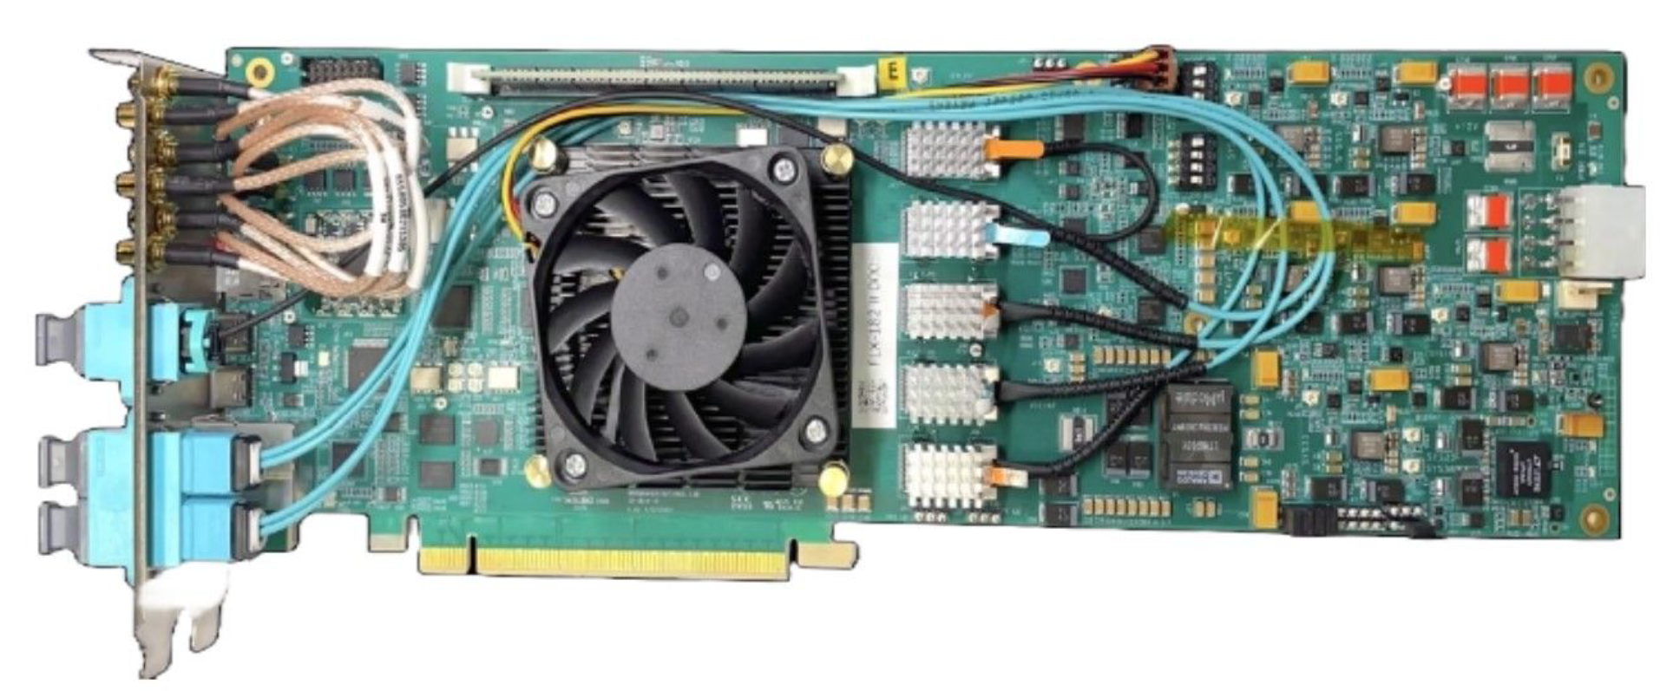
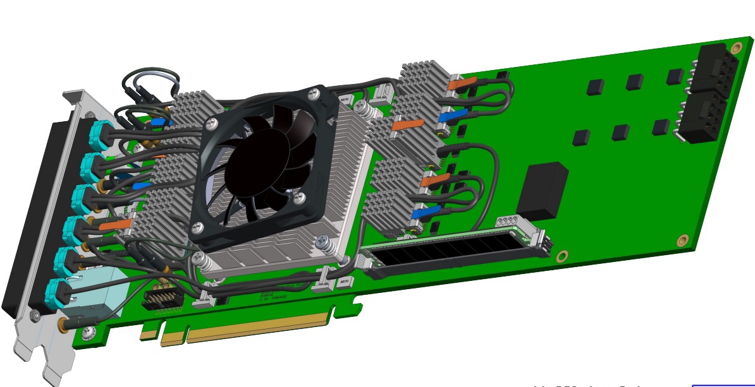
Backend: ATLAS FELIX Development for Phase-2 Upgrade
FELIX – FLX-182
FPGA: AMD Versal Prime VM1802
PCIe Gen4x16 interface (240 Gb/s)
4 FireFly transceivers with 3 possible configurations
24 links up to 25 Gb/s
24 links up to 10 Gb/s (CERN-B FireFly)
One duplex FireFly transceiver with 2 possible configurations with 14 or 25 Gb/s
FELIX – FLX-155
FPGA: AMD Versal Premium VP1552 FPGA
PCIe Gen5x16 interface (482 Gb/s)
up to 48 bidirectional links

Slide 13
Inner Barrel: MOSAIX Readout

Slide 14
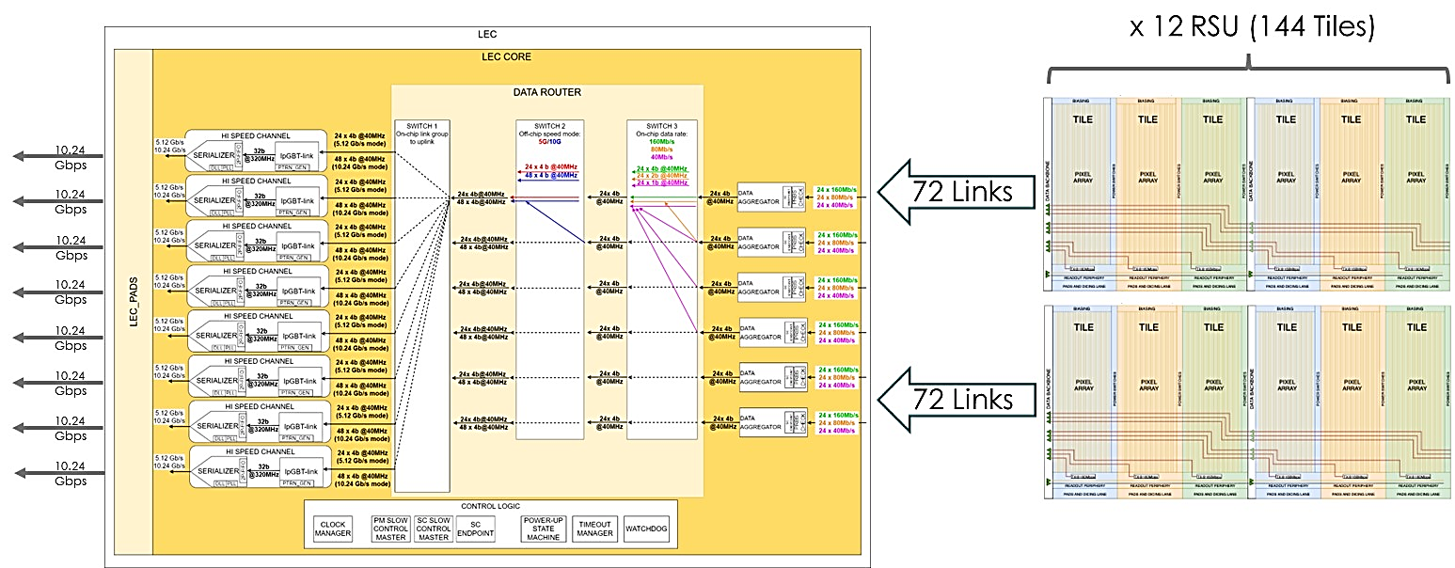
MOSAIX Data Flow – From Tiles to Left Endcap

Slide 15
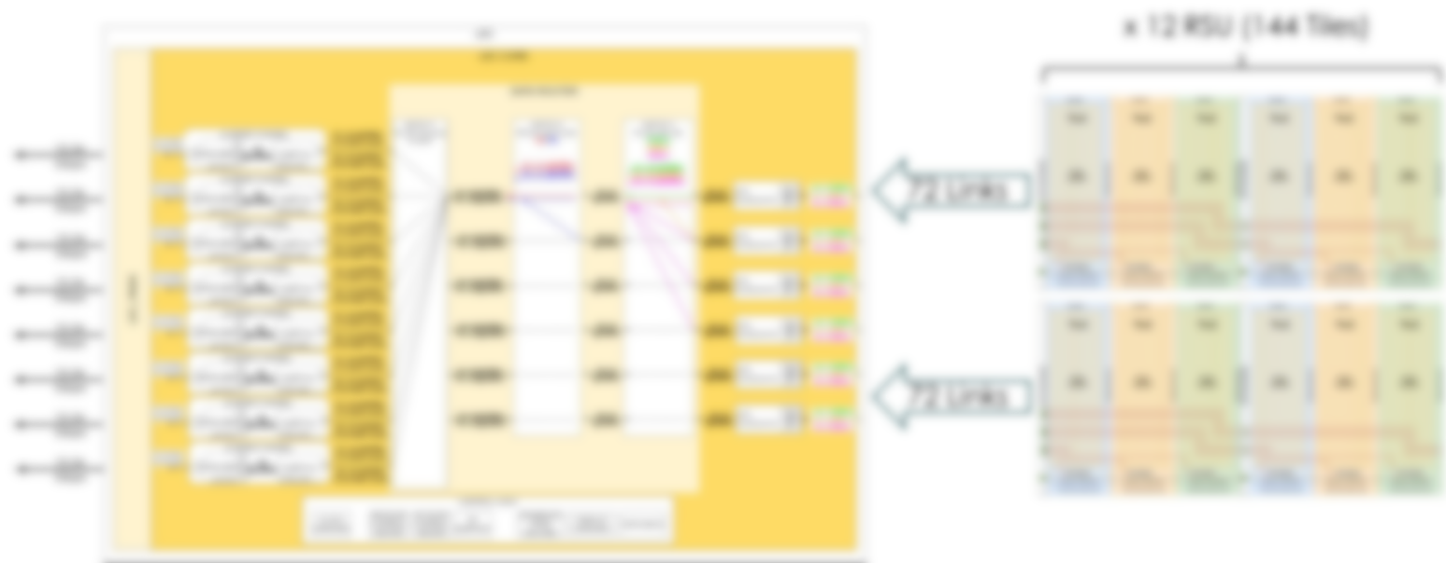
MOSAIX Data Flow – From Tiles to Left Endcap
MOSAIX is sub-divided into 144 (2 x 72) Tiles
Each Tile has its own pixel matrix read out via a 160 Mbps serial link towards the LEC
MOSAIX thus has 160 Mbps x 144 = 22.5 Gbps arriving at the LEC

Slide 16
MOSAIX Data Flow – From Tiles to Left Endcap
In the LEC, the tile serial links are received and aligned
Via a switch matrix, the data can then selectively be sent to individual encoders and off-chip serializers

Slide 17
MOSAIX Data Flow – From Tiles to Left Endcap
The data are then encoded with lpGBT IPs (providing a radiation tolerant protocol) and serialized to be shipped off the sensor via 10.24 Gbps links.
The MOSAIX design contains a total of 8 encoders and serializers, providing a total 80 Gbps bandwidth.
A fallback option is to run the serializers at 5.12 Gbps, thus still providing 40 Gbps.
This provides high redundancy for the 22.5 Gbps payload from the tiles in case of radiation damage; the switch matrix can be programmed with different (fixed) routing to mitigate the impact of failed components.
In case of the SVT LAS, only one serializer is foreseen in the design due to the much lower payload requirements in these sensors.

Slide 18
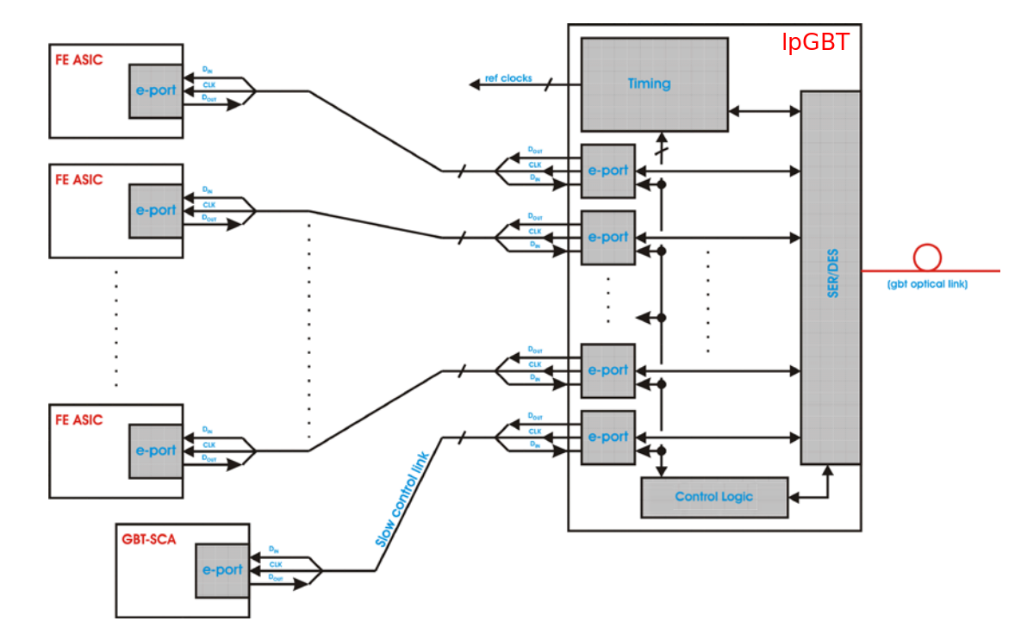
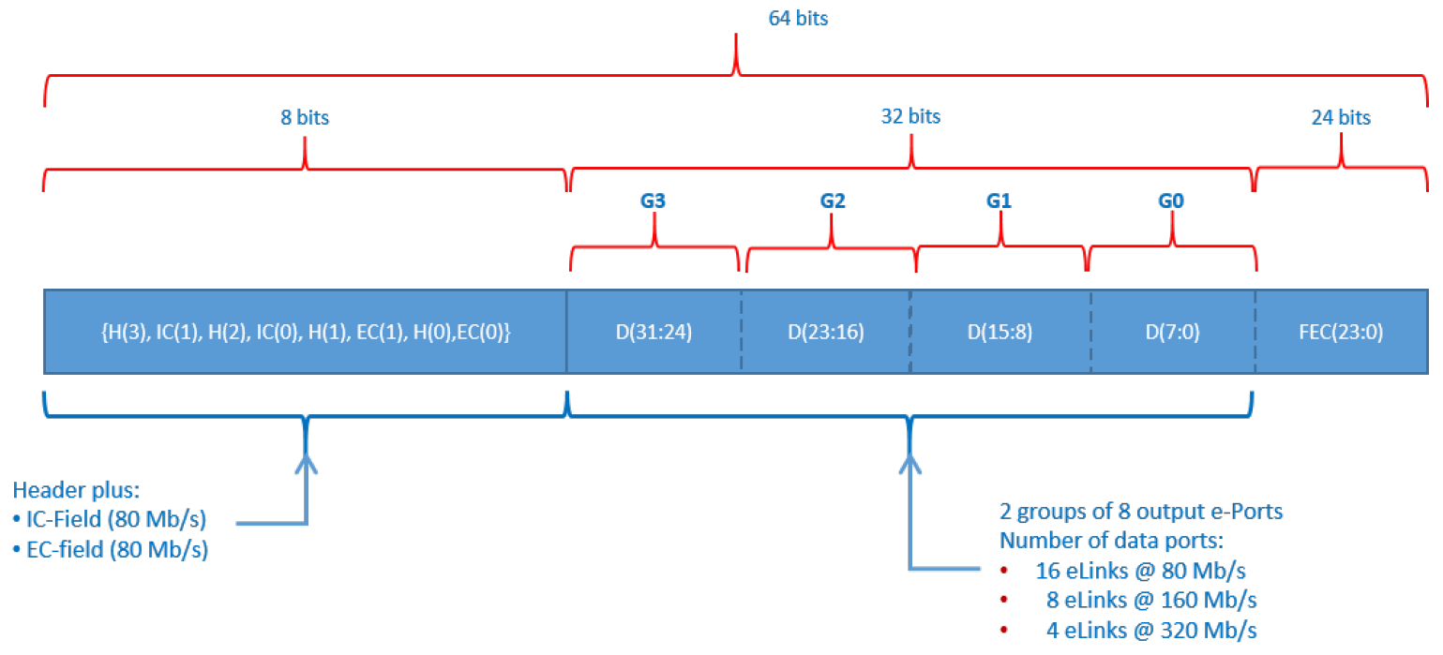

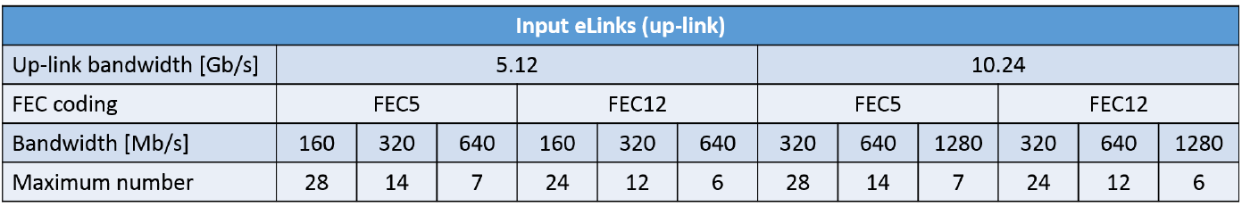
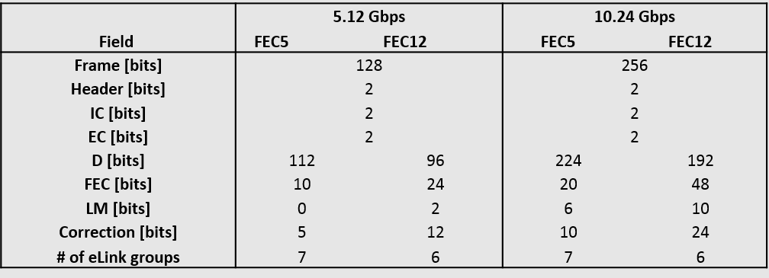
lpGBT Protocol
Downlink
Data Uplink

Slide 19
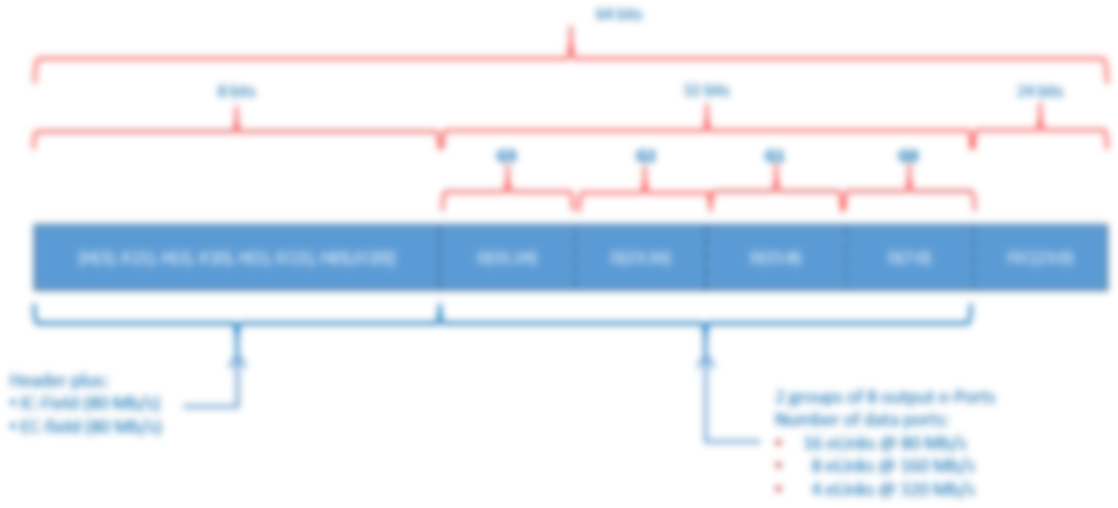

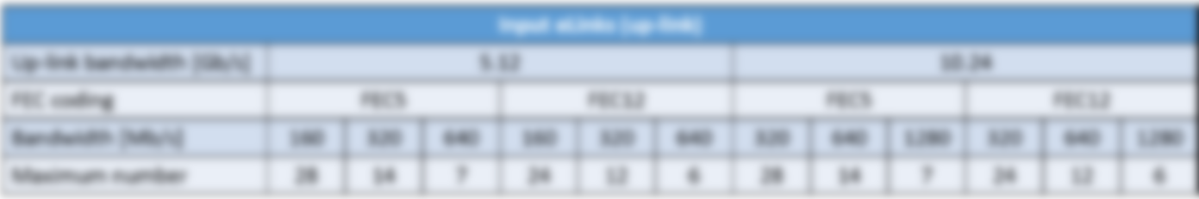
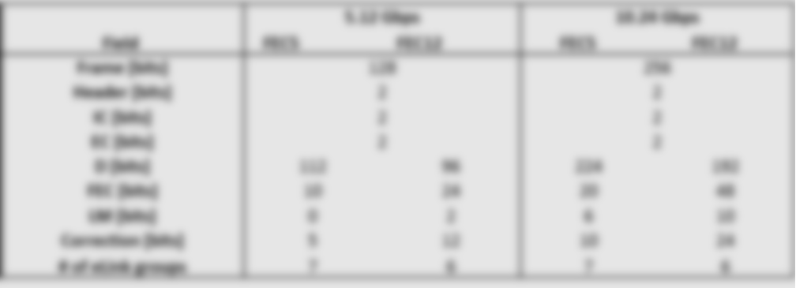
lpGBT Protocol
Front Ends connect to “e-links”
The fiber protocol includes “Forward Error Correction”

Slide 20

lpGBT Protocol
Downlink
Line Rate: 2.56 Gbps
32 out of 64 bits are data:
Payload = 1.280 Gbps
Data Uplink
Front Ends connect to “e-links”
The fiber protocol includes “Forward Error Correction”
Downlink runs at 2.56 Gbps
Downlink frame is 64bit wide, of which 32 bits are payload
1.28 Gbps payload
Up to 16 e-links @ 80 Mbps

Slide 21
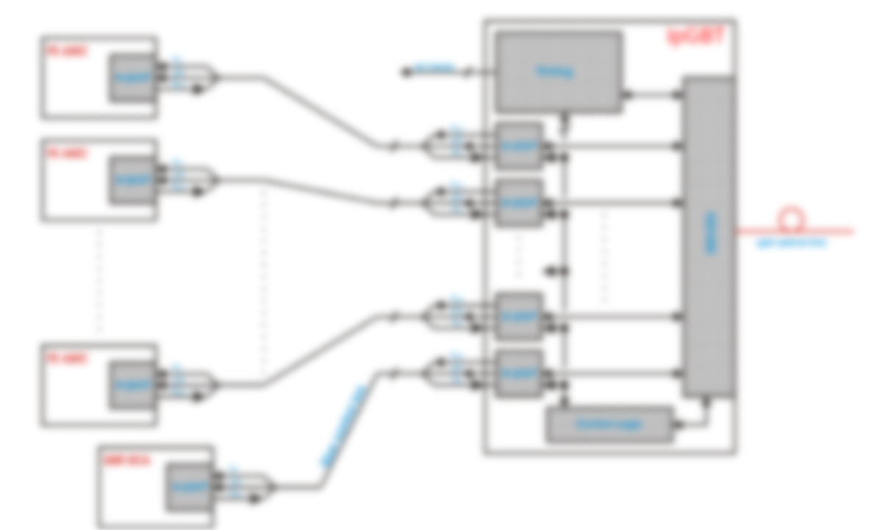
lpGBT Protocol
Downlink
Line Rate: 2.56 Gbps
32 out of 64 bits are data:
Payload = 1.280 Gbps
Data Uplink
192 out of 256 bits are data:
Payload = 7.680 Gbps
Front Ends connect to “e-links”
The fiber protocol includes “Forward Error Correction”
Downlink runs at 2.56 Gbps
Downlink frame is 64bit wide, of which 32 bits are payload
1.28 Gbps payload
Up to 16 e-links @ 80 Mbps
Uplink runs at either 10.24 Gbps or 5.12 Gbps
Uplink frame is either 128bit or 256bit
256bit frame contains 192bits of payload (7.68 Gbps)
Up to 24 e-links at either 160 Mbps or 320 Gbps

Slide 22

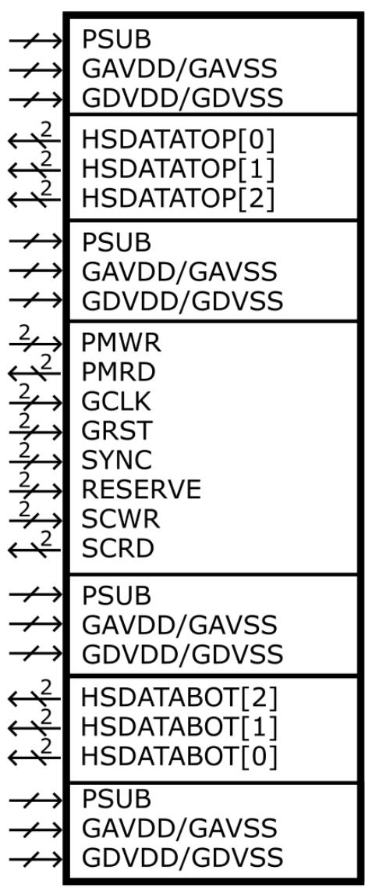
MOSAIX Interfaces in the Left End Cap (LEC)
Supplies
I/Os
Supplies
Supplies
I/Os
Supplies
Supplies
I/Os
Supplies
All I/Os are differential
8x 10.24 Gb/s data outputs
1x clock at 160 MHz
2x slow control buses at 5 Mbps (General SC and Power Management)
2x synchronization signals (SYNC and GRST)
(slow controls: 2 links up; 1 clock, 4 links, and 1 spare down)
Global analog and digital supplies per segment
On-chip supply segmentation and control
Reverse biasing of substrate (PSUB)
down
up
Slow control
down
down
down
down
down
up

Slide 23
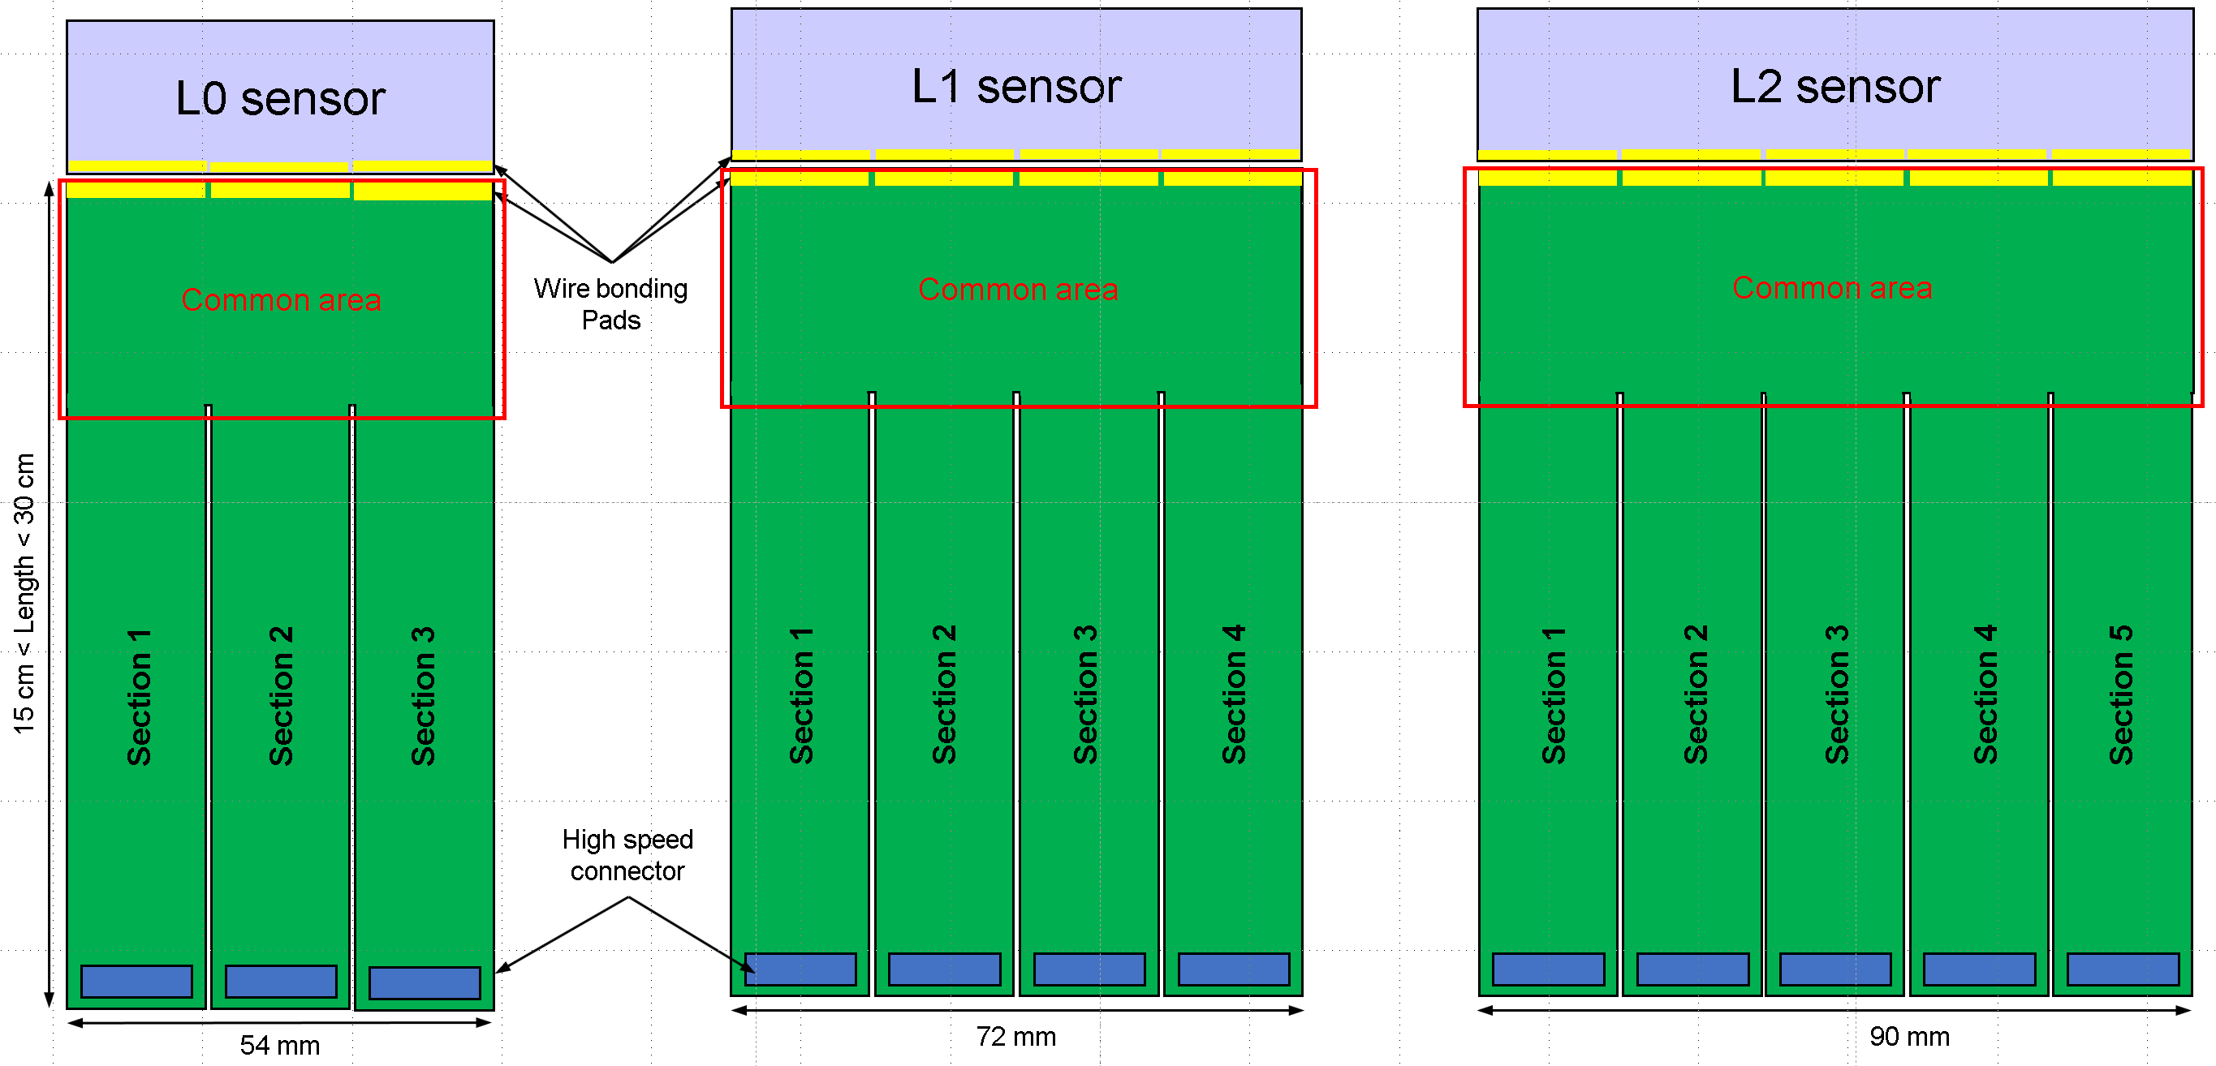
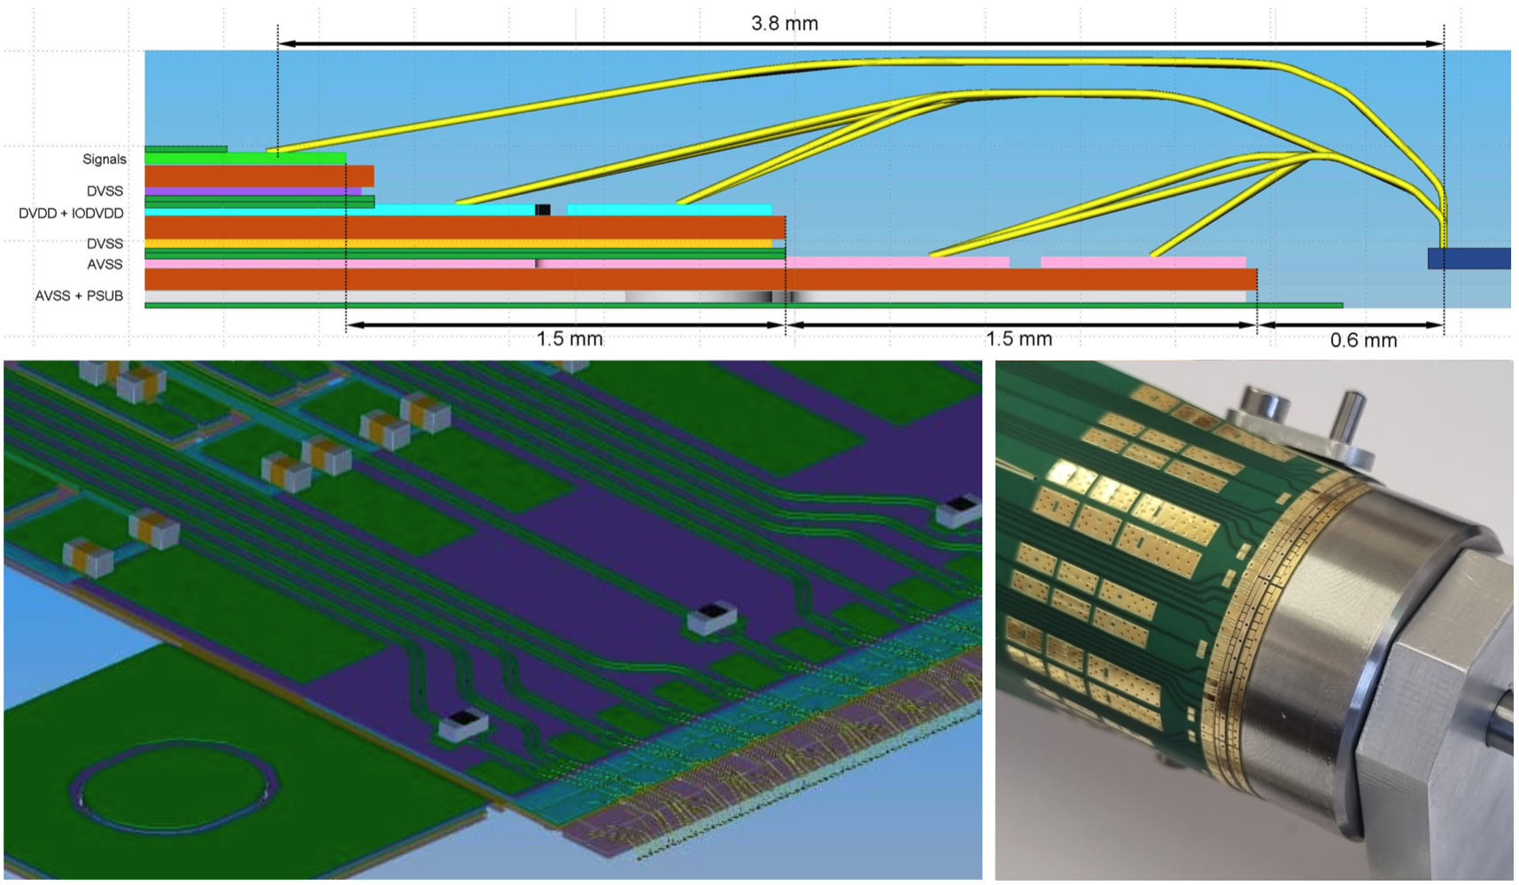
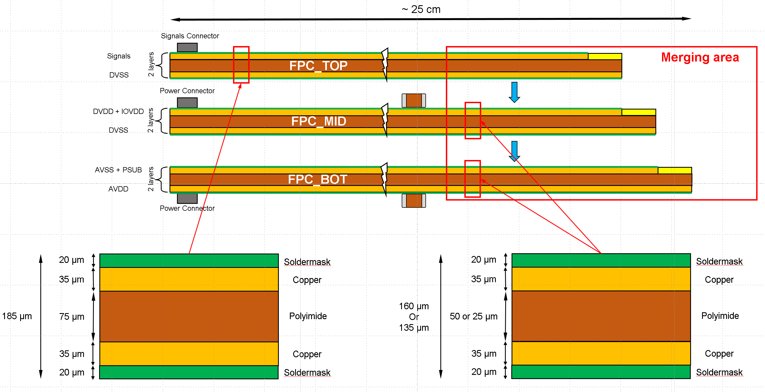
ITS3 Flex PC Design: Inspiration for SVT IB FPC design

Slide 24
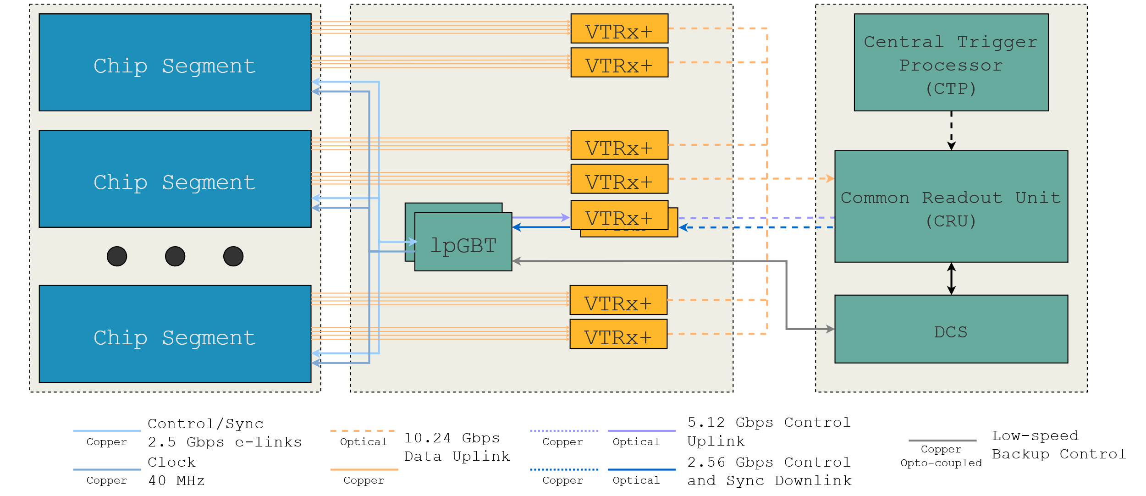
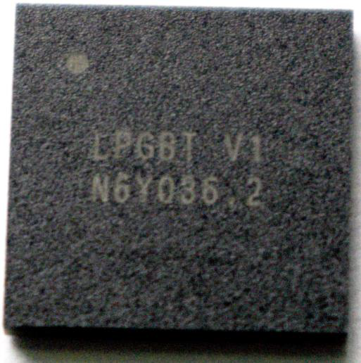
Inner Barrel Readout Electronics (inspired by ITS-3 DSE)
Radiation Area
Data
Counting House
Global Timing Unit
(GTU)
Data
FELIX
(DAM Board)
VTRx+
Data
lpGBT
5 Mbps
Data : 4 HS lines connected to 1 VTRx+ -> Fiber bundle

Slide 25
Inner Barrel Readout Electronics (inspired by ITS-3 DSE)
Radiation Area
Counting House
Global Timing Unit
(GTU)
FELIX
(DAM Board)
Control
VTRx+
lpGBT
5 Mbps
Data : 4 HS lines connected to 1 VTRx+ -> Fiber bundle
Slow Controls: uses lpGBT e-links for one-to-one connection with the LEC SC signals
lpGBTs are also used to control and monitor RDO electronics itself
lpGBTs are connected to individual VTRx+ for fiber up and downlink

Slide 26
Outer Barrel & Disk LAS Readout

Slide 27
Outer Barrel and Disk Readout Electronics
LAS
LAS
LAS
LAS
VTRx+
H/S Data
Fiber up
Disks & Staves:
Up to 4 LAS connect their H/S data to one VTRx+

Slide 28
Outer Barrel and Disk Readout Electronics
LAS
LAS
LAS
LAS
VTRx+
H/S Data
Fiber up
Slow ctrl
Slow Ctrl
Slow Ctrl
Slow Ctrl
SC up/down
VTRx+
&
lpGBT
elink 1
LAS
LAS
LAS
LAS
Fiber up/down
elink 2
Slow ctrl
Slow Ctrl
Slow Ctrl
SC up/down
Slow Ctrl
….
elink 16
….
Disks & Staves:
SC up/down
LAS
LAS
LAS
LAS
Up to 4 LAS connect their H/S data to one VTRx+
Slow Controls is provided via lpGBT e-links to a SC bus
One e-link provides SC to a group of up to four EIC-LAS
Each SC e-link has 3 signals: Clock, SC_in, SC_out
Slow ctrl
Slow Ctrl
Slow Ctrl
Slow Ctrl

Slide 29
SVT Readout Numbers

Slide 30
SVT Hit Rate Simulations
10x100 GeV ep,
4.48 x 10³³ cm⁻²s⁻¹, 184 kHz DIS event rate
10 GeV SR
10 GeV e-beam gas, 10000 Ahr
100 GeV proton-beam gas, 100 Ahr
 | Hit Rate (Hz) | Area (cm²) | Hits/s/cm²
L0 | 4.50E+06 | 610.73 | 7.37E+03
L1 | 4.85E+06 | 814.30 | 5.96E+03
L2 | 1.41E+06 | 2035.75 | 6.93E+02
L3 | 8.55E+05 | 9160.88 | 9.33E+01
L4 | 8.89E+05 | 22167.08 | 4.01E+01
 | Hit Rate (Hz) | Area (cm²) | Hits/s/cm²
ED0 | 3.66E+05 | 1767.11 | 2.07E+02
ED1 | 4.00E+06 | 5368.16 | 7.45E+02
ED2 | 3.97E+06 | 5536.32 | 7.17E+02
ED3 | 3.74E+06 | 5532.26 | 6.76E+02
ED4 | 3.35E+06 | 5524.62 | 6.06E+02
 | Hit Rate (Hz) | Area (cm²) | Hits/s/cm²
HD0 | 3.92E+06 | 1767.11 | 2.22E+03
HD1 | 4.45E+06 | 5368.16 | 8.29E+02
HD2 | 4.48E+06 | 5533.75 | 8.10E+02
HD3 | 3.83E+06 | 5513.51 | 6.95E+02
HD4 | 3.25E+06 | 5486.76 | 5.92E+02

Slide 31
SVT by the numbers
 | width (mm) | length (mm) |  | # pixels per RSU
Reticle size | 19.564 | 21.666 |  | 827,424
Pixel size | 0.0208 | 0.0228
Barrel |  |  |  |  | Sensor |  |  |  |  |  |  |  |  |  |  |  |  | 10x275GeV
Layer Index | radius (mm) | z (mm) |  | Area (mm^2) | reticles in width | reticles in length | # of sensors in r-phi | # of sensors in z |  | # pixels | # sensors | Notes | # Readout Links | # Staves | # Data VTRx+ | # SC lpGBTs |  | Hit Rate / s | Hits/pixel/2us frame
L0 | 36 | 260 |  | 58,811 | 3 | 12 | 4 | 1 |  | 119,149,056 | 4 | bent ITS3 | 96 |  | 24 | 5 |  | 2.73E+07 | 4.26E-07
L1 | 48 | 260 |  | 78,414 | 4 | 12 | 4 | 1 |  | 158,865,408 | 4 | bent ITS3 | 128 |  | 32 | 7 |  | 2.94E+07 | 3.44E-07
L2 | 120 | 260 |  | 196,035 | 5 | 12 | 8 | 1 |  | 397,163,520 | 8 | bent ITS3 | 320 |  | 80 | 17 |  | 8.55E+06 | 4.01E-08
L3 | 270 | 520 |  | 882,158 | 1 | 6 | 96 | 4 |  | 1,906,384,896 | 384 | 6 -RSU LAS | 384 | 48 | 96 | 8 |  | 5.19E+06 | 5.06E-09
L4 | 420 | 840 |  | 2,216,706 | 1 | 5 | 148 | 8 |  | 4,898,350,080 | 1184 | 5-RSU LAS | 1184 | 74 | 296 | 25 |  | 5.39E+06 | 2.05E-09
e-endcap
Disk index | z (mm) | inner r (mm) | outer r (mm) |  |  | 5-RSU LAS | 6-RSU LAS |  |  |  |  |  |  | Readout Groups
ED0 | -250 | 36.76 | 240 | 176,710 |  | 56 | 40 |  |  | 337,588,992 | 96 | 5-RSU LAS | 96 | 26 | 26 | 3 |  | 2.22E+06 | 1.22E-08
ED1 | -450 | 36.76 | 415 | 536,815 |  | 334 | 0 |  |  | 1,381,798,080 | 334 | 5-RSU LAS | 334 | 96 | 96 | 8 |  | 2.43E+07 | 3.27E-08
ED2 | -650 | 36.76 | 421.4 | 553,632 |  | 334 | 0 |  |  | 1,381,798,080 | 334 | 5-RSU LAS | 334 | 96 | 96 | 8 |  | 2.41E+07 | 3.24E-08
ED3 | -850 | 40.0614 | 421.4 | 552,835 |  | 334 | 0 |  |  | 1,381,798,080 | 334 | 5-RSU LAS | 334 | 96 | 96 | 8 |  | 2.27E+07 | 3.05E-08
ED4 | -1050 | 46.3529 | 421.4 | 551,127 |  | 334 | 0 |  |  | 1,381,798,080 | 334 | 5-RSU LAS | 334 | 96 | 96 | 8 |  | 2.03E+07 | 2.74E-08
h-endcap
Disk index
HD0 | 250 | 36.76 | 240 | 176,710 |  | 56 | 40 |  |  | 337,588,992 | 96 | 5-RSU LAS | 96 | 26 | 26 | 3 |  | 2.38E+07 | 1.31E-07
HD1 | 450 | 36.76 | 415 | 536,815 |  | 334 | 0 |  |  | 1,381,798,080 | 334 | 5-RSU LAS | 334 | 96 | 96 | 8 |  | 2.70E+07 | 3.63E-08
HD2 | 700 | 38.52 | 421.4 | 553,216 |  | 334 | 0 |  |  | 1,381,798,080 | 334 | 5-RSU LAS | 334 | 96 | 96 | 8 |  | 2.72E+07 | 3.66E-08
HD3 | 1000 | 53.43 | 421.4 | 548,909 |  | 334 | 0 |  |  | 1,381,798,080 | 334 | 5-RSU LAS | 334 | 96 | 96 | 8 |  | 2.32E+07 | 3.13E-08
HD4 | 1350 | 70.14 | 421.4 | 542,422 |  | 334 | 0 |  |  | 1,381,798,080 | 334 | 5-RSU LAS | 334 | 96 | 96 | 8 |  | 1.97E+07 | 2.65E-08
TOTAL |  |  |  | 8,161,315 |  |  |  |  |  | 19,209,475,584 | 4448 |  | 4976 |  | 1348 | 132 |  | 2.90E+08 | hits/s
 |  |  |  |  |  |  |  |  |  |  |  |  |  |  |  |  |  | 34.61 | Gbps
 |  |  |  |  |  |  |  |  |  | # of segments: | 4500
 |  |  |  |  |  |  |  |  |  | # of SC links down | 22500
 |  |  |  |  |  |  |  |  |  | # of SC links up | 9000
… plus noise

Slide 32
SVT Readout Prototype Developments

Slide 33
SVT Prototype Developments
A full setup with lpGBT, VTRx+, and FPGA development boards (stand-ins for FELIX) exists at ORNL for evaluation of the various RDO components.
Alternatives to CERN’s lpGBT universe of components using commercial alternatives are being investigated.
First results with these setups have been achieved in the context of an R&D project concerned with the Silicon using EIC project funds.
Evaluation of the Samtec Optical FireFly as an alternative to VTRx+
Evaluation of the Microchip PolarFire FPGA as a radiation-tolerant FPGA replacement of the lpGBT
Evaluation of Aggregator Board architectures with commercial FPGA development boards has been started at MIT in the context of the Silicon R&D project.
A test setup for the characterization of CERN Engineering Run chiplets to be used in the MOSAIX and LAS designs is under development.
Investigations on Redundancy issues on the LAS design interfaces has started.
Work is ongoing on defining the details of the LAS physical and protocol interfaces.

Slide 34

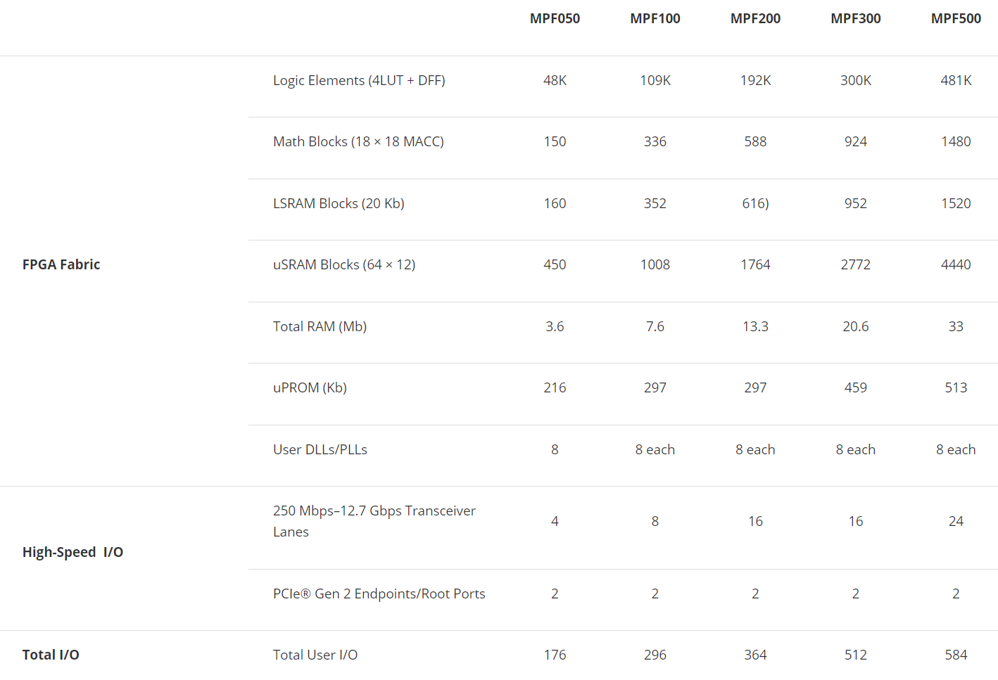
Commercial Alternatives: FireFly & PolarFire

Slide 35
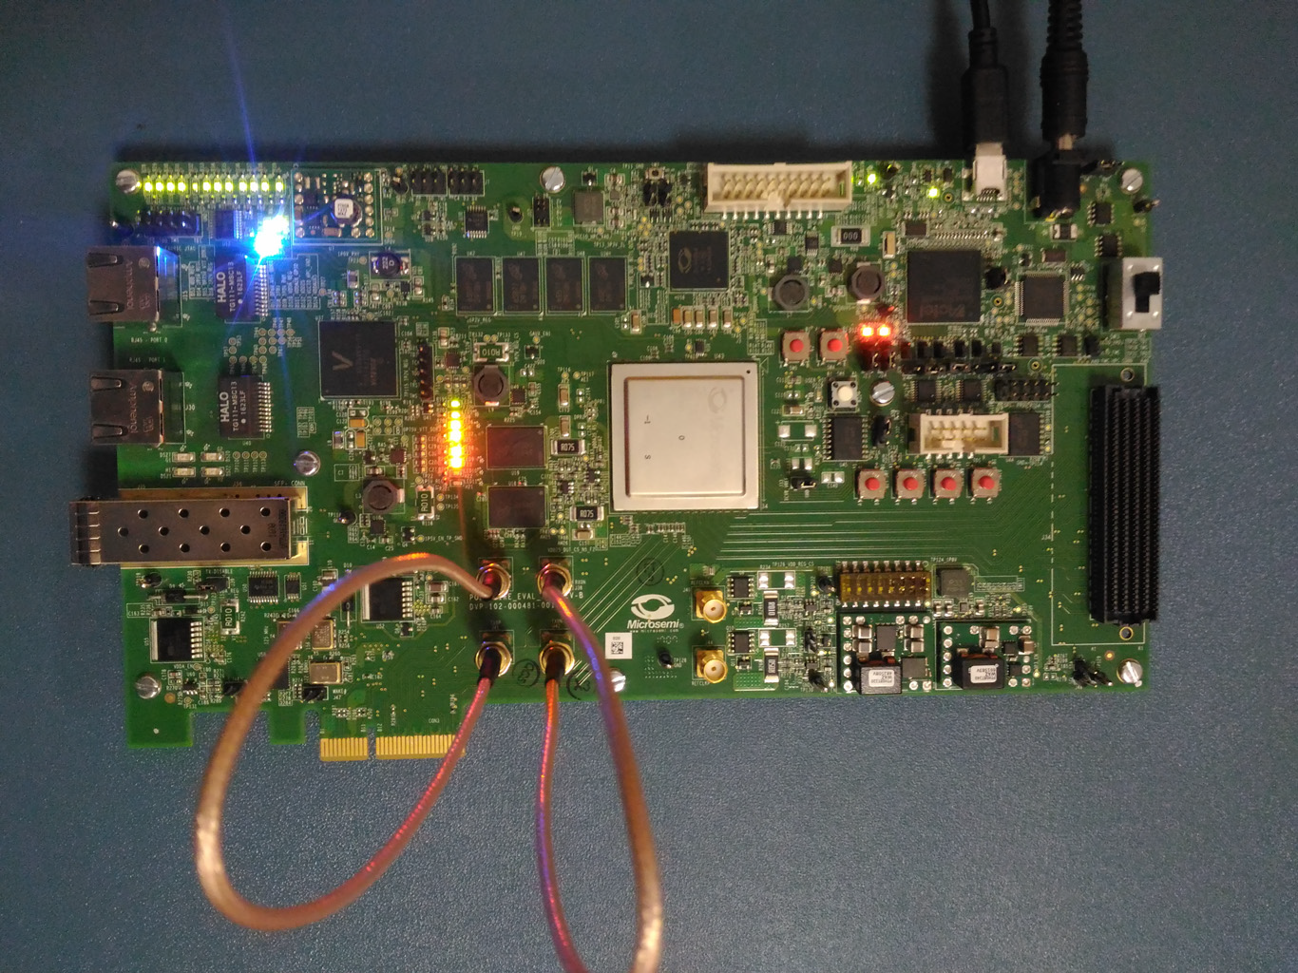
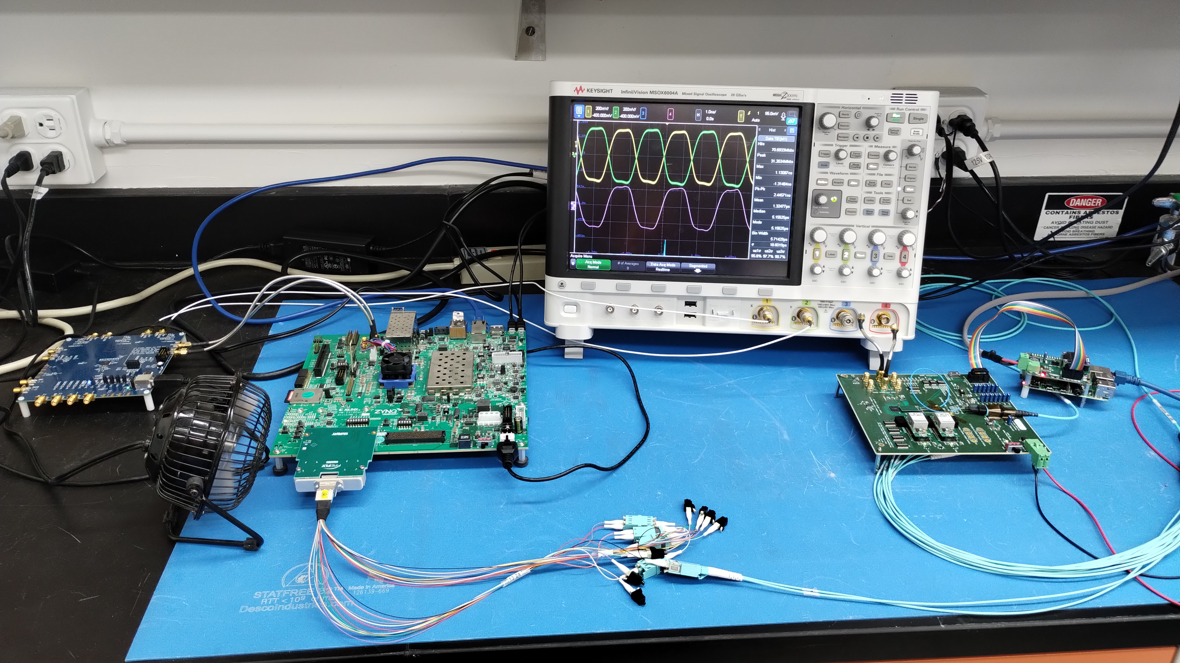
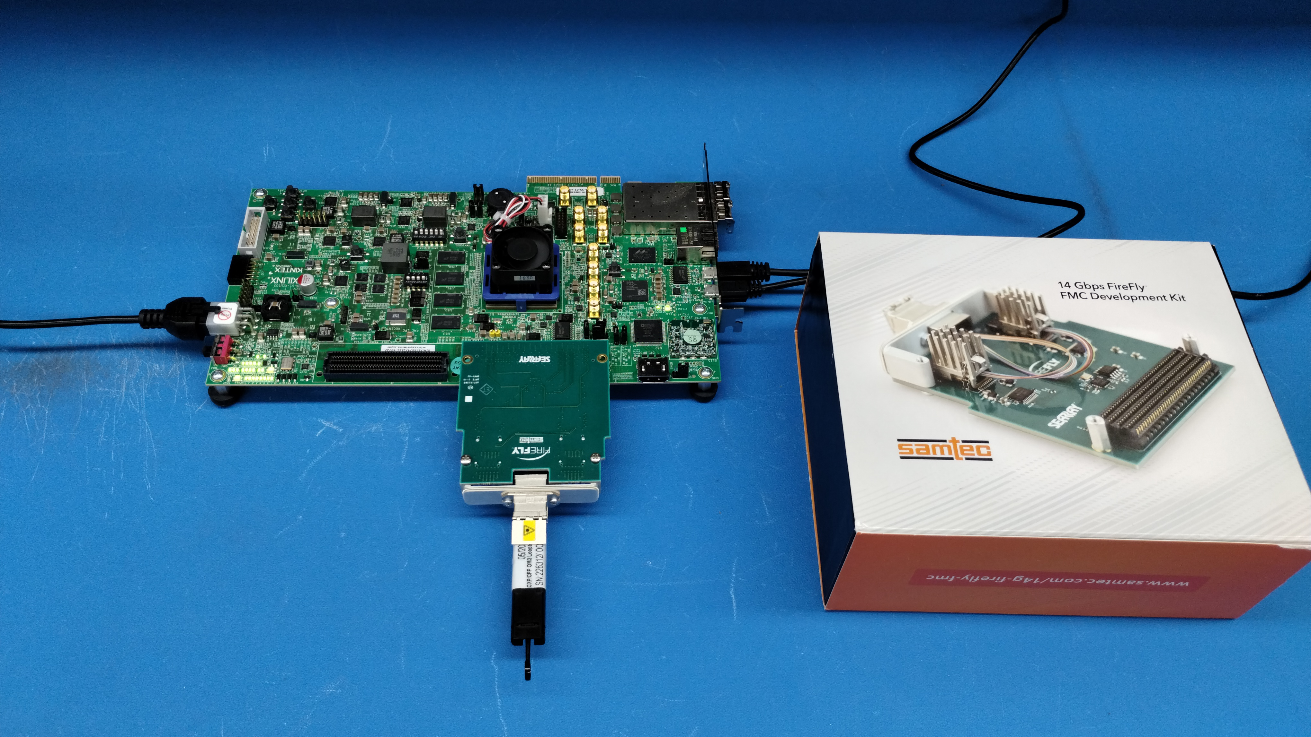
eRD104 Test Setups
lpGBT Test Setup with Samtec FireFly (VTRx+ alternative), Xilinx Ultrascale FPGA evaluation board (“FELIX), and SiliconLabs Clock Generator Board (“GTU”)
PolarFire Gigabit Transceiver Test Setup
Zync devel board running GBT-FPGA
VTRx+
SiliconLabs Clock Generator Eval Board
Raspberry Pi for programming and monitoring lpGBT
lpGBT
Samtec FireFly Test Setup with Fiber Loopback
Samtec FireFly Eval Board
VLDB+

Slide 36
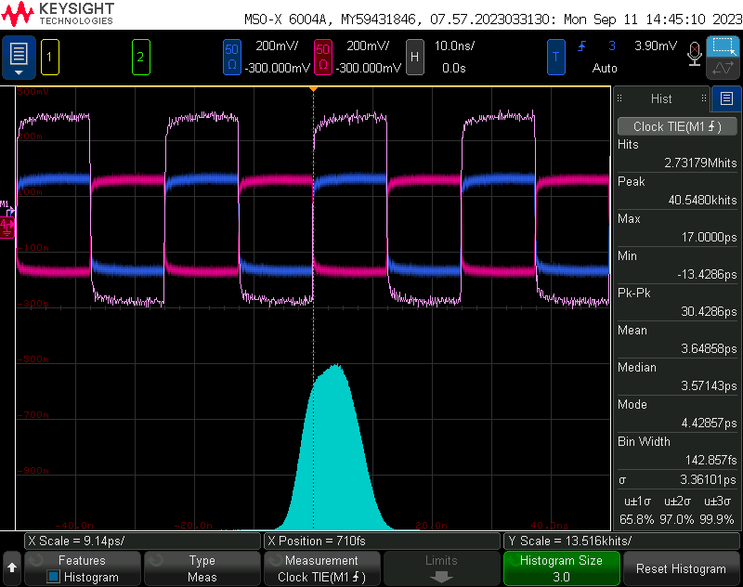
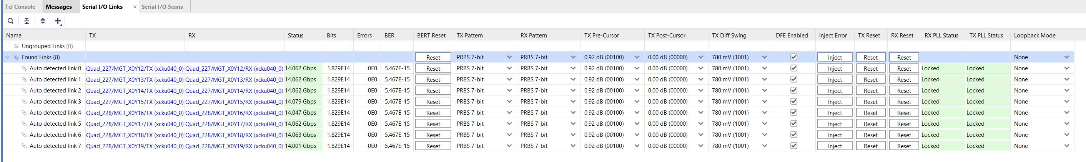
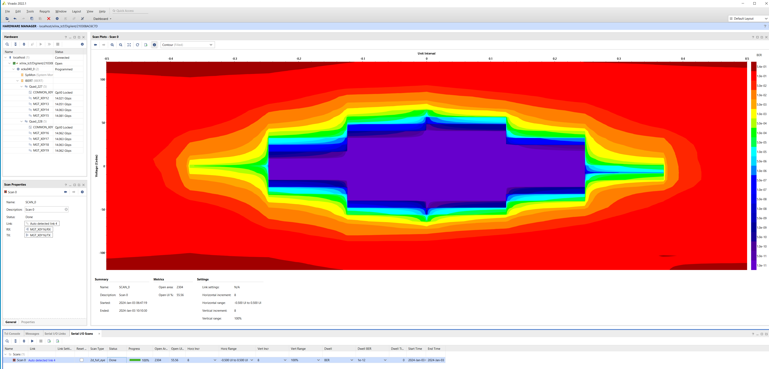
Selected Test Results:
Bit Error Rate (BER) Measurements
Scope Picture of “Phase Adjustable” recovered clock out of lpGBT
Purple: M1 = CLK+ (red) - Clk- (blue)
TIE Source : M1
Clock TIE measurement sigma = 3.36ps
FireFly “Eye” measurement @ 14 Gbps

Slide 37
Summary
An SVT Readout Design has been developed and demonstrated here
Inner Barrel RDO based on ALICE ITS-3 Service Electronics Board Design
Direct connection of multiple HS data serializers per segment to VTRx+
One-to-One connection between lpGBT e-links and LEC signals for slow controls
Direct powering of wafer scale sensor
Outer Barrel RDO concept uses a concept of LAS Readout groups
Group of up to 4 Single HS Data lines are directly connected to VTRx+
Slow Controls multiplexed between groups of 4 LAS via AncASICs on each LAS on a single bus
Prototype Setups are being investigated with evaluation boards of various components
First results have already been shown running all components at the full desired speeds and show that sufficient performance is achieved

Slide 38
Backup Slides

Slide 39
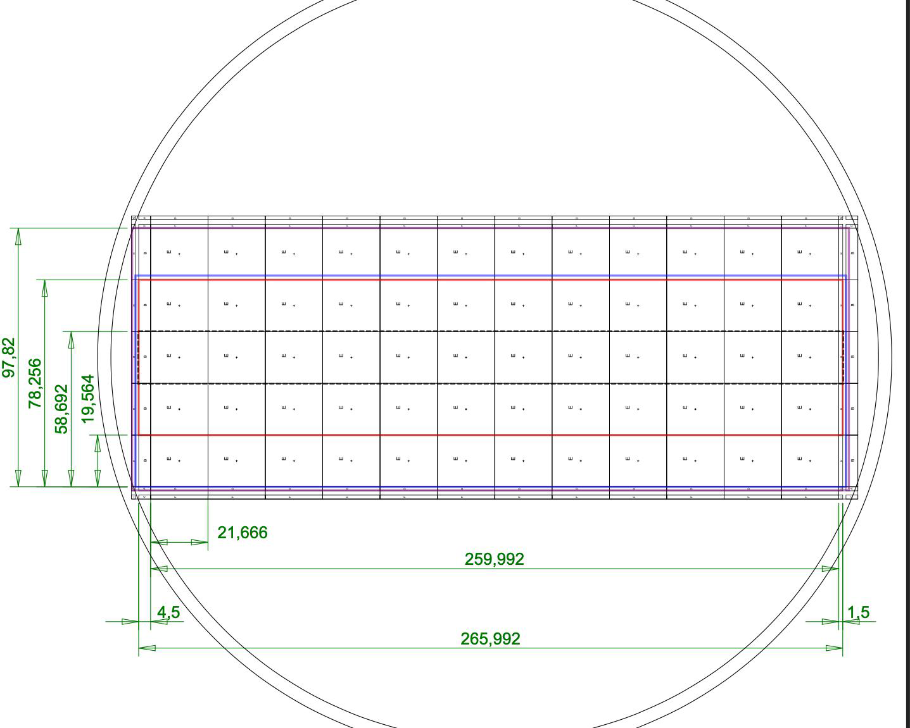
“MOSAIX” Stitched Sensor for SVT Inner Barrel
wafer
Layer 0: 12 x 3 repeated units + endcaps
Layer 1: 12 x 4 repeated units + endcaps
Layer 2: 12 x 5 repeated units + endcaps
Repeated (Stitched) Sensing Unit (RSU)
SEGMENT
Sensitive z-length
Physical z-length

Slide 40
MOSAIX Stitched Sensor Detail
Supplies
I/Os
Supplies
Supplies
I/Os
RSU
SEGMENT
Supplies
Supplies
I/Os
Supplies
12 x Repeated Sensor Unit

Slide 41
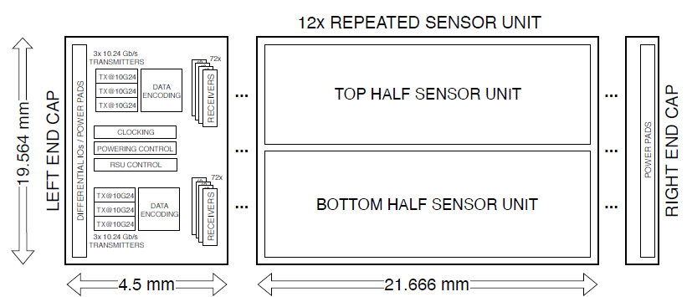
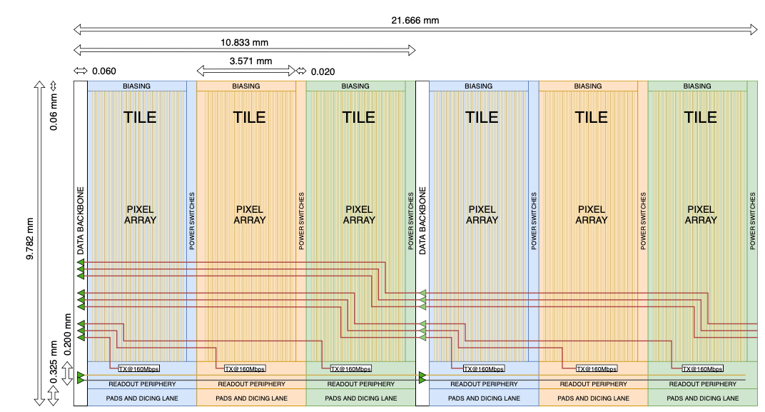
Half Repeated Sensor Unit
Each Half Unit is segmented in Tiles (Domains)
Each tile acts as an independent sensor
Separate Local Power
Configuration
Readout Link (160 Mb/s)
Each Tile data output has direct connection to the left endcap

Slide 42
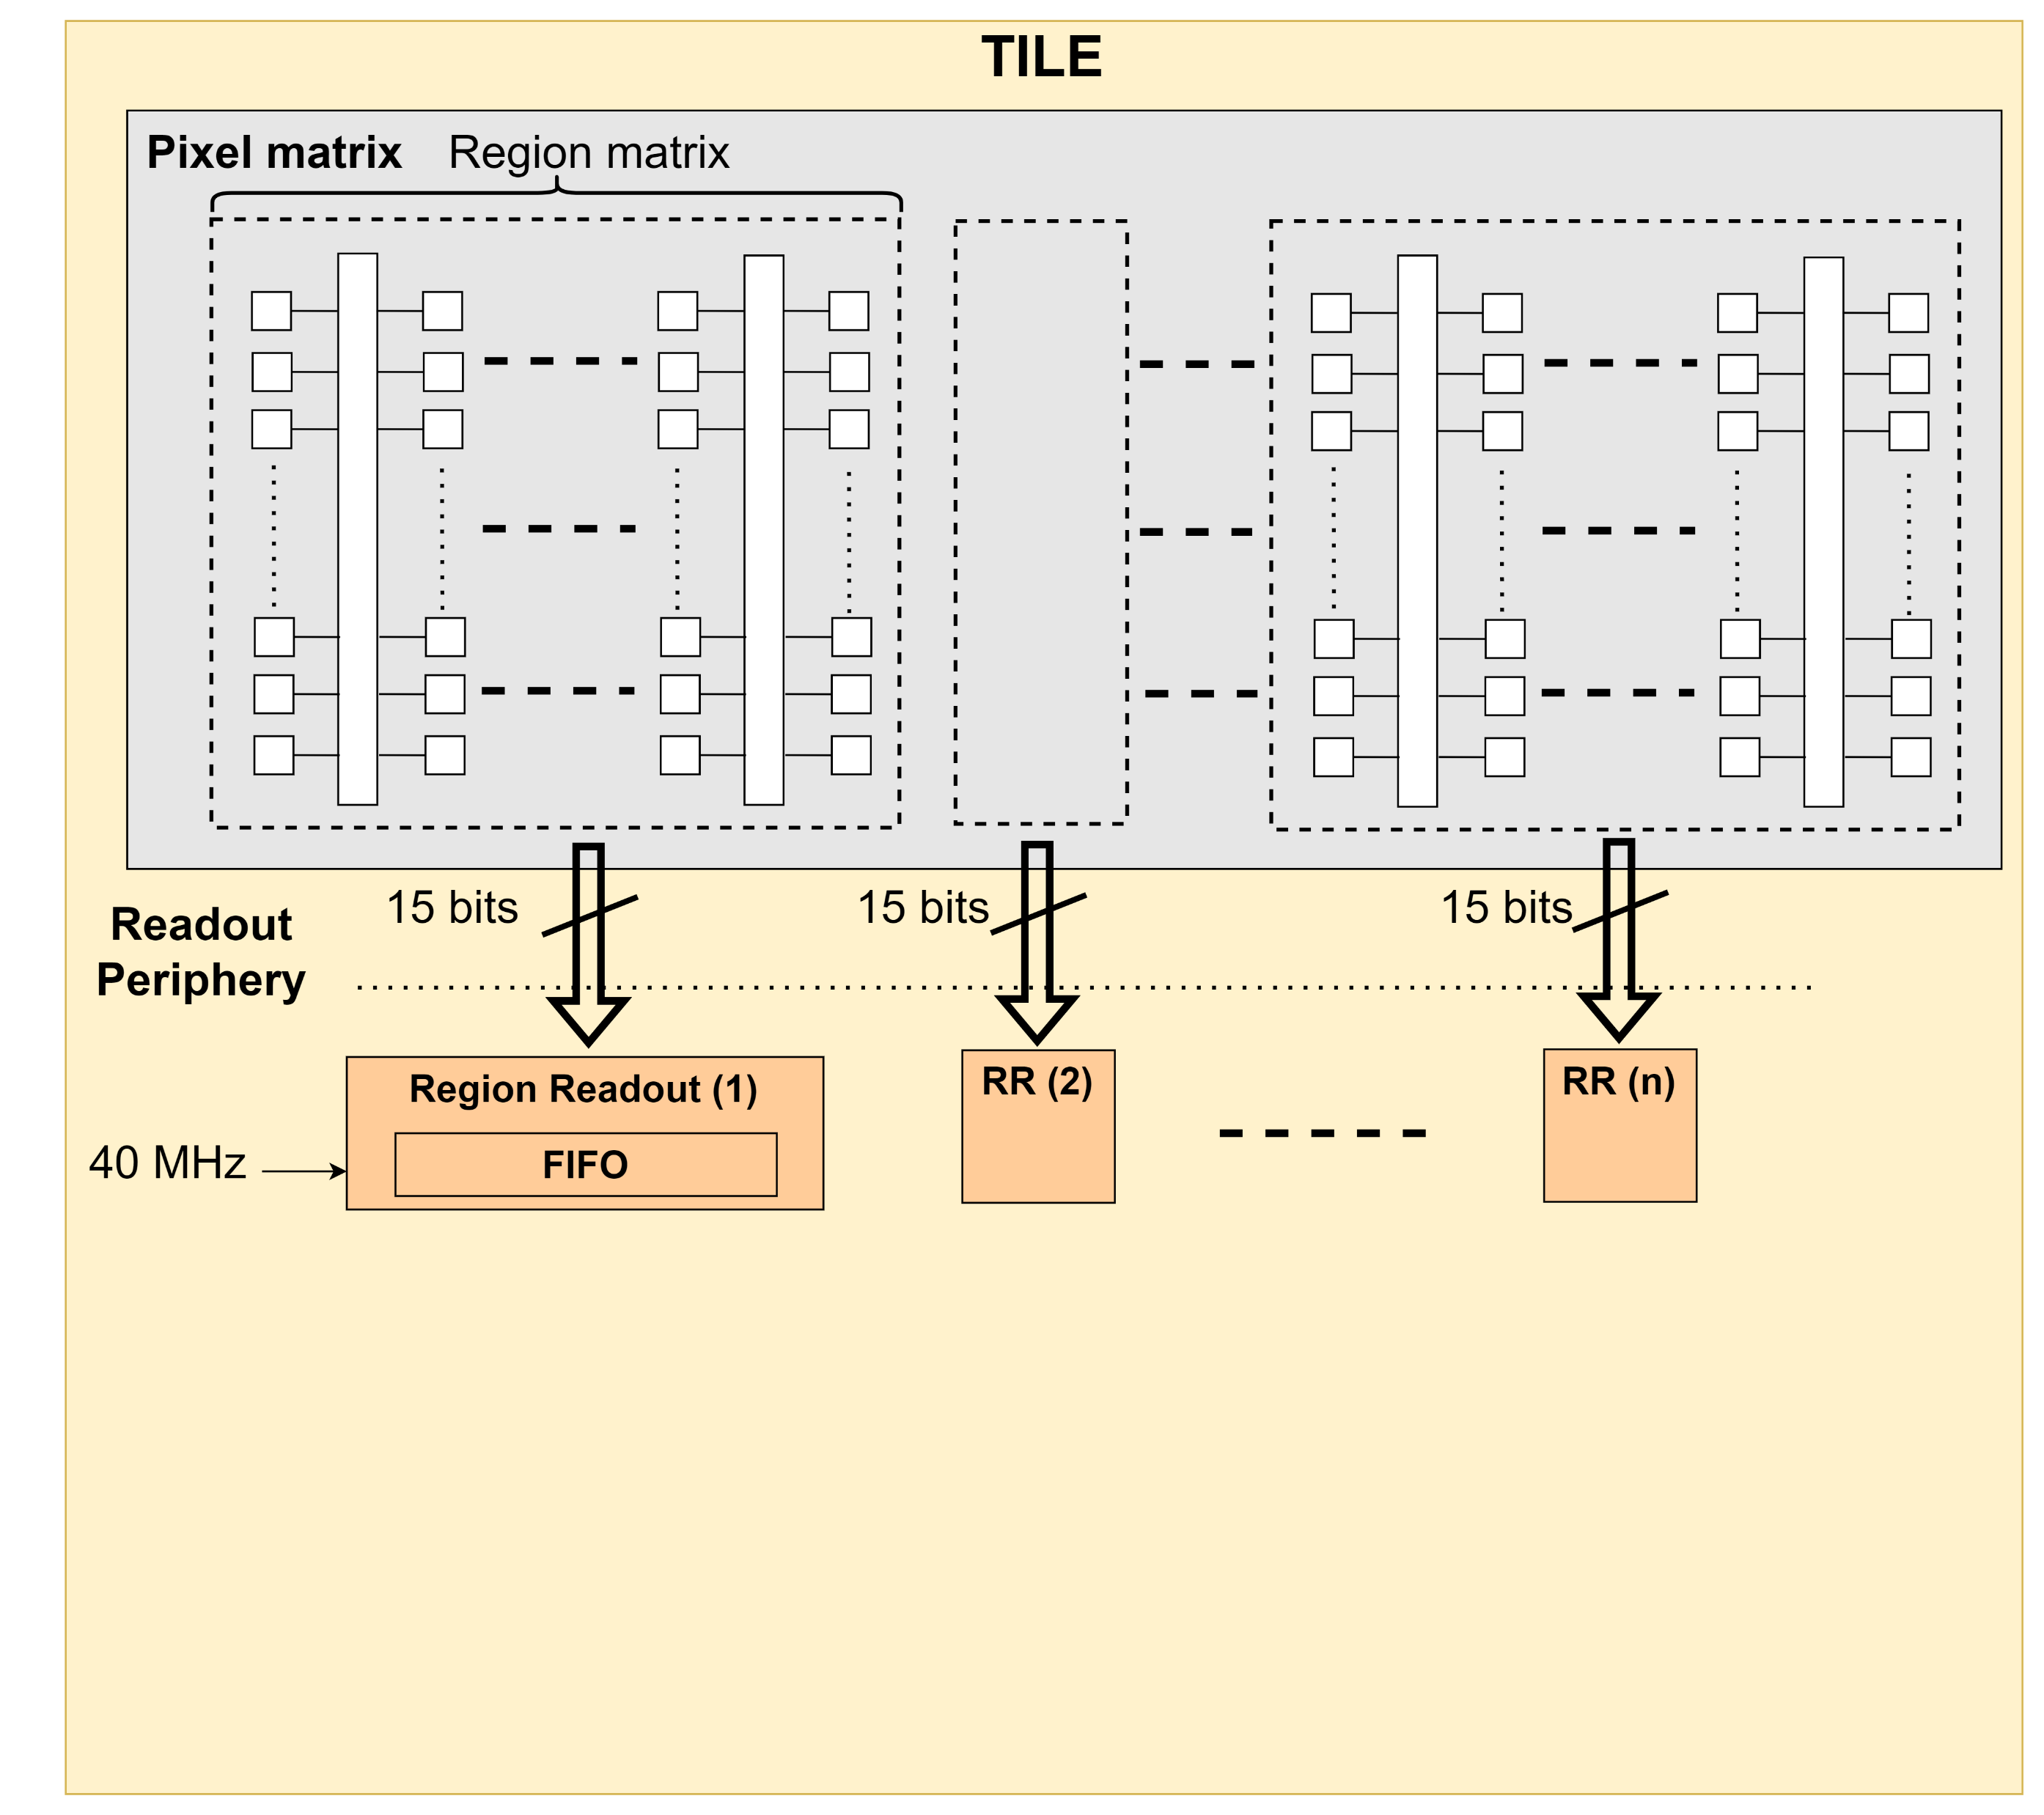
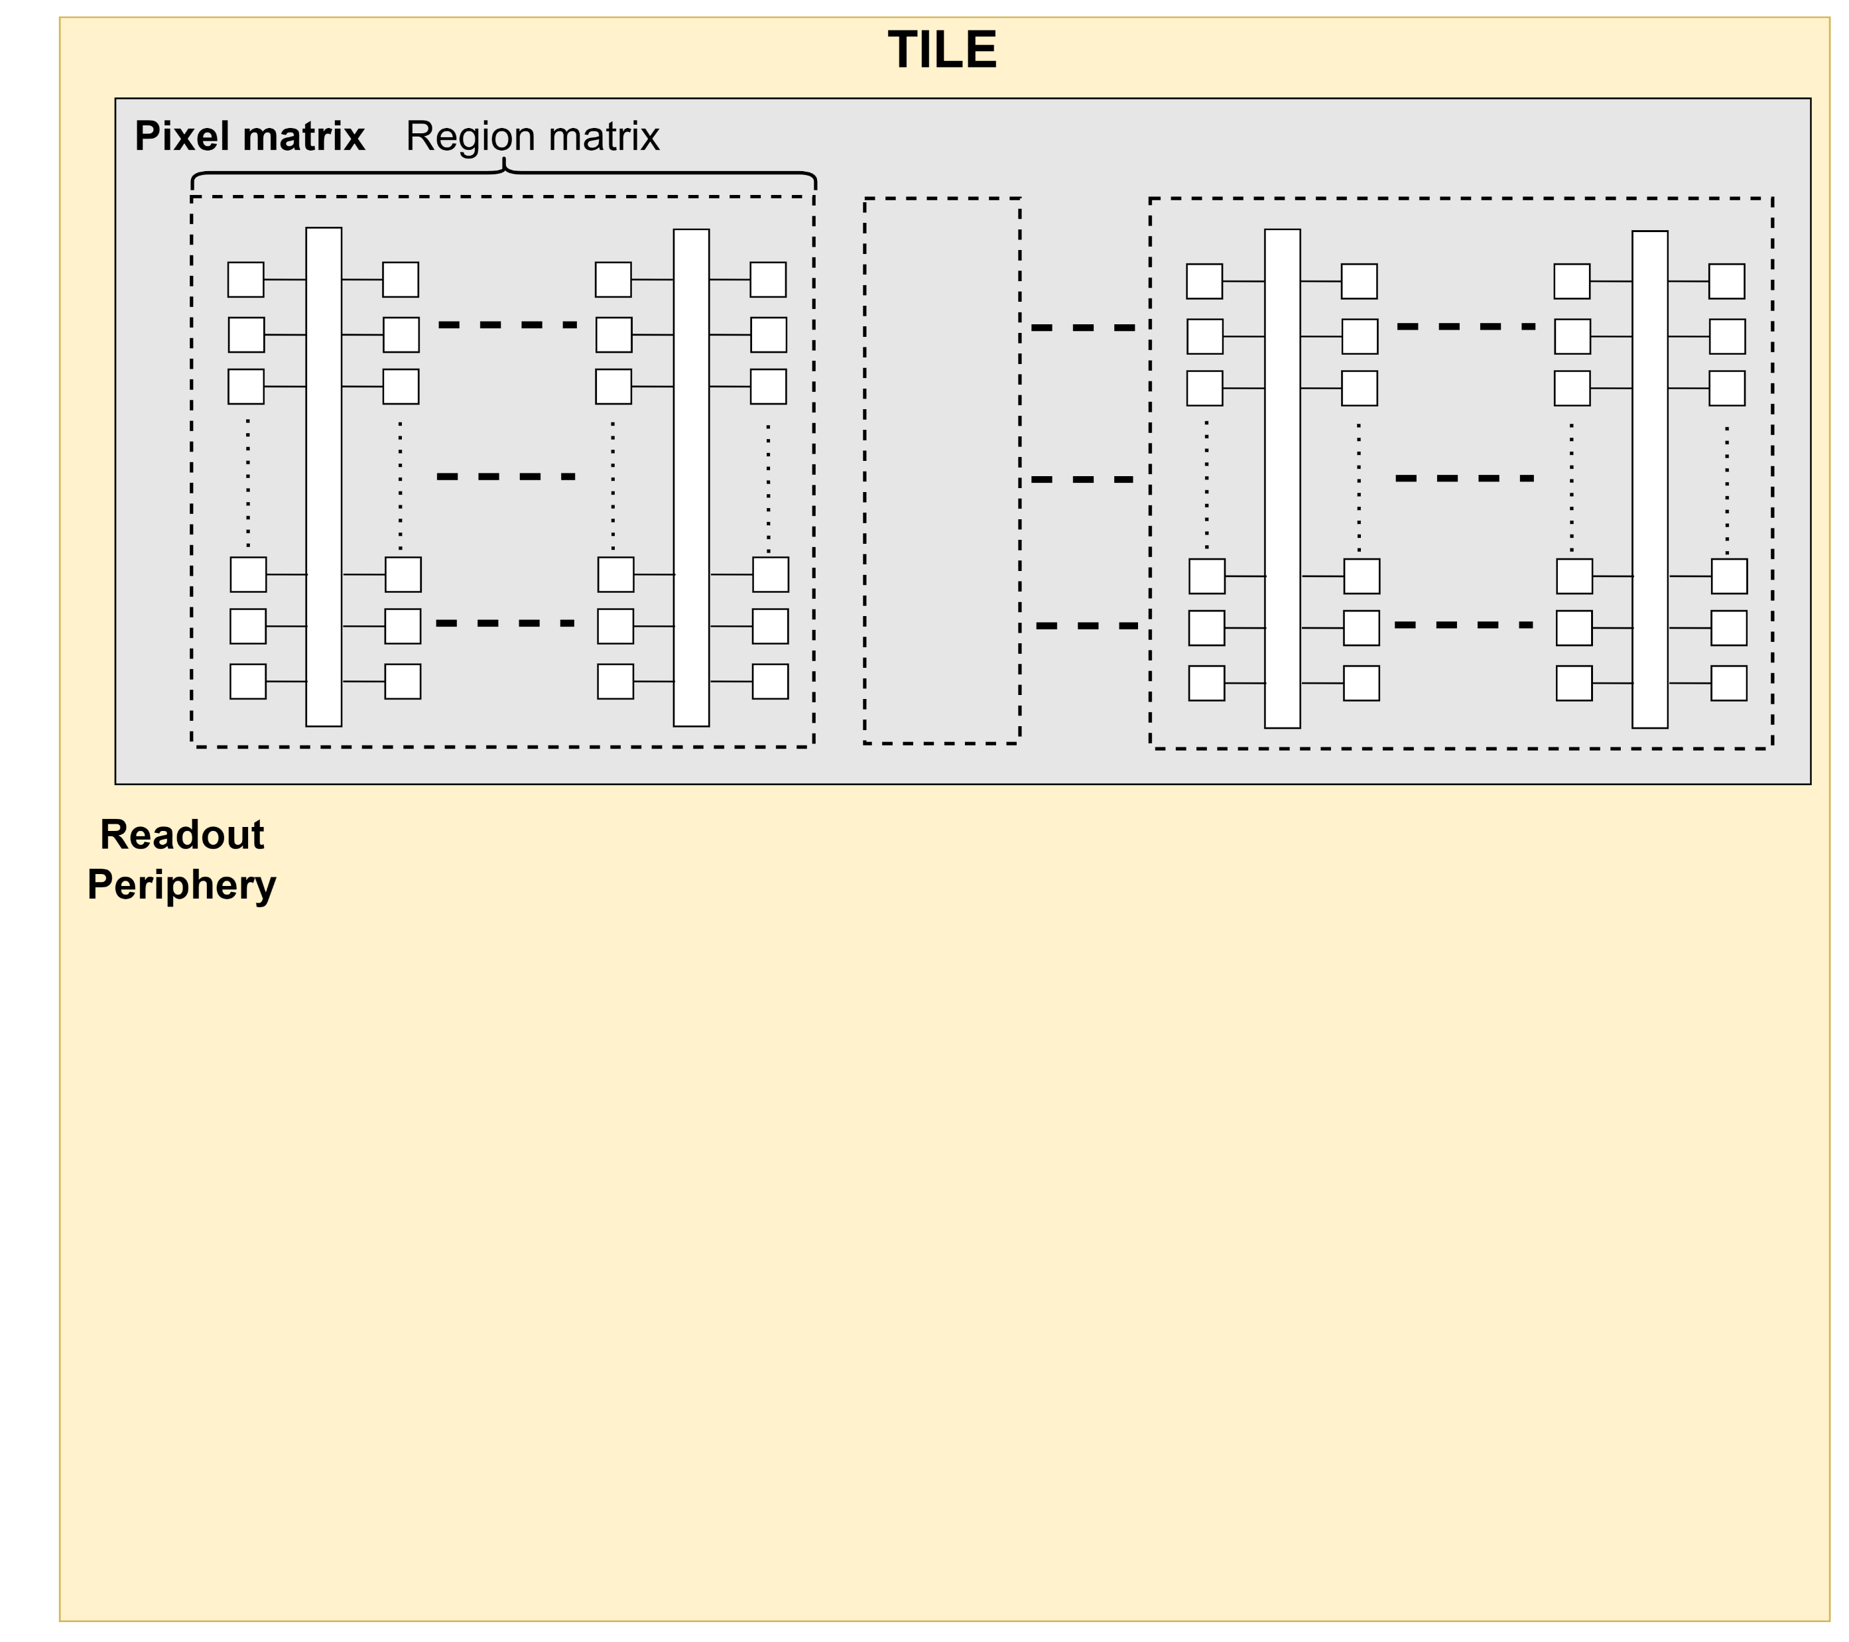
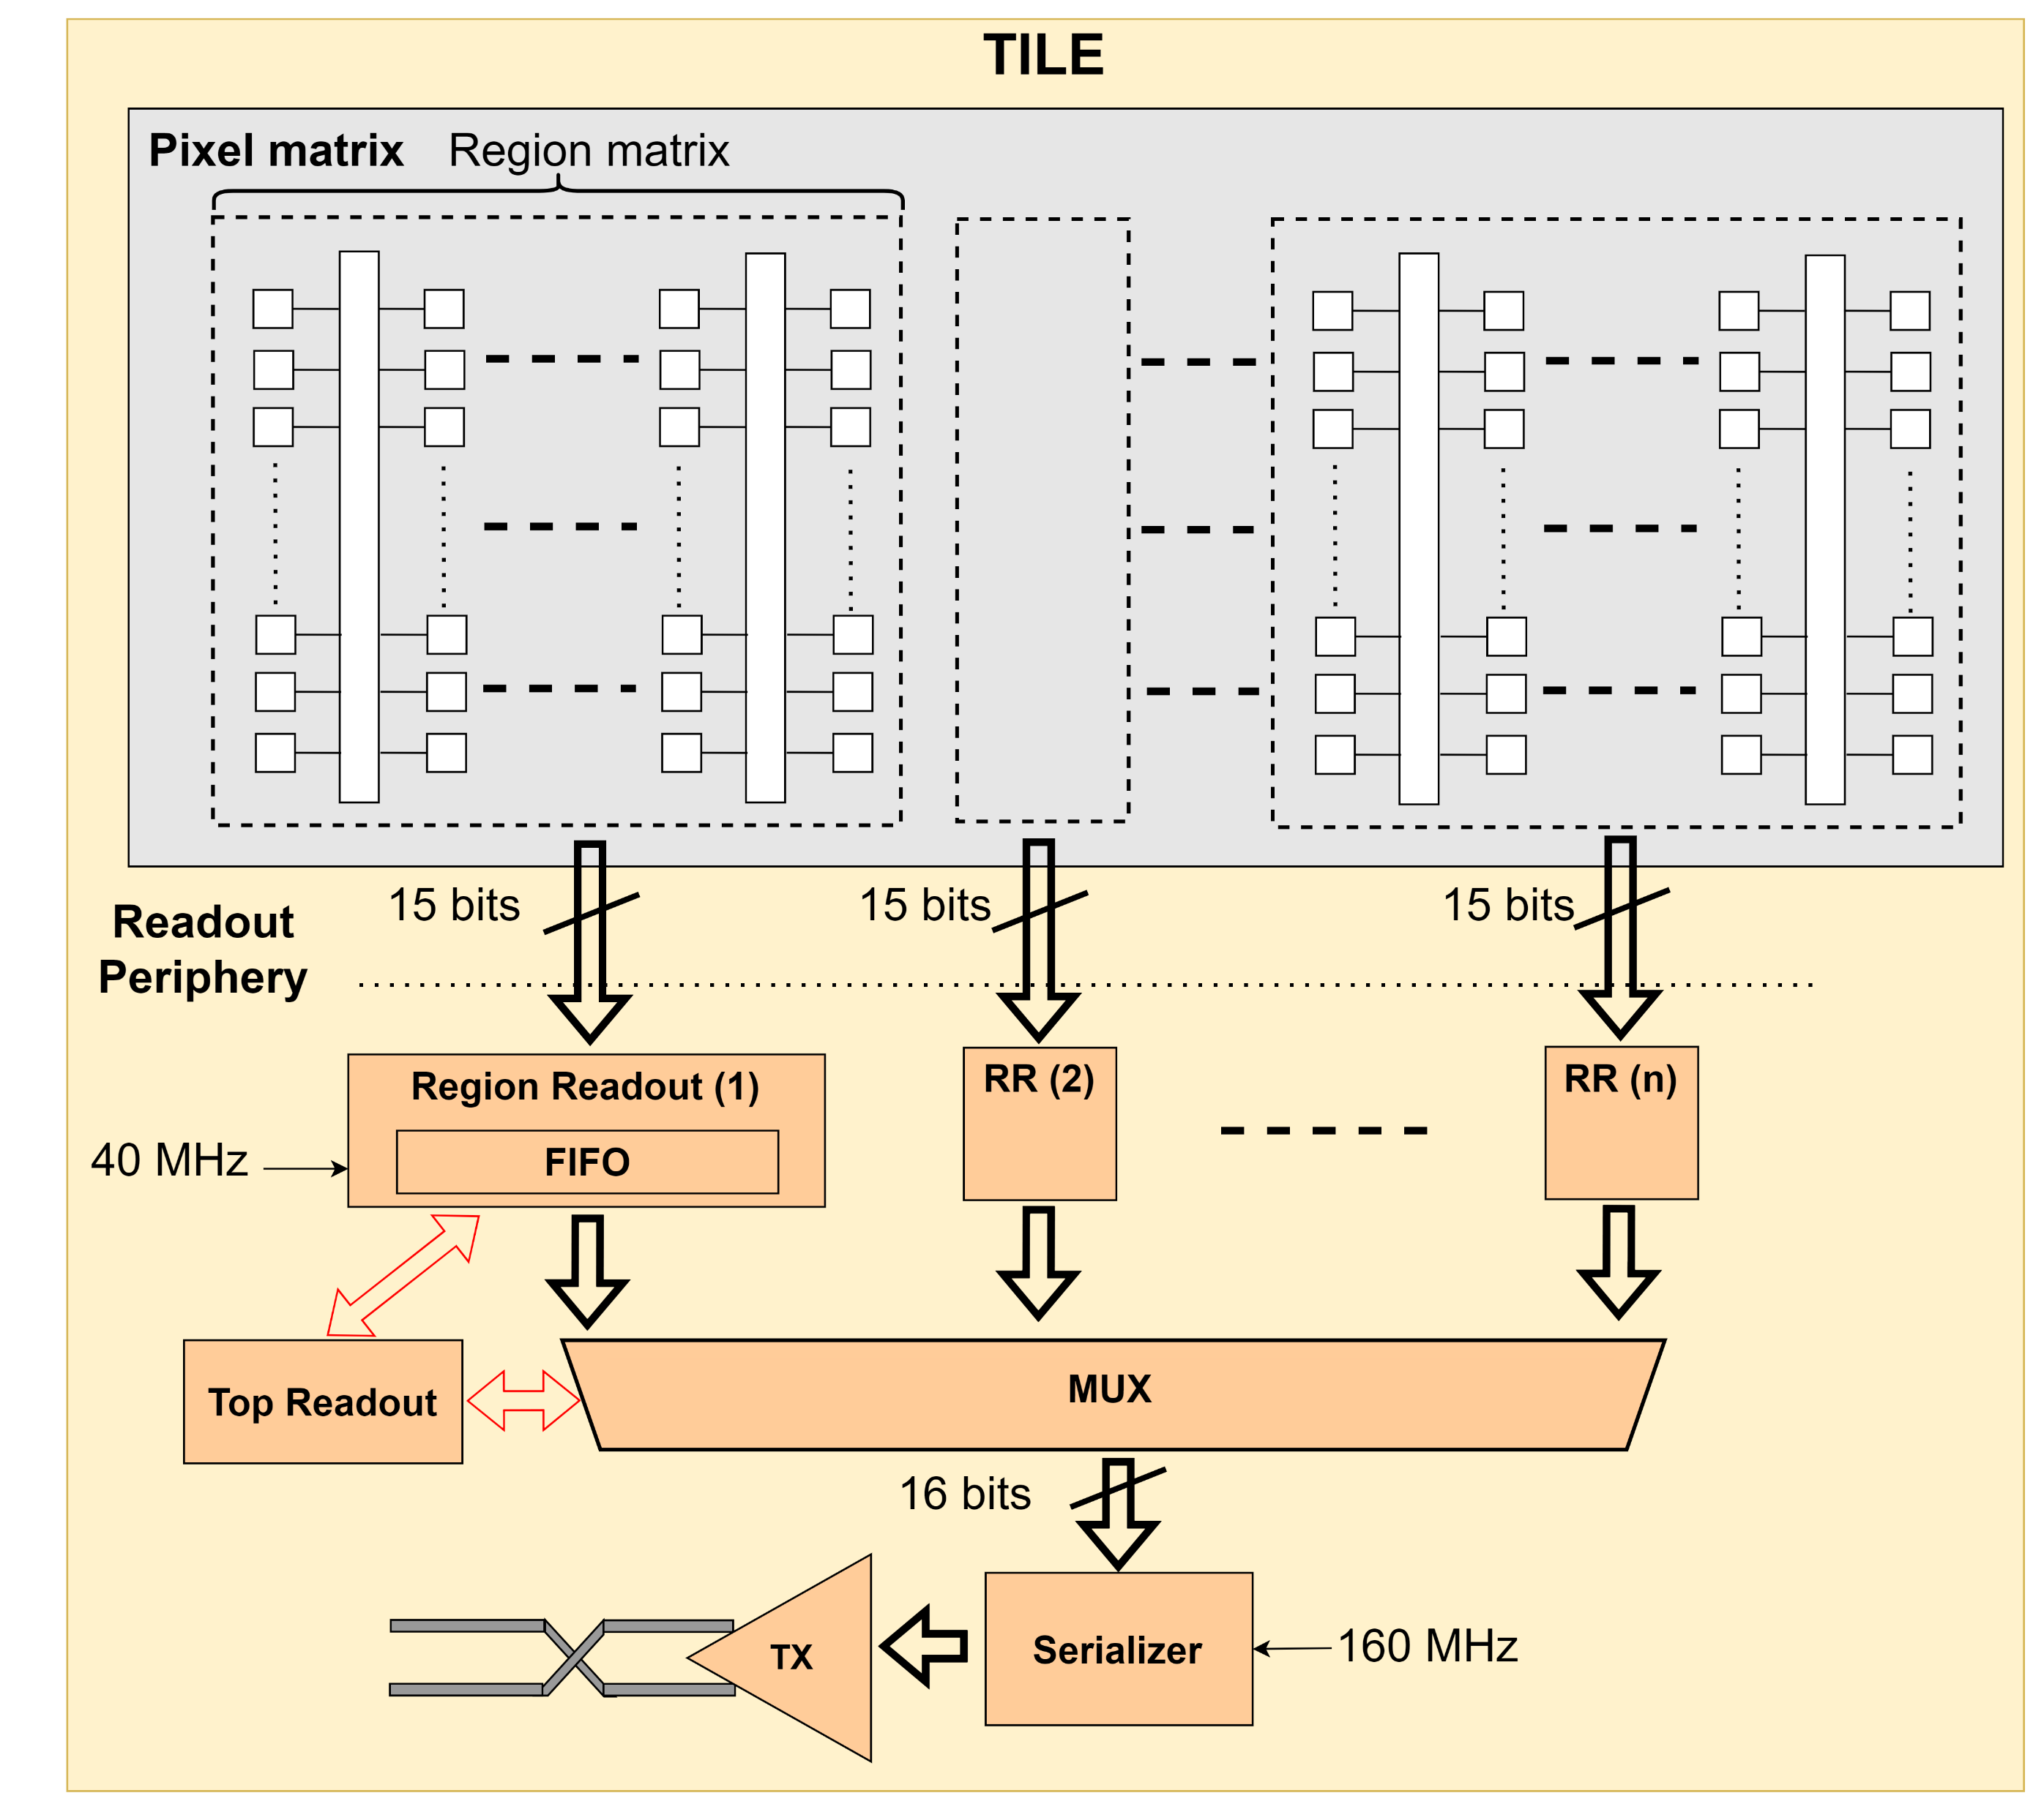
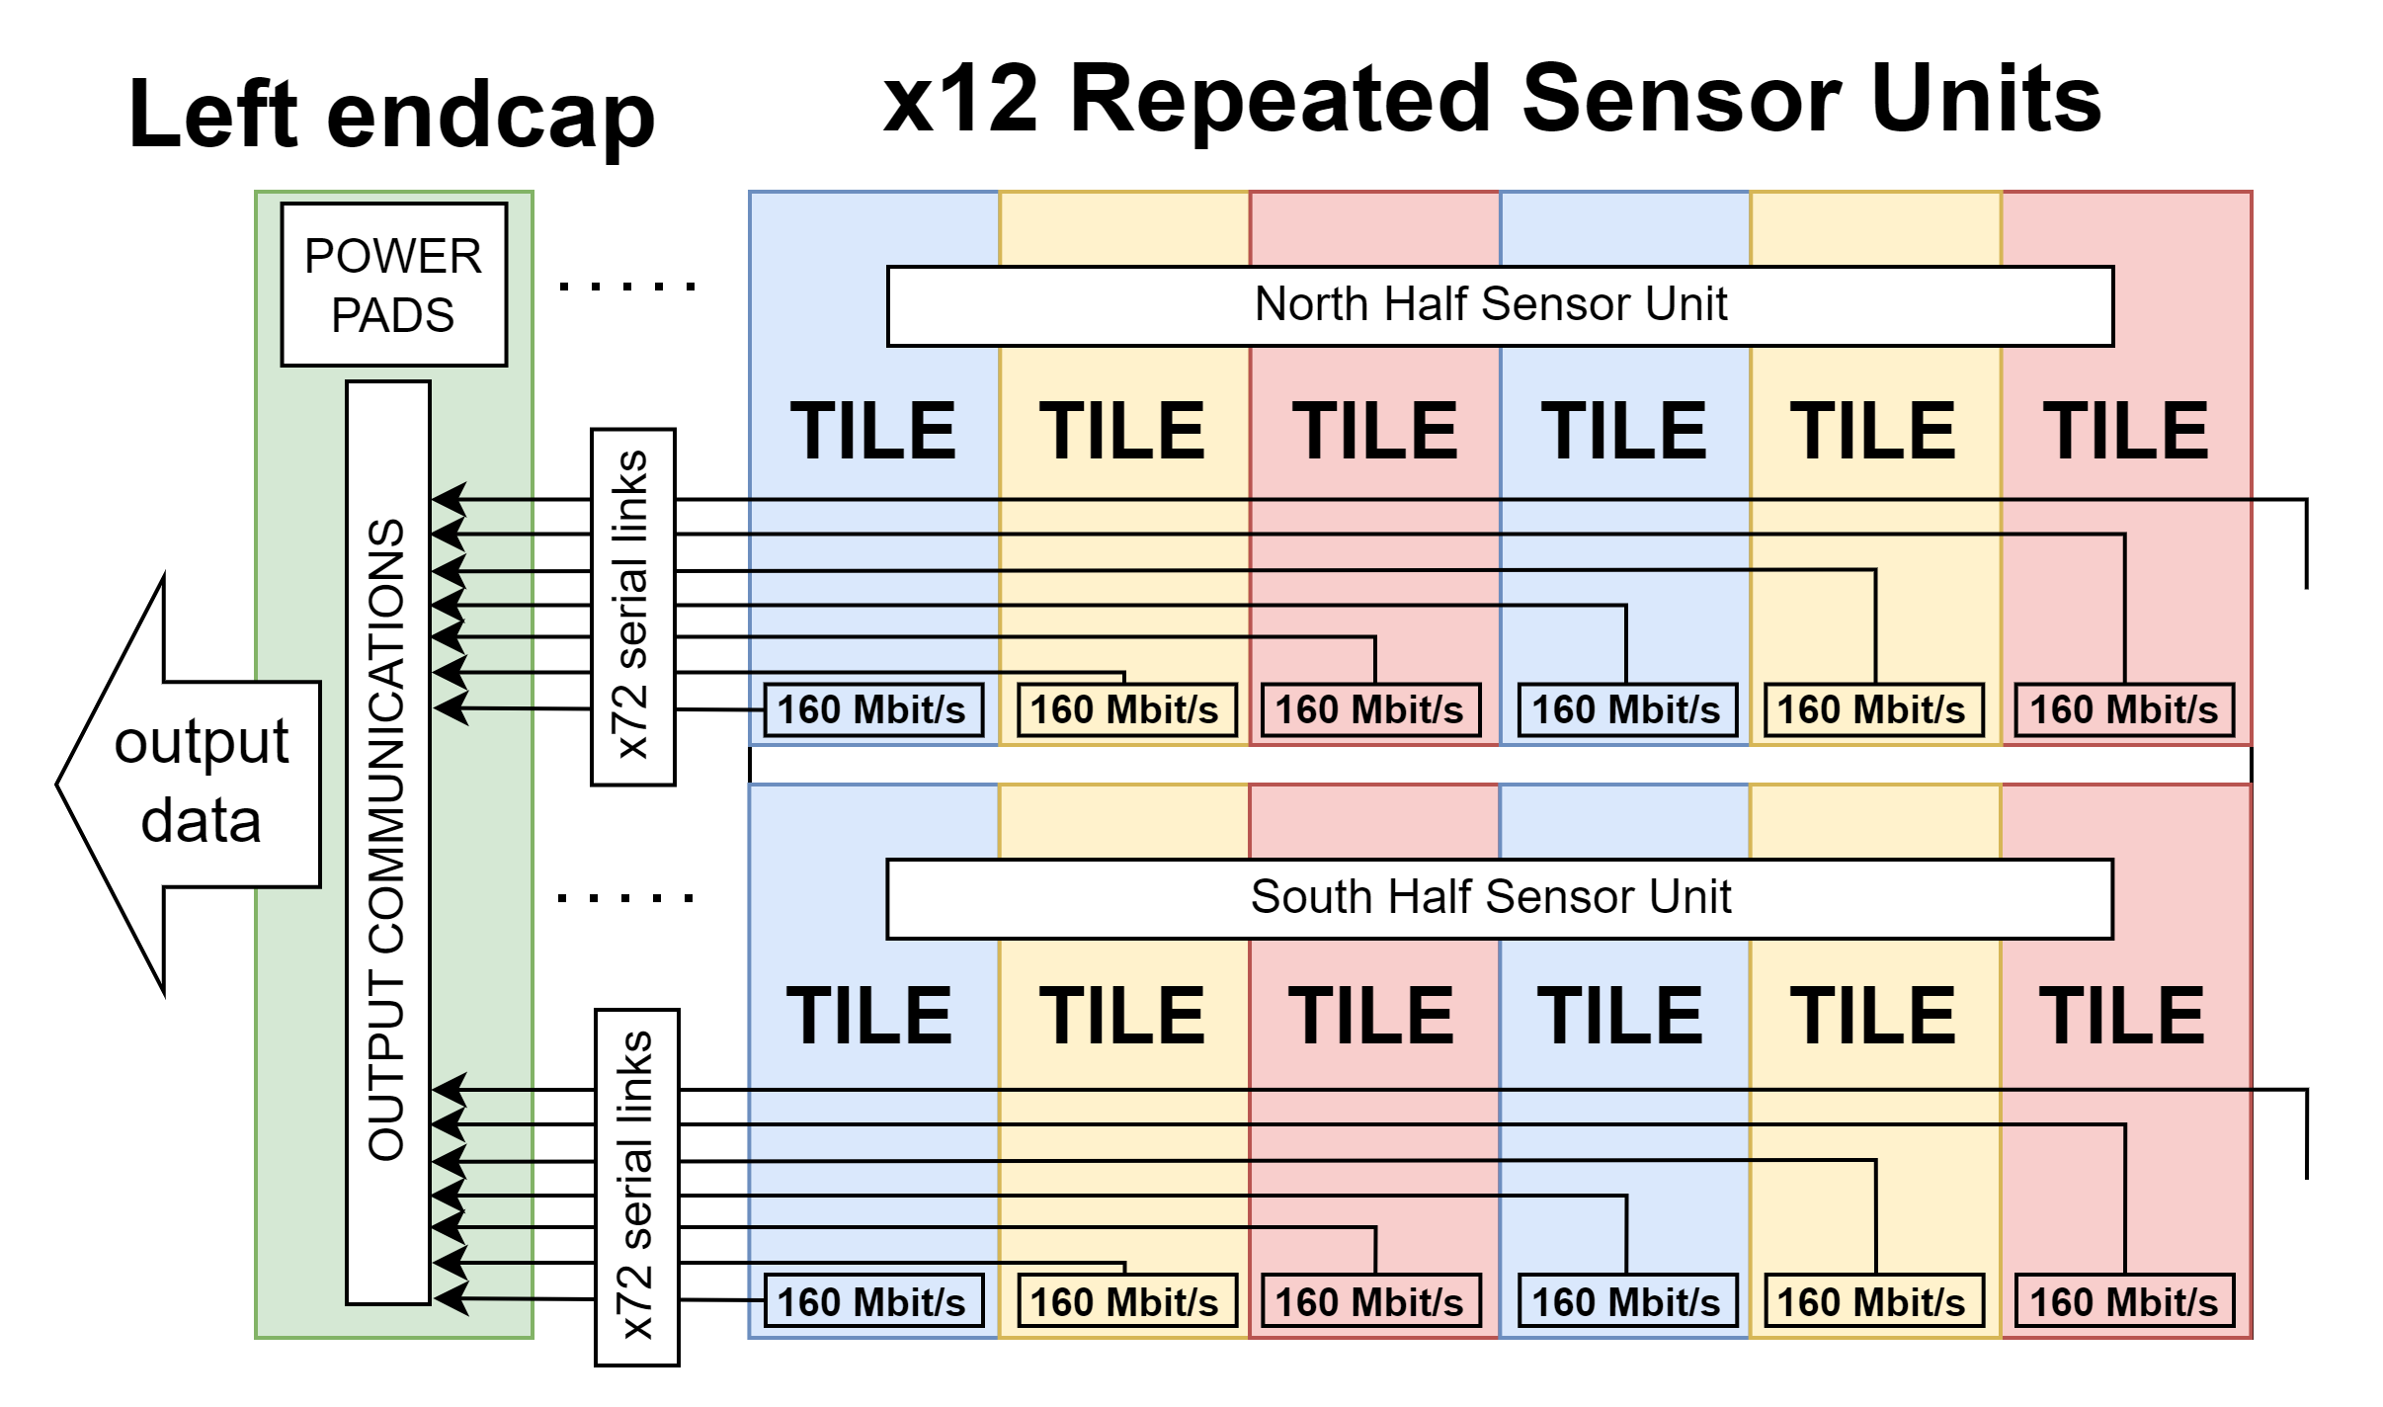
Tile Readout Scheme
16 bits
16 bits
16 bits

Slide 43
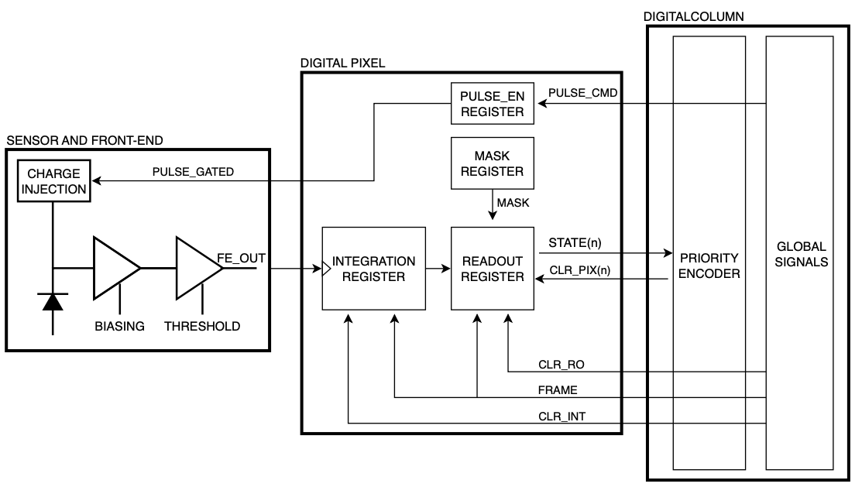
Pixel Array Readout Architecture
156 columns
442 rows
442 x 156 pixels / domain
827,424 pixels per RSU
144 domains / segment
9.929 Mpixels / segment
In pixel:
Amplification
Discrimination
Hit integration register
readout register
Test charge injection
Digital pulsing
Masking
20.8 μm x 22.8 μm pixel pitch
Continuously active front-end (40 nW typ.)
Global shutter
Zero-suppressed matrix readout
Continuous readout mode
Integration time: 2 / 5 / 10µs

Slide 44
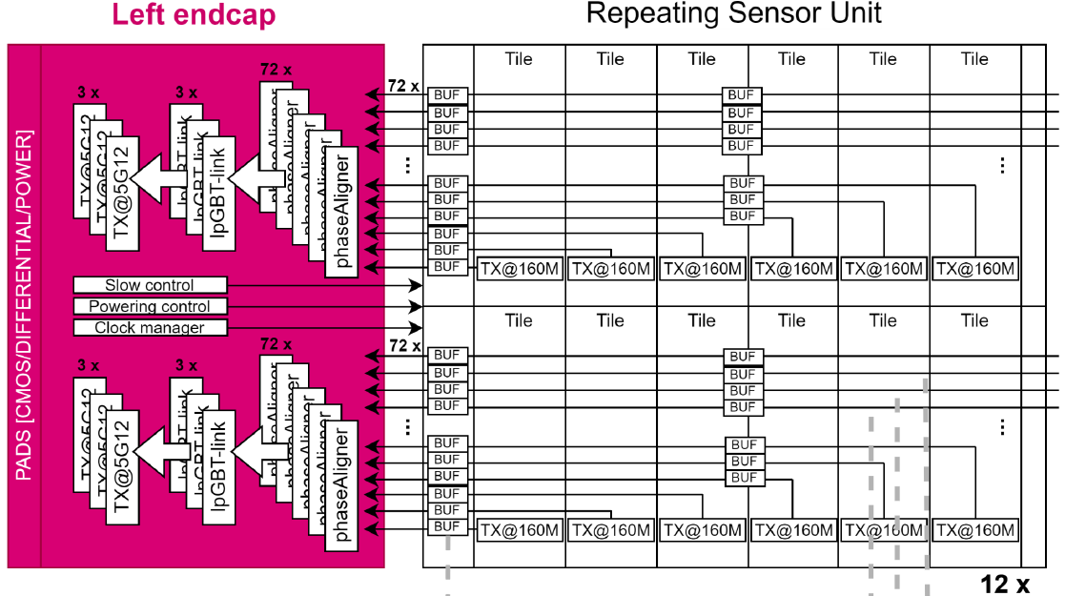
ePIC SVT: “Large Area Sensor” (LAS)
6-RSU LAS
Inner Barrel (Layers 0,1,2) will reuse ITS3-like sensors as is
Layer 0: 4 sensors in r-phi, 3 segments of 12 RSU
Layer 1: 4 sensors in r-phi, 4 segments of 12 RSU
Layer 2: 8 sensors in r-phi, 5 segments of 12 RSU
EIC variant for the Outer Barrel ( Layers 3,4) and Endcap Disks
“Large Area Sensor” (LAS)
Will be stitched, but not to wafer scale
Likely 1 Segment of 5 or 6 RSU (no need for right endcap)
The intention is to multiplex Tile data lines to 1 High-Speed output
More conventional carbon composite mechanical support with integrated cooling
1x
1x
36x
36x
MUX
36x
36x
X
5/6x
Supplies
I/Os
No Supplies
Backup

Slide 45
VTRx+ Front-end Module

