Slide 1
Silicon: Cooling
Nicole Apadula
SVT Layers & Discs Co-Convener
Lawrence Berkeley National Laboratory

Slide 2
Charge Questions Addressed
Are the technical performance requirements appropriately defined and complete for this stage of the project?
Are the plans for achieving detector performance and construction sufficiently developed and documented for the present phase of the project?
Are the current designs and plans for detector, electronics readout, and services sufficiently developed to achieve the performance requirements?
Are plans in place to mitigate risk of cost increases, schedule delays, and technical problems?
Are the fabrication and assembly plans for the various tracking detector systems consistent with the overall project and detector schedule?
Are the plans for detector integration in the EIC detector appropriately developed for the present phase of the project?
Have ES&H and QA considerations been adequately incorporated into the designs at their present stage?

Slide 3
Outline
Overview/Introduction
Baseline design
Sensor power
SVT Cooling
Inner Barrel
EIC-LAS cooling
Outer Barrel
Endcaps
System
Summary

Slide 4
Overview

Slide 5
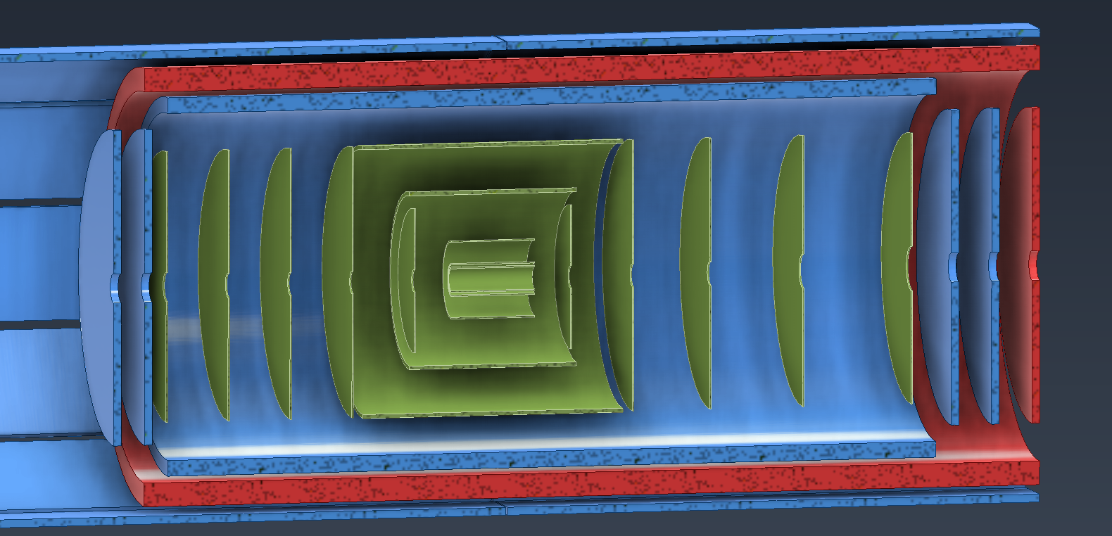
SVT Material Overview
Charge 1
Minimized material → mechanics, cooling, power, readout, etc.
Inner Barrel (IB)
Outer Barrel (OB)
Target Specifications
IB
L0 - L2: 0.05% X/X₀
OB
L3: 0.25% X/X₀
L4: 0.55% X/X₀
Endcaps
ED0-4: 0.25% X/X₀
HD0-4: 0.25% X/X₀
Electron/Hadron Endcaps (EE, HE)
Cooling has a big impact on X/X₀

Slide 6
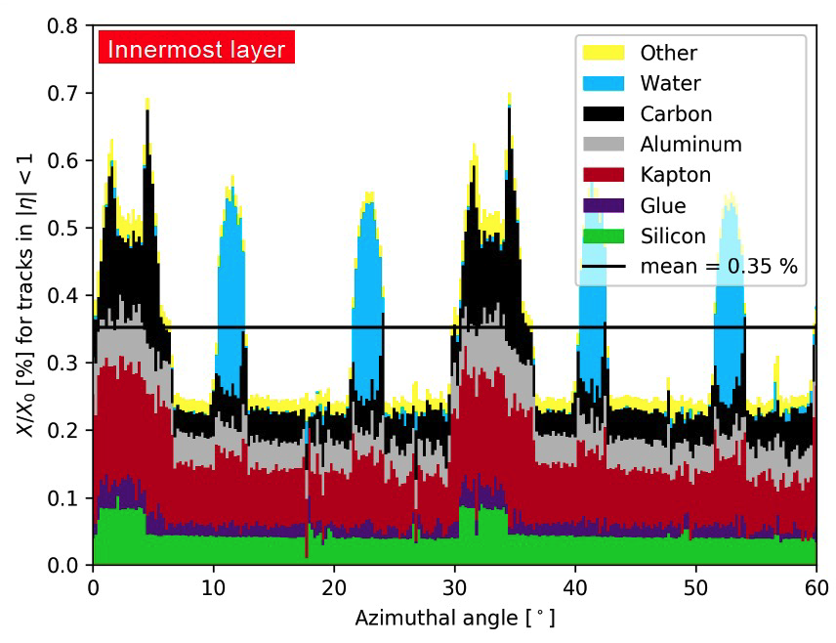
Material Implications
Charge 1, 2
Water cooling pipe: 1 mm ID tube made with 25 μm Kapton walls is ~0.3% X/X₀
Average X/X₀ of water will be less
Dependent on number of pipes & coverage
Non-homogenous material distribution
Difficult to reach target material budget with liquid cooling alone
Air <0.01% X/X₀ for relevant thicknesses

Slide 7
Baseline design
Charge 1, 3
4000 EIC-LAS sensors in the SVT
Power consumption based on best estimates: up to 1.6 W per EIC-LAS
Paired with an Ancillary chip (AncASIC) for slow control, serial powering
Baseline cooling design is air → liquid cooling in strategic places as necessary
End goal is operation of sensor at/near room temperature
Measure thermal performance with ΔT = T_{sensor} – T_{inlet air}
“Reasonable” ΔT is one that achieves room temperature operation with sensible air inlet temperature
ΔT < 10°C is used often as a “standard”, but is not a requirement

Slide 8
Sensor Power Regions
Charge 1
IB sensor: MOSAIX
LEC: ~0.8 W/cm²
12 RSUs: up to 40 mW/cm²
OB/HE/EE sensor: EIC-LAS
5-6 RSUs: same power density as MOSAIX
AncASIC:
Size & power TBD
+
EIC-LAS LEC ≤ MOSAIX LEC

Slide 9
Sensor Power
Charge 1
RSUs: Low power density
LEC:
Highest power density
Power consumption estimates for LEC & RSUs based on publicly available information → continuing effort with sensor designers
Investigated a range of values for cooling tests/calculations
ER2 crucial for more finite power numbers

Slide 10
SVT Cooling

Slide 11
Inner Barrel
Charge 3
Baseline: Air cooling with thermally conductive carbon foam near LEC
Measurements from ALICE ITS3 show this is reasonable to cool sensor
Forced convection between L0 & L1
L2: Natural convection paired with liquid cooling near LEC (as necessary)
Air inlet and outlet under design

Slide 12
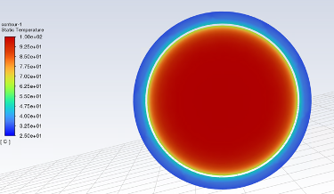

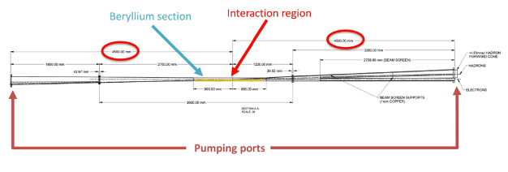
Beam-pipe Bake-out
Charge 1, 3
Beam-pipe bake-out with SVT installed
Aiming for no additions to cooling
No extra material (e.g. insulators) or changes (i.e. liquid instead of air)
ANSYS studies at JLab and LBNL
Flow N2 in beam-pipe to get inner wall >100°C
Room temperature air between beam-pipe and silicon
Studies done with both full length of beam pipe and shortened section near SVT IB
Bench setup at JLab verifies results
Covers 1 m of 3 m Be beam pipe section
Path forward to cool detector

Slide 13
Beam-pipe Bake-out
Charge 1, 3
Refine temperature envelopes for materials
ALPIDE (ITS2) can work reliably at 40°C
Estimates from climate chamber studies at LBNL up to 50°C show 65 nm DPTS performs reliably
Initial thermoelastic study done by ALICE ITS3
16 cycles between 10 – 48°C on ITS3 layer 2 (includes glue, foam, silicon) → no failures
Similar thermoelastic study upcoming for ePIC SVT IB
Cycle test, longevity test, bake-it-til-you-break-it test

Slide 14
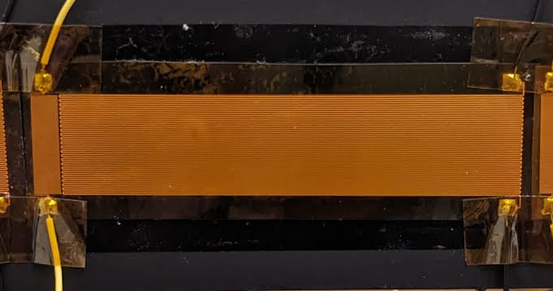
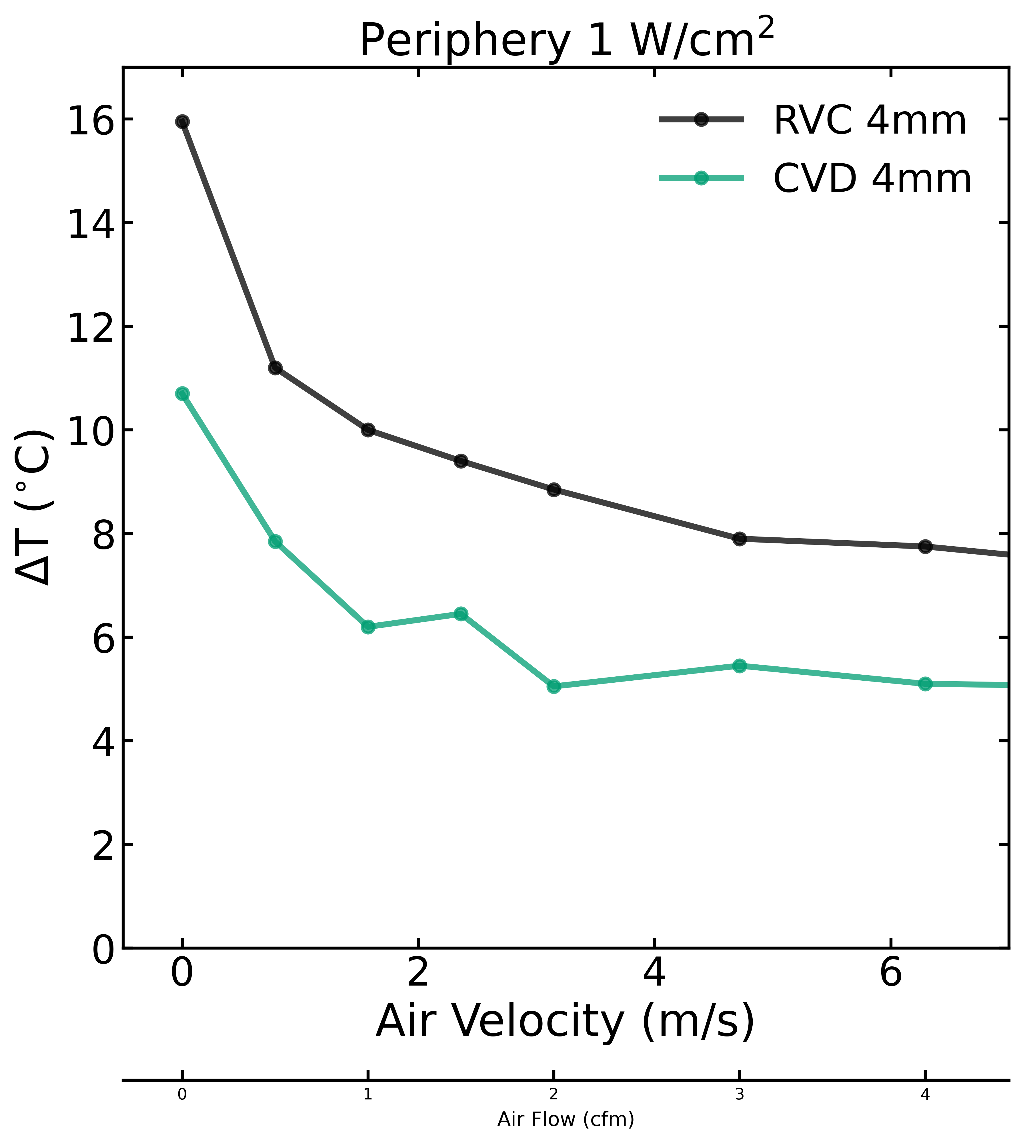
Air cooling
Charge 2, 3
Air cooling internal to the mechanical structure offers advantages (air routing, mechanical strength)
Built on previous LBNL LDRD with carbon composite structures and RVC or CVD (thermally conductive) carbon foam
Heaters with two regions to model SVT sensor power dissipation (LEC & RSUs)
ΔT reasonable (<10°C) to achieve operating temperature, but structure is material “heavy”
Can build upon this concept
~1 W/cm²
~40 mW/cm²
LEC only
*Air velocity calculated at duct

Slide 15
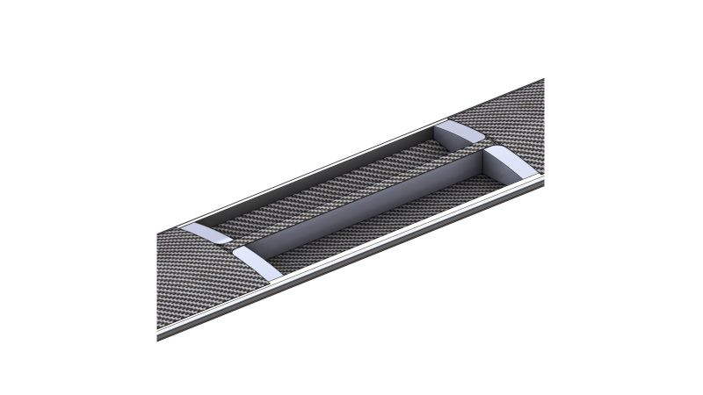
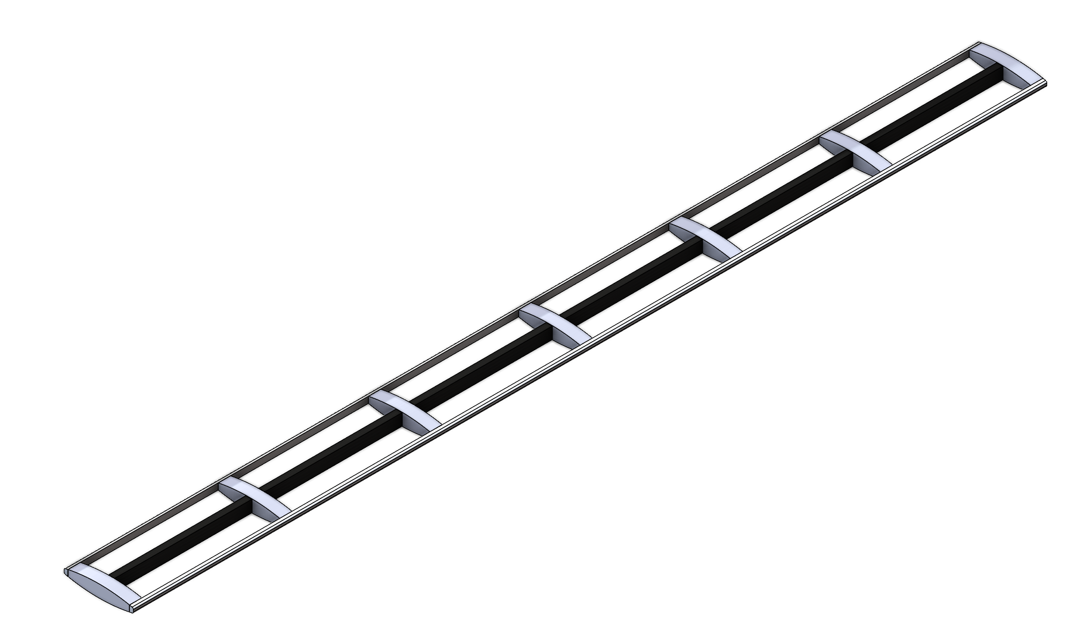
Outer Barrel
Charge 2, 3
Baseline design has options for both air and liquid cooling
Crossribs → thermally conducting carbon foam
Edges → carbon foam, could contain liquid cooling pipe
Assumptions/Estimates
4 x 0.5 cm² cross section
8 m/s air speed
Max estimate: 400 cfm total
Work ongoing that can reduce this (liquid, re-routing air, etc.)

Slide 16
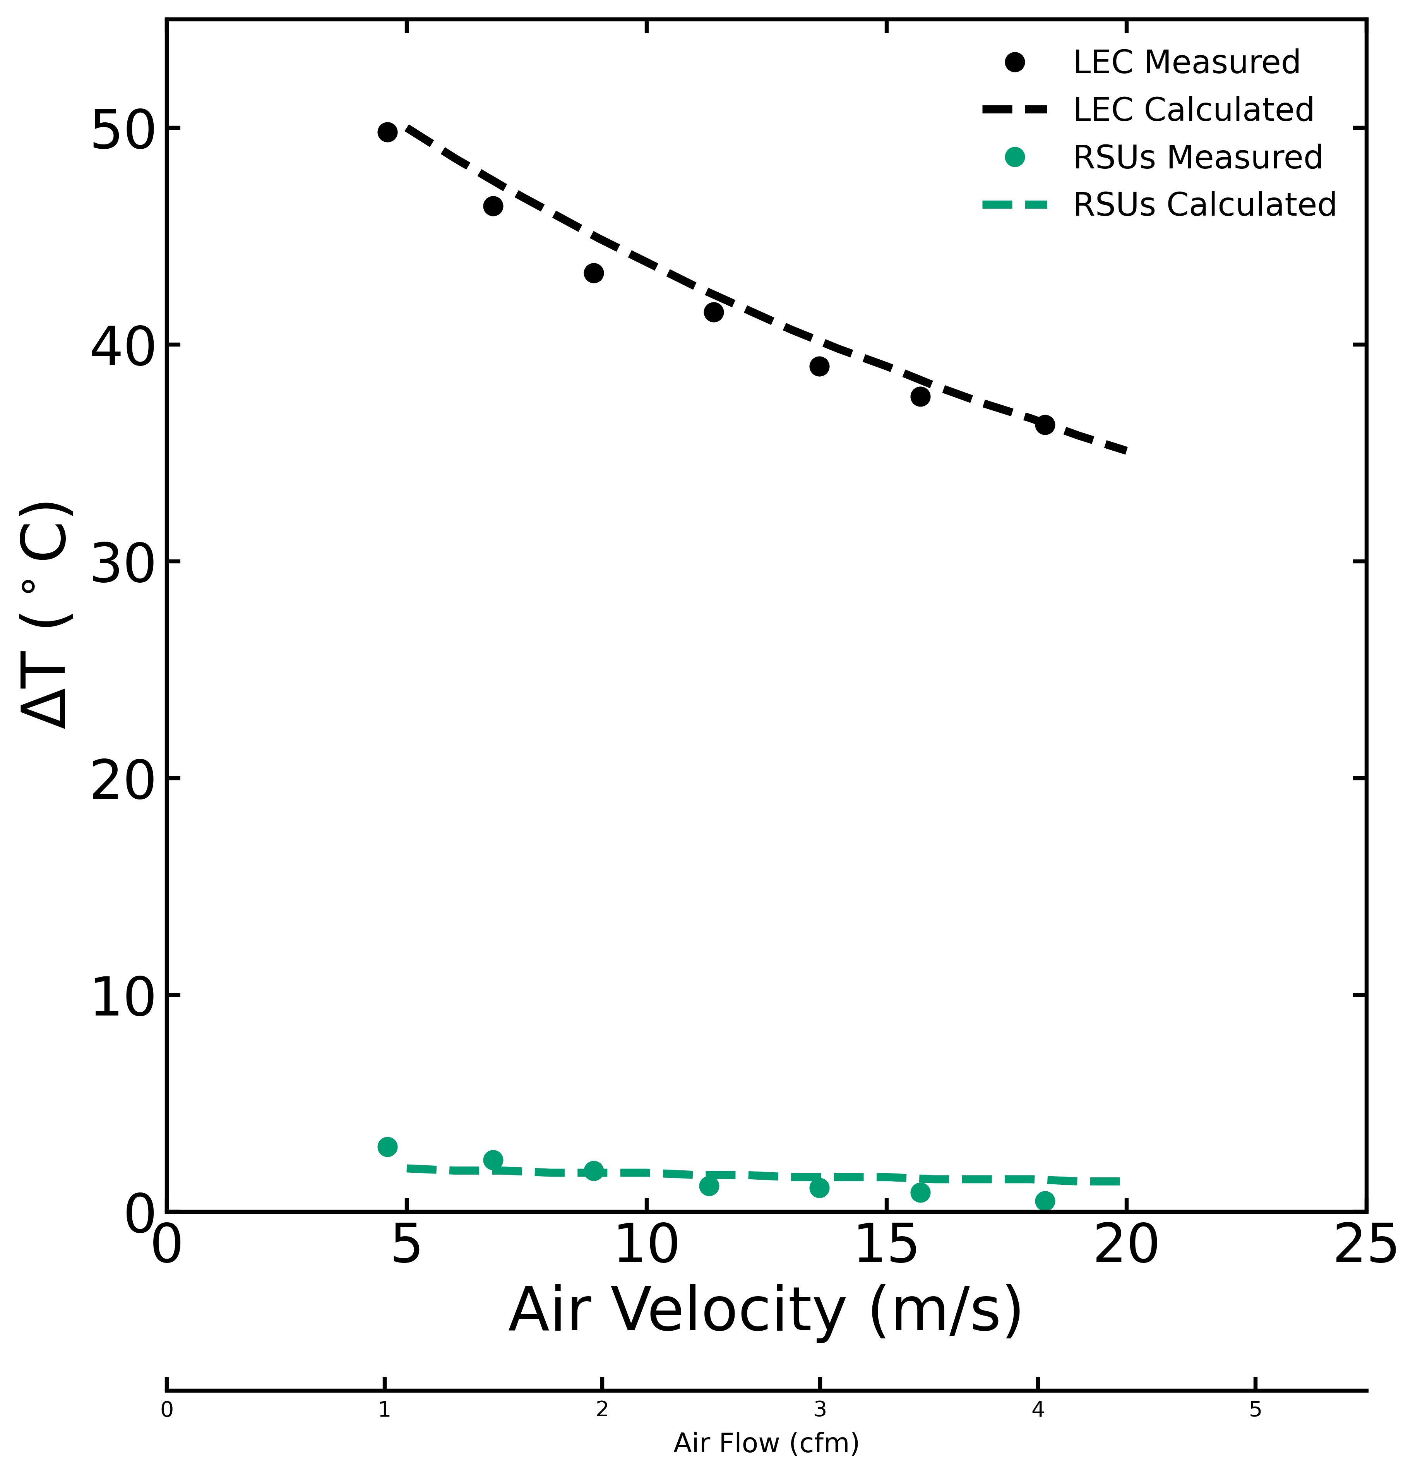
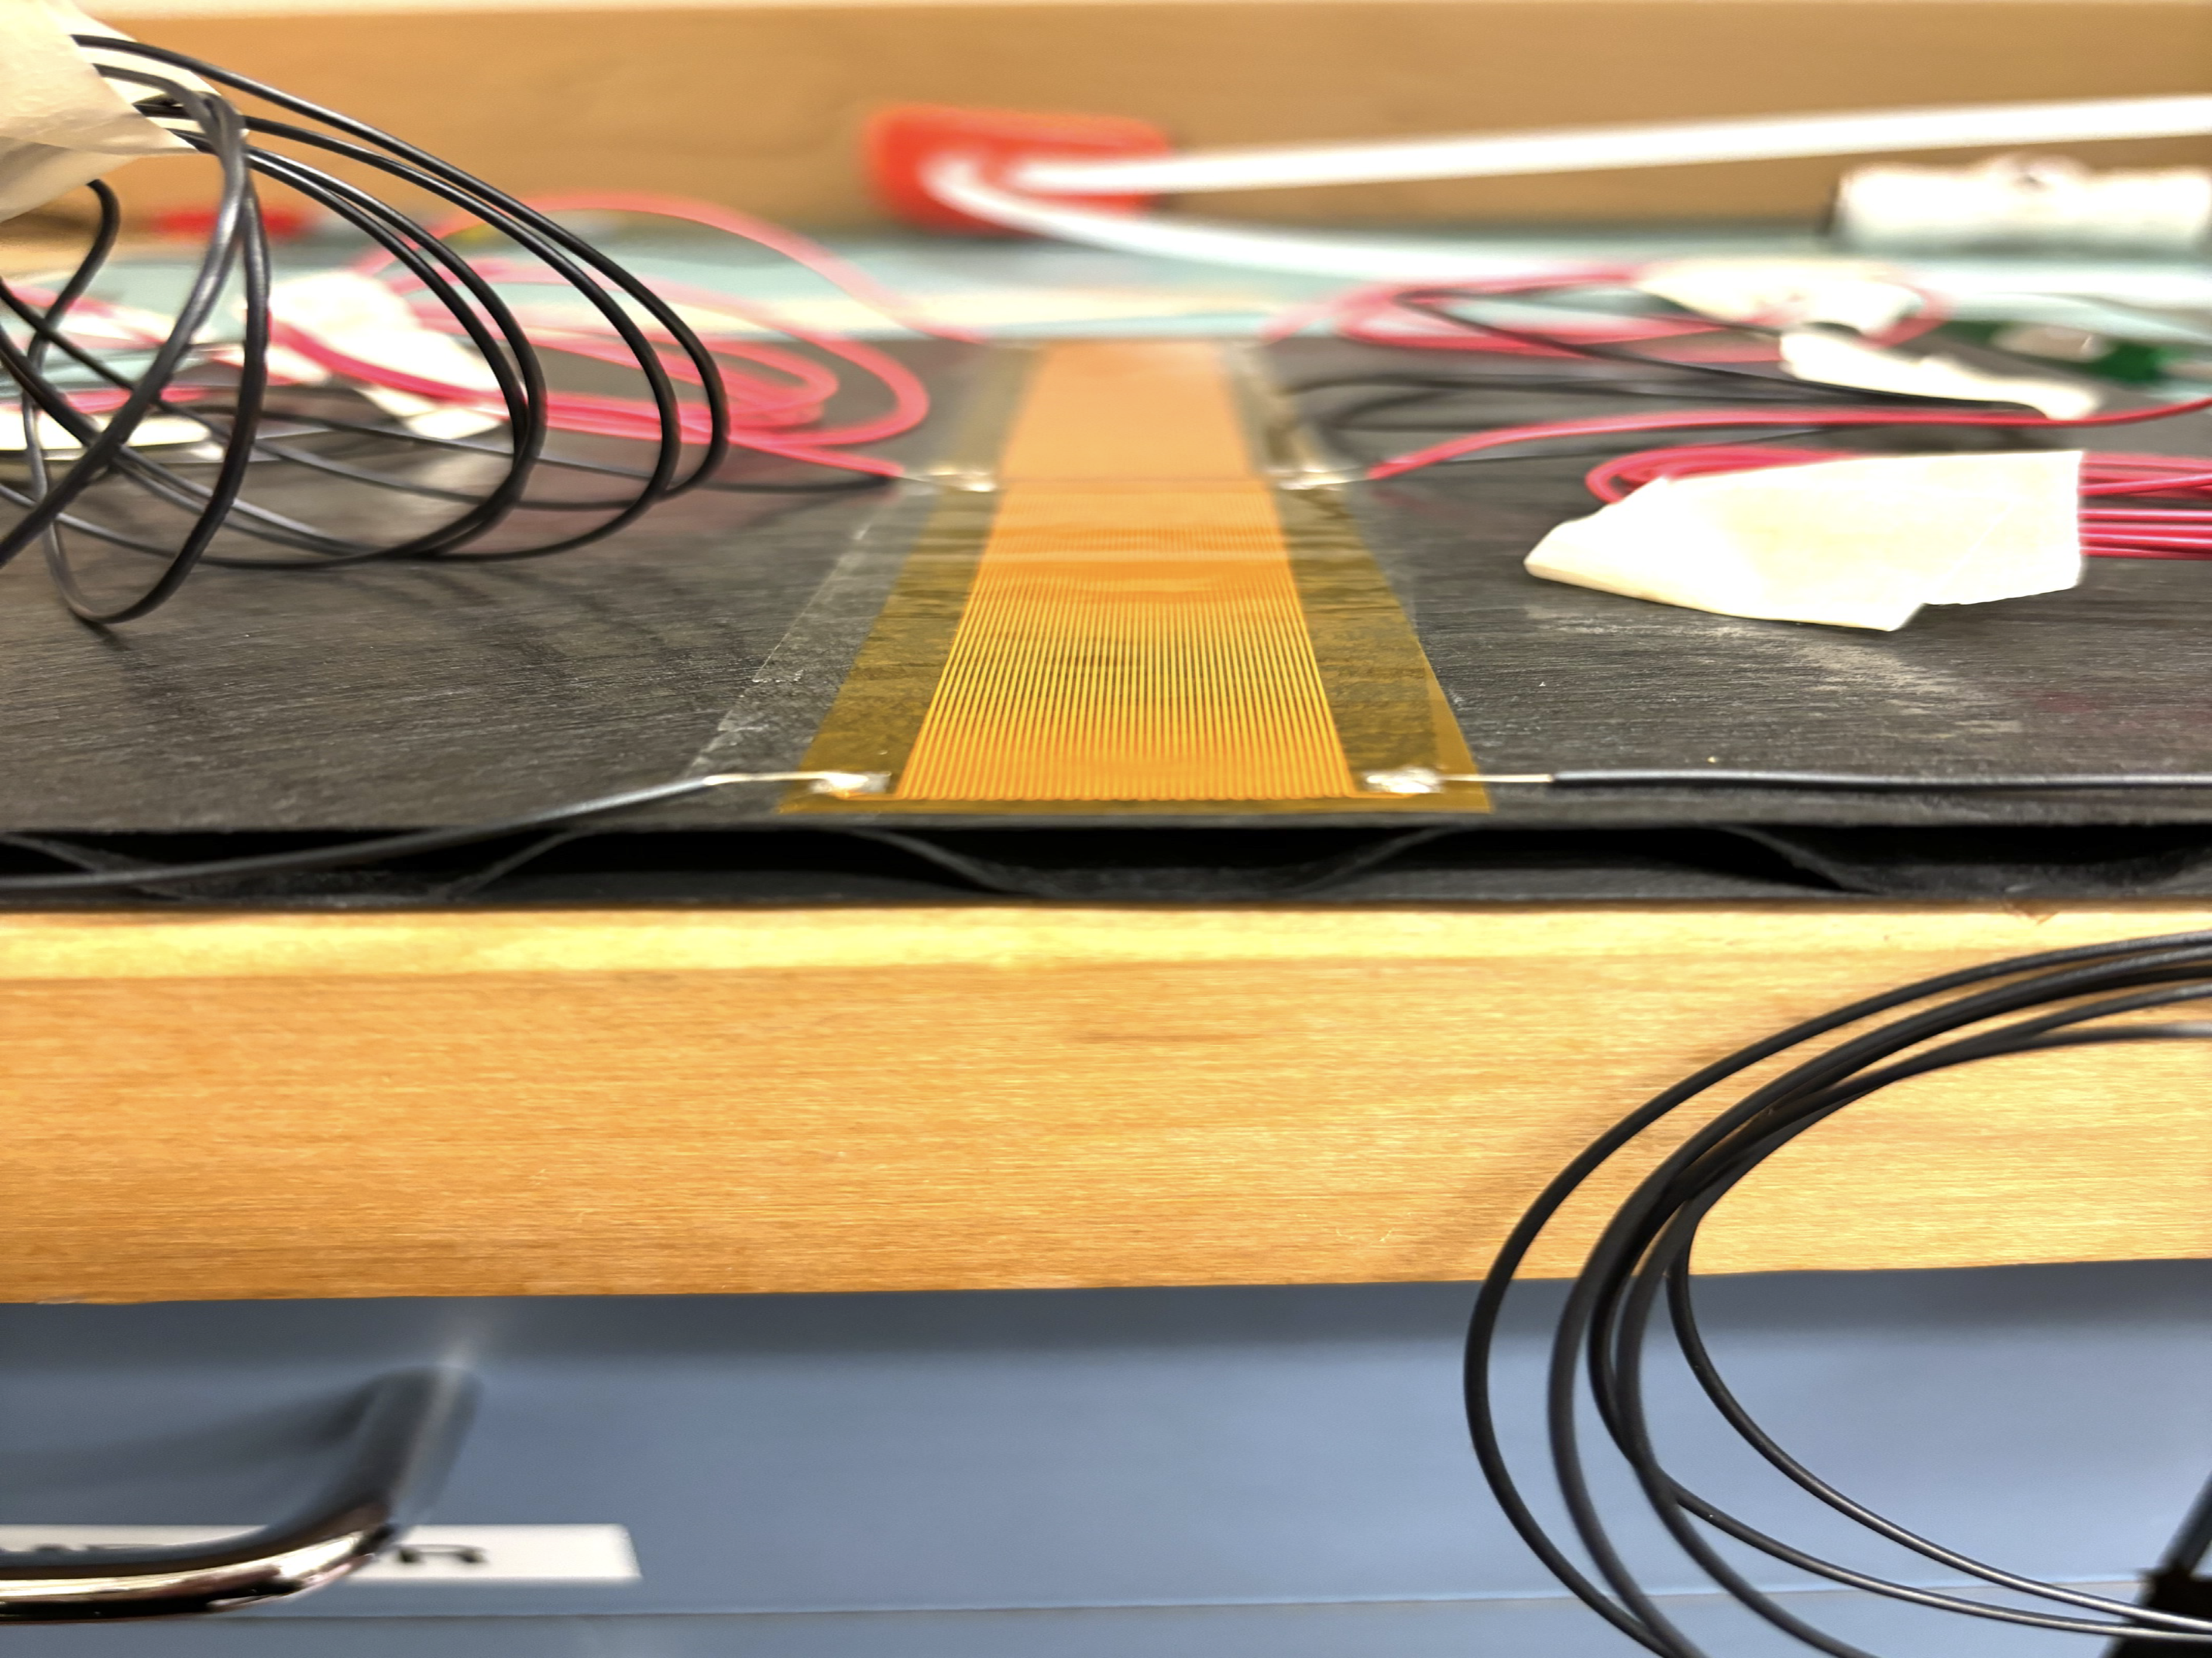
Discs: Corrugated Carbon Fiber
Charge 2, 3
Baseline disc design using corrugated carbon fiber
Provides a channel for forced air convection
Air cooling sufficient for RSUs
LEC trending in the right direction
LEC: 1 W/cm²
RSUs: 40 mW/cm²

Slide 17
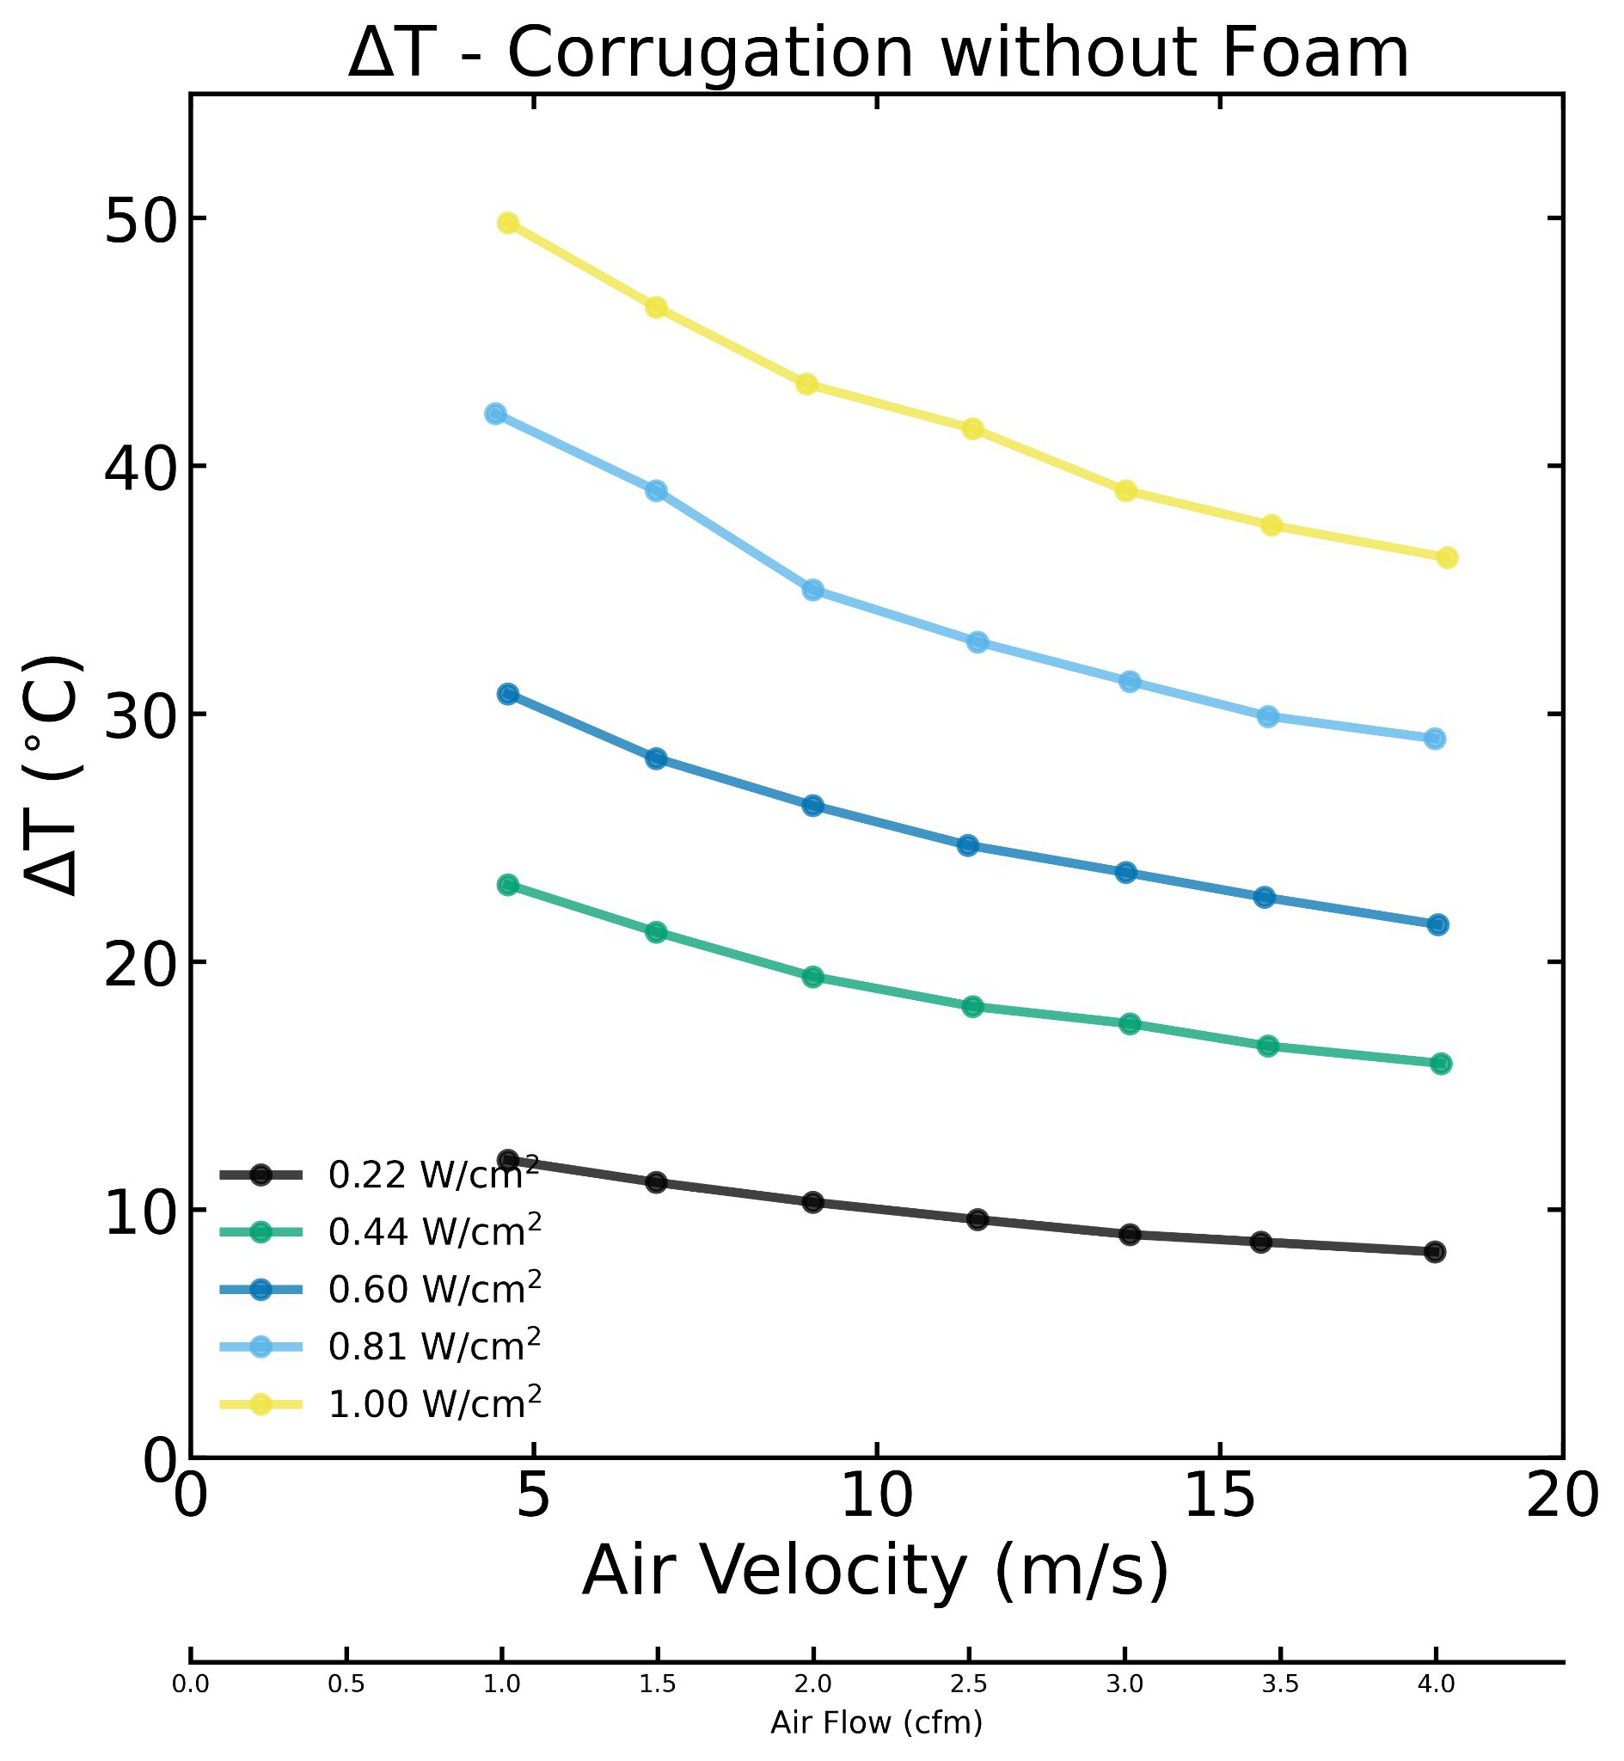
Discs: Corrugated Carbon Fiber
Charge 2, 3
Studied a range of LEC power densities
ΔT reasonable for power < 0.6 W/cm²

Slide 18
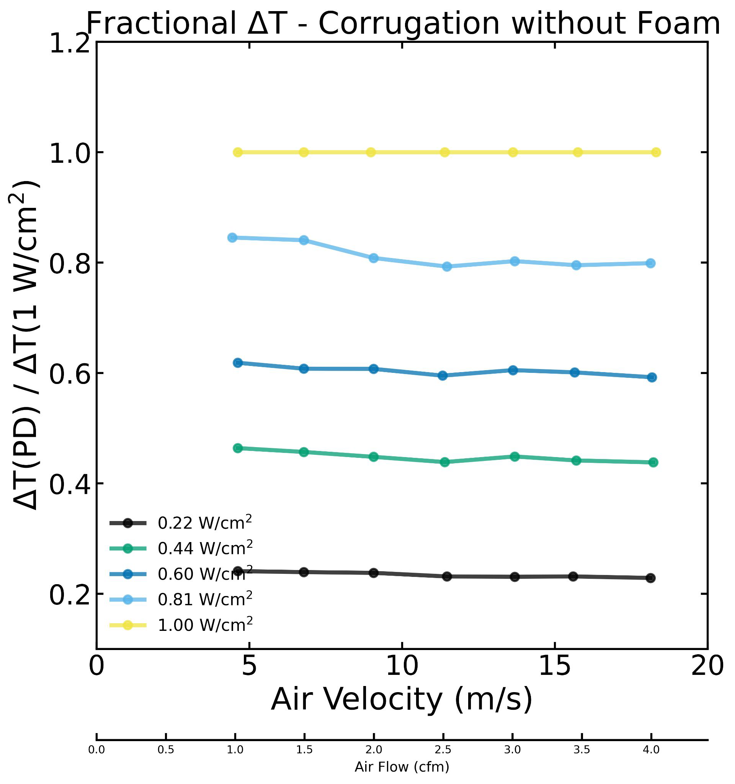
Discs: Corrugated Carbon Fiber
Charge 2, 3
Studied a range of LEC power densities
ΔT reasonable for power < 0.6 W/cm²
ΔT scales with power density

Slide 19
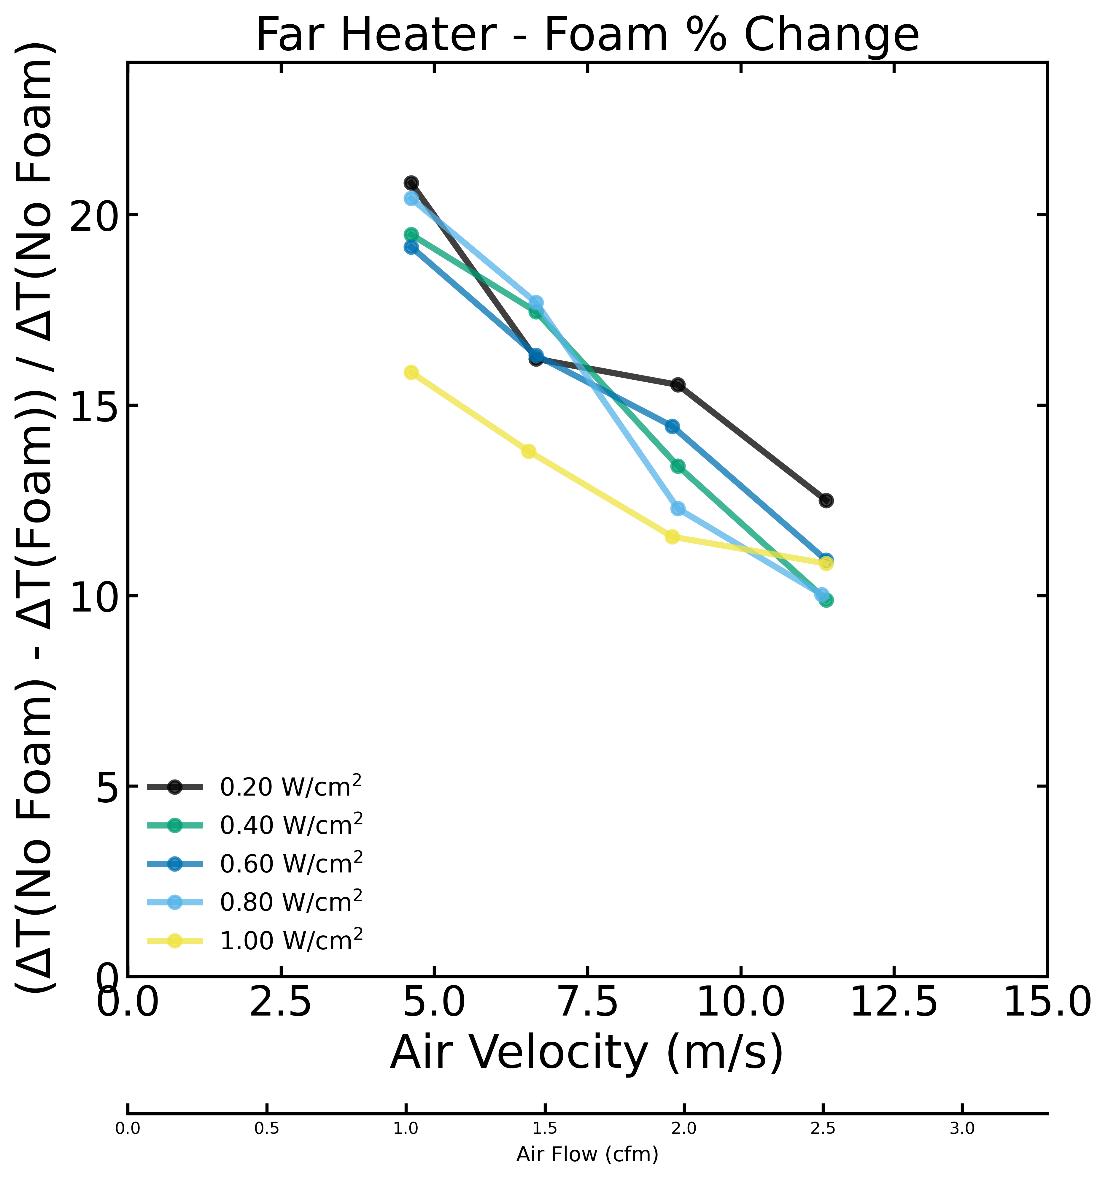
Discs: Corrugated Carbon Fiber
Charge 2, 3
Studied a range of LEC power densities
ΔT reasonable for power < 0.6 W/cm²
ΔT scales with power density
Carbon foam under LEC provides 10-20% reduction in ΔT
Caveat: this is insulating foam. Will be measured with thermally conductive foam

Slide 20
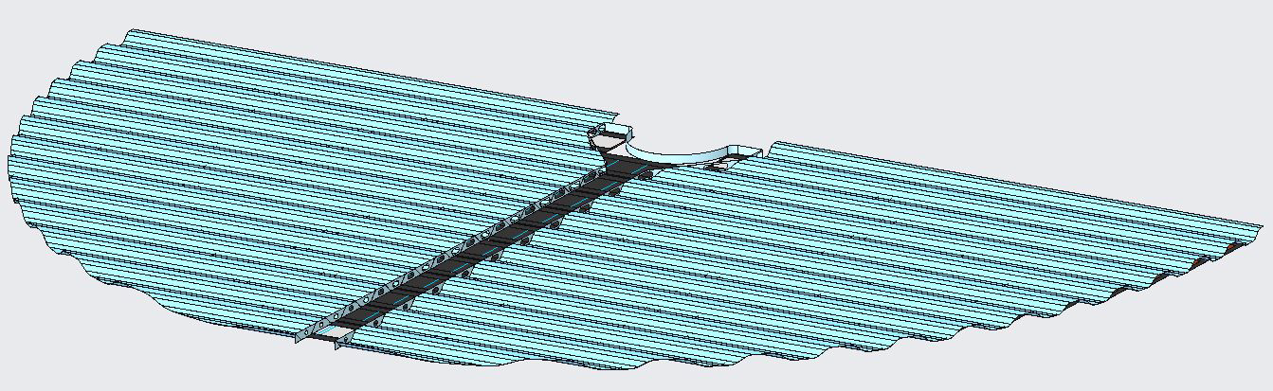
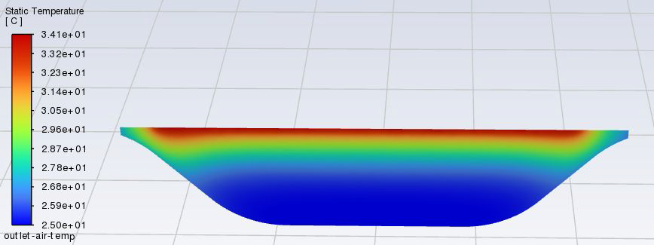
Discs: Corrugated Carbon Fiber
Charge 2, 3
Static Temperature of Cooling Channel Outlet at a Velocity of 10 m/s
Max = 34°C
Air in = 25°C
Center manifold and air metering strip through middle
Volumetric static temperature of air minimal
Air can be used in multiple channels → reduces total air volume
Under further optimization

Slide 21
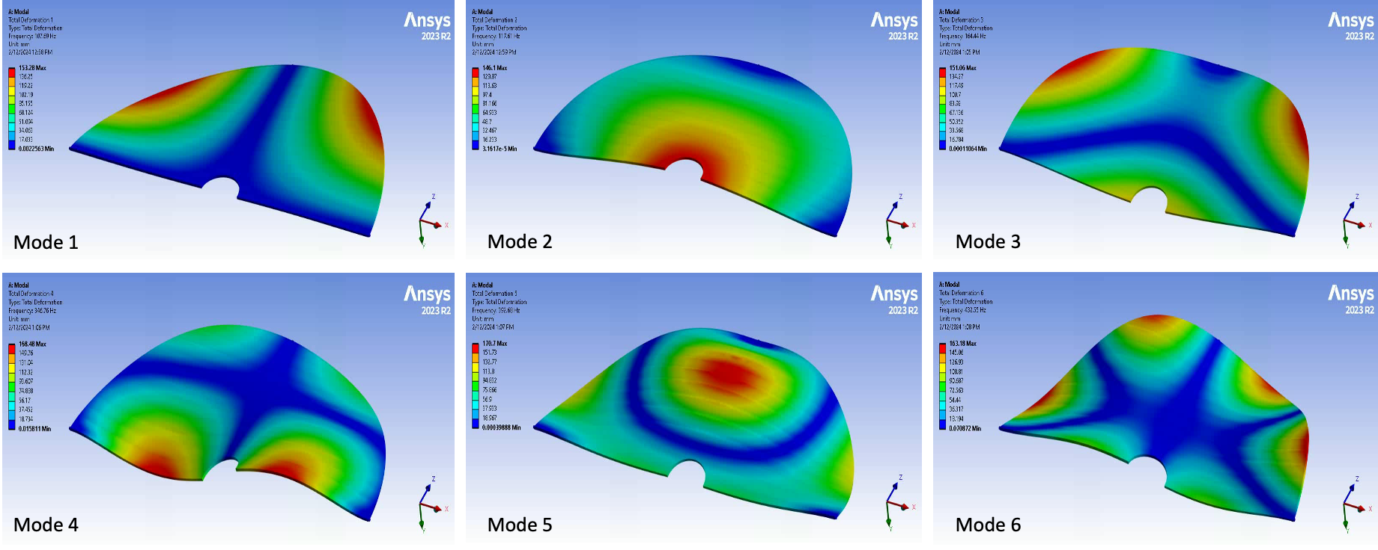
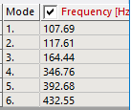
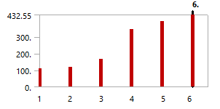
Discs: Corrugated Carbon Fiber
Charge 2, 3
Corrugated Disc of 6 mm Height – Rev 2 (Mesh size = 2 mm)

Slide 22
SVT Air
Charge 6
Current baseline estimates
IB: 50 cfm
OB: max 400 cfm
Discs: max 500 cfm
Total system as we understand it is ~1000 cfm
Requires compressed air
Optimization continues and we expect this number to go down

Slide 23
EH&S
Charge 6, 7
All work follows local laboratory EH&S requirements & training
LBNL: ISM, Work Planning & Control
JLab: ISM, Task List and ePAS (JLab-PR-725)
NRTL listed electrical equipment
Overall System
Temperature interlock → work with slow control group to ensure detector safety
Automatic turn-off if temperature goes above designated value
Pressure system → work with engineers for design and safety
Also monitored with slow control if air system fails (over-temperature)
Liquid/water cooling → flow under atmospheric pressure designed to prevent leaks
Cooling plant, temperature, flow, etc. monitoring

Slide 24
Summary
Baseline cooling design is hybrid with the dominant part done by air for material considerations
End goal is operation of SVT at/near room temperature
Thermal performance studied with a range of power dissipation values based on current sensor knowledge
EH&S
Following local laboratory requirements & training
Work with system engineers and slow control for monitoring and interlocks
Next Steps
Incorporating additional heat generating components (AncASIC, RDOs)
Continuing design of individual components and overall system

