Slide 1
Tracking Systems Overview and Requirements
Brian Eng
L3 CAM
Jefferson Lab

Slide 2
Charge Questions Addressed
Are the technical performance requirements appropriately defined and complete for this stage of the project?
Are the plans for achieving detector performance and construction sufficiently developed and documented for the present phase of the project?
Are the current designs and plans for detector, electronics readout, and services sufficiently developed to achieve the performance requirements?
Are plans in place to mitigate risk of cost increases, schedule delays, and technical problems?
Are the fabrication and assembly plans for the various tracking detector systems consistent with the overall project and detector schedule?
Are the plans for detector integration in the EIC detector appropriately developed for the present phase of the project?
Have ES&H and QA considerations been adequately incorporated into the designs at their present stage?

Slide 3
Outline
Requirements
Interfaces
Tracking Detector Layout
Risks
Safety
Summary

Slide 4
Requirements
Charge 1
https://eic.jlab.org/Requirements/index.html
 | Momentum Resolution | Spatial Resolution
Backward (-3.5 to -2.5) | ~0.10%×p⊕2.0% | ~ 30/pT µm ⊕ 40 µm
Backward (-2.5 to -1.0) | ~ 0.05%×p⊕1.0% | ~ 30/pT µm ⊕ 20 µm
Barrel (-1.0 to 1.0) | ~0.05%×p⊕0.5% | ~ 20/pT µm ⊕ 5 µm
Forward (1.0 to 2.5) | ~0.05%×p⊕1.0% | ~ 30/pT µm ⊕ 20 µm
Forward (2.5 to 3.5) | ~0.10%×p⊕2.0% | ~ 30/pT µm ⊕ 40 µm

Slide 5
Interfaces
Charge 1
https://eic.jlab.org/Interfaces/InterfaceMatrix.html
Outer barrel limited by DIRC
Disks limited by pfRICH/AC-LGAD
Inner Barrel first vertex layer 5mm from beampipe

Slide 6
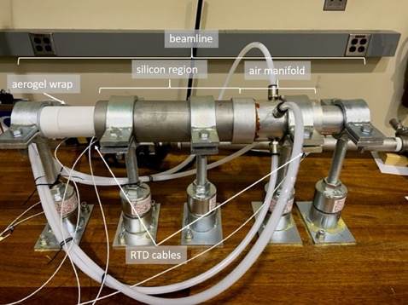
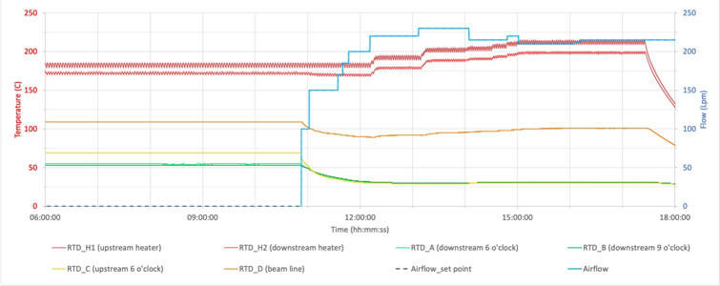
Interfaces – Beam Pipe
Charge 1
Unique beampipe
Tapered beampipe, tracking detectors must be installed prior to beampipe installation in central detector
Beampipe exposed to ambient prior to installation
Need min 100°C in beampipe to break H₂O bonds
Silicon detector epoxy limited to ~30°C due to CTE

Slide 7
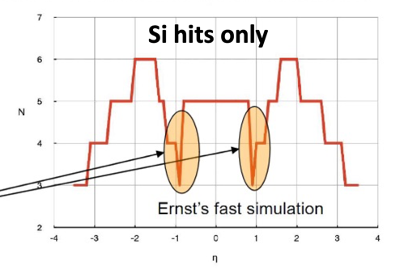
Tracking Detector Layout Modifications
Charge 2, 3
Low number of hits in certain rapidity ranges
Need more planes
Solve impact from 5 (2) μs MAPS frame accumulation time
Need enough hits from fast detectors to form a tracklet with a good pointing resolution
Need to utilize ToF and maybe Barrel-ECal AstroPix as possible
Note: Barrel ToF has good time resolution but not spatial resolution
Current layout finalized in June 2023

Slide 8
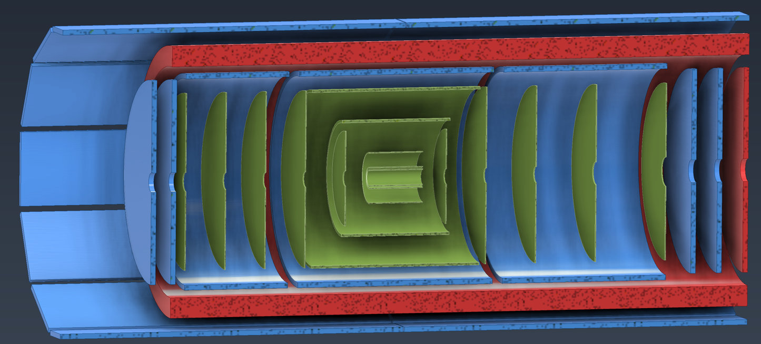
Tracking Detector Layout
Silicon
MPGD
ToF
Part of PID

Slide 9
Simulation – Nhits vs η
Only tracking detectors included, will improve further once calorimeters included which should remove dip at rapidity ±1

Slide 10
Silicon
MAPS (monolithic active pixel sensors) in 65 nm CMOS technology, developed with ALICE ITS3 collaboration
Inner Barrel: Directly use ITS3 wafer scale sensor
Outer Barrel: EIC Large Area Sensor (LAS), modification of ITS3 sensor
EIC Project, Silicon Consortium and CERN ALICE/ITS3 meeting in Q2 23
Path forward on collaboration (paperwork in process), EIC hiring 2 engineers to work directly with ALICE team on sensor development

Slide 11
Silicon – Inner Barrel
Three layers of thin, bent, wafer scale ITS3 based sensors
ITS3 concept adapted to ePIC radii
X/X0 % = 0.05
Layer | Radius (mm) | Length (mm) | Segments
L0 | 36 | 270 | 3
L1 | 48 | 270 | 4
L2 | 120 | 270 | 5

Slide 12
Silicon – Outer Barrel
Traditional stave design
Layer | Radius (mm) | Length (mm) | X/X0%
L3 | 270 | 540 | 0.25
L4 | 420 | 840 | 0.55

Slide 13
Outer Barrel – MPGD
Micromegas
Additional Tracking Points
Single Tile
51.25 x 44 cm
Simplifies production
40 Tiles Total
~30k Channels
uRWELL
Provides hits for DIRC
Capacitive-sharing 45° U-V strips
Pitch: 1.2 mm pitch
~140k Channels

Slide 14
Forward / Backward Disks – Silicon
Foundry rule/limitation, need to limit number of sizes (2-3 total)
Direct outcome from meeting with ALICE

Slide 15
Forward / Backward Disks – MPGD
uRWELL Capacitive-sharing 45° r-phi strips
Pitch: 1.2 mm pitch
~2 × 1570 phi-strips + ~ 2 × 400 r-strips
~4k strips per disk (32k channels for 8 disks)

Slide 16
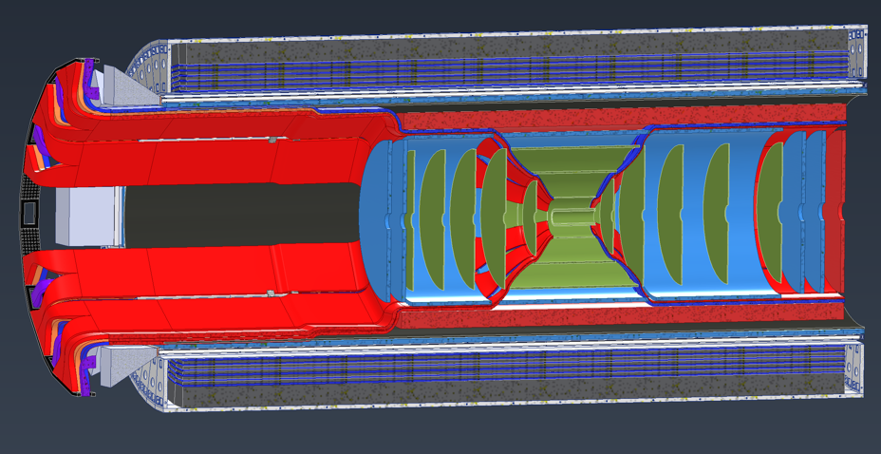
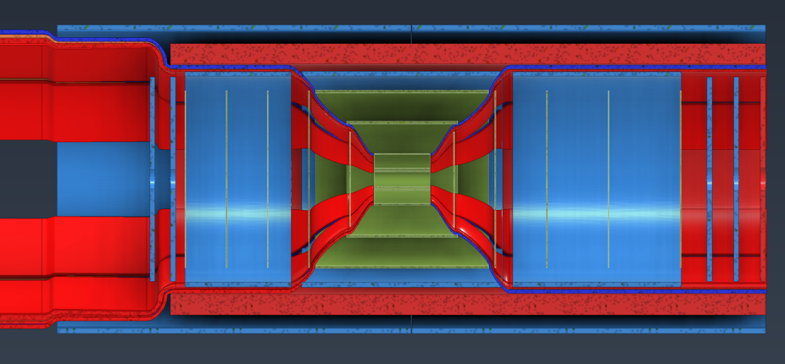
Services
Charge 3
RED = power
BLUE = cooling/gas
ORANGE = signal

Slide 17
Services
Charge 3
Subsytem | Type | Item | Material | Quantity | Diameter (cm) | Cross Area (cm^2) | +50% Packing for Bundles | Average Length (in)
Red Path IP to pfRICH Inner face
Vertex Silicon | Power | 18 awg LV Sagita | Aluminium | 12 | 0.8 | 6.03 | 9.05 | 120.00
 | Signal | Signal Bias |  | 34 | 0.2 | 1.07 | 1.60 | 120.00
 | Signal | Data * |  | 204 | 0.6 | 57.68 | 86.52 | 120.00
 | Cooling | * |  | 12 | 0.3 | 0.85 | 1.27
Sagita Silicon | Power | LV serial power |  | 29 | 0.9 | 18.45 | 27.67
 | Signal | Signal Bias |  | 771 | 0.3 | 54.50 | 81.75
 | Signal | Data * |  | 771 | 0.2 | 24.22 | 36.33
 | Cooling | Cooling Pipes * |  | 356 | 0.3 | 25.16 | 37.75
Silicon Disks | Signal | Sensor Bias | Aluminium | 1100 | 0.3 | 77.75 | 116.63 | 120.00
 | Cooling | cooling | tygon | 550 | 0.63 | 171.45 | 257.17 | 120.00
 | Power | LV current | Aluminium | 92 | 0.9 | 58.53 | 87.79 | 120.00
 | Signal | Data |  | 1100 | 0.3 | 77.75 | 116.63
Inner MPGD | Signal | FEE Data | Firefly | 60 | 1 | 47.12 | 70.69 | 120.00
 | Power | Hv |  | 40 | 0.32 | 3.22 | 4.83 | 120.00
 | Power | Lv |  | 20 | 1.163 | 21.25 | 31.87 | 120.00
 | Cooling | Gas | Polyethylene | 20 | 0.4 | 2.51 | 3.77 | 120.00
 | Cooling | Cooling | Polyurethane | 33 | 0.63 | 10.29 | 15.43 | 120.00
EE MPGD Disks | Power | FEE PWR | 20 awg (3 pair) | 11 | 1 | 8.64 | 12.96 | 120.00
 | Signal | FEE data | Fibers | 128 | 0.32 | 10.29 | 15.44 | 120.00
 | Power | 2kv Hv | Coax | 4 | 0.24 | 0.18 | 0.27 | 120.00
 | Signal | Flat Signal Cables |  | 128 | 0.3 | 76.80 | 115.20 | 120.00
 | Cooling | Gas | Tygon | 8 | 0.4 | 1.01 | 1.51 | 120.00
 | Cooling | Cooling | Tygon | 16 | 0.63 | 4.99 | 7.48 | 120.00
Inner most trackers cable path towards Lepton end
~71% space used

Slide 18
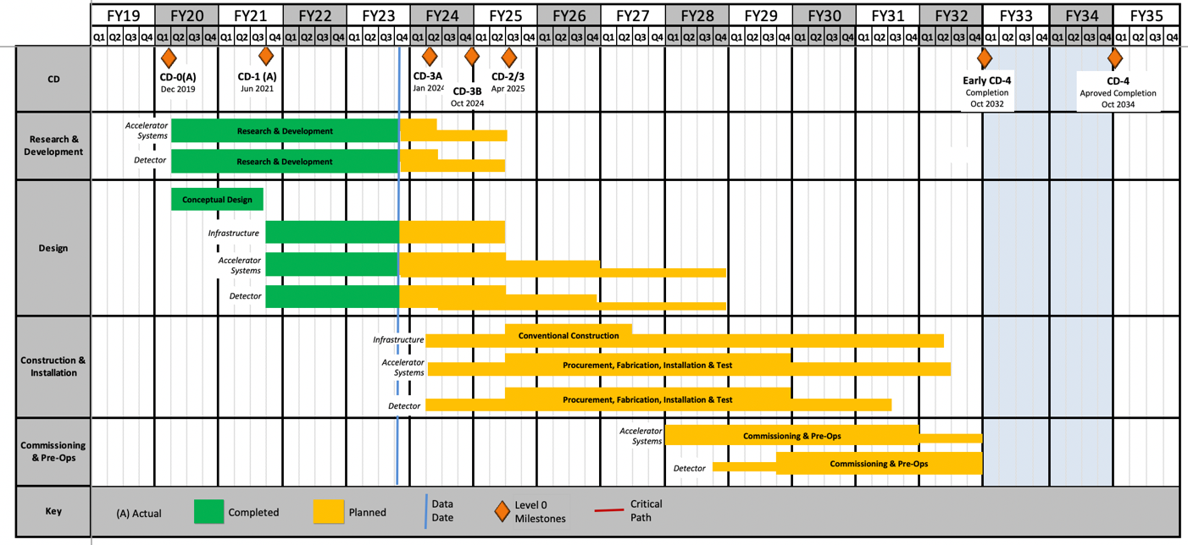
Cost / Schedule
Charge 5
Cost / Schedule is based on engineering estimates from detector experts
Inner Barrel Silicon (ITS3)
ER2 – Q1 24
Outer Barrel/Disk Silicon (LAS)
2025-2027
Stave/Disk Construction Complete
Q4 28
Ready for integration
Q2 29

Slide 19
Risks
Charge 4
Currently for the silicon trackers there is a planned engineering run during R&D with the production run taking place during PED
Benefit from ALICE ER1 and ER2 runs and that the EIC runs would be based on the final ER3 design
However, if unforeseen issues arise another engineering run for the sensors might be needed
The risk register has a proposed risk (ID RT-6-10-014) if a second engineering run is needed which would use contingency
CD-3A Director’s Review comment: “Upfront discussion of risks of R&D not coming to a favorable conclusion, and mitigation plans in this case, should be more clearly documented and presented. Where appropriate, for example for the tracking detector, more detailed plans should be developed.”
Silicon detectors have external dependency on ITS3 sensors
See backup slides for alternative layout discussion

Slide 20
Safety
Charge 7
Generally the tracking WBS is in the design phase and and such doesn’t have any safety issues
However, there are a few test stands being developed which follow their institution’s safety protocols
Protocols include required training
LBNL testing carbon foam cooling: ISM, documented in Work Planning & Control
JLAB testing beampipe bake-out: ISM, Task List and ePAS (JLab-PR-725)
Equipment going in the BNL Experimental Hall must follow NEC/NFPA 70E, 2021 and electrical safety guidelines: DOE-HDBK-1092-2013
Defines voltage hazards, cable type requirements, circuit protection, etc
Equipment must be NRTL listed or approved by BNL Electrical Equipment Inspection program

Slide 21
Summary
Recent design change to address performance issues, which has been incorporated into the ePIC collaboration’s latest models
Cost and schedule developed with input from ePIC collaborators and ALICE/ITS3 efforts
Scope change request for additional personnel based on discussions from CERN visit in progress.
Tracking WBS is in the final design stage no major ES&H issues
Test stands follow the relevant institution’s policies.
Proposed risk added to register for additional engineering runs of silicon sensors

Slide 22
Backup

Slide 23
Collaboration

Slide 24
Alternative Tracker
Goal is always to progress towards using ITS3 based sensors
Only way to meet full performance requirements
Branchpoints – both based on schedule delays
ITS3 (inner barrel) schedule remains compatible with project schedule but LAS (outer barrel & disks) development is delayed
ITS3 (inner barrel) schedule becomes incompatible with project schedule

Slide 25

Alternative Tracker – Layout
Replaced by two or three layers based on the existing ITS2 sensor, as used in ALICE and sPHENIX without EIC specific modifications
Branchpoint 2 only
Inner Barrel (IB)
Outer Barrel (OB)
Replaced with two MPGD barrel layers derived from the outer MPGD tracker, specifically its innermost (Micromegas) layer
Branchpoint 1 & 2
Replaced with (in total up to) seven near-identical MPGD disks on each side, specifically based on existing uRWELL disks
Branchpoint 1 & 2
Hadron and Electron Endcap Disks (HE, EE)

Slide 26
Alternative Tracker – Schedule
Will be further refined leading up to CD-2 based on ITS3 development
Branchpoint | Date | Milestones
1 (LAS Delay) | Q2/Q3 2026 | 1 year for MPGD foils + 3 years construction
2 (ITS3 Delay) | Q3/Q4 2027 | Same 3 years construction as current IB
CD-3
04/2025
early CD-4
09/2032
CD-4
09/2034
Oct 2028
June 2030
Apr 2031
Oct 2030
Jan 2031
Construction
Pre-OPS
Detector Assembled and Ready for Cosmic Data Taking
IR-6 ready
for installation
Early start of
Operations
&
Science
Start of
Operations
&
Science
Hadron Endcap
Detectors
installed
Barrel Detectors
installed
Electron Endcap Detectors installed

