Slide 1
Alternative Tracker
Goal is always to progress towards using ITS3 based sensors
  Only way to meet full performance requirements
Branchpoints – both based on schedule delays
ITS3 (inner barrel) schedule remains compatible with project schedule but LAS (outer barrel & disks) development is delayed
ITS3 (inner barrel) schedule becomes incompatible with project schedule

Slide 2
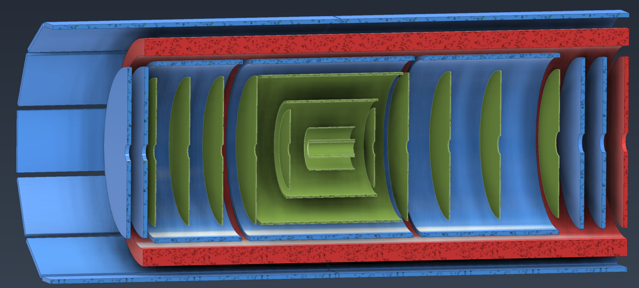
Alternative Tracker – Layout
Replaced by two or three layers based on the existing ITS2 sensor, as used in ALICE and sPHENIX without EIC specific modifications
Branchpoint 2 only
Inner Barrel (IB)
Outer Barrel (OB)
Replaced with two MPGD barrel layers derived from the outer MPGD tracker, specifically its innermost (Micromegas) layer
Branchpoint 1 & 2
Replaced with (in total up to) seven near-identical MPGD disks on each side, specifically based on existing uRWELL disks
Branchpoint 1 & 2
Hadron and Electron Endcap Disks (HE, EE)

Slide 3
Alternative Tracker – Schedule
Will be further refined leading up to CD-2 based on ITS3 development
Branchpoint | Date | Milestones
1 (LAS Delay) | Q2/Q3 2026 | 1 year for MPGD foils + 3 years construction
2 (ITS3 Delay) | Q3/Q4 2027 | Same 3 years construction as current IB
CD-3
04/2025
early CD-4
09/2032
CD-4
09/2034
Oct 2028
June 2030
Apr 2031
Oct 2030
Jan 2031
Construction
Pre-OPS
Detector Assembled and Ready for Cosmic Data Taking
IR-6 ready
for installation
Early start of
Operations
&
Science
Start of
Operations
&
Science
Hadron Endcap
Detectors
installed
Barrel Detectors
installed
Electron Endcap Detectors installed

