Slide 1
eEIC MPGD Tracking
The MPGD endacaps
2024-02-21

Slide 2
EIC Slide Deck
Provides the standard introductory slides
  Title Slide
  Charge Slide
  Outline Slide
  Generic example content slides including charge tag
  Generic presentation section separators
  Summary Slide
  Blank
  General Guidance

Slide 3
MPGD endcaps
GEM - $μ−$Rwell technoloy
Annalisa D’Angelo
Endcaps project coordinator
Incremental Design and Safety Review
of the EIC Tracking Detectors
March 20-21, 2024

Slide 4
Charge Questions Addressed
Grey out charge text not being addressed.
GRY RGB HEX CODE: #BFBFBF
Are the technical performance requirements appropriately defined and complete for this stage of the project?
Are the plans for achieving detector performance and construction sufficiently developed and documented for the present phase of the project?
Are the current designs and plans for detector, electronics readout, and services sufficiently developed to achieve the performance requirements?
Are plans in place to mitigate risk of cost increases, schedule delays, and technical problems?
Are the fabrication and assembly plans for the various tracking detector systems consistent with the overall project and detector schedule?
Are the plans for detector integration in the EIC detector appropriately developed for the present phase of the project?
Have ES&H and QA considerations been adequately incorporated into the designs at their present stage?

Slide 5
Outline
Presentation Section 1
  Topic 1.1
  Topic 1.2
Presentation Section 2
  Topic 2.1
  Topic 2.2
  ⁞
  Topic 2.n
Summary

Slide 6

GEM-$μ$Rwell ENDCAPS

Slide 7
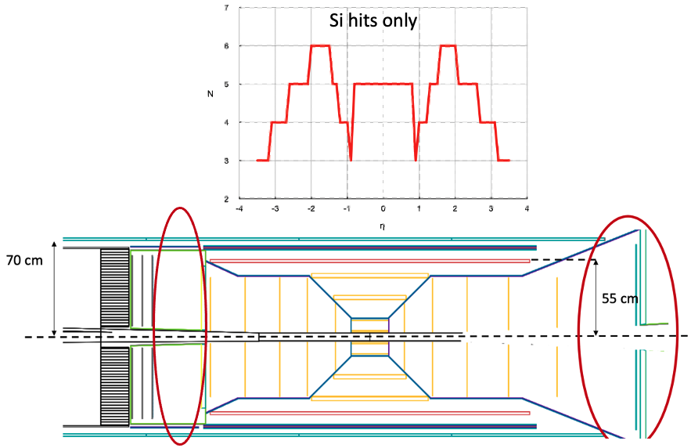
Topic – Scope of the MPGD Endcaps
Charge 1
Are the technical performance requirements appropriately defined and complete for this stage of the project?
In May 2023, MC simulations showed that the ePIC tracking configuration in the endcap regions of the ePIC detector, which will experience the highest backgrounds in the experiment, will not provide enough hit points in the |η| > 2 region for good pattern recognition (top).
ePIC tracker geometry before June 2023

Slide 8
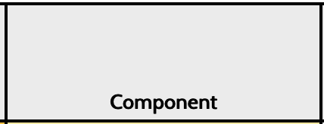
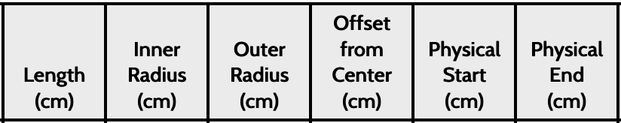
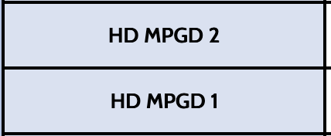
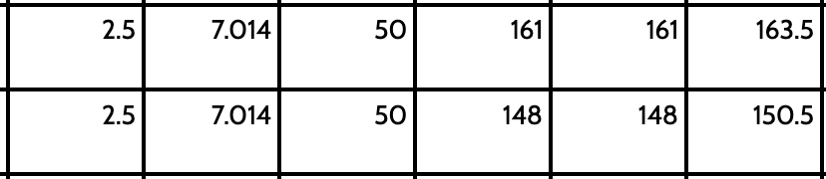
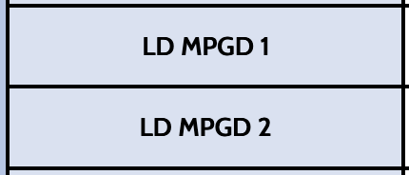
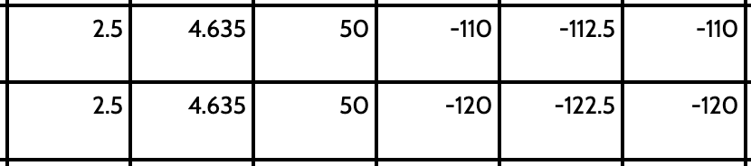
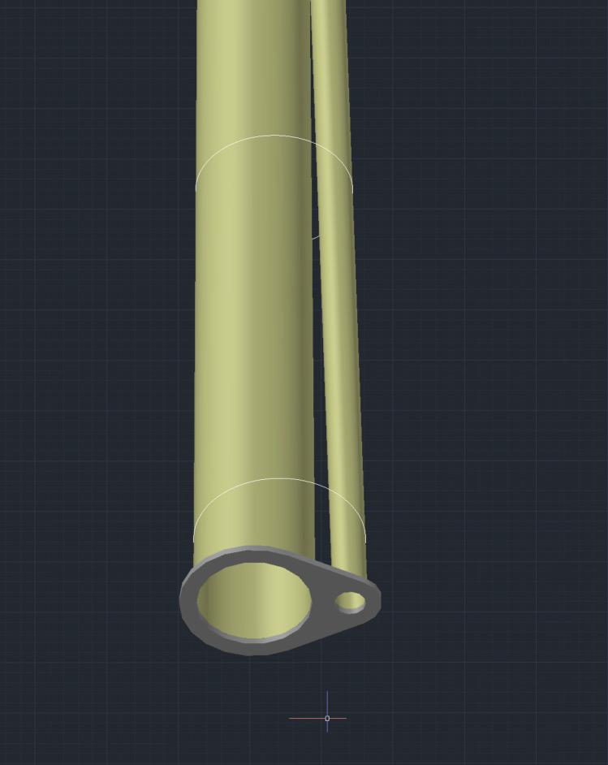
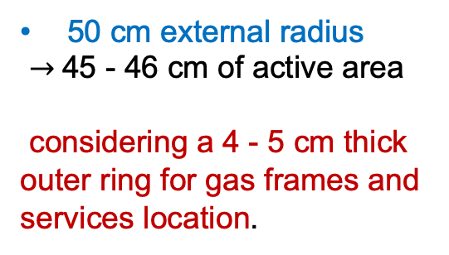

Topic 1.1 – Detector Geometry: Envelope and active region
Charge 1
Endcaps Envelope Dimensions
Beam Pipes Envelope Radii and Offsets
MPGD Disk | Max Z Pos (mm) | Calculated Inner Radius (mm) | X Offset (mm) | Disk Inner Radius (mm) | Inner active area radius (mm)
HD MPGD 2 | 1610 | 55.8 | 22.5 | 80 | 95
HD MPGD 1 | 1505 | 53.1 | 19.9 | 80 | 95
LD MPGD 1 | -1125 | 37.7 | -3.1 | 45 | 60
LD MPGD 2 | -1225 | 39.2 | -3.4 | 45 | 60
Inner Disks Radius is different for the two LD and HD regions
Outer Disks Radius
50 cm external radius
$→$45 - 46 cm of active area
considering a 4 - 5 cm thick outer ring for gas frames and services location.
Calculated
Radii
HD: 8 cm inner radius
$→$ 9.5 cm radius of active area
LD: 4.5 cm inner radius
$→$6 cm radius of active area
considering a 1.5 cm thick gas frame

Slide 9
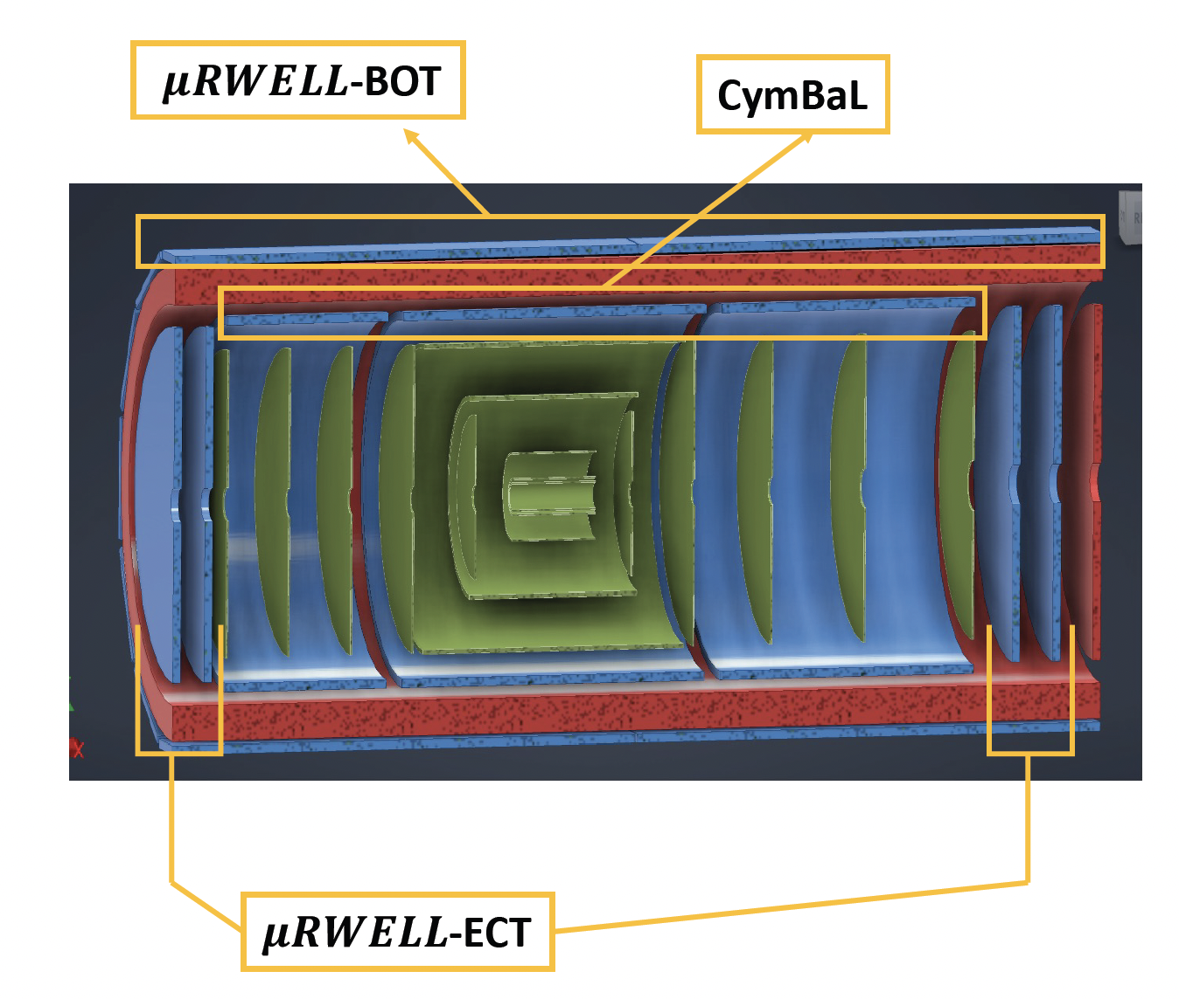


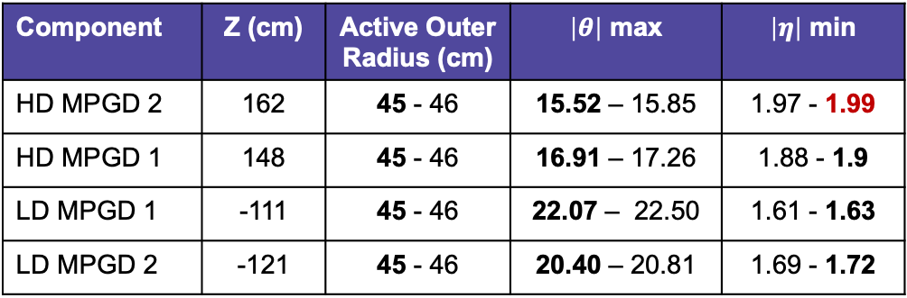

Topic 1.1 – Pseudo-rapidity coverage: minimum $\left|η\right|$ values
Charge 1
The geometrical envelope is available at: https://eic.jlab.org/Geometry/Detector/Detector-20240117135224.html
$\left|η\right|$>1.72
$\left|η\right|$>1.99
Component | Z (cm) | Active Outer Radius (cm) | $\left|θ\right|$ max | $\left|η\right|$ min
HD MPGD 2 | 162 | 45 - 46 | 15.52 – 15.85 | 1.97 - 1.99
HD MPGD 1 | 148 | 45 - 46 | 16.91 – 17.26 | 1.88 - 1.9
LD MPGD 1 | -111 | 45 - 46 | 22.07 – 22.50 | 1.61 - 1.63
LD MPGD 2 | -121 | 45 - 46 | 20.40 – 20.81 | 1.69 - 1.72
The minimum $\left|η\right|$ value is not less than 2
it is limited by the outer HD disk location/dimensions

Slide 10



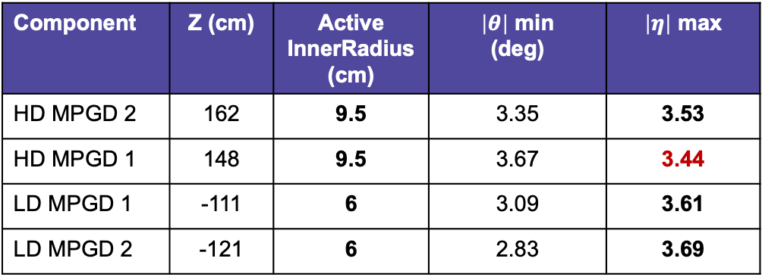
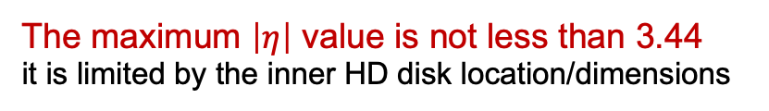
Topic 1.1 – Pseudo-rapidity coverage: maximum $\left|η\right|$ values
Charge 1
The geometrical envelope is available at: https://eic.jlab.org/Geometry/Detector/Detector-20240117135224.html
1.72$<\left|η\right|<$3.61
1.99$<\left|η\right|<$3.44
Component | Z (cm) | Active InnerRadius (cm) | $\left|θ\right|$ min (deg) | $\left|η\right|$ max
HD MPGD 2 | 162 | 9.5 | 3.35 | 3.53
HD MPGD 1 | 148 | 9.5 | 3.67 | 3.44
LD MPGD 1 | -111 | 6 | 3.09 | 3.61
LD MPGD 2 | -121 | 6 | 2.83 | 3.69
$\left|η\right|$>1.99
The maximum $\left|η\right|$ value is not less than 3.44
it is limited by the inner HD disk location/dimensions

Slide 11
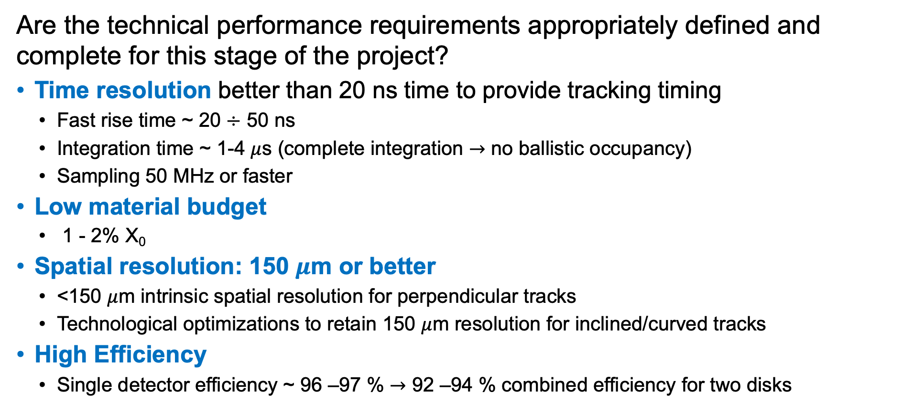
Topic 1.1 – Technical performance requirements
Charge 1
Are the technical performance requirements appropriately defined and complete for this stage of the project?
Time resolution better than 20 ns time to provide tracking timing
  Fast rise time ~ 20 $÷$ 50 ns
  Integration time ~ 1-4 $μ$s (complete integration $→$ no ballistic occupancy)
  Sampling 50 MHz or faster
Low material budget
  1 - 2% X₀
Spatial resolution: 150 $μ$m or better
  <150 $μ$m intrinsic spatial resolution for perpendicular tracks
  Technological optimizations to retain 150 $μ$m resolution for inclined/curved tracks
High Efficiency
  Single detector efficiency ~ 96 –97 % $→$ 92 –94 % combined efficiency for two disks

Slide 12
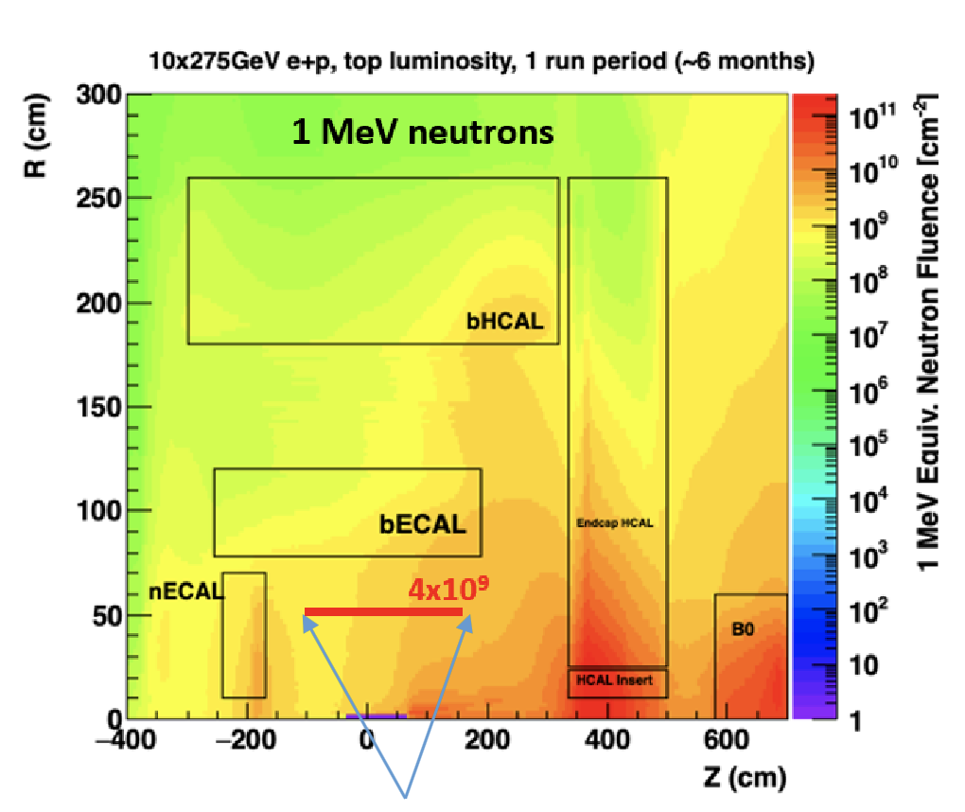
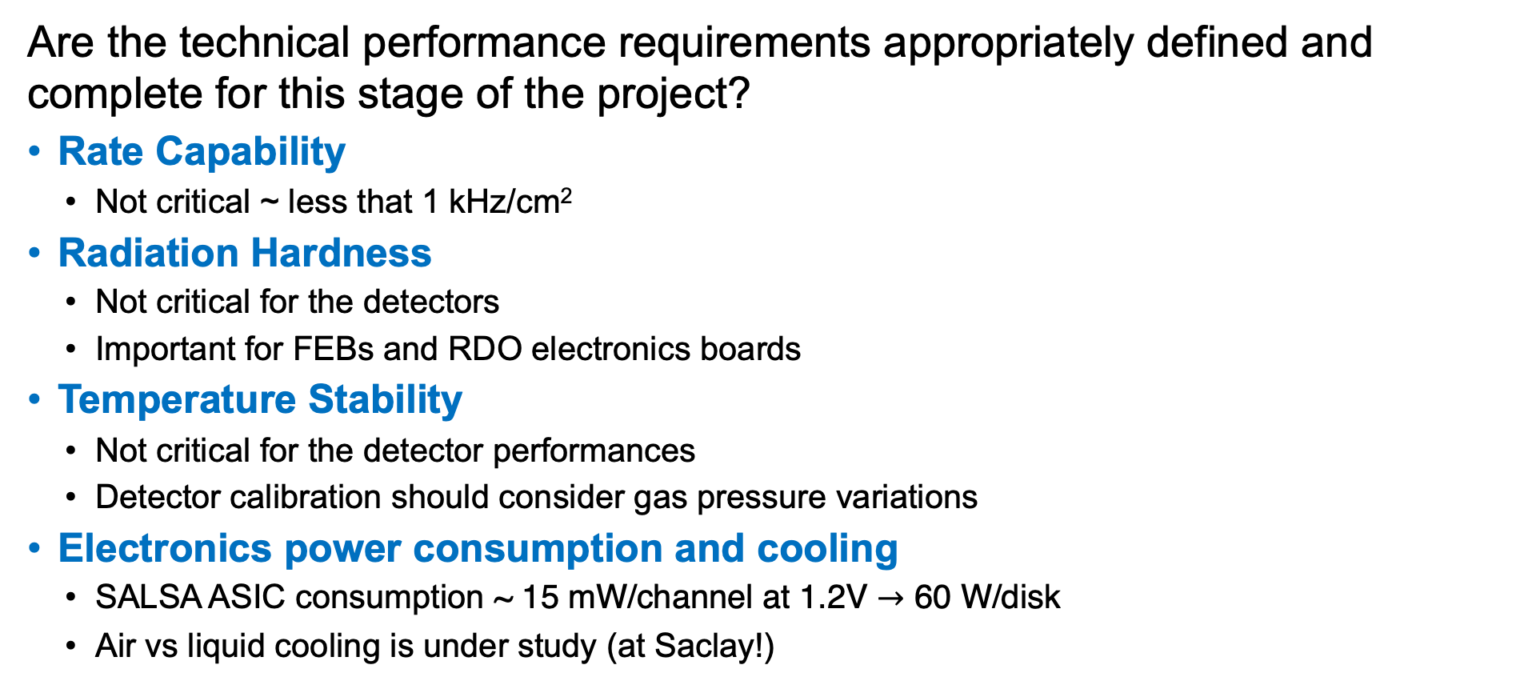
Topic 1.1 – Technical performance requirements
Charge 1
Are the technical performance requirements appropriately defined and complete for this stage of the project?
Rate Capability
  Not critical ~ less that 1 kHz/cm²
Radiation Hardness
  Not critical for the detectors
  Important for FEBs and RDO electronics boards
Temperature Stability
  Not critical for the detector performances
  Detector calibration should consider gas pressure variations
Electronics power consumption and cooling
  SALSA ASIC consumption ~ 15 mW/channel at 1.2V $→$ 60 W/disk
  Air vs liquid cooling is under study (at Saclay!)
MPGD Endcaps

Slide 13

Topic 1.2 – Detector performance and construction plans
Charge 2
(X, Y) readout is preferred vs (R,$φ$) – no FEB on the active area
500 $μm$ pitch $→$ better than 150 $μm$ intrinsic position resolution
PROs | CONs
Direct radial and azimuthal information | The linear density of the azimuthal strips increases by a factor 10 on the inner hole
 | The radial readout hybrid FE overlaps the active area or flex cables should be used.
 | Radial strip length varies by a factor 10.
PROs | CONs
The strip length does not vary much along the active area | Alignment is critical
All readout FE hybrids may be located outside the active area | Routes to read-out connectors must be accurately studied

Slide 14
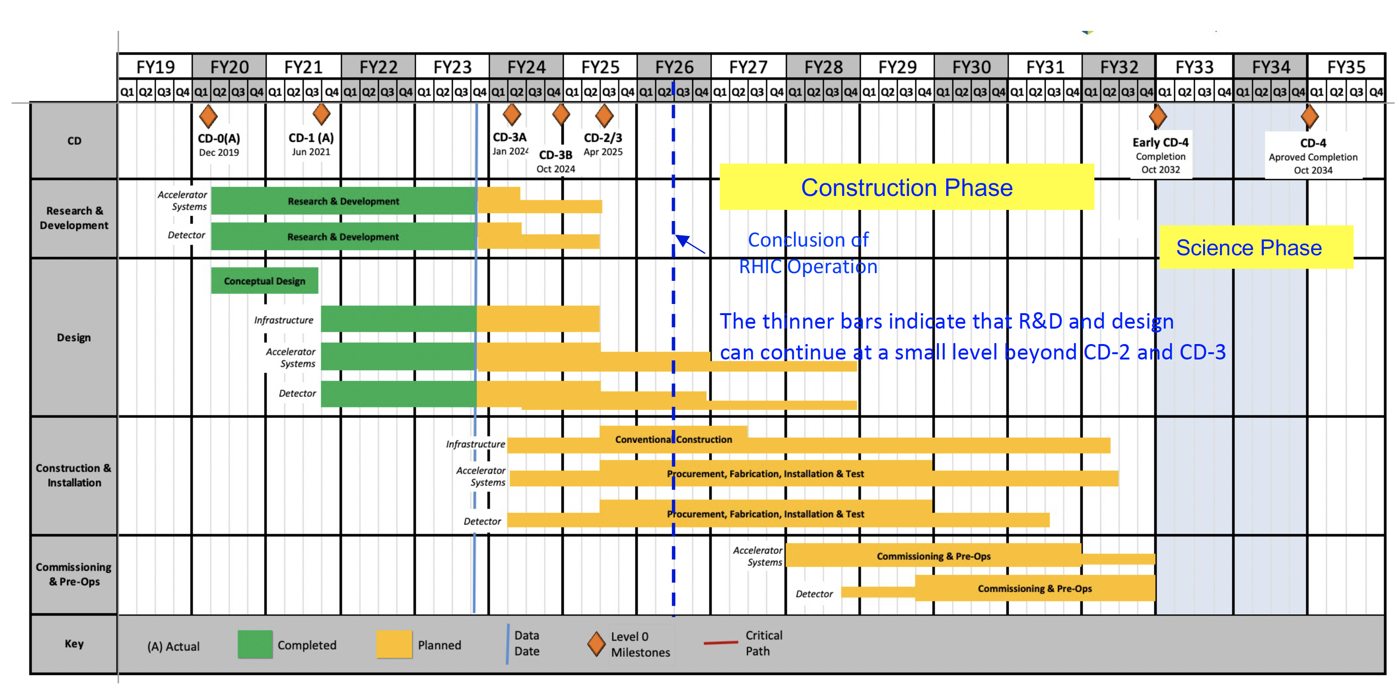
Topic 1.2 – Detector performance and construction plans
Charge 2
Are the plans for achieving detector performance and construction sufficiently developed and documented for the present phase of the project?
(Better Gan timeline to be included)
MPGD Timeline |  |  | DURATION (days)
START DATE | END DATE | DESCRIPTION
3/1/24 | 12/31/24 | Detectors Overall Design | 300
1/1/25 | 12/31/26 | Pre - Production | 720
1/1/27 | 12/31/29 | Production | 720
1/1/30 | 6/1/30 | Installation | 510

Slide 15

Topic 1.3 – Detector, Electronics Readout, and Services
Charge 3
MPDG Endcaps semi-detectors overlap
The disks will have 2 cm of active area overlap
1000 mm
1000 mm
$\left|η\right|$>1.99
525 mm
525 mm

Slide 16
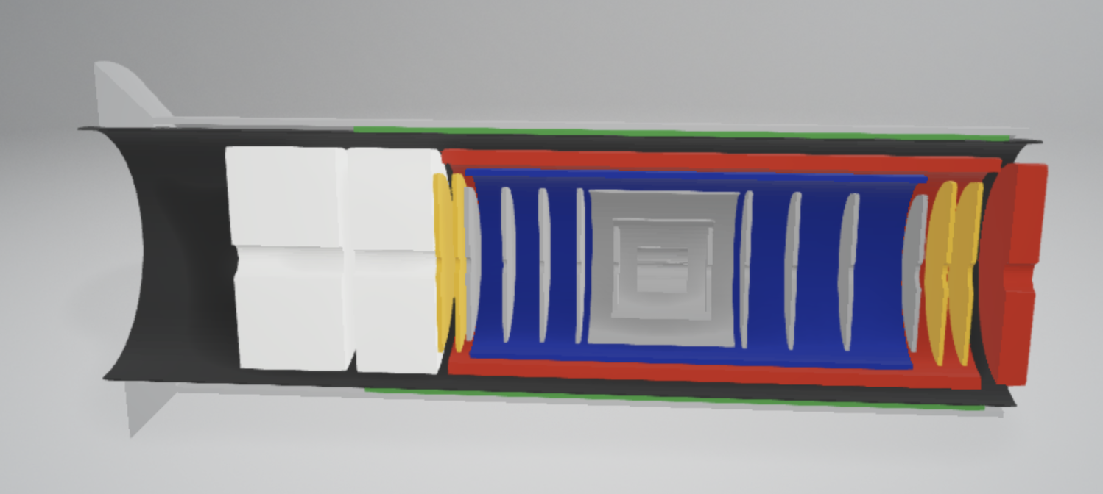
Topic 1.3 – Detector, Electronics Readout, and Services
Charge 3
For each endcap disk (4 disks in total):
16 HV cables
4 gas inlets and 4 gas outlets
32 data cables
32 low low voltage cables
2 temperature sensors cables
2 humidity sensors cables
2 inlet and 2 outlet cooling hoses (dry-air or liquid)
Space for 32 RDO cards
4 disks

Slide 17
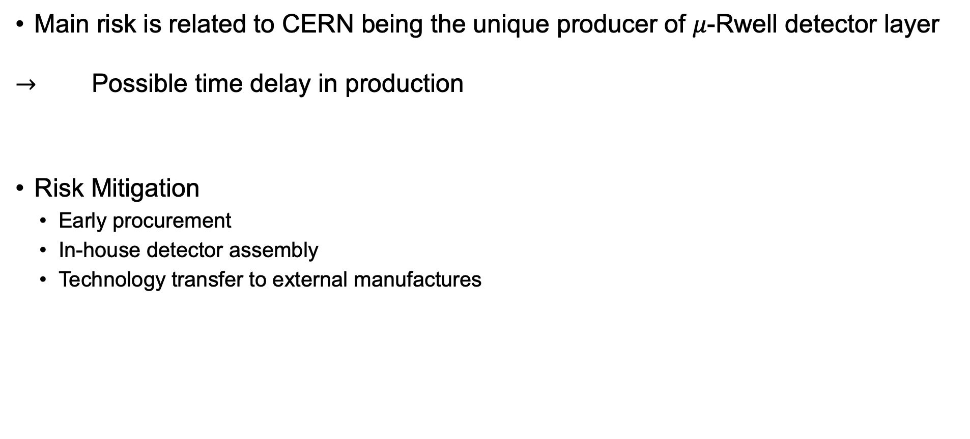
Topic 1.4 – Risks Mitigation
Charge 4
Main risk is related to CERN being the unique producer of $μ$-Rwell detector layer
$→$ Possible time delay in production
Risk Mitigation
  Early procurement
  In-house detector assembly
  Technology transfer to external manufactures

Slide 18
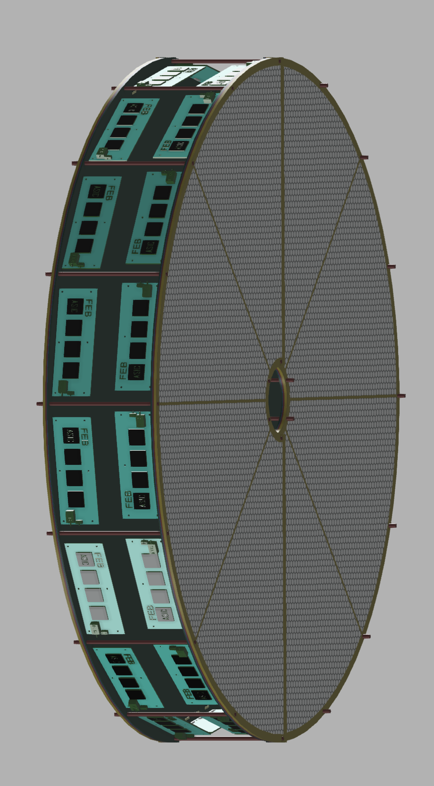

Topic 1.5 – Detector Integration in ePIC
Charge 5
The assigned envelope will encompass the detectors and the FEB electronics
The disks will have the FEBs connected perpendicularly to the disks
$\left|η\right|$>1.72
$\left|η\right|$>1.99

Slide 19
Topic 1.5 – Fabrication and Assembly Plans
Charge 5
First module by
2025-2026 pre-production; 2026 - 2029 production at BNL

Slide 20
Topic 1.7 – ES&H and QA
Charge 6
ES&H is ensured in the local laboratory
Radiation hardness not a concern – total ionization dose, low flux of low momentum protons
Single events upsets – fast recovery procedure may be implemented

Slide 21
Summary

