Slide 1
EIC Slide Deck Template
Includes additional generic and preset content,
helpful hints, etc.
2024-02-22

Slide 2
EIC Slide Deck
Provides the standard introductory slides
Title Slide
Charge Slide
Outline Slide
Generic example content slides including charge tag
Generic presentation section separators
Summary Slide
Blank
General Guidance

Slide 4
Charge Questions Addressed
Grey out charge text not being addressed.
GRY RGB HEX CODE: #BFBFBF
Are the technical performance requirements appropriately defined and complete for this stage of the project?
Are the plans for achieving detector performance and construction sufficiently developed and documented for the present phase of the project?
Are the current designs and plans for detector, electronics readout, and services sufficiently developed to achieve the performance requirements?
Are plans in place to mitigate risk of cost increases, schedule delays, and technical problems?
Are the fabrication and assembly plans for the various tracking detector systems consistent with the overall project and detector schedule?
Are the plans for detector integration in the EIC detector appropriately developed for the present phase of the project?
Have ES&H and QA considerations been adequately incorporated into the designs at their present stage?

Slide 5
Outline
Presentation Section 1
Topic 1.1
Topic 1.2
Presentation Section 2
Topic 2.1
Topic 2.2
⁞
Topic 2.n
Summary

Slide 6
Presentation Section 1

Slide 7
Topic 1.1 – Example Bullet List Layout
Charge 1, 2
Charge tag is offset down a bit to allow for slide title to use full width.
General content slide - bullets with standard indent levels and fonts.
Layout Name – “Content 1 – Bulleted”
Level 1 – Arial 24
Level 2 – Arial 20
Level 3 – Arial 18
Level 4 – Arial 16
Right click on slide on left and select “Layout >” to see which layout this is (Content 1 – Bulleted), and which others are available.

Slide 8
Topic 1.2 – Example Numbered List Layout
Charge 3, 5
Charge tag is offset down a bit to allow for slide title to use full width.
General content slide - bullets with standard indent levels and fonts.
Layout Name – “Content 1 – Bulleted”
Level 1 – Arial 24
Level 2 – Arial 20
Level 3 – Arial 18
Level 4 – Arial 16
Right click on slide on left and select “Layout >” to see which layout this is (Content 1 – Numbered), and which others are available.

Slide 9
Summary

Slide 11
Some General Guidance - I
Stay “in the box”.
Below the blue title line, above the black footer line, and generally inside the horizonal space bounded by those lines left and right.
Do not move title text boxes.
If needed, shrink the font. But try to keep your title concise anyway.
Do not move the charge tags.
Note that it’s trivial to copy and paste charge tags from an existing slide to a new one.
When you copy from one slide and paste to another, by default, the pasted object will be positioned exactly where it was on the source slide.

Slide 12
Some General Guidance - II
Learn how to use features that leverage the slide templates you’re using.
Choose or Change a Slide Layout: To choose a slide layout, right click on the slide in the thumbnail list at left, select “Layout>”, then look through the available layouts and choose what best suits your need.
Reset a Slide to its Layout Defaults: Right click on the slide in the thumbnail list at left, select “Reset Slide”.
In general, do not paste in complete slides from other presentations, unless you know what you’re doing.
You will most likely need to edit afterward, so copying and pasting slide content is “safer”.
Copying in slides will also copy in non-standard slide layouts and other “debris”.
Put in the effort now to conform to this template and you won’t need to do it again in the future.
See what works best for you – pasting in a complete slide if you know what you’re doing, or copy and pasting content from slides.

Slide 13
Some General Guidance - III
Use Ctrl+z (Undo) and Ctrl+y (Redo).
It is a common occurrence to accidentally select and drag or delete some existing object.
Ctrl+z is the easy fix to put it back exactly as it was.
Ctrl+y is the easy way to redo (undo an undo).
Stay with the Arial font. If you paste in text, edit font if needed.
Again, the slide reset will do this for you, but it will also enforce the overall layout as chosen for that slide.
The footer text is set in the main slide master. You cannot edit on a regular slide – by design. This prevents accidental text moves, page number double ups, etc.

Slide 14
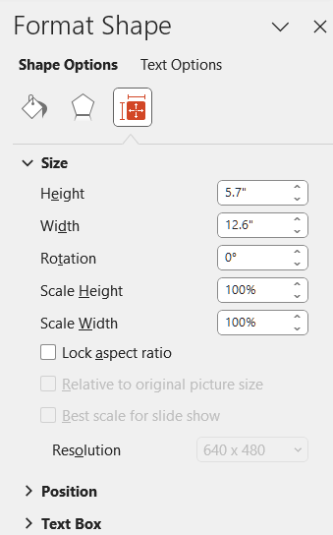
Some General Guidance - IV
When you’re pasting in pictures, plots, figures, etc. – set the sizing to “Lock Aspect Ratio” to avoid distorting them.
Right click on the content.
Select “Format Shape …”.
Select the sizing icon.
Click on “Lock Aspect Ratio”.

Slide 15
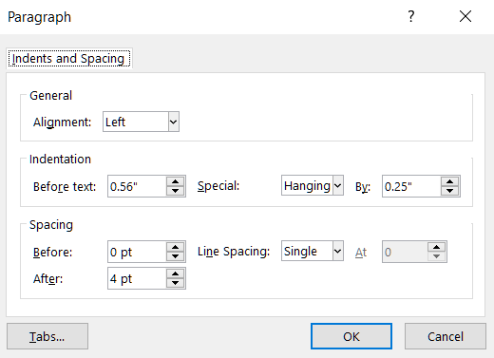
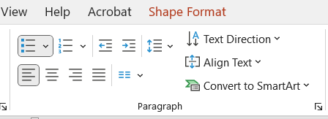
Some General Guidance - V
Don’t be lazy. Put in the simple effort to make your presentation look professional.
Take the time to properly format.
e.g. Use superscripts and subscripts as appropriate: “x²” and not “x^2”.
Spell and grammar check.
PowerPoint does this for you. Just do what it tells you to do.
Learn line and paragraph spacing.
It is preset to look decent in this template. “Spacing” settings are most important.
Settings are here, in the “Paragraph” section, in the pulldown (the arrow thingy):

Slide 16
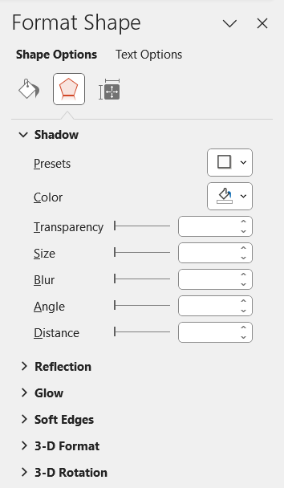
Some General Guidance - VI
Certain PowerPoint effects can help enhance the look of your presentation and make it less austere.
Often nicer than nothing or the simple “line” box around the figure.
Right click on a picture, click “Format Picture” (or Format Shape or whatever). Select <Presets> under “Shadow”. I usually use the very first one under the “Outer” category. That gives the right and bottom shadow used in the pictures here.
No shadow
Shadow

Slide 17
Commonly Used Symbols
αβγδεζηθικλνξομπρστυφχψωΩ
|¦±¯~≈≠≤≥°|ǁǀƩ‖•…⁞∆∞∙←↑→↓↔↕ꞇΦ
αβγδεζηθικλνξοπρστυφχψω

