Slide 1
Tracking Simulation/Reconstruction
Matt Posik
Deputy Technical Coordinator
Temple University

Slide 2
Charge Questions Addressed
Grey out charge text not being addressed.
GRY RGB HEX CODE: #BFBFBF
Are the technical performance requirements appropriately defined and complete for this stage of the project?
Are the plans for achieving detector performance and construction sufficiently developed and documented for the present phase of the project?
Are the current designs and plans for detector, electronics readout, and services sufficiently developed to achieve the performance requirements?
Are plans in place to mitigate risk of cost increases, schedule delays, and technical problems?
Are the fabrication and assembly plans for the various tracking detector systems consistent with the overall project and detector schedule?
Are the plans for detector integration in the EIC detector appropriately developed for the present phase of the project?
Have ES&H and QA considerations been adequately incorporated into the designs at their present stage?

Slide 3
Outline
Software Framework
ePIC Tracking Detector in DD4HEP
Coverage
Detector Hits
Material and Detector Response
Reconstruction
Workflow
Seeding
Tracking Performance
Tracking in Background
Vertex Reconstruction
Summary

Slide 4


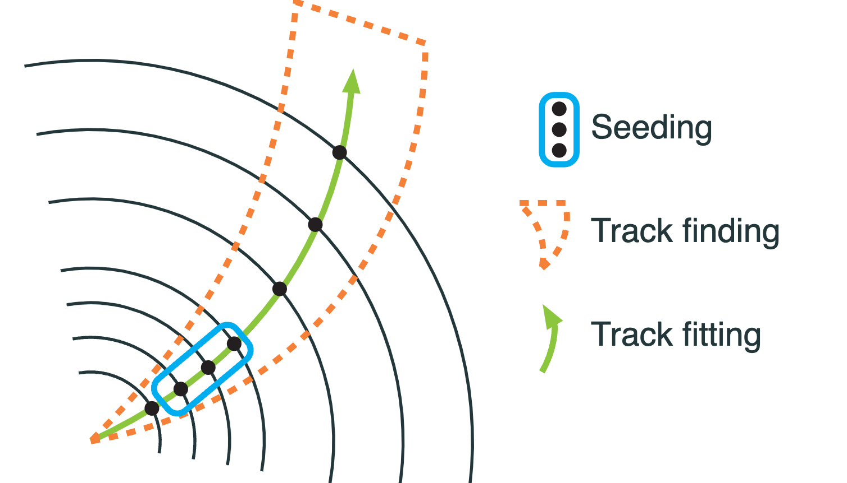
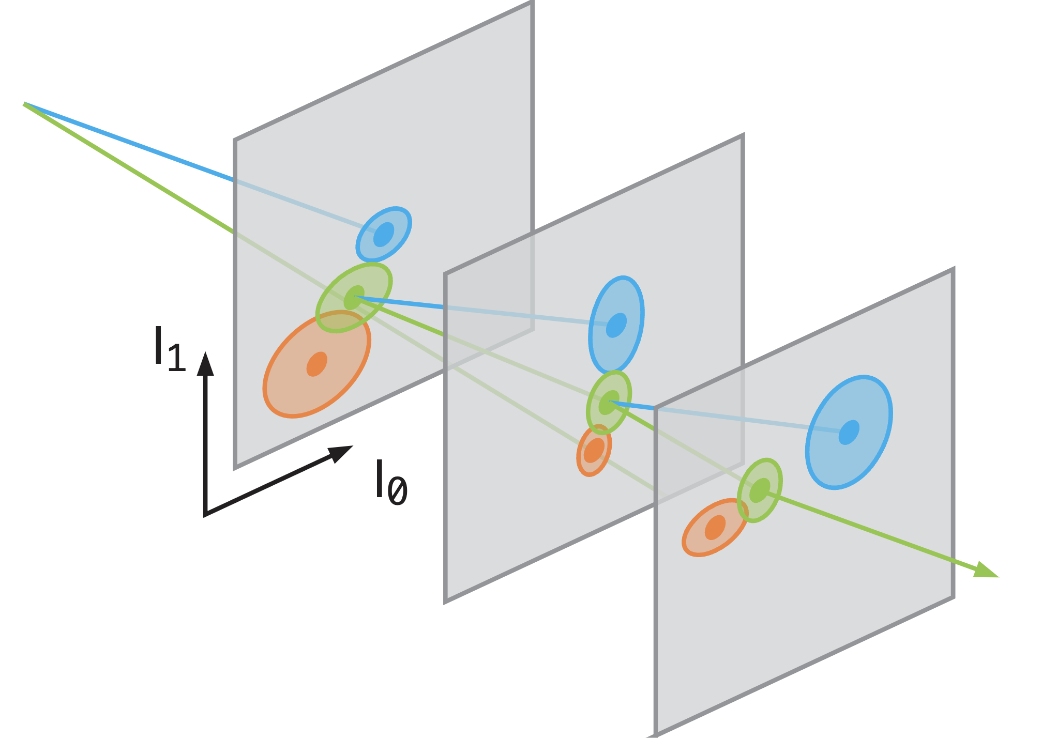
Software Framework
Charge 2, 3
Geometry Framework (epic)
Material and segmentation
Based on DD4HEP
Reconstruction Framework (EICRecon)
Based on PODIO/JANA
Digitization
Track Reconstruction
Based on ACTS Combinatorial Kalman Filter (CKF)
Combined track finding and fitting
Realistic seeder
ePIC data structure (EDM4eic) modeled after EDM4hep
A Common Tracking Software

Slide 5
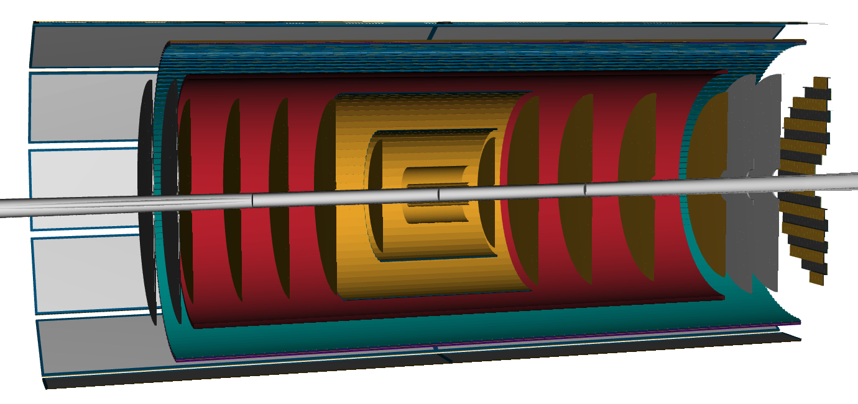



ePIC Tracking Detector in DD4HEP
Charge 2, 3
$μ$RWELL-ECT
$μ$RWELL-BOT
CyMBaL
$μ$RWELL-ECT
AC-LGAD Endcap
AC-LGAD Barrel
SVT Endcaps
SVT Barrels
SVT
SVT Endcaps
proton
electron

Slide 6
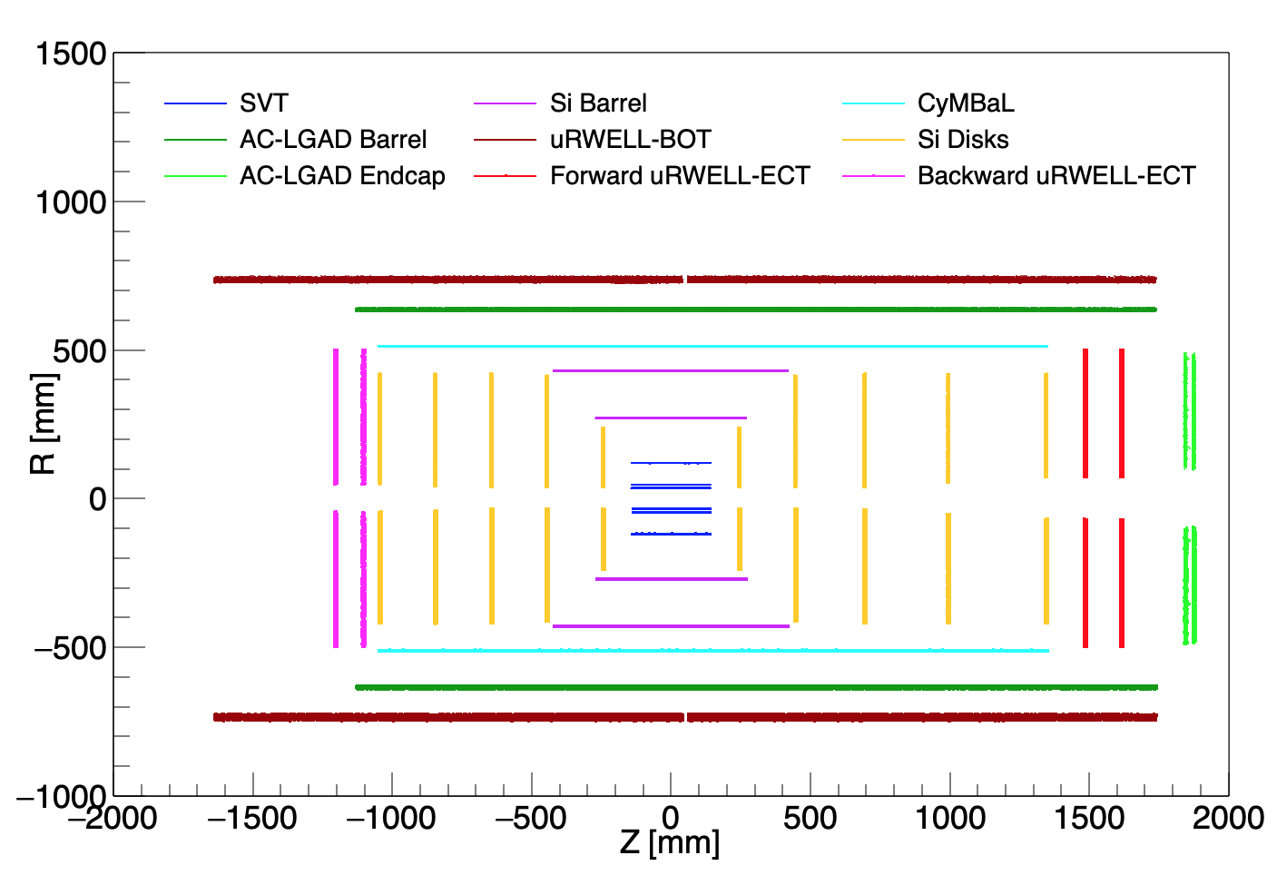
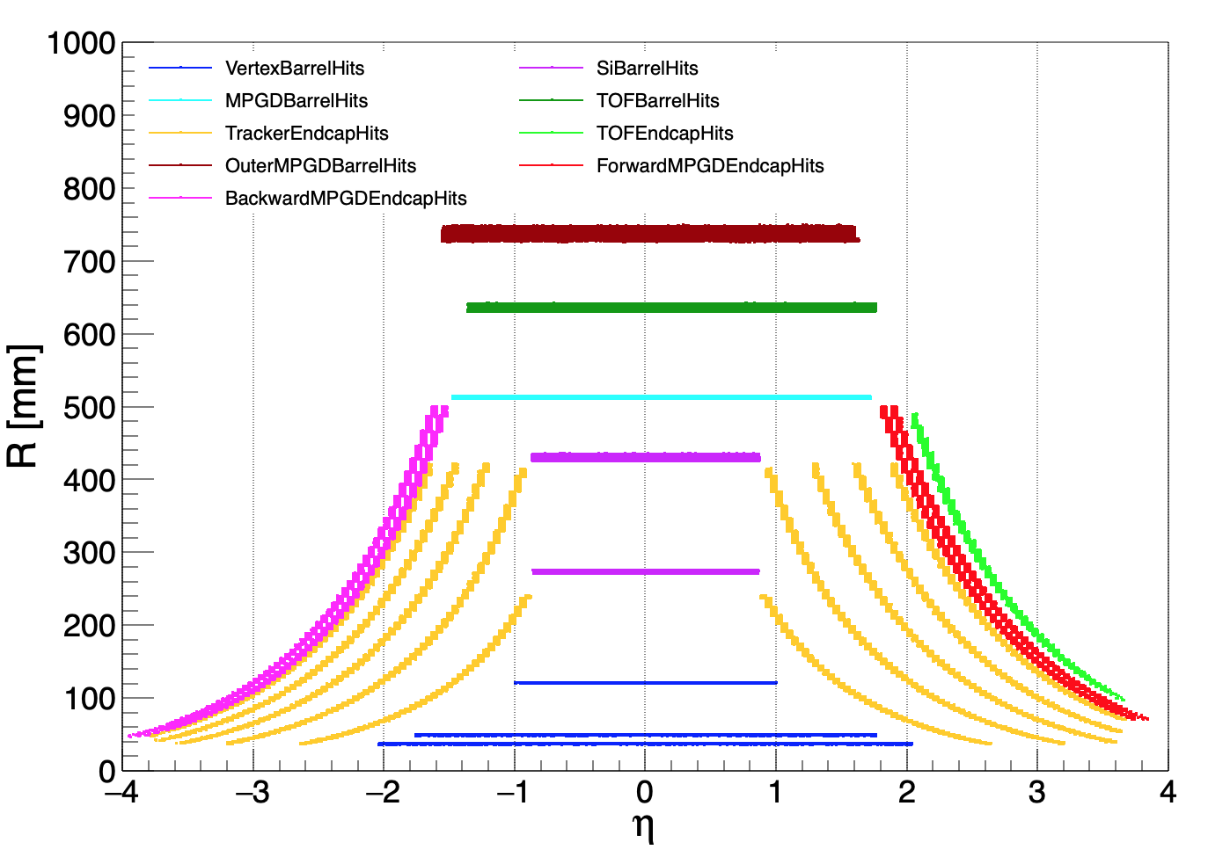
Coverage
Charge 2, 3
GEANT-level tracker hits showing geometric coverage
ePIC 24.2.1
ePIC 24.2.1
proton
electron

Slide 7
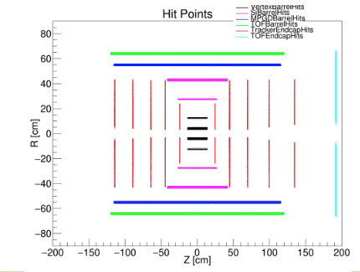
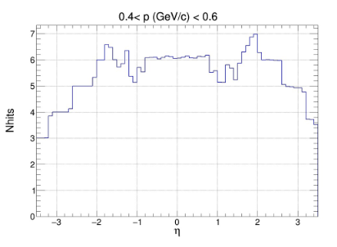
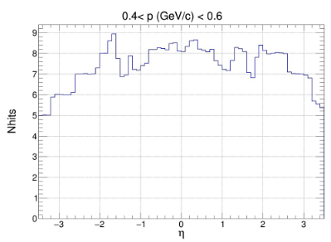
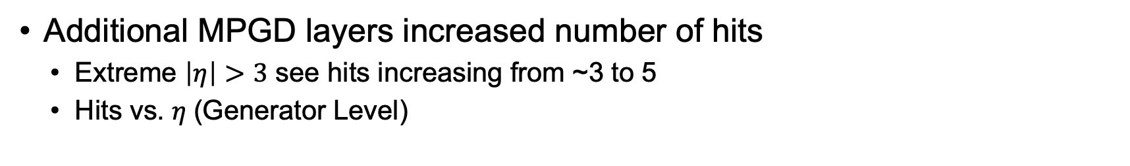
Tracker Hits
Charge 2, 3
Additional MPGD layers increased number of hits
Extreme $\left|η\right|>3$ see hits increasing from ~3 to 5
Hits vs. $η$(Generator Level)
Previous configuration
Current configuration

Slide 8
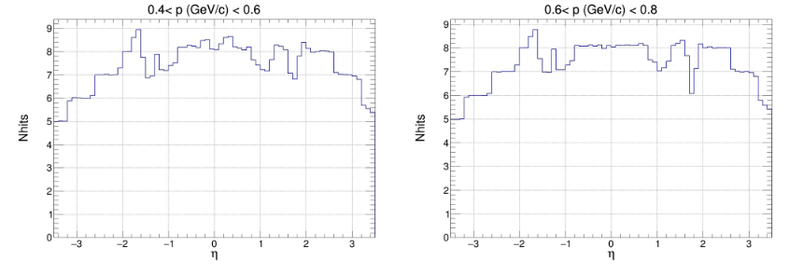
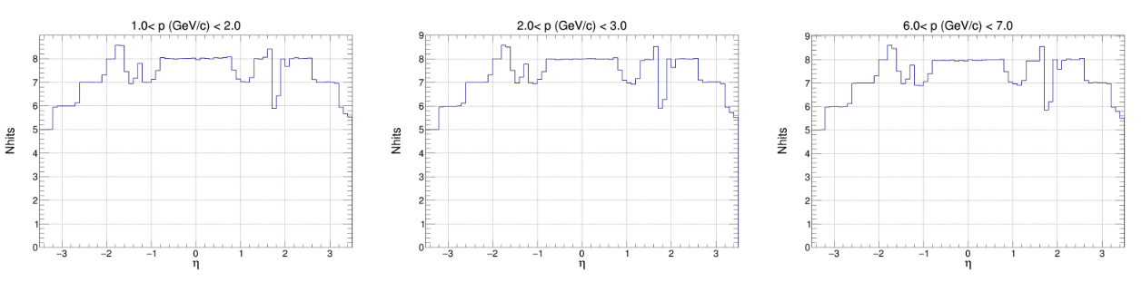
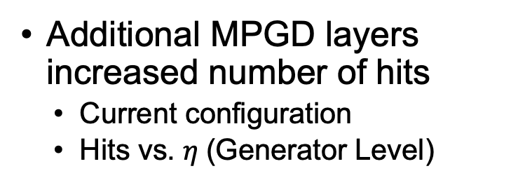
Tracker Hits: Current Configuration
Charge 2, 3
Additional MPGD layers increased number of hits
Current configuration
Hits vs. $η$(Generator Level)

Slide 9
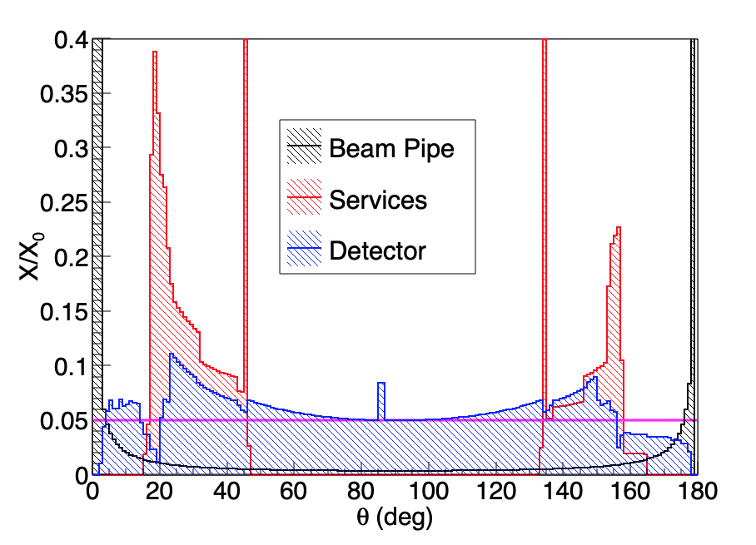
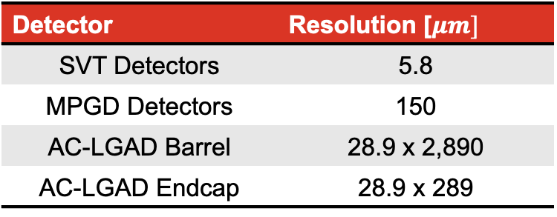
Detector Material and Response
Charge 2, 3
Detector Response
Segmentation implemented as to reproduce expected hit resolution
Digitization based on deposited energy in detector
Spatial resolutions used in simulation:
ePIC 24.2.1
Detector | Resolution [$μm]$
SVT Detectors | 5.8
MPGD Detectors | 150
AC-LGAD Barrel | 28.9 x 2,890
AC-LGAD Endcap | 28.9 x 289
electron
proton

Slide 10
Reconstruction Framework
Charge 2, 3
Truth seed
Real seed
MCparticle
* Material map
DD4hep
Trajectory
Track Params
Trak Segment
…
Initial Track Params
Track finding / fitting (CKF)
Sim Hits
Digitization
Raw Hits
Track Seed
Ambiguity Solver
Seed Finder
(triplet)
Tracker Hits
Track Measurements
Primary
Vertexing

Slide 11
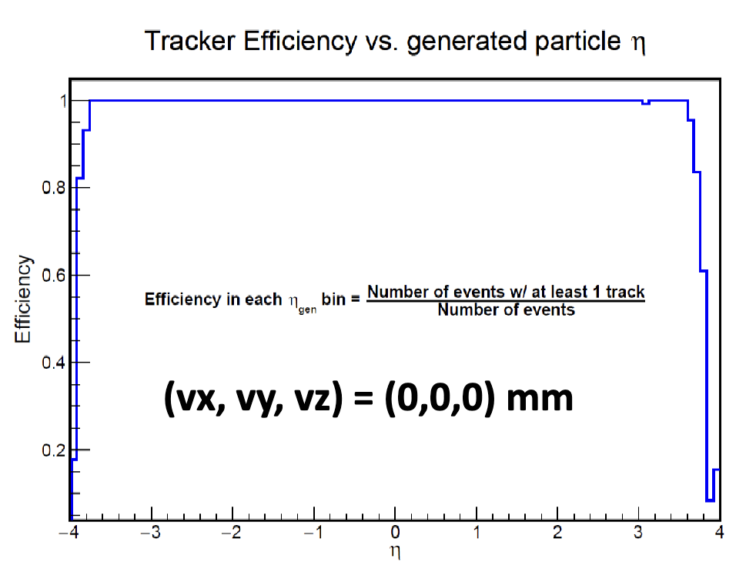
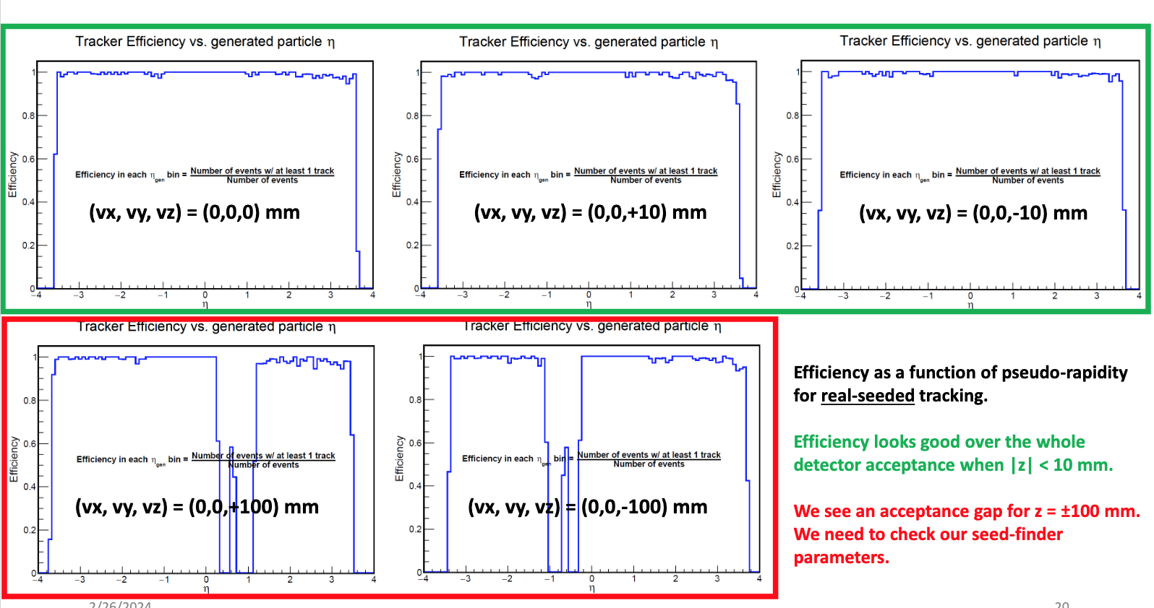
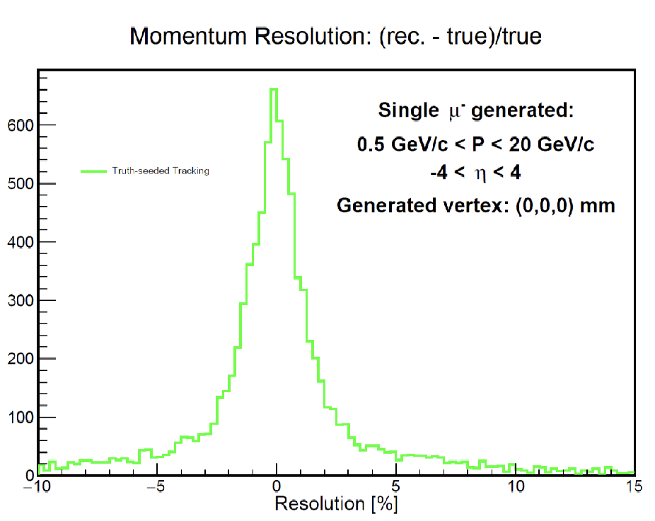
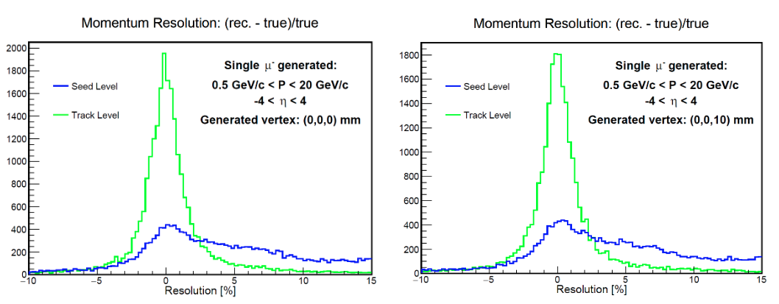


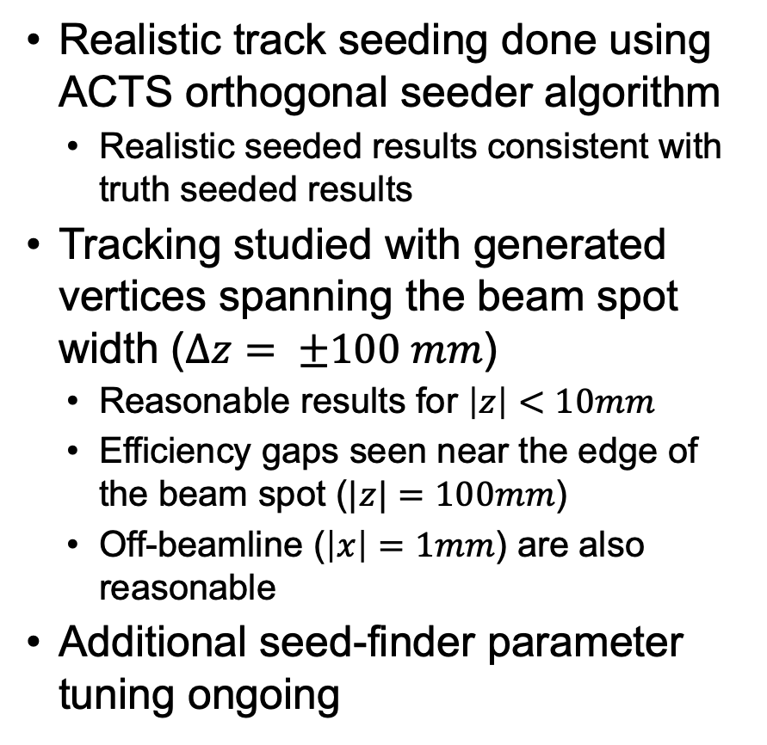


Track Seeding
Charge 2, 3
Realistic track seeding done using ACTS orthogonal seeder algorithm
Realistic seeded results consistent with truth seeded results
Tracking studied with generated vertices spanning the beam spot width ($Δz= ±100 mm$)
Reasonable results for $\left|z\right|<10mm$
Efficiency gaps seen near the edge of the beam spot ($|z|=100mm$)
Off-beamline ($\left|x\right|=1mm$) are also reasonable
Additional seed-finder parameter tuning ongoing
Truth Seed
Realistic Seed
$$\left(v_{x},v_{y},v_{z}\right)=\left(0,0,0\right)mm$$
$$\left(v_{x},v_{y},v_{z}\right)=\left(0,0,0\right)mm$$
$$\left(v_{x},v_{y},v_{z}\right)=$$
$$\left(0,0,0\right)mm$$
$$\left(v_{x},v_{y},v_{z}\right)=$$
$$\left(0,0,0\right)mm$$

Slide 12
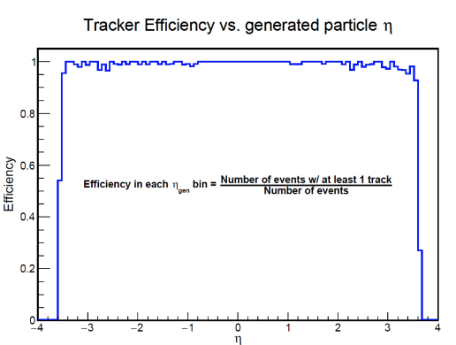
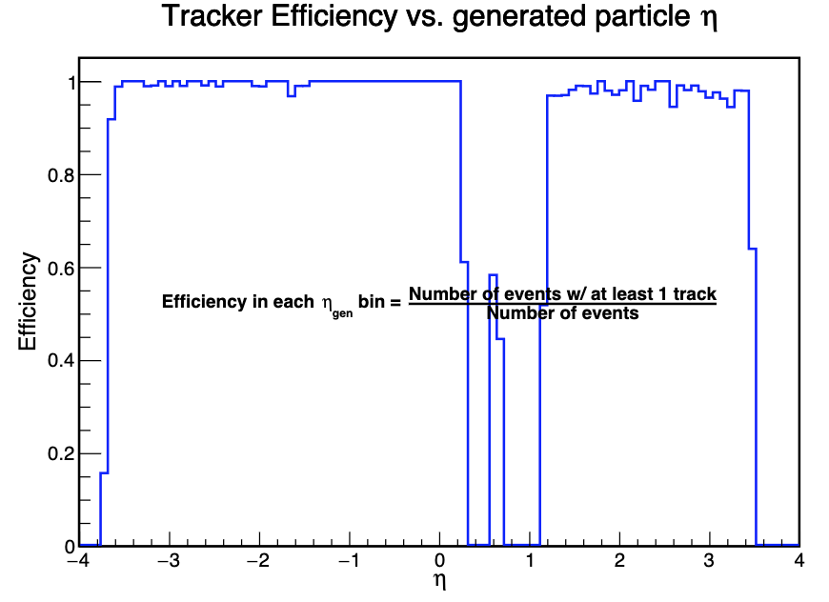
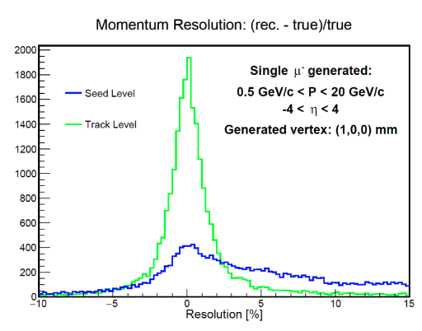
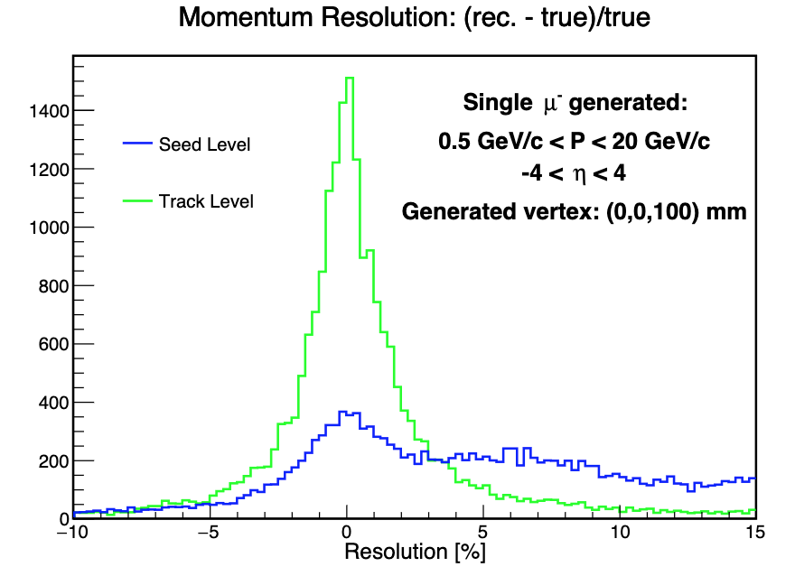






Track Seeding: Realistic Seeding
Charge 2, 3
$$\left(v_{x},v_{y},v_{z}\right)=\left(0,0,10\right)mm$$
$$\left(v_{x},v_{y},v_{z}\right)=\left(1,0,0\right)mm$$
$$\left(v_{x},v_{y},v_{z}\right)=\left(0,0,100\right)mm$$
$$\left(v_{x},v_{y},v_{z}\right)=$$
$$\left(0,0,10\right)mm$$
$$\left(v_{x},v_{y},v_{z}\right)=$$
$$\left(1,0,0\right)mm$$
$$\left(v_{x},v_{y},v_{z}\right)=$$
$$\left(0,0,100\right)mm$$

Slide 13
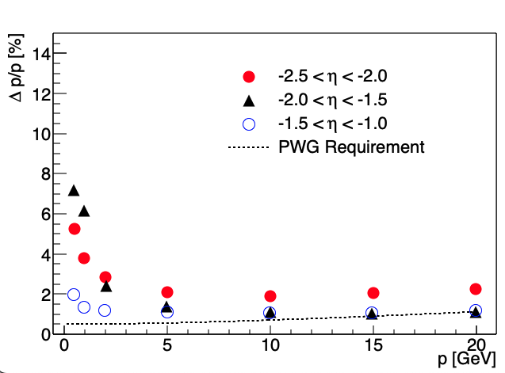
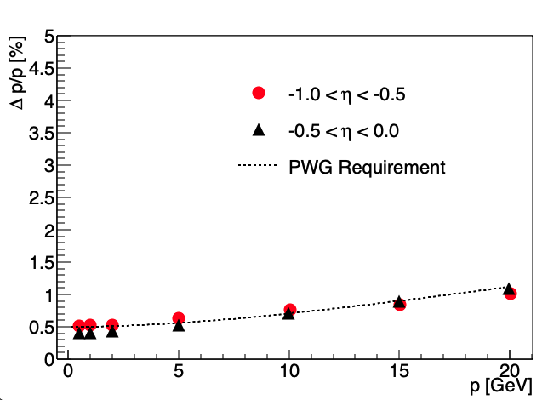
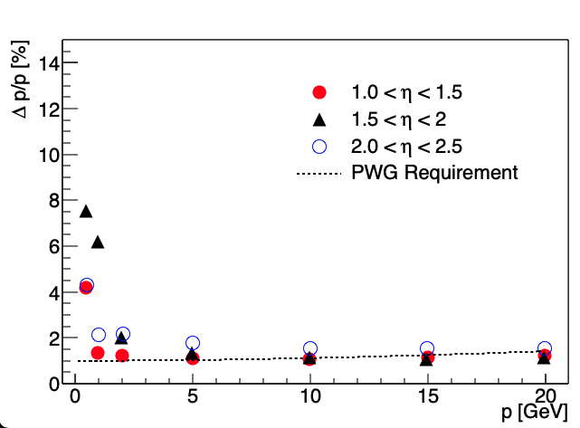
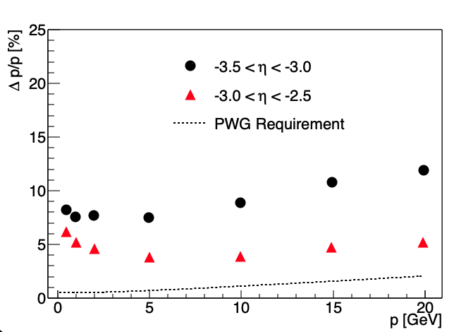
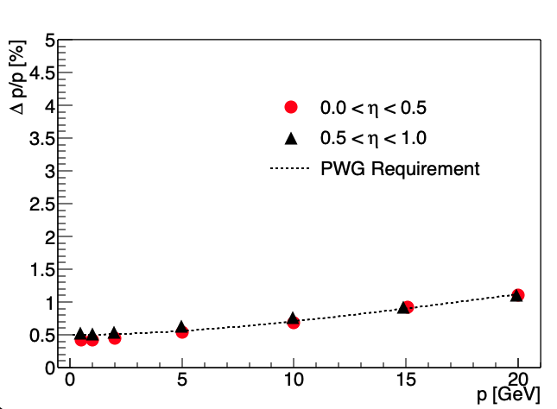
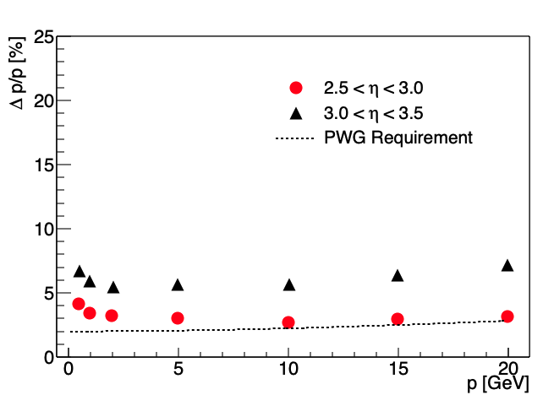
Preliminary Tracking Performance: Momentum Resolution
Charge 2, 3
Single particle (*includes AC-LGAD systems, update real seed)
Backward
Central
Forward

Slide 14
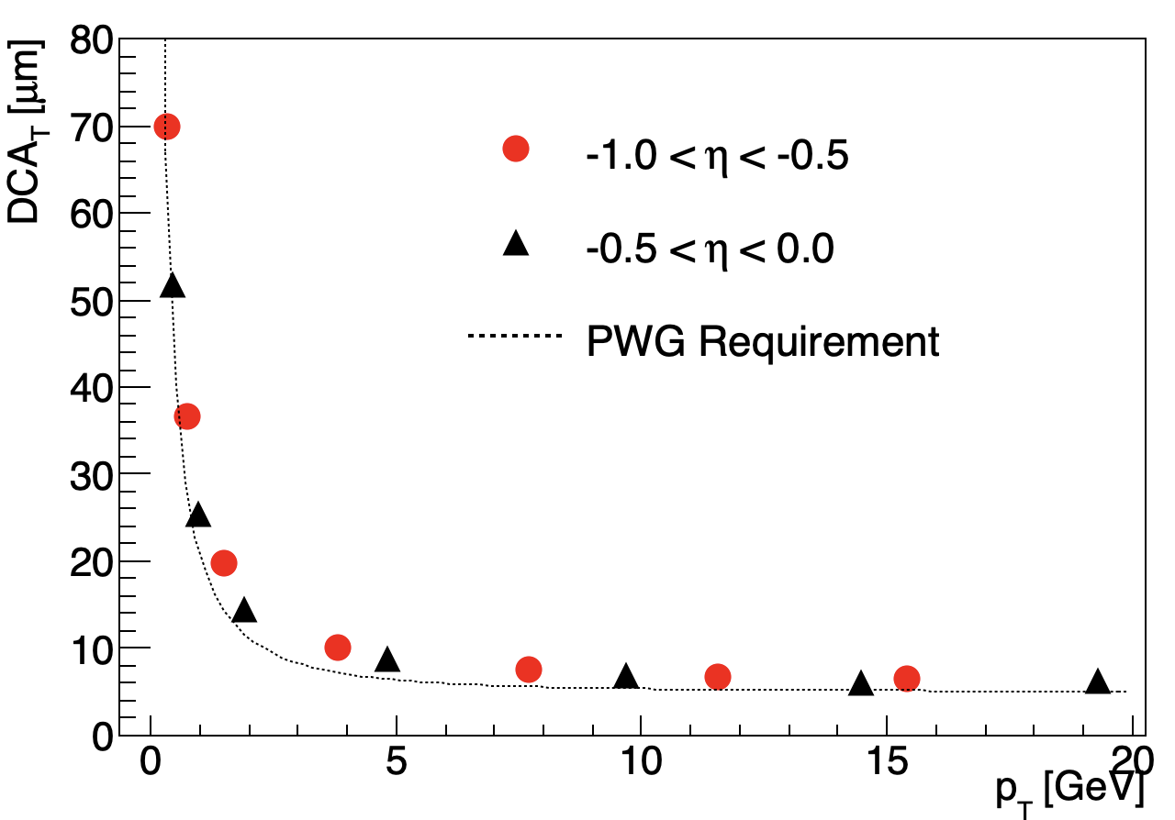
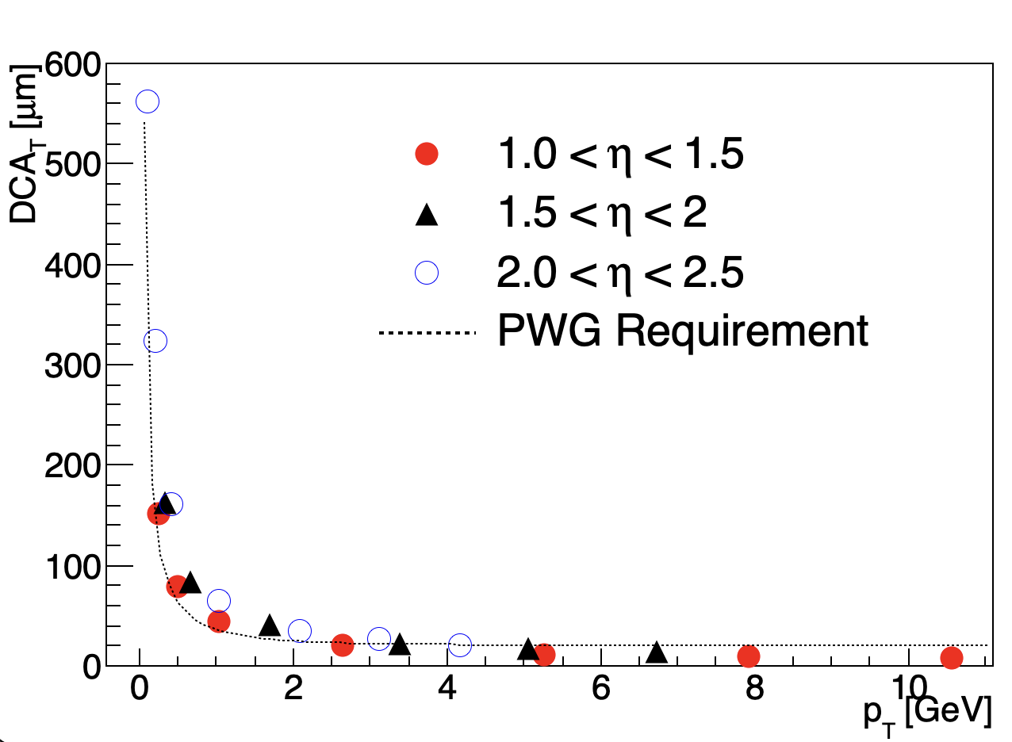
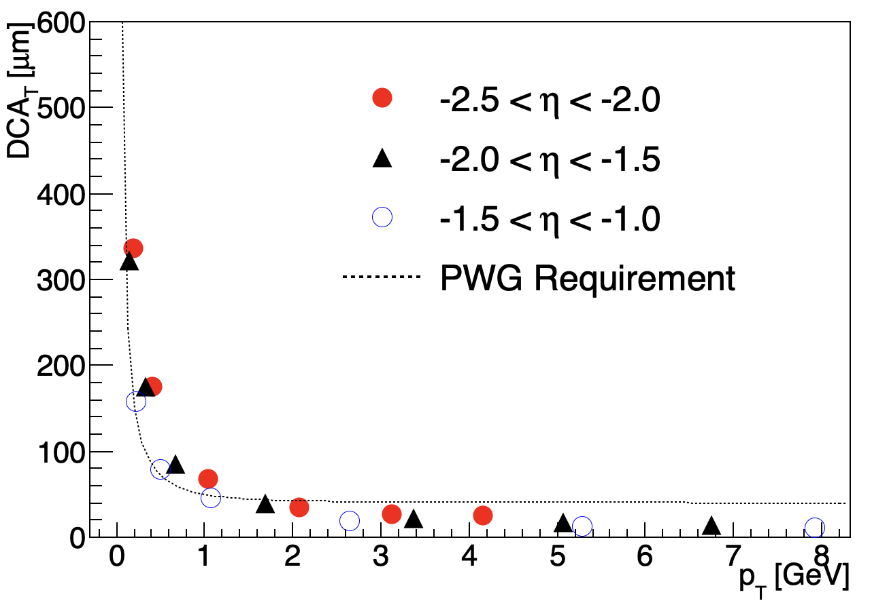
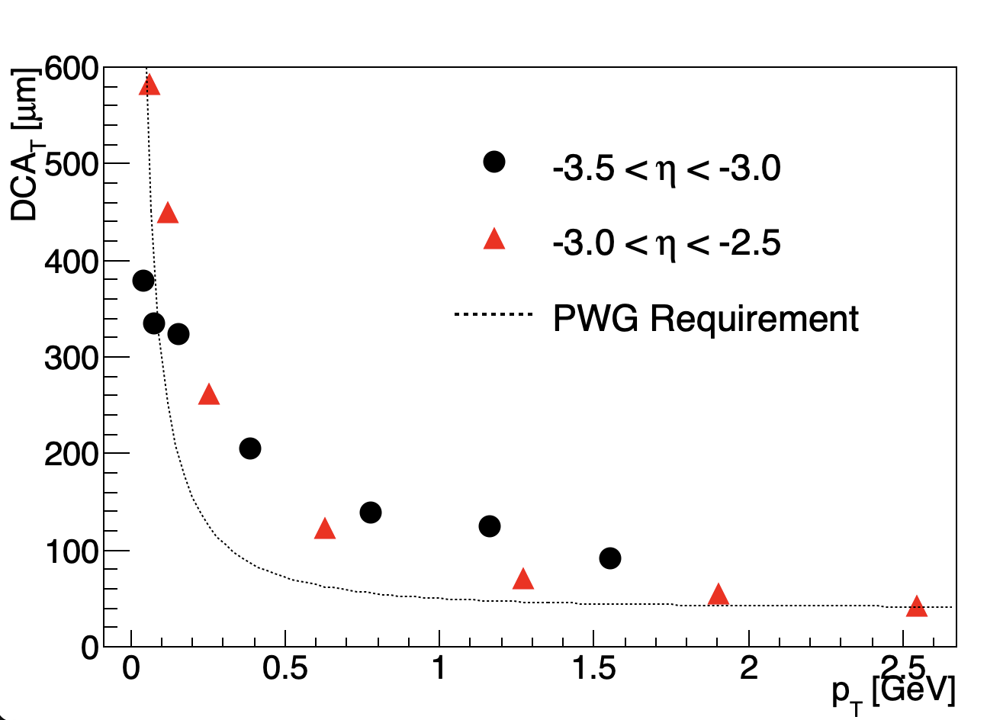
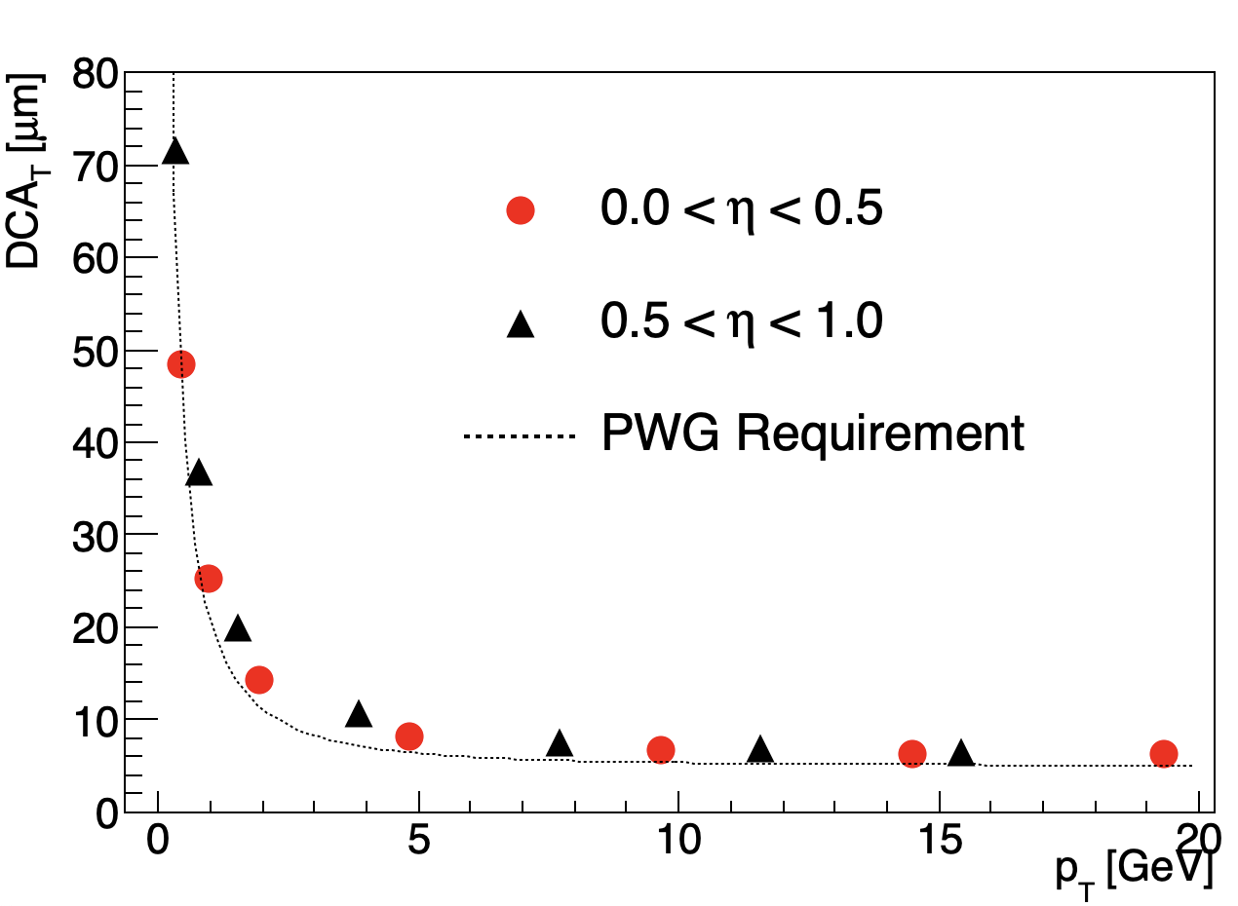
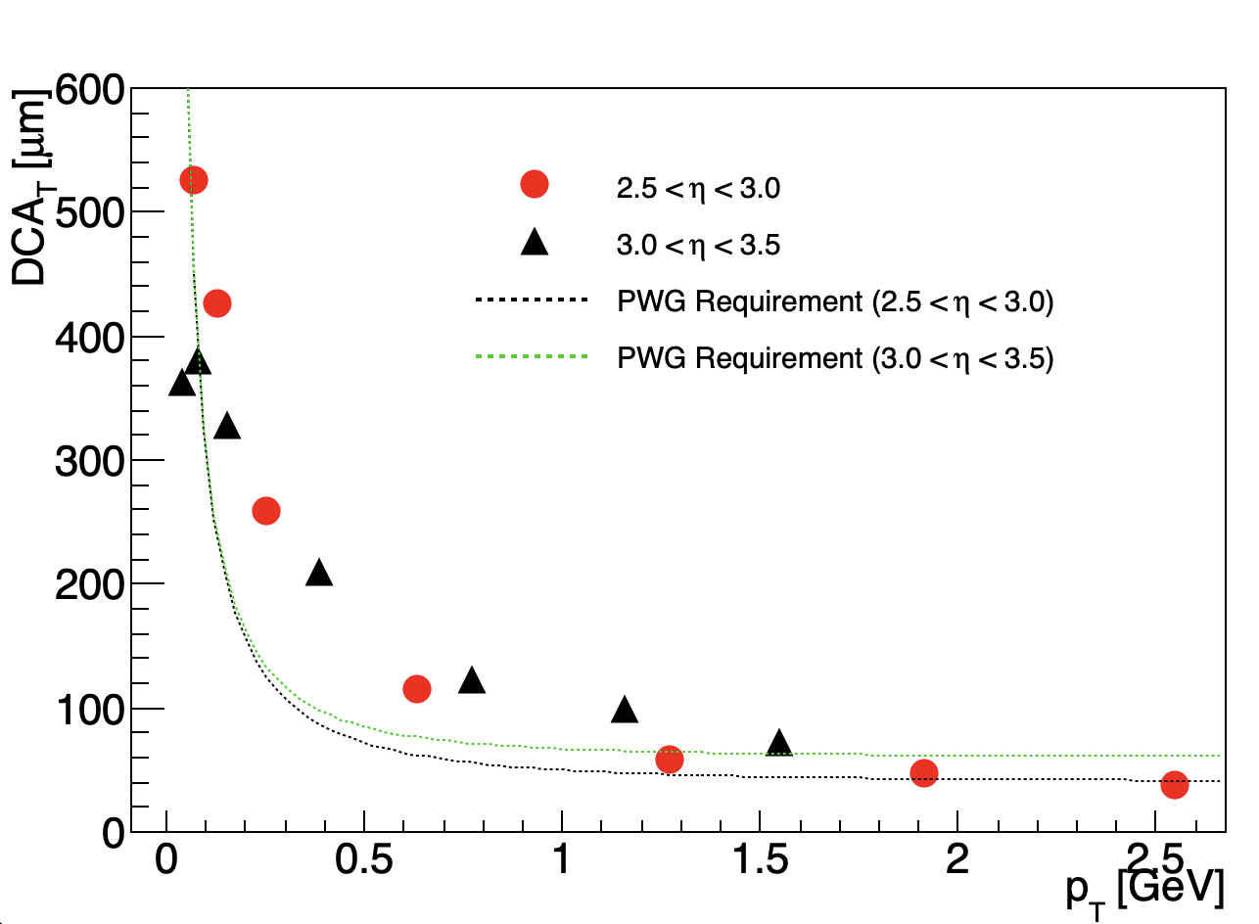
Preliminary Tracking Performance: Pointing Resolution
Charge 2, 3
Single particle (*includes AC-LGAD systems, update to real seed)
Backward
Central
Forward

Slide 15
Structure for Tracking in Background
Charge 2, 3
HEPMC Admixing code implemented
merges signal and background files
Considers three main background contributions
Synchrotron radiation, hadron beam-gas, and electron beam-gas
Signal File(s)
Merger Code
GEANT/EICRecon
Analysis
Background Files

Slide 16
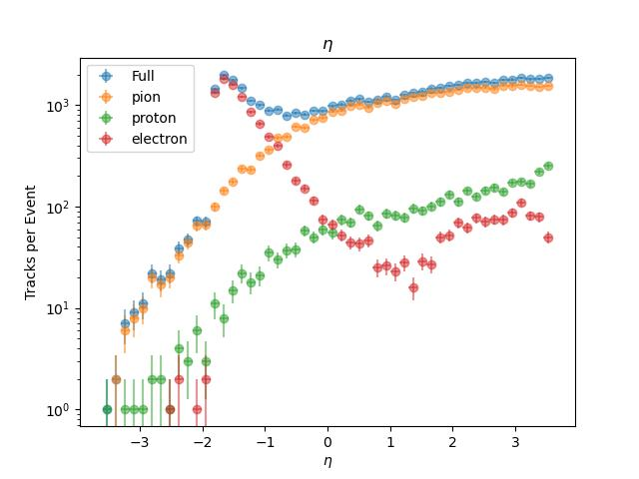
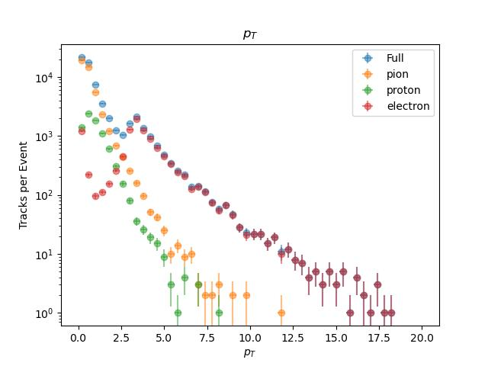
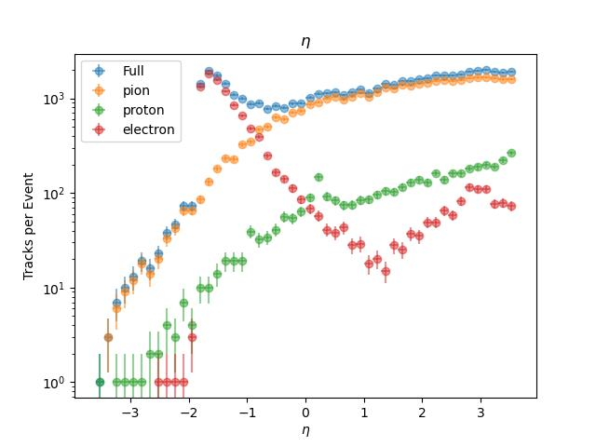
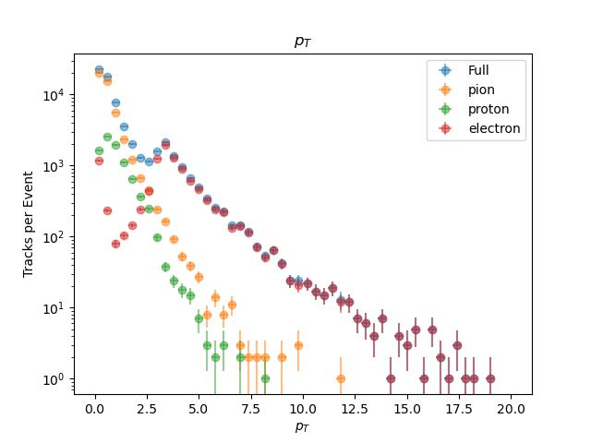
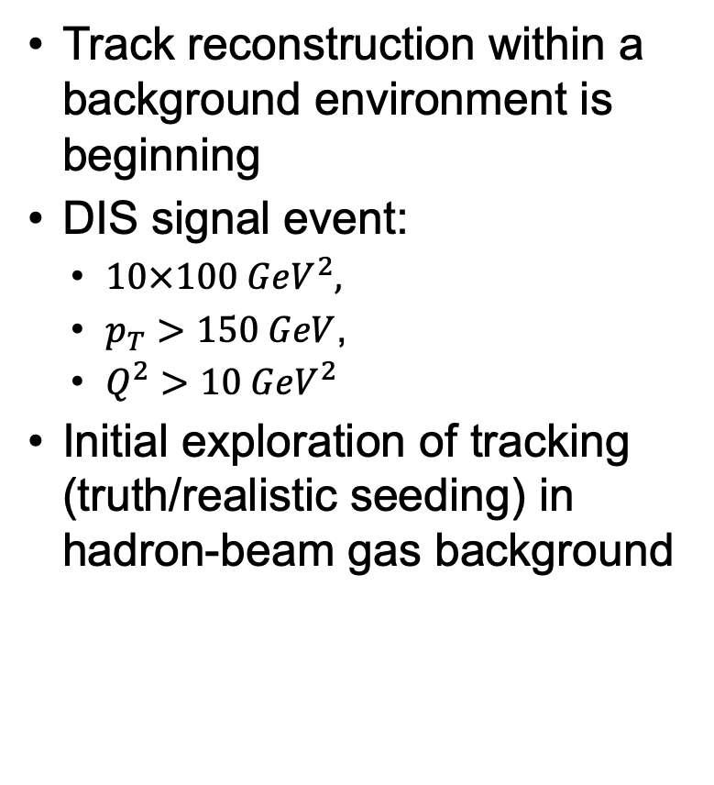
Tracking in Background
Charge 2, 3
Track reconstruction within a background environment is beginning
DIS signal event:
$10×100 GeV^{2},$
$p_{T}>150 GeV$,
$Q^{2}>10 GeV^{2}$
Initial exploration of tracking (truth/realistic seeding) in hadron-beam gas background
DIS
Signal
DIS
Signal
Hadron
Admixture
Hadron
Admixture

Slide 17
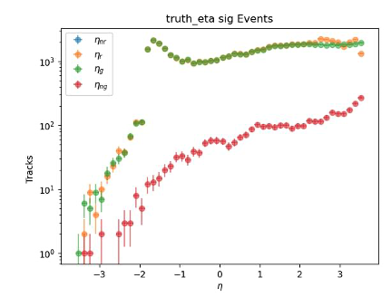
Tracking in Background
Charge 2, 3
Ongoing work to:
Look at other background sources: synchrotron radiation, electron-beam gas, and full background admixture
Use timing information in track fitting
Understand better MC Particles that do not get reconstructed
Pattern recognition algorithm
Yellow=Reconstructed Particles that get matched
Green=MC Particles that get Reconstructed
Red=MC Particles that do not get Reconstructed
Hadron Admixture
Truth Seeded

Slide 18
Vertex Reconstruction
Charge 2, 3
ACTS Iterative vertex finder algorithm implemented for vertex finding
Initial vertex reconstruction studies have begun
Vertex object data structure being reviewed for ePIC software framework

Slide 19
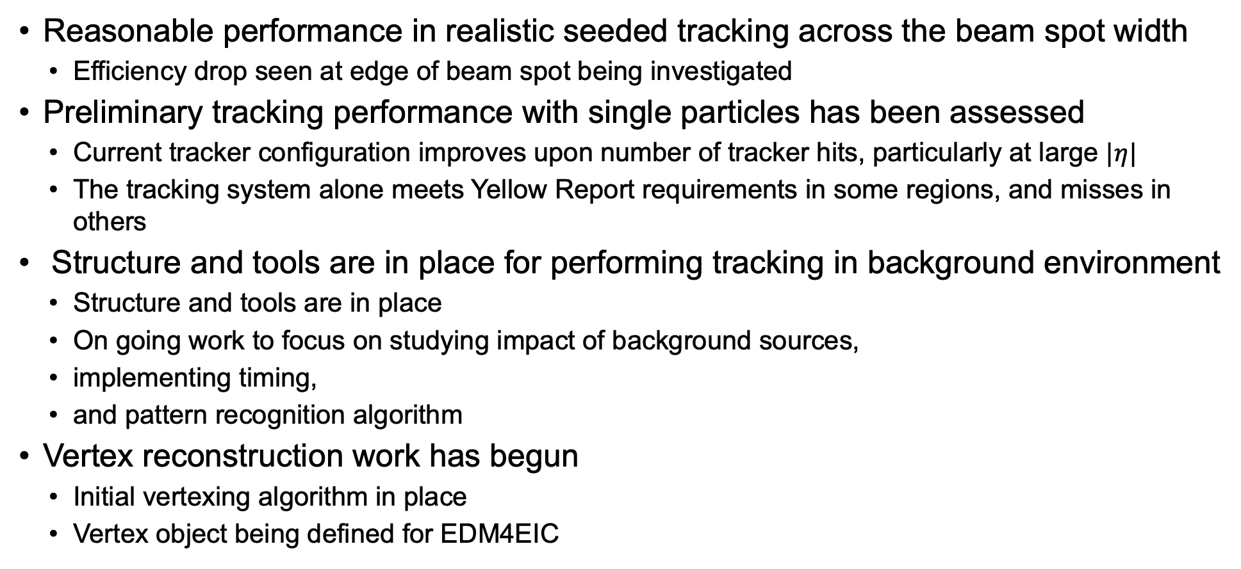
Summary
Reasonable performance in realistic seeded tracking across the beam spot width
Efficiency drop seen at edge of beam spot being investigated
Preliminary tracking performance with single particles has been assessed
Current tracker configuration improves upon number of tracker hits, particularly at large $|η|$
The tracking system alone meets Yellow Report requirements in some regions, and misses in others
Structure and tools are in place for performing tracking in background environment
Structure and tools are in place
On going work to focus on studying impact of background sources,
implementing timing,
and pattern recognition algorithm
Vertex reconstruction work has begun
Initial vertexing algorithm in place
Vertex object being defined for EDM4EIC

Slide 20
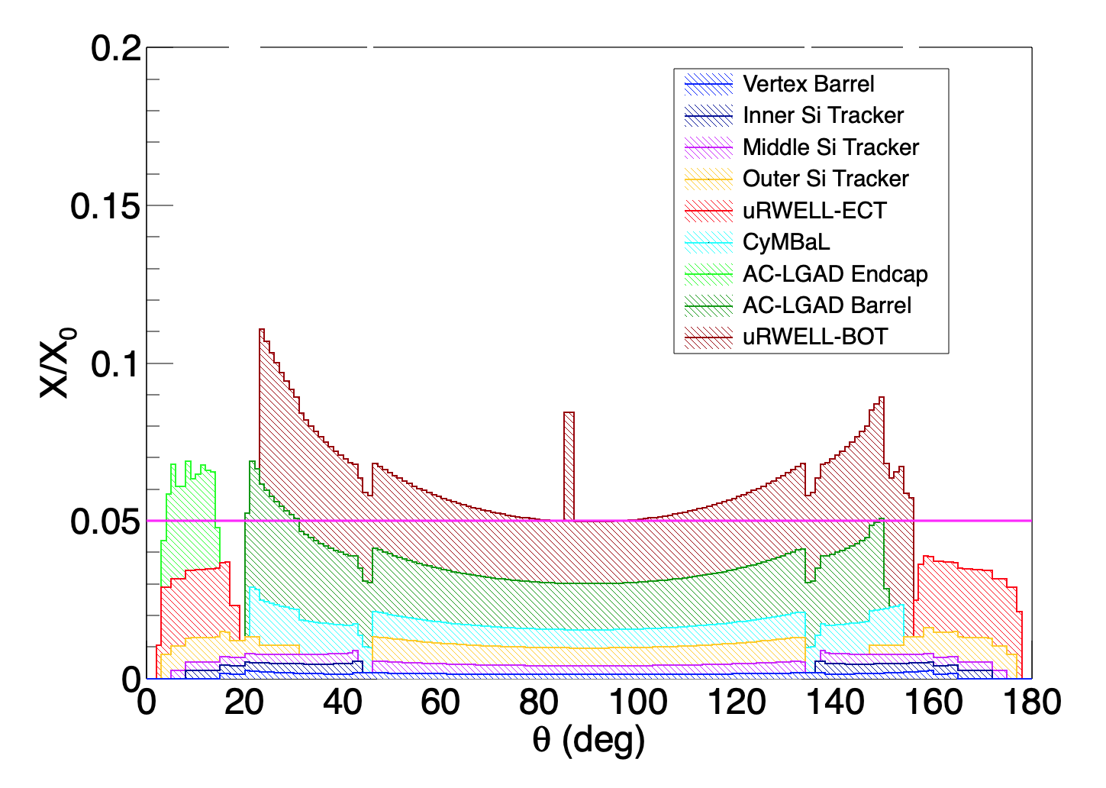
Detector Material
Charge 2, 3
ePIC 24.2.1
electron
proton

