Slide 1
EIC Slide Deck Template
Includes additional generic and preset content,
helpful hints, etc.
2024-02-22

Slide 2
EIC Slide Deck
Provides the standard introductory slides
  Title Slide
  Charge Slide
  Outline Slide
  Generic example content slides including charge tag
  Generic presentation section separators
  Summary Slide
  Blank
  General Guidance

Slide 3
Andreas Jung
Purdue University

Slide 4
Charge Questions Addressed
Grey out charge text not being addressed.
GRY RGB HEX CODE: #BFBFBF
Are the technical performance requirements appropriately defined and complete for this stage of the project?
Are the plans for achieving detector performance and construction sufficiently developed and documented for the present phase of the project?
Are the current designs and plans for detector, electronics readout, and services sufficiently developed to achieve the performance requirements?
Are plans in place to mitigate risk of cost increases, schedule delays, and technical problems?
Are the fabrication and assembly plans for the various tracking detector systems consistent with the overall project and detector schedule?
Are the plans for detector integration in the EIC detector appropriately developed for the present phase of the project?
Have ES&H and QA considerations been adequately incorporated into the designs at their present stage?

Slide 5
Outline
Presentation Section 1
  Topic 1.1
  Topic 1.2
Presentation Section 2
  Topic 2.1
  Topic 2.2
  ⁞
  Topic 2.n
Summary

Slide 6
Presentation Section 1
!!! Lots of caveats !!!

Slide 7
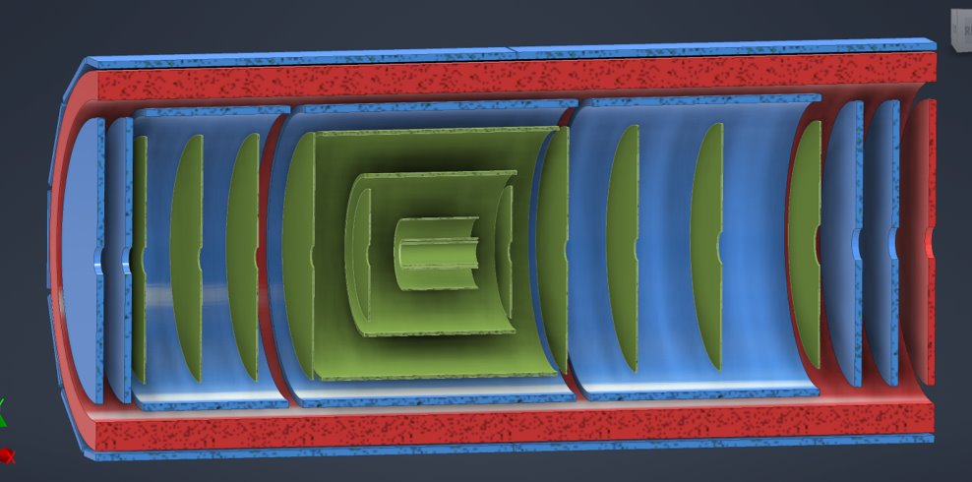
Central Detector Region & Integration: Thoughts
Broad overview of integration sequence is ”two-fold”
  Beam pipe and SVT sub-assembly
  TOF-LGAD and MPGD sub-assembly
Two large sub-assemblies independently integrated
  SVT sub-assembly staying in one physical location
  TOF-LGAD+MPGD sub-assemblies “slides” over SVT sub-assembly
Next step is to add MPGD discs e and p directions as well as FTOF-LGAD
Last step is to integrate whole inner detector region into GST / EPIC
Side remarks:
Substantial amount of temporary supports needed for beam-pipe, service, cooling, etc
Temporary structures needed to “slide” / integrate sub-assemblies together and also for final step into EPIC GST structure
“Inner detectors” = inside of the large global CF support tube
Notes:
Initial design concept following the one from STAR, we know that there will be many back-and-forth design changes

Slide 8
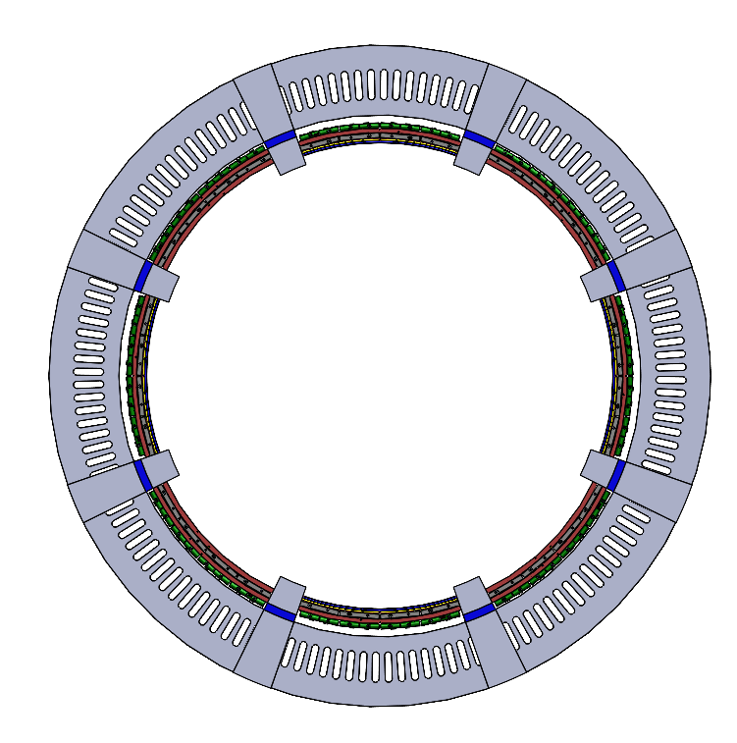
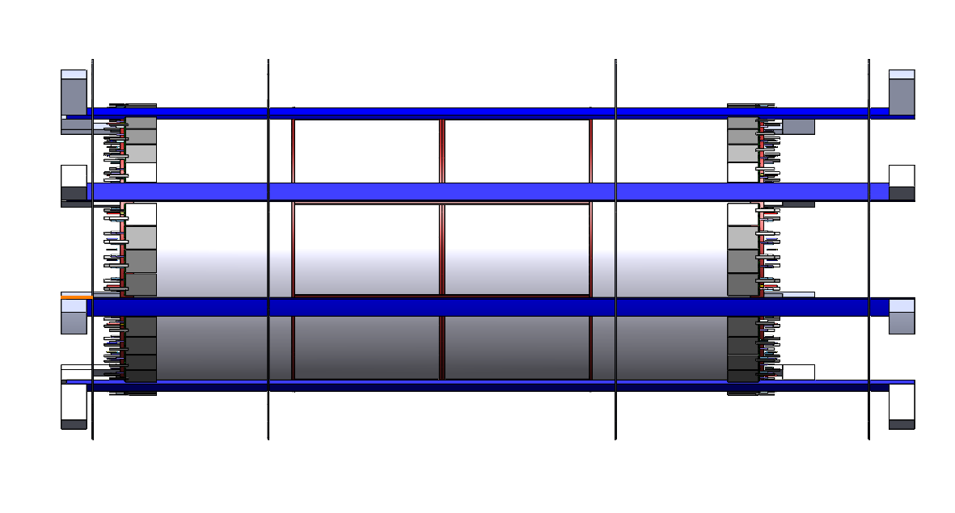
1st sub-assembly for inner detectors
1. Set of engagement rings mounted on inner rigid supports at off - 12, 3, 6, 9 o’clock positions for MPGD assembly
  - “stand-offs” (L-brackets) attach the structure in the last step to the GIST via inserts & screws
Mount inner MPGD on these “support beams/rails”
  Needs temporary support to feed out mechanics
“stand-offs”: for now looks very beefy and large, merely to have
Enough space. ”Mass-optimization” will happen but can’t prior to knowing masses and thermal loads!
Notes:
Initial design concept following the one from STAR, we know that there will be many back-and-forth design changes

Slide 9
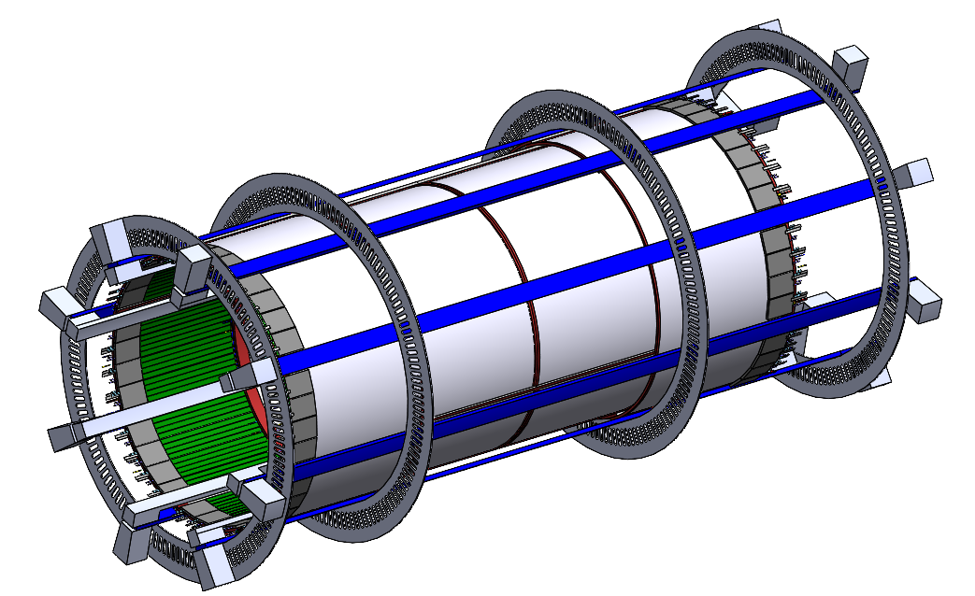
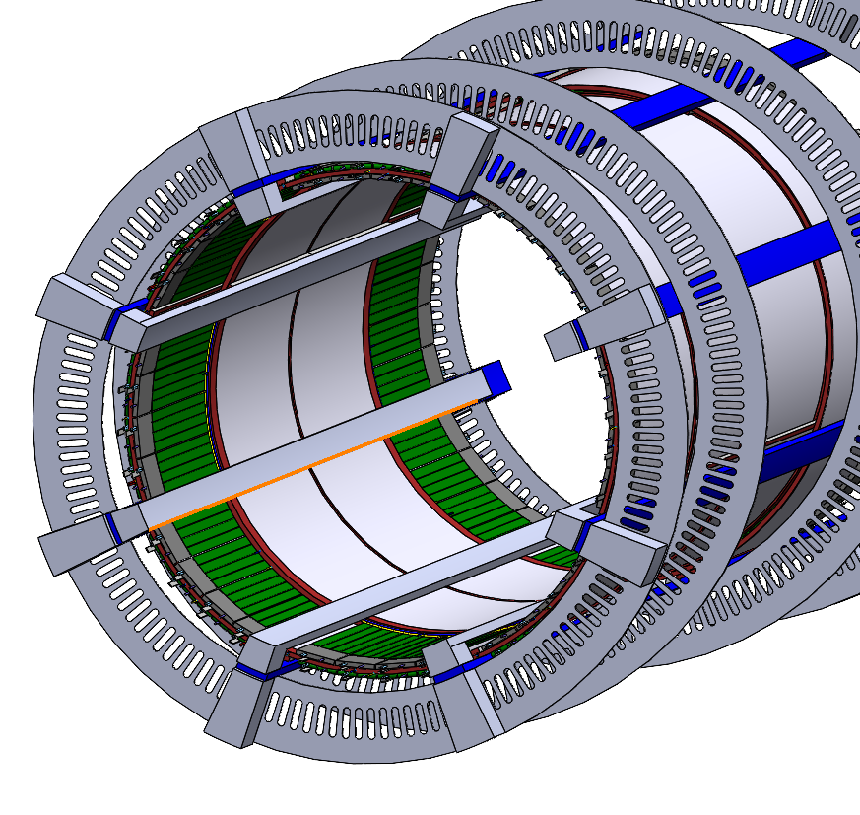
1st sub-assembly for inner detectors
3. Install inner tracks/beams per half/side to support SVT once MPGD integration is completed
- Total of 2 beams/rails support SVT
  - Again L-brackets / standoff’s
  - Supports a “Service Cylinder” for SVT barrel, discs and MPGD
Final step is to slide this “integrated” structure over the inner SVT
SVT includes the beam pipe which needs temporary support
Notes:
Initial design concept following the one from STAR, we know that there will be many back-and-forth design changes

Slide 10
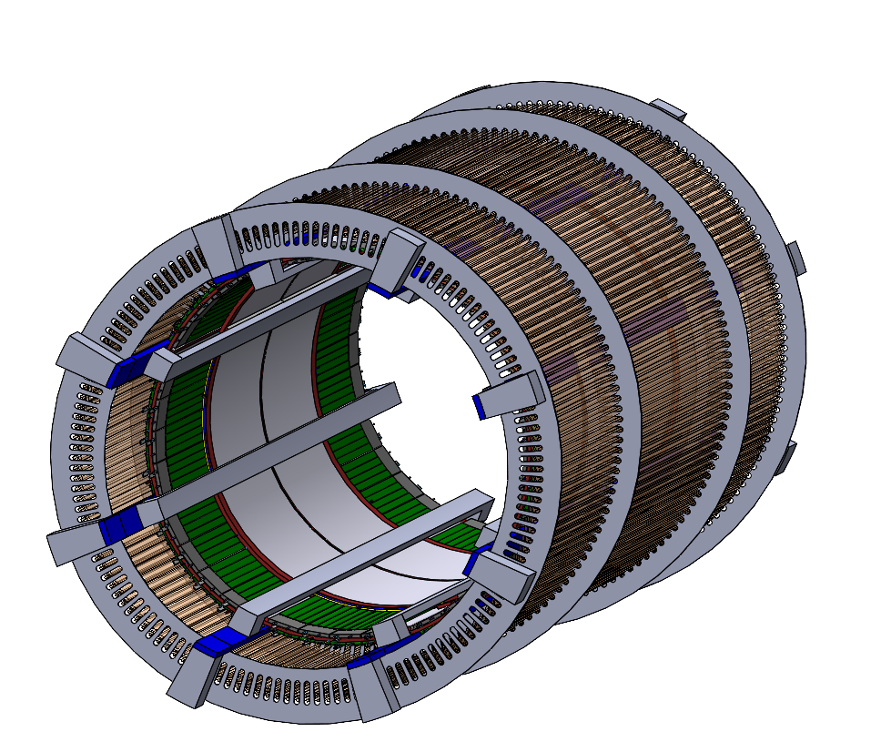
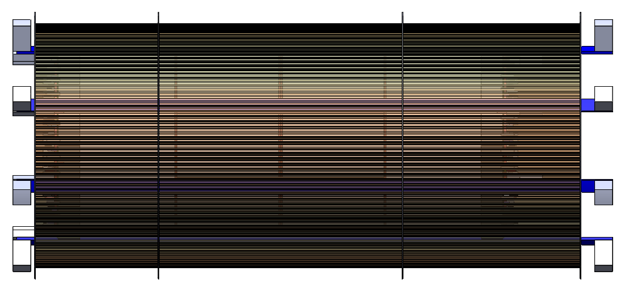
1st sub-assembly for inner detectors
3. LGAD is last in sequence prior to install whole inner detectors into EPIC
- Install LGAD TOF system prior to inserting into EPIC
- temporary supports for services & integration
TOF LGAD mounted on L-brackets or lips on engagement rings
Notes:
Initial design concept following the one from STAR, we know that there will be many back-and-forth design changes

Slide 11
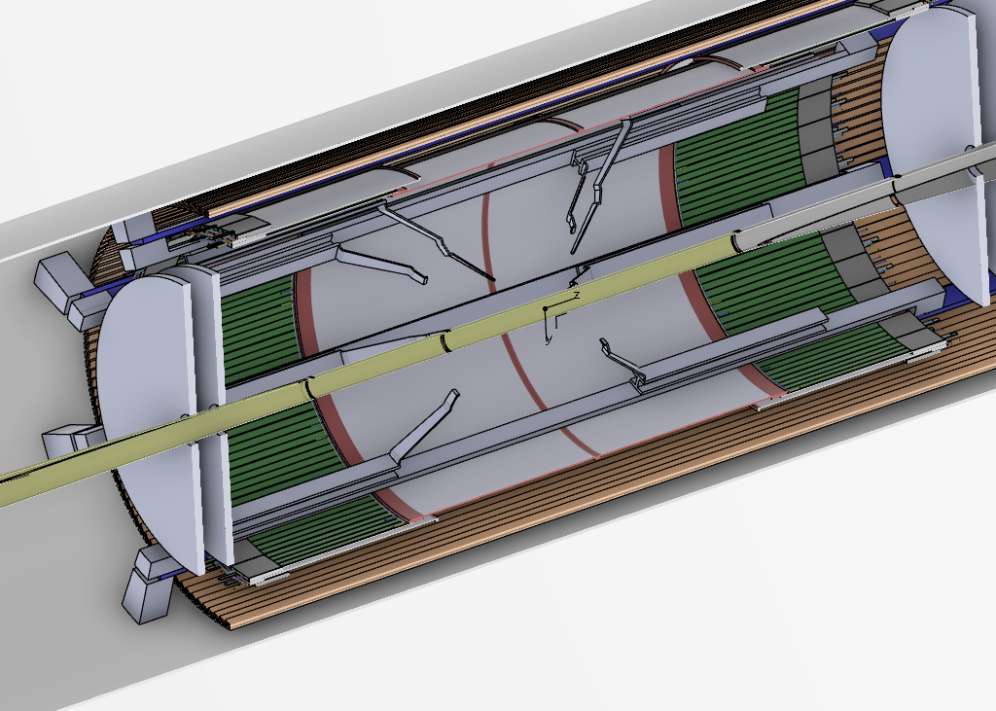
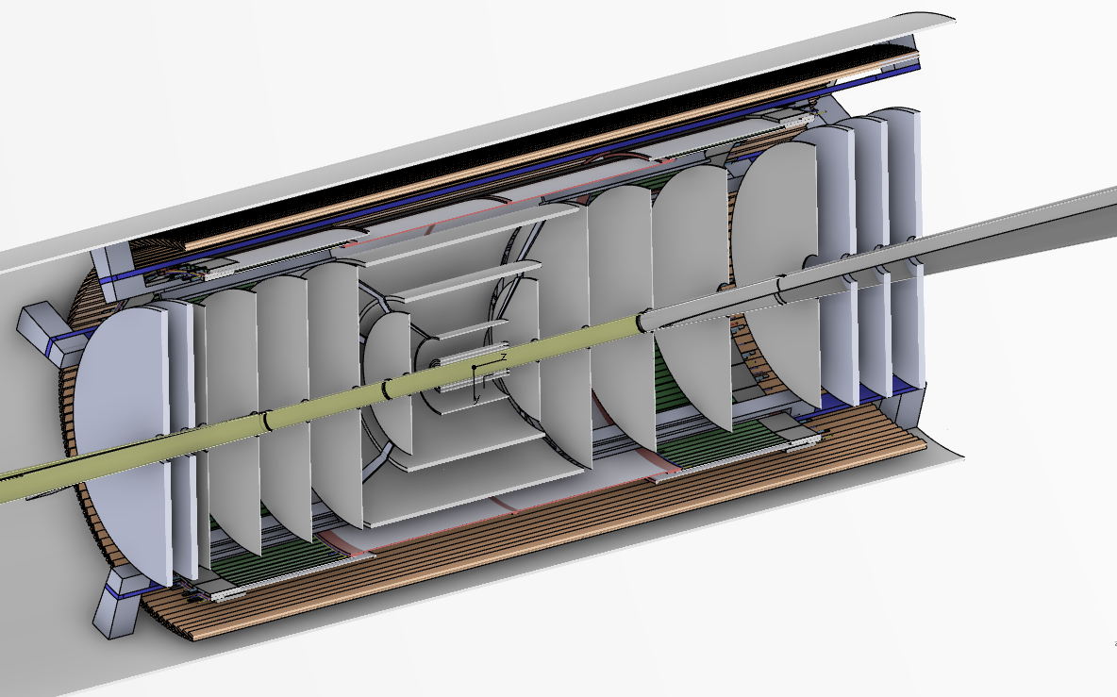
2nd sub-assembly for inner detectors
3. SVT
  Introduce (half) - “Service Cylinders” (SC) to integrate SVT into 2nd sub-assembly
  Based on Feb 20th outcomes and drawings not updated yet, shown here is more of a rib-cage and spider structure
    Translates to SVT being consisting of more sub-parts, not ideal for integration of multiple projects
    SC approach is more of all of SVT being supported, full circle and what I had proposed last year summer ☺.
  Also based on discussion with Ernst, Laura, Georg at ANL meeting
Beampipe and SVT Inner Barrel/pixel first into 1st half SC
Integrate SVT Outer Barrel first, cable and service routing outward in designated ”arc-sectors”
Add SVT-discs starting closest from IP, move outwards and cable and service routing in ”arc-sectors”
Temporary supports for beam pipe and services
Slide 2nd sub-assembly over this one and install MPGD discs, than integrate into EPIC / GST
Notes:
Initial design concept following the one from STAR, we know that there will be many back-and-forth design changes

Slide 12
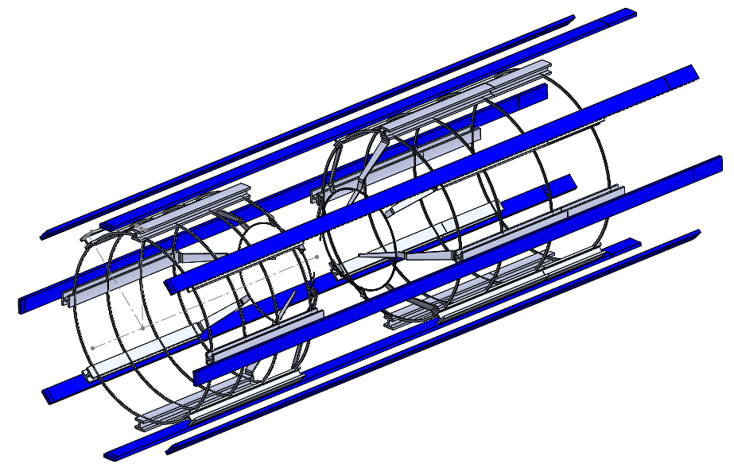
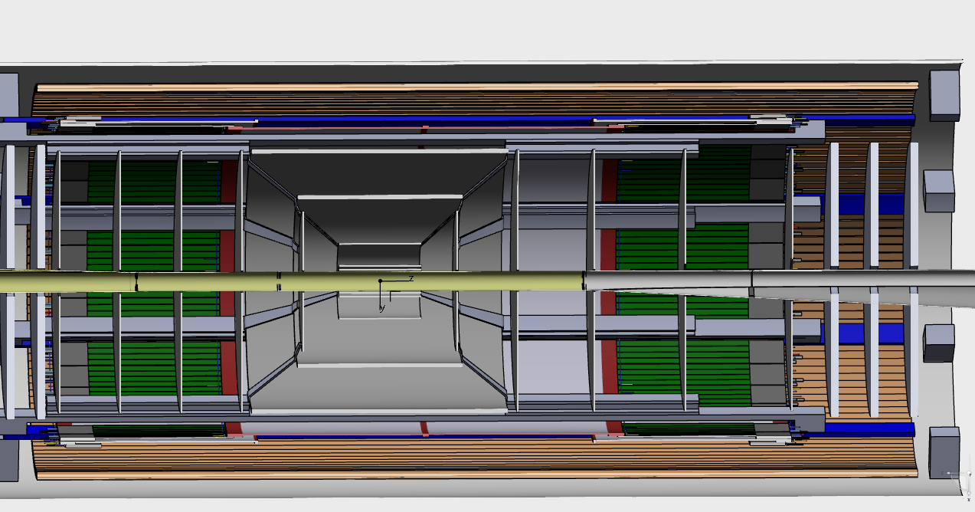
2nd sub-assembly for inner detector
3. SVT support by system of rips and rings to form a cage like structure
– Half-cylinder structures to connect to local mechanics of SVT OB+IB, discs
I need to update this
Following discussions at the 20th ad-hoc integration workshop
Outdated for SVT!
Change to half - “Service Cylinder” based 2nd sub-assembly
Provides support for VTRx cards, port cards, services, cooling pipes, etc. in shape of angled “wheels”
Notes:
Initial design concept following the one from STAR, we know that there will be many back-and-forth design changes

Slide 13
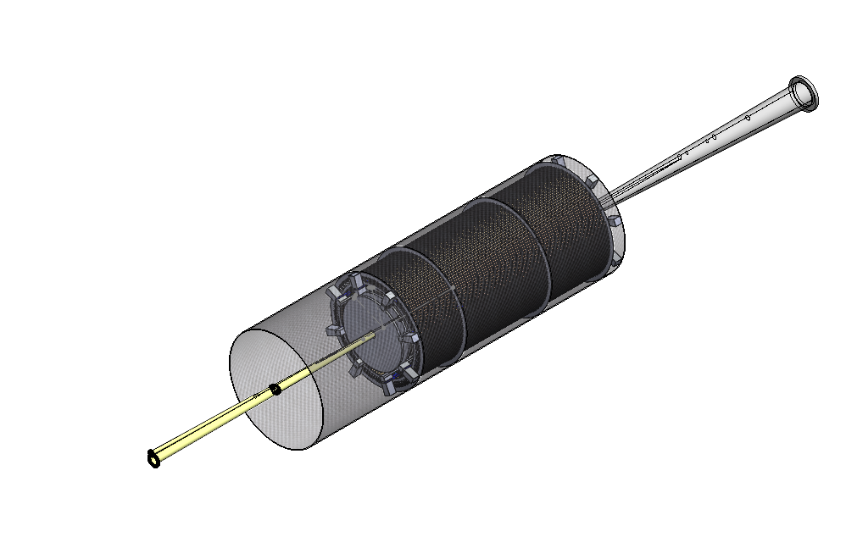
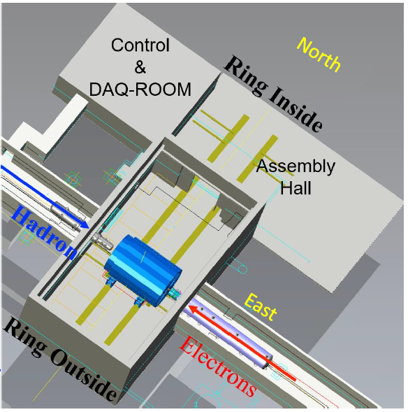
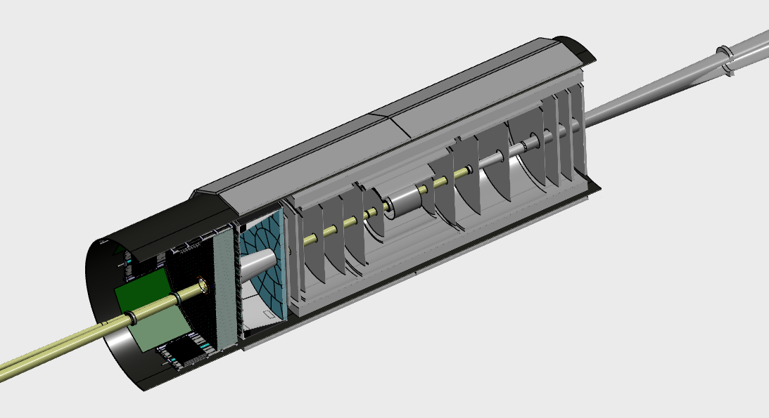
Last integration step of inner detector
Integrate the combined 1st and 2nd sub-assemblies of the inner detector
Followed by pfRICH, than ECAL
  needs temporary support for beam pipe and installation jigs to slide into GST
Currently being discussed following the 20th workshop…subject to change
  Role and “strength” of GST
All @Assembly hall
Notes:
Initial design concept following the one from STAR, we know that there will be many back-and-forth design changes

Slide 14
Roughly 4 more slides…
FEA, ES&H…
Intro for EPIC
Beam pipe support, a-la ATLAS or CMS – needs adjustment but general idea
Summary

Slide 15
Topic 1.1 – Example Bullet List Layout
Charge 1, 2
Charge tag is offset down a bit to allow for slide title to use full width.
General content slide - bullets with standard indent levels and fonts.
Layout Name – “Content 1 – Bulleted”
Level 1 – Arial 24
  Level 2 – Arial 20
    Level 3 – Arial 18
      Level 4 – Arial 16
Right click on slide on left and select “Layout >” to see which layout this is (Content 1 – Bulleted), and which others are available.

Slide 16
Topic 1.2 – Example Numbered List Layout
Charge 3, 5
Charge tag is offset down a bit to allow for slide title to use full width.
General content slide - bullets with standard indent levels and fonts.
Layout Name – “Content 1 – Bulleted”
Level 1 – Arial 24
  Level 2 – Arial 20
    Level 3 – Arial 18
      Level 4 – Arial 16
Right click on slide on left and select “Layout >” to see which layout this is (Content 1 – Numbered), and which others are available.

Slide 17
Summary

Slide 18
Conclusions
Notes:
Initial design concept following the one from STAR, we know that there will be many back-and-forth design changes

Slide 20
Some General Guidance - I
Stay “in the box”.
  Below the blue title line, above the black footer line, and generally inside the horizonal space bounded by those lines left and right.
Do not move title text boxes.
  If needed, shrink the font. But try to keep your title concise anyway.
Do not move the charge tags.
  Note that it’s trivial to copy and paste charge tags from an existing slide to a new one.
  When you copy from one slide and paste to another, by default, the pasted object will be positioned exactly where it was on the source slide.

Slide 21
Some General Guidance - II
Learn how to use features that leverage the slide templates you’re using.
  Choose or Change a Slide Layout: To choose a slide layout, right click on the slide in the thumbnail list at left, select “Layout>”, then look through the available layouts and choose what best suits your need.
  Reset a Slide to its Layout Defaults: Right click on the slide in the thumbnail list at left, select “Reset Slide”.
In general, do not paste in complete slides from other presentations, unless you know what you’re doing.
  You will most likely need to edit afterward, so copying and pasting slide content is “safer”.
  Copying in slides will also copy in non-standard slide layouts and other “debris”.
  Put in the effort now to conform to this template and you won’t need to do it again in the future.
  See what works best for you – pasting in a complete slide if you know what you’re doing, or copy and pasting content from slides.

Slide 22
Some General Guidance - III
Use Ctrl+z (Undo) and Ctrl+y (Redo).
  It is a common occurrence to accidentally select and drag or delete some existing object.
  Ctrl+z is the easy fix to put it back exactly as it was.
  Ctrl+y is the easy way to redo (undo an undo).
Stay with the Arial font. If you paste in text, edit font if needed.
  Again, the slide reset will do this for you, but it will also enforce the overall layout as chosen for that slide.
The footer text is set in the main slide master. You cannot edit on a regular slide – by design. This prevents accidental text moves, page number double ups, etc.

Slide 23
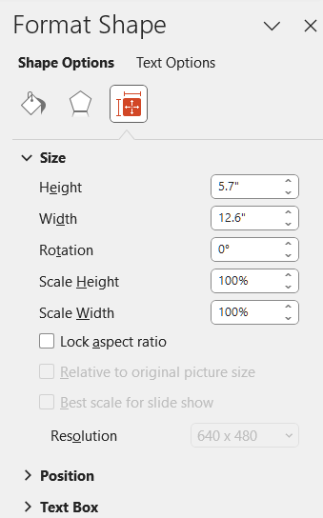
Some General Guidance - IV
When you’re pasting in pictures, plots, figures, etc. – set the sizing to “Lock Aspect Ratio” to avoid distorting them.
  Right click on the content.
  Select “Format Shape …”.
  Select the sizing icon.
  Click on “Lock Aspect Ratio”.

Slide 24
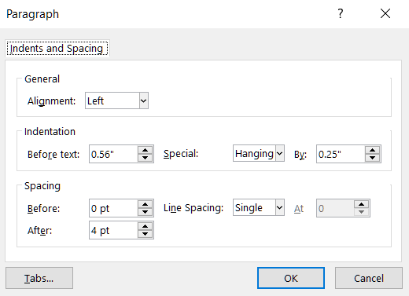
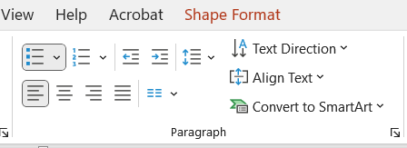
Some General Guidance - V
Don’t be lazy. Put in the simple effort to make your presentation look professional.
  Take the time to properly format.
    e.g. Use superscripts and subscripts as appropriate: “x²” and not “x^2”.
  Spell and grammar check.
    PowerPoint does this for you. Just do what it tells you to do.
Learn line and paragraph spacing.
  It is preset to look decent in this template. “Spacing” settings are most important.
  Settings are here, in the “Paragraph” section, in the pulldown (the arrow thingy):

Slide 25
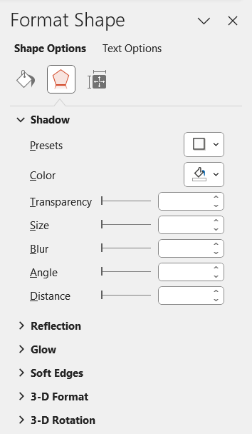
Some General Guidance - VI
Certain PowerPoint effects can help enhance the look of your presentation and make it less austere.
Often nicer than nothing or the simple “line” box around the figure.
Right click on a picture, click “Format Picture” (or Format Shape or whatever). Select <Presets> under “Shadow”. I usually use the very first one under the “Outer” category. That gives the right and bottom shadow used in the pictures here.
No shadow
Shadow

Slide 26
Commonly Used Symbols
αβγδεζηθικλνξομπρστυφχψωΩ
|¦±¯~≈≠≤≥°|ǁǀƩ‖•…⁞∆∞∙←↑→↓↔↕ꞇΦ
αβγδεζηθικλνξοπρστυφχψω

