Slide 1
Stave Thermal and Structural FEA/CFD
Preliminary Studies
Stephanie Yang (Oxford)
Adam Huddart (STFC)

Slide 2
All the results presented are preliminary, numbers and geometry used are first estimates and are not representative of an optimised stave geometry
We are more interested in demonstrating the techniques we intend to use rather than looking too deeply at the results themselves

Slide 3
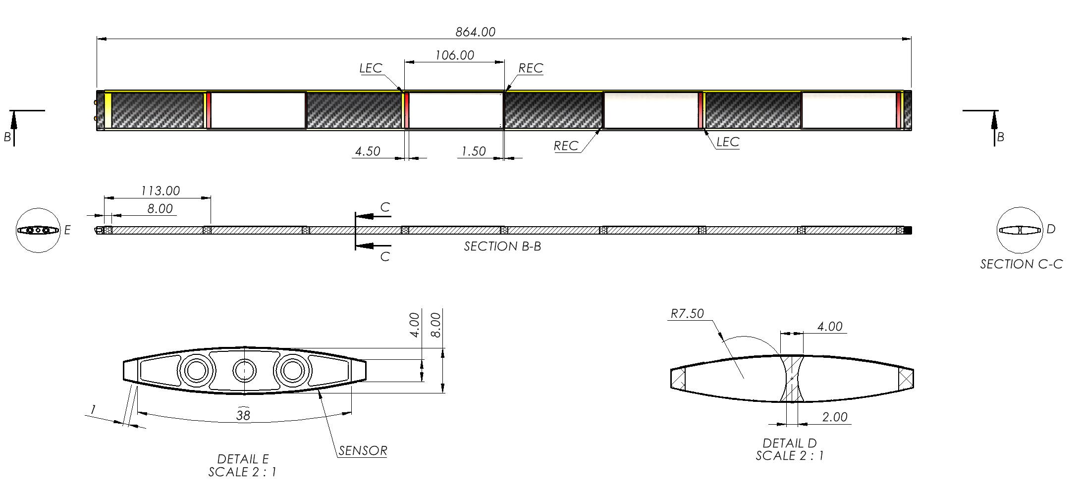
L4 Stave Construction

Slide 4
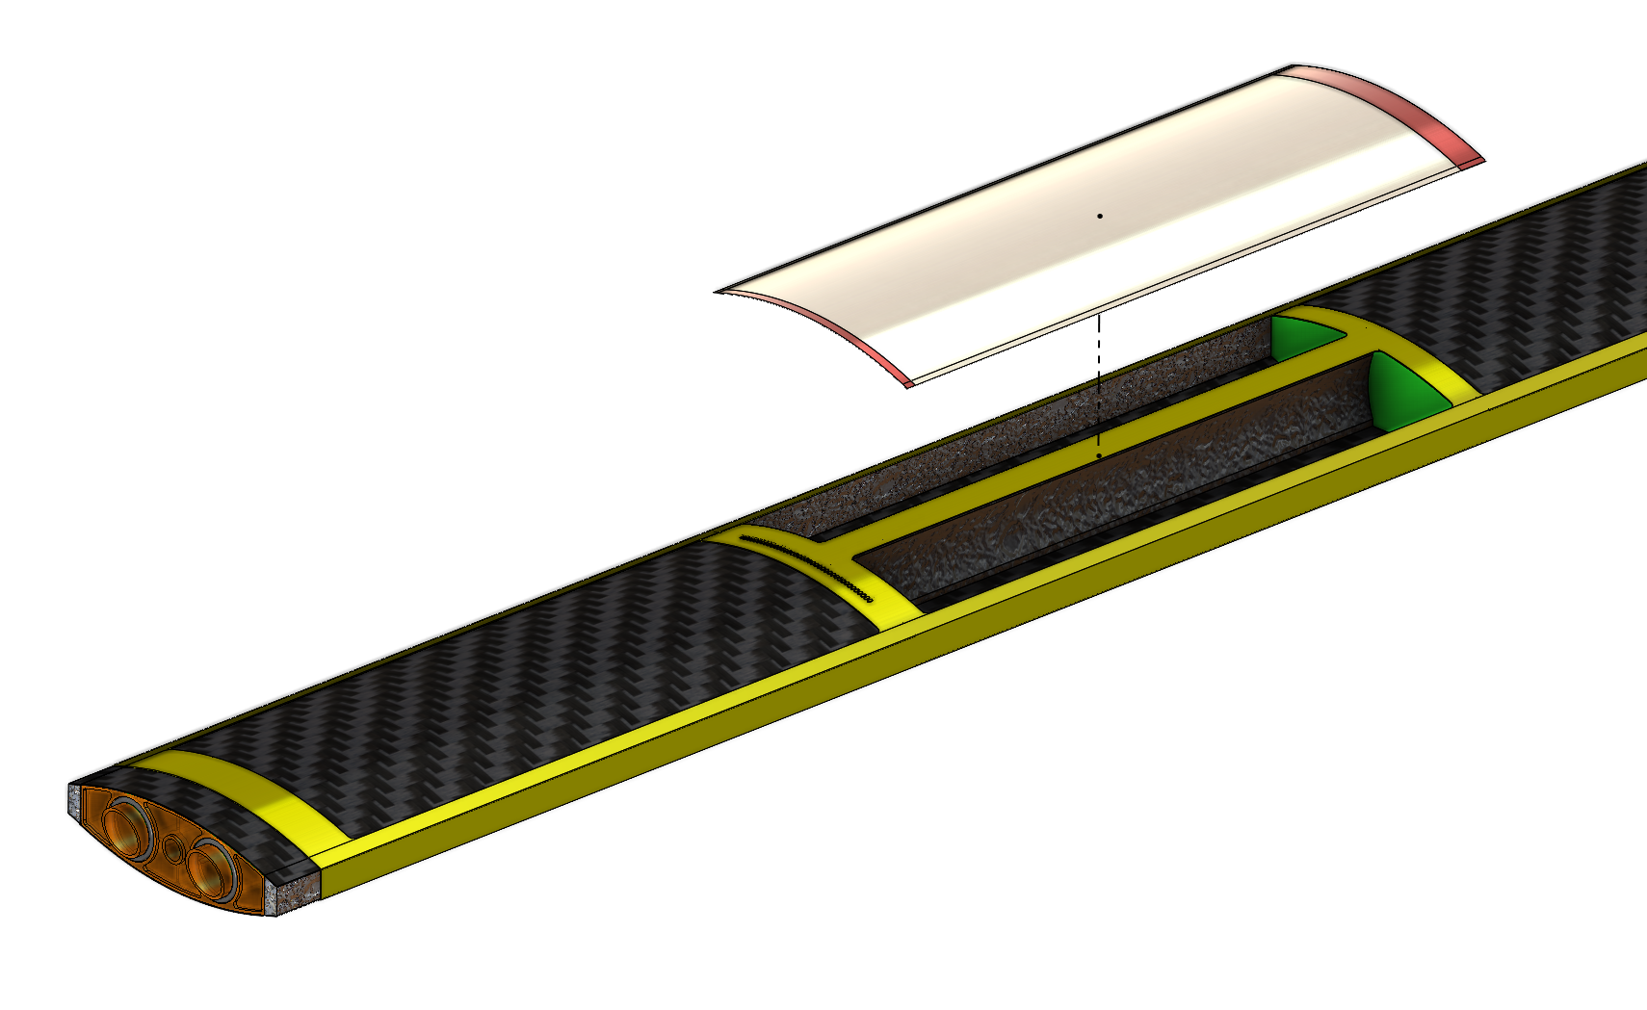
Material Assignment
Alice Silicon Sensor
0.1 mm Thick
0.1 mm carbon fibre
(Optimum layup TBD)
Continuous fibre along central spine
Kapton FPC 0.1 mm Thick
Allcomp K9
RVC Carbon Foam
3% Relative Density
Ultem end interface w/ O-ring seal
Duocel Aluminium Foam 8% Relative Density

Slide 5
Material Assignment
Isotropic Elasticity
Aluminium Foam - Longerons
101.84 MPa Elastic Modulus
216.8 kg/m³
Allcomp K9 - Cross Braces
650 MPa Elastic Modulus
200 kg/m³ (known to be quite variable)
3% RVC Carbon Foam - Centre Spine
101.84 MPa Elastic Modulus
45 kg/m³
Kapton FPC (estimate)
2.76 GPa Elastic Modulus
1420 kg/m³
Silicon (Sensor)
163 GPa Elastic Modulus
2329 kg/m³
Orthotropic Properties
Carbon Fibre Layup
Young's Modulus
(CERN/Liverpool data for K13C2U 39% fibre volume)
X direction – 353 Gpa
Y Direction – 6 GPa
Z Direction – 6 Gpa
2 Layers 0 / +90
50-micron layer thickness (100 micron total thickness)

Slide 6
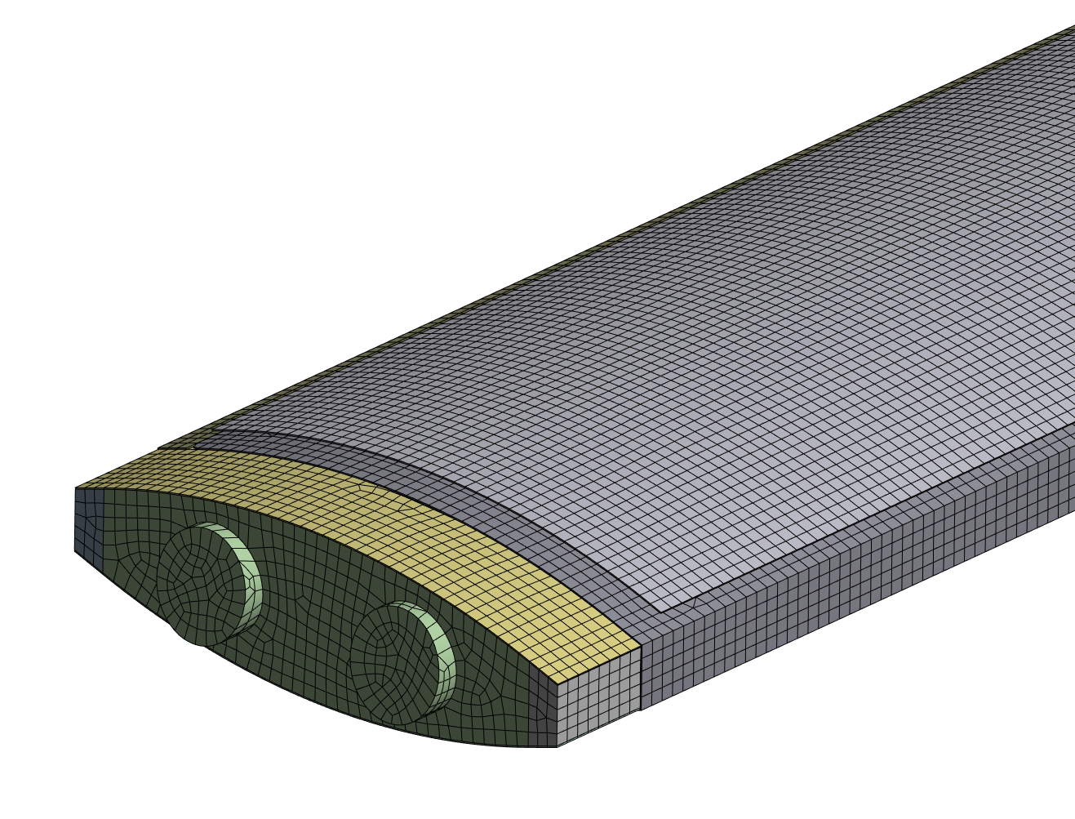
Initial Finite Element Analysis
FPCs (Kapton layer), carbon skin and sensors are geometry modelled as mid plane, with 0.1 mm thick shell elements
Carbon fibre top and bottom plates used layer section to approximate layup

Slide 7
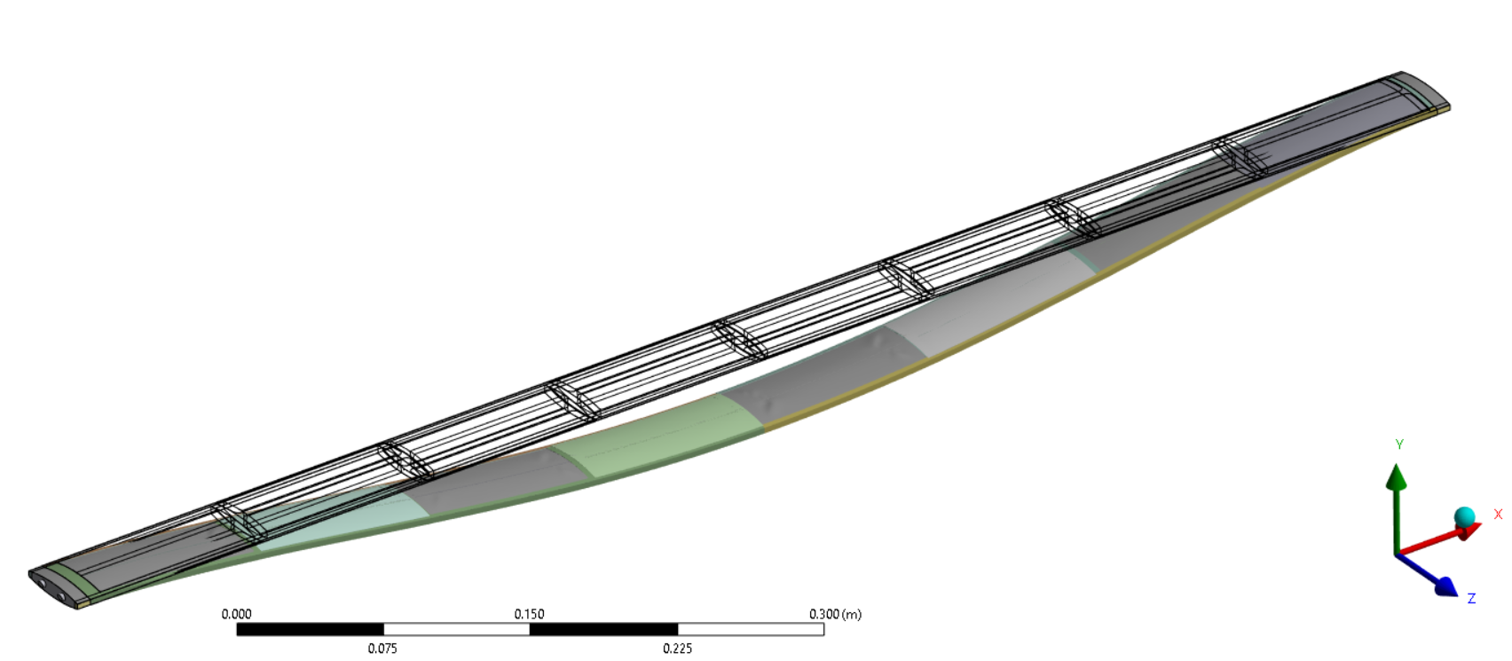
Modal Simulation
Lowest mode is Y Direction First Harmonic
108.1 Hz

Slide 8
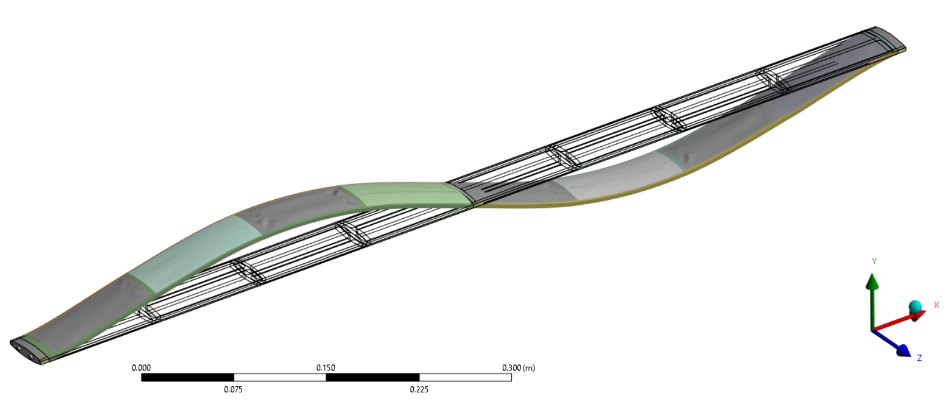
Modal Simulation
Second mode is Y Direction Second Harmonic
279.8 Hz

Slide 9
Boundary Conditions
Results presented are for a rigidly supported end face
Removing rigid constraint at one end and allowing for rotation reduces frequencies by approximately 30%
Cone interface/sealing techniques will be important

Slide 10
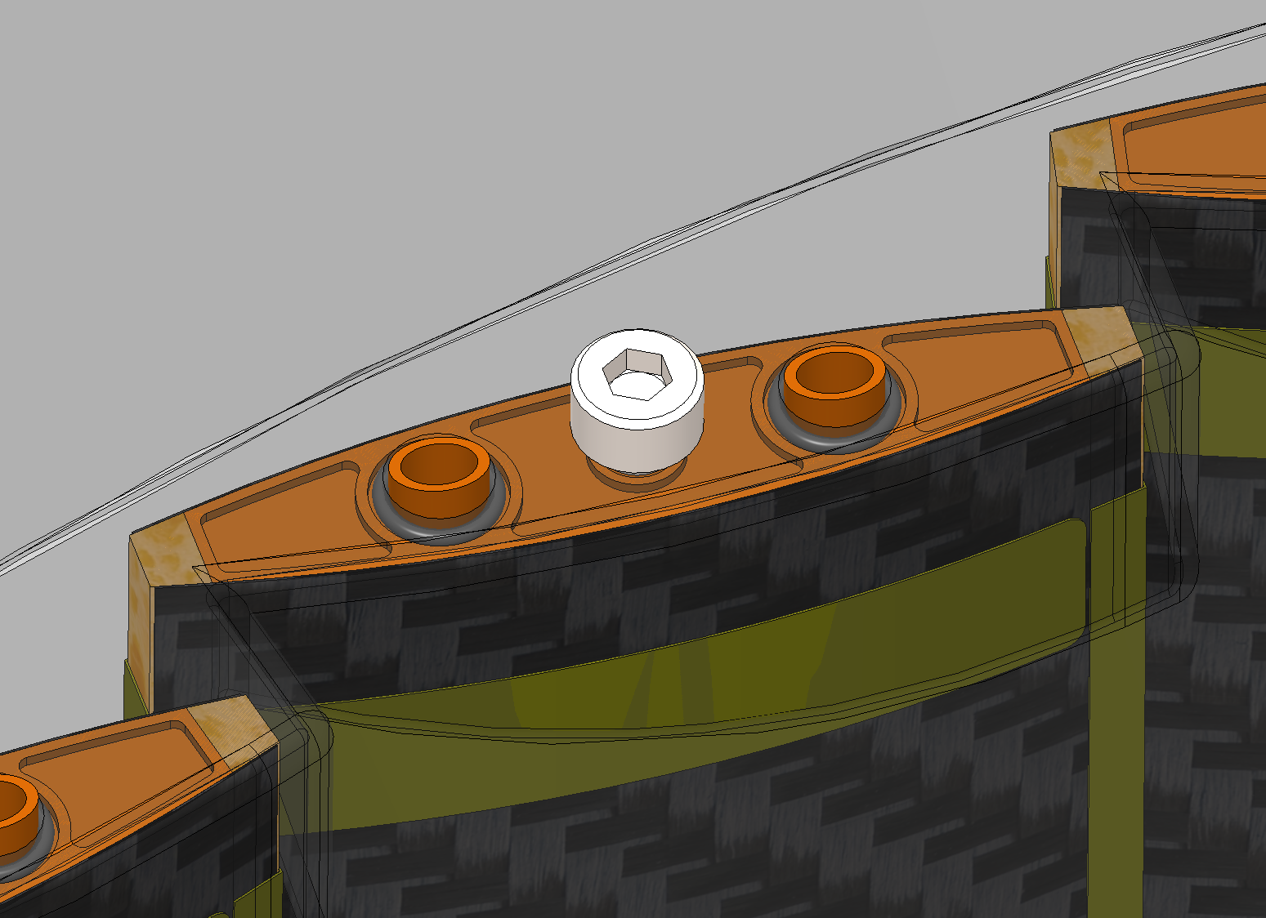
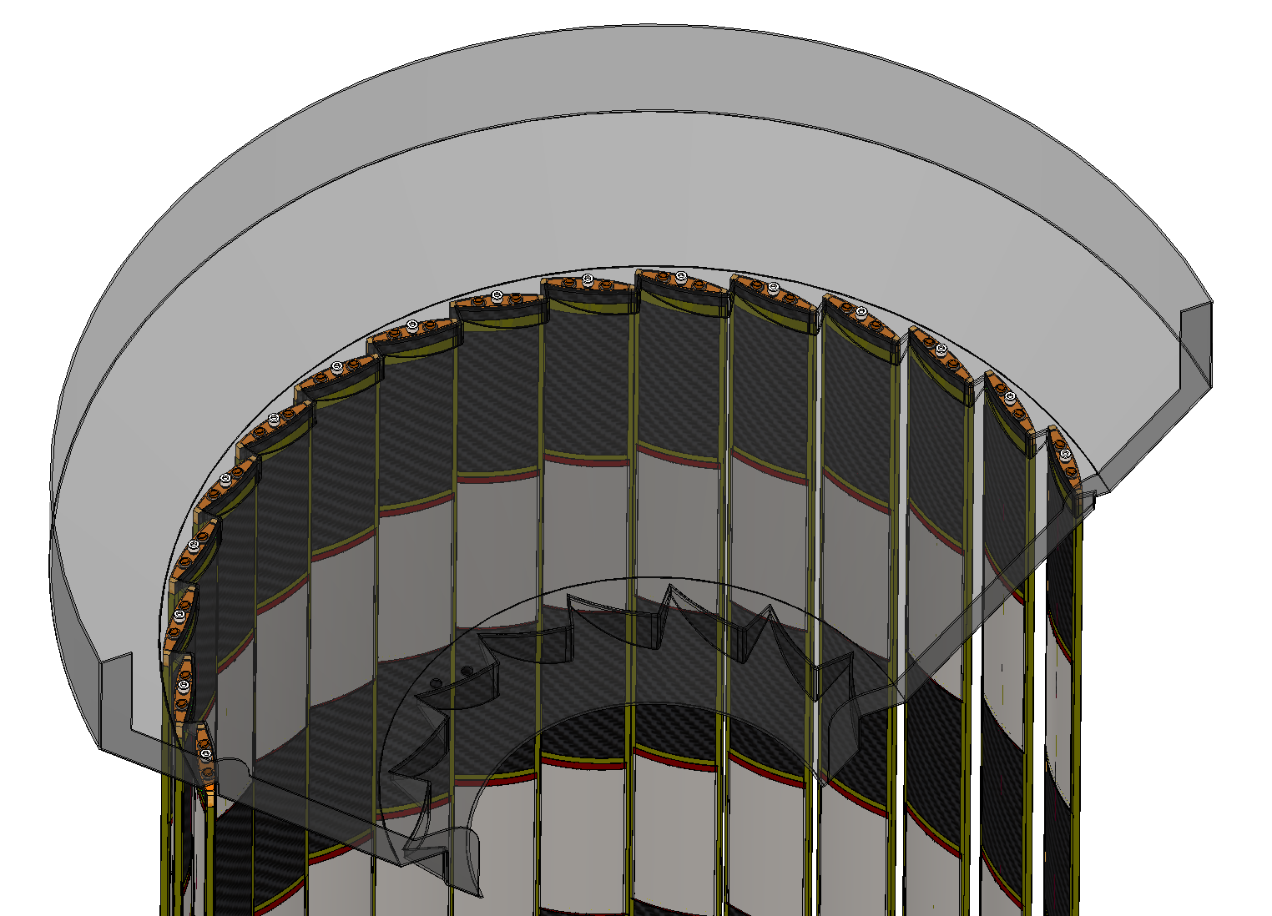
Boundary Conditions
Currently two O-rings seal the stave end plate to a inlet support cone
Screws on both end provide a “rigid” mechanical connection
Mechanical connections will need to be tolerant to small variations in stave length and cone separation.

Slide 11
Thermal FEA Modeling/CFD
2 linked thermal studies
Effect of heat transfer coefficient
Examine the temperature profile of a single 5 RSU sensor at various heat transfer coefficient values
Establish a simplified model with the equivalent power input
CFD with porous media to test out the input porous parameters
Use output of heat transfer coefficient model for first estimate of flow parameters of a 3D CFD model

Slide 12
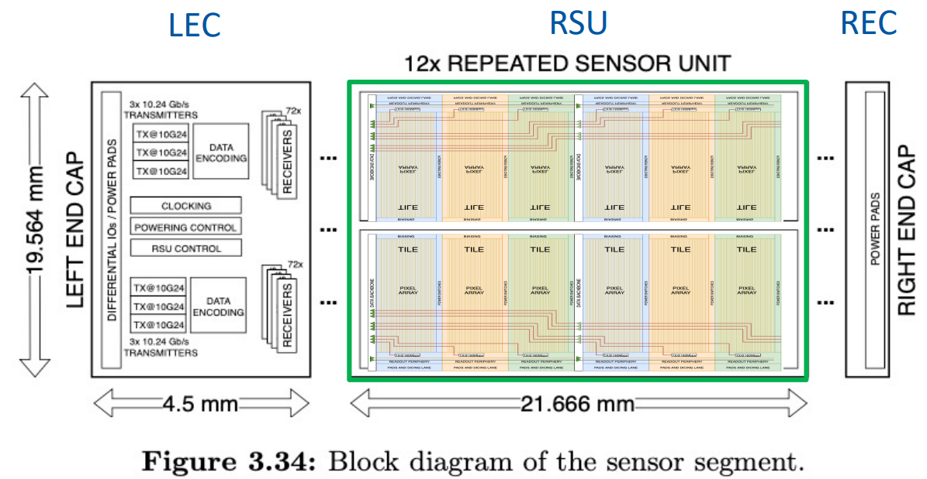
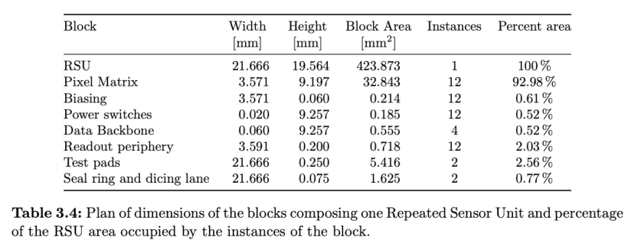
Sensor FEA geometry
https://indico.cern.ch/event/1341665/contributions/5648416/attachments/2751648/4789826/20231114-WP2-Report.pdf
114.330
LEC
RSU
Sensor geometry modelled using shell elements.
Power density input

Slide 13
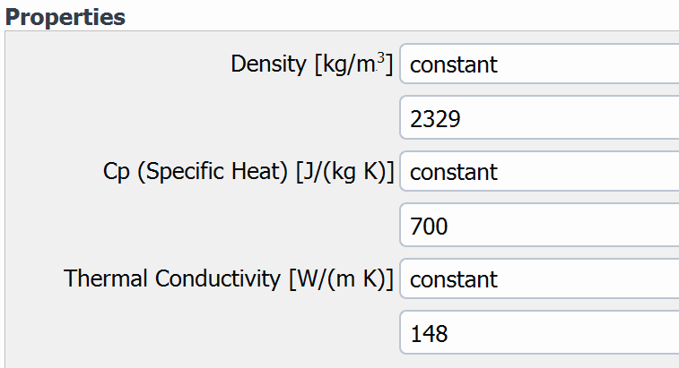
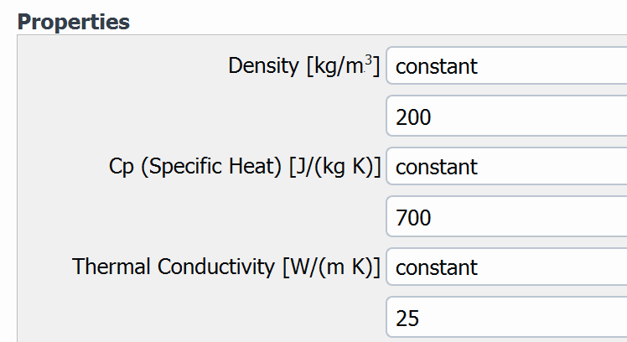
Material properties for thermal and CFD studies
Solid material_1 name: Silicon
Fluid material name: Air
Solid material_2 name: K9 foam

Slide 14
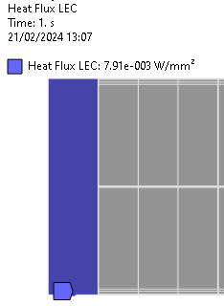
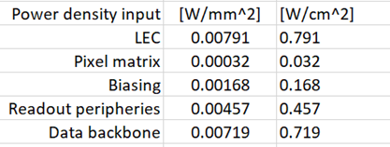
Power density input
Pixel matrix
LEC
Data backbone
Readout periphery
Boundary conditions:
Initial reference T = 22K;
HTC values from 5 to 1000 W/m²C are applied to the whole sensor surface
Steady state thermal analysis
Biasing

Slide 15
Thermal FEA result
HTC @ 700 W/m²K
As expected, the higher the HTC values the smaller the dT.

Slide 16
Simplified sensor model
Applied HTC [W/m^2 K] | Case 1 (detail model) | Case2 (simplified model)
 | dT [C] | dT[C]
5 | 272.53 | 271.37
100 | 37.704 | 37.46
175 | 25.664 | 25.489
240 | 20.504 | 20.36
300 | 17.428 | 17.305
350 | 15.545 | 15.435
450 | 12.849 | 12.758
550 | 10.995 | 10.918
650 | 9.631 | 9.565
700 | 9.075 | 9.012
1000 | 6.764 | 6.72
This result shows that the simplified sensor model with equivalent power input gives the same result as the detail sensor model.
For further CFD studies, the simplified model will be used.

Slide 17
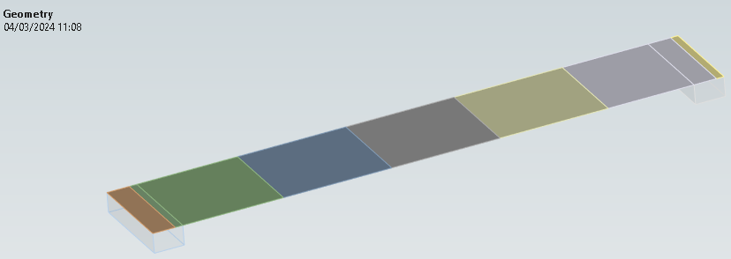
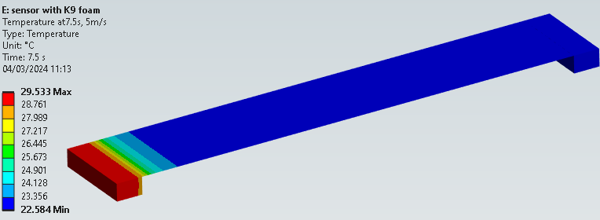
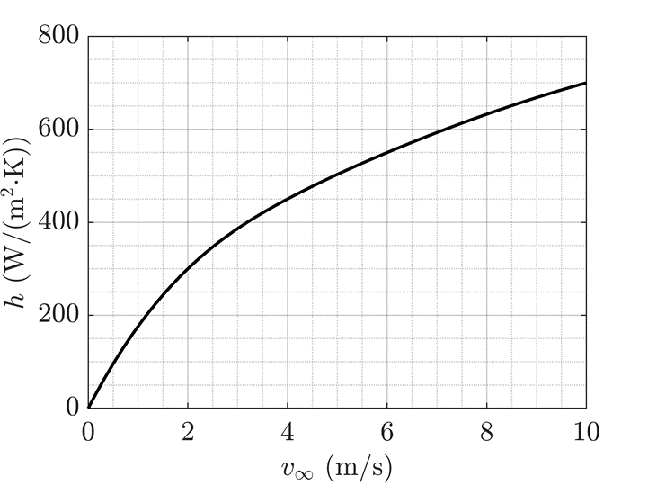
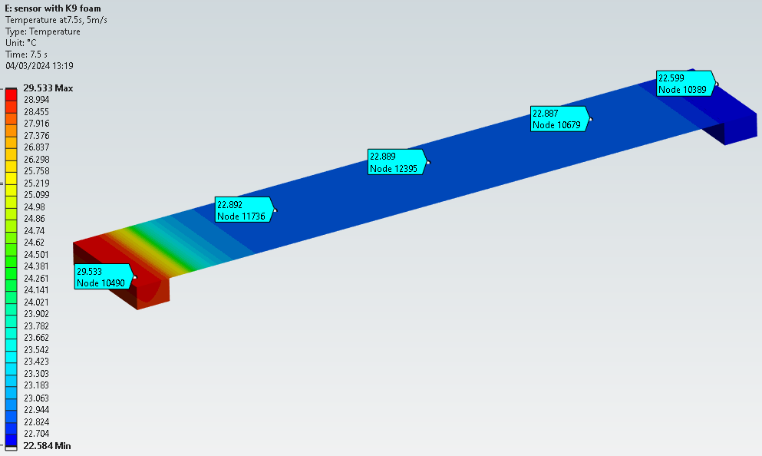
Simplified sensor model with K9 foams
RSU = 440W/m²
LEC = 7910W/m²
K9 foams
HTC applied to the surfaces of the sensor and K9 foams
T (ini_ref) = 22C
T_max = 29.53C
Delta T = 7.53C
https://indico.cern.ch/event/1228295/contributions/5390941/

Slide 18
CFD fluid porous 2D test model
air
Key porous input parameters:
(derived from CERN experiment data: https://indico.cern.ch/event/1228295/contributions/5390941/):
Porosity: 0.89;
Inertial resistance factor, C2 =1259.18 [m⁻¹];
viscous inertial resistance factor, 1/a = 4.12E+08 [m⁻²]

Slide 19
CFD fluid porous 2D test result
1000 iterations
delta T = 7.8K

Slide 20
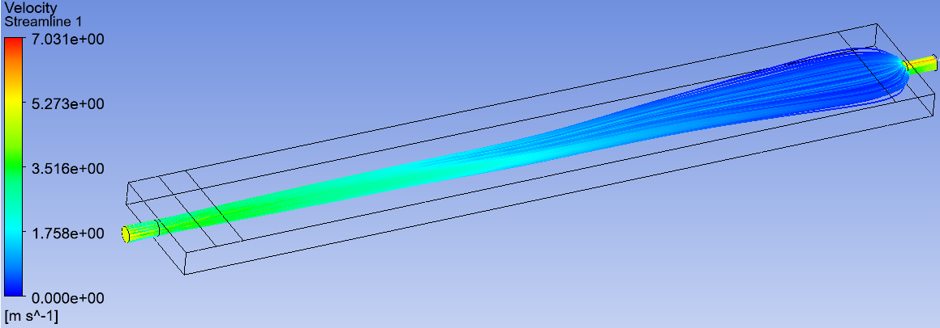
Simple 3D CFD model without foam
Fluid material: Air

Slide 21
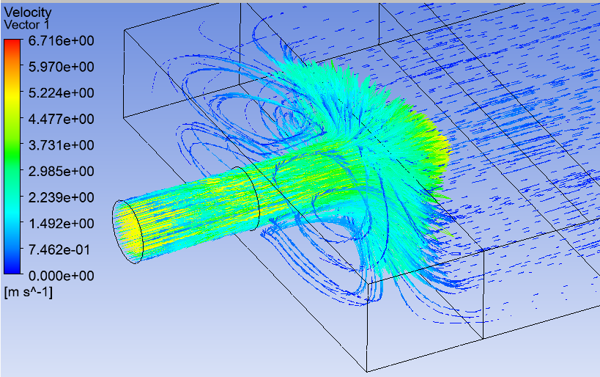
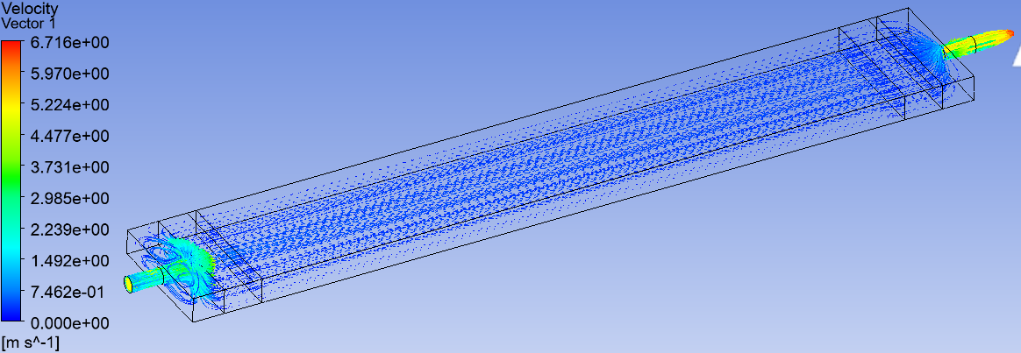
Simple 3D CFD model with foam
Work in progress…..

